Slide 1

Surface Systems and Interface Standardization
By: Jaime De Jesus Gomez Jr., Don Pittman, Gabor Tamasy, Chad Caron, Michael Dupuis, and Mark Lewis

Slide 2
Agenda
Biography
Purpose
Previous and Current Common Interface Standards
Surface Systems Interface Overview
Interface Design Principles
Conclusions and Forward Work
2

Slide 3

About Me Biography
Jaime Gomez received his BS in Mechanical Engineering from the University of South Florida. His engineering career began as a Systems Test Engineer for United Launch Alliance (ULA) in 2017. He worked on the Centaur second stage of the Atlas V rocket where he tested propulsion systems and assembled the second stage prior to launch. He also was a launch console operator where he performed launch countdown as the LOx and Haz Gas operator.
Jaime then started his career at NASA KSC in 2018 as an Operations Engineer processing Orbital Replacement Units (ORUs) for the ISS program. He led KSC teams at various launch provider sites such as Wallops, Tanegashima, and Cape Canaveral for final hardware integration activities. Now he supports the Human Landing Systems (HLS) program as the Assembly and Integration Operations Discipline Lead for the Lander Ground Operations (LGO) group. He also supports the Lunar Architecture Team (LAT) as part of their uncrewed surface group formulating uncrewed surface operations and surface systems development that will promote sustainability on the Lunar surface and future Mars missions.
Jaime Gomez

Slide 4
Purpose
The Artemis campaign promotes sustainability on the Lunar surface and future Mars missions. A key contribution to sustainability is commonality between hardware interfaces including the lander, surface assets, and cargo. A generic interface for data, communication, power, and fluids will reduce risk, promote interoperability, and define standard interfaces across the program.

Slide 5
Previous and Current Common Interfaces Standards
International Docking System Standard (IDSS)
  International Docking Adapter (IDA)
International Deep Space Interoperability Standards (IDSIS)
  Avionics & Communications
  ECLSS, Power, & Rendezvous
  Robotics, Thermal, & Software
Robotic Interface Standards
  ISO 9409-1: Manipulating industrial robots -- Mechanical interfaces -- Part 1: Plates
  ISO 9409-2: Manipulating industrial robots -- Mechanical interfaces -- Part 2: Shafts
  ISO 9787: Robots and robotic devices -- Coordinate systems and motion nomenclatures
  HEOMD-003-07: International External Robotic Interface Interoperability Standards (IERIIS)

Slide 6
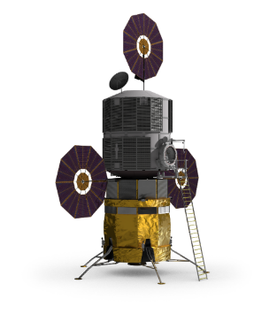
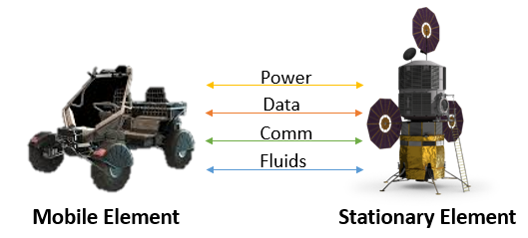
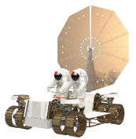
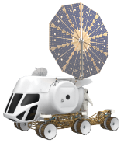
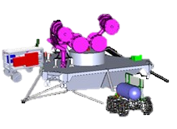
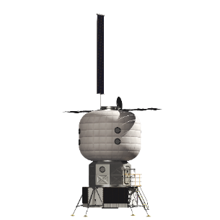
Surface Systems Interface Overview
Landers
Cargo
HLS
CLPS
ISRU
Transportation
LTV
PR
Habitation
6

Slide 7
General Interface Deign Principles
General Design
  Detailed Con-ops
  Use non-mechanical approach
  Units of measurement
Umbilical System
  Active side contains moving components. Preferred for mobile system
  Passive side has minimal complexity for multiple mating instances
Corrosion Control
  Avoid Cold welding of metallic components
Materials
  Lubrication or coatings to avoid surface damage
  Avoid galling of fasteners or other metal to metal contacts
Redundancy
  Reliability and safety of critical functions
  Manual/backup override
  Eliminate single failure points
Maintainability/Accessibility
  Accessible by EVA or robotic system
  Software is maintainable and upgradable
Safety and Reliability
  Comply with applicable NASA requirements
  Should be fail safe
  Single fault tolerant design
Position Feedback
  Fully mated feedback
  Verify good mate/demate
Connection Inspection
  Verification to ensure is operating as designed and troubleshooting functions.
Testing
  Sited requirements should be used
  Prototyping test proof of concept
Software
  Robust and provide feedback
  Should reside with the surface element which houses the active half
  Health monitoring and diagnostic capability
7

Slide 8
Mechanical Interface Design Principles
Structural-Mechanical Interfaces
  Safely function at all applicable loading conditions
  Transfer loads, provide alignment and mate/demate motion
  Separate with off-nominal conditions
  Automatically safe condition in emergency cases
Mechanisms
  Simple and minimizing moving parts
Mating/De-mating
  Detailed con-ops
  Automated and teleoperated by robotic systems
  Human operated capability
  Verify and communicate mate/demate condition
Latching
  Withstand interface loads and accommodate positional loads
  Pressurized and unpressurized state separation loads
  Single fault tolerant
Alignment
  Performed before mating operations
  Verification of proper alignment
  Self-align connectors and couplings
  Accommodate small misalignments
  Manual alignment capability
Mass
  Low/optimized launch mass
  Added to corresponding surface element mass
Loads
  Load reacting structure on both sides of the interface
  Umbilical connectors and couplings treated as non-load bearing.
8

Slide 9
Fluid Interface Design Principles
Fluid Couplings/Disconnects
  Separate commodities
  Protect from dust and kept clean
  Minimize size/mass and self sealing
  Electrically bonded to the interface structure
  Thermal conditioning
Purges
  Useful for inert, clean, or safe the interface before/during transfer
  Used to prevent dust contamination
  Purging is required for flammable, hazardous and cryogenic fluid transfers
Leak Detection
  Leak free or minimal
  Fluid connections should provide leak detection
  Operate safely or shutdown in fluid leak case
Leakage Disposal
  Seal pockets to separate fluid couplings
  If leak unavoidable then they should be contained to not contaminate adjacent hardware
  Leaks routed and vented to safe areas
9

Slide 10
Electrical Interface Design Principles
Electrical Connectors
  Self-aligning features
  Protect from dust and kept clean
  Connections de-energized during mating/demating
  Inductive or wireless power transfer recommended
  Data and power hard lines run through separate connectors
Data and Communication Interfaces
  Use of wireless data transfer
  Twisted pairs wiring with overall shield used to minimize EMI
  Wireless use of independent frequencies/channels
Grounding/Bonding
  Charge differential between two halves equalized before safe connection
  Bonding connection between active and passive halves
10

Slide 11
Environmental Interface Design Principles
Component Selection
  Extended periods of life cycle use
  Compatible with relevant environment
  Full certificates of compliance of physical and chemical
  Qualified and tested in relevant environments
Contamination Prevention/Dust Tolerance
  Operate in a dusty surface environment and should be designed to function with contamination present
  Connector and Coupling surfaces maintained clean prior to mate
  Protection against dust storms, plume impingement, and lofted dust
  Ability to be cleaned or self-clean function
  Tested with relevant simulant
  Soft good material is compatible with environment
Electromagnetic Compatibility (EMI/EMC)
  Not generate harmful EMI and must operate with EMI in the adjacent environment
Ionizing Radiation
  Analyze materials for degradation
11

Slide 12

Conclusions and Forward Work
The initial analysis performed on the early Artemis architecture and the interface principles developed are valuable stepping stones to defining interface standards on the lunar surface and future Mars missions. They identify the need for developing surface interface standards and show the importance of why commonality is an important factor for promoting interoperability and sustainability.
Forward Work:
  Further Define Standards and Specifications
  Software, Communication, and Navigation Development and Studies
  Performance Criteria
  Prototype Development for Early Lunar Surface Assets
    Ex: Dust Tolerant Automated Umbilical (DTAU)
12

Slide 13
BACKUP CHARTS

Slide 14
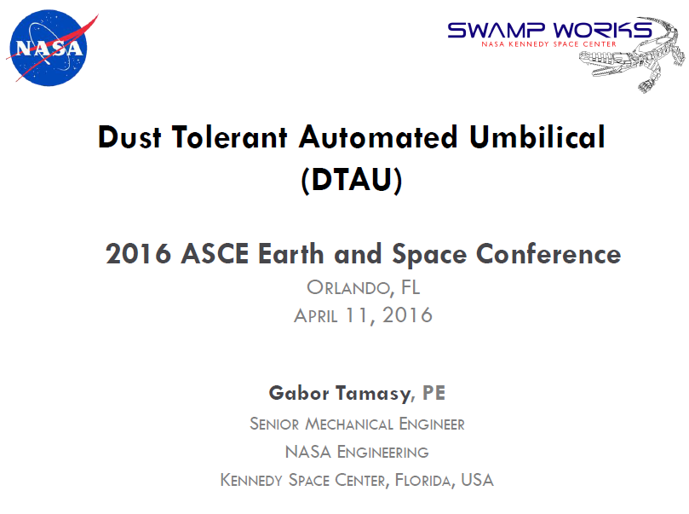

Slide 15
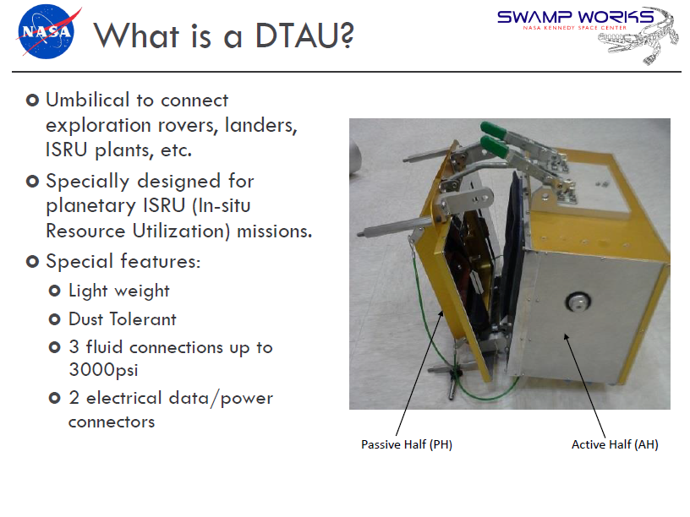

Slide 16
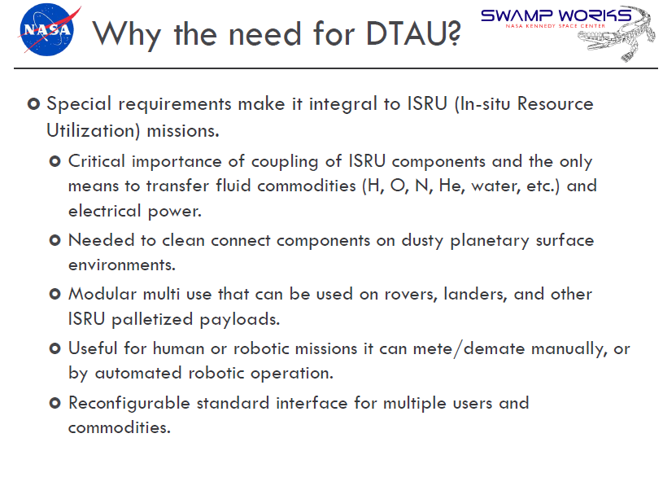

Slide 17
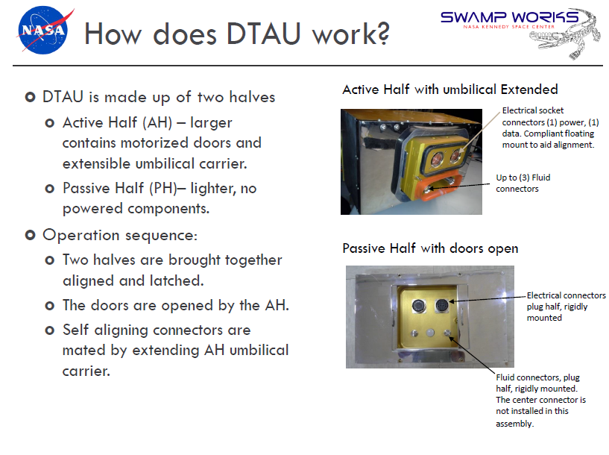

Slide 18
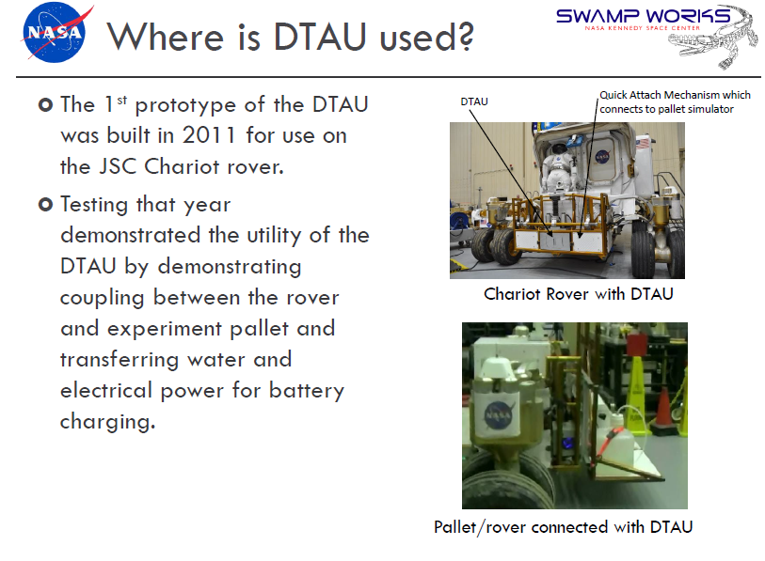

Slide 19
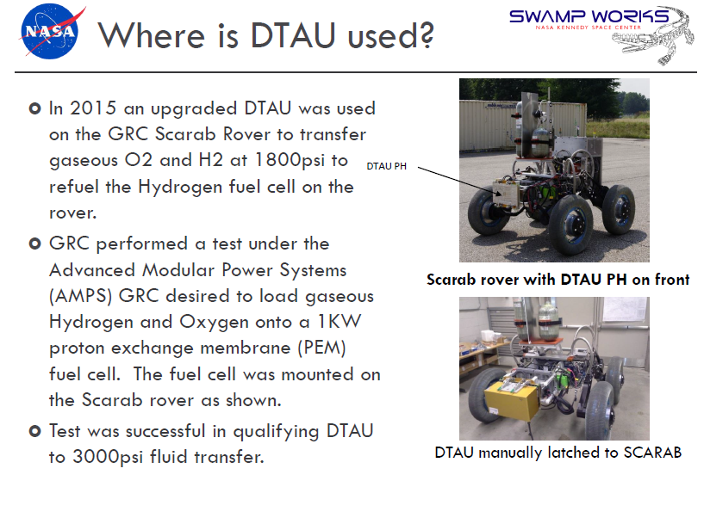

Slide 20
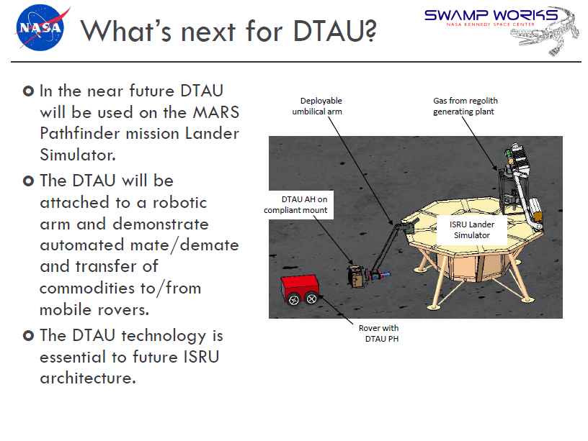

Slide 21
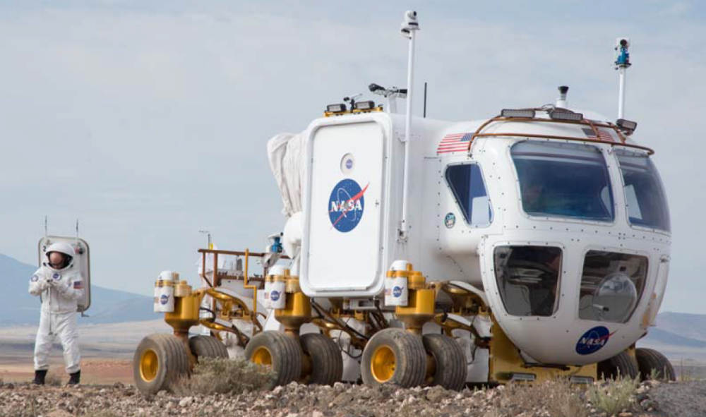
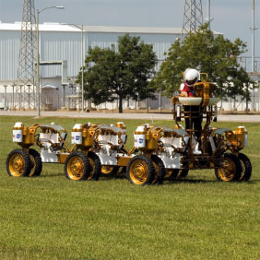
NASA Space Exploration Vehicle
NASA Chariot
21

Slide 22



