Slide 1

NASA’s Earth System Observatory Atmosphere Observing System (AOS)
Suborbital Program
Dr. Daniel J. Cecil
AOS Deputy Project Scientist / Suborbital
NASA Marshall Space Flight Center
Workshop on Atmospheric Water Cycle
Institut Pascal, University of Paris-Saclay
30 June 2022
Pre-Decisional – AOS is in Pre-Phase A and NASA makes no commitments on the final design of the mission or instruments

Slide 2
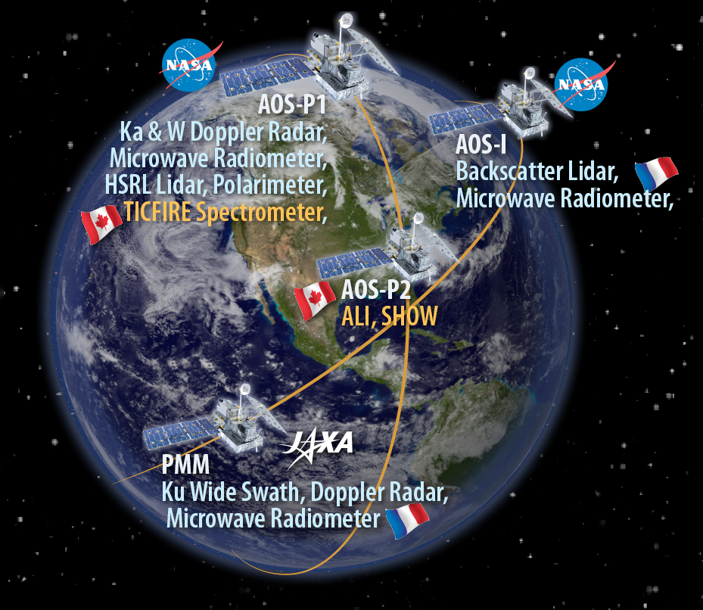
The Atmosphere Observing System (AOS) Architecture (Pending HQ Reviews, Decisions)
ACCP Study, Oct 2018 – February 2021
Pre-Phase A, Mission Concept Development, June 2021 – current
Successful Mission Concept Review, May 16-20, 2022
Key Decision Point–A Review likely in September or October (may result in architecture changes)
Pre-Decisional – AOS is in Pre-Phase A and NASA makes no commitments on the final design of the mission or instruments
Notes:
Here, I am showing the baseline architecture of AOS coming into the concept study phase of the mission. It’s an ambitious architecture with both polar- and inclined-orbiting projects. The inclined mission, slated to launch in 2028, is designed to measure sub-daily variability of clouds, precipitation, and aerosols, with a particular emphasis on convective storms and high clouds. It includes two spacecraft carrying a W-band radar, and Ku-band Doppler radar, a backscatter lidar, microwave imager, and polarimeter, and a tandem set of stereo cameras. The polar project, expected to launch up to two years later, is designed to better address climate-related processes and determine coupled cloud, aerosol, and radiation processes. It features W- and Ka-band Doppler radars, a microwave radiometer, an HSRL lidar, polarimeter and shortwave and longwave spectrometers. In addition to the orbital component, we also plan for a suborbital element designed to do science that cannot readily be done from space, such as needs for in-situ sampling or sustained ground-based measurements. AOS is a cost-capped mission. Cost assessments of all of the components of the mission are being evaluated during the study phase, including instruments and spacecraft, ground systems for operations and data processing, and science and applications. If those costs rise relative to our initial cost estimates, some elements of this architecture may need to be removed.

Slide 3
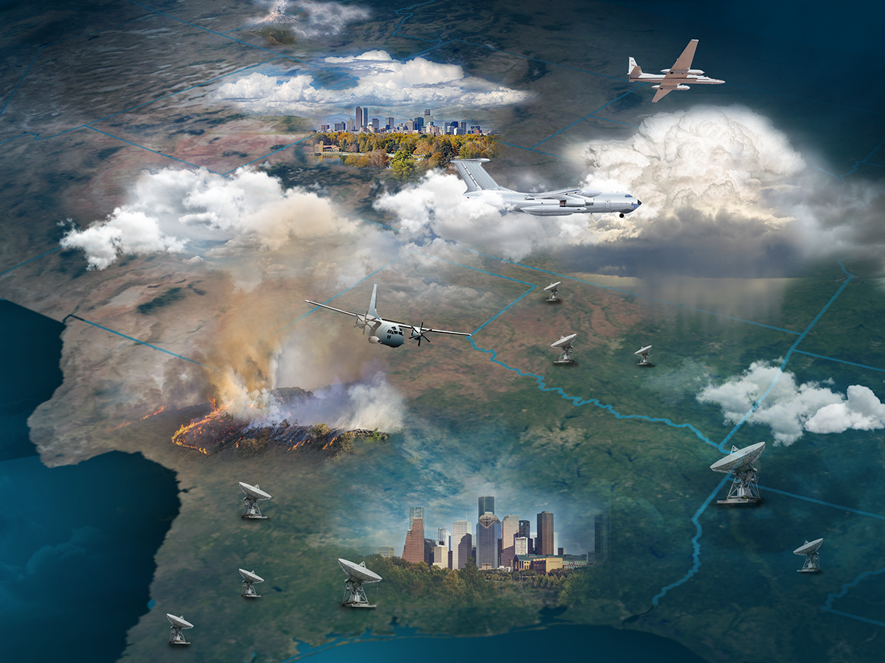


AOS Suborbital Program –
A complement to the orbital missions
Measuring Temporal Evolution
precip initiation, cloud nucleation, aerosol aqueous processing
Lagrangian sampling, airmass evolution and interactions
Advanced Measurements Suites: Going Beyond the Orbital Architectures (adding depth and breadth)
High spatial + temporal resolutions
In situ measurements
Frequencies going beyond those in orbit
Pre-Decisional – AOS is in Pre-Phase A and NASA makes no commitments on the final design of the mission or instruments
3

Slide 4
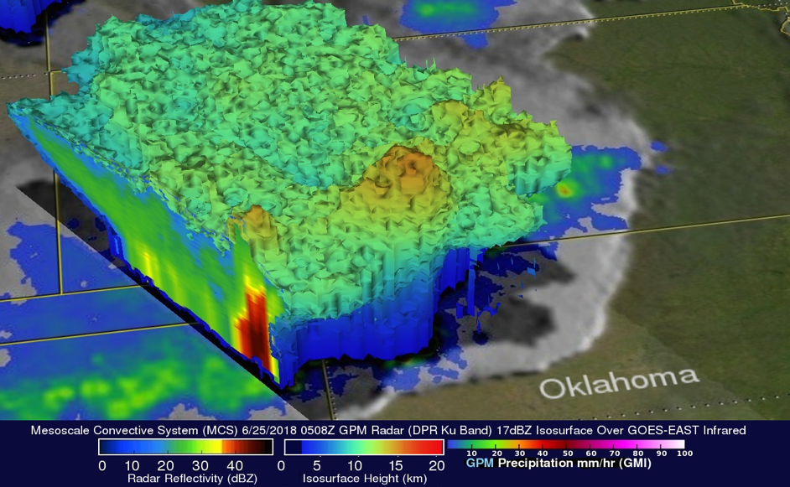
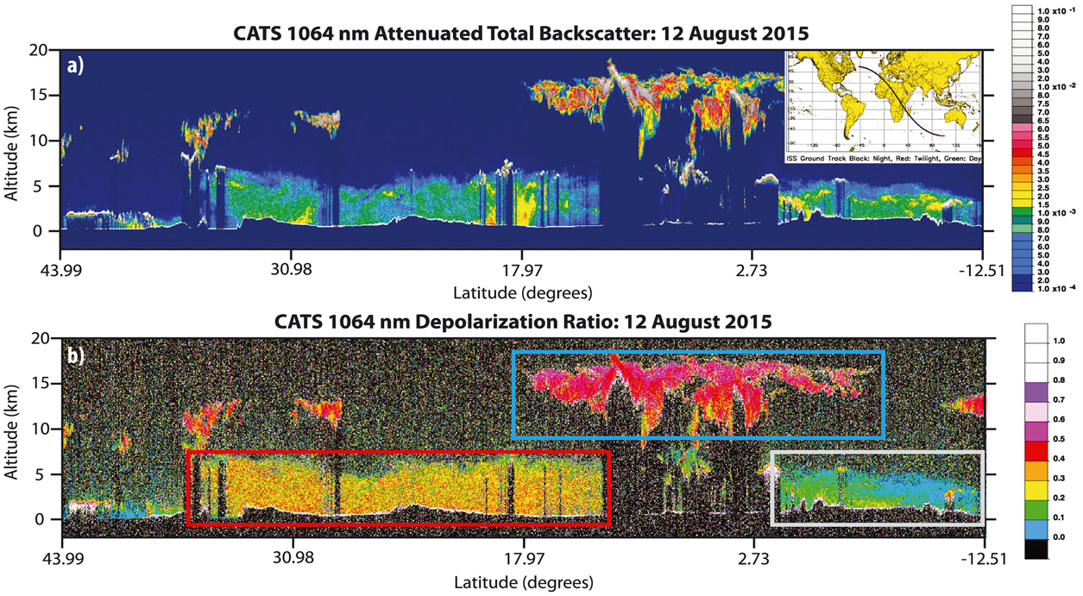
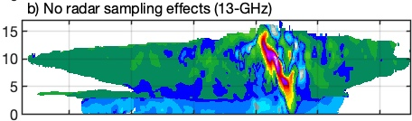
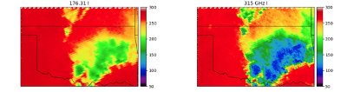
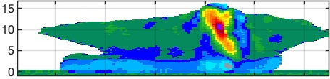
A Visual View of AOS-Inclined
Launch NET July 2028
JAXA Wide Swath Ku Doppler Radar
ALICAT 532-, 1064-nm Backscatter Lidar
Truth
CNES Microwave Radiometers (89, 183, 325 GHz)
Ku Doppler Velocity
Height (km)
55° Inclination: Compromise between NASA, JAXA, CNES
Pre-Decisional – AOS is in Pre-Phase A and NASA makes no commitments on the final design of the mission or instruments

Slide 5
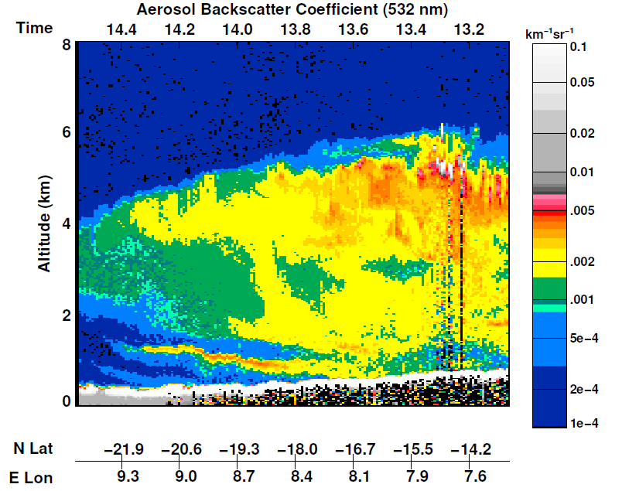
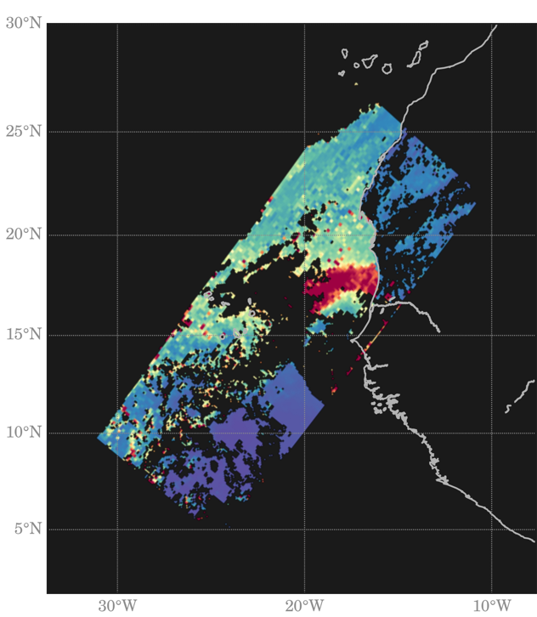
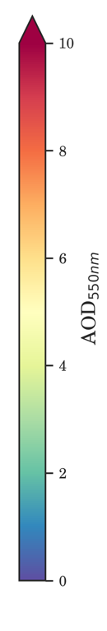
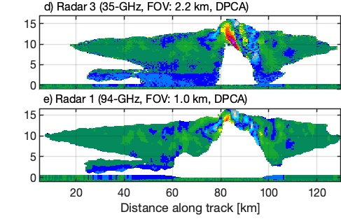

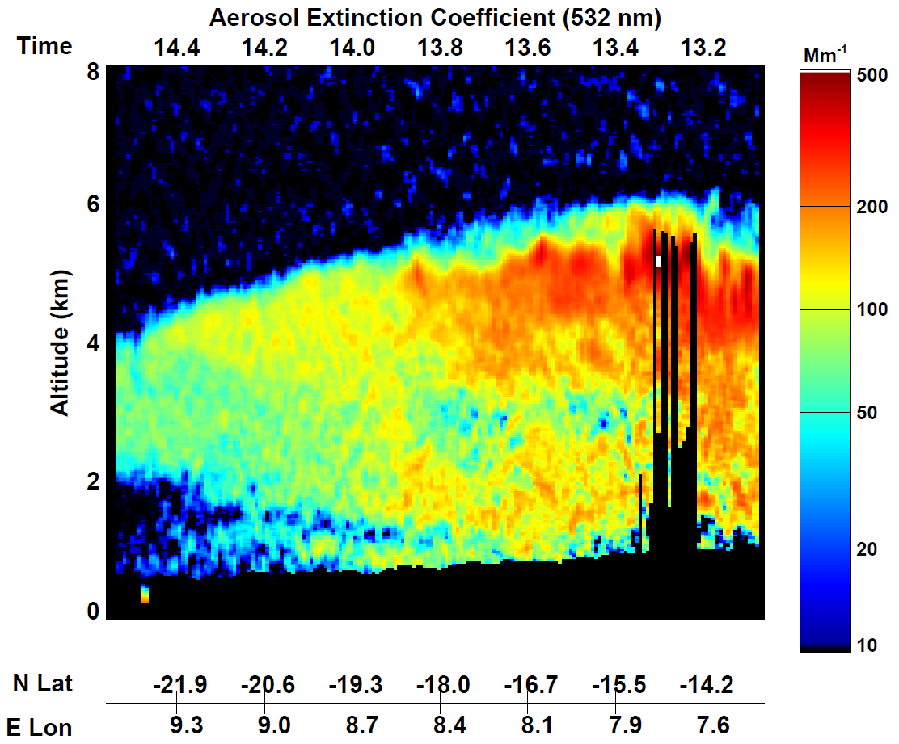
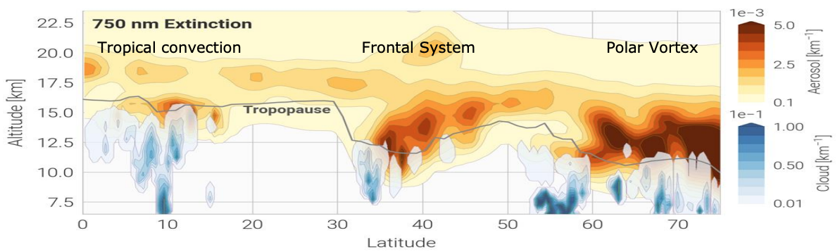
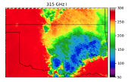
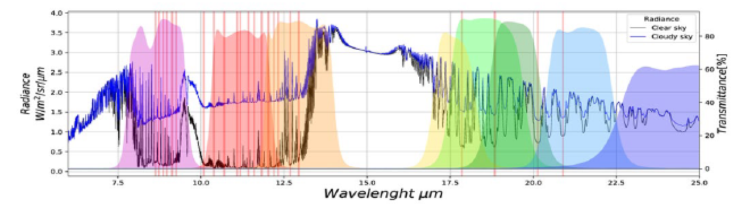
A Visual View of AOS-Polar
Launch NET December 2030
W-, Ka-band Doppler Radars
532 nm HSRL, 1064 Backscatter Lidar
UV-VIS-NIR-SWIR
Multi-angle Polarimeter
Truth
Aerosol & cloud backscatter coefficient
AOD from HARP
Cloud-top properties available also
Ka-band Radar (35-GHz, FOV: 2.2 km, DPCA)
Aerosol & cloud extinction coefficient
W-band Radar (94-GHz, FOV: 1 km, DPCA)
Microwave Radiometer: 89-700 GHz
CSA-Contributed LWIR-FIR Spectrometer
4-73 μm
CSA Aerosol/Moisture Limb Sounding
Pre-Decisional – AOS is in Pre-Phase A and NASA makes no commitments on the final design of the mission or instruments
Notes:
A visual view of the AOS-Polar measurements.
Upper-left: Doppler velocity fields from Ka (middle panel) and W (lower panel) band Doppler radars compared to the model truth (simulated Doppler velocity field from a simulation of an intense squall line). Both frequencies suffer from attenuation in the deep convection, but most precipitation will be lighter and less prone to attenuation at Ka band.
Upper middle: Aerosol and low cloud measurements of total backscatter and extinction from the HSRL lidar. Although not shown in the image, the lidar will be capable of characterizing properties of thin ice clouds.
Upper right: Aerosol optical depth from polarimeter. The polarimeter can also characterize cloud-top properties using the cloud bow technique.
Lower left: Simulated 315 GHz brightness temperatures from PMW radiometer. Channels likely to be included are 183, 325, and 650-700 GHz. Additional channels might include 89, 118, 150-182, and 800-900 GHz depending on industry availability.
Lower middle: Spectral bands from the longwave spectrometer to provide cloud phase, cloud top height & temperature, cloud optical depth, ice particle effective diameter, ice water path.
Lower right: Upper tropospheric/lower stratospheric aerosol and cloud image from OMPS and CALIPSO, used as a proxy for the lidar and aerosol limb sounder. Moisture not shown.

Slide 6
Suborbital Program Scope / Motivation
Collect data for AOS science investigations that:
Are only done, or better done, from Suborbital
  - e.g., involving temporal evolution, satellite-blind zones, direct measurements, (partially) mitigate descopes from orbital
  - Emphasis on those aspects of AOS objectives that are least suitable for observation / investigation from satellite measurements and PoR alone
Support algorithm / model needs
Provide synergies with calibration / validation
  - Cal/val is distinct from suborbital science program
Pre-Decisional – AOS is in Pre-Phase A and NASA makes no commitments on the final design of the mission or instruments

Slide 7
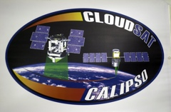


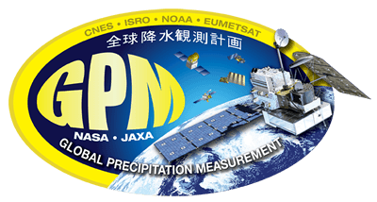


AOS Timeline
ACCP Study
Pre-
formulation
2019
2023
2027
2031
Polar
CloudSat/CALIPSO
AOS-P
Inclined
GPM
INCUS
AOS-I
AOS-SO
AOS-SO
AOS-SO
Suborbital
Pre-Decisional – AOS is in Pre-Phase A and NASA makes no commitments on the final design of the mission or instruments

Slide 8

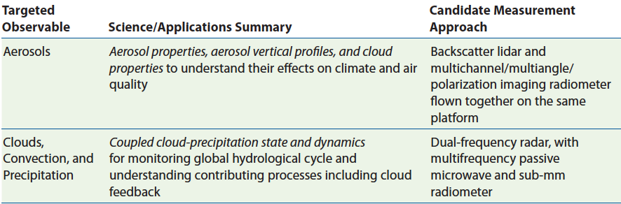
AOS Derives From Decadal Survey Recommendations
National Academies of Sciences, Engineering, and Medicine 2018
Pre-Decisional – AOS is in Pre-Phase A and NASA makes no commitments on the final design of the mission or instruments

Slide 9
Traceability to the Decadal Survey
AOS Science Objectives |  | Key Science Focuses
O1 | Low Clouds | Sensitivity of low clouds to environmental factors; solar radiative climate feedbacks
O2 | High Clouds | Relationship of high cloud properties to deep convection, environment; radiative climate feedbacks
O3 | Convective Storms | Relationship between storm vertical motions and microphysics
O4 | Cold Clouds and Precipitation | Processes that govern phase partitioning and precipitation formation in cold clouds; key drivers of climate feedbacks at high latitudes
O5 | Air Quality and Aerosol Attribution | Identifying major sources of aerosols and their type; factors that relate aerosol microphysical/optical properties to near-surface air quality
O6 | Aerosol Redistribution & Processing | Wet removal and processing of aerosol by clouds and precipitation; impacts of vertical and long-range transport of aerosol
O7 | Aerosol Direct Effects | Role of aerosols in the Earth’s energy budget; impact of absorbing aerosols on climate
O8 | Aerosol Indirect Effects | Aerosol impacts on clouds and precipitation systems; modulation of climate forcing due to changes in cloud radiative properties
ACCP Science Goals
DS Science Questions
G1 Cloud Feedbacks
Reduce the uncertainty in low- and high-cloud climate feedbacks
[G2 Storm Dynamics]
G3 Cold Cloud and Precipitation
Improve understanding of cold cloud processes and associated precipitation and their coupling to the water and energy cycles
G5 Aerosol Impacts on Radiation
Reduce the uncertainty in Direct and Indirect aerosol-related radiative forcing of the climate system.
C-2 (I-MI): Climate Feedback and Sensitivity.
W-4 (MI): Convective Storm Formation Processes.
W-5 (MI): Air Pollution Processes and Distribution.
G2 Storm Dynamics
Improve our physical understanding and model representations of cloud, precipitation and dynamical processes within convective storms
W-1 (MI): PBL Dynamics.
W-2 (MI): Larger Range Environmental Predictions.
G4 Aerosol Processes
Reduce uncertainty in key processes that link aerosols to weather, climate and air quality related impacts.
H-1 (MI): Coupling the Water and Energy Cycles.
9
Pre-Decisional – AOS is in Pre-Phase A and NASA makes no commitments on the final design of the mission or instruments
Notes:
C-2 touches upon almost all ACCP objectives and essentially represents the DS question most addressed by ACCP. Questions W-4 and W-5 highlight the most significant advancements of ACCP over prior missions with a focus on Doppler motions and HSRL measurements.

Slide 10
Science Objectives flow down from overall AOS objectives to inter-related suborbital themes:
ACCP Science Objectives​ |  | Key Science Focuses​
O1​ | Low Clouds​ | Sensitivity of low clouds to environmental factors (thermodynamics/dynamics); solar radiative climate feedbacks​
O2​ | High Clouds ​ | Relationship of high cloud formation/properties to deep convection, large-scale environment; infrared radiative climate feedbacks​
O3​ | Convective Storms​ | Relationship between storm vertical motions and microphysics​
O4​ | Cold Clouds and Precipitation​ | Processes that govern phase partitioning and precipitation formation in cold clouds; key drivers of climate feedbacks at highlatitudes​
O5​ | Air Quality and Aerosol Attribution​ | Identifying major sources of aerosols and their type/species; factors that relate aerosol microphysical/optical properties to near-surfaceair quality​
O6​ | Aerosol Redistribution and Processing​ | Wet removal and processing of aerosol by clouds and precipitation;​ impacts of vertical and long-range transport of aerosol​
O7​ | Aerosol Direct Effects​ | Role of aerosols in the Earth’s energy budget; impact of absorbing aerosols on climate​
O8​ | Aerosol Indirect Effects​ | Aerosol impacts on clouds and precipitation systems; modulation of climate forcing due to changes in cloud radiative properties​
O1, O4, O6, O8: Low Clouds
Characterize processes associated with cloud droplet, ice crystal, and precipitation initiation, and precipitation phase.
O2, O3, O6: Convection and High Clouds
Understand controls on convective storm processes and lifecycle, and anvil cirrus lifecycle.
O5, O6, O7, O8: Aerosol-Cloud-Radiation Interaction, Aerosol Attribution and Redistribution
Quantify vertically-resolved aerosol-cloud-radiation interaction processes, coupled with aerosol attribution and lifecycle.
Pre-Decisional – AOS is in Pre-Phase A and NASA makes no commitments on the final design of the mission or instruments

Slide 11
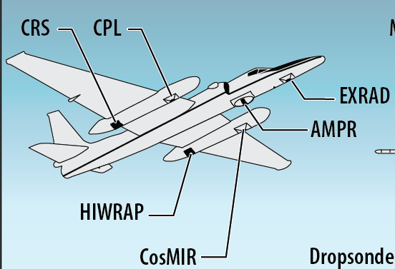
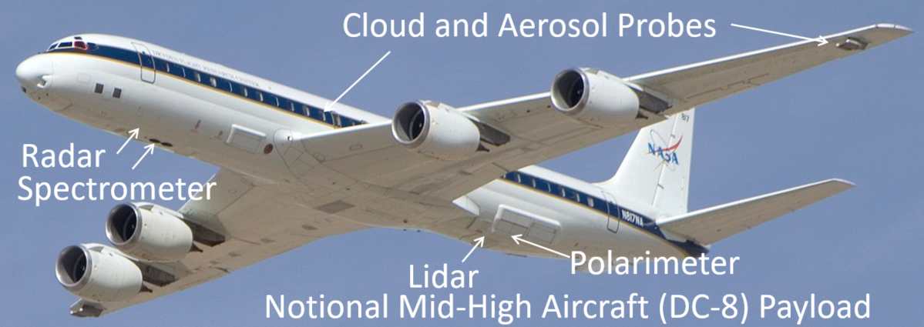
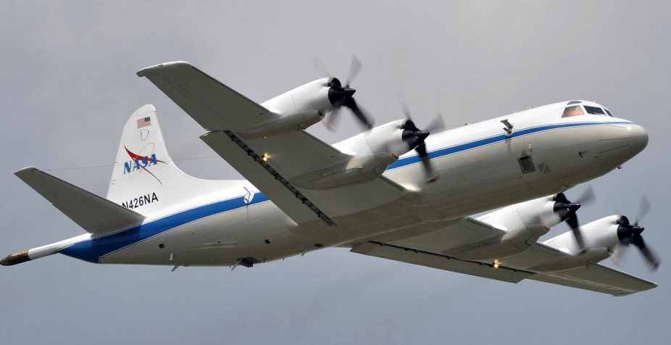
Airborne Campaigns concept
Two-Three aircraft, one is over-cloud top cloud/precip/aerosol/radiation remote sensors. One is mid-high remote sensor for aerosol and low cloud, with in situ probes. One is low-altitude in situ with radiation. Heritage instruments available for key needs.
High-altitude aircraft (~ER-2)
2) Mid-High-altitude (~DC-8, G5, Falcon or similar)
3) Low-altitude (~P-3, C130, Challenger 850 or similar)
+ Surface-based instrumentation, small UAS?
Radar
Lidar
Payloads depicted are notional… instruments to be prioritized / deconflicted for each campaign
Radar
Radiometer
Spectrometer
Notional ER-2 payload
Polarimeter
Cloud + Aerosol probes
Radar
Notional P-3 payload
Pre-Decisional – AOS is in Pre-Phase A and NASA makes no commitments on the final design of the mission or instruments
Notes:
Brief intro here, before the cartoon

Slide 12


AOS Suborbital Conceptual Model
Aerosols
High cloud
Deep Convection
Aerosols
Low clouds
Heavy Precipitation
Rain or snow
Pre-Decisional – AOS is in Pre-Phase A and NASA makes no commitments on the final design of the mission or instruments

Slide 13

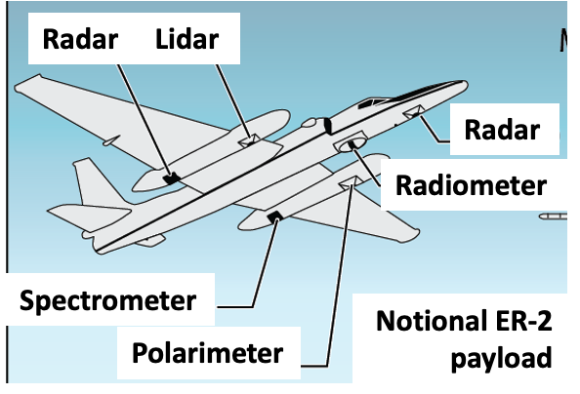
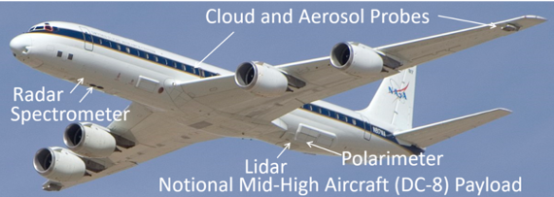
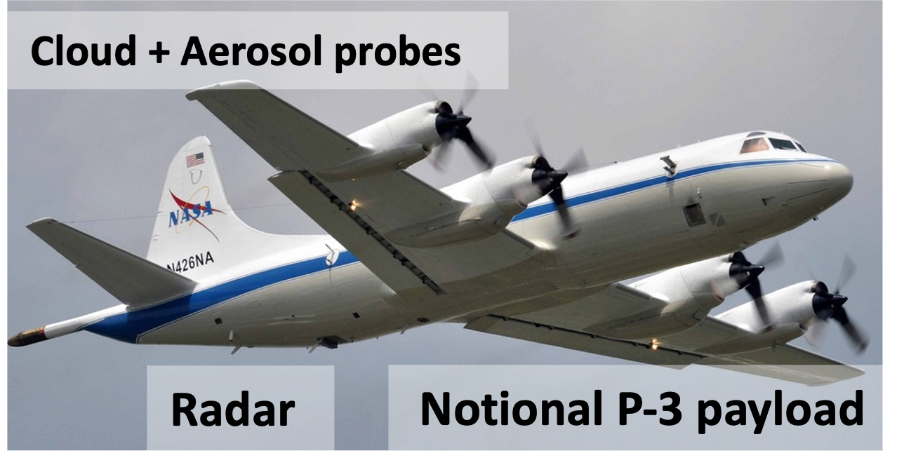
Only done from Suborbital:
Thick cloud becomes opaque to many instruments on satellite, so we investigate from multiple aircraft levels
Heavy precip attenuates radar bands on satellite; use longer wavelength on aircraft and from surface
Aerosol and cloud layers obscured from satellite by higher-altitude cloud; need aircraft at multiple levels
Pre-Decisional – AOS is in Pre-Phase A and NASA makes no commitments on the final design of the mission or instruments

Slide 14
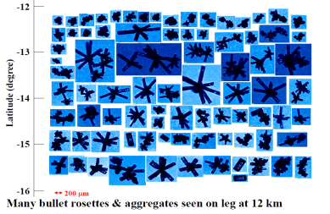
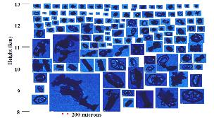
Only done from Suborbital:
In situ measurements of aerosol / cloud / precipitation particle characteristics, with details beyond what satellite remote sensors can measure
New submicron particles formed in storm outflow; in-situ aircraft obs needed
Changes in radiation measured directly within atmosphere or at surface
Surface-based instrumentation for longer-time-scale monitoring, measure processes near the surface
Pre-Decisional – AOS is in Pre-Phase A and NASA makes no commitments on the final design of the mission or instruments

Slide 15
Better done from Suborbital:
Sharp horizontal and vertical gradients within cloud and precip, unresolved by satellites
Unique combination of remote sensing + direct measurements
Meteorological observations of storm inflow / outflow
Spatial and temporal context for “snapshot” measurements from space
Air quality at nose level
Pre-Decisional – AOS is in Pre-Phase A and NASA makes no commitments on the final design of the mission or instruments

Slide 16
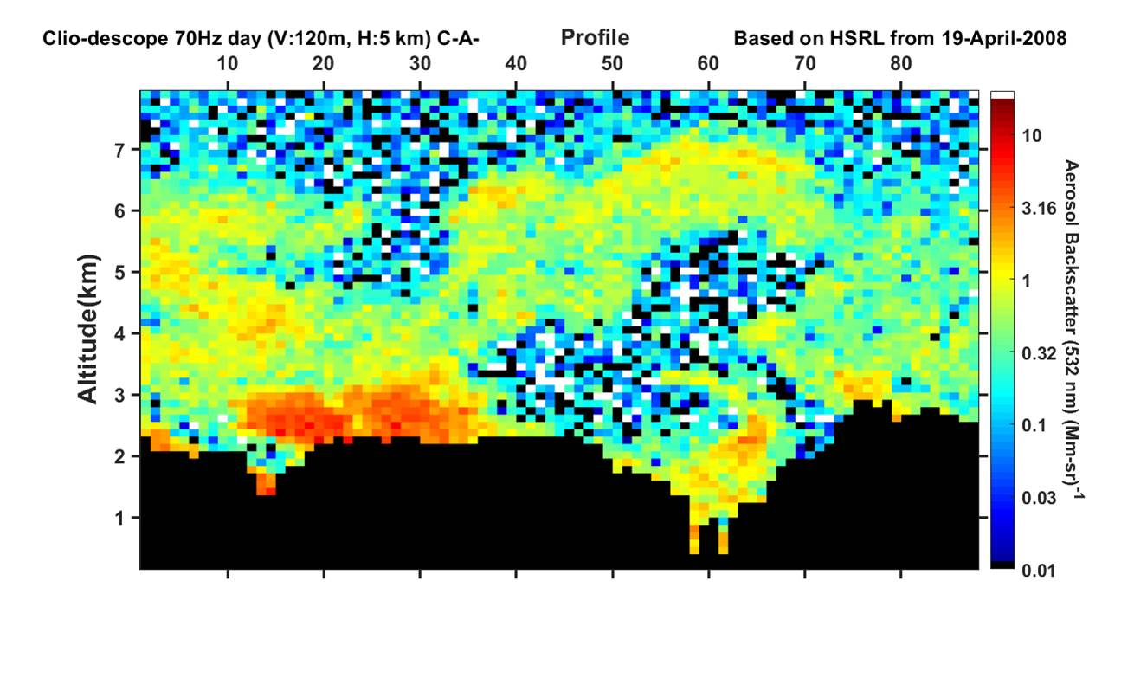
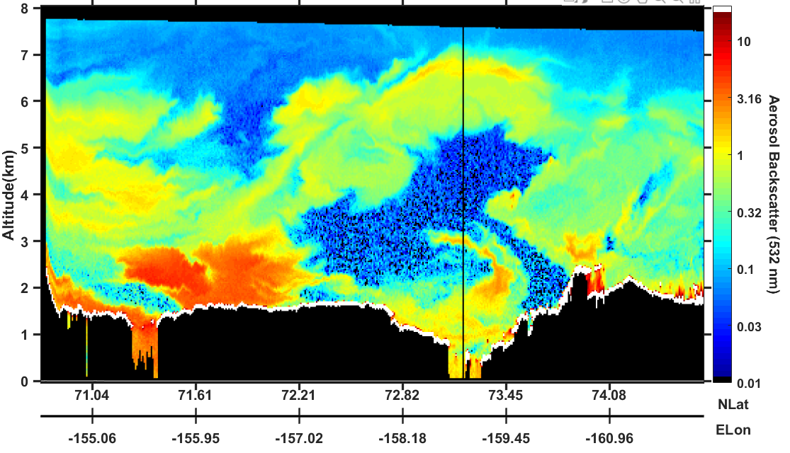
Better done from Suborbital:
Some measurements require greater accuracy / additional capabilities from suborbital than what is capable from satellite
Airborne HSRL Observations
AOS Clio HSRL Simulation
Sharp horizontal and vertical gradients between cloud and clear or aerosol-laden air
Clouds
High-resolution, high signal to noise airborne lidar
Coarser resolution from satellite (simulated)
Pre-Decisional – AOS is in Pre-Phase A and NASA makes no commitments on the final design of the mission or instruments

Slide 17
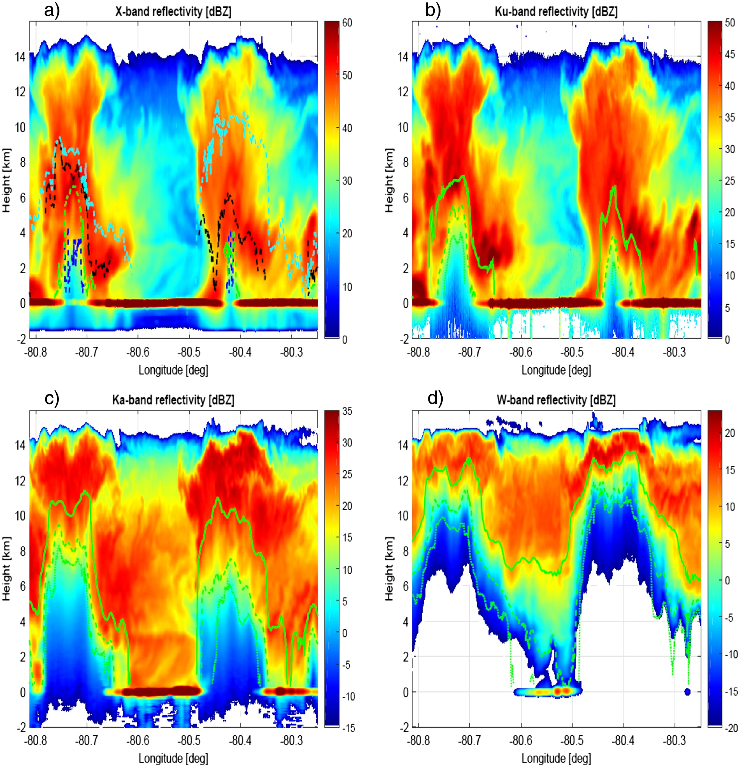
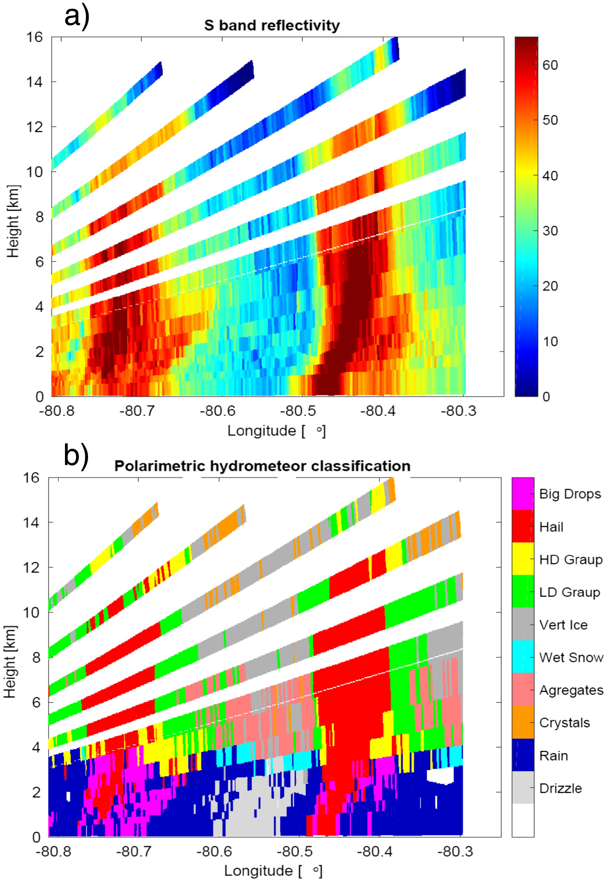
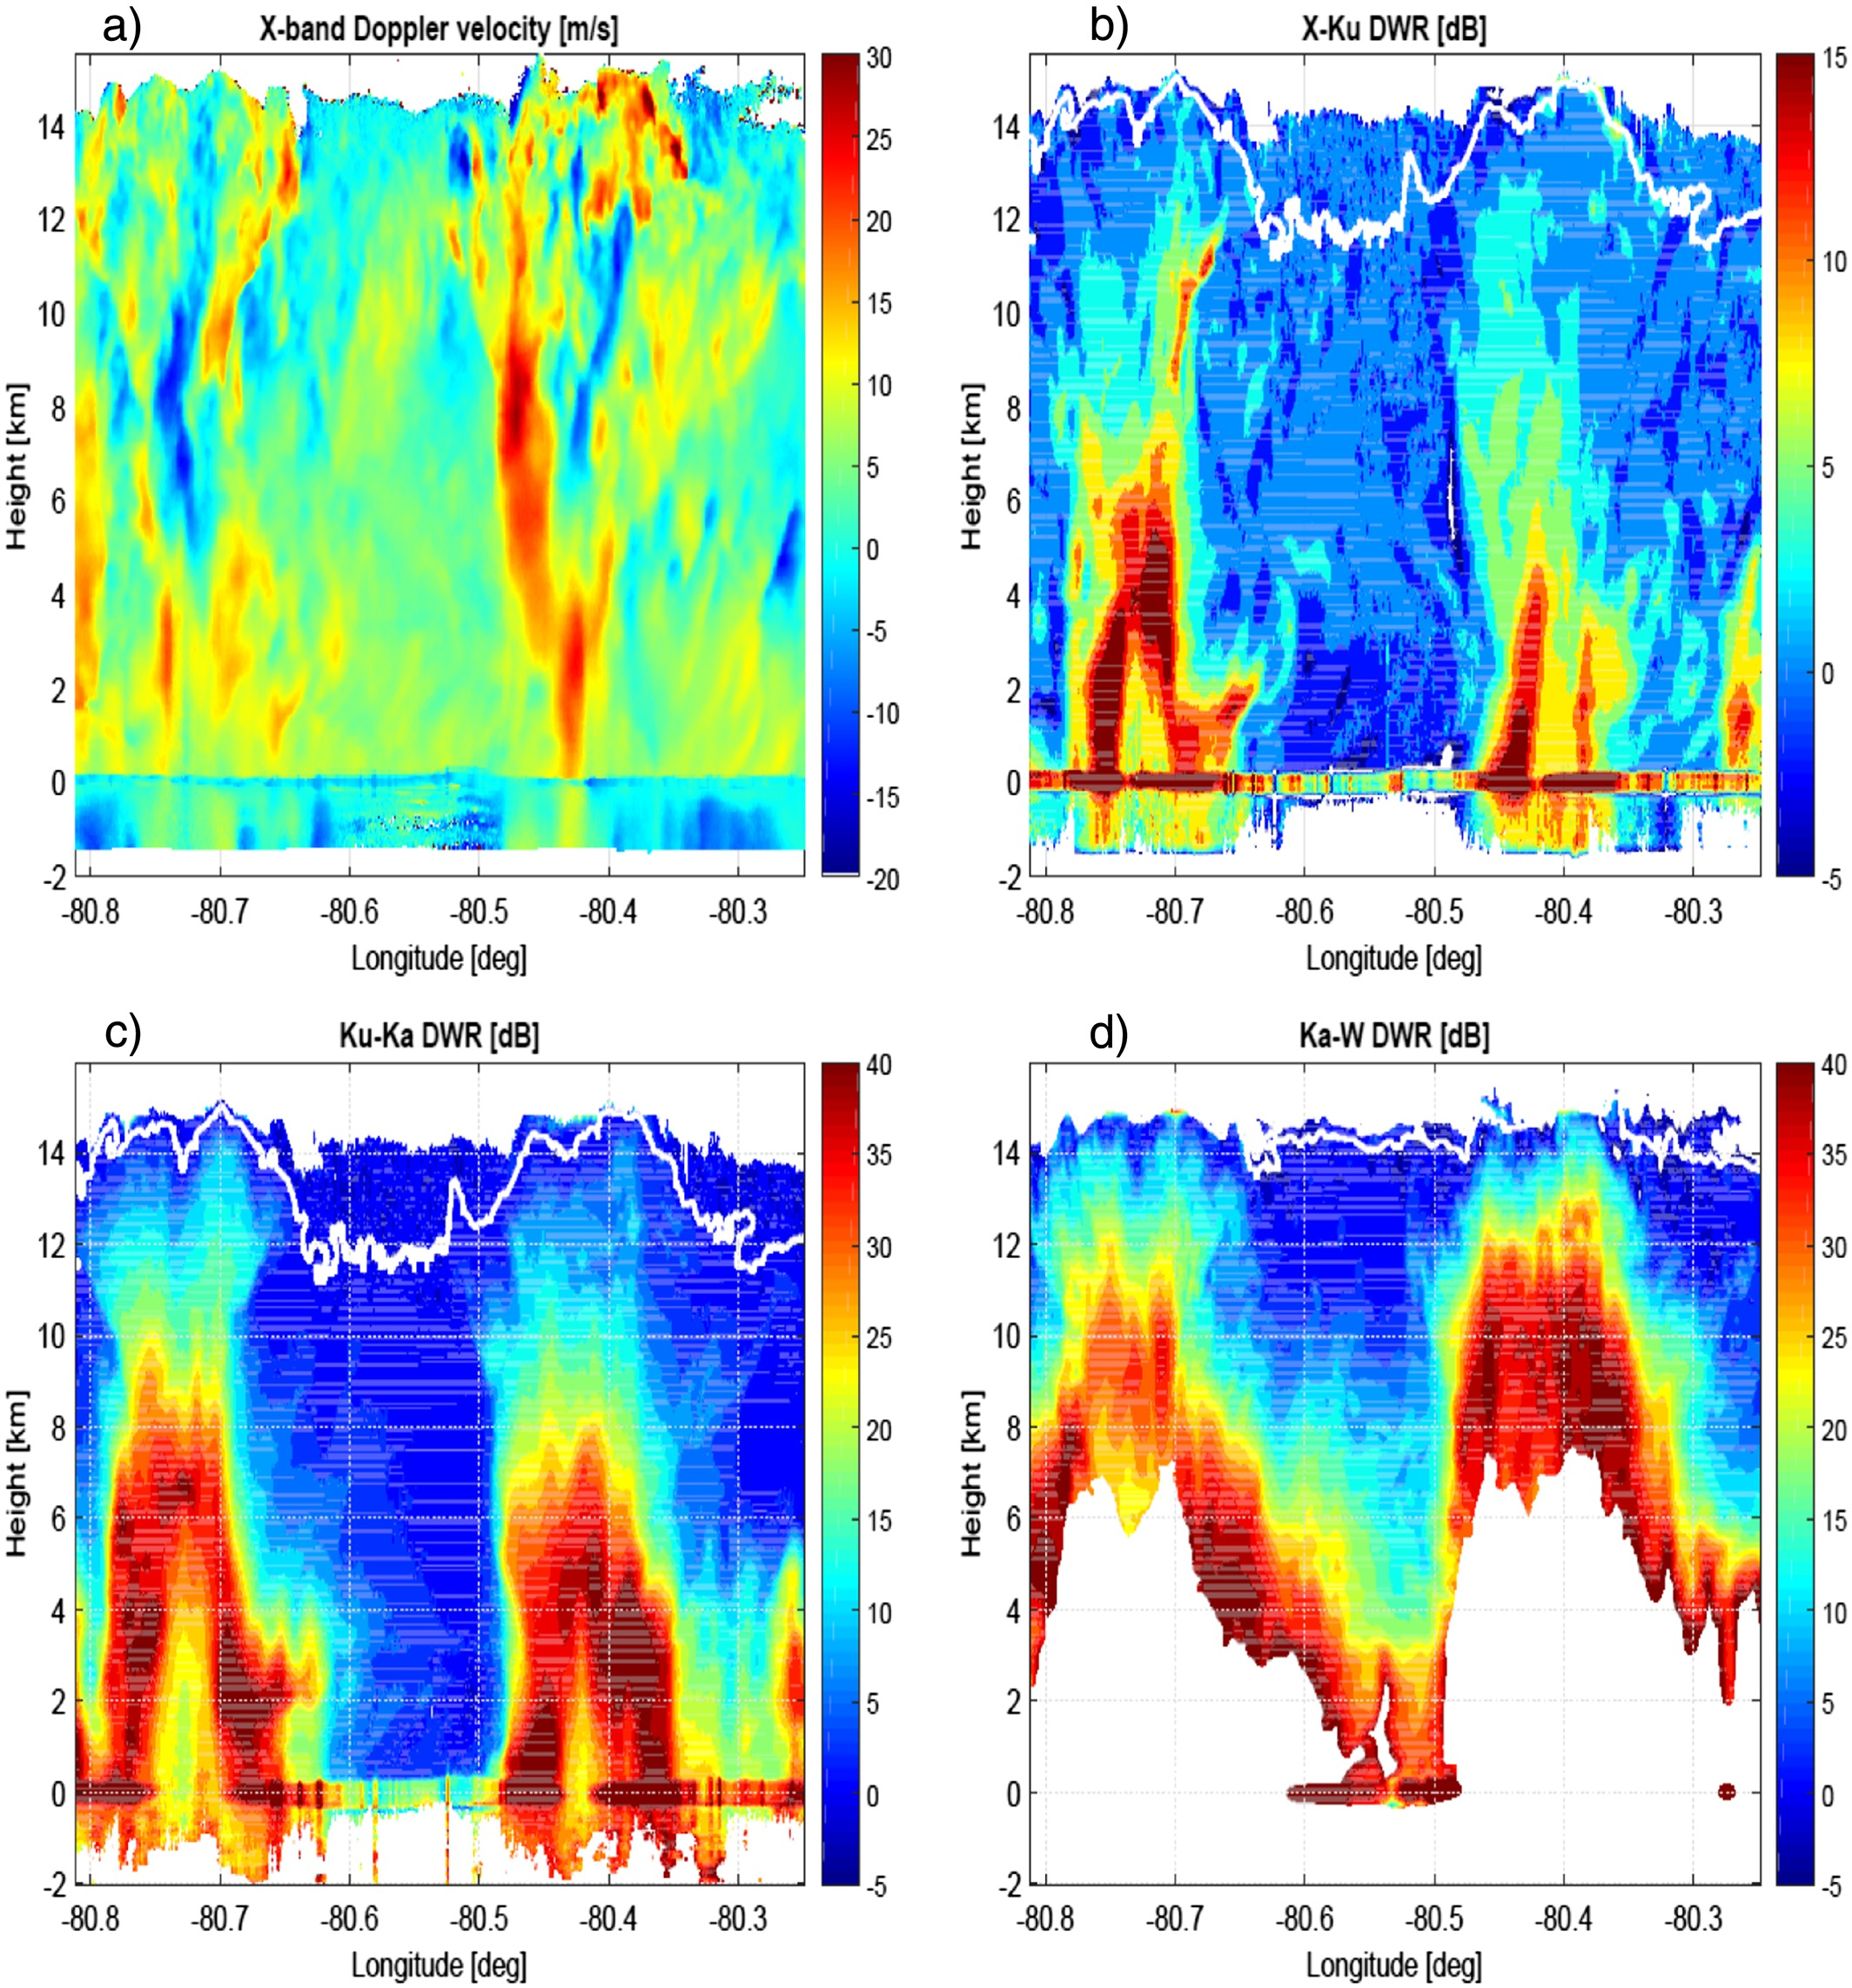
Better done from Suborbital:
Multiple radar frequencies mitigate effects of attenuation, multiple scattering
X-band reflectivity
Ku-band reflectivity
X-band Doppler
S-band reflectivity
Sharp horizontal and vertical gradients better resolved from close-range
Ka-band reflectivity
W-band reflectivity
Ku/Ka ratio
Particle type
hail
graupel
Battaglia et al. 2016
rain
Pre-Decisional – AOS is in Pre-Phase A and NASA makes no commitments on the final design of the mission or instruments

Slide 18
Best done as an integrated observing system
Suborbital observations allow deep-dive into processes for a discrete number of cases, in a discrete number of locations.
Orbital constellation provides context for how these cases and locations fit into the grand scheme... how representative are they?
- We can measure aerosol properties very well from suborbital, for a few aerosol regimes... need orbital to measure all regimes
- We can measure weather events very well from suborbital, but only in a few weather regimes... need orbital for the context of how representative or how extreme those weather events are
Pre-Decisional – AOS is in Pre-Phase A and NASA makes no commitments on the final design of the mission or instruments

Slide 19
Suborbital Implementation Components
We have identified high-priority existing (or near-term) datasets to leverage (e.g., CAMP2EX, ARCSIX, ACTIVATE), and focus on what gaps remain.
Leverage / Augment surface-based networks and supersites (e.g., GPM Validation Network, MRMS, ARM sites, AERONET, Wallops precipitation facility)
a) aircraft campaign over high-latitude site
b) mobile/deployable radar, lidar, profiler, etc. deployed to surface sites, and/or to ships operated by international partners
c) Simpler (easier) ground-based measurements
3) Partner in major campaigns led by others (TBD)
4) AOS-led major airborne campaigns (later slides)
(2) Is where we get sustained sampling
Pre-Decisional – AOS is in Pre-Phase A and NASA makes no commitments on the final design of the mission or instruments

Slide 20
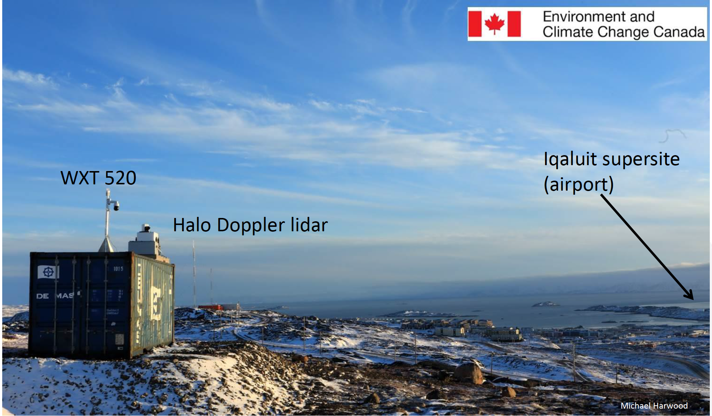



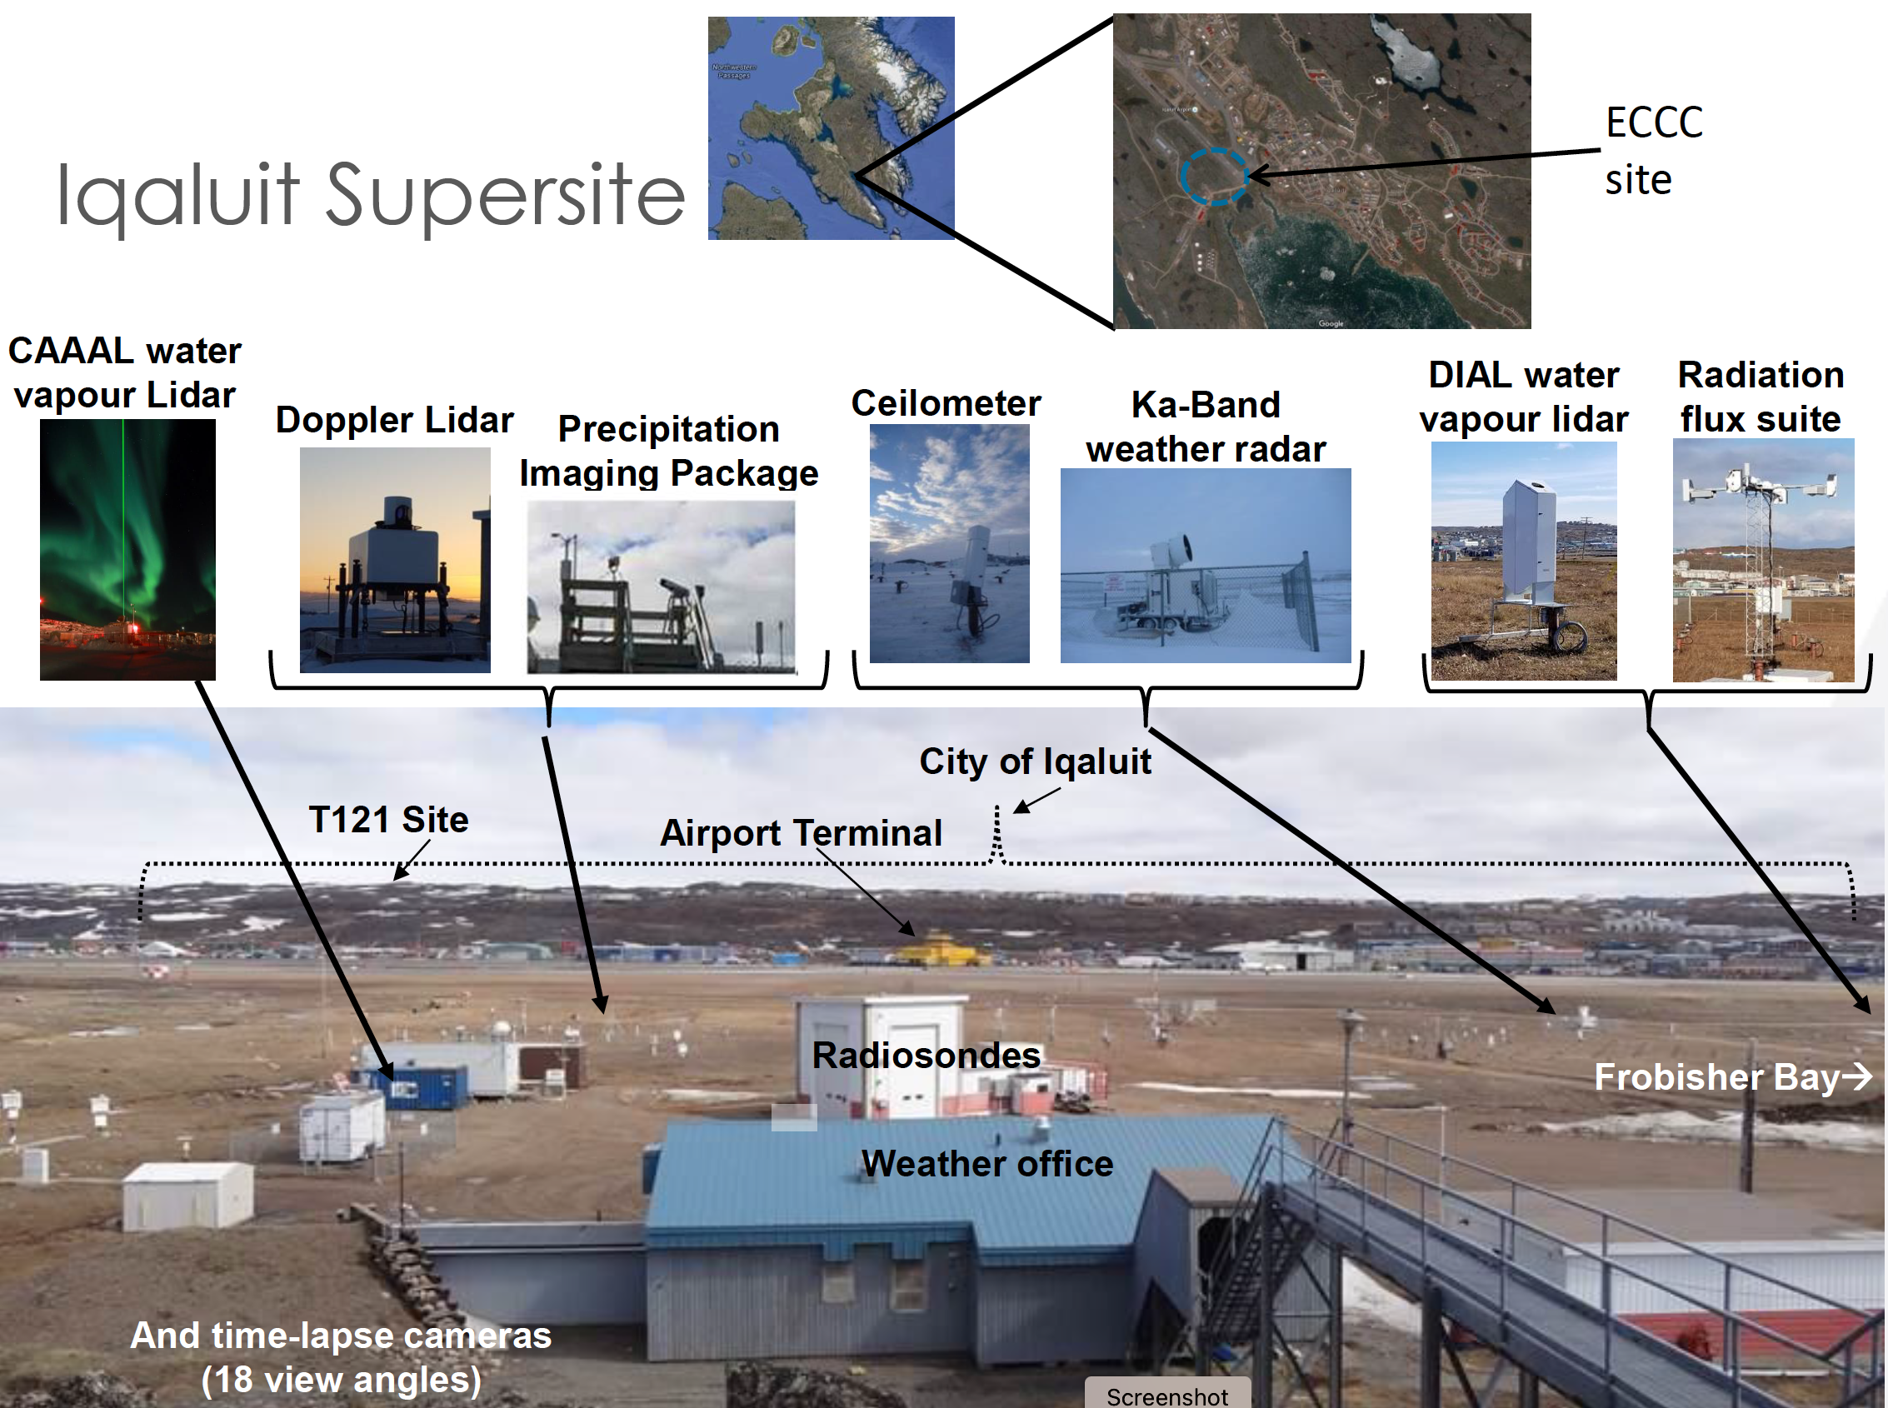
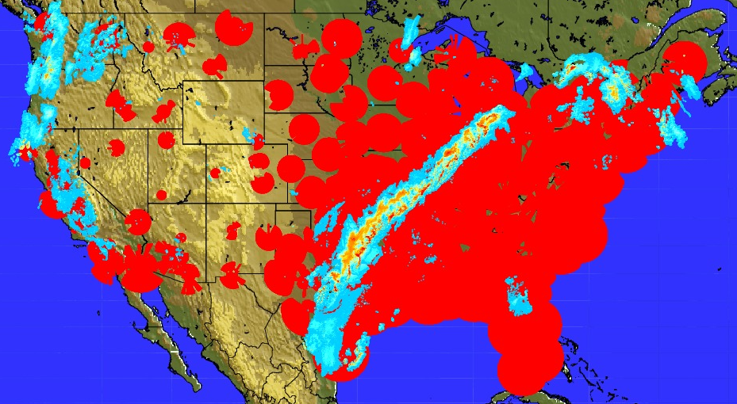
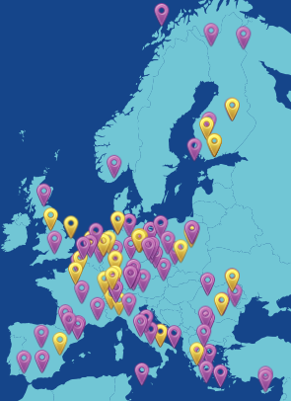
Leverage / augment surface-based networks and supersites
Build up large sample sizes and measure temporal evolution of processes from a few fixed, well-instrumented sites and networks
Radar, profiler, or air quality networks
DOE ARM sites
ESA EarthCARE validation
Etc.
Iqaluit, Canada site as example that could potentially be augmented by an aircraft in situ campaign
NOAA radar network (lower left)
ACTRIS National Facilities (lower middle)
Pre-Decisional – AOS is in Pre-Phase A and NASA makes no commitments on the final design of the mission or instruments

Slide 21
Leverage potential partnerships
NASA R&A program
External field campaigns
DOE ARM sites
NOAA radar network
ESA EarthCARE validation
Aircraft and instrumentation from international partners
Iqaluit, Canada site as example that could potentially be augmented by an aircraft in situ campaign
NOAA radar network (lower left)
ACTRIS National Facilities (lower middle)
Pre-Decisional – AOS is in Pre-Phase A and NASA makes no commitments on the final design of the mission or instruments

Slide 22
Large airborne campaigns led by AOS
Multiple (~3) campaigns / deployments, with each synergistically contributing to all three themes. Campaigns are planned as post-launch for the satellites, so they are many years away and plans must be kept general / notional; subject to change.
Aircraft focus on regions where we can leverage surface-based instrumentation, and address science objectives from all three themes.
Maintain flexibility to address issues that arise over the course of the next decade
Addressing the key objectives:
Characterize processes associated with cloud and precipitation initiation…
Understand controls on convective storm processes and lifecycle and anvil cirrus lifecycle…
Quantify vertically resolved aerosol-cloud-radiation interaction processes coupled with aerosol attribution and lifecycle...
Pre-Decisional – AOS is in Pre-Phase A and NASA makes no commitments on the final design of the mission or instruments

Slide 23
Airborne Campaigns concept
Two-Three aircraft, one is over-cloud top cloud/precip/aerosol/radiation remote sensors. One is mid-high remote sensor for aerosol and low cloud, with in situ probes. One is low-altitude in situ with radiation. Heritage instruments available for key needs.
High-altitude aircraft (~ER-2)
2) Mid-High-altitude (~DC-8, G5, Falcon or similar)
3) Low-altitude (~P-3, C130, Challenger 850 or similar)
+ Surface-based instrumentation, small UAS?
Radar
Lidar
Payloads depicted are notional… instruments to be prioritized / deconflicted for each campaign
Radar
Radiometer
Spectrometer
Notional ER-2 payload
Polarimeter
Cloud + Aerosol probes
Radar
Notional P-3 payload
Pre-Decisional – AOS is in Pre-Phase A and NASA makes no commitments on the final design of the mission or instruments
Notes:
Brief intro here, before the cartoon

Slide 24
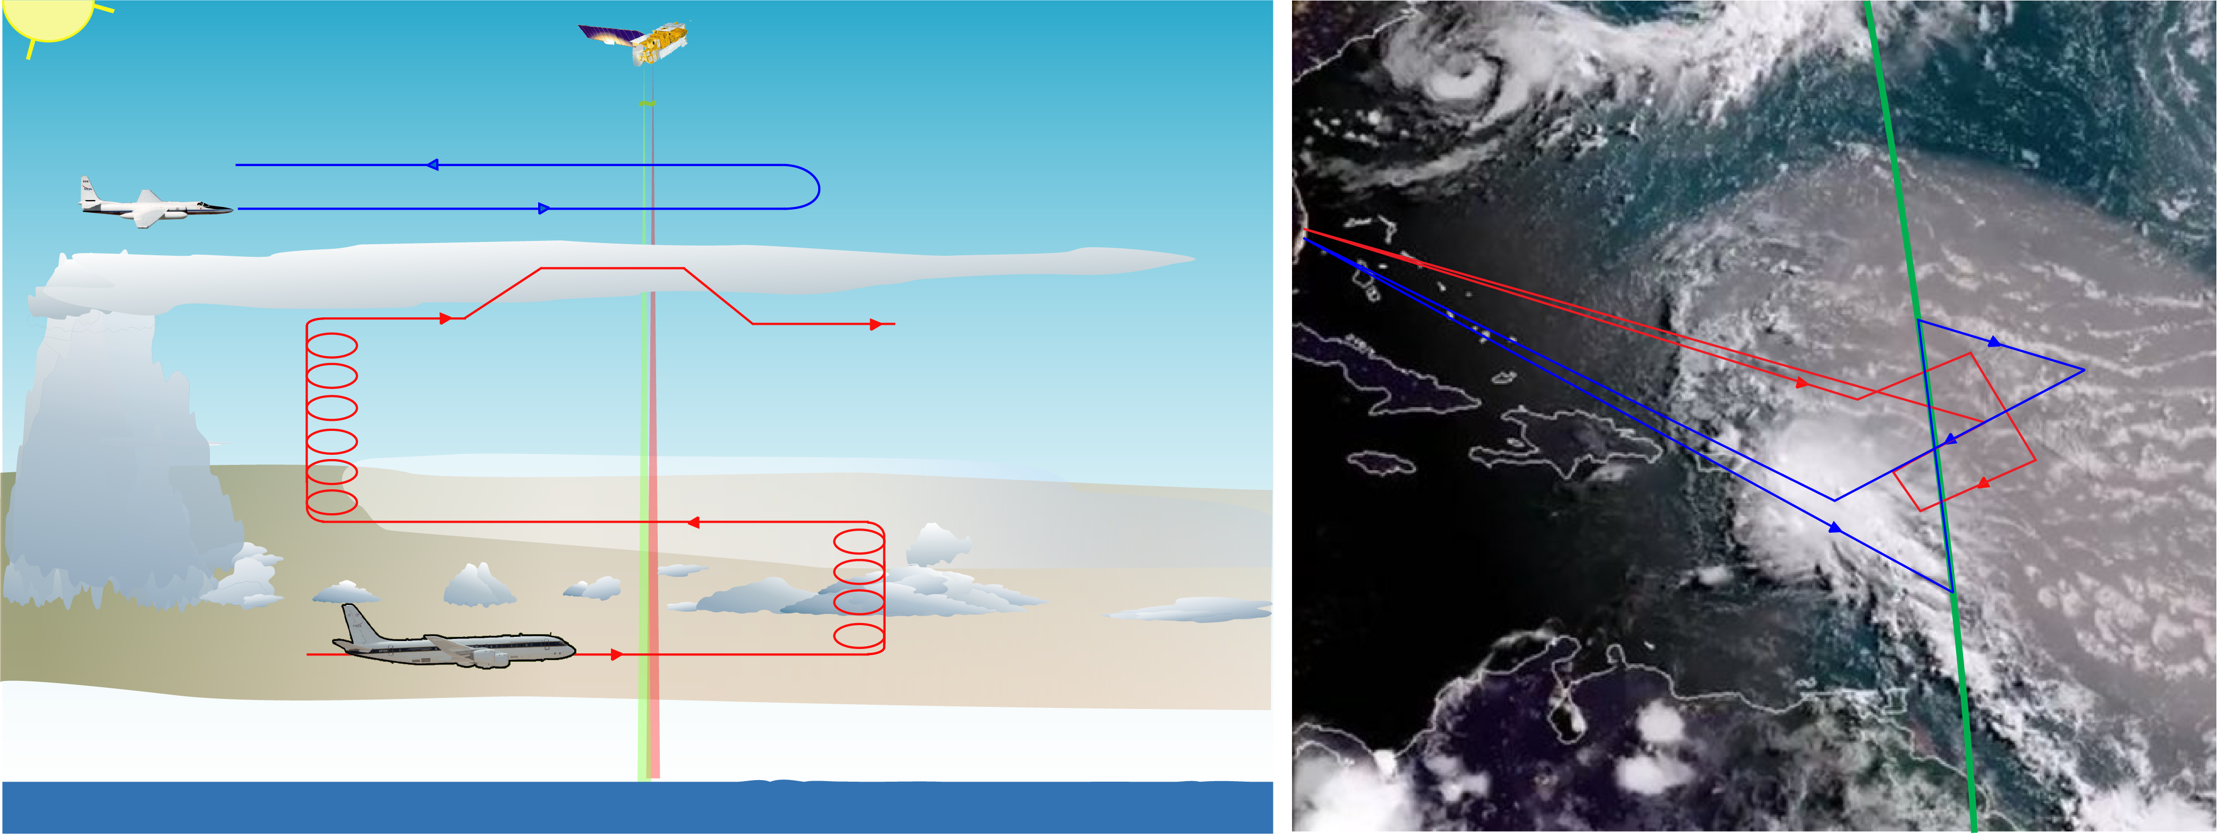
Example flight concept:
Low-cloud – dust interaction & Convection-dust interaction
AOS –P ground track
Pre-Decisional – AOS is in Pre-Phase A and NASA makes no commitments on the final design of the mission or instruments

Slide 25
Timeline
Phase C
Phase D
Phase E
AOS-I launch NET July 2028
AOS-P launch NET Dec 2030
Augment existing surface-based networks / supersites
Leverage relevant external field campaigns
Large airborne campaign, mid-latitude continental, spring-early summer after AOS-I launch (~2029)
Large airborne campaigns, early summer after AOS-P launch (~2031 and 2032)
Campaigns after launch to enable cal-val
Pre-Decisional – AOS is in Pre-Phase A and NASA makes no commitments on the final design of the mission or instruments
Notes:
Brief intro here, before the cartoon

Slide 26
Midlatitude Continental airborne campaign
Post-launch for AOS-Inclined (to maximize cal-val)
Measure deep, strong convection that is difficult for satellite instruments;
Aerosol properties and interactions - urban aerosol emissions, smoke, etc.;
Transition from low cumulus clouds to towering cumulus and cumulonimbus;
Addressing the key objectives:
Characterize processes associated with cloud and precipitation initiation…
Understand controls on convective storm processes and lifecycle and anvil cirrus lifecycle…
Quantify vertically resolved aerosol-cloud-radiation interaction processes coupled with aerosol attribution and lifecycle...
Pre-Decisional – AOS is in Pre-Phase A and NASA makes no commitments on the final design of the mission or instruments

Slide 27
Timeline
Phase C
Phase D
Phase E
AOS-I launch NET July 2028
AOS-P launch NET Dec 2030
Augment existing surface-based networks / supersites
Leverage relevant external field campaigns
Large airborne campaign, mid-latitude continental, spring-early summer after AOS-I launch (~2029)
Large airborne campaigns, (sub)tropical oceanic, early summer after AOS-P launch (~2031 and 2032)
Campaigns after launch to enable cal-val
Pre-Decisional – AOS is in Pre-Phase A and NASA makes no commitments on the final design of the mission or instruments
Notes:
Brief intro here, before the cartoon

Slide 28
(Sub)Tropical Oceanic airborne campaign
Post-launch for AOS-Polar (to maximize cal-val)
Aerosol properties and interactions – Saharan dust, sea salt, etc.;
Marine stratocumulus; transition from low cumulus clouds to towering cumulus and cumulonimbus;
Oceanic convection that is easier to penetrate for in situ observations; anvil lifecycle and high, thin cirrus
Addressing the key objectives:
Characterize processes associated with cloud and precipitation initiation…
Understand controls on convective storm processes and lifecycle and anvil cirrus lifecycle…
Quantify vertically resolved aerosol-cloud-radiation interaction processes coupled with aerosol attribution and lifecycle...
Pre-Decisional – AOS is in Pre-Phase A and NASA makes no commitments on the final design of the mission or instruments

Slide 29
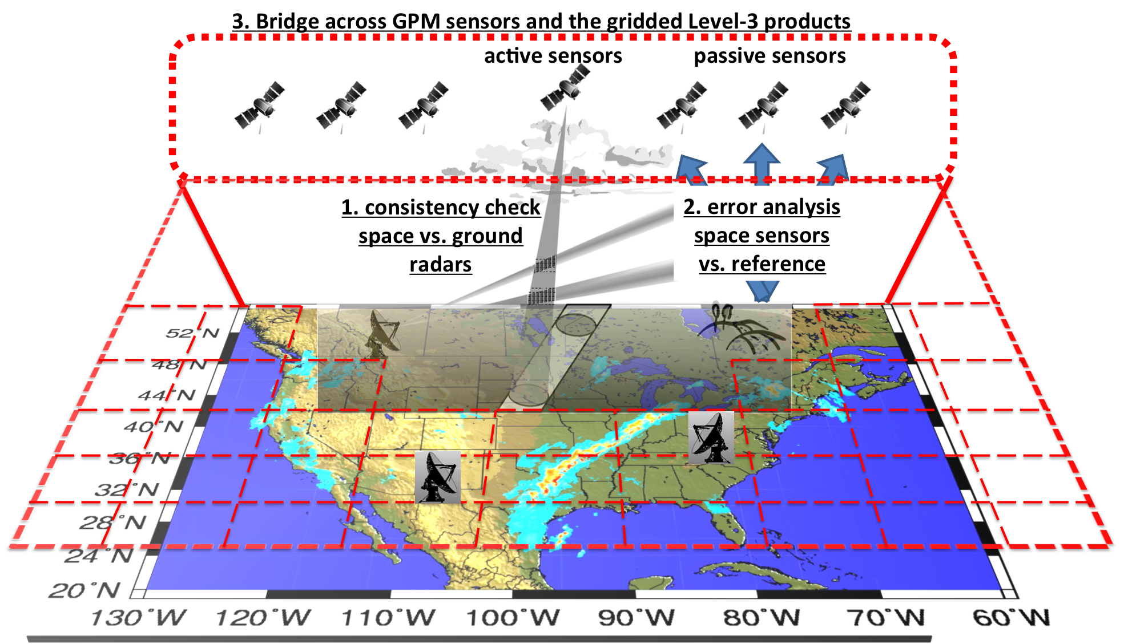
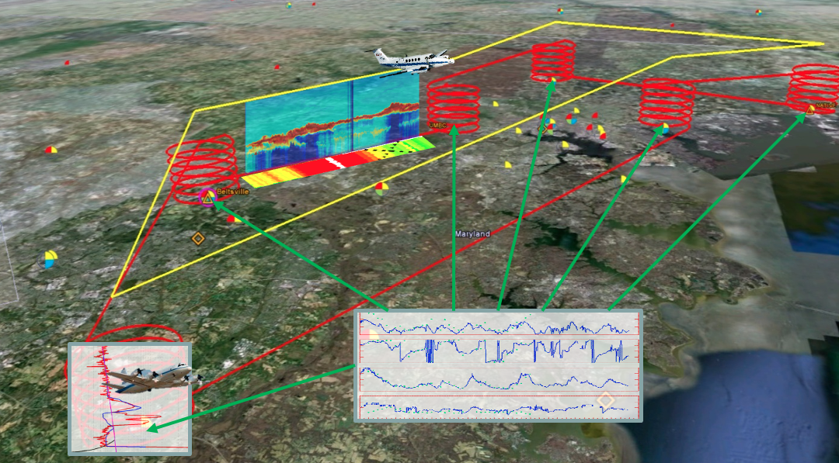
AOS Suborbital Applications
Suborbital provides early science and learning how to use the new AOS and related satellite measurements
Bridge across a spectrum of observations and stakeholder needs
Build from prior applications successes:
Prior example | AOS analog
Ground-based radar networks and satellite sensors provide complementary information on clouds, convection, precipitation, to improve L2-4 products | Ground-based networks and expansion of GPM ground validation infrastructure are a high priority for AOS Suborbital
DISCOVER-AQ coordinated flight tracks above ground-based air quality observational networks, provided vertical profile information to operational partners | AOS field campaigns / aircraft flight tracks designed to leverage / augment existing surface-based measurement sites and networks; engage partners during planning and execution
GPM deployed disdrometers to data-sparse regions and engaged local weather service on using NASA satellite and ground data | AOS surface instrumentation in critical locations that are data voids or “sweet spots”; engage local partners to maximize return
requires intentional stakeholder engagement and training to prepare users
Pre-Decisional – AOS is in Pre-Phase A and NASA makes no commitments on the final design of the mission or instruments
Notes:
User-friendly, on demand data tools especially in the cloud will make it possible to expand the use and application of AOS-Suborbital observations. Example tools include Field Campaign Explorer and CAPRi as well as NASA’s Mission Tools Suite
Application of Suborbital observations requires intentional stakeholder engagement and training prior to the flights, user-friendly data accessibility/formats, and potentially near-real time data dissemination as opposed to collection-only
4 examples are presented above
Also consider: AOS spaced-based data can enhance other field campaigns when data are provided and flights are coordinated with overpasses

Slide 30
Calibration / Validation
Leverage Suborbital science campaigns to conduct cal/val
Suborbital science payloads will have relevant remote sensors for satellite instruments, and direct in situ measurements of geophysical variables
Some cal/val requires satellite underflights that can be done during our science field campaigns, just requiring devoted flight hours / flight design
Some cal/val requires flights over particular types of targets, … can do these as dedicated cal/val flights before, during, or after a science deployment, while the payload is still on the aircraft
Dedicated cal/val scenario: For a suitable aircraft (e.g., ER-2, G-V), operate from aircraft's home base with relevant remote sensors dedicated to satellite underflights and/or priority cal/val targets
Pre-Decisional – AOS is in Pre-Phase A and NASA makes no commitments on the final design of the mission or instruments

Slide 31
Summary
AOS Mission Concept Development
  Dual-orbit solution with Suborbital Component
  Inclined orbit: NASA backscatter lidar, JAXA Ku Doppler radar, CNES passive microwave radiometers, 55° inclination
  Polar orbit: W-, Ka-band Doppler radars, HSRL lidar, passive microwave radiometer, polarimeter, and CSA FIR spectrometer & aerosol/moisture limb imagers
  Notional launches in mid 2028 (inclined), late 2030 (polar), with field campaigns after launches (nominally 3 field campaigns, TBD)
Architecture contingent on HQ’s reviews, decisions, and funding
Pre-Decisional – AOS is in Pre-Phase A and NASA makes no commitments on the final design of the mission or instruments

Slide 32
Summary
AOS Suborbital Concept
  Leverage / augment surface-based networks and supersites
  Partner in relevant field campaigns
  Lead multi-aircraft field campaigns addressing cloud & precip initiation, convective storm processes and lifecycle, anvil cirrus lifecycle, aerosol-cloud-radiation interaction processes coupled with aerosol attribution and lifecycle
    High-altitude remote sensing aircraft
    Mid-high altitude remote sensing + in situ aircraft
    Low-altitude in situ aircraft
    Emphasis on coordination between aircraft and well-instrumented surface sites
Pre-Decisional – AOS is in Pre-Phase A and NASA makes no commitments on the final design of the mission or instruments

