Slide 1

Observations and Analysis from a Scaled, Supersonic Plume-Surface Interaction Experiment
Wesley A. Chambers¹, Juan Sebastian Rubio², Matt Gorman²,
Miguel X. Diaz-Lopez², Rui Ni², and Manish Mehta¹
¹NASA Marshall Space Flight Center
²Johns Hopkins University
NASA Exploration Science Forum
20 July 2022

Slide 2
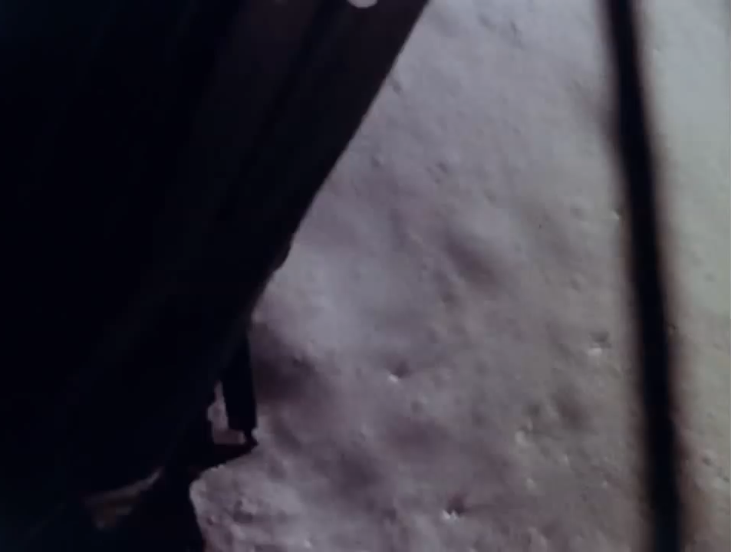
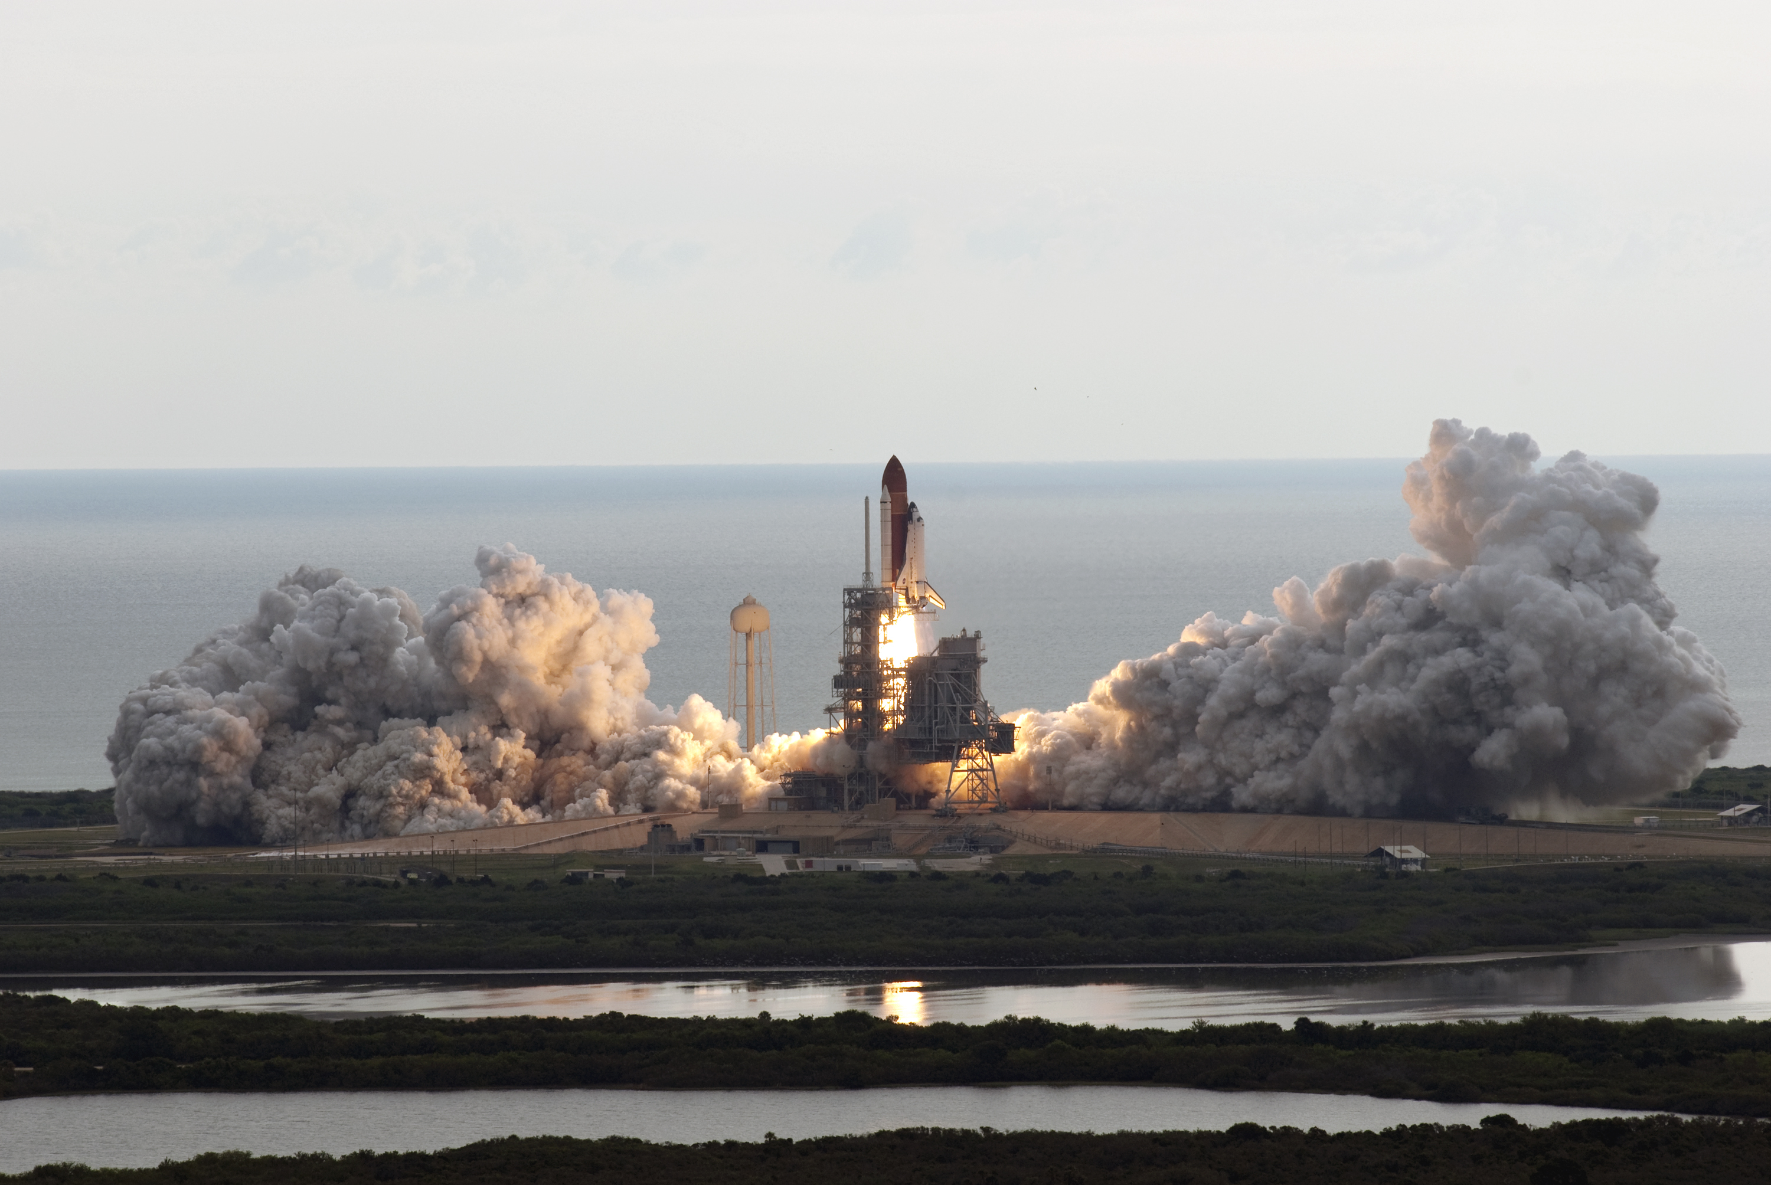
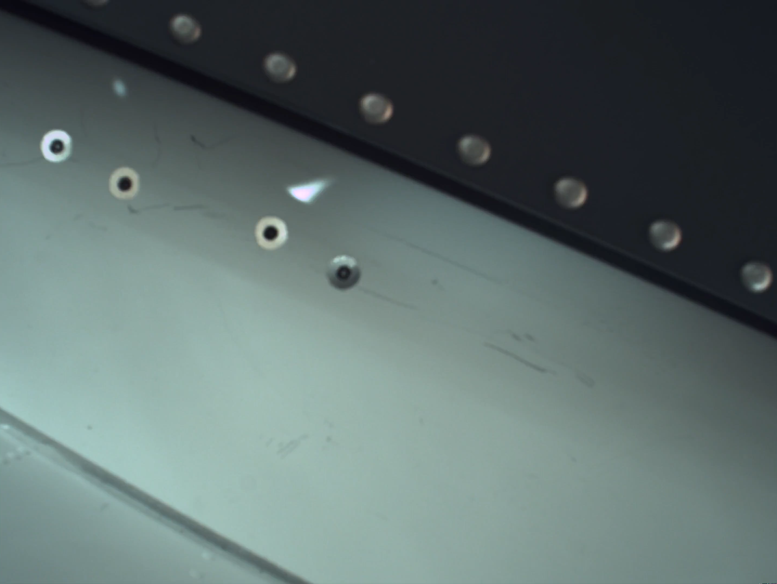
Mars 2020 (NASA/JPL)
Apollo 11 (NASA)
STS-134 (NASA/Jim Grossman)
Notes:
Shuttle image source: NASA - Launch and Landing
Apollo video source: Apollo 11 45th Anniversary Resource Reel | NASA Image and Video Library (trimmed/compressed by the author)
M2020 landing video: NASA/JPL (trimmed/compressed by the author)

Slide 3

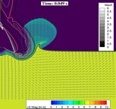
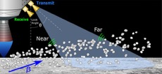
NASA’s Plume-Surface Interaction Project
Testing
PSI testing using NASA vacuum facilities
Sub-scale, inert-gas PSI test (2021/2022)
Follow-on, flight-relevant test (Planned)
Physics Focused Ground Test 1
Summer 2021
Half-space PSI experiment
Physics Focused Ground Test 2
Summer 2022
Plume impingement experiment
Modeling & Simulation
Plume flow in low-pressure environments
Mixed continuum/rarefied flow
Regolith particle phase modeling
Gas-particle interaction modeling
Instrumentation
mm-wave Doppler radar
Dust concentration monitor

Slide 4
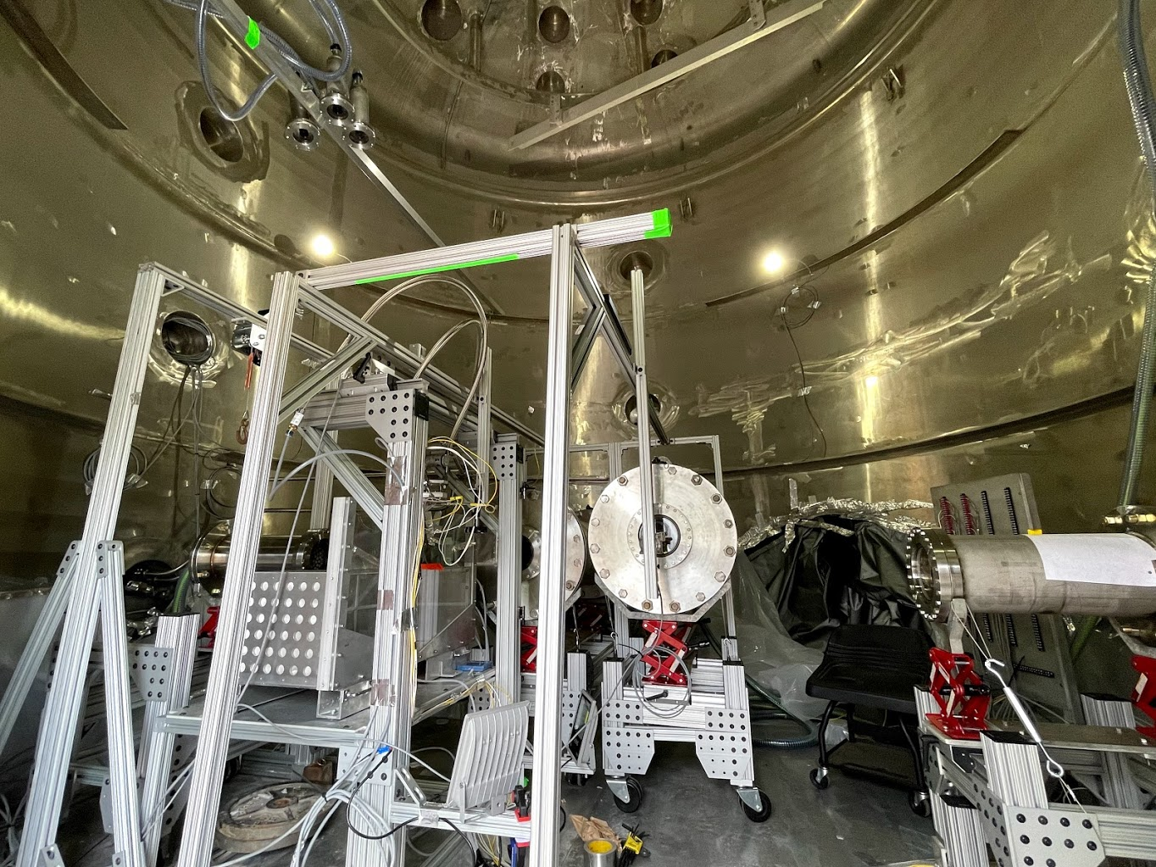
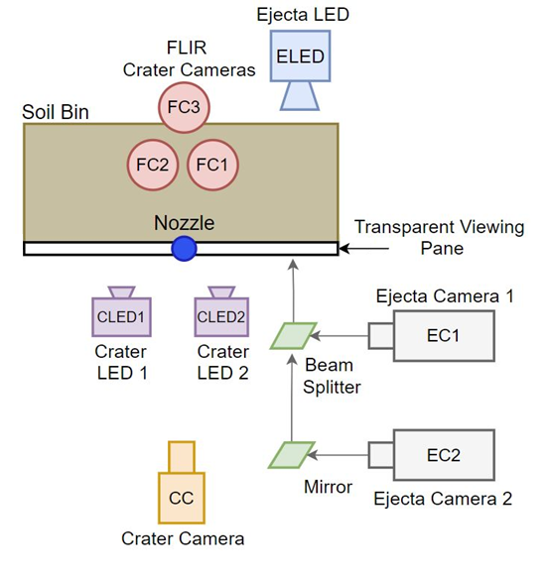
FLIR Cameras (FC1, FC2, FC3)
Experiment Diagram (Top-Down View)
HS Vision
LED
TMX
(EC1)
V2511
(EC2)
VEO
(CC)
Crater LEDs
Physics Focused Ground Test 1
MSFC Test Stand 300

Slide 5
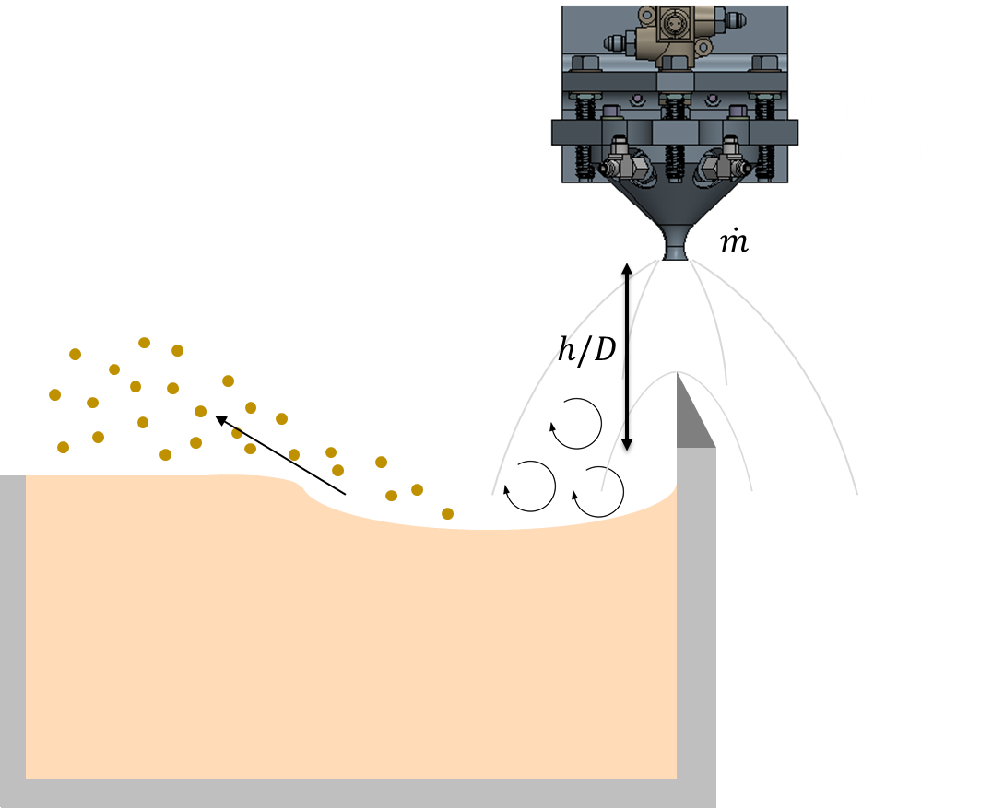
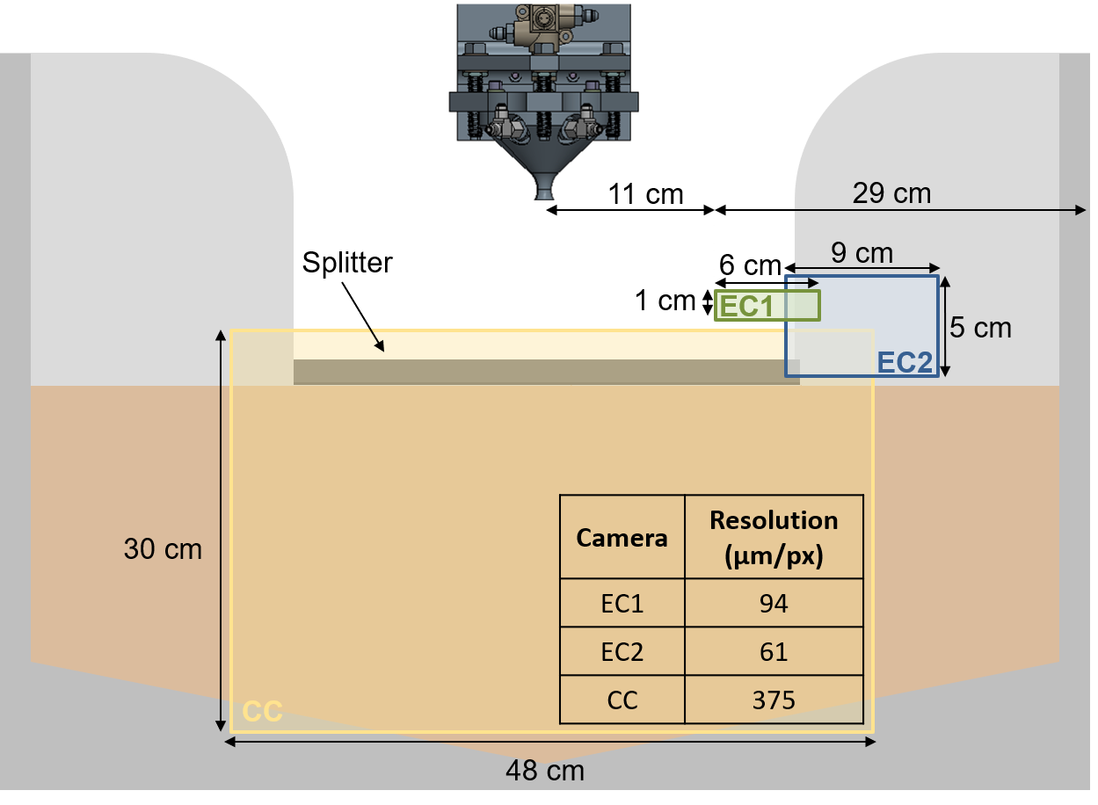

PFGT1 Regolith Bin and Nozzle Setup
$$Heated GN_{2}$$
Side-Facing Diagram
Face-On Diagram with Example High-Speed Camera Fields of View

Slide 6
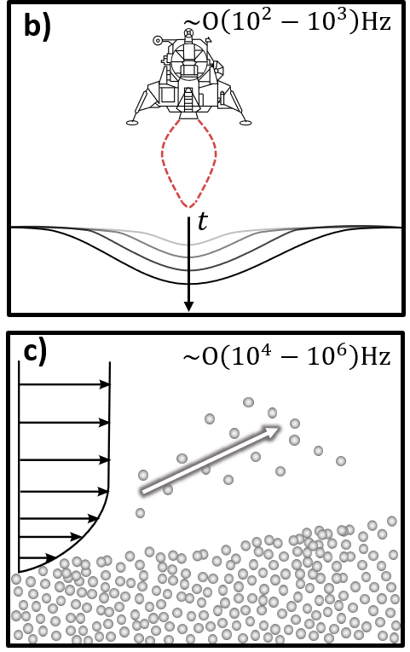
PFGT1 High-Speed Cameras
Crater Camera (CC)
Phantom VEO
5,000 Hz
Ejecta Camera 1 (EC1)
Phantom TMX
775,000 Hz
Ejecta Camera 2 (EC2)
Phantom V2511
25,000 Hz
Face-On Diagram with Example High-Speed Camera Fields of View

Slide 7
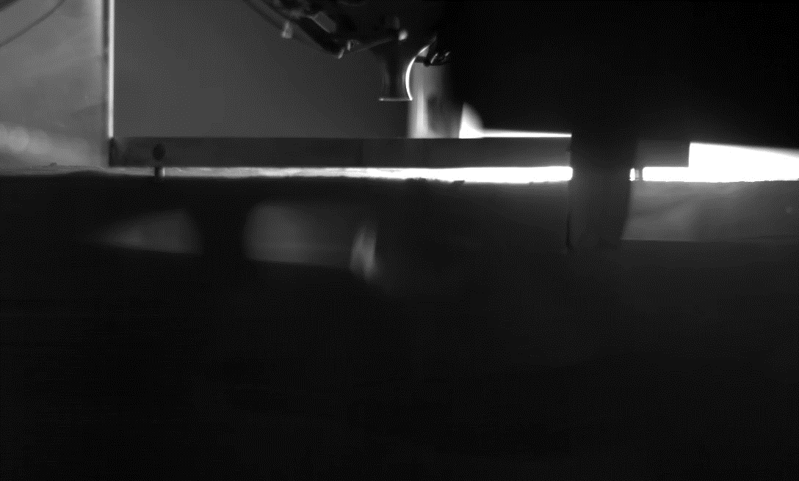
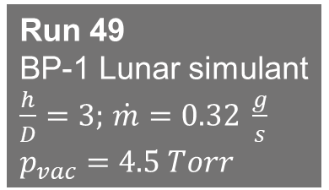
Run 49
BP-1 Lunar simulant
$\frac{h}{D}=3;$ $\dot{m}=0.32 \frac{g}{s}$
$$p_{vac}=4.5 Torr$$
PFGT1 Parameters and Simulants
Regolith Simulants |  | Description
Mono-disperse silica sand | MDS | 150 micron (mean)
Bi-disperse sand mixture | BDS | 50 micron (mean) + mono-disperse
Tri-disperse sand mixture | TRI | Sieved BP-1 + bi-disperse
BP-1 | BP1 | Full range lunar simulant
Sieved BP-1 | IRR | 300 micron (mean)
Mono-disperse glass spheres | MGB | 150 micron (mean)
Parameter | min | max
Vacuum chamber pressure [Torr] | 0.02 | 4.5
Nozzle height/nozzle diameter [dimensionless] | 3 | 13
Nozzle mass flow rate [g/s] | 0.32 | 8.6

Slide 8
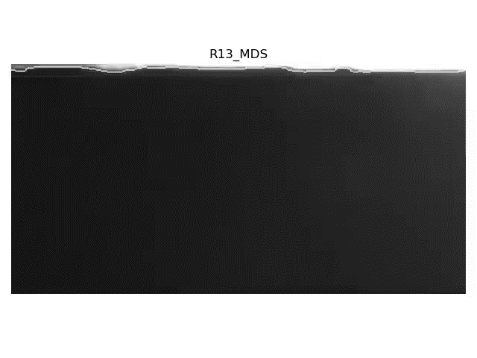

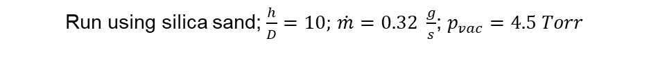
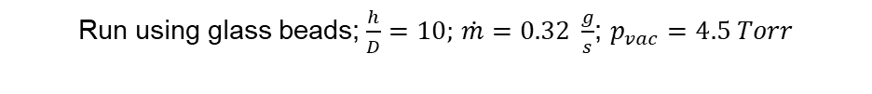
Image Analysis Techniques
Crater Profile Recovery
Ejecta Particle Tracking
Run using silica sand;$\frac{h}{D}=10;$ $\dot{m}=0.32 \frac{g}{s}$; $p_{vac}=4.5 Torr$
Run using glass beads;$\frac{h}{D}=10;$ $\dot{m}=0.32 \frac{g}{s}$; $p_{vac}=4.5 Torr$

Slide 9
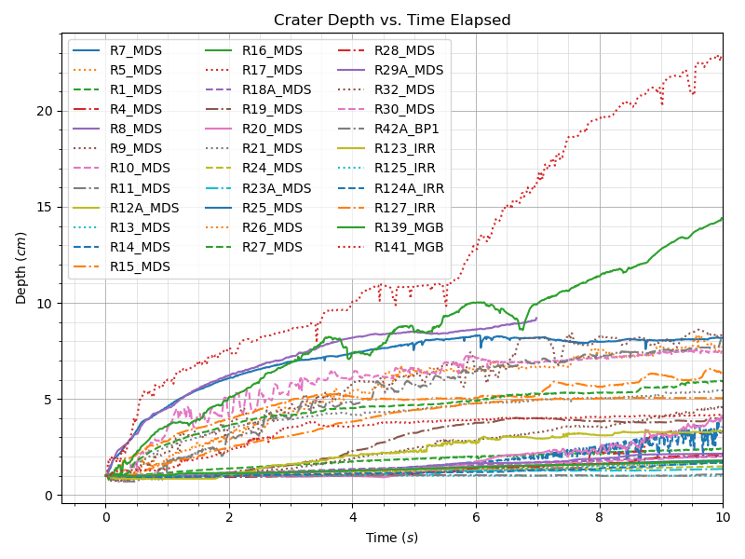
(Preliminary) Crater Analysis Results

Slide 10
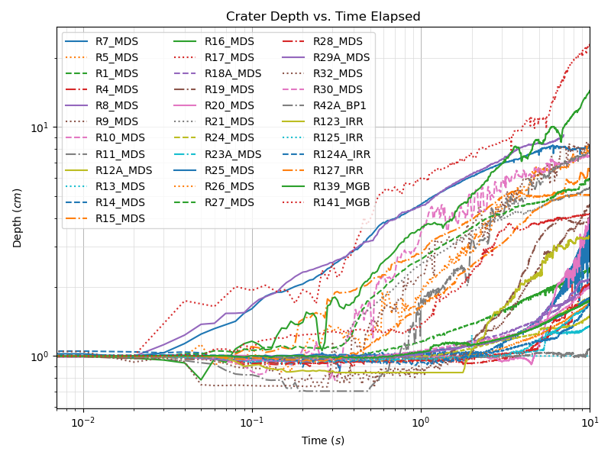
(Preliminary) Crater Analysis Results

Slide 11
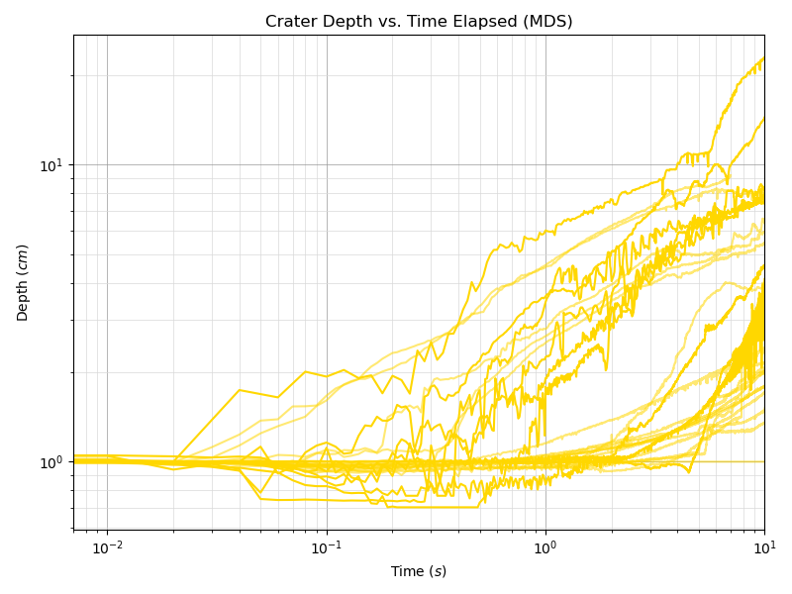
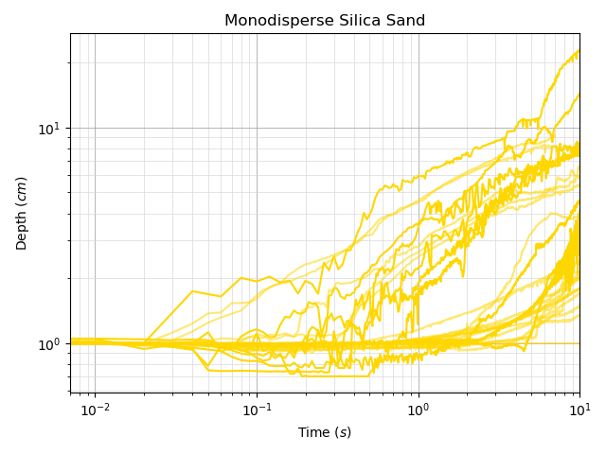
(Preliminary) Crater Analysis Results

Slide 12
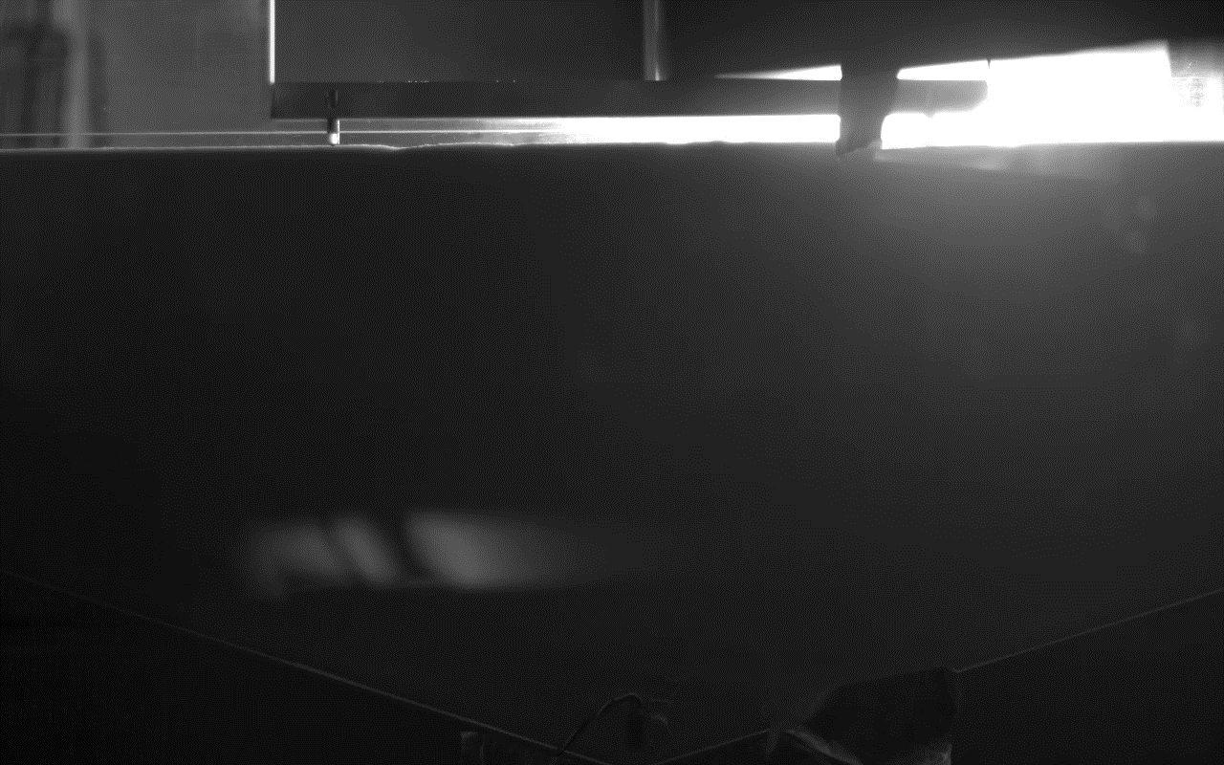
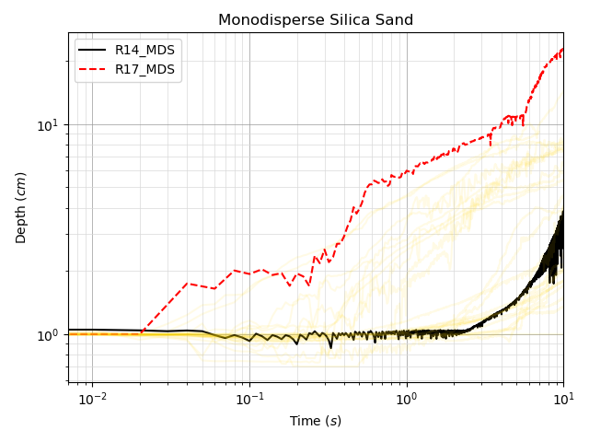
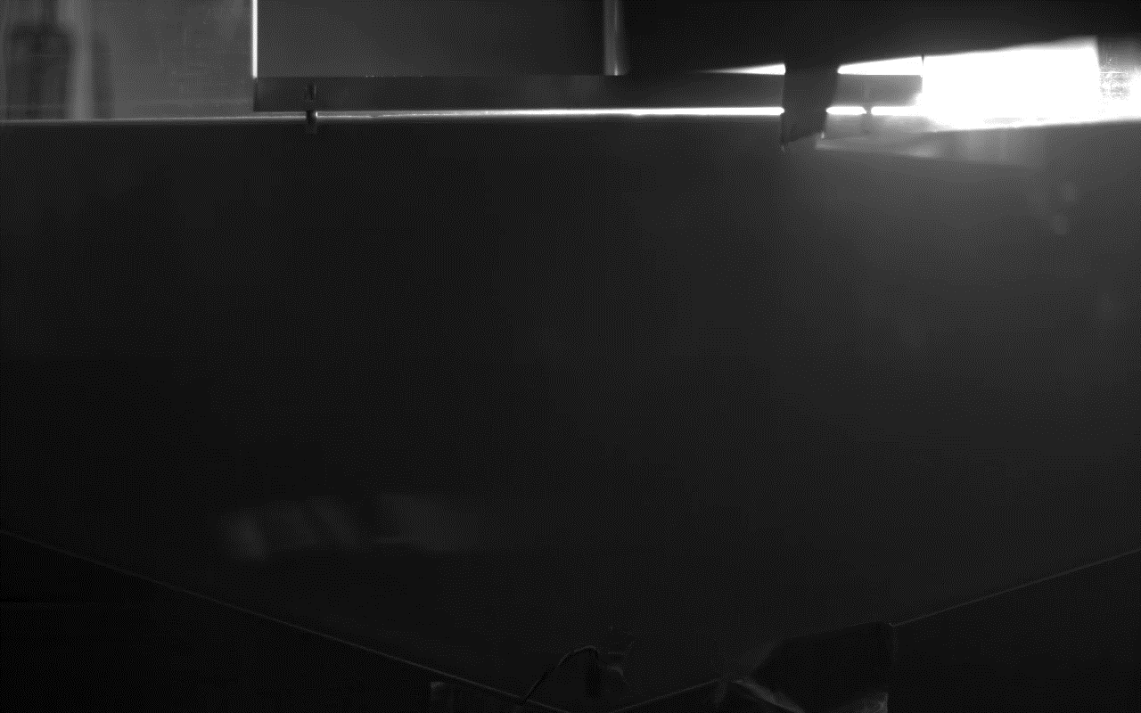
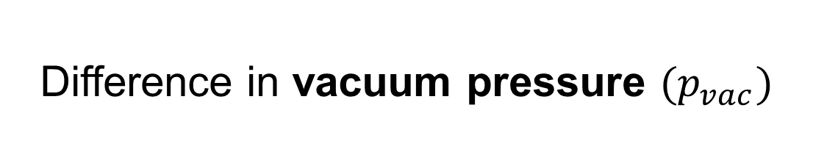

Difference in vacuum pressure $(p_{vac})$
Runs 14 & 17, $\frac{h}{D}=10$, $\dot{m}=8.6 \frac{g}{s}$
Run 14, $p_{vac}=0.053 Torr$
Run 17, $p_{vac}=4.5 Torr$(Mars atmosphere)

Slide 13
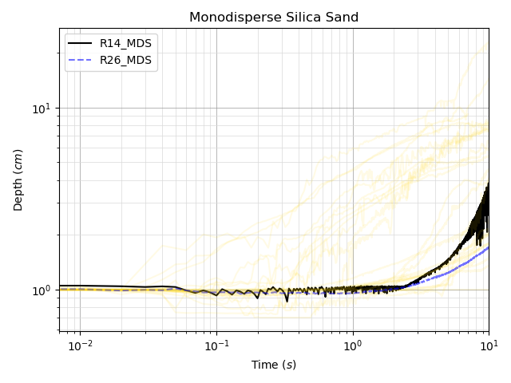
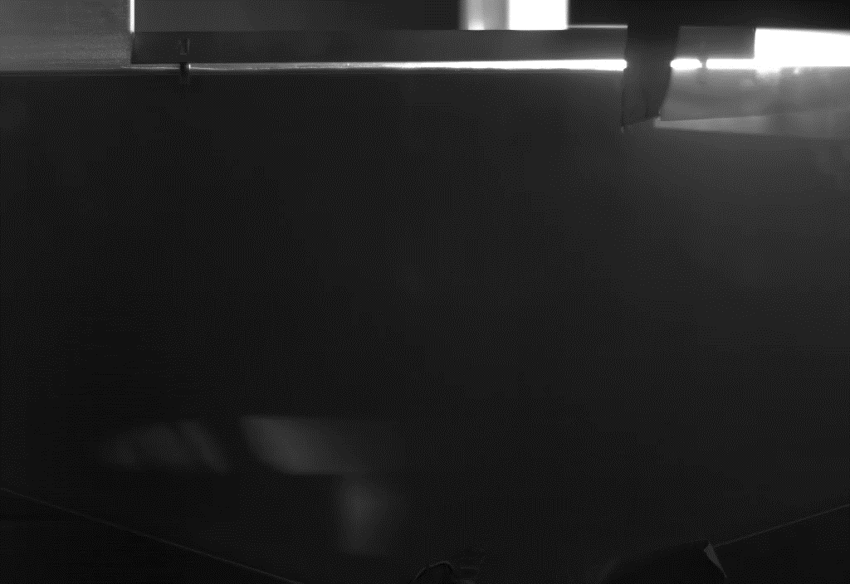


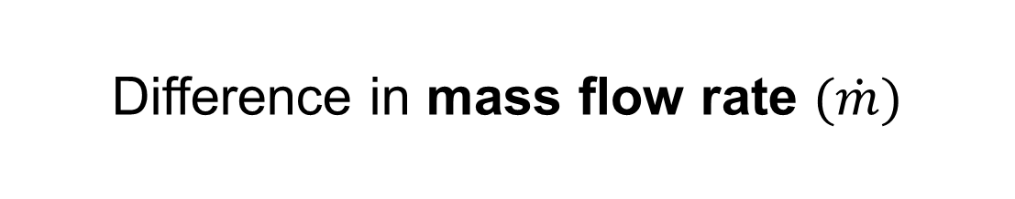

Difference in mass flow rate $(\dot{m})$
Runs 14 & 26, $\frac{h}{D}=10$, $p_{vac}=0.02 \& 0.053 Torr$
Run 14, $\dot{m}=8.6 \frac{g}{s}$
Run 26, $\dot{m}=0.32 \frac{g}{s}$

Slide 14
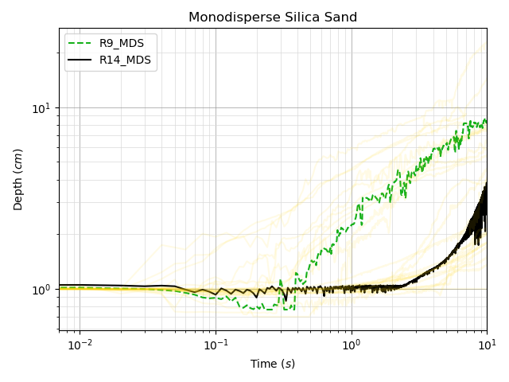
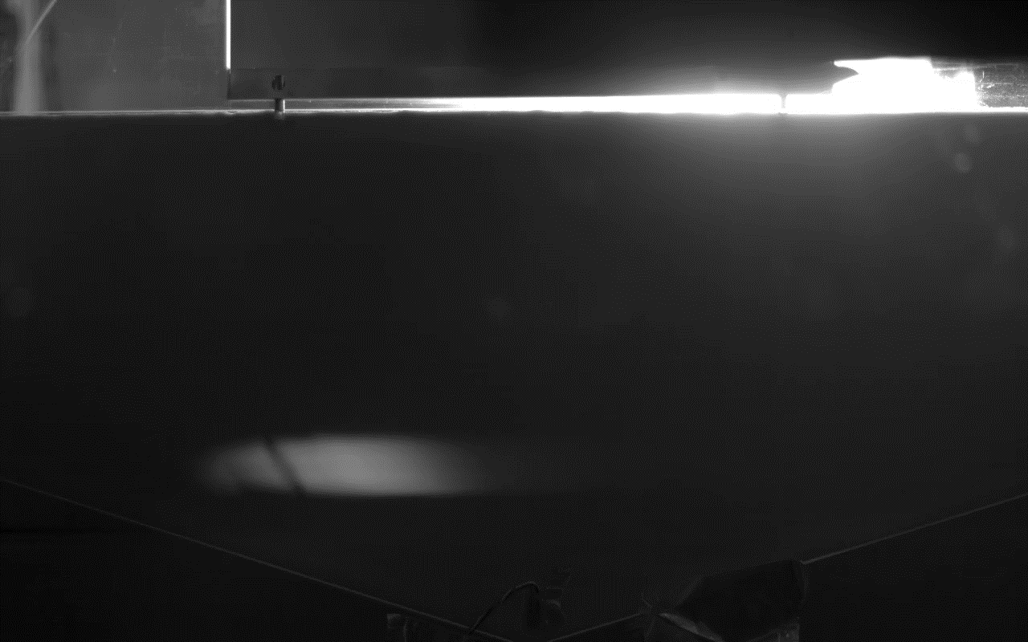
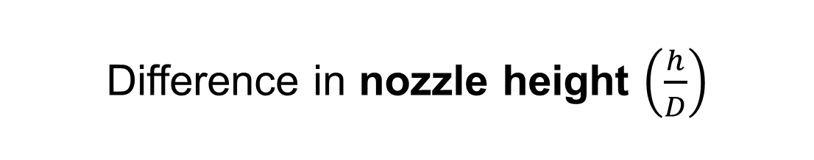

Difference in nozzle height $\left(\frac{h}{D}\right)$
Runs 9 & 14, $p_{vac}=0.053 Torr$, $\dot{m}=8.6 \frac{g}{s}$
Run 14, $\frac{h}{D}=10$
Run 9, $\frac{h}{D}=3$

Slide 15
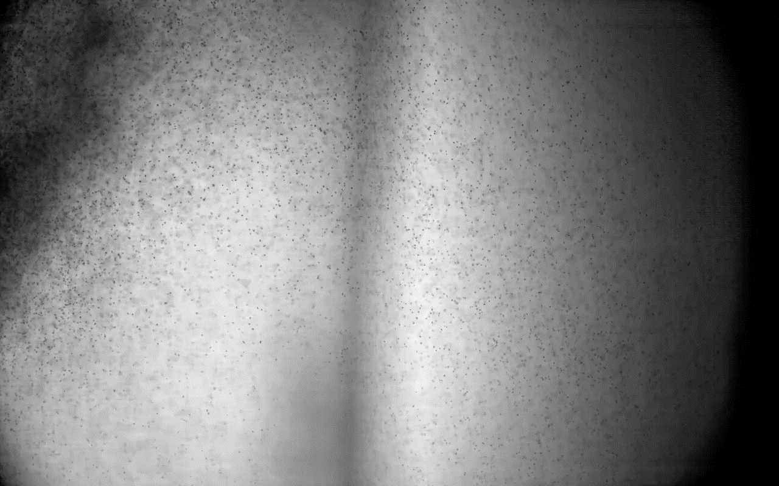
Summary/Forward Work
We have conducted Physics Focused Ground Test 1, a small-scale, inert gas, supersonic plume-surface interaction experiment
Significant variation in behaviors observed across parameter space
  Changes with vacuum pressure, mass flow rate, nozzle height
  Allows qualitative judgment about mitigation strategies
Analysis ongoing to measure crater profiles, track ejecta particles, and understand behaviors
Analysis products to be used for computational model validation

