Slide 1


Formal Analysis of the Compact Position Reporting Algorithm
Aaron Dutle
NASA Langley Research Center
Joint work with César Muñoz (former NASA), Laura Titolo (NIA), Mariano Moscato (NIA), Gregory Anderson (UVA), and François Bobot (CEA List).

Slide 2
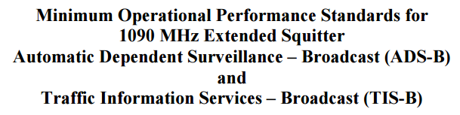
What is Compact Position Reporting?
The RTCA/EuroCAE publishes a standards document, DO-260C/ED-102.
Describes a collection of algorithms called Compact Position Reporting (CPR) to compress, broadcast and recover the approximate location of an aircraft.
Reports from pilots and manufacturers say that implementations can be inaccurate.
FAA official suggested that the Formal Methods team could investigate.

Slide 3

Why use Compact Position Reporting?
Why don’t aircraft just send a GPS location?
Earth is BIG.
Position needs accuracy to be useful.
The hardware and software used limit message size to 35 bits.
Image Credit: NASA/NOAA/GSFC/Suomi NPP/VIIRS/Norman Kuring
https://www.nasa.gov/sites/default/files/images/618486main_earth_full.jpg

Slide 4
Outline
Description of how CPR is intended to work.
What the formal analysis discovered.
Contributions NASA made to the community.

Slide 5
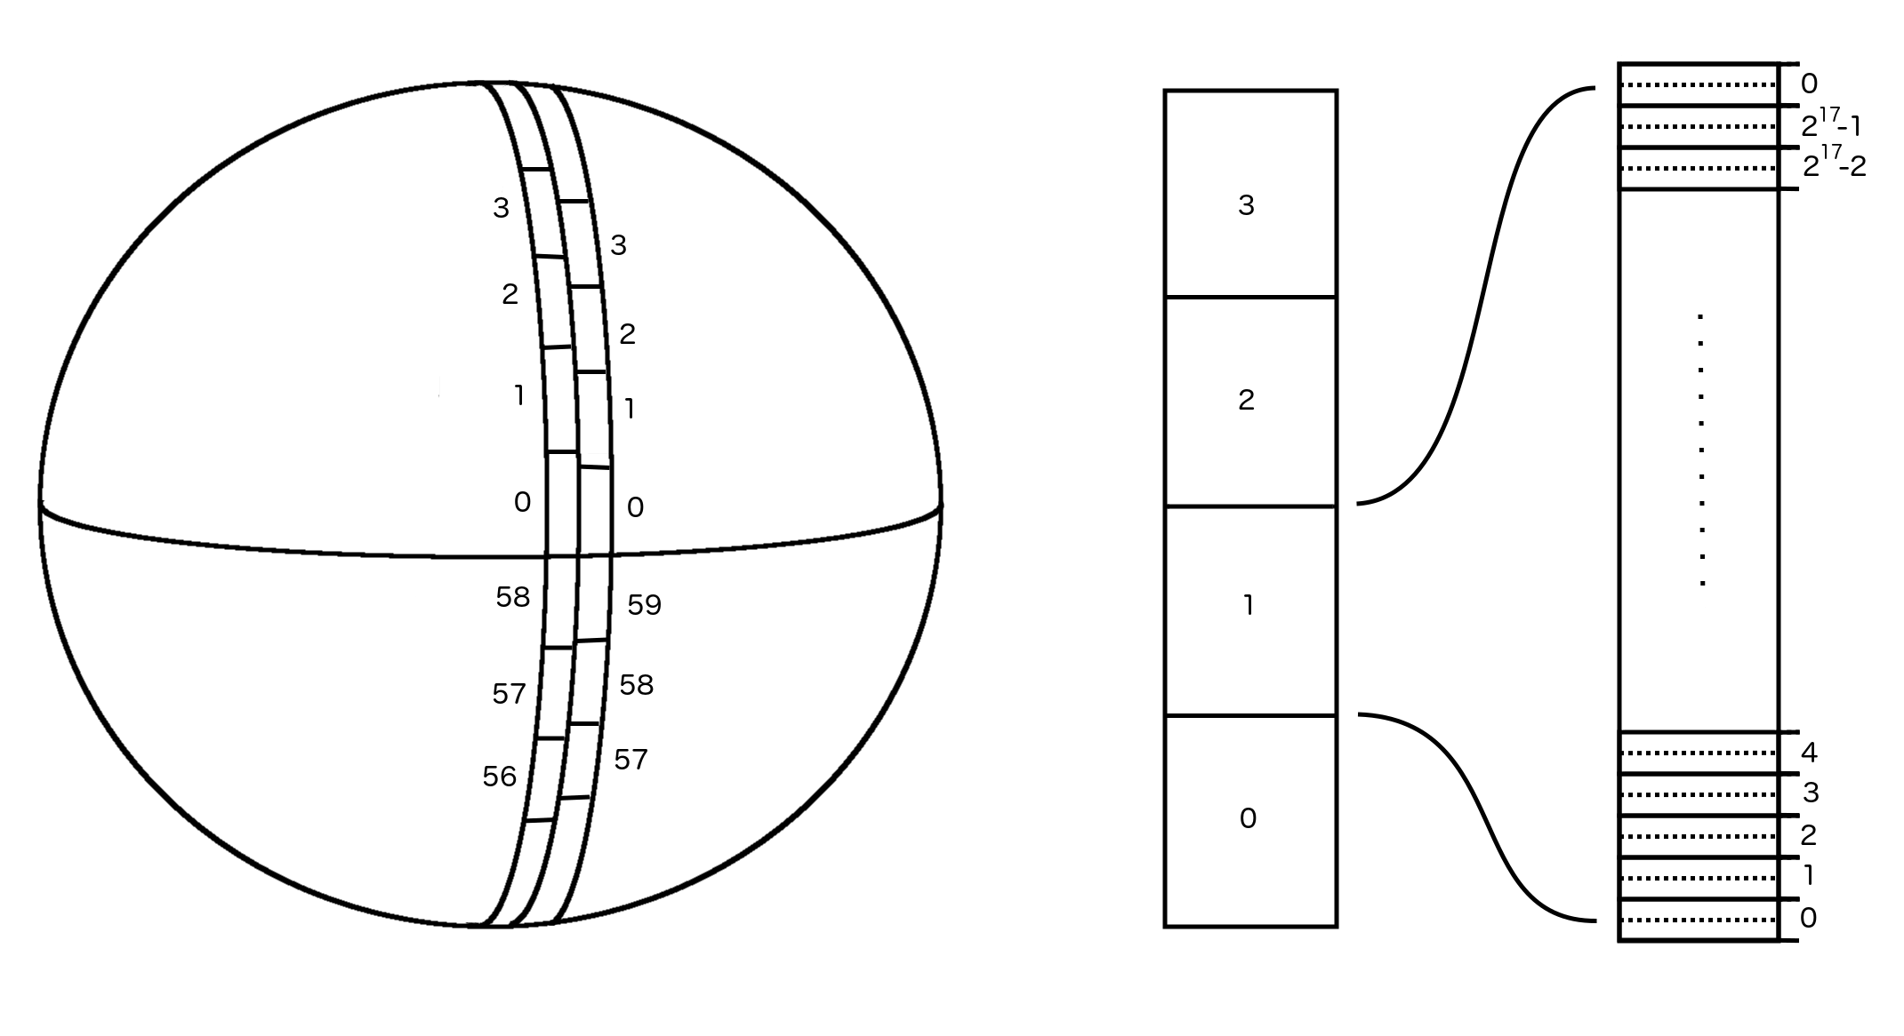
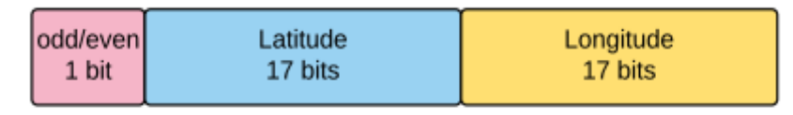
CPR in a nutshell
Focus on Latitude:
Choose a format (odd or even)
Divide latitude into equally sized zones (60 for even format, 59 for odd).
Divide each zone into 2¹⁷ equally sized bins.
Recovered position is intended to be the centerline of the bin.
Longitude is handled similarly, but the number of zones used decreases toward the poles.
CPR coordinate system for Latitude encoding
Message structure for CPR position
Notes:
Given a particular message, there are approximately 1800 positions on the globe that correspond to that message.

Slide 6
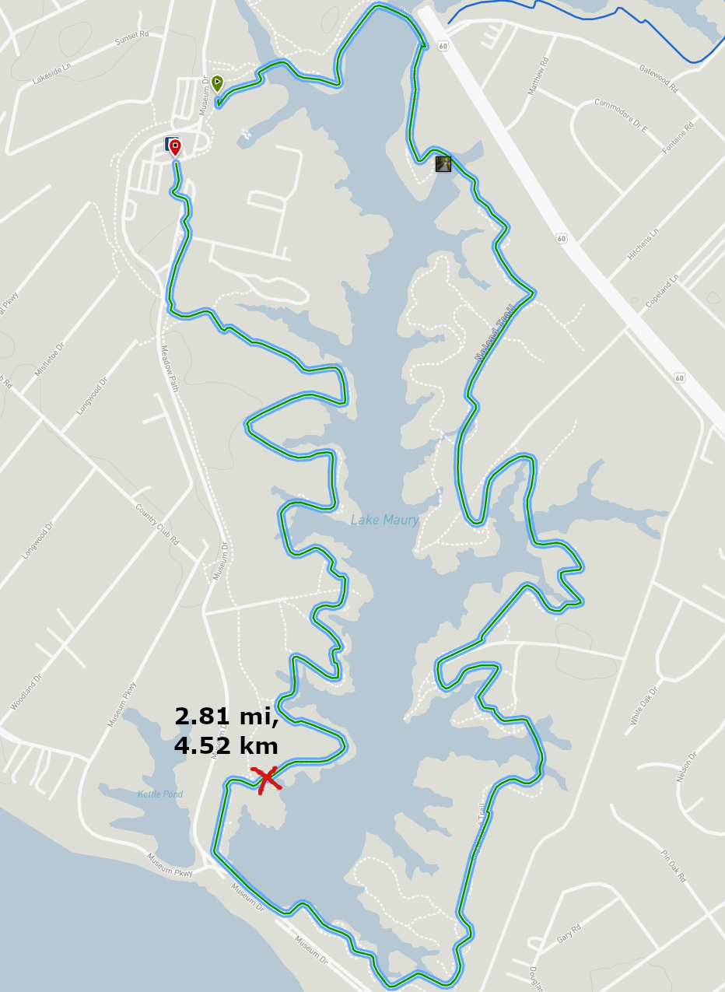
CPR Encoding analogy
Walking on a trail, you want to tell someone how far along you are.
Choose a format (miles or kilometers).
Ignore the whole number part of the measurement (zone is not broadcast).
Send the decimal portion, rounded to 2 places (the bin number is broadcast).
How does the receiver recover your position?
Maps Data: Google ©2021

Slide 7
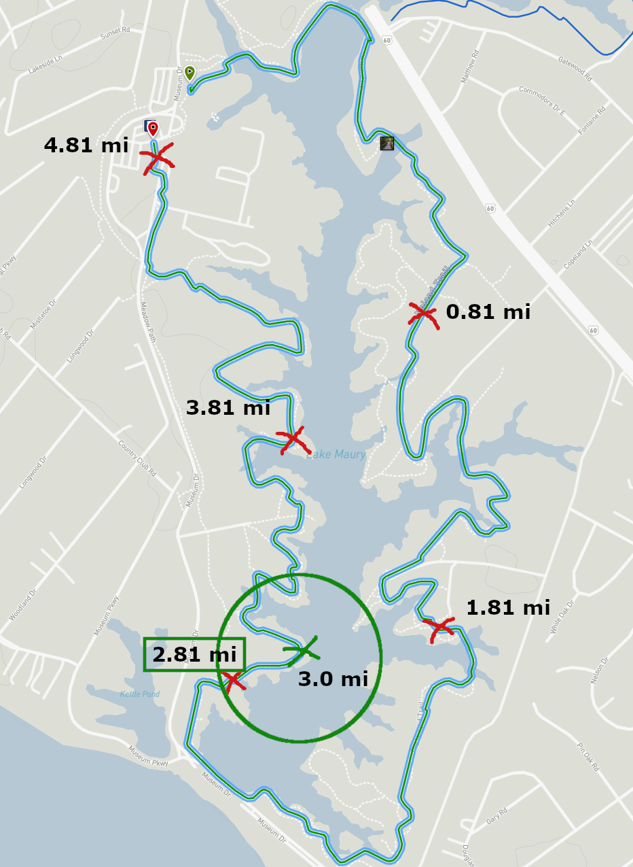
CPR Local Decoding analogy
The message contains the format and the bin, only the zone is missing.
Received message: “.81 miles”
Local decoding:
Uses a recent know location. “Close to the 3 mile marker.”
Only one position is the closest match.
Maps Data: Google ©2021

Slide 8
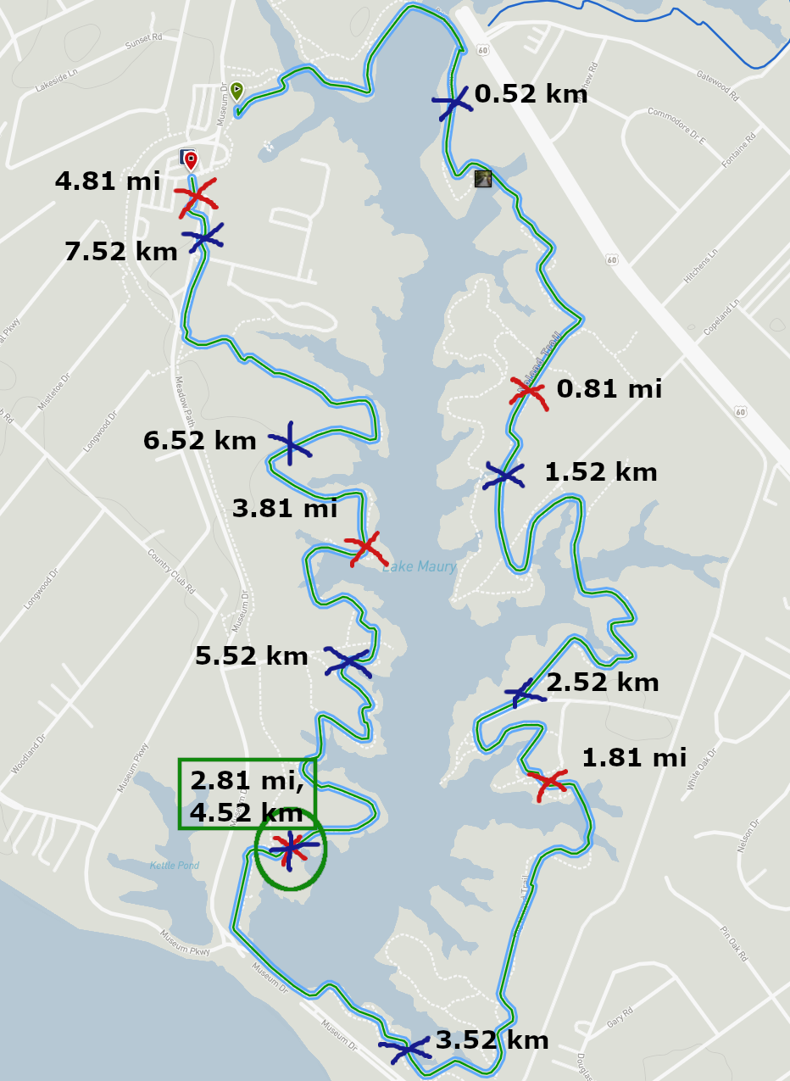
CPR Global Decoding analogy
The message contains the format and the bin, only the zone is missing.
Received message: “.81 miles”
Global decoding:
Uses a message of the other format. “.52 km”
Only one position matches.
Maps Data: Google ©2021

Slide 9
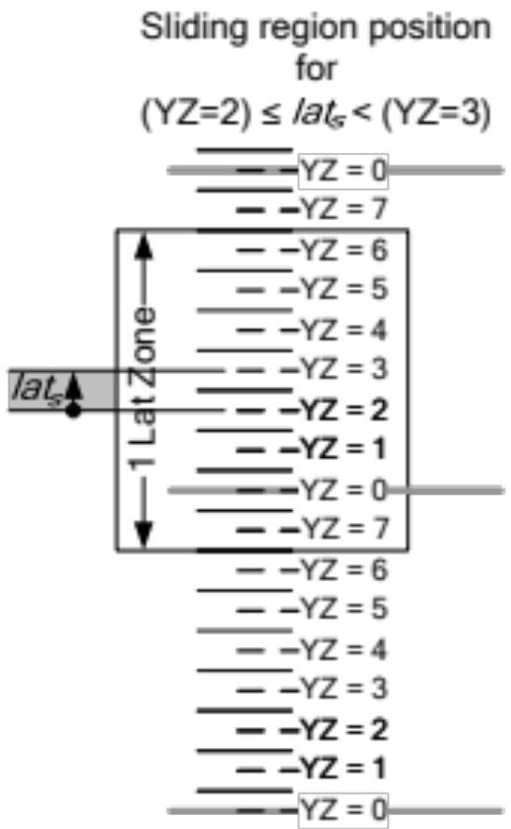
A few further details
A global decode is used to establish a first position.
Global decoding does not compute all positions and compare them. It uses the Chinese Remainder Theorem to compute the zone.
Local decoding can be used after establishing a position.
There are distance limits for correct decoding:
  Local Decoding: The reference point used should be closer than half of a zone length of the broadcast position.
  Global Decoding: The pair of positions should be closer than half of a zone offset (difference between zone sizes).
These distance limits are converted to time limits via maximum velocity assumptions.
A “one zone” decoding limit around a reference position for local decoding.

Slide 10
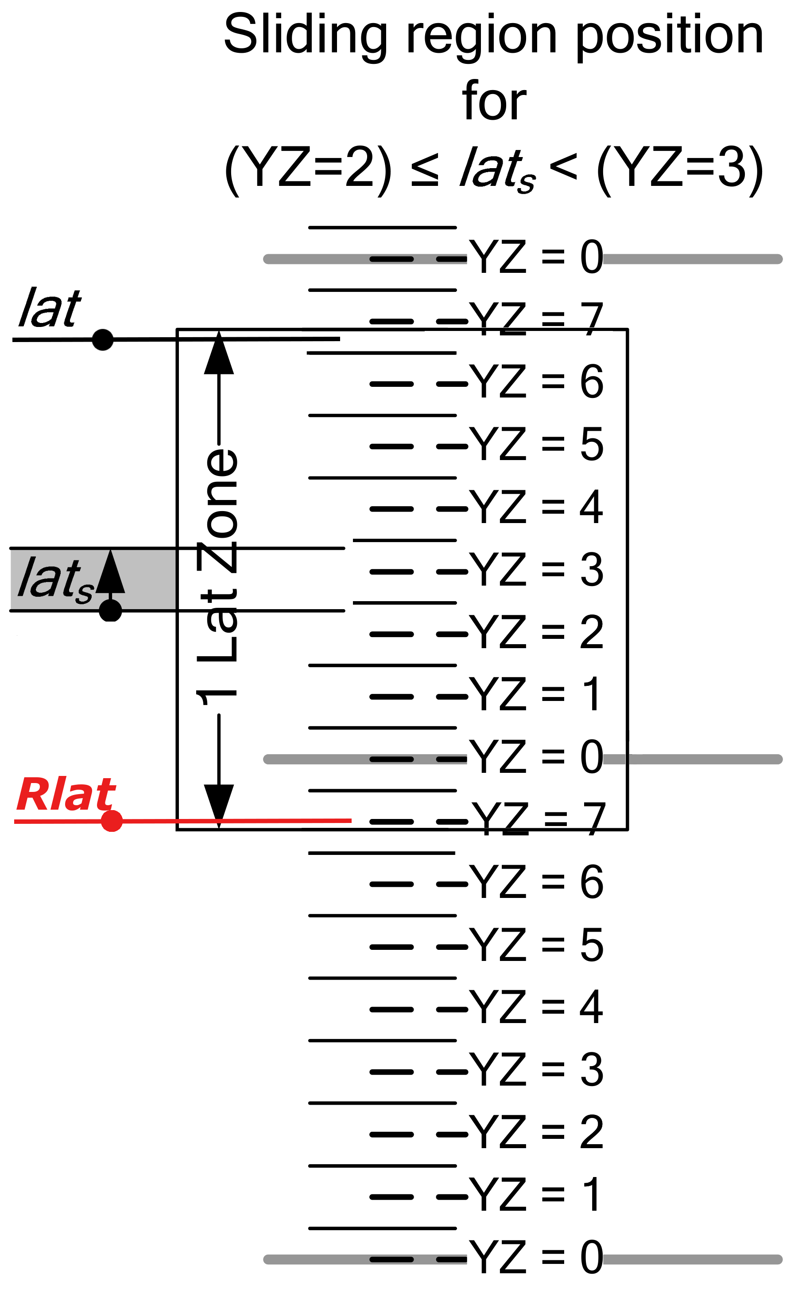
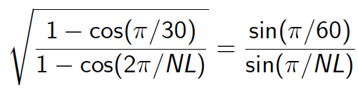

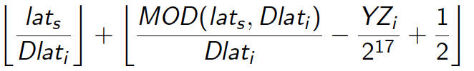
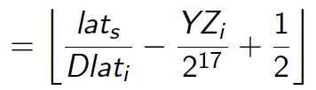
CPR Formal Analysis: Results and by-products
Analysis of the algorithm:
Formal model of the algorithm in the Prototype Verification System (PVS).
Discovered incorrect requirements for decoding, and adjusted the requirements to allow for correct operation.
Found numerous mathematical simplifications for formulas in the CPR specification, to reduce computational error.
Computing transition latitudes:
During encoding:
During Local Decoding:
Previous CPR requirements could decode to an incorrect “zone”, resulting in aircraft being reported hundreds of miles from their actual position.

Slide 11
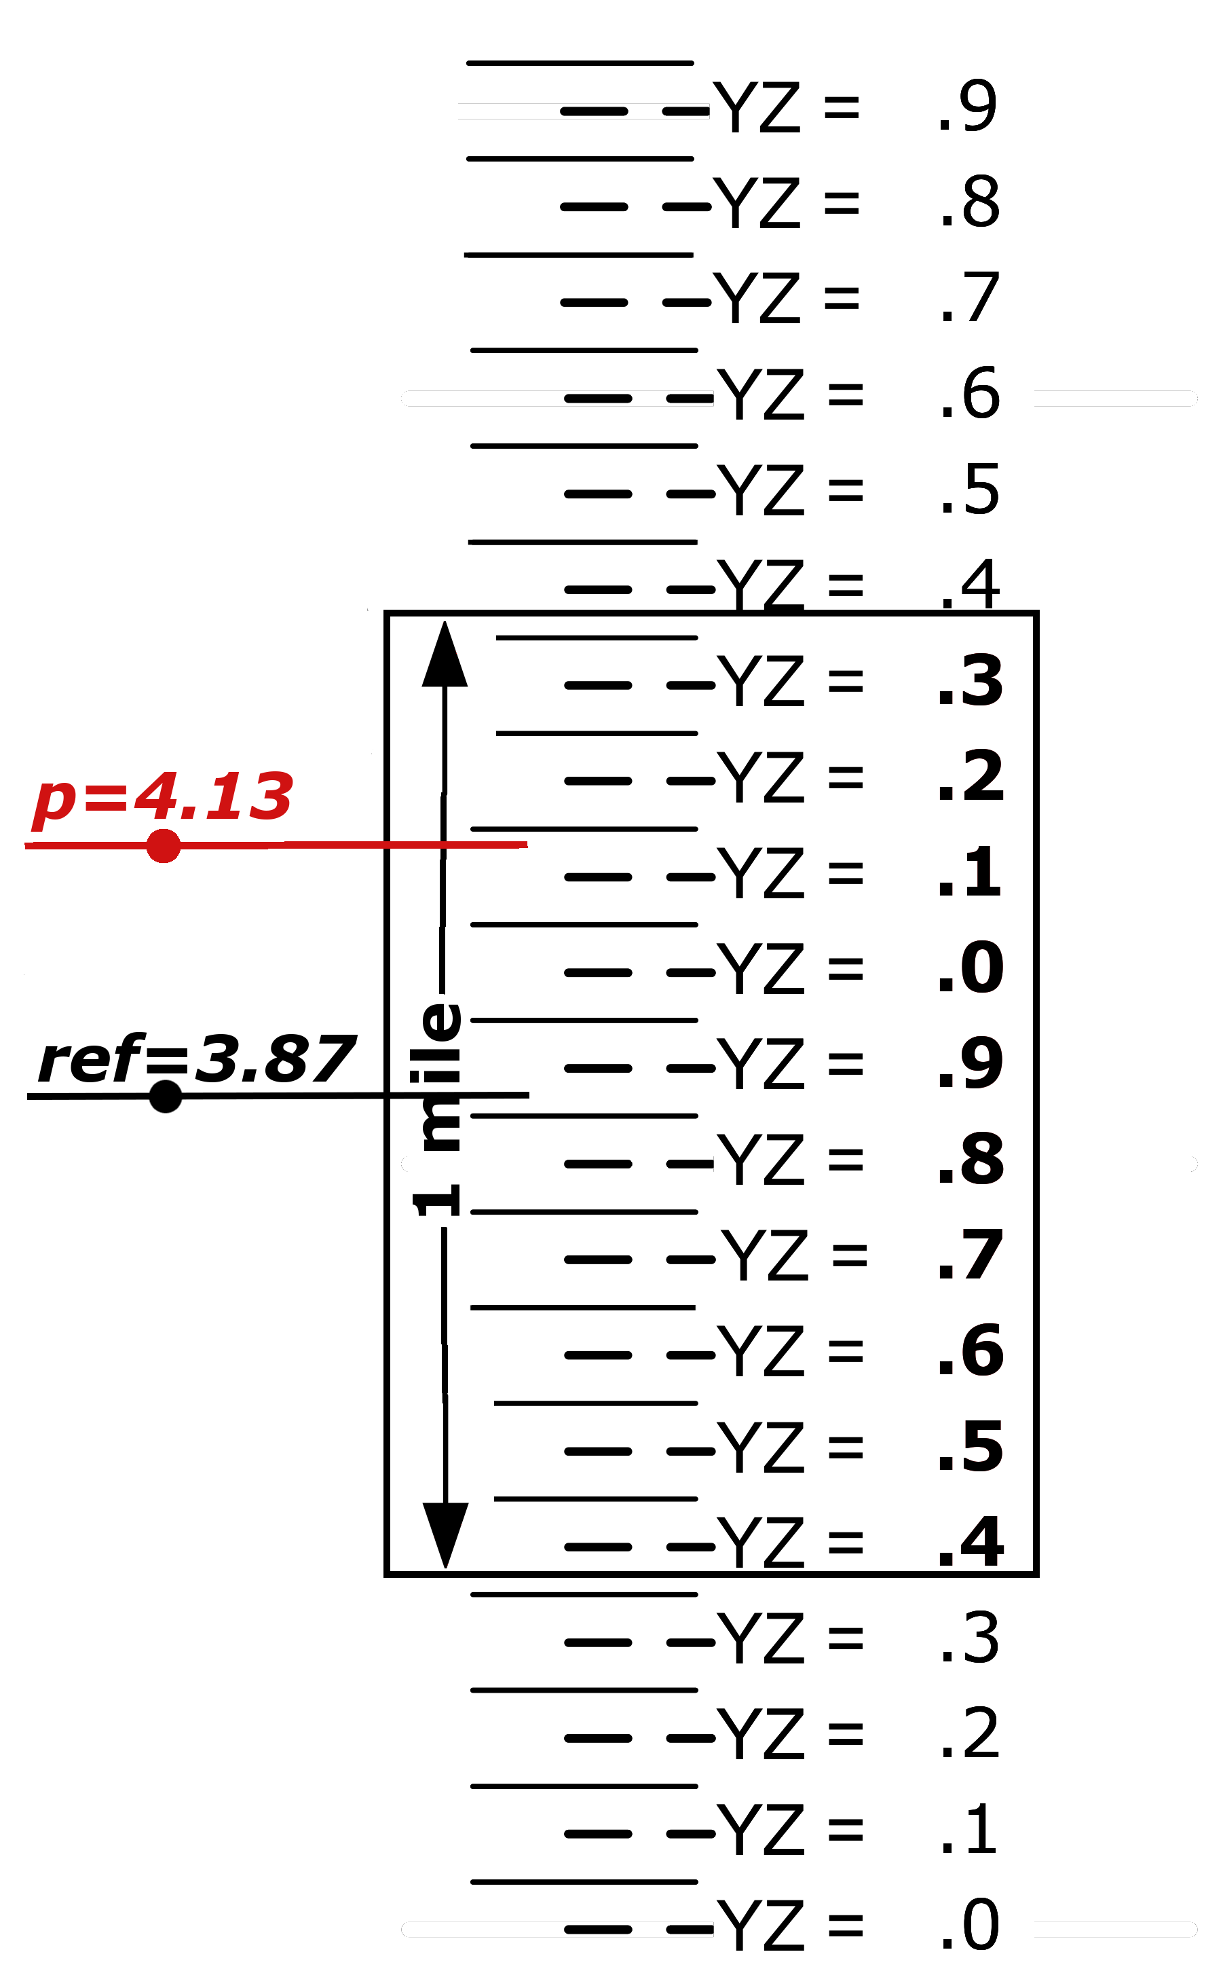
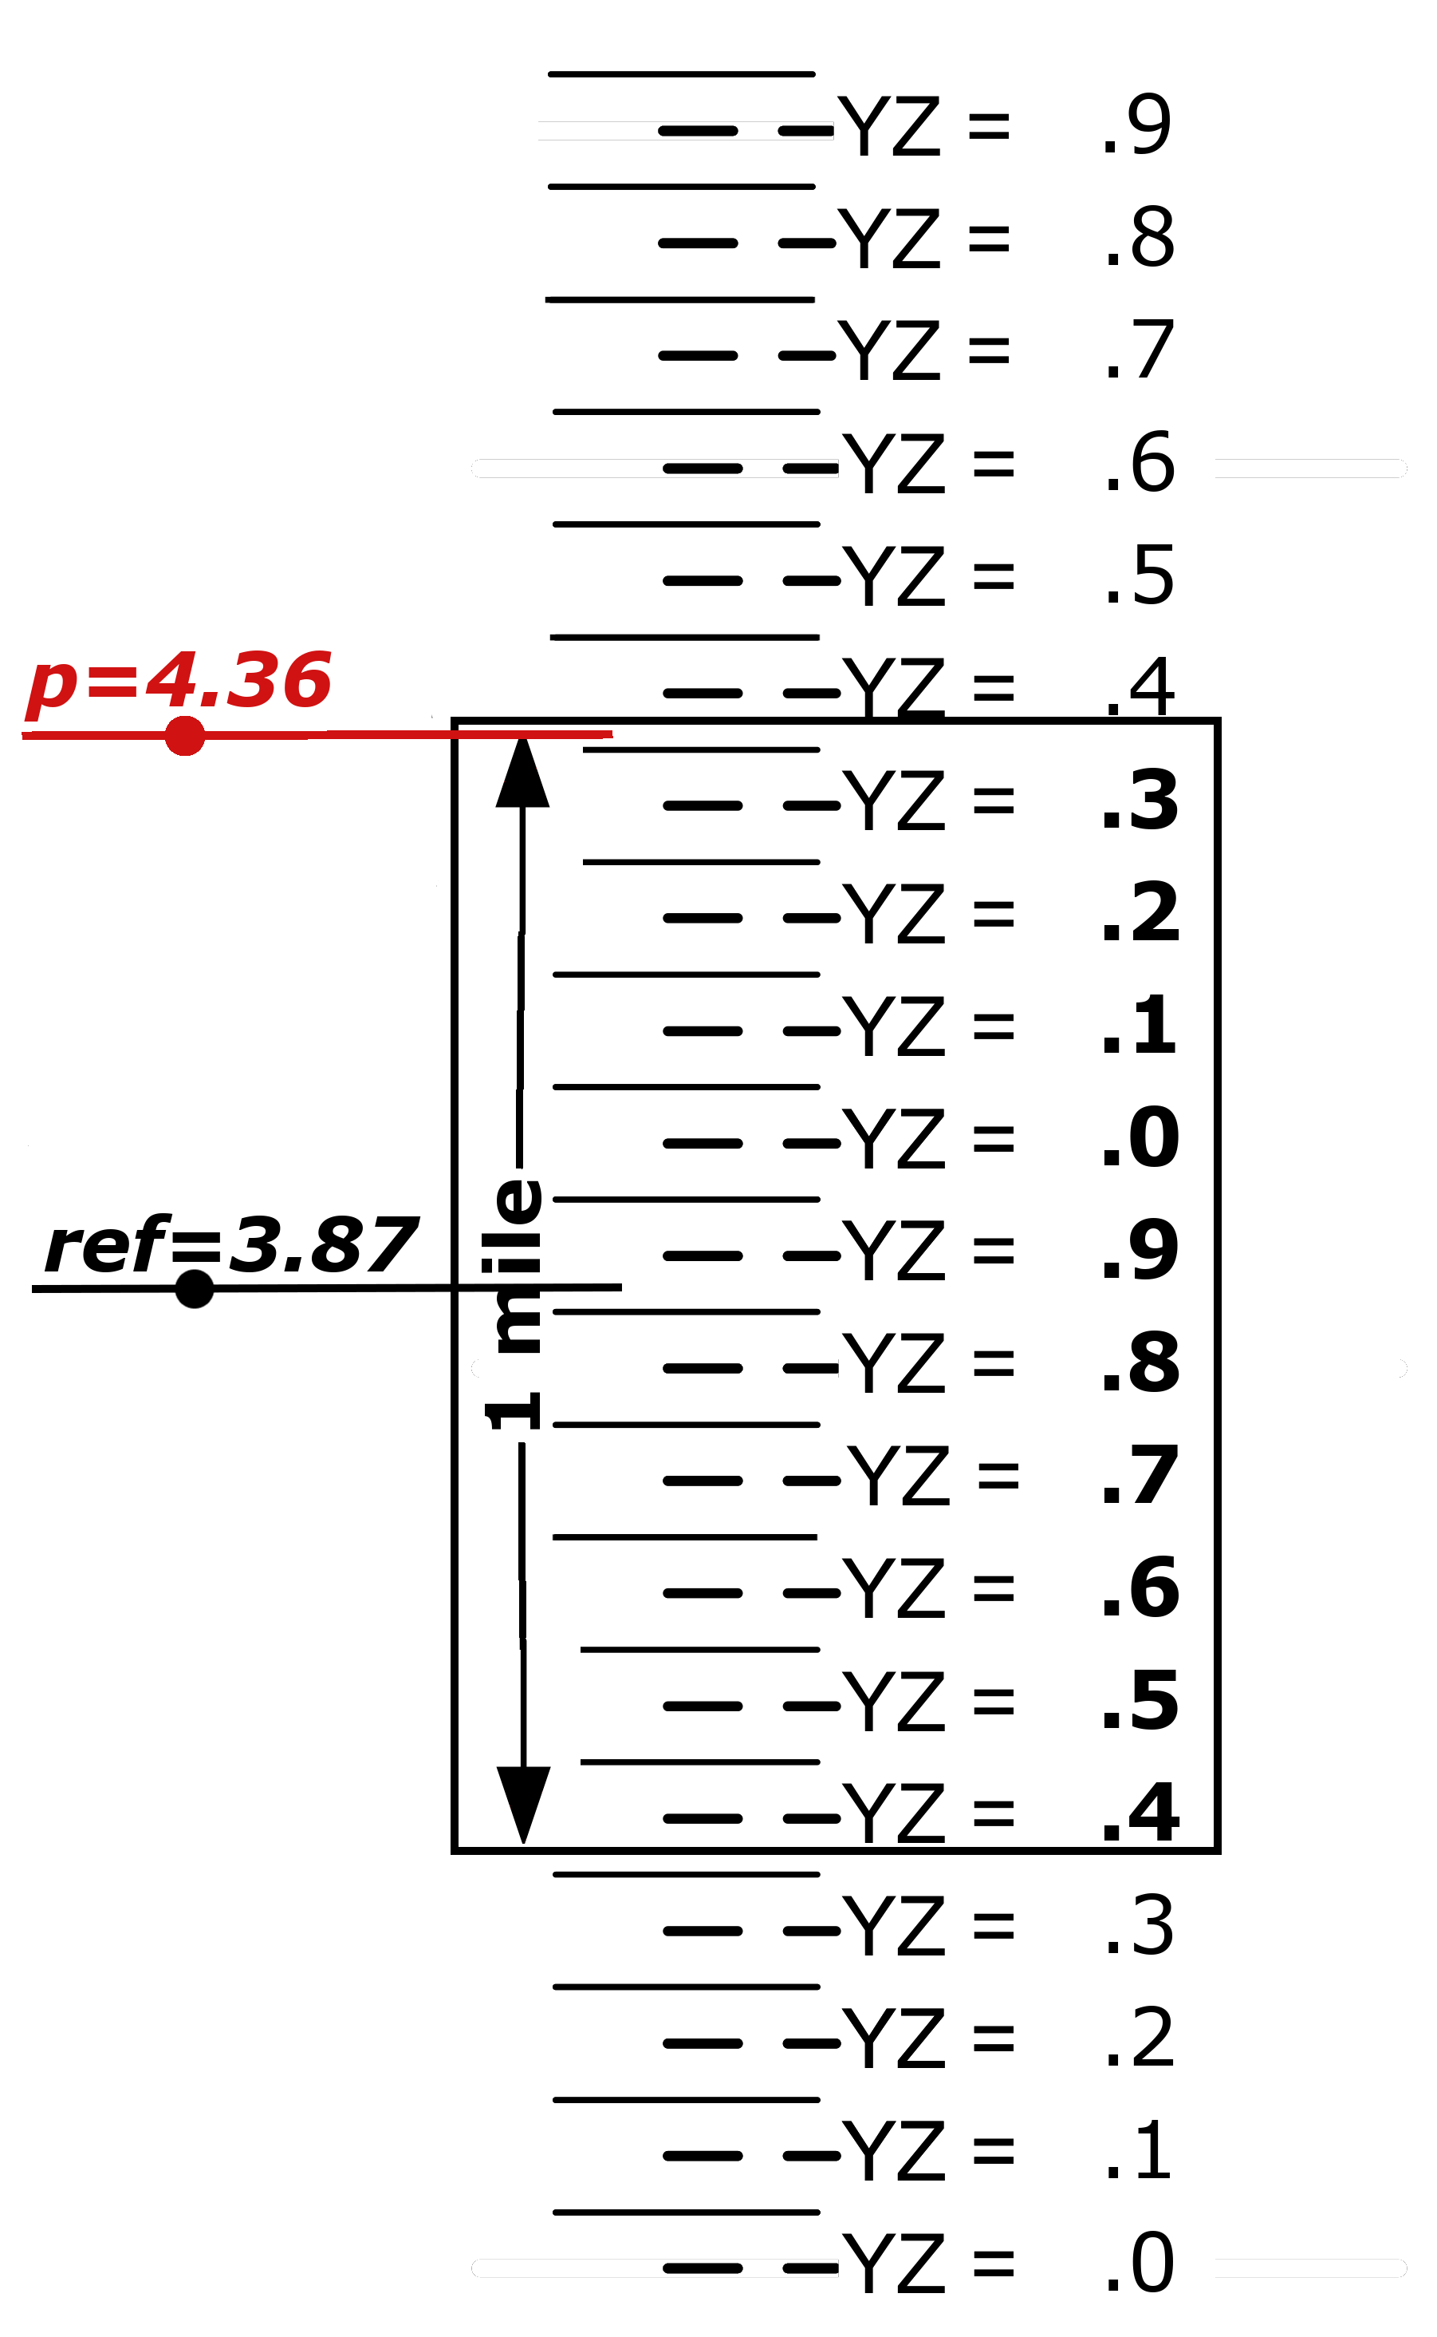
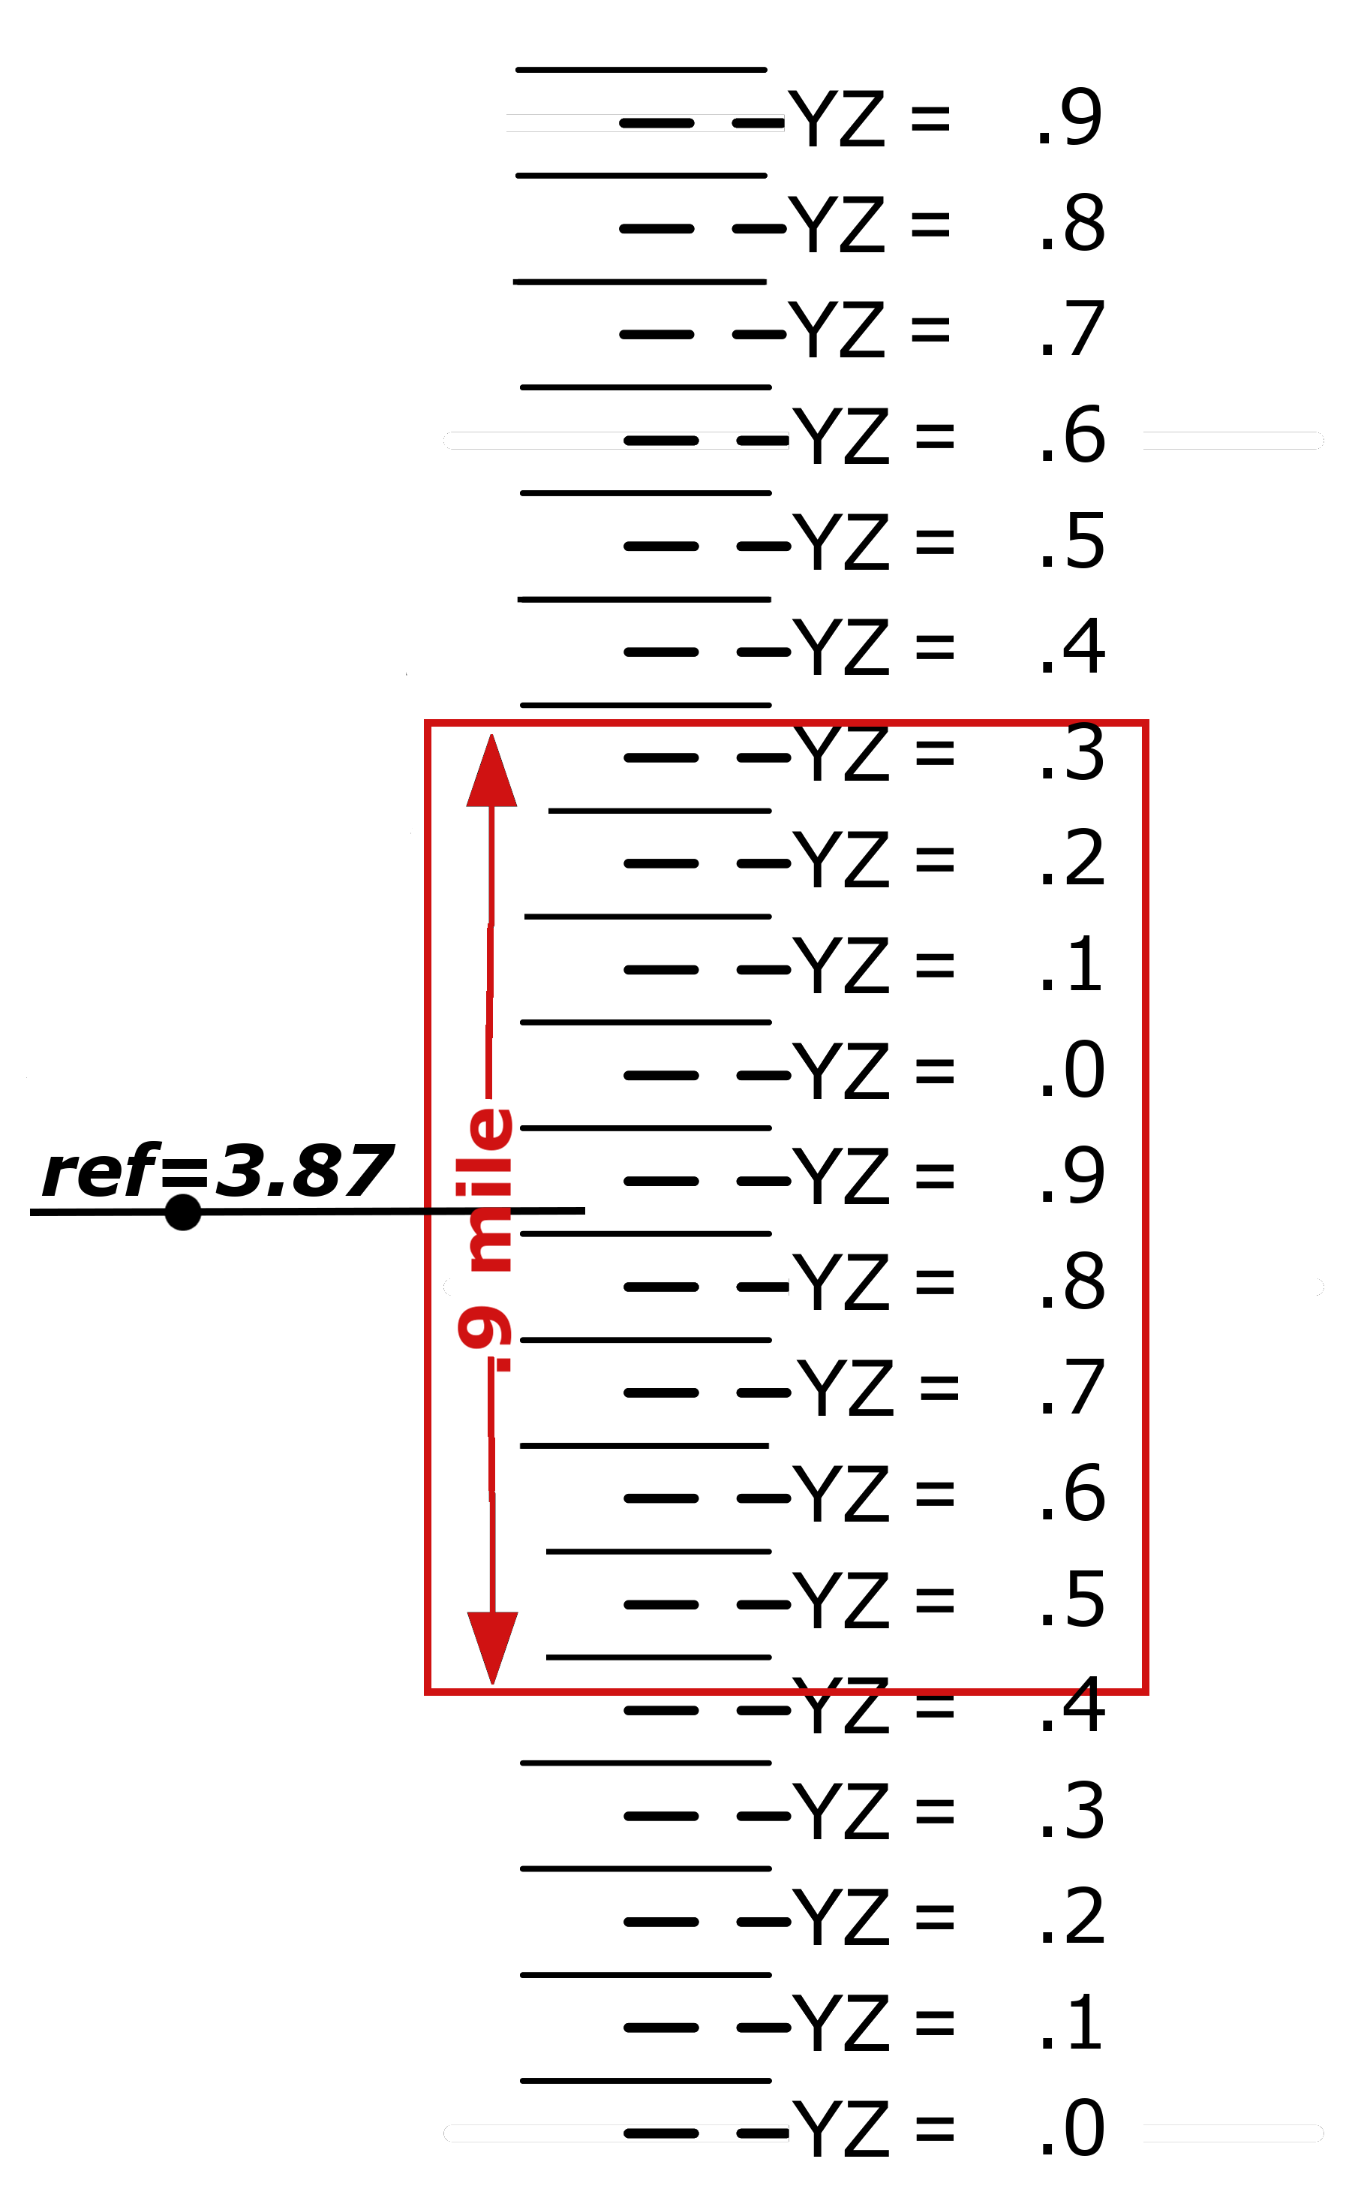
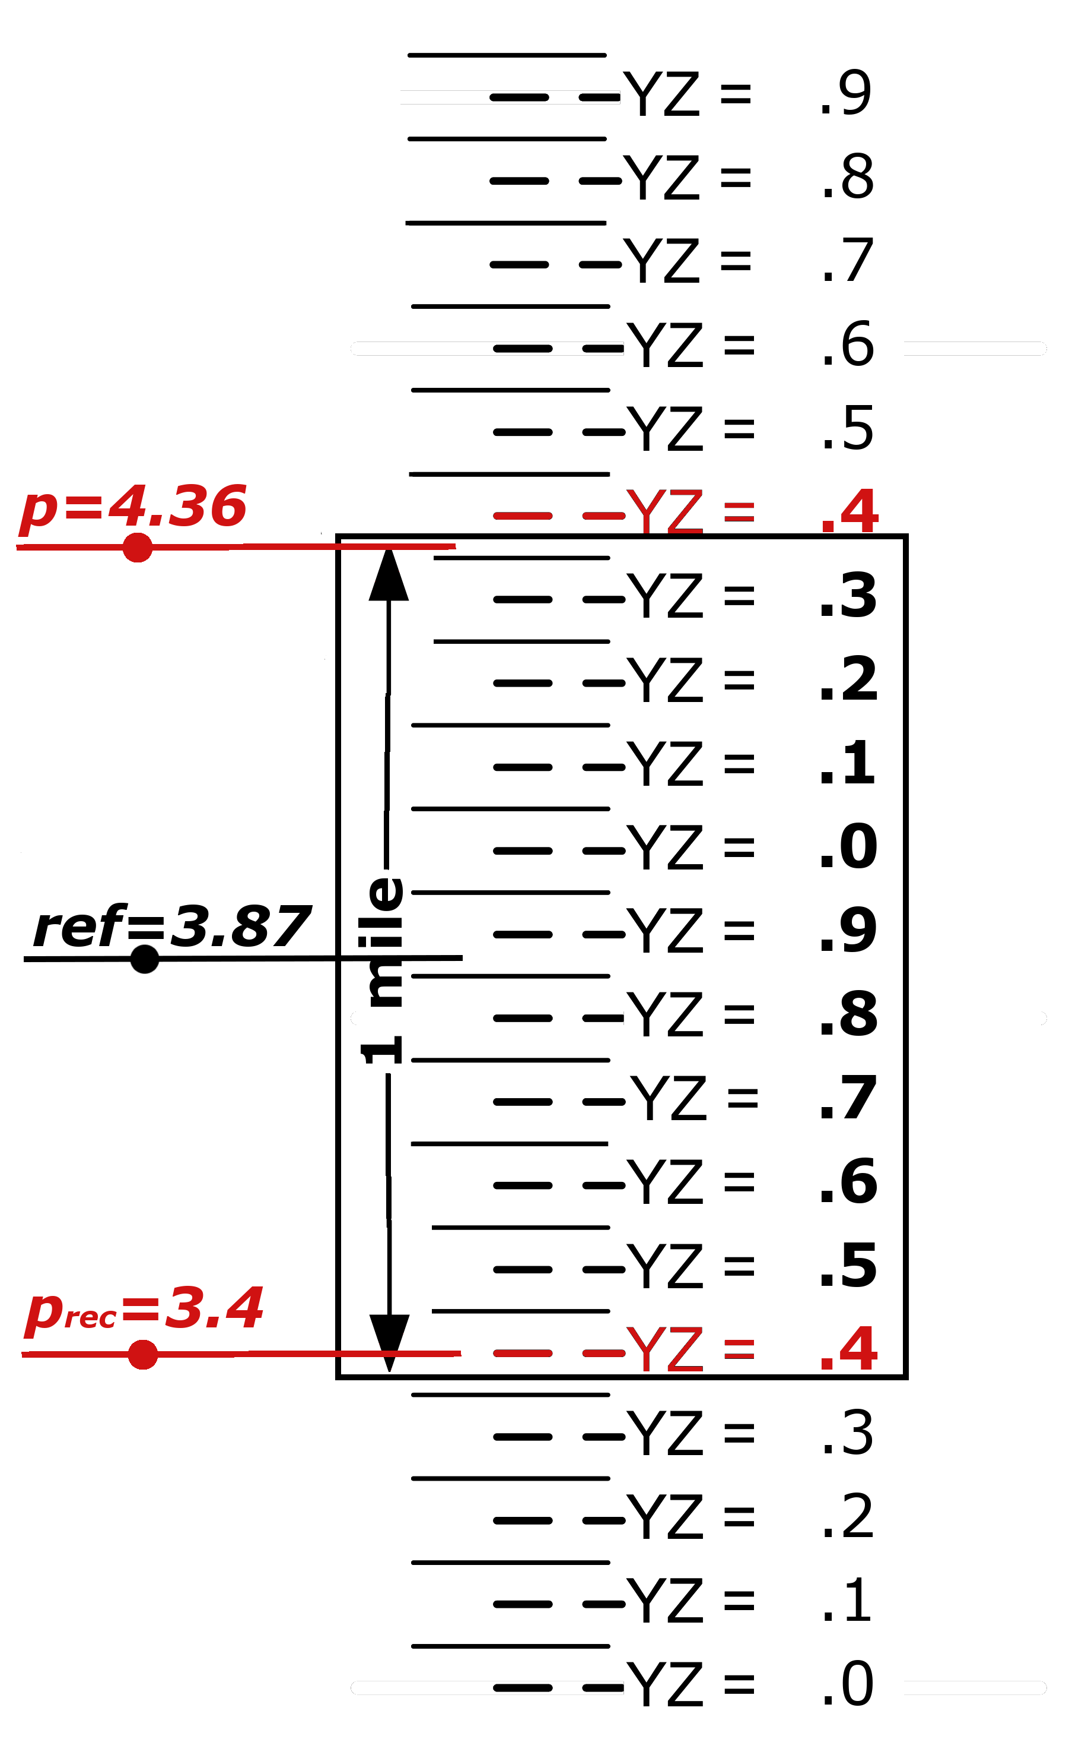
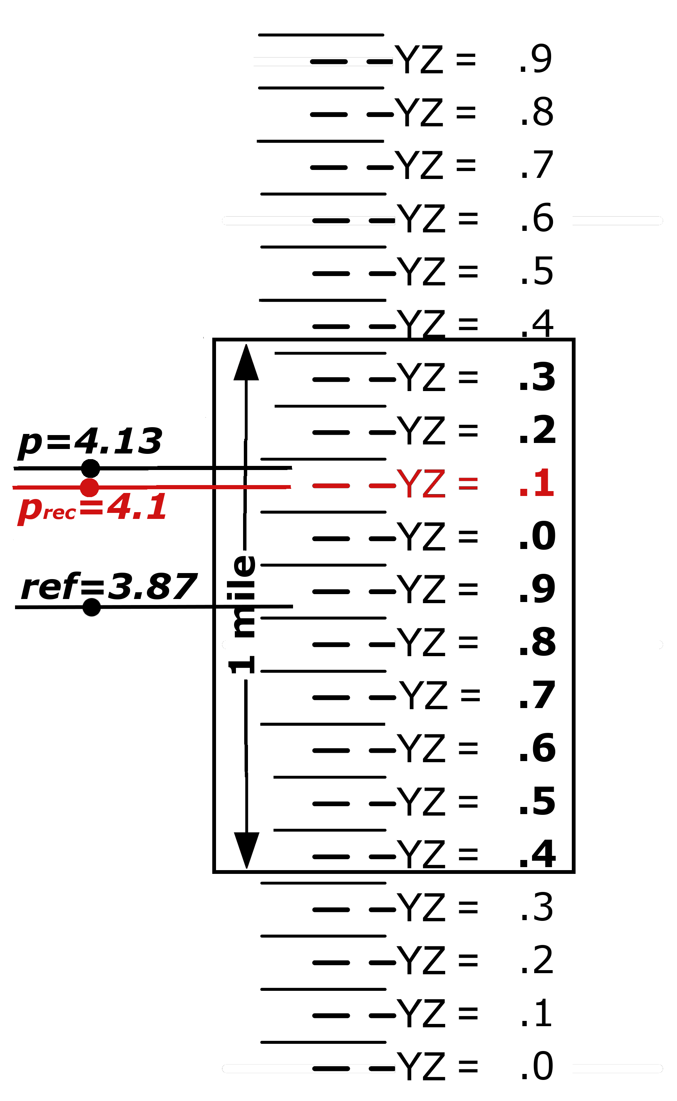
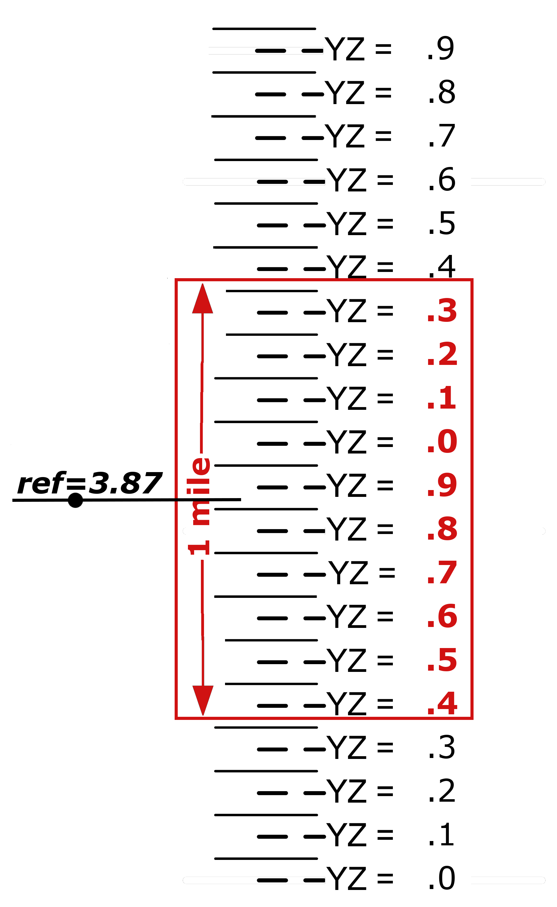
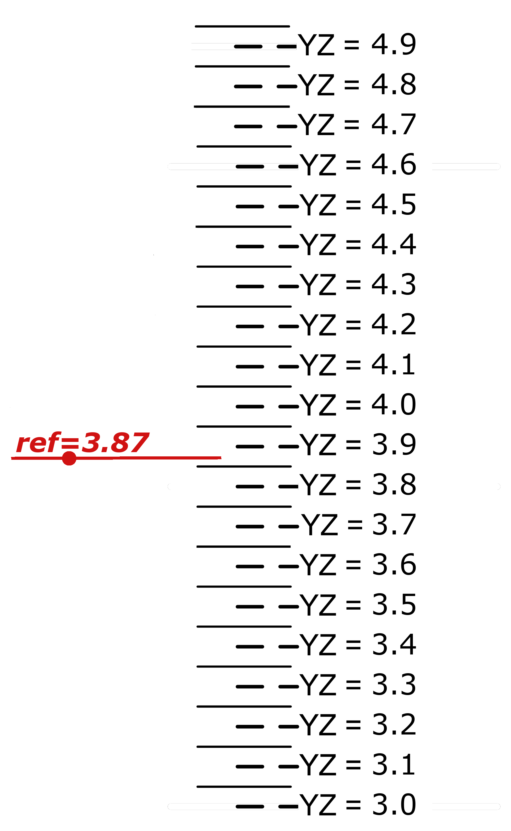
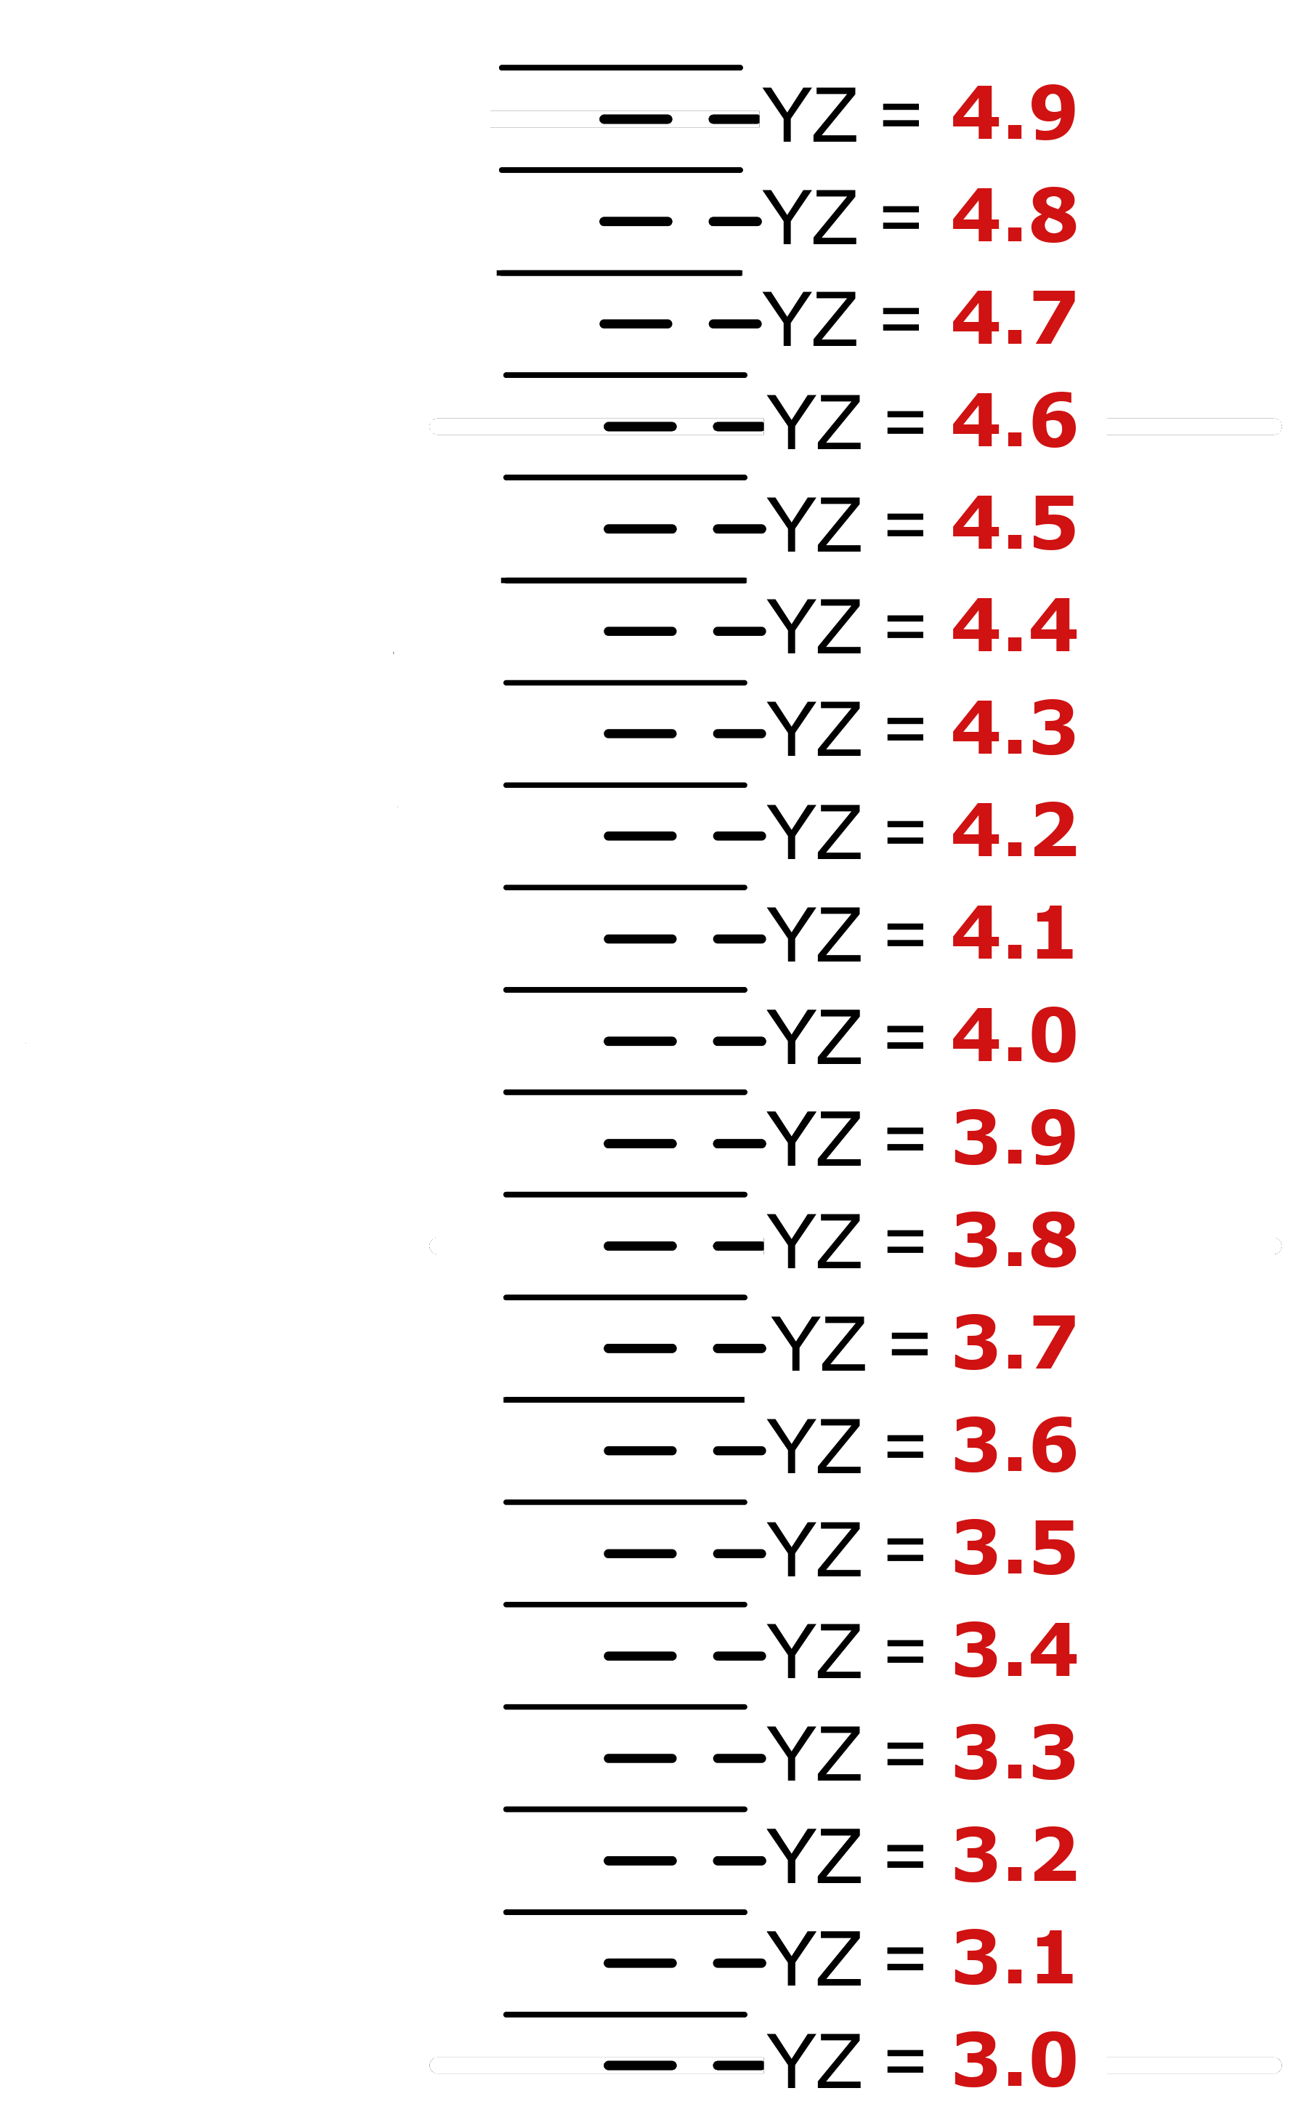
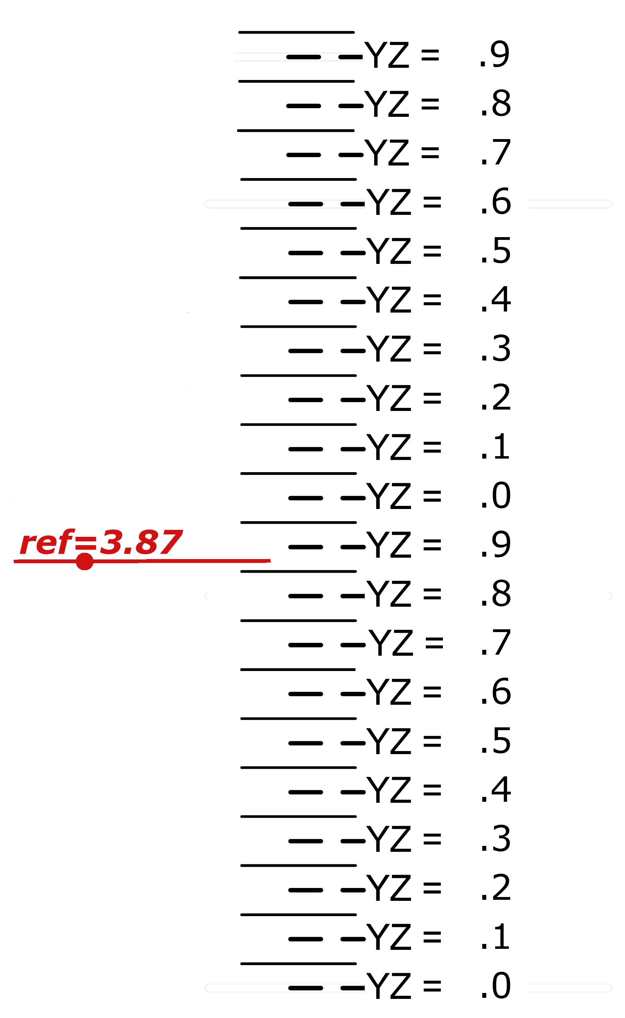
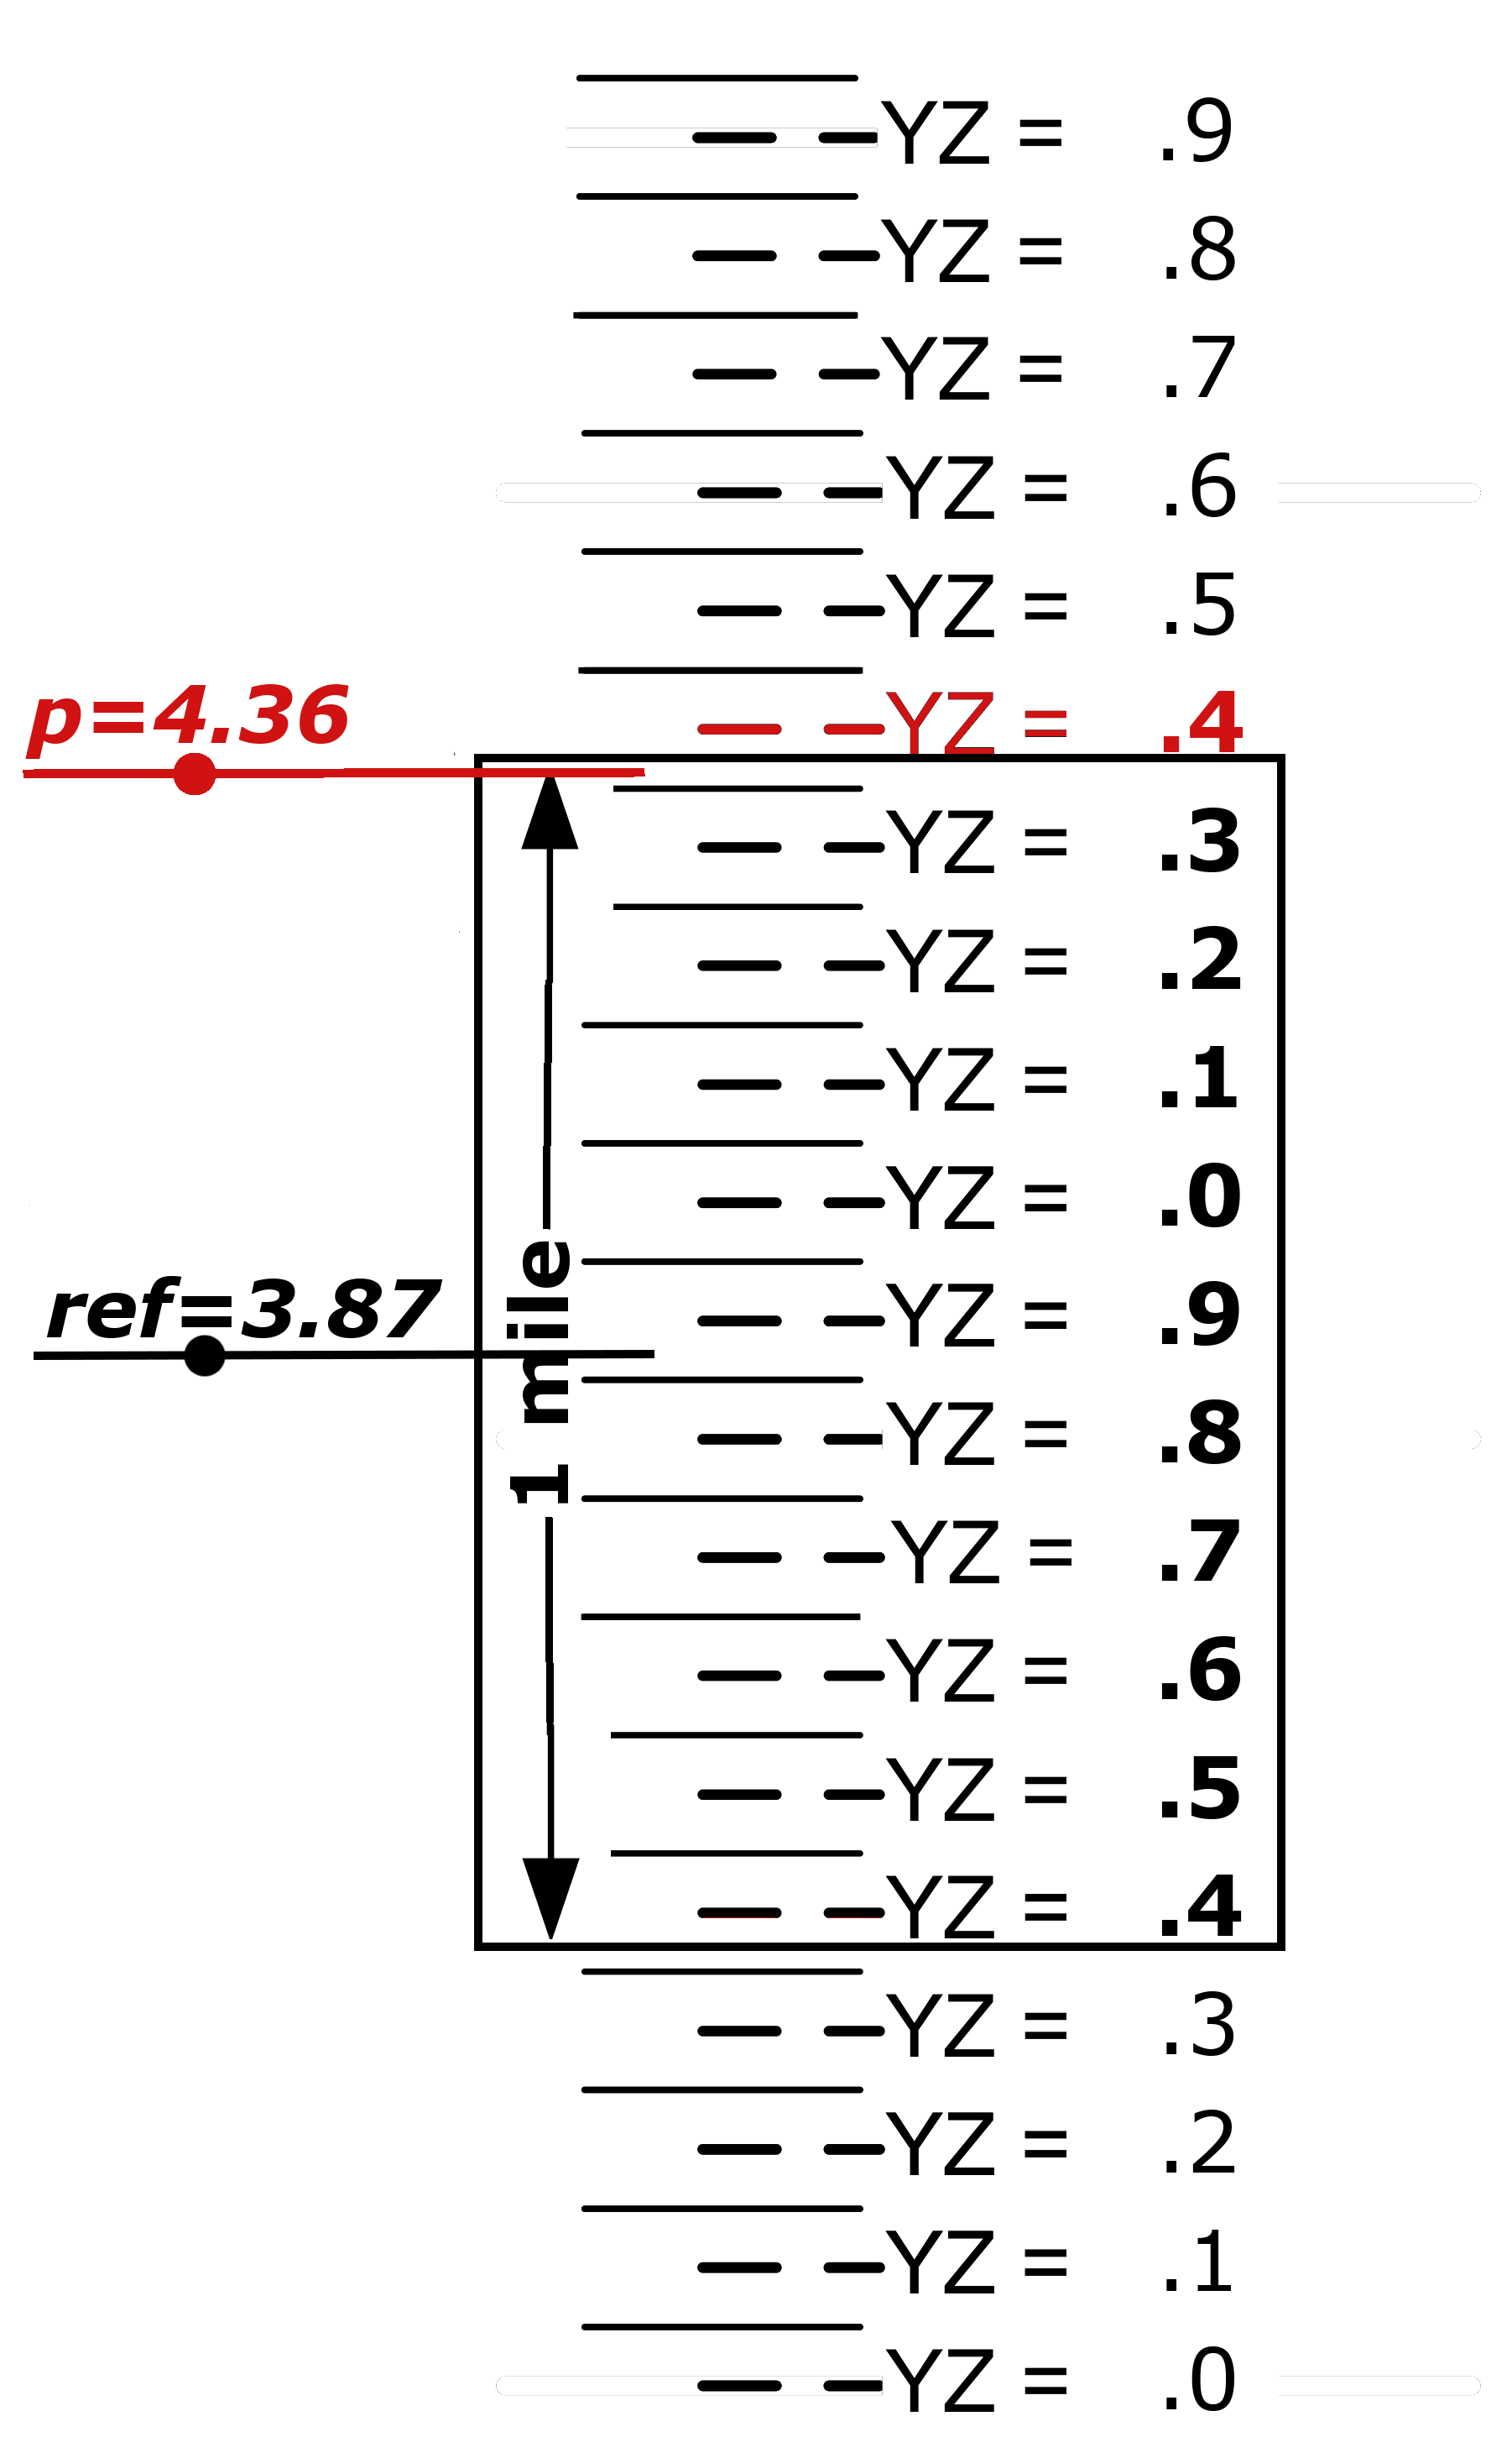
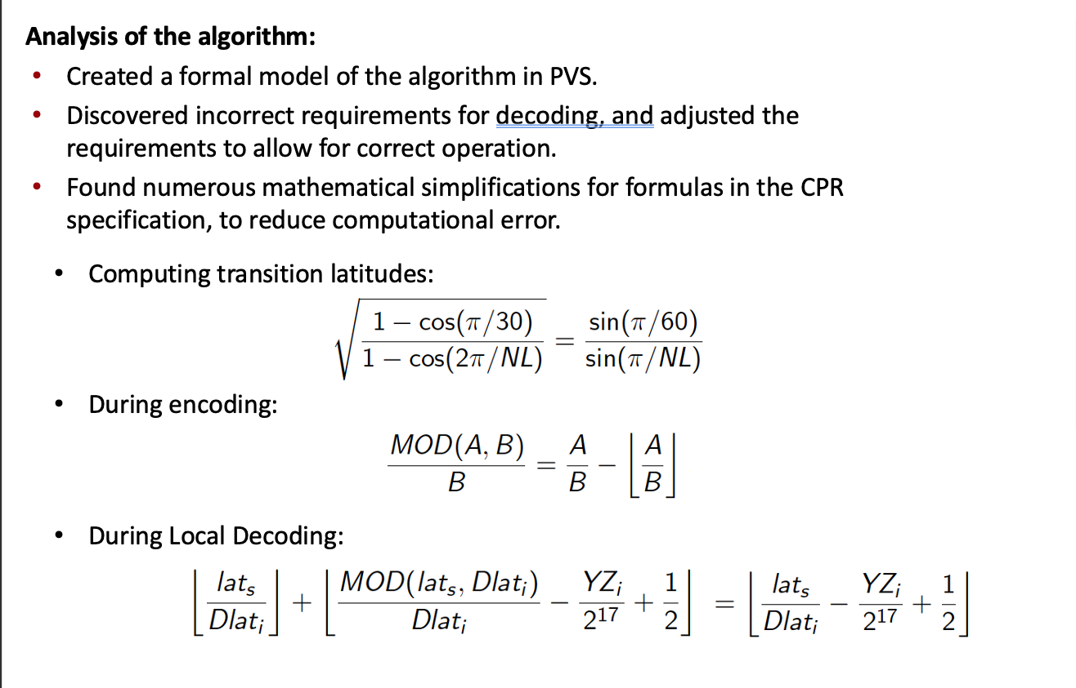
CPR Formal Analysis: Results and by-products
Previous CPR requirements could decode to an incorrect “zone”, resulting in aircraft being reported hundreds of miles from their actual position.

Slide 12
CPR Formal Analysis: Results and by-products
Previous CPR requirements could decode to an incorrect “zone”, resulting in aircraft being reported hundreds of miles from their actual position.

Slide 13
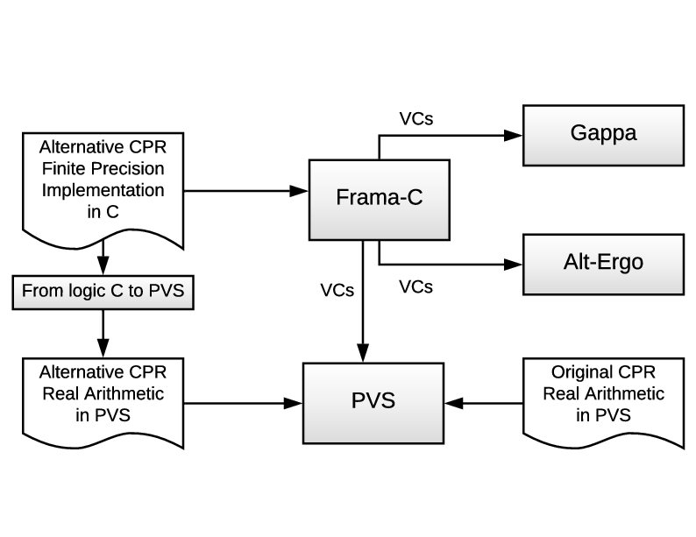
CPR Formal Analysis: Results and by-products
Analysis of CPR implementations
NASA developed and formally verified versions of CPR in floating point (double precision) and fixed point (single precision).
Led to development of PRECiSA, a state-of the art tool for analysis of floating point (IEEE-754 spec) programs.
Analysis discovered additional stressing test cases that would catch some incorrect implementations of CPR.
The formal verification of CPR implementations involved the use and interaction of several formal methods tools.
For more info about the CPR work and PRECiSA, including open-source releases:
https://shemesh.larc.nasa.gov/fm/CPR/
https://shemesh.larc.nasa.gov/fm/PRECiSA/

Slide 14
CPR Formal Analysis: Impact
Combined Surveillance Committee (RTCA/EuroCAE) accepted all of the suggested changes.
  CPR algorithm description and requirements changed as result of analysis.
    Included the alternative formulas discovered.
    Included tightened decoding requirements.
  NASA-developed reference implementation now included in the document.
    For use as an example/guideline for a correct way to implement the functions.
    For use as an ”oracle” to test an implementation against.
  Newly developed stressing test cases added to the test suite for CPR.
Revision C of DO-260 (US)/ED-102 (Europe), the global ADS-B standard, published Dec 17, 2020 with these changes.

