Slide 1
Dust Machine Learning Probability and Assessment
NASA / SPoRT
Short-term Prediction, Research, and Transition Program
Emily Berndt, Kevin Fuell

Slide 2
Dust Probability via Machine Learning Science
Emily Berndt

Slide 3
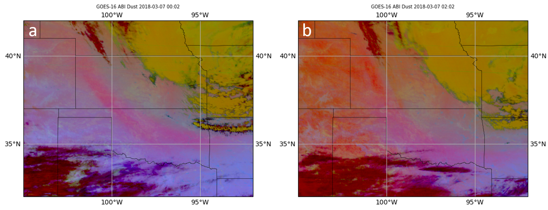
Introduction and Motivation
NASA SPoRT introduced the "Dust RGB" via NASA satellites to demonstrate GOES-R ABI capabilities and then evaluated the impact in operations (Fuell et al. 2016)
The Dust RGB allows for continued dust detection at night, but the cooling ground surface limits the effectiveness as night progresses.
SPoRT has developed a 'Machine Learning' (ML) model using a physically-based approach which can correctly label 85% of dust pixels and 99% of no-dust pixels
NASA/NOAA GOES-16 ABI
Dust RGB 7 March 2017 (a) 0002 UTC (b) 0102 UTC
Dust
Dust?
Notes:
This study applies machine learning to the problem of night-time dust detection with a physically-based simple random forest model using GOES-16 Advanced Baseline Imager (ABI) infrared imagery as inputs to the model.

Slide 4
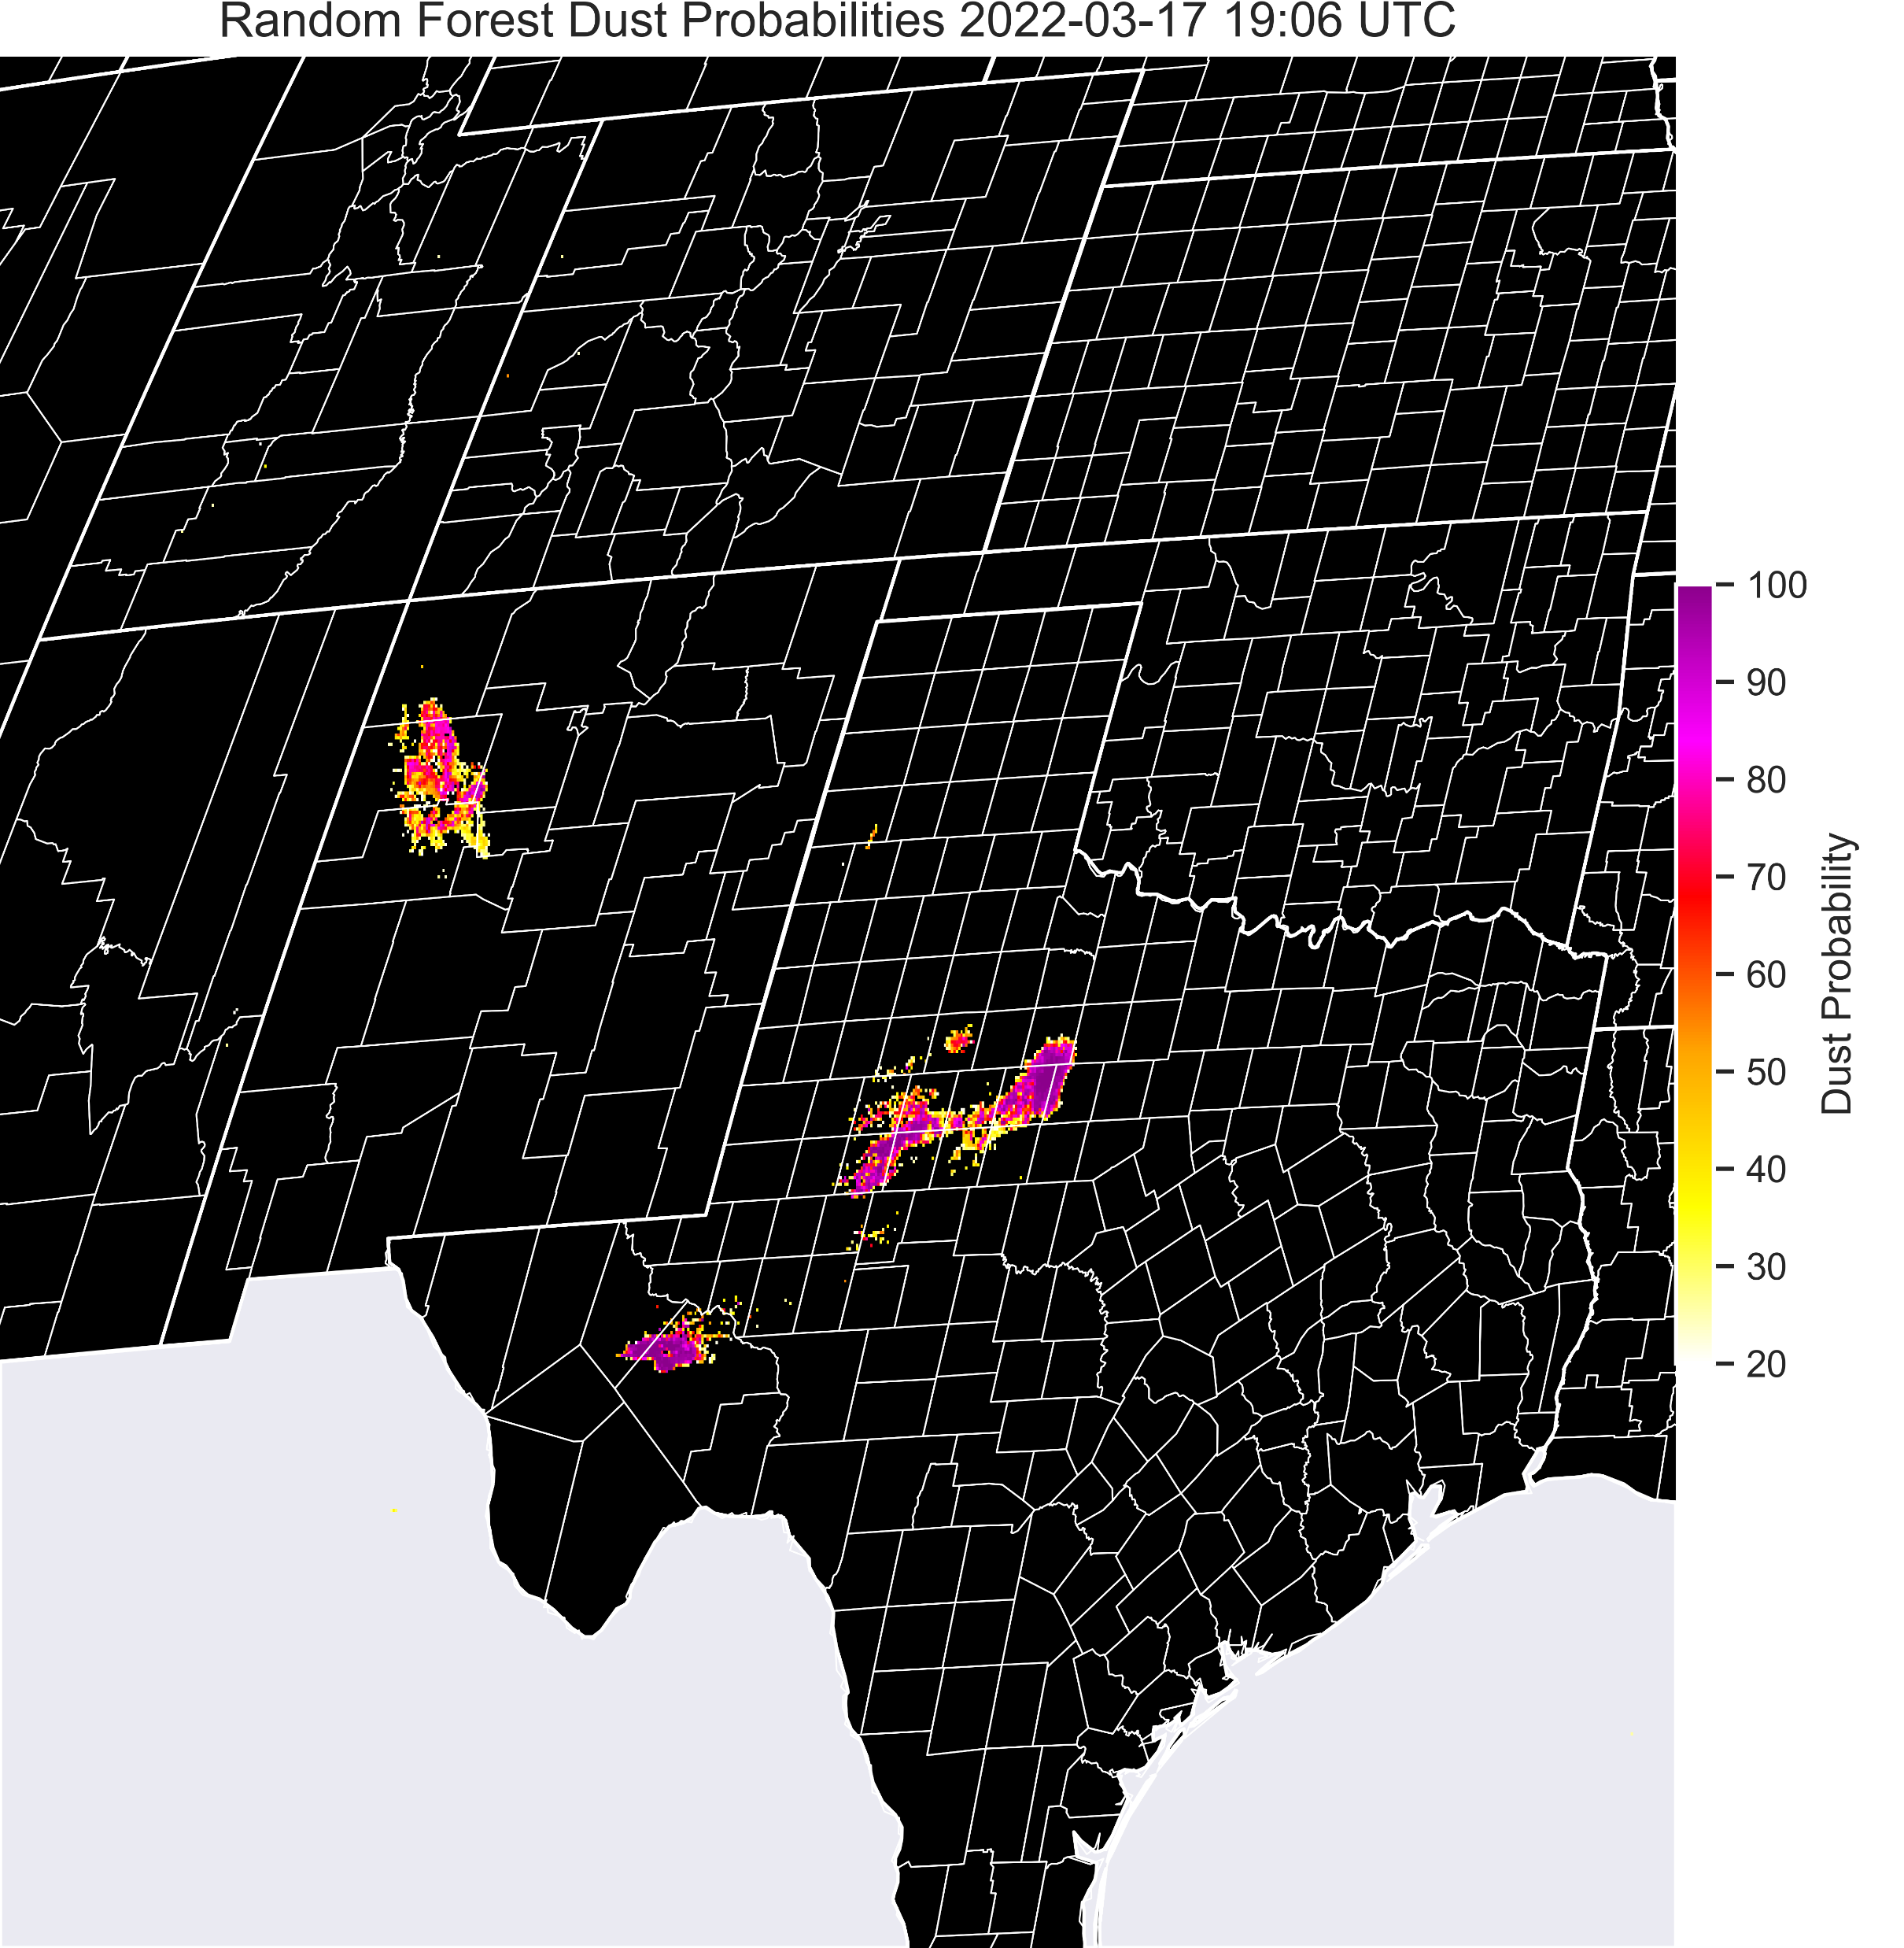
Methodology
Overcoming the limitations of night-time dust detection is addressed by using expert analysis and remote sensing principles to develop training data, model inputs, and architecture.
Focus on refining the training for Night-time dust detection
Collect night-time training dataset
Classify false surface and smoke detections
GOES-16 ABI imagery in the SW U.S. Jan. 2018-Jun. 2020
Cases were randomly split for Dust ML model training (60%), testing (20%), and validation (20%)
A total of 28 cases were gathered, which incorporates 83 distinct images a total of 790,921 dust pixels and 37,698,467 null pixels
Model Inputs
Single channels: 7.3, 10.35, 11.2, 12.3, 13.3
Differences: 12.3-10.35
11.2-8.4
Dust RGB components
Dust?
Output Probability of Dust
Evaluate Training, Model Inputs, and Performance with Statistical Approaches
Loss functions/Jaccard score
Confusion matrix
Permutation Importance
ROC/AUC
+ a few more
Random Forest Model
More information at Berndt et al. 2021
NASA ESDS Article "Dust in the Machine"
Notes:
This study applies machine learning to the problem of night-time dust detection with a physically-based simple random forest model using GOES-16 Advanced Baseline Imager (ABI) infrared imagery as inputs to the model.
Hyperparameters chosen based on loss functions and Jaccard Score to prevent over- or under-fitting
Null cases important for diversifying training and reducing the log-loss
Confusion matrices used to assess model performance on the training dataset
For images with dust present, the model correctly labels 85% of dust pixels and 99.96% of no-dust pixels.
Type 2 error (labeling dust as no dust) is reduced by 30.5% by expanding the training dataset to include a wider range of cases and null events.

Slide 5
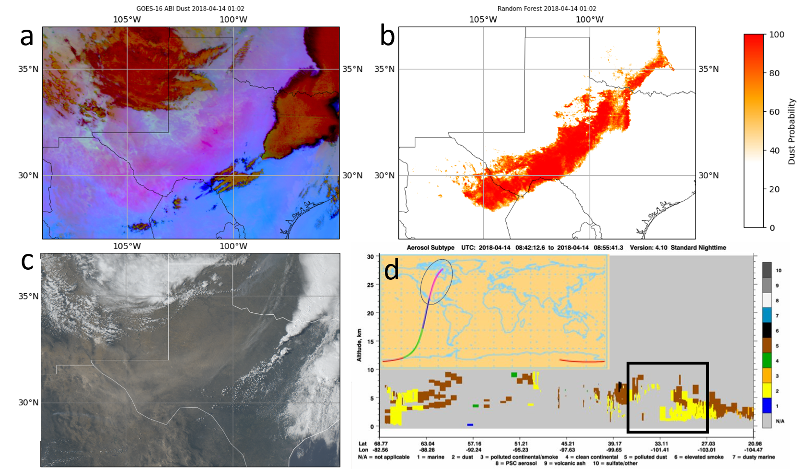
Key Findings
Statistical validation methods confirm the model classification is strongly based on the GOES-16 satellite inputs used in conventional dust detection and known to be most sensitive to airborne dust.
Type 2 error (labeling dust as no dust) is reduced by 30.5% by expanding the training dataset to include a wider range of cases and null events.
Application of the machine learning model to a dust event on 13-14 April 2018 enhances identification of the dust, providing better discernment of the plume boundaries with minimal false detection.
14 April 14 2018 0102 UTC (a) Dust Red-Green-Blue (RGB) and (b) Random Forest model output probabilities. (c) 2102 UTC April 13, 2018 True Color RGB and (d) 0842 UTC April 14, 2018 Cloud-Aerosol Lidar and Infrared Pathfinder Satellite Observation aerosol classification cross-section (area corresponding to a–c is outlined in black) and overpass (section corresponding to the cross-section is colored in magenta and circled in black).

Slide 6


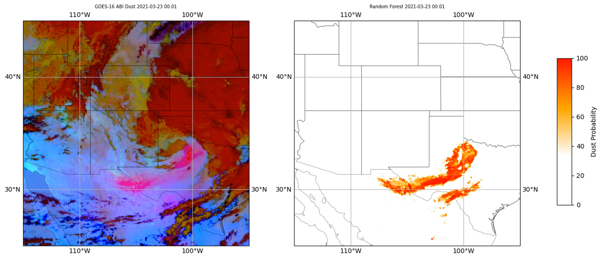


Significance
Dust on 23 March 2021 0000-0930 UTC evaluated by NWS forecasters to obtain operations to research feedback on the operational utility of ML-derived dust probabilities (Left) Dust RGB imagery and (Right) random forest model output probabilities.
Airborne dust has broad adverse effects
A physically-based approach dust detection machine learning model:
  Can be used to study the processes driving the onset and progression of high impact dust events especially as they extend into the nighttime hours.
  Has the potential to improve dust plume identification and analysis, overcoming the limitations of satellite imagery alone.
  Can potentially lead to more timely operational dust storm advisories and warnings issued to alert the public.
Impact: NWS forecaster feedback indicated machine learning dust probabilities would be valuable for:
complementing analysis with satellite imagery
improving confidence in the location and extent of dust, with plume boundaries clearly distinguished
increasing the ability to track dust longer into the night

Slide 7
Dust ML Probability Operational Assessment
Kevin Fuell

Slide 8
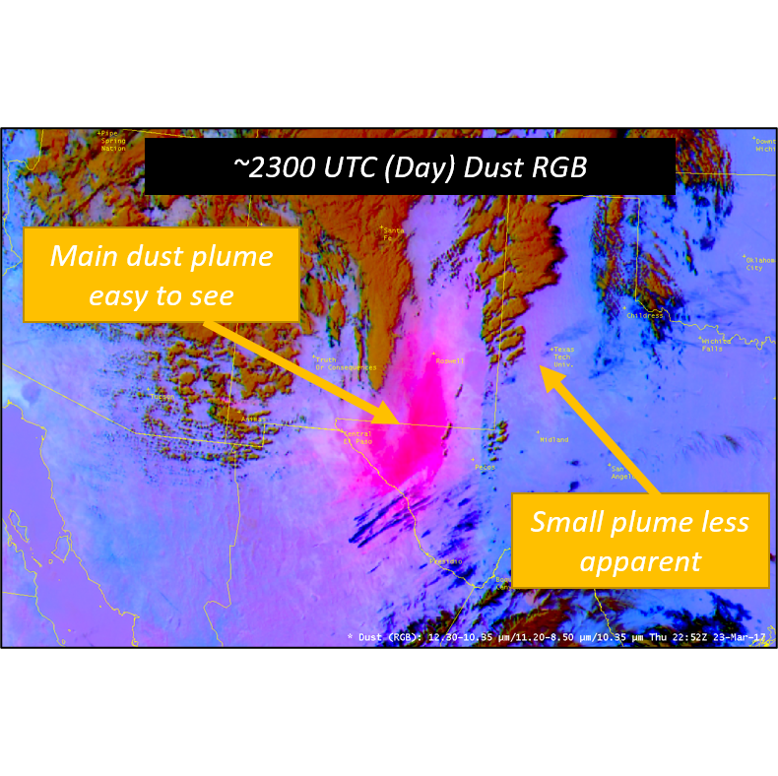
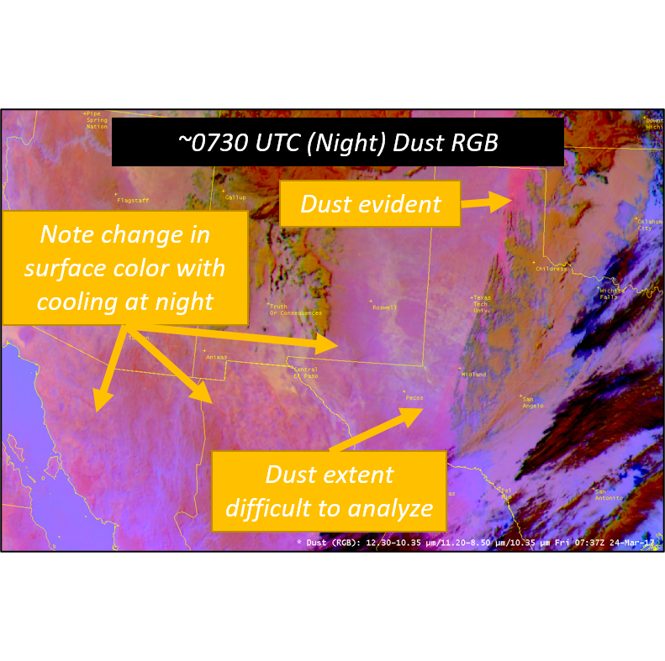
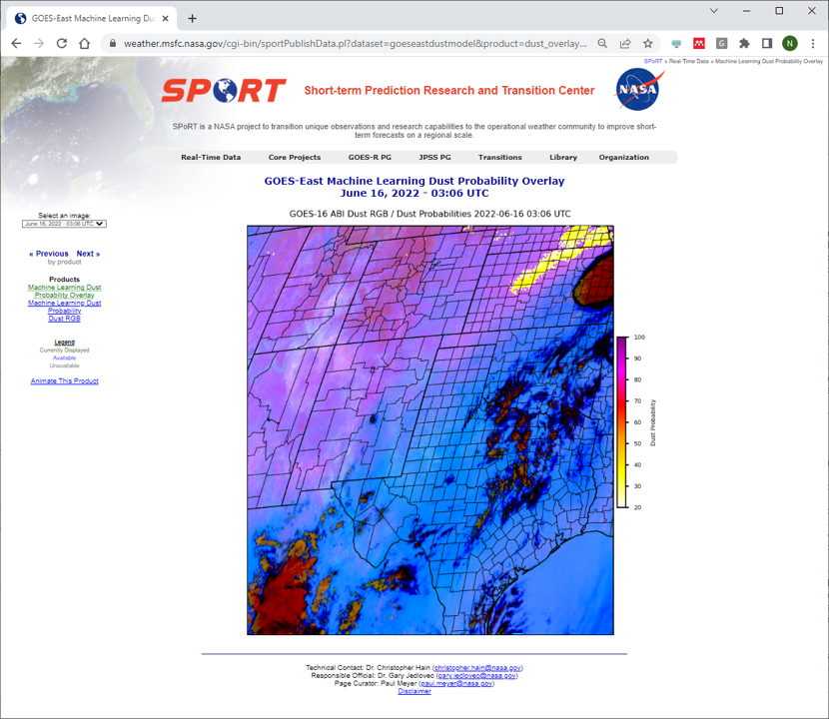
Assessment Background & Results
Who/Where: ABQ, AMA, ELP, LUB, MAF, ZAB
  1-3 staff from each location participating
When: March – April 2022 (two events just outside this period)
  Focus on night, but ML output also available in the day
Goal: Determine improvement to the user's confidence for blowing dust analysis at night in difficult scenes, as a complement to GOES imagery
How: Use of SPoRT website for product display, and online feedback form with rating and multiple-choice questions
Results Overall (~17 events, ~12 User Feedbacks):
Increased awareness over RGB and in remote areas
9 of 12 responses: Tracking period was noticeably increased over existing products
Rating of 5.1 out of 7 for value, and 5.6 of 7 as a complement
Impact to issue/limit public messages varied widely by event.

Slide 9
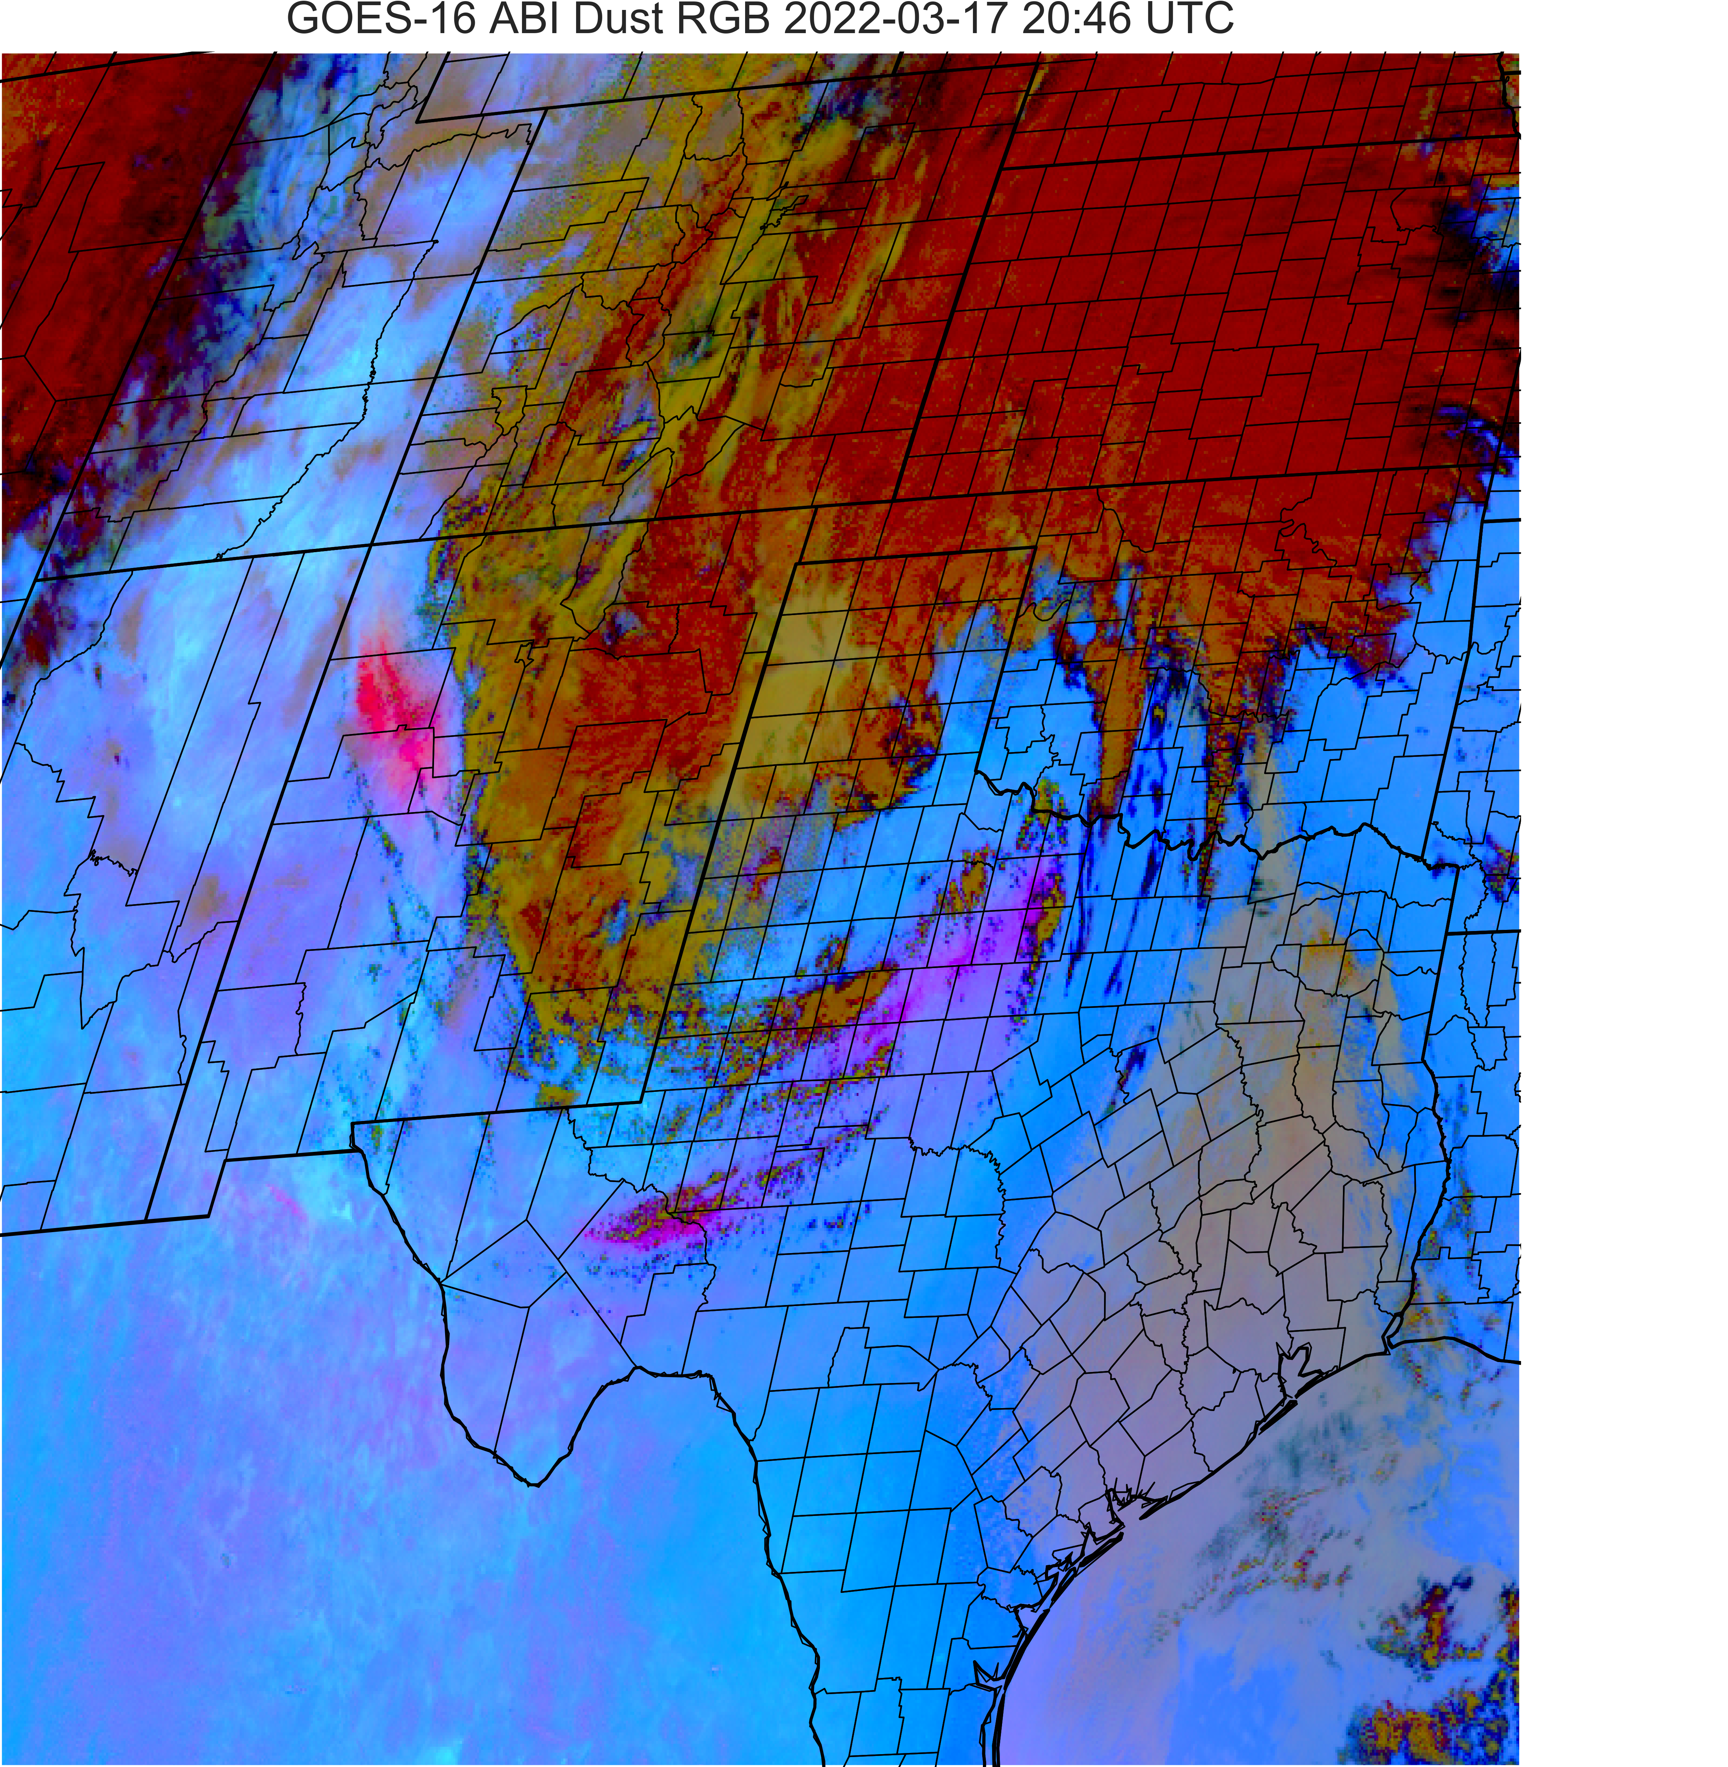
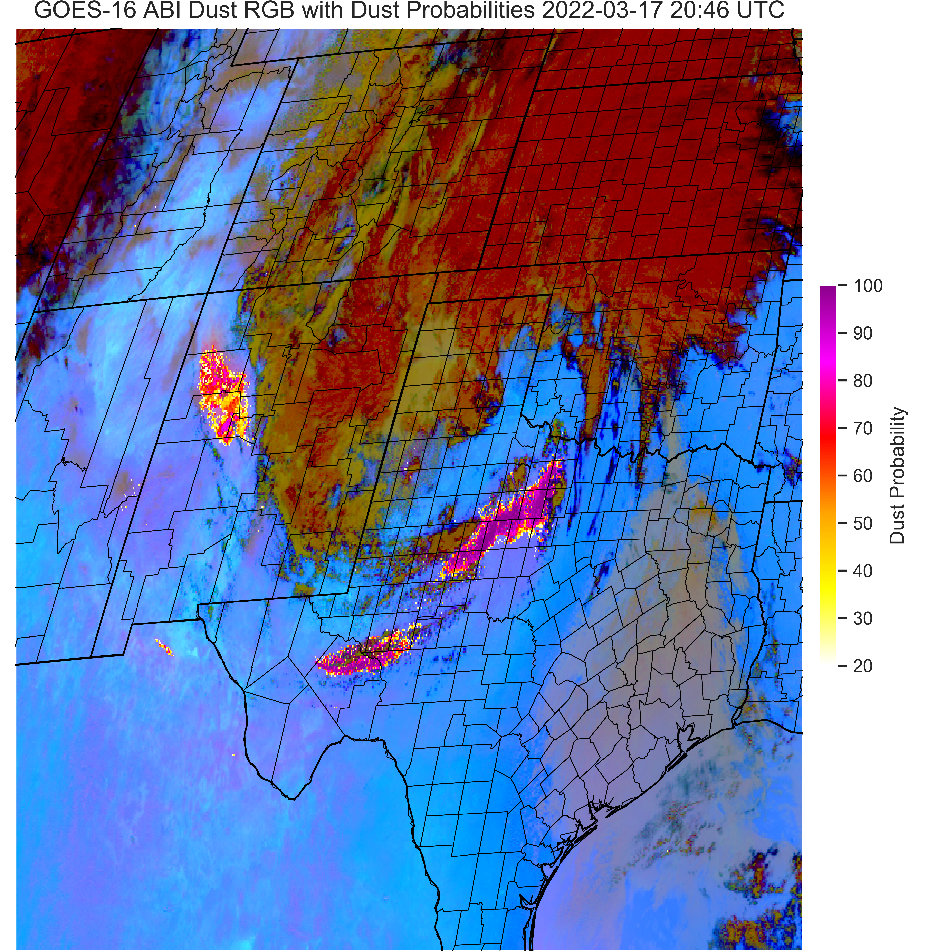
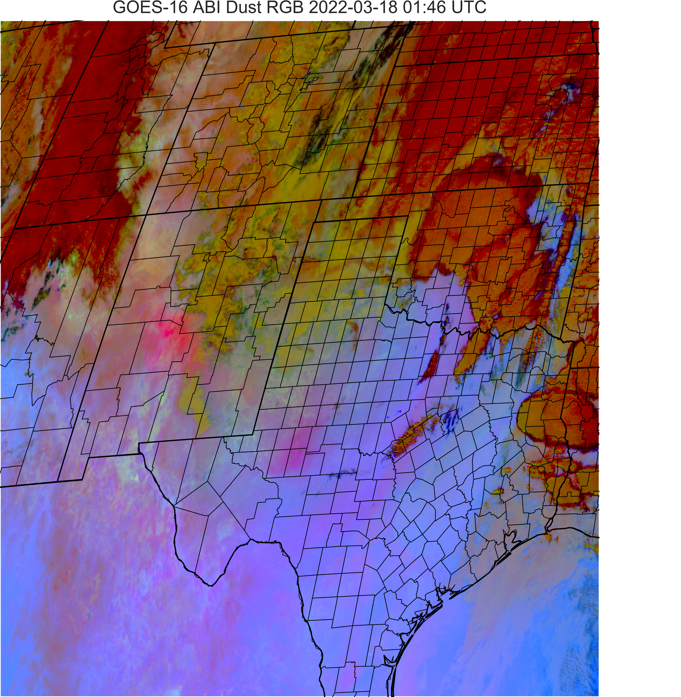
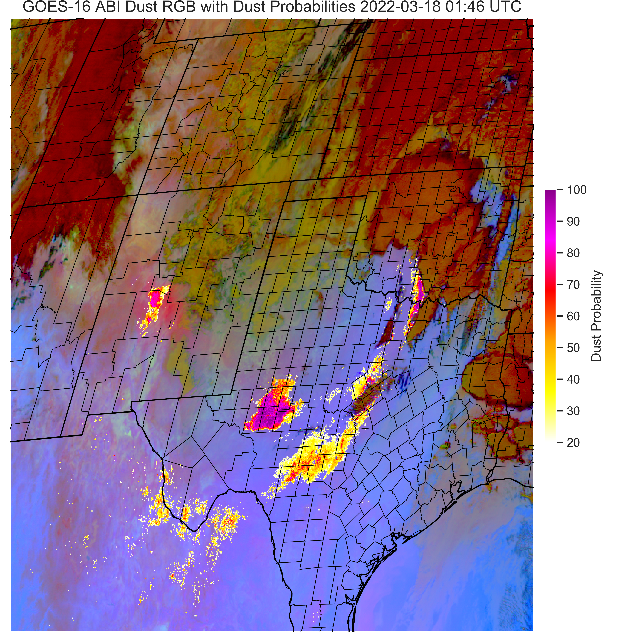
March 17 Event
3 different WFO responses
Dust RGB 2046 UTC
Dust RGB +ML 2046 UTC
March 17th event: The ML probabilities matched observations and supplemented our decision making when issuing a Blowing Dust Advisory, as well as supplemented our briefing to Emergency Managers who were dealing with an ongoing large wildfire. ~Midland, TX WFO
The fact that it matched observations early on greatly increased our confidence in the ML model output and future trends into the evening.
Dust RGB 0146 UTC
Dust RGB +ML 0146 UTC

Slide 10
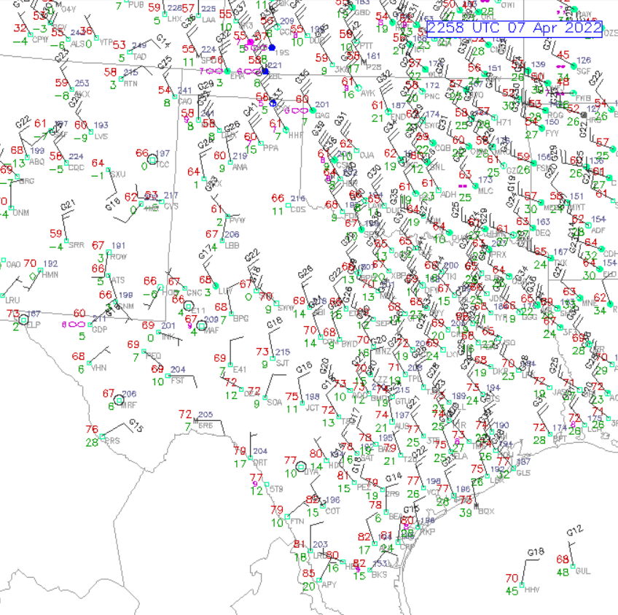
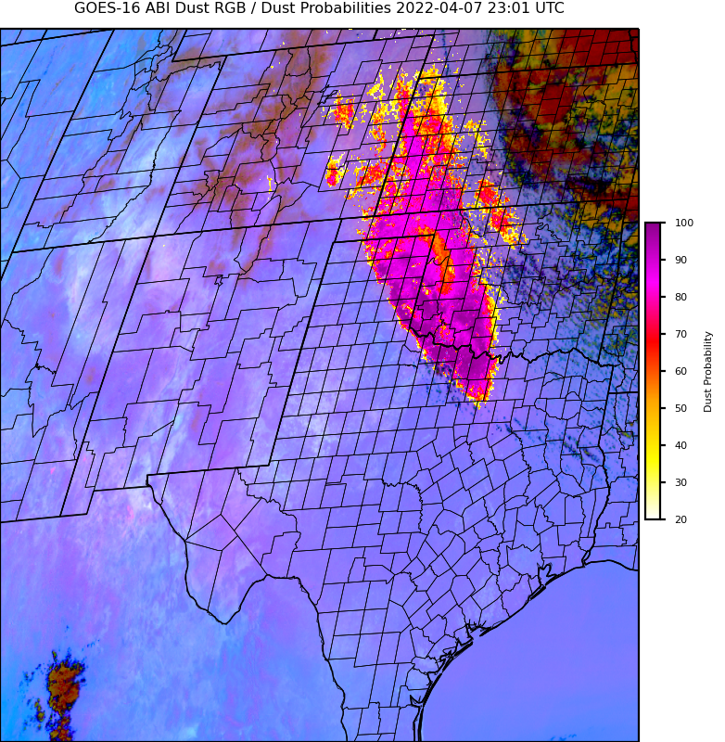
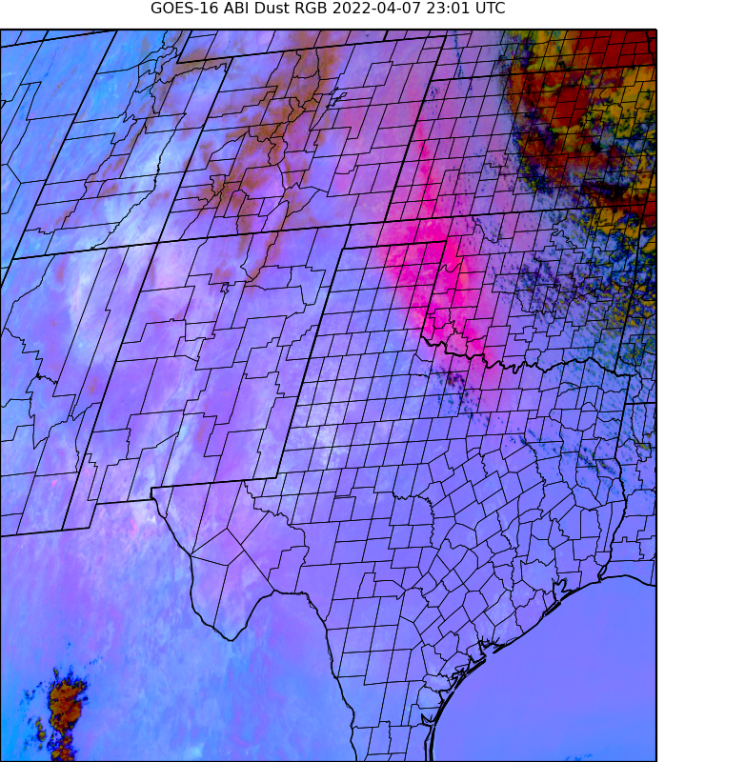
April 7-8: Event/Setup
Cyclone center well to the northeast
Prior days saw front push through TX and very similar dust event on 4/6
Northwesterly flow across the plains
Large dust plume originates in CO
Plume remained lofted at night; so surface obs. not able to track it well;
Impacts to OK and north TX, with overnight plume going toward Dallas/Ft. Worth area

Slide 11
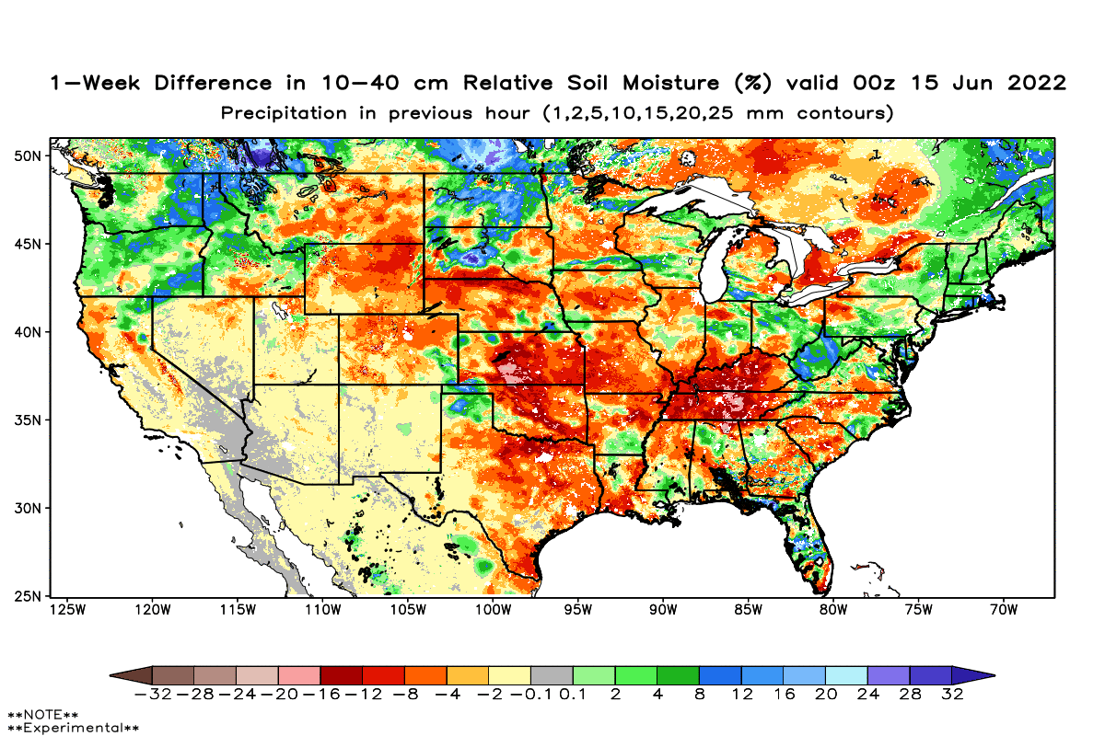
SPoRT Topics: Current and Future
Current and future topics:
  LIS for drought
  LIS for wildfire
  NUCAPS
  ESI
  TEMPO

