Slide 1

Wind Lidar Data Processing and Results from the CPEX-AW Campaign
Zhaoyan Liu, Kristopher Bedka, and Michael Kavaya
NASA Langley Research Center, Hampton, VA 23693
With contributions from the DAWN team:
LaRC: S. Chen, L. Petway, J. Yu, J. Marketon, A. Traore, A. Noe, J. Cooney, S. Rodier
SWA: D. Emmitt, S. Greco
BP: S. Henderson

Slide 2
Background
An airborne Doppler Aerosol WiNd (DAWN) Lidar System has been developed and improved at NASA LaRC over the last decade to:
demonstrate coherent Doppler lidar (CDL) technology
provide wind data for NASA airborne science campaigns,
demonstrate would be measured from a space-borne CDL
Successful field campaigns: Polar Winds I and II, Convective Processes Experiment (CPEX), Aeolus Cal/Val Test Flight Campaign, CPEX – Aerosols and Winds (CPEX-AW) .
Upcoming field campaign: CPEX – Cabo Verde (CPEX – CV) in September 2022
Data processing algorithms have been developed and applied successfully to DAWN data acquired during the April 2019 Aeolus Cal/Val Test Flight Campaign and CPEX – AW Campaign

Slide 3
Outline of This Presentation
LaRC Doppler Aerosol WiNd (DAWN) Lidar system
CDL measurement concept and wind retrieval algorithm
2021 DAWN CPEX – AW field campaign results
Summary and current/future DAWN applications

Slide 4
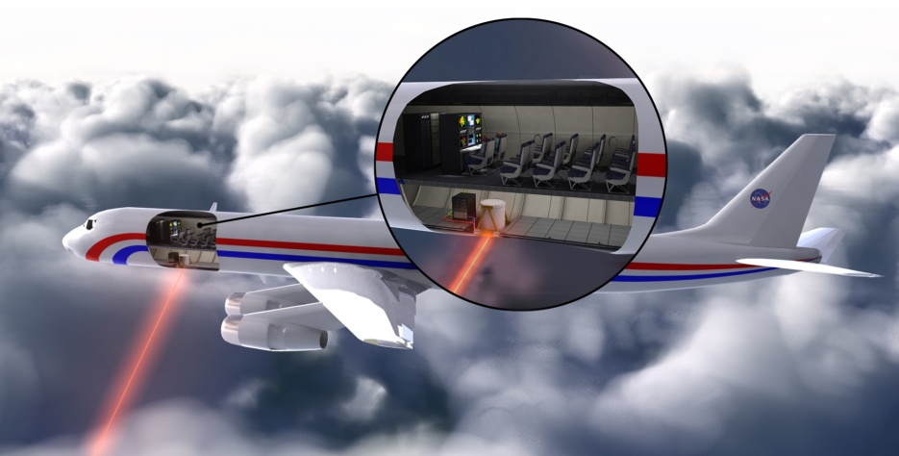
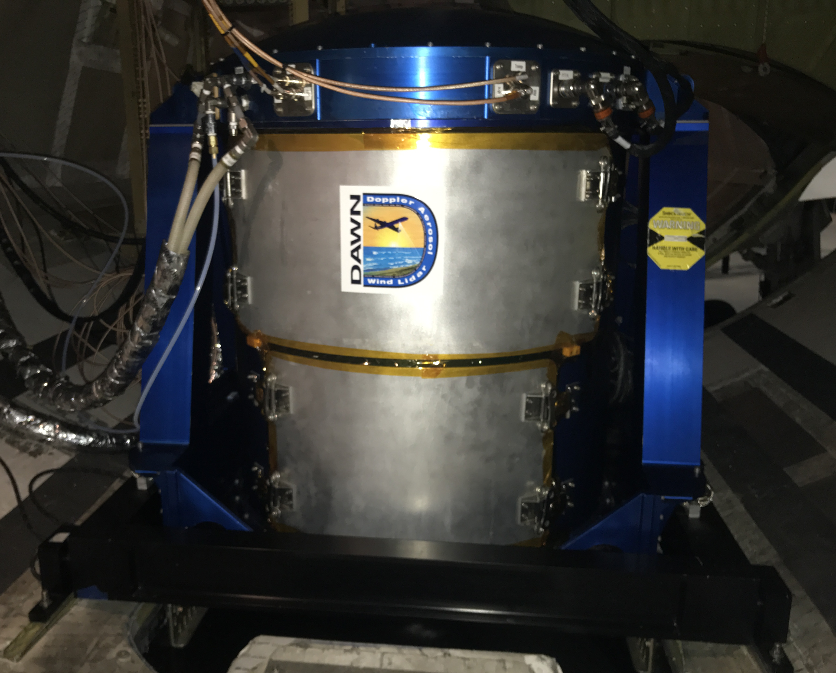
Doppler Aerosol WiNd (DAWN) Lidar System
A coherent Doppler lidar at 2.053 μm
Heterodyne: pulsed oscillator (PO) + CW local oscillator (LO)
Wind-induced Doppler shift in heterodyne (beat) signals
Wind vector derived from multiple direction measurement
DAWN Specifications
Airplanes Flown | DC-8 and UC-12B
Laser Crystal, Wavelength | Ho:Tm:LuLiF, 2.053 Microns
Laser Architecture | Master Oscillator Power Amplifier (MOPA)
Pumping Source | Laser Diode Arrays (LDA), 792 nm, 1 ms
Pulsed Laser Output | 80-100 mJ, 10 Hz, 180 ns
Telescope Diameter | 15 cm
Detector | Dual-Balanced InGaAs PIN
Scanner | Step-Stare Rotating Wedge, 30° off Nadir
Eye Safety | Safe at any Range

Slide 5
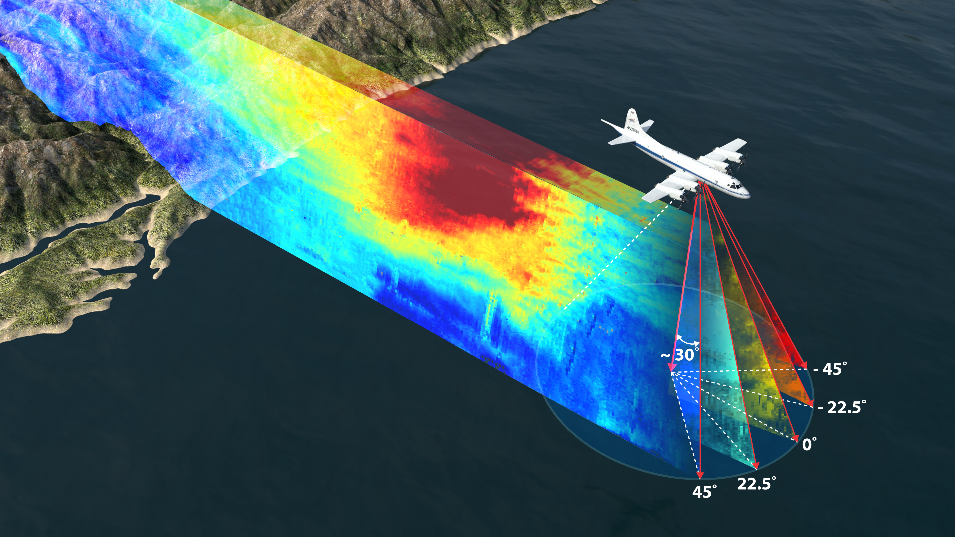
DAWN Airborne Measurement on DC-8
A 5 lines-of-sight (LOS’s) measurement pattern

Slide 6
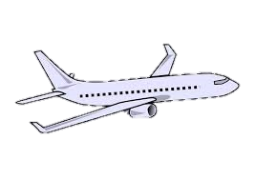
DAWN Multiple Line-of-Sight Measurement
To determine a wind vector, measurements of wind along at least at three directions or “lines of sight” (LOS’s) are necessary
If the vertical wind component is small and can be ignored, a minimum of two LOS’s are needed (assumed so in the current algorithm)
A typical pattern: 5 LOS’s with azimuth angle in the aircraft coordinate of: -45°, -22.5°, 0°, 22.5°, 45°; 20 laser shots per LOS
DAWN allows for an optional number of LOS and shots per LOS to enable a variety of science investigations and process studies
Off nadir angle = ~30°
N = 20 shots
- 45°
- 22.5°
0°
22.5°
45°
5 LOS’s = 100 laser shots
(~ 5 km)

Slide 7
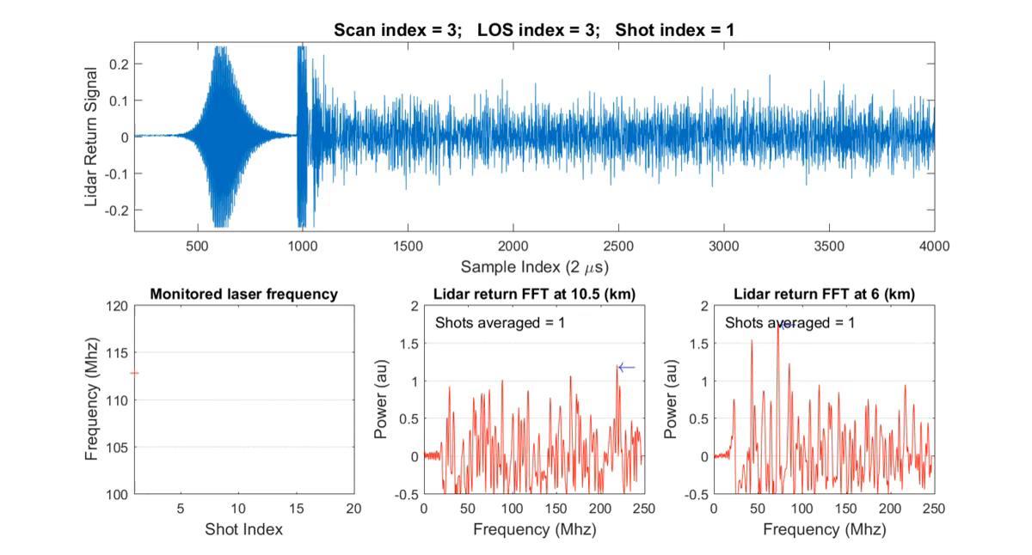
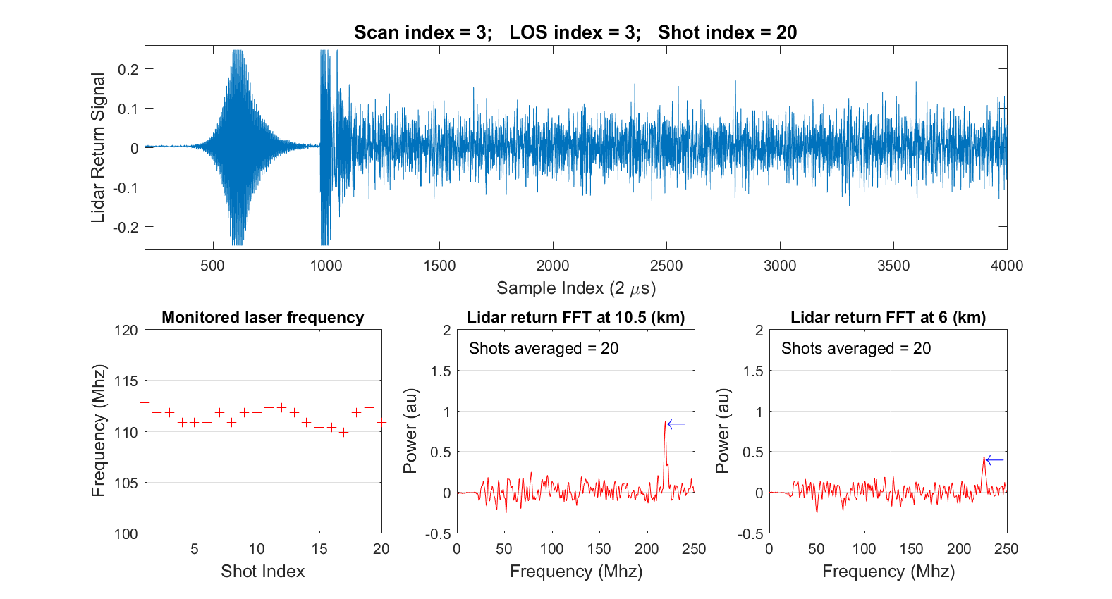
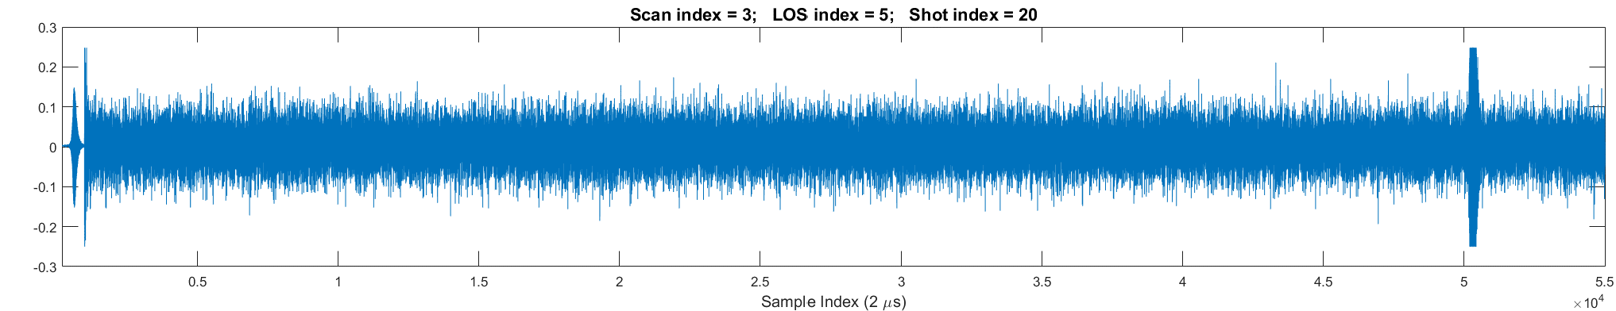

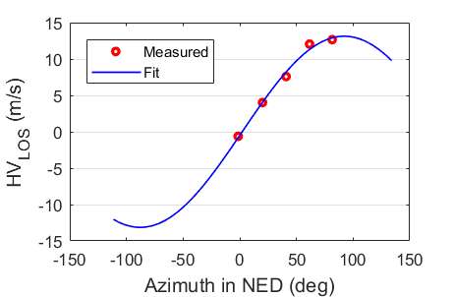


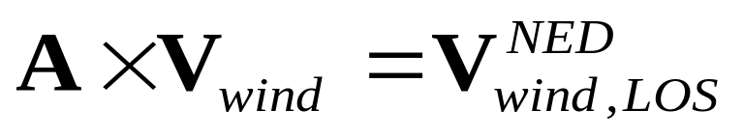
LaRC Wind Retrieval - Overview
30°
FFT shot 1
~77m (256 samples)
Correct for laser freq. variation, average over N
Range gate
FFT shot 2
…
FFT shot N
- 45°
- 22.5°
Speed
Select
5 LOS’s
n ≥ 2 LOS’s
22.5°
45°
Solve
Vertical range gate center spacing = 30 m
Direction
INS/GPS
Aircraft correction

Slide 8
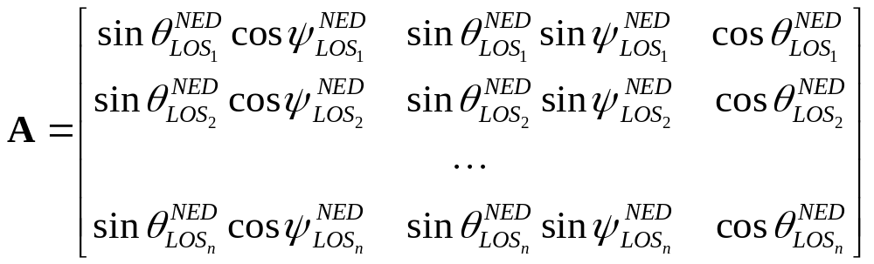
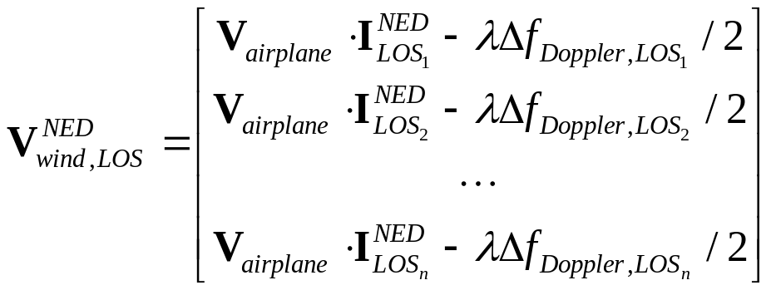
LaRC Wind Retrieval – Primary Error Source
INS/GPS
INS/GPS
FFT/Lidar
Airplane
Doppler shift
Airplane + wind
Doppler shift
Imperfect correction for airplane induced Doppler shift along each LOS is the primary source, because of the large airplane speed > 200 m/s for DC-8
NED: north-east-down coordinate; ψ and θ: azimuth and off-nadir angle in NED

Slide 9

Wind Retrieval – Periodogram Average
Monitor detector
Lidar atmospheric return (55,000 samples, ~16.5 km)
When return signal is weak from low aerosol region, averaging is necessary to successfully measure Doppler shift and wind

Slide 10

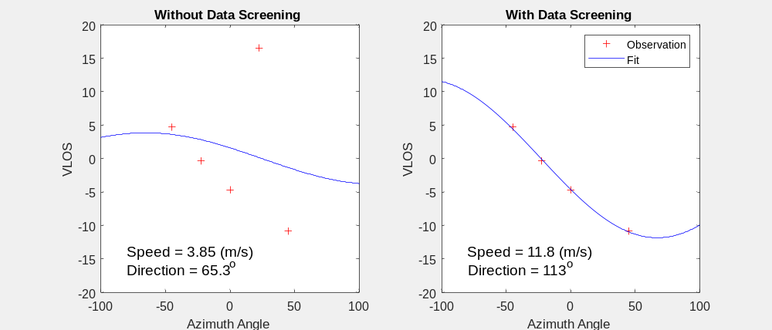
Wind Retrieval – Adaptive Threshold Data Screening
If a detected peak in the periodogram is due to a noise spike, when signal is weak
the peak can be detected randomly at any location in the periodogram (20 – 250 MHz)
therefore, it is “poisonous” to wind retrieval and causes large errors,
a noise spike must be excluded in the retrieval
Peak due to noise
Adaptive Threshold Data Screening
Select VLOS with peak > K*σ
VLOS # >= 2
Yes
Solver
No
Reduce k
Yes
k <= K_{min}
K = 16, 9, 4
Noise
A dilemma: a larger K value can help screen out noise spikes and derive a reliable wind retrieval, but the chance to mis-detect a true signal peak is higher and hence lose some spatial coverage. Wise versa.
To overcome this, we developed an adaptive threshold data screening algorithm.

Slide 11
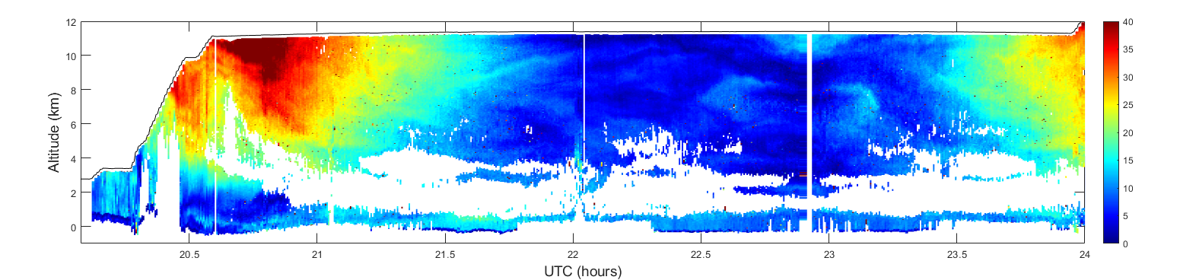

Wind Retrieval – Adaptive Threshold Data Screening
Fixed Threshold Data Screening
K = 4
Adaptive Threshold Data Screening
K = 16, 9, 4
Without the adaptive threshold data screening, isolated “dots” are seen due to the contamination of noisy data in the retrieval. Isolated dots are reduced significantly when the adaptive threshold data screening is applied.

Slide 12
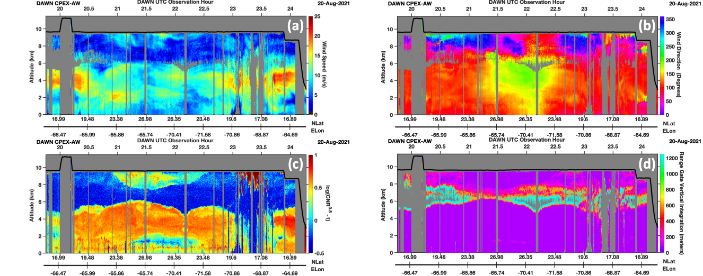
Wind Retrieval – Adaptive Vertical Resolution (AVRES)
To further improve the detection of weak lidar returns from low aerosol loading regions, an Adaptive Vertical Resolution (AVRES) integration is utilized:
If a successful retrieval is not obtained at a single base range gate, spectra from two range gates are averaged, and the retrieval procedure is repeated.
If a successful retrieval is still not obtained, the average number of range gates is doubled again until a successful retrieval is obtained, or the maximum integration depth (~ 1 km) is reached.
Adaptive SNR Threshold Data Screening
Select VLOS with power peak > K σ
VLOS # >= 2
Yes
Solver
No
Reduce K
Yes
K <= K_{min}
K= 16, 9, 4
No
Adaptive Vertical Resolution (AVRES)

Slide 13
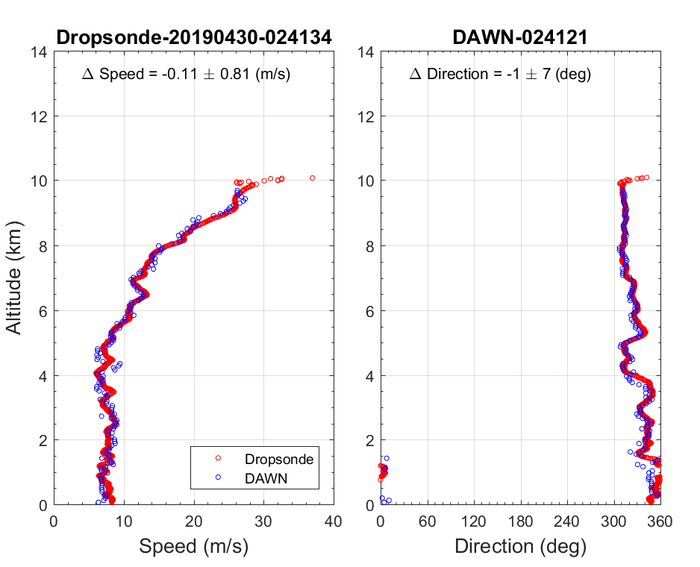
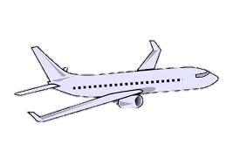
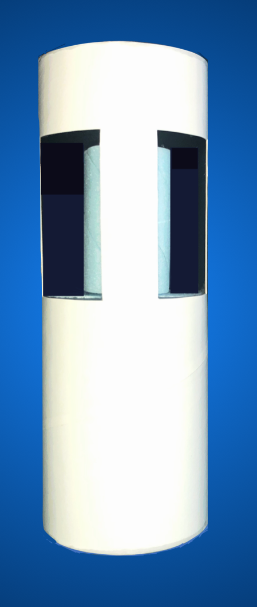
LaRC Wind Retrieval – End Result
Off nadir angle = ~30°
77m (256 samples)
Range gate
Dropsonde
- 45°
- 22.5°
0°
22.5°
45°
Vertical height spacing = 30 m.
DAWN is able to capture sharp vertical variations in wind with high precision and resolution, data attributes that are essential for process studies

Slide 14
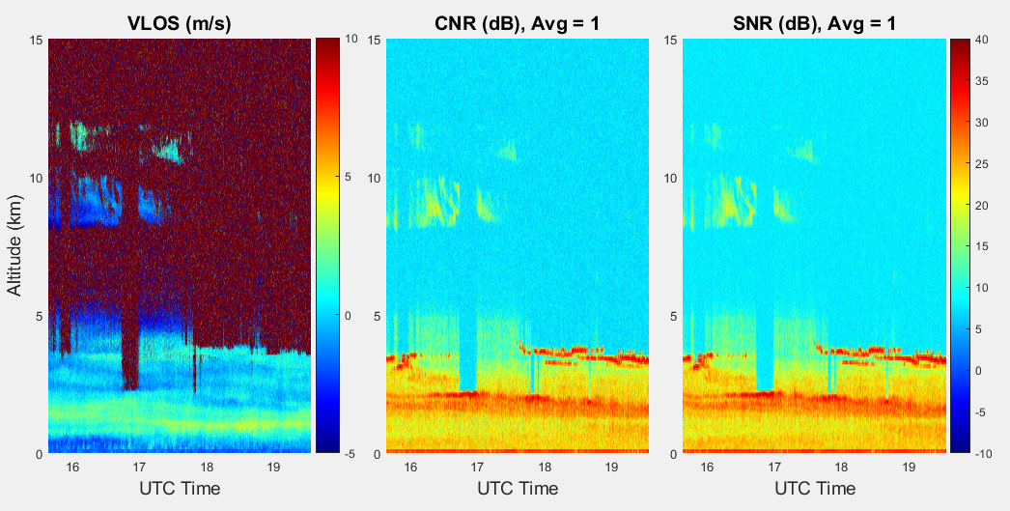
Performance – Ground Test
Cirrus
Water Cloud
Aerosol
Left: line-of-sight (LOS) wind velocity; Middle: single-shot carrier-to-noise (CNR); Right: single-shot signal-to-noise ratio (SNR)
CNR = Peak FFT signal / Noise floor; SNR = Peak FFT signal / RMS noise floor

Slide 15
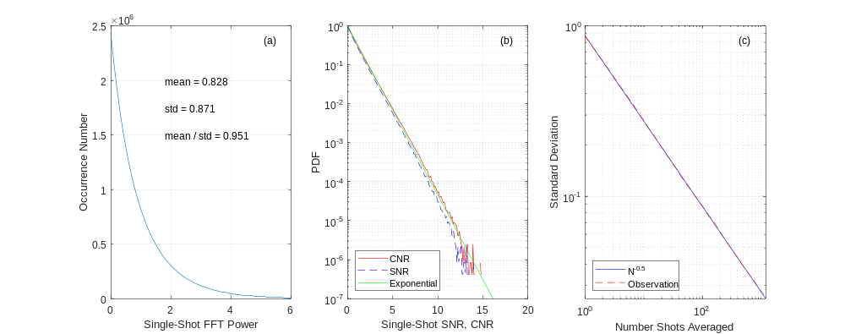
Performance – Ground Test
Distributions of single-shot noise floor (a) and SNR = FFT power/std, CNR = FFT power/mean, and an exponential fit y = e^{-x} (b), and standard deviation as a function of number shots averaged (c) that shows a perfect N^{-0.5}.

Slide 16
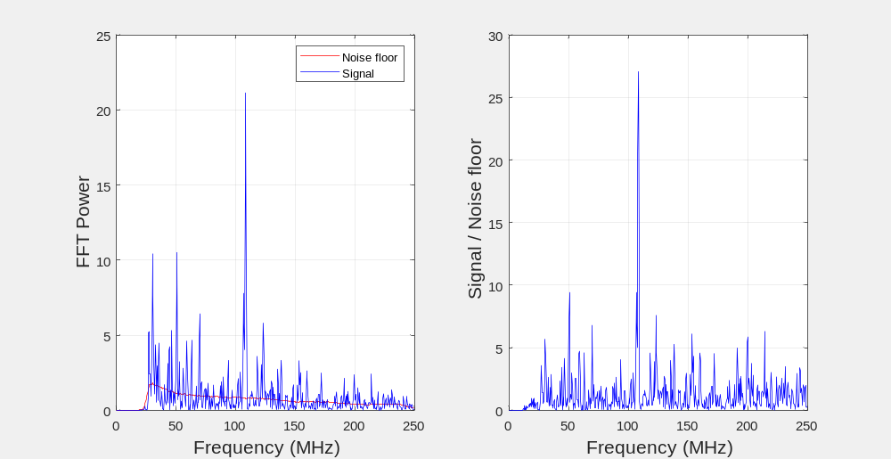


Performance – Ground Test
Single-shot Periodogram
Noise floor is derived by averaging the FFT spectra of all range gates below the surface for the airborne measurement, or the topmost 20 range gates for the ground test where there are no aerosol backscattering signals

Slide 17

CPEX-AW Field Campaign Based in St. Croix
Vertical Curtain: CALIPSO
The Convective Processes Experiment – Aerosols & Winds (CPEX-AW) campaign is a joint effort between the US National Aeronautics and Space Administration (NASA) and the European Space Agency (ESA) with the primary goal of conducting a post-launch calibration and validation activities of the Atmospheric Dynamics Mission-Aeolus (ADM-AEOLUS) Earth observation wind Lidar satellite in St. Croix.
CPEX-AW is a follow-on to the Convective Processes Experiment (CPEX) field campaign which took place in the summer of 2017 (https://cpex.jpl.nasa.gov/). In addition to joint calibration/validation of ADM-AEOLUS, CPEX-AW will study the dynamics and microphysics related to the Saharan Air Layer, African Easterly Waves and Jets, Tropical Easterly Jet, and deep convection in the InterTropical Convergence Zone (ITCZ). CPEX-AW science goals include:
CALIPSO
CALIPSO
CALIPSO
Science Objectives:
Better understanding interactions of convective cloud systems and tropospheric winds as part of the joint NASA-ESA Aeolus Cal/Val effort over the tropical Atlantic;
Observing the vertical structure and variability of the marine boundary layer (MBL) in relation to initiation and lifecycle of the convective cloud systems, convective processes (e.g., cold pools), and environmental conditions within and across the ITCZ;
Investigating how the African easterly waves and dry air and dust associated with Sahara Air Layer control the convectively suppressed and active periods of the ITCZ;
Investigating interactions of wind, aerosol, clouds, and precipitation and effects on long range dust transport and air quality over the western Atlantic.

Slide 18
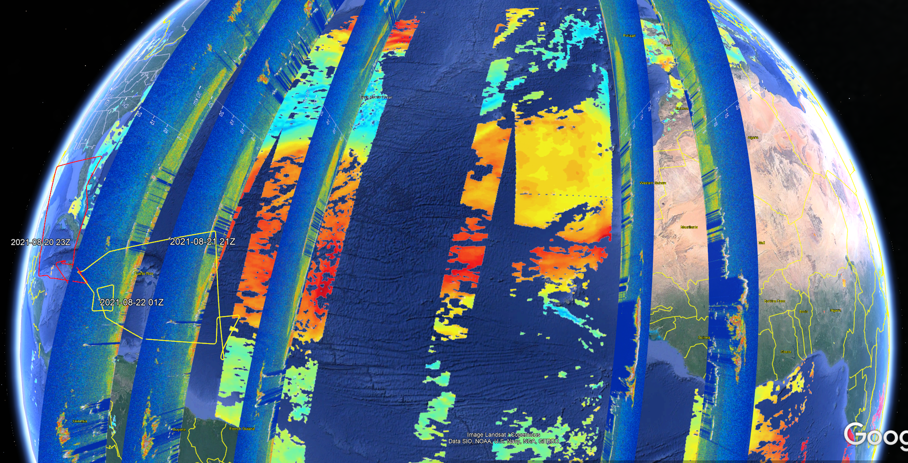
CPEX-AW Field Campaign Based in St. Croix
Vertical Curtain: CALIPSO
08-22-2021
08-21-2021
08-20-2021
08-17-2021
08-16-2021
CALIPSO
CONUS
Dust
Dust
MODIS AOD
Dust
Dust
Dust
North Africa
DC-8
DC-8

Slide 19
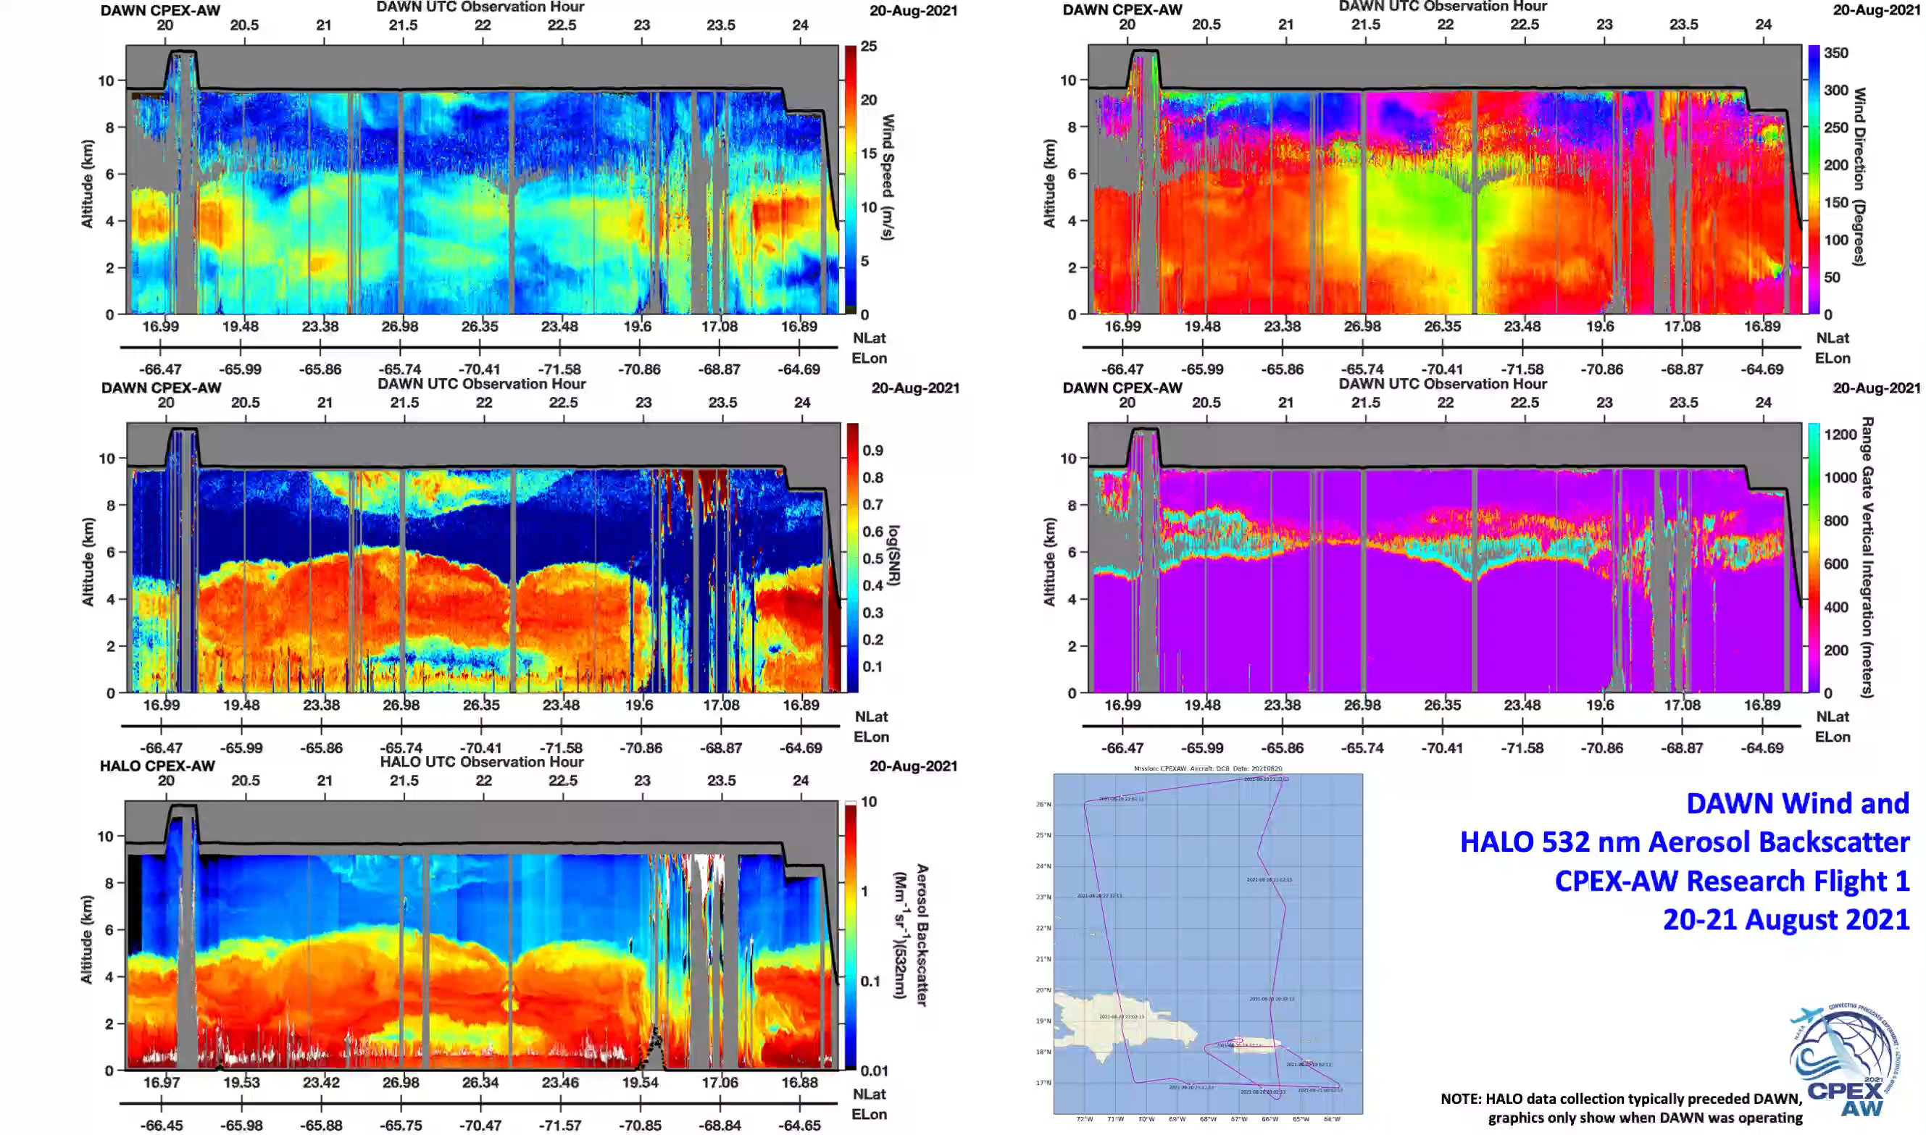
CPEX-AW First Science Flight
DAWN Speed
DAWN Direction
DAWN (CNR^{0.5}-1)
DAWN Range Gate
HALO Backscatter
(e)

Slide 20
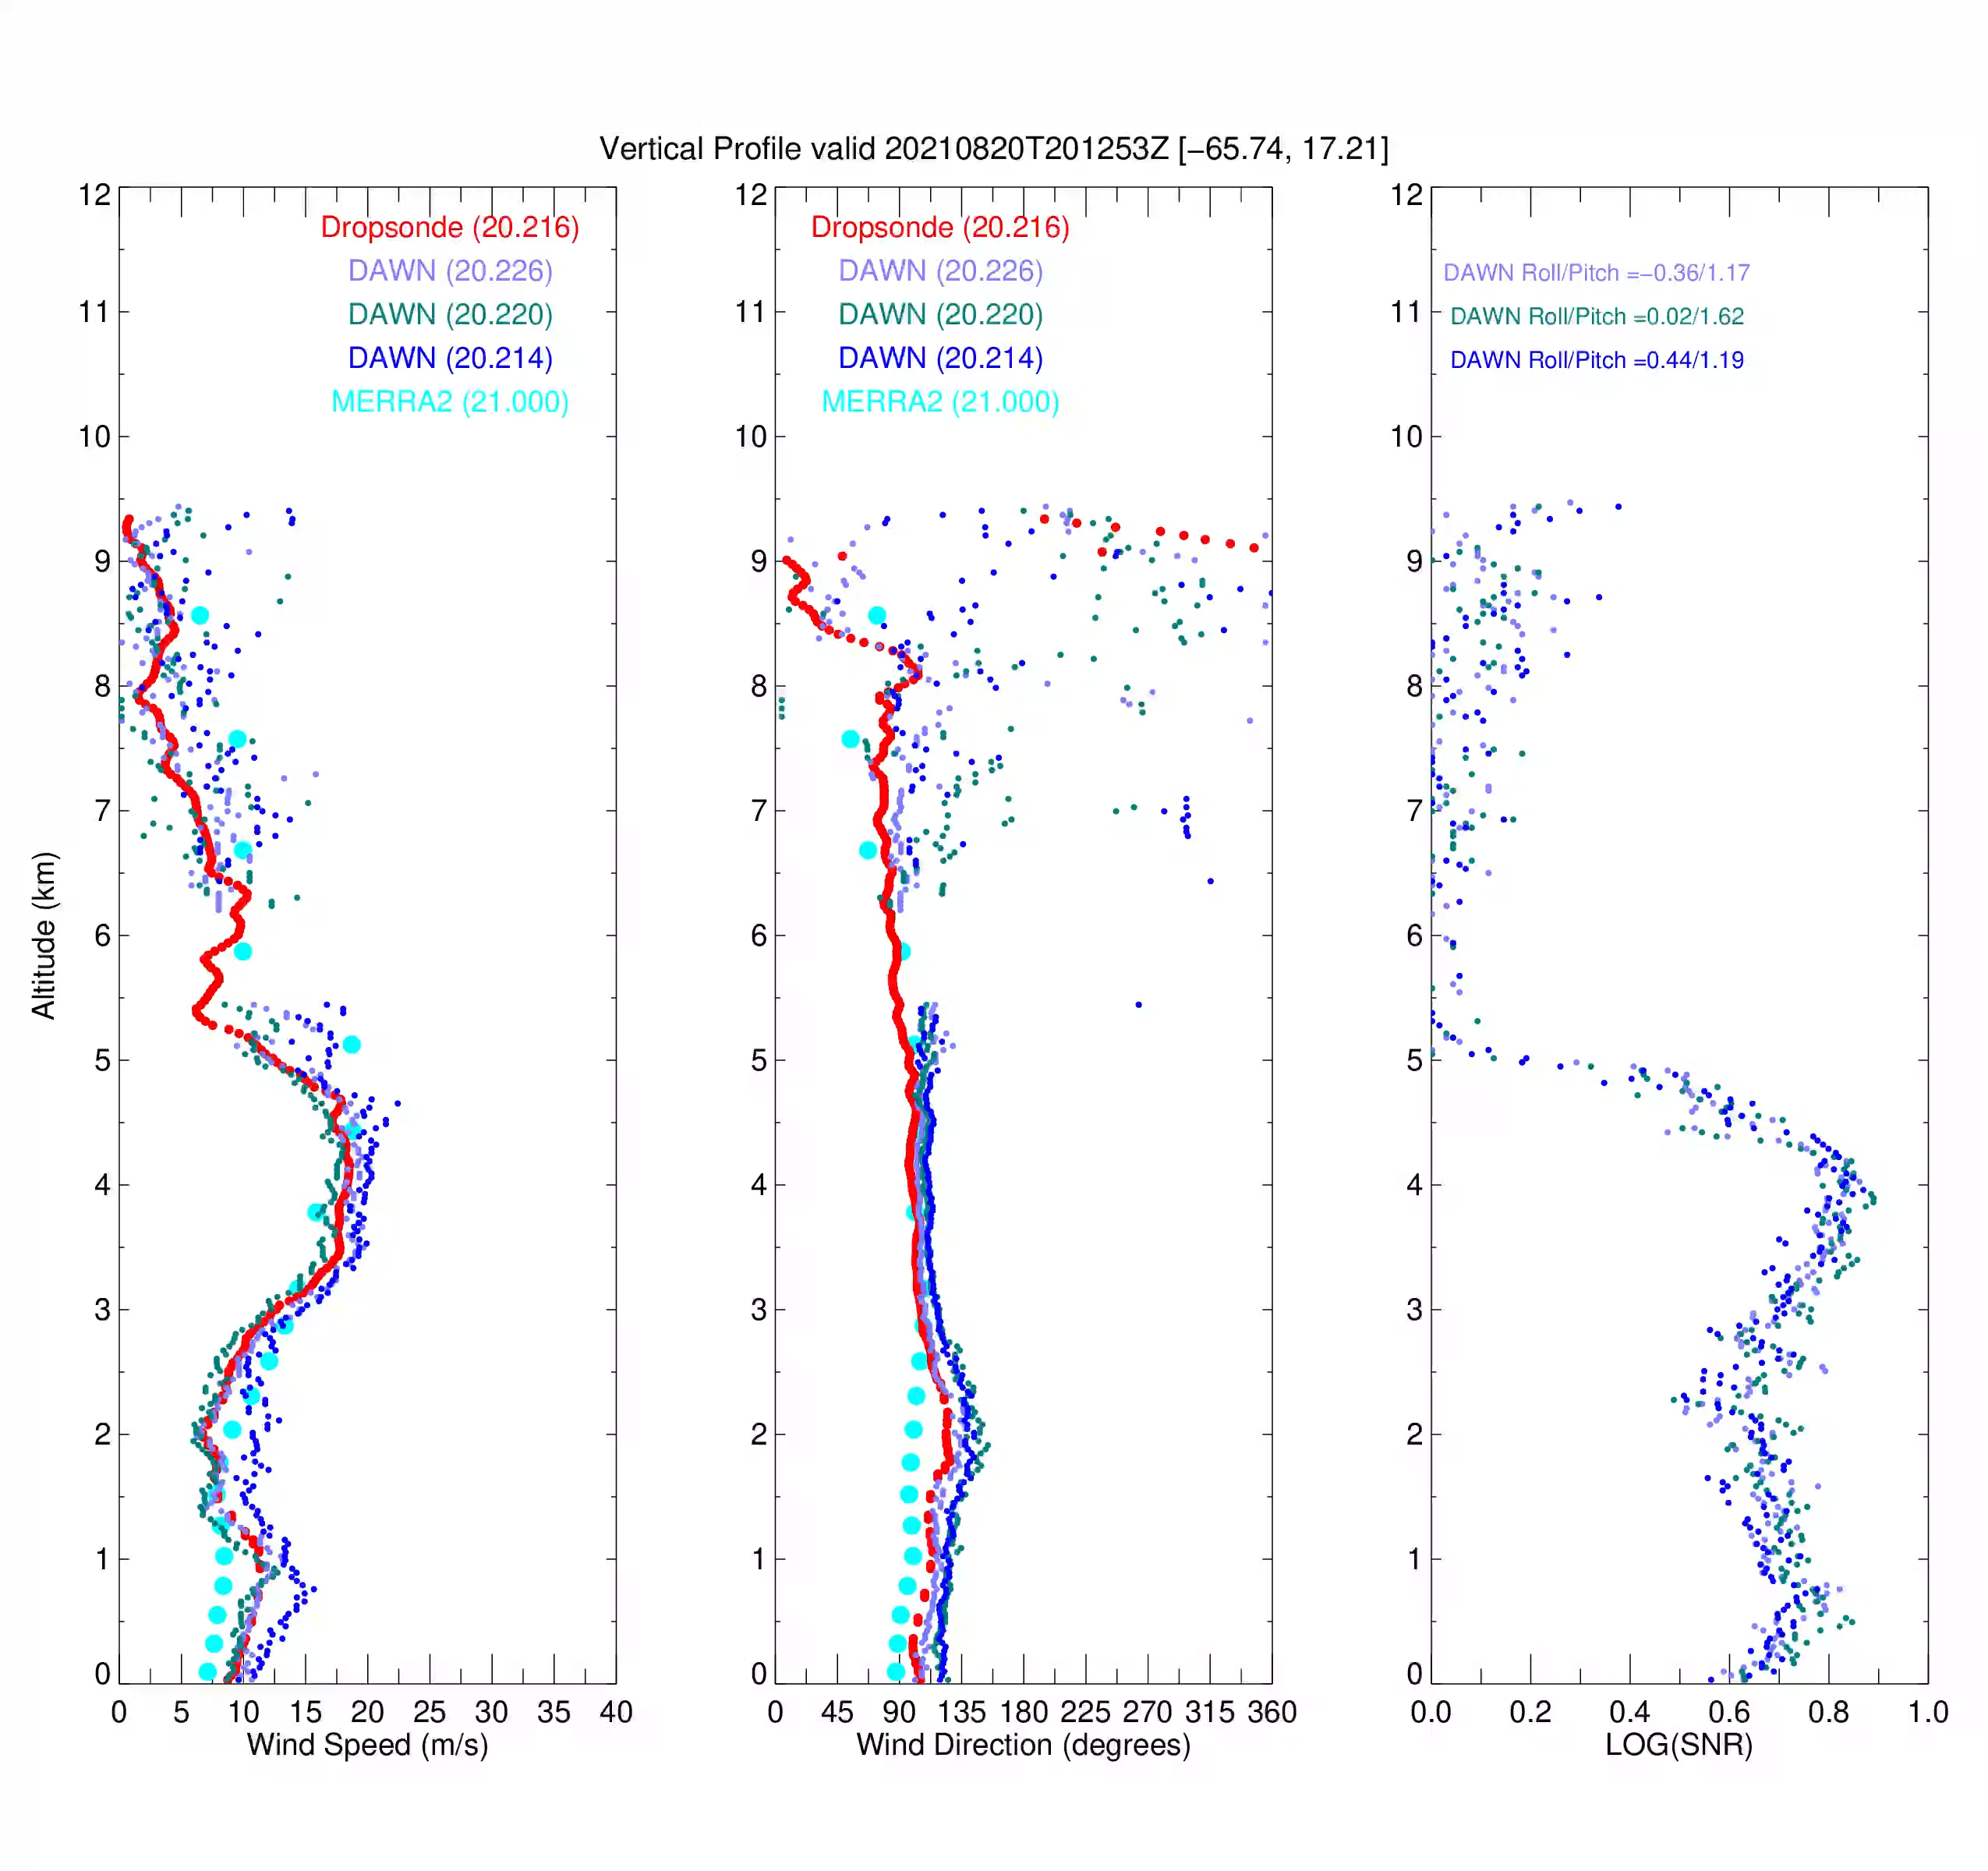
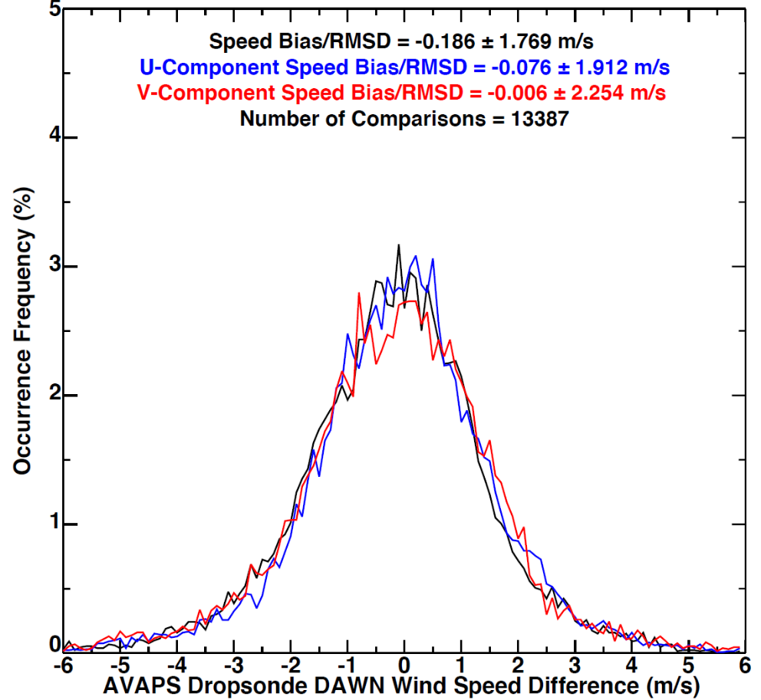
DAWN - Dropsonde Comparisons During Aeolus Cal/Val: 91 Sondes
DAWN - Dropsonde | Mean | Standard Dev
Speed (m/s) | -0.19 | 1.77
U (m/s) | -0.076 | 1.91
V (m/s) | -0.006 | 2.25
Direction (deg) | 0.11 | 11.0

Slide 21
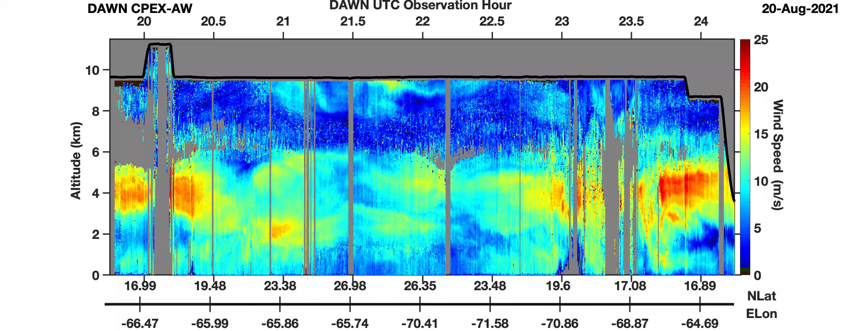
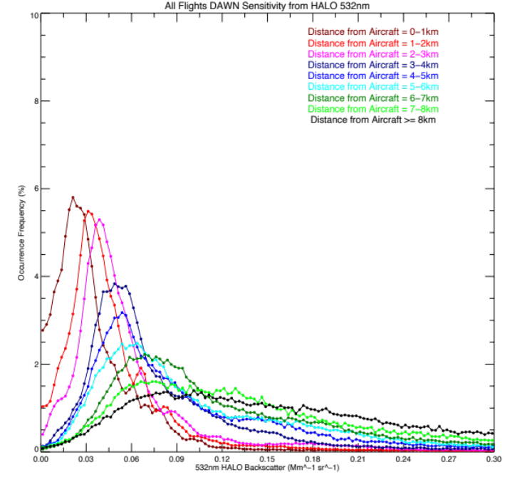
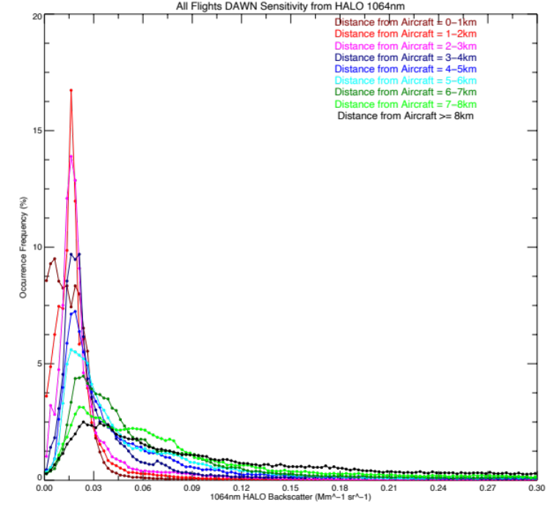
DAWN Sensitivity
Question: What is the lower limit of aerosol backscatter that DAWN can retrieve wind?
Analysis Method: Time sync and average HALO backscatter to DAWN wind product resolution (256 samples, ~66.5 m) for 5 Aeolus Cal/Val flights in 2019 and all 7 CPEX-AW flights in 2022
Answer to question: For shot integration <= 100 (typical DAWN operations), winds most often retrieved using single range gate data for aerosol backscatter β > 4.5x10⁻⁸ [m⁻¹sr⁻¹] at 532 nm and > 2x10⁻⁸ [m⁻¹sr⁻¹] at 1064 nm, (for comparison, the 532-nm molecular backscatter near the surface is ~ 1.6x10⁻⁶ [m⁻¹sr⁻¹]).
Winds can be retrieved from 1x10⁻⁸ [m⁻¹sr⁻¹] at the HALO wavelengths, if vertical integration is applied.
The detectable backscatter could be even smaller at the DAWN 2.05-μm wavelength, because of β ~ 1/λ^{α}.
Shift in peaks to the right with increasing distance from aircraft is an evidence for that the lidar sensitivity decreases as increasing range, although the aerosol loading has a similar altitude dependence.
Occurrence Frequency (%)
HALO 532nm Backscatter (Mm⁻¹sr⁻¹)
HALO 1064nm Backscatter (Mm⁻¹sr⁻¹)

Slide 22
Summary
The airborne Doppler Aerosol Wind (DAWN) Lidar has been developed at NASA LaRC and successfully participated in several field campaigns over the past decade
Data processing algorithms have also been developed at LaRC, and applied to DAWN data acquired during the April 2019 Aeolus Cal/Val Test Flight Campaign and 2021 CPEX – AW Field Campaign
Comparisons between DAWN and 91 dropsonde measurements showed a difference of -0.19 ± 1.77 m/s for wind speed and 0.11 ±11.0° for wind direction
Differences most often caused by wind spatial variability and not DAWN lidar “error”. Highly accurate INS/GPS information synced in time with DAWN pulses is crucial for wind retrieval
DAWN, HALO, and other NASA airborne data have been and will be used for a variety of investigations such as:
  Validation of space-borne ADM Aeolus Doppler lidar wind speed and aerosol products
  Developing a better understanding of flows within/near convection that contribute to storm initiation and maintenance, planetary boundary layer (PBL) processes and land/sea fluxes, and flow interaction with topography
  Validation and development of new geostationary atmospheric motion vector methods using 1-minute imagery
  NWP/Reanalysis model validation, and data assimilation to improve forecasts
DAWN, HALO, APR-3, and other instruments will be flying aboard the DC-8 in the upcoming NASA Convective Processes Experiment – Cape Verde (CPEX-CV) campaign based in Cabo Verde in September 2022

