Slide 1
ML and Earthdata Cloud
ESIP Summer meeting
July 18-22, 2022
Doug Newman
NASA ESDIS
douglas.j.newman@nasa.gov

Slide 2
Summary
What is NASA Earthdata Cloud (EDC)?
How do I discover cloud data?
How do I access cloud data?
  HTTPS
  AWS In-region S3 API
An example
Important things to know about

Slide 3
As an ML practitioner, why do I care?
NASA’s Earthdata Cloud

Slide 4
Data and lots of it!
You need training data
NASA EOSDIS stewards X Pb of earth science data
We are in the process of moving that data to the cloud
At time of writing, we have X Pb of data on AWS
We are targeting the top 50 and top 75 datasets, ranked by usage, for initial cloud migration

Slide 5
EDC discovery
How do I find the data?

Slide 6
CMR two-step discovery - an API
CMR provides a REST-based collection level search API with extensive filtering capabilities at:
https://cmr.earthdata.nasa.gov/search/collections?
Allowing users to find collections of interest leading to collection-specific granule/file searches as
https://cmr.earthdata.nasa.gov/search/granules
In a variety of result formats such as JSON, ISO and ECHO10

Slide 7
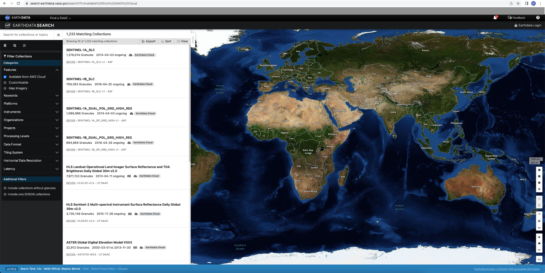
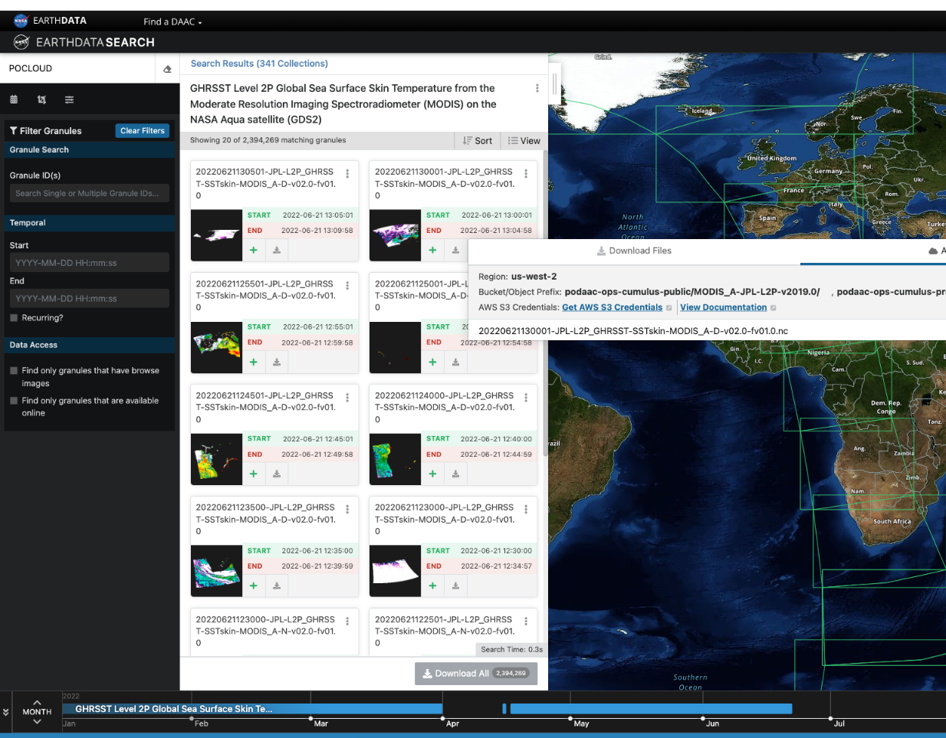
Earthdata Search - a UI
https://search.earthdata.nasa.gov

Slide 8
STAC
NASA EOSDIS’ Common Metadata Repository provides an online catalog of cloud-based earth science data in the cloud-friendly STAC format at:
https://cmr.earthdata.nasa.gov/cloudstac
STAC can be used in conjunction with other tools (intake-stac) to streamline your cloud data access in EDC.

Slide 9
Registration
How do I access the data?

Slide 10
All EDC data access and distribution requires registration.
HTTPS access - Earthdata Login (EDL)
AWS S3 access - AWS STS credentials via EDL credentials

Slide 11
Earthdata Login
Register at urs.earthdata.nasa.gov
Fill in the form
Create a username and password.

Slide 12
AWS STS credentials
Find your data’s S3 credentials endpoint
For example: https://archive.podaac.earthdata.nasa.gov/s3credentials
Using your EDL credentials, get your STS credentials
Use those credentials in conjunction with AWS S3 API invocations.

Slide 13
2. EDC data access
How do I access the data?

Slide 14
With the explosion in the size of NASA EOSDIS’ data holdings and the amount of compute required to process that data, we recognize that the ability to utilize the cloud to perform analysis on EDC data is of vital importance.
NASA EOSDIS encourage this by allowing users to bring their compute to the data.
At the same time, we continue to support more traditional means of data access.

Slide 15
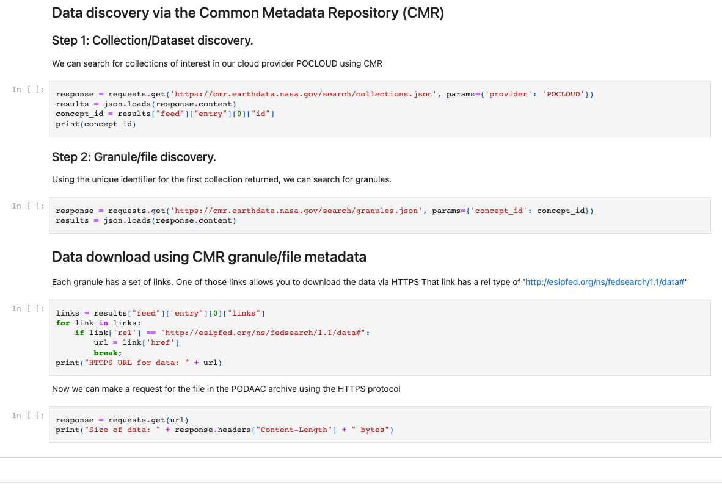
The traditional way - HTTPS
https://github.com/littleidiot40/edc-notebooks/blob/main/https-access.ipynb

Slide 16
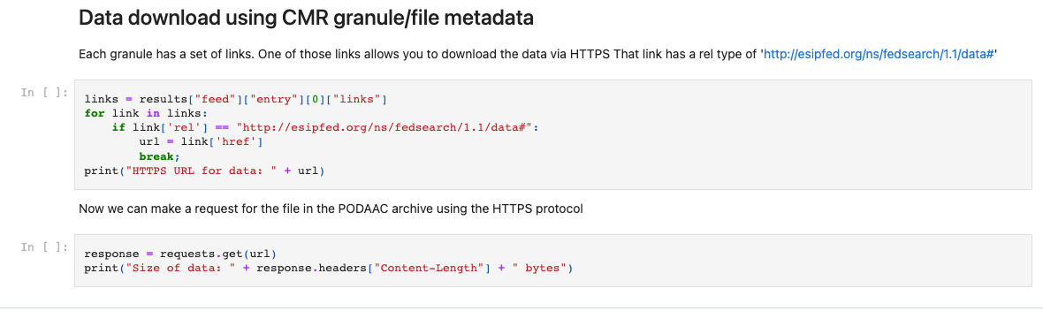

Slide 17
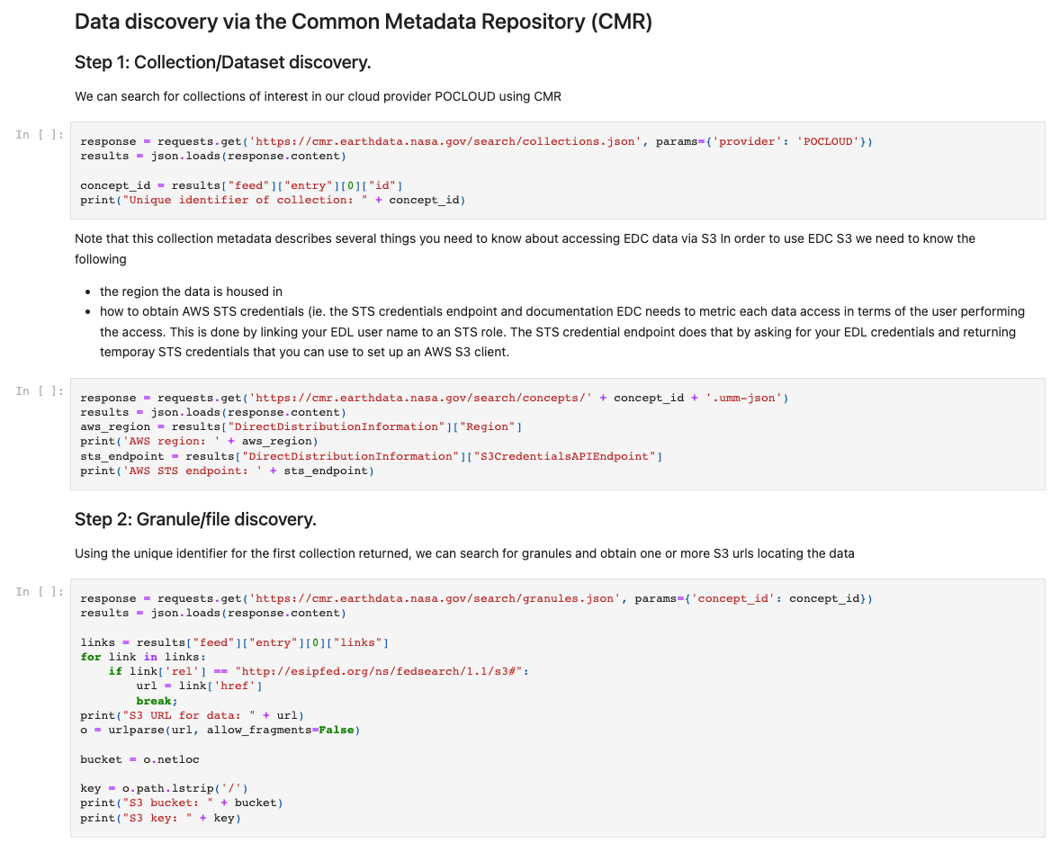
The ‘cloud’ way - AWS S3 API

Slide 18
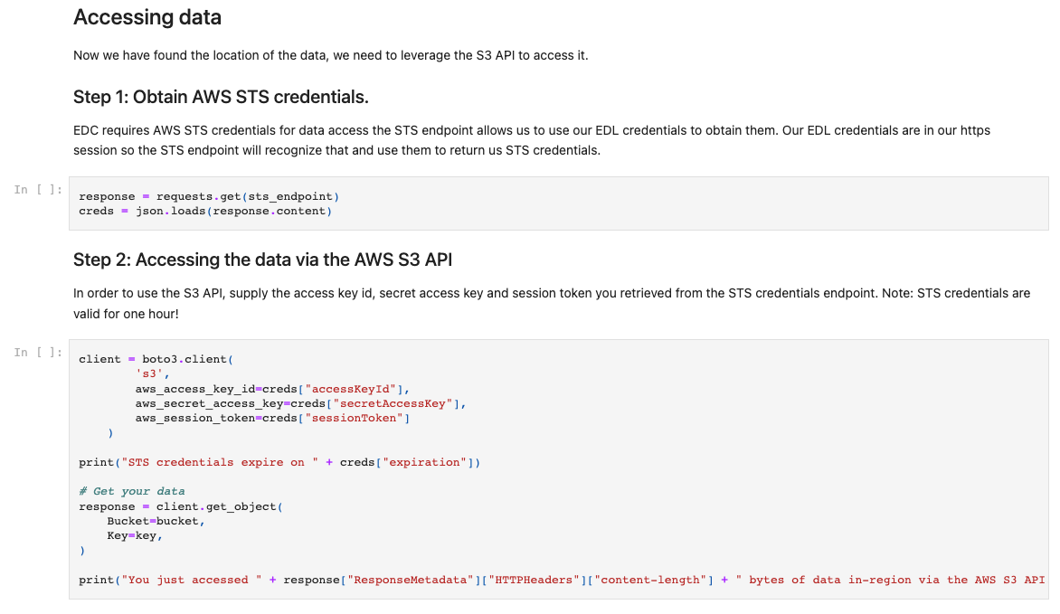
https://github.com/littleidiot40/edc-notebooks/blob/main/s3-access.ipynb

Slide 19
Important things to know

Slide 20
EDL tokens expire after 3 months
EDL tokens can be used for any data access
All EDC data resides in AWS, specifically the us-west-2 region
AWS S3 API usage is limited to in-region access. I.e. your compute must also reside in us-west-2
AWS S3 API operations are limited to list and get object
AWS STS tokens expire after 1 hour
AWS STS tokens are AWS tenant account specific.
For example, tokens gained from a PO.DAAC endpoint cannot be used for GES_DISC data.

