Slide 1
Active Flow Control (AFC) on the Simplified High-Lift CRM: Lessons Learned
LaTunia Melton, Judith Hannon, Marlyn Andino, Mehti Koklu, Keith Paschal
Flow Physics and Control Branch (D303)
and
Veer Vatsa
Computational Aerosciences Branch (D302)

Slide 2
Active Flow Control (AFC) on the Simplified High-Lift CRM: Lessons Learned
A Tribute to John Lin
LaTunia Melton, Judith Hannon, Marlyn Andino, Mehti Koklu, Keith Paschal
Flow Physics and Control Branch (D303)
and
Veer Vatsa
Computational Aerosciences Branch (D302)

Slide 3
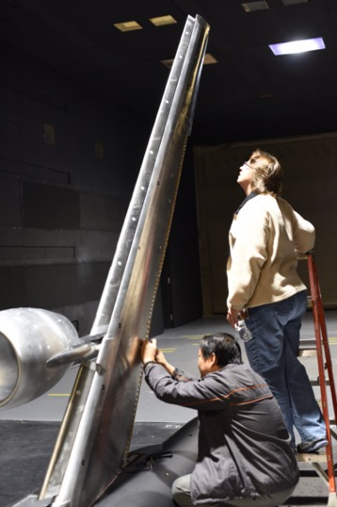
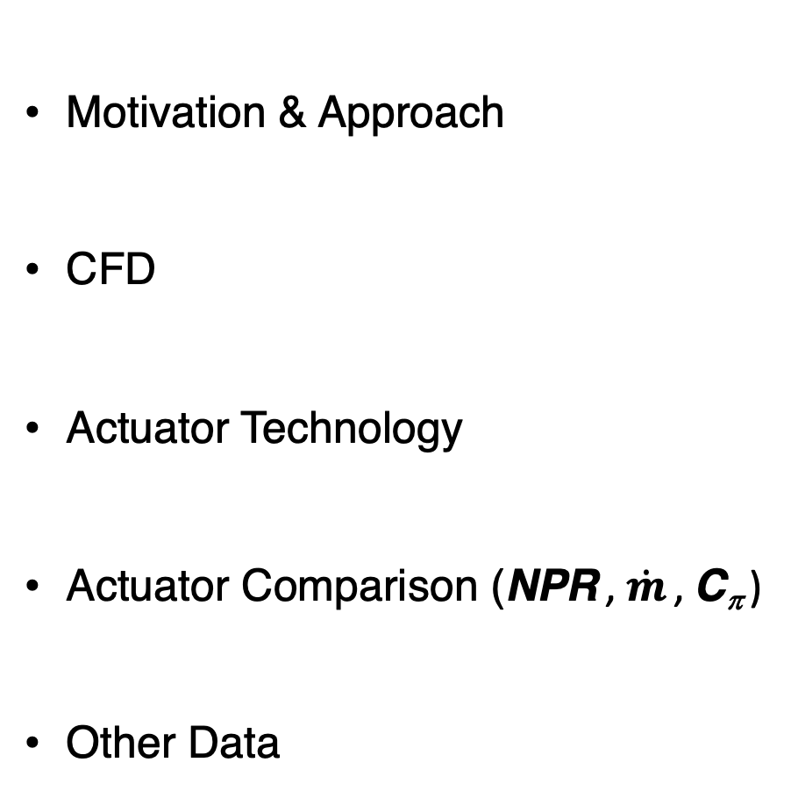
Outline
Motivation & Approach
CFD
Actuator Technology
Actuator Comparison (NPR , $\dot{m}$ , C_{π} )
Other Data

Slide 4

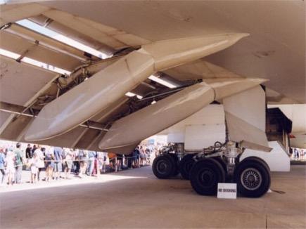
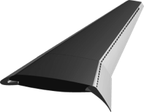

Motivation
Conventional High-Lift
AFC-enabled Simplified High-Lift
A high-lift wing using AFC to recover lift
AFC
Fairings for flap mechanism increase cruise drag
Hartwich et al. NASA/CR 2016-219170
3.3 count cruise drag reduction and 2.25% fuel savings motivate research

Slide 5
Approach
Fabricate a relevant high-lift model that can be configured with either a single-element Fowler flap or an AFC-enabled simple-hinged flap.
Integrate efficient AFC actuation systems capable of recovering the lift of the conventional high-lift system.
Perform a wind tunnel test to compare the performance of the high-lift systems.
Single-element Fowler flap
AFC-enabled simple-hinged flap
AFC
5

Slide 6
Simplified High-Lift (SHL) System Benefits
2.25% due to 3.3 count reduction of excrescence drag for twin-engine, long-range airplane from Boeing Systems Study (BAART Contract)
Fuel Savings per plane
  790 gallons of fuel per flight
  237,000 gallons of fuel per year
  $23.7 million saving during life cycle
    $5 per gallon
    20-year service life
Reduced emissions
Hartwich et al., NASA/CR-2016-21170

Slide 7
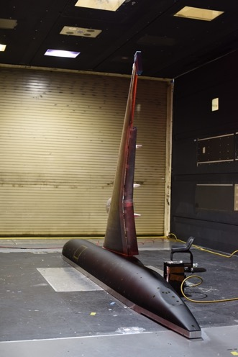
High-Lift Version of Common Research Model (CRM-HL): Landing Configuration
Single-element Fowler Flap
10% scale model
Based on geometry of Lacy and Sclafani
AIAA Paper 2016-0308
CRM-HL landing configuration: δ_{slat} = 30°, Fowler δ_{flap} = 37°
Notes:
Original nominal landing configuration prior to testing the CRM-HL model in the QinetiQ 5m tunnel. New nominal landing has a slightly different slat gap and overlap setting while maintaining slat deflection of 30 deg.
In the 2016 paper defined a nominal landing configuration that was intended to be reevaluated once wind tunnel data on the configuration had been aquired.
The biggest change is the more aggressive flap deflection. The inboard flap deflection is set at 40 deg and the outboard remains at 37deg. The deflection remain 30 deg but is changed based on how the angles rare defined.
Lacy and Clark June 2020 (https://doi.org/10.2514/6.2020-2771) Definition of Initial Landing and Takeoff Reference Configurations for the High Lift Common Research Model (CRM-HL).
Lacy and Clark call the CRM-HL model the CRM-HL geometry set.
CFD tool improvement and validation
Technology development
Wind tunnel data acquisition methodolgy development
Nacelle/pylon based on the high-speed geometry. Cowl separation numerically separated from wing stall. However, experimentally found to be too close. Should have modified the nacelle cowl because separation occurred at the same time for the nacelle cowl and the wing.

Slide 8
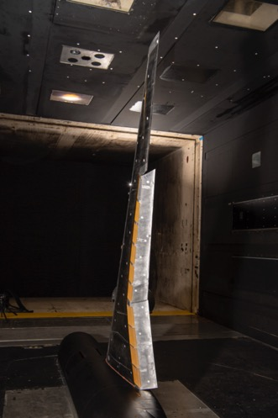
High-Lift Version of Common Research Model (CRM-HL): Landing Configurations
Single-element Fowler Flap
AFC-enabled Simple-hinged Flap
10% scale model
Based on geometry of Lacy and Sclafani
AIAA Paper 2016-0308
Simplified high-lift version of the
CRM-HL (CRM-SHL-AFC)
CRM-HL landing configuration: δ_{slat} = 30°, Fowler δ_{flap} = 37° & SHL δ_{flap} = 50°/55°

Slide 9
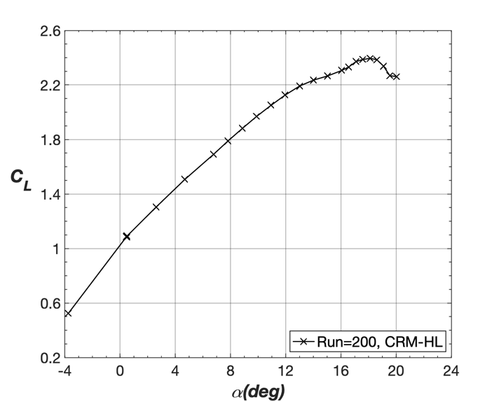
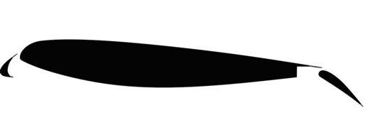
CRM-HL Lift Performance
M∞ = 0.2
Single-element Fowler flap
α (deg)

Slide 10

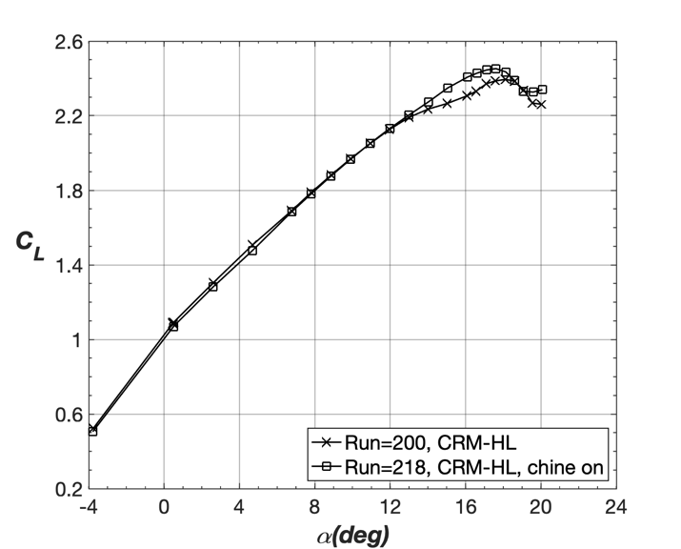
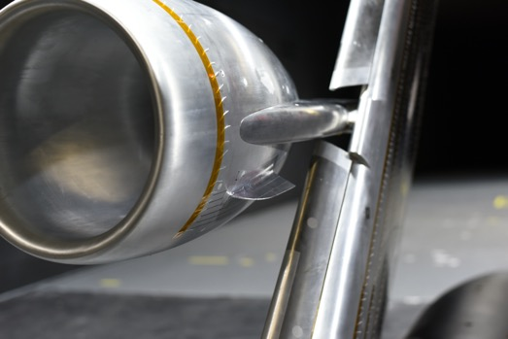
Lift Performance – CRM-HL
M∞ = 0.2
Nacelle Chine Lift Effect
α (deg)
Koklu et al., https://doi.org/10.2514/1.J059869

Slide 11
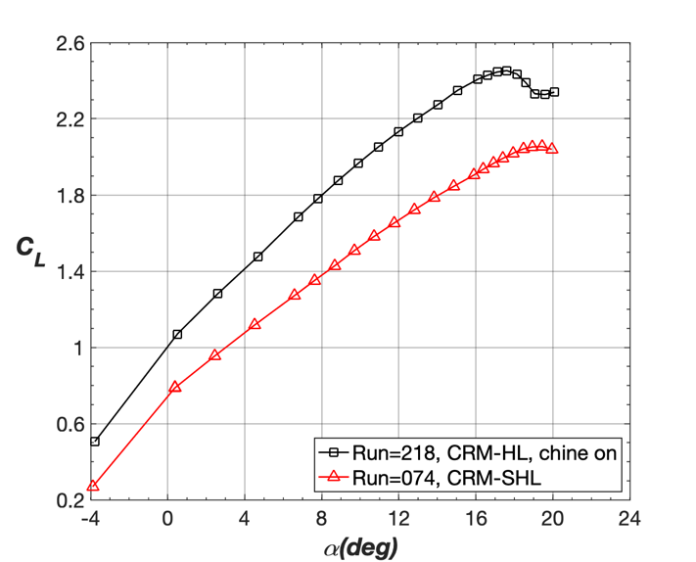


Comparison of CRM-HL and CRM-SHL (AFC off)
M∞ = 0.2
ΔC_{L} ≅ 0.5
Experimental lift objective ΔC_{L} ≅ 0.5
Matches CFD derived lift increment
Simple-hinged flap
α (deg)
Comparison of CRM-HL with nacelle chine to CRM-SHL provides C_{L} target

Slide 12
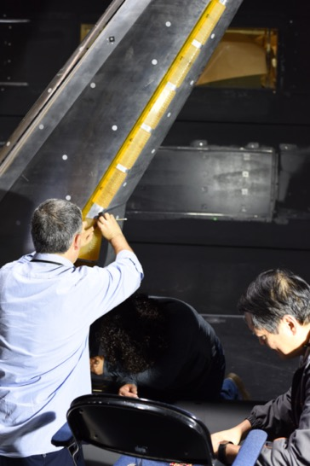
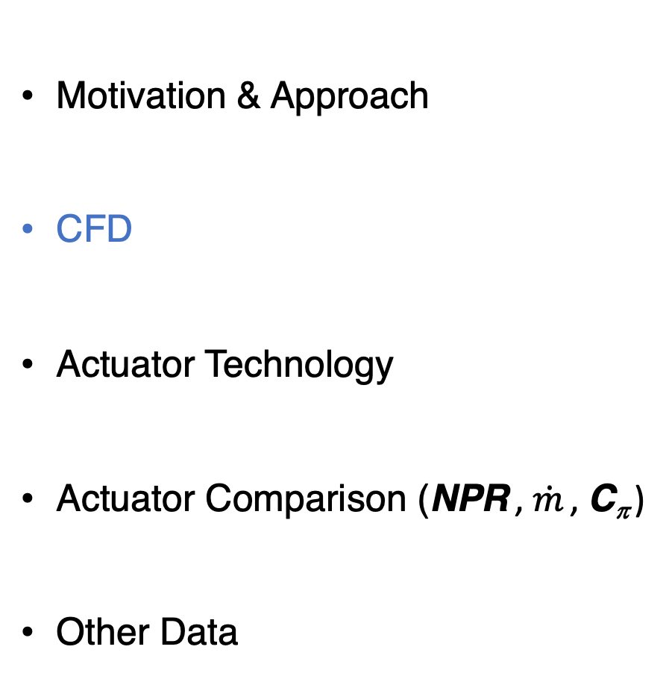
Outline
Motivation & Approach
CFD
Actuator Technology
Actuator Comparison (NPR , $\dot{m}$ , C_{π} )
Other Data

Slide 13
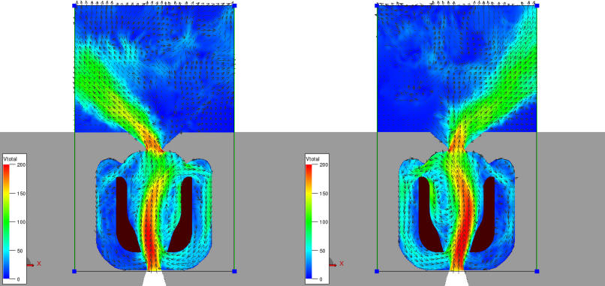
Pretest CFD: Background
Vatsa , Koklu, and Wygnanski, “Numerical Simulation of Fluid Actuators for Flow Control Applications”
AIAA Paper 2012-3239
Sweeping Jet (SWJ) Actuator
Varied actuator geometry
Blocked feedback tube
Predicted
  Jet Spreading
  Jet Profile
  Jet Frequency

Slide 14
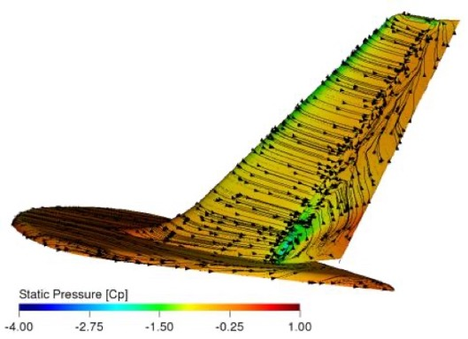
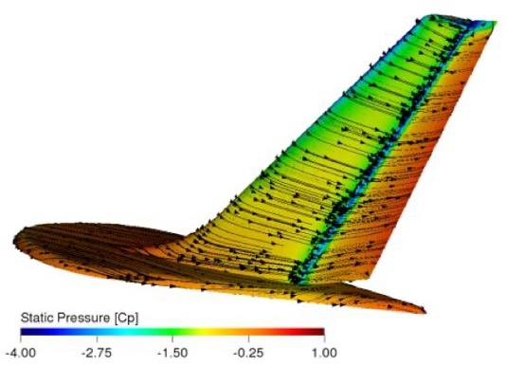
Pretest CFD: Background
Vatsa, Casalino, Lin, and Appelbaum
“Numerical Simulation of a High-Lift with Embedded Fluidic Actuators”
AIAA Paper 2014-2142
Vatsa, Duda, Fares, and Lin
“Numerical Simulation of a High-Lift Configuration Embedded with High Momentum Fluidic Actuators”
AIAA Paper 2016-3932
Baseline
C_{μ} = 1.5%

Slide 15
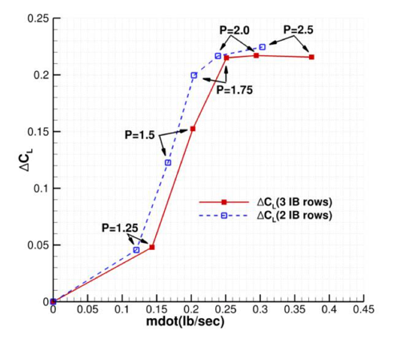
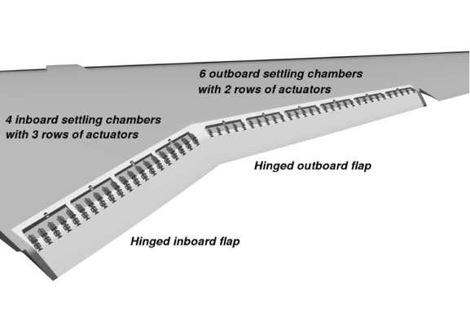

Pretest CFD: CRM-SHL-AFC
Vatsa, Duda, Lin, Melton, O’ Connell
“Numerical Simulation of a Simplified High-Lift CRM Configuration with Embedded Fluidic Actuators”
AIAA Paper 2018-2142
M∞ = 0.2
$\dot{m}$
(lbm/sec)
Pre-Test Lift Increment with SWJ Actuators

Slide 16
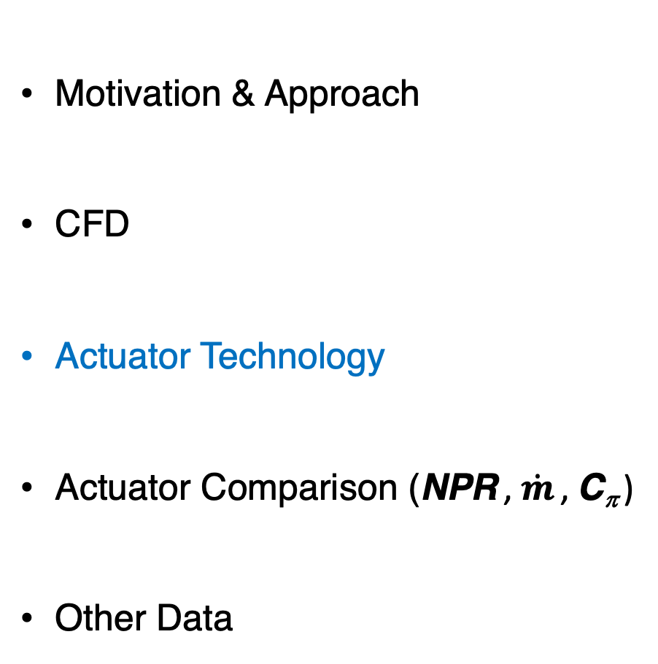
Outline
Motivation & Approach
CFD
Actuator Technology
Actuator Comparison (NPR , $\dot{m}$ , C_{π} )
Other Data
“Need more Lift?
‘HELP’ is on
the way! ”
J. C. Lin 2019

Slide 17
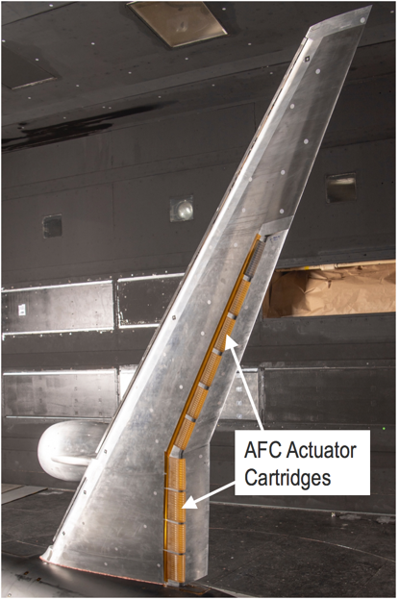
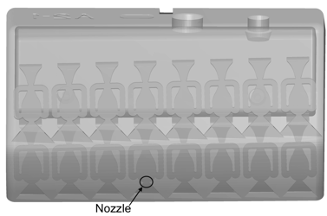
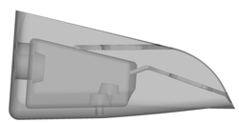
Double Row Sweeping Jet (DRSWJ) Actuator
Cartridge 1
Top view
  Modular interchangeable AFC cartridges on the flap shoulder:
  4 inboard & 6 outboard
Cartridge 1
Side view
Row 1, SWJ
Row 2, SWJ
Candidate actuators
  Double Row Sweeping Jet (DRSWJ)
  Alternating Pulsed Jet (APJ)
  High Efficiency Lower Power (HELP)
Notes:
The double row sweeping jet actuator was our initial actuator geometry due to the following reasons:
Risk reduction experiments (low speed tunnels) showed that a single row of actuator could not provide enough control authority at high flap deflection angles (df=60 deg) on a generic wing at NPR values less than or equal to 3 to attach the separated flow field.
Publications showing that multiple rows of excitation were more effective than single row excitation

Slide 18
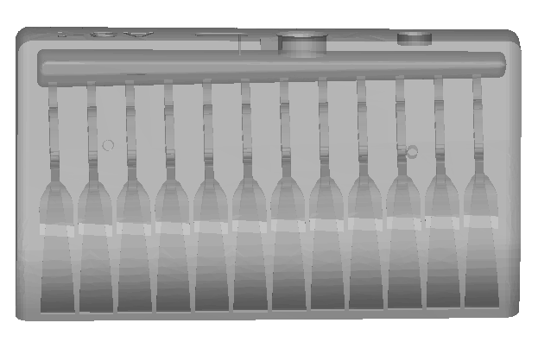
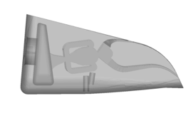
Alternating Pulsed Jet (APJ) Actuator
Cartridge 1
Top view
  Modular interchangeable AFC cartridges on the flap shoulder:
  4 inboard & 6 outboard
Cartridge 1
Side view
Row 1, PJ
Row 2, PJ
Candidate actuators
  Double Row Sweeping Jet (DRSWJ)
  Alternating Pulsed Jet (APJ)
  High Efficiency Lower Power (HELP)
Notes:
The alternation pulsed jet actuation new approach aimed at generating a generated fluidic fence that has been shown in the literature as an effective way of managing separate flows.

Slide 19
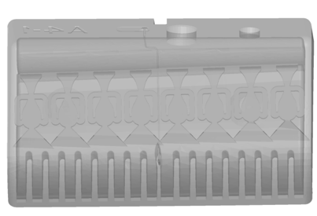
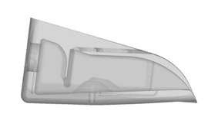
High Efficiency Low Power (HELP) Actuator
Cartridge 1
Top view
  Modular interchangeable AFC cartridges on the flap shoulder:
  4 inboard & 6 outboard
Cartridge 1
Side view
Row 1, SWJ
Row 2, STJ
Steady, discrete jet (STJ) in Row 2
Candidate actuators
  Double Row Sweeping Jet (DRSWJ)
  Alternating Pulsed Jet (APJ)
  High Efficiency Lower Power (HELP)
Notes:
HELP actuator developed as a way to introduce additional momentum into the flow field

Slide 20
CRM-SHL-AFC Pre-test CFD Lift Predictions
Vasta et al., (https://doi.org/10.2514/1.C036233)
M∞ = 0.2, α = 8°
Pre-test simulations HELP actuators meet target, DRSWJ actuators increase lift
Notes:
Prior to the the test CFD simulations were performed to develop a lift objective/target for the CRM high-lift system with a simple-hinged flap configuration. From the figure, we see that there is good agreement between the expt and computational lift objectives.
All candidate actuation approaches had one thing in common. They incorporated a sweeping jet actuator.
The other thing to note from the figure is that one actuator HELP actuator provides the necessary lift recovery with an NPR less than or equal to 3.

Slide 21
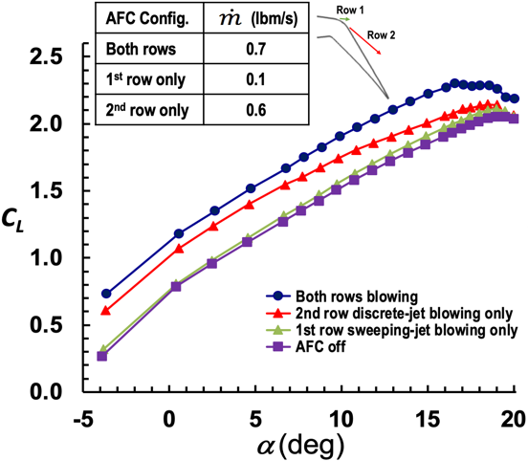
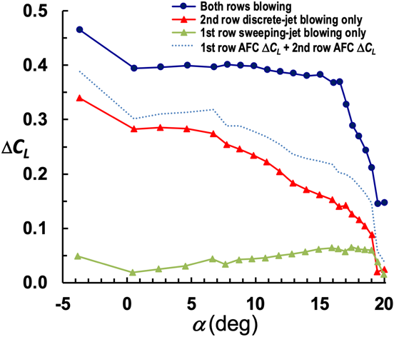
Synergistic Benefit of HELP Dual Row Actuation
M∞ = 0.2
α (deg)
α (deg)
Notes:
Prior experience in small scale experiment illustrated that a single row of excitation would not be enough to reattach the flow to the flap surface.

Slide 22
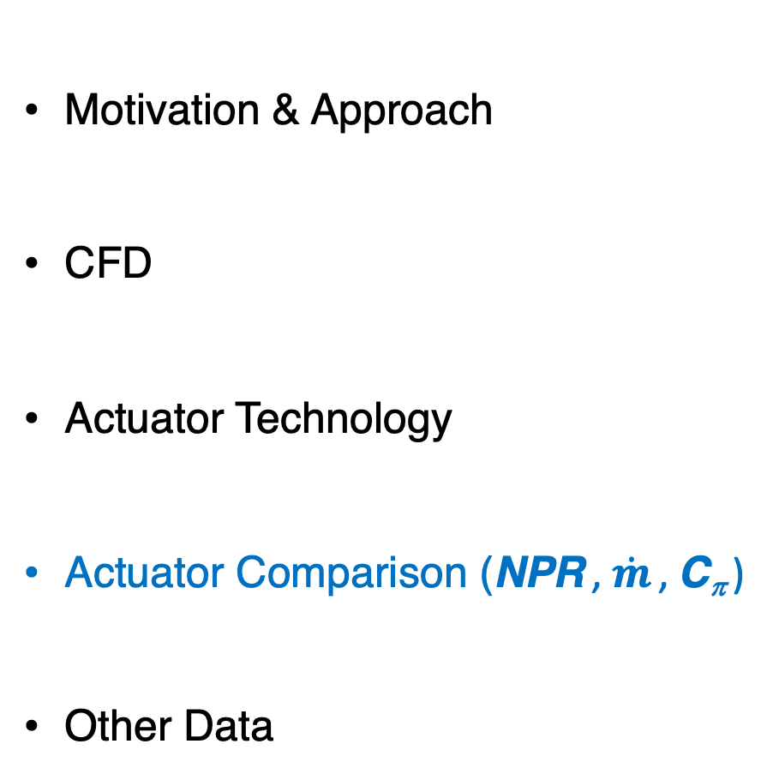
Outline
Motivation & Approach
CFD
Actuator Technology
Actuator Comparison (NPR , $\dot{m}$ , C_{π} )
Other Data

Slide 23


AFC Scaling Parameters (NPR , C_{q} , C_{π} )
M∞ = 0.2, α ≅ 8°
$NPR=P_{cav}$/$P_{∞}$

Slide 24
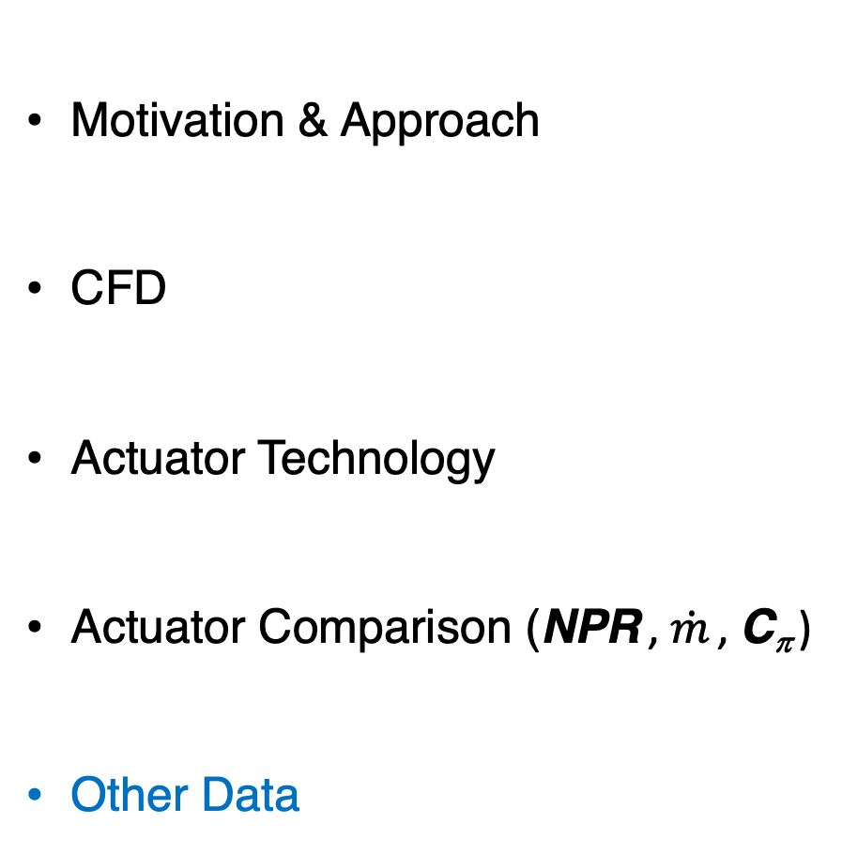
Outline
Motivation & Approach
CFD
Actuator Technology
Actuator Comparison (NPR , $\dot{m}$ , C_{π} )
Other Data

Slide 25
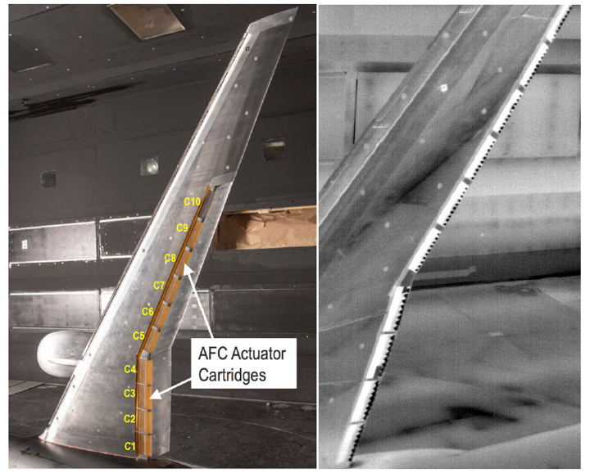
Flow Visualization: Infrared Images
Lin, et al. AIAA Paper
2020-0783
Health Monitoring
Verify Actuators Working
NPR = 2.4, α = 9°, M∞ = 0.2

Slide 26
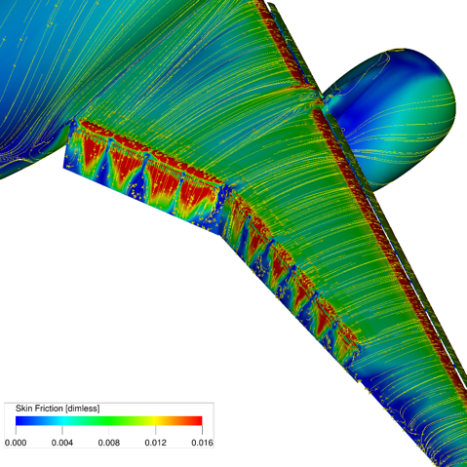
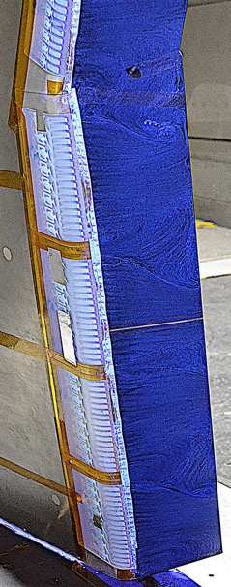
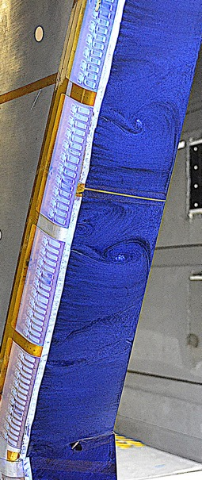
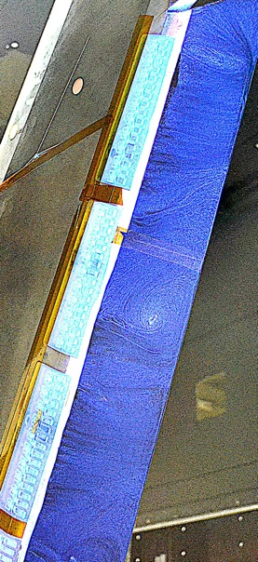
Evidences of 3D Periodic Flow on Flaps from CFD and Oil Flow Visualization
(HELP: C1-C10 & NPR = 2.4; M∞ = 0.2, α = 9° ⏤ equivalent to TWICS applied)
C5
C8
Attached flow
C10
C4
C7
Flow separation
Attached flow
C9
C3
C6
Focal points
C2
Flow separation
Flow separation
C5
C8
Above: Simulated surface streamline with from Vatsa et al. (AIAA 2019-3724)
Right: Surface oil flow visualization on inboard and outboard flaps of CRM-SHL-AFC
Attached flow
C1
Attached flow
Attached flow
Corner vortex
Inboard flap (C1-C4)
Outboard flap (C5-C8)
Outboard flap (C8-C10)

Slide 27
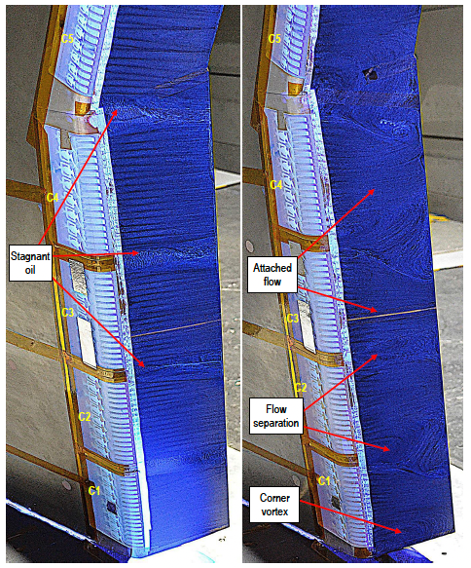
Flow Visualization: Oil Flow
Lin, et al. AIAA Paper
2020-0783
M∞ = 0.0
NPR = 2.4, α = 9°, M∞ = 0.2

Slide 28
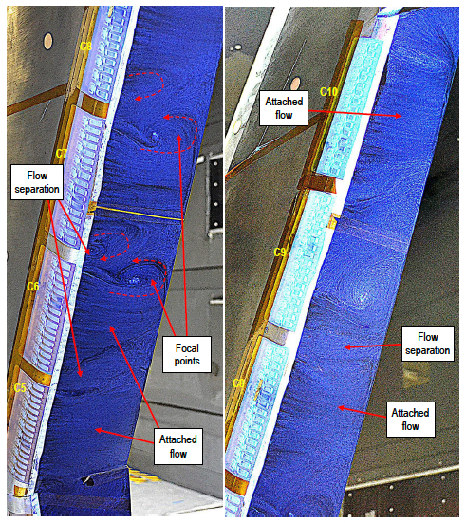
Flow Visualization: Oil Flow
NPR = 2.4, α = 9°, M∞ = 0.2
Lin, et al. AIAA Paper
2020-0783
Inboard Region of Outboard Flap
Outboard Region of Outboard Flap

Slide 29
Flow Visualization: Oil Flow
NPR = 2.4, α = 9°, M∞ = 0.2
Lin, et al. AIAA Paper
2020-0783
Inboard Region of Outboard Flap
Outboard Region of Outboard Flap

Slide 30
Flow Visualization: Fluorescent Mini Tufts
NPR = 2.4, α = 9°, M∞ = 0.2
Lin, et al. AIAA Paper
2020-0783
Inboard Region of Outboard Flap
Outboard Region of Outboard Flap

Slide 31
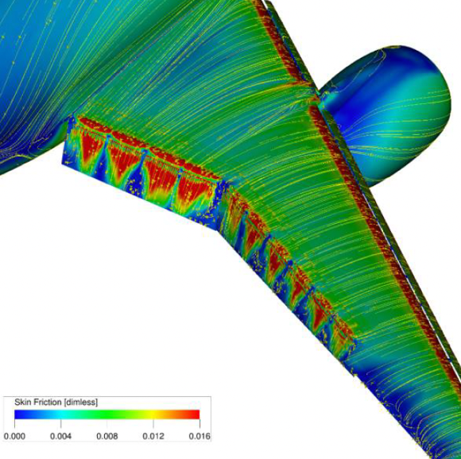
Flow Visualization: CFD
Vatsa, et al., AIAA Paper 2019-3724

Slide 32
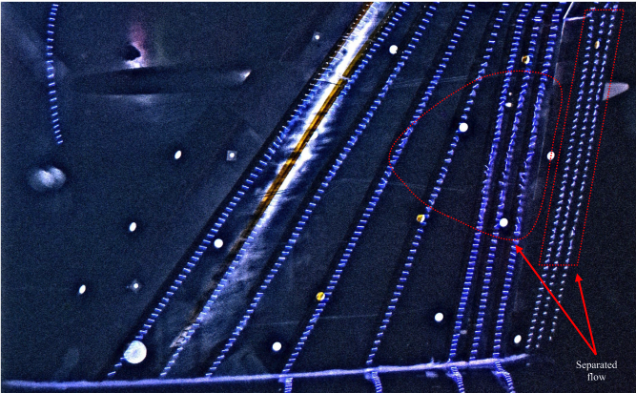
CRM-HL Flow Visualization : Fluorescent Minitufts
Koklu, et al., AIAA Journal, Vol. 59, No. 9
M∞ = 0.2, α = 16°
No Chine

Slide 33
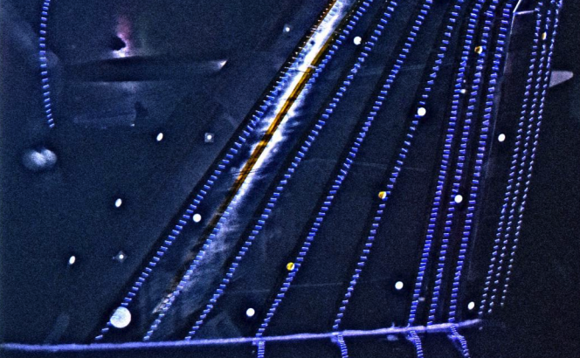
CRM-HL Flow Visualization : Fluorescent Minitufts
Koklu, et al., AIAA Journal, Vol. 59, No. 9
M∞ = 0.2, α = 16°
Chine On

Slide 34
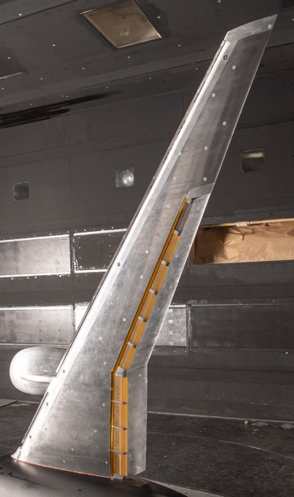
Photogrammetry Target Identification
#10
#8
#6
#3
#1

Slide 35
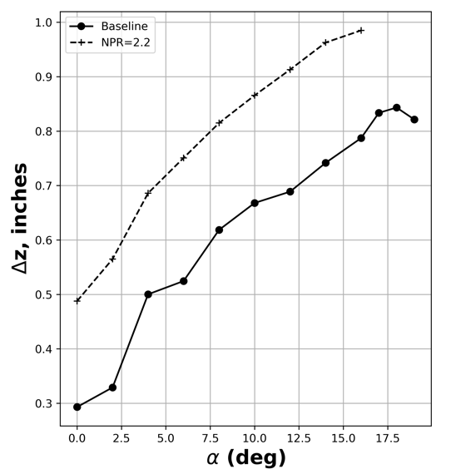
CRM-SHL-AFC - Photogrammetry
Uncorrected α
M∞ = 0.2
#10
#8
#6
#3
AFC with Cartridges 1 – 8
#1

Slide 36
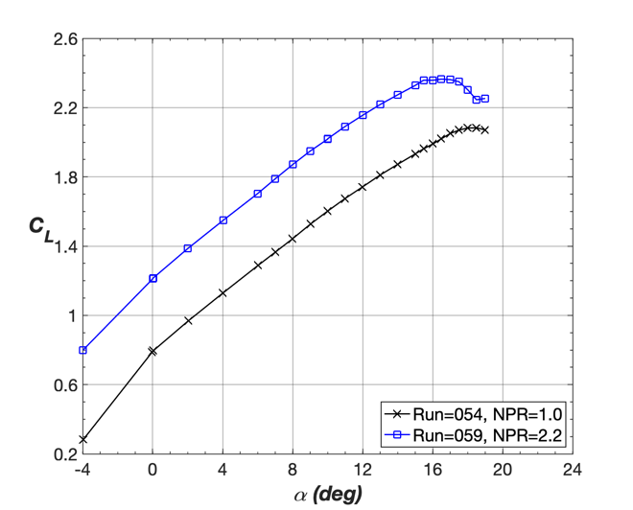
CRM-SHL-AFC – C_{L} Balance
Uncorrected Data
M∞ = 0.2
#10
#8
#6
#3
#1

Slide 37
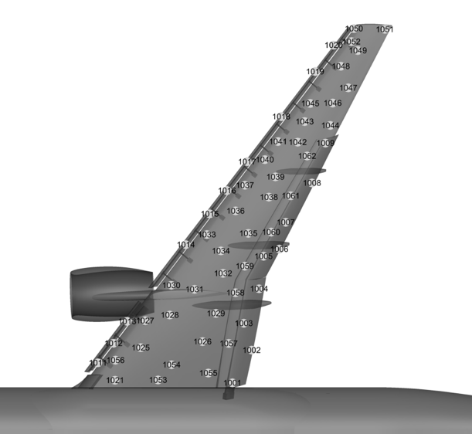
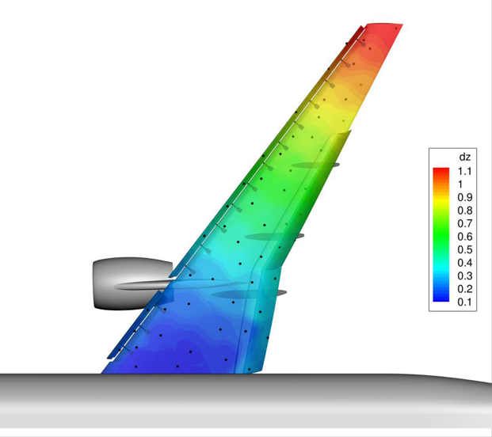
CRM-HL: Photogrammetry
M∞ = 0.2, α ≅ 19°

Slide 38

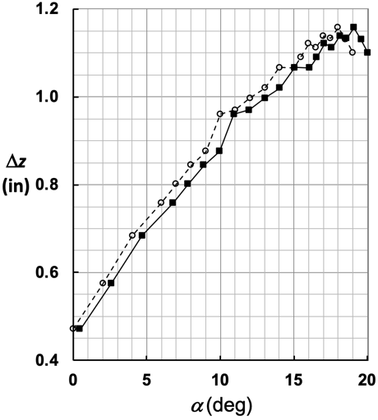
CRM-HL: Photogrammetry
Target 1051
M∞ = 0.2

Slide 39
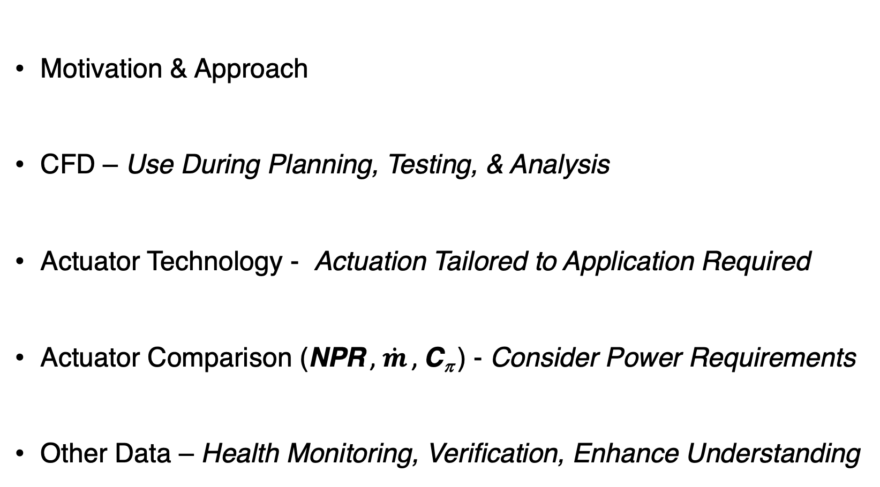
Lessons Learned
Motivation & Approach
CFD – Use During Planning, Testing, & Analysis
Actuator Technology - Actuation Tailored to Application Required
Actuator Comparison (NPR , $\dot{m}$ , C_{π} ) - Consider Power Requirements
Other Data – Health Monitoring, Verification, Enhance Understanding

Slide 40
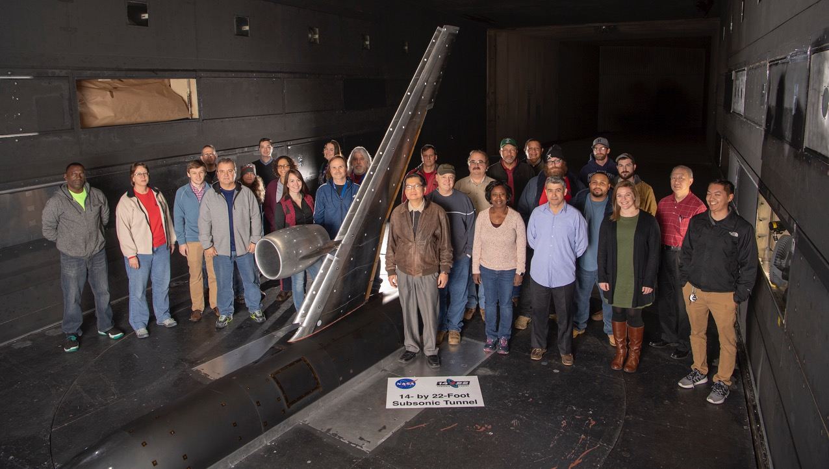
Questions ?

Slide 41
Backup Slides

Slide 42
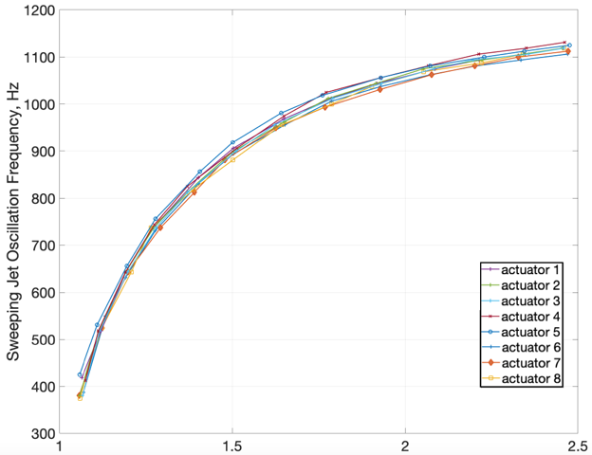
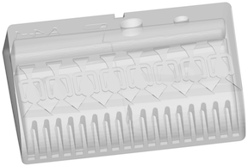
HELP Actuator Frequency Characteristics
Row 1 SWJ Actuators
NPR = P_{cav}/P∞
High Efficiency Low Power
(HELP) Actuator
Benchtop measurement with unsteady pressure probe
NPR
Notes:
The frequency vs NPR figure on the RHS illustrates the relationship between NPR or mass flow rate and jet oscillation frequency. The data were acquired during post-test benchtop measurement obtained of the outputs for the upstream row of sweeping jet actuators.
The results show that the actuator oscillation frequency varies from roughly 400 Hz to little more than 1.1 kHz.
The results also indicate that this cartridge is producing a fairly uniform output because of the similarity of the curves. Minor changes in frequency between the 8 actuators can be attributed to minor inconsistencies in the geometry.

Slide 43


Sweeping Jet (SWJ) Actuator Frequency
Paschal et al., (https://doi.org/10.2514/6.2021-1647)
M∞= 0.2, α = 8°
12 unsteady pressure transducers
Unsteady pressure sensors detect SWJ actuator frequency
Notes:
During a run with the AFC on, the unsteady pressure sensors in the row closest to the actuator exit sensed the the jet oscillation and the spectra shown on the LHS indicates that the oscillation frequency during wind on operations were similiar to those detected during benchtop testing.

