Slide 1
The impact of drifting orbits on the monthly regional TOA flux assuming constant meteorology
David Doelling, Norman Loeb, Cathy Nguyen
EUMETSAT 2022 - Meteorological Satellite Conference
19 - 23 September 2022, Brussels, Belgium
S06-A: Using EO to monitor the Earth’s climate

Slide 2
Introduction
The Terra and Aqua orbits have slowly started to drift in mean local time (MLT) towards the terminator from their fixed 10:30AM and 1:35PM MLTs.
The MLTs drift will reach 15 min in September 2022 for Terra and mid-2023 for Aqua.
An MLT drift impacts TOA fluxes derived from individual sun-synchronous satellites because the instruments sample a different part of the diurnal cycle.
Terra
Projected Terra and Aqua MLT Changes

Slide 3
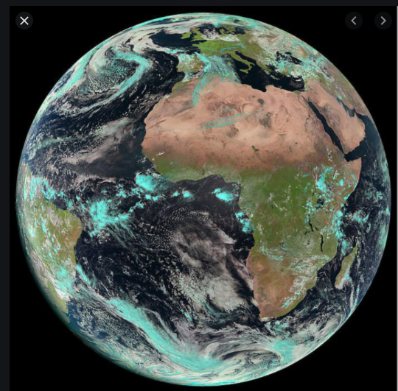
Impact of the Mean Local Time drift on CERES SSF1deg products
GERB 15-minute broadband fluxes
SSF1deg product temporal interpolation
  SW: Accounts for TOA flux changes throughout the day by assuming the scene observed at the CERES overpass time remains invariant throughout the day.
  LW: Employs linear interpolation between measurement times over ocean and a half-sine fit to take account land heating.
Approach:
Use GERB fluxes and clouds as “surrogate” CERES Terra and Aqua data at 10:30AM and 1:30PM and apply CERES SSF1deg diurnal corrections to determine monthly mean fluxes.
Compare with “CERES-Like” fluxes 15 min, 30 min…, 90 m earlier (Terra) or later (Aqua).
GERB on Meteosat Second Generation geostationary satellites resolves the diurnal cycle over the Meteosat domain every 15 min.
Sahara desert
Madagascar
Namibian stratus

Slide 4
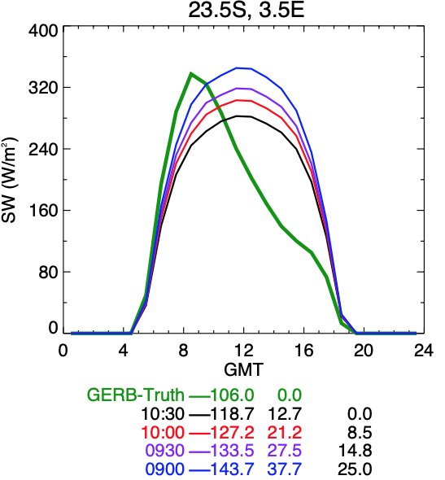
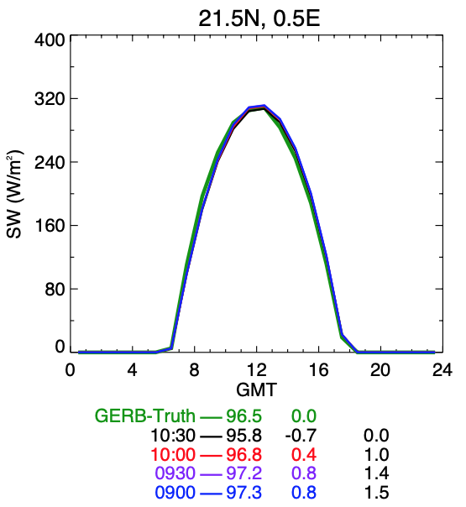
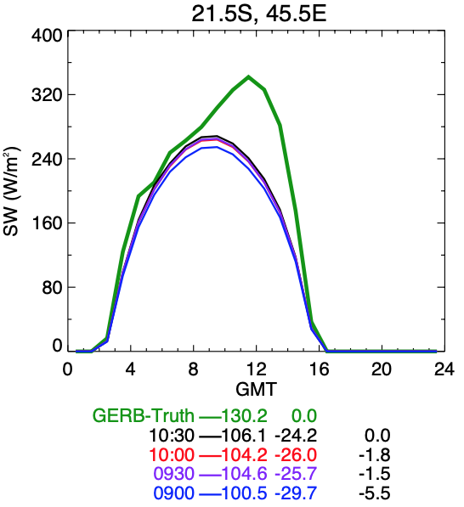
Monthly Mean SW differences relative to Terra (10:30), January 2010
Maritime stratus peaks during morning
clear-sky desert symmetric about noon
Land afternoon convection
Namibian Stratus
Sahara Desert
Madagascar
terra overpass
terra overpass
Δflux from 10:30
Δflux from 10:30
Δflux from 10:30
Terra orbit drift will increase the monthly mean SW flux
Terra orbit drift will not impact desert monthly SW fluxes
Terra orbit drift will slightly decrease monthly SW fluxes

Slide 5
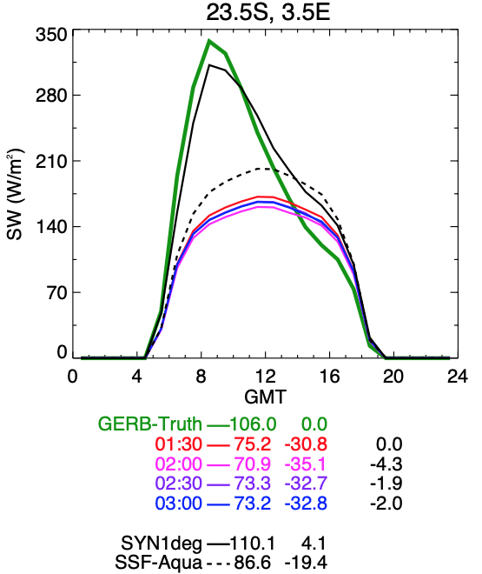
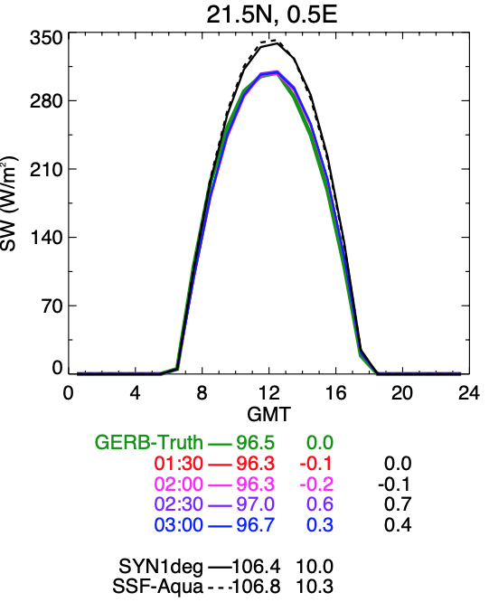
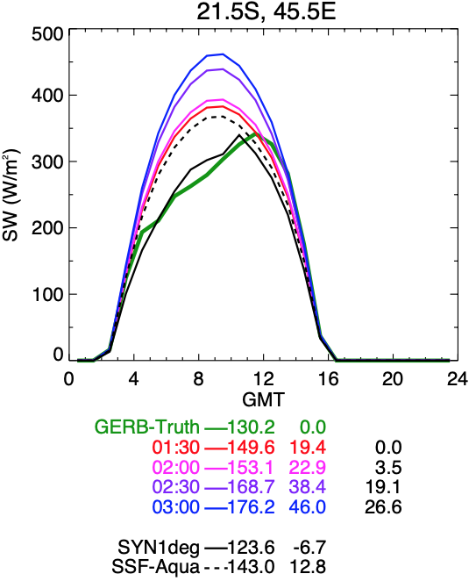
Monthly Mean SW differences relative to Aqua (1:30), January 2010
Maritime stratus peaks during morning
Desert symmetric about noon
Land afternoon convection
Namibian Stratus
Sahara Desert
Madagascar
aqua overpass
aqua overpass
Δflux from 1:30
Δflux from 1:30
Δflux from 1:30
Aqua orbit drift will decrease the monthly SW flux
Aqua orbit drift will not impact desert SW fluxes
Aqua orbit drift will increase SW fluxes

Slide 6
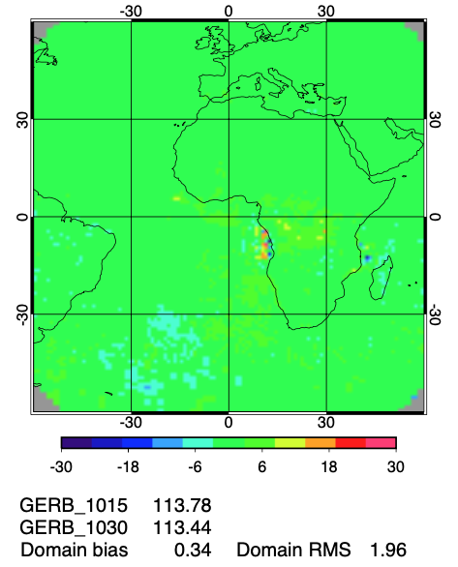
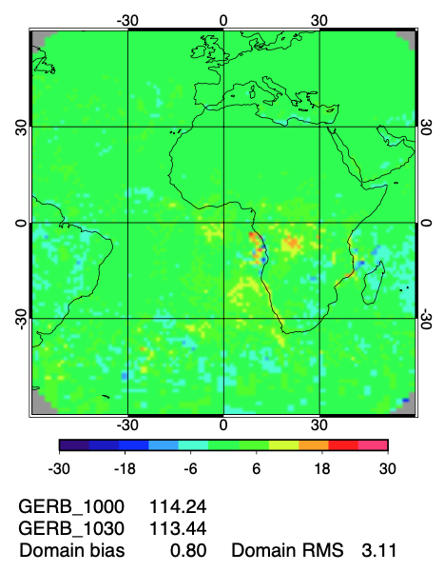
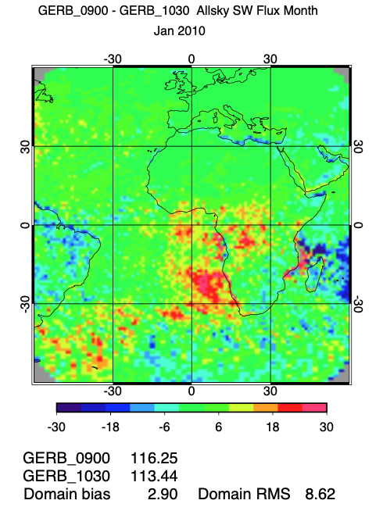
Monthly SW flux difference relative to Terra (10:30), January 2010
10:15-10:30
10:00-10:30
9:00-10:30

Slide 7
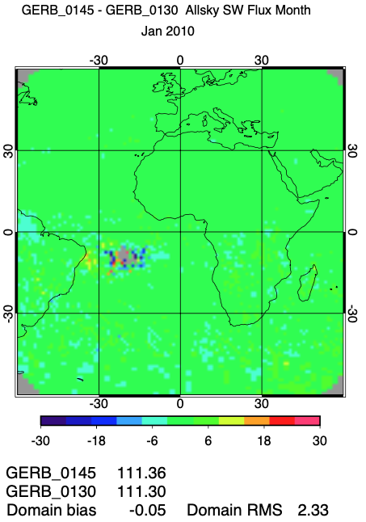
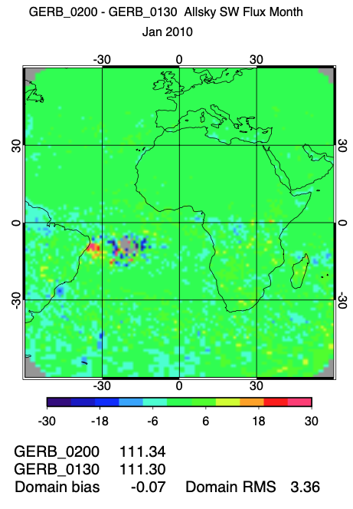
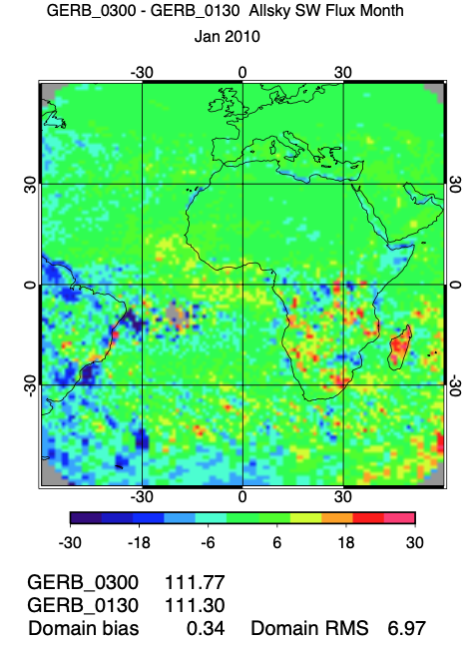
Monthly SW flux difference relative to Aqua (1:30), January 2010
1:45-1:30
2:00-1:30
3:00-1:30

Slide 8
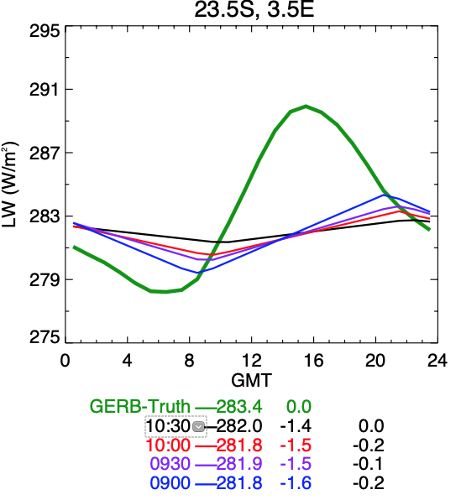
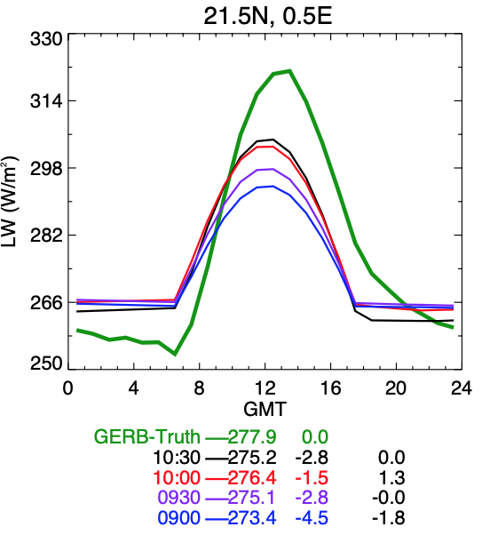
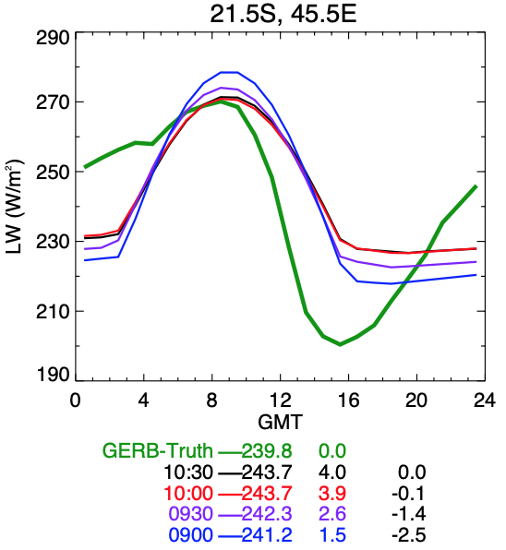
Monthly Mean LW differences relative to Terra (10:30), January 2010
Maritime stratus peaks during morning
Clear-sky desert land heating
Land afternoon convection
Namibian Stratus
Sahara Desert
Madagascar
terra overpass
terra overpass
terra overpass
terra overpass
terra overpass
Δflux from 10:30
Δflux from 10:30
Δflux from 10:30
Linear interpolate LW flux obs to compute monthly mean
Employ half sine fit to estimate LW flux due to land heating and a constant nighttime flux
land convection starts before noon and peaks at sunset

Slide 9
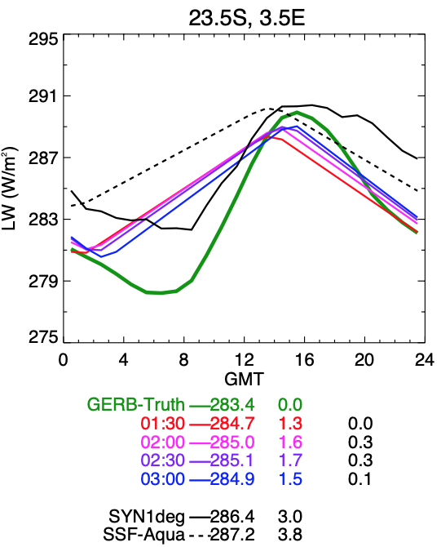
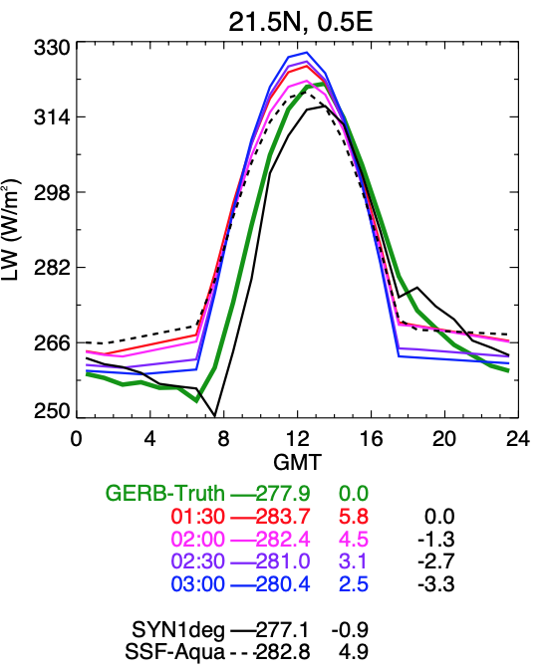
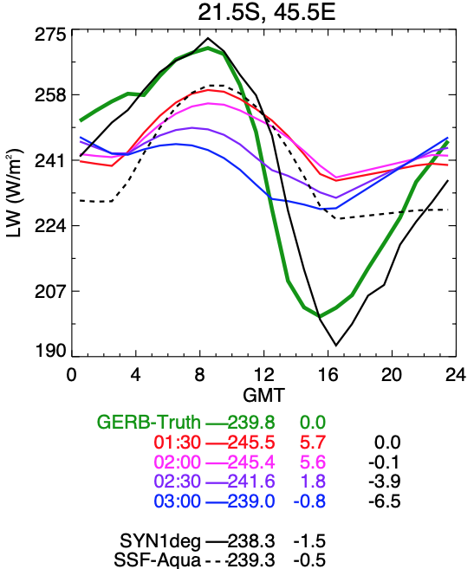
Monthly Mean LW differences relative to Aqua (1:30), January 2010
Maritime stratus peaks during morning
Desert cloud free land heating
Land afternoon convection
Namibian Stratus
Sahara Desert
Madagascar
aqua overpass
aqua overpass
Δflux from 1:30
Δflux from 1:30
Δflux from 1:30
Linear interpolate LW flux obs to compute monthly mean
Employ half sine fit to estimate LW flux due to land heating and a constant nighttime flux
land convection starts before noon and peaks at sunset

Slide 10
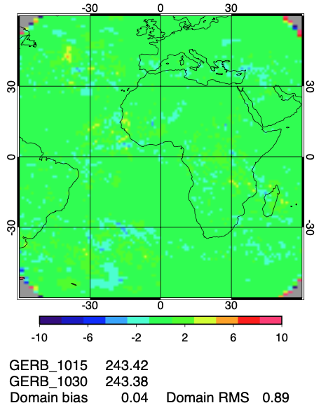
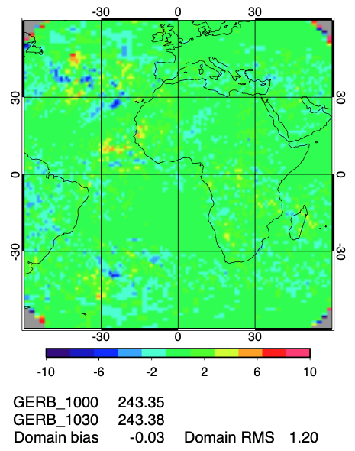
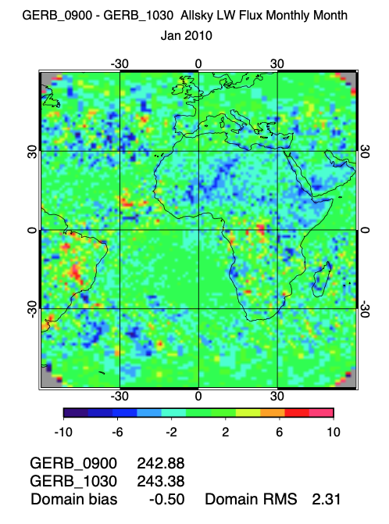
Monthly LW flux difference relative to Terra (10:30), January 2010
10:15-10:30
10:00-10:30
9:00-10:30

Slide 11
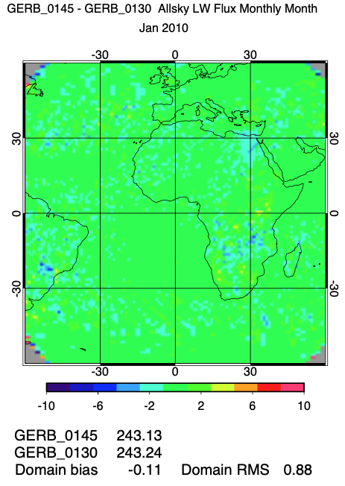
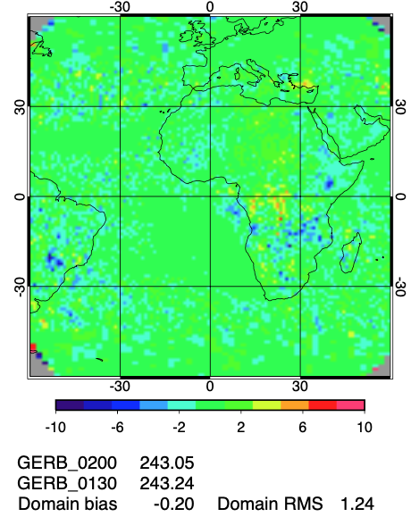
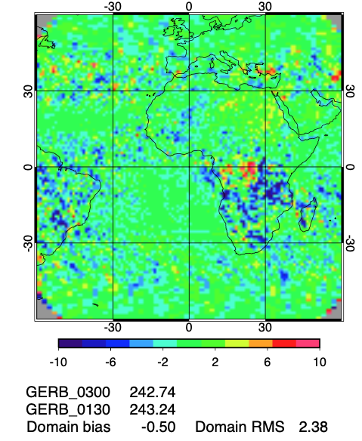
Monthly LW flux difference relative to Aqua (1:30), January 2010
1:45-1:30
2:00-1:30
3:00-1:30

Slide 12
What Can We Learn from Terra & Aqua MLT Changes?
The Terra and Aqua MLTs will cross 9:00AM and 4:00PM, respectively, in 2026 if the missions are allowed to continue that long.
While a drift in MLT has a detrimental effect on an Earth Radiation Budget (ERB) Climate Data Record (CDR), it does provide unique opportunities for evaluating the algorithms used to account for changes in the ERB diurnal cycle.
Examples:
Test of models that account for albedo variations with solar zenith angle (“directional models”).
  Compare observed growth of instantaneous albedo with solar zenith angle obtained at different MLTs with that “predicted” from CERES directional models as a function of scene type.
  (2) Test of SYN1deg, which combines Terra+Aqua+GEO data.
  Test whether diurnally averaged albedos and LW fluxes are independent of MLT in all conditions and regions over the globe.
  (3) Assess consistency of GEO imager-derived cloud properties and fluxes over a wide range of solar zenith angles everywhere between 60S-60N with MODIS cloud retrievals.

Slide 13
Conclusions
The Terra 10:30AM and Aqua 1:30PM orbits have started to drifting towards the terminator.
The MLTs drift will reach 15 min in September 2022 for Terra and mid-2023 for Aqua.
GERB 15-minute resolution TOA fluxes are used to quantify the impact of the MLT changes on monthly regional SW and LW fluxes.
We find a 15-minute drift can result in SW monthly regional flux changes of > 2 Wm⁻²
The new CERES EBAF product will transition from Terra&Aqua to NOAA-20-only (1:30) CERES observations in July 2022.
While a drift in MLT has a detrimental effect on the CERES ERB CDR, there is still significant benefit to continuing the Terra and Aqua missions until their MLTs reach the terminator.
  Provides a unique opportunity for evaluating the algorithms used to account for changes in the ERB diurnal cycle, which can be used to improve the CERES data products.

