Slide 1
Usage-Based Discovery and Graph Federation
Vincent Inverso
NASA Earth Science Data and Information System Project
ESIP Summer Meeting Pittsburgh
ESIP Discovery Cluster
July 21, 2022

Slide 2
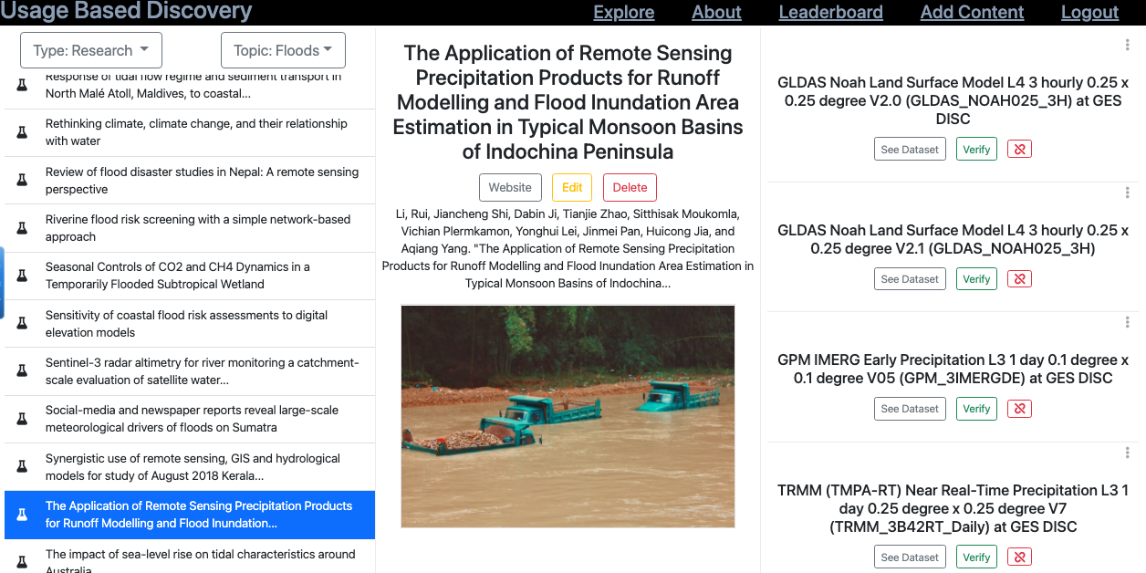
Usage-Based Discovery
https://r1z8b20vl9.execute-api.us-west-1.amazonaws.com/apps?string_type=all&string_topic=Floods&app_site=all
TOPIC
ARTICLE
DATASETS

Slide 3
Usage-Based Discovery is powered by a graph of dataset-usage and topic-dataset relationships
Topic
Fire
Article
https://doi.org/
10.1016/j.rse.
2018.04.053
Dataset
https://doi.org/
10.5067/MODIS/MCD43A4.006
about
uses

Slide 4
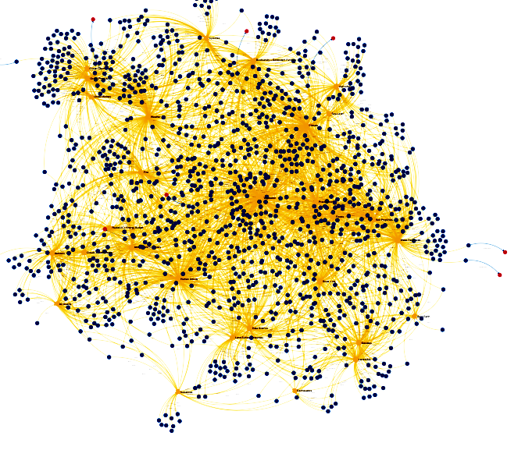
Populating the graph is an intensive community effort
ORNL DAAC
LP DAAC
Article
Dataset
Topic
Article
Dataset
GES DISC
PO DAAC
SEDAC
ASF DAAC
UBD Team
ESIP Discovery Cluster
Topic
Article
Dataset
DAAC (Distributed Active Archive Center), ORNL (Oak Ridge National Laboratory), LP (Land Processes), GESDISC (Goddard Earth Sciences Data and Information Services Center), PO (Physical Oceanography), SEDAC (Socioeconomic Data and Applications Center), ASF (Alaska Satellite Facility)

Slide 5
Other graph efforts within NASA
Goddard Earth Sciences Data and Information Services Center (GESDISC)
Center for HelioAnalytics (CfHA) Knowledge Team
Common Metadata Repository (CMR)
Inter-agency Implementation and Advanced Concepts Team (IMPACT)
Lessons Learned graph
Astronaut feedback from International Space Station expeditions
Talent graph (relationships between people, skills, and projects)
Systems Engineering (documents, requirements, test results, or operations execution)

Slide 6
Could the Usage Based Discovery graph benefit from linking to knowledge of other graphs?

Slide 7
Should we link these graphs?
Some Duplication
Little or No Overlap
(A)
(B)
(UBD)
(UBD)
(Some other graph)
(Some other graph)

Slide 8
Should we link these graphs?
Some Duplication
Little or No Overlap
(A)
(B)
(UBD)
(UBD)
(Some other graph)
(Some other graph)
☑️ Split up the effort, focus on strengths

Slide 9
Should we link these graphs?
Some Duplication
Little or No Overlap
(A)
(B)
(UBD)
(UBD)
(Some other graph)
(Some other graph)
☑️ Split up the effort, focus on strengths
☑️ Add value to each graph via latent relationships

Slide 10
Graph federation use cases for Usage Based Discovery
Decentralize the collection and maintenance of the graph
Topic
Article
Dataset

Slide 11
Graph federation use cases for Usage Based Discovery
Decentralize the collection and maintenance of the graph
Connect UBD publications with a "social/researcher graph"
Social
Graph
Topic
Article
Dataset

Slide 12
Graph federation use cases for Usage Based Discovery
Decentralize the collection and maintenance of the graph
Connect UBD publications with a "social/researcher graph"
Connect UBD datasets with a "tools graph"
Social
Graph
Topic
Article
Dataset
Tool
Graph

Slide 13
Graph federation use cases for Usage Based Discovery
Decentralize the collection and maintenance of the graph
Connect UBD publications with a "social/researcher graph"
Connect UBD datasets with a "tools graph"
Connect UBD publications with a "code repository graph"
Social
Graph
Code
Graph
Topic
Article
Dataset
Tool
Graph

Slide 14
Graph federation use cases for Usage Based Discovery
Decentralize the collection and maintenance of the graph
Connect UBD publications with a "social/researcher graph"
Connect UBD datasets with a "tools graph"
Connect UBD publications with a "code repository graph"
Augment UBD usages with an applications graph
Social
Graph
Code
Graph
Topic
Article
Dataset
Tool
Graph

Slide 15
Thanks!
Special thanks to Chris Lynnes, the ESDIS interns, and the ESIP Cluster, for creating and contributing to this project. We also are deeply grateful for the aforementioned DAACs who have made this project possible.
vincent.inverso@nasa.gov
0000-0001-9762-591X (ORCID)

