Slide 1
Coolant Leak from ISS External Active Thermal Control System (EATCS) – An Examination of Most Probable
Authors:
Darnell Cowan, Timothy Bond - NASA Johnson Space Center (JSC)
Presented By:
Darnell Cowan
51st International Conference on Environmental Systems (ICES)
10–14 July 2022, Saint Paul, MN, USA
ICES-2022-145

Slide 2
Agenda
Background
Problem Statement
Leak Testing
Disassembly & Dissection
Potential Contributors
Materials and Processes (M&P) Testing Plan
Findings
Conclusions
Recommendations
Observations

Slide 3
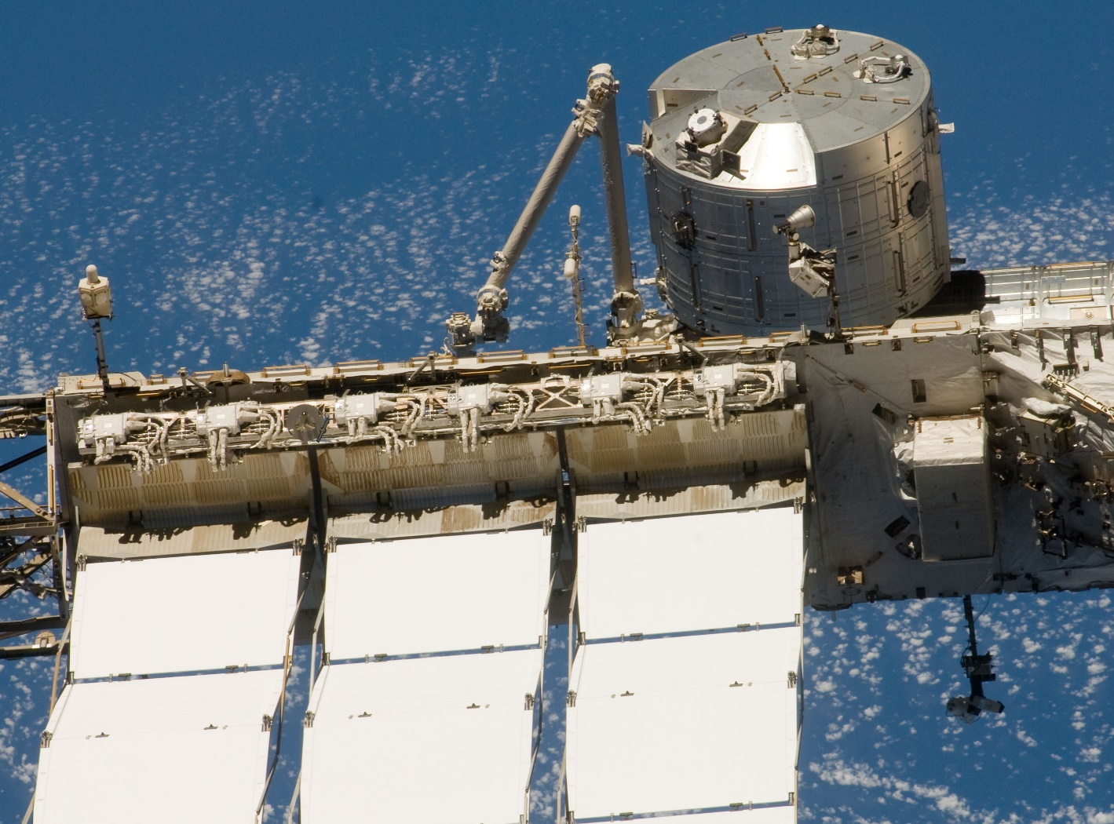
Background
The Port (P1) and Starboard (S1) External Active Thermal Control Systems (EATCS) are single phase, mechanically pumped ammonia loops that operate independently to cool the pressurized modules and external avionics on the International Space Station (ISS)
5 years after activation, the P1 EATCS experienced an accelerating coolant leak, and a series of spacewalks and robotic leak locating surveys helped narrow the source to a pair of flexible jumpers that supply coolant to and from one of three P1 EATCS radiators
Leaky Flexible Jumpers
Radiator
Figure: P1 EATCS Radiator and leaky flexible jumpers

Slide 4
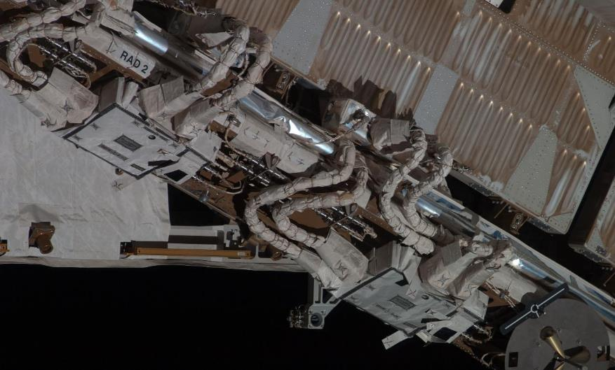
Problem Statement
The pair of jumpers were too physically close to differentiate which one was leaking, and the leak was accelerating to the point were operations could have been in jeopardy
Thus, the jumpers and radiator were vented and isolated, which stopped the leak, but consequently, reduced cooling capability
It was unknown if the cause of the leak was localized or fleet wide (24 total), and spares are not readily available or stored on the ISS due to the varying sizes and unique geometries
Therefore, the jumpers were removed and return to ground, disassembled and dissected to determine the most probable root cause, then refurbished, launch and reinstalled on the ISS radiator
Radiator
Leaky Flexible Jumpers (type 1)
Similar Flexible Jumpers (type 2)
Figure: Sample Radiator and Jumpers EATCS Radiator and leaky flexible jumpers

Slide 5
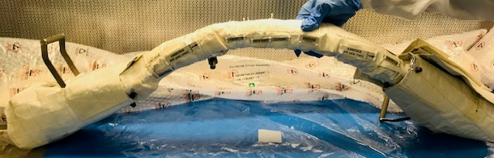
Leak Testing
Upon return to ground, both the supply and return jumpers underwent helium leak testing, and the highest leakage was found on the return jumper that receives cold ammonia from the radiator
Additional leak testing narrowed to one of two Quick Disconnects (QD) on the return jumper, or QD F128
QD F128
QD F140

Slide 6
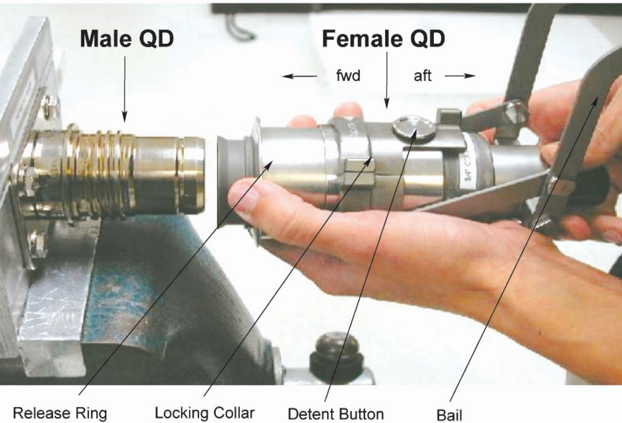
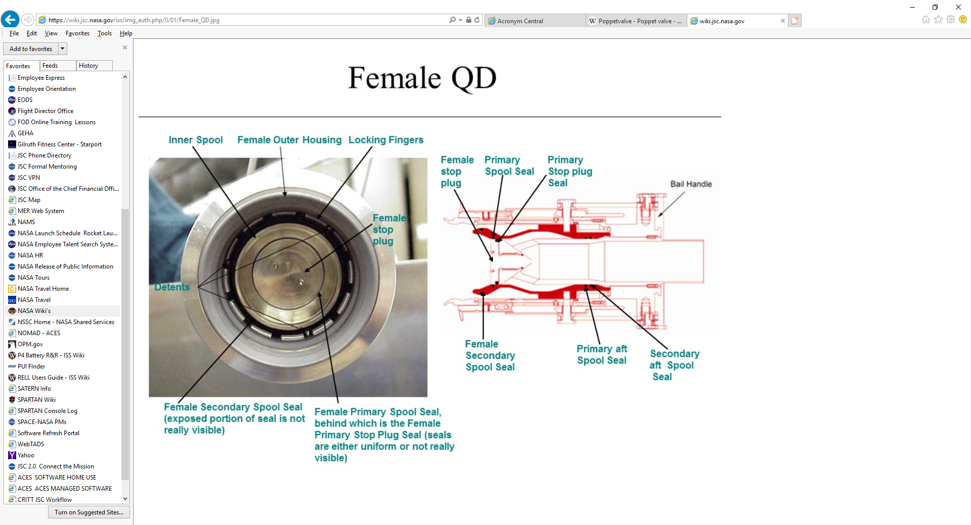
Leak Testing
Quick Disconnects (QD) are used to connect hardware to fluid lines, and female QDs, the active half of the coupling, are on each ends on the flexible radiator jumpers
The final leak test narrowed the leak to a pair of seals inside return flexible jumper QD F128
The amount of leakage measured was equivalent to what was calculated on-orbit while the P1 EATCS was leaking
Leaky Seals

Slide 7
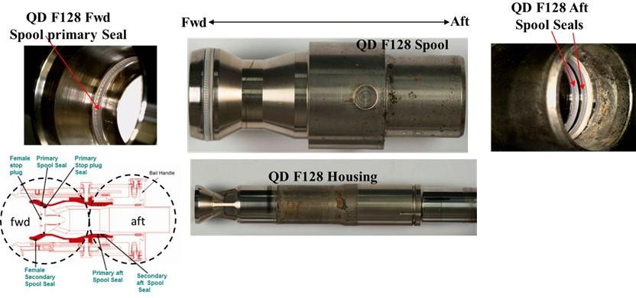
Disassembly & Dissection
The QDs (F128 & F140) on the return flexible jumper were removed disassembled by the vender, Parker Stratoflex, and brown Non-Volatile Residue (NVR) deposits were found downstream the leaky aft seals on QD F128
Chemical evaluation of the NVR found the constituents and quantity were with allowable specification for ammonia
This was evidence that ammonia was leaking pass or through the two seals to space and confirmed the leak area, but the root cause was still unknown at the time
Brown NVR Deposits near leaky area

Slide 8
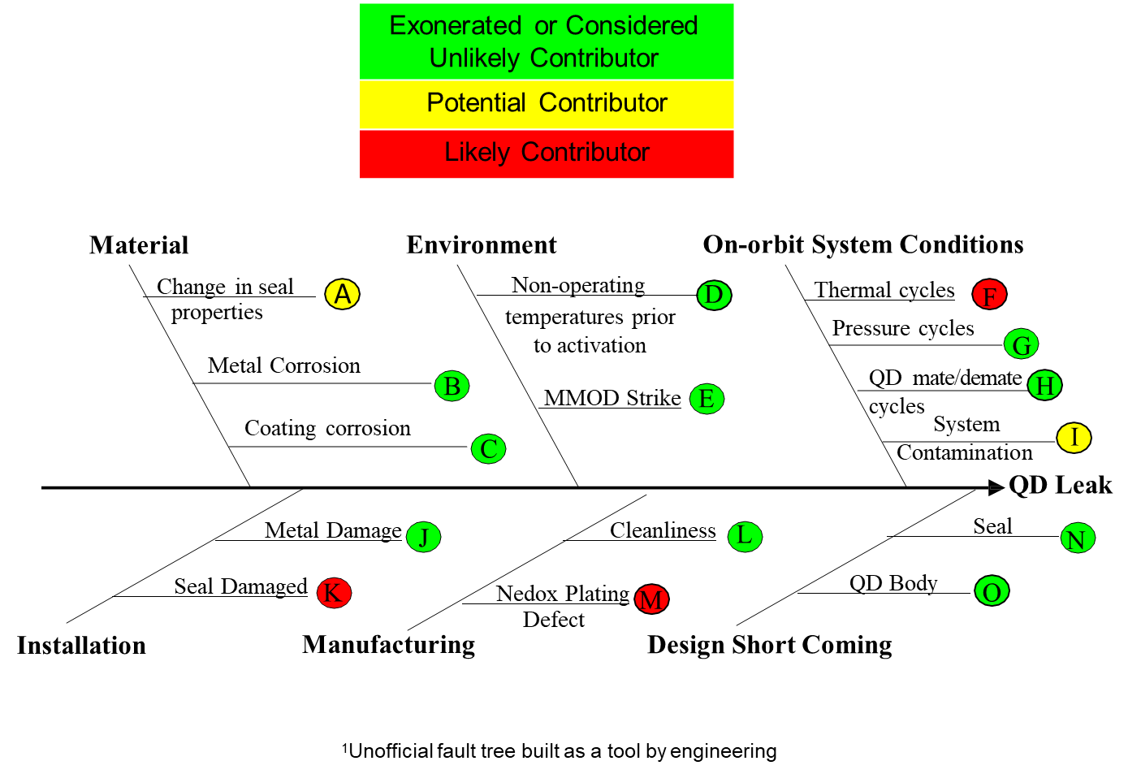
Potential Failure Contributors
Figure: Unofficial fault tree built as a tool by engineering

Slide 9
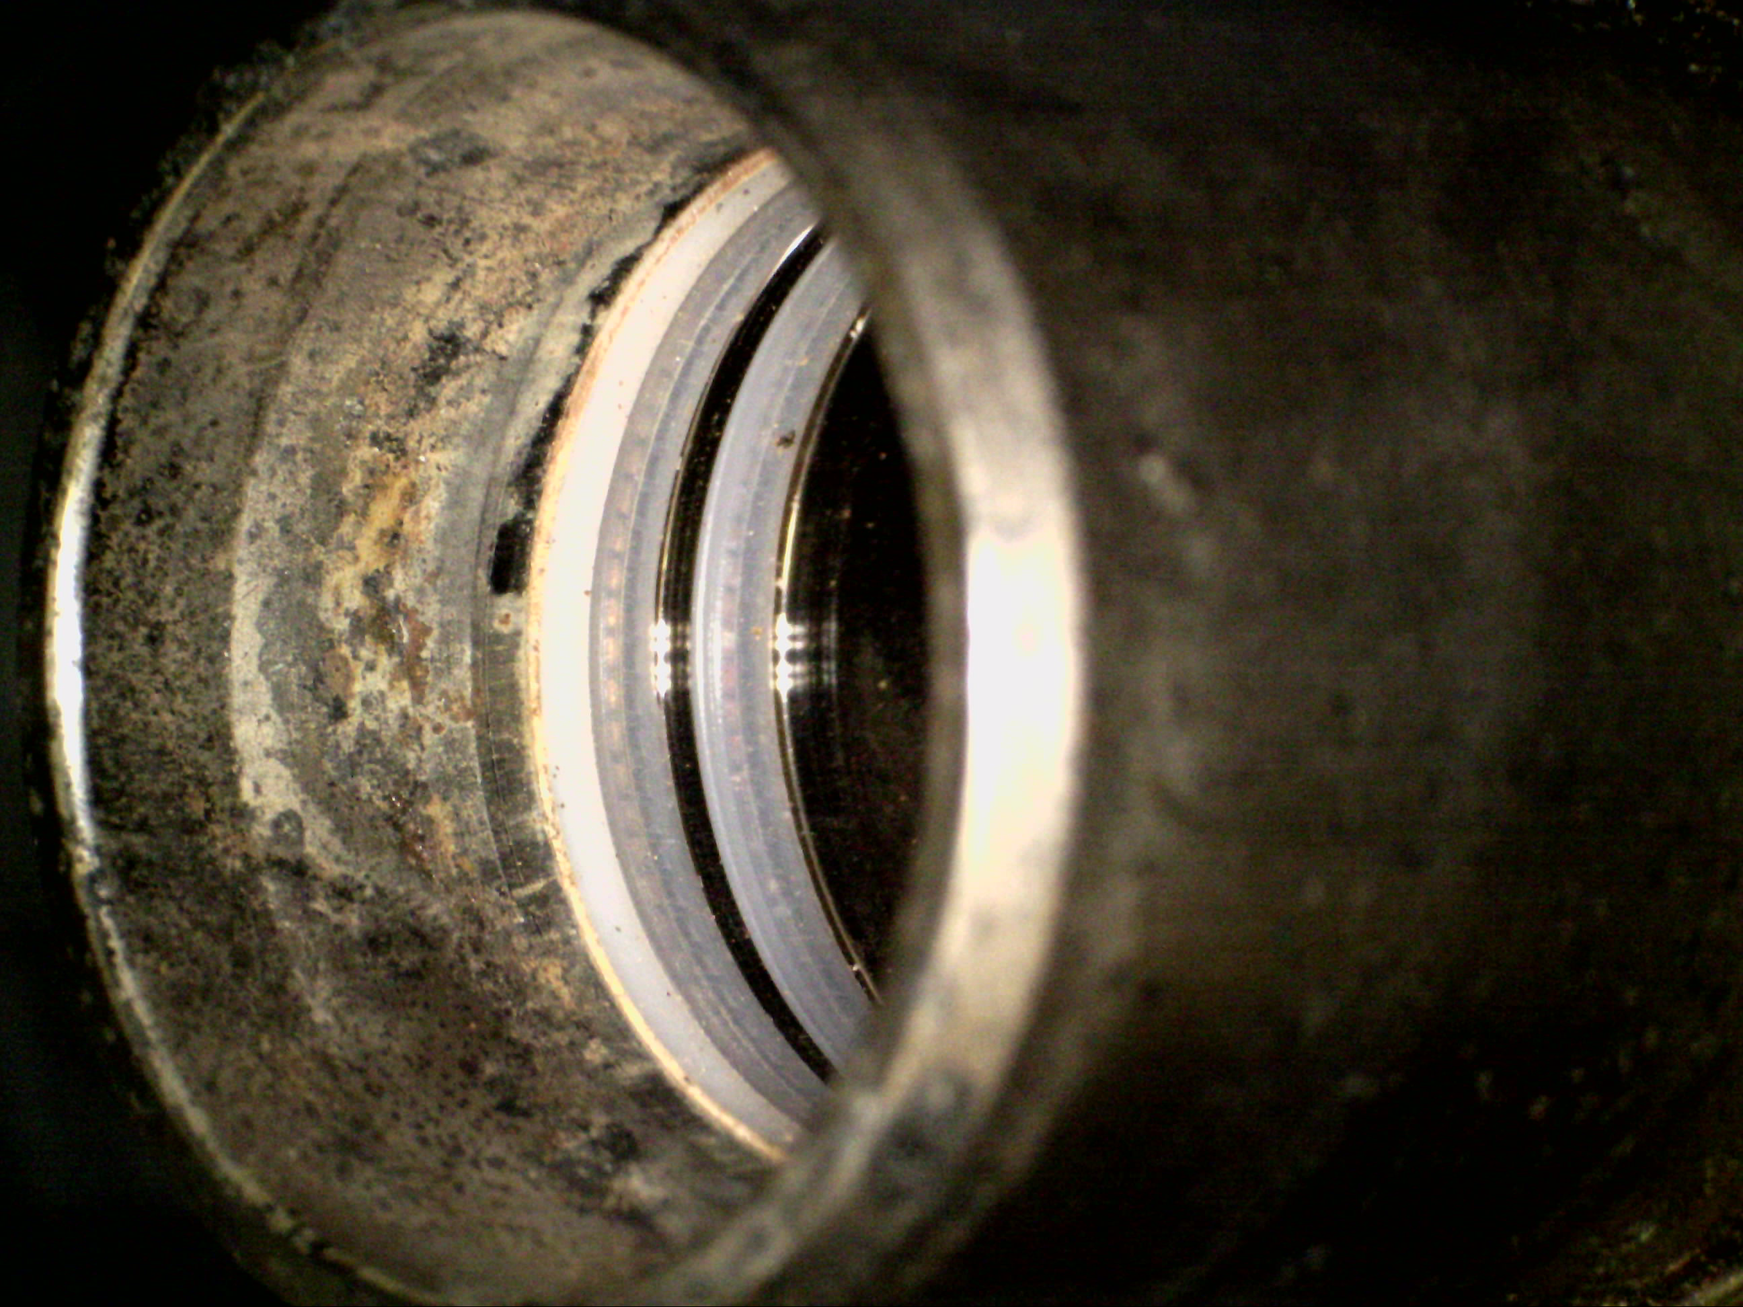
Materials and Processes (M&P) Test Plan
Non-Destructive and Destructive Evaluations were performed on the disassembled QD F128 parts, and results were compared to those of pristine parts determine the most probable cause of the leak
Imagery & Chemical Analysis
Submersion Testing
Destructive Testing
CT Scanning Dimensions
NVR Solubility
Compression Testing
Seal Loading & Deformation
Fourier-Transform
Infrared Spectroscopy (FT-IR)
NVR Chemical Assessment
Gas Chromatography –
Mass Spectrometry
Identify organic components
Stereo Microscopy
Magnified Imagery
Differential Scanning Calorimetry (DSC)
Transition temperatures
Energy Dispersive Spectroscopy (EDS) Seal and Housing Chemical Assessment
Borescope Imagery
Seal inspection

Slide 10
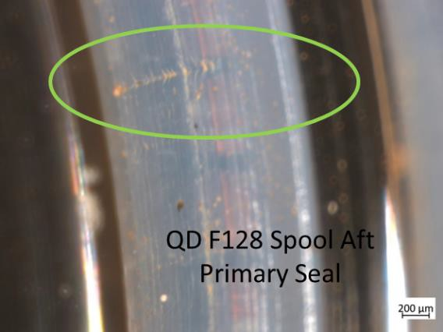
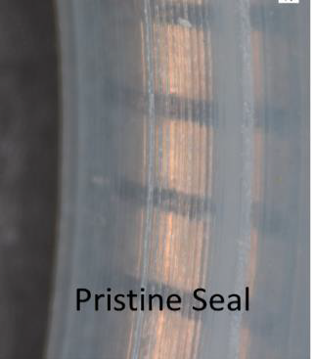
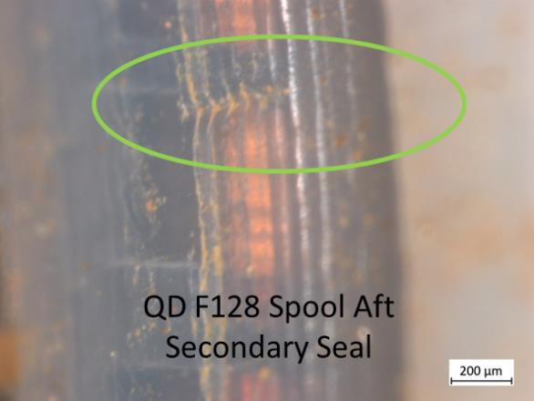
Imagery and Chemical Testing Results
No smoking gun from the destructive testing or chemical analysis, but the stereo microscopic images during the imagery inspections found what appeared to be a kink on both seals
Such defects are commonly found during ground assembly or post acceptance testing and the seals are generally replaced
No issues were recorded on these seals and the entire QD passed leakage requirements during acceptance testing, but the aft seals are not individually verifiable during the testing
QD F128 Aft Seals

Slide 11
Submersion Test Results
The disassembled parts underwent submersion testing following the reveal of the kinks, and the purpose was to determine if the brown NVR would readily dissolve in ammonia
NVR could jeopardize the seal integrity and cause problems during valve cycling; thus, dissolving the NVR could reduce this risk
The parts and seals were submerged in ammonia for increasing durations and ultimately agitation, at NASA’s White Sands Test Facility (WSTF) but the NVR did NOT readily dissolve; would take days
However, some of the NVR deposits that did dissolve revealed possible delamination of the housing plating underneath them
AFT seals slide across the surface of the housing
QD F128 Aft seals

Slide 12
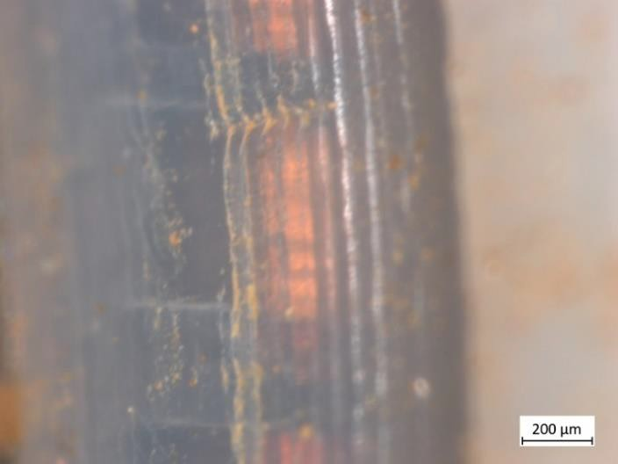
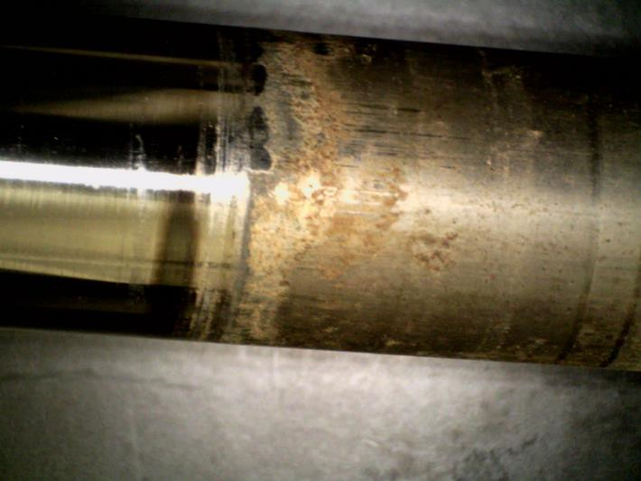
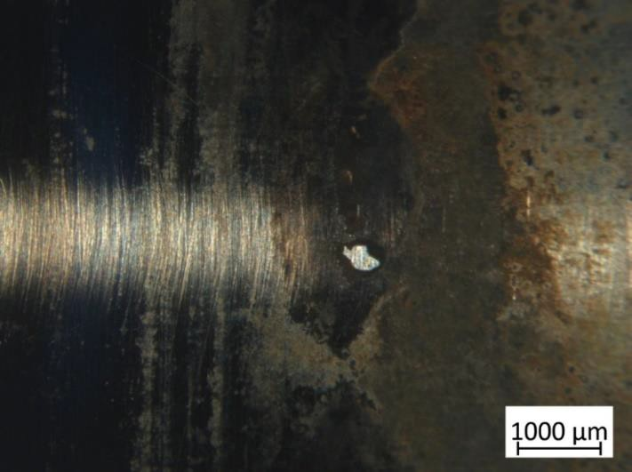
Delaminated Plating
QD housings are plated with Nedox, an electroless nickel, and stereo microscope imagery and chemical evaluation post the submersion test revealed delamination on the QD F128 housing
One delaminated area coincidently aligned on the outside edge of secondary seal, and roughly the location of aft spool seal “kinks”
QD F128 secondary aft seal
prior to Ammonia immersion test
QD 128 aft sealing surface prior to
the ammonia immersion test
QD F128 aft sealing surface
post ammonia immersion test

Slide 13
Delaminated Plating
Nedox adhesion issues have been observed on two QDs during ground inspections prior to the P1 EATCS launch, and an investigation concluded the likely cause was due to contamination of surfaces on a few parts after cleaning
These QDs were scrapped, and the other QDs from the lot (including F128, ground spares and flight units) were already installed and ready for launch when this issue was discovered
It was recommended at the time that re-inspecting the remainder of the lot was not required as it was believed the issue was localized to only those two QDs, and delamination would be detected during acceptance testing
In addition, the plating process was adjusted to prevent the issue from occurring on any future QD builds
QD F128 secondary aft seal
prior to Ammonia immersion test
QD 128 aft sealing surface prior to
the ammonia immersion test
QD F128 aft sealing surface
post ammonia immersion test

Slide 14
Delamination Exacerbation
Thermal cycling could aggravate delamination on parts with marginal plating, and the nominal on-orbit thermal cycles of QD F128 are ~ -40 to 0 Deg F (-40 to -18 Deg C) while in service
Though this is within specification, cycling of this magnitude could cause the delaminate area to exacerbate and result in an accelerating leak
The other radiator return jumper QDs on the ISS experience the same cycling but at the time of this investigation have not exhibited similar leakage
Figure: P1 EATCS mass and leak rates

Slide 15
Conclusions
The most probable root cause of the former accelerating P1 EATCS ammonia leak was due to multiple contributors
Damage to the spool seals on radiator return flexible jumper QD F128 during original installation
Combined with localized Nedox plating adhesion issues on QD F128 housing, which were coincidentally located under the damage seals, aggravated by thermal cycling
Failure investigation results and on-orbit ammonia inventory trends at the completion of the investigation indicated this type of leak signature may be unique to QD F128
Figure: Unofficial fault tree built as a tool by engineering

Slide 16
Recommendations
The following recommendations were made at the completion of the investigation
Continue with the current sparing posture of the ISS radiators jumpers, which is to assemble and launch new jumpers as needed
Reinstall the refurbished radiator jumpers to restore cooling capability (installed in March 2022 but awaiting to be reserviced)
No change to inspection and acceptance testing procedures, and continue using the current QD design with the adjusted Nedox plating process for future

Slide 17
Observations
Following the conclusion of this investigation, telemetry from the S1 EATCS (as opposed to the P1 EATCS) began showing signs of a second possible accelerating ammonia leak
Similar robotic leak locating leak locating activities were performed, and the results indicated that ammonia was originating from a similar radiator QD as the leaky QD F128
Currently, the leak rate and degree of acceleration is significantly less than that experienced on the P1 EATCS, and the system continues to operate normally
Further investigation is necessary to determine if the root cause is the same as QD F128 or not, and the conclusions from this investigation may have to be revisited

Slide 18
Acknowledgments
This work was supported by:
The NASA Lyndon B. Johnson Space Center (JSC) Active Thermal Control System (ATCS) Team
NASA JSC’s Materials and Processes (M&P) Team
NASA White Sands Test Facility (WSTF)
Boeing Huntsville Hardware Processing and Houston ATCS
Parker Stratoflex Quick Disconnect (QD)
In addition, Russell Morrison (Boeing QD Expert) and Johnny Golden (retired Boeing Materials and Processes Expert) were significant contributors to this investigation

Slide 19
Questions?

