Slide 1
Rapid Thermal Design, Modeling, and Analysis of Spaceflight Instruments
Guidelines from NASA Goddard’s Integrated Design Center
Kan Yang¹, Hume Peabody², Rachel Rivera¹
¹Civil Servant, Code 550, NASA GSFC
²Civil Servant, Code 545, NASA GSFC
Note: Reference in this course to any specific commercial products, process, service, manufacturer, company, or trademark does not constitute its endorsement or recommendation by the U.S. Government or the NESC Academy.

Slide 2
Introduction to Rapid Thermal Design of Spaceflight Instruments
This course provides a general overview of how to conduct rapid instrument thermal design, modeling, and analysis, as informed by the processes in NASA’s design labs
For typical flight projects, thermal engineers will develop initial instrument thermal models then iterate them over a project’s lifespan
  A model is developed for initial concept studies, perhaps over weeks or months
  The model is then refined by the thermal engineer in the subsequent months or years between each of the major project milestones: Mission Concept Review (MCR), Preliminary Design Review (PDR), Critical Design Review (CDR), Systems Integration Review (SIR), etc. In each iteration, the engineer will:
    Refine their thermal models and thermal designs in accordance with updates from other subsystems
    Perform trade studies
    Solve very detailed and complex analysis problems, including worst-cases and contingencies
    Pick hardware and plan for testing and integration
However, prior to a project being established, and especially for proposal development at an early conceptual stage, the luxury of multiple instrument design iterations may be limited or nonexistent
  Within a short timeline, how do you complete a thermal model or explore multiple possible instrument configurations?
  What are the critical parameters for your model? Which details do you include or
  leave out?

Slide 3

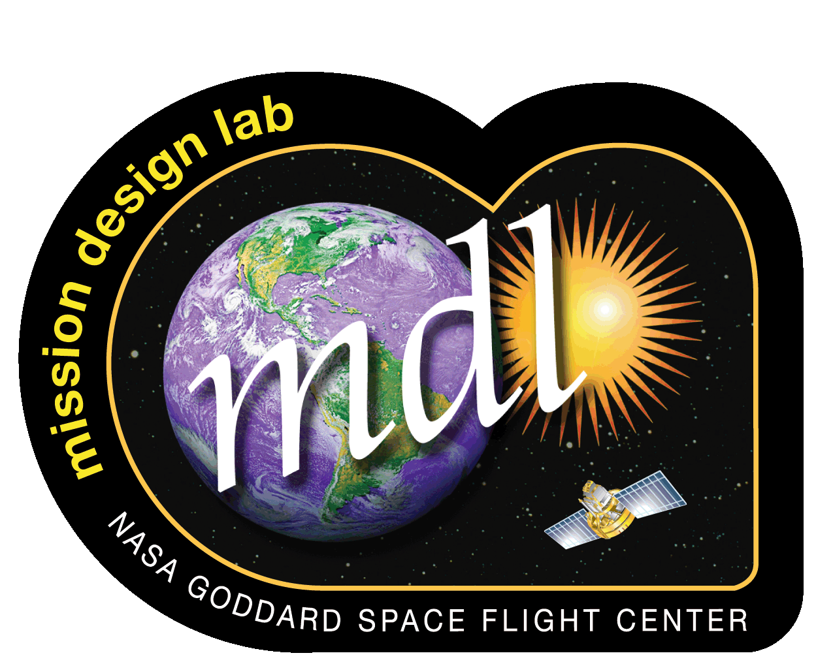
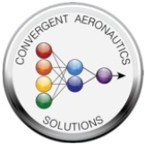
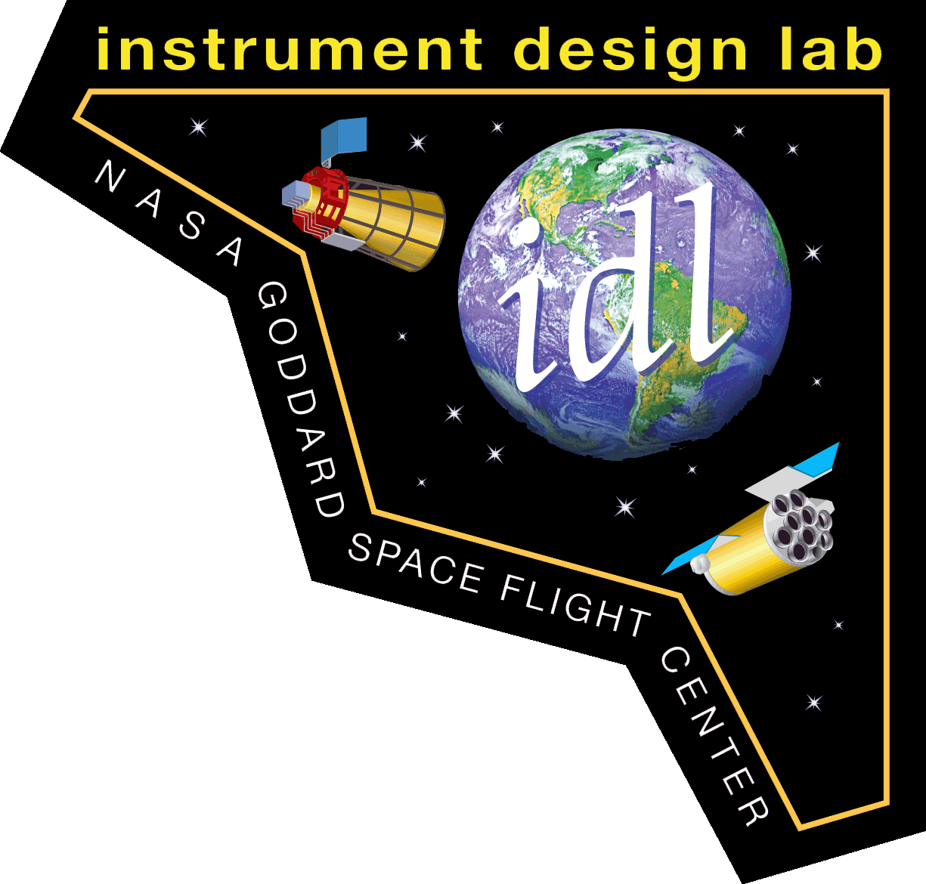
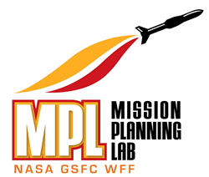
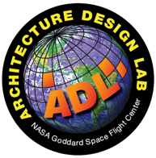


NASA’s Design Labs
NASA maintains design labs at many of its centers and facilities to develop rapid instrumentation concepts
  These labs require each supporting discipline engineer to quickly analyze and develop a design within a few days to a few weeks to create a finished product consistent between all subsystems
  The processes practiced by NASA’s design labs provide ideal guidelines for understanding how to conduct rapid thermal design, modeling and analysis
Of course, there are many other design labs in government, industry and academia, and multiple ways to approach the challenges of rapid conceptual design
For this lecture, we will be focusing on guidelines from the Instrument Design Laboratory, part of the Integrated Design Center at NASA’s Goddard Space Flight Center (GSFC)

Slide 4
Rapid Thermal Design in the IDC
GSFC’s Integrated Design Center (IDC) provides an environment that facilitates multi-disciplinary, concurrent, collaborative, space system engineering design and analysis activities, to allow rapid development of science instrumentation and mission architecture concepts
  The IDC has been in existence since 1997, and its Instrument Design Laboratory (IDL), through hundreds of instrument studies, has refined and sharpened its process for rapid instrument design
    Thermal modeling for the IDL has been adapted to a dynamic engineering environment where all subsystems are working together towards a consistent point design within a few days
  The guidelines in this lecture originate from the experience and lessons learned over two decades of IDL thermal design
    Objectives of this lecture:
      To provide a condensed guide for the most efficient way to develop thermal models and conduct thermal analysis within one to two weeks
      To quantify the resources needed to provide thermal control for the focus instrument
      To describe specific tall poles and/or lessons learned for each type of instrument across the electromagnetic spectrum, including astronaut-deployed instruments

Slide 5
Overview
Rapid Thermal Design Process
Rapid Thermal Design Process
  Determine Boundary Conditions
  Determine Worst-Case Thermal Environments
  Gather Thermal Inputs from Other Disciplines
  Determine Your Temperature “Zones”
  Build a Preliminary Thermal Model
  Iterate Technical Design with Other Disciplines
  Perform Model Checks
Typical Discipline Analysis Products
Specific Instrument Thermal Design Examples
This section features the following types of instruments: Microwave/RF (Passive, Active), Optical (Passively Cooled Detector, Actively Cooled Detector, Sub-Kelvin Detector), Laser, X-Ray, Gamma Ray, Astronaut-Operated (External, Internal), Robotic Planetary Landers
  Includes tall poles and/or lessons learned for each instrument example
Thermal
Requirements!

Slide 6
RAPID THERMAL DESIGN PROCESS

Slide 7
1. Determine Boundary Conditions
For instruments: determine where the instrument will be mounted with respect to the spacecraft
  If this information is not available yet (or if a particular spacecraft has not been chosen yet), make assumptions to spacecraft interface temperature and orientation with respect to the spacecraft bus
For Microwave/RF or Optical instruments: Ensure the Radio Frequency (RF) or Optical engineers have solidified their component placements before thermal modeling starts
  Even small changes to the Microwave/RF or Optical designs can result in vastly different mechanical packaging and thermal control methods, so it is critical that their designs are “frozen” before thermal modeling begins
Establish a common coordinate system: allows for easy reference and communication with the other members of your team. Ensure that this is consistent with other analytical models as well (mechanical CAD, structures, optical, etc.)

Slide 8
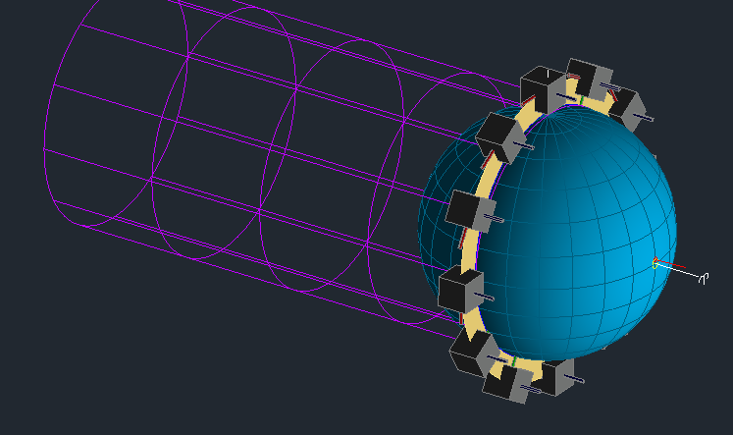
2. Determine Worst-Case Thermal Environments
A simple cube model (1m³) is sufficient to discretely quantify temperature changes due to heat flux on each side of the spacecraft’s thermal environment, and determine your worst-case thermal environments for Earth or other planetary orbits (including moons)
  With one arithmetic node on each side of the cube and coatings properties of α=1, ε=1, this allows for a rapid way to examine your heat fluxes per orbit and determine which sides are suitable for radiators, and which sides require Multi-Layer Insulation (MLI)
  Simple trade studies can also be performed with different coatings / MLI
  If thermal stability is a concern, a cube model is a great testbed for materials and corresponding thicknesses to achieve the desired thermal mass / thermal stability
  If resultant temperatures are not cold enough for passive thermal control, an Earth shield or planetary shield may be needed
+Y
-Z
Typically Nadir Side
-X
Source: NASA/K.Yang
+X
+Z
Typically Ram Side
-Y
Cube in Earth Orbit
Screenshot from Thermal Desktop™

Slide 9
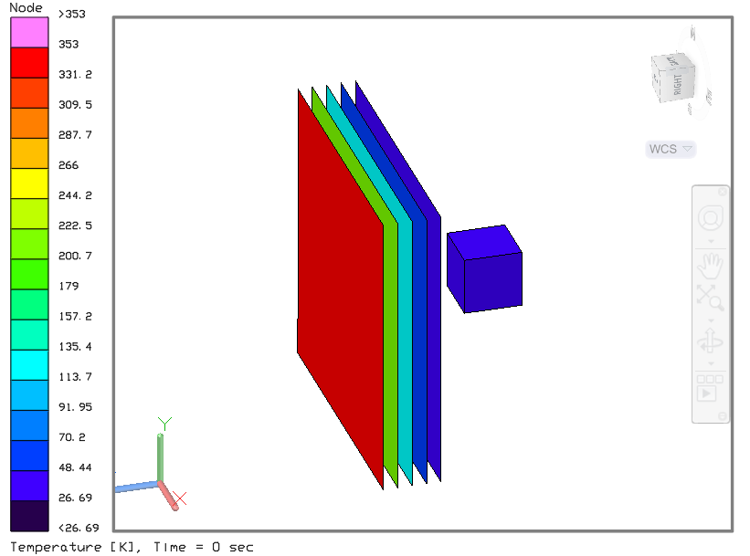


2. Determine Worst-Case Thermal Environments
Cube models are also a great place to start for sunshield design
  Number of sunshield layers, spacing between layers, and sunshield coatings can be traded until acceptable average temperatures are achieved on your cube
In more exotic environments, such as for planetary landers, it is extremely helpful to understand the environmental parameters needed for thermal modeling beforehand:
  Atmospheric composition (if there is an atmosphere), and equivalent convective coefficients at different layers of the atmosphere
  Cold sky temperatures
  Diffuse sky radiation / heating
  Average ground temperatures (day/night, profiles)
  Position of the sun / other celestial bodies (vector list, heat flux): this may not be necessary if the planetary atmosphere is sufficiently thick
  In complex deep space or planetary orbits, it may be easier to establish your orbit as a list of vectors from the position of the sun/moon etc. over time, and their corresponding heat fluxes
Source: NASA/K.Yang
Sunshield Design with a Cube Thermal Model
Cold Sky Temperature
Diffuse sky heating
Solar Flux Vector vs. Time
Planetary Flux
Vector vs. Time
Lander
Atmospheric Composition,
Convective Coefficient h
Ground Temperature vs. Time
Planetary Lander Thermal Considerations

Slide 10
3. Gather Thermal Inputs from Other Disciplines
Common Sources (Disciplines typically involved with early spaceflight instrument design)
  Detectors and Electro-optical: temperature requirement, temperature stability requirement, power dissipation, quantity, geometry and dimensions, mass, coatings
  Electrical: Number of boxes, power dissipation, dimensions, mass, temperature requirement
  Mechanical: Mechanical packaging, geometry, dimensions, mass, material, location of boxes, spacecraft thermal interface information, radiator placement
  Optical: Temperature requirement, stability gradient requirement, quantity, geometry and dimensions, mass, coatings
  RF/Communications and RF/Microwave: Power dissipation, temperature requirement, stability or gradient requirement
  Reliability: Redundancy requirement, temperatures desired to maximize reliability
  Structural: Material selection, material thickness
  Systems: Summary of thermal design requirements, orbital parameters, mass/power allocations for thermal components (if applicable), Attitude Control: sun avoidance angle, pitch/roll/yaw angles
Unique sources
  Contamination: Specific thermal coatings and degradation, outgas heater if required
  Cryogenics: Cryocooler compressor power dissipation, temperature requirement, Cryocooler cold head temperature, Adiabatic Demagnetization Refrigerator (ADR) and cryocooler thermal interfaces
  Integration & Testing: Special Ground Support Equipment (GSE) e.g., Helium sink
  Lasers: Power dissipation, temperature requirement, temperature stability requirement
  Mechanisms: Temperature requirement, geometry, dimensions, power dissipation
  Power: Battery temperature requirement, power profile

Slide 11
4. Determine Temperature “Zones”
Temperature “Zones” help define your design requirements early on, and aid in grouping components with similar thermal requirements
In addition to operational and survival temperature limits, ensure that you are capturing any temperature gradient and temperature stability requirements for specific components
  Identify areas where thermal control may be challenging
For design studies, it may be more effective for systems engineers to coordinate the gathering of thermal requirements and determination of thermal zones
Zone 1 (Z1): Op. Limit: 268-298 K Surv. Limit: 258-308 K Gradient: 4K Stability: 2K / hr | Zone 2 (Z2): Op. Limit: 81 K Surv. Limit: 65 K Gradient: N/A Stability: 5 mK / 2 min | Zone 3 (Z3): Op. Limit: 150-160 K Surv. Limit: 120-313 K Gradient: N/A Stability: N/A | Zone 4 (Z4): Op. Limit: 273-313 K Surv. Limit: 233-333 K Gradient: N/A Stability: N/A
Zone 2
Detector Enclosure
Optical Components
Zone 3
Zone 4
Zone 1
Front End Electronics
Electronics Box
Baffling or Window
Detector
Electrical Wires
Isolators
Optical Bench
Mounting Plate

Slide 12
5. Build a Preliminary Thermal Model
Before you begin
Have a list of common thermo-physical and optical properties already available (in Thermal Desktop™, this would be a common .tdp or .rco file)
Have a list of common thermal conductances, especially for thermal interface materials
Start with a template thermal model file populated with simple shapes (in primitives / shells):
  Rectangular prism (for spacecraft buses, electronics boxes etc.)
  Cylinder (cylindrical buses, rotating components, struts etc.)
  Flat plate (for optical benches, radiators. This can also be a honeycomb panel with honeycomb core properties already built in)
  Disk (for mirrors, lenses, filter wheels)
  Paraboloid (for antennas)
  Sphere, spheroid (for propulsion tanks, pressure vessels etc.)
  Heat Pipe (an already-modeled heat pipe can be extremely useful)
These shapes can be repositioned, rotated, and re-dimensioned to match a mechanical CAD file
  You do not need to start with a “final” mechanical model; start with a basic model and refine later as the mechanical design matures

Slide 13
5. Build a Preliminary Thermal Model
Model Building Tips
Start with generic values for interfaces that are not yet well-defined
  Contactors preferred over conductors. Based on mounting pressure, a relatively isolated interface can be 0.8 – 1.0 W/m²K, while a more conductive interface can be 250 – 500 W/m²K
  For conductors: establish connectivity first, and determine if it is well-coupled (1-5 W/K or greater) vs. isolated (< 0.1 W/K)
Use primitive shapes over finite elements: this allows for quick re-discretization of the mesh
  Disabling a node within a surface can represent a hole or edge notch
Do not start with too detailed of a nodal discretization; you can always refine later
Apply heat loads to surfaces rather than nodes, if possible
Use symbols for quick modification of parameters later
  Symbols are especially helpful with conductances, heat loads, and translations/rotations for any moving assemblies
Use steady-state analyses when possible

Slide 14
Worst-Case Thermal Analysis
Worst Case Stacked Parameters for Thermal Analysis in Low Earth Orbit (LEO)*
Use hot case to size radiators
Use cold case to size heaters
Survival case: use reduced operational configuration, ensure that sufficient heater circuits and power are available to meet survival limits
* Note: these values are representative of thermal parameters for a nominally circular Low Earth Orbit, typically < 1000 km altitude above the Earth’s surface. These parameters may vary greatly for another planetary or deep space orbit, and are highly dependent on instrument orientation.
 | Hot Case | Cold Case
Solar Flux | 1412 W/m² | 1322 W/m²
Albedo | 0.35 | 0.25
Earth IR | 267 W/m² | 211 W/m²
Component Power Dissipation | Max.: Head Load with Contingency | Min./ Off: Heat Load Best Estimate (No Contingency)
MLI Blanketing | Less effective emissivity on cold side, ε* ≈ 0.01 | More effective emissivity on cold side, ε* ≈ 0.05
Radiator Coating | End-of-Life Properties (higher α, lower ε) | Beginning-of-Life Properties (lower α, higher ε)

Slide 15
Thermal Hardware Mass and Power
 | Mass | Power | Comments
Multi-Layer Insulation | 0.73 kg/m² | 0 W | Based on 15 layers
Kapton Heaters | 0.36 kg/m² | Various, based on heater power requirements | Based on 10-mil thick Kapton heaters
Thermostats | 6 grams each | 0 W
Thermistors / Thermal Sensors | 1-3 grams each | ~0 W
Heat Pipes (Ammonia) | 0.15 kg/m | 0 W for Constant Conductance Heat Pipes ~10 W for Variable Conductance Heat Pipe (VCHP) Control | Mass per unit length Add 1-3 kg each for VCHP reservoirs
Loop Heat Pipe Evaporator | 2-5 kg | 10-30 W Control Power
Radiator Panels | 3.3 kg/m² | 0 W | Mass based on Aluminum Honeycomb radiator Add heat pipe mass if embedded
Electronic Controllers | 0.2 kg | 1-3 W each
Sources: Space Mission Analysis and Design, 3rd Edition [1]; NASA GSFC Thermal Engineering Branch Standards

Slide 16
Notes about Thermal Mass and Power
Historically, thermal subsystem mass is about 2-10% of spacecraft/instrument dry mass:
  Purely passive thermal design closer to 2% range
  Active thermal design closer to 10% range
  Bulk of mass is MLI and any specialized thermal components
Thermal control power estimates normally only consist of heater power, unless electronic controllers are used
Power estimates are divided in two groups:
  Operational: use coldest operational scenario with mechanical thermostats and electronic controllers with PID control (sometimes handled through flight software)
  Survival: use coldest survival scenario. Circuits should be controlled in most reliable manner, usually with mechanical thermostats and not flight software; only circuits with critical component limits have survival heating applied

Slide 17
Typical Component Temperature Ranges
The table below shows common temperature ranges for typical spaceflight instrument components
  Note, these are solely examples which may be used for early conceptual design
  Each piece of spaceflight hardware is different and has different temperature requirements. As your design progresses, please consult vendors for the appropriate temperature requirements applicable to your instrument
Component | Typical Temperature Ranges (°C) |  |  |  | Stability range (°C, if applicable)
 | Operational |  | Survival
 | Min | Max | Min | Max
Electronics Boxes (Including Cryocooler Control Electronics, Digital Signal Processors, and Laser Control Electronics) | -10 | 40 | -40 | 60
Antennas | -100 | 100 | -120 | 120
Batteries | 0 | 25 | -10 | 35
Mechanisms | 10 | 40 | -40 | 60
Optical or Laser Bench (Near-IR, Visible, UV; often require stringent thermal stability) | 5 | 35 | -20 | 40 | ± 2
Lasers (often require stringent thermal stability) | 20 | 40 | -20 | 60 | ± 1
RF Components (Analog) | -10 | 40 | -25 | 60 | ± 2
Cryocooler Thermo-Mechanical Units | 5 | 45 | -35 | 70
X-Ray Sources | 0 | 30 | -20 | 50

Slide 18
Typical Detector Temperature Ranges
Detector temperature ranges vary greatly based on instrument application
  The table below shows typical detector operational temperatures based on instrument type
  Of course, each spaceflight instrument is different, and detector temperature is highly dependent on the science, the wavelengths you're trying to measure, and temperatures needed to achieve acceptable radiometric performance.
  For the particular instrument you are conducting thermal design and analysis, consult the detectors engineer or vendor and the optical/radiometric engineer for your specific detector temperature requirements
Wavelength Range | Portion of Electromagnetic Spectrum | Example Detector Types | Typical Operational Temperatures |  | Thermal Stability Requirements
 |  |  | Low | High | More Stringent | Less Stringent
> 1 mm | Microwave and RF | Microwave / RF Receivers | 260 | 310 | ± 0.1 | ± 2
25 um - 1 mm | Sub-mm wavelengths / Terahertz range | Heterodyne Receiver (SIS, HEB), TES bolometers | < 1 | 40 | ± 0.1 | ± 1
2.5 um - 25 um | Mid-Infrared to Far-Infrared | HgCdTe, TES, Ge:Ga Photoconductors | < 1 | 100 | ± 0.001 | ± 1
750 nm - 2.5 um | Near-Infrared | HgCdTe, InGaAs, InSb, STJ, TES, Si<1100nm | 50 | 170 | ± 0.001 | ± 1
400 nm - 750 nm | Visible | Si CCD, Si CMOS, photodiodes, STJ | 170 | 340 | ± 0.005 | ± 1
1 nm - 400 nm | Ultraviolet | GaN, MAMA, Microchannel | 270 | 340 | ± 0.005 | ± 1
 | Ultraviolet | EMCCD, CCD, CMOS | 170 | 200 | ± 0.001 | ± 1
1 pm - 1 nm | X-Ray | Gas-filled, Scintillation, Microchannel, CdZnTe | 270 | 330 | ± 0.1 | ± 5
 | X-Ray | CCD, CMOS | 170 | 200 | ± 0.001 | ± 1
 | X-Ray | TES | < 0.1 | 1 | ± 0.0005 | < ± 0.001
< 10⁻¹² m | Gamma Ray | CMOS, Scintillator, CsI, SiPM, CCD, Strip Detectors | 80 | 300 | ± 0.1 | ± 1

Slide 19
6. Iterate Technical Design with Other Disciplines
These technical exchanges and iterations with other engineering disciplines are common to a majority of early design studies:
In the IDL and MDL: Sometimes, you may run out of time to close your thermal design. Do not worry: this is not uncommon. Please document in your presentation your assumptions and future work required to close the design.
Topic of Design Iteration | Dependencies | Areas of Pushback if This Becomes a Concern
Radiator: Size, Location, Material, Coating | Orbit (ACS), Available Volume (Mechanical), Available Mass (Mechanical) | Are there other faces where additional radiators can be placed? Can volume allocation increase? Can the radiator be thicker or have heat pipes embedded? Can operational loads be reduced or temperature requirements be made less stringent?
Heater: Size, Power, Placement | Available Power (Electrical/Power), Temperature Constraints (All Disciplines) | Can temperature requirements be made less stringent? Can Electrical provide more power? Can the heater be placed closer to the component or directly on the component? Can Electrical accommodate more heater services?
Thermal Transport or Thermal Isolation: Size, Location, Material | Temperature/ Gradient/ Rate Constraints (All Disciplines), Placement and Available Mass (Mechanical) | Can temperature limits, stability, or gradient requirements be made less stringent? Can the placement be changed for a certain thermally challenging component?
Cryogenic Components: parasitics to cryogenic temperature zones, cryocooler heat rejection, location of temperature intercepts | Temperature/ Gradient/ Rate Constraints (All Disciplines), Wires / Harnesses (Electrical), Placement and Available Mass (Mechanical) | What design compromises between cryogenic isolator A/L can be achieved with the structural engineer? Can windows to a cryogenic enclosure be made smaller to minimize radiative parasitics? What wire material choices can be made to minimize conductive parasitics? Can component heat dissipations be smaller? Can cryocoolers / CCEs be positioned optimally for thermal control?
Thermal Sensors | Electrical Architecture | Can more thermal sensors be accommodated by Electrical?

Slide 20
7. Perform Model Checks
Once a preliminary thermal design is established, perform these checks on your analytical model before running:
Is your instrument (or spacecraft) oriented correctly with respect to the orbit?
  Do a sanity check with the cube model. Are the temperatures what you’d expect for the cold side? For the planet-facing or sun-facing sides?
Run a connectivity check: add a heat load at one end of the model and a boundary node at the other. Exclude radiation to determine if any unconnected nodes exist
Are there any duplicate nodes or surfaces? Overlapping or coplanar surfaces?
Check active sides and optical properties: are they what you’d expect?
Are your MLI nodes on the correct sides? Are they arithmetic? Do they have correct ε* values?
Do contactors make contact as expected? Are they connecting the correct sides or edges?
Are the correct power dissipations applied in the correct cases? (symbols really help here)
For spinning components or articulators: are the correct surfaces spinning? When the articulator is set to a different value, do the correct surfaces move?
Any view factor sums not close to 1, or thermal masses (mC_{p}) much higher than average?
Are heaters controlling to the expected temperatures? Are any heaters saturated?

Slide 21
Typical Goals from Rapid Thermal Analysis
Analysis Goal or Deliverable | Required Information from Science Team | Required Information from Other Discipline Engineers | Assumptions (and/or Derivations by Thermal Engineer)
Temperature control approach and design, including block diagram and Thermal model | Required Temperature and Stability of all instrument components Observatory orbit Operation’s Concept | Component mass and power Instrument volume | Orbit Thermal Environment (Environmental Heat Fluxes) Beta angle and Eclipse duration for LEO missions Use of Conductive Coatings Nominal temperature range if instrument is embedded within observatory or spacecraft (S/C) Bounding hot, cold, and survival cases Considerations needed for ground testing Design limitations vs. thermal constraints Ability of thermal design to meet requirements Integration and Testing (I&T) considerations, such as heat pipe orientation
Location and number of Temperature Controllers and Sensors | Required Temperature and Stability of all instrument components

Slide 22
Typical Goals from Rapid Thermal Analysis
Analysis Goal or Deliverable | Required Information from Science Team | Required Information from Other Discipline Engineers | Assumptions (and/or Derivations by Thermal Engineer)
Parasitic loads onto cryogenic regions (e.g. detectors) |  | Harness specifications (if assessing conductive parasitics) Detector Enclosure design for radiative loads
Coating recommendations for Radiators and/or MLI |  |  | - Coatings and MLI ε* properties: indicate assumptions
Temperature contour maps | - Gradient requirement (if applicable) | Component mass and power Instrument volume | - Orbit screenshots may allow for visualization of worst-cases
Required Instrument Operational and Survival Heater power | - Operational component temperature range | - Electrical and mechanical components survival temperature range
Incorporate Power Dissipation from powered instrument components | - Powered element’s duty cycle. (Based on operations concept) | - Power used by all powered elements based on duty cycle
Quantification of engineering resources for thermal control, including generation of a Master Equipment List (MEL) or a Bill of Materials (BOM) |  |  | Mass of thermal components Composition Vendors / heritage Technology Readiness Level (TRL) assumptions

Slide 23
Typical Goals from Rapid Thermal Analysis
Analysis Goal or Deliverable | Required Information from Science Team | Required Information from Other Discipline Engineers | Assumptions (and/or Derivations by Thermal Engineer)
Thermal Transient Temperature within a Thermal Zone | Required duration of zone temperature stability Range of Temperature external to Instrument (if planetary) | - Mass of instrument components | Bounding hot/cold/survival cases vs. requirements Graphs of temperature vs. time
Radiator placement and orientation | -Operational S/C or Instrument nominal and worse case orientation (and slewing) with respect to Sun, Earth and moon | Surface area available for radiator mounting Available sides on the instrument or spacecraft for radiator placement Is there a dedicated cold side to the spacecraft? | - If a solar shield or Earth shield is required to achieve desired radiator temperatures, and if this is deployable vs. fixed
Required Radiator size and Temperature per Thermal zone | - Operational S/C or Instrument nominal and worse case orientation (and slewing) with respect to Sun, Earth and moon - Notional distance from instrument to radiator location on S/C | Component power Instrument volume

Slide 24
How this comes together: an example of a rapid design schedule in the IDL
Week 1: Pre-Study
Week 2: Study Week
Week 3: Study Wrap-Up
M | T | W | H | F
Design Days
M | T | W | H | F
M | T | W | H | F
Internal
Working
Day
Pre-Work
Meeting
Possibility of Targeted
Pre-study Meetings
Presen-
tations
Internal
Wrap-up
The thermal engineer, from their pre-work meeting information, determines:
Boundary Conditions
Worst-case thermal environments
Thermal engineer also meets with other discipline engineers for targeted discussions of thermal challenge areas, such as thermal and cryogenic zone interfaces, etc.
“Design Days”:
Engineers design concurrently and collaboratively with PI/Science Team via a series of discussions, each focused on specific topics which impact the conceptual design and are aimed towards reaching a design decision. Thermal engineer should:
Gather model inputs via exchanges with other discipline engineers
Determine temperature “zones” with help from Systems Engineers
Set up thermal model
Iterate technical design with other disciplines, including identifying thermal challenge areas and pushing back when necessary
Engineers present their assessments to the PI / Science Team
Engineers quantify and document the engineering resources necessary for their discipline. For thermal: radiator area, number of heaters, operational / survival heater power, number of sensors etc.
Design is “Frozen”:
Major discussion on the design completes so that the engineering team can focus on quantification of resources and ensuring consistency of design across disciplines
Thermal engineer is provided with engineering resources of the “frozen” design for all major components (mass, volume, power, etc.), as well as a Mechanical CAD model
Thermal engineer completes modeling with the “final” parameters, performs model checks, and generates analysis results
“Pre-Work Meeting”:
The Principal Investigator (PI) or members of the science team are asked to introduce their instrument concept to the entire engineering team
The Thermal Engineer is responsible for ensuring they have their design requirements, and requesting information from the PI if they do not have enough for their assessment

Slide 25
SPECIFIC INSTRUMENT Thermal design EXAMPLES

Slide 26
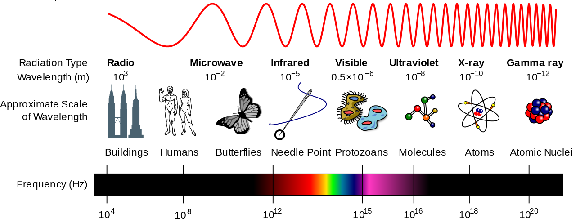
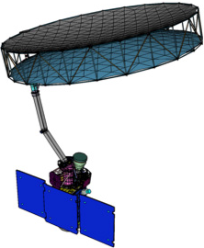
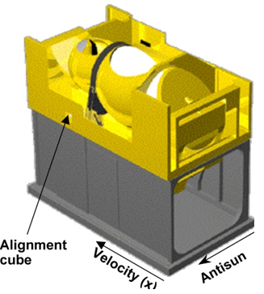
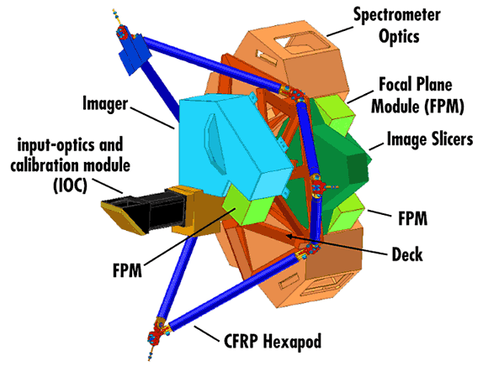
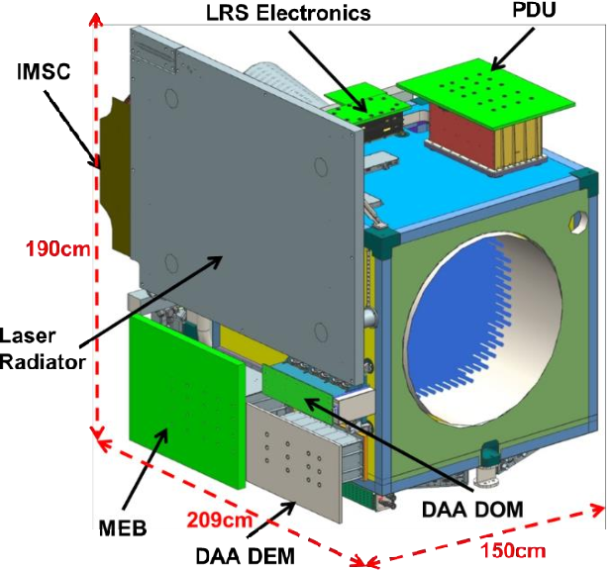
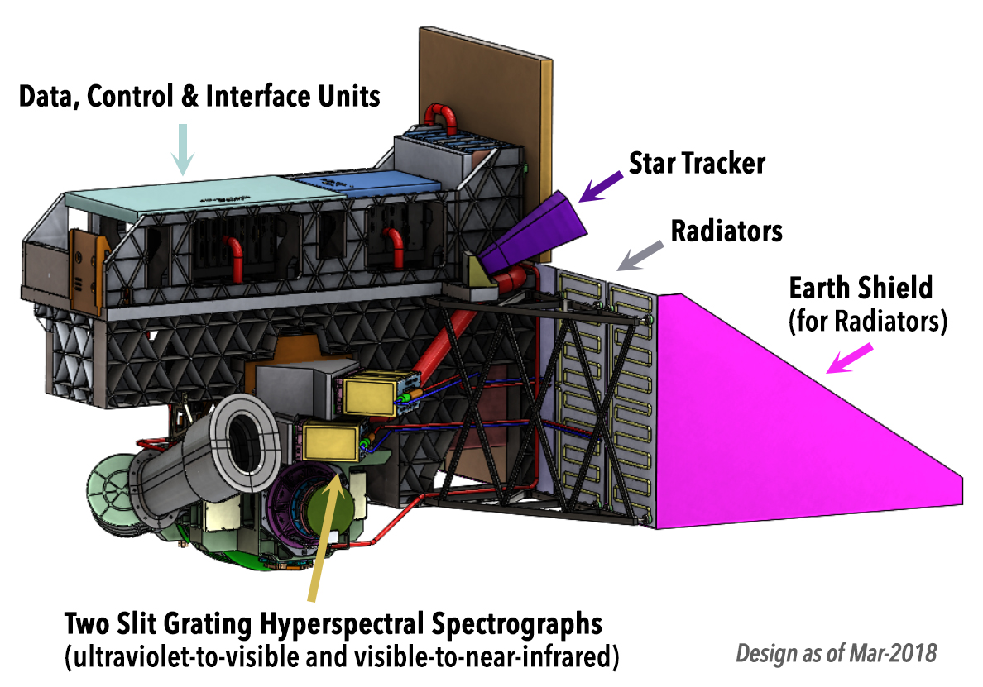
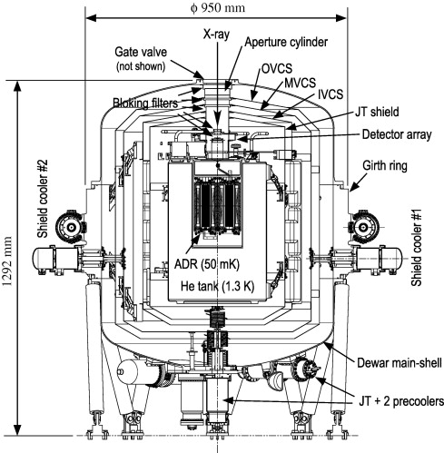
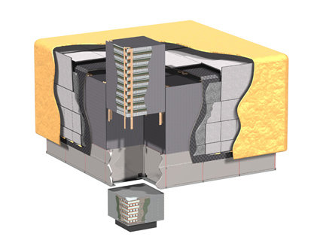
Instruments Across the Electromagnetic Spectrum
Image Source: NASA/Creative Commons
Instrument Type
Microwave or Radio Frequency (RF) Instruments
Optical Instruments,
Laser Instruments
X-Ray
Instruments
Gamma Ray
Instruments
Instrument Examples
Source: NASA
Source: NOAA/F. Weng
Source: NASA/JWST
Source: NTRS/D. Patel
Source: NASA/PACE
Source: [7]
Source: NASA/GSFC
Soil Moisture Active Passive (SMAP) [2]
Advanced Technology Microwave Sounder (ATMS) on JPSS [3]
Mid-Infrared Instrument (MIRI) on JWST [4]
Advanced Topographic Laser Altimeter System (ATLAS) on ICESat-2 [5]
Ocean Color Instrument (OCI) on PACE
Soft X-Ray Spectrometer on ASTRO-H [7]
Large Area Telescope (LAT) on Fermi [8]

Slide 27
Microwave and Radio Frequency Instruments: Passive
Ensure that Antenna and feedhorn placement is “frozen” before starting thermal modeling
Individual RF components do not need to be modeled: they are typically within an RF box or bench
  Conglomerating the heat dissipations for all RF components and spreading over a box or bench is sufficient resolution at this stage of thermal design
  Provide thermal control on the RF bench or box enclosure to meet requirements: for radiometers, this may require strict thermal stability requirements for components upstream of the first low-noise amplification stage
Waveguides from an antenna/feedhorn to an RF box may also have strict operational temperature and thermal stability requirements
  Can be modeled as tubes, similar to propulsion lines, and controlled via blanketing and line heaters
  However, waveguide components within an RF box or bench do not need to be modeled
Downstream electronics boxes (to digitize or process the RF signal) may have proximity requirements to the RF box
  If this is the case, there may be a succession of multiple high-heat-dissipating boxes next to each other. Use a common radiator if possible.
Antenna Reflector
Waveguide transition
RF Receiver
Electronics Box
Feedhorn
Waveguide
Mounting or Radiator Plate
Thermally isolating mounts
LEGEND
MLI
Heater

Slide 28
Microwave and Radio Frequency Instruments: Active
The same RF thermal design considerations from passive systems carry over to active systems, but there is now the addition of high heat dissipation transmitter components
  Power Amplifiers tend to be the largest source of heat dissipation
  Power Distribution Units can also contribute to large amounts of heat dissipation
Many active and passive systems use a rotating reflector
  A “fast spin” option in thermal analysis software can sufficiently capture the thermal effects of this component motion
  Spinning mechanisms can have large heat dissipations from their motors, and require thermal control to ensure that their mechanical lubricants and drive electronics do not exceed temperature requirements
  Deployable reflectors (using mesh material and ribs/stiffeners) are becoming more common. While these typically don’t require thermal control, their material properties (including transmissivity) need to be correctly captured
Feedhorns and waveguide transitions may require thermal control as well, but typically only thermal knowledge is needed (via thermal sensors)
Many active and passive systems also use external calibrators: “hot” targets need to be maintained with strict operational temperature limits/stability; “cold” targets view deep space
Spin Mech-anism
Antenna Reflector
Electrical Wires
Waveguide transition
RF Transmitter / Receiver
Electronics Box
Feedhorn
Waveguide
Mounting or Radiator Plate
“Hot” calibration target
LEGEND
Thermally isolating mounts
MLI
Heater

Slide 29
Optical Instruments
Optical instruments typically encompass the infrared (IR), visible, and ultraviolet (UV) portions of the electromagnetic spectrum
  Infrared instruments typically require cryogenic operational temperatures and strict temperature stability and gradient limits
  Visible and UV instruments typically do not have cryogenic temperature requirements
Ensure that optical model and optical element placement is “frozen” before starting thermal modeling
  Otherwise, a change in optical component placement after you’re started modeling will have huge impacts to your thermal design, especially for cryogenic temperature regions/zones
Use your requirements to determine what’s thermally important to model
  There may be extremely complex optics, but if the optical bench has a thermal requirement and not the individual optical elements, it may be sufficient to just model the bench
  Heat dissipating components which have low duty cycles (< 1%) or only require one-time actuations may not need to have their heat loads modeled at all

Slide 30
Optical Instruments
The following pages give guidelines for preliminary thermal design of optical instruments, for detectors with successively more difficult thermal requirements
  For detectors with cryogenic requirements, the thermal and/or cryogenics engineer should focus most of their design effort on the cryogenic enclosure for the detector, since parasitic heat tends to be a large contributor (sometimes even more than detector heat dissipation) to total heat within cryogenic zones
    Keep a detailed list early on of all of the components which dissipate heat and have high thermal conductivity
  For detector enclosures, these are common early design compromises that need to be made:
    With the structural engineer: determine acceptable Area / Length (A/L) and materials for supporting the detector enclosure
    With the optical engineer: determine acceptable cutout and baffle sizes (if there is no window present); agree on acceptable coatings for windows or enclosure walls to minimize radiative parasitics while ensuring optical signal.
    With the electrical engineer: agree on electrical wiring material and cross-section that ensures electrical signal while minimizing conductive parasitics; note that this may be the largest source of conductive parasitics

Slide 31
Optical Instruments: Passively Cooled Detector
The detector temperature requirements and stabilities typically dictate how complex of a thermal enclosure you may require (if any at all), if MLI is needed, and if passive thermal control is feasible
  The possibility for passive thermal control may hinge upon distance from the detector to the radiator, and length of heat strap or heat pipe required: an early design compromise with the optical engineer may be orienting the overall optical design and/or any upstream fold mirrors to position the detector close to the cold side of your spacecraft
Take note of any optics with more stringent temperature requirements or heat dissipations, such as a scan mirror with an active mechanism
  If there are optical components which require active heating, determine from the optical engineer whether a heater can be directly mounted, or if it requires indirect radiative heating (from a nearby heated plate, for example)
Front End Electronics (FEE) and Electronics Boxes typically have different (warmer, more relaxed) thermal requirements than the detector: placement of these components may be negotiated with the electrical engineer to minimize parasitics into the detector
LEGEND
MLI
Heater
Isolator
Heat Strap
Elec. Wire
Radiator
Heat Strap
Detector Enclosure
Optical Components
Front End Electronics
Electronics Box
Baffling or Window
Detector
Optical Bench
Mounting Plate

Slide 32
Optical Instruments: Actively Cooled Detector
A traditional mechanical cryocooler is represented here to actively cool the detector, but depending on the heat dissipations and reject temperatures, a Thermo-Electric Cooler (TEC) can also be used
  For mechanical coolers, a multi-stage cooler may be necessary depending on thermal requirements
  Mechanical coolers tend to have high heat dissipations for both their thermo-mechanical units and cryocooler electronics, and may require a separate radiator (try to position strategically with respect to cold side of spacecraft)
  Modeling of cryolines is inconsequential in early thermal design
A Digital Readout Integrated Circuit (DROIC) with an on-chip Analog-to-Digital Conversion (ADC) may seem attractive to the detector designer since it doesn’t require a separate FEE, but this tends to result in much higher heat dissipations within the cryogenic zones, and consequently a
more powerful cryocooler than a traditional detector with analog Readout
Integrated Circuit (ROIC) and separate (warmer) FEE
LEGEND
MLI
Heater
Isolator
Heat Strap
Elec. Wire
Cryocooler Cold Tip
Cryocooler Thermo-Mechanical Unit
Cryoline
Heat Strap
Detector Enclosure
Optical Components
Front End Electronics
Electronics Box
Cryocooler Control Electronics (CCE)
Baffling or Window
Detector
Optical Bench
Mounting Plate

Slide 33
Optical Instruments: Sub-Kelvin Detector (1 of 2)
Sub-Kelvin detectors (below 1 K) present a unique thermal challenge due to the multiple required stages of thermal cooling, as well as the use of multiple methods of active thermal control
  At the coldest thermal zone, conductive parasitics may dominate total heat contributions within this zone
  Under 50K, radiative parasitics may be orders of magnitude smaller than conductive parasitics and detector dissipation: radks can be reduced or omitted altogether in the coldest thermal enclosures
Cryocooler Cold Tip
Cryoline, Possible Additional Stages
Cryocooler Thermo-Mechanical Unit
LEGEND
Heat Strap
Intermediate Cryogenic Enclosure
MLI
Heater
Isolator
Heat Strap
Elec. Wire
ADR Control Electronics
Adiabatic Demagnetization Refrigerator
Heat Strap
Sub-K Detector Enclosure
Harness Heat
Intercept(s)
Optical Components
Front End Electronics
Electronics Box
Cryocooler Control Electronics (CCE)
Baffling or Windows
Detector
Optical Bench
Mounting Plate

Slide 34
Optical Instruments: Sub-Kelvin Detector (2 of 2)
Design of sub-Kelvin systems is dominated by parasitic heat management
  Clever choices on thermal zone temperatures and number of cryogenic stages have a large impact on total parasitic heat and thermal design complexity within each zone
Adiabatic Demagnetization Refrigerators (ADRs) can be used for cooling detectors to sub-Kelvin temperatures, and may reject their heat onto a more conventional cryocooler cold tip at single-Kelvin temperatures
  However, the amount of heat that they are able to extract is on the order of mW or µW, which emphasizes the criticality of using isolative materials to minimize conductive parasitics to the coldest regions, so that detector heat makes up the bulk of the total heat that the ADR extracts
  ADRs also have their associated (room-temperature) control electronics, which represent an additional heat load to manage and possibly a separate radiator from the cryocooler radiator
Other low-Kelvin or sub-Kelvin cooling methods have included: cryostat / dewar with a working fluid or solid, dilution refrigerators, Helium sorption refrigerators
Harness heat intercepts are a good method for conductive parasitic heat management: electrical wires are conductively “sunk” to an intercept plate at a certain temperature, to minimize the amount of heat transmitted via those wires into the next colder thermal zone
  These intercept plates can be passively cooled, or tied to a particular cryocooler stage
  Detector, cryocooler, and ADR components all may have their own electrical wires traveling to cold cryogenic zones
    Material choices and harness lengths can have a large impact on parasitics
    Bookkeeping these parasitics is quintessential to thermal management here, even if certain wires seem trivial (like to thermal sensors, for example)

Slide 35
Laser Instruments
Lasers typically have very tight thermal stability and gradient requirements, yet dissipate large amounts of heat
  Loop Heat Pipes (LHPs) and other more complex forms of thermal transport and control are often needed for heat rejection while maintaining hardware within thermal requirements
  Laser control electronics also contribute another source of heat
Both transmitter and receiver optical benches typically have gradient requirements to preserve alignment of the optical components
  These can be cold biased and controlled with heaters, or have more elaborate thermal control systems
  Laser may be fiber-coupled so that it is not dissipating its heat directly into the transmitter bench (i.e. thermally decoupled from the transmitter optics)
If the detector operates at IR wavelengths, it may require passive or active cryogenic control methods
  Similar to “Passively Cooled Detector” and “Actively Cooled Detector” thermal architectures presented in the previous slides
  If a cryocooler is used, trades of cryocooler power, reject temperature, and heat lift may be required to optimize these parameters for the given instrument architecture
  In Earth orbit, Earthshield may be required for passive cooling
  Multiple large sources of heat (cryocooler thermo-mechanical unit (TMU) and electronics, laser transmitter and laser control electronics, instrument electronics, detector front-end electronics) and different thermal requirements for each source may result in one large radiator, or several large radiators held at different temperatures
    Grouping of thermal zones and placement of components is critical to thermal management

Slide 36
Laser Instruments: Passively Cooled Detector
Note: If cryogenic temperatures are required on the detector, combine with “Actively Cooled Detector” architecture shown in the optical sections above
Radiator
Constant Conductance Heat Pipe or Loop Heat Pipe
Transmitter Optical Components
LEGEND
Laser
Laser Control Electronics
MLI
Heater
Isolator
Heat Strap or Heat Pipe
Elec. Wire
Transmitter Optical Bench
Radiator
Heat Strap
Detector Enclosure
Receiver Optical Components
Front End Electronics
Electronics Box
Baffling or Window
Detector
Receiver Optical Bench
Mounting Plate

Slide 37
X-Ray Instruments
X-Ray instruments are often designed with two parts: a “Mirror” or “Telescope” Assembly at the front end, and a separate “Sensor” or “Detector” Assembly at the focal plane
  These may be at large distances with respect to each other, yet require tight thermal control within and between both assemblies to ensure alignment (in grazing incidence reflection designs to allow X-ray focus at the detector)
  The Mirror Assembly commonly consists of concentric rings with diffuse inboard surfaces and specular outboard surfaces (Wolter telescope design), and tight gradient requirements are common
X-Ray instruments tend to use large format, high-dissipation detectors to acquire their science signals, along with high-dissipation Front End Electronics (FEE)
  This presents one of the most challenging parts of X-Ray instrument design
  Commonly, X-Ray Detectors and their corresponding FEE are placed in an integrated assembly with tight temperature control requirements
    This may require active cooling or passive cold bias (with trim heating) to achieve operational temperature and stability requirements
    Multiple detectors may also share a common, high-conductivity baseplate or enclosure, isolated from the surrounding environment
    More than one nested passive stage may be required to achieve cooling/stability requirements, or an active cooling option (such as TECs or a cryocooler) may be necessary. In the most challenging cases, such as for X-ray Spectroscopy, a cryogenic or sub-Kelvin cooler may be needed
    Detector assembly may require heat straps or heat pipes to transport large volumes of heat to the radiator
    Calibration sources may be integrated as part of the detector assembly
X-ray filters tend to be aluminum (or other metal)
Due to the large heat dissipations, radiators can be very large
  Earthshield is a common necessity for Earth-orbiting X-ray telescopes to passively cool to desired temperatures
  Stationary or louvered radiator fins are another option

Slide 38
X-Ray Instruments
LEGEND
Note: If cryogenic temperatures are required on the detector, combine with “Actively Cooled Detector” or “Sub-Kelvin Detector” architectures shown in the optical sections above
MLI
Heater
Isolator
Heat Strap or Heat Pipe
Elec. Wire
Heaters on each concentric ring for precise control of gradients
Radiator
Heat Strap
Heat
Pipe
X-Ray Filters
Electronics Box
Detector(s)
Front End Electronics
Plate
Detector Enclosure
Instrument Bench
Mounting Plate
Cold-biased detector enclosure with heater control
Separate trim heater on detector plate for precise temperature control
Telescope Assembly (Concentric Rings)
Sensor Assembly or Detector Assembly

Slide 39
Gamma-Ray Instruments
Gamma Ray Instruments typically require low Z-energy materials (carbon fibers, plastics, silicon and other select materials) to minimize background noise so that the science signal can be obtained
  Unfortunately, most thermal hardware is metallic and high Z-energy
  Thermally conductive carbon composites and epoxies are essential for these designs
Gamma-ray instruments require large numbers of detectors, greatly increasing heat dissipation
  Metallic heat pipes may be unavoidable due to the large quantities of heat to be transported
  However, Annealed Pyrolytic Graphite (APG) is preferable to any metals for heat straps and doublers
If stacked detector “trays” are used for these designs, it is as essential to flesh out the detailed design of each tray to ensure adequate thermal control and heat rejection as it is to manage the overall thermal design
  Note that a small change or improvement to one tray propagates to all trays, and therefore may have a huge impact on overall instrument resources
  Front-End Electronics (FEE) for these trays may be the largest source of heat
  Harness conductance must be considered as a significant vehicle for heat transport
Detector Tray
Detector
Detector Tray
Detector
Detector
Detector Tray
Radiator
Front-End Electronics
Detector Tray
Heat
Pipe
Detector Tray
Detector Tray
Detector Tray
Instrument Bench
Composite or other Low-Z Energy Structure

Slide 40
Astronaut-Operated, Internal
This slide pertains to instruments operated by astronauts within the International Space Station (ISS) or another crewed environment
Unlike prior instrument examples, convection is now a dominant form of heat transfer since this is assumed to be operated within a pressurized crewed environment
  However, transfer vehicle to the ISS may not be pressurized: the instrument needs to be designed for launch/transfer as well as nominal operations once it’s installed
Instrument heat is typically rejected via a convective interface, whether through ducted air or piped fluid
  There are typically strict requirements for the quantity of heat that can be rejected from the instrument to these interfaces
  Instrument-mounted fans may be installed for convective cooling
Design challenges
  Convective interfaces to crewed vehicles may supply cooling air or fluid at a large range of temperatures (also may be impacted by dissipations of neighboring instruments)
  Free convection in microgravity is much lower than on Earth
Example: EXpedite the PRocessing of Experiments to Space Station (EXPRESS) Rack instrument installation on the ISS
  Interface documentation for EXPRESS racks require that instrument thermal control systems:
    Correctly interface with rack-provided payload cooling provisions
    Adhere to limits on temperature of returned air
    Avoid rejecting sensible heat into ISS cabin air
    Avoid rejecting heat conductively via instrument-to-EXPRESS rack interfaces
    Maintain astronaut touch surfaces around room temperature

Slide 41
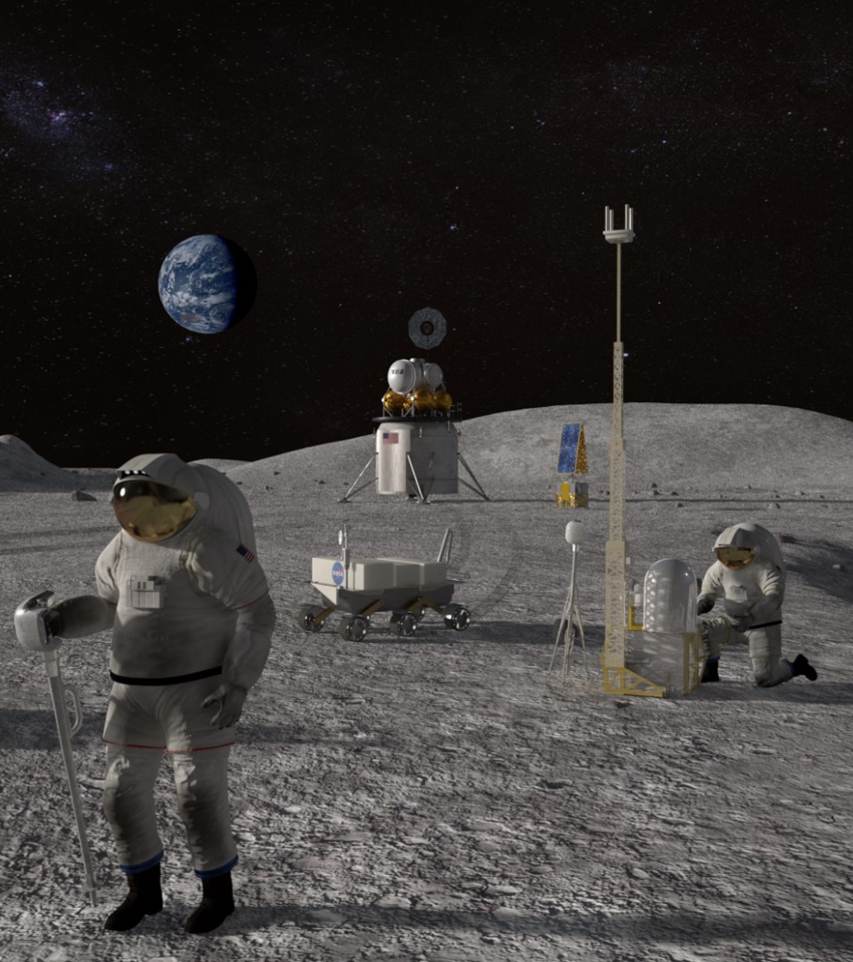
Astronaut-Operated, External
This section pertains to instruments used during astronaut Extra-Vehicular Activities (EVAs), whether in space or on a lunar surface mission
Astronaut-deployed external instrument thermal designs are highly dependent upon their operational scenarios, and prior to any design work, these top-level design decisions must be solidified:
  Concept of operations (duration of deployment, operational cadence, extent of astronaut interaction, instrument placement or relocation, onboard power dissipations vs. time)
    Will the instrument thermal design be sized for a particular operational scenario or is it meant to be versatile for a range of scenarios?
  Operational environment (spaceflight vs. surface operations)
    If Lunar surface operations: the environment is highly dependent on time and location on the moon; understanding solar illumination for the landing location during the duration of the surface mission is a critical input to thermal analysis
NASA’s Artemis Program provides useful guidelines for instrument
design, especially for astronaut touch surfaces or interfaces
  Typically, astronaut touch surface temperature requirements are
  between -43 to 63°C: handled surfaces may require active heating
Heat sources and sink temperatures change rapidly between areas
with and without solar illumination
  Unless there is a placement orientation requirement, assume there is
  no dedicated “cold” side to the instrument for radiator placement
Operations in lunar shadowed regions may require large amounts of
heater power, especially to keep batteries within operational limits
Image Source: NASA

Slide 42
Astronaut-Operated, External: Lunar Surface
Lunar South Pole example
LEGEND
Heaters on Astronaut Touch Surfaces
MLI
Heater
Isolator
Radiator
Instrument
Solar Flux Vector vs. Time
Thermally Isolating Feet
Lunar Surface

Slide 43
Instruments on Robotic Planetary Landers
Robotic planetary lander thermal designs are highly dependent upon their operational scenarios and operational environment, including:
  If the planetary or celestial body has an atmosphere
  How long the instrument is required to survive, especially in extreme heat scenarios (like the Venusian surface) or extreme cold scenarios (like Lunar Night)
  However, the thermal design needs to accommodate for all phases of the mission, including cruise and descent
Typically, landers have multiple instrument packages on their decks
  These may include instruments like mass spectrometers or gas chromatographs, which have high power dissipations in operation
    Although these instruments typically use transfer gases / calibrants and have extensive plumbing, a first-cut thermal design does not require modeling of all these components: thermal control can be assumed at a mounting board or box level
    However, their reservoir tanks may require additional thermal control
  A good understanding of instrument concept of operations is required to determine which instruments are dissipating heat at which points in the mission
  For some lander or rover architectures, they may have pumped fluid loops to maintain thermal control across multiple instruments and send their heat to a common radiator
In extreme environments, unconventional or exotic thermal hardware may be needed
  Pressure vessels can be used to shield electronics and instrumentation from temperature extremes
  Paraffin Phase Change Materials may prevent excessive heating or cooling for components attached to them
  Heat switches allow conductive decoupling from surrounding environment

Slide 44
Robotic Planetary Landers: Surface of Venus
Example of a probe on Venus
Heat Sink
Pressure Vessel with thermal insulation
Fluid Loop
Instru-ment 1
Instru-ment 2
Penetrations through the pressure vessel are major sources of parasitic heat
Detailed knowledge of temperature profiles and convective coefficients through the atmosphere is necessary for thermal design of the descent phase (from Taylor, 2014 [9])
Instrument Deck with Embedded PCM
Thermal Isolators from Deck to Pressure Vessel
Thermally Isolating Feet
Venusian Surface

Slide 45
CLOSING REMARKS

Slide 46
Summary and Conclusion
SUMMARY
This lecture presented the thermal design processes of NASA Goddard’s Instrument Design Laboratory as a guideline for rapid thermal design, modeling, and analysis
Specific tall poles and/or lessons learned were also presented for instruments across the electromagnetic spectrum
CONCLUSION
The most effective and efficient methods for thermal engineers to quickly perform thermal modeling and analysis for conceptual designs is to:
  Identify the worst-case environmental scenarios through simple models and perform instrument thermal design to those worst-cases
  Coordinate with other subsystem engineers to solidify boundary conditions, instrument mechanical design, and worst-case heat dissipations
  Understand thoroughly the specific type of instrument you’re designing to and what the design drivers are
  Design to the “heart” of the instrument: Which details must be included? Which details can be left out? Determine what is thermally challenging and important
  Quantify engineering resources and identify tall poles for the next design iteration

Slide 47
Acknowledgements
The authors would like to thank
Jennifer Bracken
for her support and sponsorship of this effort
Carl Kotecki, Steven Rickman, and Ruth Amundsen
for their diligent review and excellent recommendations for the content in this course

Slide 48
List of Acronyms
Acronym | Definition | Acronym | Definition
α | Absorptivity | EXPRESS | EXpedite the PRocessing of Experiments to Space Station
A/L | Area / Length | FEE | Front End Electronics
ADC | Analog-to-Digital Conversion | g | gram
ADR | Adiabatic Demagnetization Refrigerator | GaN | Gallium Nitride detector
APG | Annealed Pyrolytic Graphite | Ge:Ga | Gallium doped Germanium Photoconductive detector
BOM | Bill of Materials | GSE | Ground Support Equipment
°C | degrees Celsius | GSFC | NASA's Goddard Space Flight Center
CAD | Computer-Aided Design (model) | HEB | Hot Electron Bolometer detector
CCD | Charge-Coupled Device detector | HgCdTe (or MCT) | Mercury Cadmium Telluride detector
CdZnTe (or CZT) | Cadmium Zinc Telluride detector | IDL | Instrument Design Laboratory (at NASA GSFC)
CMOS | Complementary Metal-Oxide Semiconductor detector | IEB | Instrument Electronics Box
CsI | Cesium Iodide Scintillation detector | InGaAs | Indium Gallium Arsenide detector
ε, ε* | Emissivity, effective emissivity | InSb | Indium Antimonide detector
EMCCD | Electron Multiplying Charge-Coupled Device detector | IR | Infrared
EVA | Extra-Vehicular Activity | ISS | International Space Station

Slide 49
List of Acronyms
Acronym | Definition | Acronym | Definition
K | Kelvin | PI | Principal Investigator
kg | kilograms | pm | picometer (10⁻¹² m)
LEO | Low-Earth Orbit | RF | Radio Frequency
LHP | Loop Heat Pipe | ROIC / DROIC | Readout Integrated Circuit / Digital Readout Integrated Circuit
MAMA | Multi-Anode MicroChannel Array detector | S/C | Spacecraft
m | meter | Si | Silicon
mC_{p} | thermal mass, defined as mass * specific heat | SiPM | Silicon Photomultiplier detector
MEL | Master Equipment List | STJ (or SIS) | Superconducting Tunnel Junction (or Superconductor–Insulator–Superconductor tunnel junction) detector
µm (or um) | micrometer (10⁻⁶ m) | TEC | Thermo-Electric Cooler
µW (or uW) | microWatt (10⁻⁶ W) | TES | Transition-Edge Sensor detector
mil | one thousandth (1/1000) of an inch | TMU | Cryocooler Thermo-Mechanical Unit
mm | millimeter (10⁻³ m) | TRL | Technology Readiness Level
mW | milliWatt (10⁻³ W) | UV | Ultraviolet
NASA | National Aeronautics and Space Administration | W | Watts
nm | nanometer (10⁻⁹ m)

Slide 50
References
[1] Larson, W., Wertz, J., D’Souza, B. Space Mission Analysis and Design, 3rd Edition. ISBN-13: 978-1881883104
[2] Emis, N., Kwack, E., Mikhaylov, R., Lau, D., Miller, J., and Cucullu, G. "Design Overview of the Thermal Control System for the SMAP Mission," 23rd Thermal Fluids & Analysis Workshop, Pasadena, CA, 2012.
[3] Kim, E., Lyu, C.-H. J., Anderson, K., Leslie, R. V., and Blackwell, W. "S-NPP ATMS instrument prelaunch and on-orbit performance evaluation," Journal of Geophysical Research: Atmospheres, vol. 119, no. 9, pp. 5653-5670, 2014.
[4] Parrish, K., Glazer S., and Thomson, S. "The Cryogenic Thermal System Design of NASA’s James Webb Space Telescope (JWST) Integrated Science Instrument Module (ISIM)," in International Conference on Environmental Systems, Rome, Italy, 2005.
[5] Ku, J., Robinson, F., Patel, D., Ottenstein, L. “Thermal Performance of ATLAS Laser Thermal Control System Demonstration Unit.” 44th AIAA Thermophysics Conference, San Diego, CA, 2013.
[6] Gorman, E. “The NASA Plankton, Aerosol, Cloud, ocean Ecosystem (PACE) mission: An emerging era of global, hyperspectral Earth system remote sensing.” SPIE Remote Sensing, Strasbourg, France, 2019.
[7] Fujimoto, R., Mitsuda, K., et al. "Cooling system for the soft X-ray spectrometer onboard Astro-H," Cryogenics, vol. 50, pp. 488-493, 2010.
[8] Atwood, W.B. et al. “The Large Area Telescope on the Fermi Gamma-ray Space Telescope Mission.” The Astrophysical Journal. 697:1071-1102, 2009.
[9] Taylor, F.W. The Scientific Exploration of Venus. Cambridge University Press, New York, NY, 2014. ISBN-13: 978-1107023482

