Slide 1
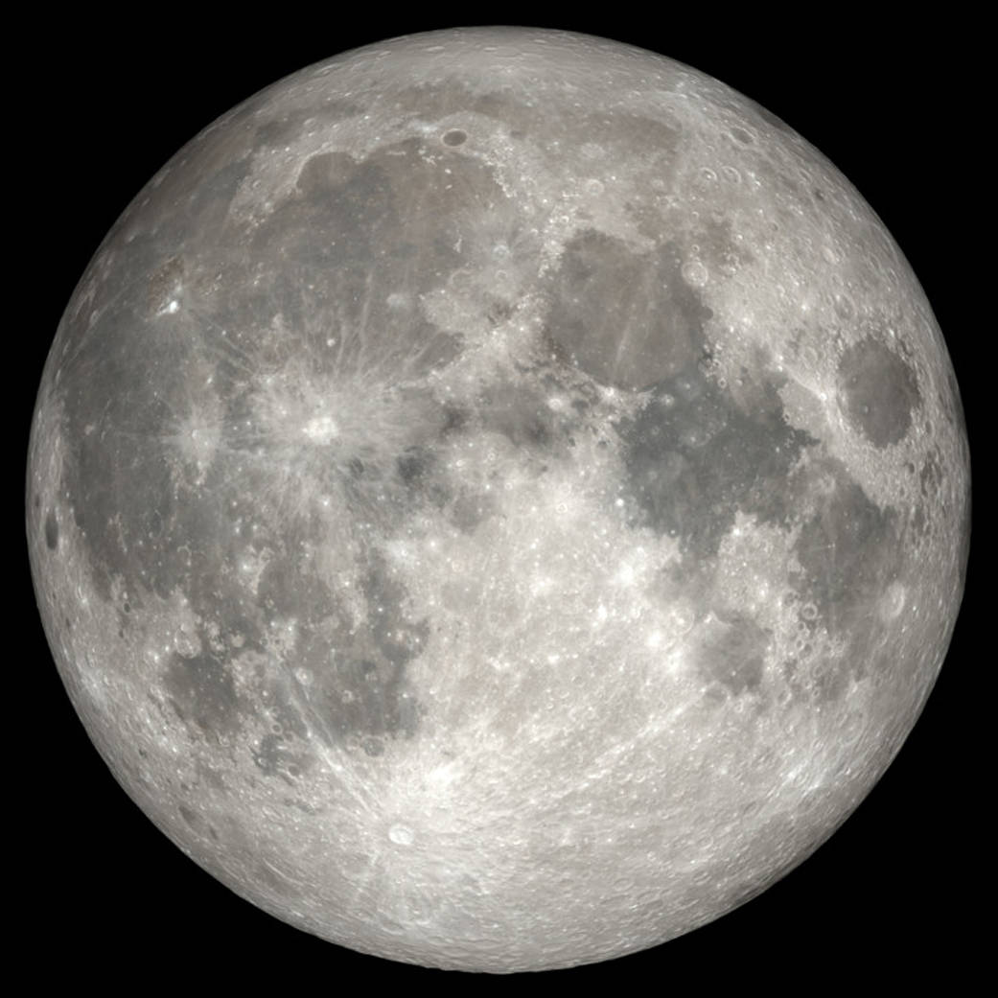

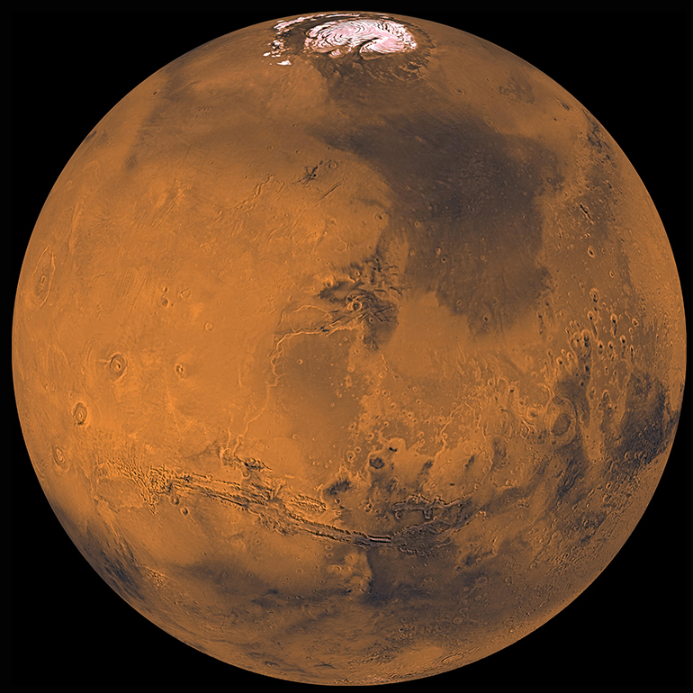
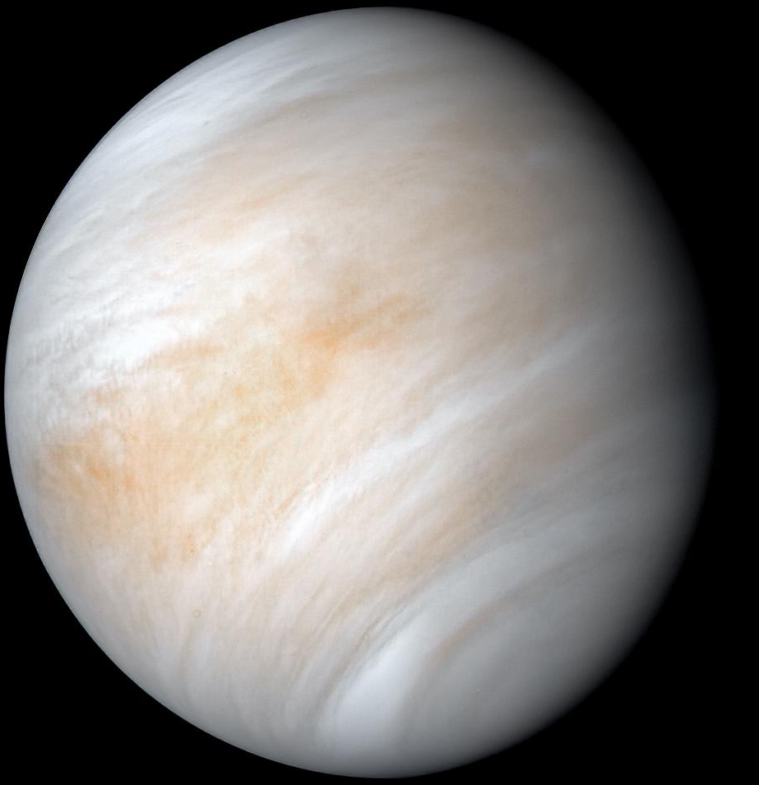
Venus Science Enabled by Human Proximity Workshop
Keck Institute for Space Studies
Interplanetary Trajectories Perspective
Patrick R. Chai
Exploration System Development Mission Directorate
Mars Architecture Team

Slide 2
Background
Mars “Opposition Class” missions have been of interest recently to enable shorter roundtrip missions to Mars; these mission can utilize Venus flybys to help reduce the total energy required
Compared to longer minimum energy “Conjunction Class” missions which utilize the planet’s natural motion around the Sun to minimize the roundtrip energy
ESDMD Mars Architecture Team (MAT) has been performing analysis to define the trade space and integrate with internal and external stakeholders to help identify potential options

Slide 3
Deep Space Mission “Change of Reference”
Earth is no longer the center of the reference frame
All scales and reference of existing human spaceflight are no longer representative
Earth
Moon
Apollo 13 Altitude Record: 400,000km
ISS: 420km
Avg. Distance 384,000km
Earth
Mars
Venus
Average Distance 40,000,000km
Average Distance 225,000,000km
Earth
Venus
Mars
Maximum Distance 260,000,000km
Maximum Distance 400,000,000km
Roundtrip Distance Traveled will be Significantly More!

Slide 4

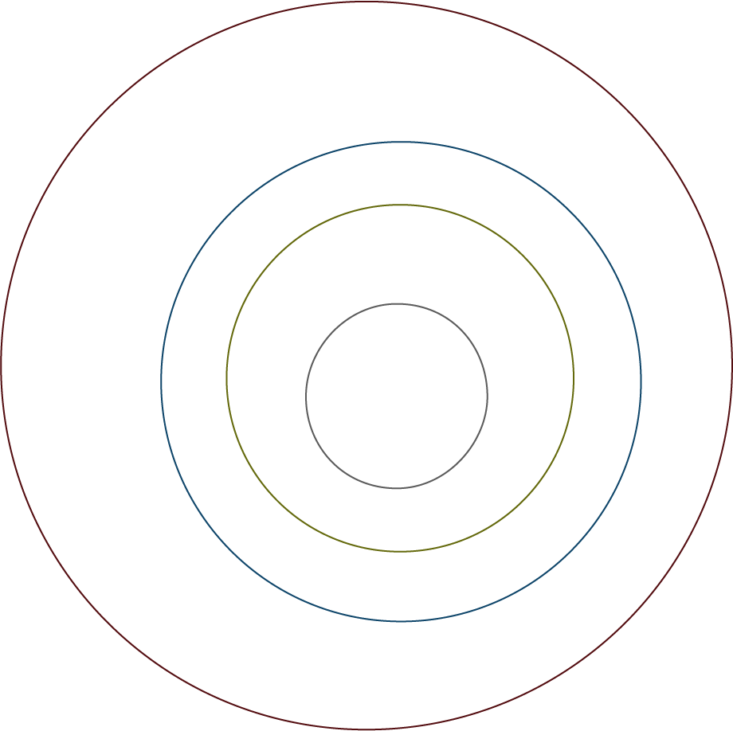



Getting to Mars or Venus
Interplanetary Transits are governed by heliocentric orbital dynamics
Relative Velocity between Planets & Spacecraft will dictate the energy required
Phasing is most important, must depart and arrive at the right time to minimize energy
Earth
Mercury
Sun
Venus
Mars

Slide 5
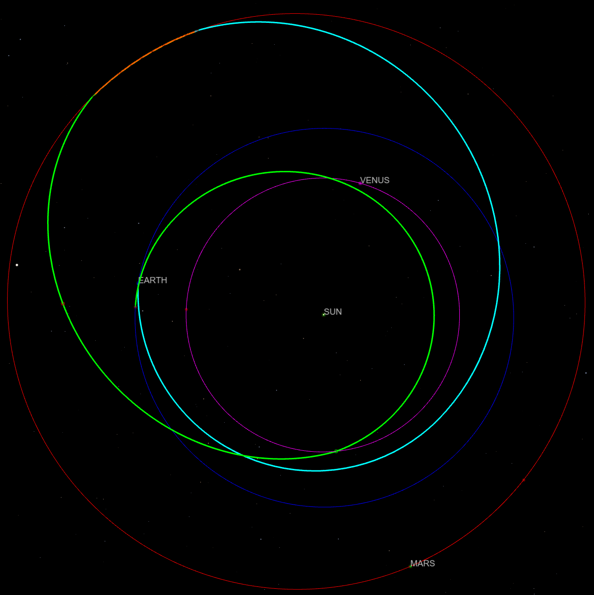
Example Mars + Venus Flyby Mission
Outbound
Stay
Inbound
2039 High Energy Roundtrip Mission to Mars with a Venus Flyby
From 400x400,000 km High Earth Orbit To: 1-Day Period Elliptical Mars Orbit
Earth Departure | 03/11/2039
Mars Arrival | 01/29/2040
Mars Departure | 03/20/2040
Venus Flyby | 10/05/2040
Earth Arrival | 03/18/2041
Outbound | 324 | Days
Stay | 51
Inbound | 363
Total | 738
Total ΔV | 8,867 | m/s

Slide 6
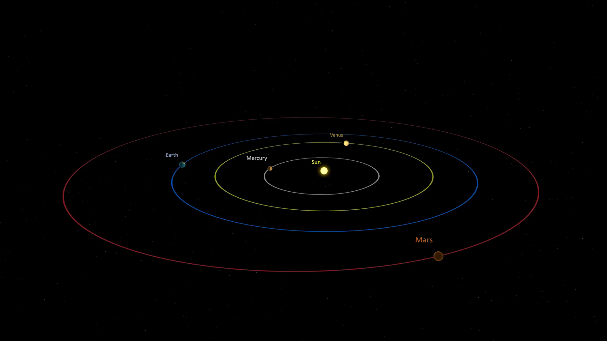
Visualization of Mars with Venus Flyby

Slide 7
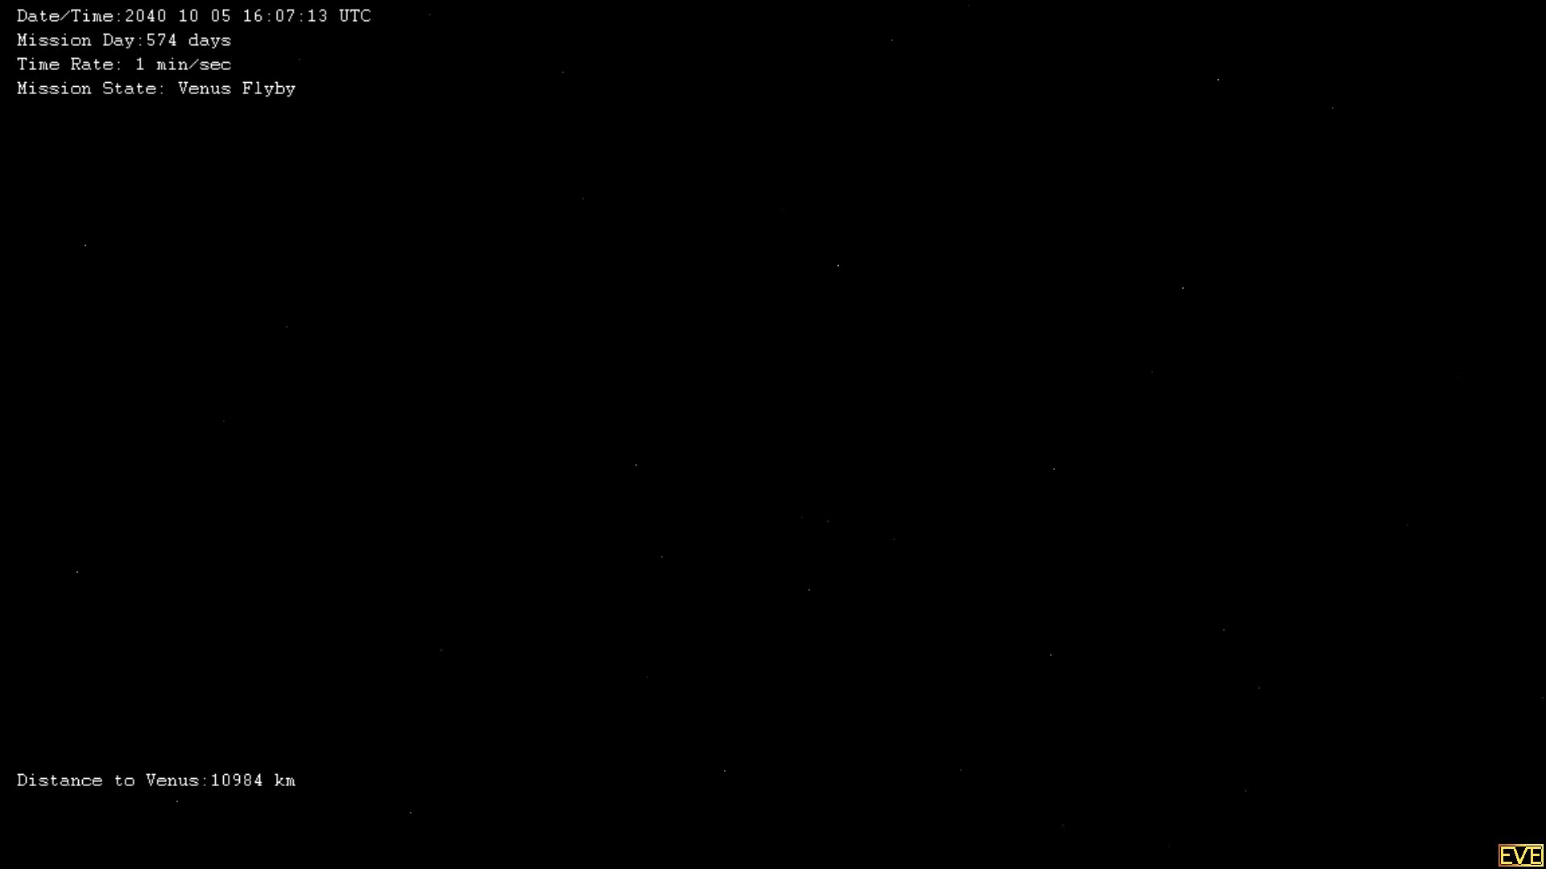
Example Venus Flyby

Slide 8
Example Direct Roundtrip Mission Comparisons
2039 Minmum Energy Roundtrip Mission to Mars
From 400x400,000 km High Earth Orbit To: 1-Day Period Elliptical Mars Orbit
Earth Departure | 09/20/2039
Mars Arrival | 08/25/2040
Mars Departure | 08/07/2041
Earth Arrival | 05/29/2042
Outbound | 340 | Days
Stay | 347
Inbound | 296
Total | 982
Total ΔV | 2,952 | m/s
2039 Minimum Energy Roundtrip Mission to Venus
From 400x400,000 km High Earth Orbit To: 1-Day Period Elliptical Venus Orbit
Earth Departure | 07/20/2039
Venus Arrival | 12/22/2039
Venus Departure | 03/17/2041
Earth Arrival | 08/04/2041
Outbound | 155 | Days
Stay | 450
Inbound | 140
Total | 745
Total ΔV | 2,218 | m/s

Slide 9
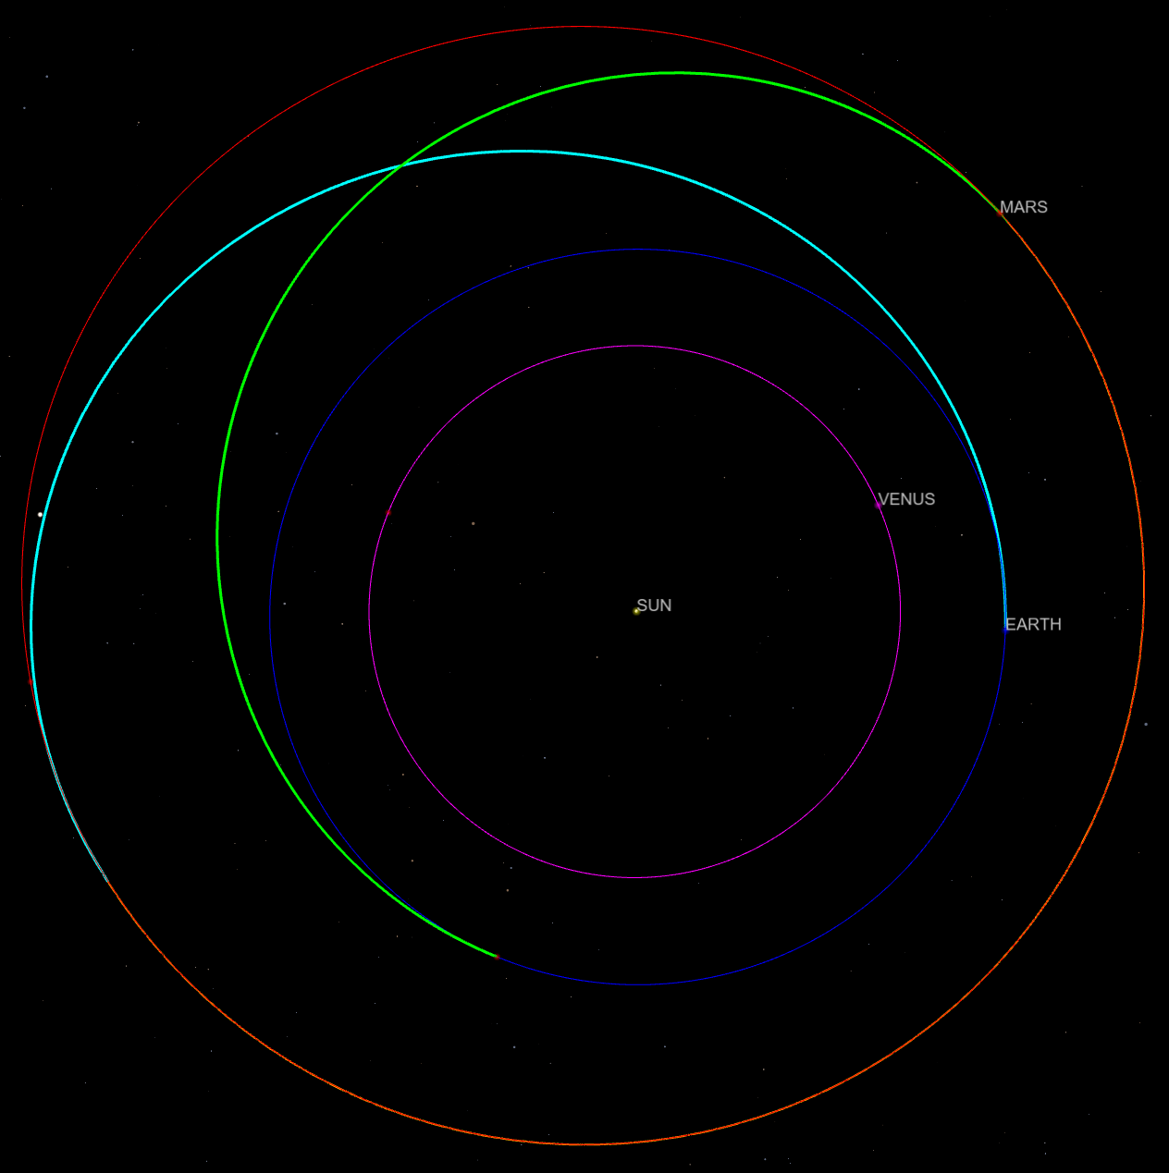
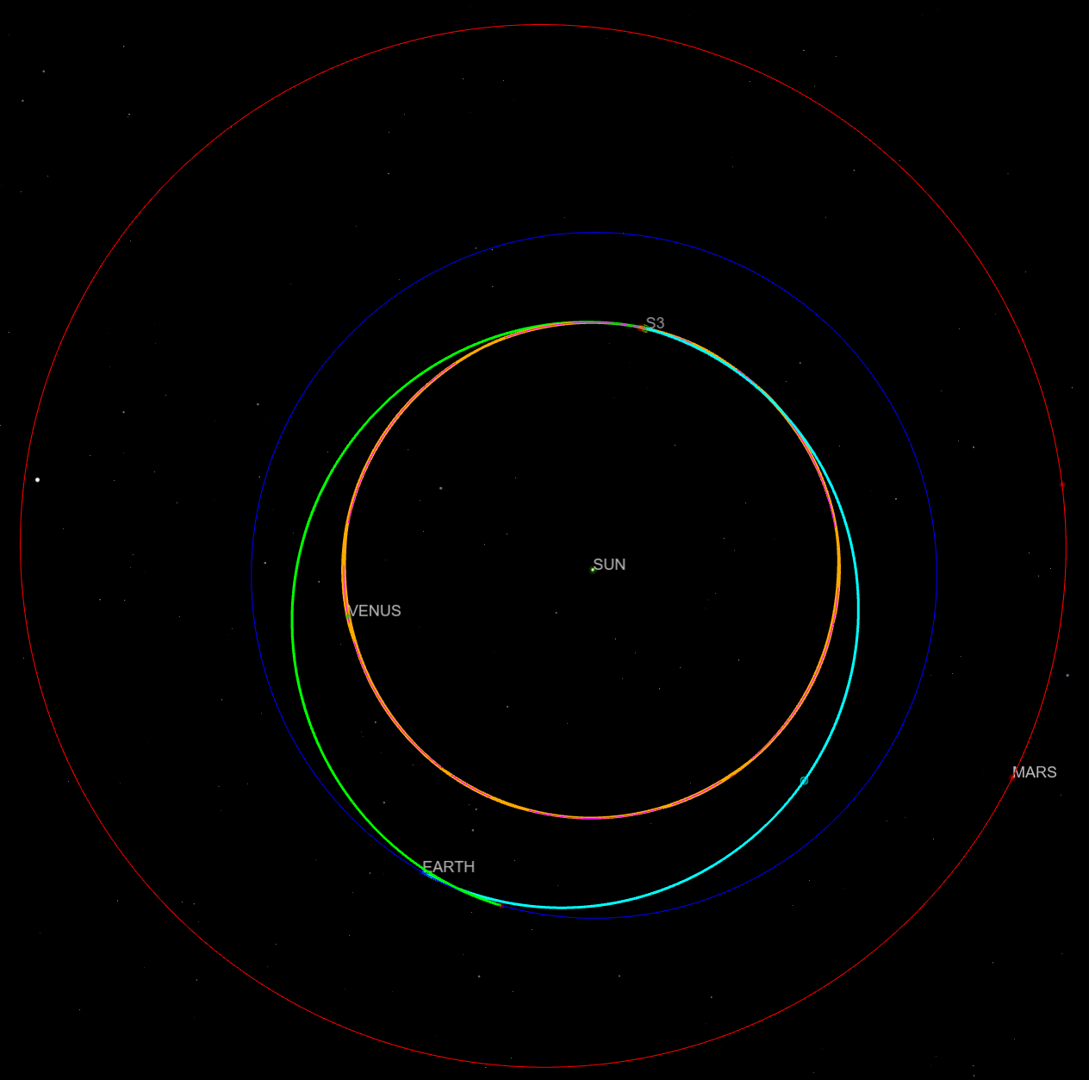
Example Roundtrip Mission Comparisons
Outbound
Outbound
Stay
Stay
Inbound
Inbound
2039 Minimum Energy Roundtrip to Mars – 982 Day Roundtrip
2039 Minimum Energy Roundtrip to Venus – 745 Days Roundtrip

Slide 10
The Energy cost
ΔV requirement translates to an exponential growth in mass
Figure shows the propellant mass required for a 100t and 200t spacecraft (including habitation) with chemical propulsion system
Minimum Energy Roundtrip mission ΔVs are in the 2-4 km/s range
Mars + Venus Flyby missions ΔVs are in the 7-10 km/s range

Slide 11
When does it make sense?
Venus flyby in the context of a Mars mission would help reduce the energy required for very short missions to Mars
But these missions are very high energy and require significant amount of mass to be launched and assembled in orbit
Forcing Flybys for longer missions will be costly
Duration where Flybys Provide Energy Saving
Current ESDMD Mars Study Reference

Slide 12
Summary
Conjunction (minimum energy) vs Opposition (high energy) has been a big part of the talking point, with opposition enabled by Venus flybys
Mars and Venus missions trade space is not bimodal, but rather a continuous space with regards to mission duration
Direct missions to Venus are somewhat comparable to Mars, but more analysis will be needed to understand the trade space
Venus flybys as part of a Mars mission are only worthwhile if total mission duration is suppressed, and will require significant technology investment and/or large number of launches to assemble the spacecraft

