Slide 1
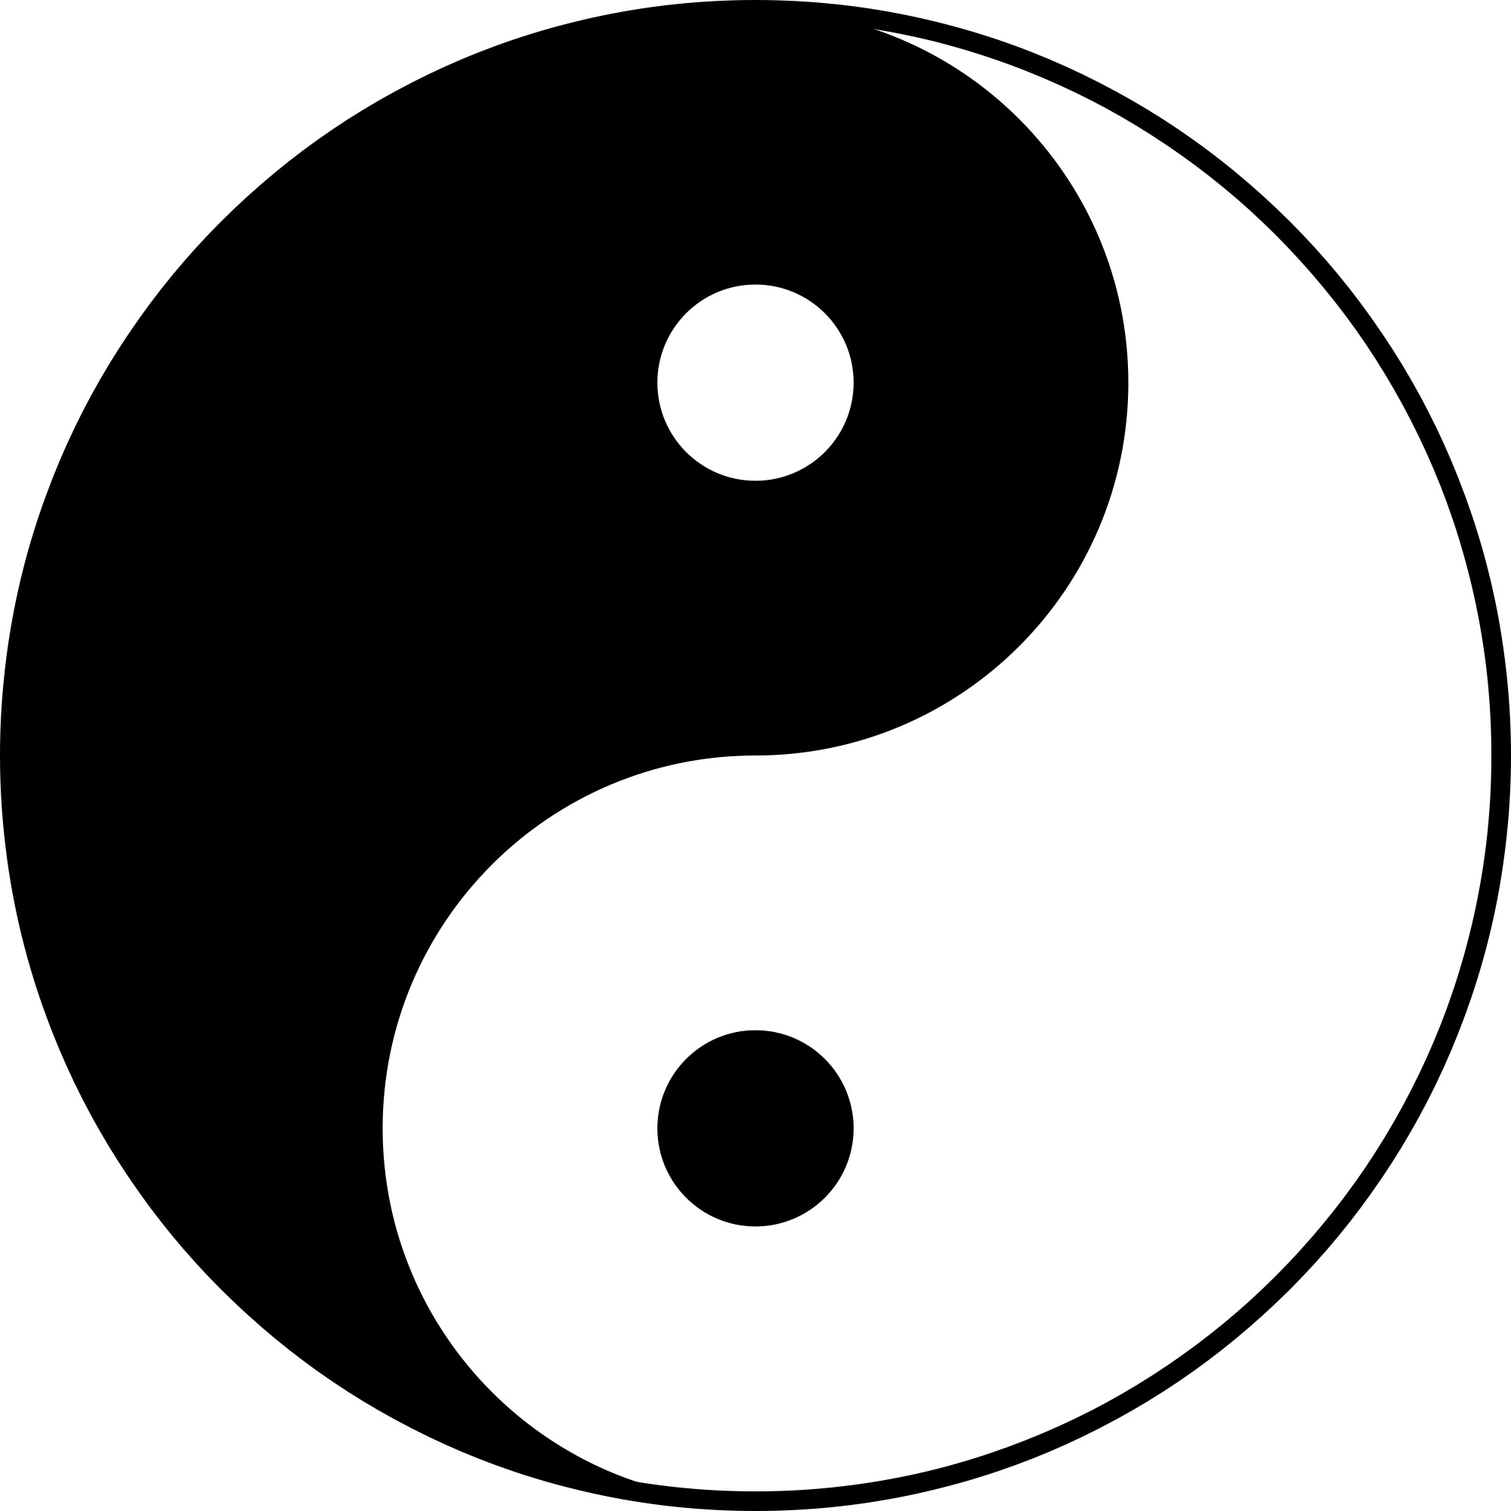
IEEE International Symposium on Electromagnetic Compatibility
August 1-5, 2022
The Yin/Yang Relationship Between Conducted and Radiated Coupling
August 1, 2022
John McCloskey
NASA/GSFC Chief EMC Engineer
John.C.McCloskey@nasa.gov
(301) 802-6274
Yin/Yang image by Unknown Author on this and subsequent pages licensed under CC BY-NC-ND

Slide 2
Acronyms
AC Alternating Current
AF Antenna Factor
CMCE Common Mode Conducted Emissions
CMCS Common Mode Conducted Susceptibility
DC Direct Current
EMC Electromagnetic Compatibility
EMI Electromagnetic Interference
RF Radio Frequency

Slide 3
Topics
Introduction/Executive Summary
Dipole Antenna Basics
Radiated Fields from Current-Carrying Wire
Field-to-Wire Coupling – Transmission Line Model
Mitigation Strategies
Summary

Slide 4
Introduction
One of the biggest challenges an EMC engineer faces on a nearly daily basis is the need to convince electronics developers that EMI actually exists as something to which they should pay attention
To an electronics designer who is accustomed to thinking in terms of voltages and currents, the concept of radiated energy is a mere abstraction and a distraction from their work. (“I can’t see it, I can’t smell it, I can’t feel it, so why should I care?”)
Purposes of this presentation:
  Provide basis for understanding yin/yang relationship between conducted and radiated coupling
  Show how to correlate radiated energy to voltages and currents that electronics designers understand and provides tangible guidance that electronics designers can implement in order to better control radiated emissions and susceptibility.
  Provide tools for EMC engineers to explain these concepts to electronics designers to get them to finally “see it, smell it, feel it, taste it, etc.”

Slide 5
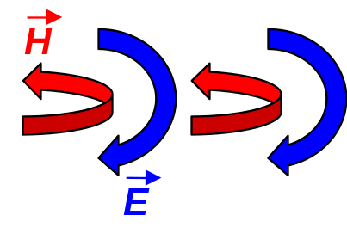
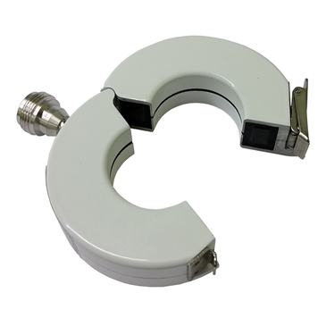
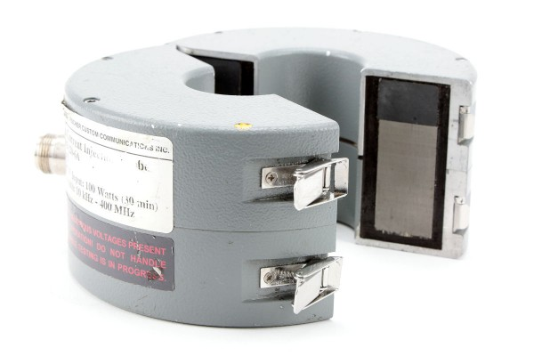
Executive Summary
Voltages and currents in culprit equipment...
...produce electric and magnetic fields...
...that produce voltages and currents in victim equipment
V
I
I
V
Current emissions and susceptibility measurements possible
Provide indirect assessement of radiated emissions and susceptibility
May be peformed in hardware development laboratory before bringing equipment to dedicated EMI test facility

Slide 6
Dipole Antenna Basics
Inspired by Henry Ott’s “Dipoles for Dummies”
Antenna is transducer between conducted and radiated energy
Antenna is formed by establishing an RF potential between two conductors
Capacitance between two conductors provides current path
Dipole provides simple analytical model for upper bound of radiated efficiency of unintentional antenna
I_{T}
I_{R}
+
H
+
V_{T}
V_{R}
-
-
E

Slide 7
Unintentional Radiators, a.k.a. Antennas
If any part of your equipment radiates or is susceptible to radio frequency (RF) energy, you have created an antenna whether or not you call it one
Unintentional antenna can be formed between any two conductors, e.g.:
  Cable and chassis
  Cable and ground plane (structure)
  PC board trace and chassis
  Poorly bonded connector and chassis (seams on chassis)
  Etc.
RADIATED FIELDS
I_{CM}

Slide 8

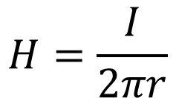


Radiated Fields from Current-Carrying Wire
(Bare Wire in Space - No Ground Plane Cancellation)
CURRENT PRODUCES
MAGNETIC FIELD- AMPÈRE’S LAW
(accurate close to long wire)
CURRENT PRODUCES
ELECTRIC FIELD
(worst-case upper bound approximations; details in backup slides)
l
I
I
$$H=\frac{I}{2πr}$$
r
r
(B = μ₀H)
Electrically short wire (l < λ/10):
B = magnetic flux density
$$E_{short}≈\frac{μ_{0}lfI}{2r}$$
H = magnetic field intensity
Maximum for tuned half-wave dipole:
µ₀ = permeability of free space
$$E_{MAX}=\frac{60 I}{r}$$
(~ 1.3 µH/m)

Slide 9
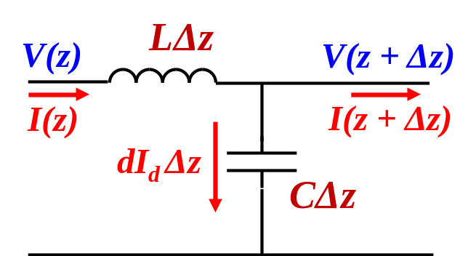
Wire-Above Ground Transmission Line
Cable above ground plane behaves as wire-above-ground transmission line
Transmission line current has horizontal and vertical components
  Horizontal component is current flowing on wire itself
  Vertical component is displacement current flowing in dielectric of transmission line
Resulting electric field will have horizontally and vertically polarized components with magnitudes corresponding to horizontal and vertical current components
Electric field will be function of average current integrated along length of wire
Details in backup slides
h = 5 cm per MIL-STD-461
l
I_{H}
Lossless transmission line model
I_{V}
E_{V}
E_{H}

Slide 10
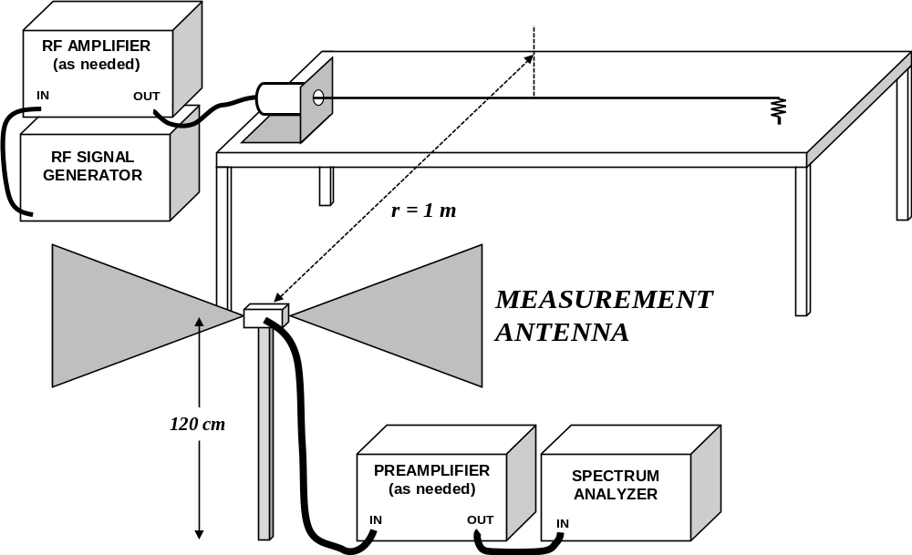
|E/I| Measured vs. Predicted for 1-Meter Wire
Predicted envelope derived in backup slides
Additional info provided in “Radiated Emissions as a Function of Common Mode Current,” demo recorded for 2016 IEEE EMC Symposium by John McCloskey and Jen Dimov (link on “References” page)
I
E
80-90 cm

Slide 11
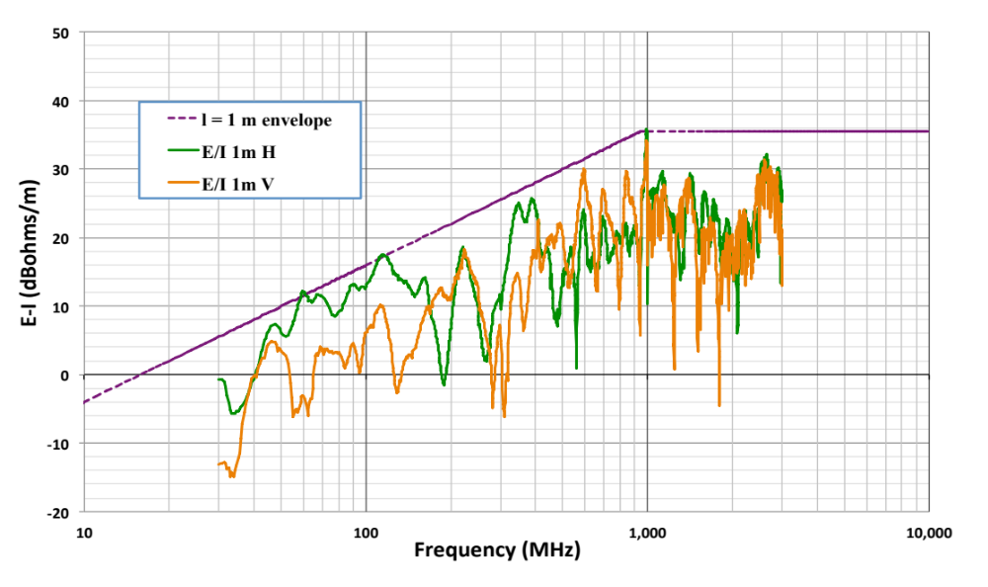
|E/I| Measured vs. Predicted for 1-Meter Wire (cont.)
Predicted |E/I| envelope provides reasonable upper bound for measured values
THEORY
EXPERIMENT

Slide 12
Current and Fields – Things to Consider
Measured current is excellent predictor of magnetic field in close proximity to long wire
  Per Ampère’s Law (current probe directly employs that very principle)
  Useful for assessing coupling to nearby conductors, a.k.a. “near field” (e.g. crosstalk)
Measured current is useful for predicting UPPER BOUND for the electric field (horizontal and vertical components) measured in far field
  Most likely common mode current on bulk cable (can be measured directly with current probe; no disconnections or power cycles needed)
These analytical techniques are NOT intended nor useful for estimating a current on a wire/cable from a measured electric field in the near field
  VERY large error bar if attempted in that direction
I
Current monitor probe employs Ampère’s Law

Slide 13


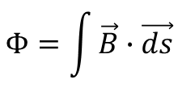
Magnetic Coupling: Faraday’s Law
Time-varying magnetic flux through loop induces potential
  a.k.a. electromotive force (emf)
B
CULPRIT CIRCUIT
I_{C}
VICTIM CIRCUIT
Total magnetic flux through loop:
V_{emf}
$$Φ=\int{\vec{B}∙\vec{ds}}$$
Induced potential:
$$V_{emf}=−\frac{dΦ}{dt}$$

Slide 14

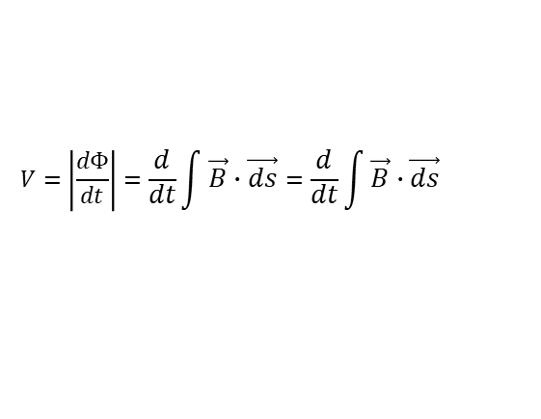
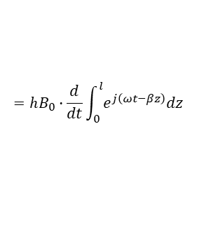
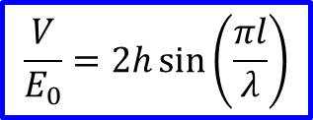




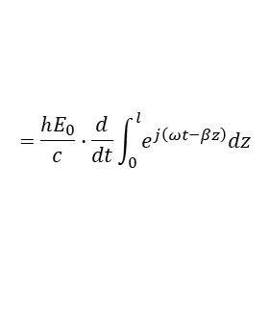

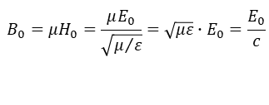
Field-to-Wire Coupling – Transmission Line Model
Inspired by Ken Javor, “On Field-to-Wire Coupling Versus Conducted Injection Techniques”
l
h
Incident plane wave oriented for worst-case coupling
(H-field normal to loop)
+
E
V
+z
-
h = 5 cm per MIL-STD-461
H
Faraday’s Law:
$$E(t,z)=E_{0}e^{j\left(ωt−βz\right)}$$
$$V=\left|\frac{dΦ}{dt}\right|=\frac{d}{dt}\int{\vec{B}∙\vec{ds}}=\frac{d}{dt}\int{\vec{B}∙\vec{ds}}$$
$$H(t,z)=H_{0}e^{j\left(ωt−βz\right)}$$
$$B(t,z)=B_{0}e^{j\left(ωt−βz\right)}$$
$$=hB_{0}∙\frac{d}{dt}\int_{0}^{l}{e^{j\left(ωt−βz\right)}dz}$$
Wave impedance:
$$\frac{E}{H}=η=\sqrt{\frac{μ}{ε}}=120π≈377 Ω$$
(air/vacuum)
$$=\frac{hE_{0}}{c}∙\frac{d}{dt}\int_{0}^{l}{e^{j\left(ωt−βz\right)}dz}$$
Velocity of propagation:
$$c=\frac{1}{\sqrt{με}}=3×{10}^{8} m/s$$
(air/vacuum)
Derivation in backup slides
B in terms of E:
$$B_{0}=μH_{0}=\frac{μE_{0}}{\sqrt{μ/ε}}=\sqrt{με}∙E_{0}=\frac{E_{0}}{c}$$
$$\frac{V}{E_{0}}=2h\sin\left(\frac{πl}{λ}\right)$$
Wavenumber:
$$β=\frac{ω}{c}=\frac{2π}{λ}$$

Slide 15
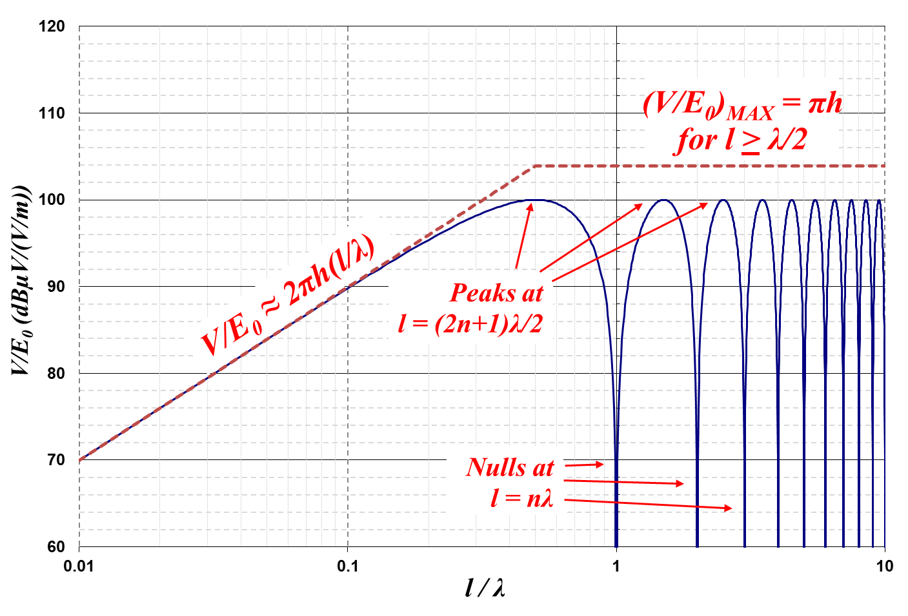
Field-to-Wire Coupling – Transmission Line Model (cont.)
(V/E)_{MAX} =
150 mV/(V/m)
for h = 5 cm
= 104 dBµV/(V/m)

Slide 16

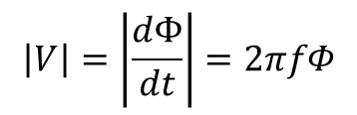




Field-to-Wire Coupling – Transmission Line Model (cont.)
B(z)
l = λ/2
B(z)
l = λ
z
Net coupled flux decreases with frequency
z
$$Φ=Φ_{MAX}$$
$$Φ=0$$
Cancellation
B(z)
l = 3λ/2
B(z)
l = 2λ
z
$$Φ=\frac{Φ_{MAX}}{3}$$
z
$$Φ=0$$
Cancellation
B(z)
l = 5λ/2
B(z)
l = 3λ
z
$$Φ=\frac{Φ_{MAX}}{5}$$
z
$$Φ=0$$
$$\left|V\right|=\left|\frac{dΦ}{dt}\right|=2πfΦ$$
Increases with frequency
But:
Constant B (vs. f )
→ Constant V_{peak}
B(z)

Slide 17
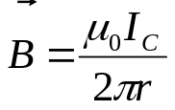
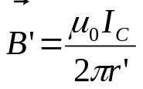
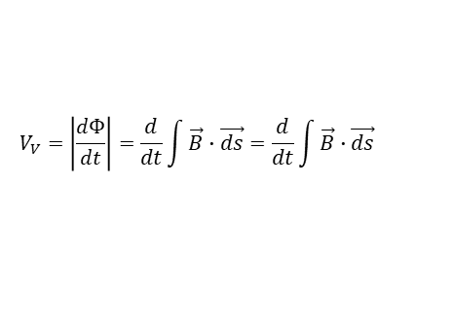
Cable-to-Cable Inductive Crosstalk
Similar analysis applies to cable-to-cable crosstalk
  Coupled potential in terms of culprit current instead of incident electric field
Once again, it comes down to Faraday’s Law (details in backup)
Magnetic flux density due to culprit wire
b = culprit to victim cable separation,
h = height of cables above ground plane
a = wire radius
r
VICTIM WIRE
I_{C}
b
I_{v}
h
CULPRIT WIRE
V_{v}
Faraday’s Law:
$$V_{V}=\left|\frac{dΦ}{dt}\right|=\frac{d}{dt}\int{\vec{B}∙\vec{ds}}=\frac{d}{dt}\int{\vec{B}∙\vec{ds}}$$
r'
CULPRIT IMAGE
Magnetic flux density due to culprit image

Slide 18
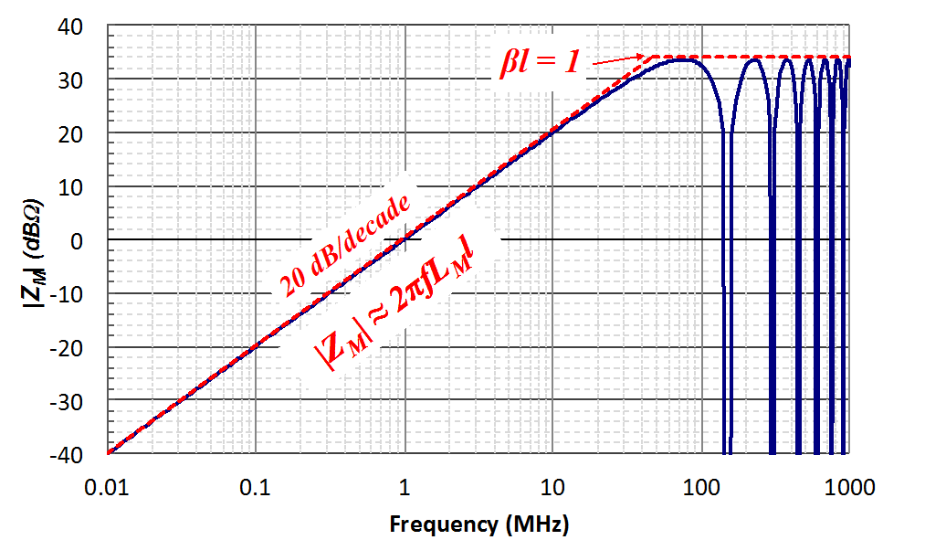
Predicted Coupled Voltage Due to Average Current
Example: b = h = 5 cm, l = 1 m
Transfer impedance:
Induced victim potential as function of culprit current

Slide 19
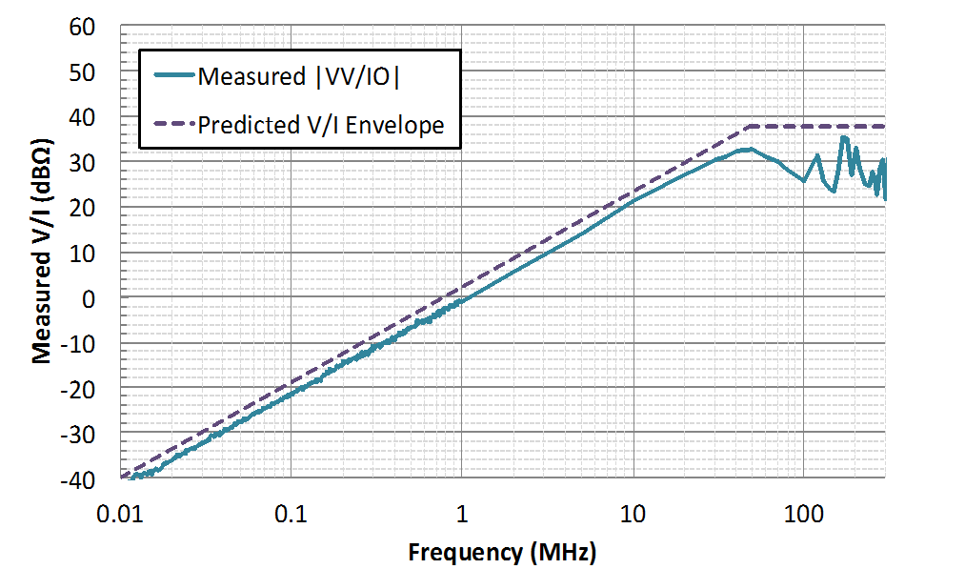
Measured Coupled Voltage Due to Average Culprit Current
Example: b = h = 5 cm, l = 1 m

Slide 20
Field-to-Wire Coupling / Crosstalk Summary
Incident field induces potential in wire-above-ground loop (Faraday’s Law)
Induced current is determined by impedance of configuration
For shielded cable with shields terminated to chassis at both ends:
  Impedance is dominated by loop inductance for l < λ/2 (~1 μH/m for h = 5 cm)
  Impedance plateaus at characteristic impedance of wire-above-ground transmission line for l > λ/2 (~300 Ω for h = 5 cm); wire-above-ground transmission line parameters in backup slides
MIL-STD-461G CS114 test method for bulk cable injection
  Developed specifically to simulate coupled currents from incident fields (injection probe employs Faraday’s Law)
  Includes precalibration step into 100 Ω fixture, giving “transfer function” in high frequency plateau of 1.5 mA per V/m; actual injected current determined by loop impedance
  Injects common mode current on bulk cable; no disconnections or power cycles needed
I
V
Current injection probe employs Faraday’s Law

Slide 21

Tuned Half-Wave Dipole Parameters (Worst-Case Coupling)
Tuned half-wave dipole
antenna factor effective height h_{e}
(ratio of open-circuit received potential to incident electric field):
I_{R}
+
$$h_{e}=\frac{V_{R}}{E}=\frac{λ}{π}$$
V_{R}
-
Tuned half-wave dipole impedance
(details in backup slides):
73 Ω
Useful analytical tools for calculating worst-case coupling to victim equipment
V
I

Slide 22
Mitigation Strategies: Twisted Pairs
Provide dedicated return path for differential mode currents
  Twist (+) and (-) wires together
Emissions
  Provides return current path to cancel culprit current
  Reduced net current reduces net magnetic field
Susceptibility
  Reduced loop area
  Voltages induced on adjacent half-twist loops cancel
  Worst case induced voltage is that induced on loop area of single half twist
Total enclosed I → 0
Net B → 0
I_{C}
CULPRIT CIRCUIT
V_{C}
R_{L}
I_{C}
V_{HT1}
V_{HT2}
V_{HT3}
V_{HT4}
V_{HT5}
VICTIM CIRCUIT
+
-
+
-
+
-
+
-
+
-
R_{NE}
R_{FE}

Slide 23
Mitigation Strategies: Shielding
Emissions
  Culprit common mode noise current couples to its own shield and returns to its source
  Minimizes emissions
Susceptibility
  Any remaining current that makes its way to victim couples to victim’s shield and gets shunted back to source (via ground), protecting victim signal wire(s)
  Incident field couples to shield, which shunts current away from signal-carrying conductors
Shields must provide low impedance path back to source
  Includes shield terminations, connector to chassis connections, reference plane to chassis connections, etc.
CULPRIT CIRCUIT
V_{C}
I_{C}
I_{CV}
C_{CV}
VICTIM CIRCUIT
R_{NE}

Slide 24

Mitigation Strategies: Route Cable Over Ground Plane
ROUTING CABLE OVER GROUND PLANE PROVIDES ADDITIONAL LOW IMPEDANCE RETURN PATH FOR COMMON MODE CURRENTS, FURTHER REDUCING RADIATED FIELDS
BOX A
BOX B
I_{CM}
ROUTING CABLE OVER GROUND PLANE MINIMIZES LOOP AREA, THUS MINIMIZING OPPORTUNITY FOR COMMON MODE COUPLING

Slide 25
Common Mode Current Measurements
Measure common mode conducted emissions (CMCE) and common mode conducted susceptibility (CMCS) at component level
Measure on all cables (power and signal) to provide:
  Direct assessment of cable-to-cable crosstalk risk
  Indirect assessment of radiated emissions and radiated susceptibility
Use clamp-on current probes
  Easily move from cable-to-cable
  No disconnections or power cycles needed
  May be performed in hardware development lab before taking product to EMI facility
  Don't have to fight RF background, room resonances, etc.
  Identify specific sources of potential problems as early as possible
Current monitor probe for CMCE
Current injection probe for CMCS

Slide 26
Summary
Radiated and conducted EMI issues are "joined at the hip”
  You can’t have one without the other
  Well-established analytical techniques facilitate correlation between the two, giving EMC engineers useful tools for explaining issues to electronics engineers in terms they will best understand (voltages and currents)
Current probe is your friend
  Measure currents early and often; anechoic chamber not needed
  Measure in development lab long before going to EMI lab
Control current return paths
  Provide desired low impedance path (e.g. dedicated return wire, twisted pair, shield, ground plane, etc.) and make them flow where you want them to
  Let nature do the work
When you control your current return paths, you go a long way toward controlling radiated EMI problems

Slide 27
References
Textbooks
  Ott, Henry: Electromagnetic Compatibility Engineering
  Paul, Clayton: Introduction to Electromagnetic Compatibility
  Cheng, David: Field and Wave Electromagnetics
Papers, articles, etc.
  Henry Ott, “Dipoles for Dummies”
    http://www.hottconsultants.com/pdf_files/dipoles-1.pdf
    http://www.hottconsultants.com/pdf_files/dipoles-2.pdf
  Ken Javor, “On Field-to-Wire Coupling Versus Conducted Injection Techniques”, 1997 IEEE EMC Symposium record
Video of hardware demonstration
  John McCloskey and Jen (Roberts) Dimov, “Radiated Emissions as a Function of Common Mode Current,” recorded for 2017 IEEE EMC Symposium
    https://ieeetv.ieee.org/radiated-emissions-as-function-of-common-mode-current-emc-society-demo

Slide 28
BACKUP

Slide 29






Electric Field, Potential, and Capacitance
Electric field is negative gradient of potential (units of V/m)
Capacitance is the ratio of charge to potential between 2 conductors
Capacitive reactance decreases with frequency
Time-varying electric field induces displacement current (I_{D}) through dielectric
Area (A)
+Q
+
d
$$\vec{E}=−∇V$$
$$I_{D}=C\frac{dV}{dt}$$
V
-
-Q
Capacitance:
Parallel plate:
Capacitive reactance (decreases with frequency):
$$C=\frac{Q}{V}$$
$$C=\frac{ε_{0}A}{d}$$
$$X_{C}=\frac{1}{jωC}$$
ε₀ = permittivity of free space
(~ 8.84 pF/m)

Slide 30
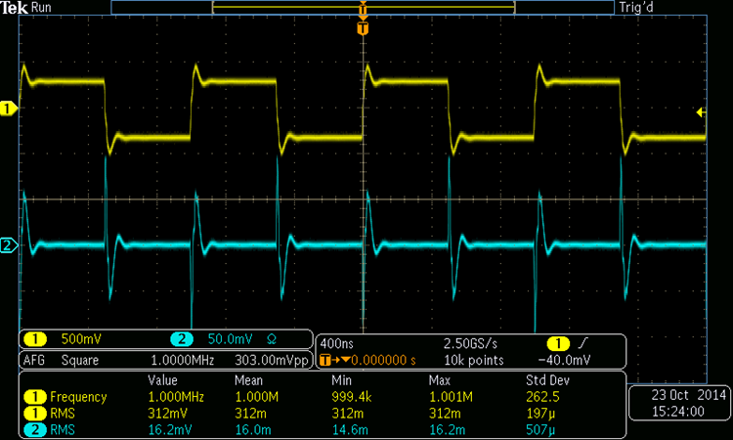





Electric Field (Capacitive) Coupling
AC potential in culprit circuit couples AC potential in victim circuit according to impedance divider
More likely between unshielded conductors in close proximity (e.g. adjacent PC board traces, unshielded wires, etc.)
CAPACITIVE COUPLING EXAMPLE
+
V_{C}
CULPRIT
CULPRIT CIRCUIT
I_{C}
I
R₂
-
C
+
V_{V}
-
VICTIM
R₁
$$I=C\frac{dV}{dt}$$
VICTIM CIRCUIT
Victim circuit resistance:
$$I=C\frac{dV}{dt}≈\left(200 pF \right)\left(\frac{500 mV}{50 nsec}\right)≈2 mA$$
$$R_{V}=R_{1}||R_{2}$$
Coupled potential into victim circuit:
$$V_{V}≈\left(2 mA\right)\left(25 Ω\right)≈50 mV$$
$$V_{V}≈IR_{V}$$
50 Ω // 50 Ω

Slide 31
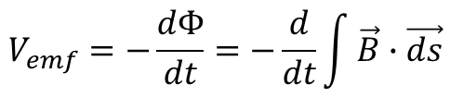


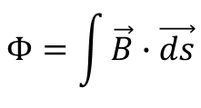
Magnetic Field (Flux), Current, and Inductance
Magnetic flux induces potential (emf) in loop (Faraday’s Law)
  Magnitude is time derivative of total magnetic flux through loop (Φ)
  Induced emf opposes (impedes) coupled flux (negative sign)
Inductance is the ratio of induced magnetic flux to the current causing it
Inductive reactance increases with frequency
Total magnetic flux through loop:
B
$$Φ=\int{\vec{B}∙\vec{ds}}$$
I_{C}
induced potential (emf):
$$V_{emf}=−\frac{dΦ}{dt}=−\frac{d}{dt}\int{\vec{B}∙\vec{ds}}$$
V_{emf}
Inductance:
Inductive reactance (increases with frequency):
$$L=\frac{Φ}{I}$$
$$X_{L}=jωL$$

Slide 32
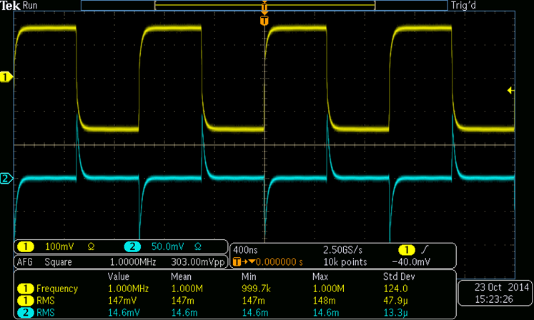



Magnetic Field (Inductive) Coupling
Magnetic flux generated by culprit current produces noise potental in victim circuit (Faraday’s Law)
More likely at system level, e.g. cable-to-cable crosstalk
B
INDUCTIVE COUPLING EXAMPLE
CULPRIT
CULPRIT CIRCUIT
I_{C}
VICTIM
$$V_{emf}=−\frac{dΦ}{dt}=−L_{M}\frac{dI}{dt}$$
VICTIM CIRCUIT
Mutual inductance:
$$\left|V_{emf}\right|=L_{M}\frac{dI}{dt}≈\left(1 μH\right)\left(\frac{6 mA}{50 nsec}\right)≈120 mV$$
$$L_{M}=\frac{Φ}{I_{C}}$$
6 mA = 300 mV / 50 Ω

Slide 33
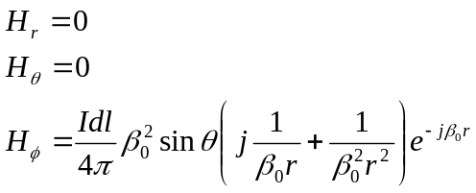
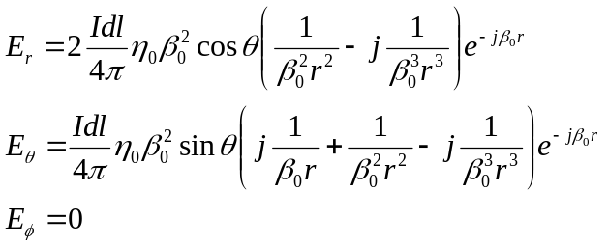







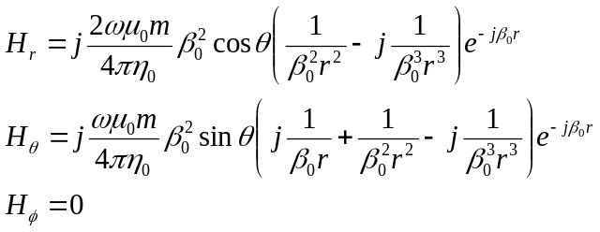
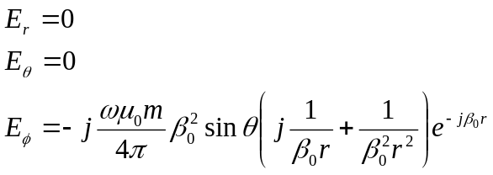




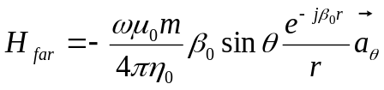


Radiated Fields from Elemental Dipoles
Electric (Hertzian) Dipole
z
θ
r
Complex dependence on 1/r and 1/r² in near field
Complex dependence on 1/r, 1/r², & 1/r³ in near field
dl
y
x
Wavenumber:
Only 1/r dependence remains in far field
Only 1/r dependence remains in far field
z
Magnetic (Loop) Dipole
θ
r
Complex dependence on 1/r, 1/r², & 1/r³ in near field
I
Complex dependence on 1/r and 1/r² in near field
b
y
x
Only 1/r dependence remains in far field
Only 1/r dependence remains in far field
Magnetic dipole moment:

Slide 34









Radiated Field from Electrically Short Wire
(Bare Wire in Space - No Ground Plane Cancellation)
Velocity of propagation:
Wave impedance:
Wavenumber:
$$c=\frac{1}{\sqrt{μ_{0}ε_{0}}}≈3×{10}^{8} m/s$$
(air/vacuum)
$$η_{0}=\sqrt{\frac{μ_{0}}{ε_{0}}}=120π≈377 Ω$$
(air/vacuum)
$$β_{0}=\frac{2π}{λ}=\frac{2πf}{c}=2πf\sqrt{μ_{0}ε_{0}}$$
z
A Very Sick Integral:
$$E_{θ}=\int_{−l/2}^{l/2}{\frac{I(z)}{4π}η_{0}β_{0}^{2}\sin{θ}\left(j\frac{1}{β_{0}r}+\frac{1}{β_{0}^{2}r_{0}^{2}}−j\frac{1}{β_{0}^{3}r_{0}^{3}}\right)}e^{−jβ_{0}r}dz$$
θ
l
Far field assumption for high frequencies (β₀r > 1):
r
$$E_{θ}=\int_{−l/2}^{l/2}{j\frac{I(z)}{4π}η_{0}β_{0}\sin{θ}\frac{e^{−jβ_{0}r}}{r}}dz$$
(still a bit sick)
Additional simplifying assumptions:
Wire is electrically short (l < λ/10)
θ = 90º (sin θ = 1)
r is constant for all points along wire
Current is constant along length
All contributions are in phase
(unrealistic, but provides useful worst-case upper bound)
$$E_{MAX}≈\frac{Il}{4πr}η_{0}β_{0}$$
$${η_{0}β}_{0}=2πfμ_{0}$$
$$E_{MAX}≈\frac{μ_{0}lfI}{2r}$$
Upper bound for ELECTRICALLY SHORT wire

Slide 35






Radiated Fields from Finite Linear Dipole
z
“h” used for height of each diplole “leg”
R’
θ
h
R
dz
I_{m}
h
= 0 with symmetrical integration limits
But:
CONTINUED…

Slide 36
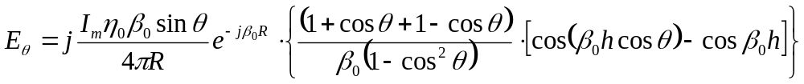
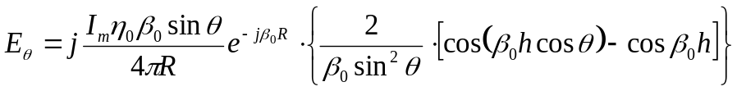


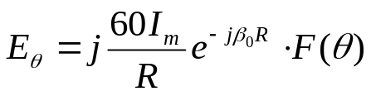
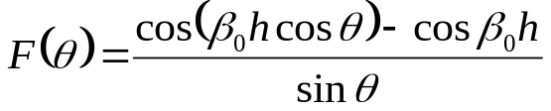
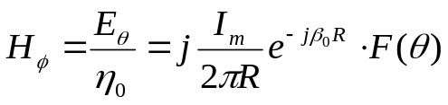


Radiated Fields from Linear Dipole (cont.)
Pattern Function:
Maximum field levels for tuned half-wave dipole (h = λ/4) and θ = 90º:
$$E_{MAX}=\frac{60 I_{M}}{R}$$
$$H_{MAX}=\frac{I_{M}}{2πR}$$

Slide 37
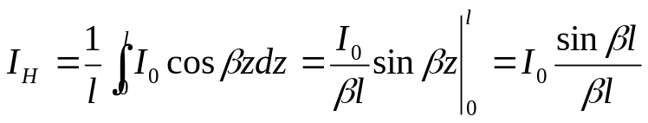

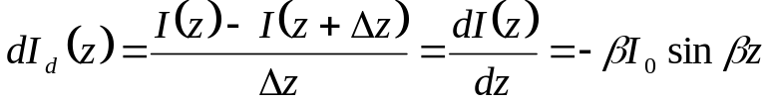
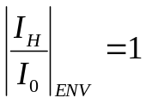

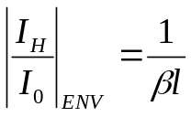
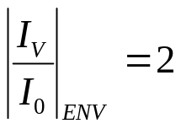
Transmission Line Currents
Current on wire:
I(z) = I₀e ^{–j βz}
Re[I(z)] = I₀cosβz
Integrated average horizontal current:
Integrated average vertical current:
βl < 1:
l = λ/2π is breakpoint
βl > 1:

Slide 38
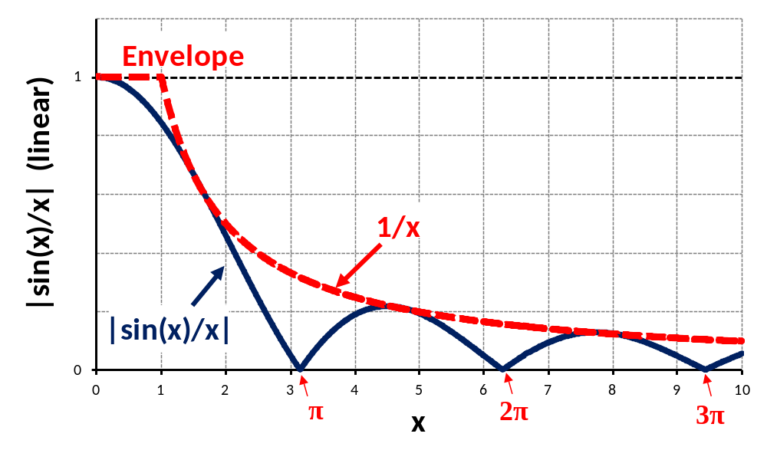
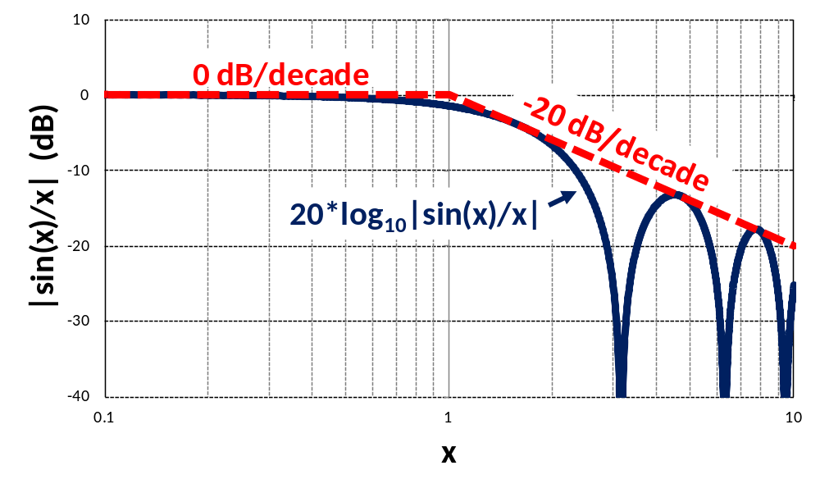
Response and Envelope of sin(x)/x
Response of |sin(x)/x|:
0 for x = nπ
1/x for x = (n+1)π/2
Envelope of |sin(x)/x|:
1 for x < 1
1/x for x > 1
Lines meet at x = 1

Slide 39
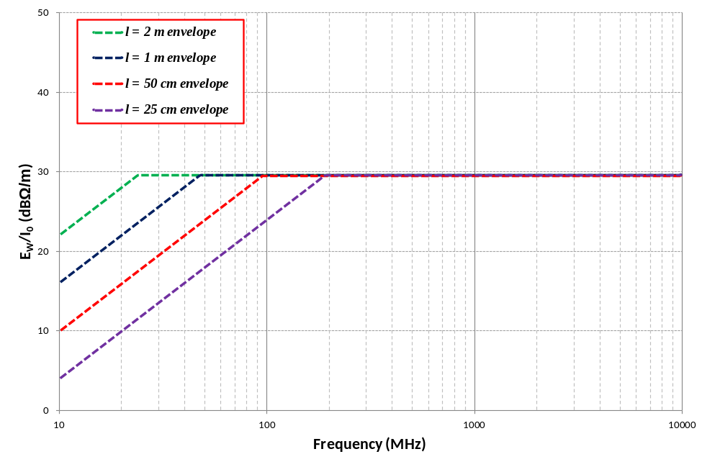
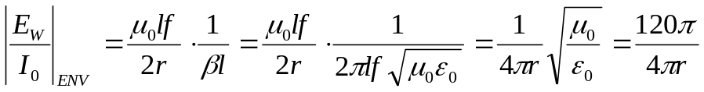
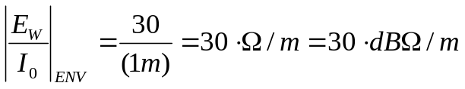
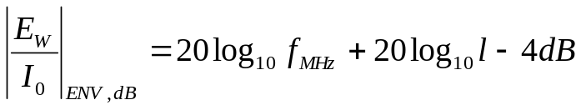

Horizontal E-Field (No Ground Plane Attenuation)
h = 5 cm per MIL-STD-461G
$${\left|\frac{E_{W}}{I_{0}}\right|}_{ENV}=\frac{4π×{10}^{−7}}{2(1 m)}∙lf=\left(2π×{10}^{−7}\right)∙lf$$

Slide 40
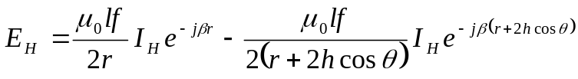
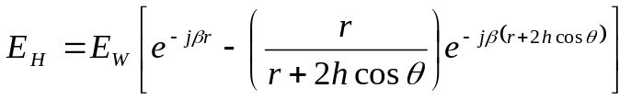
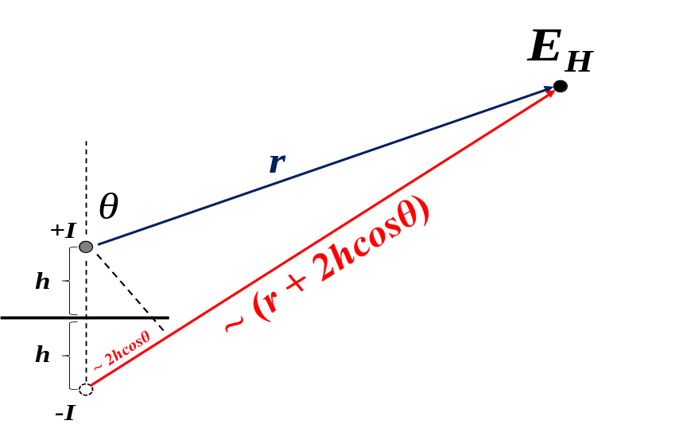
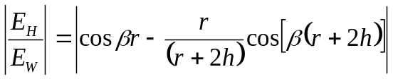







Ground Plane Attenuation (Horizontal Polarization Only)
$$E_{H}=\frac{μ_{0}lf}{2r}I_{H}\left[e^{−jβr}−\left(\frac{r}{r+2h\cos{θ}}\right)e^{−jβ\left(r+2h\cos{θ}\right)}\right]$$
h = 5 cm per MIL-STD-461G
r = 1 m per MIL-STD-461G RE102 method
where:
$$E_{W}=\frac{μ_{0}lf}{2r}I_{H}$$
Electric field from current on bare wire
Setting θ = 0 for worst-case and taking real part:
βr < 1:
βr > 1:
= +6 dB max

Slide 41

Ground Plane Attenuation (Gain, Really)
Peaks at h = (2n+1)λ/2
βr = 1
f = 48 MHz
Ground plane provides best attenuation at frequencies for which h is electrically short and for which emissions from cables are most likely

Slide 42


|E_{H}/I₀| with Ground Plane Attenuation
High frequency asymptote:
$${\left|\frac{E_{H}}{I_{0}}\right|}_{ENV}=36{dBΩ}/m=60 Ω/m$$
(r = 1 m)
(Same as tuned half-wave dipole)
Length dependence disappears at high frequencies

Slide 43






Vertical: |E_{V}/I₀|
Electric field from tuned dipole:
For h = 5 cm, horizontal and vertical transfer functions are identical above ~100 MHz

Slide 44








Linear Dipole Impedance
Evaluated numerically
For half-wave dipole, 2h = λ/2, β₀h = π/2:

Slide 45





2-Wire Transmission Line Parameters
a
a
D
Inductance per unit length:
Capacitance per unit length:
D/2a dependence
μ_{r} = 1 for non-magnetic materials

Slide 46


2-Wire Transmission Line Parameters (cont.)
a
a
D
D/2a dependence
No dependence on length

Slide 47






Coaxial Transmission Line Parameters
a
b
Inductance per unit length (H/m):
Capacitance per unit length (F/m):
(typ.)

Slide 48


Coaxial Transmission Line Parameters (cont.)
a
b
Characteristic impedance (Ω):
(typ.)
Typical values:
50 Ω, 75 Ω

Slide 49



Wire-Above-Ground Transmission Line Parameters
Inductance per unit length:
$$L=\frac{μ_{0}}{2π}ln\left[\frac{h}{a}+\sqrt{{\left(\frac{h}{a}\right)}^{2}−1}\right]$$
Capacitance per unit length:
$$C=\frac{2πε_{0}}{ln\left[\frac{h}{a} +\sqrt{{\left(\frac{h}{a}\right)}^{2}−1}\right]}$$
Characteristic impedance:
$$Z_{0}=\sqrt{\frac{L}{C}}=\frac{1}{2π}\sqrt{\frac{μ_{0}}{ε_{0}}}ln\left[\frac{h}{a}+\sqrt{{\left(\frac{h}{a}\right)}^{2}−1}\right]$$
µ₀ = permeability of free space = 4π x 10⁻⁷ H/m
ε₀ = permittivity of free space = 1/(36π) x 10⁻⁹ F/m
h = height of wire (cable) above ground plane
a = wire (cable) radius

Slide 50













Field-to-Wire Coupling: The Math
$$\left|V\right|=\left|\frac{dΦ}{dt}\right|$$
“h” used for height of wire above ground plane
Faraday’s Law:
$$B=B_{0}e^{j\left(ωt−βz\right)}={μH}_{0}e^{j\left(ωt−βz\right)}$$
$$H_{0}=\frac{E_{0}}{η}=\frac{E_{0}}{\sqrt{μ/ε}}$$
B put in terms of E
(In terms of culprit current for crosstalk)
$$B=\frac{μE_{0}}{\sqrt{μ/ε}}e^{j\left(ωt−βz\right)}=\sqrt{με∙}{E_{0}e}^{j\left(ωt−βz\right)}={\frac{E_{0}}{c}e}^{j\left(ωt−βz\right)}$$
Total integrated magnetic flux:
$$Φ=\frac{hE_{0}}{c}\int_{0}^{l}{e^{j\left(ωt−βz\right)}dz}=−\frac{{hE}_{0}}{βc}\left[e^{\left.j(ωt−βl\right)}−e^{jωt}\right]$$
$$V=\frac{dΦ}{dt}=−\frac{jωhE_{0}}{βc}\left[e^{\left.j(ωt−βl\right)}−e^{jωt}\right]$$
$$V=−jhE_{0}\left[e^{\left.j(ωt−βl\right)}−e^{jωt}\right]$$
$$V=hE_{0}\left[−\sin\left(ωt−βl\right)+\sin\left(ωt\right)\right]$$
$$\sin{A−\sin{B=2\sin\left(\frac{A−B}{2}\right)\cos\left(\frac{A+B}{2}\right)}}$$
$$V=2hE_{0}\sin\left(\frac{βl}{2}\right)\cos\left(2ωt−βl\right)$$
Maximum occurs when time dependent term = 1
$$\frac{V}{E_{0}}=2h\sin\left(\frac{βl}{2}\right)$$
$$β=\frac{2π}{λ}$$
$$\frac{V}{E_{0}}=2h\sin\left(\frac{πl}{λ}\right)$$

Slide 51
Inductive (Magnetic Field) Crosstalk
CULPRIT WIRE
VICTIM WIRE
l
I_{C}
b
h
h
I_{C} = current on culprit wire
b = culprit to victim wire separation
h = height of wires above ground plane
a = wire radius
l = length of parallel run of culprit and victim wires

Slide 52
Inductive (Magnetic Field) Crosstalk (cont.)
Magnetic flux density due to culprit wire
b = culprit to victim cable separation,
h = height of cables above ground plane
a = wire radius
r
VICTIM WIRE
I_{C}
b
I_{v}
h
CULPRIT WIRE
V_{v}
r'
CULPRIT IMAGE
Magnetic flux density due to culprit image

Slide 53







Inductive Crosstalk (cont.)
Magnetic flux density at distance y from victim wire:
b = culprit to victim cable separation
h = height of culprit & victim cables above ground plane
a = wire radius
b
VICTIM WIRE
Differential magnetic flux per unit length through victim circuit:
CULPRIT WIRE
I_{C} (into page)
y
h
θ
B
Magnetic flux per unit length through victim circuit:
y’
CULPRIT IMAGE
I_{C} (out of page)
CULPRIT WIRE CONTRIBUTION
IMAGE CONTRIBUTION
VICTIM IMAGE
Mutual inductance per unit length:

Slide 54



Inductive Crosstalk (cont.)
b = culprit to victim cable separation
h = height of culprit & victim cables above ground plane
a = wire radius
b
VICTIM WIRE
Mutual inductance per unit length:
CULPRIT WIRE
I_{C} (into page)
y
h
θ
B
Potential coupled into victim circuit:
y’
CULPRIT IMAGE
I_{C} (out of page)
VICTIM IMAGE

Slide 55



Inductive Crosstalk – Electrically Short Model
b = culprit to victim cable separation
h = height of culprit & victim cables above ground plane
a = wire radius
b
VICTIM WIRE
For electrically short (l << λ) shielded bulk cable:
R_{NE}, R_{FE} = 0
Impedance of victim circuit is purely inductive
Self inductance per unit length of victim circuit
(a = cable radius, h = height above ground plane):
CULPRIT WIRE
I_{C} (into page)
y
h
θ
B
y’
CULPRIT IMAGE
I_{C} (out of page)
VICTIM IMAGE
Current coupled into victim circuit:
Coupling Transfer Function:
Frequency dependence cancels out

Slide 56

Inductive Crosstalk – Electrically Short Model (cont.)
Later examples:
h = 5 cm, b = 5 cm
~15 dB attenuation

Slide 57

Transmission Line Current Distribution (cont.)
l
Z_{S}
CURRENT MAXIMUM AT SHORT
V_{S}
( γ, Z₀ )
z
z' = l - z
Average current:
βl < 1:
βl > 1:

Slide 58

Average Current Example: h = 5 cm, l = 1 m
-20 dB/decade

Slide 59
Coupled Voltage Due to Average Current
b = culprit to victim cable separation
h = height of culprit & victim cables above ground plane
a = wire radius
b
VICTIM WIRE
Mutual inductance per unit length:
CULPRIT WIRE
I_{C} (into page)
y
h
θ
B
Potential coupled into victim circuit:
y’
CULPRIT IMAGE
I_{C} (out of page)
VICTIM IMAGE
For l > 0.1λ,
I_{C} = ~I_{AV}

Slide 60


I_{V}/I_{C} for various geometries, βl < 1
$\frac{I_{V}}{I_{C}}≈\frac{L_{M}}{L_{V}}=\frac{ln\left[\frac{b^{2}+{\left(2h−a\right)}^{2}}{b^{2}+a^{2}}\right]}{2∙ln\left[\frac{h}{a}+\sqrt{{\left(\frac{h}{a}\right)}^{2}−1}\right]}$

