Slide 1


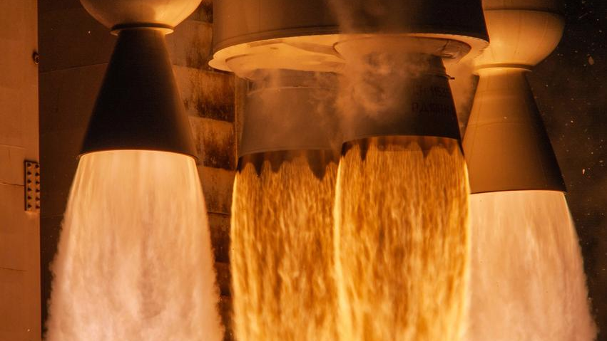
Pathways Showcase
Michaelle Ramos
July 26, 2022
Notes:
https://images-assets.nasa.gov/image/KSC-20220519-PH-KED02_0003/KSC-20220519-PH-KED02_0003~medium.jpg

Slide 2
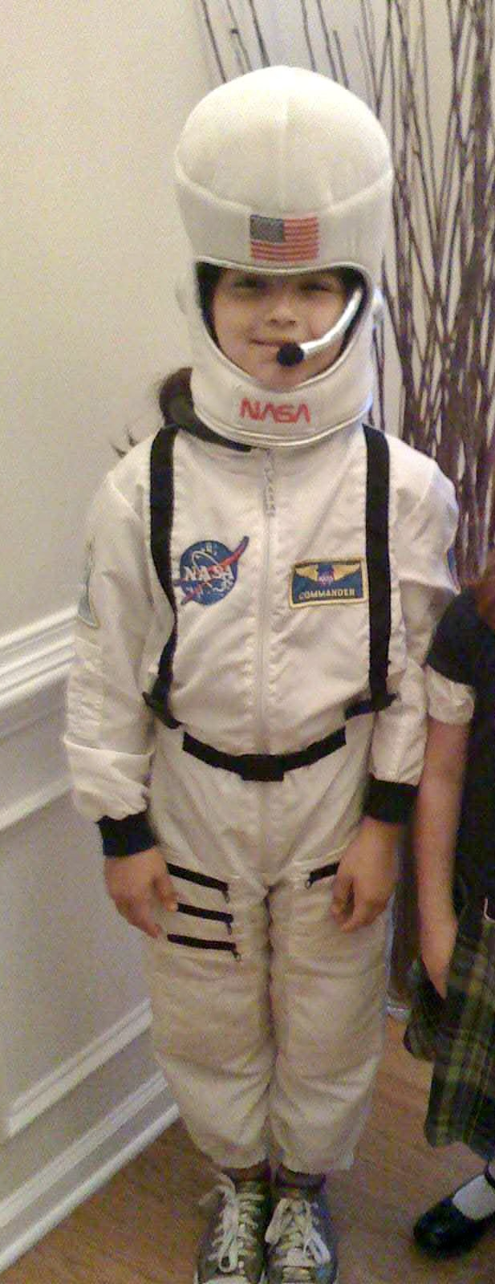
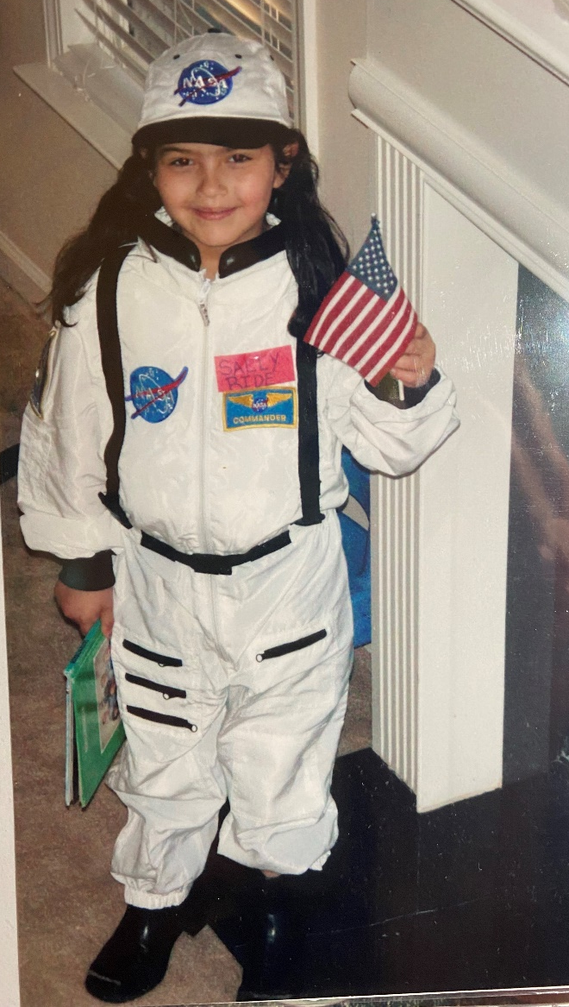
I blame ET…
Notes:
Short and sweet

Slide 3
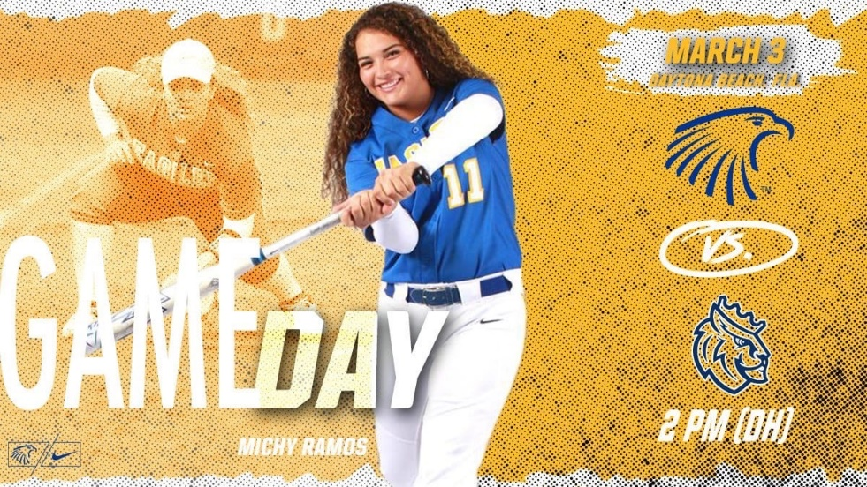
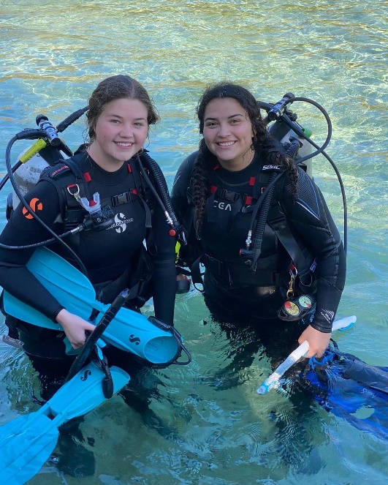
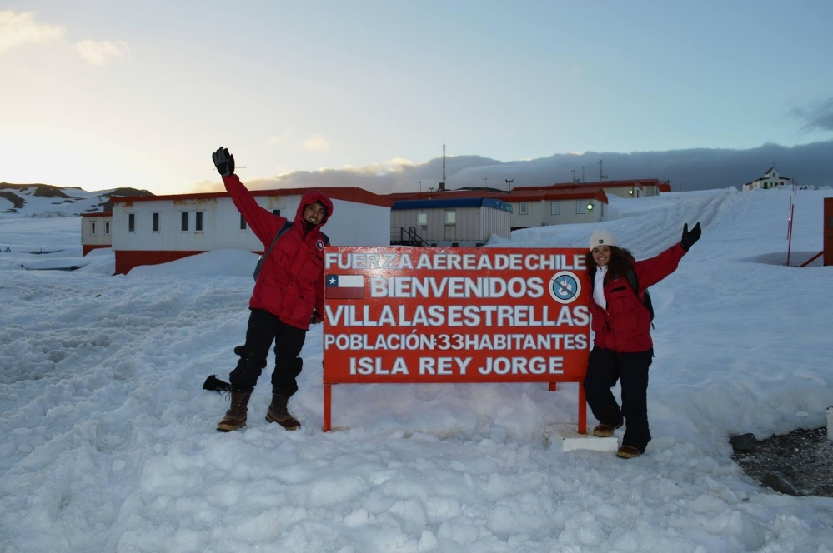
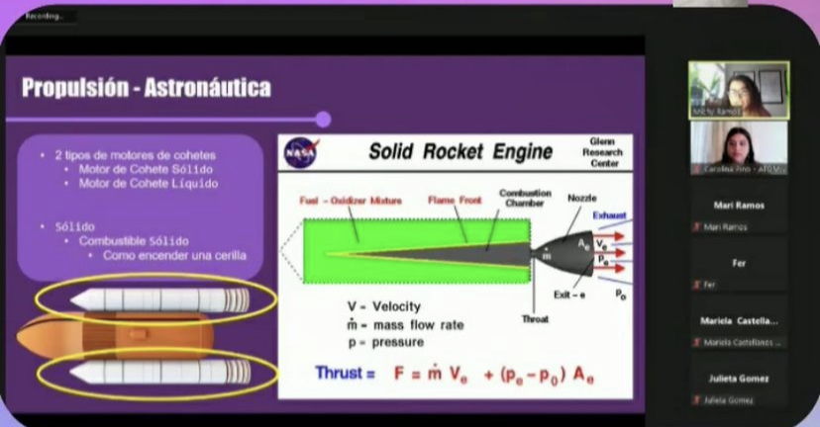
Education & Hobbies
B.S Aerospace Engineering (Astro)
  Applied Mathematics
  Computer & Electrical Engineering
Hobbies:
  SCUBA Diving, Outdoor Adventures, Softball
  Outreach, Original Scientific Research & Expeditions
Notes:
Short and sweet

Slide 4
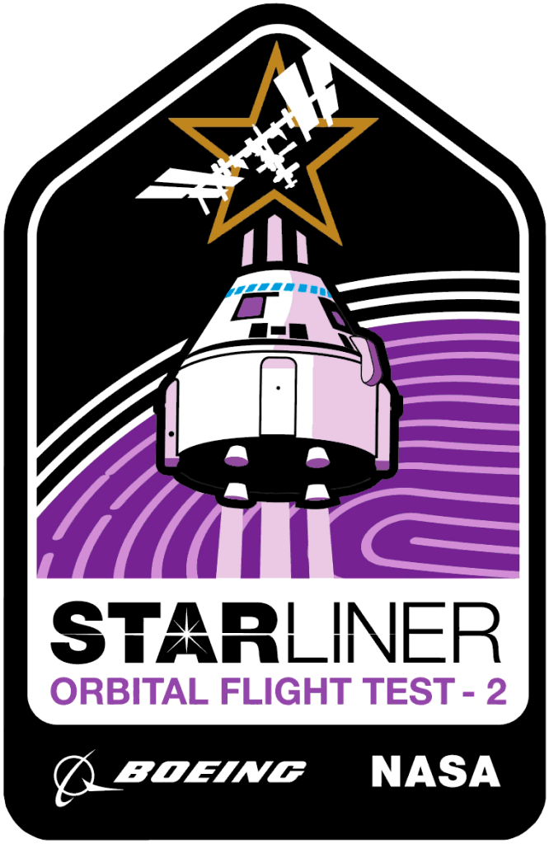




Office of Safety & Mission Assurance
Assures the safety and enhances the success of all NASA activities ^{[8]}
Safety & Mission Assurance Launch Services Division (SA-D)
My Branch: SA-D1 (Safety & Quality Engineering)
Recent Mission Successes
Support
Provide Safety, Quality & Mission Assurance to Launch Services Program (LSP)
Acquire
Acquire Launch Services for NASA Satellites & Payloads
Manage
Shepherd Payload & Rocket Cradle to Launch
Notes:
Safety & quality-
Ixpe dart
Oft-2 shared assurance mission where LSP provided the shared assurance to ccp

Slide 5
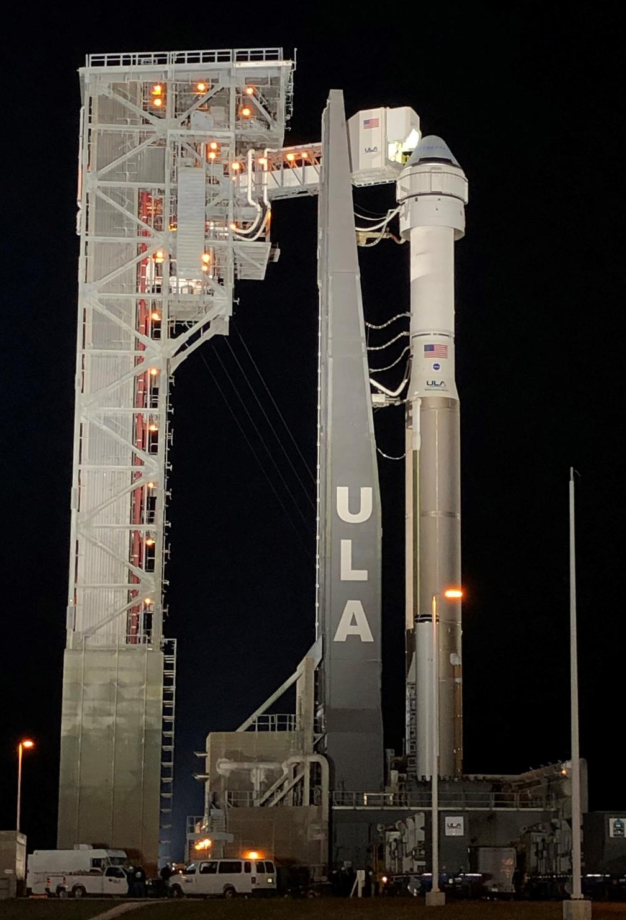
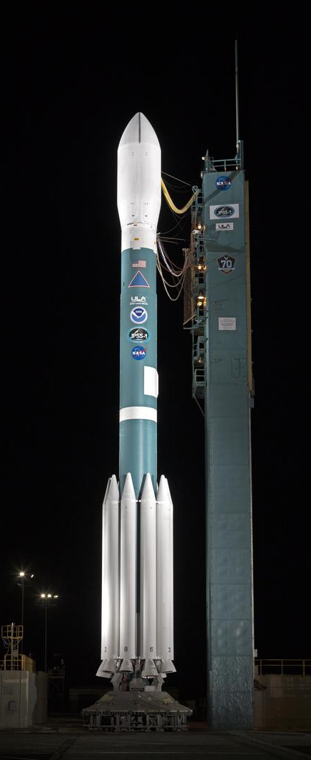
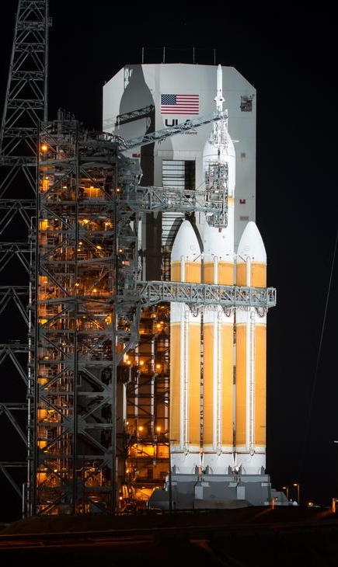
Launch Vehicle Certification
NASA Certification Process
  Launch Vehicle Certification Requirements Matrix ^{[4]}
    (Vehicle Maturity, Payload Class, Management, Flight Experience, Design, etc.)
United Launch Alliance (ULA)
  Launch Vehicle Provider
  Vulcan Centaur ^{[6]}
    1st Launch: Coming Soon
Atlas V
Delta II Heavy
Delta IV Heavy
Notes:
These are other vehicles that have gone through verification in the past (include pics)
Fleet ^{[2]}
images-assets.nasa.gov/image/jsc2022e044244/jsc2022e044244~orig.jpg

Slide 6

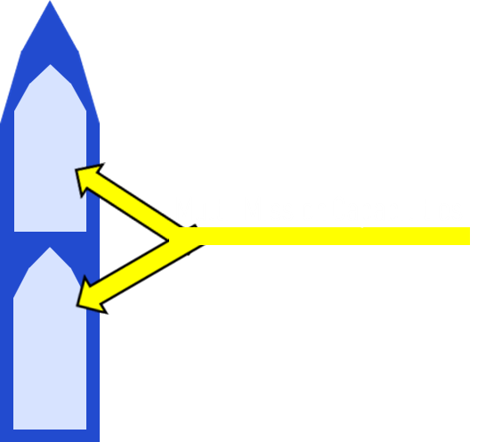
Vulcan – Payload Fairing
70 feet
51 feet
Diameter: 18 feet
Notes:
18 feet: Width of two car driveway or two parking spots
51 feet: Semi truck trailer
70 feet: two school busses

Slide 7
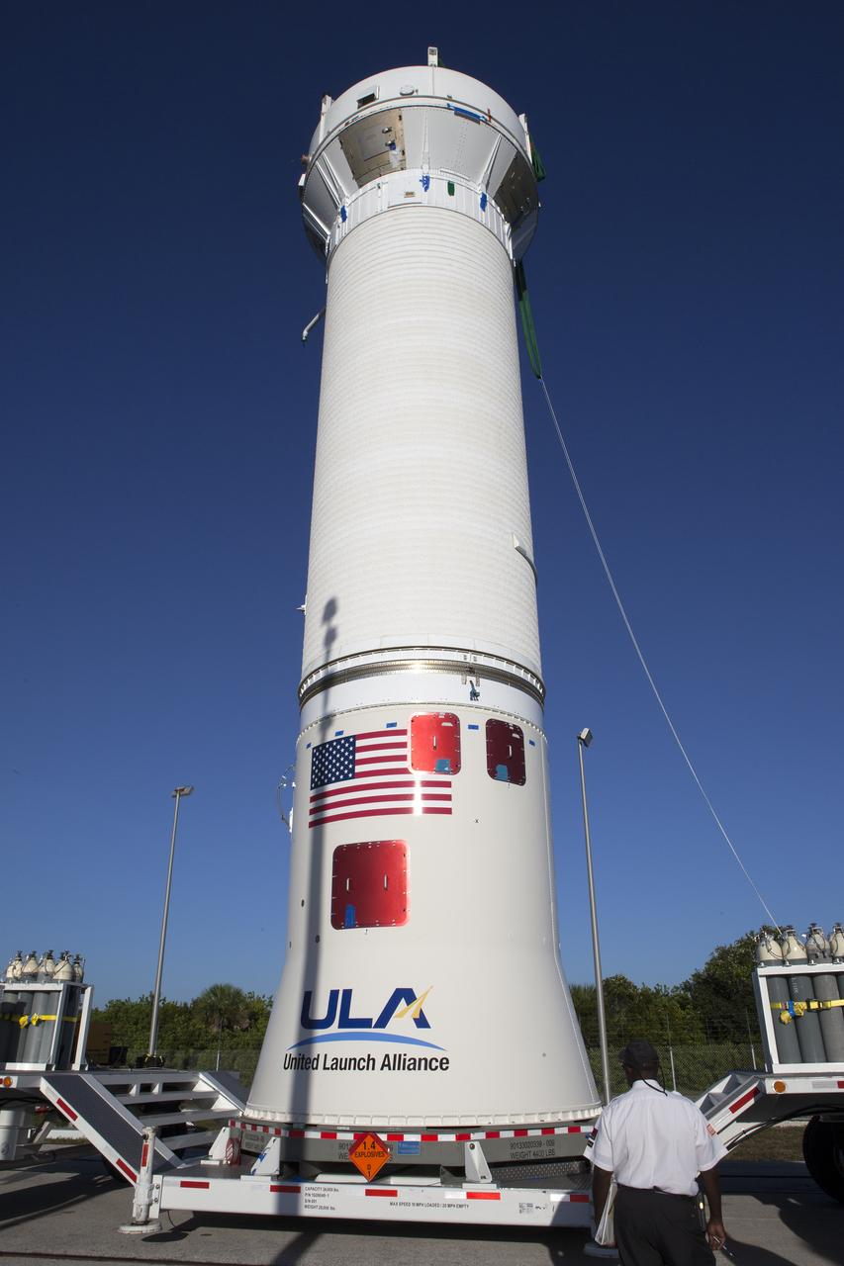
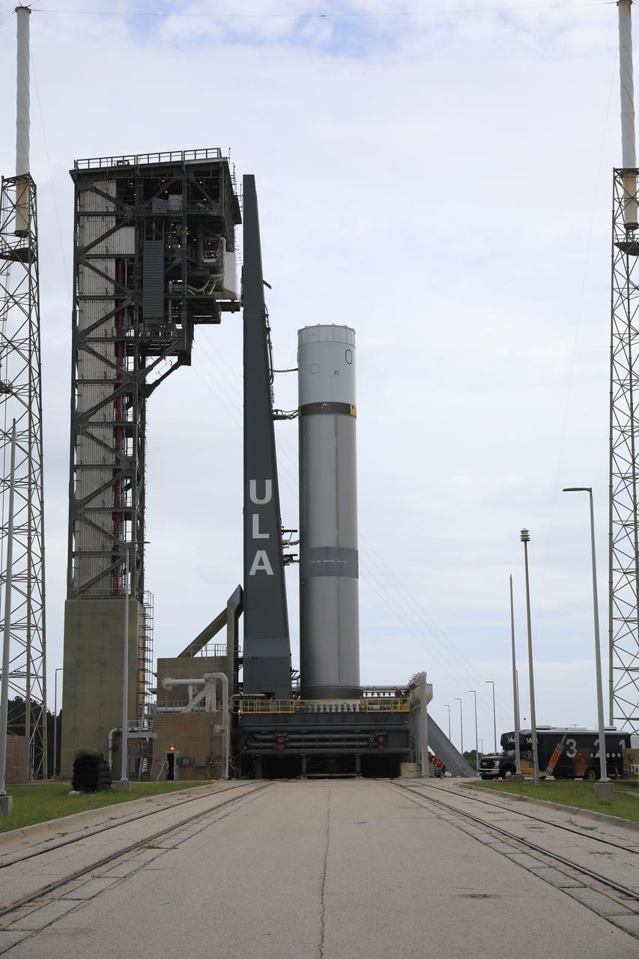
Vulcan – 1st & 2nd Stages
Second Stage
  Centaur V
    18ft Diameter X 38.5 ft Long
  RL-10 Engines
    Designed By: Aerojet Rocketdyne
    Propellants: Liquid Hydrogen/ Liquid Oxygen
    Thrust: 24,000 lbf
First Stage
  Booster
    18ft Diameter X 109 ft Long
  GEM 63XL SRB’s
    Designed By: Northrop Gruman
    0, 2, 4, & 6 Configurations
[7] OSIRIS-REx, Atlas V Centaur Stage Arrival and Lift & Mate
[9] ULA Vulcan Rocket Unveiled at SLC-41 ^{[3]}
Notes:
Srm or srb

Slide 8
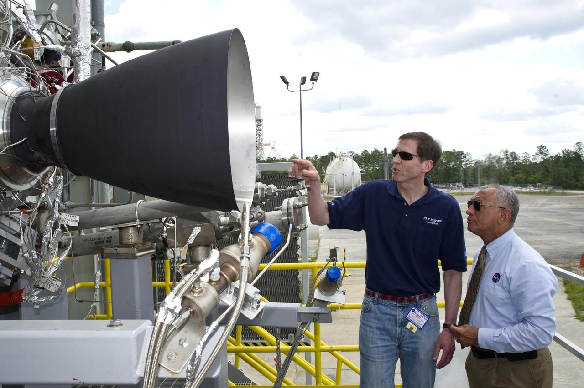
Blue Origin – BE-4 Engines
Designed By: Blue Origin
  Ox-Rich Staged Combustion Engine made in USA ^{[7]}
  Utilizes Liquified Natural Gas (LNG) & Liquid Oxygen
  Thrust: 550,000 lbf
[5] Blue Origin Testing BE-3 Engine ^{[5]}
Notes:
[5]

Slide 9
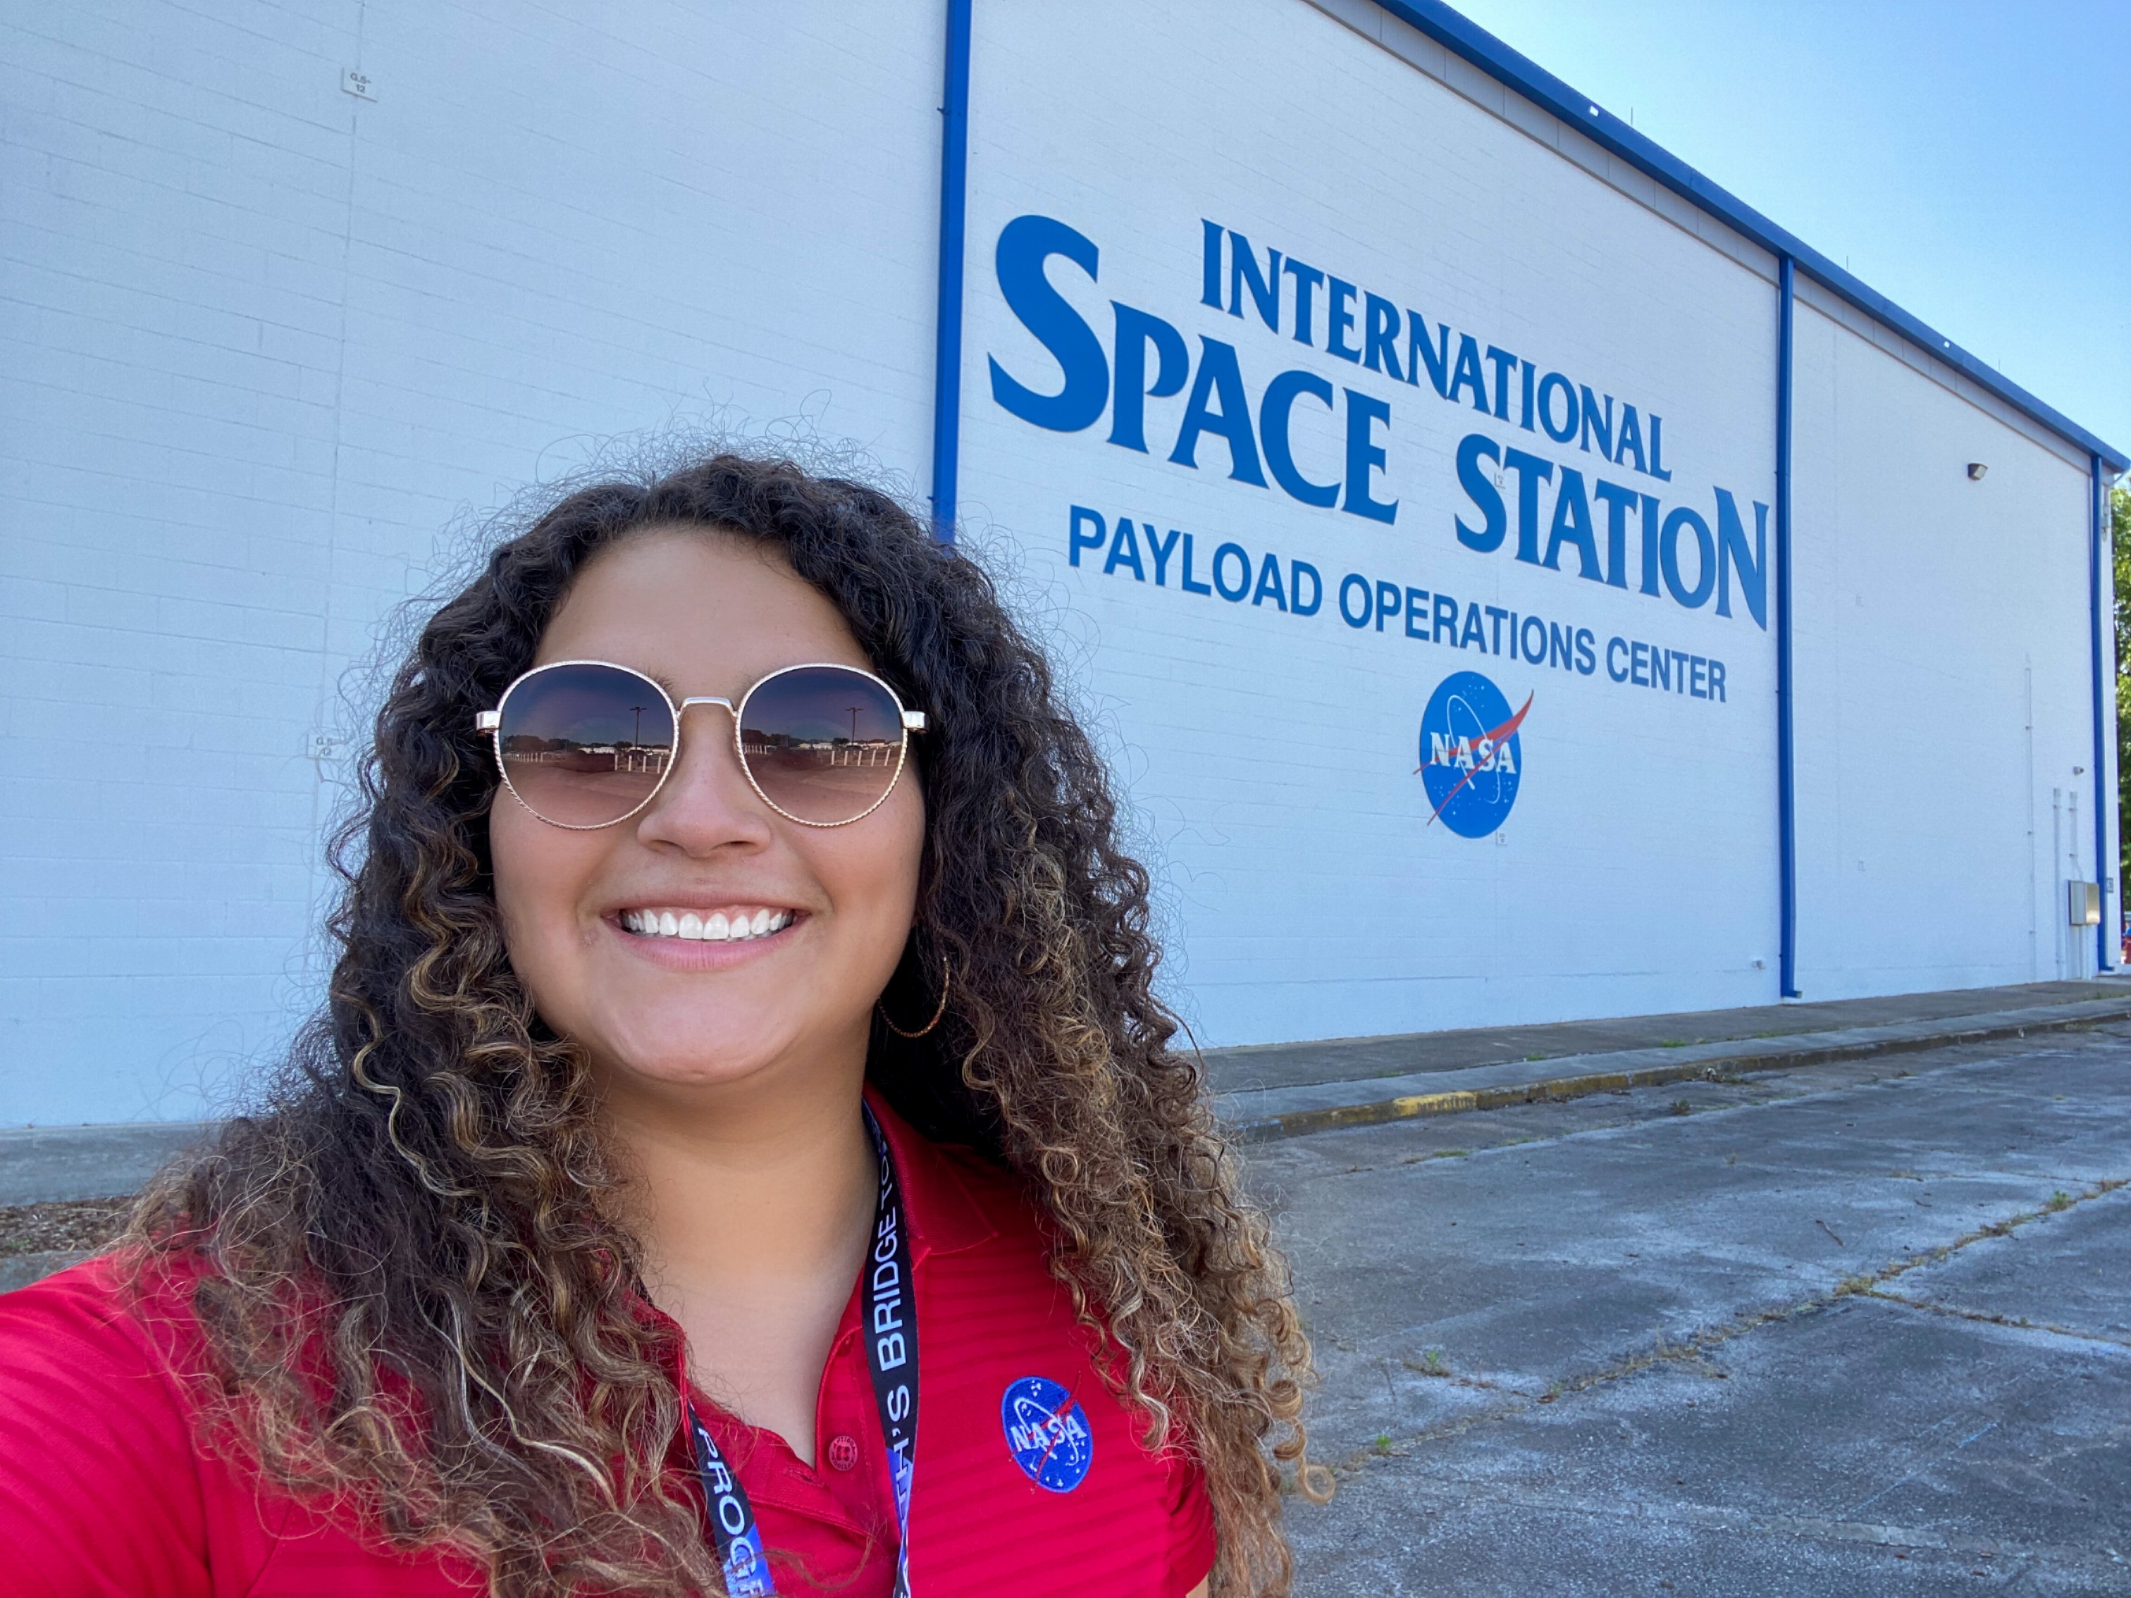
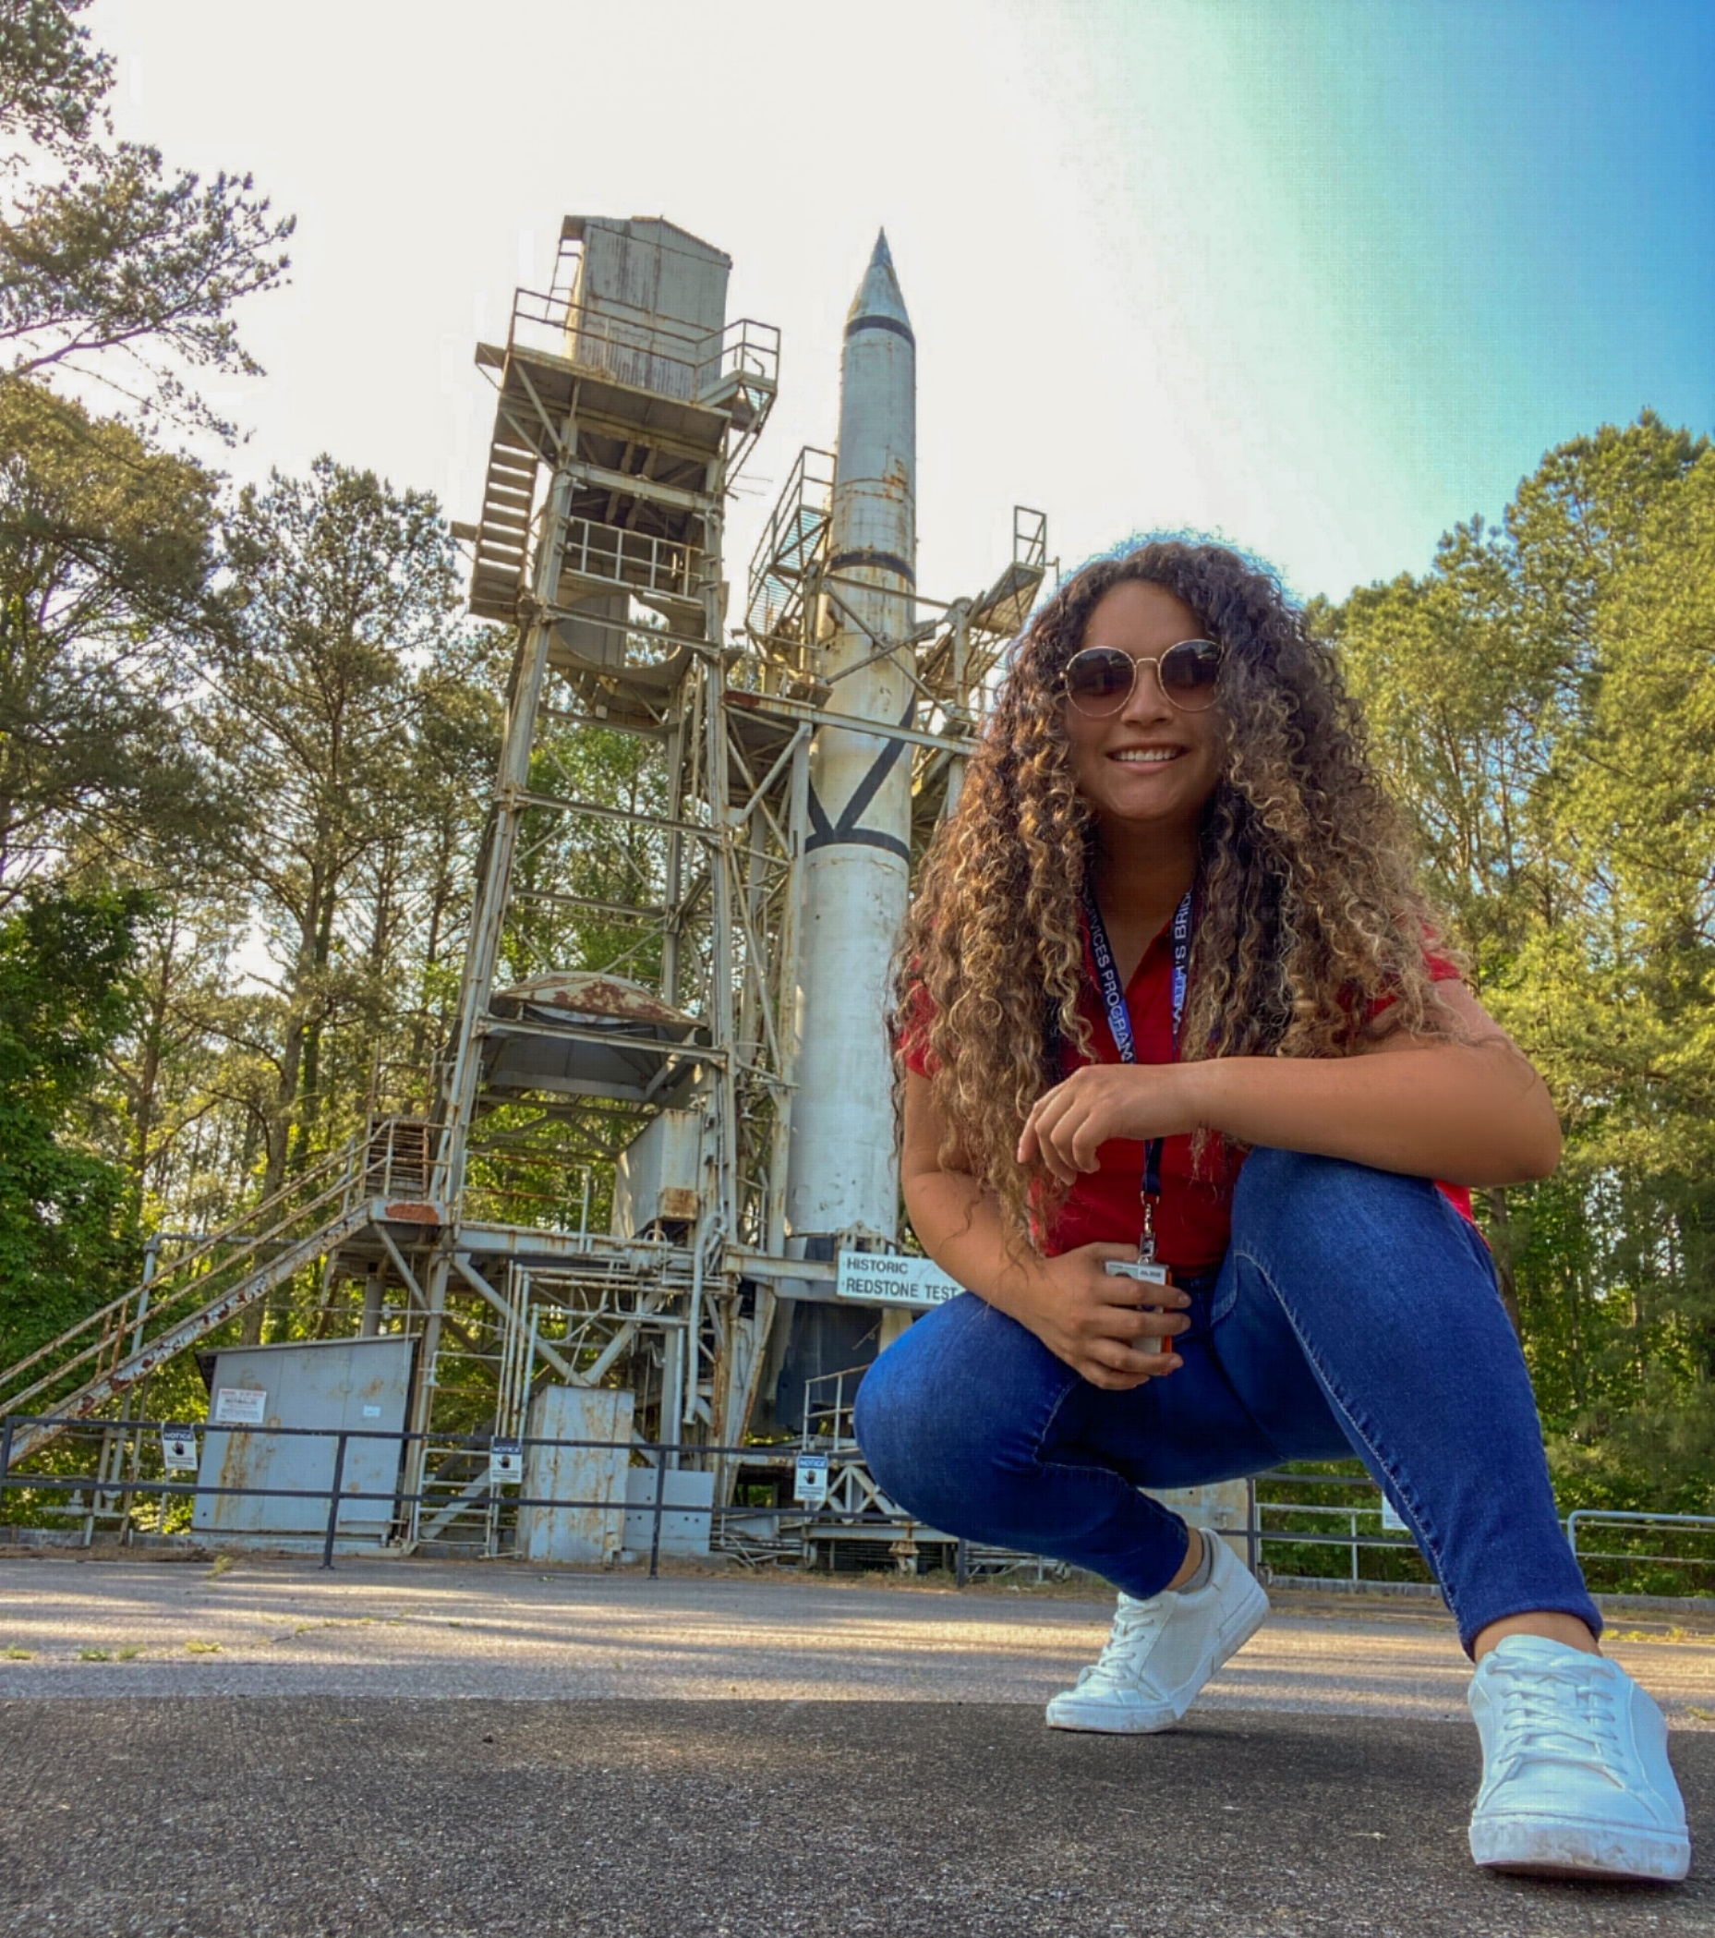
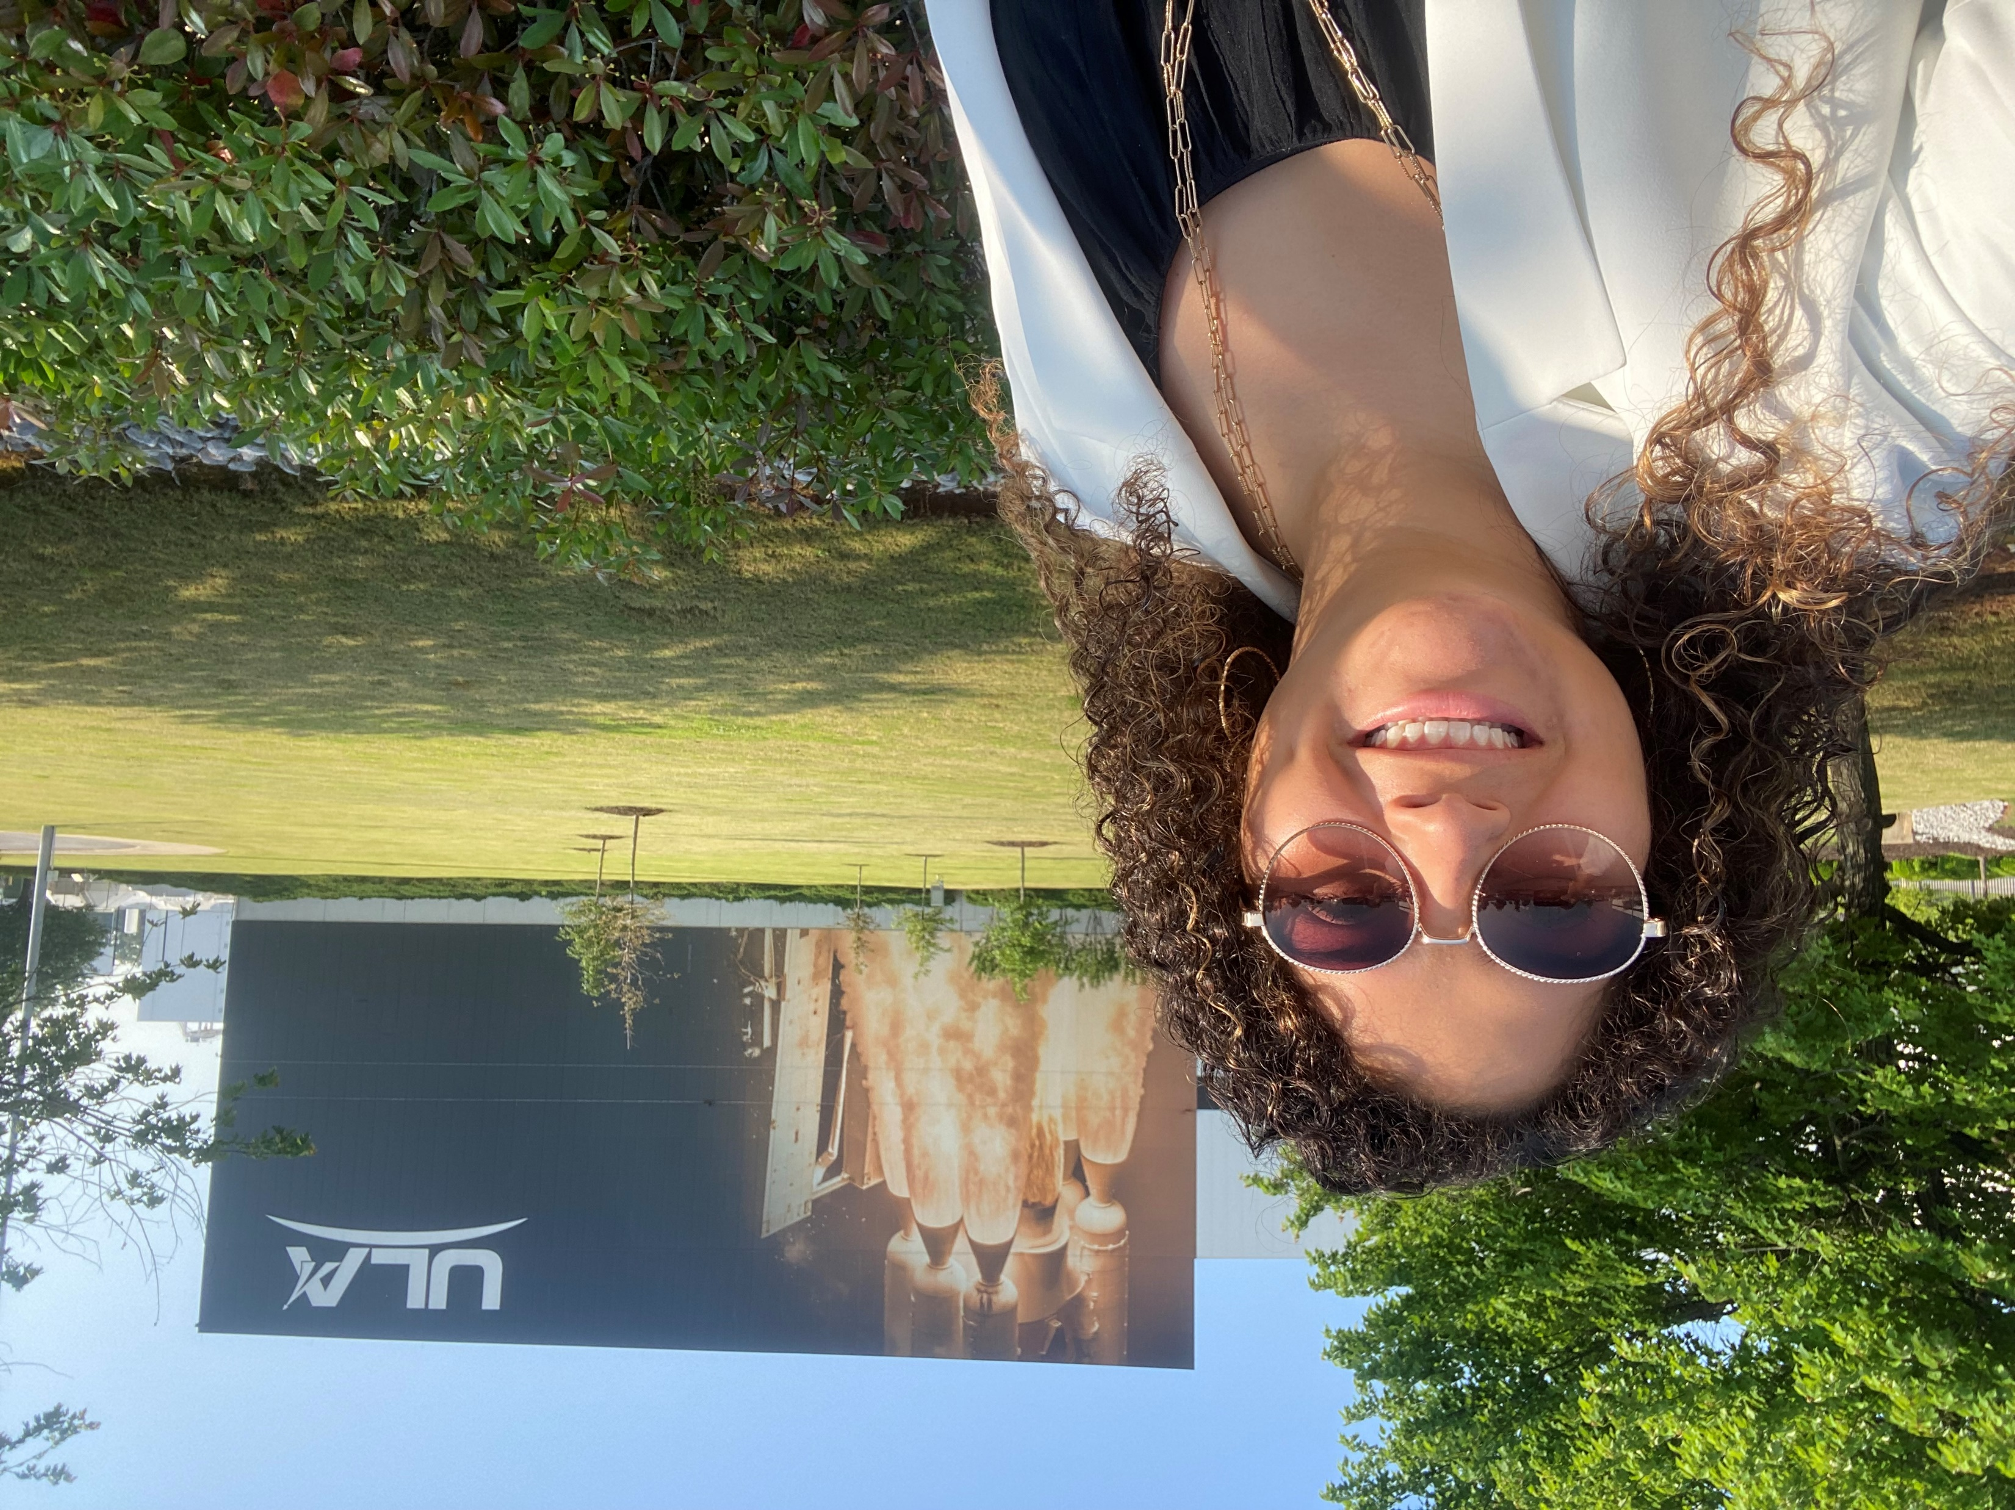
Vulcan Centaur V Certification
Safety & Quality Assurance
  Review design and follow development processes
    Provide an Overview of the BE-4 Main Engine Controller (MEC) for SA-D (Summer 2021)
  Assist in preparation for an upcoming audit
    Select unique processes used for the MEC and Turbopump to follow through audit (Summer 2022)
Notes:
Complete project by:
MSFC & ULA Decatur Facility understanding of manufacturing processes
Centennial CO Audit Support – understanding of audits and how they work

Slide 10
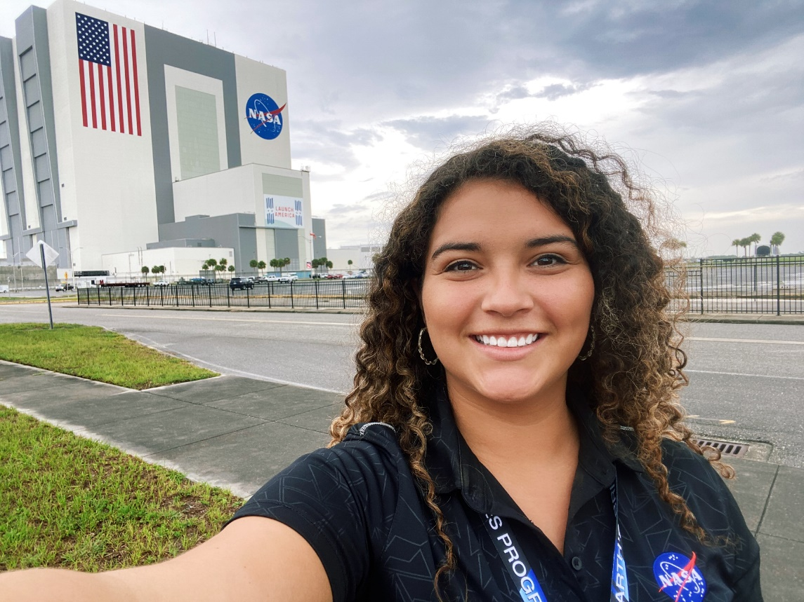
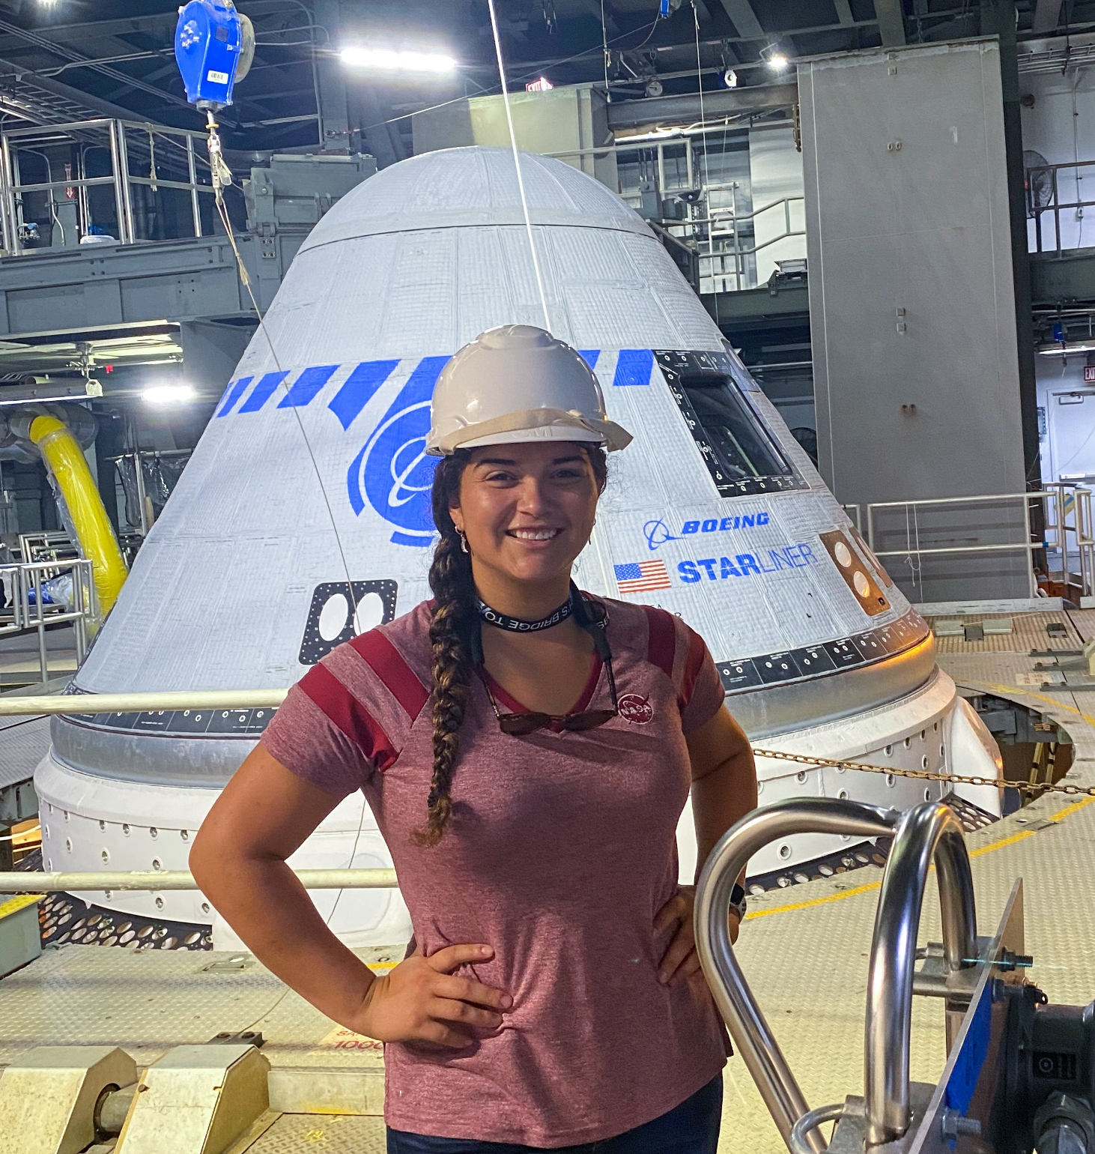
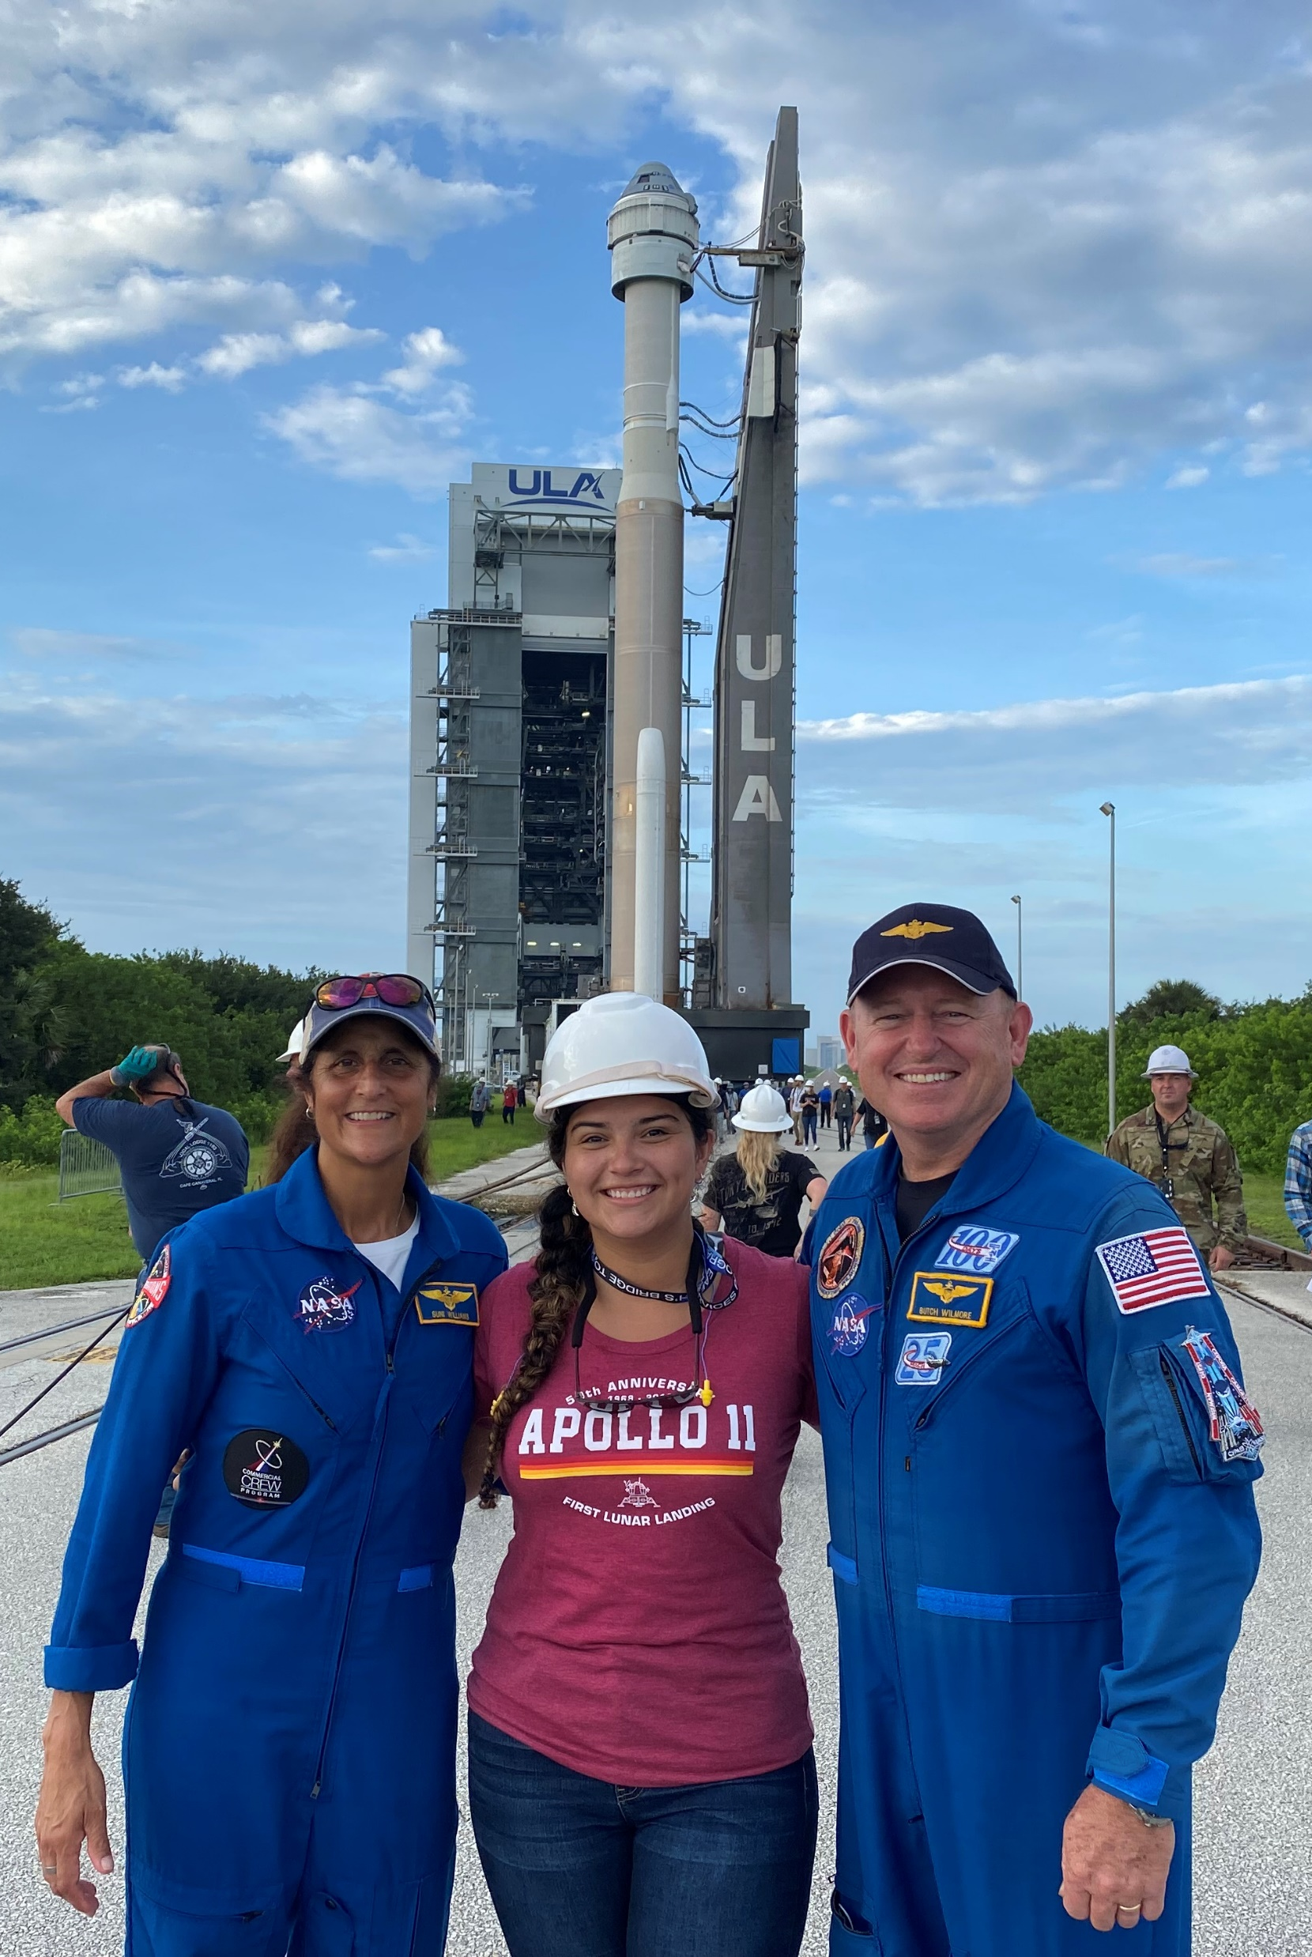
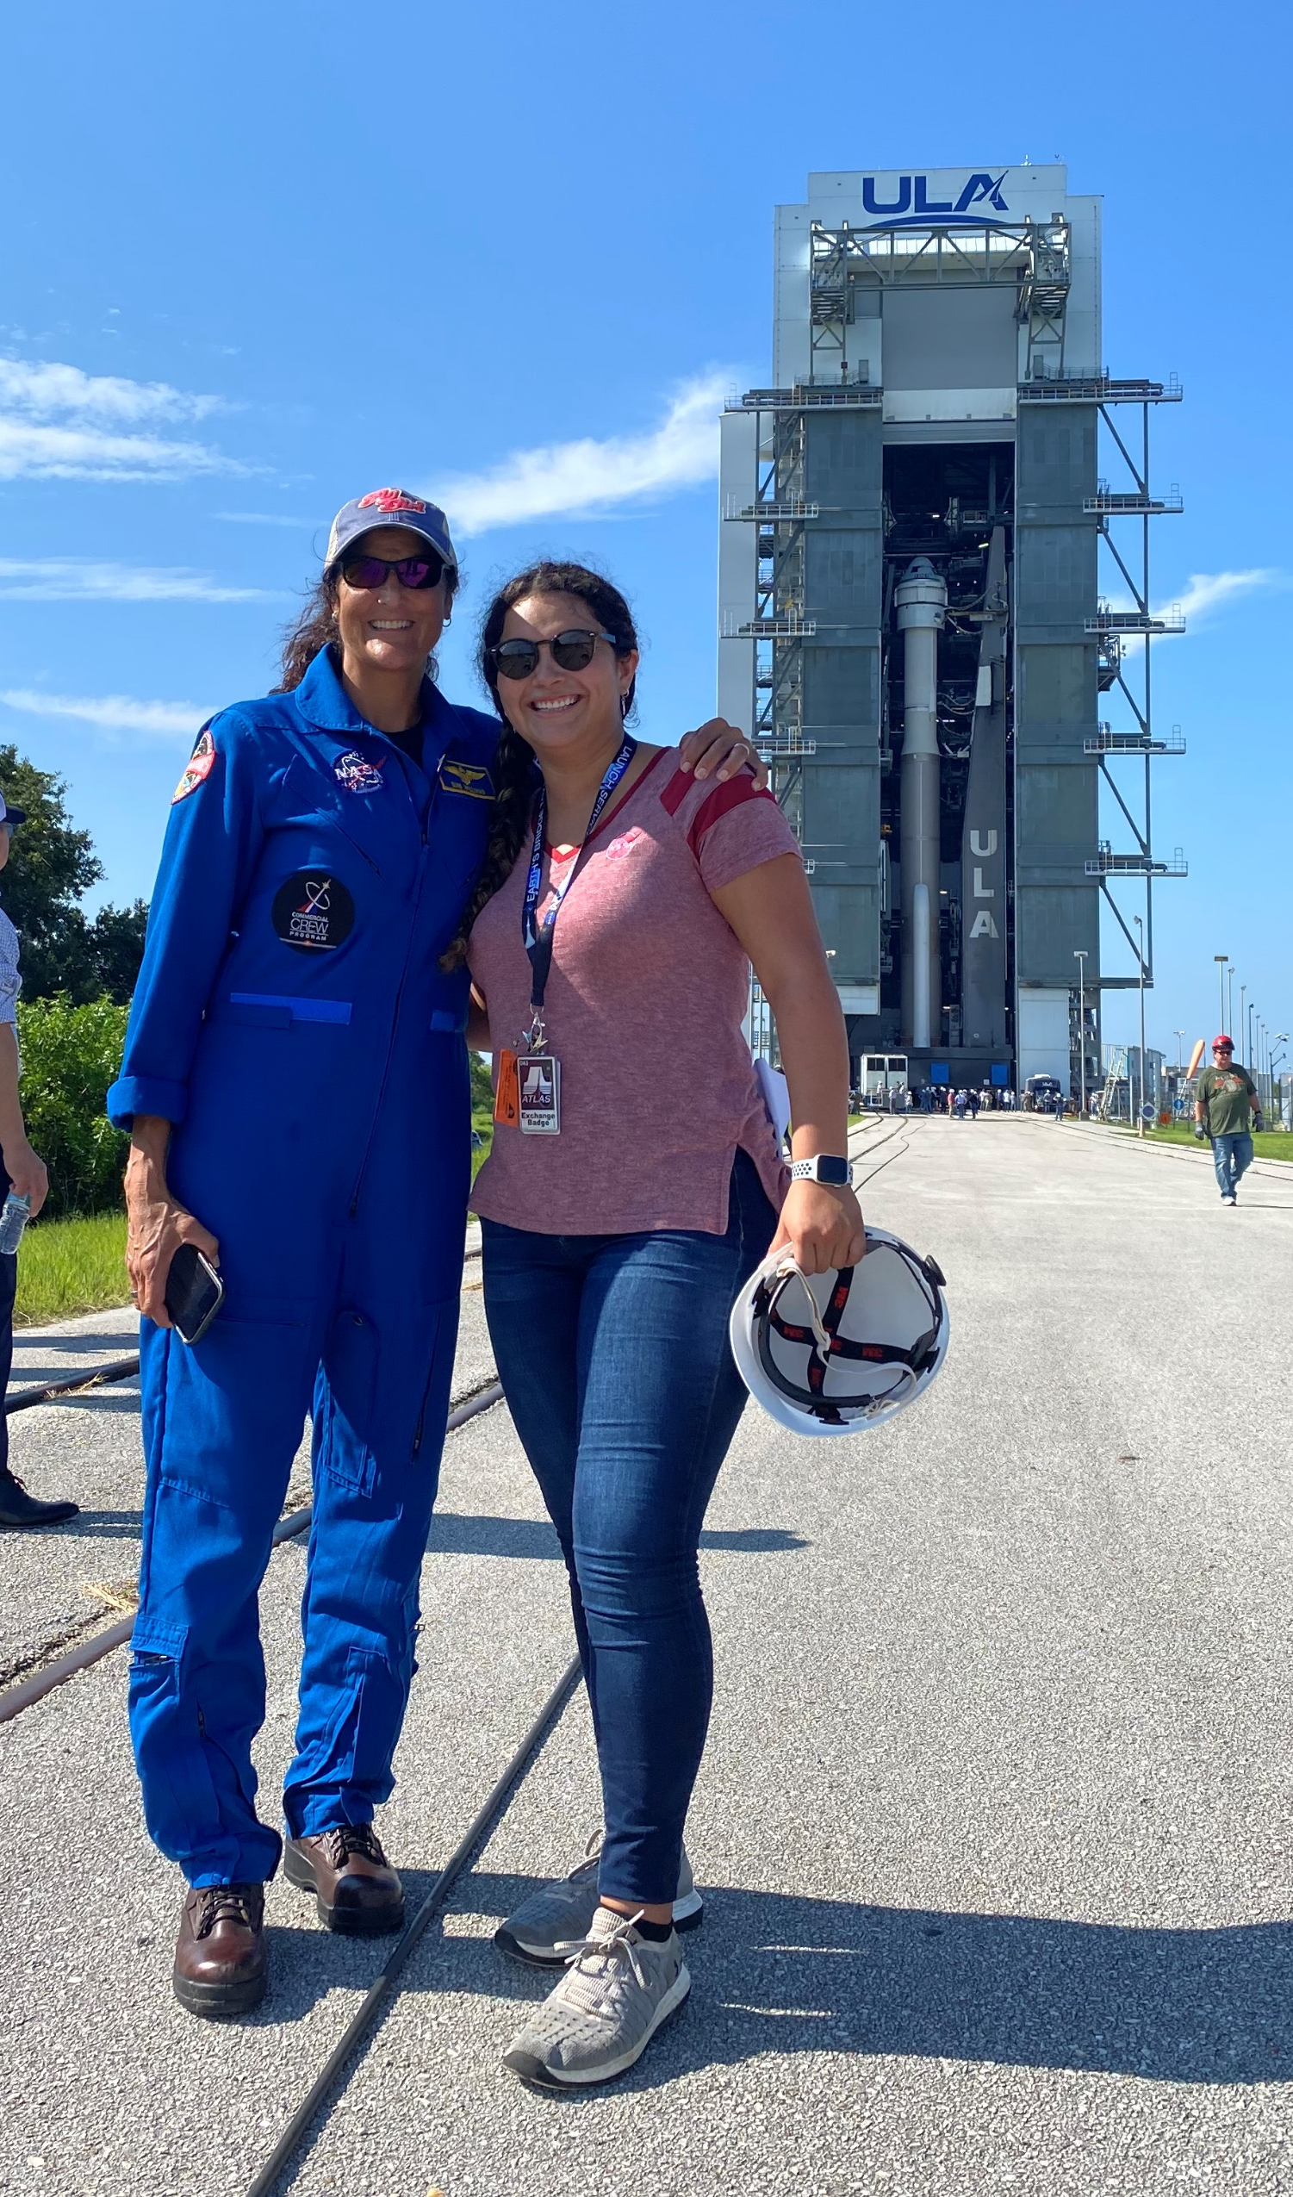
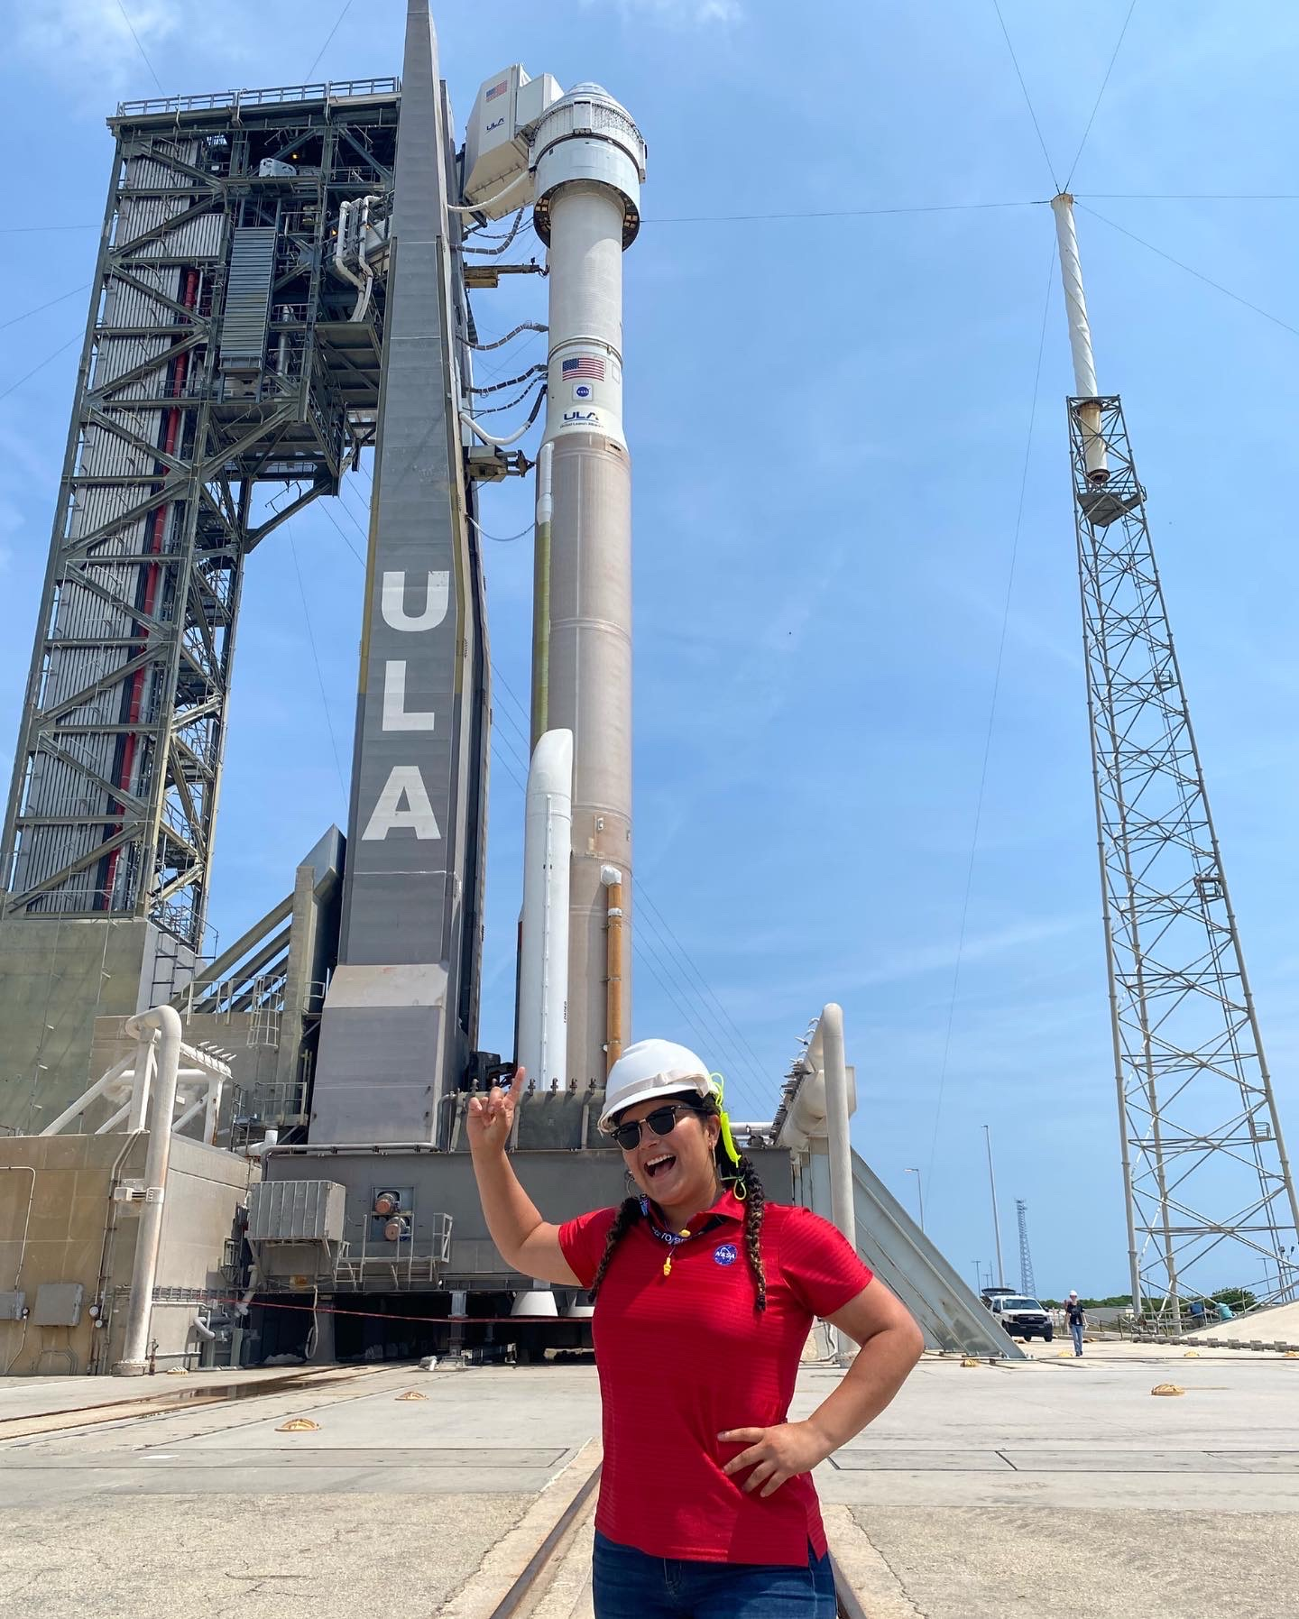
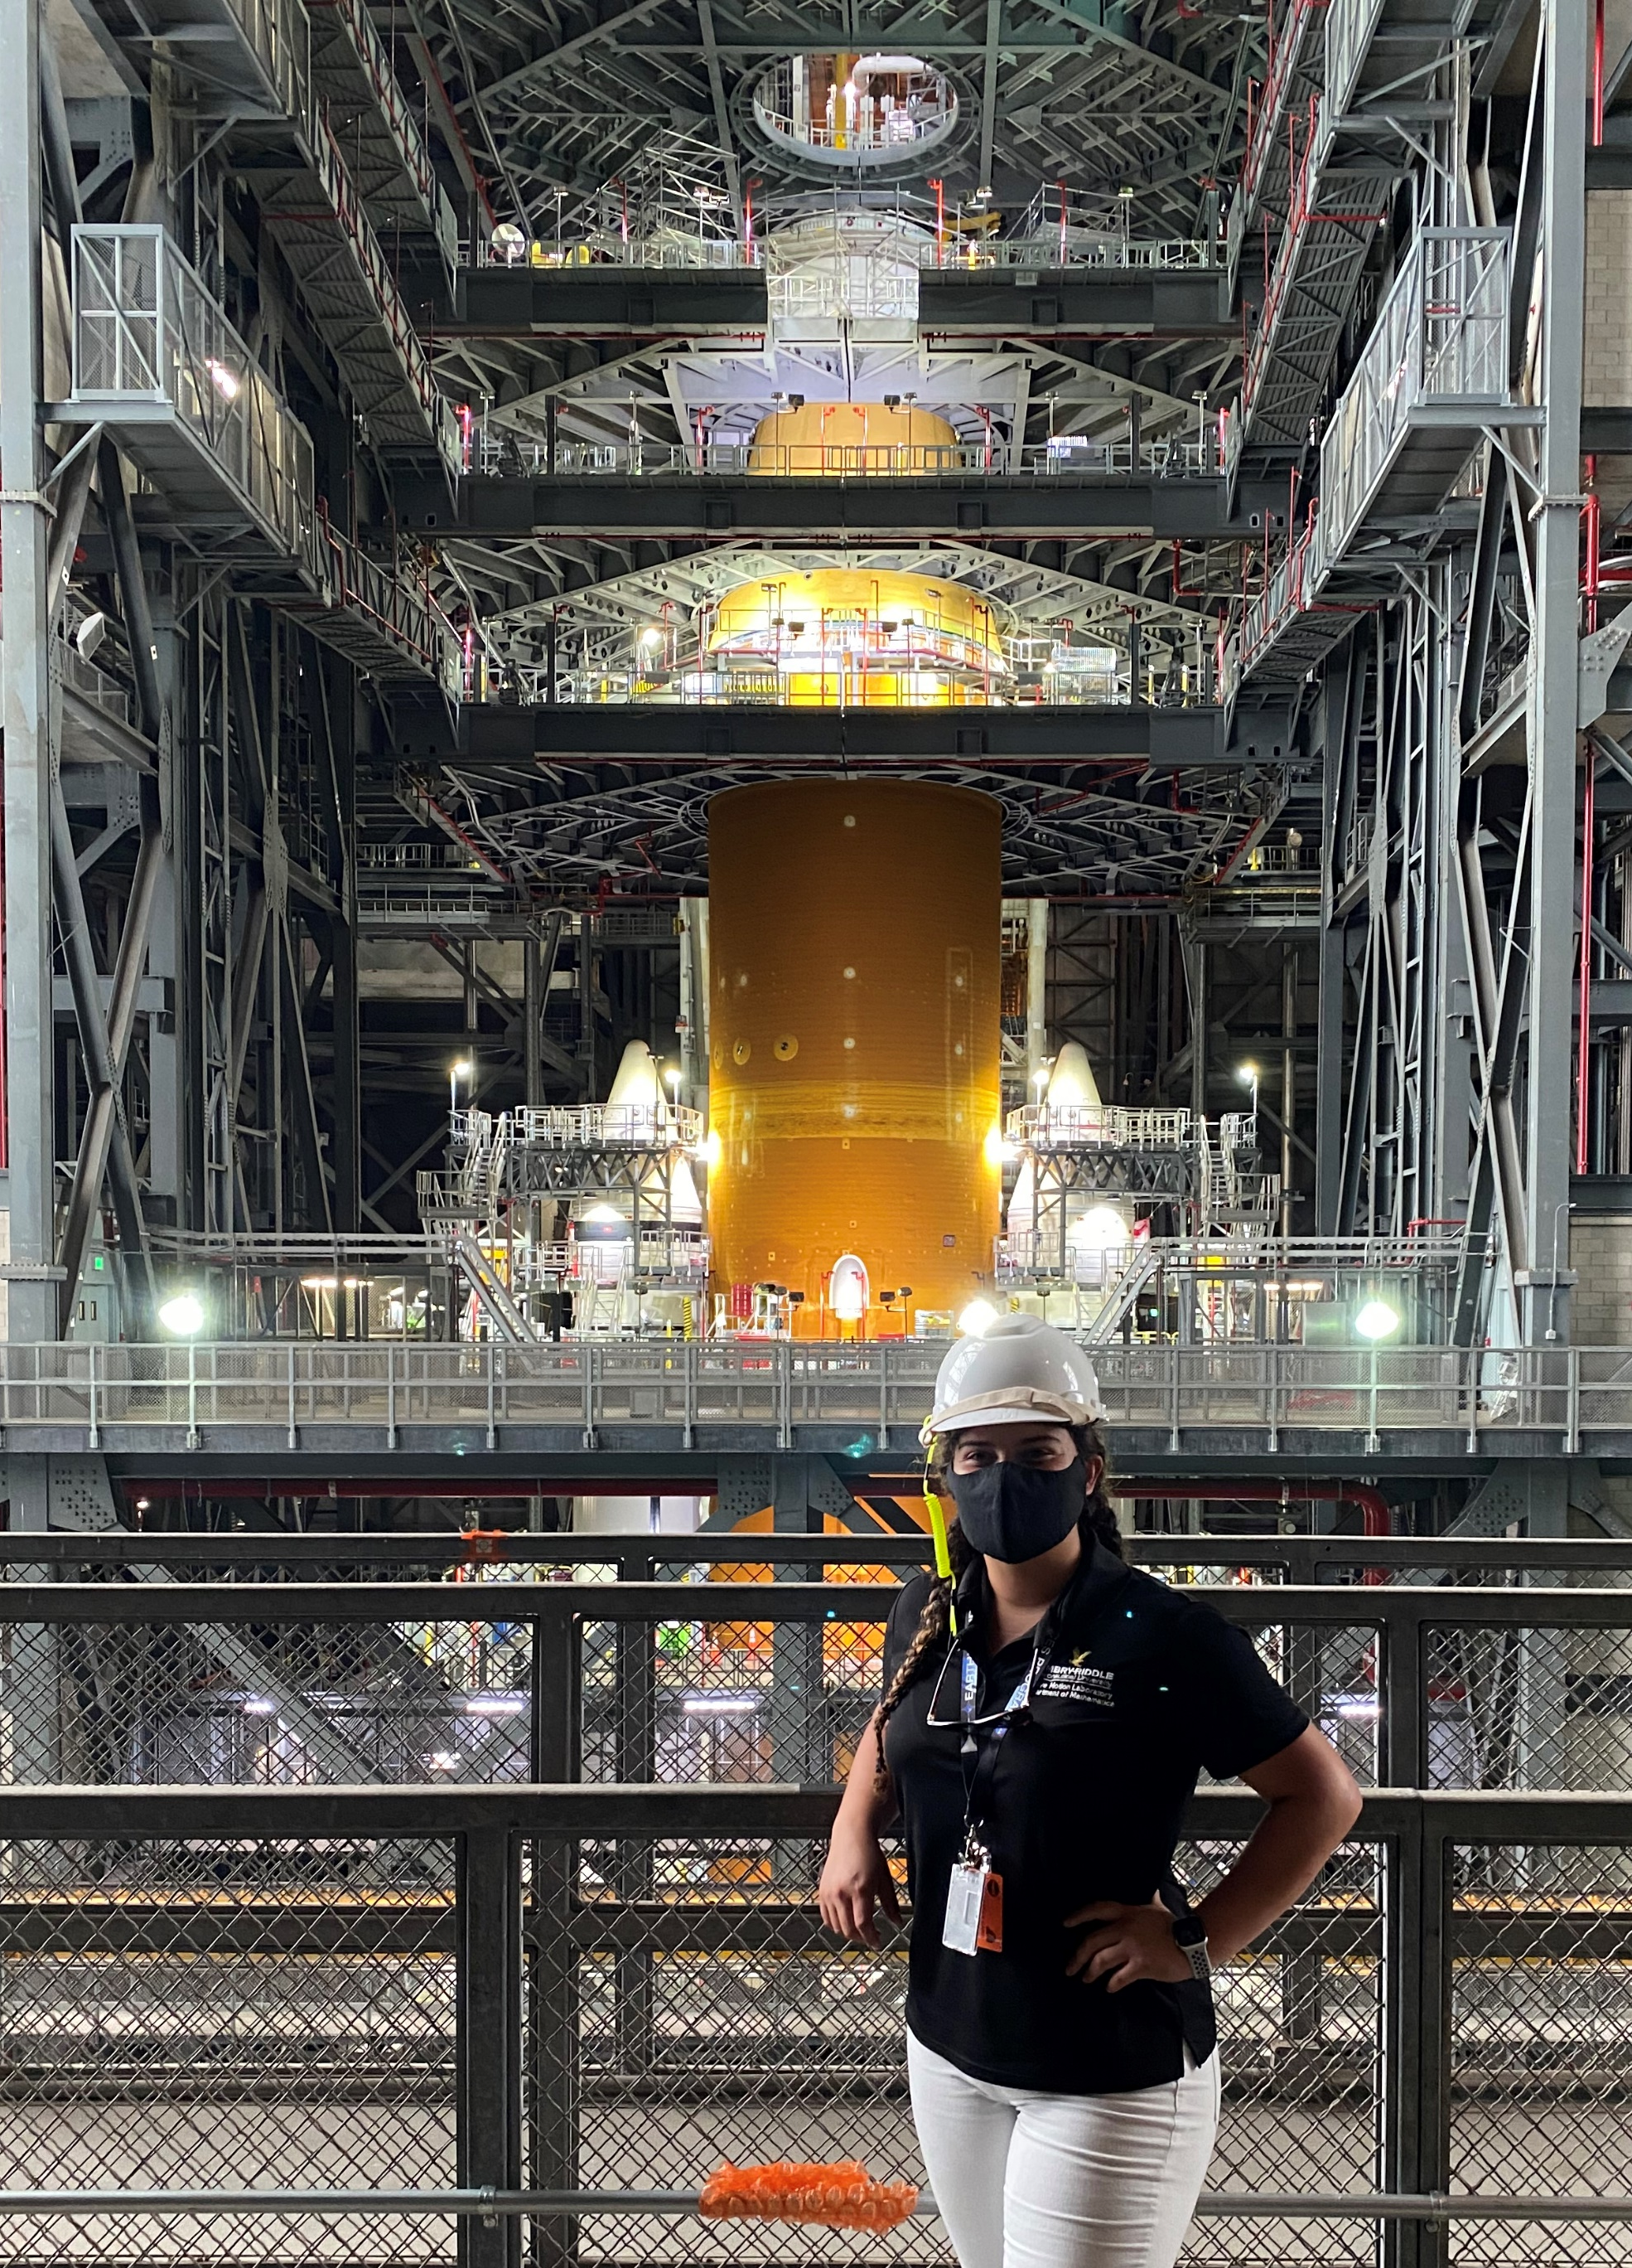
Experiences
VAB Selfie
OFT-2 Starliner 2021
OFT-2 Launch 2022
Artemis Viewing in VAB
(L-R) Astronaut Sunita Williams, Michy Ramos, Astronaut Butch Wilmore
(L-R) Astronaut Sunita Williams, Michy Ramos

Slide 11
Thank you!
Pathways Program
Mai Miller
Rocky Nance
LSP & SA-D Teams
Mark Ross
Carol Bacque-Carson
Brittany White
Jeff Savage-Skaja
Eb Farris
John Ilgenfritz

Slide 12
References
[1] https://www.ulalaunch.com/
[2] https://www.ulalaunch.com/rockets
[3] https://images.nasa.gov/details-KSC-20210826-PH-KLS01_0073
[4] https://nodis3.gsfc.nasa.gov/NPD_attachments/AttachmentA_7C.pdf
[5] https://images.nasa.gov/details-SSC-20120420-S00534S
[6] https://www.ulalaunch.com/rockets/vulcan-centaur
[7] https://images.nasa.gov/details-KSC-20160811-PH_KLS01_0068
[8] https://sma.nasa.gov/
[9] https://images.nasa.gov/details-KSC-20210826-PH-KLS01_0053

