Slide 1

ISS R&D
Plant Research Looking Forward 2023 -2030
July 2022
Charles Quincy

Slide 2
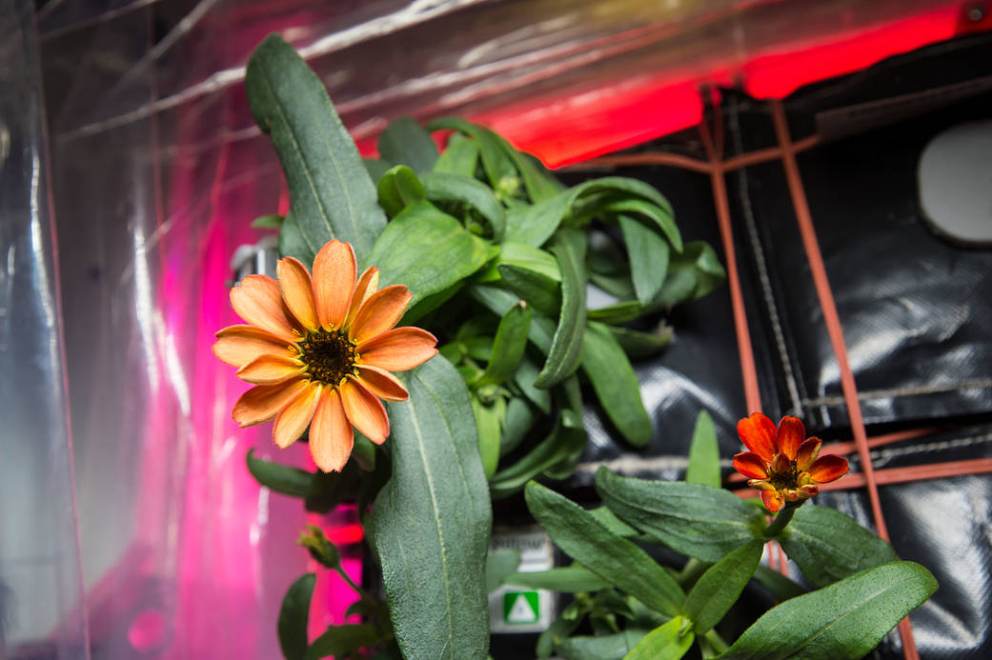
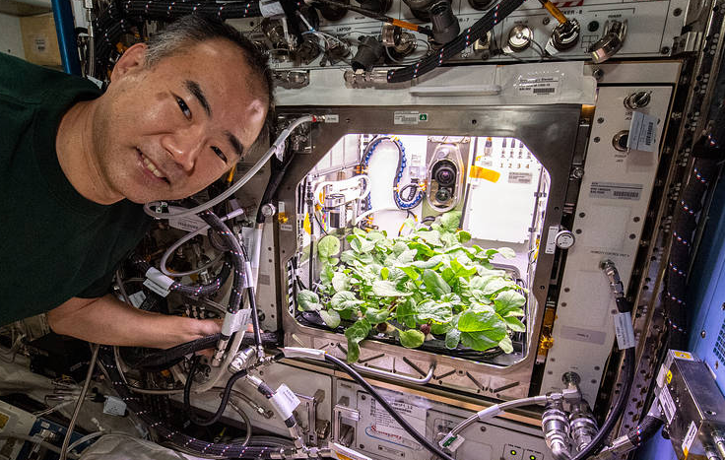
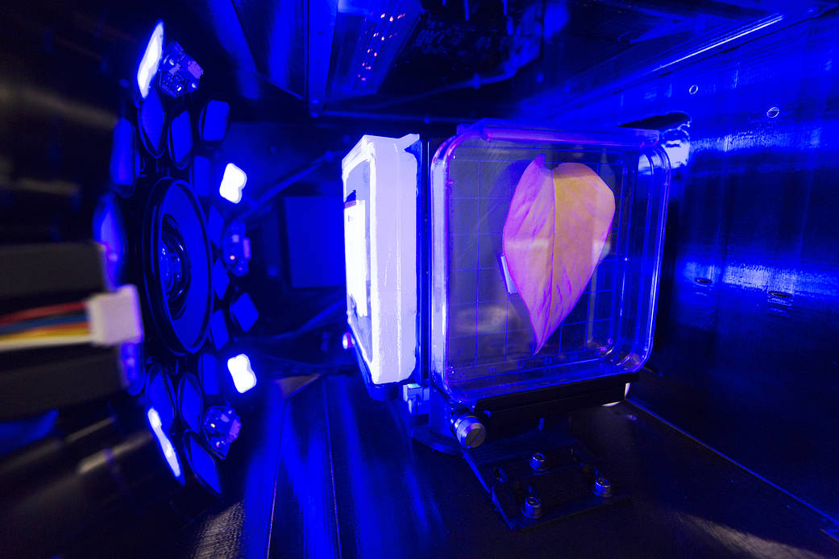
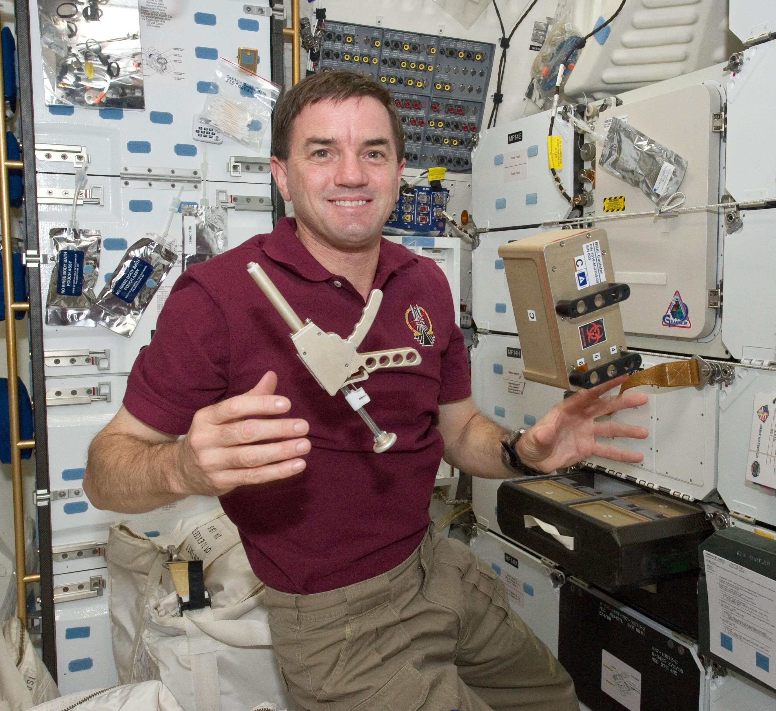
Research on ISS
The plant research capability currently on ISS (VEGGIE, APH, BRIC-LED, Spectrum, and soon OHALO) are needed
  through the life of ISS
  into the commercial station period
Required for the science to make exploration possible.
  Plant and microbiome adaptations to space
  Understanding watering systems in micro and partial gravity
Enable Space Crop production

Slide 3

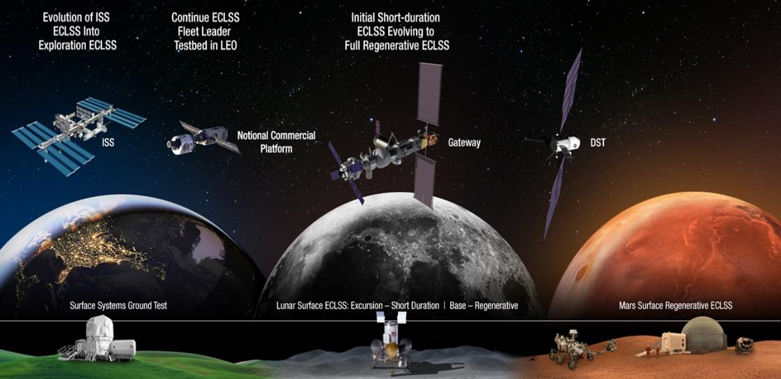
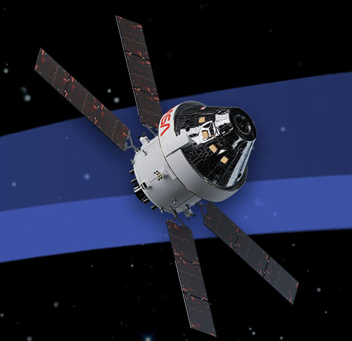


Space Crop Science Roadmap For Exploration
GATEWAY, and Artemis III, IV
(Plant Research)
ISS and commercial platforms (Plant Research)
Small scale transit vehicle test bed.
Mitigate plant, ecosystem and biophysical challenges.
Characterize crop phenotypic plasticity, physiology and associated microbiome in µg. Association to genotype to inform “space trait” selection.
Enabling hardware: small growth chamber and sequencing capability. (<5kg)
Seed and propagule viability in radiation environment
Plant microbial ecosystem stability
Nutrient and crop production validation
Imaging methods to characterize physiological stress
Growth validation tests in Artemis IV/Gateway chamber intend for Lunar surface science
Enabling Hardware: Veggie, APH, Spectrum, BRIC, OHALO
Characterization of factors regulating plant growth
Nutrient production
Phenomes/ Genomes/ Metabolomes
Plant microbiome & human pathogen understanding
Lunar Surface
Integrate Artemis and Gateway vetted science into plant growth chamber to conduct surface habitation relevant plant science.
Enabling hardware: LEAF 1 payload imaging and environmental monitoring. LEAF II with sequencing and analytical chemistry capability. (30kg each)
Ground (Plant Research)
Select crops suitable for growth in space.
Growth under relevant conditions (lighting, spectrum, pressures, atmospheres, simulated microgravity).
Photosynthetic efficiency via imaging
Crop productivity
Regolith return sample for soil amendment investigation
Phenotype, genotype, and metabolite correlations
Plant-microbiome interaction characterization
Enabling Hardware: Controlled environment chambers and microgravity simulation support facility
Plant and human pathogen testing
Regolith amendment, hydroponic and aeroponic validation
Polycropping, multigenerational testing, large scale crop assessment, trait identification, citizen science
Martian Surface
3

Slide 4
SCIENCE GOALS for Artemis Missions
Primary goal: Understand the effects of the transit vehicles, LEO and cislunar environments on the phenotype of space crops. (e.g. partial or microgravity, habitat pressure, atmosphere, and radiation)
Secondary goal: Prepare for future long term plant growth experiments that will develop model crops as food sources for sustained exploration transit missions.
Data will be obtained through targeted and well-controlled science experiments and state-of-the-art analyses and computational approaches
SCIENCE VISION
Understand the biological effects of the Space environment on plants and ultimately crop production.
Drive plant performance in Space habitats by adjusting environmental conditions based on integrated biological datasets.
Objectives:
Objective 1: Compare the phenotype of model space crops under treatments cultivated within the ISS environment payload and ground controls
  Objective 1A: Assess plant germination and asexual/clonal reproduction rates for space crops in variety of growth medium;
  Objective 1B: Monitor: Carbon fixation (net photosynthesis and respiration) across development;
  Objective 1C: Monitor: Plant morphology and growth across development, including innate oscillations in growth;
  Objective 1D: Monitor: Plant pigmentation and secondary metabolism across development.
Objective 2: Determine genotype-sensitivity of model space crops to Lunar radiation and partial gravity to arrive at beneficial ‘space traits.
Objective 3: Validate crop production systems in the cis-lunar and Lunar surface environments

Slide 5
ISS and Commercial Platforms (Plant Research)
Identify plant, ecosystem and biophysical challenges.
Characterize crop phenotypic plasticity, physiology and microbiome in µg.
Association to genotype to inform “space trait‘ selection.
Enabling Hardware on ISS:
  Veggie, APH, Spectrum, BRIC, OHALO
End Goals
Understand the space environment and how to optimize plant performance
Understand how to establish and maintain a healthy microbiome in space
Test designs for crop production in space
Demonstrate production of meaningful crops in meaningful quantities

Slide 6
Why should we demonstrate plant growth in preparation for Exploration Missions and LEO Commercial Development?
Food is a “red risk” item in Mars mission planning.
Plants will provide nutrients, calories, and atmospheric regeneration for astronauts on long duration Exploration Missions.
Food production in space can significantly reduce uplift mass from Earth
Without a detailed scientific understanding of the biological effects of the variables present in space exploration habitats, this capability will not be possible.
Why should we demonstrate plant growth on ISS?
LEO provides a lower cost scientific testbed for long duration space flight where the effects of partial and microgravity on plants can be investigated and where grow systems can be evaluated.
Knowledge in this area is essential to LEO commercialization and deep space exploration

Slide 7
Critical Science Questions
These can be assessed using a systems biology approach to parameterize and build models from the following:
  A complete parameterization of the selective variables present in the ISS environment,
    microgravity
    radiation levels in low Earth orbit,
    atmospheric composition and pressure.
  Then correlate these variables to their impact on plants:
    mutation rates,
    growth rate,
    development,
    photosynthesis,
    metabolite production,
    microbiome
    response to bacterial symbionts and pathogens,
    regeneration,
    immunity,
    dormancy and
    ultimately plant genetics.
This knowledge will provide critical data to enable the validation of models that predict the ability to successfully grow plants off-planet and provide information as to what types of plants will be most successful in providing the greatest dietary and nutritional value and benefits.

Slide 8
Science Impacts
Hypothesis: A systems biology approach which links biological outcomes to physical variables will lead to an integrated model able to identify the plant ecosystem diversity needed to support human exploration of space.
Specific research questions to address existing plant science gaps :
  What are the short- and long- term plant-microbial responses to the closed microgravity environment?
  What are the genetic mechanisms employed and what phenotypes will prove most beneficial when adapting novel ‘space traits’ to LEO and transit habitat environments?
  What are the plant boundaries for temperature, humidity, light, pressure, trace gas, oxygen and CO₂, moisture and nutrients in the LEO and transit habitat environments?
  Which plant growth systems, (ex. hydroponic, aeroponic or solid media) are best able to produce the biomass and nutritional content required to support crews?

Slide 9
Successfully addressing the critical science questions associated with crop production will require three elements.
Capability to perform the needed tests
Teams to execute the testing
Principal investigators and their teams to guide the testing and analyze the results

