Slide 1
Expanding Orbital Testing:
NASA Small Spacecraft Technology Program
Presented by Elwood Agasid
Deputy Program Manager, NASA’s Ames Research Center
DISTRIBUTION A. Approved for public release; distribution unlimited.
Notes:
Outline:
Intro to SST and its mission
Briefly review the connection with FO
Introduce SST Activities
CubeSats in Action
Where have we been (Early Firsts)
What do we do now
Where are we going

Slide 2
WITH SMALL SPACECRAFT
The Small Spacecraft Technology program expands the ability to execute unique missions through rapid development and demonstration of capabilities for small spacecraft applicable to exploration, science and the commercial space sector.

Slide 3
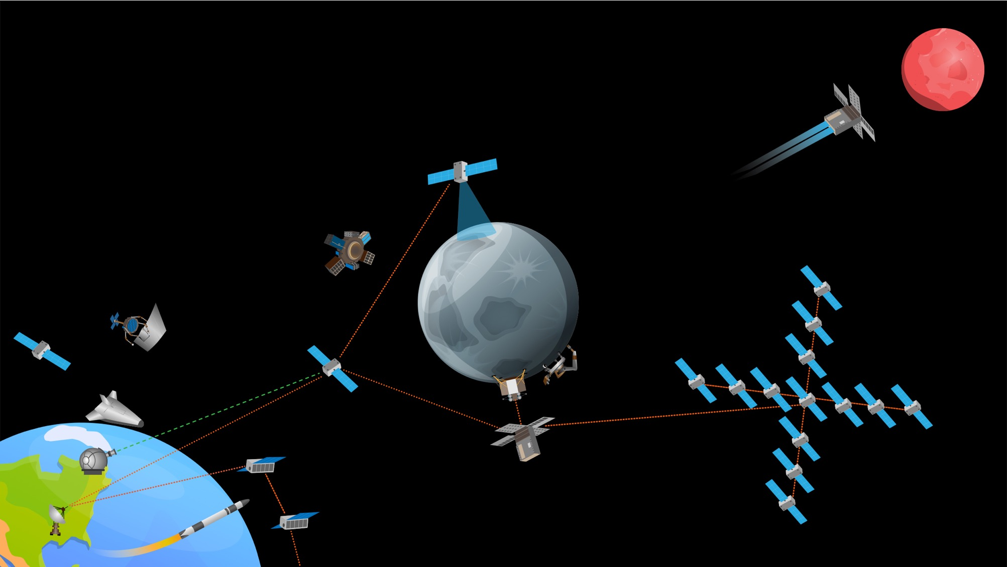
CHANGING THE PACE OF SPACE
Leveraging small spacecraft and responsive launch to rapidly expand space capabilities at dramatically lower costs
Rapid Leap from Lab to Orbit
On-Demand Missions Beyond Earth
Commercial suborbital and orbital test capabilities de-risking technology for future missions. Technology moves from lab to orbit in <9 months.
Responsive deep space access
Targeted measurements of Moon, Mars, Venus, and the asteroid belt in response to events and opportunities. Capabilities are competitive with traditional systems but developed for <$30M in <3 years.
Sustained deep space presence
Commercial lunar activity
In-situ resource extraction
and utilization
Expanded space commerce
On-orbit manufacturing, assembly, and inspection
Unparalleled Sensing Capabilities
Networked spacecraft providing multi-kilometer synthetic apertures and massive sensor webs of 30 to 100 spacecraft. Each node costs <$10M to build and deliver to space.
Unprecedented Deep Space Infrastructure
Modular communications, navigation, and mission support that provides full coverage of Moon and Mars. Each node costs <$20M to build and deliver to space.
NOT ALL ACTIVITIES DEPICTED ARE CURRENTLY FUNDED OR APPROVED. DEPICTS “NOTIONAL FUTURE” TO GUIDE TECHNOLOGY VISION

Slide 4
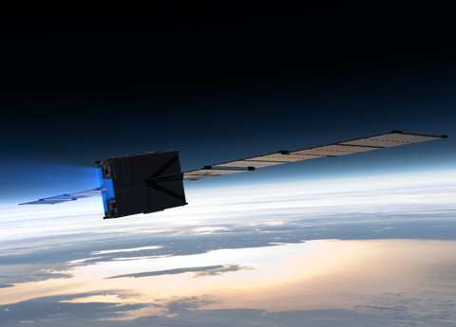
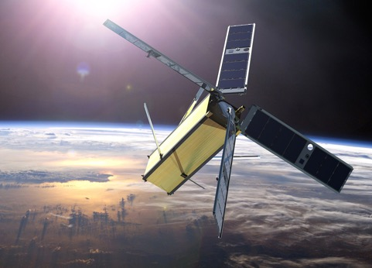
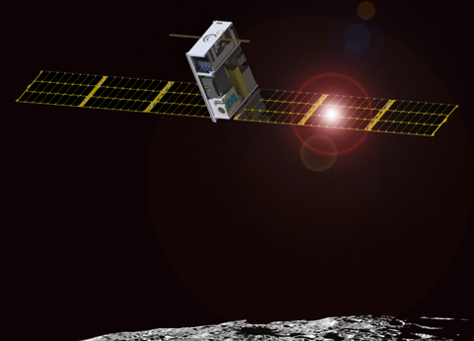
NASA Small Spacecraft Activities
Space Technology
Developing and demonstrating new small spacecraft technologies and capabilities for NASA’s missions in science, exploration and space operations.
Science
Conducting scientific investigations and developing precursor instrument technologies for future science measurements. Providing opportunities for secondary payloads in mission opportunities.
Exploration
Sponsoring missions beyond low-Earth orbit to address key strategic knowledge gaps for exploration. Providing access to space (launch opportunities) to the U.S. CubeSat community (academia, government, and non-profits).
Space Technology
Developing and demonstrating new small spacecraft technologies and capabilities for NASA’s missions in science, exploration and space operations.
Science
Conducting scientific investigations and developing precursor instrument technologies for future science measurements. Providing opportunities for secondary payloads in mission opportunities.
Exploration
Sponsoring missions beyond low-Earth orbit to address key strategic knowledge gaps for exploration. Providing access to space (launch opportunities) to the U.S. CubeSat community (academia, government, and non-profits).
Notes:
CubeSat Definition
SmallSat Definition

Slide 5
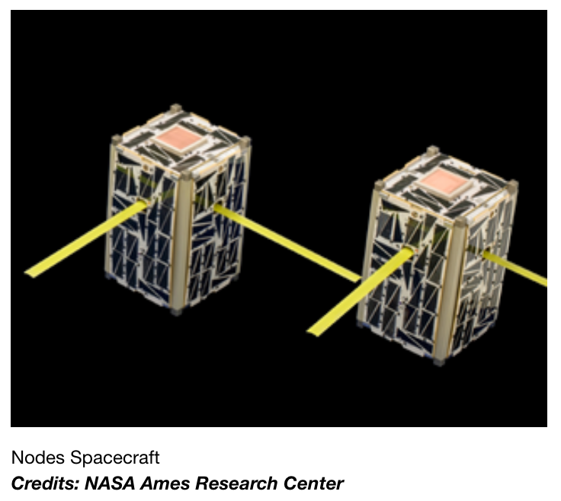


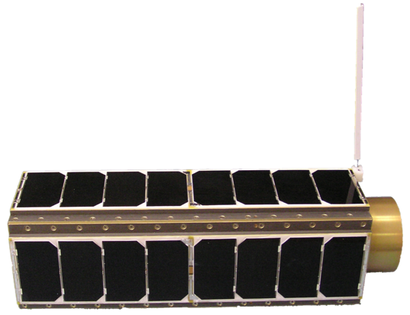




The Benefit of SmallSats
1.5U CubeSats
SmallSats technology more capable than ever
Scientific and engineering impact has far reach
Increases access to space
(e.g., Academic Partnerships, Small Businesses)
Multiple Flights Possible
Autonomous Operations
Technology Migration
3U CubeSats
3U CubeSats
Credits: NASA/Ames, 4.4 kg, 3 L)
Notes:
SmallSats are ever more capable: Miniature/micro/nano technologies
bioengineered organisms; fabrication; materials; optics; sensors; actuators; MEMS; fluidics; electronics; communications; instrumentation; data handling & storage
Power generation & storage density up; power needs down
Access to space: Low-cost launches as secondary payloads
military, government, commercial; US, Russia, Europe, Canada, India, …
Multiple flights possible - test, learn, iterate
Excellent education vehicle: Significant academic participation worldwide
Autonomous operations: Less reliance on human-tended experiments
Technology migration: ISS; landers/orbiters for moon, Mars, other planets

Slide 6
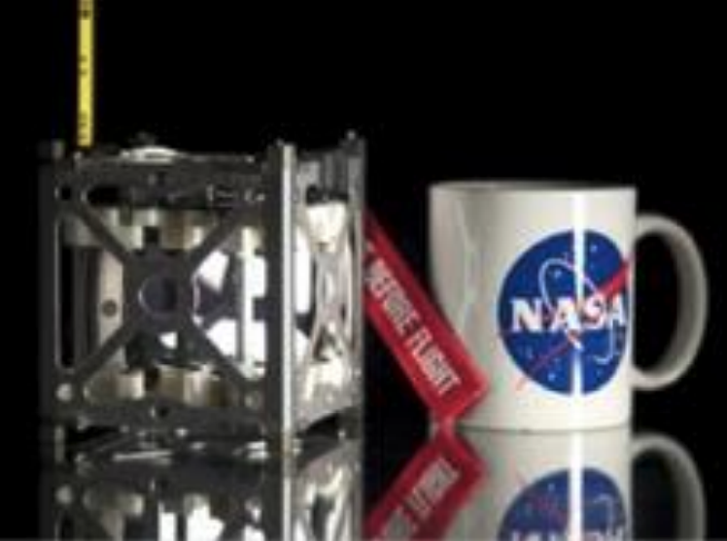
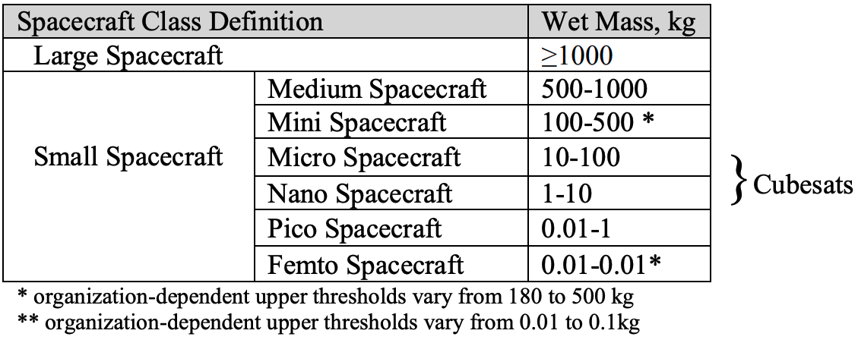
Understanding Small Spacecraft and CubeSats
Figure 1 Typical 1U Cubesat
Table 1 Spacecraft classification based on wet mass
The standard “one unit” (1U) cubesat spacecraft is a cube 10 cm on each side with a mass of approximately 1 kg. (CubeSat Program, 2014).
CubeSats can be composed of a single cube (a “1U” cubesat) or several cubes combined forming, for instance, 3U, 6U or even 27U integrated units.
Notes:
Reference for this slide: https://ntrs.nasa.gov/api/citations/20190031730/downloads/20190031730.pdf

Slide 7
TYPICAL CUBESAT PAYLOAD ACCOMMODATIONS
CLASS | 3U | 6U | 12U
Payload Volume (typical) | ~1 – 1.5 U | ~ 4U | ~8U
Payload Power | 15 – 20 W depending upon solar array configuration | 45 W – depending upon solar array configuration | > 50W depending upon solar array & battery configuration
On-board Data Storage | 4 GB | > 4GB | > 4GB
Data Interfaces | 3.3V, RS422, RS485, Spacewire | 3.3V, RS422, RS485, Spacewire | 3.3V, RS422, RS485, Spacewire
LEO Downlink | S-Band up to 2Mbps | S-Band up to 2Mbps X-Band up to 10Mbps | S-Band up to 2Mbps X-Band up to 10Mbps
Pointing Stability | 1 arc-sec over 1 sec | 1 arc-sec over 1 sec | 1 arc-sec over 1 sec
Orbit Life | LEO ~5 yrs | LEO ~5 yrs | LEO ~5 yrs
NOTE: 1U = 10cm X 10cm X 10cm volume

Slide 8
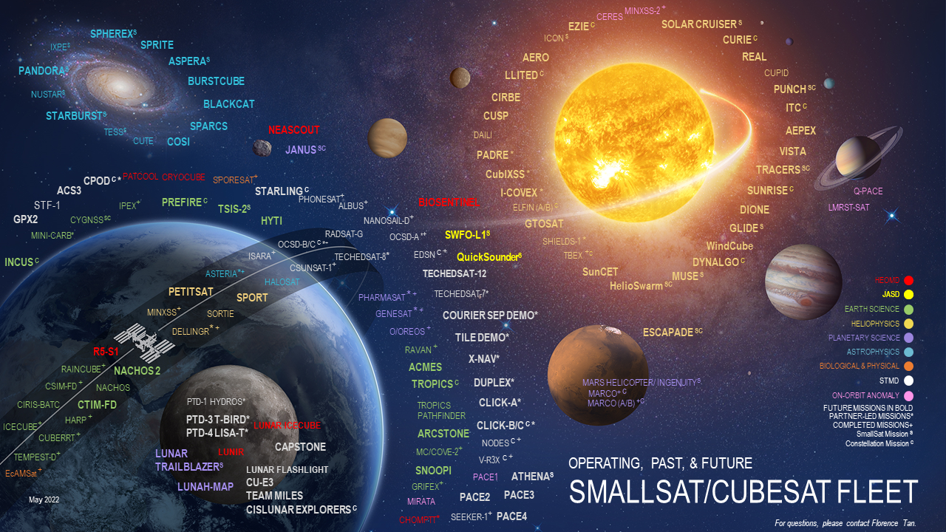
https://s3vi.ndc.nasa.gov/cubesat/

Slide 9
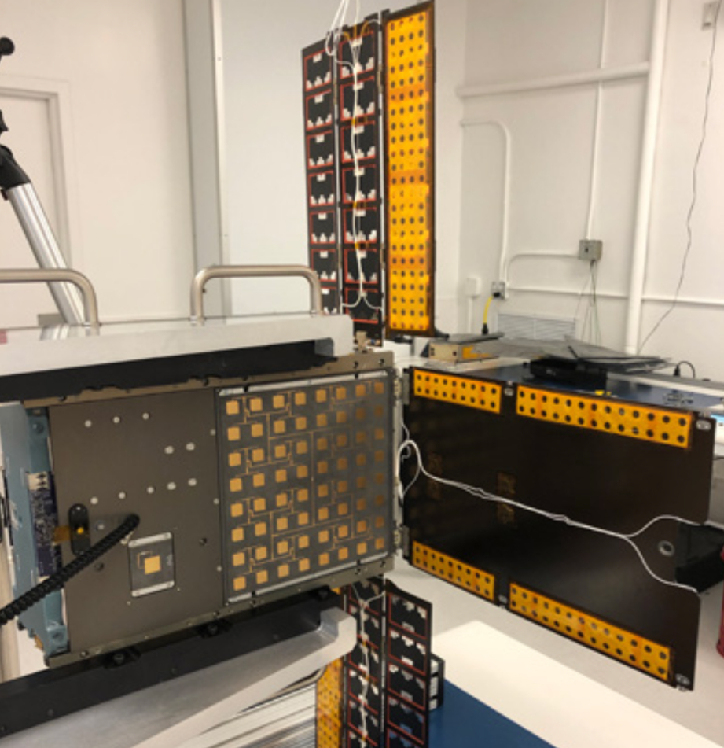
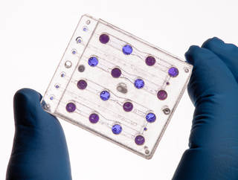
CubeSats in Action: BioSentinel
Microfluidics Biosensor Instrumentation
Artemis I Mission, 6U CubeSat
NASA’s AMES Research Center
The primary objective of BioSentinel is to develop a biosensor instrument to detect and measure the impact of space radiation on living organisms over long durations beyond low-Earth Orbit (LEO).
Scientific Impact
BioSentinel will address strategic knowledge gaps related to the biological effects of space radiation and will provide an adaptable platform to perform human- relevant measurements in multiple space environments in the future, including on lunar and Mars landers and orbiters.
Credit: NASA/Dominic Hart
Notes:
The following slides are just a few examples of CubeSats in action.
Reference: https://www.nasa.gov/centers/ames/engineering/projects/biosentinel.html

Slide 10
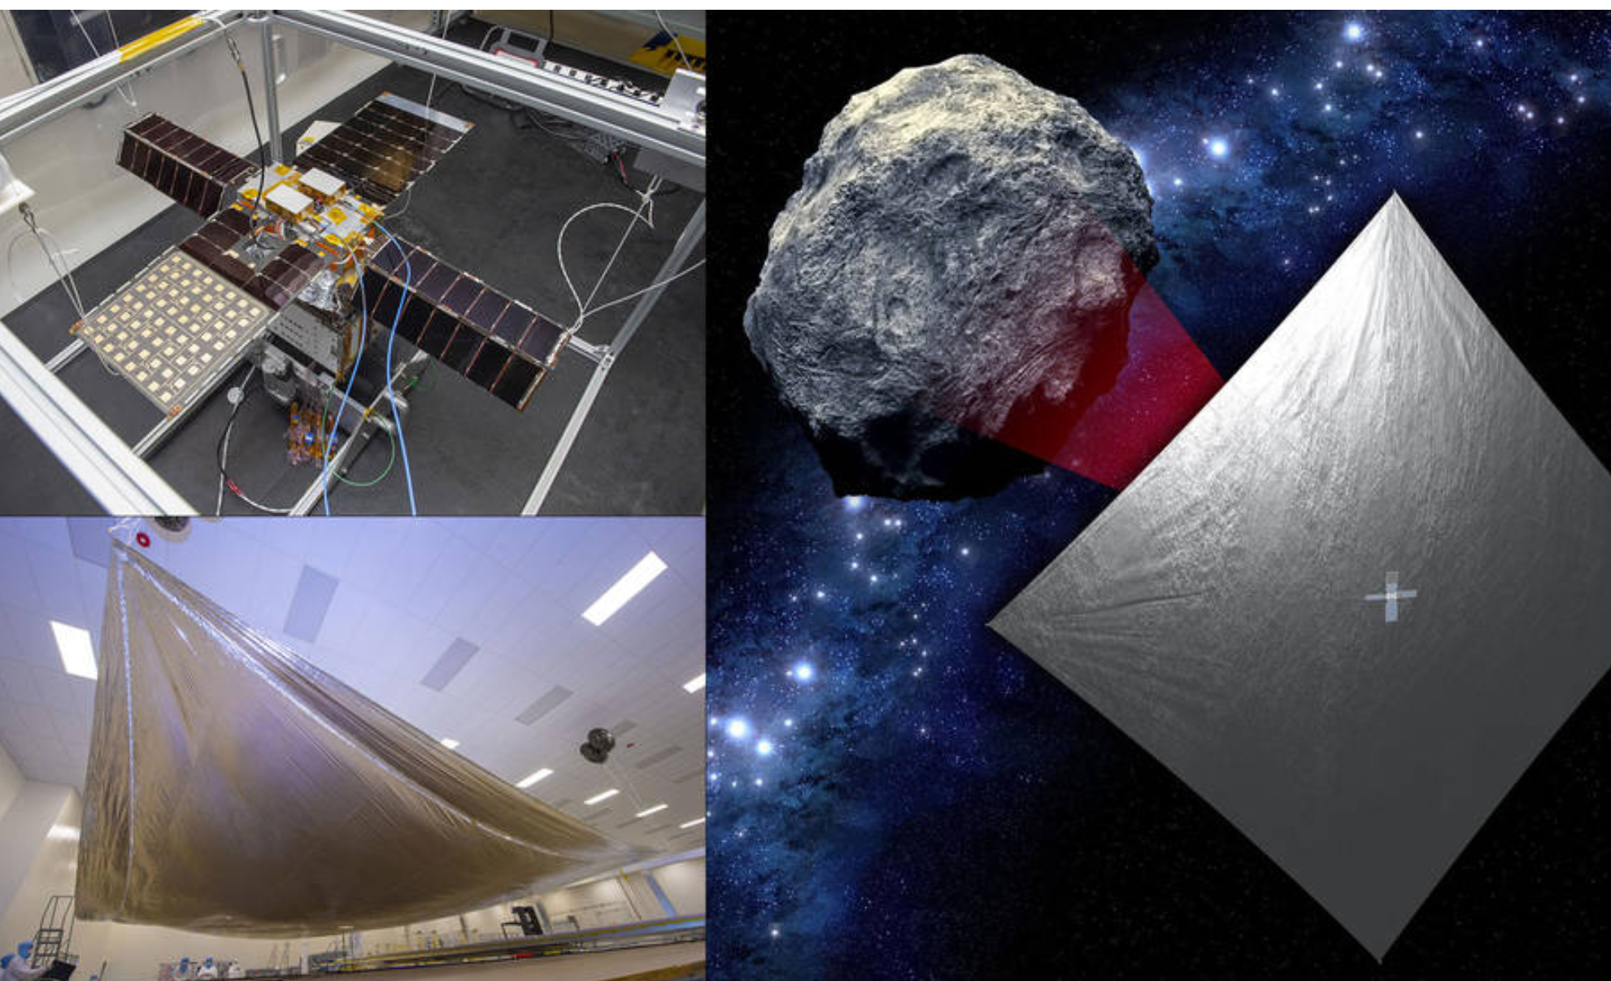
CubeSats in Action: NEA Scout
Near-Earth Asteroid (NEA) Observation and Characterization
Artemis I Mission, 6U CubeSat
NASA's Marshall Space Flight Center and NASA’s Jet Propulsion Laboratory
Outfitted with a camera, this advanced CubeSat will take photographs to help determine the physical properties, (shape/volume, rotational properties, debris/dust field, and regolith characteristics) of a near-Earth asteroid. It will be the first interplanetary CubeSat to image and characterize a near-Earth asteroid, combining the proven capabilities of solar sail propulsion with critical science needs.
Scientific Impact
NEA Scout will fly by and return data from an asteroid representative of near-Earth asteroids that may one day be human destinations.
Credit: NASA
Notes:
The following slides are just a few examples of CubeSats in action.
Source: https://www.jpl.nasa.gov/news/nasa-solar-sail-mission-to-chase-tiny-asteroid-after-artemis-i-launch

Slide 11
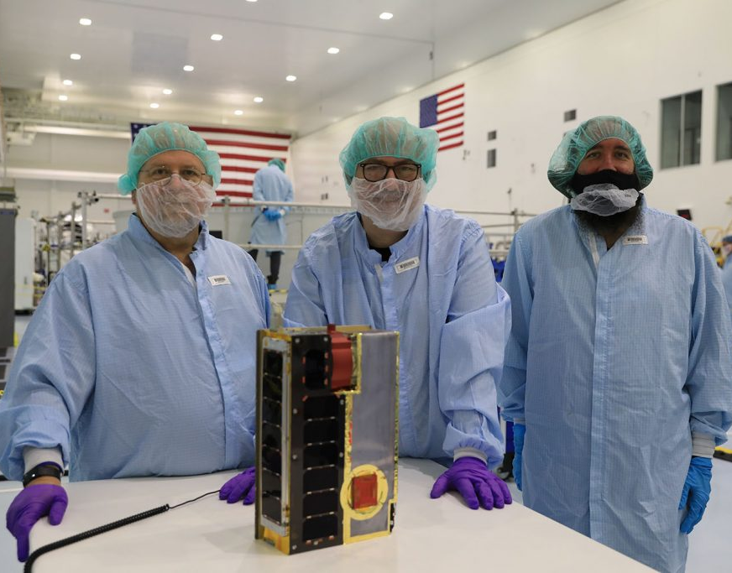
CubeSats in Action: CuSP
Solar Particles Observation and Characterization
Artemis I Mission, 6U CubeSat
Southwest Research Institute (SwRI), NASA’s Goddard Space Flight Center, and NASA’s Jet Propulsion Laboratory
CubeSat to Study Solar Particles’ (CuSP) orbit of the Sun with three instruments has the purpose of measuring incoming radiation and magnetic fields. CuSP can observe events in space hours before those events potentially reach Earth.
Scientific Impact
CuSP’s research will help with studies of solar particles that have a variety of effects on Earth, such as interfering with radio communications, tripping up satellite electronics, and creating electronic currents in power grids.
Credit: NASA
Notes:
The following slides are just a few examples of CubeSats in action.
https://blogs.nasa.gov/blog/tag/cusp/

Slide 12
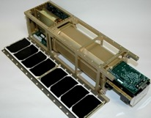
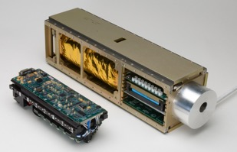
First CubeSat Technology Demonstration Mission – NASA’s GeneSat-1
Notes:
Source:

Slide 13
How SST enables progress towards the Biological and Physics Science (BPS) Goal
Having started with 1U CubeSat and now moving to potentially unlimited CubeSats, the SST makes possible the incredible research needed to achieve the BPS Goal.
  BPS GOAL
  Understand the fundamental biological effects of short and long duration exposure to the lunar environment on…
  BPS-1 | Human physiology and disease.
  BPS-2 | Plants used to provide crew nutrition/behavioral health.
  BPS-3 | The survival and adaption of microbes associated with the crew, plants, and the built environment.
  Understand transient or permanent physiological changes on…
  BPS-4 | Several generations of organisms.
GeneSat (2006)
3U
PharmaSat (2009)
3U
O/OREOS (2010)
3U
E. Coli
Brewer's Yeast
2 Bacteriae and Other Biomolecules
Different Radiation Exposures, Optical Density, and Fluorescence Spectroscopy
BioSentinel (2021)
6U Artemis-1
Brewer's Yeast
Antifungal Agent Efficacy and Optical Density
Cell Growth and Gene Expression Measured by Light Scattering and Fluorescence
Deep Space Radiation Effects and Optical Density
EcAMSat (2017)
SporeSat (2014)
3U
Fern Spores
Lab-on-Chip Measured Ion Concentrations
6U
E-Coli
Antibiotic Efficacy and Optical Density
Notes:
The Goal: Understand fundamental Biological effects when organisms are present in fractional-gravity and deep-space environments, to gain new scientific understanding and information to guide system development.

Slide 14
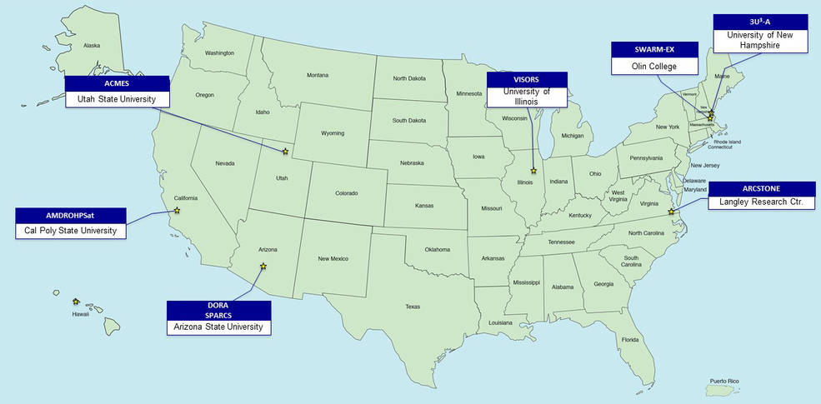
Getting to Space with CubeSat Launch Initiative
Through innovative technology partnerships NASA provides these CubeSat developers a low-cost pathway to conduct scientific investigations and technology demonstrations in space, thus enabling students, teachers, and faculty to obtain hands-on flight hardware design, development, and build experience.
Partners may arise from
U.S. Universities
High Schools
Non-Profit Organizations
(e.g., informal educational
institutions such as museums
and science centers)
Notes:
Cubesat photo from: https://www.nasa.gov/sites/default/files/thumbnails/image/elana-feature.jpg
To date, 210 CubeSat missions from 42 states, the District of Columbia, and Puerto Rico have been selected, and 134 CubeSat missions have launched into space through ELaNa rideshare opportunities.
(Reference: https://www.nasa.gov/feature/nasa-announces-13th-round-of-candidates-for-cubesat-space-missions)
CSLI 13th Round CubeSat Selections (March 2022)
The organizations and the CubeSats chosen during this selection round are:
Arizona State University
University of Illinois at Urbana-Champaign
NASA Langley Research Center
California Polytechnic State University
Olin College
University of New Hampshire
Utah State University
Arizona State University

Slide 15
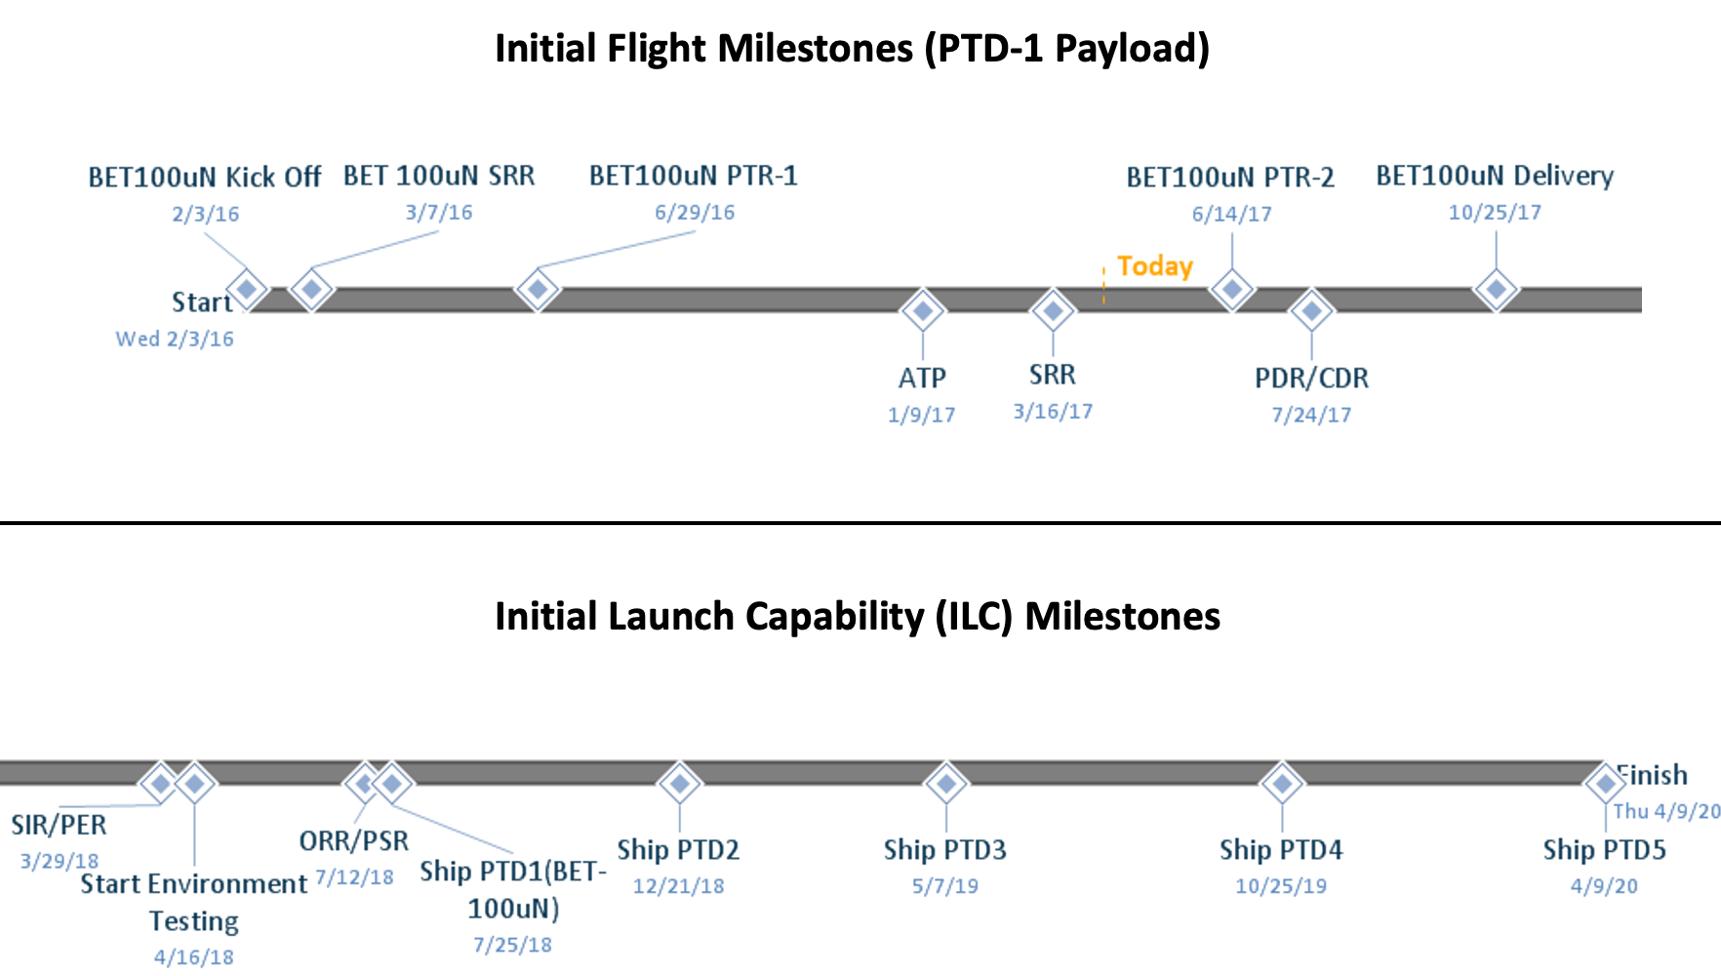
Payload Development and Maturation to Flight Readiness
Subject to change

Slide 16
Environmental Conditions and Test Requirements
Understanding variables and possible controls
Example Environment Conditions
Between 65 – 75 degrees F in hangar, with the potential for up to 75% humidity
Temperature on launchpad could range from 50 – 90 degrees F with up to 65% humidity
Required Payload Testing
Static load
Sine vibration
Acoustic
Shock
Random vibration
Electromagnetic compatability
Combined thermal and vacuum
Pressure systems
Notes:
Source: SpaceX https://storage.googleapis.com/rideshare-static/Rideshare_Payload_Users_Guide.pdf (Page 17)
Understanding the environmental controls provided - biological payloads want to see temp and humidity controls; PI can start to request some of these controls

Slide 17
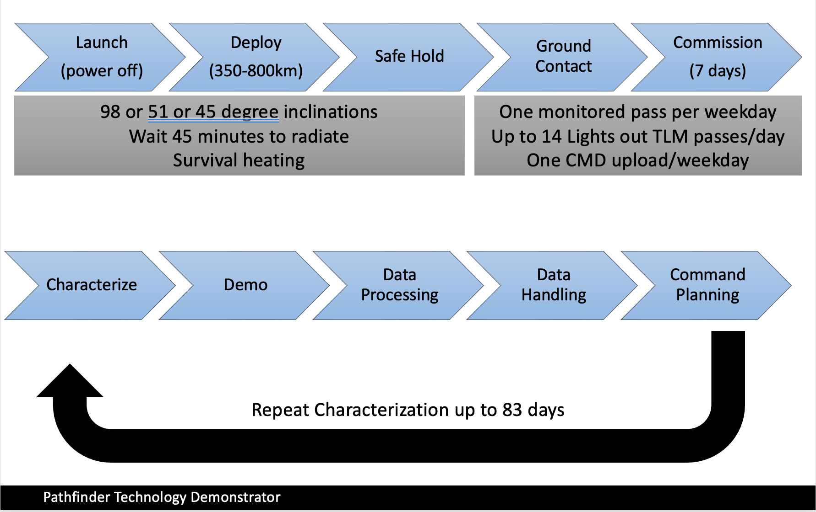
Example Operations Flow
Notes:
Source:
All mission operations look very similar to this. The spacecraft won’t turn on until after 45 from deployment by the launch provider. You won’t get immediate info; when spacecraft is stable, we go into mission ops with the PI to start doing science work. For as long as the spacecraft is in space, the PI can run their experiment.

Slide 18
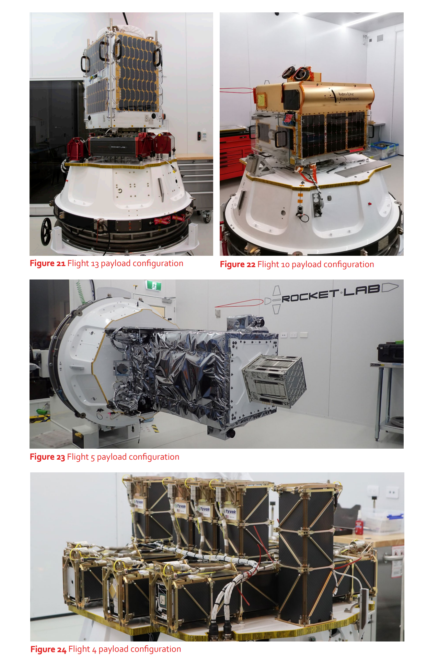
Venture-Class Acquisition of Dedicated Rideshare (VADR)
Small Launch Vehicles
Companies that applied and are awarded VADR missions to operate their small launch vehicles for science and technology payloads:
ABL Space Systems (El Segundo, CA)
Astra Space, Inc. (Alameda, CA)
Blue Origin Florida, LLC (Merritt Island, FL)
L2 Solutions, LLC (Houston, TX)
Northrop Grumman Systems Corporation (Chandler, AZ)
Phantom Space Corporation (Tucson, AZ)
Relativity Space, Inc (Long Beach, CA)
Rocket Lab USA, Inc (Long Beach, CA)
Spaceflight Inc (Seattle, WA)
Space Exploration Technologies Corp – SpaceX (Hawthorne, CA)
United Launch Services, LLC (Centennial, CO)
Virgin Orbit, LLC (Long Beach, CA)
Credit: Rocket Lab
Notes:
Photos from https://www.rocketlabusa.com/assets/Uploads/Payload-User-Guide-LAUNCH-V6.6.pdf (Page 26)
Companies that applied and are awarded Venture-Class Acquisition of Dedicated Rideshare (VADR) missions to operate their small launch vehicles for science and technology payloads:
ABL Space Systems (El Segundo, CA)
Astra Space, Inc. (Alameda, CA)
Blue Origin Florida, LLC (Merritt Island, FL)
L2 Solutions, LLC (Houston, TX)
Northrop Grumman Systems Corporation (Chandler, AZ)
Phantom Space Corporation (Tucson, AZ)
Relativity Space, Inc (Long Beach, CA)
Rocket Lab USA, Inc (Long Beach, CA)
Spaceflight Inc (Seattle, WA)
Space Exploration Technologies Corp – SpaceX (Hawthorne, CA)
United Launch Services, LLC (Centennial, CO)
Virgin Orbit, LLC (Long Beach, CA)

Slide 19
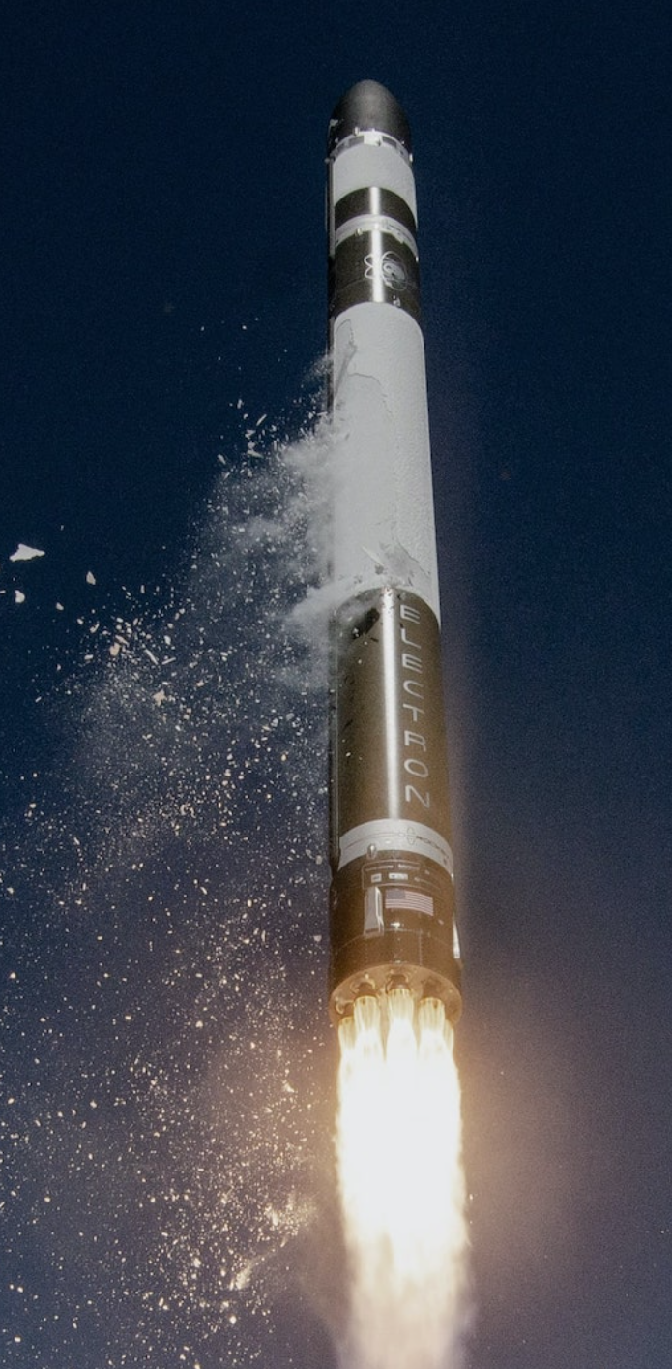
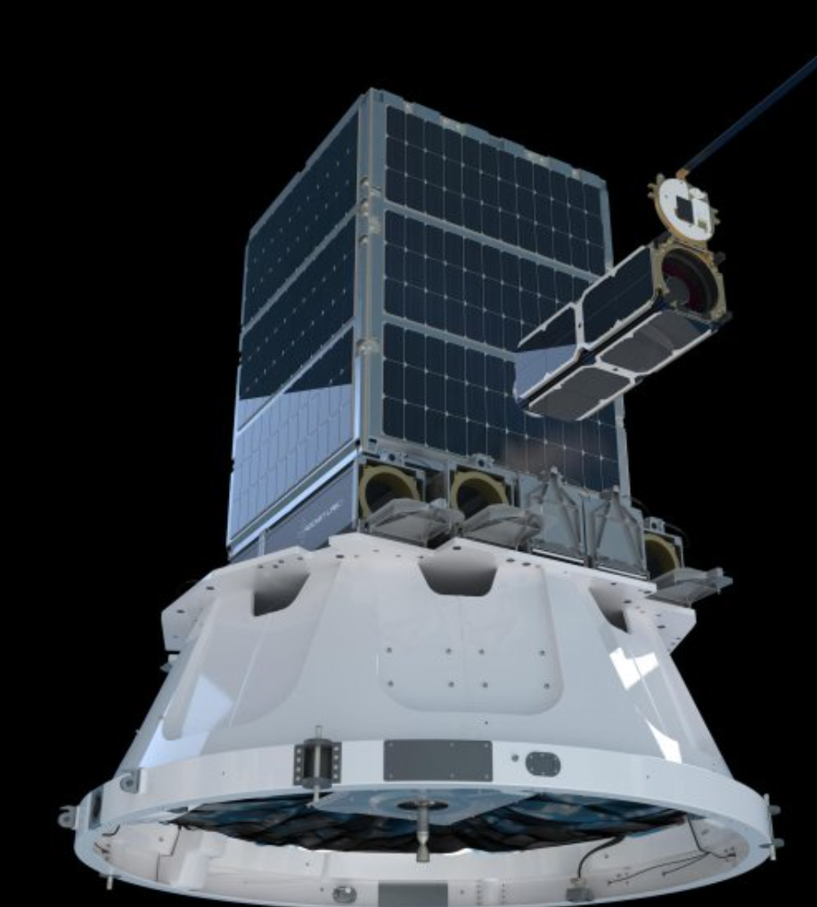
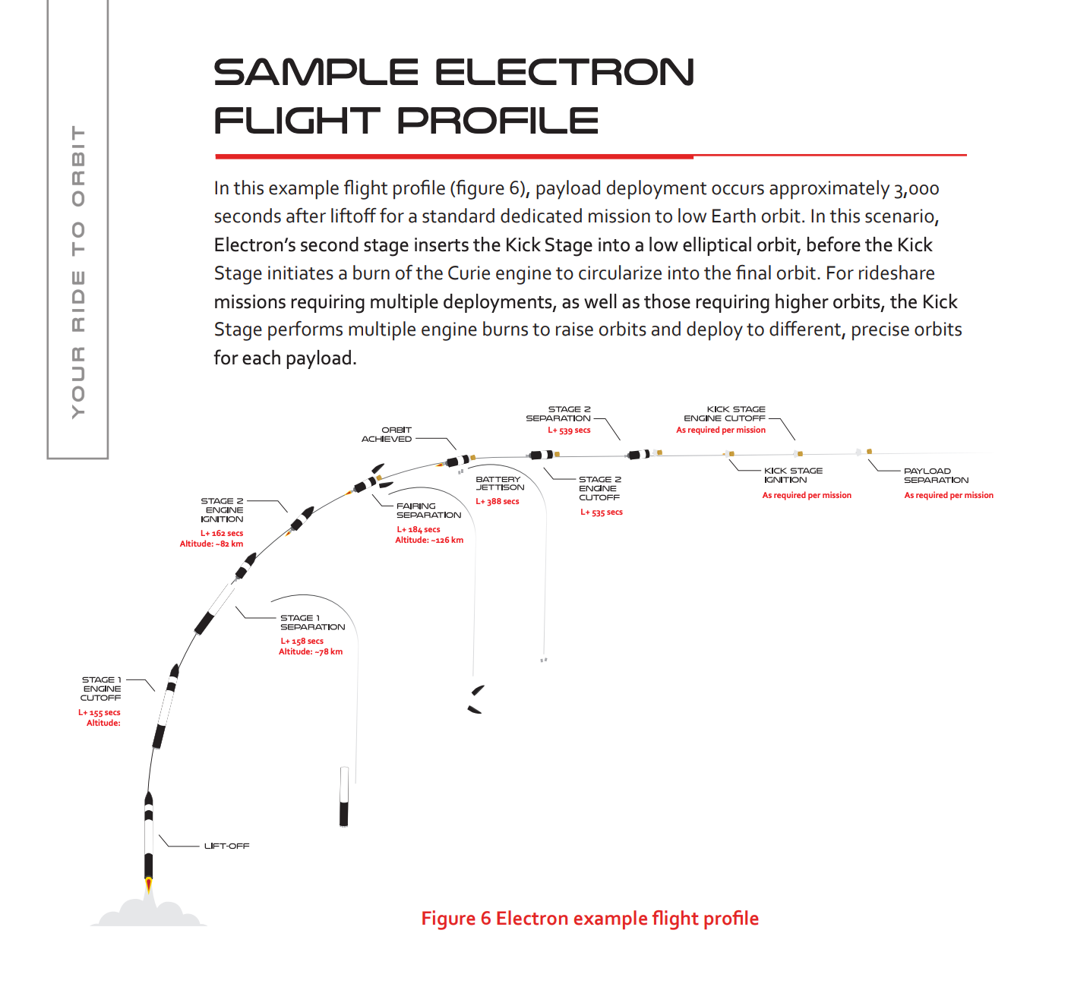
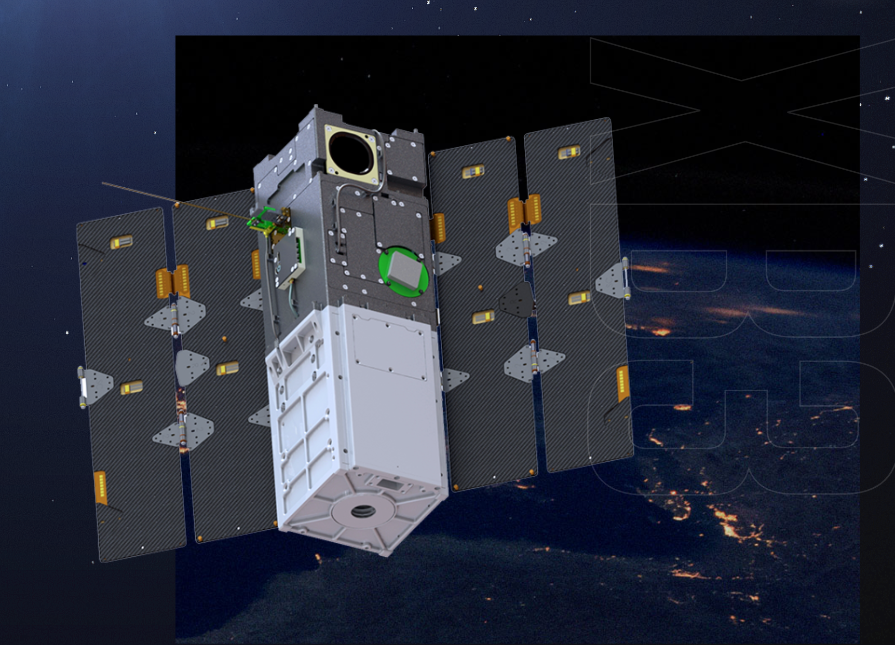
Examples from a VADR Company: Rocket Lab, Inc
Credit: Rocket Lab
Notes:
Photos from Rocket Lab’s Electron webpage: https://www.rocketlabusa.com/launch/electron/
Flight Profile from: https://www.rocketlabusa.com/assets/Uploads/Rocket-Lab-Launch-Payload-Users-Guide-6.5.pdf (Page 10)
Kick Stage
Electron’s unique Kick Stage is designed to deliver small satellites to precise and unique orbits, whether flying as dedicated or ride share.
Deployment of payloads at multiple planes/inclinations
Higher altitude deployment
Hosted payload support
Multiple trajectory changes
Sustained low altitude orbits
Deorbiting payloads to eliminate space debris

Slide 20
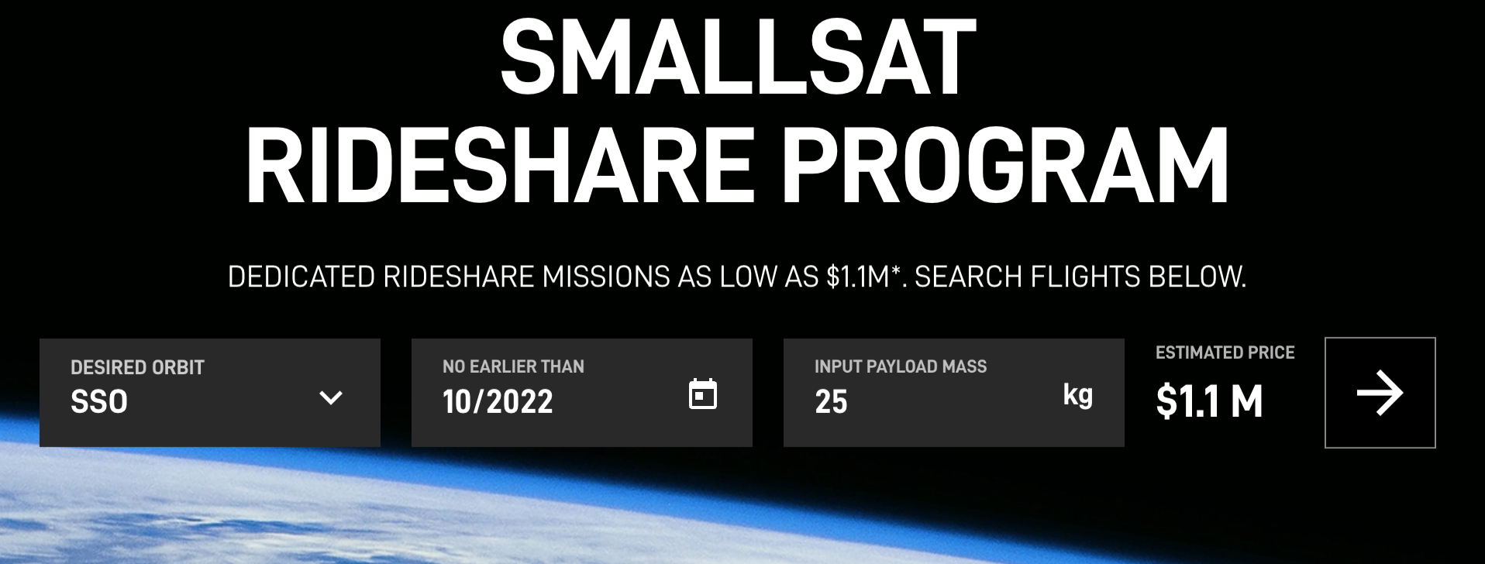
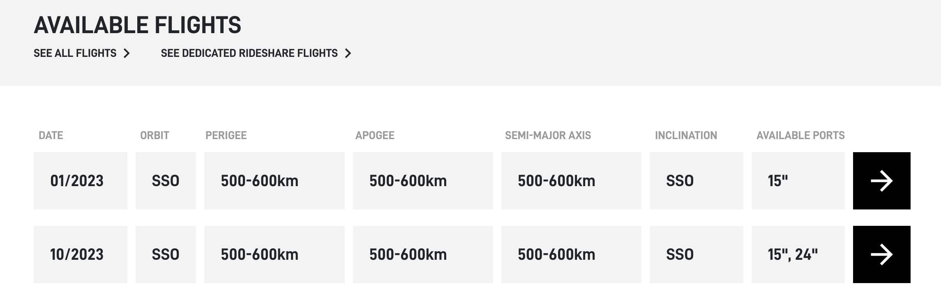
Examples from a VADR Company: SpaceX
SmallSat Rideshare Program
Notes:
Website screen capture: https://www.spacex.com/rideshare/

Slide 21
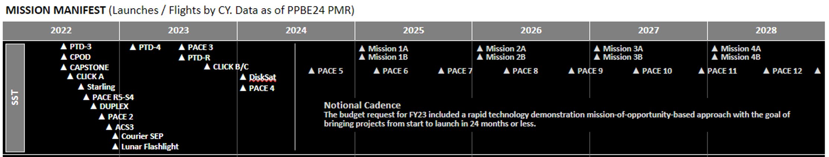
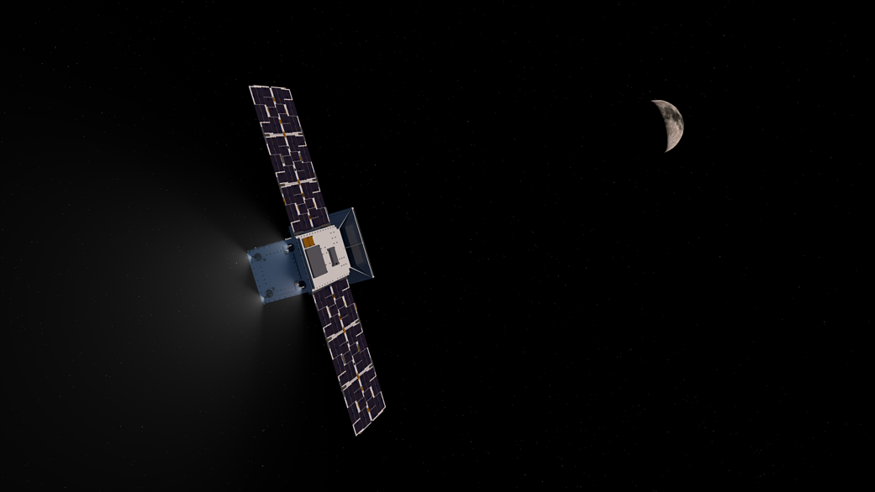
What is to come: Small Spacecraft Missions Timeline
Notes:
Photo reference: https://www.nasa.gov/sites/default/files/styles/full_width_feature/public/thumbnails/image/capstone_tli_04_copy1.png
There are plenty of opportunities - for your payloads on our tech demos.

Slide 22
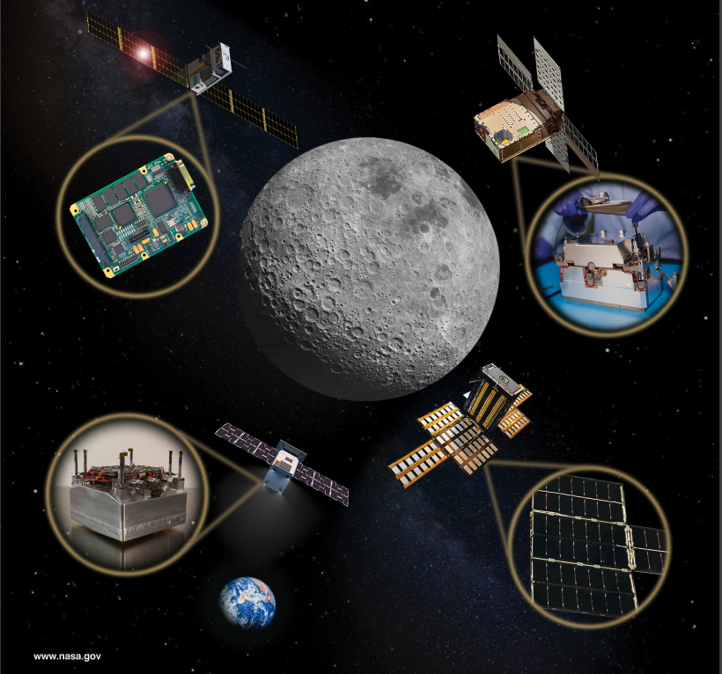
Scientific Discovery Enabled for the Future
  The Small Spacecraft Technology program promotes research discovery today and, in the future, because it offers:
  Frequent access to space; and
  Further development of key technology so that the spacecraft can properly facilitate the science.
Notes:
Image Credit: https://www.nasa.gov/sites/default/files/atoms/files/soa_2021_1.pdf (Page 5)

Slide 23
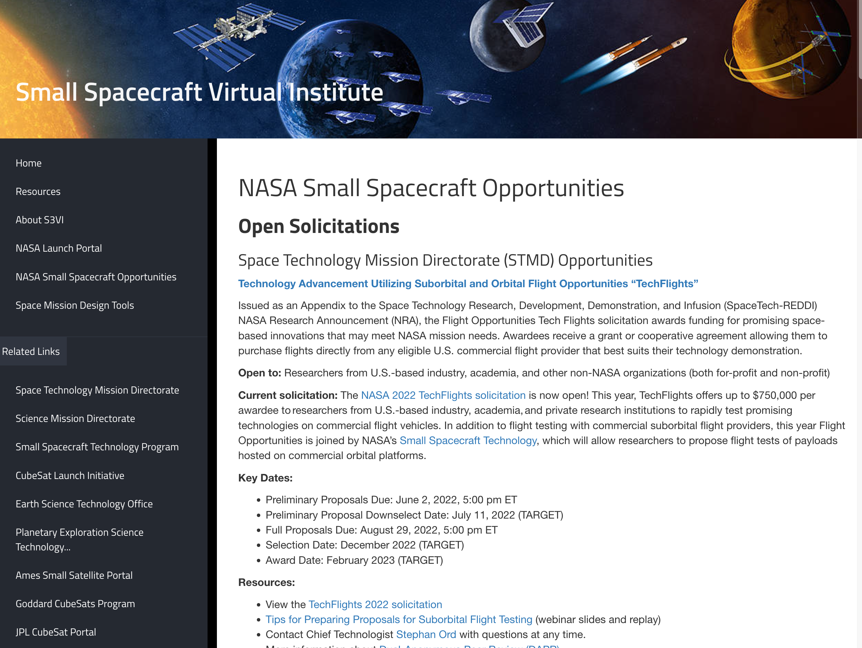
For More Information
Visit
Small Spacecraft Technology Program
https://www.nasa.gov/smallspacecraft
Small Spacecraft Systems Virtual Institute
https://www.nasa.gov/smallsat-institute
CubeSat101 | Basic Concepts and Processes for First-Time CubeSat Developers
https://www.nasa.gov/sites/default/files/atoms/files/nasa_csli_cubesat_101_508.pdf
Sign Up
Small Spacecraft Systems Virtual Institute Newsletter
https://lp.constantcontactpages.com/su/hkvyjHq/S3VISubscription

Slide 24

SPACE TECH STRATEGIC FRAMEWORK
techport.nasa.gov/framework
WWW.NASA.GOV/SPACETECH
www.nasa.gov/smallspacecraft
www.nasa.gov/flightopportunities

