Slide 1
CONCEPT MATURITY LEVEL FRAMEWORK TO ADVANCE CONCEPTS
Concurrent Engineering
STM
Specify
Eval Criteria
Examine Trade Space
IDEA
Consider Key Design Drivers
Trade Analysis
Produce Key Questions
Generate & Assess
Partials
Prioritize Promising Approaches
Core Team
SMEs as Needed
GR&As
CML 1
CML 2
CML 3
CML 4
Concept/Idea
Feasibility
Assessment
Trade Space Understood
Point
Design
LEGEND:
IDEA
CONCEPTS & TRADES
POINT DESIGNS
BASELINE DESIGN
CML 1
“Ask a Mission Designer”
Office Hours scheduled by appointment.
Opportunity for early concept feedback.
MDC Process Maturation Framework.
CML 2
“Feasibility Assessment Studies”
Study Formats include:
Mini Consultation (small focused study).
Detailed Study with larger SME pool.
Cross Collaboration with External Partners.
CML 3
“Trade Space Analysis”
Study Goals & Formats
Focused on Trade Space exploration.
Assess key metrics
Mini Consults & Detailed studies.
CML 4
“Point Design for MCR/Proposal”
Study Goals & Formats
Focused on producing baseline point design.
Format can be adjusted to work Mini Consults & Detailed studies.

Slide 2
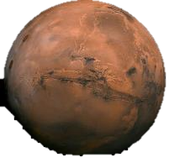
MISSION ARCHITECTURE DEFINITION TRADES
ARCHITECTURE 1- PRE MARS-ORBIT INSERTION
ARCHITECTURE 2- POST MARS-ORBIT INSERTION
ARCHITECTURE 3- FROM LOW MARS ORBIT
6
Probe Deployment From Elliptical Orbit
Probe Deployment From Science Orbit
3
2
1
2
1
5
4
3
4
5
2
3
1
4
1
PERIAPSE LOWER
MANEUVER
4
PROBE ENTRY
FROM SCIENCE ORBIT
REPEAT STEPS 2-3
1
SORTIE 1 DEPLOY
5
TCM for MOI
Entry, descent & impact of probe.
1
Maneuver S/C bus to deploy orientation.
4
Distribute remaining probes to complete required network distribution.
Sequentially deploy 6 probes to achieve partial surface coverage.
Maneuver S/C bus to deploy probe.
6
MOI BURN
PROBE DEPLOY
RELEASE PROBES
2
SORTIE 2 DEPLOY
Perform MOI burn into required science orbit.
2
Release probe.
5
S/C MANEUVER FOR NEXT DEPLOYMENT
2
Release probe. Assume probe has dV to prevent skip-out. dV requirement probe design dependent.
TBD h later, deploy 6 more probes.
3
PERIAPSE RAISE MANEUVER
Orbit change as necessary for next probe deployment.
3
SORTIE 3 DEPLOY
TBD h later, deploy 6 more probes.
Maneuver S/C bus to avoid atmosphere.
3
CONFIRM SUCCESSFUL SURFACE
PLACEMENT PRIOR TO NEXT DEPLOY
4
SORTIE 4 DEPLOY
TBD h later, deploy remaining 6 probes.
Confirm surface element is active.

Slide 3
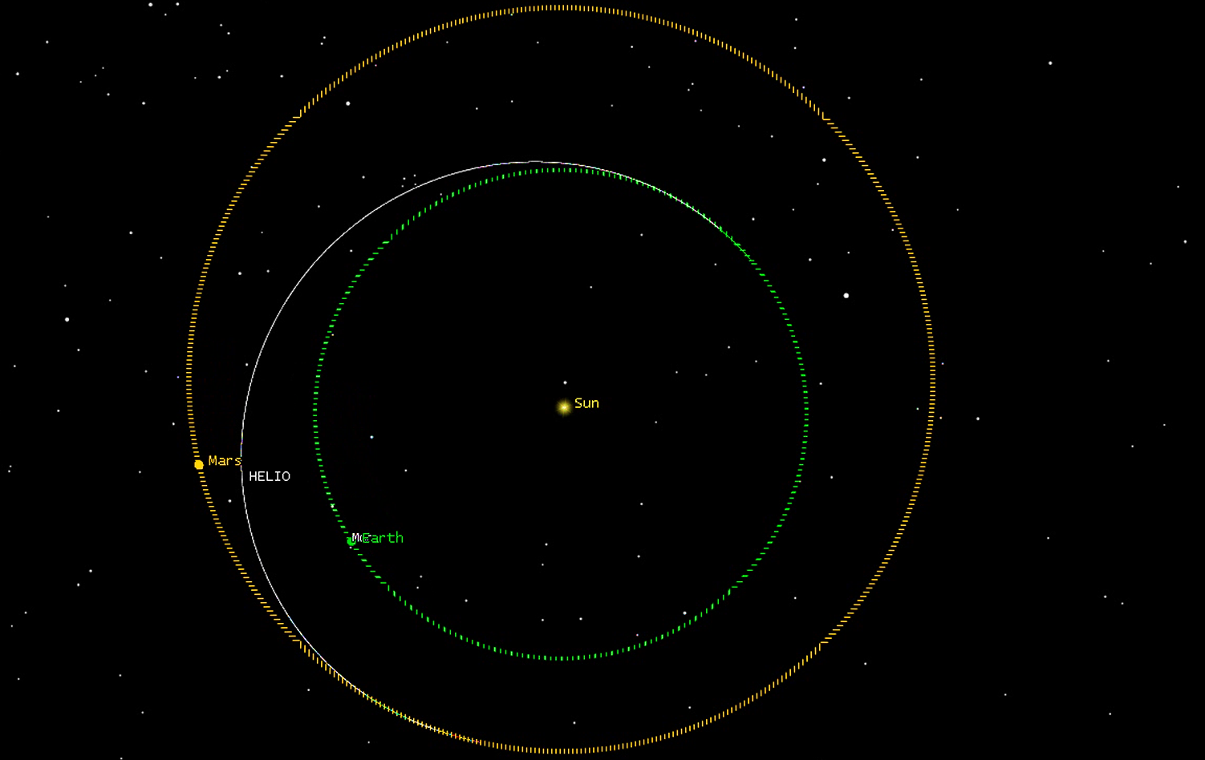
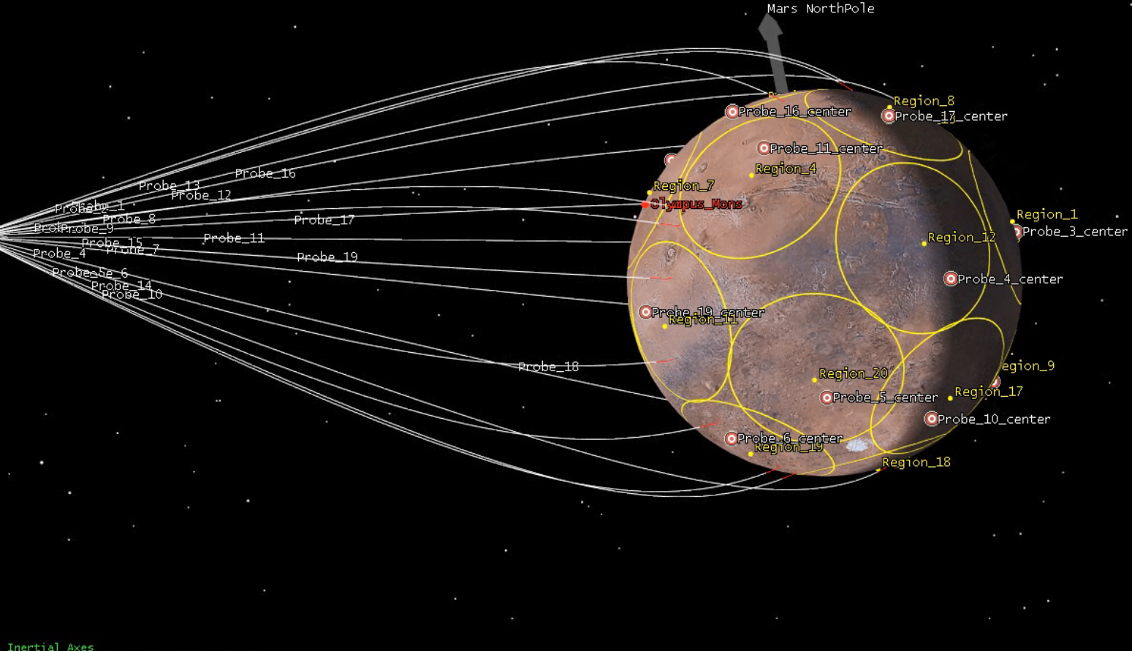
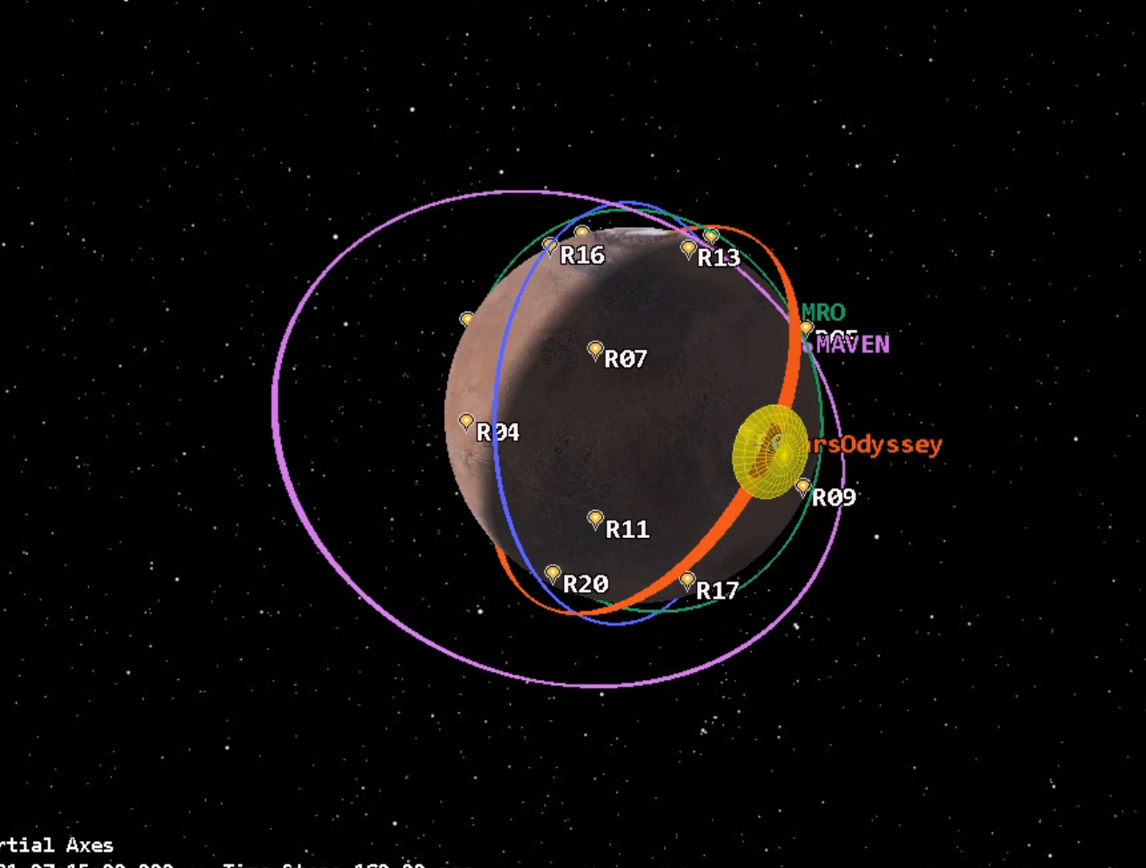
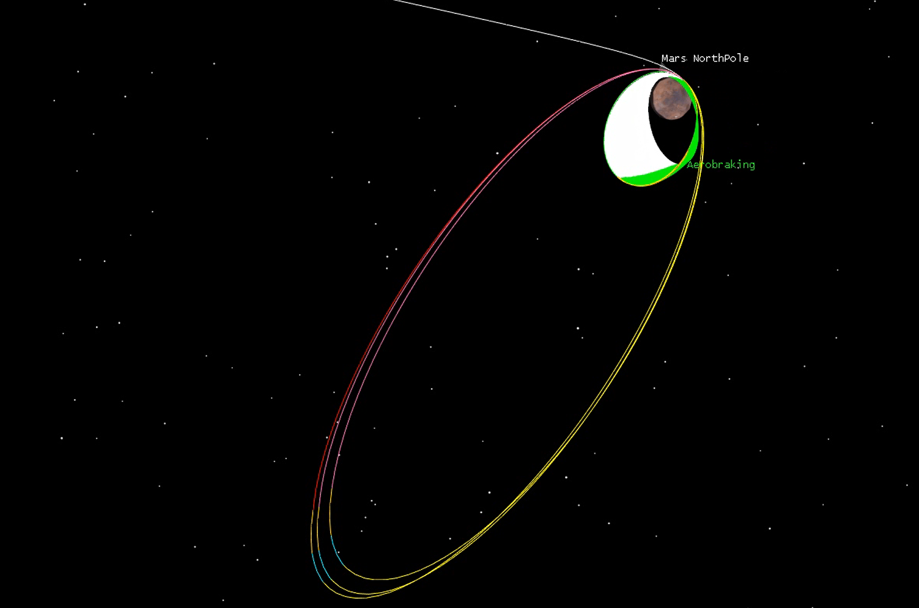
TRAJECTORY ANALYSIS, VISUALIZATION, & SCENARIO PLANNING
Deployment of lander network on hyperbolic approach
Heliocentric Transfers
Orbit Insertion & Circularization
Surface Network to Orbiter Relay Planning

Slide 4
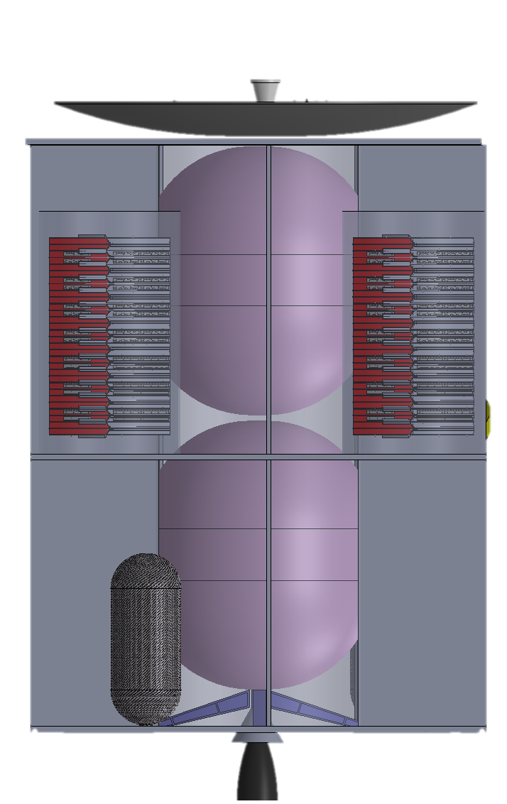
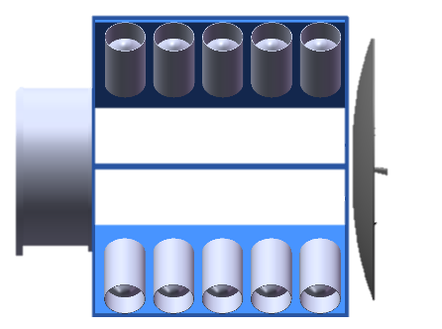
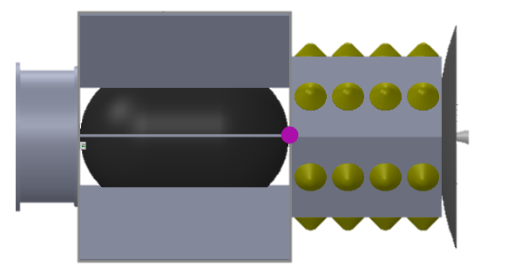
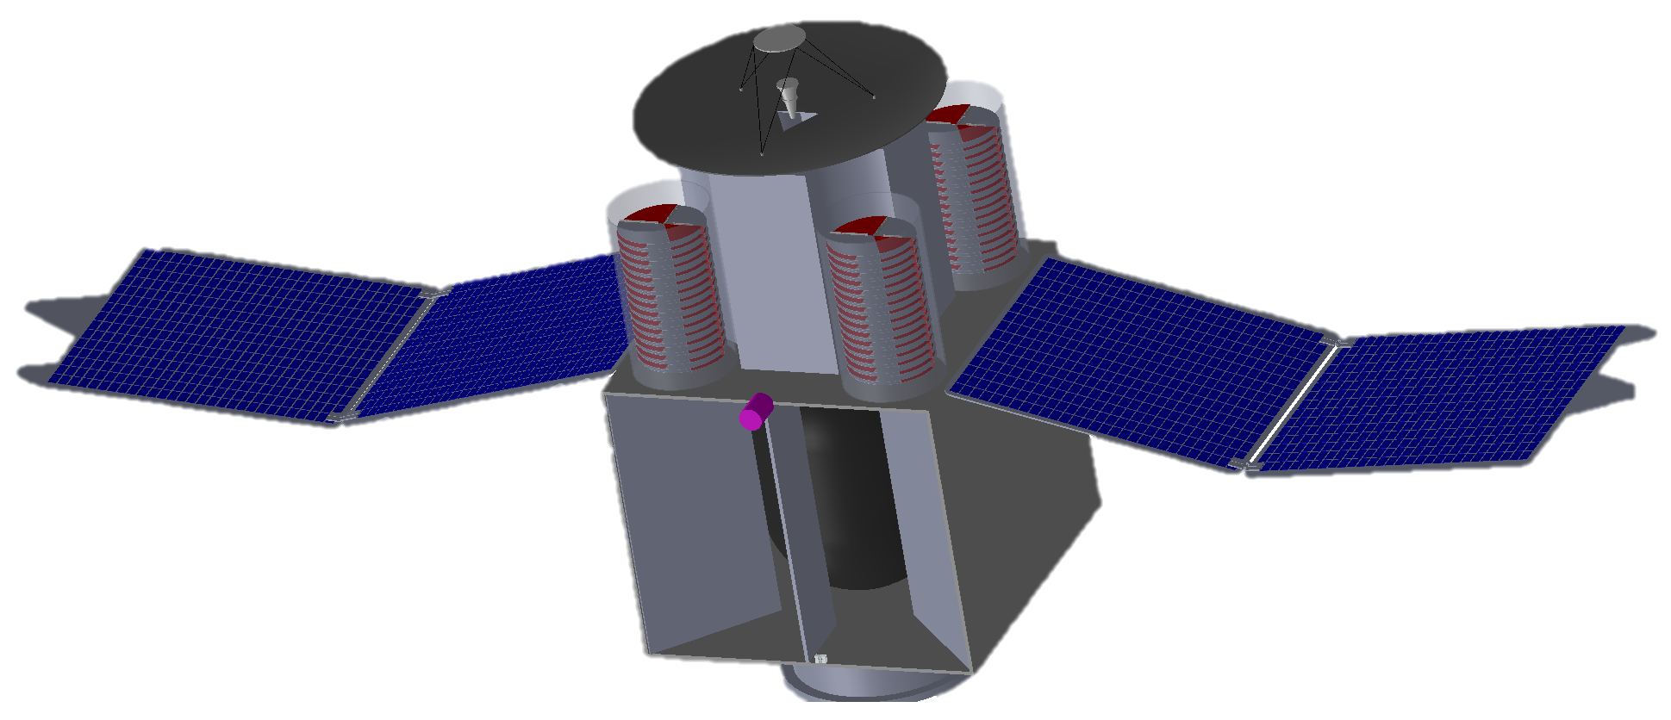
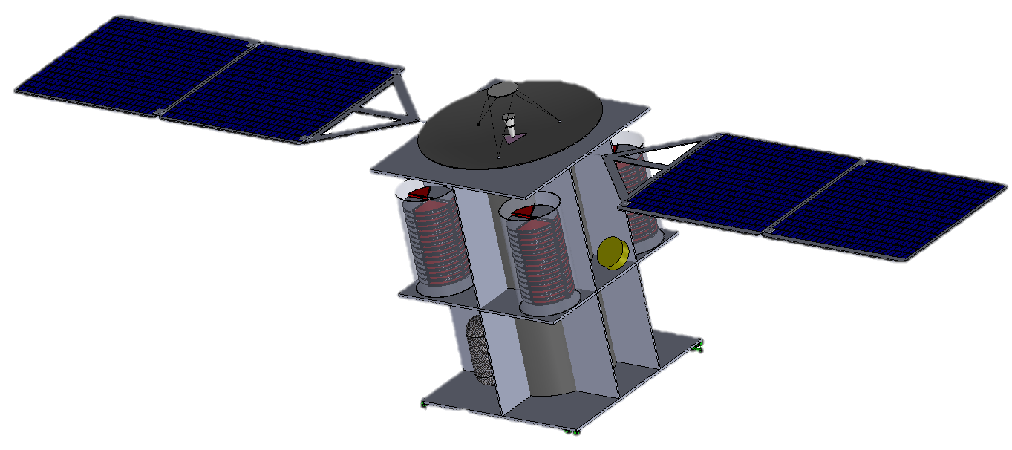
TRADE STUDIES
Heritage Probe Concepts
-Module(s) that can be bolted onto primary S/C
-Volume constraints with heritage probe design
Novel Probe Concept Designs
(60 total probes in stowed configuration)
Monopropellant Spacecraft
Bipropellant Spacecraft
Probe Deck
Avionics &
Instrument
Deck
ESPA Concept
Side view
Probe Module Concept
20 probes integrated onto S/C bus
20 probes integrated
as separate module.

Slide 5
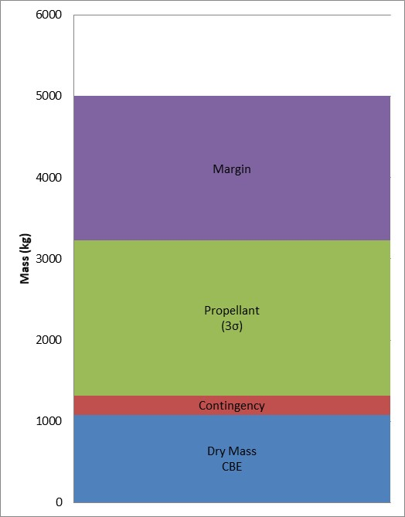
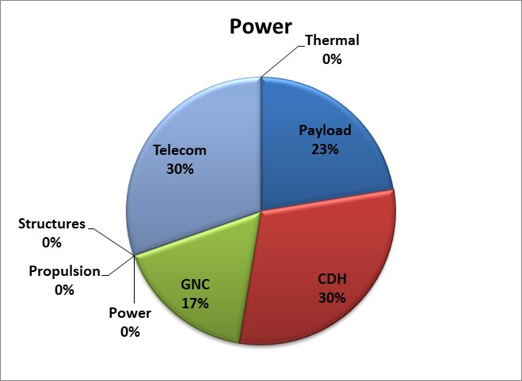
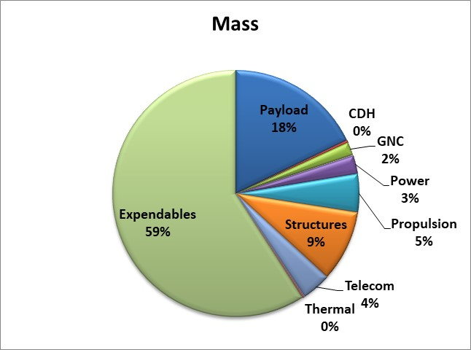
CONCURRENT ENGINEERING
Resource | Value | Allocation / Requirement | Margin
Launched Dry Mass (kg) | 1319 | 2000 | 52%
Propellant Mass (kg) | 1905 | 3000 | 57%
Total Power (W) | 743 | 1493 | 50%
Battery DOD (%) | __ | 80 | __%
Pointing (arcsec) | * | 360 | *
Attitude Knowledge (arcsec) | * | 72 | *
Jitter (arcsec/s) | * | 2 | *
S/C Delta V (m/s) | 1700-2500 | 3089 | __%
Science Mode Power

Slide 6
INTERFACE ANALYSIS
Science Team
Mission Ops
DSN
Orbiter
Other SC Data
Orbit determination and commanding
On-board sensors
Propulsion system
Solar arrays
Ka-band transceiver
Activity | Mission Element
Science Mode | Orbiter
Direct-to-Earth Communication (45+ min) | DSN, Ka-band transceiver, X-band transceiver
Instrument Calibration (15 min / 10 days) | Instruments
UHF Network / Probe Communication | Electra radio, Frontier-Lite radio, LoRa radio
UHF Network to Earth (5 min / 7 days) | UHF Comm Network
Ground Operations | Science team, Mission ops
Spacecraft Data Storage and Processing | On-board computer, other SC data
X-band transceiver
UHF Comm Network
Mars Express (elliptical, 87°)
Odyssey (circular LMO, 93°)
TGO (circular LMO, 74°)
MAVEN (elliptical, 75°)
MRO (circular LMO, 93°)
On-board Computer
(data storage and processing)
Electra
Instrument Data
Inst #1
Inst #2 (2x)
Inst #3
Inst #4
LoRa*
Probes
2-way comm (Rx/Tx)
1-way comm
Cables or interface cards
Trade not completed
Frontier-Lite
*LoRa is still being considered for redundancy but likely to be eliminated due to mass constraints
LoRa*

Slide 7
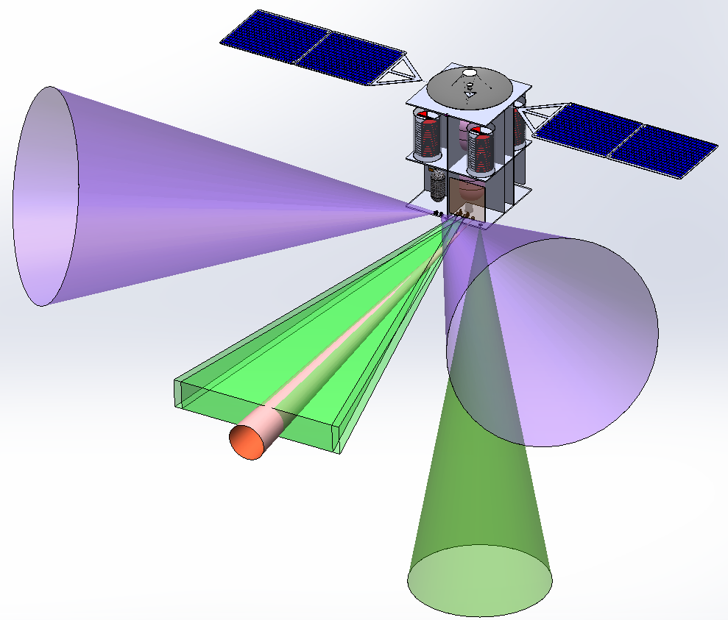
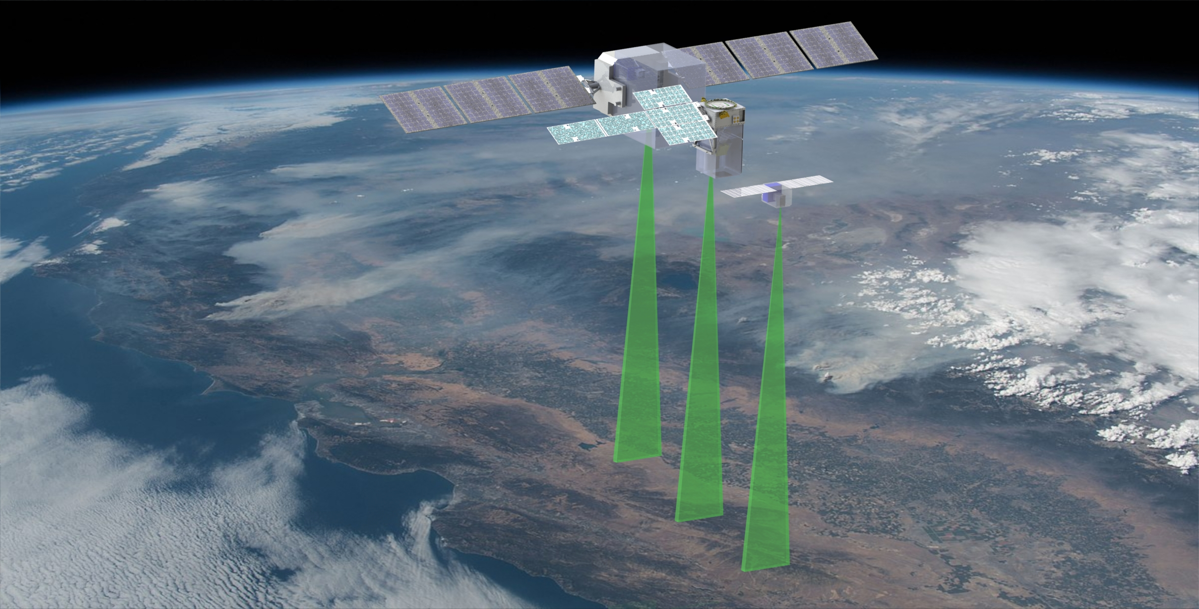
MECHANICAL CONCEPTS AND GRAPHIC DESIGN
DTE HGA
Velocity Vector
Star Tracker1 FoV
RADIATOR
Star Tracker2 FoV
Inst 2a (O3 & CO2) FoV, 4°x20°
Inst 2b FoV, 2°x30°
Inst 3 FoV, 10°
Inst 1
Instruments & Star Trackers Fields of View
Concept Rendering & Operational Visualization

