Slide 1

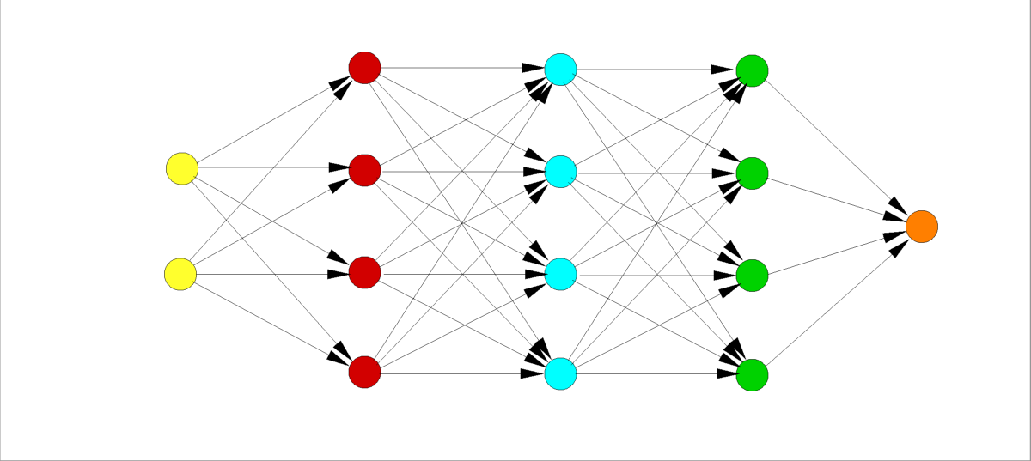
Introduction to the Collaborative Testing Challenge
C. L. Rumsey
NASA Langley Research Center
Copyright 2022 United States Government as represented by the Administrator of the National Aeronautics and Space Administration. No copyright is claimed in the United States under Title 17, U.S. Code. All Other Rights Reserved. Published by the American Institute of Aeronautics and Astronautics, Inc. with permission.
2022 Symposium on Turbulence Modeling: Roadblocks, and the Potential for Machine Learning

Slide 2
Motivation
Traditional RANS is known to be inadequate for reliable prediction of separated and other “difficult” flows
Much work is ongoing in the research community to attempt to improve RANS models using data-driven techniques
  By their very nature, these improvements are typically only applicable to cases that are very similar to those they were trained for
  We seek improved turbulence models that can be used more generally and confidently in predictive situations <- this is ultimately what is needed
    (Imagine trying to apply the model to a high-lift aircraft configuration!)
Our own attempts to achieve a broadly-applicable model enhancement using FIML methodology (AIAA 2022-0937):
  Unsuccessful
    Improving one flow inevitably made some other flow much worse
    Inappropriate or inadequate feature selection?
    Insufficient coverage of the training data? (a common complaint)

Slide 3
Motivation, cont’d
The “Collaborative Testing Challenge” was conceived as an integral part of this symposium
  Get broad range of experts to try to achieve data-driven turbulence models that work well for a broad range of simple test cases
  Nonthreatening, noncompetitive, friendly environment
    We know this is a difficult challenge!
    There is no right answer
    We seek to encourage discussion, ideas, future collaborations
Ground Rules: Each participant to apply their best turbulence model scheme (framework) derived from a data-driven (or other) approach to a range of flows specified by the conference organizers

Slide 4
Test Cases
To be a valid entry, the same turbulence model must be applied to each of the following cases (use the same grids employed for the results shown on the Turbulence Modeling Resource (TMR) website if possible):
  2DZP: 2D Zero Pressure Gradient Flat Plate Validation Case
    Show (1) C_{f} vs. x and (2) u⁺ vs. log(y⁺) at x=0.97; compare with theory
  2DFDC: 2D Fully-Developed Channel Flow at High Reynolds Number Validation Case
    Show u⁺ vs. log(y⁺) at x=500; compare with theory
  ASJ: Axisymmetric Subsonic Jet
    Show (1) u/U_{jet} vs. x/D_{jet}, (2) u/U_{jet} vs. y/D_{jet} at 5 specified stations, and (3) u'v'/(U_{jet}²) vs. y/D_{jet} at 5 specified stations; compare with experiment
  2DWMH: 2D NASA Wall-Mounted Hump Separated Flow Validation Case
    Show (1) C_{p} vs. x/c, (2) C_{f} vs. x/c, (3) u/U_{inf} vs. y/c at 7 specified stations, and (4) u'v'/(U_{inf}²) vs. y/c at 7 specified stations; compare with experiment
  2DN00: 2D NACA 0012 Airfoil Validation Cases (4 separate cases)
    Angles of attack = 10, 15, 17, and 18 deg.
    Show (1) C_{L} vs. alpha, (2) C_{D} vs. C_{L}, (3) C_{p} vs. x/c, and (4) C_{f} (upper surface) vs. x/c; compare with experiment (except for C_{f})

Slide 5
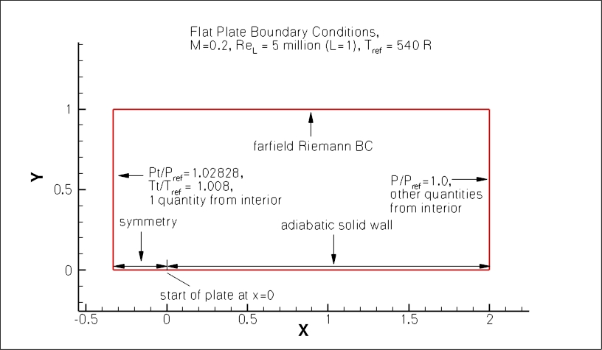
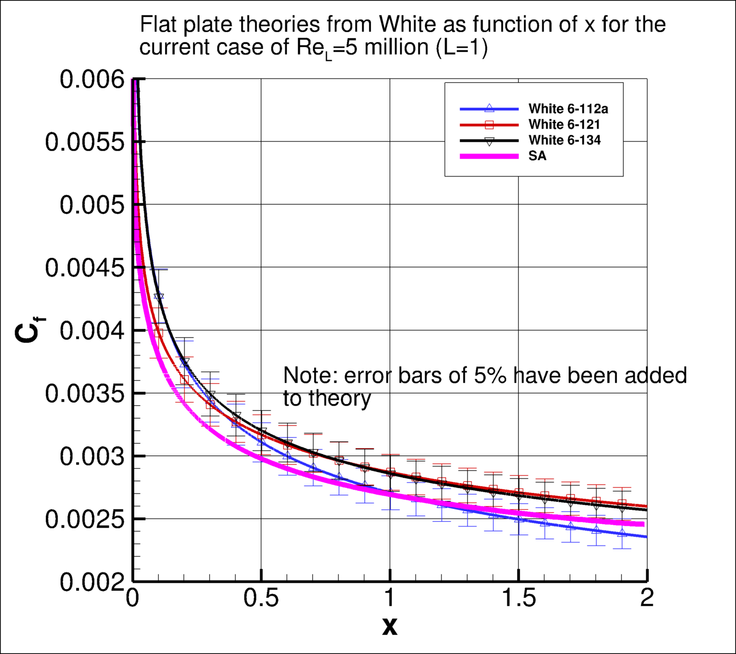
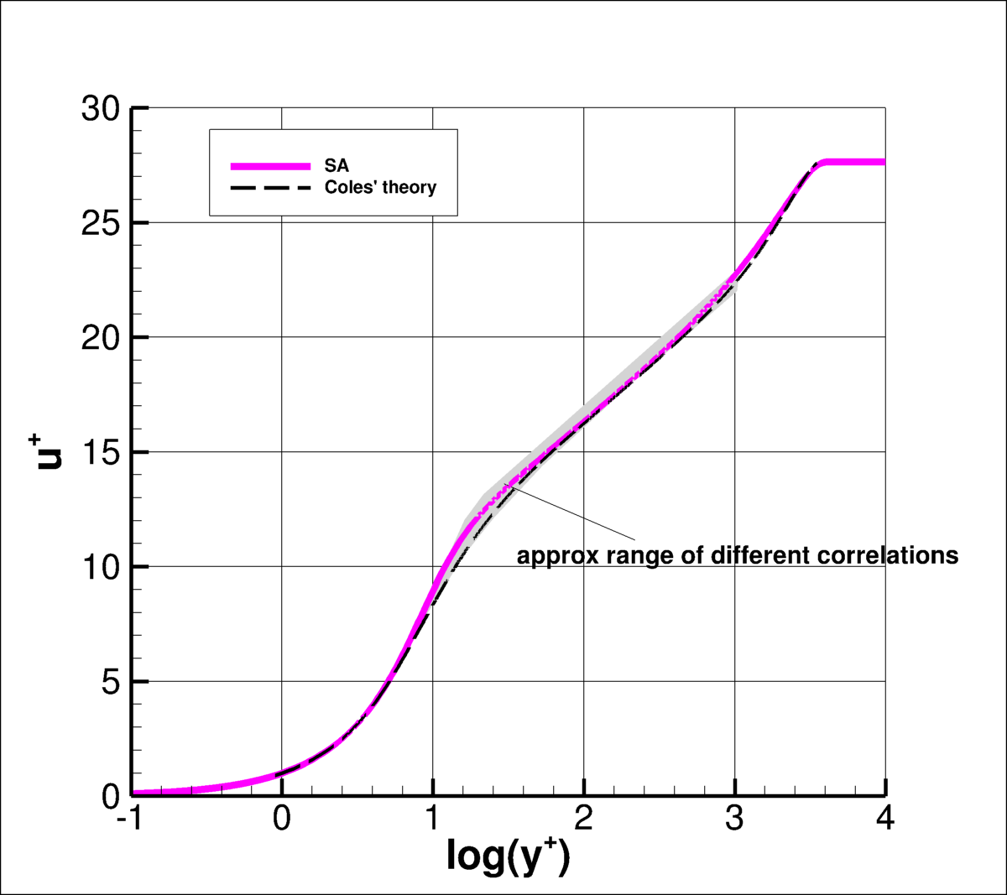
2DZP

Slide 6
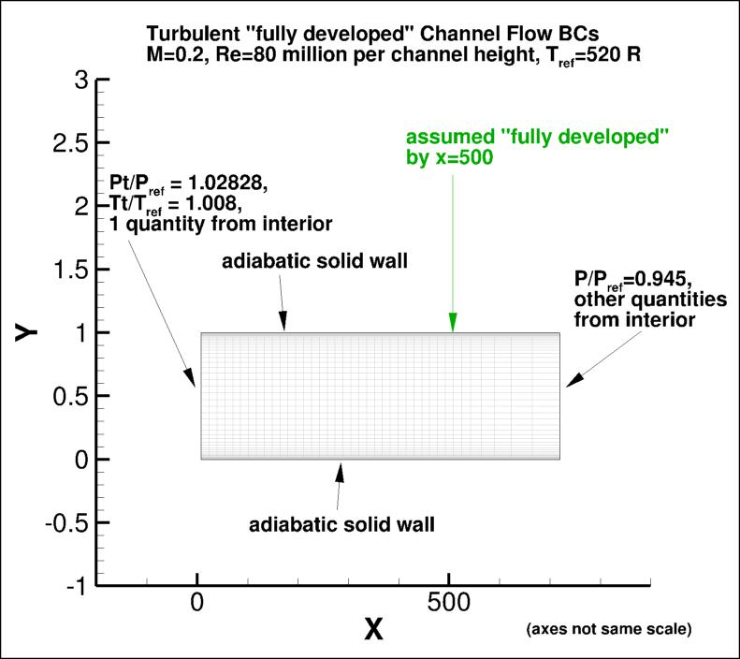
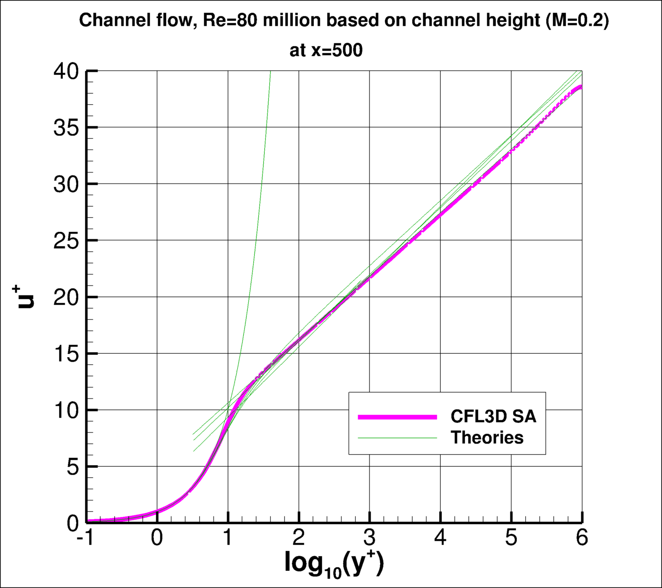
2DFDC

Slide 7
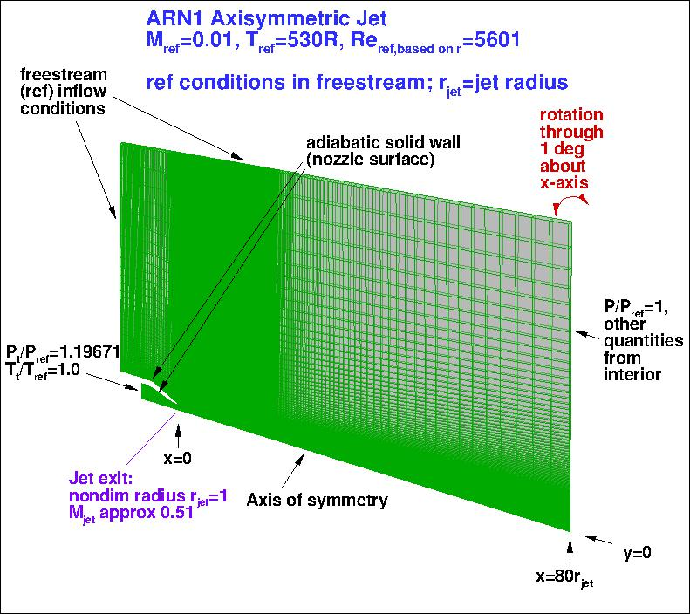
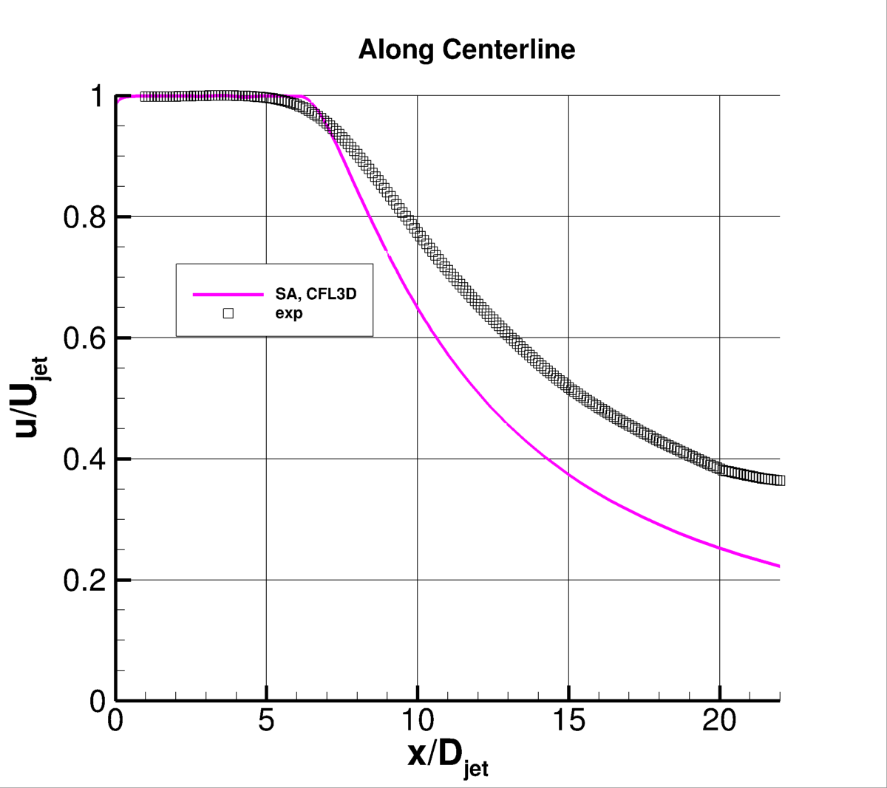
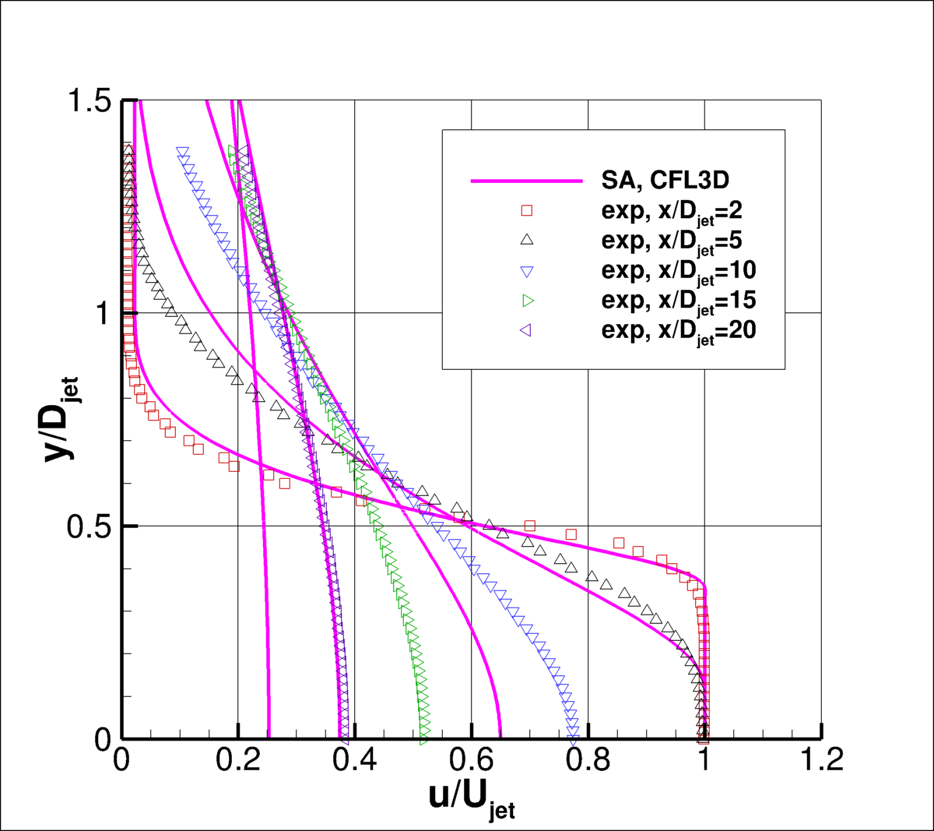
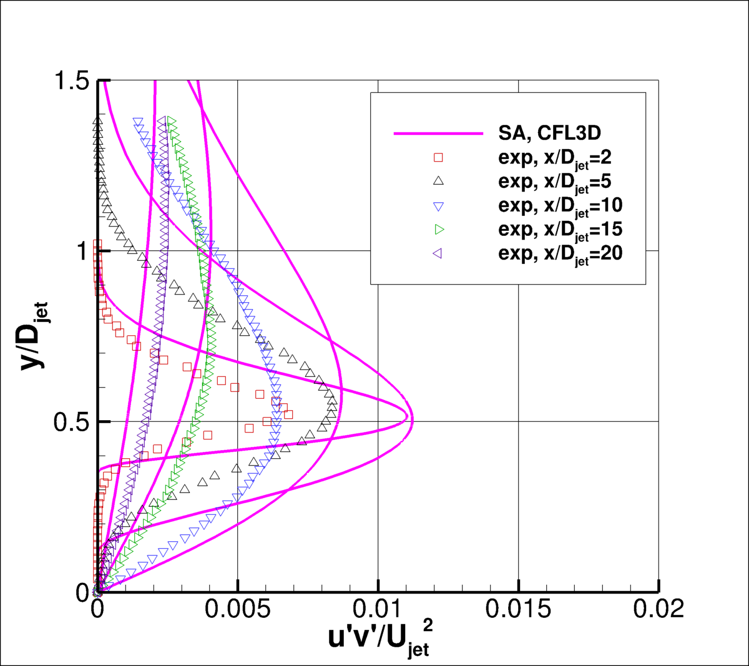
ASJ

Slide 8
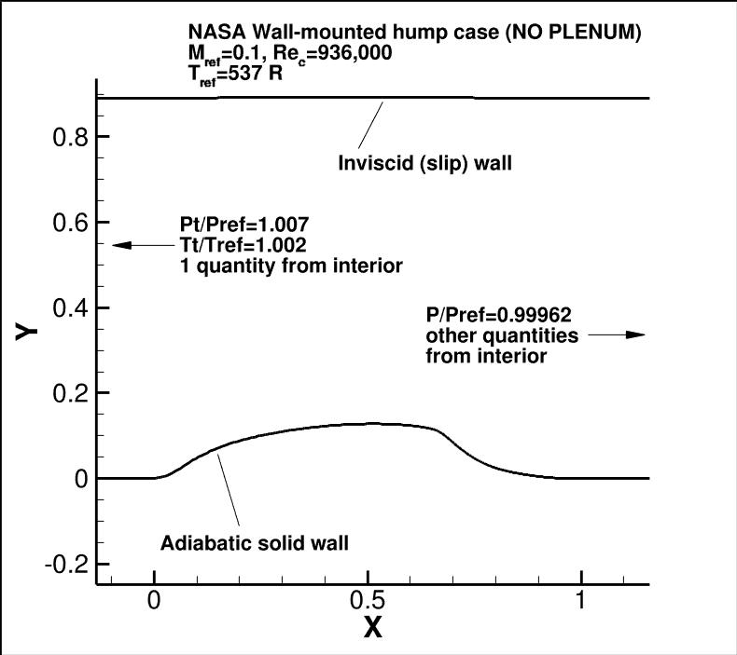
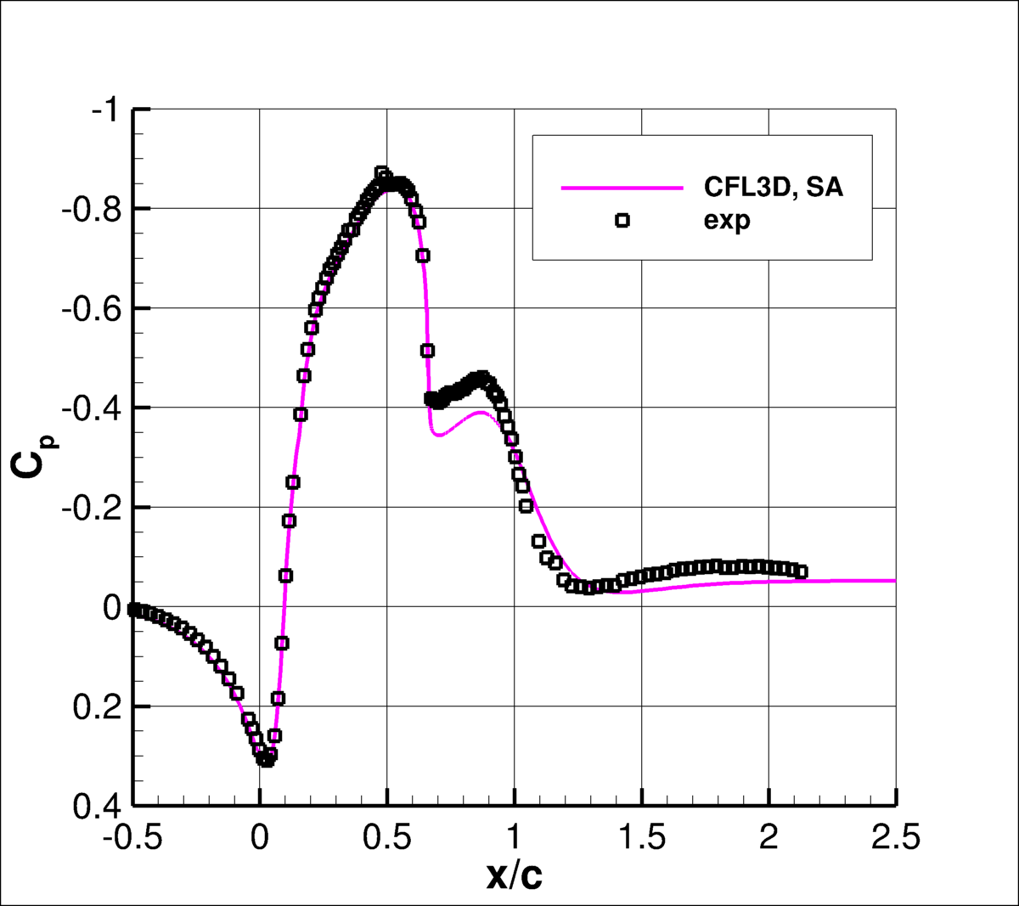
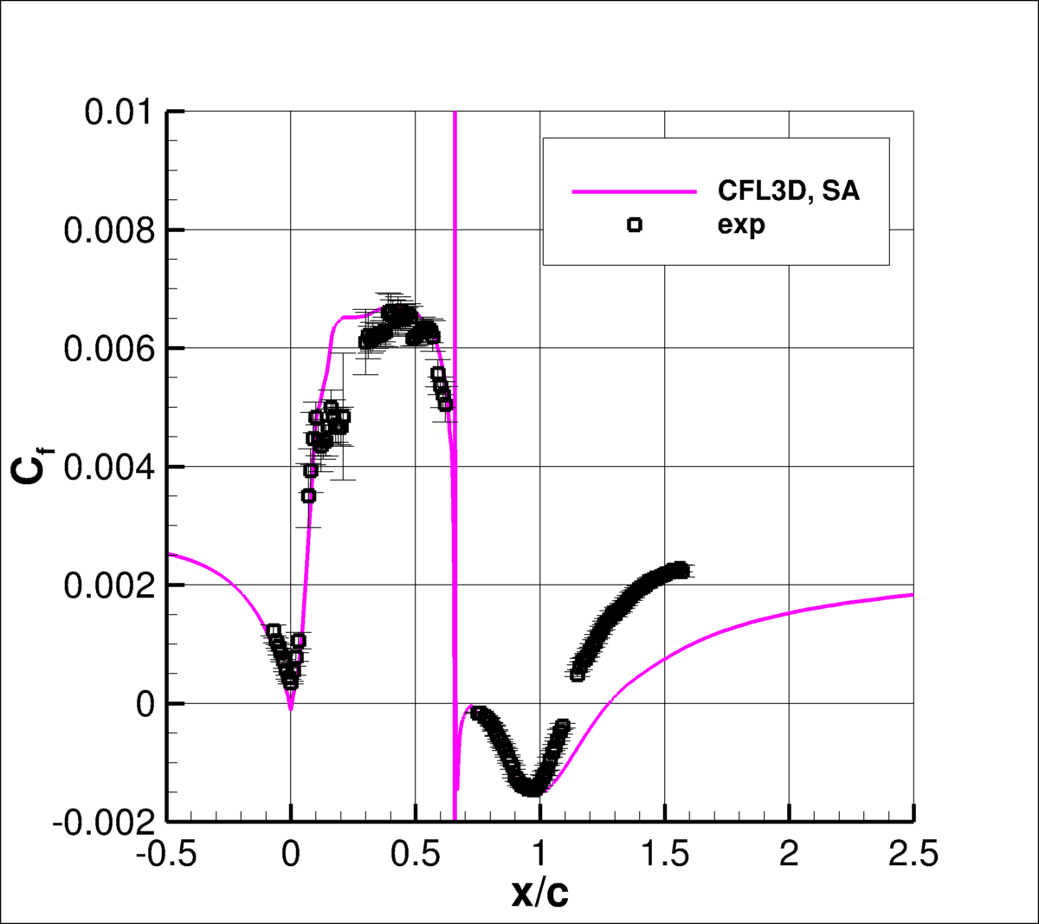
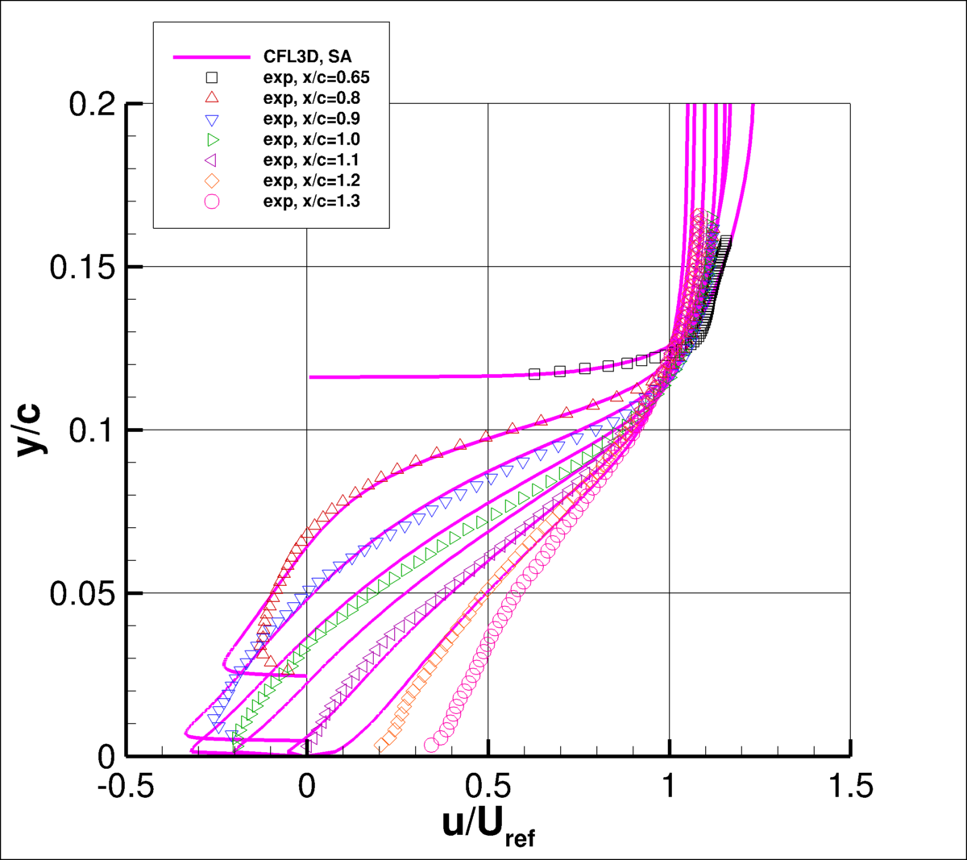
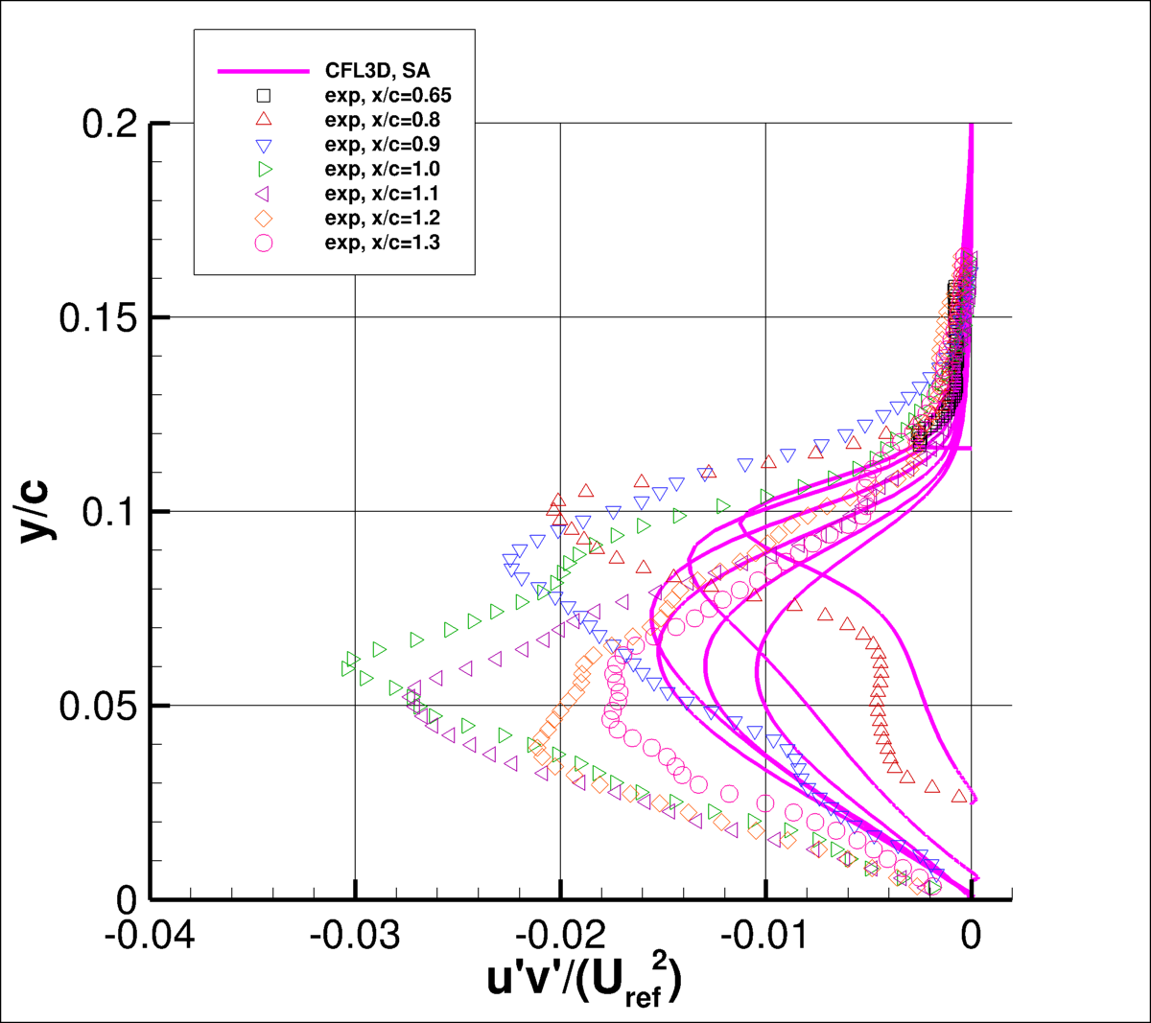
2DWMH

Slide 9
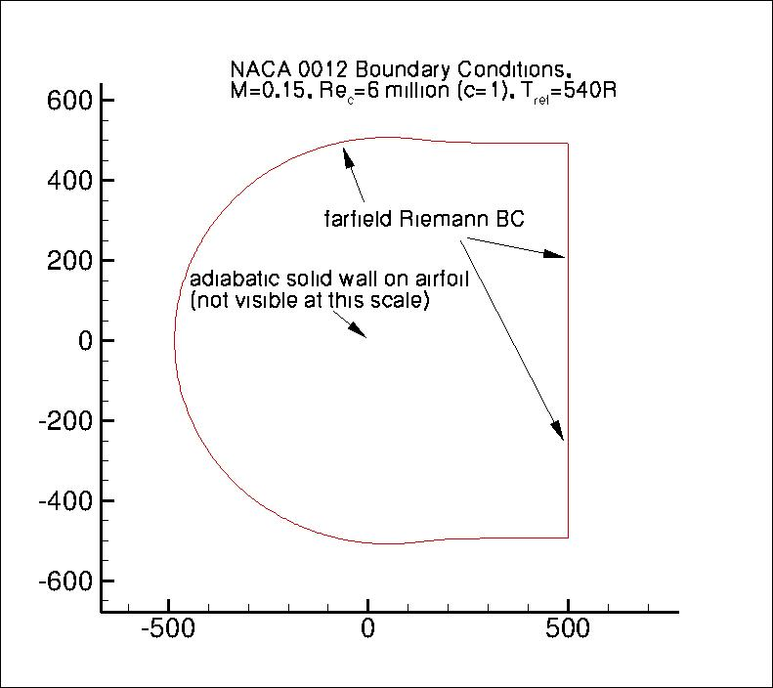
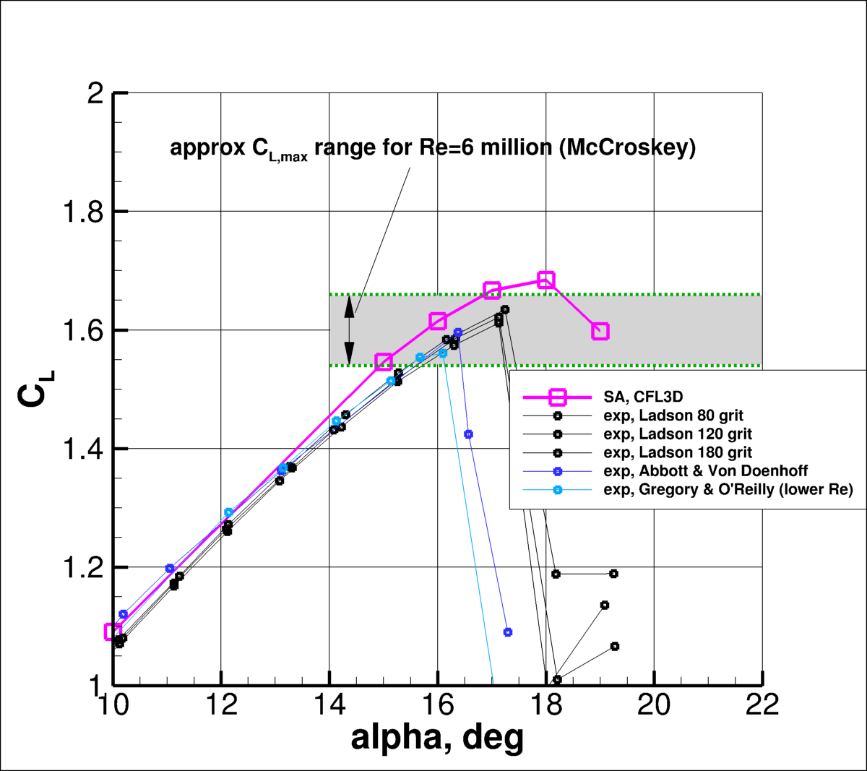
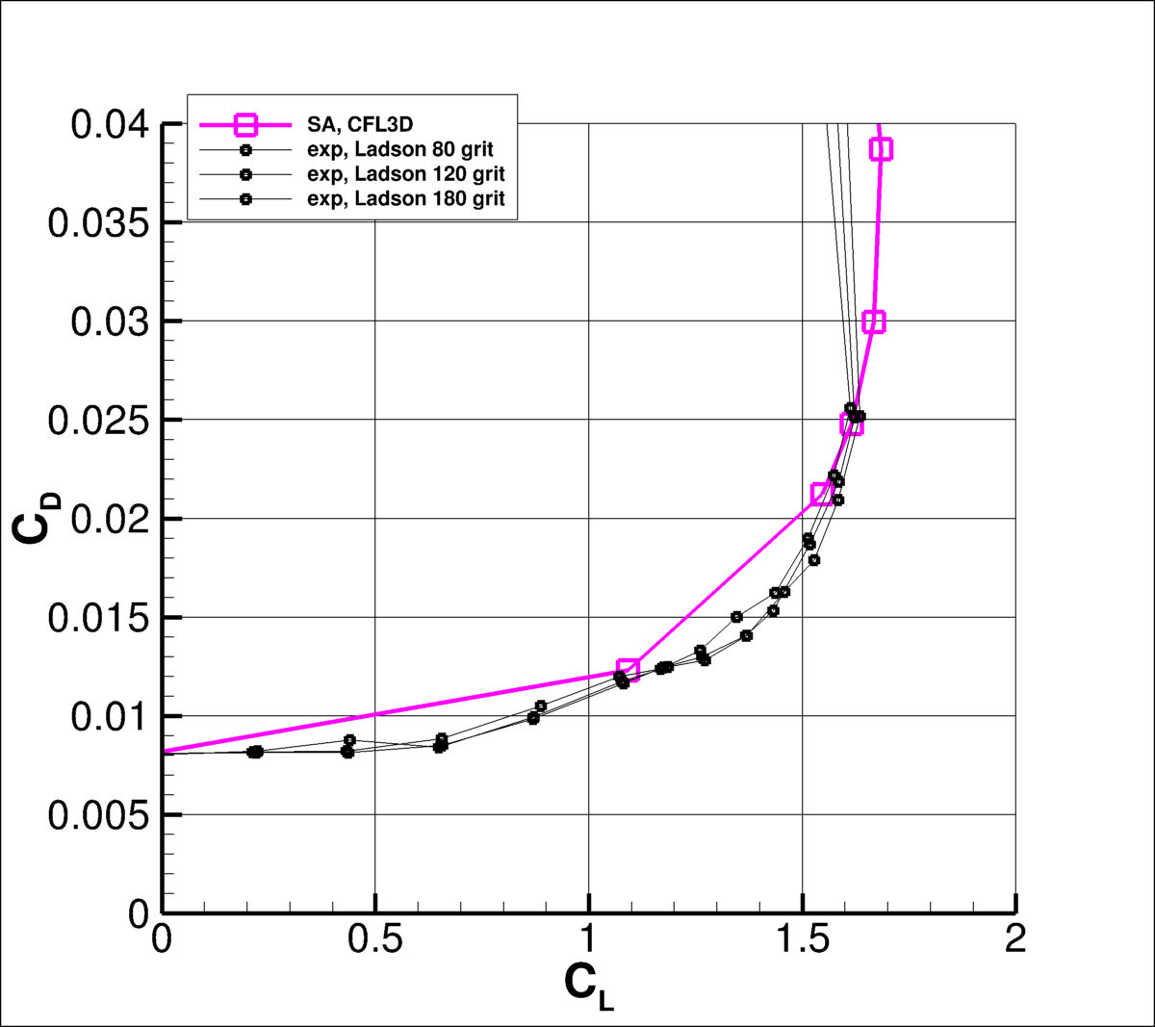
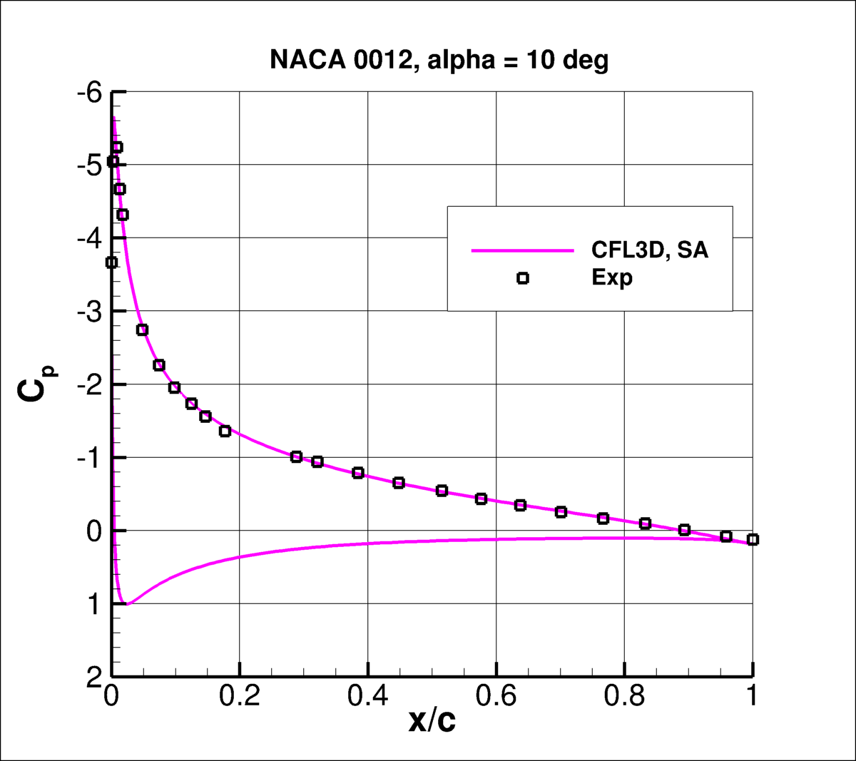
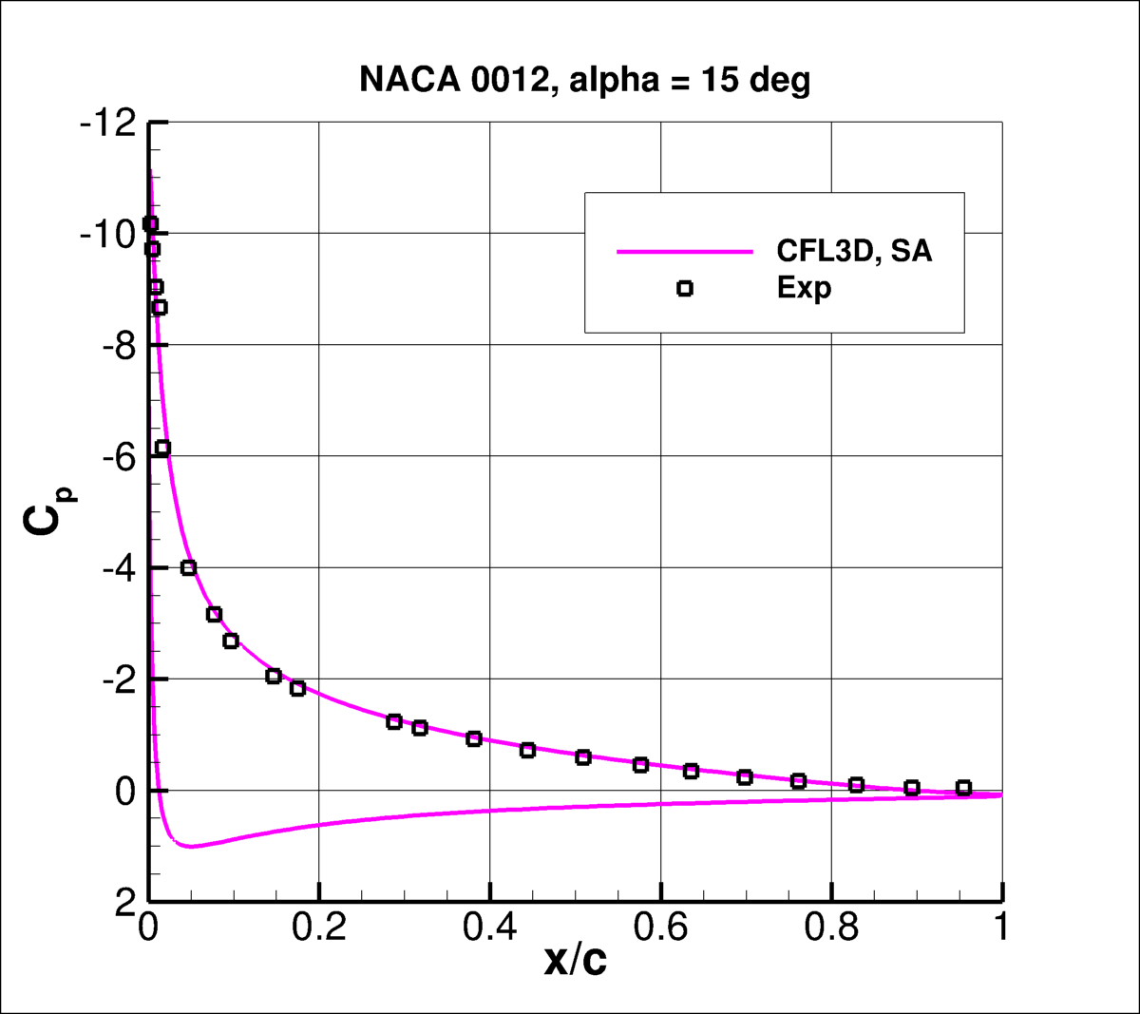
2DN00

Slide 10
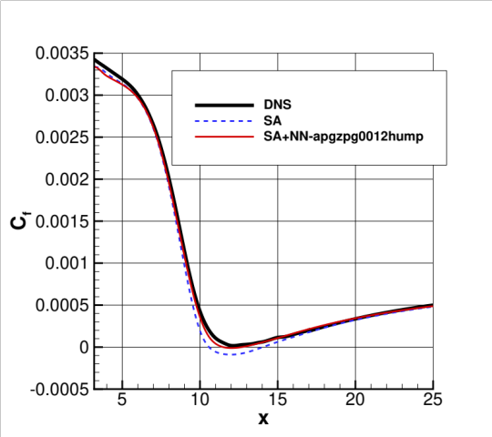
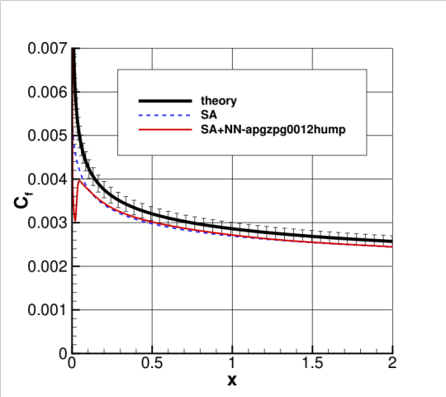
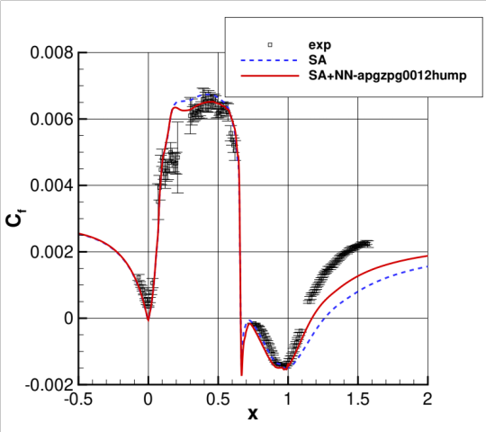
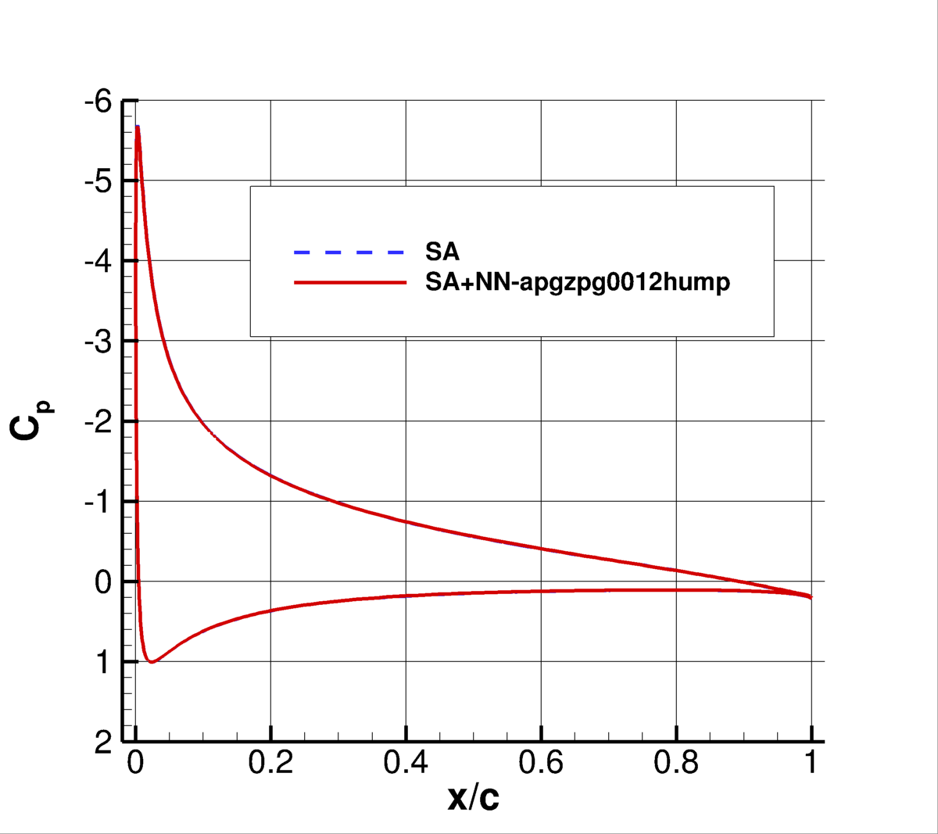
Our Personal Experience Along These Lines
Our personal experience with somewhat different cases (AIAA 2022-0937) :
  Neural Network (NN) training done on 4 simple cases (simultaneously):
    ZPG-APG plate
    ZPG plate
    NASA hump
    NACA 0012 at one AoA
  Then…

Slide 11
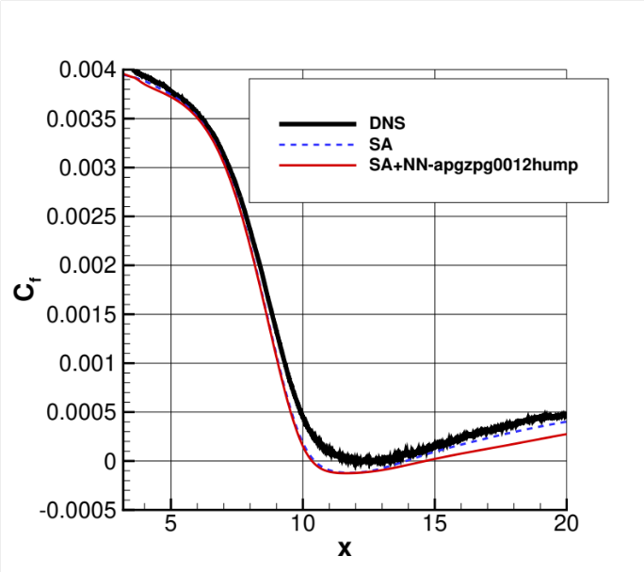
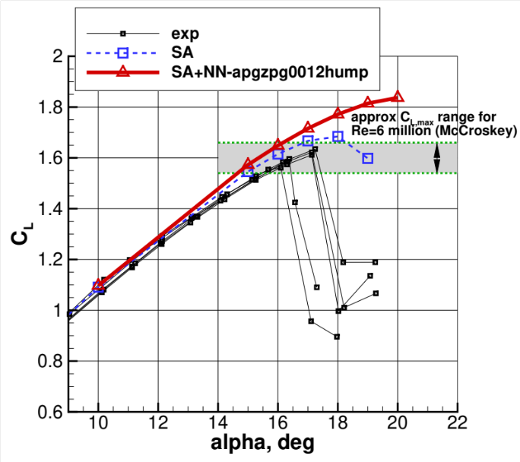
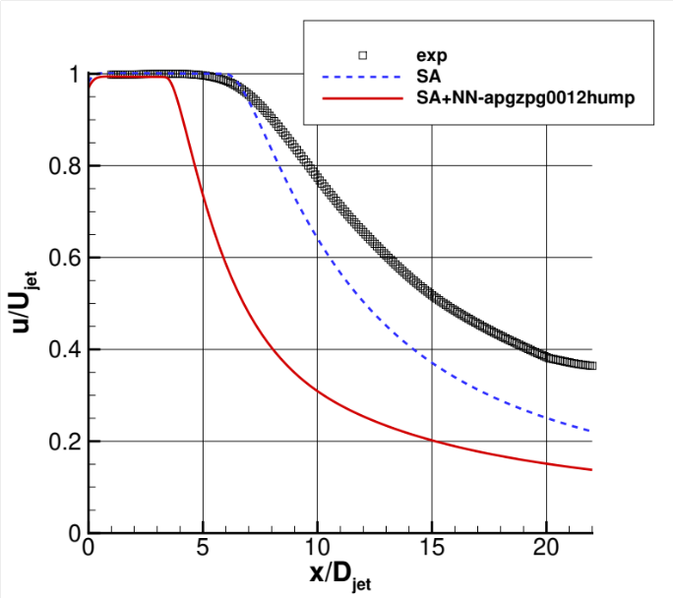
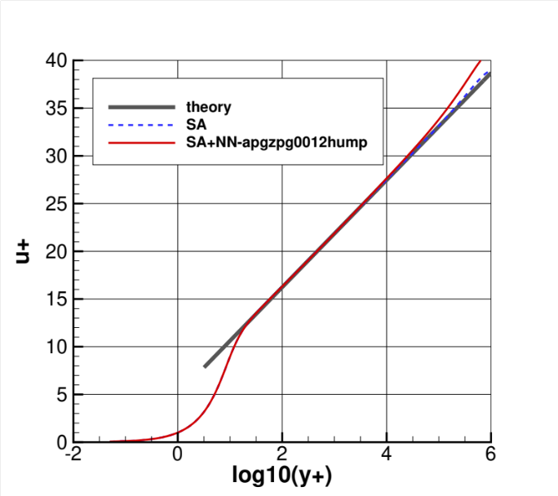
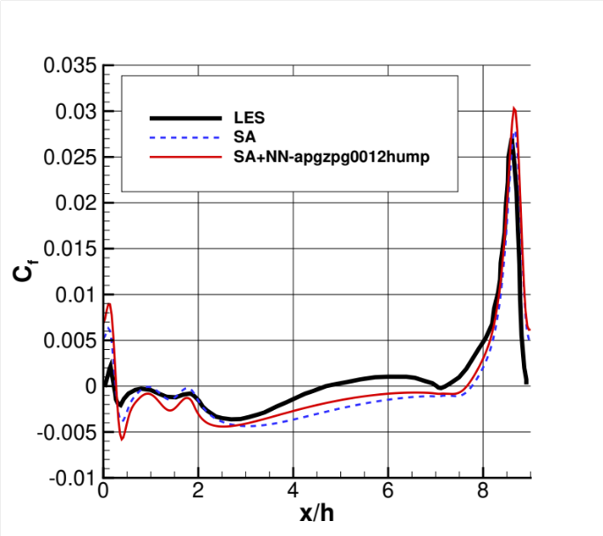
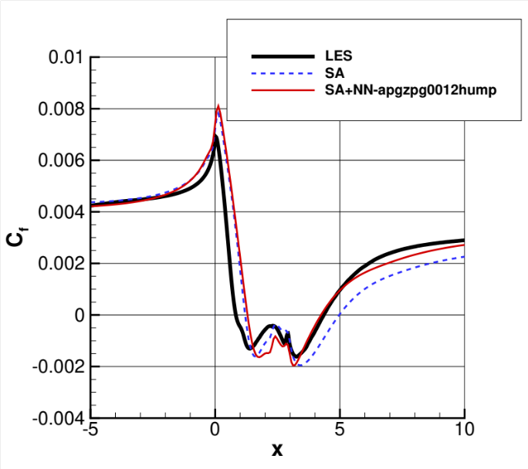
… applied to wide variety of flows NOT in the training
x
x
x
x
Worse
Better
Wash
√
-
Worse than standard SA in 4 out of the 6 cases tested!
x
-
√

Slide 12
Challenge Participants (as of 07/13/2022)
Michael Stoellinger (University of Wyoming)
Soufiane Cherroud (Arts et Metiers Paristech)
Yuan Fang (University of Melbourne)
Eric Parish (Sandia National Labs)
Yuanwei Bin and Jiaqi Li (Penn State University)
Venkat Viswanathan (Carnegie Mellon University)
Koushik Marepally (University of Maryland)
Richard Dwight (TU Delft)

Slide 13
What’s Next for the Challenge part of Symposium
8 talks total
  5 of them are combination “symposium talks” + “challenge method/results” (1/2 hr each)
  3 of them are solely on “challenge method/results” (15 min each)
1 hour general discussion about the Challenge at the end

Slide 14
Questions to ask/think about
If the usual machine learning techniques were used, what cases were used in the training? (all? some?)
How “good” were the results compared to each theory/experiment?
Were the results “better”/”similar”/”worse” than existing traditional RANS turbulence models (e.g., SA, SST, SSGLRR-RSM)?
What would happen if the trained model were used on a completely different TMR case?
Could others implement this model in their RANS codes?
Does the model consist of codable equations, or is it a NN or black box?

