Slide 1
Full-sun UV Rocket Spectrometer Calibration System and Progress
Genevieve Vigil, Nic Donders, Adam Kobelski
SPIE Astronomical Telescopes
and Instruments 2022

Slide 2

Outline
Intro
Science background
Instrument
Calibration goals
Calibration plan
System design
Updates
Next steps and launch schedule

Slide 3
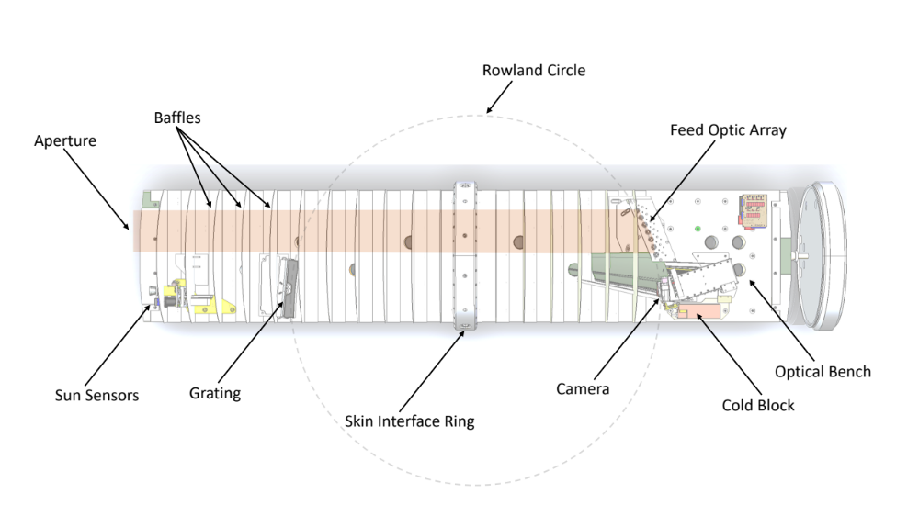
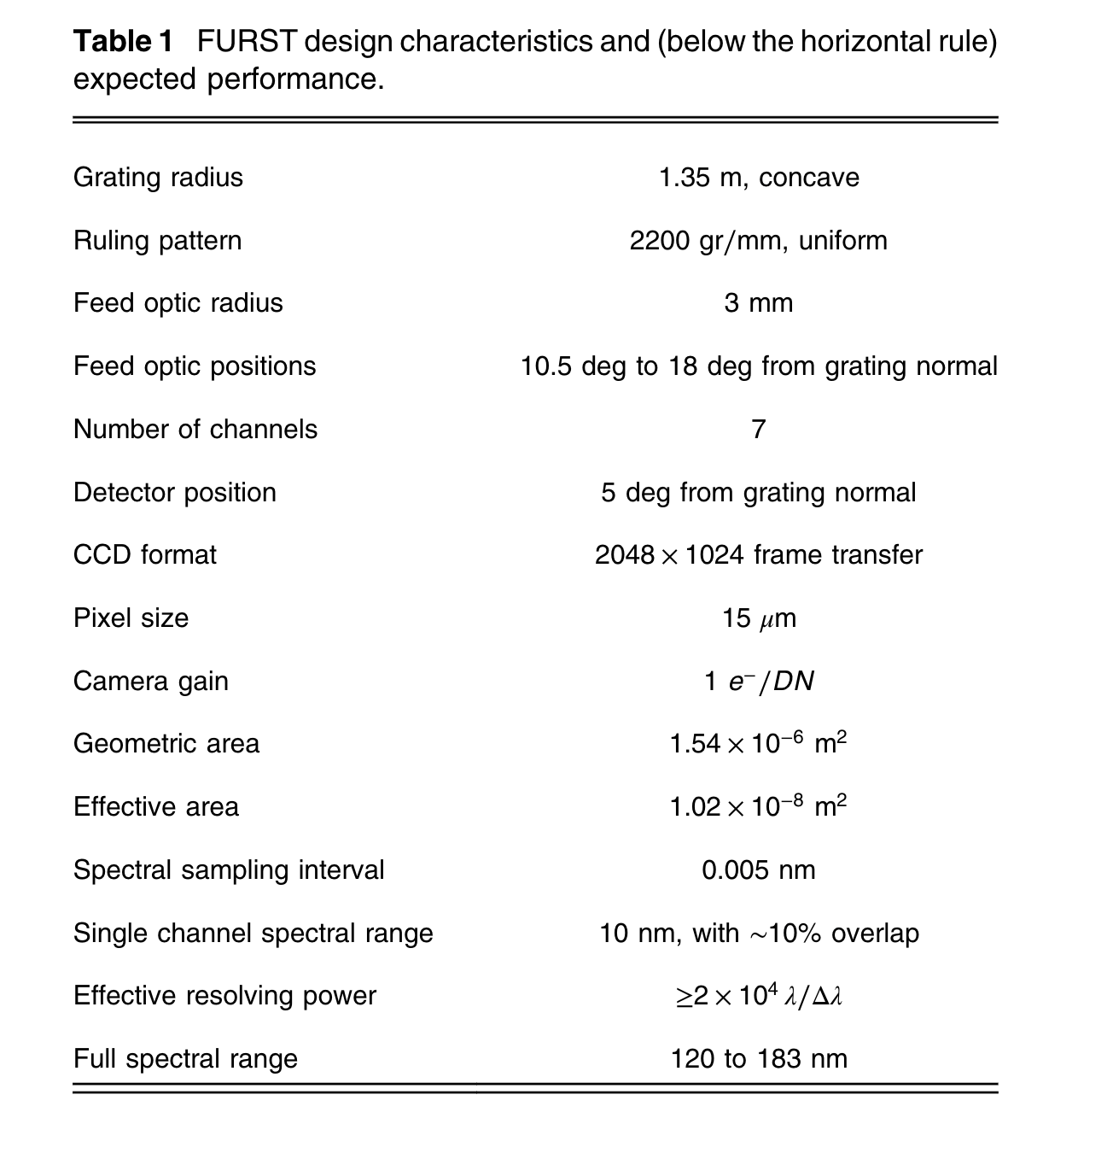
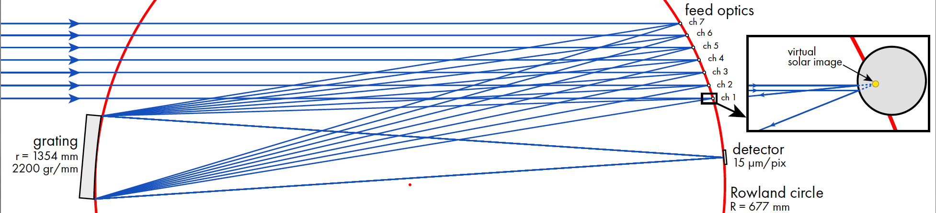
FURST Instrument
FURST instrument top view layout
FURST optical path

Slide 4
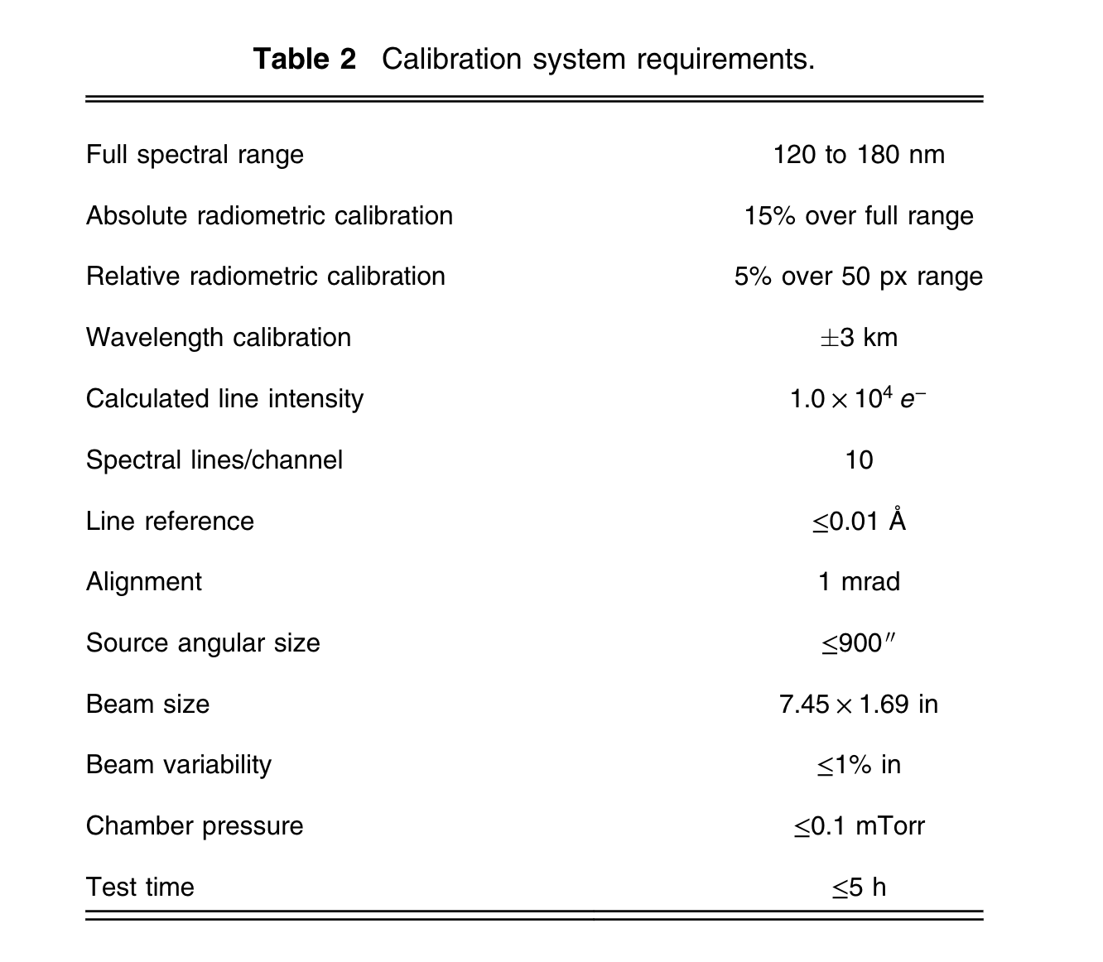
Calibration Goals
Falling out of the science goals and requirements for the instrument, calibration requirements are constructed
Radiometric calibration is most stringent, but 15% is expected to be achievable with 10% or less expected for some regions of the spectra
Wavelength calibration also shown here, but not the focus of this discussion

Slide 5
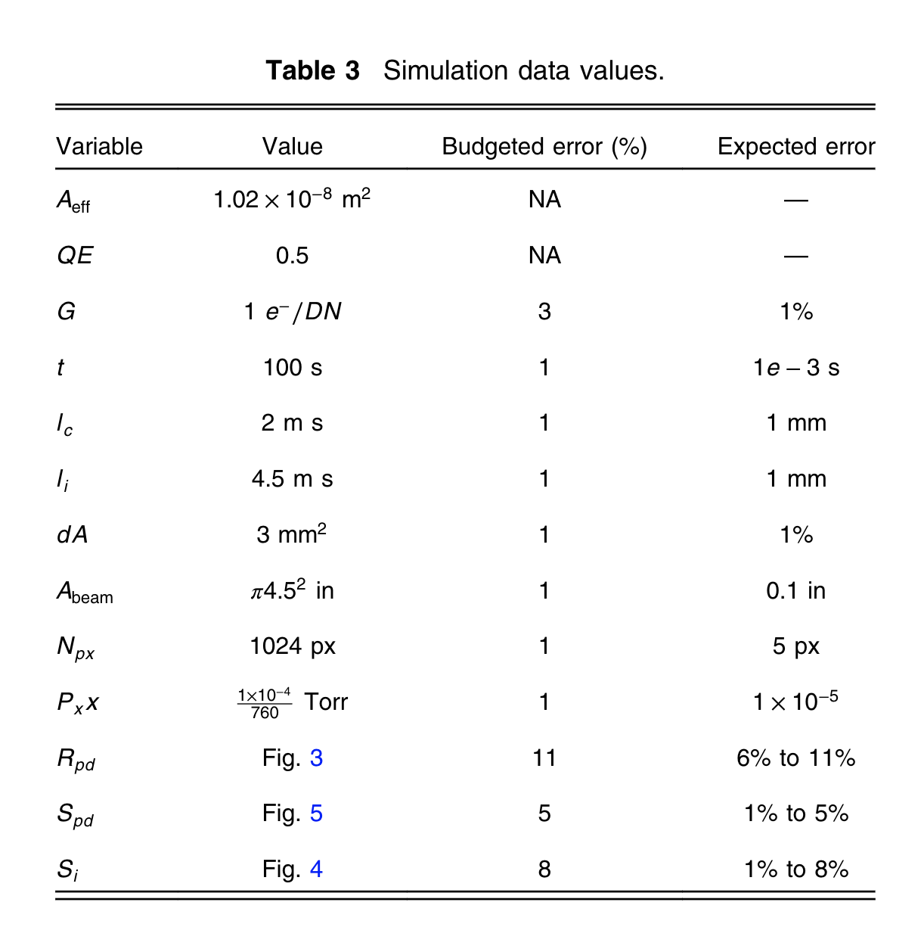




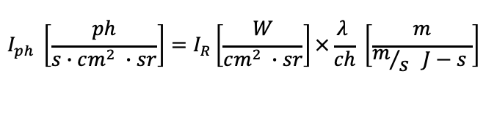
Calibration System Plan: Error Budget
$$I_{ph} \left[\frac{ph}{s∙cm^{2} ∙sr}\right]=I_{R}\left[\frac{W}{cm^{2} ∙sr}\right]×\frac{λ }{ch} \left[\frac{m}{m/s J−s }\right]$$
$$I_{c} \left[\frac{ph}{s cm^{2}}\right]=I_{ph}\left[\frac{ph}{s∙cm^{2} ∙sr}\right]×Ω \left[sr\right]×T_{c}×γ_{c}$$
$Ω \left[sr\right]≡$ solid angle collected by optical system, $∝{\left(\frac{1}{F\#}\right)}^{2}$
$T_{c}≡$Trans. ratio due to absorptions in imperfect vacuum, $∝\exp{(−k ℓ PP)}$
$$S_{pd}\left[A\right]=I_{c}\left[\frac{ph}{s cm^{2}}\right]×A_{pd}\left[cm^{2}\right]×R_{pd}\left[\frac{A}{W}\right]×\frac{hc}{λ} \left[\frac{J}{ph}\right]$$
$$S_{I}\left[DN\right]=I_{c}×A_{eff}×QE ×G_{I}×t ×T_{i}$$

Slide 6
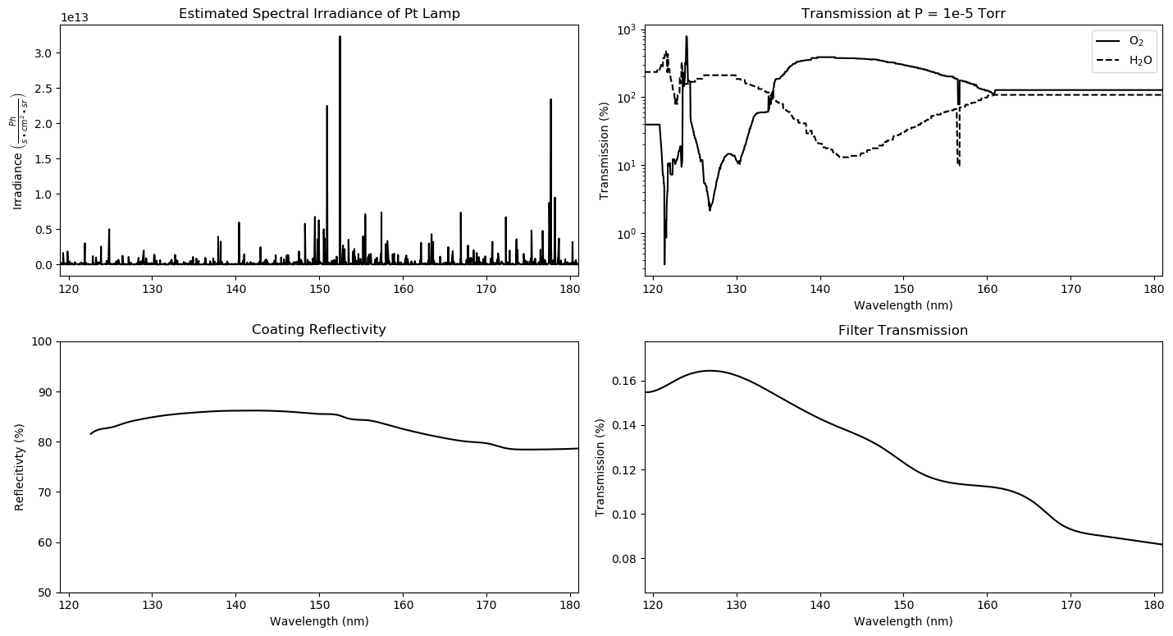
Calibration System Plan
Accounting for spectrum of source, absorption and throughput of system, the expected signals can be determined to help better inform the design.

Slide 7
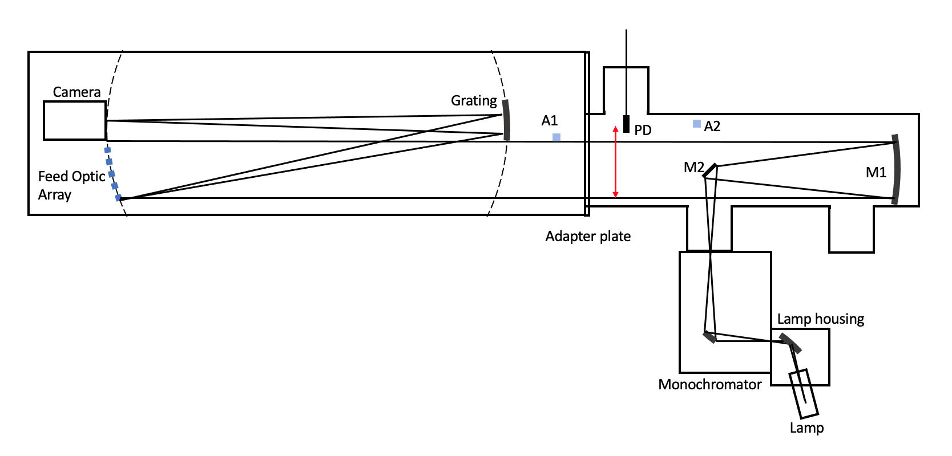
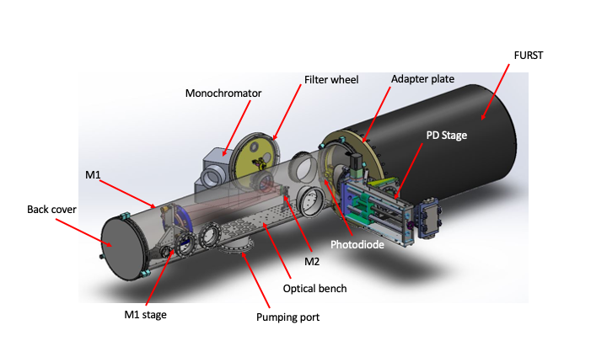
Calibration Plan: System Design
Integrated instrument and
calibration section diagram
SS vacuum chamber
Flexible optical configurations possible
In vacuum fine alignment and focus
In vacuum filter changes and PD movement
Flexible interfaces and ports
Newtonian telescope, 9in diam.
FURST Calibration Section Model

Slide 8
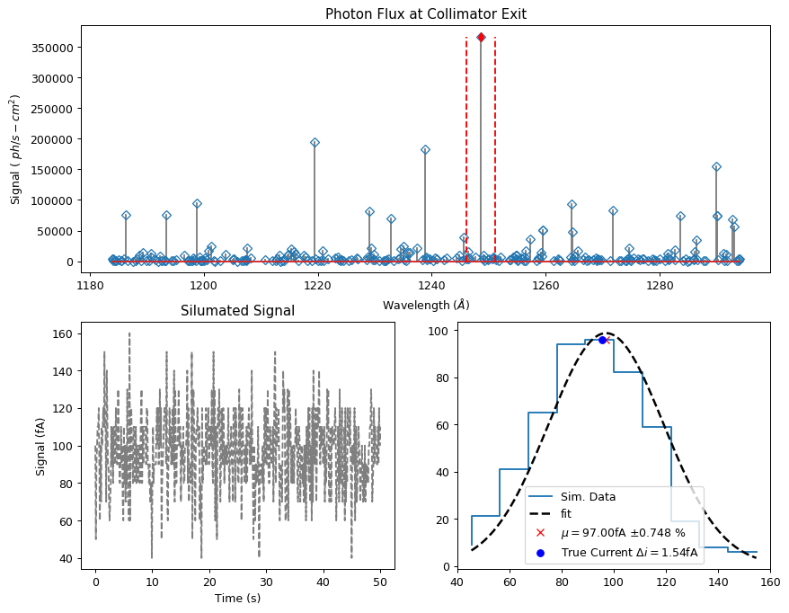
Simulated Data
Expected signal and measurement capabilities
Help inform the procedure for calibration to validate requirements
Photodiode measurements levels expected for bright line in channel 1

Slide 9
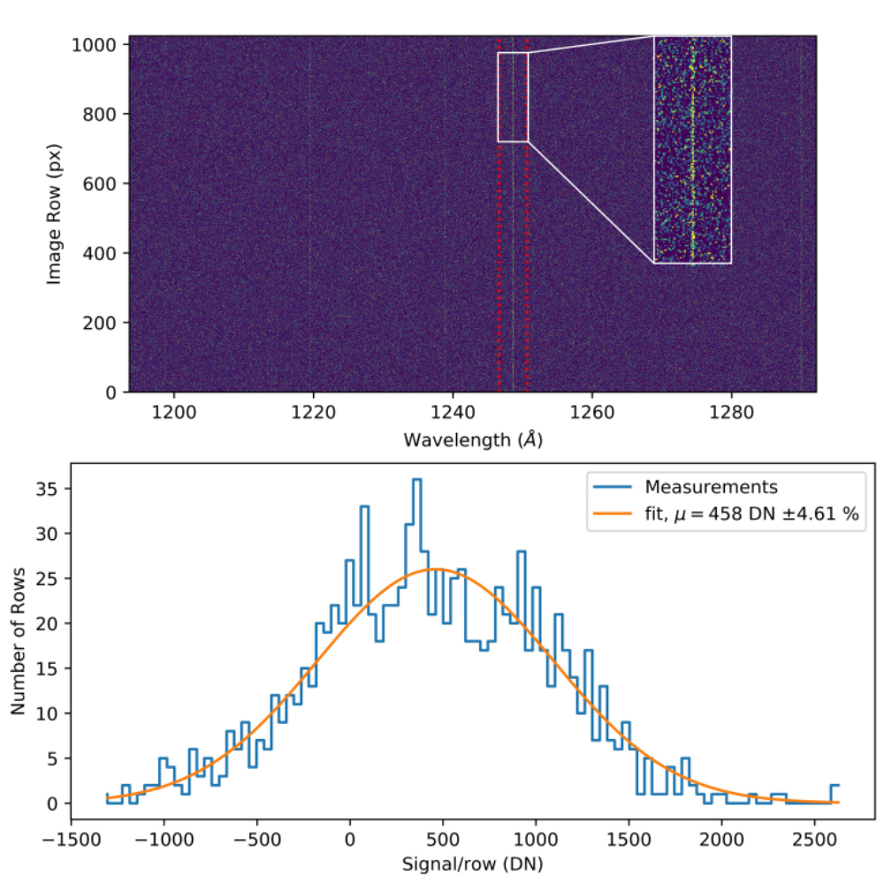
Simulated Data
Simulated imaging data
Determine needed exposure and noise performance to achieve required SNR
Radiometric calibration at 16 lines across spectra

Slide 10
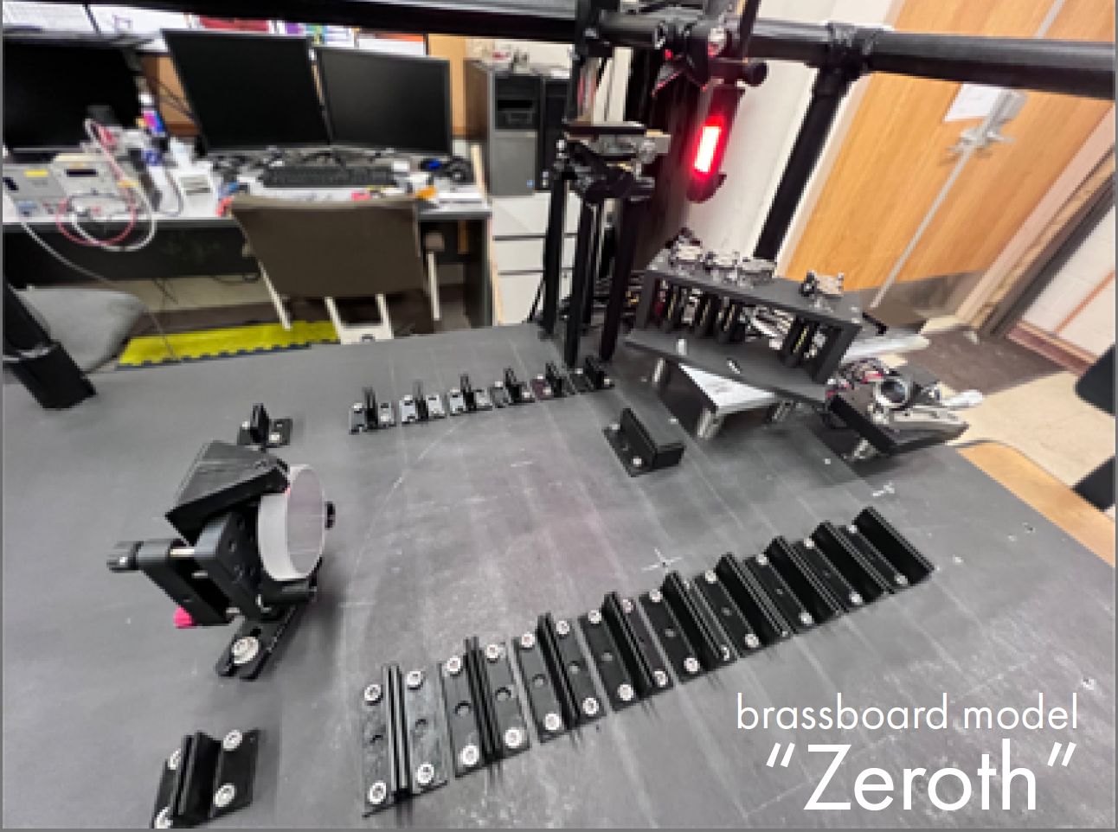
Instrument Update
Zeroth progress
Bench
Camera built and about to undergo testing
  Flat field
  Gain – inflight gain calibration scheme
  Linearity and dynamic range
  Noise analysis
Calibration section progress
  Mirrors
  Stages
  Chamber
  Contamination control hardware
[3]
Place holder for photo of cal section chamber. No radix joints will be shown

Slide 11
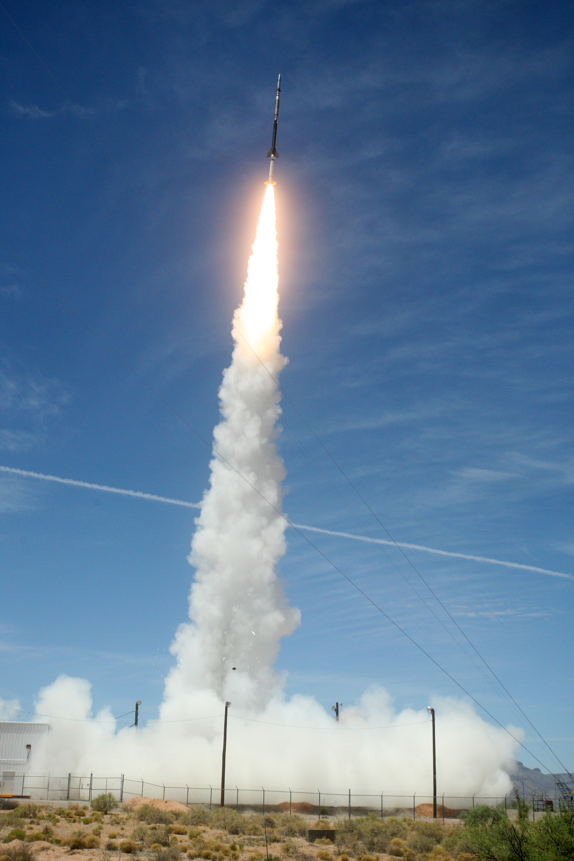
Next steps
Prelim calibration scheduled for early 2023
Launch scheduled for Spring 2023
  Although slips may be expected as we are still dealing with delays related to the pandemic

Slide 12
References
Kankelborg, C., Judge, P., Winebarger, A., & Kobayashi, K. (2017). VUV Spectrum of the Sun as a Star. 1–23.
Vigil, G. D., Winebarger, A., Rachmeler, L., Donders, N., Athiray, P. S., Kobayashi, K., & Kankelborg, C. (2021). Design for a portable calibration system for the Full-sun UV Rocket SpecTrometer instrument. https://doi.org/10.1117/1
Bunn, C., & Kankelborg, C. (2022). The Full-Sun Ultraviolet Rocket Spectrometer: Filling in the VUV Spectrum of the Sun as a Star. Heliophysics 2050 Workshop .

