Slide 1
PROBING THE LOWER-THERMOSPHERE-IONOSPHERE IN-SITU WITH SMALL SPACECRAFT
Therese Moretto Jorgensen, NASA Ames
Rebecca Bishop, Aerospace Corporation
Scott Palo, University of Colorado, Boulder
Nikolaos Paschalidis, NASA Goddard
Charles Swenson, Utah State University
Marcus Murbach & Seth Schisler, NASA Ames
44th COSPAR Scientific Assembly 2022, Session C1.4

Slide 2
Outline
The science of the LTI
  The need for in-situ measurements – the Daedalus mission concept
  The role of small satellites – multipoint observations
Cubesat instruments for insitu measurements in the LTI
  Current and on-the-horizon capabilities
  Illustrative examples: SPORT, PetitSat, LLITED, SWARM-EX
Enabling technologies
  Swarm communication and control (propulsion): SWARM-EX
  Probing the lower altitudes of the LTI: TechEd Sat program
Oustanding challenges
  Unchartered territory
  Data infusion into models

Slide 3
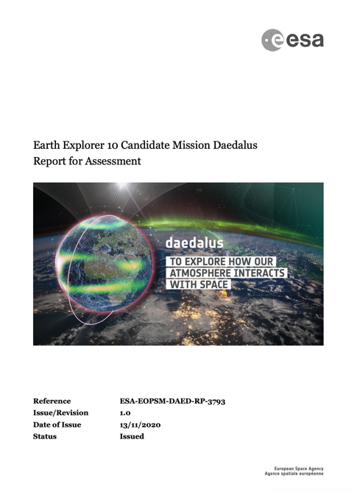
The Story of Daedalus
Notes:
Screenshot and picture from ESA Report for Assessment for the Daedalus mission, available at: https://esamultimedia.esa.int/docs/EarthObservation/EE10_Daedalus_Report-for-Assessment-v1.0_13Nov2020.pdf
Therese Moretto Jorgensen was a co-author of the report; content can be used with credit to the source and ESA

Slide 4

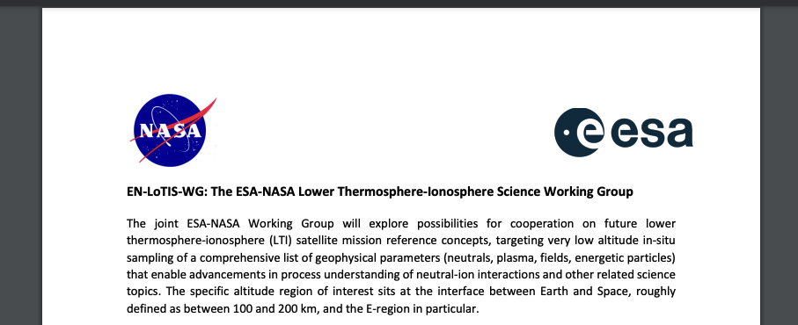
The Story of Daedalus
En-LoTIS-WG
Notes:
To the previous slide added:
Screenshot of public notice regarding the formation of the ESA-NASA Science Working Group, found at: https://missionadvice.esa.int/esa-nasa-science-working-group/

Slide 5
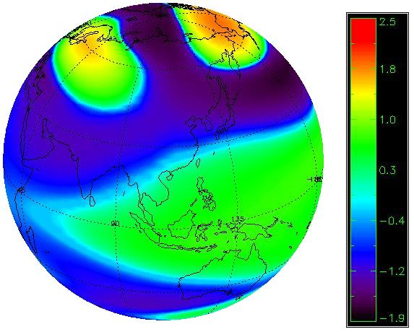

Daedalus Science
Energetic
Particle
Precipitation
(EPP)
Field
Aligned
Currents
Auroral
Electrojet
Field
Aligned
Currents
Targets the LTI transition region ~100-200km altitude
Quantify neutral-plasma interaction processes
Innovative orbital and mission design
First time complete set of in-situ, simultaneous measurements of all key parameters needed to fully characterize the region and its significant processes
Pedersen
Currents
Neutral
winds
Thermal
Tides
Sq
Current
Equatorial Electrojet
Gravity
Waves
Notes:
Table and figures from ESA Report for Assessment for the Daedalus mission, available at: https://esamultimedia.esa.int/docs/EarthObservation/EE10_Daedalus_Report-for-Assessment-v1.0_13Nov2020.pdf
Therese Moretto Jorgensen was a co-author of the report; content can be used with credit to the source and ESA

Slide 6
The role of CubeSats
Daedalus Expendable Subsatellites to provide:
  Prolonged measurements at lower altitudes
  Vertical gradients
  Temporal variations
General:
  Large constellations for global dynamics
  Dense swarms for regional & small-scale phenomena
  Expendable probes for altitude profiles
  Replenishable for extended missions

Slide 7
In-situ LTI measurements on CubeSats
Fields
Magnetic
Electric
CINEMA, DICE, Ex-Alta-1, etc
DICE
SPORT
DIONE, SPORT, etc
Energetic Particles
Electrons
Ions
CSSWE, FIREBIRD, ELFIN
CSSWE, AALTO-1, ELFIN
CIRBE, etc
DIONE, CIRBE, etc
PROVEN
NOTEWORTHY ATTEMPT
UPCOMING

Slide 8
In-situ LTI measurements on CubeSats
Plasma
Density
Ion Drift Vel.
DICE, QB50
SORTIE
InspireSAT, PetitSat, SPORT, etc
InspireSAT, PetitSat, SPORT, SWAM-EX, LLITED, etc
Composition
Ion Temp
Electron Temp
QB50
InspireSAT, SPORT, SWAM-EX, LAICE, etc
SORTIE
InspireSAT, PetitSat, SPORT, LAICE, etc
EXOCUBE, Dellingr
PetitSAT, CIRCE, etc
PROVEN
NOTEWORTHY ATTEMPT
UPCOMING

Slide 9
In-situ LTI measurements on CubeSats
Neutral Atmosphere
Density
Wind Vel.
QB50
LLITED
LLITED, LAICE, SWARM-EX
Composition
Temp
LAICE
DIONE, PetitSat, CIRCE
EXOCUBE, Dellingr, QB50
PROVEN
NOTEWORTHY ATTEMPT
UPCOMING

Slide 10
Scintillation Prediction Observations Research Task (SPORT)
- a joint Brazilian and US nanosatellite to study the formation and evolution of equatorial plasma bubbles which may, in turn, cause scintillation
PI: Charles Swenson, Utah State University
getting ready for delivery to Nanoracks (from Brazil) on July 19th.
Launch to the ISS currently scheduled for October 3rd (Space X-26).
Notes:
Slide provided by co-author, Charles Swenson, USU

Slide 11
Plasma Enhancements in The Ionosphere-Thermosphere Satellite (PetitSat)
NASA GSFC
Thermosphere waves and plasma density enhancements
Mini-INMS heritage from Exocube & Dellingr (ions only)
Notes:
Slide provided by co-author Nickk Paschalidis, NASA GSFC

Slide 12
LLTID, LAICE Neutral Atmosphere
https://www.nasa.gov/sites/default/files/thumbnails/image/aurora_trails4.jpg
Notes:
Slide provided by co-author Rebecca Bisho, Aerospace Corp.

Slide 13
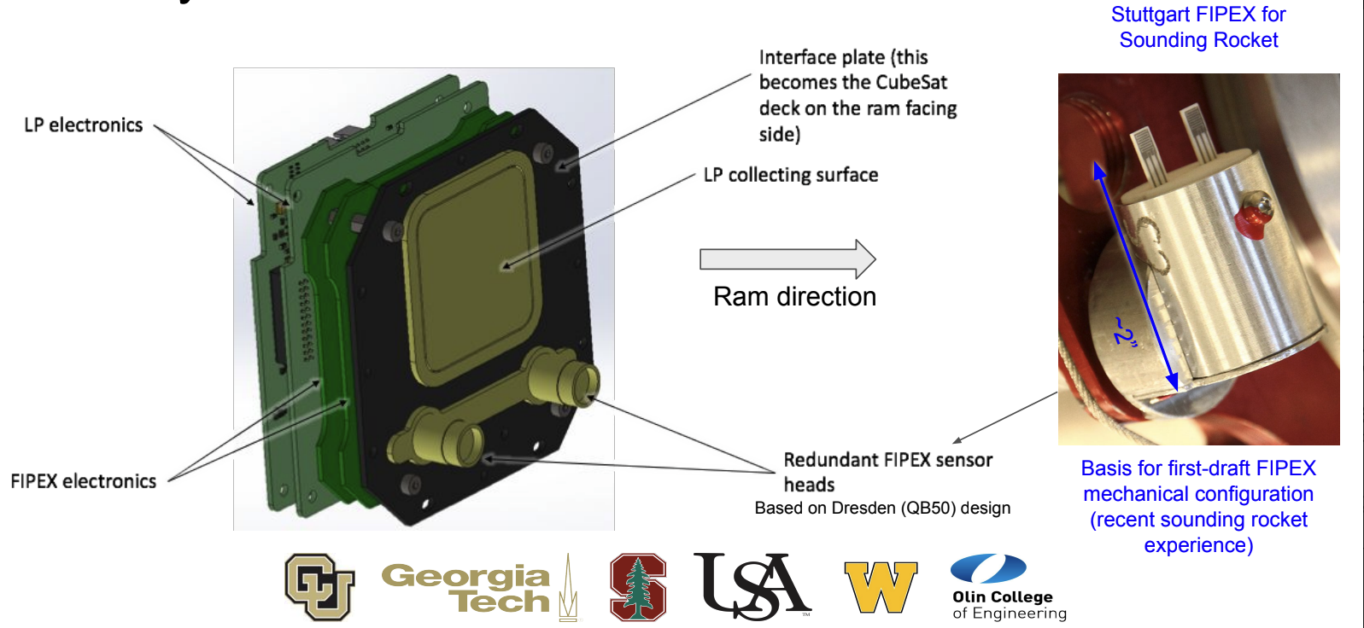

Swarm-EX
Instruments
FIPEX neutral oxygen sensor (flight heritage from ISS)
Langmuir Probe for ion density (flight heritage from DICE)
Space Weather Atmospheric Reconfigurable Multiscale Experiment CubeSat (SWARM-EX)
PI: Scott Palo, University of Colorado Boulder
Collaboration between six colleges and universities
3 Cubesat pathfinder mission
Key technologies and science of the equatorial ionization anomaly (EIA) and equatorial thermospheric anomaly (ETA)
Launch in 2023
SWARM-EX is an NSF funded mission
Notes:
Slides to be provided by co-author Scott Palo, UC Boulder

Slide 14
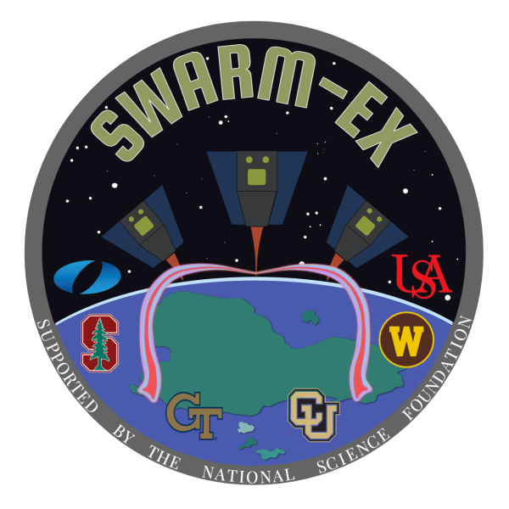
Swarm-EX: Swarm Communication & Control
SWARM-EX will advance the state of the art in spacecraft formation flying in several key ways
First demonstration of passively safe, autonomous formation flying for more than two spacecraft
UHF Inter-satellite communication link
Novel hybrid propulsive/differential-drag control scheme
Fuel balancing among the spacecraft in the formation using a virtual chief method
Relize a distributed aeronomy sensor
Notes:
Slide material provided by co-author Scott Palo, UC Boulder

Slide 15
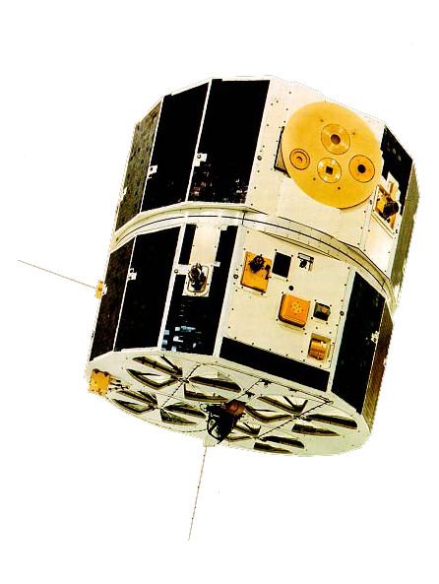
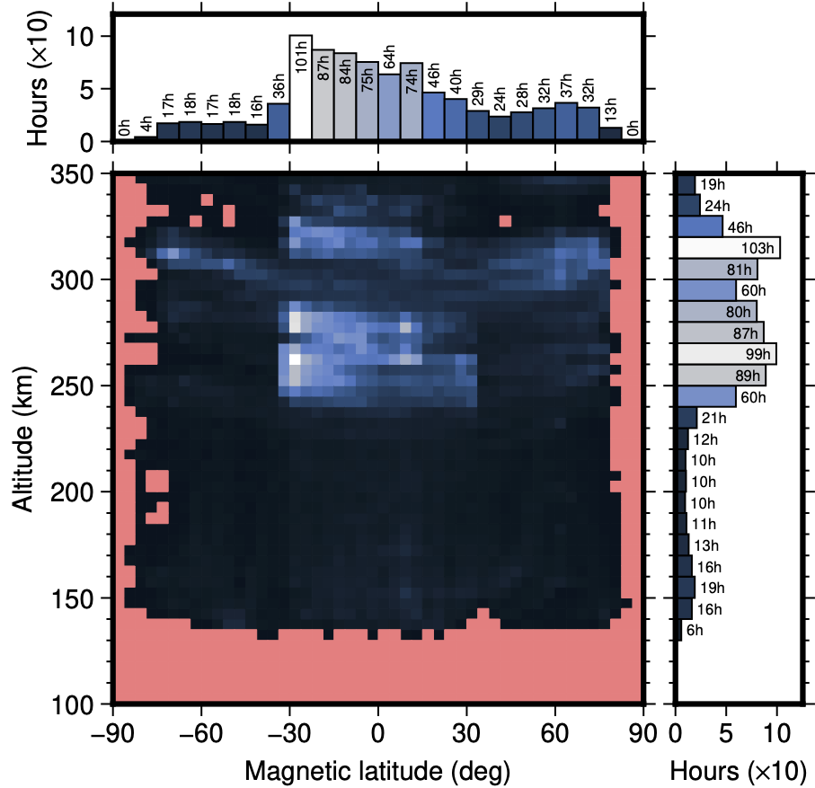
In-situ spacecraft data below 350km
Atmosphere Explorers AE-C/D/E (1973-1981) – neutrals, plasma
Total observation time < 200 km: 60.3 hours (Unified Abstract data)
Notes:
Figuresfrom ESA Report for Assessment for the Daedalus mission, available at: https://esamultimedia.esa.int/docs/EarthObservation/EE10_Daedalus_Report-for-Assessment-v1.0_13Nov2020.pdf
Therese Moretto Jorgensen was a co-author of the report; content can be used with credit to the source and ESA

Slide 16
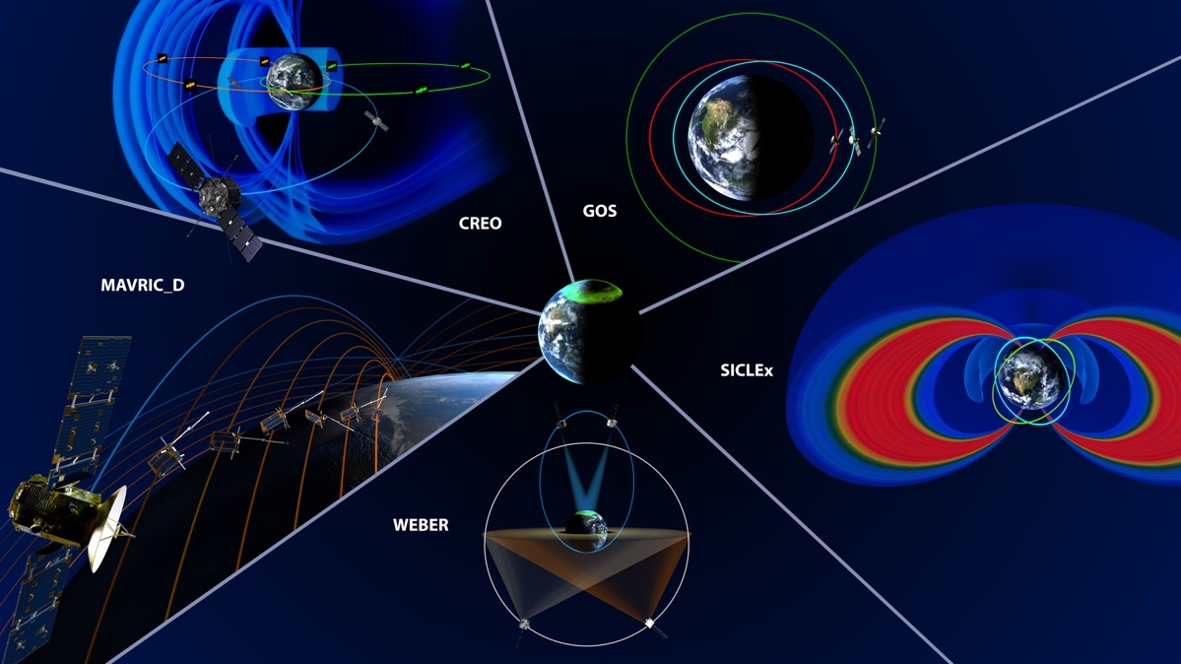
LWS Architecture Study
Committee Chair: Christina Cohen, Caltech. Final Report expected August 2022
GeoSpace
LTI Science Objective: To examine the heating & cooling process in the thermosphere
MAVRIC_D: goal is to measure atmospheric data at altitudes between 600km and 200km spaced at least 50 km apart vertically
Possible application of Ames Exobrake technology
Wallops Mission Planning Lab (MPL) and Ames MDC will explore small sat concept architectures based on results from 2021 LWS study
Preliminary concept illustration courtesy of Christina Cohen
Notes:
Image NASA, for publication in LWS Architecture Study report.

Slide 17
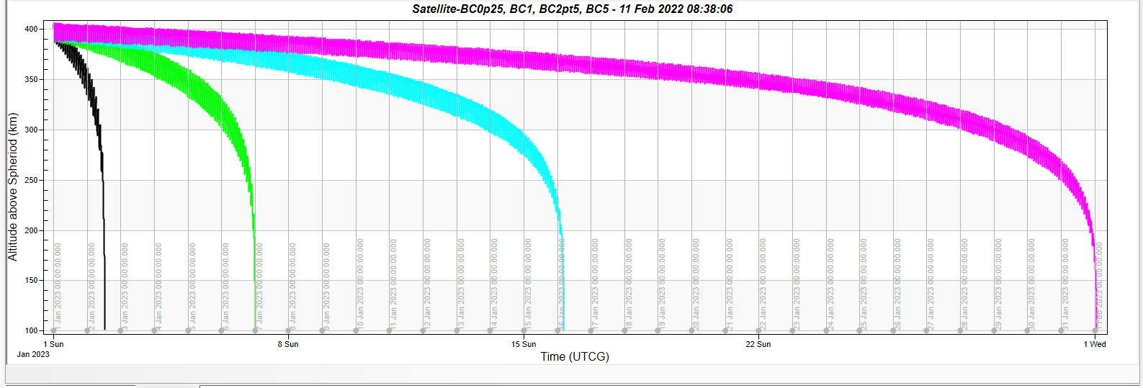
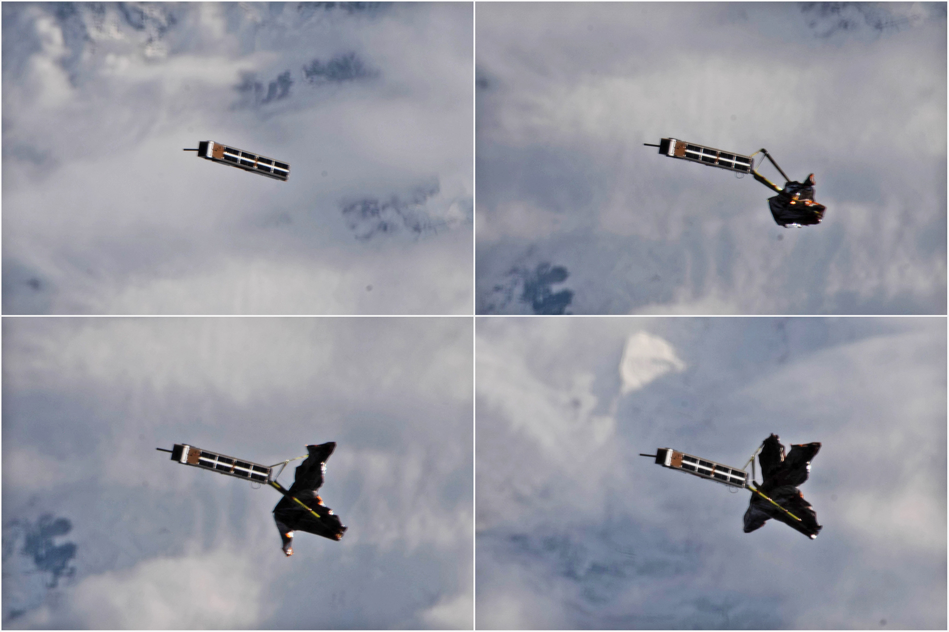
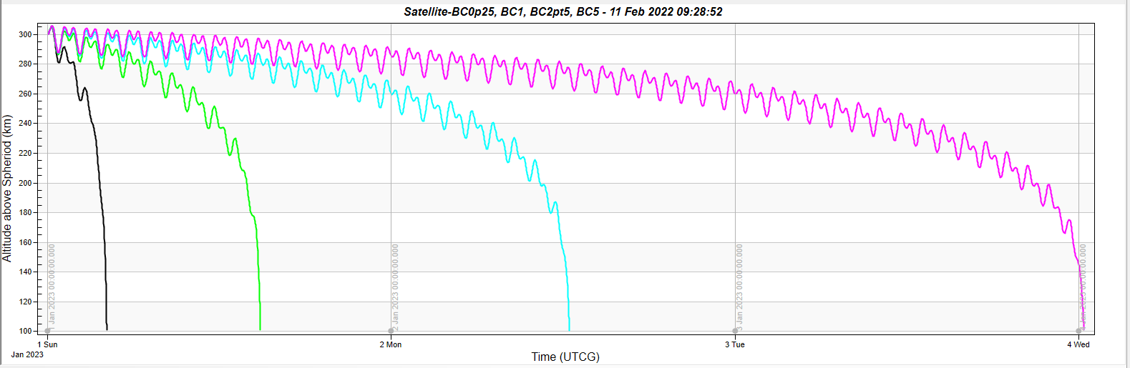
TechEdSat: Nano-Sat Exobrake
Developed by ARC as part of the TecEdSat Program to enable sample return from the ISS
Exobrake can rapidly bring a cubesat down from 400km to 250km, then be released to allow natural orbit decay from 250km, or vice versa.
Can also be used with the elliptical orbit concept
Undergoing further technology development
Drag Maneuvering with Variable Ballistic Coefficient
In general, the higher the BC (kg/m²) the longer the satellite lifetime
STK Modeling: H=400km, Inclination = 51º
400km
Altitude
100km
1 month
STK Modeling: H=300km, Inclination = 51º
300km
Altitude
100km
TechEdSat-10 from ISS, July 2020
4 days
TechEdSat POC: Marcus Murbach & Seth Schisler, NASA ARC
Notes:
Graphs and pictures: NASA
Image: https://www.nasa.gov/sites/default/files/thumbnails/image/exobrake_deployment-1920.jpg
Graphs provided by Marcus Murbach, NASA ARC

Slide 18
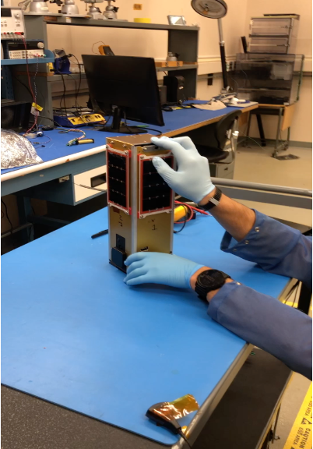
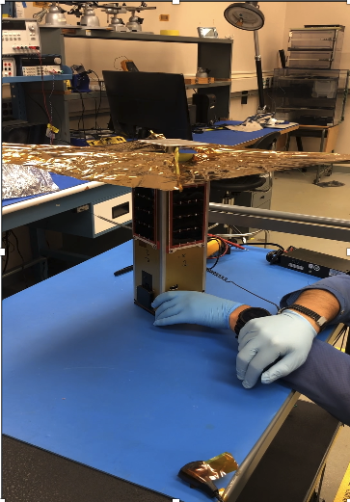
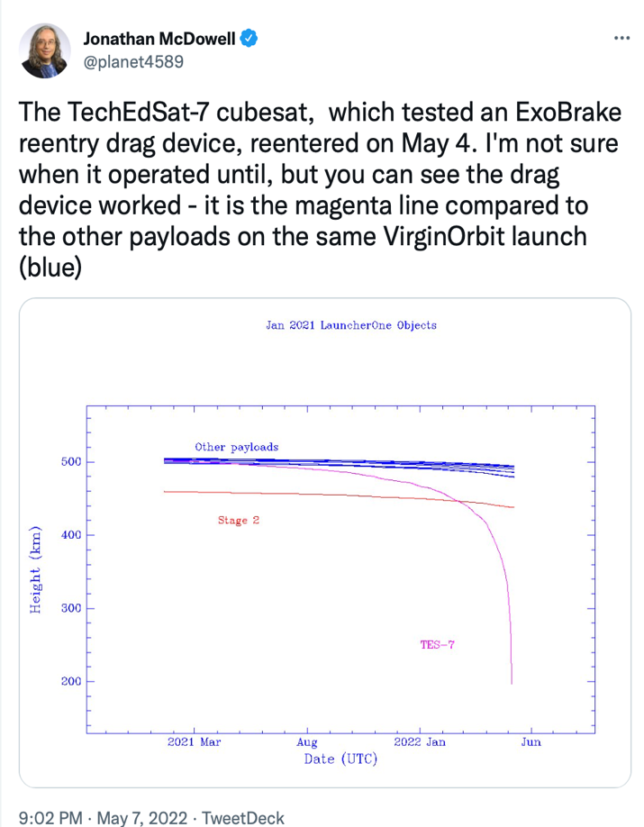
TechEdSat-7 Success!
TES-7 was deployed from 500km on the Virgin Orbit Launcher 1, Jan 17, 2021
With BC of 6kg/m2, it re-entered in a record 1.3 years
Illustrates actual rapid drag-based de-orbit for debris mitigation –and ATM Science
Notes:
Pictures: NASA, provided by Marcus Murbach, NASA ARC
Screenshot of Twitter post

Slide 19
Additional Challenges
Unchartered territory:
  Shockwaves produced by a satellite flying at low altitudes may disturb the in-situ observation of the neutral and plasma observables
Data infusion into models
  Simulation and modeling needed for interpretation (gaining new knowledge from observations)

Slide 20
Back-up

Slide 21
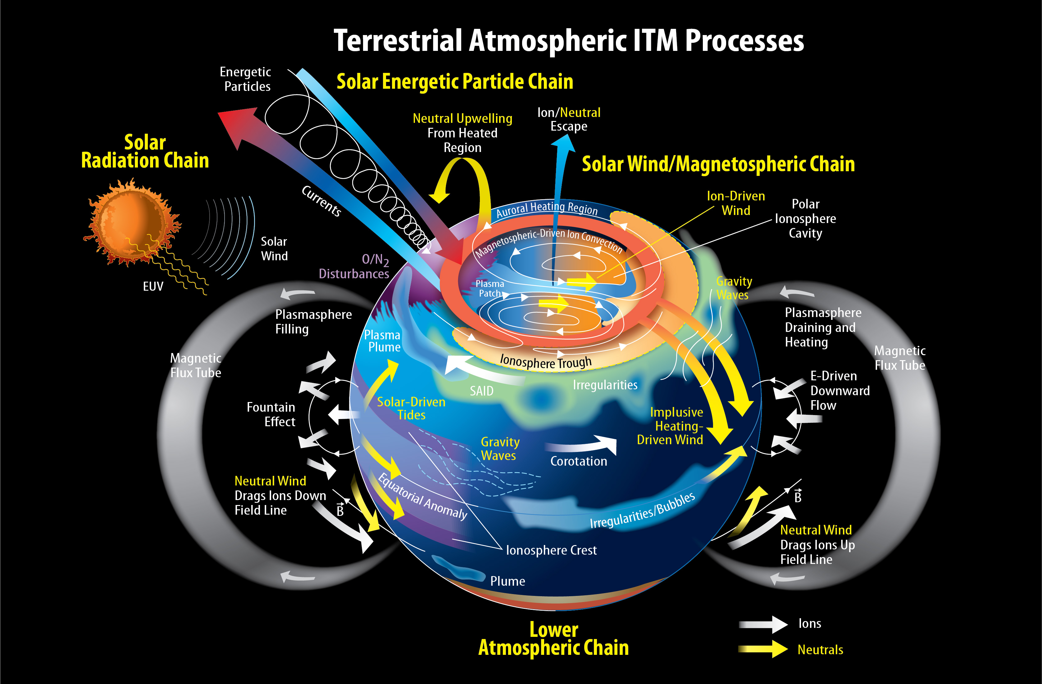
Credit: NASA's Scientific Visualization Studio
Notes:
NASA image available at: https://svs.gsfc.nasa.gov/4641

