Slide 1
P L A N E T A R Y M I S S I O N E N T R Y V E H I C L E S QUICK REFERENCE GUIDE • VERSION 4.0
NASA/SP-20220010761
PLANETARY MISSION ENTRY VEHICLES
Quick Reference Guide Version 4.0
Content Editors:
Parachute Editor:
Production Editors:
Original Content Editor 2002:
Cover Photograph:
Kayla Parcero, AMA INC.
Gary Allen, AMA INC.
Al Witkowski, Databasis Engineering
Sharon McKee, NASA Ames
Leah Torres, AMA INC.
Carol Davies, ELORET Corporation
Compliments of Advanced Concepts Lab (ACL), NASA Langley
To all those who have contributed to either previous versions of the “Blue Book” or have volunteered to send in information to our current release, thank you. Without the support of our community, this book would not be possible.

Slide 2
NASA STI Program
Since its founding, NASA has been dedicated to the advancement of aeronautics and space science. The NASA scientific and technical information (STI) program plays a key part in helping NASA maintain this important role. The NASA STI program operates under the auspices of the Agency Chief Information Officer. It collects, organizes, provides for archiving, and disseminates NASA’s STI. The NASA STI program provides access to the NTRS Registered and its public interface, the NASA Technical Reports Server, thus providing one of the largest collections of aeronautical and space science STI in the world. Results are published in both non-NASA channels and by NASA in the NASA STI Report Series, which includes the following report types: TECHNICAL PUBLICATION. Reports of completed research or a major significant phase of research that present the results of NASA Programs and include extensive data or theoretical analysis. Includes compilations of significant scientific and technical data and information deemed to be of continuing reference value. NASA counter-part of peer-reviewed formal professional papers but has less stringent limitations on manuscript length and extent of graphic presentations. TECHNICAL MEMORANDUM. Scientific and technical findings that are preliminary or of specialized interest, e.g., quick release reports, working papers, and bibliographies that contain minimal annotation. Does not contain extensive analysis. CONTRACTOR REPORT. Scientific and technical findings by NASA-sponsored contractors and grantees.
CONFERENCE PUBLICATION. Collected papers from scientific and technical conferences, symposia, seminars, or other meetings sponsored or co-sponsored by NASA. SPECIAL PUBLICATION. Scientific, technical, or historical information from NASA programs, projects, and missions, often concerned with subjects having substantial public interest. TECHNICAL TRANSLATION. English-language translations of foreign scientific and technical material pertinent to NASA’s mission. Specialized services also include organizing and publishing research results, distributing specialized research announcements and feeds, providing information desk and personal search support, and enabling data exchange services. For more information about the NASA STI program, see the following: Access the NASA STI program home page at http://www.sti.nasa.gov E-mail your question to help@sti.nasa.gov Phone the NASA STI Information Desk at 757-864-9658 Write to: NASA STI Information Desk Mail Stop 148 NASA Langley Research Center Hampton, VA 23681-2199

Slide 3
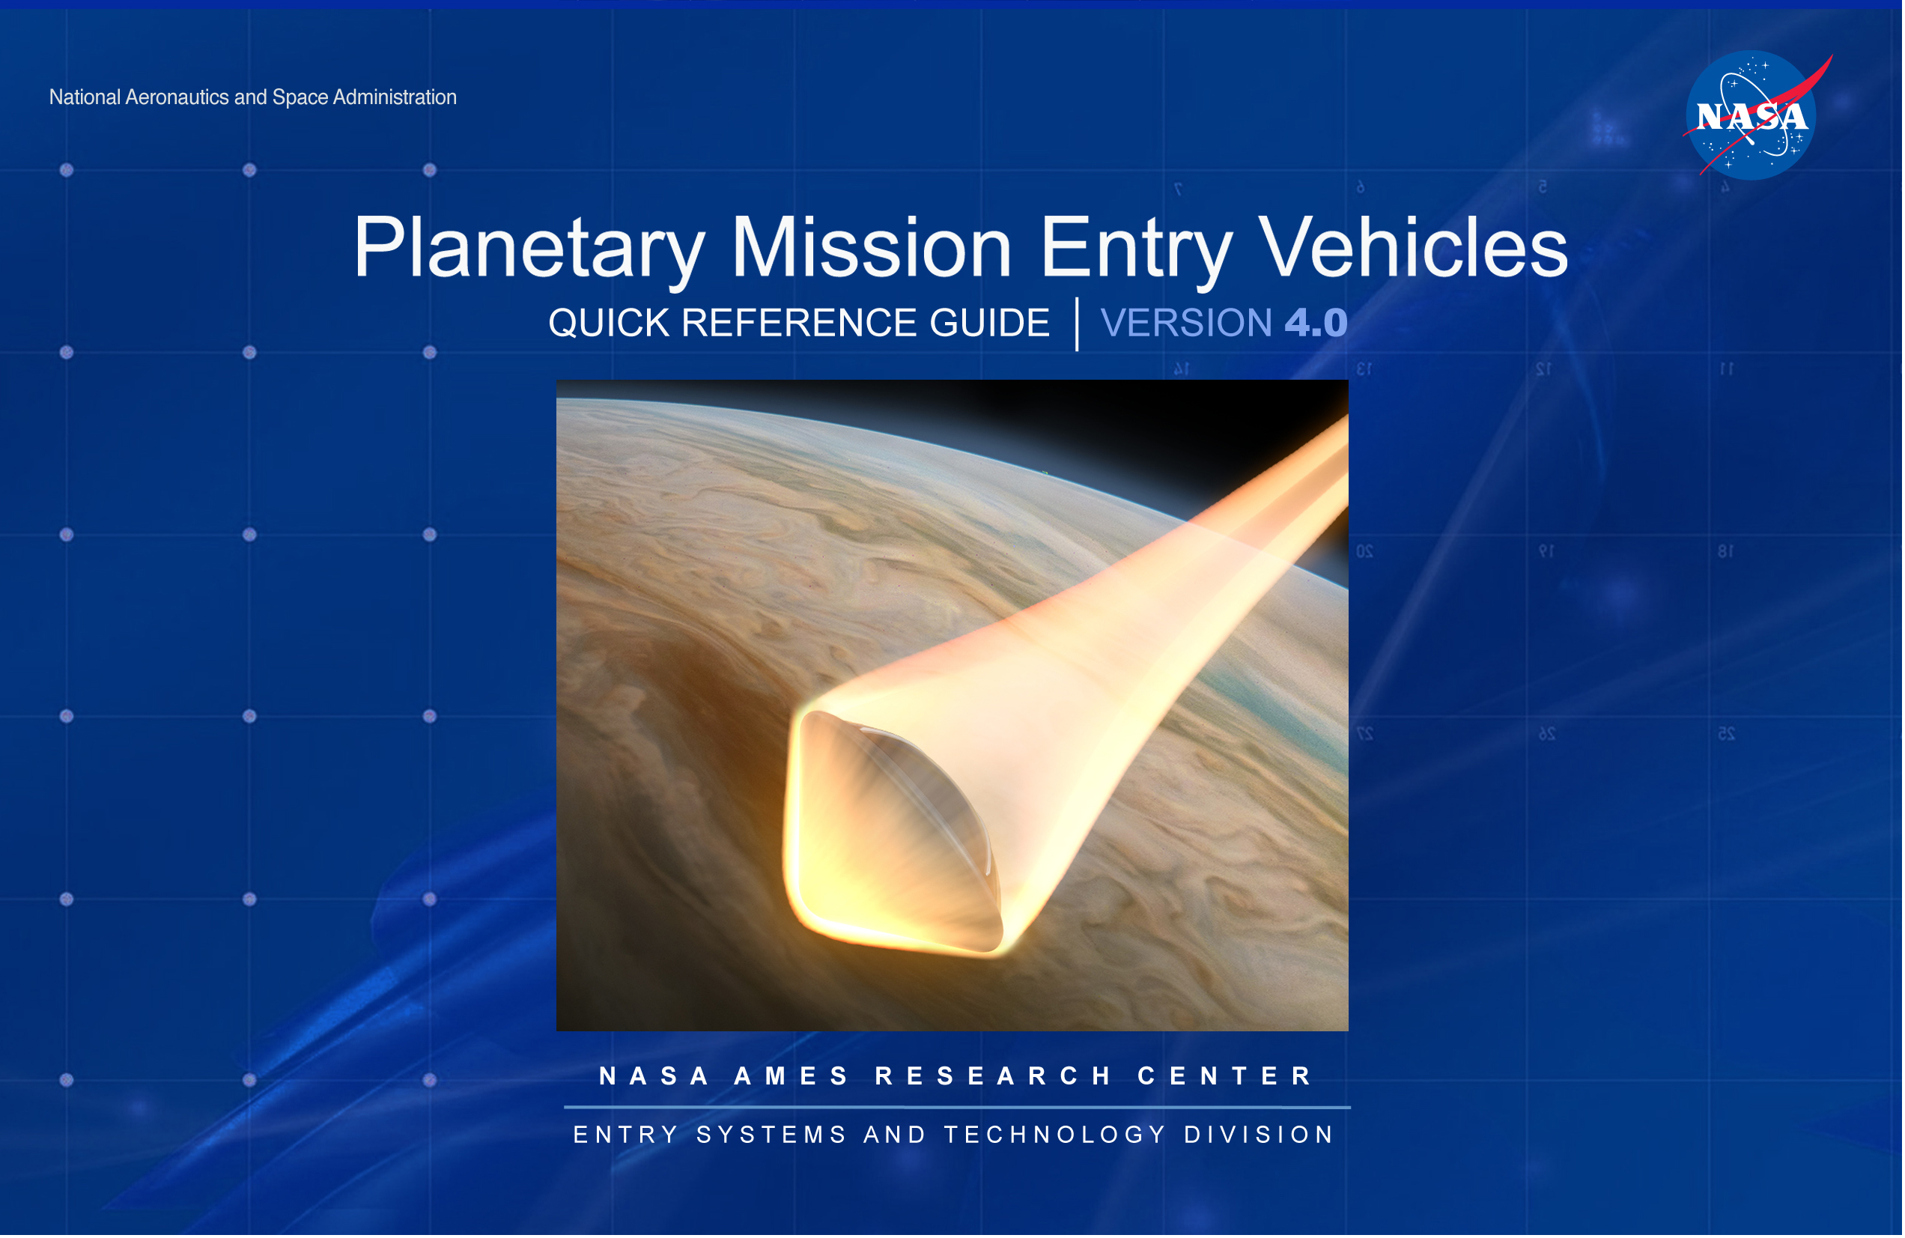

Slide 4
Planetary Mission Entry Vehicles
QUICK REFERENCE GUIDE
VERSION 4.0
N A S A A M E S R E S E A R C H C E N T E R
E N T R Y S Y S T E M S A N D T E C H N O L O G Y D I V I S I O N

Slide 5
P L A N E T A R Y M I S S I O N E N T R Y V E H I C L E S QUICK REFERENCE GUIDE • VERSION 4.0
Back in the era before ubiquitous portable electronics with instantaneous access to all the world’s information at a fingertip, one had to rely on dead-reckoning to compare new concepts with historical analogs. This effect permeated all our endeavors and certainly so in the niche world of planetary entry vehicles. So, it was in the days of designing the Stardust return capsule that in meetings, more often than not, someone would ask, “how does this <heat rate, cone angle, g-load...> compare to <Apollo, Viking, Galileo...>?” Thus was born V1 of the Planetary Mission Entry Vehicles Quick Reference Guide, thereafter, dubbed the “Probe Blue Book,” containing the high-level characteristics of past entry systems and easily tucked into a daily planner, notebook, or other carry-along work aid.
Now that cell phones with global internet access are here, seemingly the era of the Probe Blue Book has passed. Yet ironically, we now suffer too much information. To obtain that one useful, comparative number becomes an exercise of selecting judicious search terms then reconciling conflicting results. Persisting in its convenient form and function, this 4th version contains an expanded set of missions as well as additional information on each mission. Inevitably, there are ambiguities and uncertainties in the data contained herein. There are often differences between design vs. construction, nominal vs. upper limit, and directly measured vs. inferred. In general, preference is given to best estimates of as-built construction and as-flown conditions. In some cases, references are cited. In other cases, the editors made best estimates. In all cases, an attempt is made to state the provenance of the listed value. References are included as an entry point into the publication record.
The editors would be appreciative of suggested corrections or clarifications to improve future versions of the guide. While it must be acknowledged that an Entry Vehicle is merely a tool (usually disposable!) toward achieving a greater goal of scientific discovery or expanding human presence, still there is excitement in the vehicle itself; our own shooting star containing and preserving the wishes of our collective human enterprise of discovery.
Dean Kontinos
Chief Engineer
NASA Ames Research Center

Slide 6
P L A N E T A R Y M I S S I O N E N T R Y V E H I C L E S QUICK REFERENCE GUIDE • VERSION 4.0
Explanation of data types:
Best-estimated: Derived from information on the as-built and as-flown spacecraft configuration and mission. These values are based on any available flight telemetry along with Best-Estimated Trajectory (BET) and follow-on simulation data.
Design: Derived from information from spacecraft project design documents. These may deviate from what a best-estimated value would be due to design unknowns and conservatisms.
Editor’s Estimate: Derived from editor research and simulations, where design information is unavailable or in conflict. This is a credible engineering estimate.
Explanation of symbols used for each data type:
Geometry Use 123 for Best-estimated [123] for design ~123 for editor's estimate | Aerothermal Use 123 for Best-estimated [123] for design ~123 for editor's estimate | TPS Use 123 for Best-estimated [123] for design ~123 for editor's estimate Use (1), (2), (3) to designate multiple materials | Parachutes Use 123 for Best-estimated [123] for design ~123 for editor's estimate Use (1), (2), (3) to indicate multiple parachute stages, as per Table 3 of AIAA 2006-6792

Slide 7
P L A N E T A R Y M I S S I O N E N T R Y V E H I C L E S QUICK REFERENCE GUIDE • VERSION 4.0
Table of Contents
MISSION
LAUNCH DATE
PAGE
MISSION
LAUNCH DATE
PAGE
FIREII………………………………… MAY 1965………. 1
Apollo AS-201………….……….…… FEB 1966………. 2
Apollo AS-202…………………….… AUG 1966………. 3
Apollo 4…………………………....… NOV 1967………. 4
Apollo 6……………………….…..… APR 1968………. 5
Reentry F………………………....… APR 1968………. 6
PAET……………………………....… JUN 1971………. 7
Viking Lander 1…………………….. AUG 1975………. 8
Viking Lander 2…………………….. SEP 1975………. 9
Pioneer-Venus: “North Probe”….… AUG 1978………. 10
Pioneer-Venus: “Night Probe”…..… AUG 1978………. 11
Pioneer-Venus: “Day Probe”……… AUG 1978………. 12
Pioneer-Venus: “Sounder Probe”… AUG 1978………. 13
Galileo……………………………..… OCT 1989………. 14
OREX………………………………… FEB 1994………. 15
Pathfinder………………….………… DEC 1996………. 16
Mirka………………………...…...….. OCT 1997………. 17
Huygens……………………………… OCT 1997………. 18
ARD……...…………………………… OCT 1998………. 19
Deep Space 2.………...……….…… JAN 1999………. 20
Stardust ……..……………………… FEB 1999………. 21
Genesis.……………...………...…… SEP 2001………. 22
Hayabusa.……………….………..… MAY 2003………. 23
Beagle 2…….………………………...JUN 2003………. 24
Mars Exploration Rovers……….…...JUN 2003………. 25
MSL …………………...………..…… NOV 2011………. 26
IRVE …………………...………....… JUL 2012………. 27
Hayabusa 2………………..…...…… DEC 2014………. 28
Exploration Flight Test-1 ………...… DEC 2014………. 29
ExoMars 2016…………………...….. MAR 2016……….30
OSIRIS-REx…………….…………… SEP 2016………. 31
Mars2020……………………………..JUL 2020………...32
Appendix 1: List of Space Vehicles and Missions……. 33
Appendix 2: Definitions………………………………….. 33
Appendix 3: Unit Conversion Factors………………….. 35
Appendix 4: References…………………………………. 35

Slide 8
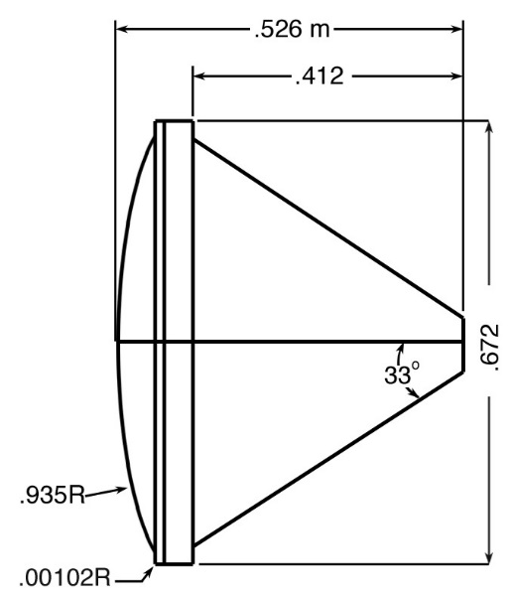
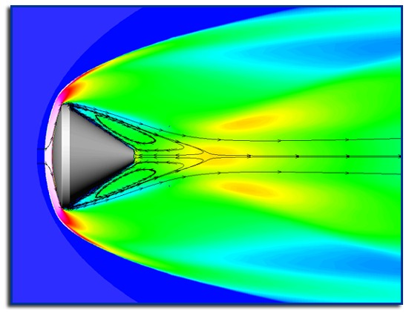
MISSION: FIRE II
PLANET: EARTH
LAUNCH: MAY 22, 1965
ENTRY: MAY 22, 1965
MISSION DESCRIPTION: Pile driver flight test of a scaled Apollo CM geometry to measure reentry heating environment. Launched with Atlas D LV then pile driven into atmosphere to high speed with Antares II-A5 rocket motor.
INSTRUMENTATION: 3 forebody calorimeters, 11 forebody thermocouples,12 offset radiometer thermocouples and one static pressure transducer on the afterbody.
NOTES: This aerothermal flight test was to evaluate radiative heating for Apollo.
The reentry package consisted of three nested phenolic-asbestos heatshields sandwiched between three beryllium calorimeters that ablated or melted away, therefore the mass and OML changed with time.
Trajectory
Geometry
Aero/thermal
TPS
Parachutes
Entry angle | Inertial: -14.24° | Shape | spherical section | Velocity at peak heat | 10.2 km/s | Forebody material designation | See note above | Type | N/A
Entry velocity: inertial & relative | Inertial: 11.74 km/s Relative: 11.35 km/s | Nose radius | 0.935 m 0.805 m 0.702 m | Peak convective heating | ~920 W/cm² | Forebody thickness & mass | 0.3 cm | Deployment method | N/A
Trim L/D (specify trim α) | 0° (spin stabilized) | Base area | 0.354 m² 0.312 m² 0.271 m² | Peak radiative heating | ~350 W/cm² (.2-.4μ) implying ~650 total Traj value 487 W/cm² | Ablating Ejected | Fore: ablated and melted Aft: ablated | Reference diameter / area | N/A
Control method | Ballistic, spin stabilized | Vehicle mass | 86.57 kg | Integrated total heatload | 16136 W/cm² | TPS Integration method | Nested/ layered TPS | Deployment mach | N/A
Ballistic co-eff. | 164.1 kg/m² | Payload mass | N/A | PH stag. pressure | 1.046 atm | Aftbody material designation | Phenolic-asbestos and silicon elastomer | Deployment dynamic pressure | N/A
Peak deceleration | ~77.2 g | TPS mass fraction, inc. insul. |  | Peak stag. heating rate | 1339 W/cm² | Aftbody thickness & mass |  | Parachute materials | N/A

Slide 9
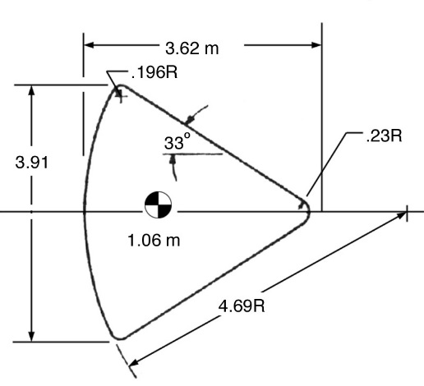

MISSION: APOLLO AS-201
PLANET: EARTH
LAUNCH: FEB 26, 1966
ENTRY: FEB 26, 1966
MISSION DESCRIPTION: First unmanned suborbital flight to test the Saturn 1B launch vehicle, and the command and service modules.
INSTRUMENTATION: 36 pressure sensors all worked; 35 calorimeters worked initially.
NOTES: TPS thickness: Ablator = 4.32 cm, braised stainless-steel substructure (PH 15-7 MO) = 5.08 cm; Insulation: (TG-15,000) =
2.03 cm, aluminum honeycomb (2014-T6 and 5052-H39) = 3.81 cm
Peak heating is not at stagnation point. Manufacturer: AVCO Corp.
Trajectory
Geometry
Aero/thermal
TPS
Parachutes
Entry angle | Inertial: -8.58° Relative: -9.03° | Shape | Capsule: 33° cone | Velocity at peak heat | 5.73 km/s | Forebody material designation | Avco 5026-39 HC | Type | (1) 2 conical ribbon drogue parachutes, (2) 3 ringshot pilot parachutes, (3) 3 ringsail main parachutes
Entry velocity: inertial & relative | Relative: 7.67 km/s | Nose radius | 4.69 m, 3 m effective | Peak convective heating | 186 W/cm² at peak | Forebody thickness & mass | Ablator = 4.32 cm, braised stainless-steel substructure (PH 15-7 MO)=5.08 cm | Deployment method | (1) mortar (2) drogue parachute (3) pilot parachute
Trim L/D (specify trim α) | -19.7° < α < 21.3° | Base area | 12.02 m² | Peak radiative heating | 0 W/cm² | Ablating Ejected | Ablated: yes Ejected: no | Reference diameter / area | (1) 4.9 m dia. (2) 2.2 m dia. (3) 25.5 m dia.
Control method | No control: rolled | Vehicle mass | 5027.48 kg | Integrated total heatload | 7600 J/cm² | TPS integration method | Honeycomb bonded to substructure; cells filled w/ablative compound | Deployment mach | ~0.7
Ballistic co-eff. |  | Payload mass | N/A | PH stag. pressure | 0.85 atm | Aftbody material designation |  | Deployment dynamic pressure
Peak deceleration | 14.3 g | TPS mass fraction, inc. insul. | 13.7% | Peak stag. heating rate | 186 W/cm² at peak | Aftbody thickness & mass |  | Parachute materials
— 2 —

Slide 10
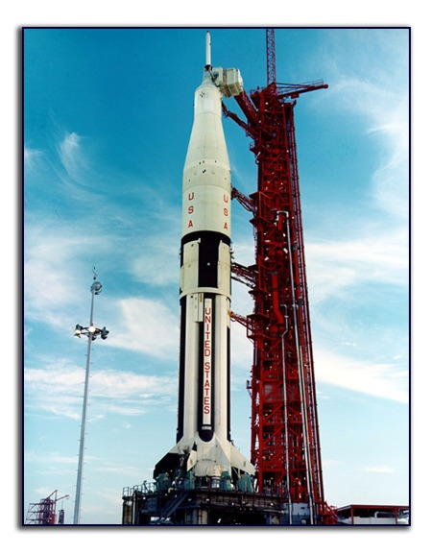
MISSION: APOLLO AS-202 (APOLLO-3)
PLANET: EARTH
LAUNCH: AUG 25, 1966
ENTRY: AUG 25, 1966
MISSION DESCRIPTION: Second unmanned suborbital flight to test the Saturn 1B launch vehicle, and the command and service modules.
INSTRUMENTATION: 36 pressure sensors all worked; 35 calorimeters worked initially.
NOTES: TPS thickness: Ablator = 4.32 cm, braised stainless-steel substructure (PH 15-7 MO) = 5.08 cm. Insulation: (TG-15000) = 2.03 cm, aluminum honeycomb (2014-T6 and 5052-H39) = 3.81 cm Manufacture: AVCO Corp.
Trajectory
Geometry
Aero/thermal
TPS
Parachutes
Entry angle | Inertial -3.57° Relative -3.74° Entry altitude 121.67 km | Shape | Capsule 33°cone | Velocity at peak heat | 7.94 km/s | Forebody material designation | Avco 5026-39 HC | Type | (1) 2 conical ribbon drogue parachutes, (2) 3 ringshot pilot parachutes, (3) 3 ringsail main parachutes
Entry velocity: inertial & relative | Inertial: 8.75° km/s Relative: 8.35 km/s | Nose radius | 4.59 m, 3 m effective | Peak convective heating | 59.2 W/cm² at peak | Forebody thickness & mass | Ablator = 4.32 cm braised stainless-steel substructure (PH 15-7 MO) = 5.08 cm | Deployment method | (1) mortar (2) drogue parachute (3) pilot parachute
Trim L/D (specify trim α) | 0.372 Avg. Resultant L/D | Base area | 12.2 m² | Peak radiative heating | 0 W/cm² | Ablating Ejected | Ablated: yes Ejected: no | Reference diameter / area | (1) 4.9 m dia. (2) 2.2 m dia. (3) 25.5 m dia.
Control method | Roll modulation | Vehicle mass | 5424.51 kg | Integrated total heatload | 18789 J/cm² | TPS integration method | Honeycomb bonded to substructure; cells filled with ablative compound | Deployment mach | ~0.7
Ballistic co-eff. | N/A | Payload mass | Apollo CM test flight | PH stag. pressure | 0.11 atm | Aftbody material designation |  | Deployment dynamic pressure
Peak deceleration |  | TPS mass fraction, inc. insul. | 13.7% | Peak stag. heating rate | 59.2 W/cm² at peak | Aftbody thickness & mass |  | Parachute materials
— 3 —

Slide 11

MISSION: APOLLO AS-501 (APOLLO-4)
PLANET: EARTH
LAUNCH: NOV 9, 1967
ENTRY: NOV 9, 1967
MISSION DESCRIPTION: Test of Saturn V launch vehicle and overall reentry operations.
INSTRUMENTATION: 17 pressure sensors all worked, and 23 calorimeters worked initially. Radiometer functioned well.
NOTES: TPS thickness: Ablator = 4.32 cm, braised stainless-steel substructure (PH 15-7 MO) = 5.08 cm. Insulation: (TG-15,000) = 2.03 cm, aluminum honeycomb (2014-T6 and 5052-H39) = 3.81 cm Manufacturer: AVCO Corp.
Trajectory
Geometry
Aero/thermal
TPS
Parachutes
Entry angle | Inertial -6.93 Relative-7.19° Entry altitude 121.92 km | Shape | Capsule: 33° cone | Velocity at peak heat | 10.04 km/s | Forebody material designation | Avco 5026-39 HC | Type | (1) 2 conical ribbon drogue parachutes, (2) 3 ringshot pilot parachutes, (3) 3 ringsail main parachutes
Entry velocity: inertial & relative | Inertial: 11.14 km/s Relative: 10.73 km/s | Nose radius | 4.66 m, 3 m effective | Peak convective heating | 219 W/cm² | Forebody thickness & mass | TPS thickness: Ablator = 4.32 cm, braised stainless-steel substructure (PH 15-7 MO) = 5.08 cm | Deployment method | (1) mortar (2) drogue parachute (3) pilot parachute
Trim L/D (specify trim α) | 0.37 < L/D < 0.44 24° < α <28° | Base area | 12.08 m² | Peak radiative heating | 317 W/cm² | Ablating Ejected | Ablated: yes Ejected: no | Reference diameter / area | (1) 4.9 m dia. (2) 2.2 m dia. (3) 25.5 m dia.
Control method | Roll modulation | Vehicle mass | 5424.5 kg | Integrated total heatload | 24122 J/cm² | TPS integration method | Honeycomb bonded to substructure; cells filled with ablative compound | Deployment mach | ~0.7
Ballistic co-eff. | ~340 kg/m² | Payload mass | N/A | PH stag. pressure | 0.542 atm | Aftbody material designation |  | Deployment dynamic pressure
Peak deceleration | 8.79 g | TPS mass fraction, inc.insul. | 13.7% | Peak stag. heating rate | 527 W/cm² peak | Aftbody thickness & mass |  | Parachute materials

Slide 12
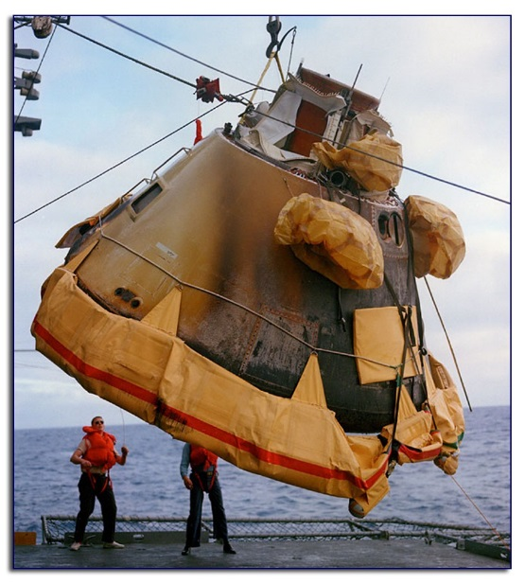
MISSION: APOLLO AS-502 (APOLLO-6)
PLANET: EARTH
LAUNCH: APR 4, 1968
ENTRY: APR 4, 1968
MISSION DESCRIPTION: Final qualification test for launch vehicle and command module for manned mission.
INSTRUMENTATION:
NOTES: TPS thickness: Ablator = 4.32 cm, braised stainless-steel substructure (PH 15-7 MO) = 5.08 cm Insulation: (TG-15,000) = 2.03 cm, aluminum honeycomb (2014-T6 and 5052-H39) = 3.81 cm.
Manufacture: AVCO Corp Saturn-V malfunctioned causing the CM to follow a spurious return trajectory.
Trajectory
Geometry
Aero/thermal
TPS
Parachutes
Entry angle | Inertial: -5.9° | Shape | Capsule: 33° cone | Velocity at peak heat | 8.32 km/s | Forebody material designation | Avco 5026-39 HC | Type | (1) 2 conical ribbon drogue parachutes, (2) 3 ringshot pilot parachutes, (3) 3 ringsail main parachutes
Entry velocity: inertial & relative | Inertial: 10.00 km/s Relative: 9.60 km/s | Nose radius | 4.69 m, 3 m effective | Peak convective heating | 197 W/cm² | Forebody thickness & mass | TPS thickness: Ablator = 4.32 cm, braised stainless-steel substructure (PH 15-7 MO) = 5.08 cm | Deployment method | (1) mortar (2) drogue parachute (3) pilot parachute
Trim L/D (specify trim α) | 0.35 < L/D <0.4 24°< α <28° | Base area | 12.02 m² | Peak radiative heating | 43 W/cm² | Ablating Ejected | Ablated: yes Ejected: no | Reference diameter / area | (1) 4.9 m dia. (2) 2.2 m dia. (3) 25.5 m dia.
Control method | Roll modulation | Vehicle mass | 5424.9 kg | Integrated total heatload | 32000 J/cm² | TPS integration method | Honeycomb bonded to substructure; cells filled with ablative compound | Deployment mach | ~0.7
Ballistic co-eff. | 395.8 kg/m² | Payload mass | N/A | PH stag. pressure | 0.354 atm | Aftbody material designation |  | Deployment dynamic pressure
Peak deceleration |  | TPS mass fraction, inc.insul. | 13.7% | Peak stag. heating rate | 240 W/cm² peak | Aftbody thickness & mass |  | Parachute materials

Slide 13
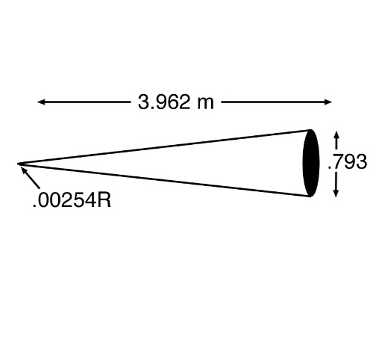
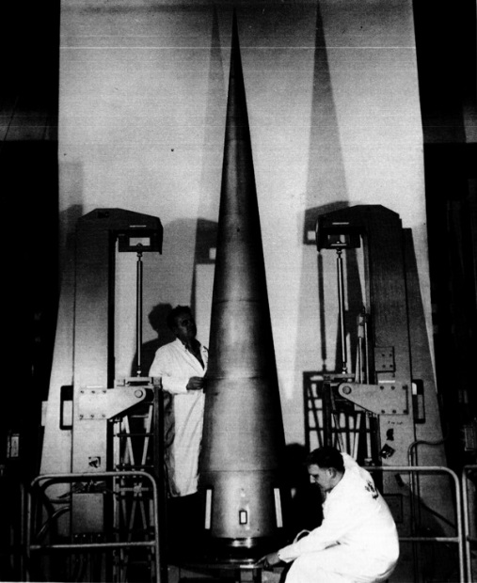
MISSION: REENTRY F
PLANET: EARTH
LAUNCH: APR 27, 1968
ENTRY: APR 27, 1968
MISSION DESCRIPTION: To measure turbulent heating rates and transition onset in a flight environment.
INSTRUMENTATION: Multiple thermocouples and pressure sensors at 21 stations on cone, 4 heat-flux gauges and 2 pressure gauges on base. 3 thermocouples in nose-tip assembly.
NOTES: Nose-tip heating rate is not relevant for this flight, which was designed to measure heating on a sharp cone. The nose tip was meant to ablate during entry 3. The beryllium heat shield melted for ~40 seconds after entry.
Trajectory
Geometry
Aero/thermal
TPS
Parachutes
Entry angle | -20.78° | Shape | 5°half cone, 3.962 m long | Velocity at peak heat | 5.47 km/s | Forebody material designation | Nose-tip: ATJ graphite Body: beryllium | Type | N/A
Entry velocity: inertial & relative | Inertial: 6.28 km/s Relative: 5.96 km/s | Nose radius | 0.254 cm | Peak convective heating | 32 W/cm² | Forebody thickness & mass | Be: 1.524 cm | Deployment method | N/A
Trim L/D (specify trim α) | 0° ballistic | Base area | 0.3772 m² | Peak radiative heating | ~0 W/cm² | Ablating Ejected | Nose-tip: Yes Ejected: No | Reference diameter / area | N/A
Control method | N/A | Vehicle mass | 272 kg | Integrated total heatload |  | TPS integration method |  | Deployment mach | N/A
Ballistic co-eff. | ~50000 kg/m² | Payload mass | N/A | PH stag. pressure | 250 atm | Aftbody material designation |  | Deployment dynamic pressure | N/A
Peak deceleration |  | TPS mass fraction, inc. insul. |  | Peak stag. heating rate | 32 W/cm² | Aftbody thickness & mass |  | Parachute materials | N/A

Slide 14
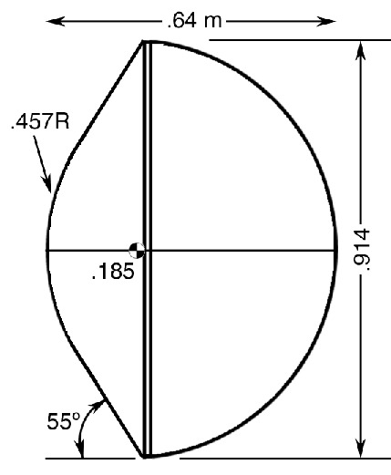
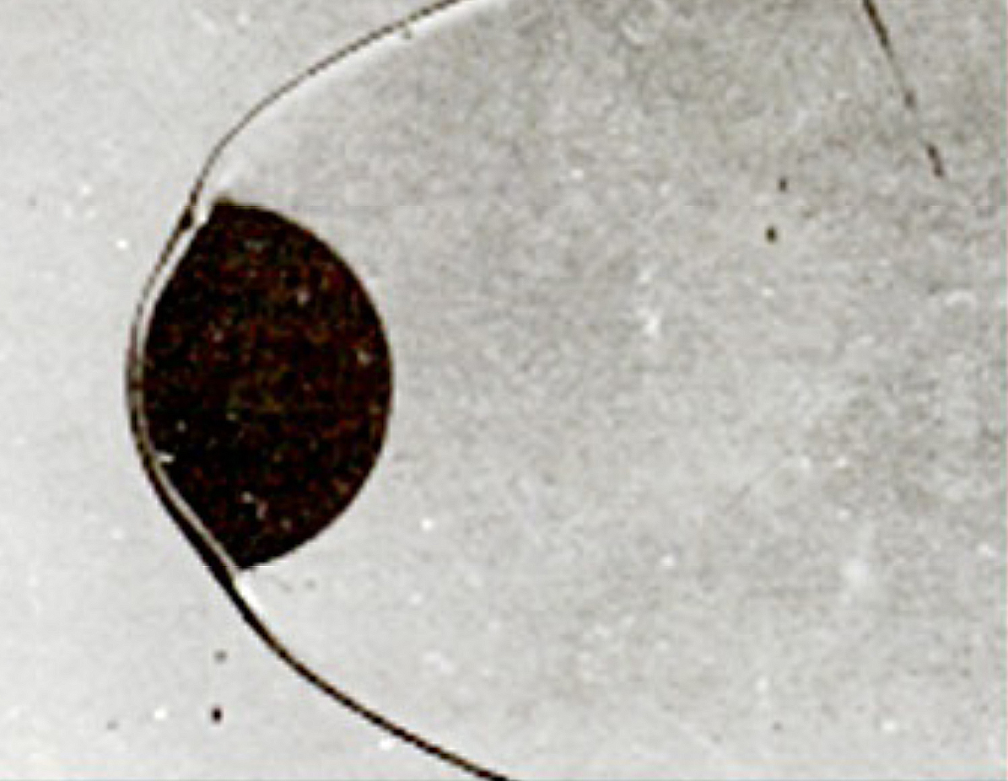
MISSION: PAET
PLANET: EARTH
LAUNCH: JUL 2, 1971
ENTRY: JUL 2, 1971
MISSION DESCRIPTION: To test the capability to determine the composition of unknown atmospheres during high-speed entry.
INSTRUMENTATION: Multiple thermocouples and pressure sensors at 21 stations on cone, 4 heat-flux gauges and 2 pressure gauges on base. 3 thermocouples in nose-tip assembly.
Shadowgraph of PAET Model in Ballistic Range Test
NOTES:
Trajectory
Geometry
Aero/thermal
TPS
Parachutes
Entry angle | Relative: -41° Inertial: -38.98° 93 km altitude | Shape | Blunt-nose, 55° half-cone angle | Velocity at peak heat | 5.7 km/s | Forebody material designation | Nose: Beryllium heatsink Conical frustum: ESA 3560 ablator | Type | N/A
Entry velocity: inertial & relative | Inertial: 6.88 km/s Relative: 6.66km/s | Nose radius | 0.457m | Peak convective heating | ~228 W/cm² | Forebody thickness & mass | Nose: 1-2.5 cm Conical frustum: 0.76 cm | Deployment method | N/A
Trim L/D (specify trim α) | 0 | Base area | 0.66 m² | Peak radiative heating | Negligible | Ablating Ejected | Frustum ablated Ejected: no | Reference diameter / area | N/A
Control method | Ballistic | Vehicle mass | 62.1 kg | Integrated total heatload | Stag. pt. 1982 J/cm² | TPS integration method | None (solid Be) | Deployment mach | N/A
Ballistic co-eff. | 68.4 kg/m² | Payload mass | 14 kg | PH stag. pressure | 0.60 atm | Aftbody material designation |  | Deployment dynamic pressure | N/A
Peak deceleration | 76 g | TPS mass fraction, inc. insul. | Forebody: 13.7% Afterbody: 3.5% | Peak stag. heating rate | Max: 228 W/cm² (no ablation) | Aftbody thickness & mass |  | Parachute materials | N/A

Slide 15
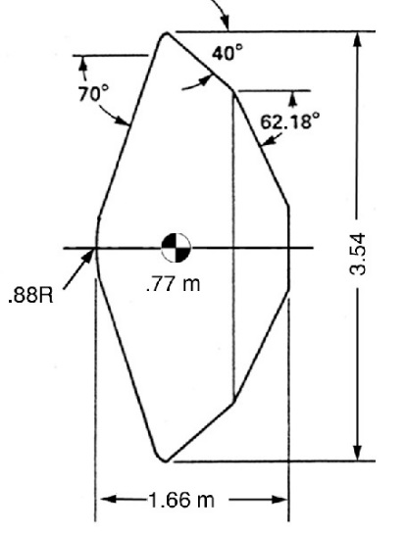

MISSION: VIKING LANDER 1
PLANET: MARS
LAUNCH: AUG 20, 1975
ENTRY: JUL 20, 1976
MISSION DESCRIPTION: To characterize the structure and composition of the atmosphere and surface of Mars.
INSTRUMENTATION: The forebody aeroshell was not instrumented, but the wake enclosure (backshell) had thermocouples. There was one pressure port off stagnation point and one on the base cover. Temperature gauges were on the back face and on both backshell frustums.
NOTES: Resin Material: silicone elastomer with glass microspheres and cork; Matrix material: fiberglass-phenolic honeycomb. RCS was used to maintain trim angle of attack.
Trajectory
Geometry
Aero/thermal
TPS
Parachutes
Entry angle | Inertial: -17.00° Relative: -17.76° Entry altitude 242.8 km | Shape | 70° sphere-cone | Velocity at peak heat | 4.06 km/s | Forebody material designation | SLA561-V | Type | Single DGB parachute
Entry velocity: inertial & relative | Inertial: 4.610 km/s Relative: 4.418 km/s | Nose radius | 0.8763 m | Peak convective heating | 21.1 W/cm² | Forebody thickness & mass | Variable: (max) 1.38 cm | Deployment method | Main parachute directly deployed by 15 in. diameter mortar
Trim L/D (specify trim α) | α = - 11.1° | Base area | 9.84 m² | Peak radiative heating | 0 | Ablating Ejected | Ablator-pyrolyzed Ejected: yes | Reference diameter / area | 16.2 m dia.
Control method | 3-axis RCS rate limiting | Vehicle mass | 982.9 kg | Integrated total heatload | ~1001 J/cm² | TPS integration method | Honeycomb bonded to substructure; cells filled with ablative compound | Deployment mach | ~1.1
Ballistic co-eff. | At peak dyn. p.: 60.41 kg/m² | Payload mass | N/A | Peak heating stag. pressure | 0.06 atm | Aftbody material designation | Inner cone: laminated glass fabric/phenolic resin; outer cone: aluminum | Deployment dynamic pressure | ~380 Pa
Peak deceleration | ~6.86 g | TPS mass fraction, inc. insul. | 2.8% | Peak stag. heating rate | Peak: 21.1 W/cm² | Aftbody thickness & mass |  | Parachute materials | Dacron

Slide 16
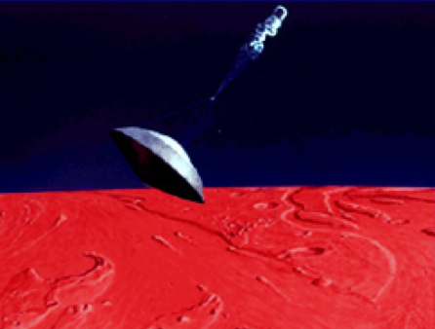
MISSION: VIKING LANDER 2
PLANET: MARS
LAUNCH: SEP 9, 1975
ENTRY: SEP 3, 1976
MISSION DESCRIPTION: To characterize the structure and composition of the atmosphere and surface of Mars.
INSTRUMENTATION: The forebody aeroshell was not instrumented, but the wake enclosure (backshell) had thermocouples. There was one pressure port off stagnation point and one on the base cover. Temperature gauges were on the back face and on both backshell frustums.
NOTES: Resin material: silicone elastomer with glass microspheres and cork. Matrix material: fiberglass-phenolic honeycomb. RCS was used to maintain trim angle of attack.
Trajectory
Geometry
Aero/thermal
TPS
Parachutes
Entry angle | Inertial: -17.08° Relative: -17.62° Entry altitude 240.99 km | Shape | Blunt-nosed 70°half cone | Velocity at peak heat | 4.1 km/s | Forebody material designation | SLA561-V | Type | Single GBD parachute
Entry velocity: inertial & relative | Inertial: 4.61 km/s Relative: 4.48 km/s | Nose radius | 0.876 m | Peak convective heating | ~21.95 W/cm² | Forebody thickness & mass | Variable: (max) 1.38 cm | Deployment method | Main parachute directly deployed by 15 in. diameter mortar
Trim L/D (specify trim α) | 0.18 at α = -11.3° | Base area | 9.84 m² | Peak radiative heating | 0 | Ablating Ejected | Ablator-pyrolyzed Ejected: yes | Reference diameter / area | 16.2 m dia.
Control method | 3-axis RCS rate limiting | Vehicle mass | 981.6 kg | Integrated total heatload | ~1043 J/cm² | TPS integration method | Honeycomb bonded to substructure; cells filled with ablative compound | Deployment mach | ~1.1
Ballistic co-eff. | 61.44 kg/m² | Payload mass | N/A | PH stag. pressure | ~0.041 atm | Aftbody material designation | Inner cone: laminated glass fabric/phenolic resin; outer cone: aluminum | Deployment dynamic pressure | ~408 pa
Peak deceleration | ~7.2 g trajectory ~8.5 g chute snap | TPS mass fraction, inc. insul. | 2.8% | Peak stag. heating rate | Max: 21.95 W/cm² | Aftbody thickness & mass |  | Parachute materials | Dacron

Slide 17
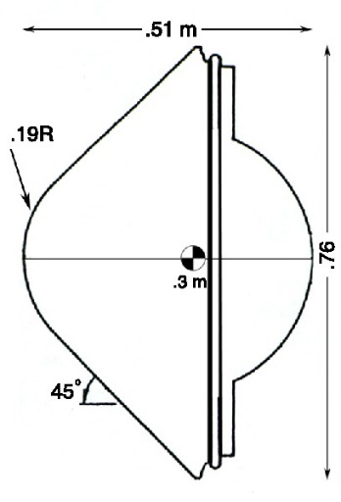
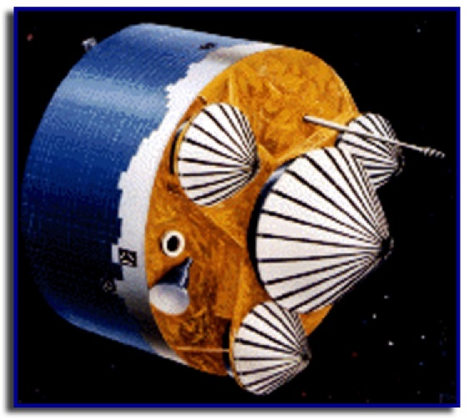
MISSION: PIONEER-VENUS: SMALL ‘NORTH PROBE’
PLANET: VENUS
LAUNCH: AUG 8, 1978
ENTRY: : DEC 9, 1978
MISSION DESCRIPTION: A 60° N day entry to map atmosphere, including characterizing wind and turbulence.
INSTRUMENTATION: Thermocouples: one at 17 ° off stagnation point (0.41 cm below heat-shield surface); another on conical frustum ahead of shoulder (0.30 cm below heat-shield surface) at s/Rn = 2.2.
NOTES: Heating rates and loads are based on Tauber correlations in radiative equilibrium (very model sensitive). Pioneer-Venus "North Probe" experienced 466 g which was greatest for a successful probe.
Trajectory
Geometry
Aero/thermal
TPS
Parachutes
Entry angle | Inertial & Relative: -68.74° @ 200 km | Shape | Blunt-nosed, 45° half-cone angle | Velocity at peak heat | 10.83 km/s | Forebody material designation | Carbon-phenolic FM 5055 | Type | N/A
Entry velocity: inertial & relative | Inertial & Relative: 11.54 km/s | Nose radius | 0.19 m | Peak convective heating | ~3085 W/cm² | Forebody thickness & mass | 1.2 cm at stagnation point | Deployment method | N/A
Trim L/D (specify trim α) | 0 | Base area | 0.46 m² | Peak radiative heating | ~3273 W/cm² | Ablating Ejected | Ablated: yes Ejected: no | Reference diameter / area | N/A
Control method | Ballistic | Vehicle mass | 91 kg | Integrated total heatload | At stag. pt ~10502 J/cm² | TPS integration method | Nose: chopped molded; conical section: tape-wrapped | Deployment mach | N/A
Ballistic co-eff. | 190 kg/m² | Payload mass | 3.60 kg | Peak heating stag. pressure | ~16.5 atm | Aftbody material designation |  | Deployment dynamic pressure | N/A
Peak deceleration | 465.9 g | TPS mass fraction, inc. insul. | 12.9% | Peak stag. heating rate | 6150 W/cm² | Aftbody thickness & mass |  | Parachute materials | N/A

Slide 18
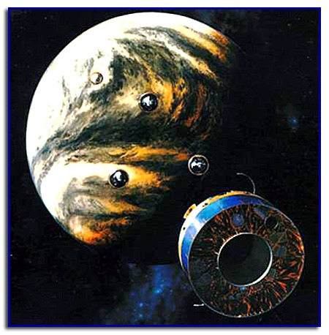
MISSION: PIONEER-VENUS: SMALL ‘NIGHT PROBE’
PLANET: VENUS
LAUNCH: AUG 8, 1978
ENTRY: : DEC 9, 1978
MISSION DESCRIPTION: To map the atmosphere, including temperature and pressure, from a night side entry.
INSTRUMENTATION: Thermocouples: one at 17° off stagnation point (0.41 cm below heat-shield surface); another on conical frustum ahead of shoulder (0.30 cm below heat-shield surface) at s/Rn = 2.2.
NOTES: Heating rates and loads are probably for non-ablating conditions.
Trajectory
Geometry
Aero/thermal
TPS
Parachutes
Entry angle | Inertial & Relative: -41.50° @ 200 km | Shape | Blunt-nosed, 45.2° half-cone angle | Velocity at peak heat | ~10.79 km/s | Forebody material designation | Carbon-phenolic FM 5055 | Type | N/A
Entry velocity: Inertial & Relative | Inertial & Relative: 11.54 | Nose radius | 0.19 m | Peak convective heating | ~2743 W/cm² | Forebody thickness & mass | 1.2 cm at stagnation point | Deployment method | N/A
Trim L/D (specify trim α) | 0 | Base area | 0.46 m² | Peak radiative heating | ~2330 W/cm² | Ablating Ejected | Ablated: Yes Ejected: No | Reference diameter / area | N/A
Control method | Ballistic | Vehicle mass | 91 kg | Integrated total heatload | At stag.pt ~11413 J/cm² | TPS integration method | Nose: chopped molded; conical section: tape-wrapped | Deployment mach | N/A
Ballistic co-eff. | 190 kg/m² | Payload mass | 3.60 kg | Peak heating stag. pressure | ~4.9 atm | Aftbody material designation |  | Deployment dynamic pressure | N/A
Peak deceleration | 353.7 g | TPS mass fraction, inc. insul. | 12.9% | Peak stag. heating rate | ~4906 W/cm² | Aftbody thickness & mass |  | Parachute materials | N/A

Slide 19
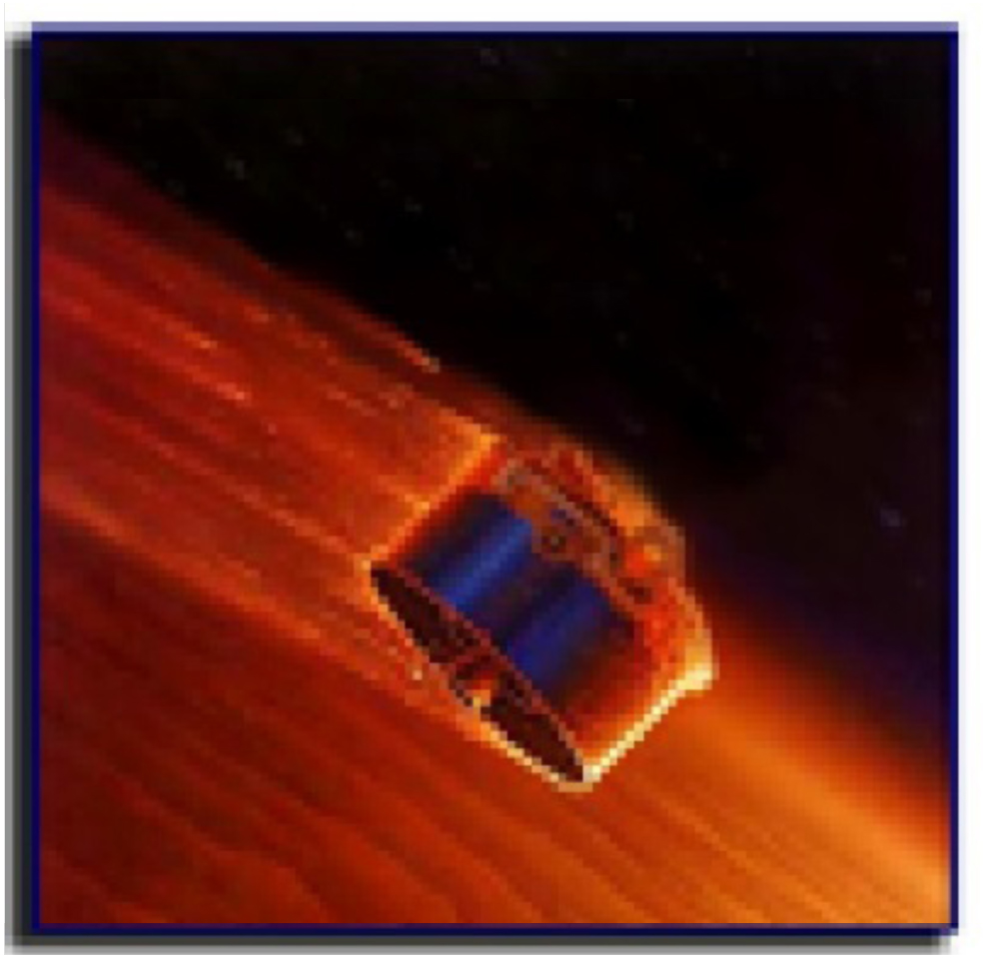
MISSION: PIONEER-VENUS: SMALL ‘DAY PROBE’
PLANET: VENUS
LAUNCH: AUG 8, 1978
ENTRY: : DEC 9, 1978
MISSION DESCRIPTION: To map the atmosphere, including radiative energy, from a day side entry.
INSTRUMENTATION: Thermocouples: one at 17° off stagnation point (0.41 cm below heat-shield surface); another on conical frustum ahead of shoulder (0.30 cm below heat-shield surface) at s/Rn = 2.2.
NOTES: Heating rates and loads are probably for non-ablating conditions.
Day Probe survived surface impact (accidentally) or 1 hour, 7.58 minutes.
Trajectory
Geometry
Aero/thermal
TPS
Parachutes
Entry angle | Inertial: -25.41° Relative: -25.42° @ 200 km | Shape | Blunt-nosed, 45° half-cone angle | Velocity at peak heat | 10.68 km/s | Forebody material designation | Carbon-phenolic FM 5055 | Type | N/A
Entry velocity: inertial & relative | Inertial & Relative: 11.54 km/s | Nose radius | 0.19 m | Peak convective heating | ~2250 W/cm² | Forebody thickness & mass | 1.2 cm at stagnation point | Deployment method | N/A
Trim L/D (specify trim α) | 0 | Base area | 0.46 m² | Peak radiative heating | ~1363 W/cm² | Ablating Ejected | Ablated: Yes Ejected: No | Reference diameter / area | N/A
Control method | Ballistic | Vehicle mass | 91 kg | Integrated total heatload | At stag.pt ~13264 J/cm² | TPS integration method | Nose: chopped molded; conical section: tape-wrapped | Deployment mach | N/A
Ballistic co-eff. | 190 kg/m² | Payload mass | 3.60 kg | Peak heating stag. pressure | ~8.1 atm | Aftbody material designation |  | Deployment dynamic pressure | N/A
Peak deceleration | 227.7 g | TPS mass fraction, inc. insul. | 12.9% | Peak stag. heating rate | 3476 W/cm² | Aftbody thickness & mass |  | Parachute materials | N/A

Slide 20
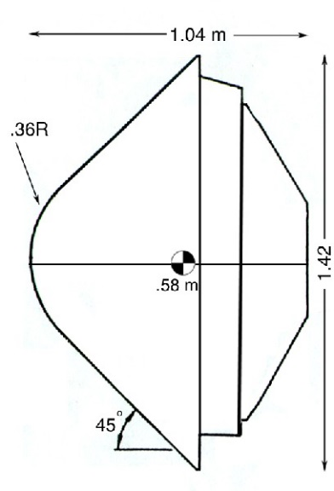

MISSION: PIONEER-VENUS: LARGE PROBE ‘SOUNDER’
PLANET: VENUS
LAUNCH: AUG 8, 1978
ENTRY: DEC 9, 1978
MISSION DESCRIPTION: This probe contained 7 experiments, including 1 to measure the atmospheric composition.
INSTRUMENTATION: Thermocouples: one at 17° off stagnation point (0.41 cm below heat-shield surface); another on conical frustum ahead of shoulder (0.30 cm below heat-shield surface) at s/Rn = 2.2.
NOTES: Heating rates and loads are probably for non-ablating conditions.
Parachute deployed at 66.46 km to extract probe from heat shield. Parachute detached from probe at 1076 sec after entry Probe impacted surface (signal ended) 3261 sec. after entry.
Trajectory
Geometry
Aero/thermal
TPS
Parachutes
Entry angle | Inertial & Relative: -32.37° @ 200 km | Shape | Blunt-nosed, 45° half-cone angle | Velocity at peak heat | 10.82 km/s | Forebody material designation | Carbon-phenolic FM 5055 | Type | (1) Ribless guide surface, 8 gore pilot chute, (2) Conical ribbon, 18 gore main chute
Entry velocity: inertial & relative | Inertial & Relative: 11.54km/s @ 200 km | Nose radius | 0.36 m | Peak convective heating | ~1813 W/cm² | Forebody thickness & mass | 1.60 cm at stagnation point | Deployment method | (1) Mortar (2) Pilot chute
Trim L/D (specify trim α) | 0 | Base area | 1.59 m² | Peak radiative heating | ~2468 W/cm² | Ablating Ejected | Ablated: Yes Ejected: Yes | Reference diameter / area | (1) 0.76 m dia. (CdA=0.37 m²) (2) 4.94 m dia. (CdA=10.4 m²)
Control method | Ballistic | Vehicle mass | 316.483 kg | Integrated total heatload | At stag.pt ~11305 J/cm² | TPS integration method | Nose: chopped molded; conical section: tape-wrapped | Deployment mach | ~0.82
Ballistic co-eff. | 189.7 kg/m² | Payload mass | Science instr. 29.15 kg (9.2%) | Peak heating stag. pressure | ~10.2 atm | Aftbody material designation |  | Deployment dynamic pressure | ~3287 pa
Peak deceleration | 286.4g | TPS mass fraction inc.insu. | Forebody: 8.83% Aft cover:1.52% | Peak stag. heating rate | 4145 W/cm | Aftbody thickness & mass |  | Parachute materials | (1) Dacron 1.25 oz/yd² (2) Dacron 2.25 oz/yd²

Slide 21
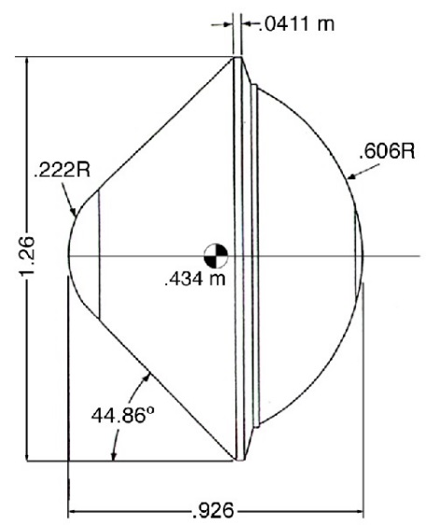

MISSION: GALILEO
PLANET: JUPITER
LAUNCH: OCT 18, 1989
ENTRY: DEC 7, 1995
MISSION DESCRIPTION: To descend into the Jovian atmosphere, collect atmospheric data and relay to the orbiter.
INSTRUMENTATION: Forebody TPS: ablation recession gauges. Afterbody TPS: thermocouples in the nylon phenolic. Galileo was the most difficult entry in the history of space exportation. Attempts to model Galileo's entry are little more than educated guesses with many phenomena poorly understood.
NOTES: Reported CG estimates varied widely. "Blockage" refers to reduction in outer wall heating due to ablation effects.
Trajectory
Geometry
Aero/thermal
TPS
Parachutes
Entry angle | Inertial: -6.65° Relative: -8.41° at 450 km | Shape | Blunt-nosed 44.86° half-cone angle | Velocity at peak heat | 39.4 km/s | Forebody material designation | Carbon-phenolic | Type | (1)Pilot: 20° conic ribbon (2) Main: 20° conic ribbon
Entry velocity: inertial & relative | Inertial: 59.83 km/s Relative: 47.41 km/s | Nose radius | 0.222 m | Peak convective heating |  | Forebody thickness & mass | 14.6 cm at stagnation | Deployment method | (1) Mortar launched with aft cover (2) Pilot parachute
Trim L/D (specify trim α) | 0 | Base area | 1.26 m² | Peak radiative heating | ~38055 W/cm² [unblocked] ~16272 W/cm² [blocked] | Ablating Ejected | Ablated: yes Ejected: yes | Reference diameter / area | (1) 1.14 m dia. (CdA=0.51 m²) (2) 3.8 m dia. (CdA=5.46 m²)
Control method | Ballistic | Vehicle mass | At entry: 338.93 kg | Integrated total heatload | ~210826 J/cm² with ablation | TPS integration method | Nose: chopped molded; conical section: tape-wrapped | Deployment mach | g-switch malfunctioned; chute deployed at 16.6 km above one bar altitude
Ballistic co-eff. | ~267.6 kg/m² | Payload mass | Science 8.3% | PH stag. pressure | 7.55 atm | Aftbody material designation | Phenolic-nylon | Deployment dynamic pressure | see above
Peak deceleration | ~228 g | TPS mass fraction, inc. insul. | Forebody: 45.4% Afterbody: 5% | Peak stag. heating rate | 16858 W/cm² [unblocked] 3286 W/cm² [blocked] | Aftbody thickness & mass |  | Parachute materials | Dacron
— 14 —

Slide 22
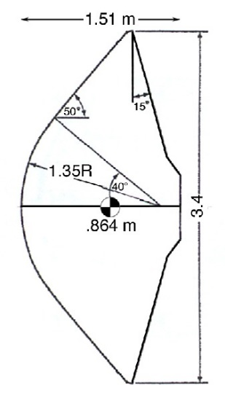
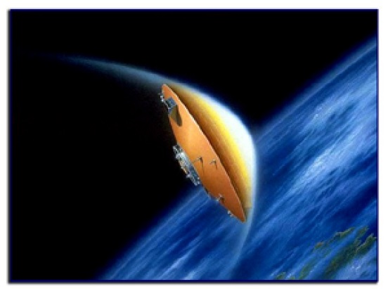
MISSION: OREX
PLANET: EARTH RETURN
LAUNCH: FEB 4, 1994
ENTRY: FEB 4, 1994
MISSION DESCRIPTION: To collect information on the design of a reentry vehicle to support Japanese unmanned space shuttle HOPE.
INSTRUMENTATION: Wall catalycity measurement, electrostatic probe, and heat shield temperature sensors.
NOTES: RCS was used to maintain a trim angle of attack of zero.
Trajectory
Geometry
Aero/thermal
TPS
Parachutes
Entry angle | Relative -3.17° | Shape | 50° sphere-cone | Velocity at peak heat | 6.4 km/s | Forebody material designation | Si Coated C-C for nose | Type | N/A
Entry velocity: inertial & relative | Inertial: 7.8 km/s Relative: 7.43 km/s | Nose radius | 1.35 m | Peak convective heating | 51 W/cm² | Forebody thickness & mass | 4 cm | Deployment method | N/A
Trim L/D (specify trim α) | 0 | Base area | 9.08 m² | Peak radiative heating | 0 | Ablating Ejected | Ablated: No Ejected: No | Reference diameter / area | N/A
Control method | RCS | Vehicle mass | 761 kg at entry | Integrated total heatload |  | TPS integration method | Tiled | Deployment mach | N/A
Ballistic co-eff. | 56 kg/m² | Payload mass | N/A | PH stag. pressure | 0.078 atm | Aftbody material designation |  | Deployment dynamic pressure | N/A
Peak deceleration |  | TPS mass fraction, inc. insul. | N/A | Peak stag. heating rate | 51 W/cm² | Aftbody thickness & mass |  | Parachute materials | N/A
— 15 —

Slide 23
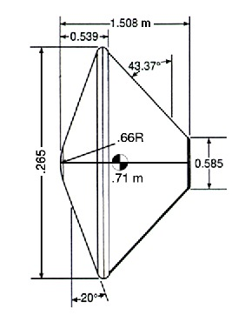

MISSION: MARS PATHFINDER
PLANET: MARS
LAUNCH: DEC 4, 1996
ENTRY: JUNE 4, 1997
MISSION DESCRIPTION: To demonstrate a simple, low-cost system for placing a science payload on the surface of Mars.
INSTRUMENTATION: TPS instrumented with thermocouples only
Rover called "Sojourner”.
NOTES: Spin stabilized.
Trajectory
Geometry
Aero/thermal
TPS
Parachutes
Entry angle | Inertial -14.06° at 130.86 km | Shape | 70° sphere-cone | Velocity at peak heat | Relative: 6.62 km/s | Forebody material designation | SLA-561 V | Type | DGB
Entry velocity: inertial & relative | Inertial: 7.26 km/s Relative: 7.48 km/s | Nose radius | 0.66 m | Peak convective heating | 100.69 W/cm² | Forebody thickness & mass | 1.9 cm | Deployment method | Mortar fired
Trim L/D (specify trim α) | Ballistic (0° average) | Base area | 5.51 m² | Peak radiative heating | ~5.27 W/cm² (with ablation) | Ablating Ejected | Ablated: yes Ejected: yes | Reference diameter / area | 12.7 m
Control method | Ballistic | Vehicle mass | At entry: 585.3 kg | Integrated total heatload | ~3834 J/cm² with ablation | TPS integration method | Honeycomb bonded to substructure; cells filled with ablative compound | Deployment mach | 1.71
Ballistic co-eff. | At peak dyn. p. : ~61.5 kg/m² | Payload mass | N/A | PH stag. pressure | ~0.19 atm | Aftbody material designation | SLA-561S | Deployment dynamic pressure | 588 Pa
Peak deceleration | 16 g | TPS mass fraction, inc. insul. | Forebody 6.2% Backshell 2% | Peak stag. heating rate | 105.96 W/cm² | Aftbody thickness & mass | 1.27 cm | Parachute materials | Nylon, polyester, Kevlar

Slide 24
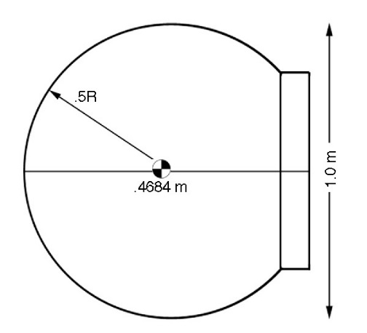
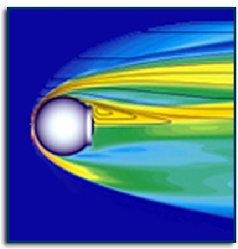
MISSION: MIRKA
PLANET: EARTH
LAUNCH: NOV 9, 1997
ENTRY: NOV 23, 1997
MISSION DESCRIPTION: To qualify a reentry heatshield concept with scientific and engineering experiments conducted by German researchers.
INSTRUMENTATION: 3 acceleration sensors, 3 angular rate sensors, 24 thermocouples, RAFLEX (pressure, temperature & heat flux sensors) and PYREX (pyrometric temperature measurements).
NOTES: CFRP: Carbon Fiber Reinforced Plastics. SPA: Surface Protected Ablator. This was the first successful Western European reentry mission.
Trajectory
Geometry
Aero/thermal
TPS
Parachutes
Entry angle | Relative: -2.51° | Shape | Spherical 1 m diameter | Velocity at peak heat | 6.51 km/s | Forebody material designation | CFRP: carbon fiber reinforced plastics SPA: surface protected ablator and fiber ceramic cover | Type | unknown
Entry velocity: inertial & relative | Inertial: separation Velocity: 7.3 km/s Relative: 7.6 km/s at 120 km | Nose radius | 0.5 m | Peak convective heating | 120 W/cm² | Forebody thickness & mass | Front: 3 cm Back: 2 cm | Deployment method
Trim L/D (specify trim α) | 0 | Base area | 0.785 m² | Peak radiative heating | 0 | Ablating Ejected | Ablated: yes Ejected: no | Reference diameter / area
Control method | Ballistic | Vehicle mass | 154 kg | Integrated total heatload | 12000 J/cm² | TPS integration method |  | Deployment mach
Ballistic co-eff. | 214 kg/m³ | Payload mass | N/A | PH stag. pressure | 0.178 atm | Aftbody material designation |  | Deployment dynamic pressure
Peak deceleration |  | TPS mass fraction, inc. insul. | 36% | Peak stag. heating rate | Peak: 120 W/cm² | Aftbody thickness & mass |  | Parachute materials
— 17 —

Slide 25
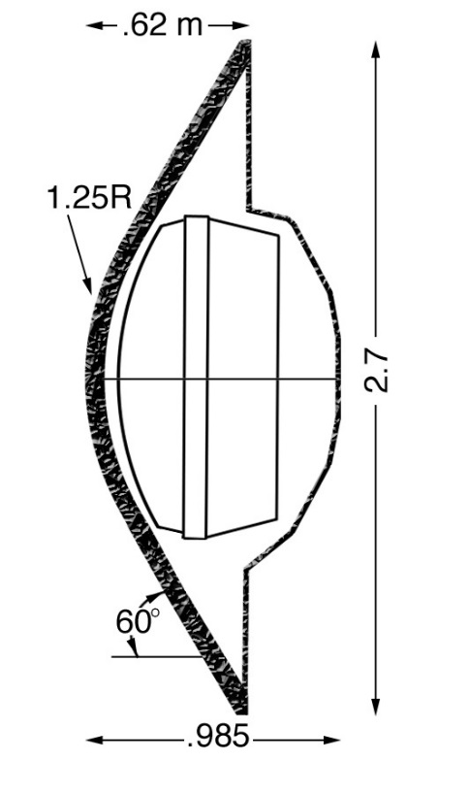

MISSION: HUYGENS
PLANET: TITAN
(A moon of Saturn)
LAUNCH: NOV 15, 1997
ENTRY: JAN 14, 2005
MISSION DESCRIPTION: To explore the atmosphere of Titan.
INSTRUMENTATION: No aeroheating data. A mass spectrometer for atmospheric composition was deployed after the heat shield was ejected.
NOTES: Huygens is a European Space Agency probe that was carried by the Cassini Saturn Orbiter. AQ60 silica fibers reinforced by phenolic resin.
Trajectory
Geometry
Aero/thermal
TPS
Parachutes
Entry angle | Relative: -65.4° Inertial: -65.5° | Shape | 60° sphere-cone | Velocity at peak heat | ~5.1 km/s | Forebody material designation | AQ60/I | Type | (1) Pilot: DGB (2) Main: DGB (3) Descent: DGB
Entry velocity: inertial & relative | Inertial: 6.0 km/s at 1270 km Relative: 6.0 km/s | Nose radius | 1.25 m | Peak convective heating | ~29.3 W/cm² | Forebody thickness & mass | At stag: 17.4 mm On flank:18.2 mm 39 kg TPS, 76 kg w/ struct. | Deployment method | (1) Mortar (2) Pilot (3) Main
Trim L/D (specify trim α) | 0 | Base area | 5.73 m² | Peak radiative heating | ~0 W/cm² | Ablating Ejected | Ablated: yes Ejected: yes | Reference diameter / area | (1) 2.6 m dia. (2) 8.3 m dia. (3) 3 m dia.
Control method | Ballistic | Vehicle mass | 320 kg | Integrated total heatload | ~1397 J/cm² | TPS integration method | Tiled | Deployment mach | (1) 1.46 (2) 1.36 (3) 0.14
Ballistic co-eff. | 34.5-37.5 kg/m² | Payload mass | 44 kg | PH stag. pressure | 0.1 atm | Aftbody material designation | Prosial | Deployment dynamic pressure | (1) 309 Pa (2) 275 Pa (3) 10 Pa
Peak deceleration | ~12 g | TPS mass fraction, inc. insul. | Forebody: 12.2% Aft: 1.64% | Peak stag. heating rate | ~29.3 W/cm² (140W/cm² design) | Aftbody thickness & mass | 0.03-0.31 cm, 5.2 kg TPS, 17 kg w/ struct. | Parachute materials | Nylon fabric Kevlar Structurals
— 18 —

Slide 26
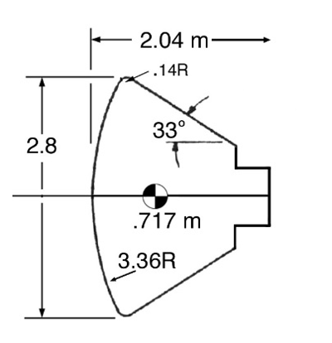
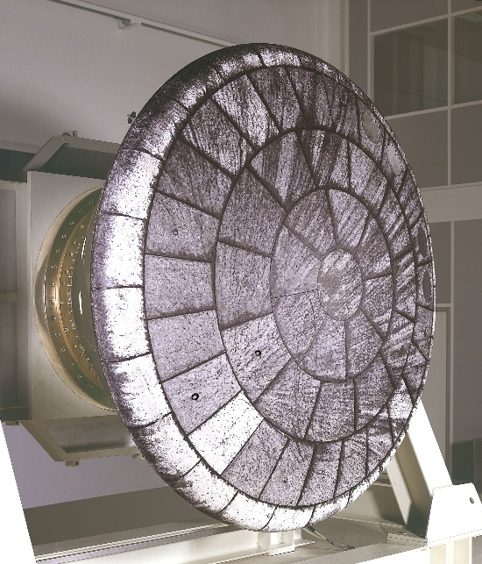
MISSION: ARD 'Atmospheric Reentry Demonstrator'
PLANET: EARTH
LAUNCH: NOV 21, 1998
ENTRY: NOV 21, 1998
MISSION DESCRIPTION: To undertake a complete space flight cycle for ESA, with emphasis on reentry technologies.
INSTRUMENTATION: The capsule afterbody was instrumented with 7 surfaces pressure sensors, 2 thermal plugs with 2 thermocouples each on the back cover, and 4 surface-mounted copper calorimeters on the cylindrical section. The front cone contained 18 pressure sensors, 14 thermal plugs with 3 or 5 TC each.
NOTES: Aleastril: silica fibers with phenolic resin; Norcoat: cork powder and phenolic resin. 4 experimental Ceramic Matrix Composite (CMC) tiles and samples of Flexible External insulation (FEI).
Trajectory
Geometry
Aero/thermal
TPS
Parachutes
Entry angle | -2.6° | Shape | Apollo-like capsule, 33° cone | Velocity at peak heat | 7.2 km/s | Forebody material designation | Aleastrasil | Type | (1) Extraction parachute (2) drogue parachute (3) 3 ringsail main parachutes
Entry velocity: Inertial & Relative | Inertial: 7.86 km/s Relative: 7.45 km/s | Nose radius | 3.36 m | Peak convective heating | 120 W/cm² | Forebody thickness & mass | 40-65 mm | Deployment Method | (1) Mortar (2) Extraction parachute (3) Drogue parachute
Trim L/D (specify trim α) | -21.2° | Base area | 6.15 m² | Peak radiative heating | ~0 W/cm² | Ablating Ejected | Ablated: yes Ejected: no | Reference diameter / area | (1) 0.9 m dia. (2) 5.8 m dia. (3) 22.9 m dia.
Control method | RCS: 7 thrusters | Vehicle mass | 2715 kg (inc.1017 kg front heat shield) | Integrated total heatload | ~24000 J/cm² | TPS integration method | Tiled | Deployment mach | ~0.8
Ballistic co-eff. | ~347 kg/m² | Payload mass | N/A | PH stag. pressure | 0.22 atm | Aftbody material designation | Norcoat 622-50FI (See note) | Deployment dynamic pressure
Peak deceleration | ~11 g | TPS mass fraction, inc. insul. | 23% (626 kg TPS) | Peak stag. heating rate | 120 W/cm² | Aftbody thickness & mass | 19 mm | Parachute materials
— 19 —

Slide 27
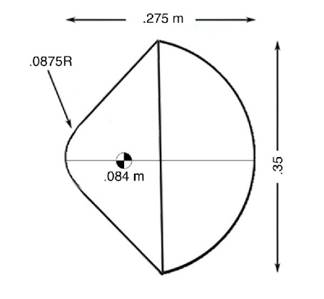

MISSION: DEEP SPACE 2
PLANET: MARS
LAUNCH: JAN 3, 1999
ENTRY: DEC 3, 1999
MISSION DESCRIPTION: To penetrate the Martian surface with two small probes.
INSTRUMENTATION:
NOTES: The DS-2 aeroshells were on the failed Mars Polar Lander.
They were to be jettisoned 5 minutes before the lander entered the Martian atmosphere. No signals from the probes were received.
Trajectory
Geometry
Aero/thermal
TPS
Parachutes
Entry angle | Inertial -13.25° at 128 km | Shape | 45° sphere-cone, spherical aft | Velocity at peak heat | 5.94 km/s | Forebody material designation | SIRCA-SPLIT | Type | N/A
Entry velocity: inertial & relative | Relative: 6.9 km/s | Nose radius | 0.0875 m | Peak convective heating | 194 W/cm² | Forebody thickness & mass | ~1 cm | Deployment method | N/A
Trim L/D (specify trim α) | 0 | Base area | 0.096 m² | Peak radiative heating | N/A | Ablating Ejected | Ablated: Ejected: no | Reference diameter / area | N/A
Control method | Ballistic | Vehicle mass | 3.67 kg | Integrated total heatload | 8712 J/cm² | TPS integration method | Monolithic | Deployment mach | N/A
Ballistic co-eff. | 36.2 kg/m² | Payload mass | N/A | PH stag. pressure |  | Aftbody material designation | FRCI: Fibrous refractory composite insulation | Deployment dynamic pressure | N/A
Peak deceleration | 12.4 g | TPS mass fraction, inc. insul. | N/A | Peak stag. heating rate | 194 W/cm² | Aftbody thickness & mass |  | Parachute materials | N/A
— 20 —

Slide 28
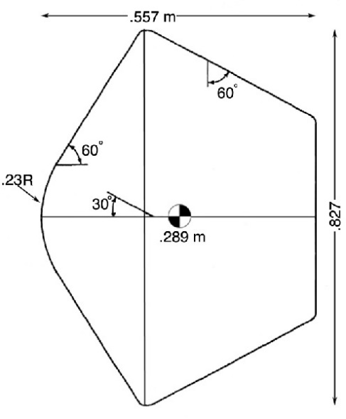
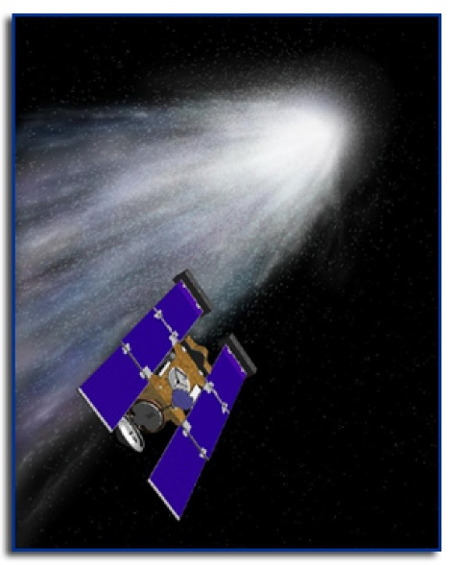
MISSION: STARDUST
PLANET: EARTH RETURN
LAUNCH: FEB 7, 1999
ENTRY: JAN 15, 2006
MISSION DESCRIPTION: To collect comet material from Wild 2 and return to Earth.
INSTRUMENTATION: Stardust has the highest successful Earth return velocity. Most heating models breakdown for Stardust. Classic Fay-Riddell is not trustworthy for Stardust.
NOTES: The rendezvous with Wild 2 occurred on Jan 2, 2004. The Stardust capsule made a successful return to Earth on Jan 15, 2006. Engineering methods and CFD disagree for heating rates. Traj. gives at stag. point 762 W/cm² peak total heat rate and 122 W/cm² peak radiative heat rate. Total heat load is 20978 J/cm².
Trajectory
Geometry
Aero/thermal
TPS
Parachutes
Entry angle | -8.23° at 134.4 km | Shape | Blunt-nosed 60° half-angle cone | Velocity at peak heat | 11.1 km/s | Forebody material designation | PICA-15 | Type | (1) Pilot: DGB (2) Main: Triconical
Entry velocity: inertial & relative | Inertial: 12.8 km/s Relative: 12.45 km/s | Nose radius | 0.23 m | Peak Convective heating | ~817 W/cm² | Forebody thickness & mass | 5.82 cm | Deployment method | (1) Mortar (2) Pilot pulled
Trim L/D (specify trim α) | 0 | Base area | 0.52 m², 0.50 m² (ablated) | Peak Radiative heating | ~71 W/cm² | Ablating Ejected | Ablated: yes Ejected: no | Reference diameter / area | (1) 0.83 m dia. (2) 7.3 m dia.
Control method | Ballistic, spin-stabilized at 14.5 rpm | Vehicle entry mass | 45.8 kg | Integrated total heatload | ~26210 J/cm² | TPS integration method | PICA: single-piece, direct bonded to substructure with HT-424 | Deployment mach | (1) 1.4m +/- 0.3
Ballistic co-eff. | 60.0 kg/m² 60.4 kg/m² (ablated) | Payload mass | N/A | PH stag. pressure | 0.22 atm | Aftbody material designation | SLA-561V | Deployment dynamic pressure | (1) 713 Pa
Peak deceleration | 32.89 | TPS mass fraction, inc. insul. | 22% | Peak stag. heating rate | ~880 W/cm² | Aftbody thickness & mass | Design: 1.397 cm | Parachute materials | Canopy: nylon, Kevlar suspension lines
— 21 —

Slide 29
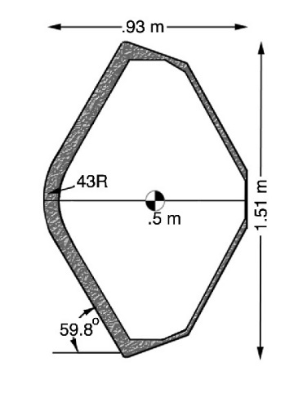
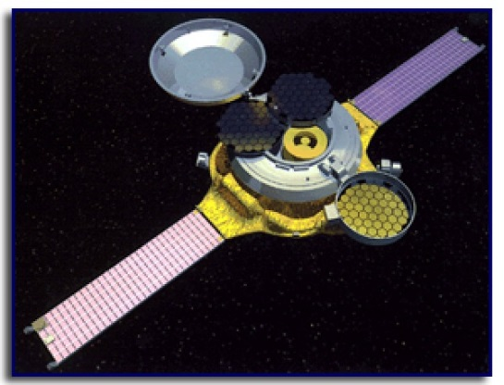
MISSION: GENESIS
PLANET: EARTH RETURN
LAUNCH: SEP 8, 2001
ENTRY: SEP 8, 2004
MISSION DESCRIPTION: To collect solar wind particles and return to Earth.
INSTRUMENTATION: Thermosensitive paint strips.
NOTES: The capsule crashed violently into the desert after failing to deploy the drag devices. Despite this mishap, many of the collectors remained intact and most of the mission goals should be accomplished.
Trajectory
Geometry
Aero/thermal
TPS
Parachutes
Entry angle | -8° | Shape | 59.81° | Velocity at peak heat | 9.2 km/s | Forebody material designation | Carbon-carbon sheet over FiberForm® | Type | (1) Pilot: DGB (2) Main: Parafoil
Entry velocity: inertial & relative | Inertial: 11.0 km/s Relative: 10.8 km/s | Nose radius | 0.43 m | Peak convective heating | 670 W/cm² | Forebody thickness & mass | 3.8 cm C-C sheet; 2.2 cm carbon FiberForm® | Deployment Method | (1) Mortar (2) Pilot parachute
Trim L/D (specify trim α) | 0 | Base area | 1.78 m² | Peak radiative heating | 30 W/cm² | Ablating Ejected | Ablated: yes Ejected: no | Reference Diameter / Area | (1) 2.07 m dia. (2) 325 m² area
Control method | Spin-stabilized aero-ballistic | Vehicle mass | 210 kg | Integrated total heatload | 16600 J/cm² | TPS integration method |  | Deployment mach | (2) ~1.4
Ballistic co-eff. | 80 kg/m³ | Payload mass | N/A | PH stag. pressure | N/A | Aftbody material designation | SLA-561V | Deployment dynamic pressure | N/A
Peak deceleration | ~25.7 g | TPS mass fraction, inc. insul. | ~18% | Peak stag. heating rate | 700 W/cm² | Aftbody thickness & mass |  | Parachute materials | Nylon fabric Kevlar structural
— 22 —

Slide 30
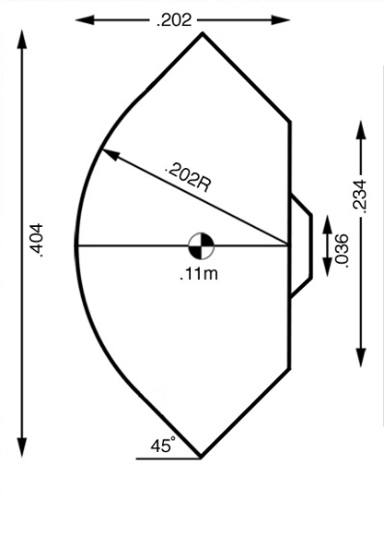
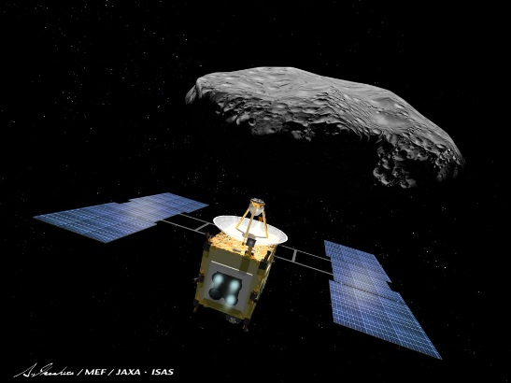
MISSION: HAYABUSA
PLANET: EARTH RETURN
LAUNCH: MAY 9, 2003
ENTRY: JUL 13, 2007
MISSION DESCRIPTION: To collect samples from asteroid Itokawa (1998SF36) and return to Earth.
INSTRUMENTATION: A one-axis accelerometer for parachute deployment.
NOTES: The mission's name was changed from MUSES-C.
Trajectory
Geometry
Aero/thermal
TPS
Parachutes
Entry angle | -12.79° @199.97 km | Shape | 45° sphere-cone | Velocity at peak heat | 10.61 km/s | Forebody material designation | Carbon-phenolic | Type | Cross-type
Entry velocity: inertial & relative | Inertial: 12.04 km/s Relative: 11.65 km/s | Nose radius | 0.202 m | Peak convective heating | 1050 W/cm² | Forebody thickness & mass | 3.0 cm | Deployment method | Mortar fired
Trim L/D (specify trim α) | 0 | Base area | 0.128 m² | Peak radiative heating | 264 W/cm² | Ablating Ejected | Ablated: yes Ejected: yes | Reference diameter / area | 2.8 m²
Control method | none | Vehicle mass | 18 kg | Integrated total heatload | 23051 J/cm² | TPS integration method | Segmented | Deployment mach | 0.8
Ballistic co-eff. | 133.72 kg/m³ | Payload mass | 1.04 kg | PH stag. pressure | 0.63 atm | Aftbody material designation | Carbon-phenolic | Deployment dynamic Pressure
Peak deceleration | ~53.36 g | TPS mass fraction, inc. insul. | 43% | Peak stag. heating rate | 1314 W/cm² | Aftbody thickness & mass | 2 cm | Parachute materials | Canopy: polyester
— 23 —

Slide 31
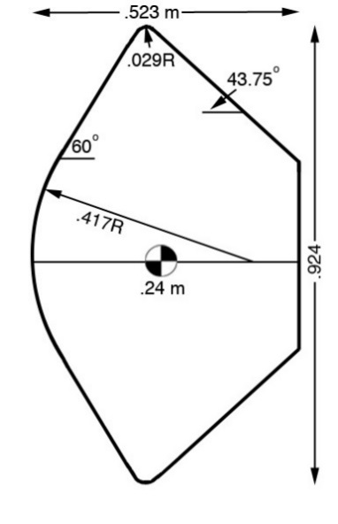
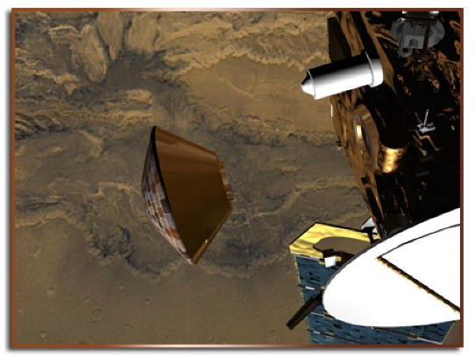
MISSION: BEAGLE 2
PLANET: MARS
LAUNCH: JUN 2, 2003
ENTRY: DEC 25, 2003
MISSION DESCRIPTION: To develop a low-cost, low-mass system for placing an exobiology science payload on Mars. Beagle 2 was transported by the European Space Agency’s 2003 Mars Express mission.
INSTRUMENTATION: No TPS instrumentation: axial accelerometers only.
NOTES: Beagle 2 landed on Mars but did not make radio contact and was never operative.
Trajectory
Geometry
Aero/thermal
TPS
Parachutes
Entry angle | Inertial: -15.8° | Shape | 60° sphere-cone | Velocity at peak heat | Relative: 4.70 km/s | Forebody material designation | Norcoat-Liege (EADS) | Type | (1) DGB pilot (2) Ringsail main
Entry velocity: inertial & relative | Inertial: 5.63 km/s Relative: 5.40 km/s | Nose radius | 0.417 m | Peak convective heating | 72.11 W/cm² | Forebody thickness & mass | 8mm | Deployment method | (1) Mortar (2) Pilot parachute
Trim L/D (specify trim α) | Ballistic (2° average) | Base area | 0.67 m² | Peak radiative heating | 0.17 W/cm² | Ablating Ejected | Ablated: yes Ejected: yes | Reference diameter / Area | (1) 3.2 m dia. (2) 10 m dia.
Control method | Ballistic | Vehicle mass | Entry: 68.46 kg | Integrated total heatload | 2449 J/cm² | TPS integration method | Tiled | Deployment mach | (1) 1.5
Ballistic co-eff. | Peak heat flux: 69.9 kg/m² | Payload mass | 11.4 kg (science) (33.2 kg landed) | PH stag. pressure | 0.18 Atm | Aftbody material designation |  | Deployment dynamic pressure | (2) 730-750 Pa
Peak deceleration |  | TPS mass fraction, inc. insul. | Forebody: 9.2% Back shell: 15.2% | Peak stag. heating rate | 72.28 W/cm² | Aftbody thickness & mass |  | Parachute materials | Nylon, Kevlar
— 24 —

Slide 32
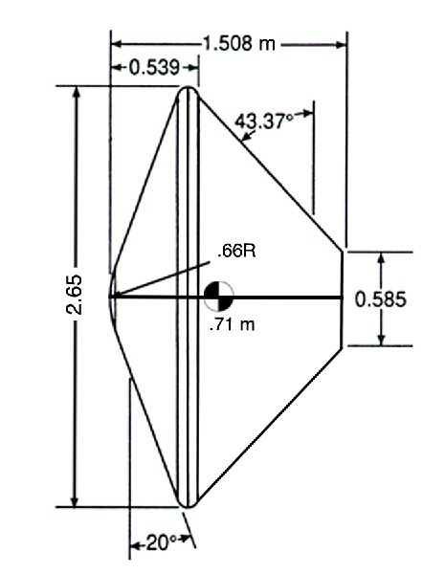
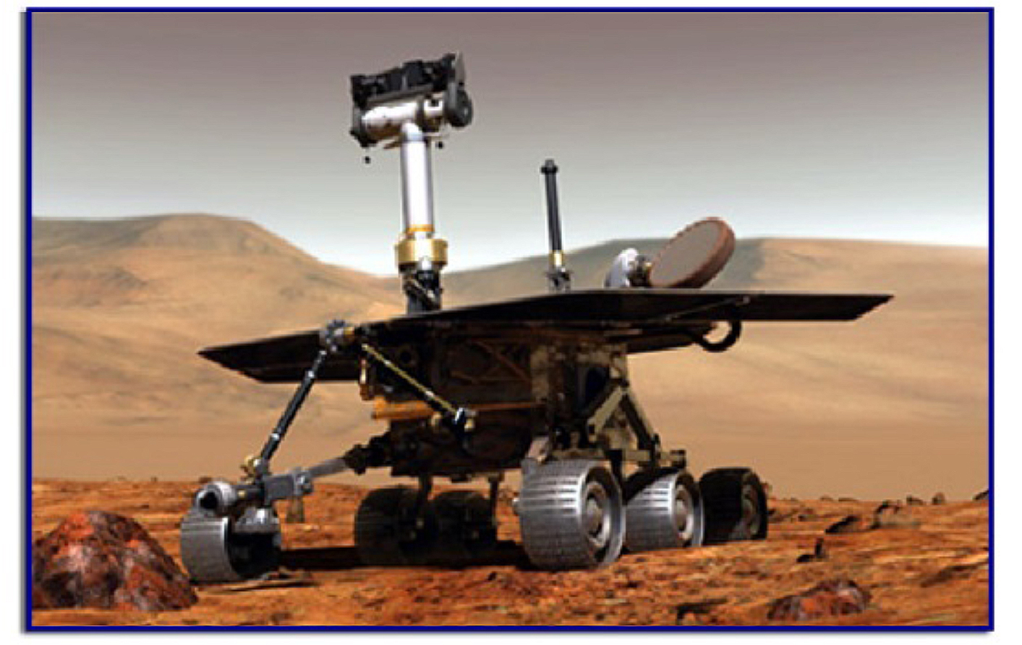
MISSION: MARS EXPLORATION ROVERS ‘SPIRIT’ AND ‘OPPORTUNITY’
PLANET: MARS
LAUNCH: JUN 10, 2003 & JUL 7, 2003
ENTRY: JAN 3, 2004 & JAN 24, 2004
MISSION DESCRIPTION: To place two rovers (A and B) on Mars to conduct
remote geological investigations including search for past water activity.
NOTES: MER A and MER B are two separate missions, each carrying a rover to Mars. Data here are for MER B, the most severe entry environment. This mission uses an entry aeroshell like that of Pathfinder, however the enclosed rovers are larger than Sojourner and are self-contained. There are 3 TIRS (Transverse Impulse Rocket System) covers made of SIRCA spaced around the backshell.
Trajectory
Geometry
Aero/thermal
TPS
Parachutes
Entry angle | -10.75° @ 126.799 km | Shape | 70° sphere-cone | Velocity at peak heat | ~4.96 km/sec | Forebody material designation | SLA-561V (SLA-561S for backshell) | Type | Single DGB
Entry velocity: inertial & relative | Inertial: 5.78 km/sec Relative: 5.39 km/sec | Nose radius | 0.66 m | Peak convective heating | ~37.72 W/cm² | Forebody thickness & mass | 1.57 cm | Deployment method | Mortar
Trim L/D (specify trim α) | 0 | Base area | 5.499 m² | Peak radiative heating | ~0 | Ablating Ejected | Ablated: Yes Ejected: Yes | Reference diameter / area | 14.1 m dia.
Control method | Ballistic, spin-stabilized | Vehicle mass | 832.2 kg | Integrated total heatload | ~3064.45 J/cm² | TPS integration method | Honeycomb bonded to substructure; cells filled with ablative compound | Deployment mach | 1.77
Ballistic co-eff. | ~88.96 kg/m² | Payload mass | ~525 kg (landed mass, rover+lander) | PH stag. pressure | 0.08 atm | Aftbody material designation | SLA-561S for backshell, backshell interface plate (BIP): SIRCA | Deployment dynamic Pressure | 765±77 Pa
Peak deceleration | ~4.78 g | TPS mass fraction, inc. insul. | Forebody: (TPS only) 3.6% Back shell: (TPS only) 2% | Peak stag. heating rate | ~37.72 W/cm² | Aftbody thickness & mass | 0.5 cm (CDR) 10.4 kg (CDR CBE) | Parachute materials | Disk: nylon fabric Band: polyester fabric Kevlar structural
— 25 —

Slide 33
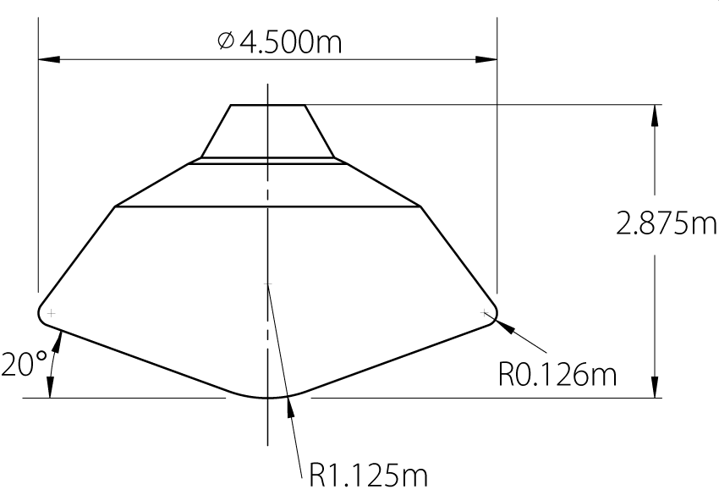
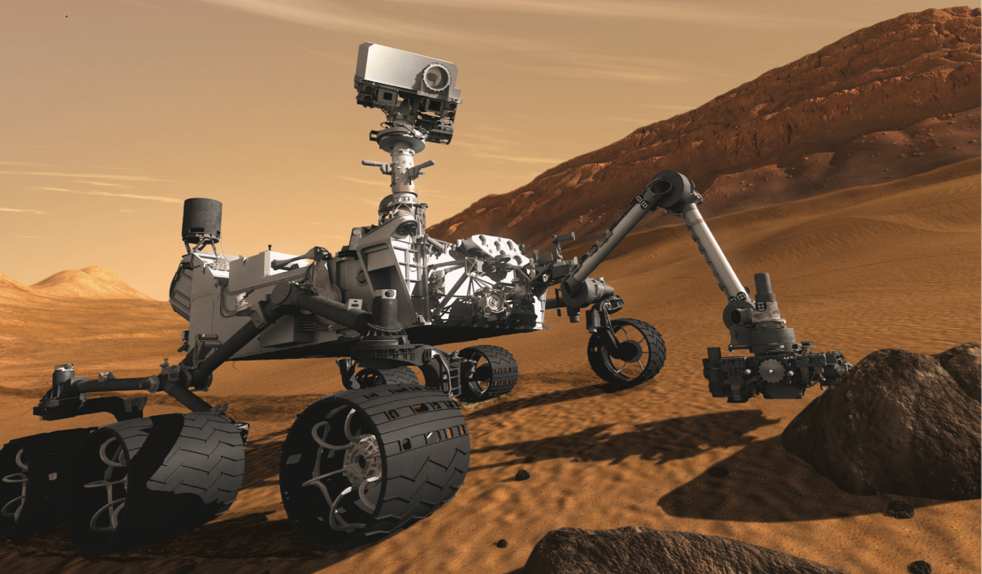
MISSION: MARS SCIENCE LABORATORY (MSL)
PLANET: MARS
LAUNCH: NOV 26, 2011
ENTRY: AUG 6, 2012
MISSION DESCRIPTION: To determine if Mars was ever able to support microbial life.
INSTRUMENTATION: 24 thermocouples, MEADS (Mars Entry Atmospheric Data System) for temperature and isotherm tracking.
NOTES:
Trajectory
Geometry
Aero/thermal
TPS
Parachutes
Entry angle | -16° | Shape | 70° sphere-cone | Velocity at peak heat | 5.33 km/s | Forebody Material designation | PICA | Type | DGB
Entry velocity: Inertial & Relative | Relative: 5.8 km/s Inertial: 6.08 km/s | Nose radius | 1.125 m | Peak convective heating | [197 W/cm²] | Forebody Thickness & mass | [3.18 cm] | Deployment Method | Mortar fired
Trim L/D (specify trim α) | 0.24 | Base area | 15.90 m | Peak radiative heating |  | Ablating Ejected | Yes | Reference Diameter / Area | 21.35 m
Control method | RCS: 8 thrusters ballast ejection | Vehicle entry mass | 3257 kg | Integrated total heatload | [5477 J/cm²] | TPS Integration method | PICA: tiled, direct bonded to substructure | Deployment mach | 1.7
Ballistic co-eff. | [146 kg/m²] | Payload mass | 75 kg | PH stag. pressure |  | Aftbody material designation | SLA-561V | Deployment dynamic pressure | 493.6 Pa
Peak deceleration | ~9.7 g | TPS mass fraction, inc. insul. |  | Peak stag. heating rate |  | Aftbody thickness & mass | [1.27 cm] | Parachute materials | Canopy: nylon, Suspension lines: Technora T221 and Kevlar 29
— 26 —

Slide 34
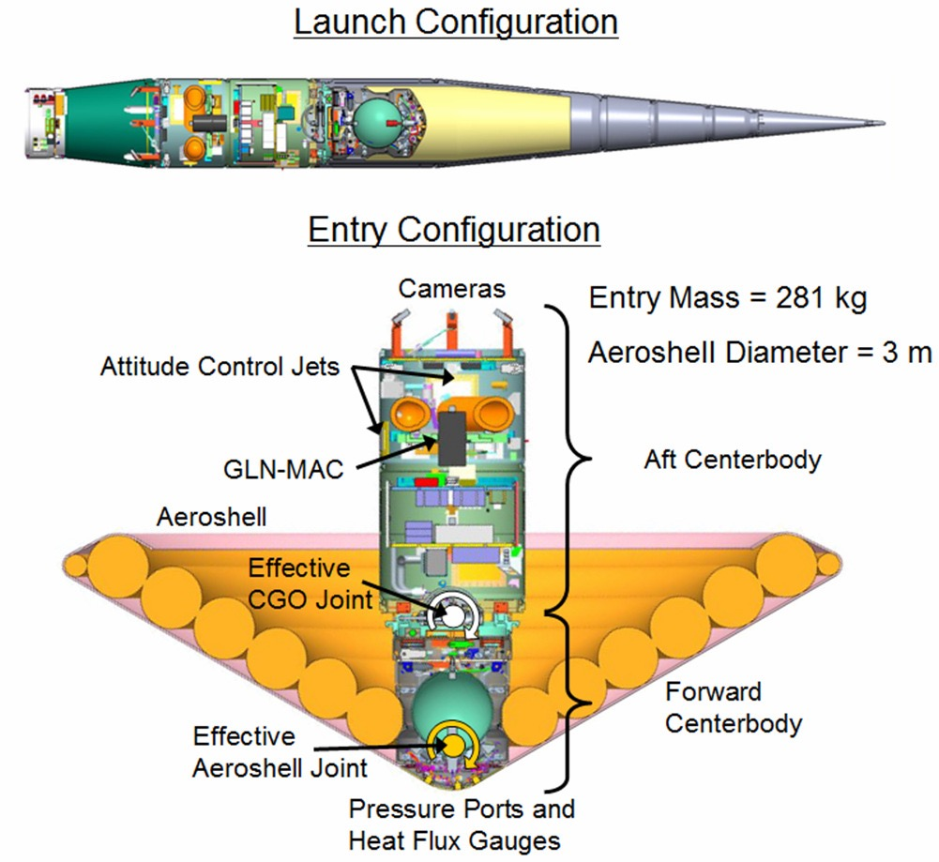
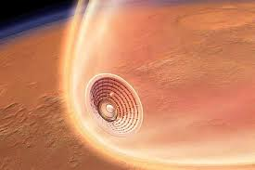
MISSION: INFLATABLE REENTRY VEHICLE EXPERIMENT-3 (IRVE-3)
PLANET: EARTH (SUBORBITAL)
LAUNCH: JUL 23, 2012
ENTRY: JUL 23, 2012
MISSION DESCRIPTION: To advance the hypersonic inflatable aerodynamic decelerator (HIAD) technology, reach higher than 12 W/cm² cold-wall heat flux on the flexible TPS, and generate aerodynamic lift, with the potential for guided entry applications.
INSTRUMENTATION:
NOTES: IRVE-3 is NASA's second successful flight test of Hypersonic Inflatable Aerodynamic Decelerator (HIAD).
Trajectory
Geometry
Aero/thermal
TPS
Parachutes
Entry angle | -74° | Shape | 60° half angle sphere-cone | Velocity at peak heat | Mach 7.3 | Forebody Material designation | Nextel BF-20 | Type | N/A
Entry velocity: inertial & relative | Relative: 2.7 km/s | Nose radius | 0.191 m | Peak convective heating | 14 W/cm² (cold wall) | Forebody Thickness & mass | 0.6 cm | Deployment method | N/A
Trim L/D (specify trim α) | 0.2 (max.) at 16° | Base area | 7.07 m² | Peak radiative heating | 0 | Ablating Ejected | Flexible | Reference diameter / area | N/A
Control method | Cold argon gas pre-entry alignment, roll control during entry. Movable radial mass offset entry. | Vehicle entry mass | 281 kg | Integrated total heatload | 193 J/cm² (cold wall) | TPS Integration method | Sewn fabric | Deployment mach | N/A
Ballistic co-eff. | 58 kg/m² | Payload mass | N/A | PH stag. pressure | 1 psia | Aftbody material designation | N/A | Deployment dynamic pressure | N/A
Peak deceleration | 20.2 g | TPS mass fraction, inc. insul. | 0.20 | Peak stag. heating rate |  | Aftbody thickness & mass | N/A | Parachute materials | N/A
— 27 —

Slide 35
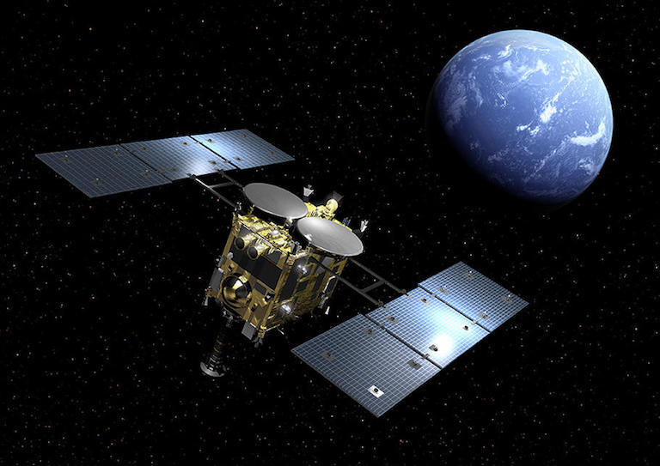

MISSION: HAYABUSA 2
PLANET: EARTH RETURN
LAUNCH: DEC 3, 2014
ENTRY:DEC 5, 2020
MISSION DESCRIPTION: To collect samples from asteroid RYUGU (1999JU3) and return to Earth.
INSTRUMENTATION: A one-axis accelerometer of parachute deployment REMM(Reentry Flight Measurement Module) which measures and records the heatshield temperature, the acceleration and the attitude motion of SRC during the reentry.
NOTES:
Trajectory
Geometry
Aero/thermal
TPS
Parachutes
Entry angle | -12.06° | Shape | 45° sphere-cone | Velocity at peak heat | ~10.5 km/s | Forebody material designation | Carbon-phenolic | Type | Cross-Type
Entry velocity: inertial & relative | Inertial: 11.84 km/s Relative: 11.58 km/s | Base radius Nose radius | 0.202 m | Peak convective heating | ~1110 W/cm² | Forebody thickness & mass |  | Deployment method | Mortar fired
Trim L/D (specify trim α) | 0 | Base area | 0.128 m² | Peak radiative heating | ~180 W/cm² | Ablating Ejected | Ablated: yes Ejected: no | Reference diameter / area | 2.8 m²
Control method | None | Vehicle entry mass | 16.03 kg | Integrated total heatload | ~27000 J/cm² | TPS integration method | Segmented | Deployment mach | Subsonic
Ballistic co-eff. | 113.5 kg/m³ | Payload mass | 1.13 kg | PH stag. pressure | ~0.44 atm | Aftbody material designation | Carbon-phenolic | Deployment dynamic pressure | < 2kPa
Peak deceleration | 46.3 g | TPS mass fraction, inc. insul. |  | Peak stag. heating rate |  | Aftbody thickness & mass | 2 cm | Parachute materials | Canopy: polyester
— 28 —

Slide 36
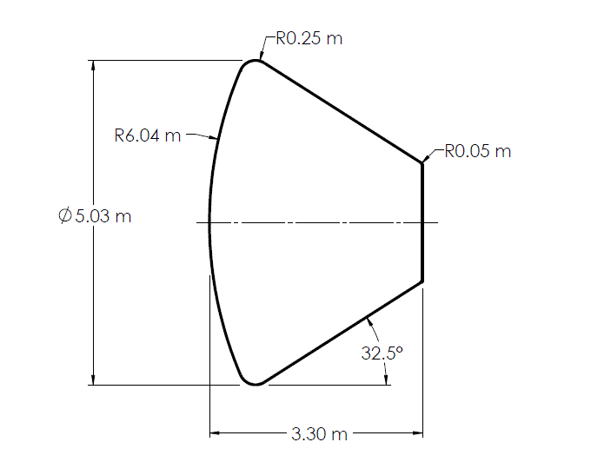
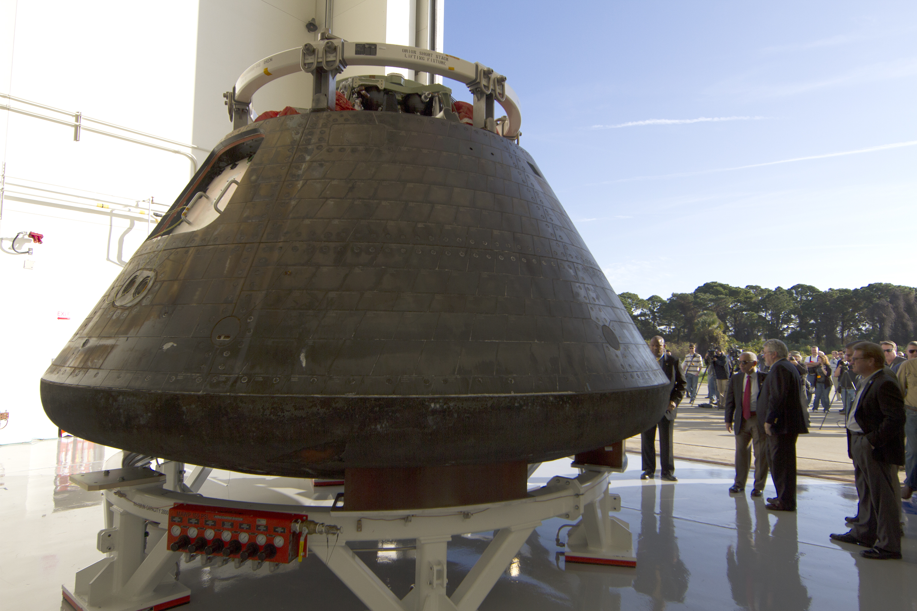
MISSION: EXPLORATION FLIGHT TEST-1
PLANET: EARTH RETURN
LAUNCH: DEC 5, 2014
ENTRY: DEC 5, 2014
MISSION DESCRIPTION: To flight test Orion through two orbits of Earth with observation of radiation stresses and orbit debris environment.
INSTRUMENTATION: 2 broadband radiometers.
NOTES: Aerothermal values are margined.
Trajectory
Geometry
Aero/thermal
TPS
Parachutes
Entry angle | -12.6° | Shape | Spherical | Velocity at peak heat | ~7.53 km/s | Forebody material designation | Avcoat | Type | (1) Drogue = VPCRibbon 2x (2) Pilot = VPCRibbon 3x (3) Main = Ringsail 3x
Entry velocity: inertial & relative | Inertial: 8.5 km/s Relative: 8.9 km/s | Nose radius | 6.035 m | Peak convective heating | Flown:170 W/cm² [Design: 400W/cm²] | Forebody thickness & mass | Var. thick 2.5-4cm ~454 kg | Deployment method | (1) Mortar drogue (2) Mortar pilot (3) Pilot main
Trim L/D (specify trim α) | 0.25 | Base area | 19.8 m² | Peak radiative heating | Flown: 15 W/cm² [Design: 50 W/cm²] | Ablating Ejected | Ablated: yes Ejected: no | Reference diameter / area | (1) 7.0 m dia. (2) 3.0 m dia. (3) 35.4 m dia.
Control method | RCS Thrusters | Vehicle entry mass | 9611 kg | Integrated total heatload | ~250 MJ/m² | TPS integration method | Honeycomb bonded to substructure; cells filled with ablative compound | Deployment mach | (1) 0.42 (2) 0.17
Ballistic co-eff. | 360 kg/m² (C_{D} = 1.4 at EI+50 sec.) | Payload mass | Minimal | PH stag. pressure | ~0.56 atm | Aftbody material designation | RCG coated AETB-8 | Deployment dynamic pressure | (1) ~5746 Pa (2) ~1915 Pa
Peak deceleration | ~3.2 gs | TPS mass fraction, inc. insul. | Fore: 4.7% Aft: 1.2% | Peak stag. heating rate |  | Aftbody thickness & mass | Var. thick 2.5-4.2 cm ~120 kg | Parachute materials | Nylon and Kevlar
— 29 —

Slide 37
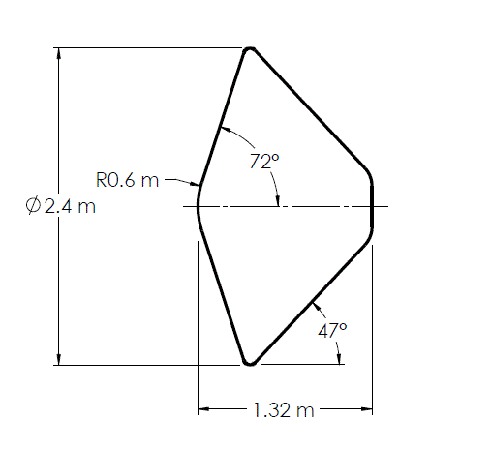
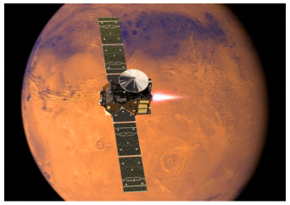
MISSION: EXOMARS 2016
PLANET: MARS
LAUNCH: MAR 14, 2016
ENTRY: OCT 19, 2016
MISSION DESCRIPTION: To search for signs of past life on Mars.
INSTRUMENTATION: 21 thermocouples, 4 pressure sensors, accelerometer, 3 COMARS+ units.
NOTES: ExoMars 2016 mission comprised of a trace gas orbiter and the Schiaparelli ExoMars EDL demonstrator module. An anomaly in the measurement and navigation sequence resulted in the Schiaparelli module crash-landing on the surface of Mars.
Trajectory
Geometry
Aero/thermal
TPS
Parachutes
Entry angle | -12.43° | Shape | 47° blunted-nose conical backshell 70° sphere-cone front shield | Velocity at peak heat | ~ 5 km/s | Forebody material designation | Norcoat-Liège | Type | DGB
Entry velocity: inertial & relative | Relative: 5.83 km/s | Nose radius | 0.6 m | Peak convective heating | ~ 50 - 70 W/cm² | Forebody thickness & mass | 0.8 to 1.8 cm 80 kg (incl. frontshield structure) | Deployment method | Mortar fired
Trim L/D (specify trim α) |  | Base area | 4.52 m² (2.4 m dia. heatshield) | Peak radiative heating | ~ 9 W/cm² | Ablating Ejected | Ablated: yes Ejected: yes | Reference diameter / area | 12 m dia.
Control method |  | Vehicle entry mass | 577 kg | Integrated total heatload |  | TPS integration method | Tiled | Deployment mach | 0.45
Ballistic co-eff. | 74.6 kg/m² | Payload mass | ~ 5 kg science; ~280 kg EDM Lander | PH stag. pressure | ~ 0.11 atm | Aftbody material designation | Norcoat-Liège over AI honeycomb | Deployment dynamic pressure
Peak deceleration |  | TPS mass fraction, inc. insul. | 0.17 | Peak stag. heating rate |  | Aftbody thickness & mass | 1.5 cm, 20 kg with substructure | Parachute materials | Nylon, Kevlar
— 30 —

Slide 38
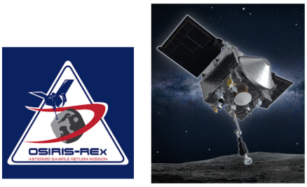
MISSION: OSIRIS-REX
PLANET: EARTH RETURN
LAUNCH: SEPT 8, 2016
ENTRY: PLANNED FOR
SEPT 24, 2023
MISSION DESCRIPTION: To return and analyze samples from asteroid Bennu (1999RQ36) and return to Earth.
INSTRUMENTATION:
NOTES: The OSIRIS-REx capsule outer geometry and TPS are
build-to-print based on the Stardust capsule.
Trajectory
Geometry
Aero/thermal
TPS
Parachutes
Entry angle | [-8.2°] | Shape | Blunt-nosed 60° half-angle once | Velocity at peak heat | 11.1 km/s | Forebody material designation | PICA-15 | Type | (1) Pilot: DGB (2) Main: Triconical
Entry velocity: inertial & relative | Relative: [12.2 km/s] | Nose radius | 0.23 m | Peak convective heating | [1070 W/cm²] | Forebody thickness & mass | 5.82 cm | Deployment method | (1) Mortar (2) Pilot parachute
Trim L/D (specify trim α) | 0 | Base area | 0.52 m² | Peak radiative heating | [130 W/cm²] | Ablating Ejected | Ablated: yes Ejected: no | Reference diameter / area | (1) 0.83 m dia. (2) 7.3 m dia.
Control method | Ballistic, spin-stabilized at 13 rpm | Vehicle entry mass | ~46 kg | Integrated total heatload | [36000 J/cm²] | TPS integration method | PICA: single-piece, direct bonded to substructure with HT-424 | Deployment mach | (1) [1.3] (2) [0.12]
Ballistic co-eff. | ~71 kg/m² | Payload mass | N/A | PH stag. pressure | [0.22 atm] | Aftbody material designation | SLA-561V | Deployment dynamic pressure | (1) ~1350 Pa (2) ~700 Pa
Peak deceleration | ~32 g's | TPS mass fraction, inc. insul. | 0.22 | Peak stag. heating rate | [1200 W/cm²] | Aftbody thickness & mass | [1.397 cm] | Parachute materials | Canopy: Nylon, Kevlar suspension lines
— 31 —

Slide 39
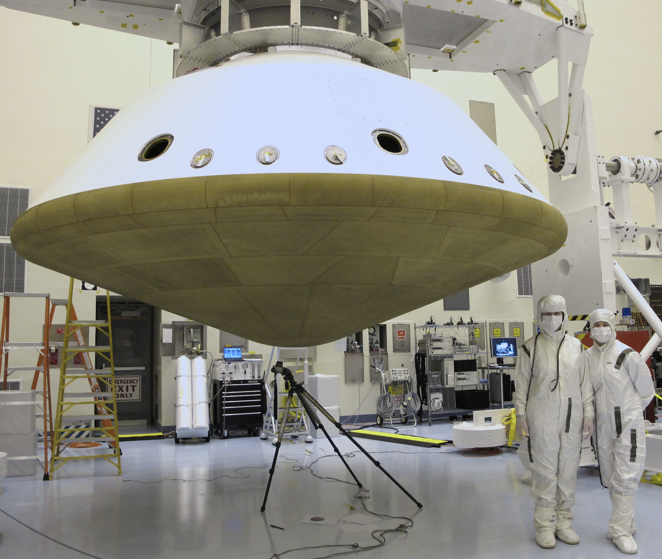
MISSION: MARS2020
PLANET: MARS
LAUNCH: JUL 30, 2020
ENTRY: FEB 18, 2021
MISSION DESCRIPTION: Seek signs of ancient life and collect samples of rock and regolith (broken rock from soil) for possible return to Earth.
INSTRUMENTATION: MEADS (Mars Entry Atmospheric Data System): 1 hypersonic heatshield pressure transducer, 6 supersonic heatshield pressure transducers, 1 low pressure transducer on backshell. MISP (MEDLI2 Instrumented Sensor Plugs): 11 PICA heatshield plugs with 1-3 embedded TCs, 6 SLA-561V plugs on backshell with 1-2 embedded TCs, and 3 direct heat flux sensing elements on backshell (2 total heat flux gauges and 1 radiometer).
NOTES:
Trajectory
Geometry
Aero/thermal
TPS
Parachutes
Entry angle | Relative: -16.18° | Shape | 70° sphere-cone | Velocity at peak heat (PH) | 4880 m/s | Forebody material designation | PICA | Type | DGB
Entry velocity: inertial & relative | Relative: 5.33 km/s at 128.2 km | Nose radius | 1 m | Peak convective heating | 68.4 W/cm² | Forebody thickness & mass | [3.18 cm] [212 kg] | Deployment method | Mortar fired
Trim L/D (specify trim α) | 0.248 at -16.71° | Base area | 15.9 m² | Peak radiative heating | ~0 W/cm² | Ablating Ejected | Ablated: yes Ejected: yes | Reference diameter / area | 21.5 m
Control method | RCS: 8 thrusters ballast ejection | Vehicle entry mass | 3317.3 kg | Integrated total heatload | 1672.5 J/cm² | TPS integration method | PICA: tiled, direct bonded to substructure | Deployment mach | 1.81
Ballistic co-eff. | 143.2 kg/m² | Payload mass | 1022.8 kg | PH stag. pressure | 24 kPa | Aftbody material designation | SLA-561V | Deployment dynamic pressure | 519.6 Pa
Peak deceleration | 10.73 g | TPS mass fraction, inc. insul. | Fore: [6.4%] Aft: [1.9%] | Peak stag. heating rate | 68.4 W/cm² | Aftbody thickness & mass | [1.27 cm] [64 kg] | Parachute materials | Canopy: Nylon, Suspension lines: Technora T221 and Kevlar 29
— 32 —

Slide 40
APPENDIX I List of Space Vehicles and Their Missions Unmanned Planetary Probes
For a complete list of deep space exploration go to www.nasa.gov –> Downloads –> History E-books –> Beyond Earth: A Chronicle of Deep Space Exploration.
History e-Books | NASA
APPENDIX II Definitions
Entry angle
The angle between the local horizontal plane (orthogonal to the vector from the planet center to the vehicle) and the velocity vector of the vehicle, V, at a reference altitude, h. The entry angle can be inertial or relative, depending on entry velocity used. Y is negative when V, is below the horizontal plane, as in planetary entry.
Entry velocity inertial
The vehicle velocity at reference altitude, h, assuming a non-rotating planet.
Entry velocity relative
The inertial entry velocity amended by the component of the planet’s rotation, assuming the atmosphere to be a solid body.
Trim L/D
The L/D where vehicle is statically stable. The vehicle will trim (restore) to trim angle of attack if variations occur.
Control method
(a) Ballistic: no control, subject to drag forces only, with passive stability about zero lift condition; (b) Controlled Ballistic: active control to maintain zero lift; and (c) RCS: a set of small engines called the reaction control system (RCS) engines.
Ballistic coefficient
The ratio of the product of drag coefficient (Cd) and projected reference area (A) to mass (m), giving m/CdA.
Peak deceleration
Maximum deceleration force on the vehicle during entry, stated in Earth gravity, g.
Shape
All vehicles are spherically blunted cones, or spherical, or conical.
Nose radius
The radius of the spherical nose, or the capsule radius.
Base area
The total apparent or drag area projected along the centerline.
Vehicle entry mass
The total vehicle mass of the vehicle at entry, including TPS and payload. Generally, the vehicle mass at entry is the same as take-off mass minus any fuel used for maneuvering. However, the mass can change after leaving the orbiter but before entry. An example is the small probe of Pioneer Venus where the spin yo-yo was jettisoned before entry. The mass can also change during entry if the heat shield material ablates. An (extreme) example was the Galileo probe that lost about 26% of its entry mass to ablation.
Payload mass
The proportion of payload mass (scientific instruments and may include transmitters, batteries etc.) to vehicle mass. For missions with landed payloads and eject-able heatshields/backshells, this is total mass of the vehicle carried within the entry system.
— 33 —

Slide 41
TPS mass fraction
The proportion of TPS mass to vehicle mass at entry. Insulator may or may not be included.
Velocity at peak heat (PH)
The velocity when the vehicle reaches the maximum convective heat flux at the stagnation point.
Peak convective heating
The maximum convective heat flux at the leading edge stagnation point. Depends on trajectory. The stagnation point is a point in the flowfield where the local velocity of the fluid is zero. Location depends on angle of attack and deviation behind the shock. The “peak convective heating” (peak convective heat flux) is often at the entry vehicle’s leading edge stagnation point, but not always.
Peak radiative heating
The maximum radiative heat flux at the leading edge stagnation point. Depends on trajectory. The stagnation point is a point in the flowfield where the local velocity of the fluid is zero. Location depends on angle of attack and deviation behind the shock. The “peak radiative heating” (peak radiative heat flux) is often at the entry vehicle’s leading edge stagnation point, but not always.
Integrated total heat load
The convective heat flux integrated over flight time. The highest heat load is usually, but not always, at the stagnation point. The integrated heat load will vary over the vehicle surface.
Peak heat (PH) stagnation pressure
The pressure at the time of maximum convective heat flux. This is not the peak pressure, which occurs later in the trajectory.
Peak stag. heating rate
The maximum combined convective and radiative heating rate during the trajectory. Peak convective stagnation point heating seldom occurs at the same time as peak radiative stagnation point heating, therefore, not the simple sum of those values unless one is zero. Peak radiative heating rate (if nonzero) always occurs before peak convective heating rate.
Forebody material designation
This can be a material trade name, defined by the manufacturer (e.g., SLA-561V) or a generic designator applied to a class of materials (e.g., carbon phenolic). It provides little useful information about the material
other than a broad description of its constituents.
Forebody thickness & mass
This is “as manufactured” thickness of the material, usually specified at the stagnation point. Useful for a TPS of uniform thickness; less useful for a “tailored” TPS. The “as manufactured” thickness includes the “nominal design thickness” to which additional thickness is added (margin) to accommodate uncertainties in the entry environment and/or material performance.
Ablating / Ejected
Information on whether the forebody TPS material experienced or was designed for ablating. Ejected refers to whether the vehicle was designed to eject the forebody TPS.
TPS integration method
Details on TPS integration method with the supporting substructure. Examples are single piece, direct bonded to substructure; cells filled with ablative compound.
Aftbody material designation
This can be a material trade name, defined by the manufacturer (e.g./ SLA-561V) or a generic designator applied to a class of materials (e.g., carbon phenolic). It provides little useful information about the material other than a broad description of its constituents.
Aftbody thickness & mass
This is “as manufactured” or “as flown” thickness of the material. Descriptions vary by mission, since a common reference point for a thickness specification, such as the stagnation point, doesn’t exist.
Parachute: Type
General parachute design type descriptor for decent or recovery parachutes. Examples include Cross Type, Ringsail, or Disk-Gap-Band (DGB).
Deployment method
Method for releasing parachute system during descent/ entry. An example is mortar fired.
— 34 —

Slide 42
Reference diameter / area
Number to generate reference area, or calculated from reference area of the decelerator, used as a common size reference for interpreting decelerator aerodynamic properties.
Deployment mach
Local Mach number at the time of parachute deployment.
Deployment dynamic pressure
The measured/ calculated dynamic pressure at the forebody at the time of deployment (similar to Mach number).
Parachute materials
Description of parachute materials used for construction, including canopy and suspension lines when possible. Examples include nylon, polyester, and Kevlar.
APPENDIX III Unit Conversion Factors
1 cm = 0.3937 in
1 m = 3.28084 ft
1 m² = 10.764 ft²
1 km/s = 3280.8 ft/s
1 g =. 9.81 m/s²
1 kg = 2.20462 lb
1 kg/m² = 0.2048 lb/ft²
1 kg/m³ = 0.06243 lb/ft³
1 Joule = 0.9478x10^{–3} BTU
1 Watt = 1 J/s = 0.9478x10^{–3} BTU/s
1 J/cm² = 0.88055 BTU/ft²
1 W/cm² = 0.88055 BTU/s*ft²
1 atm = 1.01325x105 Pa
APPENDIX IV References
Mission: FIRE II
1. Cauchon, D.V.: Radiative Heating Results from the Fire II Flight Experiment at a Re-entry Velocity of 11.4 km/s. NASA-TM-X-1402, Jul 1967.
2. Cornette, E.S.: Forebody Temperatures and Calorimeter Heating Rates Measured during Project Fire II Re-entry at 11.35 km/s. NASA-TM-X-1305, Nov 1996.
3. Slocumb, T.H.: Project Fire Flight II Afterbody Temperatures and Pressures at 11.35 km/s. NASA-TM-X-1319, Dec 1966.
4. Wright, M.; Loomis, M.; and Papadopoulos, P.: Aerothermal Analysis of the Project Fire II Afterbody Flow. AIAA-2011-3065, 35th Thermophysics Conference, Anaheim Ca, Jun 2011
Collected by: Trajectory Data Verified by: Traj Ver 17.06, Gary A Allen, Jr., 22 Feb 2019
Mission: Apollo AS-201
1. Lee, D.B.; Bertin, J.J.; and Goodrich, W.D.: Heat Transfer and Pressure Measurements Obtained During Apollo Orbital Entries. NASA-TN-D-6028, Oct 1970.
2.Erb, R.B.; Greeshields, D.H.; Lee, D.B.; and Weston, K.C.: Aerothermodynamics-Apollo Experience. Proceedings of the 1967 Heat Transfer and Fluid Mechanics Institute, San Diego CA, Jun 1967, edited by P.A Libby; D.B. Olfe; and C.W. Van Atta, Stanford University Press, 1967.
3. Lee D.B.; Apollo Experience Report: Aerothermodynamics Evaluation. NASA-TN-6843, Jun 1972.
4. North American Aviation Inc. Space and Information Systems Division, Aerodynamic Data Manuel for Project Apollo, NAS 9-150, Accession No. 07499-65, Feb 1966.
Mission: Apollo AS-202 (Apollo-3)
1. Lee, D.B.; Bertin, J.J.; and Goodrich, W.D.: Heat Transfer and Pressure Measurements Obtained During Apollo Orbital Entries. NASA-TN-D-6028, Oct 1970.
2. Hillje, E.R.: Entry Flight Aerodynamics from Apollo Mission AS-202. NASA-TN0#04185, Dec 1967.
3. Erb, R.B.; Greenshields, D.H.; Lee, D.B.; and Weston, K.C.: Aerothermodynamics-Apollo Experience. Proceedings of the 1967 Heat Transfer and Fluid Mechanics Institute, San Diego CA, Jun 1967, edited by P.A. Libby; D.B. Olfe; and C.W. Van Atta, Stanford University Press, 1967.
4. Crowder, R.S.; and Moote, J.D.: Apollo Entry Aerodynamics. Journal of Spacecraft and Rockets, Vol 6, No 3, Mar 1969.
— 35 —

Slide 43
Mission: Apollo AS-501 (Apollo-4)
1. Hillje, E.R.; and Savage, R.: Status of Aerodynamic Characteristics of the Apollo Entry Configuration. AIAA-1968-1143, Entry Vehicle Systems and Technology Meeting, Williamsburg VA, Dec 1968.
2. Hillje, E.R.: Entry Aerodynamics at Lunar Return Conditions Obtained from the Flight of Apollo 4 (AS-501). NASA-TN-D-5399, Oct 1969.
3. Reid, R.C., Jr; Rochelle, W.C.; and Milhoan, J.D.: Radiative Heating to the Apollo Command Module: Engineering Prediction and Flight Measurement. NASA-TM-X-58091, Apr 1972.
Mission: Apollo AS-502 (Apollo-6)
1. Hillje, E.R.; and Savage, R.: Status of Aerodynamic Characteristics of the Apollo entry Configuration. AIAA-1968-1143, Entry Vehicle Systems and Technology Meeting, Williamsburg VA, Dec 1968.
2. Lee, D.B.; and Goodrich, W.D.: The Aerothermodynamic Environment of the Apollo Command Module During Superorbital Entry. NASA-TN-D-6792, Apr 1972.
3. Strouhal, G.; Curry, M.; and Janney, J.M.: Thermal Protection System Performance of the Apollo Command Module. AIAA/ASME 7th Structures and Materials Conference, Cocoa Beach FL, Apr 1966.
4. Bartlett, E.P.; Nicolet, W.E.; Abbett, M.J.; and Moyer C.B.: Improved Heat-Shield Design Procedures for Manned Entry Systems: Part 2. Application to Apollo: Final Report. NASA-CR-108689, Jun 1970.
Mission: Reentry F
1. Write, R, L.; and Zoby, E.V.: Flight Measurements of Boundary-Layer Transition on a 5 Degree Half-Angel Cone at a Free-Stream Mach Number of 20 (Reentry F). NASA-TM-X-2253, May 1971.
Mission: PAET
1. Vojvodich, N.S.: PAET Entry Heat Protection Experiment. Journal of Spacecraft and Rockets, Vol 10, No 3, Mar 1973, pp 181-189.
2. Seiff, A.; Reese, D.E.; Sommer, S.C.; Kirk, D.B.; Whiting, E.E.; and Niemann, H.B.: PAET, An Entry Probe Experiment in Earth's Atmosphere. ICARUS, Vol 18, Apr 1973, pp 525-563
Mission: Viking Lander 1
1. Inogoldby, R.N.; Michael, F.C.; Flaherty, T.M.; Doty, M.G.; Preston, B.; Villyard, K.W.; and Steele, R.D.: Entry Data Analysis of Viking Landers 1 and 2: Final Report. Martin-Marietta Co., TN-3770218, NASA-CR-159388, Nov 1976.
2. Kirk, D.B.; Intrieri, P.F.; and Seiff, A.: Aerodynamics Behaviour of the Viking Entry Vehicle: Ground Test and Flight Results. Journal of Spacecraft and Rockets, Vol 156, No 4, Jul-Aug 1978.
3. Viking '75 Project, Aerodynamics Data Book. NAS1-9000, Martin-Marietta, Revision E, 1974.
4. Cooley, C.G: Viking 75 Project: Viking Lander System, Primary Mission Performance Report. NASA-CR-145148, Apr 1977. 4. Edquist, K.T.; Wright, M.J.; and Allen Jr., G.A.: Viking Afterbody Heating Computations and Comparisons to Flight Data. AIAA-2006-386, 44th Aerospace Sciences Meeting, Reno, NV, Jan 2008.
Mission: Viking Lander 2
1. Inogoldby, R.N.; Michael, F.C.; Flaherty, T.M.; Doty, M.G.; Preston, B.; Villyard, K.W.; and Steele, R.D.: Entry Data Analysis of Viking Landers 1 and 2: Final Report. Martin-Marietta Co., TN-3770218, NASA-CR-159388, Nov 1976.
2. Kirk, D.B.; Intrieri, P.F.; and Seiff, A.: Aerodynamics Behaviour of the Viking Entry Vehicle: Ground Test and Flight Results. Journal of Spacecraft and Rockets, Vol 156, No 4, Jul-Aug 1978.
3. Viking '75 Project, Aerodynamics Data Book. NAS1-9000, Martin-Marietta, Revision E, 1974.
4. Cooley, C.G: Viking 75 Project: Viking Lander System, Primary Mission Performance Report. NASA-CR-145148, Apr 1977.
Pioneer-Venus: Small ’North Probe’
1. Nolte, L.J.; and Sommer, S.C.: Probing a Planetary Atmosphere: Pioneer-Venus Spacecraft Description. AIAA-1975-1160, Conference on the Exploration of the Outer Planets, St. Louis Mo, Sep 1975.
2. Pioneer-Venus Large and Small Probe Databook, Bendix, NAS2-830Q, Jun 1976.
3. Entry vector based upon a letter by Charles F. Hall, 21 Mar 1979.
4.Allen, G.: Trajectory and Heating calculated using TRAJ Code, private communication, Mar 2003.
— 36 —

Slide 44
Pioneer-Venus: Small ’Night Probe’
1. Nolte, L.J.; and Sommer, S.C.: Probing a Planetary Atmosphere: Pioneer-Venus Spacecraft Description. AIAA-1975-1160, Conference on the Exploration of the Outer Planets, St. Louis Mo, Sep 1975.
2. Pioneer-Venus Large and Small Probe Databook, Bendix, NAS2-830Q, Jun 1976.
3. Allen, G.: Trajectory and Heating calculated using TRAJ Code, private communication, Mar 2003.
Pioneer-Venus: Small 'Day Probe'
1. Nolte, L.J.; and Sommer, S.C.: Probing a Planetary Atmosphere: Pioneer-Venus Spacecraft Description. AIAA-1975-1160, Conference on the Exploration of the Outer Planets, St. Louis Mo, Sep 1975.
2. Pioneer-Venus Large and Small Probe Databook, Bendix, NAS2-830Q, Jun 1976.
3. Entry vector based upon a letter by Charles F. Hall, 21 Mar 1979.
4. Allen, G.: Trajectory and Heating calculated using TRAJ Code, private communication, Mar 2003.
Pioneer-Venus: Large Probe 'Sounder'
1. Nolte, L.J.; and Sommer, S.C.: Probing a Planetary Atmosphere: Pioneer-Venus Spacecraft Description. AIAA-1975-1160, Conference on the Exploration of the Outer Planets, St. Louis Mo, Sep 1975.
2. Pioneer-Venus Large and Small Probe Databook, Bendix, NAS2-830Q, Jun 1976.
3. Entry vector based upon a letter by Charles F. Hall, 21 Mar 1979.
4. Allen, G.: Trajectory and Heating calculated using TRAJ Code, private communication, Mar 2003.
Galileo
1. Givens, J.; Nolte,L.; and Pochettino, L.: Galileo Atmospheric Entry Probe System: Design, Development and Test. AIAA-1983-0098, 21st Aerosciences Meeting, Jan 1983.
2. Milos, F.; Chen, Y.K.; Squire, T.; and Brewer, R.: Analysis of Galileo Probe Heat Shield Ablation and Temperature Data. AIAA-1997-2480, 32nd Thermophysics Conference, Atlanta GA, Jun 1997.
3. Milos, F.: Galileo Probe Heat Shield Ablation Experiment. AIAA Journal of Spacecraft and Rockets, Vol 34, No 6, Nov-Dec 1997.
Orex
1. Yamamoto, Y.; and Yoshioka, M.: CFD and FEM Coupling Analysis of OREX Aerothermodynamic Flight Data. AIAA-1995-2087, 30th Thermophysics Conference, San Diego CA, Jun 1995.
2.Gupta, R.N.; Moss, J.M.; and Price, J.M.: Assessment of Thermochemical Nonequilibrium and Slip Effects for Orbital Reentry Experiment (OREX). AIAA-1996-1859, 31st Thermophysics Conference, New Orleans LA, Jun 1996.
Pathfinder
1. Spencer, D.A.; Blanchard, R.C.; Braun, R.D.; Kallemeyn, P.H.; and Thurman, S.W.: Mars Pathfinder Entry, Descent, and Landing Reconstruction. Journal of Spacecraft and Rockets, Vol 36, No 3, May-Jun 1999.
2. Milos, F.S.; Chen, Y.K.; Congdon, W.M.; and Thornton, J.M.: Mars Pathfinder Entry Temperature Data, Aerothermal Heating, and Heatshield Material Response. Journal of Spacecraft and Rockets, Vol 36, No 3, May-June 1999.
3. Michaeltree, R.A.; and Gnoffo, P.A.: Wake Flow About the Mars Pathfinder Entry Vehicle. Journal of Spacecraft and Rockets, Vol. 32, No. 5, Sep-Oct 1995. Witkowski, A.: Mars Pathfinder Parachute System Performance. AIAA-1999-1701, 15th Aerodynamic Decelerator Systems Technology Conference, Toulouse, France, Jun 1999.
Mirka
1. Schmitt, G.; Pfeuffer, H.; Kasper, R.; Kleppe, F.; Burkhardt, J.; and Schottle, U.M.: The MIRKA Re-entry Mission. IAF-98-V2.07, 49th Intl Astronautical Congress, Melbourne, Australia, Sep-Oct 1998.
2. Schmitt, G.; and Kasper, R.: MIRKA Micro Re-entry Capsule. IAF-94-V.2.532, 45th Intl Astronautical Congress, Jerusalem, Israel, Oct 1994.
Huygens
1. Jones, J.C.; and Giovagnoli, F.: Huygens: Science, Payload and Mission. A Wilson, editor, ESA-SP-1177, Aug 1997.
2. Baillion, M.; and Pallegoix, J.F.: Huygens Probe Aerothermodynamics, Aerospatiale Espace and Defense copyrighted document, AIAA-1997-2476, 32nd Thermophysics Conference, Atlanta GA, Jun 1997.
3. Bouilly, J.M.; and Guerrier, D.: Entry Testing of AQ60 for Huygens. Presented at the First ESA/ESTEC Workshop on Thermal Protection Systems, Noordwidjk, The Netherlands, May 1993.
— 37 —

Slide 45
4. Wright, M.J.; Olejniczak, J.; Walpot, L.; Raynaud, E.; Magin, T.; Callaut, L.; and Hollis, B.: A Code Calibration Study for Huygens Entry Aeroheating. AIAA-2006-0382, 44th Aerospace Sciences Meeting, Reno NV, Jan 2006.
5. Lingard, J. and Underwood, J., "Huygens DCSS post flight reconstruction”, AIAA Aerodynamic Decelerator Systems Technology Conference and Seminar, Williamsburg, VA, 2007. (AIAA 2007-2579)
6. Bouilly, J-M: Thermal Protection of the Huygens Probe during Titan Entry: Last Questions. Presented at 2nd International Planetary Probe Workshop, Moffett Field, CA, Aug. 2004.
ARD 'Atmospheric Reentry Demonstrator’
1. The Atmospheric Reentry Demonstrator, ESA publication BR-138, Oct 1998.
2. Johnston, I.A.; Weiland, M.; Schramm, J.M.; Hannemann, K.; and Longo, K.: Aerothermodynamics of the ARD: Postflight Numerics and Shock-Tunnel Experiments. AIAA-2002-0407, 40th Aerospace Sciences Meeting, Reno NV, Jan 2002.
3. Tran, P.; and Soler, J.: Atmospheric Reentry Demonstrator Post Flight analysis: Aerothermal Environment. Proceedings of the 2nd Intl Symposium on Atmospheric Reentry Vehicles, Arachon, France Mar 2001.
4. Tran, P.; Paulat J.C.; Boukhobza, P.; Re-entry Flight Experiments Lessons Learned – The Atmospheric Reentry Demonstrator ARD, RTO-EN-AVT-130.
Deep Space 2
1. Mitcheltree, R.A.; DiFulvio, M.; Horvath, T.J.; and Braun, R.D.: Aerothermal Heating Predictions for Mars Microprobe. AIAA-1998-0170, 36th Aerospace Sciences Meeting, Reno NV, Jan 1998.
Stardust
1. Olynick, D.; Chen, Y.K.; and Tauber, M.E.: Aerothermodynamics of the Stardust Sample Return Capsule. Journal of Spacecraft and Rockets, Vol 36, No 3, May-Jun 1999, pp 442-462.
2. Mitcheltree, R.A.; Wilmoth, R.G.; Cheatwood, F.M.; Brauckmann, G.J.; and Greene, F.A.: Aerodynamics of Stardust Sample Return Capsule. AIAA-1997-2304, 15th Applied Aerodynamics Conference, Atlanta GA, Jun 1997.
3. Brandis, A.M.; Johnston, C.O; Characterization of Stagnation-Point Heat Flux for Earth Entry. AIAA-2014-2374, 45th AIAA Plasmadynamics and Laser Conference, Atlanta GA, Jun 2014.
Genesis
1. Lo, M.W.; Williams B.G.; Bollman E.; Han, D.; Hahn, Y.; Bell, J.L.; Hirst, E.A.; Corwin, R.A., Hong, P.E.; and Howell, K.C.: Genesis Mission Design. AIAA-1998-4468, AIAA/AAS Astrodynamics Specialist Conference and Exhibit, Boston MA, Aug 1998.
2. Cheatwood, F.M.; Merski, N.R.; Riley, C.J.; and Mitcheltree, R.A.:
Aerothermodynamic Environment Definition for the Genesis Sample Return
Capsule. AIAA-2001-2889, 35th AIAA Thermophysics Conference, Anaheim CA, Jun 2001
3. Tang, C. and Wright, M., "Analysis of the Forebody Aeroheating Environment during Genesis Sample Return Capsule Reentry”, AIAA Aerospace Sciences Meeting and Exhibit, Reno, NV, 2007. (AIAA 2007-1207)
4. Jenniskens, P., et al, “Surface Heating from Remote Sensing of the Hypervelocity Entry of the NASA GENESIS Sample Return Capsule”, AIAA Aerospace Sciences Meeting and Exhibit, Reno, NV, 2006. (AIAA 2006-381)
Hayabusa
1. Ishii, N.; Hiraki, K.; Yamada, T.; Inatani, Y.; and Honda, M.: System Description and Reentry Operation Scenario of MUSES-C Reentry Capsule. Institute of Space and Astronautical Science Report, SP No 17, edited by Y. Inatani, Mar 2003, pp 389-400.
Mars Exploration Rovers "Spirit" and "Opportunity"
1. Roncoli, R.B.; and Ludwinski, J.M.: Mission Design Overview for the Mars Exploration Rover Mission. AIAA-2002-4823, AIAA/AAAS Astrodynamics Specialist Conference and Exhibit, Monterey CA, Aug 2002.
2. Szalai, C.; Chen Y.; Loomis, M; and Hui, F.: Mars Exploration Rover TIRS Cover Thermal Protection System Design Verification. AIAA-2003-3767, 36th AIAA Thermophysics Conference, Orlando FL, Jun 2003.
3. “Mars Exploration Rover Aeroshell, Critical Design Review” document, 30-31 May 2001 by JPL, NASA and Lockheed Martin
4. AIAA-2005-1605 "Mars Exploration Rover Parachute System Performance" 18th AIAA Aerodynamic Decelerator Systems Technology Conference, May 2005, Munich Germany
— 38 —

Slide 46
Beegle 2
1. Burnell, S.; Liever P.; Smith, A.; and Parnaby G.: Prediction of the Beagle 2 Static Aerodynamic Coefficients. Atmospheric Reentry Vehicles and Systems, Arcachon 2000.
2. Smith A.; Parnaby, G.; Jones, T.V.; and Buttsworth, D.: Aerothermal Environment of the Beagle 2 Probe. Fourth European Symposium on Aerothermodynamics, Capua, Italy, Oct 2001.
3. Liever, P.A.; Habchi, S.D.; Burnell, S.I.; and Lingard, J.S.: Computational Fluid Dynamics Predictions of the Beagle 2 Aerodynamics Database. Journal of Spacecraft and Rockets, Vol 40, No 5, Sep-Oct 2003.
Mars Science Laboratory
1. Dutta, S.; Braun, R.D.: Statistical Entry, Descent, and Landing Performance Reconstruction of the Mars Science Laboratory. AIAA-2014-0385, AIAA Atmospheric Flight Mechanics Conference, National Harbour, MD, January 2014.
2. Karlgaard, C.; Kutty, P.; Schoenenberger, M.; Munk, M.M.; Little, A.; Kuhl, C.A.; and Shidner, J.: Mars Science Entry Atmospheric Data System Trajectory and Atmospheric Reconstruction. Journal of Spacecrafts and Rockets, Vol. 51, No.4, July-August 2014, pp. 1029-1047.
3. Beck, R.A.S.; Driver, D.A.; Wright, M.J.; Hwang, H.H.; Edquist, K.T.; and Sepka, S.A.: Development of the Mars Science Laboratory Heatshield Thermal Protection System. Journal of Spacecrafts and Rockets, Vol. 51, No.4, July-August 2014, pp. 1139-1150. Wright, M.J.; Beck, R.A.S.; Edquist, K.T.; Driver, D.; 4. Sepka, S; Slimko, S.A.; and Willcockson, W.H.: Sizing and Margins Assessment of Mars Science Laboratory Aeroshell Thermal Protection System.
5. Bose, D.; White, T.; Mahzari, M.; and Edquist, K,: Reconstruction of Aerothermal Environment and Heat Shield Response of Mars Science Laboratory. Journal of Spacecrafts and Rockets, Vol. 51, No.4 , July-August 2014, pp. 1174-1184.
6. Cruz, J.R.; Way, D.W.; Shidner, J.D.; Davis, J.L.; Adams, D.S.; and Kipp, D.M.: Reconstruction of the Mars Science Laboratory Parachute Performance. Journal of Spacecrafts and Rockets, Vol. 51, No.4, July-August 2014, pp. 1185-1196
Inflatable Reentry Vehicle Experiment-3 (IRVE-3)
1.Olds, A.D.; Beck, R.E.; Bose, D.M.; White J.P.; Edquist, K.T.; Hollis, B.R.; Lindell, M.C.; Cheatwood, F.M.; Gsell, V.T.; and Bowden, E.L.: IRVE-3 Post-Flight Reconstruction, Aerodynamic Decelerator Systems Technology AIAA 2013-1390
Hayabusa 2
1. Yamada, T.; Yoshihara, K.; Yamada, K.; and Shimoda, T.: Development of a Hayabusa-2 Sample Return Capsule, Presented July 10, 2015, 2015-k-62
Exploration Flight Test-1
1. Details on where data can be found in a public location: Woollard, B.A.; Braun, R.D.; and Bose, D.: Aerothermodynamic and Thermal Protection System Instrumentation Reference Guide. IEEE-2016-2104, 2016 IEEE Aerospace Conference, Big Sky, MT, Mar 2016.
2. Sinclair, R.: A Status Report on the Parachute Development for NASA's Next Manned Spacecraft. NTRS 20080015895, Safety and Flight Equipment Symposium, Genena, Jan 2008.
3. Bibb, K., Robinson, P., and Cassady, L., “Reconstruction of the Orion Crew Module Aerodynamics for theft-1 Flight Test”, AIAA Aviation Forum 2016, Washington, D.C., June 2016.
ExoMars 2016
1. Tolker-Nielsen, T.: Exomars 2016 - Schiaparelli Anomaly Inquiry. DG-I/2017/546/TTN, May 2017.
https://exploration.esa.int/web/mars/-/47852-entry-descent-and-landing-demonstrator-module
https://spaceflight101.com/exomars/Schiaparelli-edm/
2. Gülhan, A.; Thiele, T.; Siebe, F.; Aerothermal Measurements from the Exomars Schiaparelli Capsule Entry. Journal of Spacecraft and Rockets. Vol. 56, No. 1, January-February 2019, pp. 68-81.
3. Pinaud, G.; Bertrand, J.; Soler, J.; Tran, P.; Ritter, H.; and Bayle, O.: Exomars mission 2016: A preliminary post-flight analysis of the heat shield during entry on Mars Atmosphere. AIAA SciTech Forum, San Diego CA, Jan 2019.
4. Brandis, A.M.; White, T.R.; Saunders, D.A.; Hill, J.P.; and Johnston, C.O.; Simulation of the Schiaparelli Entry and Comparison to Aerothermal Flight Data. AIAA 2019-3260, AIAA Aviation Forum, Dallas TX, Jun 2019.
5. Bonetti, D.; De Zaiacomo, G.; Blanco, G.; Pontijas Fuentes, I.; Portigliotti, S.; Bayle, O.; Lorenzoni, L.; ExoMars 2016: Schiaparelli coasting, entry and descent post flight mission analysis. Acta Astronautica 149 (2018) 93-105. May 2018.
— 39 —

Slide 47
OSIRIS-REx
1. Beshore, Edward, et al., The OSIRIS-REx Asteroid Sample Return Mission, 2015 IEEE Aerospace Conference, 7-14 March 2015.
2. Lauretta, D.S.; Balram-Kutson, S.S.; OSIRIS-Rex: Sample Return from Asteroid (101955) Bennu, Space Sci Rev 212, 925-984 (2017).
3. Olynick, D.; Chen, Y.K.; and Tauber, M.E.: Aerothermodynamics of the Stardust Sample Return Capsule. Journal of Spacecraft and Rockets, Vol. 36, No 3, May-Jun 1999, pp 442-462.
MARS 2020
1. Karlgaard, C., et al, "Mars Entry, Descent, and Landings Instrumentation 2 Trajectory, Aerodynamics, and Atmosphere Reconstruction," AIAA SciTech 2022, AIAA Atmospheric Flight Mechanics Conference, San Diego, CA, 2022. (AIAA 2022-0423)
2. White, T., et al, "Mars Entry Instrumentation Flight Data and Mars 2020 Entry Environments" AIAA SciTech 2022, AIAA Atmospheric Flight Mechanics Conference, San Diego, CA, 2022. (AIAA 2022-0011)
3. Way, D., et al, "Assessment of the Mars 2020 Entry, Descent, and Landing Simulation" AIAA SciTech 2022, AIAA Atmospheric Flight Mechanics Conference, San Diego, CA, 2022. (AIAA 2022-0421)
4. Dutta, S., et al, "Post-flight Analysis of Atmospheric Properties from Mars 2020 Entry, Descent, and Landing", AIAA SciTech 2022, AIAA Atmospheric Flight Mechanics Conference, San Diego, CA, 2022. (AIAA 2022-0422)
— 40 —

