Slide 1


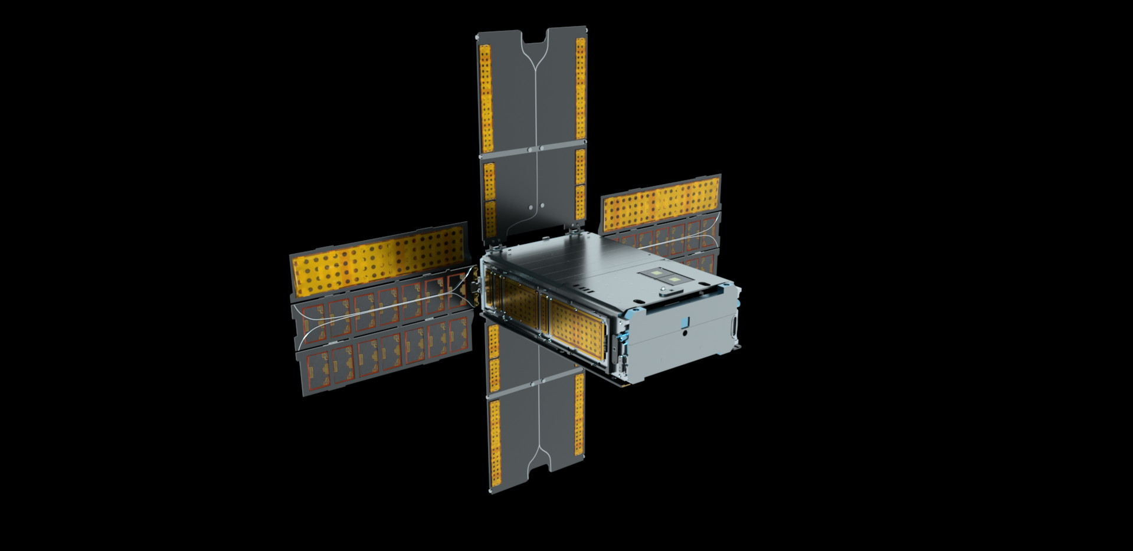
BioSentinel: a biology CubeSat for deep space
understanding the risks on biology from deep space radiation

Slide 2

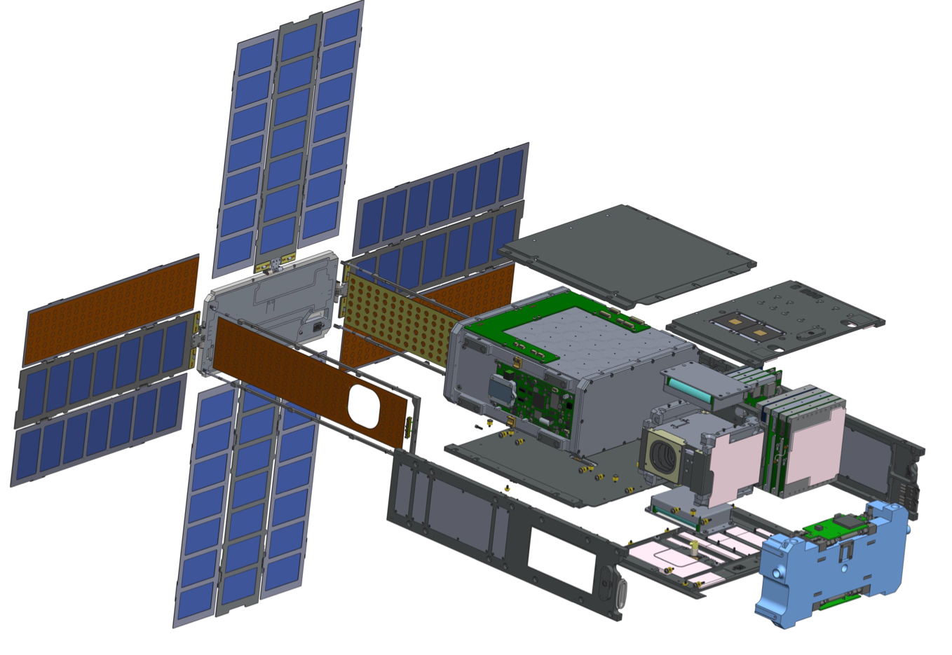
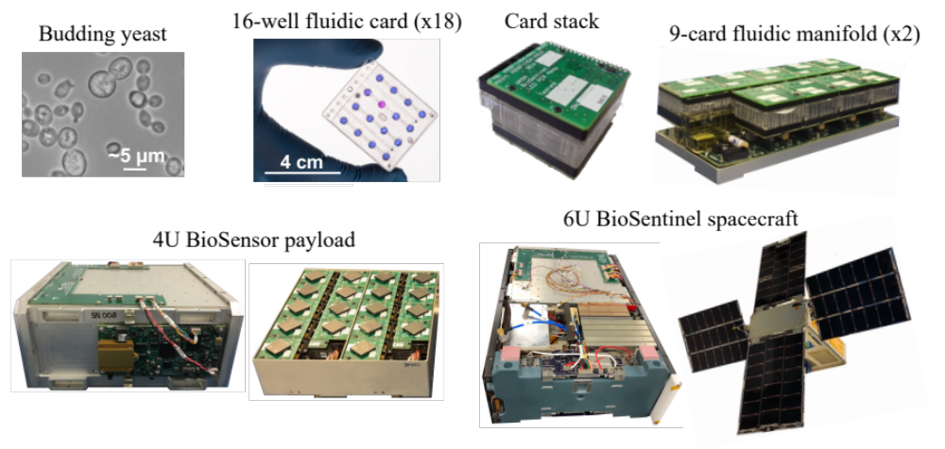
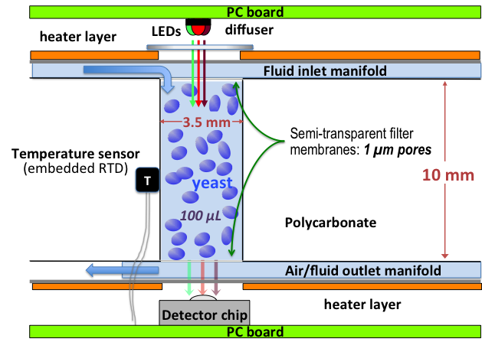
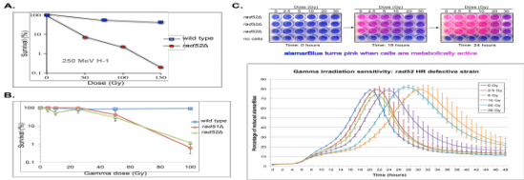
BioSentinel: large experiment in a compact spacecraft
microfluidics
delivery system
BioSensor payload
(~4U, 4.5 kg)
Solar arrays
Low-gain antennas
Batteries
Solar array
gimbal
Command & data handling EPS
Iris
transponder
Medium-gain antenna
Propulsion system
LET radiation sensor
Star tracker window
Attitude control subsystem

Slide 3





BioSentinel: sending biology further than ever before
The limits of life in space – as we know it – is 12.5 days on a lunar round trip or 1.2 years in LEO. As we send people further into space, we need to understand the biological risks and how they can be addressed
36 million mi
Mars
Millions mi
NEA
Saccharomyces Cerevisiae
• L2
240,000 mi
Unknown
Distance from Earth
Known
Yeast cells that can survive in stasis for long durations
180-300 mi
Extended ISS
62 mi
6 months
12 months
18 months
3 years

Slide 4
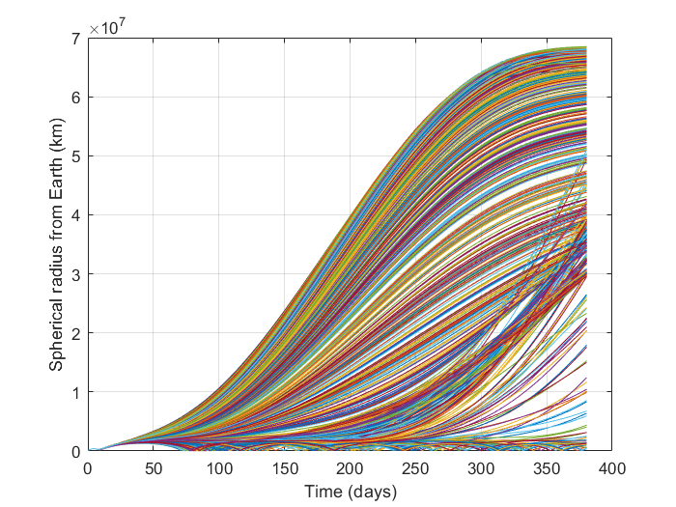
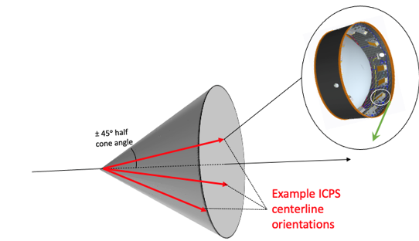
BioSentinel: preparing for trajectory uncertainty
BioSentinel is traveling to deep space on board the maiden voyage of the Space Launch System during the Artemis-1 mission. The nominal plan is for the BioSentinel spacecraft to enter a heliocentric orbit and travel far into deep space beyond the protective influence of Earth. As a secondary payload, final trajectory placement is uncertain due to multiple variables prior to deployment of the spacecraft.
Potential trajectories include: heliocentric, earth return and orbit, earth impact, and lunar impact.
Mission operations team is preparing for the wide variety of trajectory scenarios.
Nominal
Captured by Earth – Moon system
Lunar or Earth Impact
Monte Carlo analysis of BioSentinel position
(Aug 23rd launch date)

