Slide 1

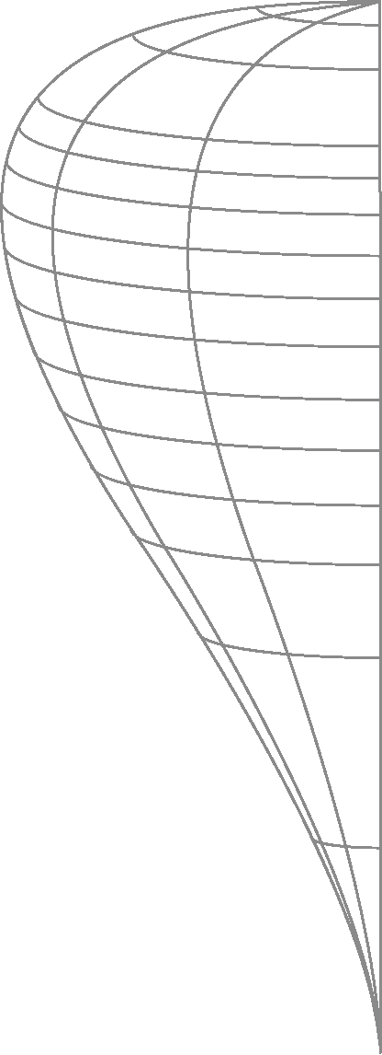
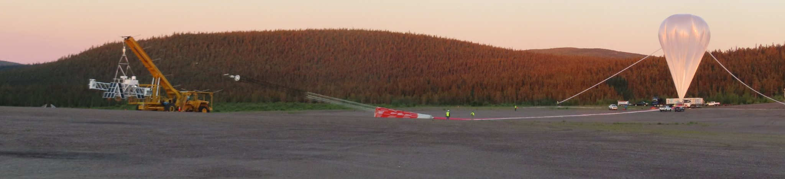
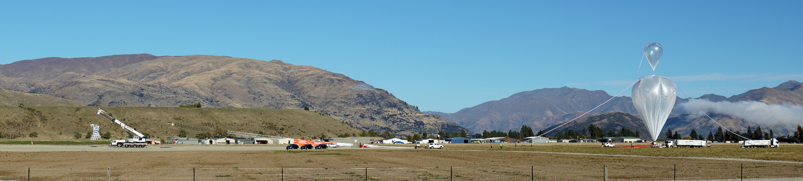
July 14-22, 2018 – Pasadena, California
2022 NASA Balloon Program Update
Debora Fairbrother and Andrew Hamilton
NASA Balloon Program Office
Suborbital and Special Orbital Projects Directorate
Wallops Flight Facility

Slide 2
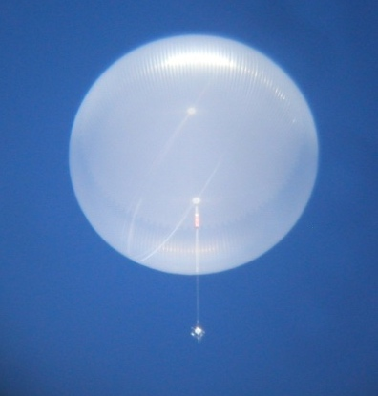
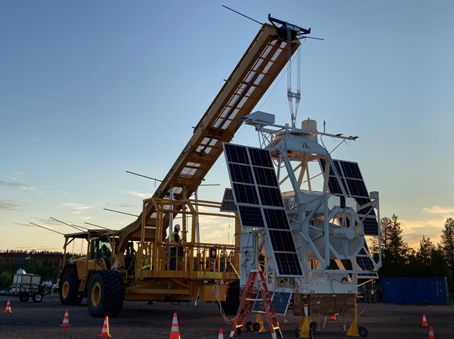
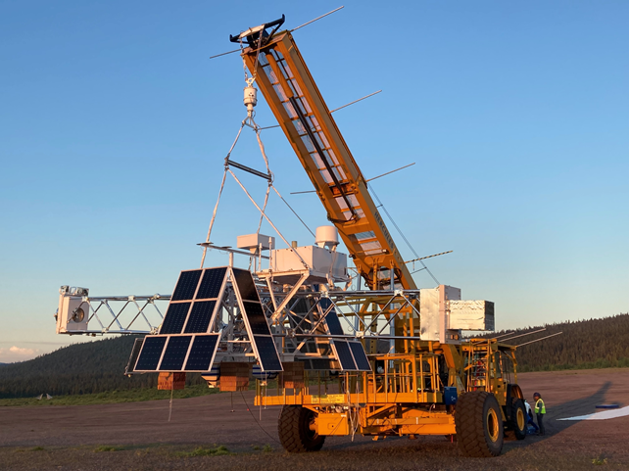
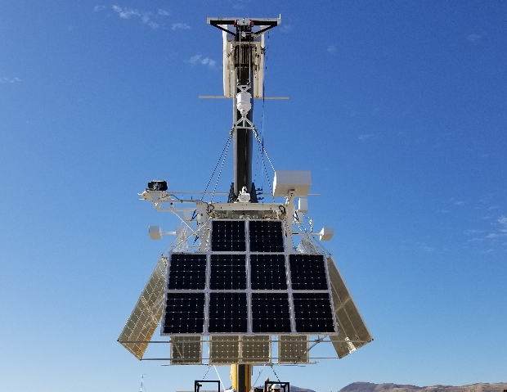
Balloon Program Overview
Strategic Objective:
Enable discovery through conduct of frequent scientific balloon flight opportunities for NASA scientific, technology development, and educational investigations.
Balloons provide low-cost, quick response, near space access for:
Conducting cutting-edge research.
Developing technologies to enable future spacecraft science missions.
Advancing lighter-than-air platform technologies.
Providing Calibration and Validation of on-orbit instrumentation.
Enabling Hands-on Training of the next generation of scientists and engineers.
Annual Program Snapshot
8-12 Launched
3+ campaigns
300+ ugrad/grad students participate
40+ Research Institutions
BOOMERANG
Super-Pressure Balloon
SPB
SN/07
SUNRISE III
XL-Calibur/WASP

Slide 3
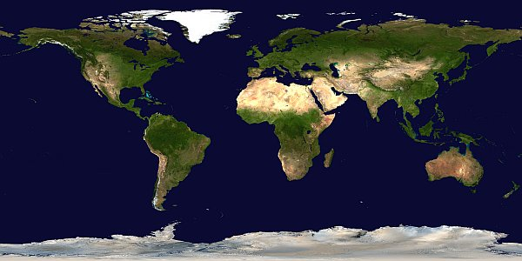
NASA Launch Locations
Esrange, Sweden
Fort Sumner, New Mexico
Palestine, Texas
Alice Springs, Australia
= Conventional Missions
= Long Duration Missions
=Super Pressure Missions
Wanaka,
New Zealand
McMurdo, Antarctica

Slide 4
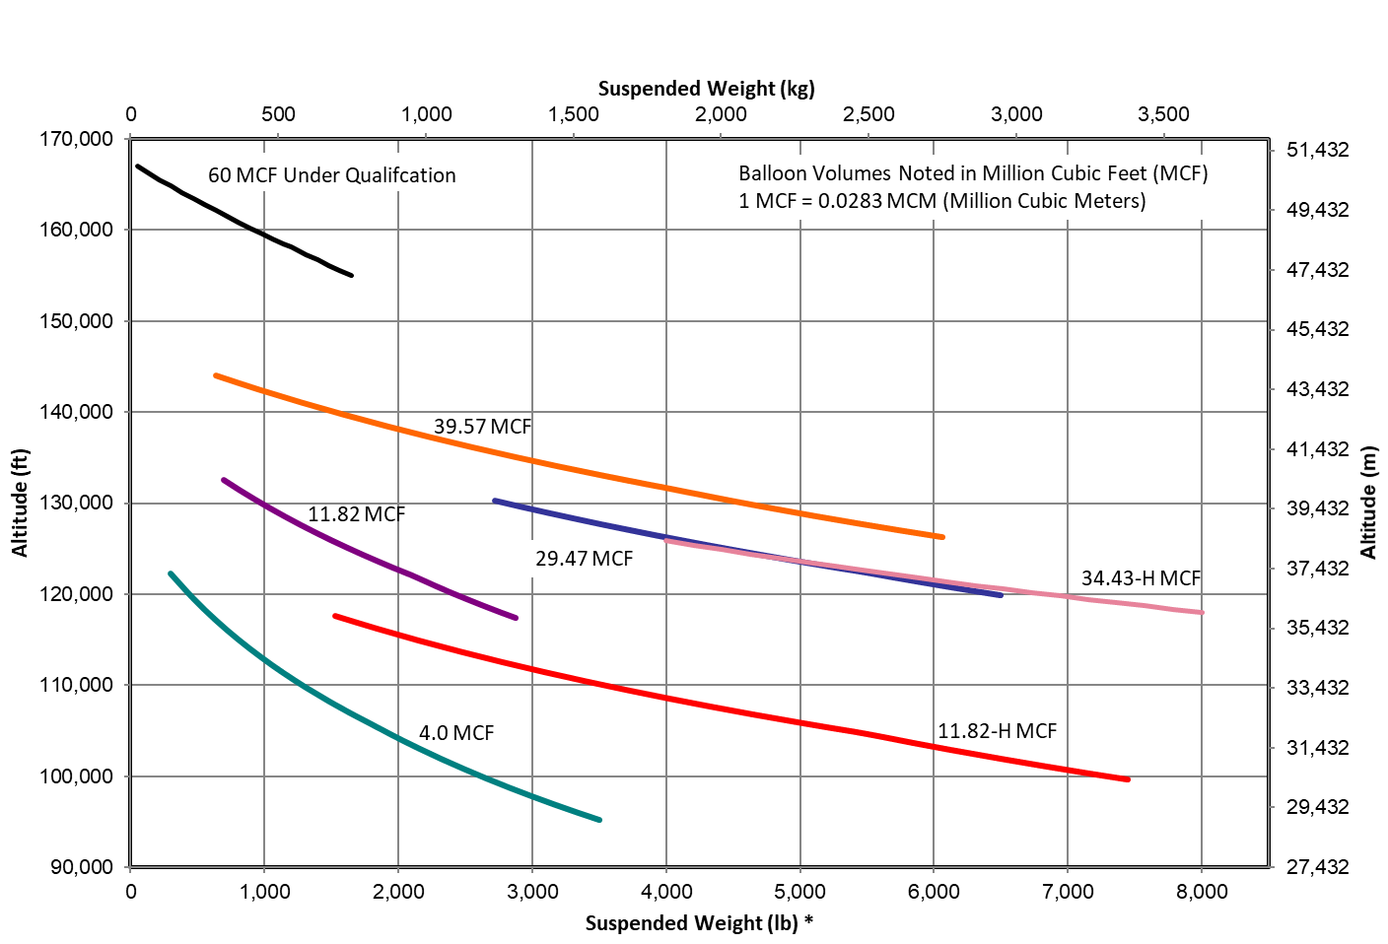
NASA Zero Pressure Standard Balloons
SPB 18.8 MCF
* Includes weight of parachute and flight train

Slide 5
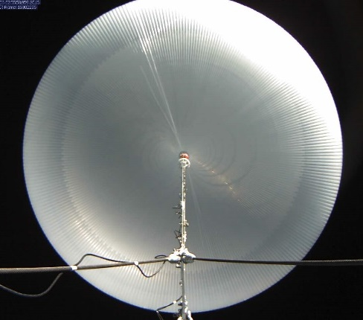
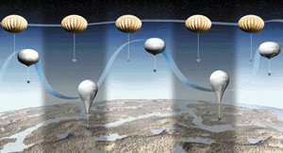
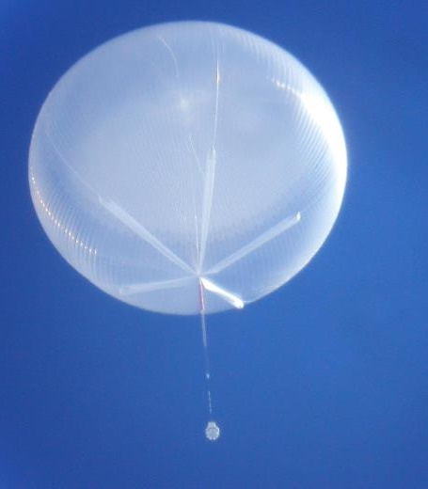
Balloon Types
Super Pressure Balloon maintains nearly constant volume – under development
  Allows Ultra Long Duration Balloon (ULDB) Flights
  Provides stable altitude Long Duration Balloon (LDB) flights at mid-latitudes
Zero-Pressure (ZP) Balloon changes volume due to radiative input
  • Used for Conventional Flights and Polar LDB Flights

Slide 6
NASA Support Systems
Balloon Type | Zero Pressure (ZP) | ZP | Super Pressure (SP)
Mission Type | Conventional | LDB | ULDB (In development)
Duration | 2 hours to 3 days | 4-6 days for Sweden 7-15 for Antarctica up to 55+ days | Up to 100 days 2016 Mid-Latitude Flight = 46 Days
Science Payload Weight | Up to 2,948 kg (Up to 6,500 lbs) | Up to 2,948 kg (Up to 6,500 lbs) | 18.8 MCF* – 907 kg (2,000 lbs)
Typical Float Altitude | 29.2 to 38.7 km (96 to 127 kft) | 36.5 to 38.7 km (120 to 127 kft) | 18.8 MCF – up to 34 km (῀110 kft)
Support Package | Consolidated Instrumentation Package (CIP) Line of Sight (LOS) Up to 12 Mbps direct return | Support Instrumentation Package (SIP) Line of Sight (LOS) - Up to 12 Mbps direct return Over The Horizon (OTH) 6 kbps / 92 kbps TDRSS Downlink** 80 kbps Iridium option***
 | Small Launch Package Stand alone package for small payload support LOS and OTH TM & Command (Iridium) 255 byte/min packets Up to 12 Mbps LOS option System without batteries ~20 lbs (9 kg) * MCF – Million Cubic Feet **300kbps/1Mbps in development ***Iridium – limited support

Slide 7
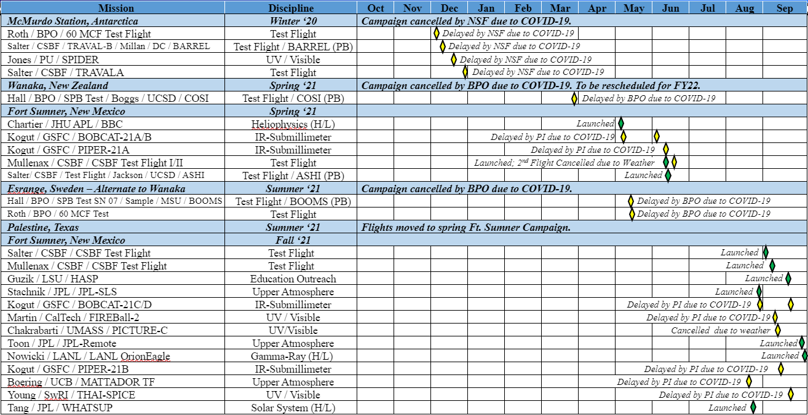
FY21 Flight Manifest

Slide 8
FY22 Flight Manifest
Mission | Discipline | Oct | Nov | Dec | Jan | Feb | Mar | Apr | May | Jun | Jul | Aug | Sep
Wanaka, New Zealand | Austral Fall ‘22
Jones / PU / SuperBIT [Payload of Opportunity] | SuperBIT (PO)
Fairbrother / WFF / SPB SN07 | Qualification Flight
Fairbrother / WFF / SPB SN08 | Qualification Flight
Esrange, Sweden | Summer ‘22
Roth / WFF/ 60MCF Test | Qual.Flight
Krawczynski / WUSTL / XL-Calibur | Gamma-Ray
Wakely / UC / HELIX | Cosmic Ray, Particle
Solanki / MPS / SUNRISE-III | Heliophysics
Fort Sumner, New Mexico | Fall ‘22
Fries / JSC / CDCP | Solar System (ETF) [H/L]
Wender / LANL / TinMan | Gamma Ray [H/L]
Salter / CSBF / CSBF Test Flight Salter | Test Flight
Kogut / GSFC / BOBCAT | IR, Submillimeter, Radio
Zhou / UCLA / BALBOA | Heliophysics (ETF)
Guzik / LSU / HASP | Student Outreach
Mullenax / CSBF / CSBF TF Mullenax | Test Flight
Boering / UCB / MATTADOR-TF | Upper Atmosphere
Martin / CalTech / FIREBall-II | UV and Visible
Chakrabarti / UMASS / PICTURE-C | UV and Visible
Young / SWRI / THAI-SPICE | UV and Visible
Switzer / GSFC / EXCLAIM | IR, Submillimeter, Radio
Kogut / GSFC / PIPER | IR, Submillimeter, Radio
Cancelled by PI
Launch Abort
Postponed to FY23 by PI
Cancelled by BPO
Inflight Anomaly
Delayed by PI
Science Pointing Anomaly
Delayed by PI
Delayed
Delayed by PI
Delayed by PI
Delayed by PI
Delayed

Slide 9
FY22 Antarctica Site Visit
Small Deployment Team
Required 5-day quarantine in San Francisco Plus 14-day quarantine in New Zealand
  2 CSBF employees
  2 subcontractors
No major issues noted except for identification of launch vehicle tire replacement need.​
Buildings and shipping containers dug out
Facility and Science support​
Sea vessel left McMurdo with CSBF equipment​
  Two Helium ISOPAKS ​
  Three 20 ft containers​

Slide 10
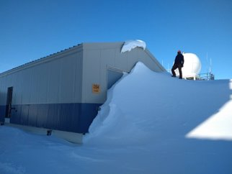
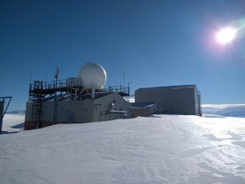
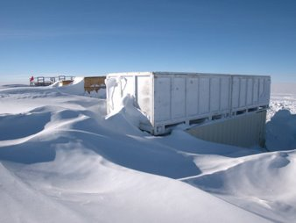
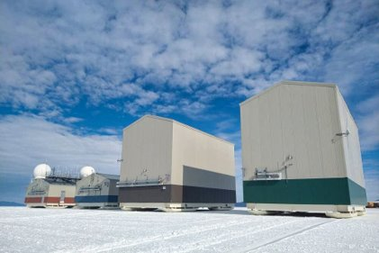
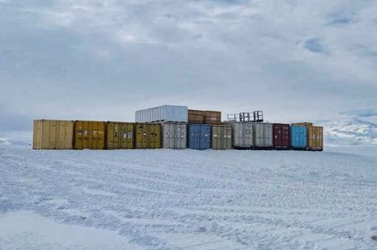
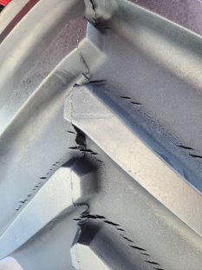
FY22 Antarctica Photos
Launch Vehicle Tire
Tread

Slide 11
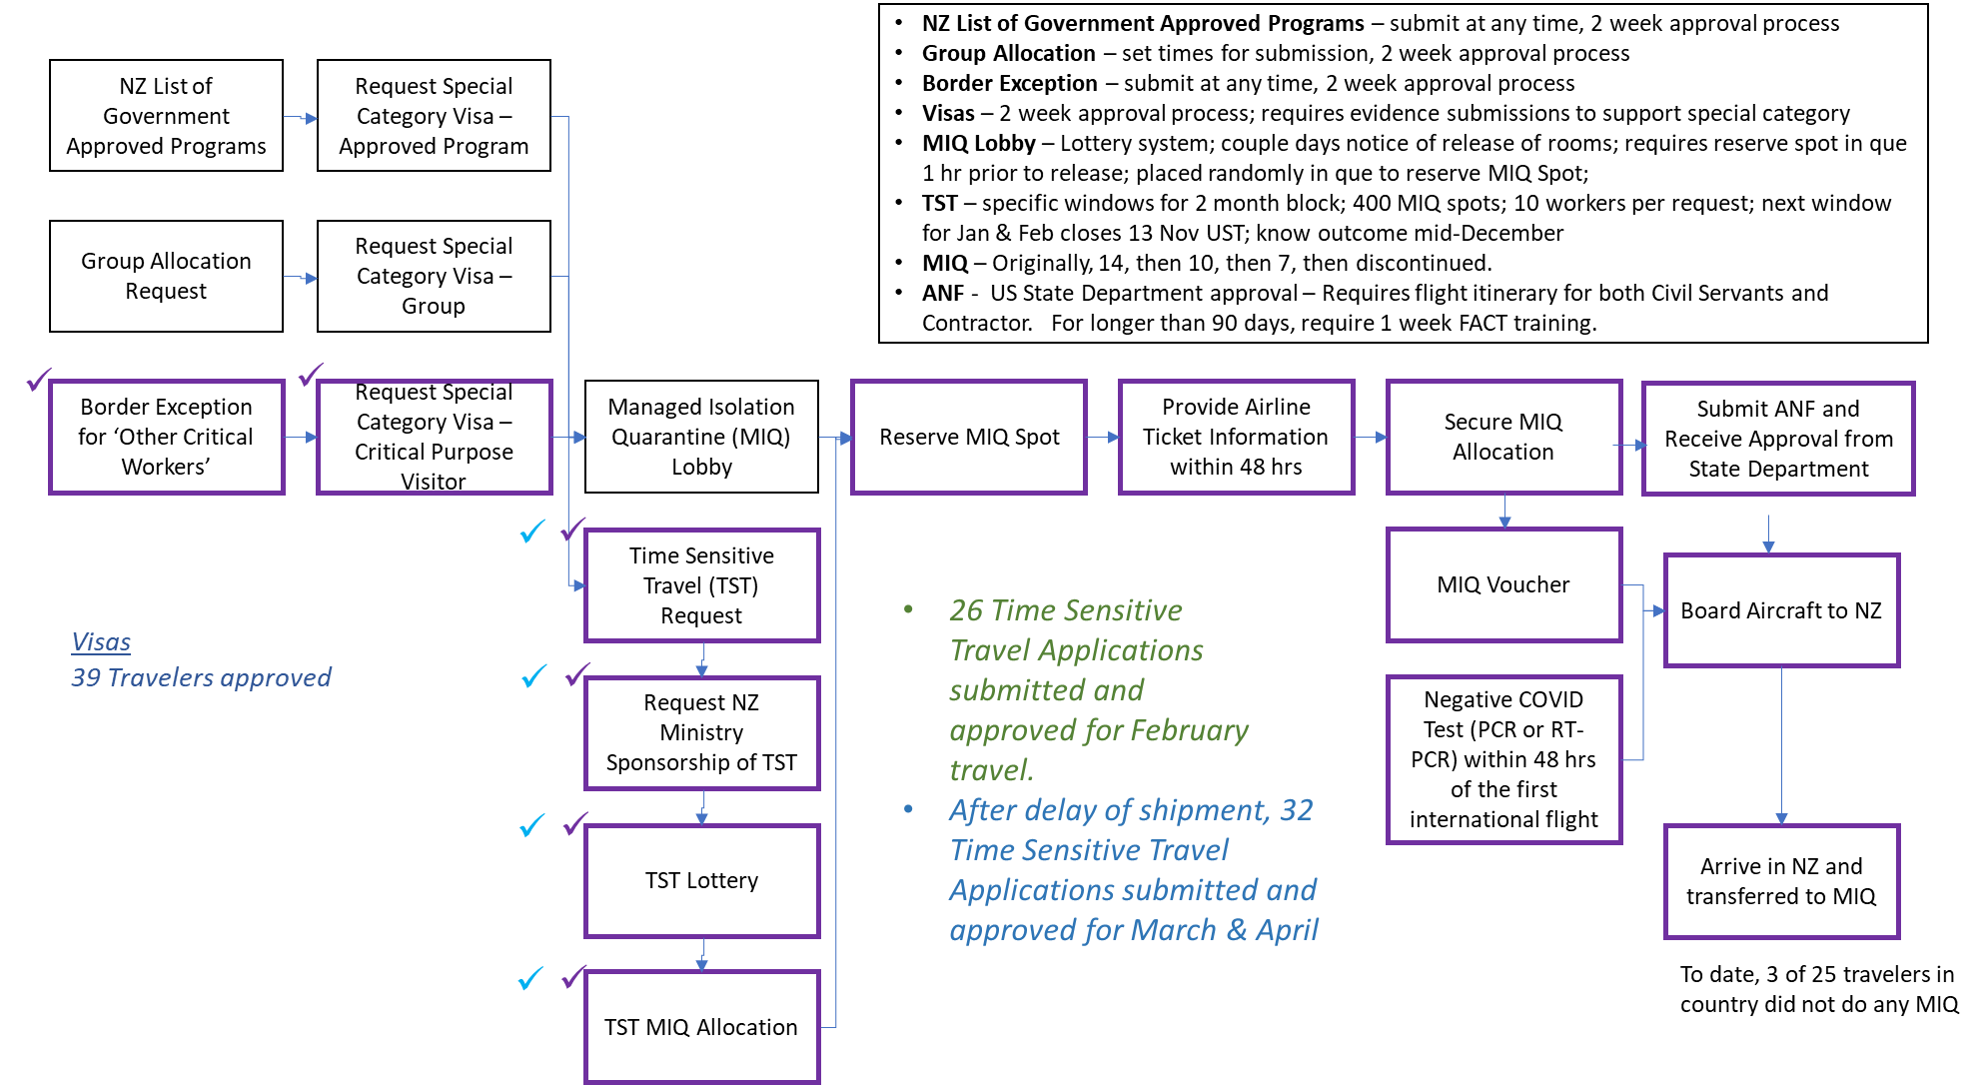
Process to get to New Zealand FY22

Slide 12
FY22 New Zealand
The NASA SPB is being developed to provide a stable platform at constant density altitude for extended duration science investigations at polar and mid latitudes.
An incremental approach has been applied to the development:
Volume | Suspended Weight | Altitude | Flight Number | Duration | Launch Location | Launch Date
7 MCF | 680 KG (1,500 Lbs) | ~33.5 KM (110 KFT) | 591 NT | 54 days | Antarctica | Dec 28, 2008
14.9 MCF | 1,814 KG (4,000 Lbs) | Holes During Press. Burst – Peeled Seal ~33.5 KM (110 KFT) | 599 NT 616 NT | 4.2 hours 2.8 hours 22 days | Sweden Antarctica Antarctica | June 22,2009 Dec 10, 2009 Jan 9, 2011
18.8 MCF | 2,268 KG (5,000 Lbs) 2,268 KG (5,000 Lbs) 2,268 KG (5,000 Lbs) 2,268 KG (5,000 Lbs) 2,495 KG (5,500 Lbs) 2,495 KG (5,500 Lbs) | Peeled Seal During Production ~33.5 KM (110 KFT) ~33.5 KM (110 KFT) ~33.5 KM (110 KFT) ~33.5 KM (110 KFT) ~33.2 KM (109 KFT) ~33.2 KM (109 KFT) | 631 NT 659 NT 662 NT 669 NT 679 NT Abort 30 | 6.5 hours 43 hours 32 days 46 days 12.2 days N/A | Sweden Antarctica New Zealand New Zealand New Zealand New Zealand | Feb 2012 Aug 14, 2012 Dec 28, 2014 Mar 26, 2015 May 16, 2016 April 24, 2017 May 27, 2022

Slide 13
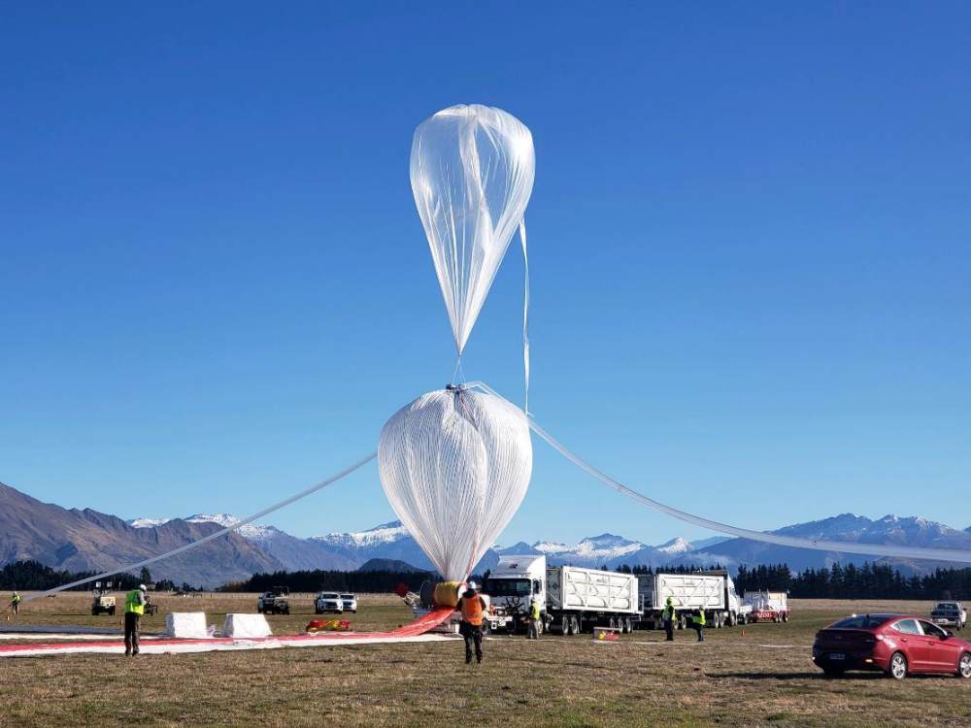
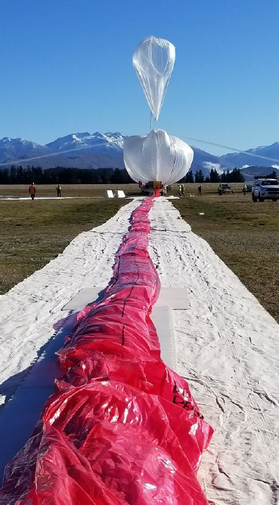
FY22 New Zealand – SPB Launch Abort

Slide 14
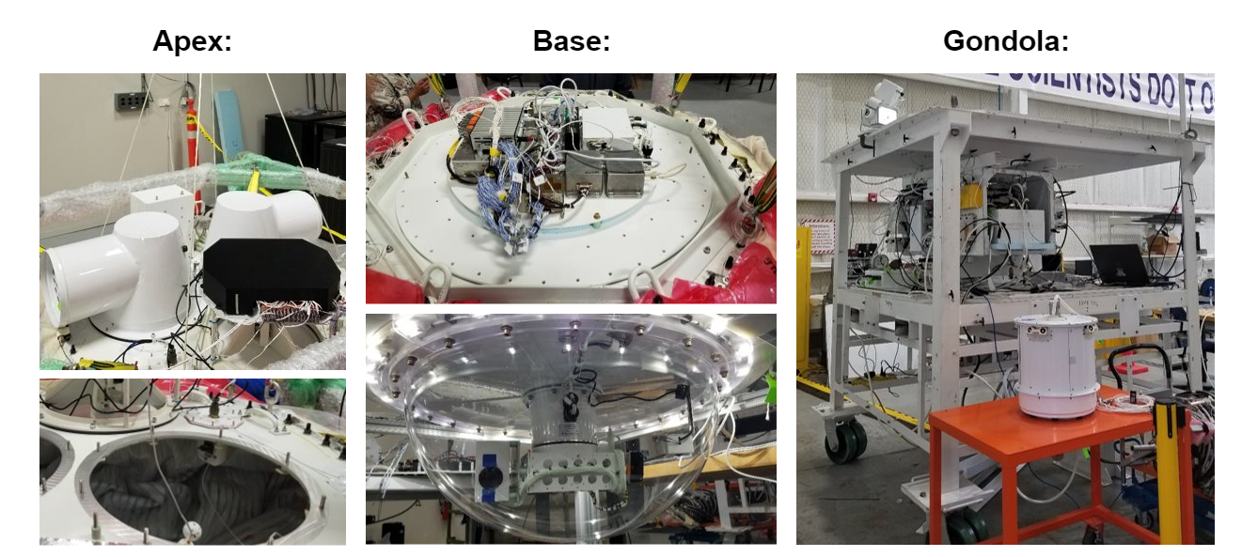
Super Pressure Balloon Instrumentation

Slide 15
FY22 Sweden
The FY22 Sweden campaign kicked off during the FY22 New Zealand campaign.
Initially, two science missions and one test flight planned. The test flight was cancelled due to the late season launches for the science payloads.
SUNRISE III
XL-Calibur/WASP
Flight 720 N
Flight 719N

Slide 16
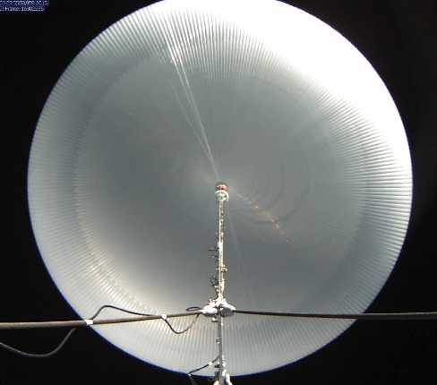
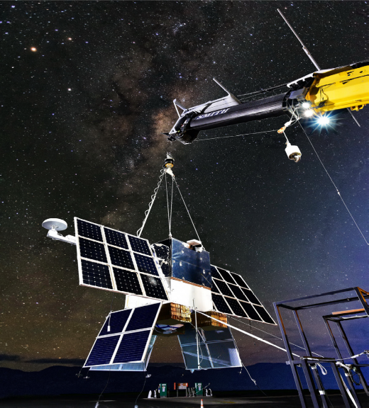
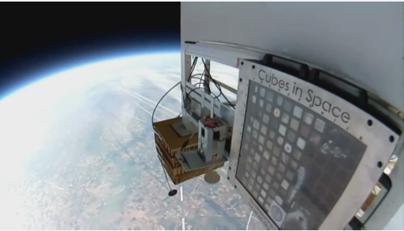
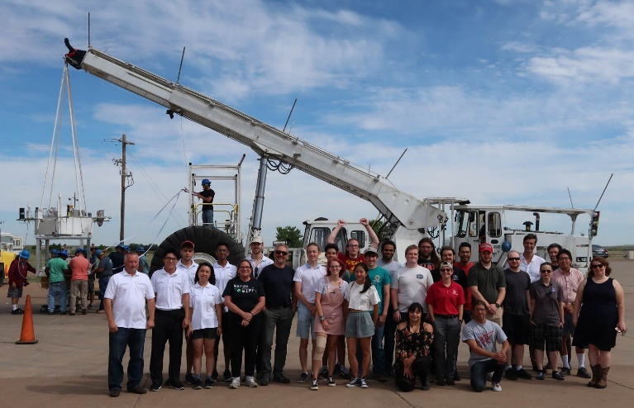
Summary
The NASA Balloon Program has continued to provide stable platforms for science.
The NASA Balloon Program encourages feedback from the science community on future needs.
Balloons provide an excellent training ground for scientists and engineers.
The Program has been busy trying to catch up after the downtime due to the coronavirus pandemic.

Slide 17
Acknowledgements
The activities reported today would not have been possible without the dedication and support from NASA, NSF, the Balloon Program Office, the CSBF, Raven Aerostar, the science community, and our support contractors!

