Slide 1


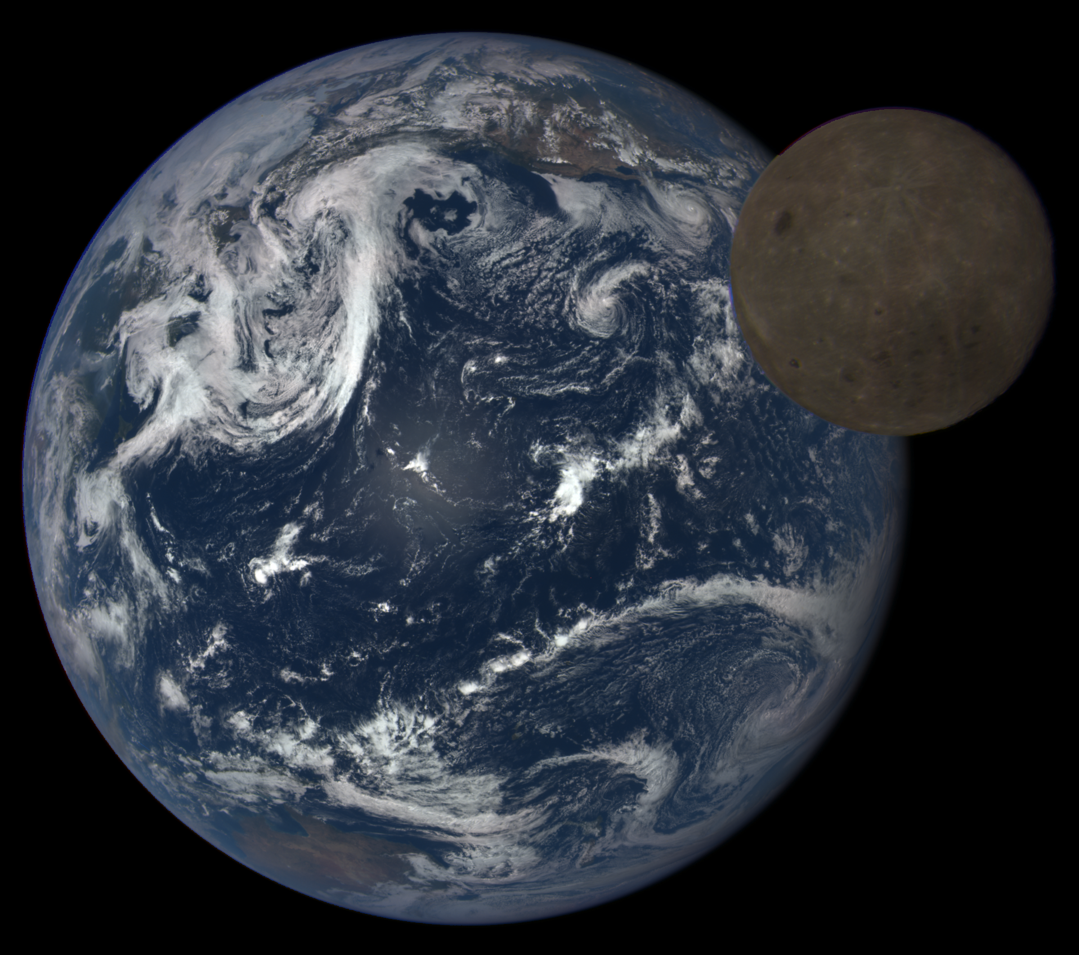
LEIA: Lunar Explorer Instrument for space biology Applications
A. Mark Settles
Bioengineering Branch
NASA Ames Research Center
andrew.m.settles@nasa.gov
Sergio R. Santa Maria
KBR/FILMSS
NASA Ames Research Center
sergio.santamaria@nasa.gov
Image credit: NASA

Slide 2

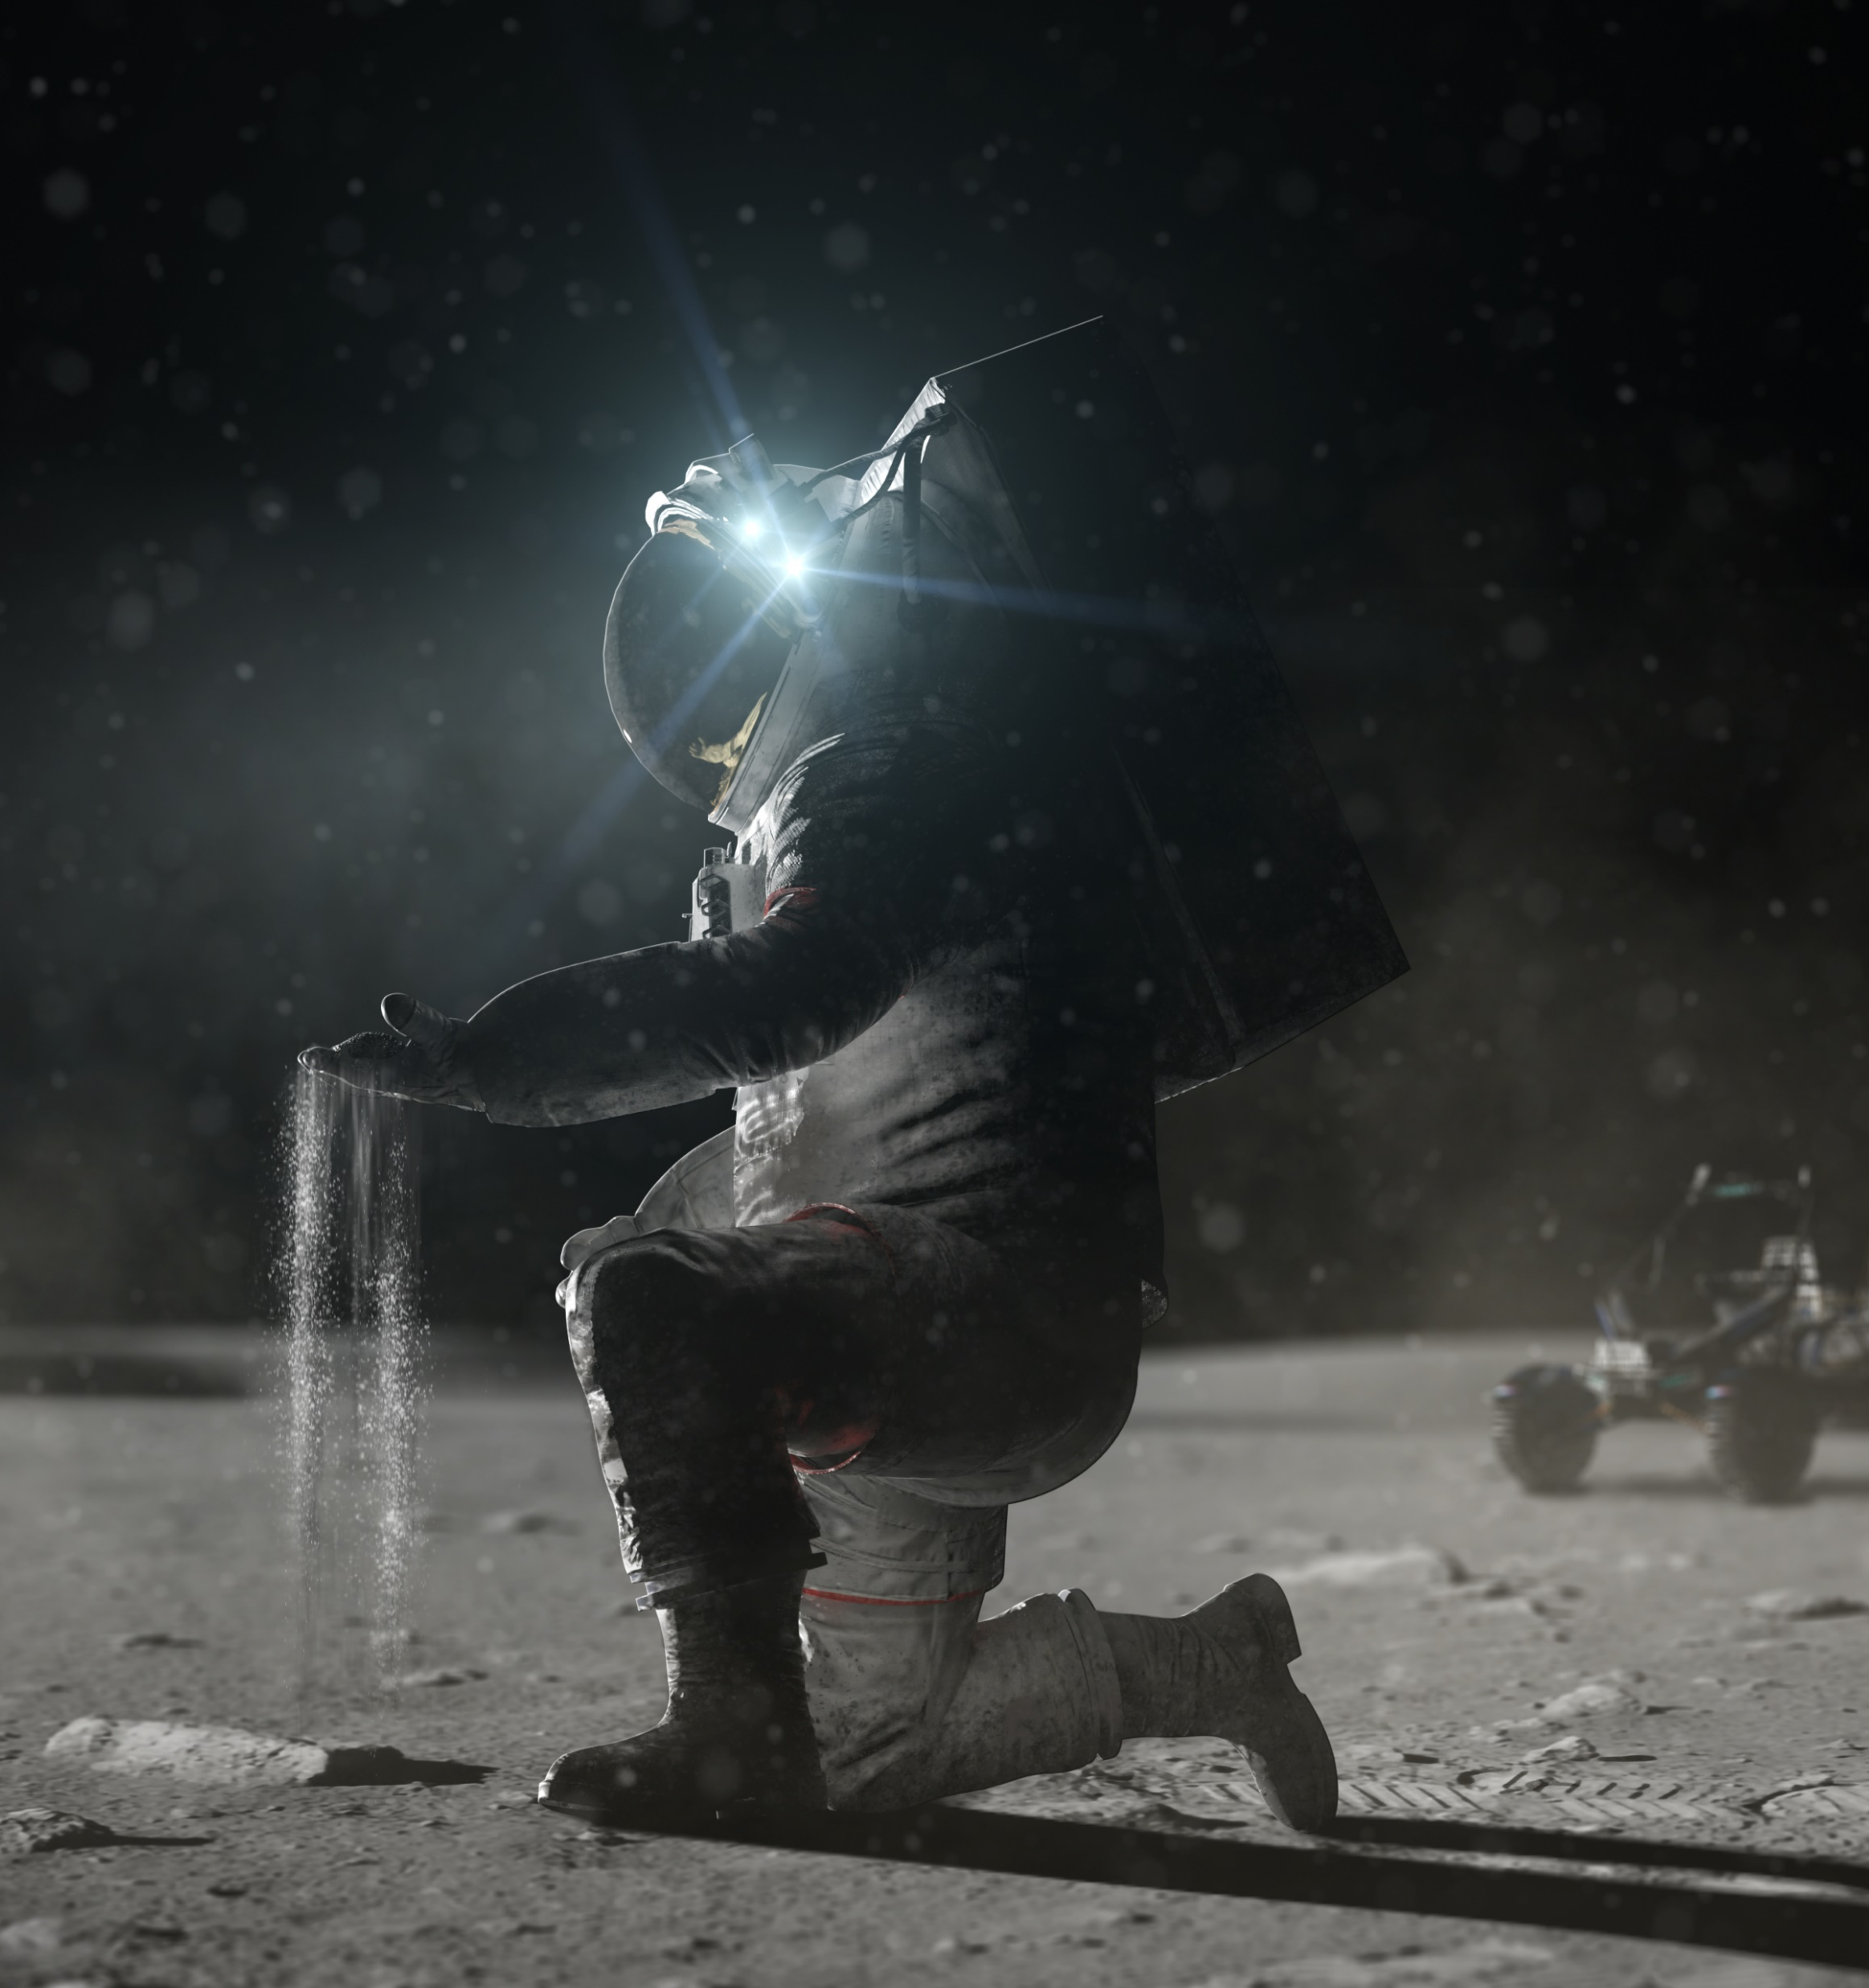
Image credit: NASA

Slide 3
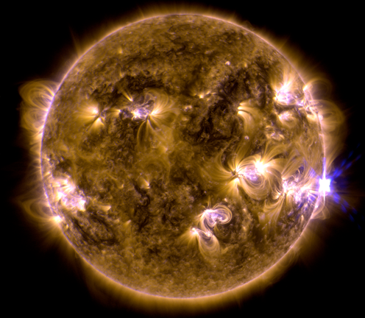
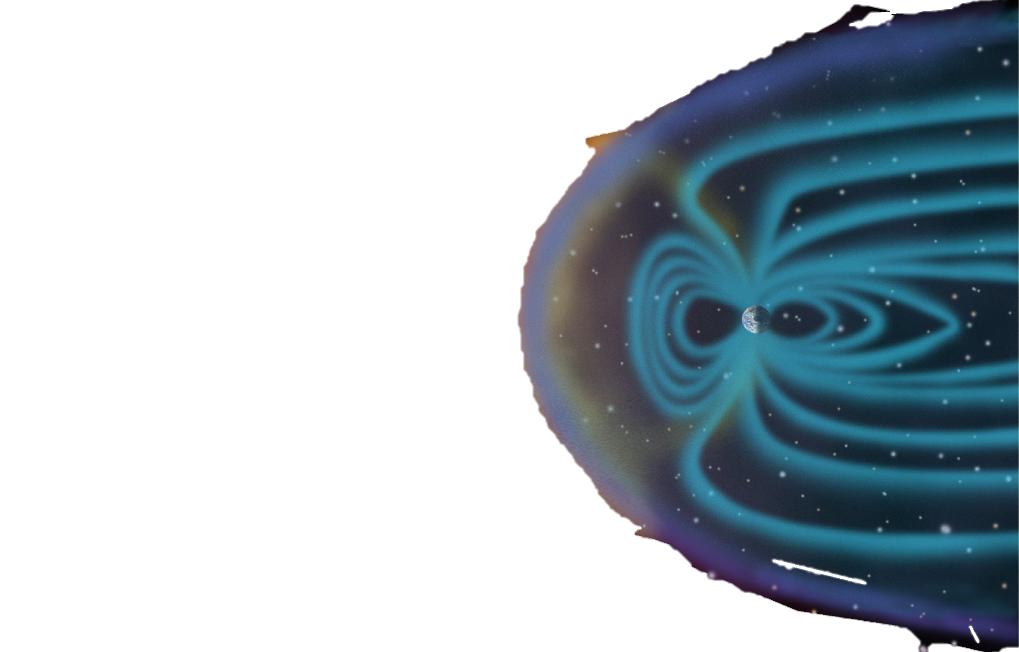
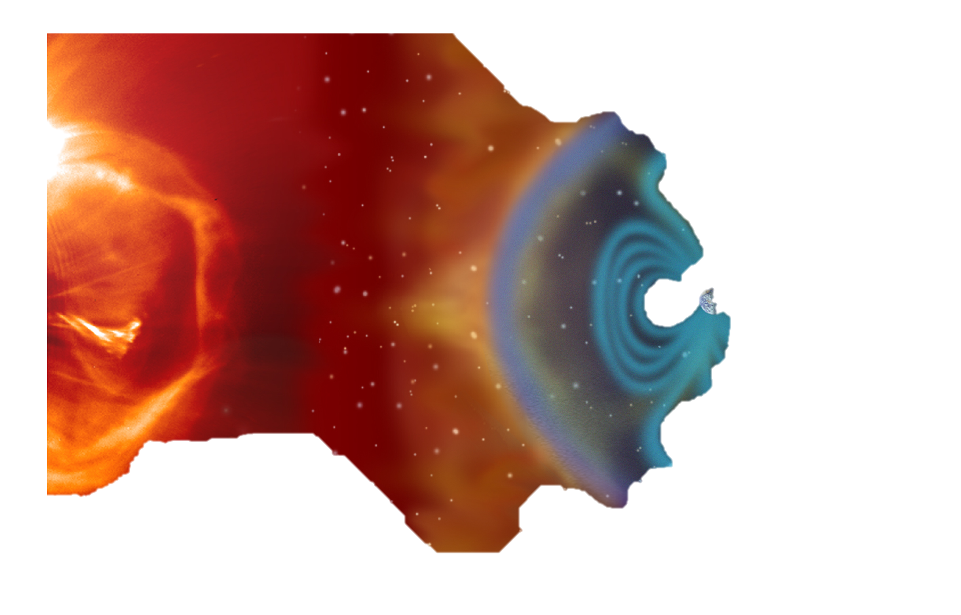
Radiation is a significant risk for organisms traveling in deep space
Galactic Cosmic Rays (GCRs)
Solar Particle
Events (SPEs)
Trapped particles
SPEs: sporadic, transient (mins to days); high proton flux (low-medium energy)
GCRs: high-energy protons and highly charged, energetic heavy particles
GCRs are not easy to shield
Deep space radiation levels are modulated by the 11-year solar cycle
Image credit: NASA

Slide 4
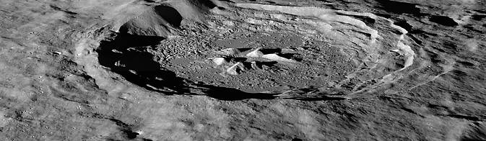
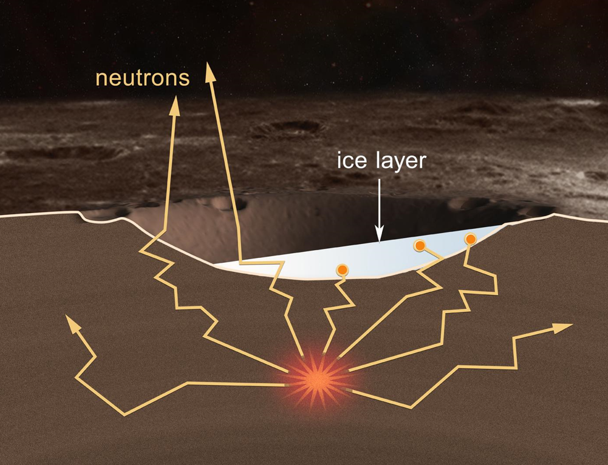
Lunar surface radiation is a distinct environment from deep space
GCR
γ
Hayn Crater
Lunar regolith absorbs galactic cosmic radiation (GCR) to produce secondary albedo neutrons
    High-energy, fast neutrons cause direct cellular damage
    Fast neutrons also produce ionizing radiation
    Estimates of surface neutron doses vary widely
    Effects of lunar surface radiation on bioprocessing are unknown
Image credits: NASA

Slide 5


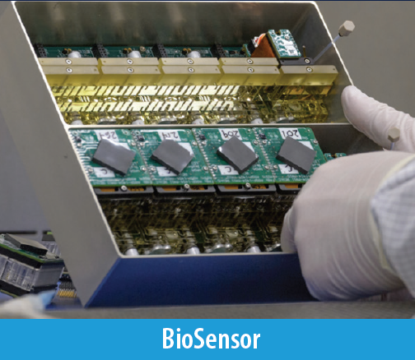
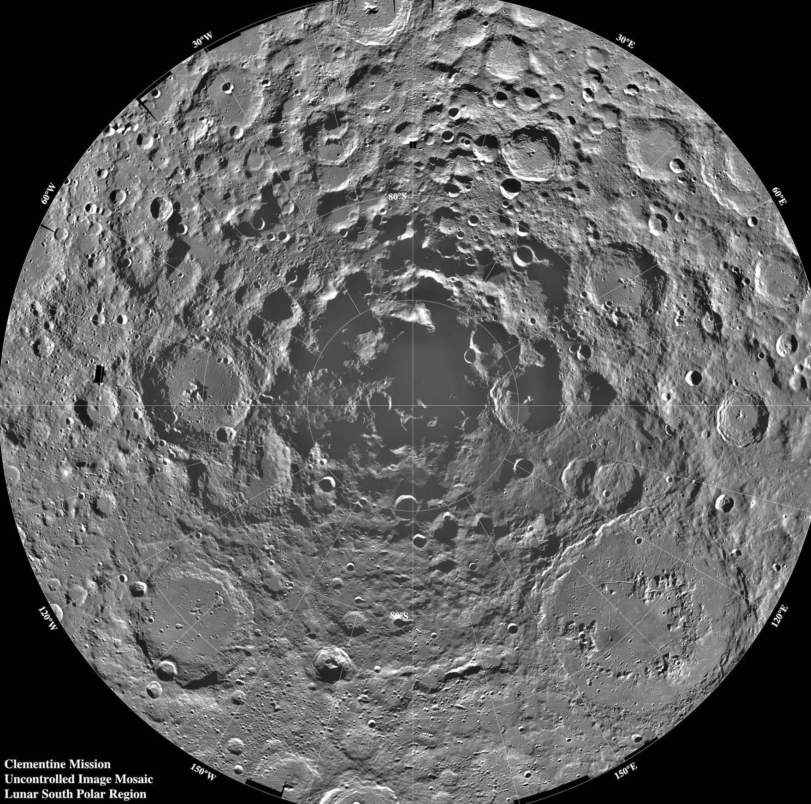
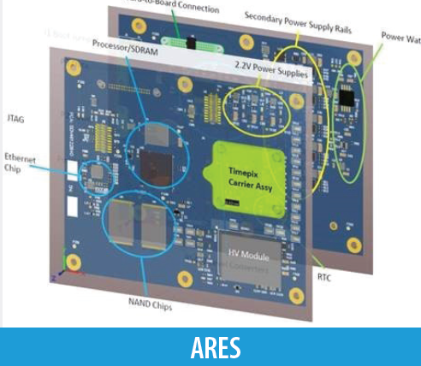
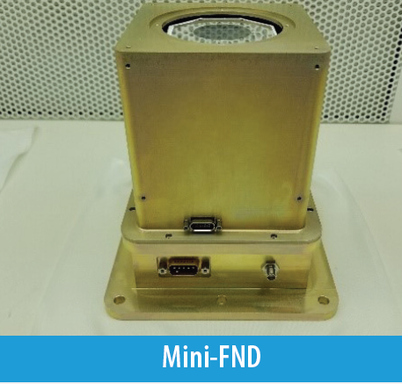
Lunar Explorer Instrument for space biology Applications:
a South Pole Lunar surface investigation
Motivation.
What are the radiation health risks for crewed exploration of the lunar surface?
Will proposed mitigations for crew health using in-space biomanufacturing be effective beyond low Earth orbit?
Approach.
Engineer yeast strains to test growth and metabolism for sensitivity to radiation.
Measure biologically relevant radiation in transit and on the lunar surface.
Expected Outcomes and Impact.
Determine cellular sensitivity to the lunar environment.
Evaluate feasibility of bioproduction on the Moon.
Test genetic strategies to enhance cellular tolerance to the lunar environment.
Determine ground truth radiation risks for crew.
LEIA Instruments
Team: Dr. A. Mark Settles (PI), Dr. Sergio Santa Maria (Deputy PI), Dr. Donald M. Hassler (Co-I, SwRI), Brandon Maryatt (PM), Leandro James (SE)
For more information: https://www.nasa.gov/press-release/nasa-selects-new-instruments-for-priority-artemis-science-on-moon
Image credits: NASA

Slide 6
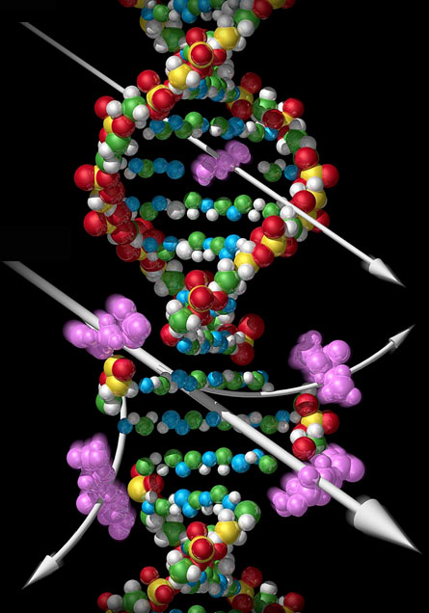
Radiation causes cellular stress through DNA damage and Reactive Oxygen Species (ROS)
Protein & Ion Leaks
Cellular Effects of ROS Damage
X-ray
Cell cycle arrest
Peroxidation of lipids
Heavy ion
Low ATP
DNA Damage
Repressed translation
Consequences for biology:
DNA damage leads to mutations.
ROS damages all parts of the cell.
Cells shift energy from growth to repairing damage.

Slide 7


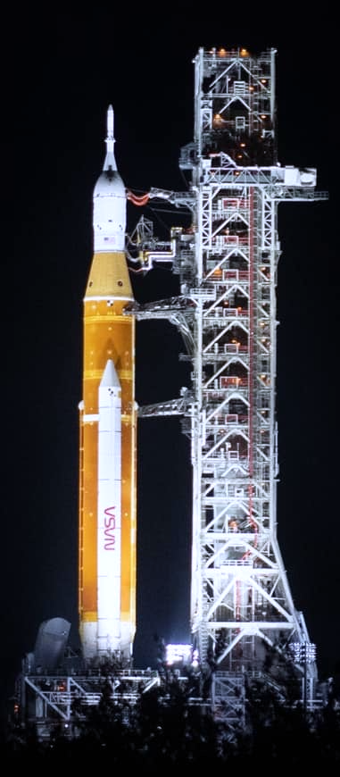
Biological space missions using CubeSats
E. coli GeneSat-1 (2006 / 3U): gene expression
EcAMSat (2017 / 6U): antibiotic resistance
S. cerevisiae PharmaSat (2009 / 3U): drug dose response
BioSentinel (2022 / 6U): cell damage repair
B. subtilis O/OREOS* (2010 / 3U): survival, metabolism
*Organism/Organic Response to Orbital Stress
C. richardii SporeSat-1 (2014 / 3U): ion channel sensors, µ-centrifuges
Image credits: NASA

Slide 8
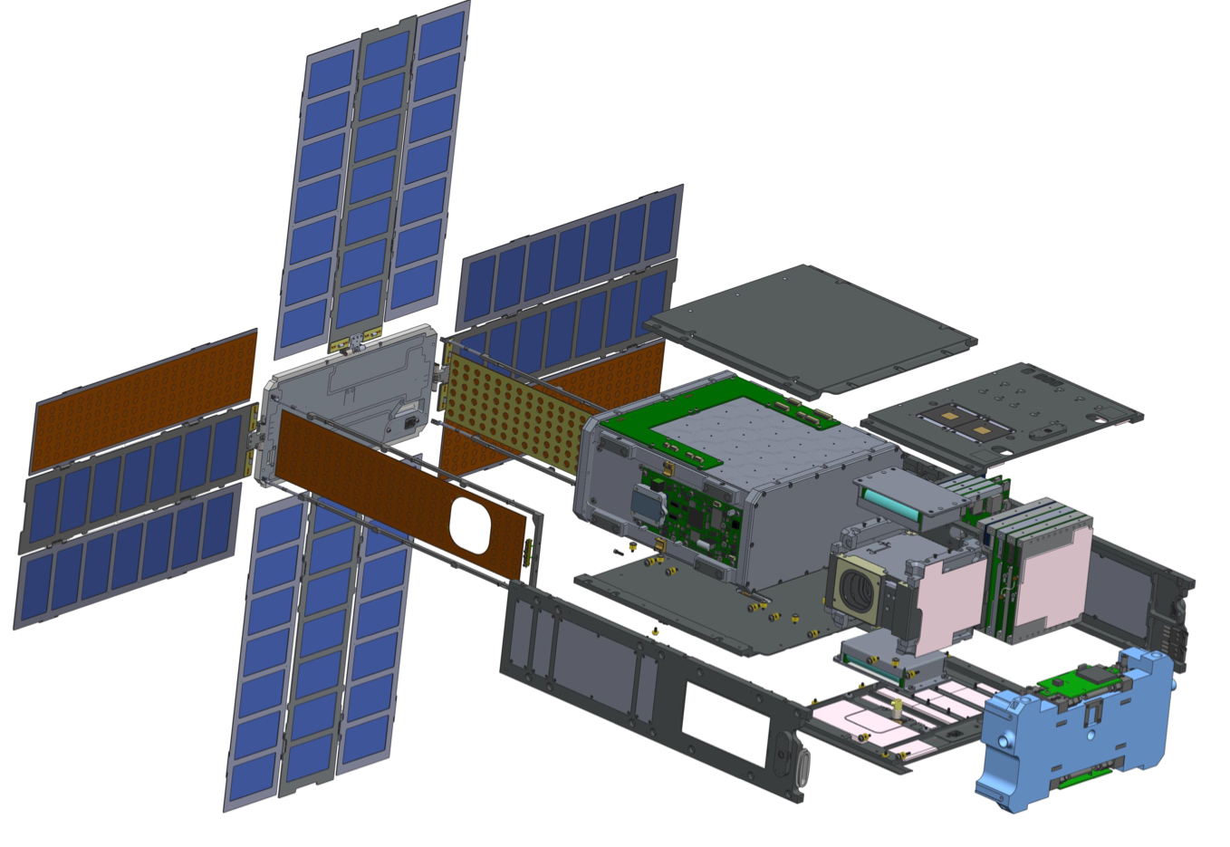
BioSentinel: a CubeSat for deep space biological investigation
BioSensor payload
(~4U, 4.5 kg)
Solar arrays
Low-gain antennas
Batteries
Solar array
gimbal
Command & data handling EPS
Iris
transponder
Propulsion system
Medium-gain antenna
LET radiation sensor
Star tracker cutout
Attitude control subsystem

Slide 9
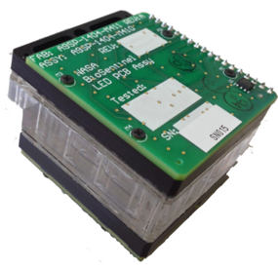
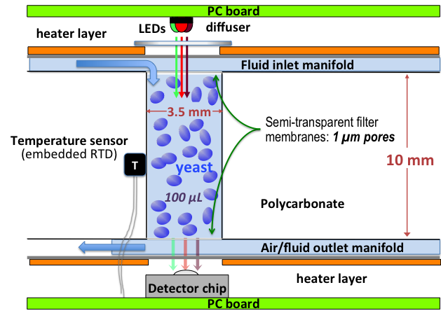
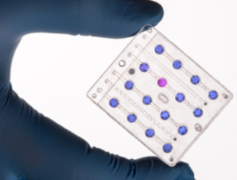
BioSentinel biological payload is housed in the BioSensor
4U BioSensor
Microfluidic Card
Individual Cell Culture Well
4 cm
~5 cm
For LEIA:
BioSensor will contain 16 microfluidic cards
Each card has 16 culture wells (256 wells total)
Pumps and valves control medium addition through 2 separate manifolds
Each well can record light absorbance data at 3 LED wavelengths

Slide 10
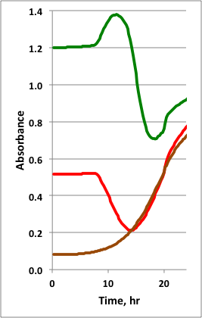
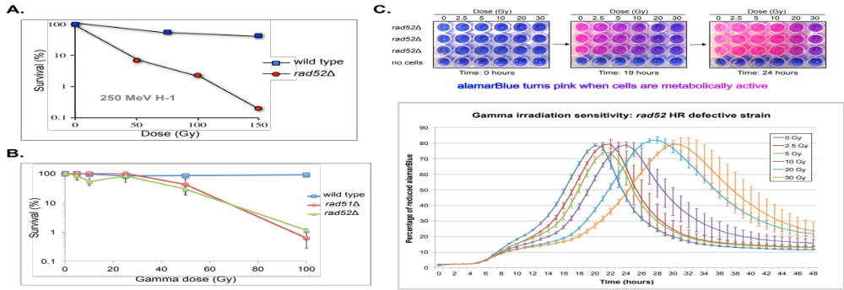
BioSensor optical detection system
3-color optical system at each well tracks
cell growth via infrared optical density
cell metabolic activity via alamarBlue dye color changes
LEDs:
570 nm - green, measures pink alamarBlue
630 nm - red, measures blue alamarBlue
850 nm - infrared, measures cell growth
Yeast growth with flight-like optical unit

Slide 11

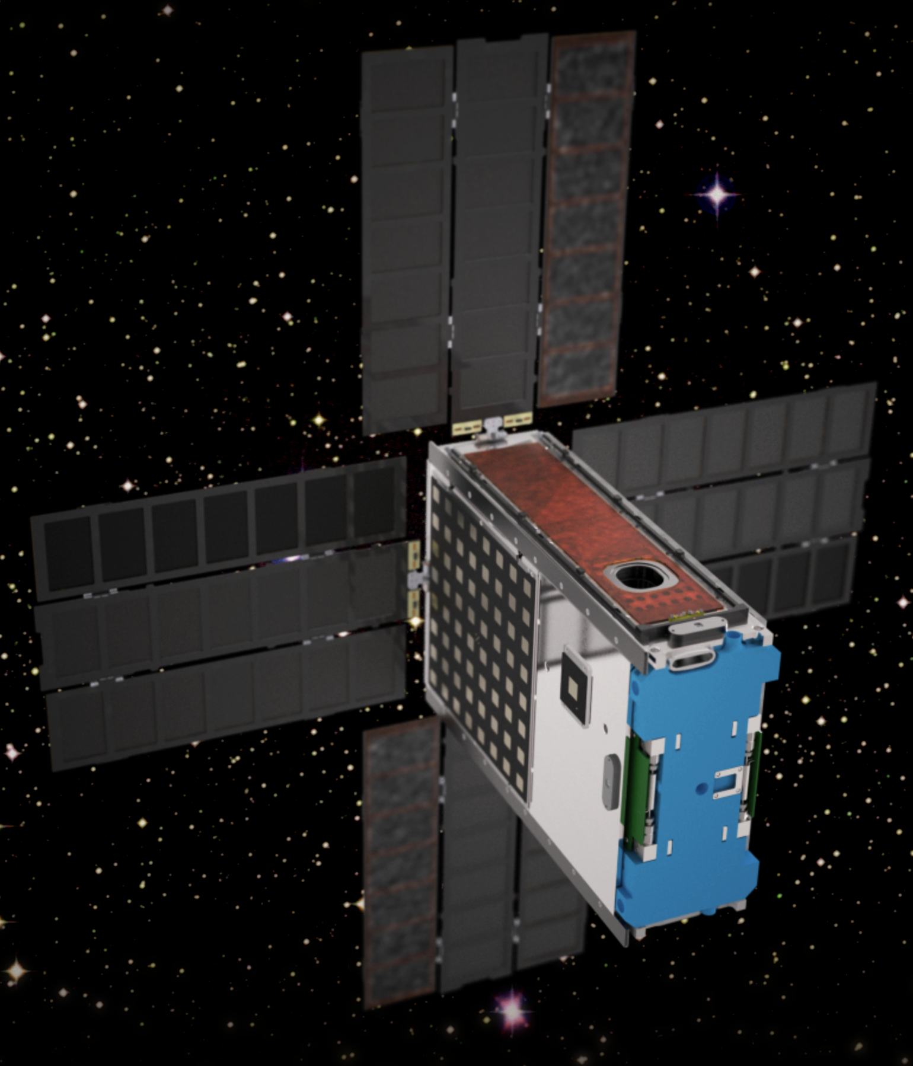
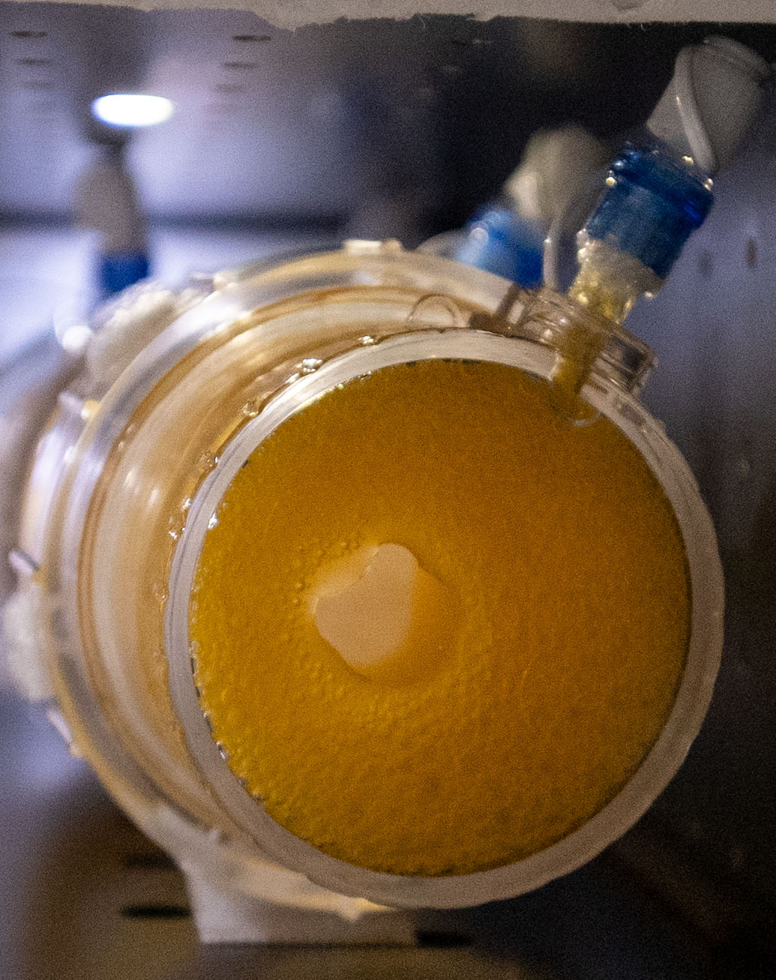

Central goal: Identify genetic factors impacting cellular response to lunar surface radiation and gravity.
Specific Aims:
Aim 1. Determine cellular sensitivity to the lunar environment.
Direct comparison to BioSentinel mission
Aim 2. Test production of antioxidant carotenoids for use in crew dietary supplementation.
Comparison to BioNutrients mission
Aim 3. Engineer genes from tardigrades and yeast to test for enhanced tolerance to the lunar surface.
Aim 4. Measure biologically relevant radiation at the south pole landing site.
Image credits: NASA

Slide 12
Yeast will be engineered to be more sensitive to the mission environment
Strains developed for the BioSentinel mission have single and multiple DNA repair mutants.
These mutants show slower metabolic activation and higher sensitivity to exposure to gamma radiation.
Additional mutants will be generated to test multiple genes involved in ROS and DNA damage.

Slide 13
Synthetic biology products are an engineered read-out of cellular metabolism.
Metabolic stress during the mission may be revealed in reduced production.
Swap out one of the BioSensor LEDs and replace with a 465 nm emission light.
Carotenoids absorb at this wavelength.
Mixed carotenoid and wild-type cells emulate reduced production with a linear relationship.
This spectroscopy approach allows a direct read-out of nutrient or protein production levels.
465 nm
570
630
Y55
Extract
aB
Relative Absorbance/Emission
350
400
450
500
550
600
650
700
Wavelength (nm)

Slide 14
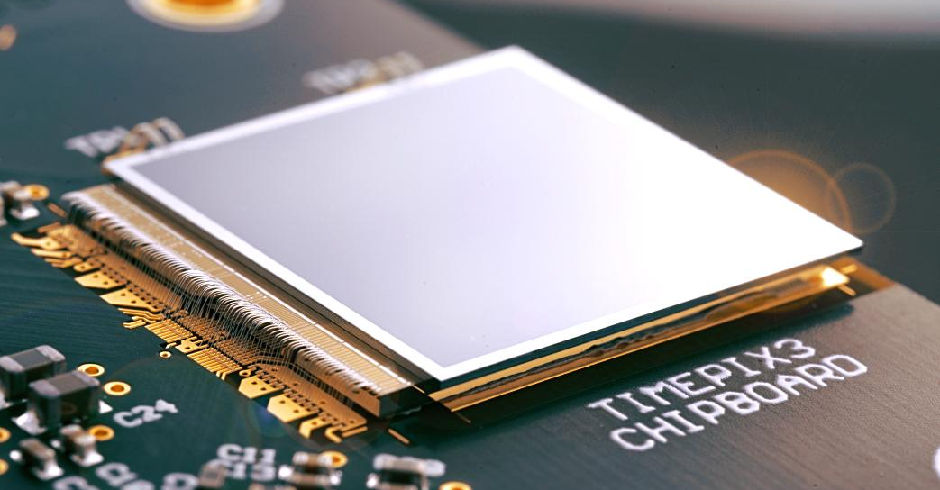
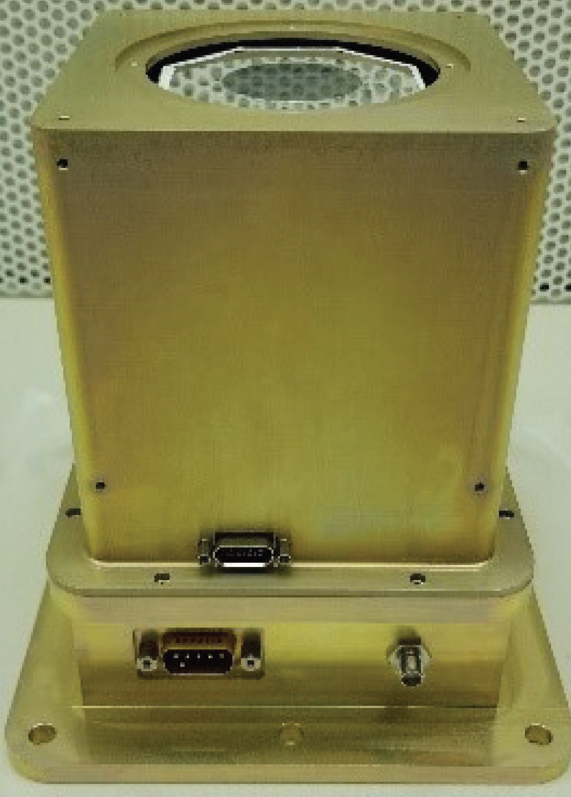
Lunar surface radiation is primarily extrapolated from lunar orbiter data.
There is not yet a consensus for the percentage of fast neutrons in total dose.
Mission | Project | Dose Type | % Fast Neutron
Chandrayaan-1 | RADOM | Effective | 2-20%
Lunar Prospector | LP | Effective | 16-18%
LRO | CRaTER | Absorbed | 0.7%
Chang’E 4 | LND | Absorbed | 23%
Linear Energy Transfer (LET) spectrometer
Mini-Fast Neutron Detector (FND)
Direct measurement of charged particles and fast neutrons will provide ground truth data at a south polar landing site.

Slide 15
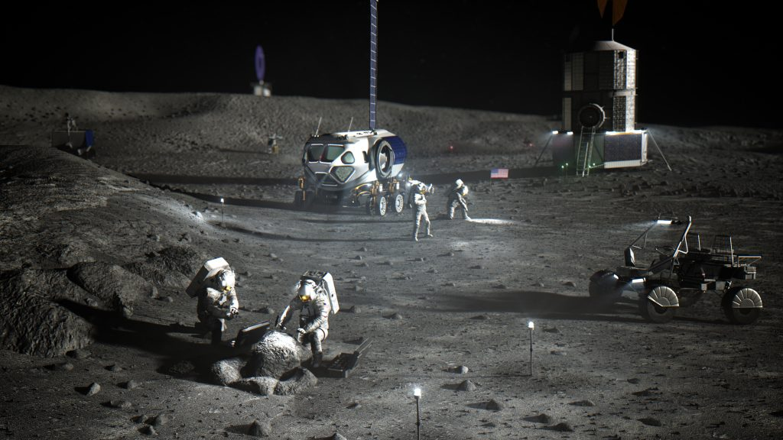
LEIA expected outcomes
Determine cellular sensitivity to the lunar environment.
Evaluate feasibility of bioproduction on the Moon.
Test genetic strategies to enhance cellular tolerance to the lunar environment.
Determine ground truth radiation risks for crew.
Image credits: NASA

Slide 16
Project team
A. Mark Settles (Principal Investigator)
Sergio Santa Maria (Deputy PI)
Donald M. Hassler (Co-I, SwRI)
Brandon Maryatt (PM)
Dave Pletcher (PM)
Science Team
Natalie Ball
Jared Broddrick
Jessica Chau
Natalya Dvorochkin
Jennifer Gil Acevedo
Diana Gentry
Aditya Hindupur
Jessica Lee
Lauren Liddell
Jack Miller
Cary Zeitlin
BioSensor Engineering Leads
Leandro James (Systems Engineering)
Earl Daley (Mechanical)
Shang Wu (Electrical)
Brandon Schmitt (Software)
Alex Szerszen (Thermal)
Mike Padgen (Fluidics)
Mini-FND Engineering (SwRI)
Traci Case (PM)
Bent Ehresmann
Kerry Neal
Brian Pyke
Michael Shoffner
Funding
NASA PRISM-2
NASA Space Biology

Slide 17
References/Background
Ball N., Kagawa H., Hindupur A., Sims K., Hogan J., Levri J. (2020) BioNutrients-1: Development of an On-Demand Nutrient Production System for Long-Duration Missions. ICES-2020-119. https://ttu-ir.tdl.org/handle/2346/86343.
Ball N., Hindupur A., Kagawa H., Kostakis A., Gresser A.L., Levri J.A., Sims K., Sharif S., Villanueva A.G., Donovan F., Settles A.M., Hogan J. (2021) BioNutrients-2: Improvements to the BioNutrients-1 Nutrient Production System. ICES-2021-331. https://ttu-ir.tdl.org/handle/2346/87260.
Ricco, Antonio & Santa Maria, Sergio & Hanel, Robert & Bhattacharya, Sharmila. (2020). BioSentinel: A 6U Nanosatellite for Deep-Space Biological Science. IEEE Aerospace and Electronic Systems Magazine. 35. 6-18. doi:10.1109/MAES.2019.2953760.
Santa Maria, S.R., Marina, D.B., Massaro Tieze, S., Liddell, L. C., Bhattacharya, S. (2020) BioSentinel: Long-Term Saccharomyces cerevisiae Preservation for a Deep Space Biosensor Mission. Astrobiology doi:10.1089/ast.2019.2073.

