Slide 1
GIS Spatial Analysis and Habitat Suitability Modeling Using Remote Sensing Data to Help Identify At-risk Populations of US Carolina Coastal Plain Endemic Venus Flytrap (Dionaea muscipula)
Kathryn Caruso, Jayne Lampley, Monika Rock, Ashna Siddhi, Seamore Zhu, John L. Randall, Damon Waitt, Alan Weakley, Sarah Payne, and Marguerite Madden
Botany 2022 – Anchorage, Alaska
Notes:
Good afternoon, Alaska! Thank you for attending my presentation. I’m coming to you today from Alabama. I will be presenting this work on habitat suitability modeling of the plant species Dionaea muscipula, or Venus flytrap, which was a collaboration between the NASA DEVELOP program and the University of Georgia NASA DEVELOP node and the North Carolina Botanical Garden. Katie Caruso, myself (Jayne Lampley), Mo Rock, Ashna Siddhi, and Seamore Zhu (listed alphabetically) represent the NASA DEVELOP team which conducted the study. Our co-authors Dr. Damon Waitt, Dr. Johnny Randall, and Dr. Alan Weakley of the North Carolina Botanical Garden and Herbarium of University of North Carolina - Chapel Hill provided resources and guidance throughout the project. Sarah Payne was our NASA DEVELOP Fellow and Dr. Marguerite Madden, professor at UGA’s Center for Geospatial Research, was our science advisor for the 10-week term project. The Natural Heritage programs of NC and SC also collaborated with us and provided up-to-date species occurrence data.
Hi all! Thank you for joining our presentation on the results of our NASA DEVELOP term. Over the past ten weeks, we mapped habitat suitability of the Venus flytrap and engaged in science communication to support the conservation of this species. In this presentation, we will introduce you to the Venus flytrap and its habitat, describe the results of our habitat suitability modeling, and share the deliverable we created as an education and outreach tool to communicate with the public about our work.
We are: Monika Rock (team lead, Katie Caruso, Jayne Lampley, Ashna Siddhi, and Seamore Zhu and we are based out of the NASA DEVELOP Georgia Node.
///////////
In this project, we partnered with three organizations to meet these objectives:
The North Carolina Natural Heritage Program, or NHP, gathers and shares information about rare species and natural communities in North Carolina to ensure public access to information necessary to evaluate the ecological significance of natural areas and the potential ecological impacts of conservation and development projects. This inventory helps guide decision-making that benefits society and the economy while minimizing ecological damage. The NHP collaborated on this project by sharing VFT presence data that the team used to train the habitat suitability model.
The UNC Herbarium is the premier collection of plant and fungi biodiversity in the Southeastern United States, with over 800,000 specimens dating back to the 1800's. Through data it preserves on plant identification and distribution, the Herbarium is a key resource for supporting plant science and conservation. In this project, the Herbarium shared information on VFT that informed suitability modeling.
The North Carolina Botanical Garden inspires understanding, appreciation, and conservation of plants and cultivates sustainable relationship between people and nature. The Botanical Garden protects plants native to North Carolina through plant propagation, seed banking and reintroduction, land restoration and protection, education, sustainable gardening, and by supporting relationships between people and nature. The NCBG collaborated with the DEVELOP team throughout the project by sharing information about the VFT and supporting our science communication effort. As the end user, the NCBG will receive habitat suitability maps that can inform their conservation efforts as well as public-facing outreach and education tools.

Slide 2
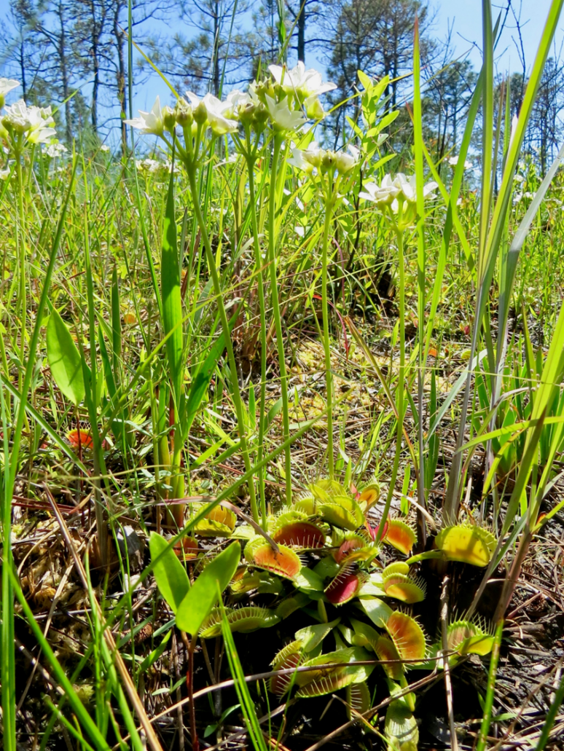
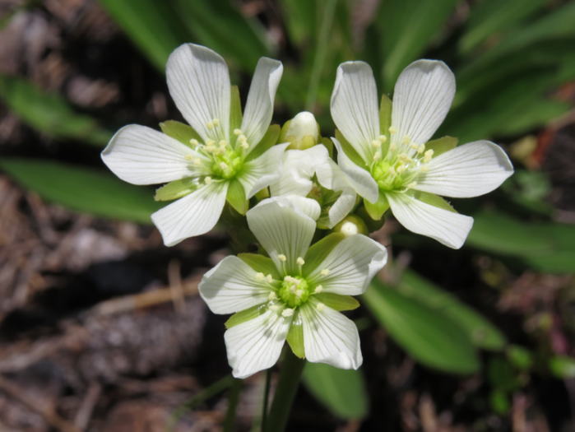
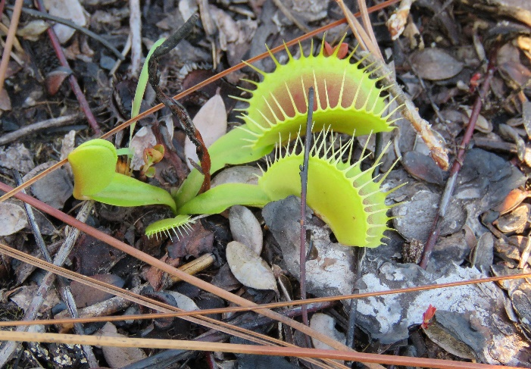
VENUS FLYTRAP (VFT)
(Dionaea muscipula)
"The most wonderful plant in the world"
— Charles Darwin
Droseraceae, Caryophyllales
Monotypic genus
Carnivorous – active snap-trap (modified leaves)
  Adaptation to obtain nutrients
  Waterwheel plant (Aldrovanda vesiculosa)
Perennial herb, 20+ yr. lifespan
Flower: May–June, Fruit: June–July
Pollination: Beetles, small flies, spiders
Seeds germinate without dormancy period; seedlings susceptible to drought conditions
Credits: Clyde Sorenson
Notes:
First an introduction to the species. Dionaea is a monotypic genus of the Droseraceae family. It is therefore evolutionarily important, but more notably because it is carnivorous. Further, its type of trapping mechanism is an active snap-trap which is only found in one other species: the closely related aquatic waterwheel plant, also of Droseraceae. Catching and digesting insect prey is an adaptation which allows Dionaea to thrive in low-nitrogen and low-phosphorous soils. Dionaea muscipula is herbaceous and perennial, often living 20 years or more in the wild. It flowers in the spring, May to June, and is in fruit from June through July. Little is known about pollination in the species, but it is thought to be accomplished by various beetles, small flies, and possibly spiders. Seeds germinate almost immediately or within a few months after falling from the fruits, which means that population survival requires a persistent presence of mature plants year after year and decent ground moisture levels.
//////////////////////////////
The NASA DEVELOP team created this project to support the conservation of the Venus flytrap, one of the most widely recognized plant species on Earth. These small perennial herbs, which live up to 20 years, captivated Charles Darwin, who described Venus flytraps as the most wonderful plants in the world. Among over 800 known carnivorous plants, the Venus flytrap is the only terrestrial species with leaf morphology evolved into an active snap trap capable of capturing and digesting insects, which supplements the poor nutrient content in the soils they grow. These leaves, which consist of two lobes (indicated by arrows in the video), are adapted with sensitive hairs around their margins that, when stimulated, trigger the two lobes of each leaf to snap shut around anything unlucky enough to be caught inside.
------------------------------Image Information Below ------------------------------
•Image credit for 3 photos: Clyde Sorenson
•Image Source: Images provided by project partner, used with permission

Slide 3
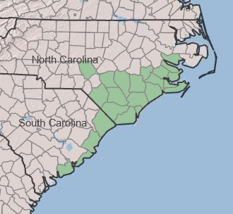
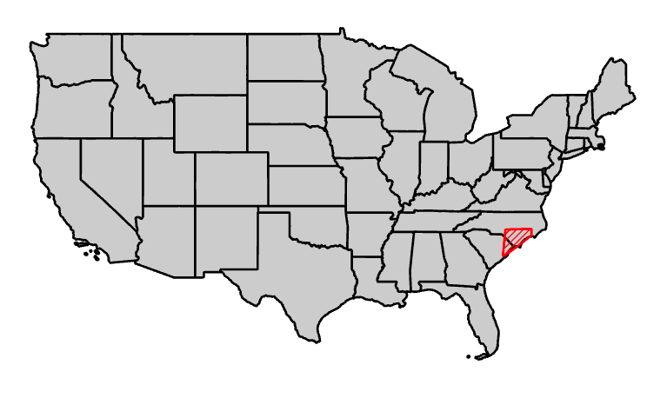
DISTRIBUTION
  Carolina Coastal Plain and Sandhills
  90 km radius of Wilmington, NC
  21 counties, 259 sites (historic)
  12 counties: 11 NC; 1 SC (extant)
  Introduced in FL & NJ
N
Wilmington
0
300 km
Credit: USDA-NRCS
Notes:
Though Venus flytrap is one of the most widely recognized plant species, it is endemic to a narrow portion of the Coastal Plain and Sandhills regions of North and South Carolina. Populations occur roughly within a 90 km radius around Wilmington, NC. Herbarium records document that Venus flytrap occurred in at least 21 counties at 259 sites historically, however occurrences have dwindled to only 11 counties in NC and one in SC today. Venus Flytrap has also been introduced and has naturalized in parts of FL and NJ.
------------------------------Image Information Below ------------------------------
•1st image credit: USDA NRCS
•Image Source: https://plants.usda.gov/home/plantProfile?symbol=DIMU4

Slide 4
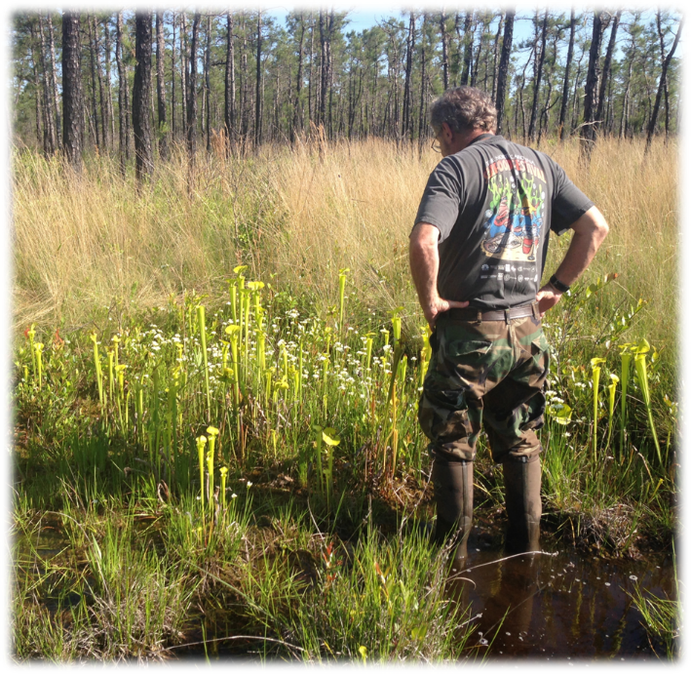
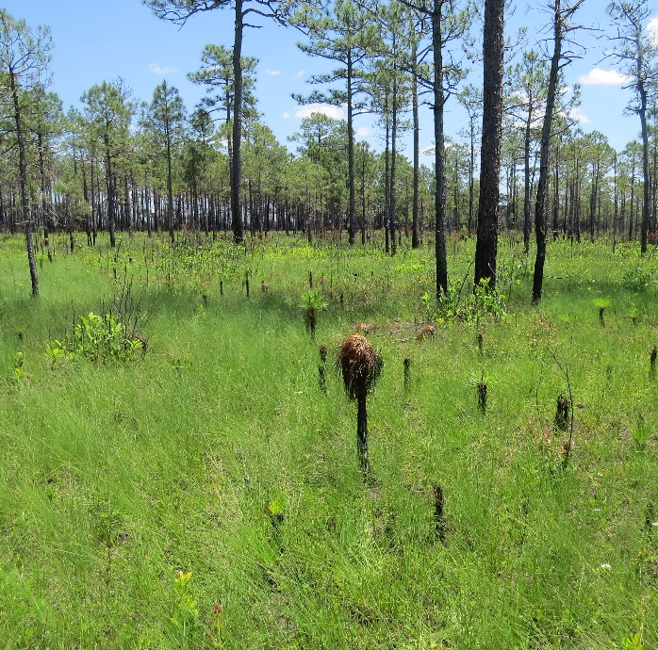
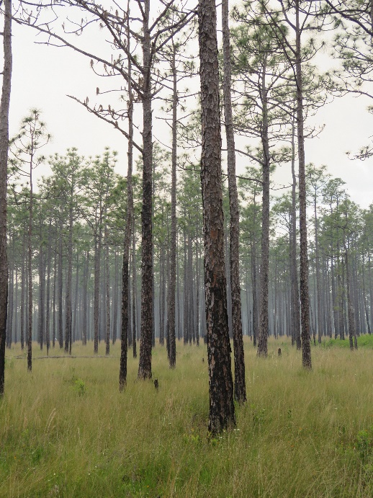
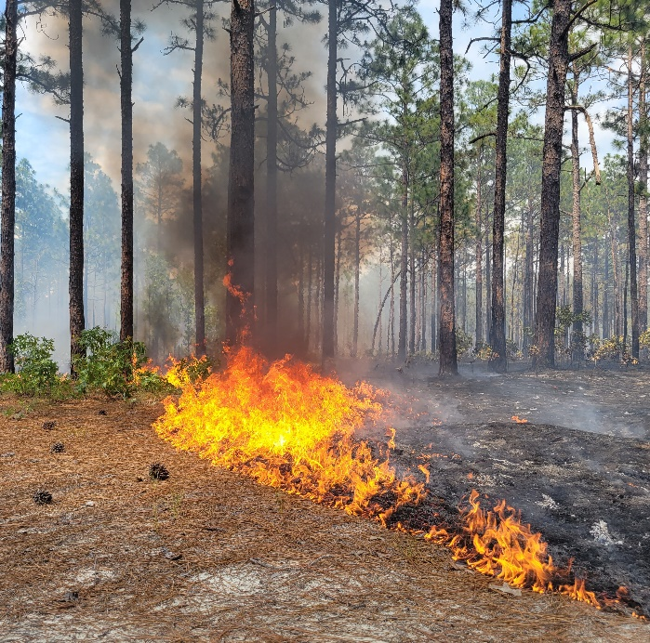
HABITAT
  Open canopy; shade intolerant
  Fire frequency of 3–5 years to reduce sunlight competition
  Wet savannas (e.g., longleaf pine), bogs, pocosins, wet ecotones, other wetlands
  Nutrient-poor soil (N, P)
  Peaty, sandy, acidic soils (2 m above an impermeable layer) with poor drainage
  Flat areas, relatively low elevation (2 –20 m above sea level)
Credits: Clyde Sorenson
Credit: Natalie Kerr
Notes:
Venus Flytrap has very strict habitat requirements. It requires an open canopy with full sunlight as well as frequent fires to reduce competition from other plants. Venus flytrap is typically found in wet savannas and pine flatwoods, bogs, pocosins and other wetlands. It thrives in nutrient poor soils. Two meter-thick layers of sandy or peaty soil typically overlie an impermeable layer of coastal plain sediment. Preferred Venus Flytrap habitat is usually flat and at 2-4 m above sea level although populations may be found as high as 20 m. This unique habitat preference makes Venus flytrap highly sensitive to fluctuations in the environment. (The Carolina coastal plain has a humid-subtropical climate.)
------------------------------Image Information Below ------------------------------
•1st, 2nd, 3rd image credit: Clyde Sorenson
•Image Source: Image provided by project partner, used with permission
•4th image credit: Natalie Kerr
•Image Source: Image provided by project partner, used with permission

Slide 5
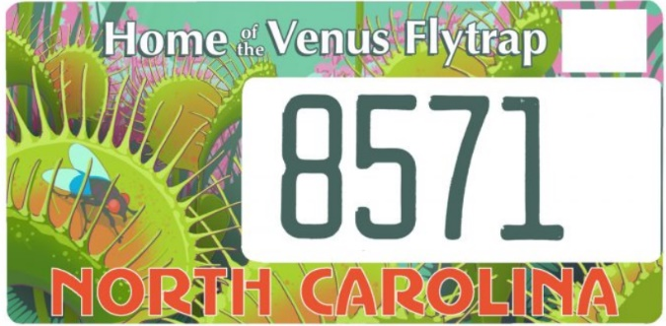
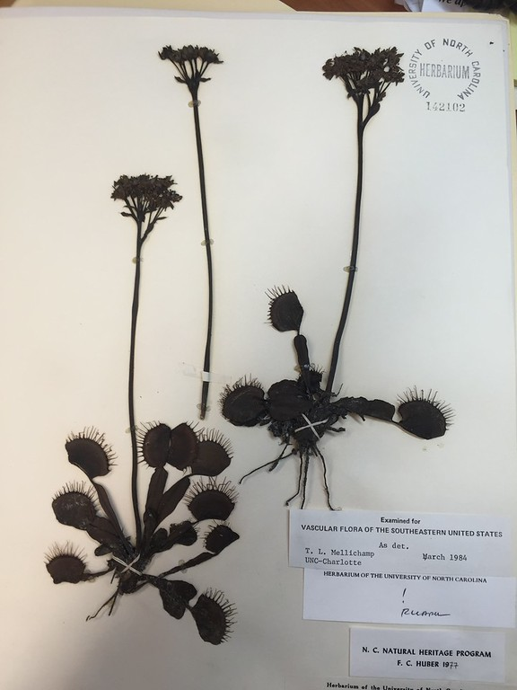
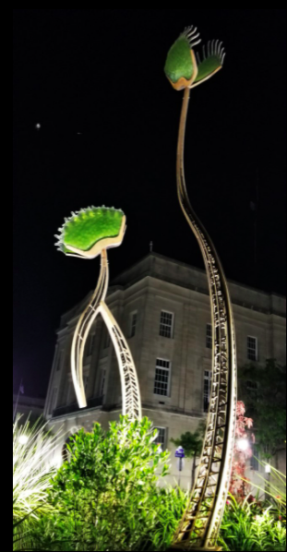
VFT POPULATIONS AT RISK
Surviving on Nature Conservancy lands, state-owned lands, and military bases
Threats to VFT populations:
  Fire suppression
  Poaching
  Habitat loss/ development
  Changes to hydrology
  Climate change
  Reproductive isolation/ Loss of genetic diversity
IUCN Red List: Vulnerable (VU)
NatureServe: G2 Imperiled
2014: VFT poaching a felony in NC
CITES Appendix II (Convention on International Trade in Endangered Species of Wild Fauna and Flora)
Credit: NCBG
Credit: NCBG
Credit: Johnny Randall
Notes:
Today, Venus flytrap populations survive mainly on protected Nature Conservancy and government owned lands. Threats to all populations include fire suppression, plant poaching, development, agriculture, altered hydrology due to drainage of wetlands, climate change and potential sea-level rise, and reduction of genetic diversity due to loss of habitat connectivity. In light of this, the IUCN Red List ranks the species as Vulnerable, and NatureServe lists it as G2, Globally Imperiled. Some protections are in place however: in 2014, NC passed a law making poaching of Venus flytrap a felony with penalties of prison time. Venus flytrap also received some international trade protections when it was listed on Appendix II of CITES, the convention on international trade in endangered species.
------------------------------Image Information Below ------------------------------
•Herbarium Image: North Carolina Botanical Garden (NCBG)
•Image Source: Image provided by project partner
License Plate Image: NCBG
Image Source: https://ncbg.unc.edu/support/venus-flytrap-license-plate/
Flytrap Statue Image: Dr. Johnny Randall
Image Source: Image provided by project partner

Slide 6
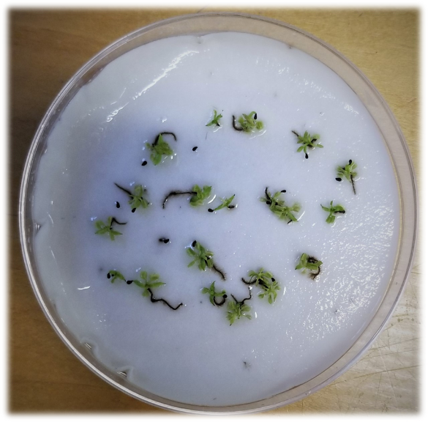
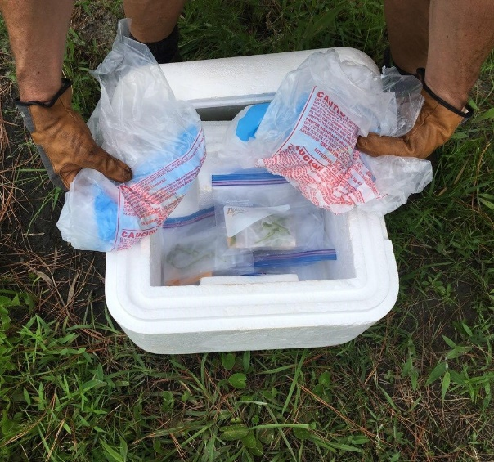
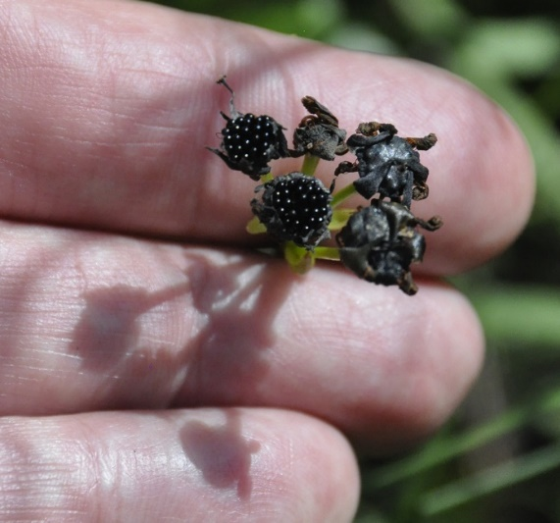
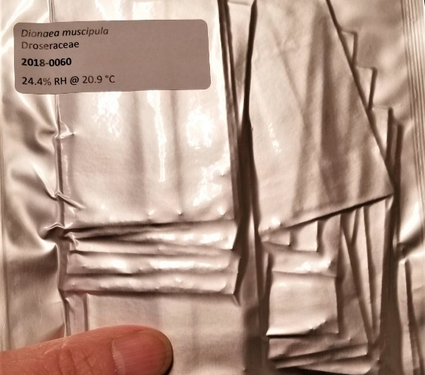
VFT CONSERVATION
NORTH CAROLINA BOTANICAL GARDEN (NCBG)
Research collaborations
  Surveying genetic diversity
  Pollinator/prey distinction of snap-traps
Seed banking (~300 rare species)
  Temp/humidity controlled room
Searching for new populations and locations to conserve
2016: 26 researchers submitted petition to list VFT as Endangered under 1973 Endangered Species Act
Credits: Johnny Randall
Notes:
The North Carolina Botanical Garden has been working to protect Venus flytrap for the last 50 years, in partnership with researchers, conservation groups and government agencies. Recent garden research projects include surveying Venus flytrap populations to determine genetic diversity and studies of how Venus flytrap plants differentiate between pollinator and prey insects. North Carolina Botanical Garden conservation efforts also include seed banking and searching for new populations. Additionally in 2016, researchers at the garden joined a group of botanists to petition the U.S. Government to list Venus flytrap as an endangered species to afford it federal protection status. This petition is likely to be ruled on in 2023. Last fall, in order to further advance these conservation efforts, the Garden partnered with our NASA DEVELOP Program ecological forecasting team to map potential suitable habitat for Venus flytrap.
------------------------------Image Information Below ------------------------------
•Image 1, 2, 3, and 4 credit: Johnny Randall
•Image Source: Images provided by project partner, used with permission

Slide 7
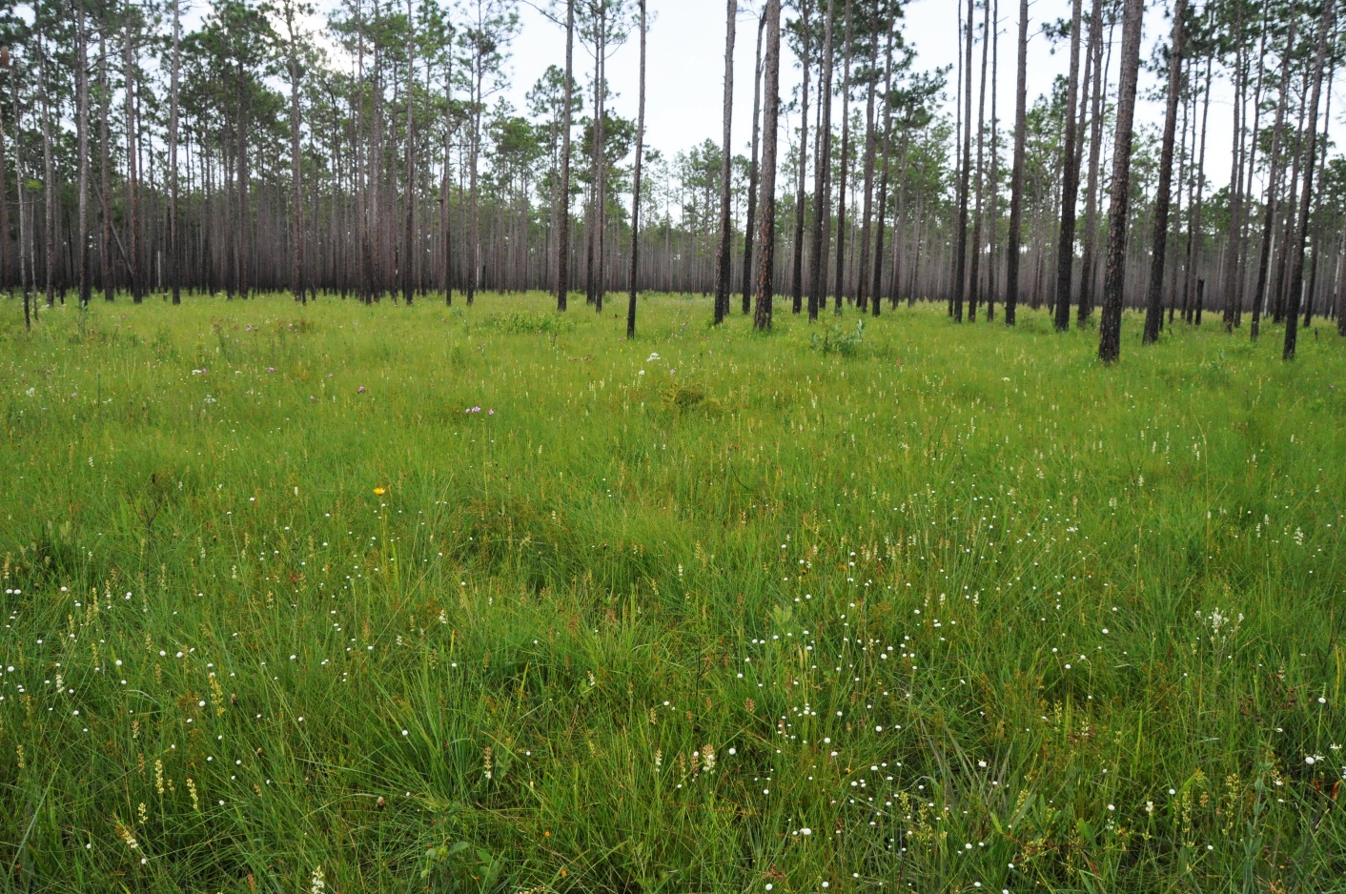
OBJECTIVES
Generate present-day (2021) map of suitable VFT habitat using habitat suitability models (HSM) created in SAHM software
Generate future (2050) land use map using TerrSet Land Change Modeler software
Credit: Johnny Randall
Notes:
Objectives of this project were to:
1. Generate a present-day (2021) map of suitable Venus flytrap habitat using habitat suitability models (HSM) created in SAHM (Software for Assisted Habitat Modeling) software
A Habitat Suitability Model quantifies preferred habitat for a species of interest. In other words, the model shows you where on the landscape a species can survive. The model is based on species occurrence points and environmental predictor variables. The SAHM software enabled us to develop a model and generate a map of suitable habitat for Venus flytrap based on those inputs.
2. The second objective was to generate a future (2050) land use map using TerrSet Land Change Modeler software to forecast potential gain or loss of habitat.
Land Change Modeling is a method for simulating changes in land cover in the future. This is done using both historic and current land use maps. The maps are then compared (‘subtracted’) to determine how land within the maps changed in the time between them. Based on differences in land cover between the maps, the program, in our case TerrSet, forecasts the potential of land to transition to another type of land cover at a specified date. TerrSet also uses predictor variables but, unlike environmental predictor variables used by SAHM, these variables explain key drivers behind land-use change.
------------------------------Image Information Below ------------------------------
•Credit images: Johnny Randall
•Image Source: Project partner provided with permission

Slide 8
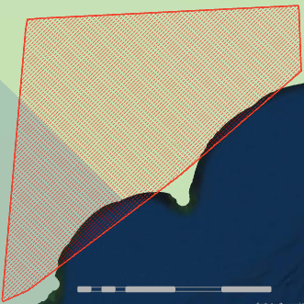
Defining the Study Area
Convex polygon around all known VFT locations
  400+ species occurrence points
  Herbarium records 100+ y.o.
10 km buffer to include any outliers
ArcGIS Pro shapefile
NC
SC
N
0
20
40
80
120 km
Notes:
The first step in our project was to gather species occurrence data for Venus flytrap populations and to define the study area. Location data were provided by the Natural Heritage programs of North and South Carolina and were based on exhaustive searches of herbarium records and years of field survey data. The data included more than 400 polygons representing current and historic Venus flytrap populations. Our study area was defined by creating a convex hull around all 400 polygons. As a best practice, we then extended the study area perimeter by 10 km. The total study area covered approximately 41,000 km2.
------------------------------Image Information Below ------------------------------
1. Images created by team

Slide 9
Methods: Habitat Suitability Model (HSM)
1
Gather species presence data
2
Collect predictor variables
3
Run software for assisted habitat modeling
Gather Species Presence Data
Over 400 polygons were gathered
Quality check: omitted likely extirpated populations and low accuracy data
252 points were retained for model runs
Notes:
The steps to successfully run the SAHM program are to gather and check species presence data and environmental predictor variables, plug them into the software, and run models to map suitable habitat.
Of the 400 polygons of current and historic Venus flytrap populations, approximately 252 points were used to train the model. Locations categorized as historic had not been observed in the last 40 years and were considered to be likely extirpated populations. These were excluded, so that our model would use the most current data to identify currently suitable habitat. Furthermore, data that had low accuracy or missing information were also excluded.
------------------------------Image Information Below ------------------------------
1. All clip art images: PowerPoint Icons
Image Source: PowerPoint

Slide 10
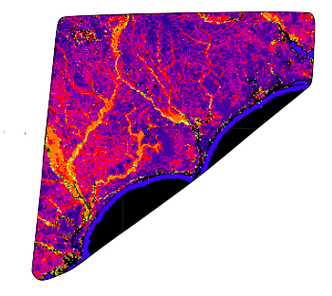
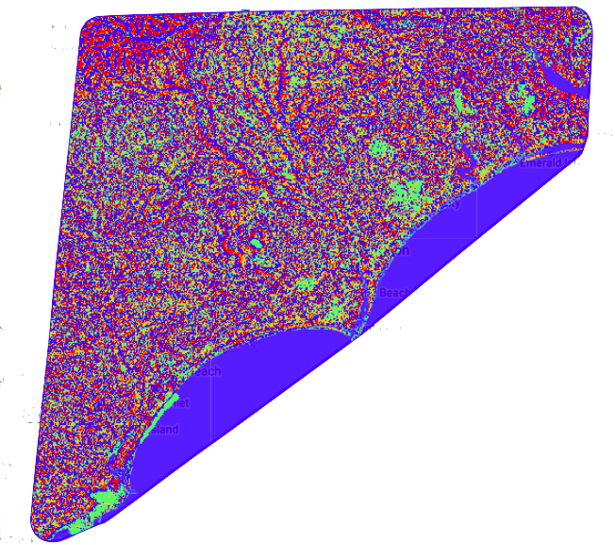
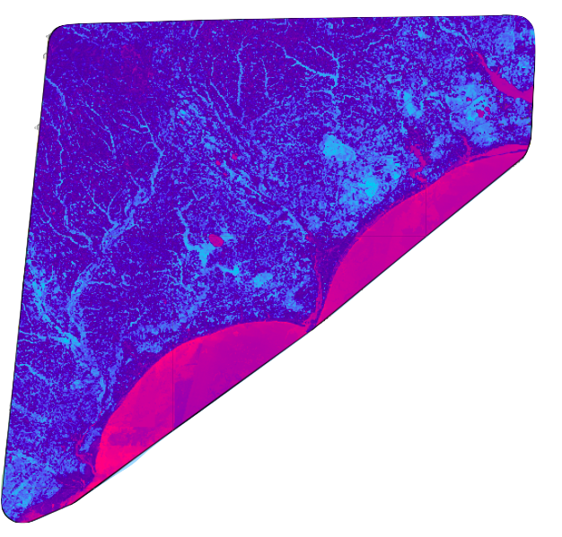
Methods: Predictor Variables
Vegetation Indices
NDVI is a measure of the state of plant health based on how the plant reflects light at specific frequencies
Fire Variables
LANDFIRE - Landfire (LF) Historical fire regimes, intervals, and vegetation conditions are mapped using the Vegetation Dynamics Development Tool (VDDT)
Topographic Variables MTPI distinguishes ridges from valley forms
Notes:
Environmental predictor variables were the next input to our models. These variables were gathered as raster layers of varying pixel resolution primarily from Google Earth Engine and ArcGIS Pro. Google Earth Engine hosts satellite imagery and geospatial datasets. The pixels in the raster layers each have a unique value correlating to the predictor variables themselves and are crucial in creating a habitat suitability model. For example, a precipitation layer will have a pixel indicating that one area gets 10cm of rainfall a year, whereas the pixel next to it gets 20cm of rainfall. These values are used by the model to calculate probability, showing for example that the species of interest might prefer 10cm of rainfall a year over 20cm.
Our predictor variables included burn indices because of the Venus flytrap's dependence on frequent fire. Pictured here is an example of one layer pulled from the LANDFIRE dataset.
***** CUE ANIMATION 1
Topographic Variables such as multi-scale topographic position index or MTPI is shown here. MTPI distinguishes ridges from valley forms and is one of many topographic variables we included.
***** CUE ANIMATION 2
Many Vegetation Indices were also included. This example shows NDVI. NDVI is often used to distinguish plant health.
------------------------------Image Information Below ------------------------------
1. All clip art images: PowerPoint Icons
Image Source: PowerPoint
2. Map imaged were all created by the team

Slide 11
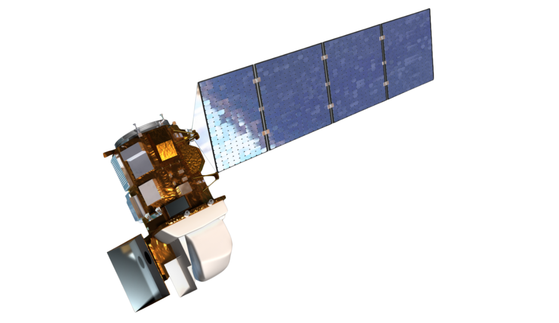
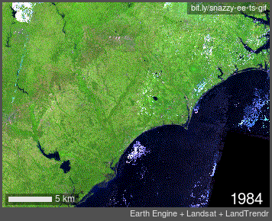
Methods: Predictor Variables & Satellites
Landsat 8 TIRS
Surface temperature
Sentinel-2 MSI
Vegetation indices
Terra MODIS
Surface temperature
ALOS PALSAR
Topographic variables
Other datasets
Soil
Fire
Land cover
Canopy cover
Precipitation
Image Credit: NASA & Earth Engine - LandTrender
Notes:
Many of our predictor variables were gathered from remotely sensed satellite imagery from multiple satellites and sensors. For example, we used the Thermal Infrared Sensor on Landsat 8 for land surface temperature, the Multispectral Instrument on Sentinel-2, a European Space Agency Satellite, for vegetation indices, the Moderate Resolution Imaging Spectroradiometer on Terra for surface temperature as well, and the Phased Array type L-band Synthetic Aperture Radar on the Advanced Land Observation Satellite, a Japanese Aerospace Exploration Agency satellite, for topographic variables,.
We gathered other datasets on soil from USDA SSURGO and International Soil Reference and Information Centre World Soil Information, fire regimes from LandFire, land cover from the USGS National Land Cover Database, canopy cover from Landsat Vegetation Continuous Fields, and precipitation from Climate Hazards Group. In all, we gathered 50 different predictor variables to use as inputs for our model.
------------------------------Image Information Below ------------------------------
1. Landsat 8 OLI Credit: NASA
- Image Source: https://landsat.gsfc.nasa.gov/landsat-8/landsat-8-overview
2. Earth Engine-Landsat-LandTrendr Gif
NASA
https://landsat.gsfc.nasa.gov/outreach/make-landsat-gif
https://emaprlab.users.earthengine.app/view/lt-gee-time-series-animator

Slide 12
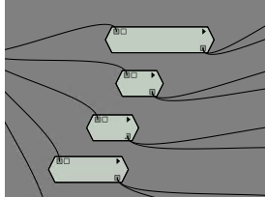
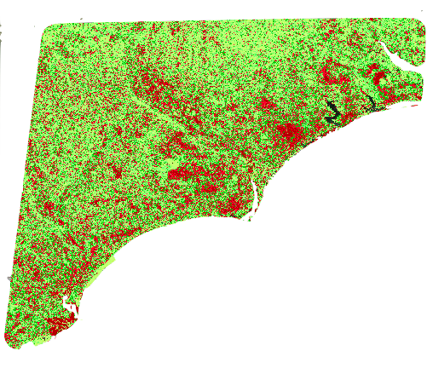
SOFTWARE FOR ASSISTED HABITAT MODELING
INPUTS
MODELS
Boosted regression tree
Random Forest
Generalized linear model
MARS
Maxent
1
Species presence data
N=252
2
Predictor variables
N=22
HOW IT WORKS
Uses the pixel value for each layer at different presence points to calculate probability
Identifies suitable habitat across the study area based on these calculations
OUTPUT
Habitat suitability model for VFT in study area
Notes:
The next step was running our data through SAHM. The software is able to take the presence points and theoretically 'drop a pin' through all our predictor variables. It can then calculate the 'ideal' habitat for Venus flytraps by grabbing these numbers from each layer corresponding to where our presence points are. Because the point data used to train the model were presence-only data based on documented populations, 3000 background points were generated as pseudo-absence points to compensate for the lack of absence data
Once it calculates the 'ideal' habitat, the program runs through five modeling algorithms: Boosted Regression Tree, Random Forest Model, Generalized Linear Model, MARS, and Maxent. In the upper right-hand side of the screen, you can see the pathways for four of our models. SAHM is set up through these pathways, called pipelines, allowing us to run all the models simultaneously. These models all function a little differently and are commonly used in habitat modeling. The outputs from SAHM are three different Habitat Suitability Models, from which we can choose the best model for our purposes, or the one that is the best fit.
------------------------------Image Information Below ------------------------------
Image: Screen Grab from SAHM
•All clip art images: PowerPoint Icons
•Image Source: PowerPoint

Slide 13
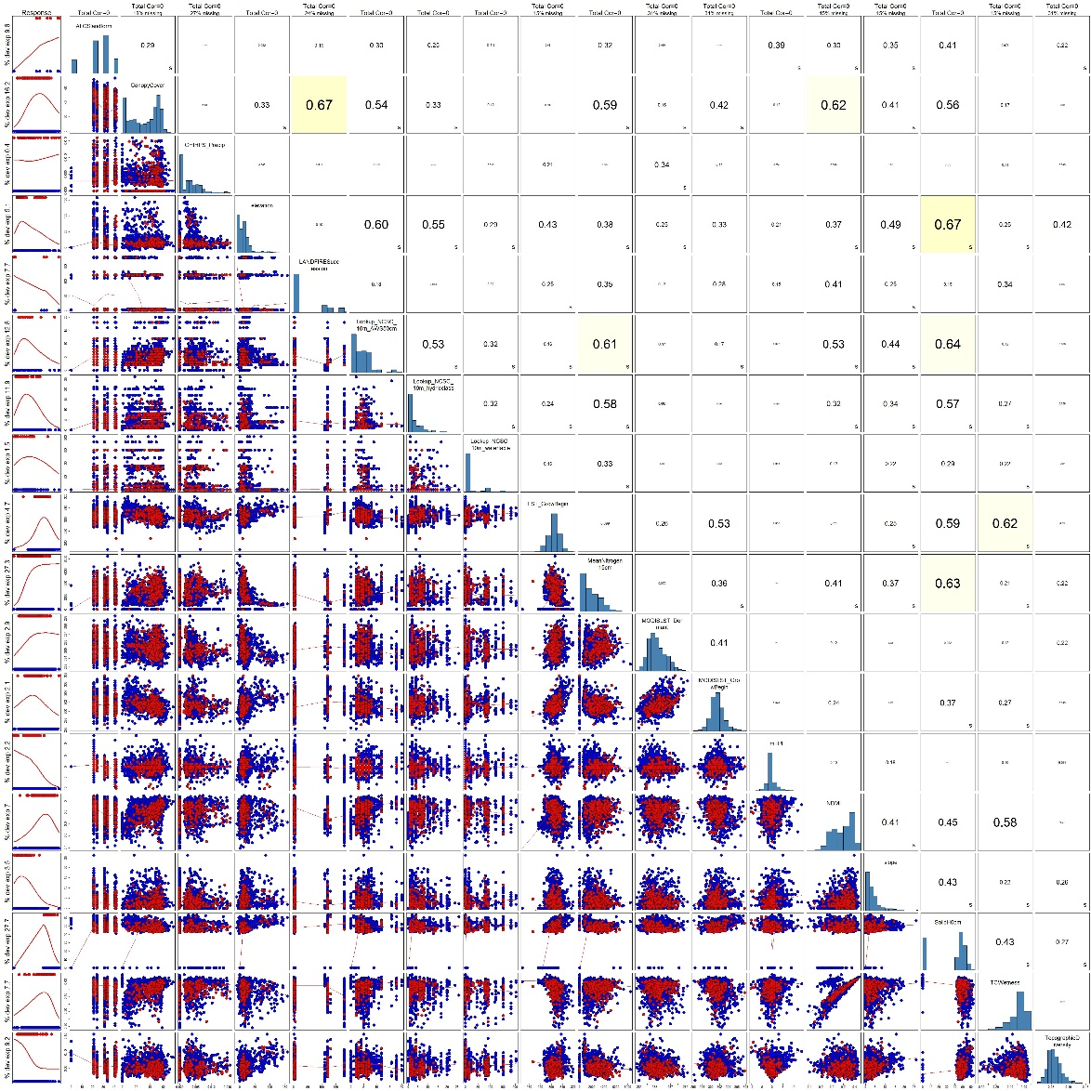
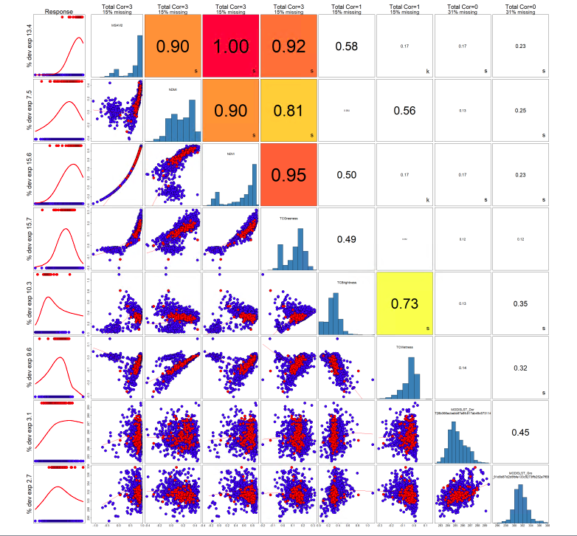
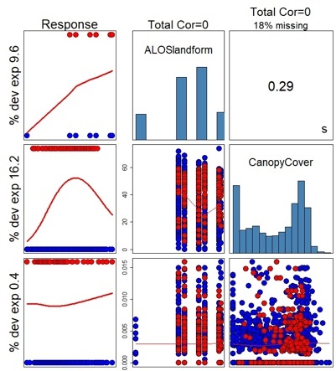
Predictor Variables for Final Run
Covariate Correlation Display
Variable and Response
Correlation
Notes:
Prior to the completion of the model, SAHM gives the user power to choose and set aside variables that are over correlated. This step is called The Covariate Correlation and Selection. Any variable with over .7 or 70% correlation is considered too high and one needs to be dropped from the model.
Here on the left we have a screen shot of SAHM prior to eliminating over correlated variables. This chart can be hard to interpret but the variables are listed in the boxes with blue bar graphs and they correspond with each other at each intersection.
SAHM also color codes variables that may be over correlated, with Red being the highest. The Red 1 box is showing that two variables, NDVI and MSAVI2 are 100% correlated, which makes sense because they were derived from the same data and both showing a different Vegetation Indices. Moving forward with this model we would remove one of these variables based on its % deviance explained. The % deviance explained is how influential the variable was in predicting suitable habitat at presences points or how much the model is weighing that particular variable.
On the right hand side of the screen you can see a zoomed in area of this chart. The most important factor for us to look at when choosing variables is the correlation. Here it shows Landform and Canopy Cover being .29% correlated which is perfectly fine for our model so both variables were kept.
***CUE ANIMATION 1
Finally, we have a very zoomed out covariate and correlation chart showing the final predictors in our models, we will walk through these on the next slide, but notice the lack of bright colors! We have no variables that correlate above .7.
------------------------------Image Information Below ------------------------------
1. All clip art images: PowerPoint Icons
Image Source: PowerPoint

Slide 14
Methods: Predictor Variables
 | SOURCE | SCALE/RES
Elevation | JAXA’s ALOS DSM | 30m
Slope | JAXA’s ALOS DSM | 30m
Topographic Diversity (TD) | JAXA’s ALOS DEM | 30m
Landform | JAXA’s ALOS DEM
CHILI Continuous Heat Insolation Index | JAXA’s ALOS DEM | 30m
MTPI Multi-Scale Topographic Position Index | JAXA’s ALOS DEM-AVE Band | 30m
Precipitation | Climate Hazards Group CHIRPS | 5566m
Soil Type (Taxonomic Class) | USDA gSSURGO | 10m
Available Water Storage 0-25cm | USDA gSSURGO | 10m
Available Water Storage 25-50cm | USDA gSSURGO | 10m
Flood Frequency Maximum | USDA gSSURGO | 10m
Drainage Class | USDA gSSURGO | 10m
Ponding Frequency (Presence) | USDA gSSURGO | 10m
Water Table Depth (Apr-Jun Min.) | USDA gSSURGO | 10m
Hydric Class | USDA gSSURGO | 10m
Soil Moisture | USDA gSSURGO | 10m
Notes:
Here are all 22 variables that we chose to keep in the model after the Covariate correlation and selection tool.
------------------------------Image Information Below ------------------------------
1. All clip art images: PowerPoint Icons
Image Source: PowerPoint

Slide 15
Methods: Predictor Variables
 | SOURCE | SCALE/RES
Hydric Class | USDA gSSURGO | 10m
Soil Moisture | USDA gSSURGO | 10m
Mean Nitrogen (5, 15, 30 cm) | OpenLandMap ISRIC | 250m
Soil pH (0, 10, 30 cm) | OpenLandMap ISRIC | 250m
Soil Texture (0, 10, 30 cm) | OpenLandMap ISRIC | 250m
Clay Content (0, 10, 30 cm) | OpenLandMap ISRIC | 250m
Sand Content (0, 10, 30 cm) | OpenLandMap ISRIC | 250m
Fire: % Low Severity | LANDFIRE | 30m
Fire: % Mixed Severity | LANDFIRE | 30m
Fire: % Replacement Severity | LANDFIRE | 30m
Fire: Historical Mean Interval | LANDFIRE | 30m
Fire: Historical Regimes | LANDFIRE | 30m
Fire: Veg Departure from Historical | LANDFIRE | 30m
Fire: Veg Succession Classes | LANDFIRE | 30m
Fire: Veg Classes | LANDFIRE | 30m
Notes:
all 22 variables continued.... ( that we chose to keep in the model after the Covariate correlation and selection tool)
------------------------------Image Information Below ------------------------------
1. All clip art images: PowerPoint Icons
Image Source: PowerPoint

Slide 16
Methods: Predictor Variables
 | SOURCE | SCALE/RES
Land Cover | National Land Cover Database
Waterways GLCF: Landsat Global Inland Water | Landsat 8 | 30m
NDVI Normalized Differenced Vegetation Index | Sentinel-2 | 10m/30m
MSAVI2 Modified Soil Adjusted Vegetation Index | Sentinel-2 | 10m
NDWI Normalized Differenced Wetness Index | Sentinel-2 / Landsat | 10m/30m
NLCD Vegetation | GAP/CONUS | 30m
Existing Vegetation Cover |  | 30m
Tree Cover | Landsat 8 (For 2000, 2005, and 2010) | 30m
Tassel-Cap Brightness | Sentinel-2 | 10m
Tassel-Cap Greeness | Sentinel-2 | 10m
Tassel-Cap Wetness | Sentinel-2 | 10m
Land Surface Temperature | Terra MODIS | 250m
Land Surface Temperature | Landsat 8 TIRS | 30m
Notes:
all 22 variables continued.... ( that we chose to keep in the model after the Covariate correlation and selection tool)
(Existing Vegetation Cover was from LANDFIRE)
------------------------------Image Information Below ------------------------------
1. All clip art images: PowerPoint Icons
Image Source: PowerPoint

Slide 17
Methods: Future Modeling
Using TerrSet: Land Change Modeler
Collect future predictor variables
Run software to generate map of potential land cover change
Notes:
Moving on to our second objective, future modeling, we used Land Change Modeler within TerrSet to generate a future potential land cover change map for the year 2050 using different predicted variables that explained the change.
------------------------------Image Information Below ------------------------------

Slide 18
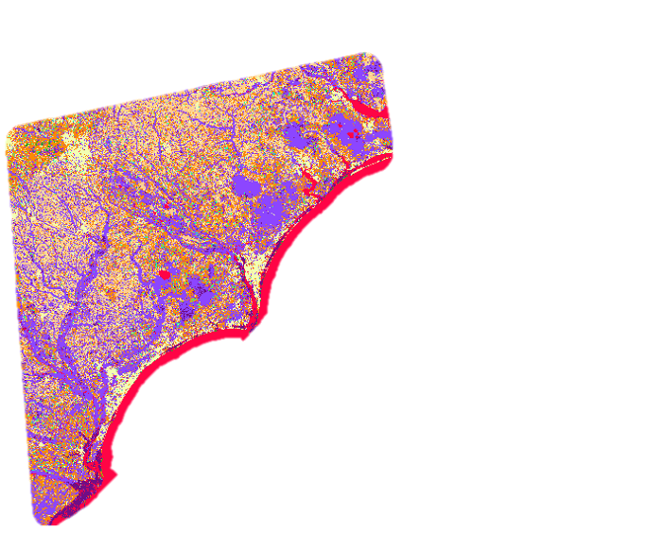
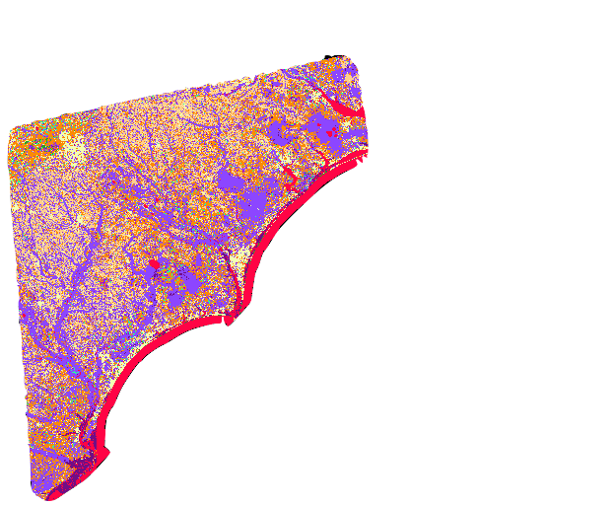
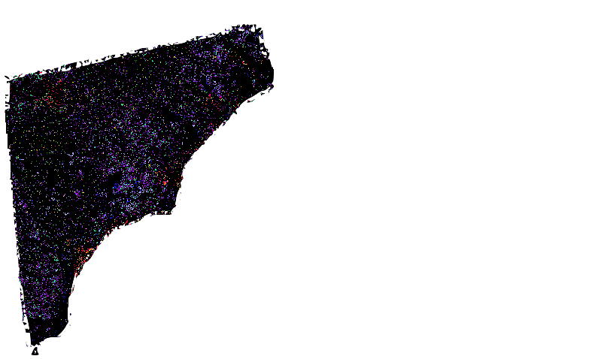


Methods: TerrSet Land Change Modeler
2001 Land Cover
2019 Land Cover
Land Cover Change Map
Open Water
Developed
Barren Land
Forest
Shrubs
Grassland
Cultivated/Planted
Woody Wetland
Herbaceous Wetland
Forest to Developed
Shrubs to Developed
Cultivated to Developed
Woody Wetland to Developed
Shrubs to Forest
Grassland to Forest
Cultivated to Forest
Forest to Shrubs
Notes:
First, we input two landcover maps: the first map was a past landcover for the year 2001 and the second was the most recent available land cover which was created from data captured in 2019. Based on these inputs, we generated a land cover change map for the same time period that is being shown on the right side. We then further analyzed the change map to understand the major landcover transitions of interest.
Based on our analysis and knowledge of Venus flytrap, we concluded that development was a major cause of habitat loss for Venus flytrap. We, hence, focused on modeling areas of transition to developed regions. To accomplish this modeling, we collected four main explanatory variables that were likely to be major driving forces for development.
------------------------------Image Information Below ------------------------------
1. All clip art images: PowerPoint Icons
Image Source: PowerPoint

Slide 19
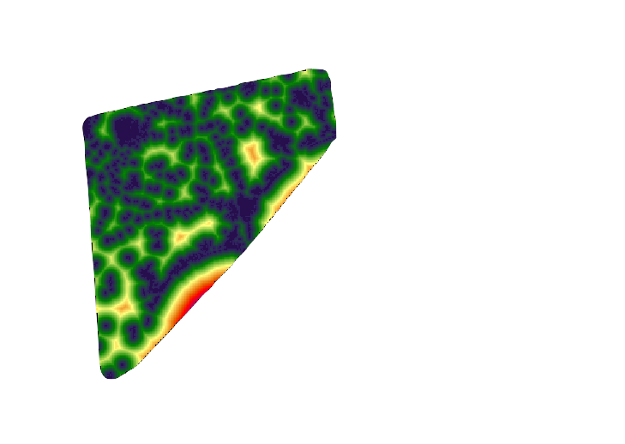
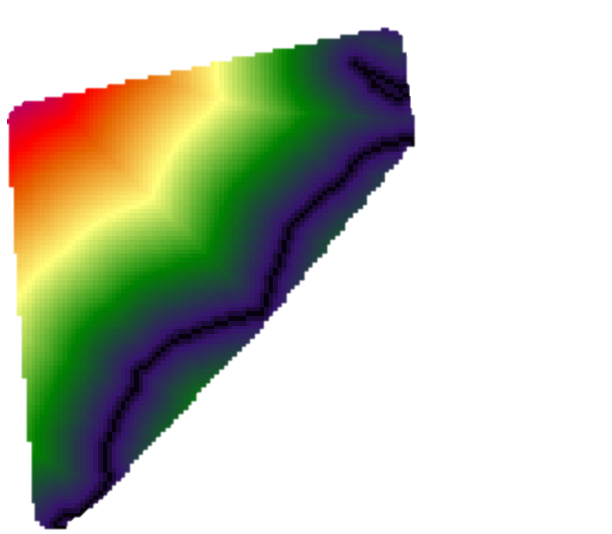
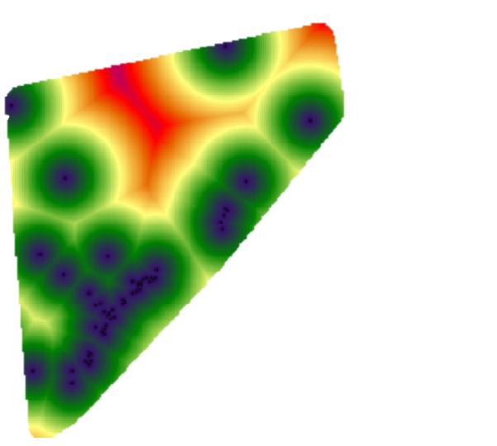
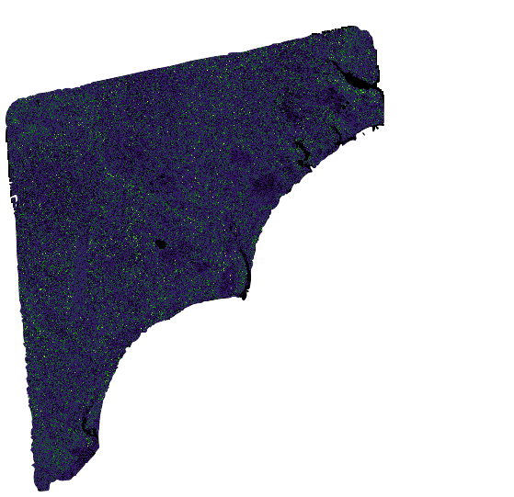
Methods: Explanatory Predictor Variables
Distance to Coast
Slope
Distance to Golf Course
Distance to Urban
Areas
Notes:
These explanatory variables were distance to coast,
**Cue to click**
distance to golf course,
**Cue to click**
slope,
**Cue to click**
distance to urban area/cities.
Explanatory variables were imported from ArcGIS online and preprocessed in ArcGIS Pro.
------------------------------Image Information Below ------------------------------
1. All clip art images: PowerPoint Icons
Image Source: PowerPoint

Slide 20
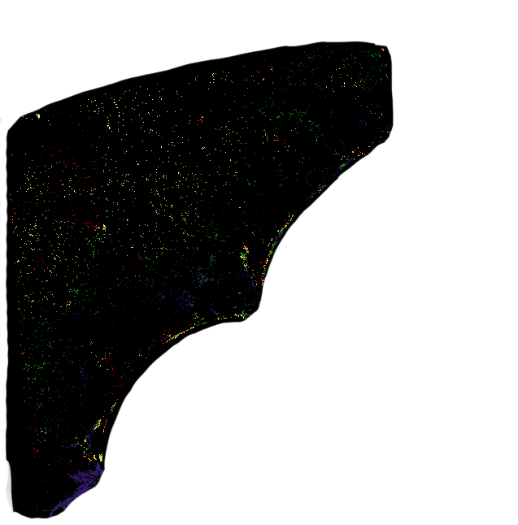
Methods: TerrSet Land Change Modeler
1
HOW IT WORKS
Random sample of pixel that experienced the change is created as a training site
Weights are applied to each variables
Quantity of change in each transition is modeled
Two landcover maps
2
Predictor variables
MODELS RUN
Multi-Layer Perceptron (MLP)
OUTPUT
Transition Potential Models
Future Potential Transition Map
Herbaceous to Developed
(Transition Potential Model)
Notes:
Once we had our four predictor variables, we used the multi-layer Perceptron (MLP) neural network, which is a machine learning technique, to generate transition models.
We then used these models to generate our final future potential transition map for the year of 2050. Since the final map will be used for habitat assessment, a soft prediction model was used to generate the final landcover map of vulnerability to change.
------------------------------Image Information Below ------------------------------
1. All clip art images: PowerPoint Icons
Image Source: PowerPoint

Slide 21
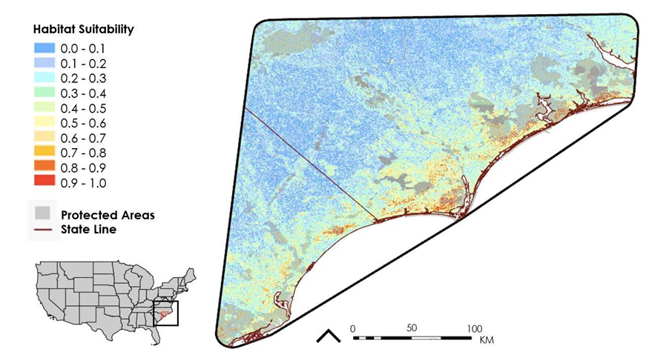

Results: 2021 RF HSM
Most Important Variables:
Soil data: available water storage (25-50 cm depth)
Mean nitrogen (15 cm depth)
Vegetation cover
N
Notes:
Here are our results. This model is RF, or random forest, and was chosen to run the best fit model.
To select the most appropriate model for predicting suitable habitat for Venus flytrap among the five models run, we considered area under the curve (AUC), the calibration plot for the cross-validation split, response curves for each predictor variable used, and the spatial pattern of deviance residuals.
For RF the most important predictor variables were, in order of importance: 1) available water storage from a depth of 25-50cm; 2) mean nitrogen at a depth of 15cm; and 3) existing vegetation cover.
***CUE ANIMATION
As it is hard to see detail at this resolution, we have zoomed into an area of our study in this screen grab.
------------------------------Image Information Below ------------------------------
1. All clip art images: PowerPoint Icons
Image Source: PowerPoint

Slide 22
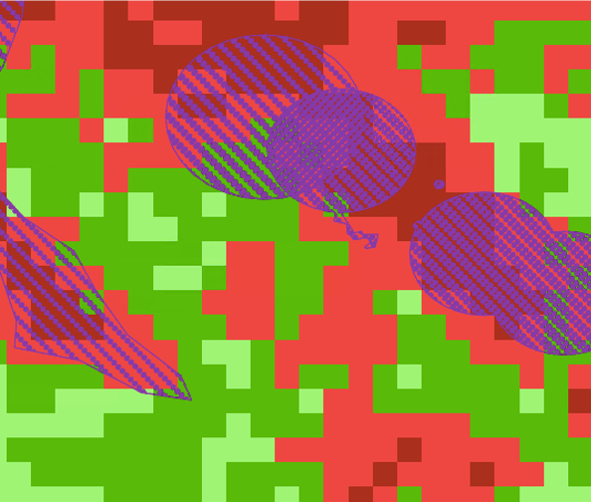
Results: 2021 BRT HSM
N
Suitability of Habitat
Presence Data
Very Low
Low
Medium
High
Very High
0
50
100
m
Notes:
As it is hard to see detail at this resolution, we have zoomed into an area of our study in this screen grab. Here, from the BRT HSM results, you can see Venus flytrap presence points, indicated in the purple polygons, overlapping with areas identified in the model to contain highly suitable habitat. Highly suitable habitat in this map is indicated in red whereas habitat with low suitability are indicated in dark green.
BRT Important Variables:
Soil data
LANDFIRE
Topography
NDMI
Vegetation indices
------------------------------Image Information Below ------------------------------
1. All clip art images: PowerPoint Icons
Image Source: PowerPoint

Slide 23
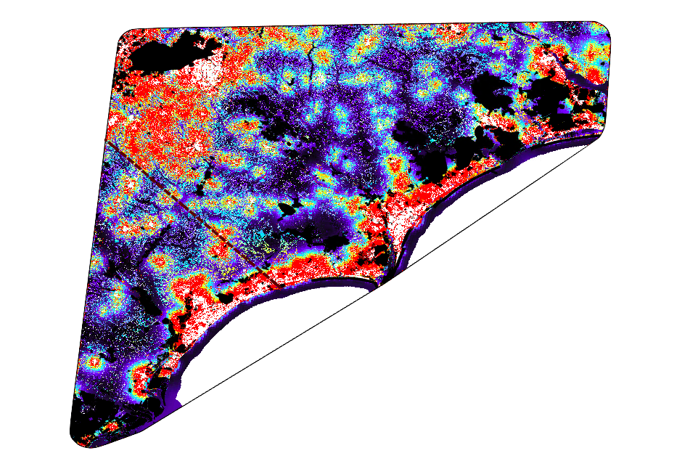

Results: 2050 Potential Transition Map
N
Factors Driving
Development:
Proximity to coast
Proximity to current cities
Proximity to golf courses
Probability of Development
High
Medium
Low
Protected
0
25
50
km
State Boundary
Notes:
This is our TerrSet Land Transition Map, which shows the potential of the land cover to become developed by 2050.
Areas in red shows the highest probability to change to developed land cover, whereas areas in the blue show the lowest potentiality of being developed. Protected areas, in which development will not occur, are cut out in black. Ashna explained, the primary factors identified to drive land development were proximity to the coast, expansions of current towns and cities, and the growth of golf courses. These factors were used as explanatory variables in the model.
------------------------------Image Information Below ------------------------------
1. All clip art images: PowerPoint Icons
Image Source: PowerPoint

Slide 24
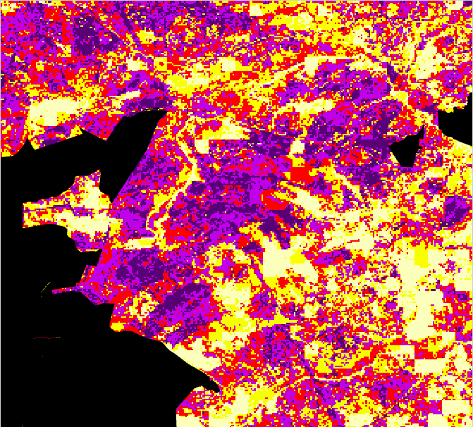
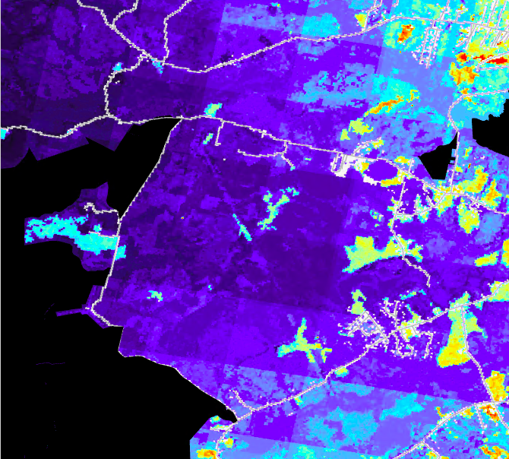
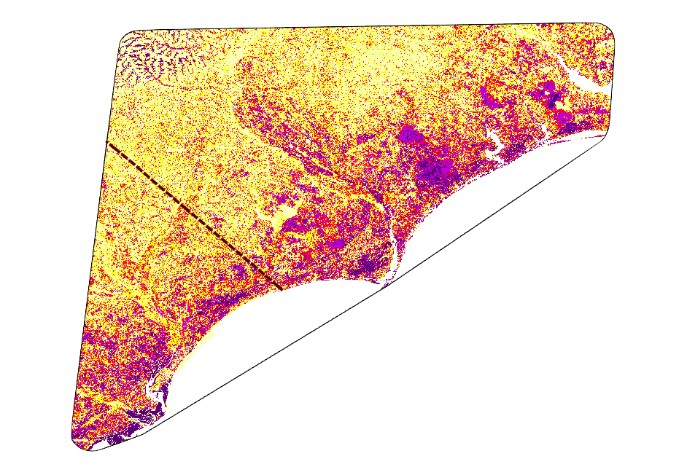
Results: Comparing HSM & Potential Transition
HSM
Potential Transition
Areas with suitable habitat and low probability of being developed
N
Suitability of Habitat
0
0.5
1
km
Probability of Development
Very Low
Low
High
Medium
Medium
High
Very High
Low
Protected
0
50
100
km
Notes:
Here is a closer look at an overlapping area in the habitat suitability map and potential transition maps.
These two maps are taken from the coastline of North Carolina, indicated by the small red box on the map in the lower right. In the habitat suitability map, you can see an area that has a high probability of containing suitable habitat. The land change transition map on the right illustrates a low probability of development between now and 2050 in the same area. These low risk areas may serve as enduring habitat and a safer investment of conservation efforts.
------------------------------Image Information Below ------------------------------
1. All clip art images: PowerPoint Icons
Image Source: PowerPoint

Slide 25
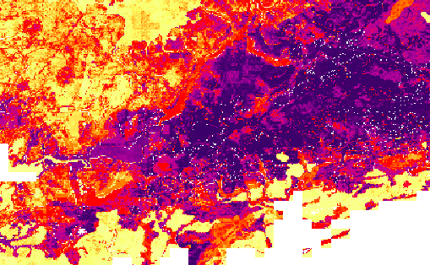
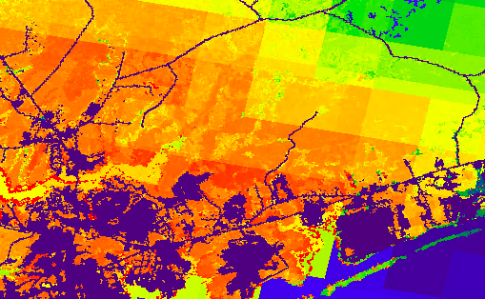
Results: Comparing HSM & Potential Transition
HSM
Potential Transition
Areas showing future conflict between suitable habitat and development
0
2.5
5
km
Suitability of Habitat
N
Probability of Development
Very Low
High
Low
Medium
Medium
High
Low
Very High
Protected
0
50
100
km
Notes:
These two maps, on the other hand, depict conflict between highly suitable habitat and likely future development. On the habitat suitability map, you can see an area with a high probability of suitable habitat. The same area is forecasted to transition to developed land cover by 2050, which is illustrated in the land change transition map on the right.
These potential conflict zones occur largely along the coast where development is most likely, and reveal the populations which are at the greatest risk of local extirpation.
------------------------------Image Information Below ------------------------------
1. All clip art images: PowerPoint Icons
Image Source: PowerPoint
2. Maps made by the team.

Slide 26
Results: Areas of Interest and Potential Conflict
Comparing the 2021 RF HSM and 2050 Potential Transition Map
 | Area
>80% Probable Suitable Habitat | 355 km²
>50% Land Change Potential by 2050 | 7532 km²
Protected >80% probable suitable habitat | 140 km²
Overlap between predicted suitable habitat and development potential | 107 km²
40% of highly suitable habitat already on protected lands
30% of highly suitable habitat threatened by development by 2050
50% of highly suitable habitat on unprotected land predicted to transition by 2050
Notes:
Approximately 355 square kilometers in the study area have 80% or greater probability of containing suitable habitat. Based on the Land Transition Potential Map, 7,532 square kilometers of land are forecasted to become developed by 2050. >80% probable suitable habitat on currently protected lands is approximately 140 km² There are 107 square kilometers of land with a high probability of containing suitable habitat and high potential to transition to developed land.
Percentage of > 80% probable suitable habitat on currently protected lands is 39.4%. There is also a 30% conflict between predicted suitable habitat and forecasted land development by 2050. Finally, the percentage of >80% probable suitable habitat on unprotected land predicted to transition by 2050 is 49.8%.

Slide 27
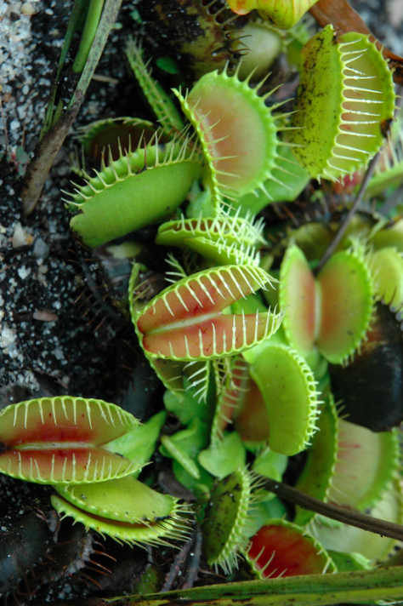
CONCLUSIONS
SAHM and TerrSet
  Map of current suitable VFT habitat
  Map of suitable habitat at greatest risk of future development (esp. outer coastal areas)
Random Forest model
Predictor variables: available water storage; mean nitrogen; existing vegetation cover.
Finding undocumented populations or locations for reintroduction
Identify most at-risk populations to development
Assists in land management decisions; identify best investment of conservation efforts
Credit: NCBG
Notes:
In conclusion, current habitat suitability maps overlaid with future land change maps allow us to identify currently suitable habitat and areas that are most likely to be developed. Random Forest was the best fit model for our data. Important predictor variables for VFT were 1) available water storage 25-50cm; 2) mean nitrogen 15cm; and 3) existing vegetation cover.
Although as of July 2022, new populations have not been discovered yet, the information in these maps is a powerful tool for assessing locations of undocumented populations, current populations most at-risk of development, best investments for conservation land purchases, and locations of enduring habitat for reintroduction efforts.
------------------------------Image Information Below ------------------------------
1. VFT Image: North Carolina Botanical Garden
Image Source: Received from Partners

Slide 28
Misty Buchanan, North Carolina Natural Heritage Program
Meredith Wojcik, North Carolina Natural Heritage Program
Dale Suiter, U.S. Fish and Wildlife Service
Sarah McRae, U.S. Fish and Wildlife Service
Stephanie Horton, North Carolina Natural Heritage Program
Joseph Lemeris, South Carolina Natural Heritage Program
Keith Bradley, South Carolina Natural Heritage Program
Dr. Clyde Sorenson, North Carolina State University
Notes:
With that, we want to thank everyone that contributed to our project, listed here…

Slide 29
Dr. Natalie Kerr, Duke University
Laura Hamon, North Carolina State University
Julie Moore, Venus Flytrap Champions
Peder Engelstad, Colorado State University
Alex Posen, NASA DEVELOP
Dr. Kenton Ross, Mentor NASA DEVELOP National Program Office
Sean McCartney, Mentor, SSAI, NASA Goddard Space Flight Center
An ArcGIS StoryMap entitled “Sweet Home Carolinas” may be found at https://storymaps.arcgis.com
This material contains modified Copernicus Sentinel data (2020 – 2021), processed by ESA.
Notes:
And here…
Also, we shared the results of our study through a public facing ArcGIS StoryMap in order to support the conservation of the VFT and the mission of the North Carolina Botanical Garden. The information in our StoryMap was coupled with videos and images of VFT and will be used by NCBG as an outreach and education tool. It can be found at storymaps.arcgis.com; search for Sweet Home Carolinas.
We have time for questions.

Slide 30
THANK YOU
Botany 2022 – Anchorage, Alaska

Slide 31

LIMITATIONS
Study area may not have included full historic range of species
Presence-only points in SAHM
Population size not accounted
Natural land cover transitions in TerrSet
Time restraints on models
Credit: Clyde Sorenson
Notes:
Here are some limitations to our study.
First, our study area was limited to observed occurrences only. This may have inadvertently excluded areas of suitable habitat where extirpated populations grew historically, but were never collected. Second, not including absence data indicating where Venus flytraps do not grow was a limitation in modeling suitable habitat in SAHM. Third, all populations were simplified to a single point regardless of size, meaning, large populations with a lot of individuals received the same weight as smaller populations with very few individuals. Fourth, the TerrSet map of land cover change was based on potential transitions of natural land cover categories to developed land and did not differentiate transitions from one natural land cover category to another natural land cover category. Finally, the project was time-limited and models took longer to run than anticipated.
------------------------------Image Information Below ------------------------------
1. VFT Image: Clyde Sorenson
Image Source: Received from Partners

Slide 32
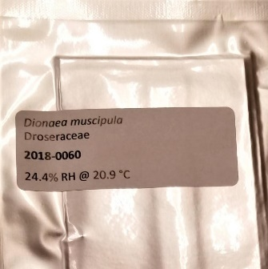
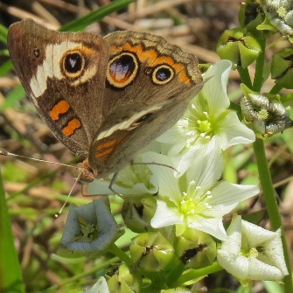
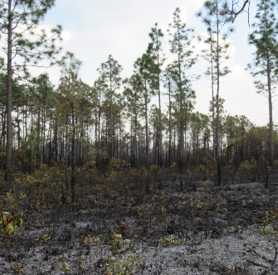
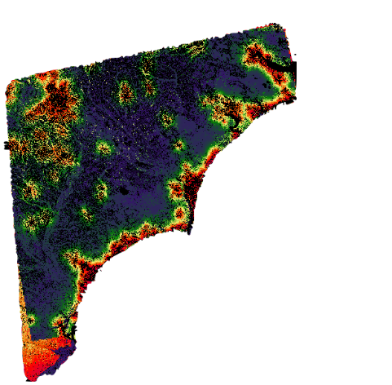
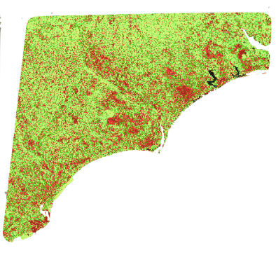



FUTURE WORK
Land protection/
reintroduction
Associate species
Coastal Plain/
Sandhills Habitats
Survey for new populations
Develop
2050 HSM
Expand
study area
Credits: Johnny Randall, Clyde Sorenson, Natalie Kerr
Notes:
Based on the results of this project, future work can be pursued to support the long-term survival of Venus flytrap populations:
*** CUE ANIMATION 1
1. First, project partners can conduct field surveys to identify previously unknown populations in areas identified as high probability suitable habitat in our 2021 map.
*** CUE ANIMATION 2
2. Secondly, Project partners can prioritize key lasting habitats as predicted by the 2050 land cover change model. These lasting habitats can be sites of potential reintroduction and protection.
*** CUE ANIMATION 3
3. Also, the future 2050 land cover change model can be further developed with climate change predictions such as sea-level rise, which may restrict the range of the species.
*** CUE ANIMATION 4
4. Location data of Venus Flytrap associate plant and insect species can be incorporated to inform the habitat suitability model.
*** CUE ANIMATION 5
5. Fifth, our refined models can be tested on a much larger study area to predict suitable habitat throughout the Atlantic Coastal Plain.
*** CUE ANIMATION 6
6. Finally, our partners are interested in investigating the sharp contrast between habitats in the Sandhills and Coastal Plain regions, which both contain suitable habitat for Venus flytraps despite being distinct physiographic regions. Future work can examine these two regions separately comparing the similarities and differences between the suitable areas.
------------------------------Image Information Below ------------------------------
•1st Image Credit: Clyde Sorenson
•Image Source: Image provided by project partner, used with permission
•2nd Image Credit: Johnny Randall
•Image Source: Image provided by project partner, used with permission
•3rd Image Credit: Natalie Kerr
•Image Source: Image provided by project partner, used with permission
•4th Image Credit: Clyde Sorenson
•Image Source: Image provided by project partner, used with permission
•5th Image Credit: Clyde Sorenson
•Image Source: Image provided by project partner, used with permission
•6th Image Credit: Clyde Sorenson
•Image Source: Image provided by project partner, used with permission
•All clip art images: PowerPoint Icons
•Image Source: PowerPoint

