Slide 1
Current State of Cloud-Native Geospatial Formats
Brianna R. Pagán
NASA Goddard Earth Services (GES)
Data and Information Services Center (DISC)
Adnet Systems

Slide 2
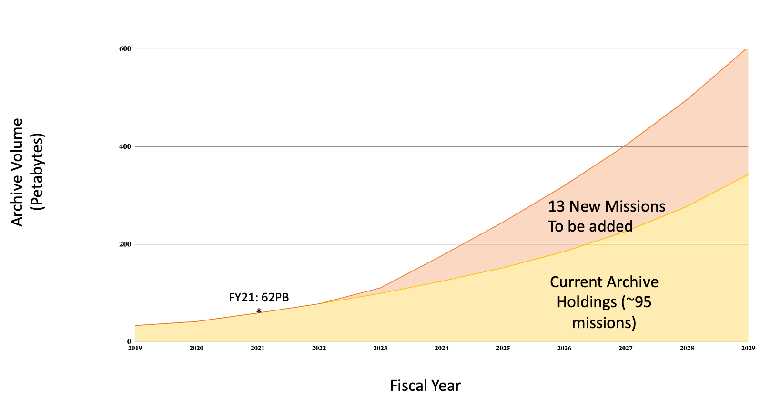
Motivation
EOSDIS Archive Growth Projections
Upcoming SWOT mission
Produces 20 TB every day
Requires 20 laptops with 1 TB storage
With a 25 mb/s download speed, each laptop four days to download
This volume of data will make it impractical for researchers to download the data if they want to do timely analyses.

Slide 3
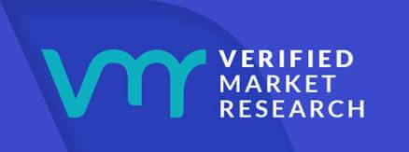
Beyond EOSDIS and Satellites
Not just limited to data archived at EOSDIS, for the satellite industry as a whole
Estimated 100TB of data received everyday if we consider commercial missions, which has results in a space tech boom.
More of these satellite data providers are becoming more vertically integrated, meaning they not only supply data, but they also provide data processing and analytics tools
Last year Satellogic and Plant two major companies went public, and the satellite data analytics market value is estimated to grow from 8 to 40 billion by 2030
Not just limited to satellites, we mean geospatial data acquisition from variety of sources including UAVs, airborne missions and personal cell phones
Upcoming SWOT mission
Produces 20 TB every day
Requires 20 laptops with 1 TB storage
With a 25 mb/s download speed, each laptop four days to download
Notes:
Not just limited to data archived at EOSDIS, for the satellite industry as a whole
Estimated 100TB of data received everyday if we consider commercial missions, which has results in a space tech boom.
First, more of these satellite data providers are becoming more vertically integrated, meaning they not only supply data, but they also provide data processing and analytics tools
Last year Satellogic and Plant two major companies went public, and the satellite data anlystics market value is estimated to grow from 8 to 40 billion by 2030
Not just limited to satellites

Slide 4
Motivations and Definitions
Time, energy and resources needed to work with this data will change how researchers do science.
As data providers, this also changes how we archive and provide data.
Cloud Native Geospatial:
Geospatial standards and software built for the cloud from the ground up
Cloud Native Geospatial Principles (from Chris Holmes):
  Read Oriented
    Performance (Parallel, Partial)
    Convenience
    Compatibility
    Compression
  HTTP S3/GCS/AZ interfaces
  Open Source
  Multiscale Metadata

Slide 5
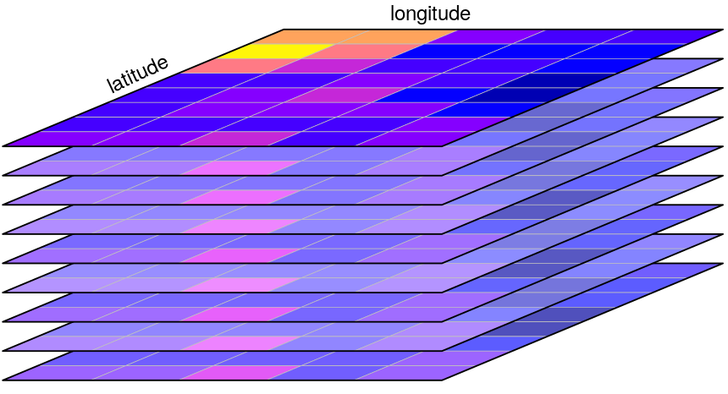


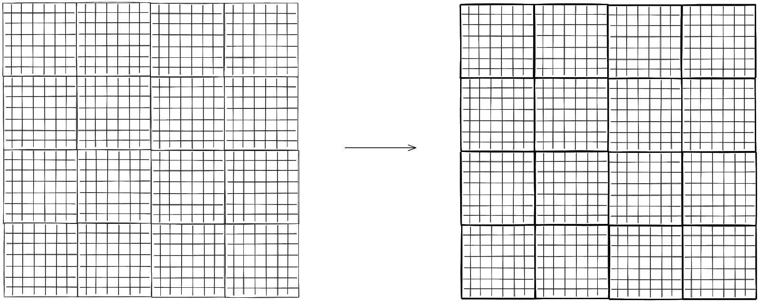
Cloud-Native Geospatial Formats
Raster
Snapshot in time gridded data: DEMs or multi-band single date satellite acquisition
GeoTiFFs (.geotiff,.tiff)
band
Cloud Optimized GeoTIFFs (COGs), OGC standards
Additional restrictions to perform in cloud environments (Tiles and Overviews)
chunking
Notes:
All COGs are valid GeoTIFFs
Impose additional restrictions to perform in cloud environments
Tiles come into play when some small portion of the overall file needs to be processed or visualized. This could be part of an overview, or it could be at full resolution. But the tile organizes all the relevant bytes of an area in the same part of the file, so the Range request can just grab what it needs.
Overviews come into play when the client wants to render a quick image of the whole file - it doesn’t have to download every pixel, it can just request the much smaller, already created, overview. The structure of the GeoTIFF file on an HTTP Range supporting server enables the client to easily find just the part of the whole file that is needed.
Key advantage of COG is that there is a standard

Slide 6
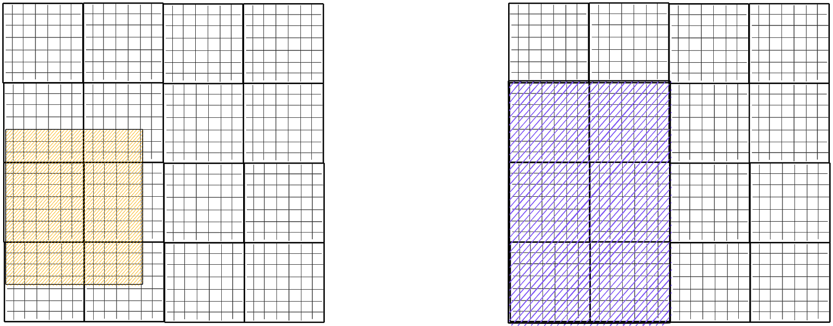
Cloud-Native Geospatial Formats
Raster
Snapshot in time gridded data: DEMs or multi-band single date satellite acquisition
GeoTiFFs (.geotiff,.tiff)
band
Cloud Optimized GeoTIFFs (COGs), OGC standards
Additional restrictions to perform in cloud environments (Tiles and Overviews)
Desired selection and corresponding chunks
Notes:
All COGs are valid GeoTIFFs
Impose additional restrictions to perform in cloud environments
Tiles come into play when some small portion of the overall file needs to be processed or visualized. This could be part of an overview, or it could be at full resolution. But the tile organizes all the relevant bytes of an area in the same part of the file, so the Range request can just grab what it needs.
Overviews come into play when the client wants to render a quick image of the whole file - it doesn’t have to download every pixel, it can just request the much smaller, already created, overview. The structure of the GeoTIFF file on an HTTP Range supporting server enables the client to easily find just the part of the whole file that is needed.
Key advantage of COG is that there is a standard

Slide 7
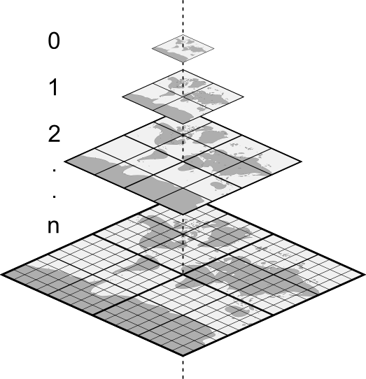
Cloud-Native Geospatial Formats
Raster
Snapshot in time gridded data: DEMs or multi-band single date satellite acquisition
GeoTiFFs (.geotiff,.tiff)
band
Cloud Optimized GeoTIFFs (COGs), OGC standards
Additional restrictions to perform in cloud environments (Tiles and Overviews)
Notes:
All COGs are valid GeoTIFFs
Impose additional restrictions to perform in cloud environments
Tiles come into play when some small portion of the overall file needs to be processed or visualized. This could be part of an overview, or it could be at full resolution. But the tile organizes all the relevant bytes of an area in the same part of the file, so the Range request can just grab what it needs.
Overviews come into play when the client wants to render a quick image of the whole file - it doesn’t have to download every pixel, it can just request the much smaller, already created, overview. The structure of the GeoTIFF file on an HTTP Range supporting server enables the client to easily find just the part of the whole file that is needed.
Key advantage of COG is that there is a standard

Slide 8
Cloud-Native Geospatial Formats
Raster
Snapshot in time gridded data: DEMs or multi-band single date satellite acquisition
GeoTiFFs (.geotiff,.tiff)
band
Cloud Optimized GeoTIFFs (COGs), OGC standards
Additional restrictions to perform in cloud environments (Tiles and Overviews)
A true COG should be made available on a server supporting HTTP range requests
Notes:
All COGs are valid GeoTIFFs
Impose additional restrictions to perform in cloud environments
Tiles come into play when some small portion of the overall file needs to be processed or visualized. This could be part of an overview, or it could be at full resolution. But the tile organizes all the relevant bytes of an area in the same part of the file, so the Range request can just grab what it needs.
Overviews come into play when the client wants to render a quick image of the whole file - it doesn’t have to download every pixel, it can just request the much smaller, already created, overview. The structure of the GeoTIFF file on an HTTP Range supporting server enables the client to easily find just the part of the whole file that is needed.
Key advantage of COG is that there is a standard

Slide 9
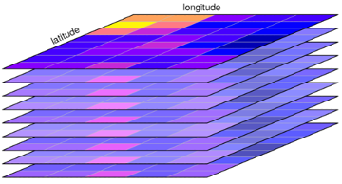
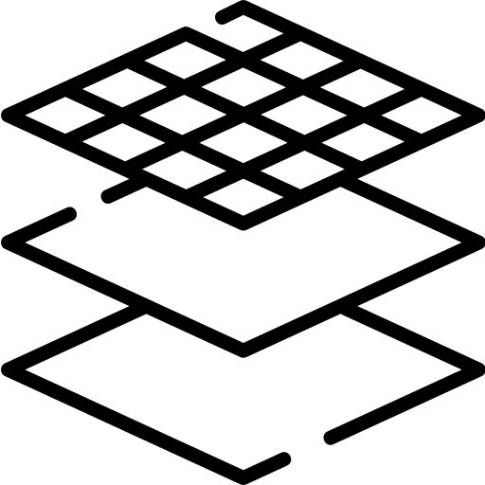
Cloud-Native Geospatial Formats
Multi-Dimensional Raster
Data cubes, typically in time: weather forecasts
NetCDF (.nc) /HDF (.hdf)
band
time
Zarr is open-source specification for storing chunked, compressed, N-dimensional arrays
Ongoing efforts for standardization via OGC
GeoZarr Spec: https://github.com/christophenoel/geozarr-spec
Notes:
check htm compability, abnormal indexing

Slide 10
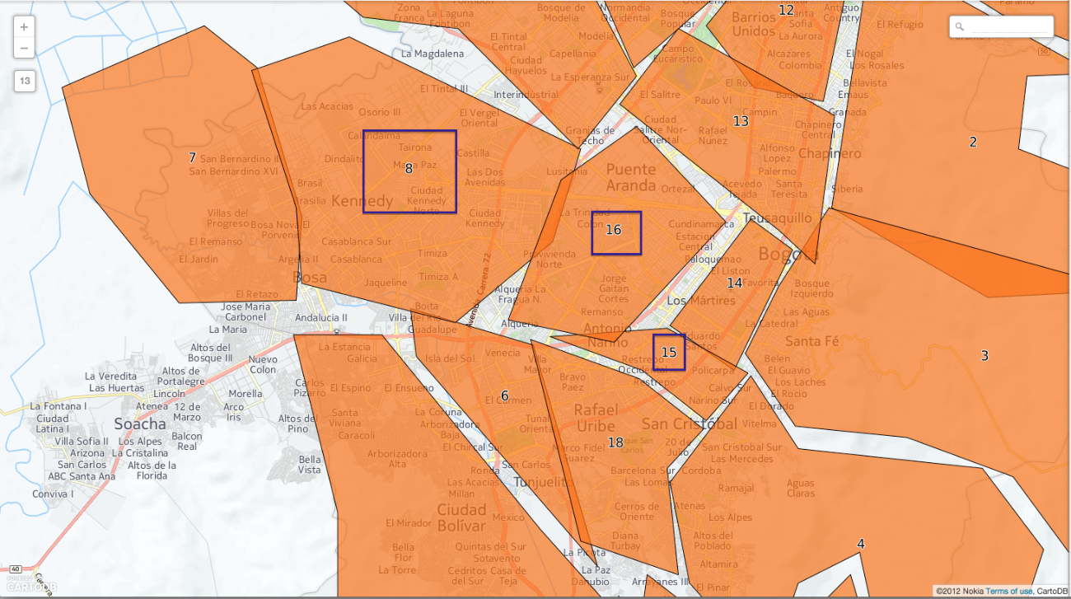
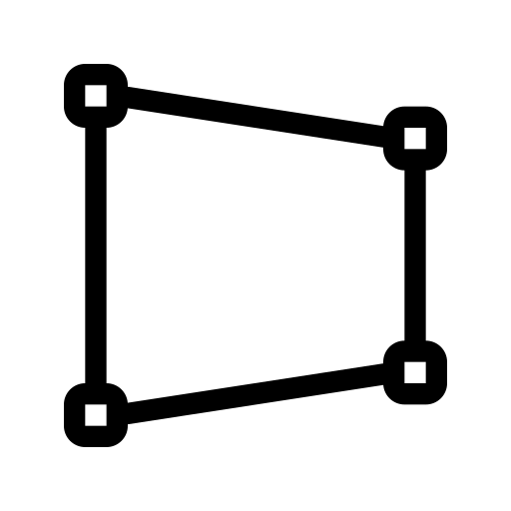
Cloud-Native Geospatial Formats
Vector
Columnar data including lines and polygons
Shapefiles (.shp)
GeoParquet, defines how to store vector data in Apache Parquet
Supports efficient filtering of chunks based on column stats
Ability to partition data into different files
Will enable spatial indexing
Notes:
All COGs are valid GeoTIFFs
Impose additional restrictions to perform in cloud environments
Tiles come into play when some small portion of the overall file needs to be processed or visualized. This could be part of an overview, or it could be at full resolution. But the tile organizes all the relevant bytes of an area in the same part of the file, so the Range request can just grab what it needs.
Overviews come into play when the client wants to render a quick image of the whole file - it doesn’t have to download every pixel, it can just request the much smaller, already created, overview. The structure of the GeoTIFF file on an HTTP Range supporting server enables the client to easily find just the part of the whole file that is needed.

Slide 11
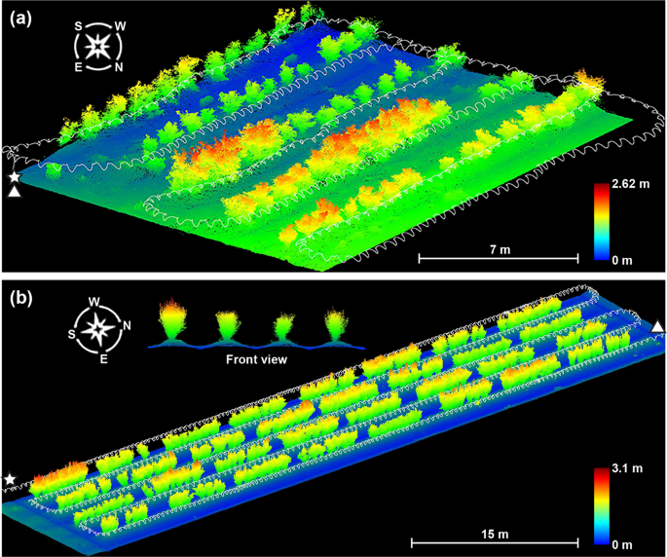

Cloud-Native Geospatial Formats
Point-Cloud
Set of data points in space, LiDAR measurements
Polygon File Format, .ply or .xyz
COGs for point clouds
LASZip ubiquitous geospatial cloud format
Notes:
N

Slide 12
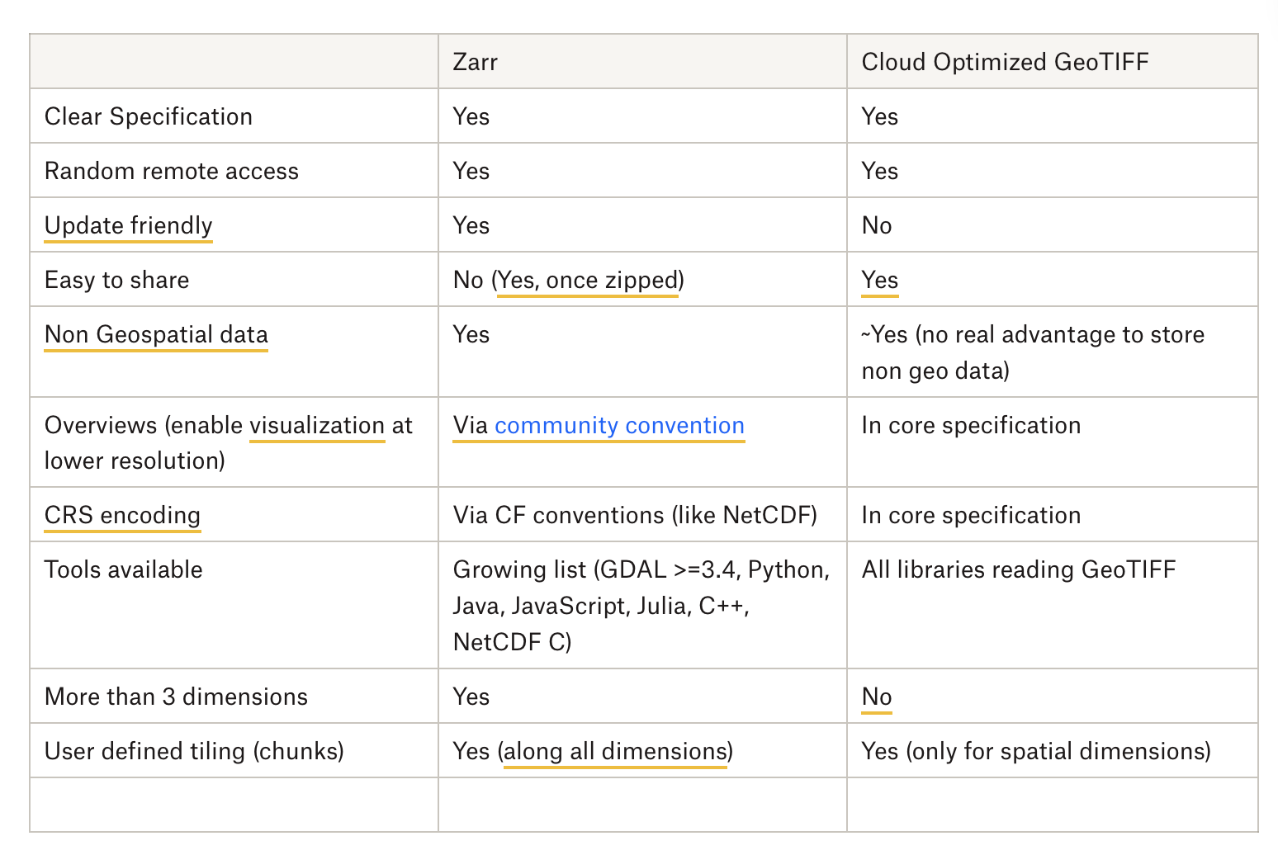
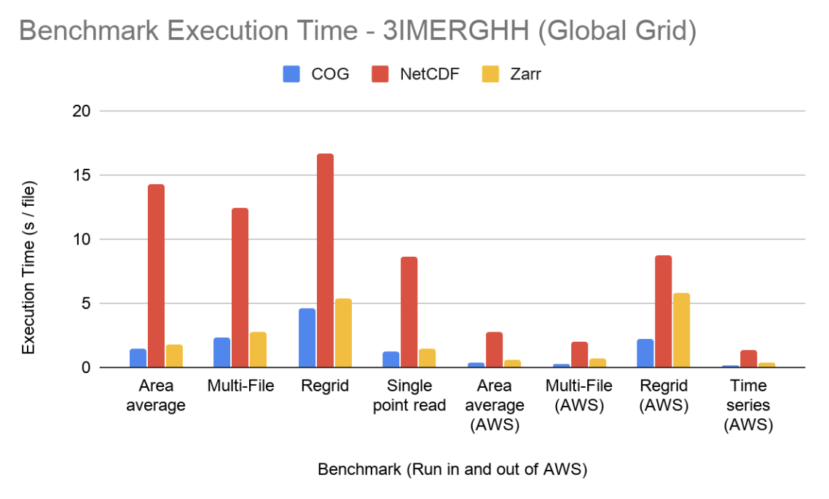
Which Format and When
Zarr is not a new kind of netCDF/HDF5
COG vs Zarr or COPC vs TileDB is the wrong framing
  Use case dependent
  Are you trying to visualize? Probably COG.
  Trying to do long term time series analysis? Probably Zarr.
  Comparisons paper: https://paper.dropbox.com/doc/COG-and-Zarr-for-Geospatial-Data--BlqSiyw23qG1akcNnPyieDsfAg-NTY7c2dmGxr96D0MDdxf6
There is no “ideal cloud format” - Howard Butler @Hobu dev for PDAL/COPC
  “Rather they are extensions of formats which allow spatially accelerated reading over HTTP”

Slide 13
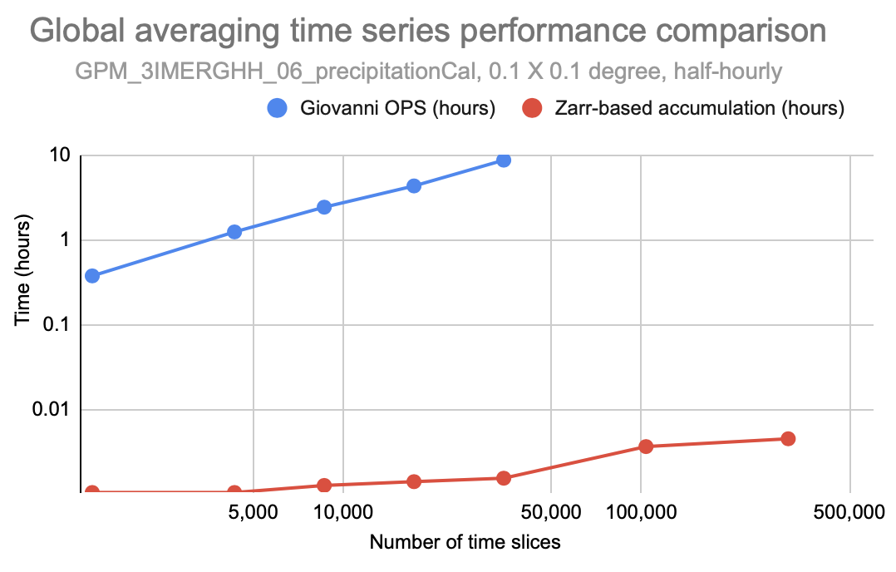
Which Format and When: GES DISC Example
What is my use case?
What are my limiting factors? (local storage? egress costs?)

Slide 14
Closing Remarks
“The danger of user centered design is that it releases the designer of the responsibility for having a vision of the world…
The user sees the world as it is.
Our job as builders is to create the world as it could be.” – from the book Syntax and Sage, Reflections of Software and Nature by Sep Kamvar
Notes:
Ask Hailang

