Slide 1



pyQuARC: Development of a Service to Enable FAIR-er Metadata
July 19th, 2022
Presenter: Aaron Kaulfus¹
Co-authors: Jeanné le Roux², Slesa Adhikari², Jenny Wood², Rajesh Pandey², Ashish Acharya², Prasanna Koirala², Iksha Gurung², Camille Woods², Samuel Ayers², Bradley Baker², Emily Foshee², Andrew Weis², Stephen McNeal², Shelby Bagwell², Kaylin Bugbee¹, Rahul Ramachandran¹
¹NASA Marshall Space Flight Center, ²University of Alabama in Huntsville

Slide 2
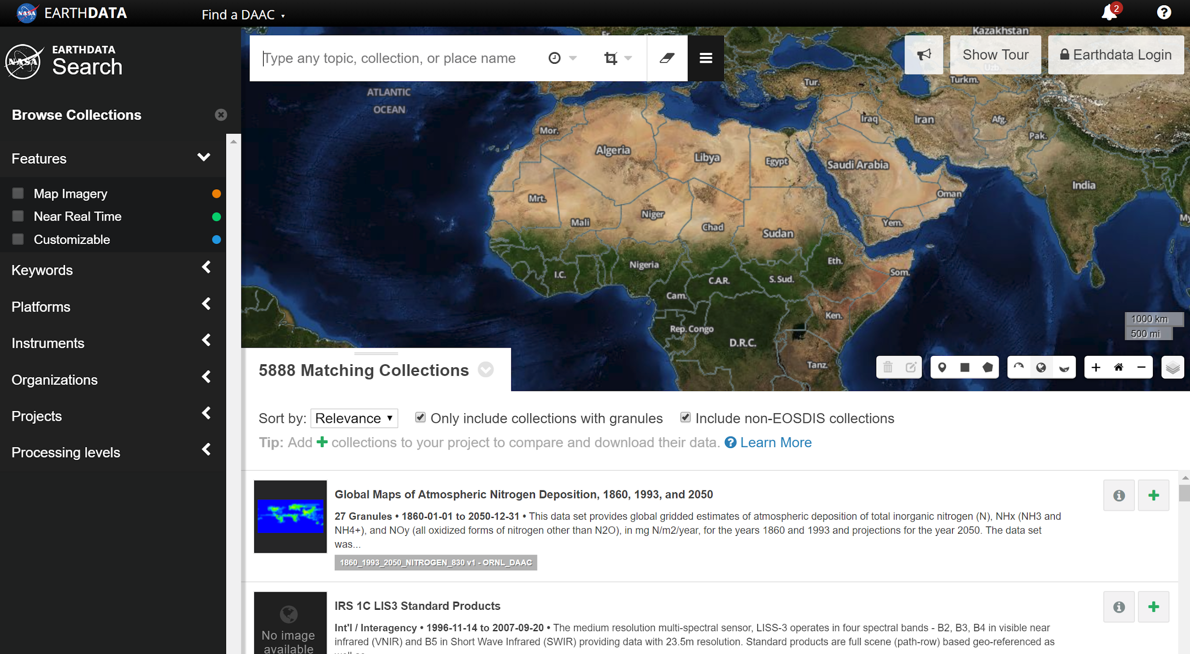
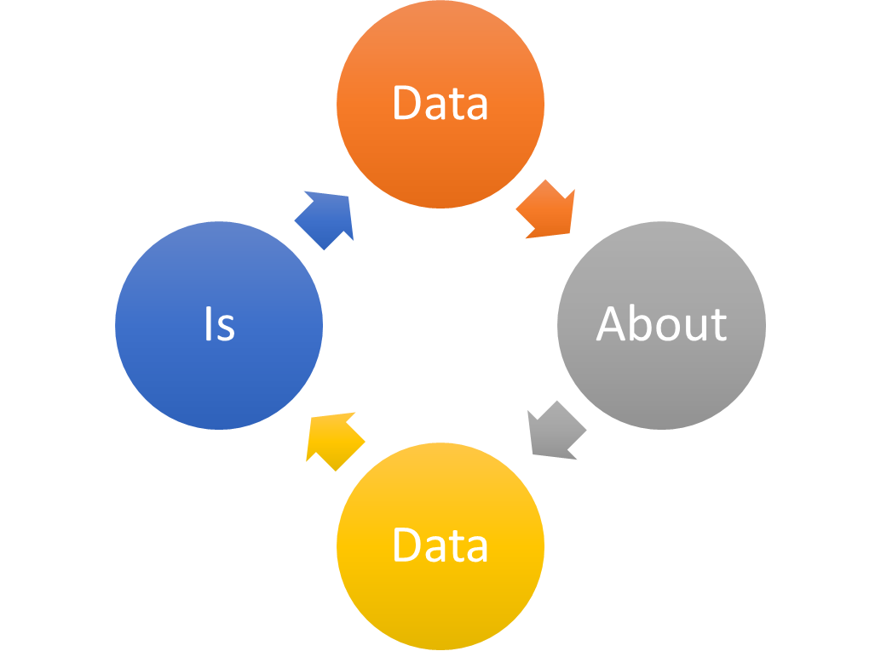
Introduction - The ARC Project
    ARC = “Analysis and Review of the CMR”
Established to assess and collaboratively improve EOSDIS metadata quality
Identify and define quality criteria
Perform detailed quality assessment of all EOSDIS collections in the CMR
Collaborate with the DAACs to improve individual metadata holdings
Identify opportunities for improvement at the process and policy level
Goals/Outcomes:
More complete & consistent metadata
Improved data discoverability, accessibility, usability
Improved documentation and communication regarding metadata best practices

Slide 3



ARC Process
CMR
Resolve collection and granule metadata content issues
ARC Team
DAAC devises strategy and timeline to work findings
Remain informed on CMR and metadata model updates
Report progress to ESDIS
DAAC
ESDIS &
CMR Team
DAAC performs incremental metadata improvements
DAAC ingests improved metadata into CMR
Process repeats until a certain level of quality is achieved and community consensus is built around new policies and best practices

Slide 4
ARC Metadata Quality Framework
Priority matrix
Systematically assess metadata records for quality
Emphasizes correctness, completeness, consistency
Color flag assigned to each metadata element based on the urgency/importance of any findings
Quality criteria is documented in the CMR metadata curation wiki space
Priority Categorization | Justification
Red = High Priority Findings | Emphasizes metadata completeness, accuracy, and data accessibility. Metadata that fails to meet CMR requirements or that are factually incorrect constitute a high priority finding. Examples: Broken or missing data access URL Non-compliance to controlled vocabulary Metadata fields flagged as red are required to be addressed by the data center.
Yellow = Medium Priority Findings | Emphasizes metadata completeness and consistency - recommendations focus on ways to help improve data discoverability and usability that go beyond CMR requirements. Examples: A URL is missing a description. While not required, descriptions provide important context for the URL. The same resource is labelled differently between metadata records Data centers are highly encouraged to address yellow findings and are encouraged to provide a rationale for unaddressed items.
Blue = Low Priority Findings | Documents minor metadata consistency, completeness and accuracy issues. Examples: URLs that need to be updated from the ‘http’ to ‘https’ protocol A DOI is provided but the DOI Authority is not specified Addressing blue findings are optional and up to the discretion of the data center.
Green = No Findings/Issues | Metadata elements flagged green are free of issues and require no action on behalf of the data center.

Slide 5
pyQuARC
pyQuARC - open source python library for Earth observation metadata quality assessment
Goal: implement ARC’s metadata quality assessment framework in an automated tool
Flags opportunities to improve or add to contextual metadata information in order to help the user connect to relevant data products
Frees up human evaluators to make more sophisticated assessments
Open source software that can be adapted and customized by a data provider to allow for quality checks that evolve with their needs
https://github.com/NASA-IMPACT/pyquarc
pyQuARC
CMR
ARC imports metadata record
Two ARC curators perform a content review
ARC’s findings are reported to the DAAC
DAAC ingests improved metadata into CMR
DAAC resolves findings

Slide 6
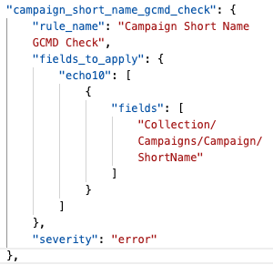
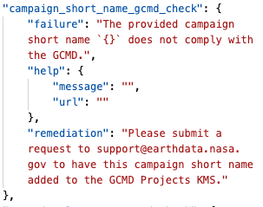
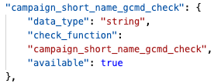
pyQuARC Development
The checks, messages, and rule_mappings files work together to feed into the validators
Checks.json - holds the data type and the check function to apply
Messages.json - contains the failure and the remediation message
rule_mappings.json
Rule_mappings.json - includes the fields to apply as well as the severity
messages.json
checks.json
Notes:
The validators holds and maintains the check functions, which are described in the checks.json, messages.json, and rule_mappings json files. The example on the slide shows the campaign short name GCMD check. Figure 8 displays the checks file which holds the data type and the check function to apply. Figure 9 shows the messages file which contains the failure message and the remediation message if a check should fail. Figure 10 depicts the rule mappings file which includes the fields to apply as well as the severity if the check should fail. Note that a user can add a custom check by following the formats shown in these figures. These three files then work together to feed into the validators portion of pyQuARC.

Slide 7
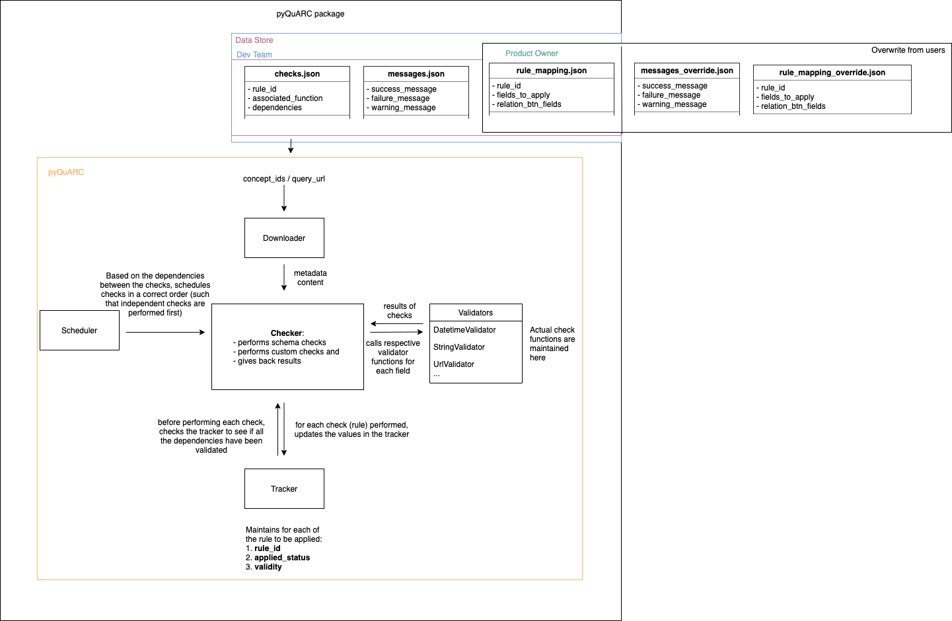
pyQuARC Data Flow
+checks_override
main.py executes the checker
Scheduler ensure checkers are performed in the correct order and applies appropriate validator
Datetime Example: Datetime format check (independent) > Range datetime check (dependent)
Validator executes appropriate check function, feeds the tracker, and provide output to the checker

Slide 8
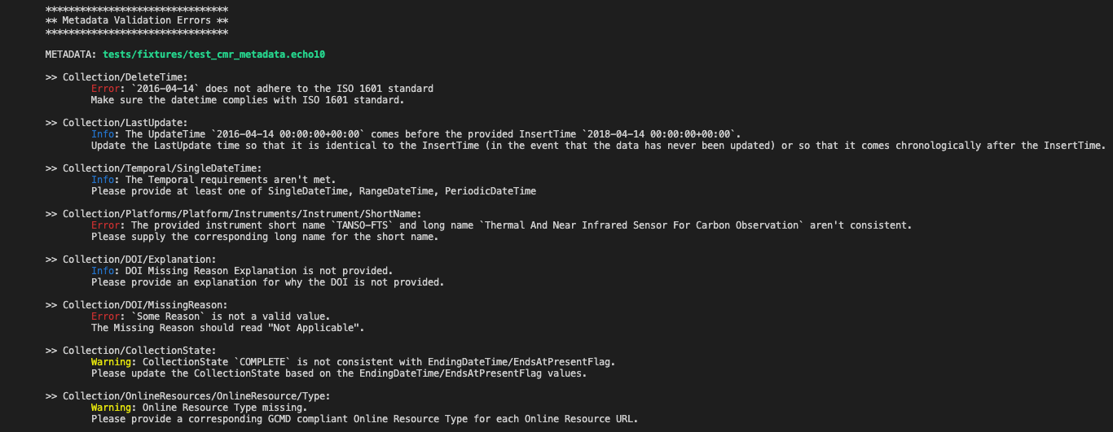
pyQuARC Example
Example pyQuARC output:

Slide 9
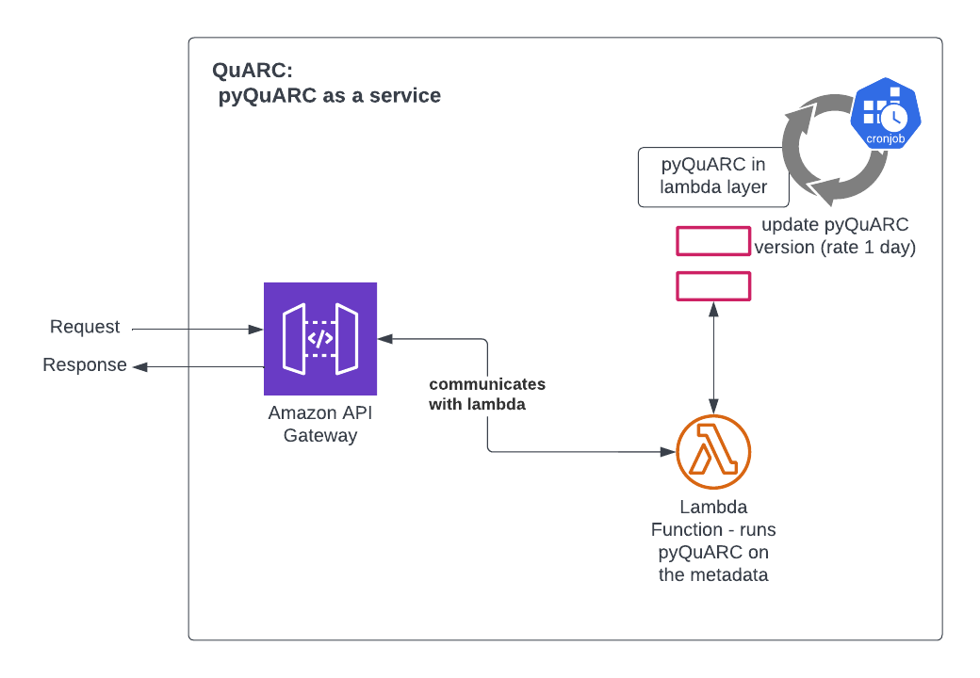
pyQuARC as a Service
QuARC: pyQuARC as a service
Deployed to Amazon Web Services cloud environment
Redeploys most recent version of pyQuARC from Github
User interacts through simple API
  Upload valid metadata file or CMR query
  Output pyQuARC validation results in json format along with summary statistics
https://quarc.nasa-impact.net/docs/
QuARC cloud architecture.

Slide 10
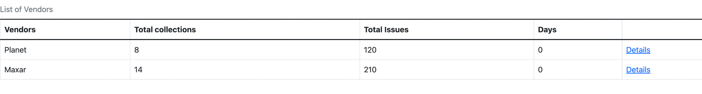
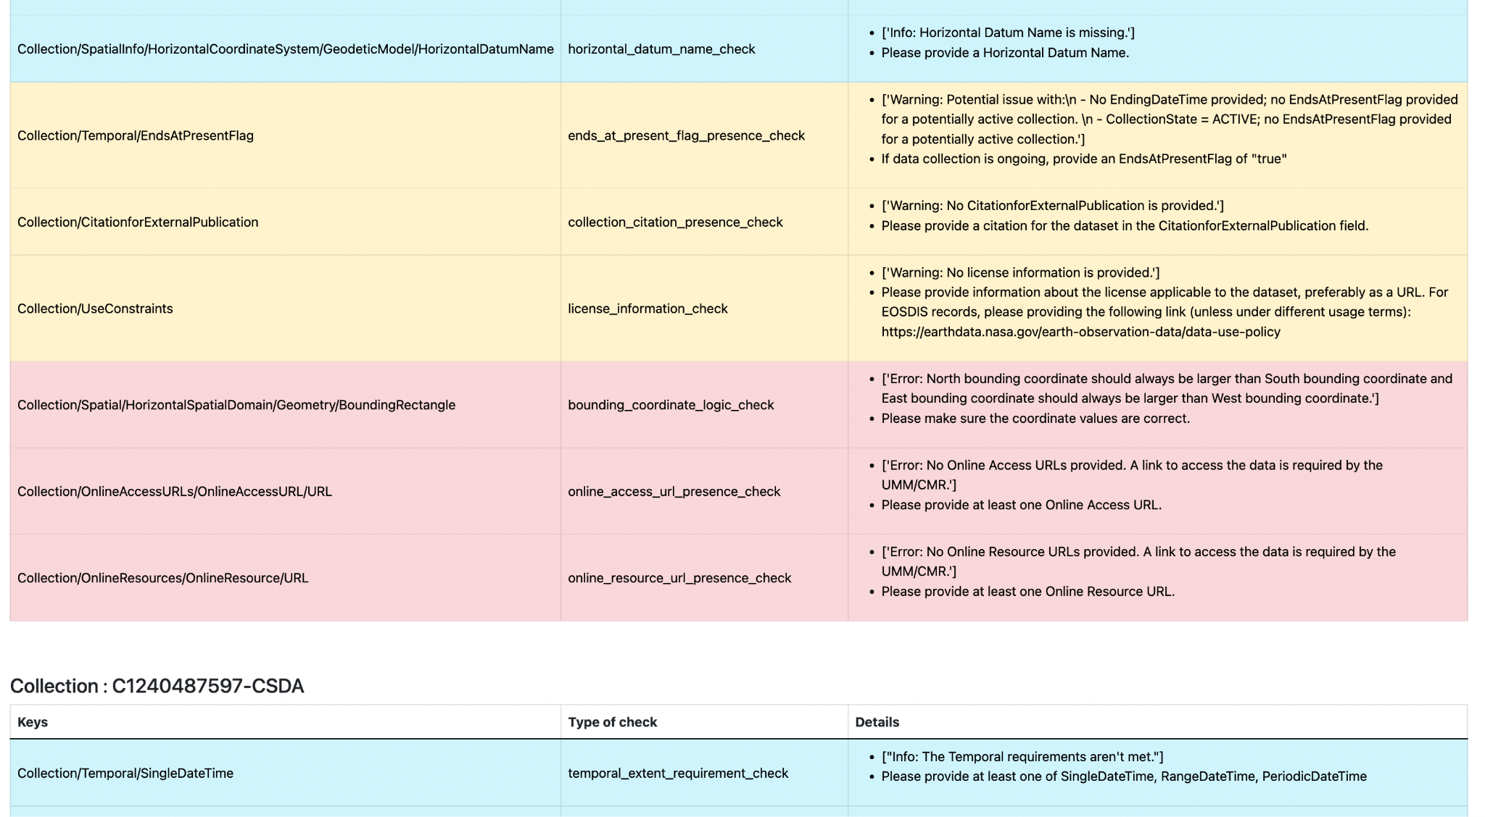
Community Adoption
The Commercial Smallsat Data Acquisition (CSDA) Program is adopting pyQuARC to assist in curation and monitoring of metadata
CSDA is responsible for the stewardship of Earth Observing commercial satellite data products acquired by NASA and must ensure:
Generated metadata is complete and accurate prior to publication
Generated metadata is consistent and accurate over sustained time periods
Vendor provided metadata does not degrade over time
Long-Term Monitoring
Data Publication
CMR
CSDA acquires vendor data and metadata
CSDA generates NASA compliant metadata
Findings reviewed and resolved
DAAC ingests metadata into CMR
CSDA imports metadata record
QuARC

Slide 11
ARC / QuARC Enabling FAIR
The ARC project is dedicated to improving metadata, contributing to thousands of improvements and corrections in NASA metadata (Bugbee et al., 2021), and in doing so promotes FAIR data principles.
pyQuARC is open source software, developed around the ARC assessment framework, which can be adapted and customized by curators to allow for quality checks that evolve with needs.
Community contributions to pyQuARC will ensure FAIRness as metadata and community standards evolve while QuARC promotes widespread adoption the standards.

Slide 12

Thank you.
pyQuARC GitHub: https://github.com/NASA-IMPACT/pyQuARC
QuARC API (beta): https://quarc.nasa-impact.net/docs/

