Slide 1
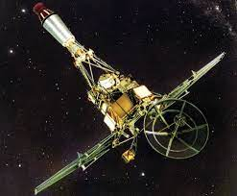


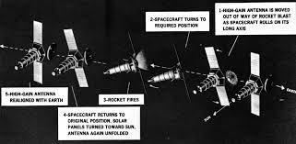
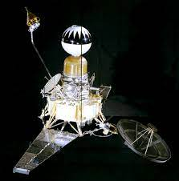


Planetary Protection, Parts, and Perception:
The Ranger Missions as the Origin Story
of the Myth of Planetary Protection-Related Mission Failures
Dr. Betsy Pugel
NASA Goddard Space Flight Center
betsy.pugel@nasa.gov
PPP.1-0014-22
Notes:
A0.1 01 Doe.pptx.
PPP.1-0014-22 Pugel

Slide 2
Origin stories and oral tradition in cultural anthropology
An Origin Story conveys how something came to be—typically a universe or key event.
An Origin Story is communicated between generations to provide continuity of heritage/community.
https://www.loc.gov/exhibits/world/world-creating.html
https://www.loc.gov/exhibits/exploring-the-early-americas/interactives/heavens-and-earth/heavens/artifact8-heaven.html
Notes:
You heard about the many Greek origin story and many myths at the opening event on Monday night. In planetary protection, there is also a myth of sorts that has been conveyed by oral tradition. There is an origin story that I will discuss today as it related to planetary protection and the Ranger missions.
I am taking this approach in order to address a larger and near-common perception that planetary protection always poses a problem—from an engineering pov, cost, POV.
I spent years when I was at Headquarters drilling down to the source of this perception via interviews with other NASA engineers, scientists and project managers and the common origin was the Ranger Program.
It was Ranger that led folks to believe that planetary protection and specifically sterilization, was the root of many problems in missions.

Slide 3
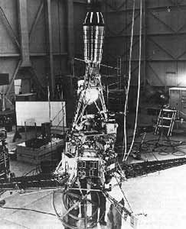
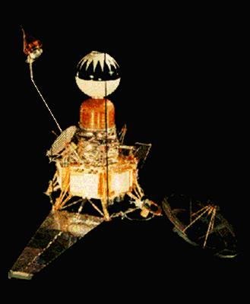
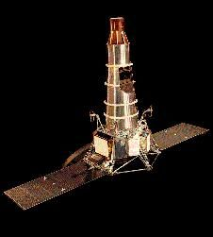
Rangers 1 and 2
Rangers 3, 4, 5
Rangers 6, 7, 8, 9
Block I
Block II
Block III
Notes:
The characters in our myth are the three blocks of the Ranger Spacecraft—Block 1—Rangers 1 and 2, Block II – Rangers 3,4,5 and Block III – Rangers 6,7,8,9

Slide 4
Mission Summary
Mission | Launch Date | Mission Status
Ranger 1 | 8/23/1961 | Failure
Ranger 2 | 11/18/1961 | Failure
Ranger 3 | 1/26/1962 | Failure
Ranger 4 | 4/23/1962 | Failure
Ranger 5 | 10/18/1962 | Failure
Ranger 6 | 1/30/1964 | Fully Successful
Ranger 7 | 7/28/1964 | Fully Successful
Ranger 8 | 2/17/1965 | Fully Successful
Ranger 9 | 3/21/1965 | Fully Successful
Notes:
The plot line of this origin story centers around failure –there were five failures in the Ranger mission series of nine spacecraft. It is often said that all five failures are attributable to planetary protection measures taken at the time. Today, I’ll talk about where the myths and truths within this origin story lie.
The point here is not to be critical, it is to raise awareness and help break through some of the skepticism and cultural biases that exist in our community towards planetary protection

Slide 5
What was the dividing line between success and failure?
Mission | Launch Date | Mission Status
Ranger 1 | 8/23/1961 | Failure
Ranger 2 | 11/18/1961 | Failure
Ranger 3 | 1/26/1962 | Failure
Ranger 4 | 4/23/1962 | Failure
Ranger 5 | 10/18/1962 | Failure
Ranger 6 | 1/30/1964 | Fully Successful
Ranger 7 | 7/28/1964 | Fully Successful
Ranger 8 | 2/17/1965 | Fully Successful
Ranger 9 | 3/21/1965 | Fully Successful
Notes:
So what we will talk about today is where were the dividing lines between success and failure and where does planetary protection come into play?

Slide 6
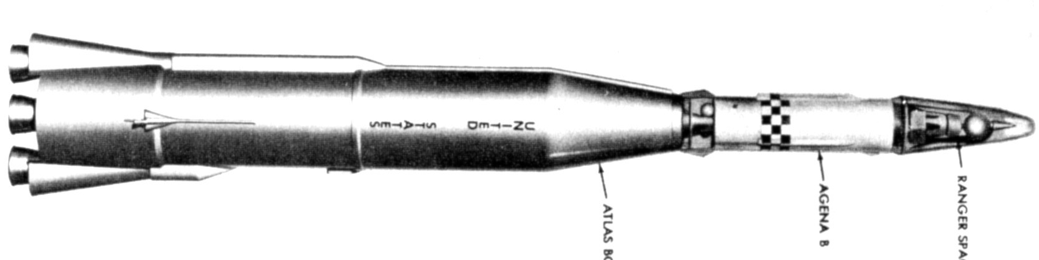
Launch Vehicle
Spacecraft
Atlas Booster
Agena B
Upper Stage
Ranger Spacecraft
Notes:
There will be two dividing lines that I will talk about today—one is the diving line between the launch vehicle and spacecraft as the sources of failure

Slide 7
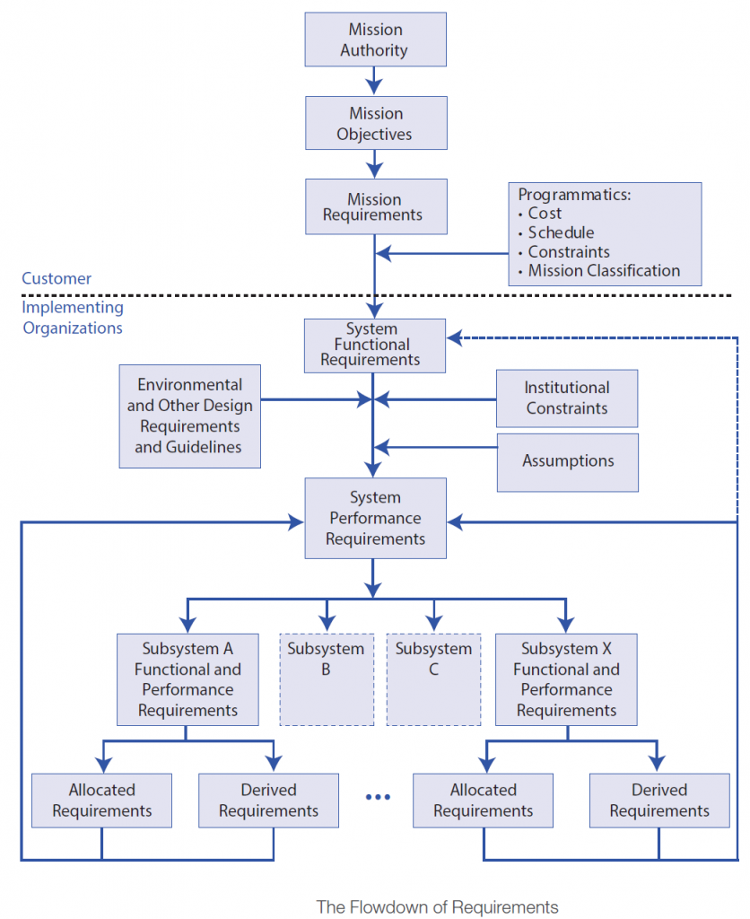
Programmatics,
Politics (National Agenda)
Process
People
Parts (Design, Reliability, Workmanship)
Planetary Protection
https://www.nasa.gov/sites/default/files/atoms/files/nasa_systems_engineering_handbook_0.pdf

Slide 8
Analyze Agena Flight Logs, which include Ranger Launch Details
Agena Flight Number | Launch Date | Mission Status | Root Cause
 |  | Failure on Orbit
 |  | Failure on Ascent
 |  | Marginal Success
 |  | Success
Notes:
As you will see in the technical paper, I look at Agena flight logs from 1959- until August 1961 and binning data based on failures that happened on orbit/on ascent, to marginally successful to a fully successful launch

Slide 9
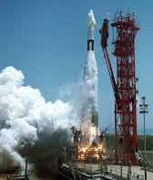
Notes:
It comes as no surprise, given the 50 launches that occurred from 1959 through to Ranger 3, which this data summarizes

Slide 10
Root Cause of Ranger
1-3
Failures
Ranger 1: Design Inadequacy in the Agena B
Propulsion - Overheated pressure switch circuit.
Ranger 1 was stranded in a low Earth orbit when Agena 6001 failed to reignite properly for its second burn
Agena oxidizer manifold pressure switch failed to make contact to admit fuel to engine for second burn. Oxidizer pumped overboard. Spacecraft left in Earth orbit.
Ranger 2: Inadequate design of readiness system
Guidance – Gyro inoperative at launch
Agena 6002 was unable to initiate a second burn due to a malfunction in its roll gyro.
The spacecraft was unable to enter its high apogee orbit.
Ranger 3: Environmental Design and Fabrication inadequate, Pre-flight Agena Check procedures inadequate.
Guidance – personnel error.
Agena 6003 was placed in the wrong trajectory as a result of an incorrect constant entered by personnel for Agena velocity meter.
Ranger 3 was off by almost 4x the capacity for a midcourse correction (40,000km off)
Burke, Ranger Inflight Failures. Oct 1962

Slide 11
Mission | Launch Date | Mission Failure Cause
Ranger 1 | 8/23/1961 | Agena 6001 Failure
Ranger 2 | 11/18/1961 | Agena 6002 Failure
Ranger 3 | 1/26/1962 | Agena 6003 Failure
Ranger 4 | 4/23/1962 | Failure
Ranger 5 | 10/18/1962 | Failure
Ranger 6 | 1/30/1964 | Fully Successful
Ranger 7 | 7/28/1964 | Fully Successful
Ranger 8 | 2/17/1965 | Fully Successful
Ranger 9 | 3/21/1965 | Fully Successful
Launch Vehicle
Spacecraft
Atlas Booster
Agena B
Upper Stage
Ranger Spacecraft
Ranger 1-3 Failures
Notes:
There will be two dividing lines that I will talk about today—one is the diving line between the launch vehicle and spacecraft as the sources of failure

Slide 12
Notes:
Looking at the launch events between Ranger 3 and 4, which was a three month period, we see that launch vehicle performance is improving. What about the spacecraft?

Slide 13
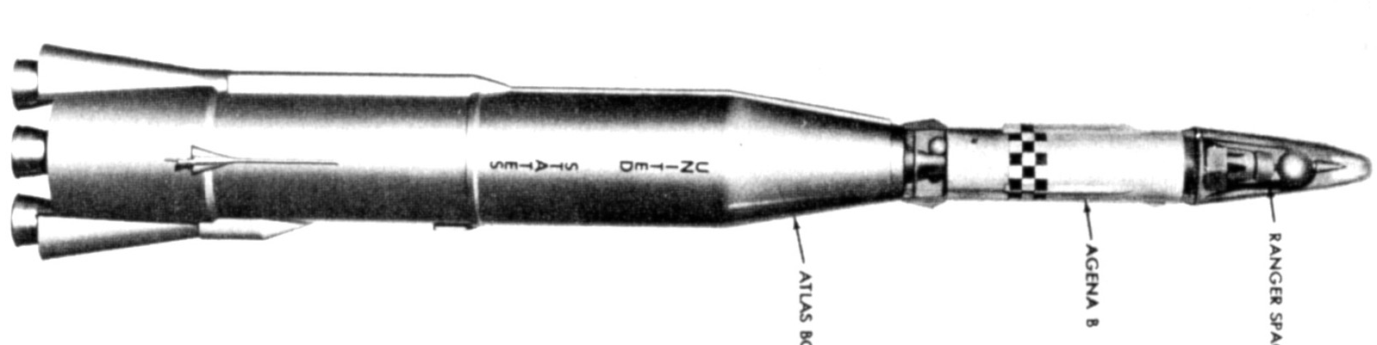
Launch Vehicle
Spacecraft
Agena B
Upper Stage
Ranger Spacecraft
Atlas Booster
Ranger 4-5 Failures
Notes:
There will be two dividing lines that I will talk about today—one is the diving line between the launch vehicle and spacecraft as the sources of failure

Slide 14
Root Cause of Ranger
4-5 Failures
Ranger 4 - Spacecraft - Unknown.
An onboard computer failure caused failure of the deployment of the solar arrays and navigation system operations. R4 crashed into the Moon
  Possibly nonmarginal design of computer circuits, component failure due to environment or marginal quality parts.
  Failure never seen before flight, never duplicated despite many attempts after flight.
Computer Failure -> Power and Nav loss
“The laboratory scrutinized the possible reasons for the computer failure but without conclusive result.”
California Institute of Technology Working Group Paper, 1978
.
Ranger 5 - Spacecraft - Unknown.
A malfunction with the spacecraft's batteries caused them to drain after about eight hours of flight and an electrical short in the solar array. The spacecraft missed the Moon by ~700km and remains in heliocentric orbit.
Root cause: Electrical System Failure
“Ranger 5’s in-flight failure appeared to be localized in a power switch and logic module; examination of spare units revealed many weaknesses in design and assembly.”
Burke, Ranger Inflight Failures. Oct 1962
Notes:
Well, while the launch vehicle was working, the spacecraft did not work. The onboard computer failed and Ranger 4 crashed into the moon. The root cause analysis was inconclusive.

Slide 15
Before moving on…
Mission | Launch Date | Mission Failure Cause
Ranger 1 | 8/23/1961 | Agena 6001 Failure
Ranger 2 | 11/18/1961 | Agena 6002 Failure
Ranger 3 | 1/26/1962 | Agena 6003 Failure
Ranger 4 | 4/23/1962 | Spacecraft failure
Ranger 5 | 10/18/1962 | Failure
Ranger 6 | 1/30/1964 | Fully Successful
Ranger 7 | 7/28/1964 | Fully Successful
Ranger 8 | 2/17/1965 | Fully Successful
Ranger 9 | 3/21/1965 | Fully Successful
For R1-4, sterilization is not implicated as the source of failure…
“It is likely that sterilization procedures have compromised spacecraft reliability, however there is insufficient data to positively confirm this suspicion”
January 1962, Ranger 4
Missions subjected to component, system-level and terminal sterilization
Notes:
There are suspicions, though sterilization was the most unknown of the disciplines familiar to the team.

Slide 16
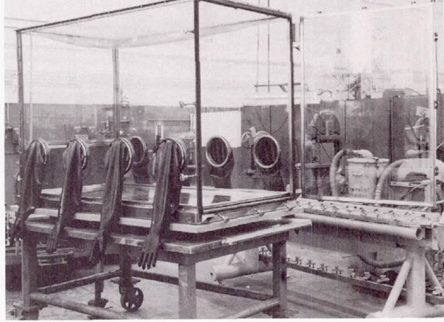
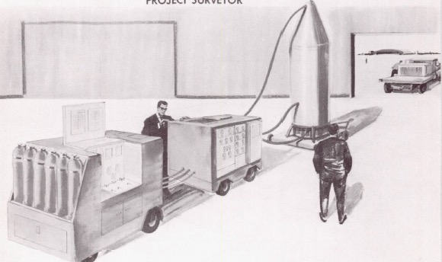
What was the planetary protection process for Block II (R3-5) ?
Component-level Sterilization: if amenable, components, subassemblies, assemblies adhesives, lubricants, seal ants, and any other constituent of which the complete spacecraft is composed (125C, 35 h, 24 h )
Aseptic Assembly of subsystems and integrate into spacecraft
Seal and Soak-Terminal Sterilization:
Aseptically-assembled spacecraft was enclosed in a sealed spacecraft compartment.
Sterilant gas (12% wt EtO+Freon-12) was introduced into the sealed compartment and soaked for 12 hrs
Purged with dry, sterile N2 for 2 hrs
Transported to the launch site to mated to the LV.
Keep it clean until launch: Sterile conditions were mechanically maintained via a diaphragm until the spacecraft left the Earth atmosphere (ejected above 300,000 feet--sterile)

Slide 17

Events around Ranger 5 launch (1962)
24 April
External contractor engaged to fabricate follow-on spacecraft
13 July
Ranger Spacecraft Block III serious electrical power problem identified (R6-9)
25 July
Request to relax sterilization requirements
2 August
Ranger Spacecraft Block III power problem communicated to NASA
18 October
Ranger 5 Launch
Notes:
Just want to call to your attention...
These events influenced the success of Ranger 6 and some are independent of sterilization
This is a rapid cadence mission, so while getting Ranger 5, block II design, Block III, Rangers 6 and beyond was being built and there were issues found.

Slide 18
Events around the Ranger 5 launch (1962-1963)
24 April
External contractor engaged to fabricate follow-on spacecraft
13 July
Ranger Spacecraft Block III serious electrical power problem identified (R6-9)
25 July
Request to relax sterilization requirements
2 August
Ranger Spacecraft Block III power problem communicated to NASA
6 November
NASA Authorizes cessation of heat sterilization for Ranger spacecraft
18 October
Ranger 5 Launch
30 November
Ranger Board of Inquiry Completed, Kelly Report Released
29 October
NASA HQ requests Board of Inquiry to review Ranger Program
14 September
Diode problems identified in Block III
18 October
Postponement of Ranger 6 until diode issue is resolved
1962
1963

Slide 19
Board of Inquiry Objectives:
  Review the history of the Ranger spacecraft and its present status
  Recommend steps necessary to achieve successful Ranger operation--changes in management procedures, systems, components, testing, quality control, reliability assurance procedures, and operation procedures
Programmatics,
Politics (National Agenda)
Example Findings:
People
Process
Parts (Design, Reliability, Workmanship)
Planetary Protection
“The present review has disclosed many potentially unreliable areas associated with design, choice of components, implementation and processes.”
“shoot and hope” approach:
“Shoot enough and sooner or later one of the series will work”
This approach was a remnant of a history of the organization’s involvement with military missiles—test flights were used to iron out issues—a different approach was needed for spacecraft
Recommendation: “Set down specific and detailed mission objectives for each future Ranger flight and eliminate all activities or operations which do not contribute to these objectives (e.g., sterilization, "development of planetary technology").”
https://www.nasa.gov/sites/default/files/atoms/files/nasa_systems_engineering_handbook_0.pdf
Notes:
Here is where the second dividing line comes into play
The internal review board in October – November was tasked to look at what the history was with Ranger and what needed to be changed to help make it work. These included everything from management to Process, Parts, Reliability Design and Workmanship
The Kelley report had the following observations---some examples are shown here, though there were many
Their recommendation was to simplify and change management. There wasn’t a specific call out or even enough data to point directly to sterilization as the culprit.
We’re not sure if sterilization is the problem, though with the other issues that are there from a reliability and redundancy POV, it’s probably not going to help to keep sterilizing.
WE have to move fast, so

Slide 20
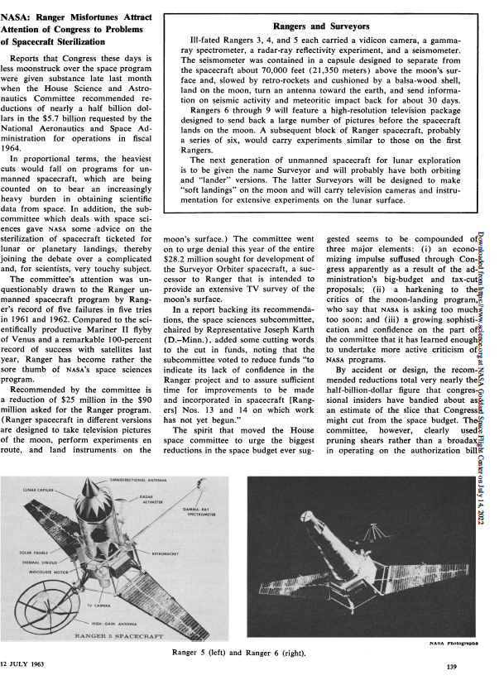
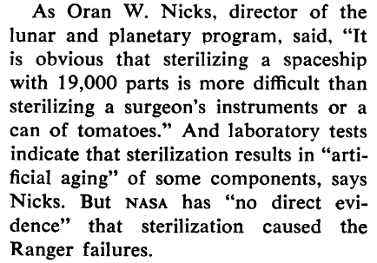

Science 141, 139 (1963)

Slide 21
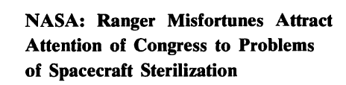
Brief Congressional Hearing Interlude…
Mission | Launch Date | Mission Failure Cause
Ranger 1 | 8/23/1961 | Agena 6001 Failure
Ranger 2 | 11/18/1961 | Agena 6002 Failure
Ranger 3 | 1/26/1962 | Agena 6003 Failure
Ranger 4 | 4/23/1962 | Spacecraft Failure
Ranger 5 | 10/18/1962 | Spacecraft Failure
Ranger 6 | 1/30/1964 | Fully Successful
Ranger 7 | 7/28/1964 | Fully Successful
Ranger 8 | 2/17/1965 | Fully Successful
Ranger 9 | 3/21/1965 | Fully Successful
Notes:
Of course, after 5 failures, congress conducted an oversight investigation hearing and focused in on sterilization

Slide 22
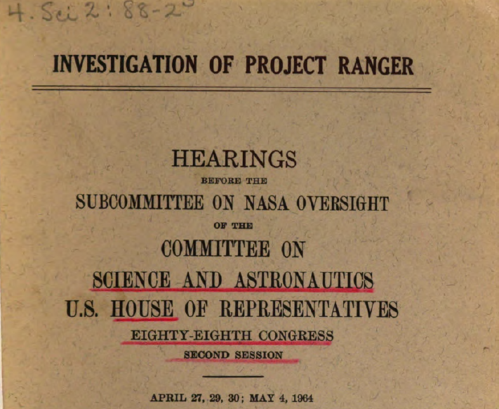
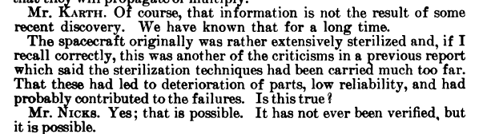
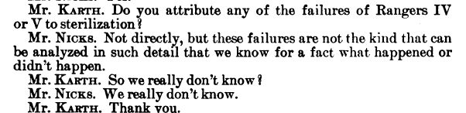

Slide 23
Was Sterilization the Culprit?
”Sterilization added uncertainty
to an already compromised project.”
Mass margin limits led to little/no redundancy
Personnel Shortage
Undersized battery
Limited power capacity
Single-string attitude control gas system
No parts control process for high reliability parts
No operational testing for electronics components
Undersized motor
for midcourse corrections
Schedule constraints
Notes:
When you look back with the eyes of a systems engineer, this is a very risky mission—mass margins and schedule. Power constrained the use of redundancy and parts selection.
The number of single string critical subsystems, like attitude control, comms, telemetry, clocks, backup timers, are mindboggling.
As mass was king, power was simply a loyal subject—the battery was undersized, midcourse correction motor too small.
Schedule constraints made it challenging, if not impossible for results from proof test models to be incorporated into the flight model.
The good news was as a result of these findings, there was an extensive design review and modifications to the design as well as to the manufacturing contractor occurred.

Slide 24
Mission Summary, Revisited
Mission | Launch Date | Mission Status | Source of Failure
Ranger 1 | 8/23/1961 | Failure | Agena B
Ranger 2 | 11/18/1961 | Failure | Agena B
Ranger 3 | 1/26/1962 | Failure | Agena B
Ranger 4 | 4/23/1962 | Failure | Unknown
Ranger 5 | 10/18/1962 | Failure | Unknown
Ranger 6 | 1/30/1964 | Fully Successful | Fully Successful
Ranger 7 | 7/28/1964 | Fully Successful | Fully Successful
Ranger 8 | 2/17/1965 | Fully Successful | Fully Successful
Ranger 9 | 3/21/1965 | Fully Successful | Fully Successful
Quesstions? Dr. Betsy Pugel
NASA Goddard Space Flight Center
betsy.pugel@nasa.gov
PPP.1-0014-22
24
Notes:
What I want to leave you with here is a very positive message
Under a very high pressure circumstance, we, as an organization learned quickly and well
This very complicated system with mass constraints power constraints
Learned quickly and learned well
2 years failure to success
Sterilization was in the center of that, though perhaps not for the reasons that were linked to root cause

