Slide 1
LISA Telescope
Manufacturing and Testing Plans
July 26, 2022
Jeff Livas
Goddard Space Flight Center

Slide 2
LISA Telescope Team
C. Austin ª, R. Bousquet ª, K. Boyce ª, A. Davis ª, R. DeRosa ª, P. Fulda ^{b}, J. Gleason ^{b}, T. Hardwick ª, W. Hayden ª, H. Hollis ^{b}, J. Howard ª, J. Ivanov ª, T. Johnson ª, C. Jones ª, J. Kelly ª, R. Keski-Kuha ª, S. Kulkarni ^{b}, H. Legesse ª, J. Livas ª, G. Mathews ª, G. Mueller ^{b}, J. Sanjuan Munoz ^{b,c}, J. Papa ª, S. Sankar ª, L. Seals ª, Ada Umińska ^{b}, Andrew Weaver ª, Alexander Weaver ^{b}, M. Wilson ª
ª NASA-GSFC, 8800 Greenbelt Rd, Greenbelt, MD-20771, USA
^{b} University of Florida, Gainesville, FL, 32611, USA
^{c} Texas A&M University, College Station, TX 77843, USA
Development Partner: L3Harris Technologies, Rochester, NY

Slide 3
Related talks
July 26 – LISA Instrumentation Parallel Session 1/3
  20:00 CEST: Tilt-to-length Coupling in LISA Pathfinder, Marie-Sophie Hartig (MPI)
  20:20 CEST: Post-processing Subtraction of Tilt-to-Length Noise in LISA, Sarah Paczkowski (MPI)
  20:40 CEST: Using Fisher Matrices to Constrain TTL Coefficients with TDI, Daniel George (UF)
July 28 – LISA Instrumentation Parallel Session 3/3
  18:15 CEST Simulating Micrometeoroid Impacts on the Primary Mirror of the LISA Telescope, Corey Austin (Goddard Space Flight Center)
  18:35 CEST Dimensional Stability Verification of the LISA Telescope, Ada Umińska (University of Florida)
Pre-recorded talk
  Monte Carlo Analysis of the LISA Telescope Build Process, Corey Austin (Goddard).

Slide 4
Outline
Contract status
Requirements review
Design review
Monte Carlo analysis summary
Testing plans
  at L3Harris
  At Goddard
  At UF

Slide 5
L3Harris Contract
Purpose of the contract is for technology development
Contract is for 3 similar units:
Structural thermal model (STM)
  Correct structure but optics are just ground glass, not polished or coated
  Practice unit for assembly and alignment
  An early chance to do ”environmental tests” – shock, vibration, TVAC
Engineering Development Unit 1 (EDU1)
Engineering Development Unit 2 (EDU2)
Long term one of the EDUs and maybe the STM will be delivered to ESA.
The other EDU will remain in the US for further testing.

Slide 6
Telescope Engineering Unit Development Timeline
Date | Milestones
Sep 16, 2019 | Final Request For Proposals posted
Mar 19, 2020 | Contract start date with L3Harris, Rochester, NY
Mar 27, 2020 | Kick-off meeting
Jun 26, 2020 | System Requirement Review
Aug 21, 2020 | Integrated Baseline Review
Sep 18, Dec 4, 2020 | Peer Review 1,2 Review
Jan 21, 2021 | Single Design Review
Oct 2022 | Structural Thermal Model (STM) Environmental Testing at L3Harris
Dec 2022 | Structural Thermal Model (STM) Delivery to UF for OPL testing
Mar 2023 | Engineering Development Unit 1 (EDU1) Environmental Testing at L3Harris
May 2023 | Engineering Development Unit 1 (EDU1) Delivery to Goddard for testing
Nov 2023 | Delivery of EDU2
Dec 2023 | Contract end
now
About 28 months into a 44 month contract.

Slide 7
Strategy to Get to Adoption in 2023
Need to show we are at (ISO) TRL-6
  Or have a credible plan to get there
Environmental testing (vibration, TVAC) is done at L3Harris
More detailed optical testing is done at Goddard
  boresight
  WFE tests over field
  pupil mapping
  Scattered light performance
Optical path length stability (OPL) testing is done at University of Florida Gainesville
Use the STM instead of the EDU 1 for initial OPL testing at UF
  Gains 5-6 months in schedule (Dec 2022 instead of May 2023)
  Requires different work to add optics to the STM
  Not the final optical path but includes all relevant bonds plus anything added for testing
  May want to test an EDU later to confirm depending on the results
For more OPL testing details, please see:
Dimensional Stability Verification of the LISA Telescope, Ada Umińska (University of Florida)
July 28 – LISA Instrumentation Parallel Session 3/3
10:35 am EDT/16:35 CEST:

Slide 8
Technology Readiness Assessment (TRA)
Expected Status Spring 2023
Environmental testing of the STM at L3Harris
  Expected to be completed by end of October 2022
Environmental testing of EDU1 at L3Harris
  Expected to be completed by end of March 2023
  Delivery to Goddard expected in May 2023
Preliminary results of optical pathlength stability testing at UF
  Delivery expected in December 2022
    Add mirrors (~ 1 month = Jan)
    Initial test at room temperature (~ 1 month = Feb)
    Rerun test to confirm (~ 1 month): preliminary results by the end of March
  Very tight timing, but have a credible test plan

Slide 9
Requirements Review

Slide 10
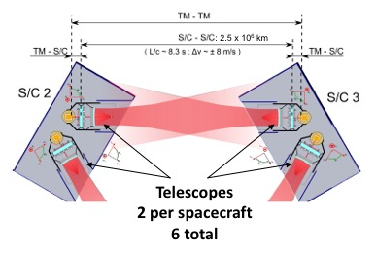
Telescope Functional Description
Efficiently deliver power on-axis between spacecraft (2.5 million km)
Simultaneous transmit and receive (Tx/Rx)
Afocal beam expander
  300 mm diameter large beam
  2.24 mm diameter on bench
  134X magnification
TM-TM
S/C - S/C: 2.5 x 10⁶ km
TM-S/C
L/c ~ 8.3 s, ∆υ ~ +/- 8 m/s
TM-S/C
Application is PRECISION LENGTH MEASUREMENT, not image formation
  Keep optical pathlength stable to ~ 1 pm/√Hz over the measurement bandwidth
  Minimize phase noise from coherent transmitter backscattered light
  Minimize tilt to length (TTL) coupling
Notes:
The LISA Telescope is designed to enable a precision length measurement between two widely space test masses. The measurement budget between pairs of proof masses is roughly 10 pm/√Hz.
There are two telescopes in series with the measurement, so their optical pathlength must be stable to ~ 1 pm/√Hz over the measurement band.

Slide 11
Key Telescope Optical Specifications
Specification | Value | Units | Comments
Wavelength | 1064 | nm | nominal system operating wavelength
Conjugates | Afocal |  | Telescope is an afocal transceiver, i.e. object and image at infinity. Specifications generally assume ”receive” mode, where the entrance pupil is the “large” pupil in inertial space
Field of Regard for Acquisition | +/- 225 | µrad | Circular field of view
Field of view for Science | +/- 20 | µrad | Circular field of view
Wave-front error | < 40 | nm | wavelength/30 with bipods
Large Pupil diameter | 300+/- 1 | mm | Large pupil is associated with M1, inertial space
Small pupil diameter | 2.24 +/- 0.0075 | mm | Small pupil is located at the system stop on the optical bench
Base ray deviation from optical axis (large pupil) | < 10 | µrad | The “base ray” is the center-field center-pupil ray. Boresight error associated with the large pupil
Base ray deviation from optical axis (small pupil) | < 1.3 | mrad | Interface requirement with the optical bench
Tilt-to-length (TTL) | < 0.6 | pm/nrad | “as built” over the science FOV
Optical path length stability | <1.1 | pm/√Hz | x u(f) = (1 + (f₀/f)⁴)^{1/2}, where f₀ = 2 mHz

Slide 12
Key Telescope Challenges/design drivers
Dimensional Stability
  Low coefficient of thermal expansion (CTE) material and thermal stability at the 10 µK/√Hz level, using thermal baffles fixed to the spacecraft that act as a passive thermal filter
  Assume spacecraft core is stable at the ~ 1 mK/√Hz level.
Minimize Coherent backscattered light
  Adopt an unobstructed optical design and plan the design to accommodate contamination
  Low scatter coatings and dimensionally stable structure so scattered light phase is stable
  Keep spacing between the telescope and optical bench stable
Minimize Tilt-to-length (TTL) coupling
  Careful design to minimize pathlength differences with field angle (δOPL vs Field)
  Careful alignment of measurement axes during integration (bench to telescope and bench to GRS) to minimize spacecraft jitter coupling to the displacement measurement
  Wavefront errors projected into the far-field will also couple TX angular jitter into an apparent length signal (keep wavefront error low: WFE < 35 nm RMS = λ/30 at 1064 nm)
  Post processing used to correct residual errors
July 26 – LISA Instrumentation Parallel Session 1/3
  20:20 CEST: Post-processing Subtraction of Tilt-to-Length Noise in LISA, Sarah Paczkowski (MPI)
Notes:
Key challenges and design drivers for the telescope. From Pep, 12inside the LCA (LTP Core Assembly) it was 1 mK/rtHz at 0.1 mHz and rolling off as ~1/f^(2.5). Outside the LCA, the stability was about 50 mK/rtHz at 0.1 mHz and rolling off as 1/f^1.3, which is 1 mK/rtHz at around 1-2 mHz.

Slide 13
Key Telescope Interfaces
Optical
  Small pupil/external stop on the optical bench
  Virtual large pupil located at the center of mass of the test mass
  optimize pupil imaging between the stop and the large pupil to minimize TTL coupling in the telescope itself
Mechanical
  3 pairs of bipod flexure interfaces to the MOSA Support Structure (MSS)
  Adequate mechanical clearance with the optical bench
  Designed for a fundamental mode of 120 Hz to accommodate worst case launch loads
Thermal
  Nested set of thermal baffles mounted to the spacecraft to filter thermal fluctuations to an acceptable level
  Baffles are sized to accommodate MOSA articulation
  Additional baffle to shield the optical bench
  Notional conduction paths through the bipod interface and from a cable harness to the optical bench
  Temperature sensors to monitor actual conditions
Notes:
Key challenges and design drivers for the telescope.

Slide 14
Design Review

Slide 15
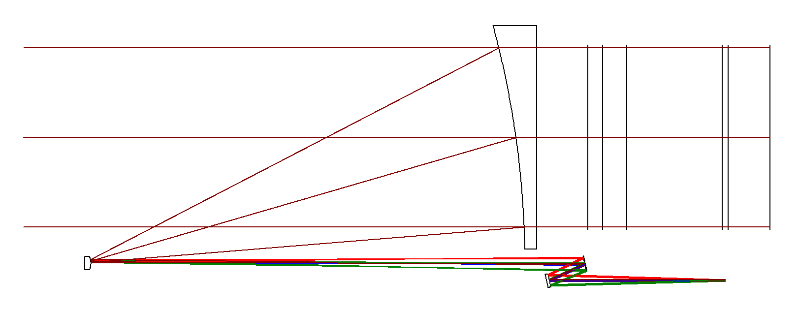
Baseline EDU Optical Design
Moveable Optical Sub-Assembly (MOSA) Side View
Optical Bench
M1
Center plane of Test Mass (TM), 420 mm to M1
Test Mass
Y
Beam folded onto bench
Large Pupil (∅300 mm)
M3
M2
X
Z
Small Pupil /stop (∅2.24 mm)
Global Origin M1 Vertex
M4
Global Coordinate System
Origin at M1 Vertex
Z-axis: parallel to optical axis (object and image space)
Y-axis: perpendicular to optical axis, within screen
X-axis: perpendicular to optical axis, into screen
 | Type | Conic | Radius (mm) | Clear Aperture (mm) | Edge Diameter (mm)
M1 | Parabola | -1 | -1475.246 | 345.3 | 365
M2 | Hyperbola | -1.0928 | -25.813 | 6.4 | 25.4
M3 | XY Polynomial | 0 | Infinity | 24.6 | 27.4
M4 | Flat | 0 | Infinity | 21.0 | 27.4
”freeform” optic flattens the δOPL vs field (TTL) response
Notes:
Latest EDU design layout. The telescope maps the small aperture external stop from the bench to the center of mass of the TEST MASS. The main unusual feature is M3, which is a generalized asphere, commonly called a “freeform” optic. The departure from a biconic is slight, and the additional degrees of freedom enable essentially zero pupil wander and tilt-to-length (TTL) coupling in the design. The primary is kept near F/1 to control cost and fabrication risk.

Slide 16
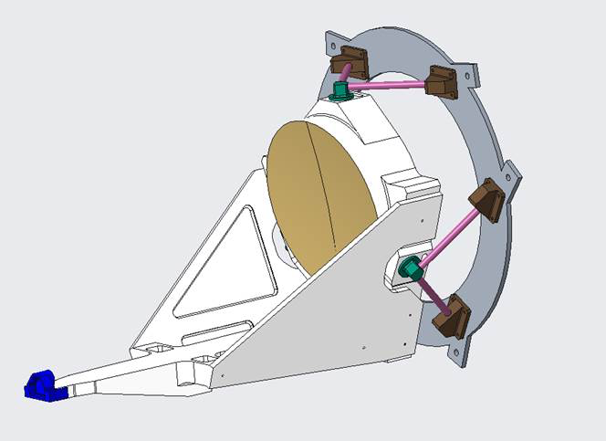
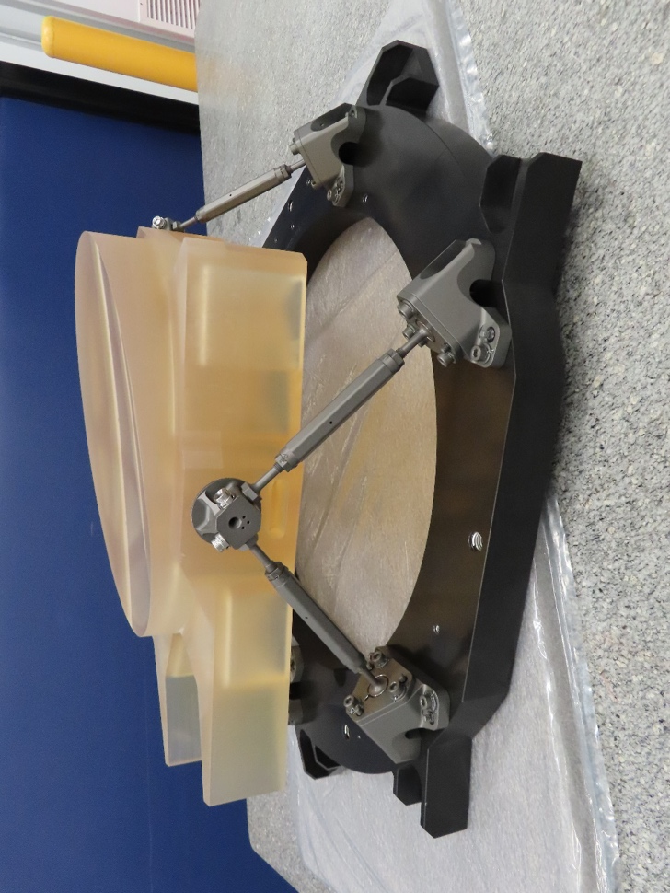
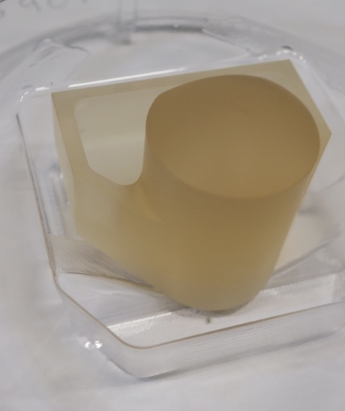
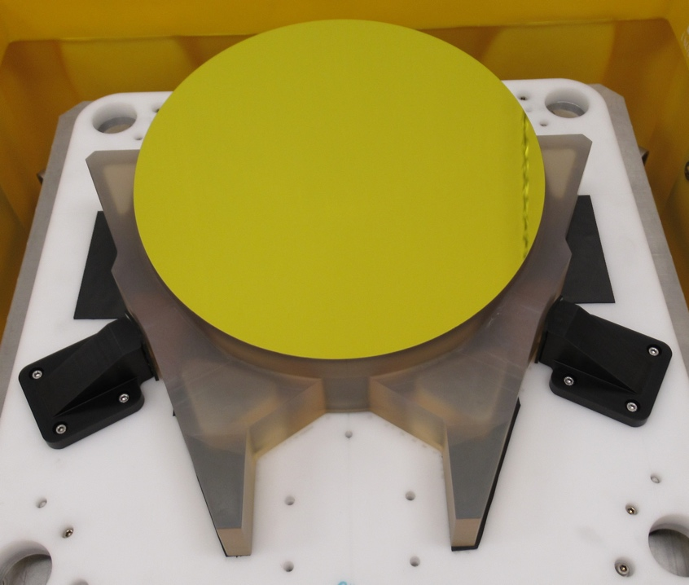
EDU Telescope Mechanical Design
STM: uncoated
All Zerodur except the Titanium bipods
bipods
Joint Design
Optical axis
Epoxy pad
Tower
Epoxy pads:
In matched pairs
Perpendicular to the optical axis
Gussets
M2 assembly
Image credit: L3Harris Technologies
Primary Mirror
Protected gold coating
Image credit: L3Harris Technologies
Secondary Mirror (M2)
MOSA Support Structure
Image credit: L3Harris Technologies
Tower

Slide 17
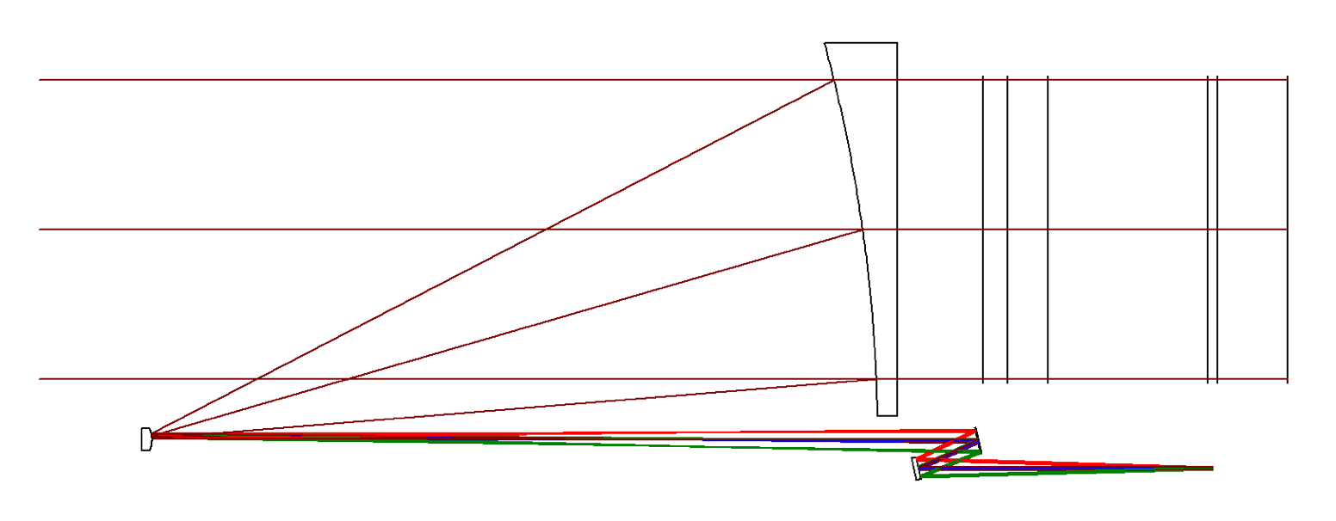
Design Update for Flight
Simulations at the University of Florida uncovered a geometrical Tilt-to-Length (TTL) coupling of relative angular motion between the bench and the telescope converted to pathlength by the offset between the large and small beams axes.
For the (TEL-OB interface):
  the effect is proportional to the sine of the tilt angle (~ δθ) x L_{offset}
For the OB-Test mass:
  the effect is proportional to the cosine of the tilt angle (~ δθ²)
Make the TEL-OB interface on-axis
δθ
Optical Bench
M1
Test Mass
L_{OB-TM}
Measurement axis is test mass to test mass between spacecraft
Beam folded onto bench
M2
Small Pupil /stop
L_{offset}
Moveable Optical Subassembly (MOSA) geometry

Slide 18
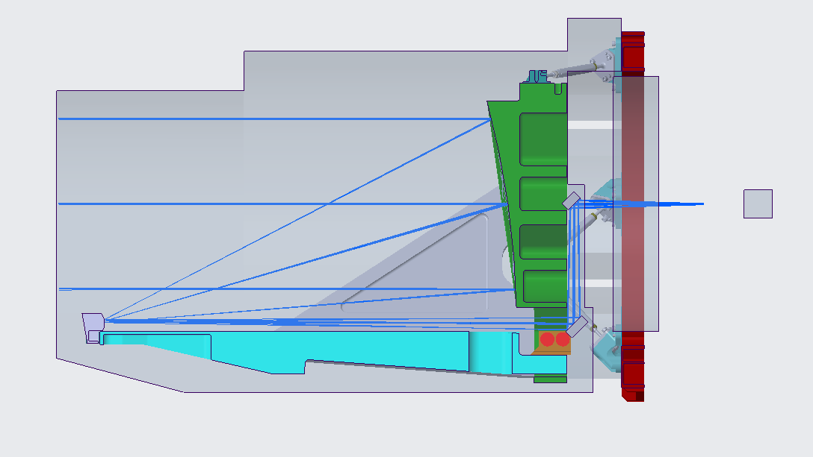
On-axis Interface Design: 4-mirror, 2 freeforms
EDU Design
New Design Summary
M1
M1 unchanged from EDU
M2 very slightly stronger (25.8 → 25.75 mm radius of curvature)
M3, M4 XY-polynomials similar to the EDU M3 design
Pros:
  No change to the MOSA: matches existing interfaces
  Compatible with the OB keep out zones
Cons:
  No flat (helps make alignment adjustments orthogonal)
M3
M2
M4
New Design Overlaid on current EDU design for comparison
New 4-mirror Design
OB keep-out zone
M1
M1
Optical Bench
M4
M4
Test Mass
Small pupil: routed on the bench to the position of the stop
M2
M3
M3
M2
Existing MOSA Mechanical Envelope (no change)
15

Slide 19
Impact on the Engineering Development Unit (EDU) Program
None. It is not practical at this stage:
  28 months into a 44-month program
  All of the parts have been fabricated except EDU2 M1 (and that is nearly complete)
  New design requires further analysis (MC) for fabrication and alignment tolerances
The EDU program is intended to demonstrate TRL-6 before adoption
  Mono-material (low CTE glass or ceramic) construction for optical path length stability
  Meet environmental launch requirements while maintaining alignment
  Not to implement a particular design
Plan was always to redesign for flight once requirements were known
  Other changes will be considered later as part of normal work
Main impact:
  Had to re-think the plans for optical pathlength stability testing at UF

Slide 20
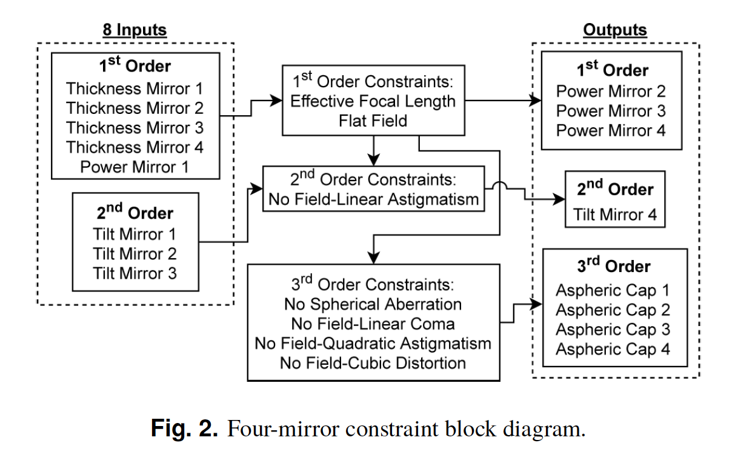
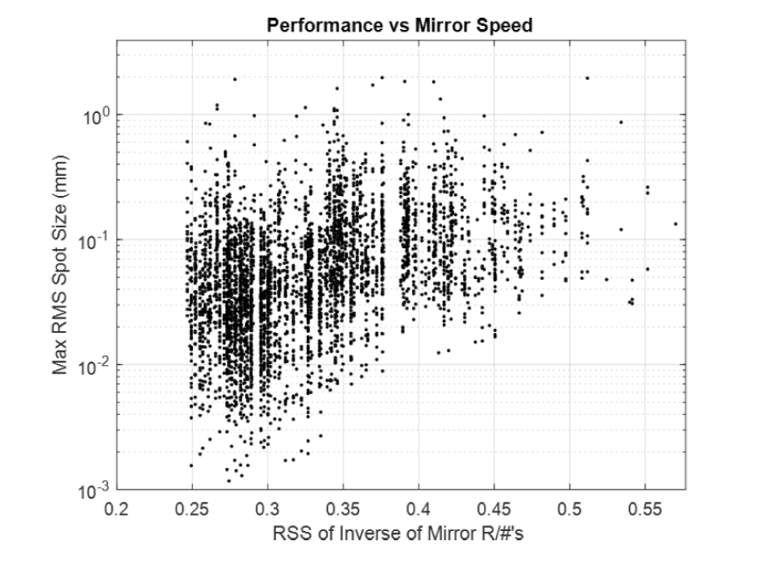
Normal Phase B1 work: further design study
Reference:
Papa, J., Howard, J., Rolland, J.; “Survey of the four-mirror freeform imager solution space”, Optics Express, Vol. 29 No. 25, 6 Dec 2021, 41534.
Fig. 2. Four-mirror constraint block diagram.
Fig. 9. The performance of the systems versus the Root Sum Square (RSS) of the inverse of the mirror R-Numbers (R/#). Systems with slower mirrors perform better.
Will also consider 6-mirror designs to see if they offer any advantage for assembly/alignment.

Slide 21
Telescope Monte Carlo Analysis
For more information, see the pre-recorded talk:
  Monte Carlo Analysis of the LISA Telescope Build Process, Corey Austin (Goddard).

Slide 22
Overview
Monte Carlo Analysis of the Telescope fabrication and assembly/alignment
Incorporates uncertainties in
  Alignment and assembly
  Fabrication of parts – in process
Allows us to study the yield (need to build ~ 9-10 telescopes for flight)
Same
CodeV (with python and Matlab)
Uniform uncertainties only
Hardware Limitations
Optics perturbed around their vertex
Build Steps
Different
 | L3Harris | NASA
Model set-up | Receive mode, single pass (reversed at end) | Single pass transmit mode (final reversed for TTL only)
ACF | Tilt on M1 | Input field angle perturbations
Tag Mirror |  | Coordinate system perturbation
N_{runs} | 100 | 1000

Slide 23
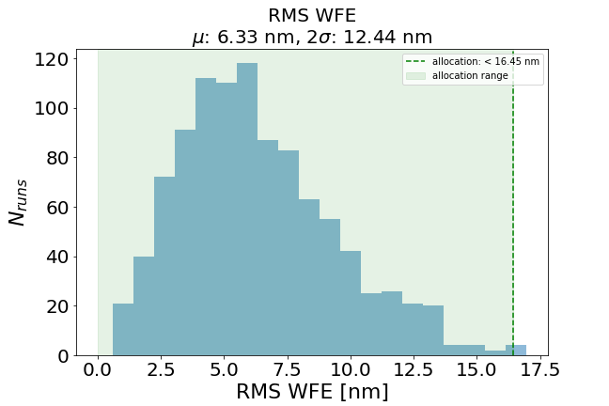
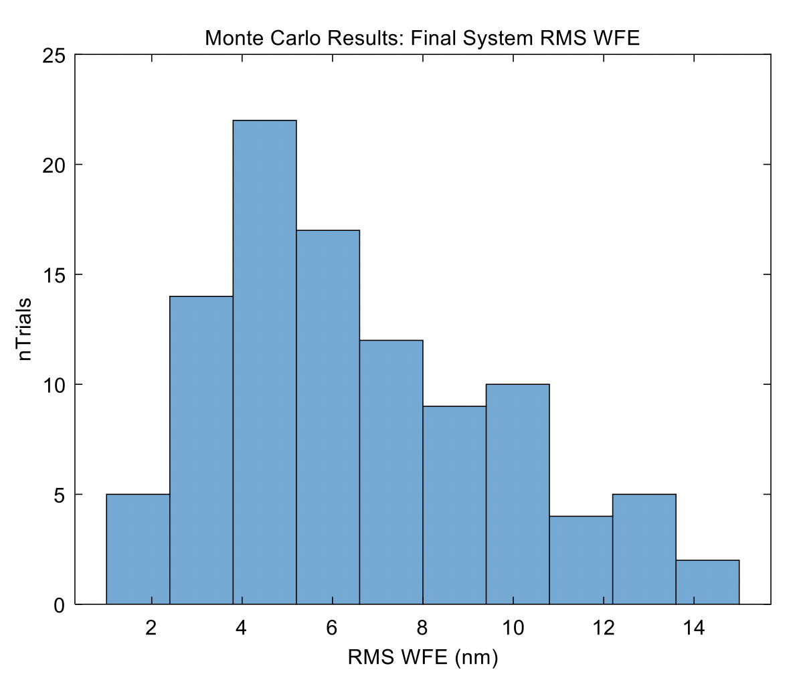

RMS WFE
good agreement
NASA 1000 runs
L3H 100 runs
2$σ$: 12.5 nm
16.45 nm
Notes:
What is my binning?

Slide 24
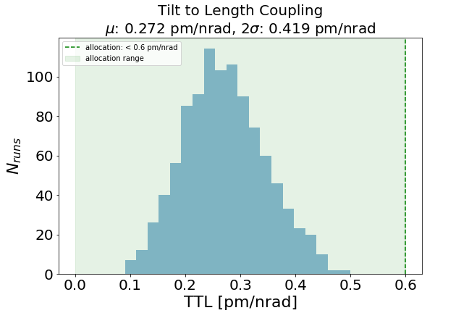
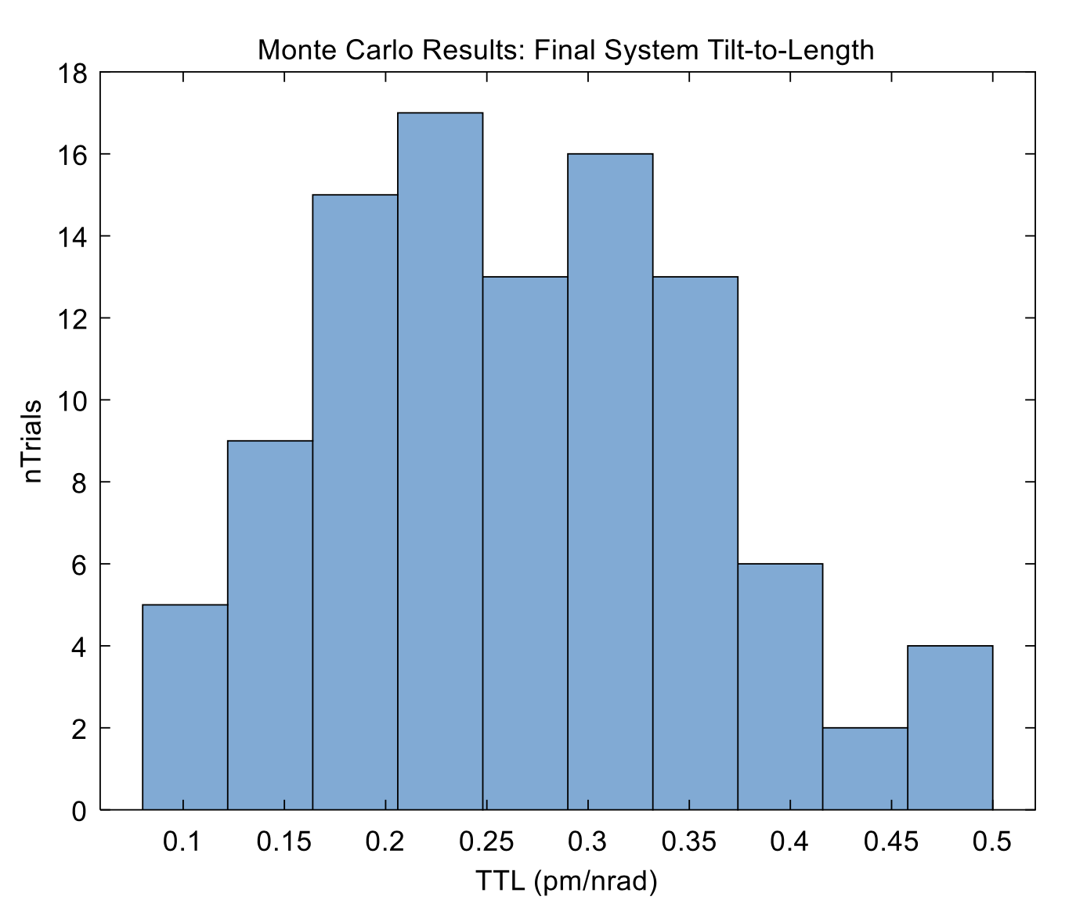

Tilt to Length
good agreement
NASA 1000 runs
L3H 100 runs
2$σ$: 0.436 pm/nrad
0.6 pm/nrad

Slide 25
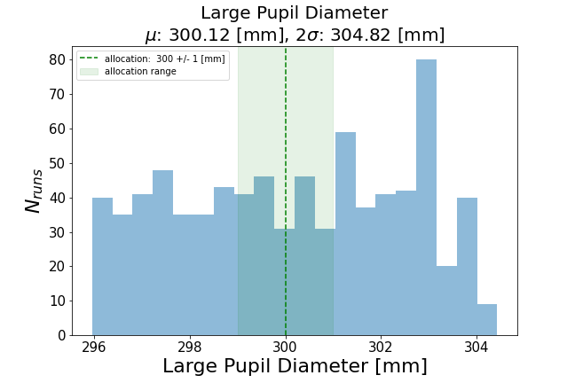
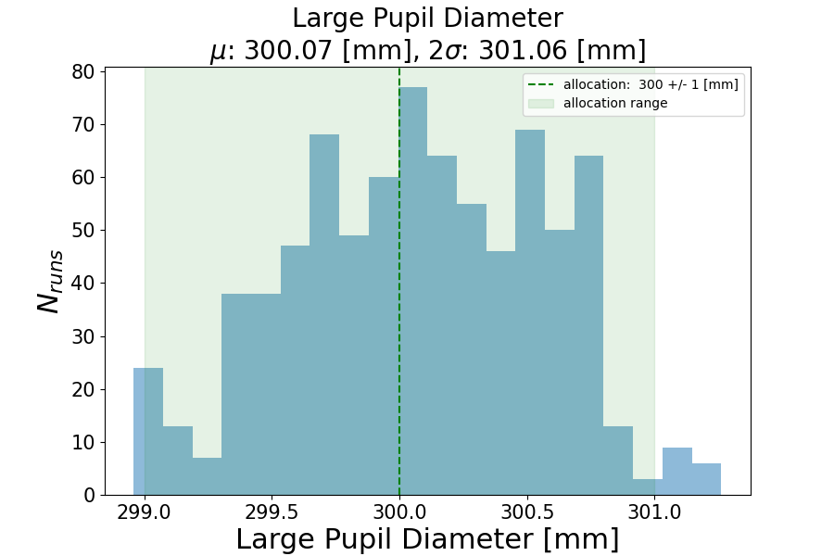
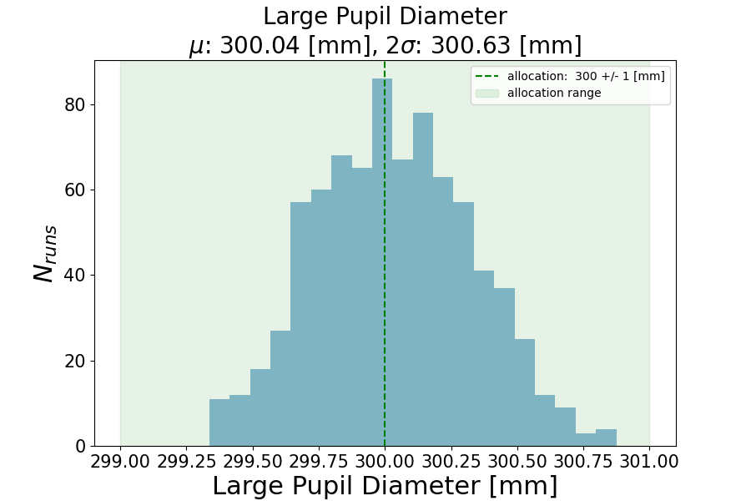
M2 Tolerance Effect on Pupil Diameter
M2 Radius of Curvature tolerance needs to be tightened
EDU Tolerance (+/- 0.35 mm)
From the drawings
Tighter Tolerance (+/- 0.070 mm)
Tighter Tolerance (+/- 0.035 mm)
(Delivered M2 optics met this tolerance)
Out of spec on ~75% of builds
Meets spec on ~100% of builds

Slide 26
Testing Plans
Goddard Space Flight Center

Slide 27
Co-boresight , WFE tests, and Pupil Mapping
To verify that the performance of the LISA EDU Telescope meets some key performance parameters specified in requirements document “LISA-tele-spec-0001(rev b)”.
  Tel-80 boresight accuracy - Verify parallelism between the small pupil base ray and the large pupil base ray < 130 urad (or 27 arcsec).
  Tel-110 boresight knowledge - Verify that the L3 Harris Boresight is specified better that 300 urad (or 61.8 arcsec)
Independently determine wavefront error across science field of view and compare to L3H results
  Tel-170/190: Across the Science FOV, the telescope shall provide an RMS wavefront error (WFE) of < 40 nanometers over the operating wavelength
Gravity release, via testing at 3 orientations
Find zero field angle and relate its angle to a measurable target on the LISA telescope (TBD)
Determine testing errors and validate/verify error budgets (useful for future discussions about flight units)
Pupil mapping test is a proxy for a direct TTL measurement

Slide 28
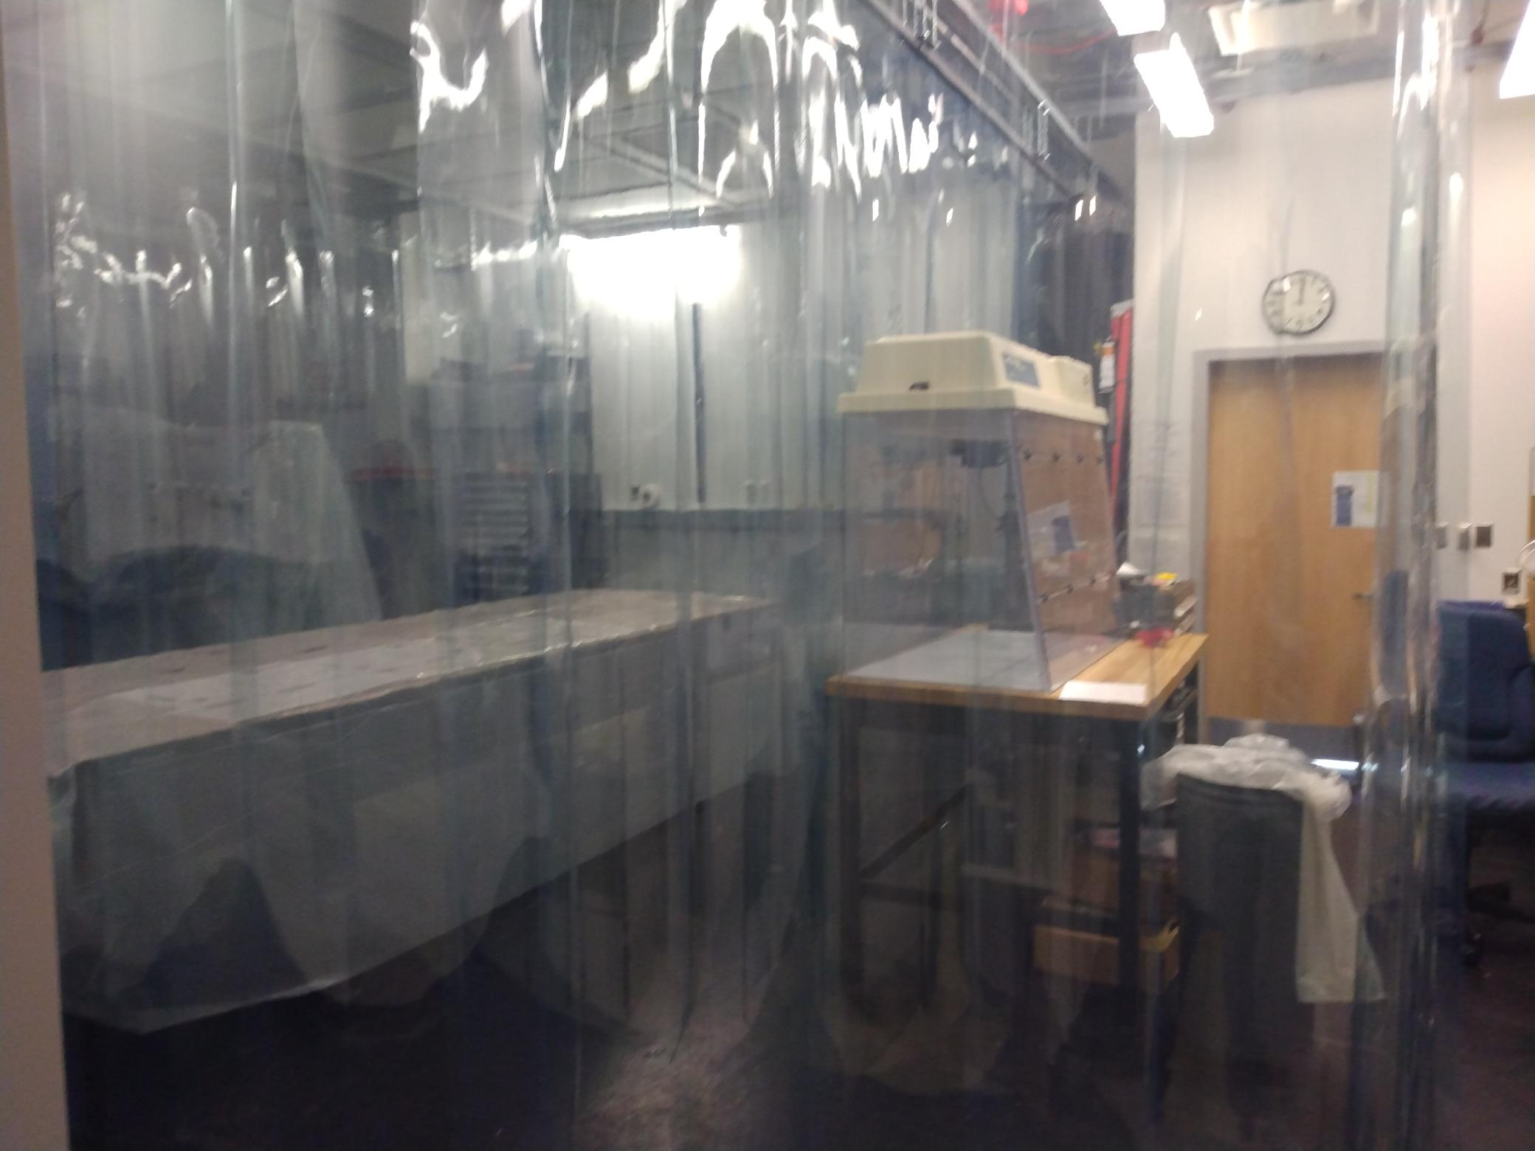
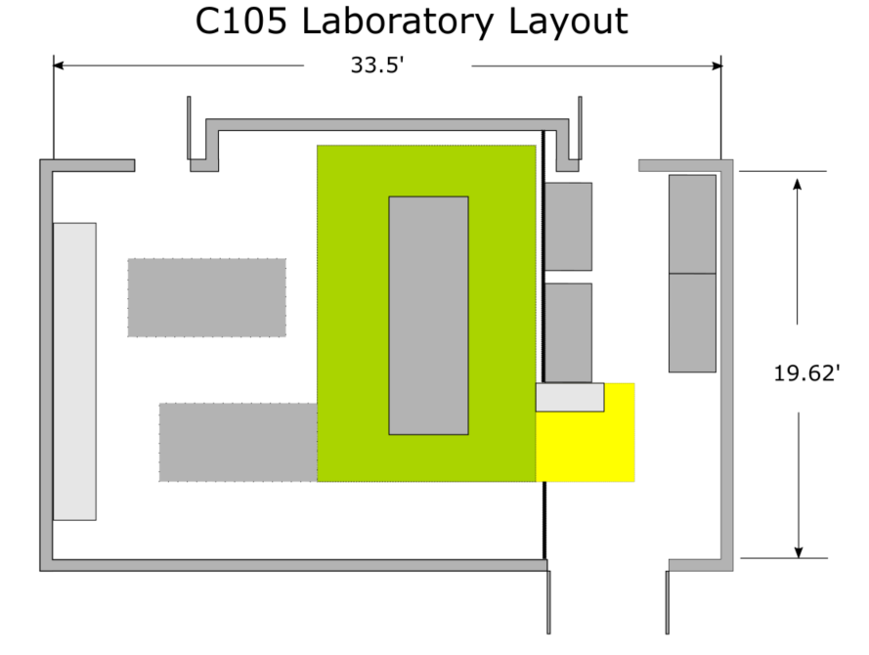
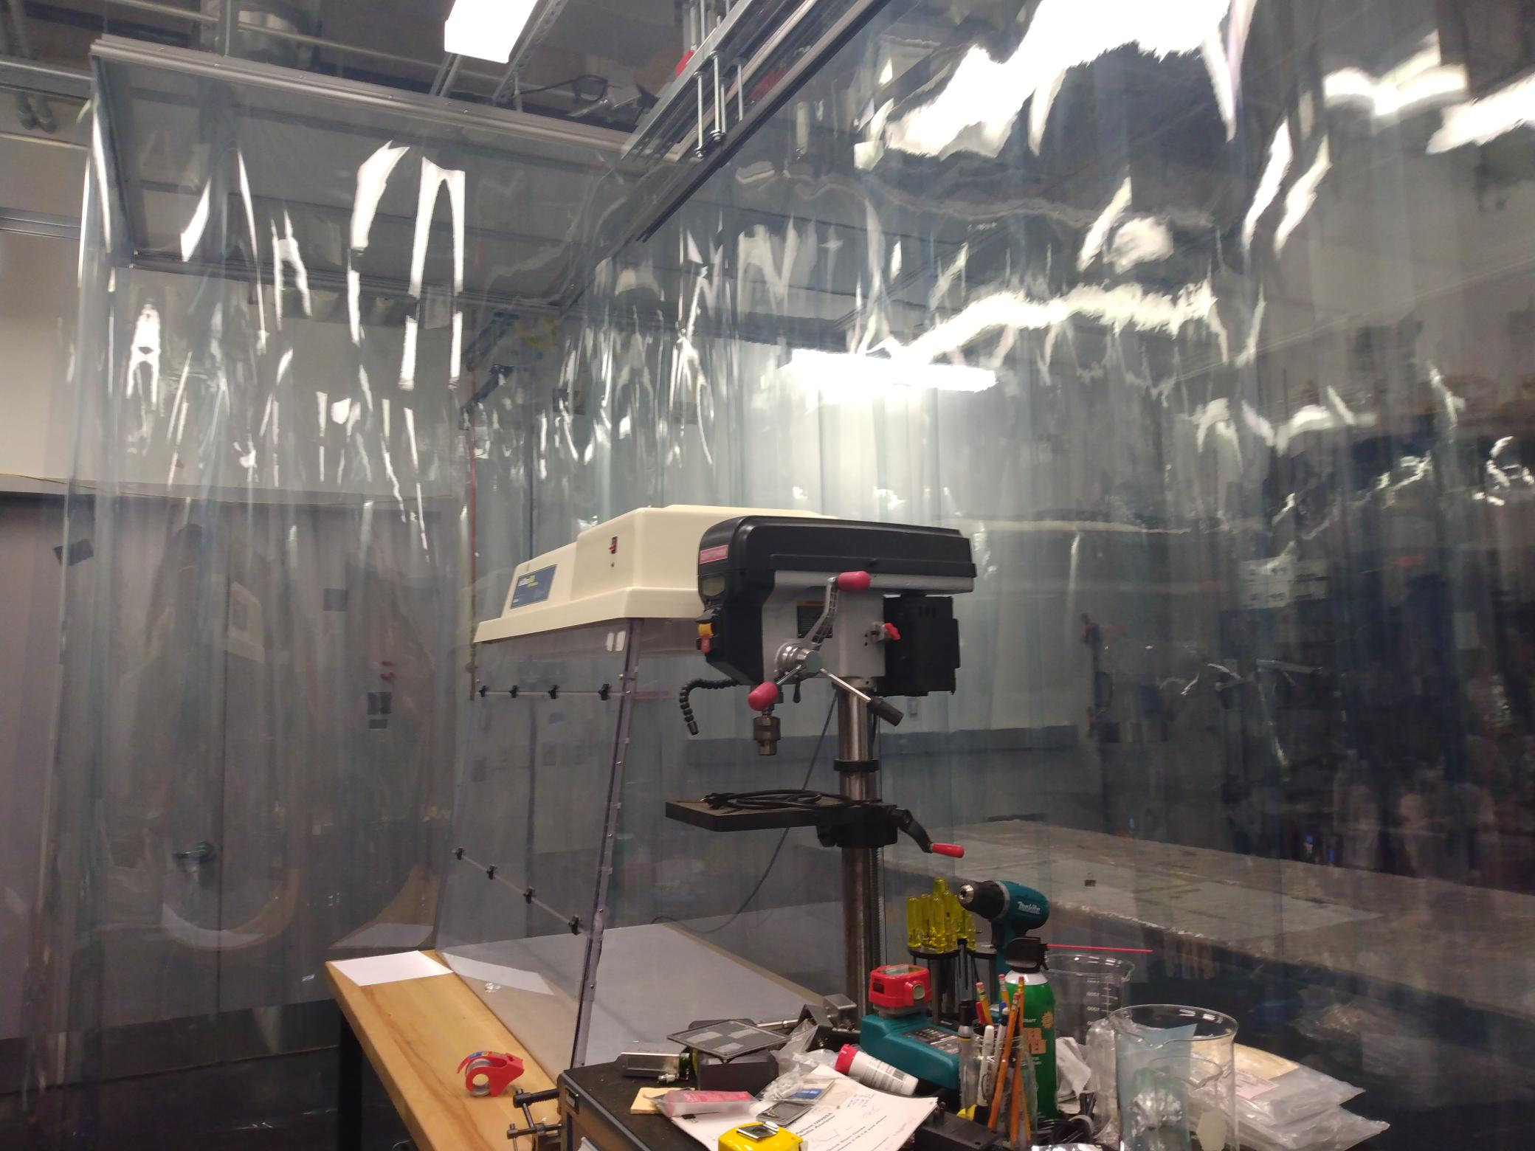
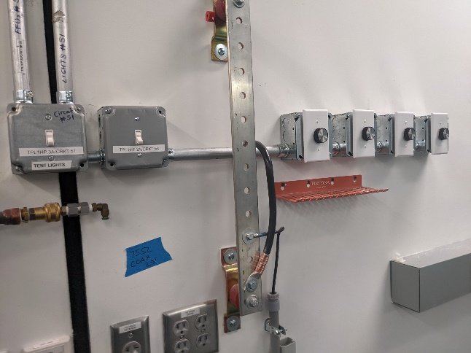
The Lab: Bldg 34 RM C105
A class 10K facility custom build tent has been placed in C105 featuring…
Double soft-walled tent
Suspended from ceiling (no posts)
Separate gowning area.
Adjustable vertical flow.
Climate controlled.
Temperature based humidity control.
High ceiling height to support the telescope installation.
4x12 Newport optics bench
Full ISO 7 cleanliness will be used.
A draft contamination plan is in place.
Tent
Gowning Area
Air Flow Controllers

Slide 29
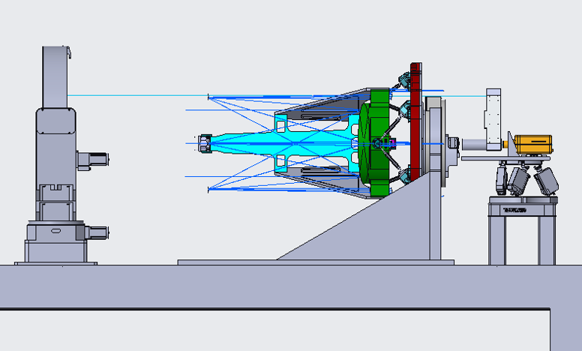
LISA Telescope WFE Layout
Small pupil/attocube
Afocal/Converging lens tube
M1 mirror
Periscope
600mm ACF/STANDA
4D Phasecam 6000 @1064nm
PI hexapod
Coordinate system fiducials (x3)

Slide 30
Testing Plans
University of Florida
For more details, please see:
July 28 – LISA Instrumentation Parallel Session 3/3
  10:35 am EDT/16:35 CEST:
  Dimensional Stability Verification of the LISA Telescope, Ada Umińska (University of Florida)

Slide 31
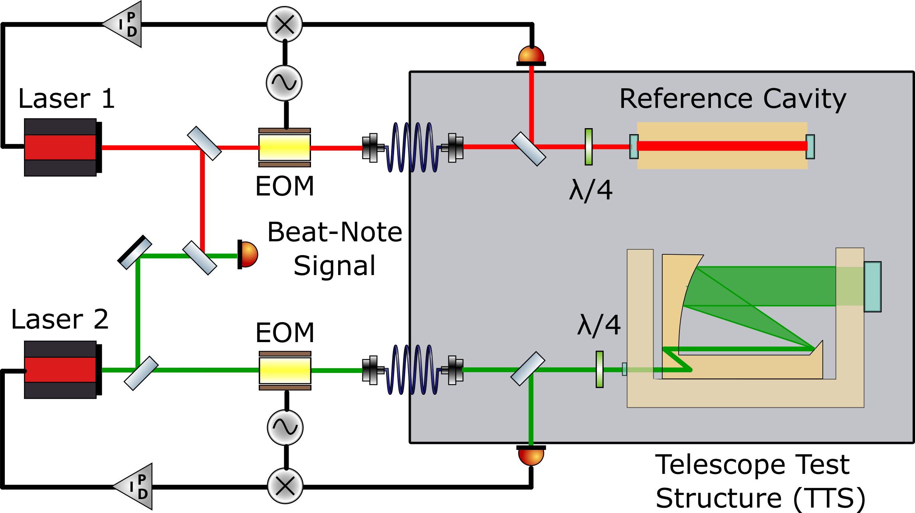

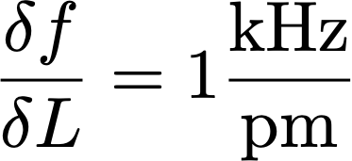
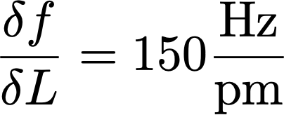
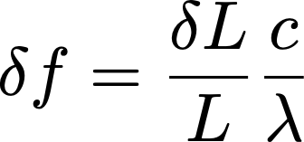
Measurement principle:
Ruler: Laser wavelength
  Length defined by optical cavity
  Resonance:
Stabilize λ to cavity length
  Lock-in technique (PDH)
Reference
  Monolithic Zerodur block (pm)
  Iodine standard (long term, µm)
Compare laser frequencies
  Radio frequency beat signal
Separate vacuum tanks
  Scaling:
  L = 30 cm —>
  L = 2 m —>

Slide 32
Summary
Technology Development of an all-zerodur telescope is making good progress
Credible plan to demonstrate TRL-6 by Adoption
Looking ahead to flight
  Determination of all critical requirements
  Further design optimization planned once requirements known
    Need to include “design for manufacturing” concerns (we need to build ~ 10)

