Slide 1

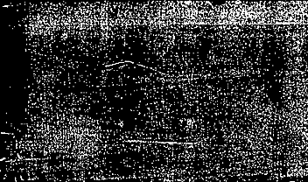
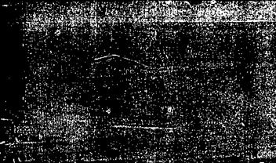
Application of a Deep Neural Network to Improve Clear-sky Temperatures in Support of Satellite Cloud Retrievals
Benjamin Scarino, William L. Smith Jr., Baojuan Shan, Rabindra Palikonda, and Szedung Sun-mack

Slide 2
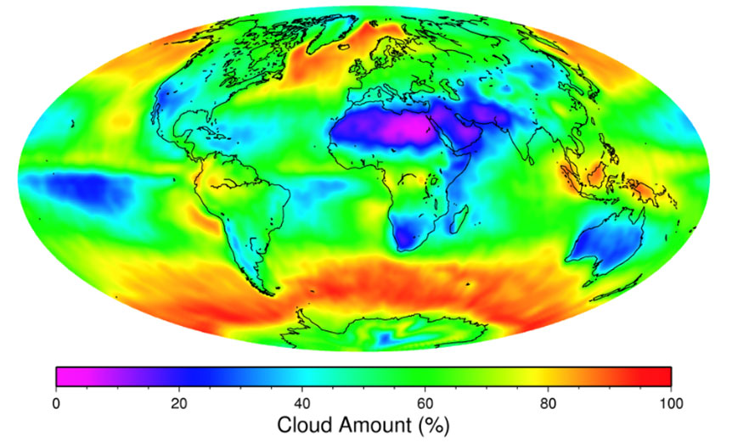
Background
Global cloud coverage estimates important for Earth Radiation Budget (ERB) monitoring efforts, e.g., CERES (Clouds and Earth’s Radiance Energy System)
Cloud detection algorithms rely radiance thresholding
  Satellite-measured radiance compared to an expected radiance
Necessary to know the expected global skin temperature (T_{skin}) in cloud-free conditions
  Differences between NWP analysis and satellite derived Land Surface Temperature (LST) can exceed 5 K
Clouds influence NWP model LST
  LST characterization is tied to model’s accuracy in resolving clouds
LST estimate can vary between different reanalysis models
  E.g., GEOS5 vs. MERRA-2
ceres.larc.nasa.gov/wp-content/uploads/cloud-amount.jpg

Slide 3
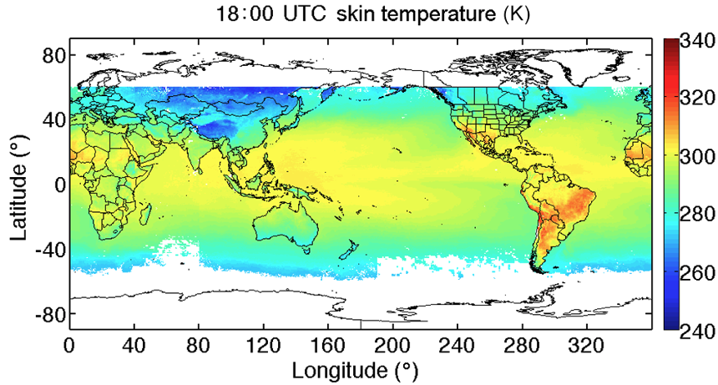
Goal
Develop a better way of estimating a consistent LST
Train Deep Neural Networks (DNNs) to tie reanalysis air temperature to satellite-observed T_{skin} (truth)
  DNNs are specific to a certain reanalysis model
The DNN-predicted T_{skin} should…
  Have have much smaller bias relative to truth compared to reanalysis
  Be consistent regardless of the reanalysis input source
  Be uninfluenced by diurnal factors
Achieved using seasonal months of global GEO satellite-observed cloud-free T_{skin}
This work should lead to improved satellite cloud retrievals that enhance ERB monitoring efforts
Scarino et al. (2017), doi.org/10.5194/amt-10-351-2017

Slide 4
DNN Architecture
Input Layer
  Reanalysis 2-m Air Temp (T_{air})
  Latitude
  Longitude
  Day of Year
  Local Time
  Solar Zenith Angle
  IGBP Scene Type
Hidden Layers
  5 Layers
  200 Neurons
  ReLU
Output Layer
  Predicted Observed T_{skin}
  Regression
T_{air}
H₁¹
H₁²
H₁³
H₁⁴
H₁⁵
Lat
H₂¹
H₂²
H₂³
H₂⁴
H₂⁵
Lon
H₃¹
H₃²
H₃³
H₃⁴
H₃⁵
Day of Year
H₄¹
H₄²
H₄³
H₄⁴
H₄⁵
T_{skin}
Local Time
H₅¹
H₅²
H₅³
H₅⁴
H₅⁵
SZA
Scene
H₂₀₀¹
H₂₀₀²
H₂₀₀³
H₂₀₀⁴
H₂₀₀⁵

Slide 5
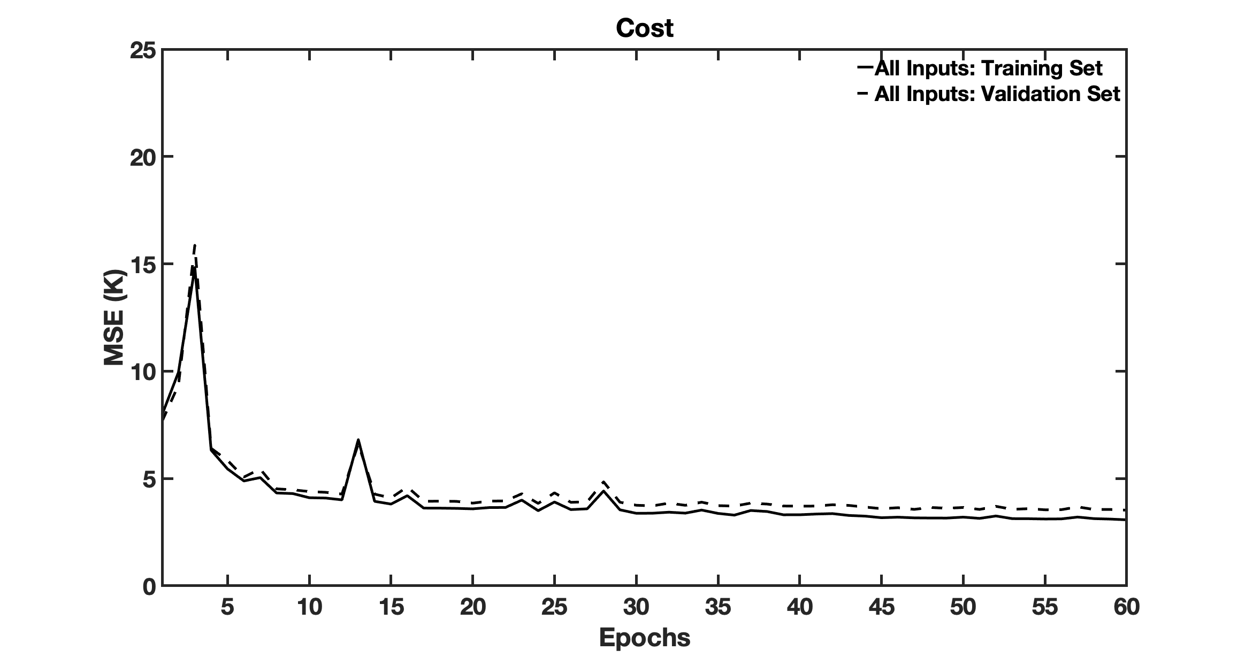
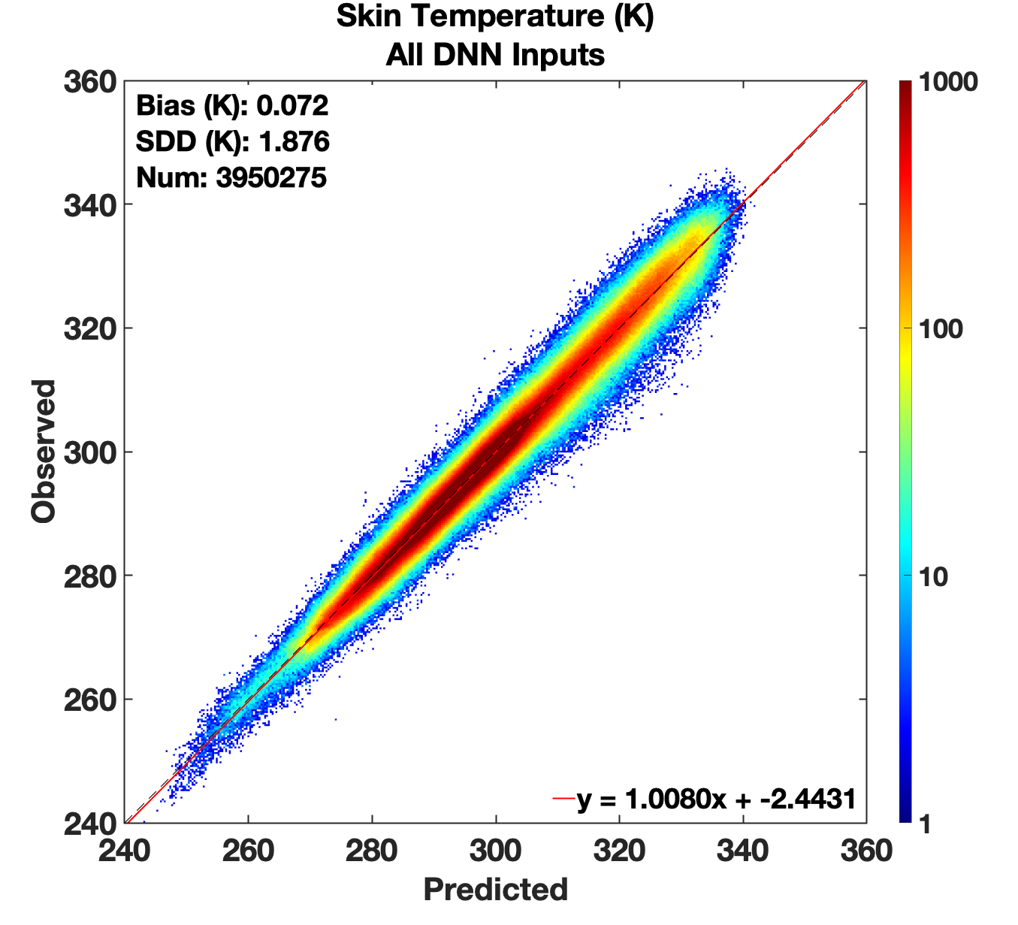
Training Results and Input Sensitivity
Validation set results exhibit good linearity
Minimizes Mean Square Error (MSE) between Prediction and Truth

Slide 6
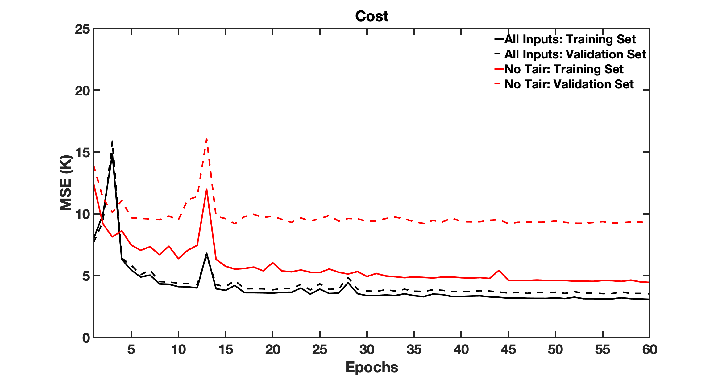
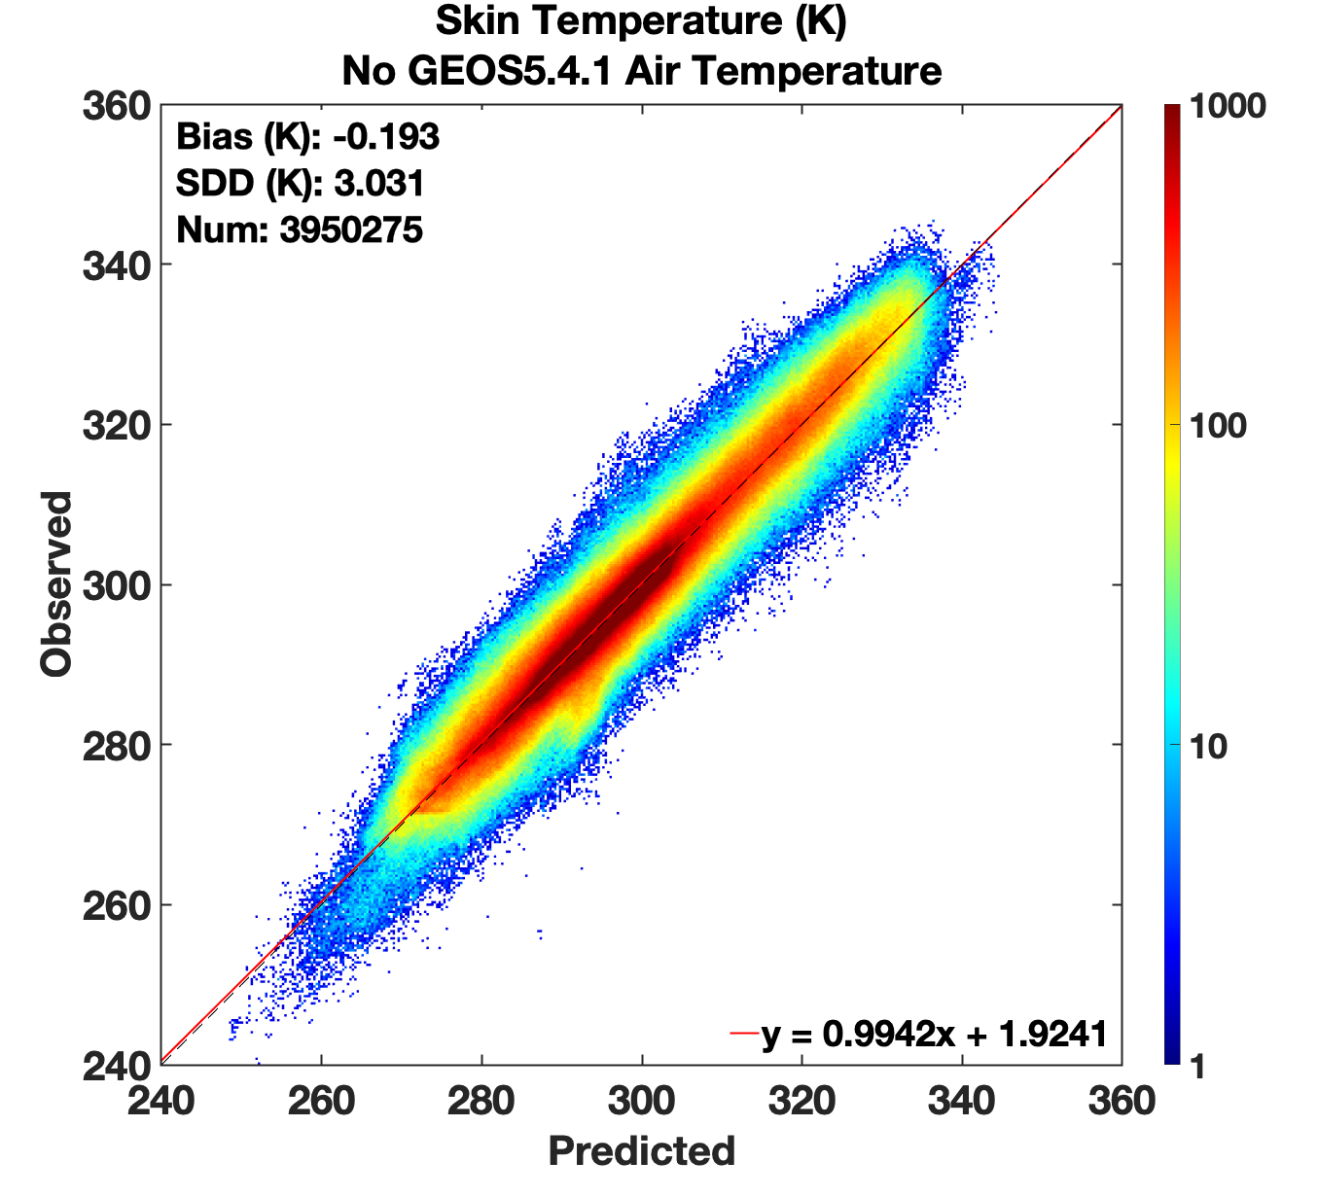
Training Results and Input Sensitivity
Validation set results exhibit good linearity
Higher uncertainty without T_{air}
Minimizes Mean Square Error (MSE) between Prediction and Truth
Model generalization sensitive to T_{air} input

Slide 7
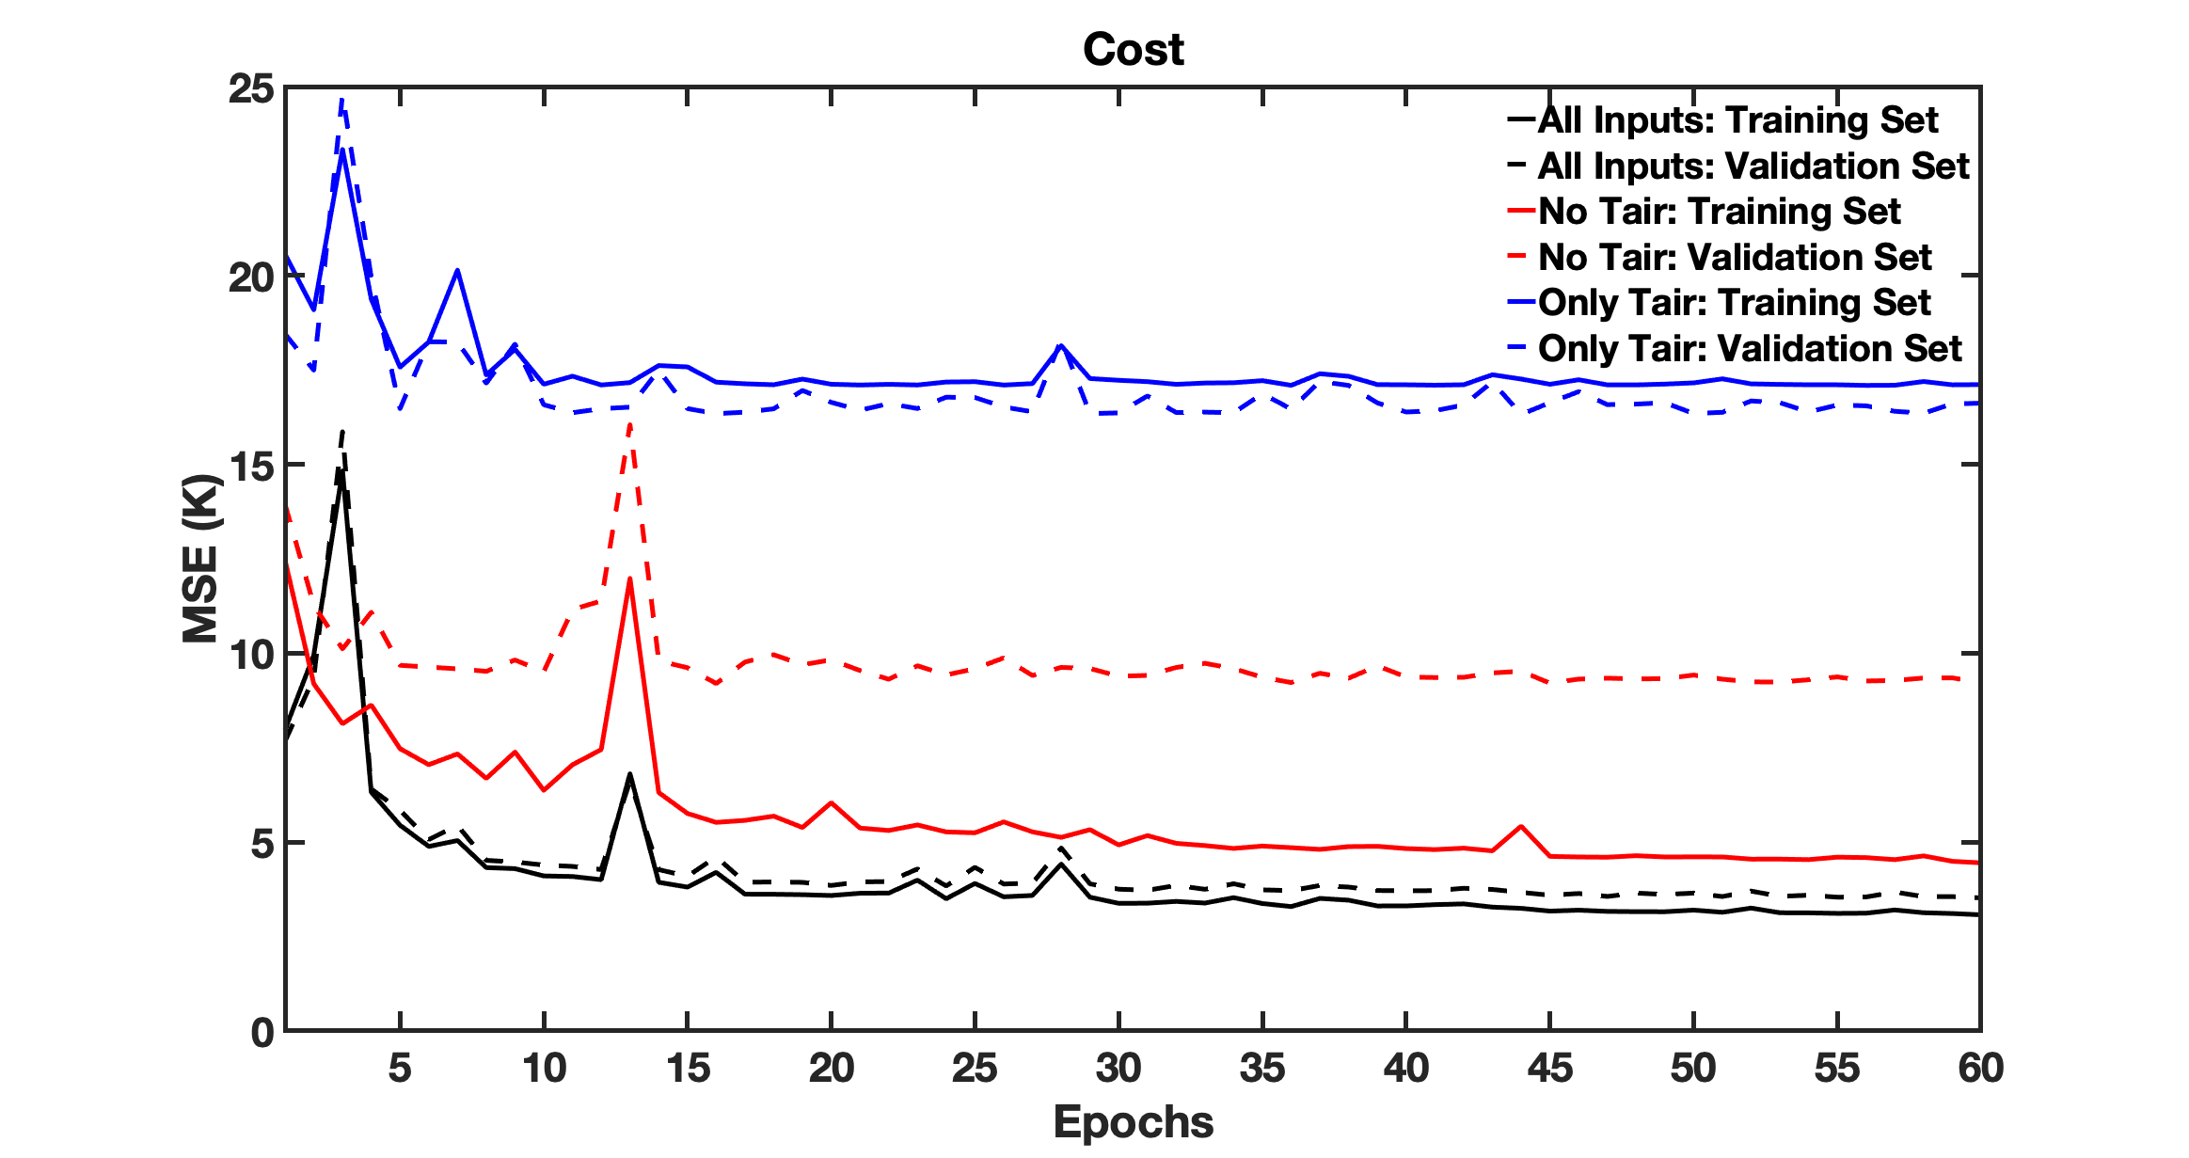
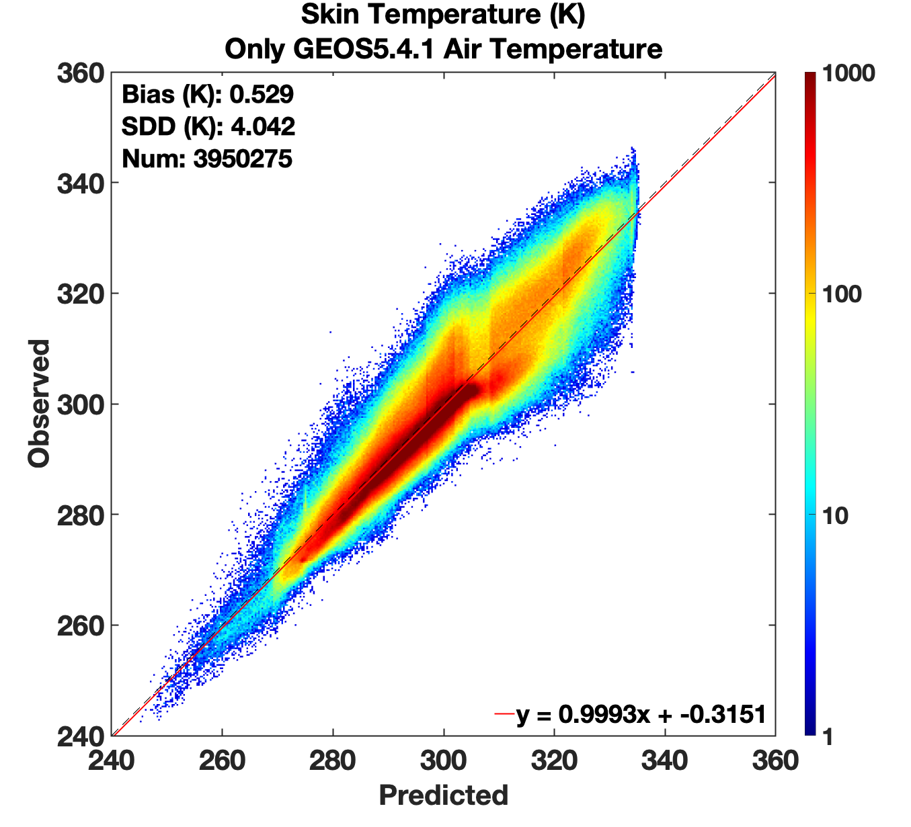
Training Results and Input Sensitivity
Validation set results exhibit good linearity
Higher uncertainty without T_{air}
Loses cohesion without regional/diurnal information
Minimizes Mean Square Error (MSE) between Prediction and Truth
Model generalization sensitive to T_{air} input
High sensitivity to auxiliary inputs (location, time, surface type)

Slide 8
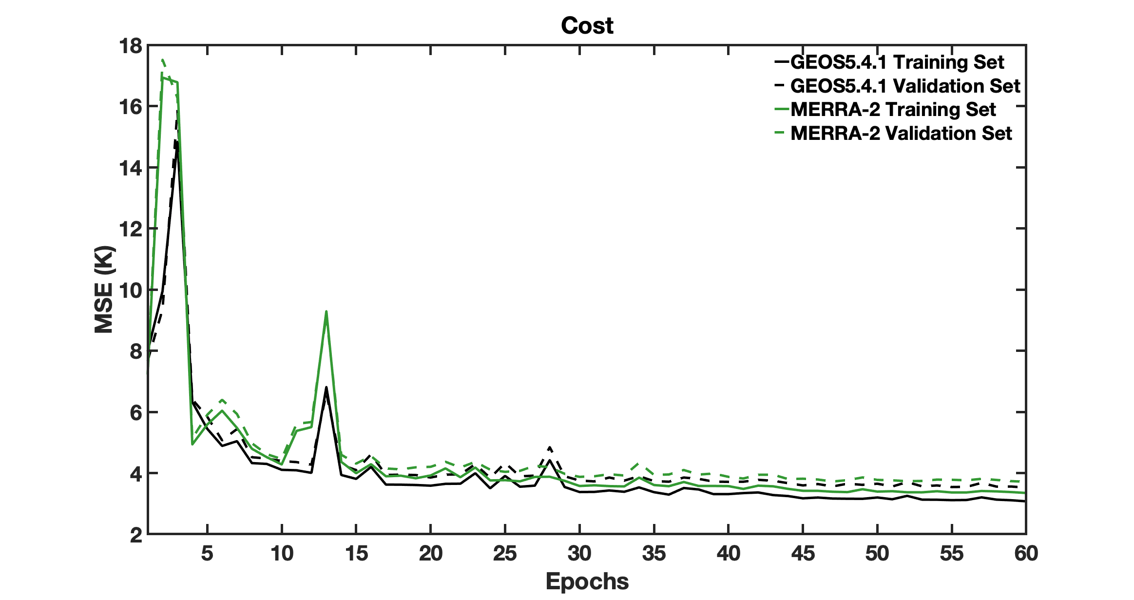
GEOS5.41 or MERRA-2: DNN Results
Train two DNNs with same Auxiliary inputs
Use either GEOS5.4.1 or MERRA-2 T_{air}
Training/Validation sets split by whole weeks (85% / 15%)
How does the predicted T_{skin} compare to the observed truth?

Slide 9
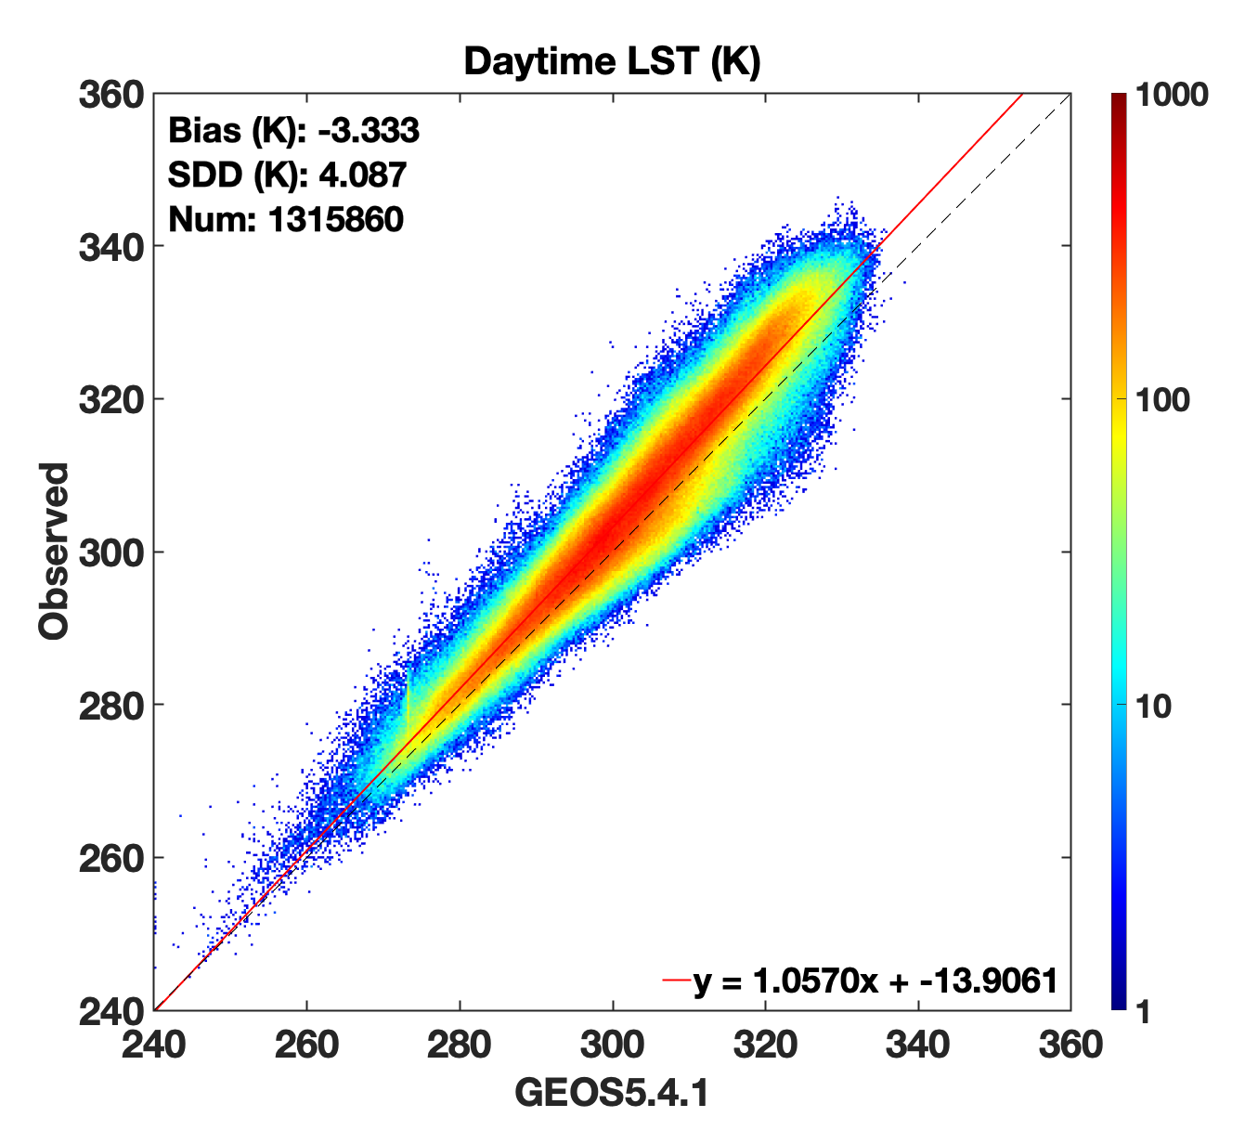
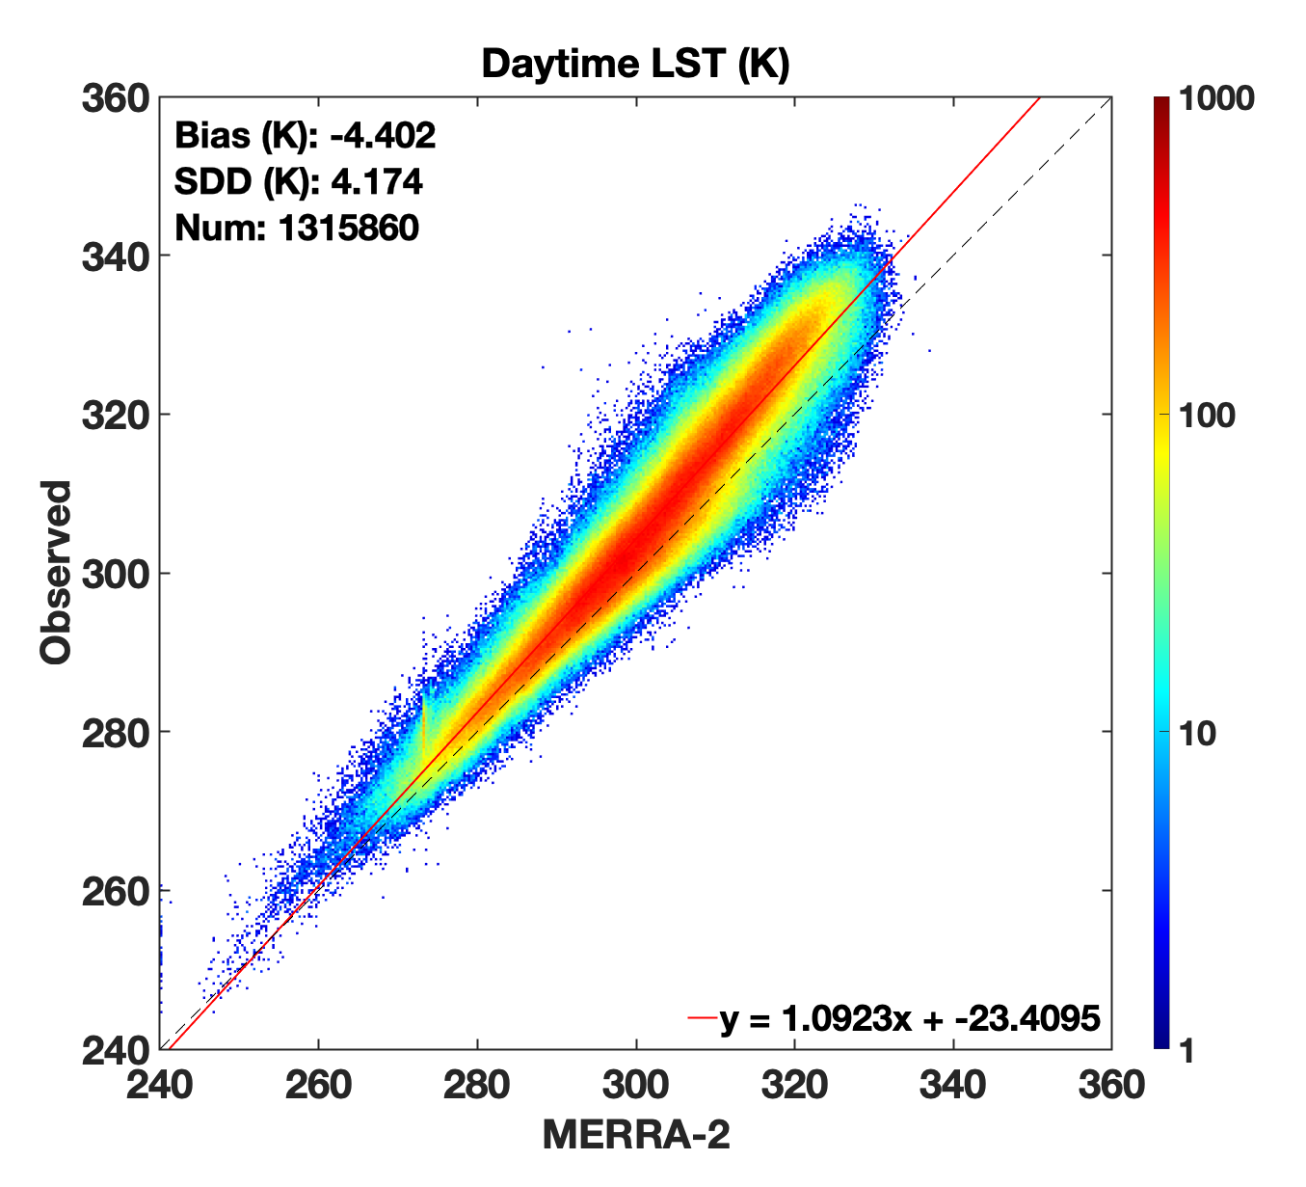
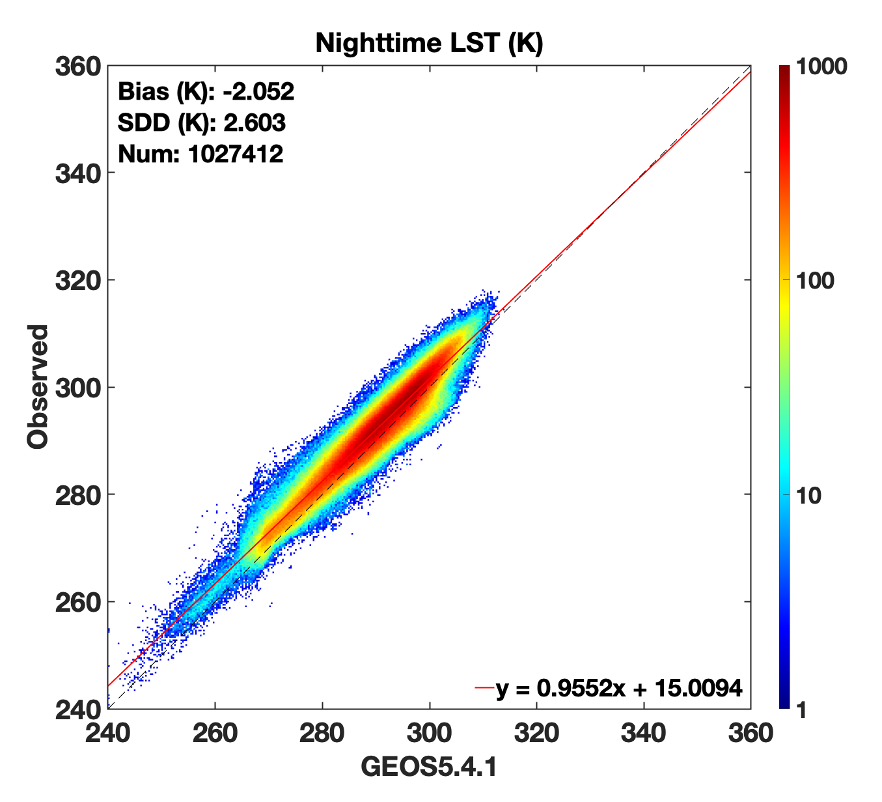
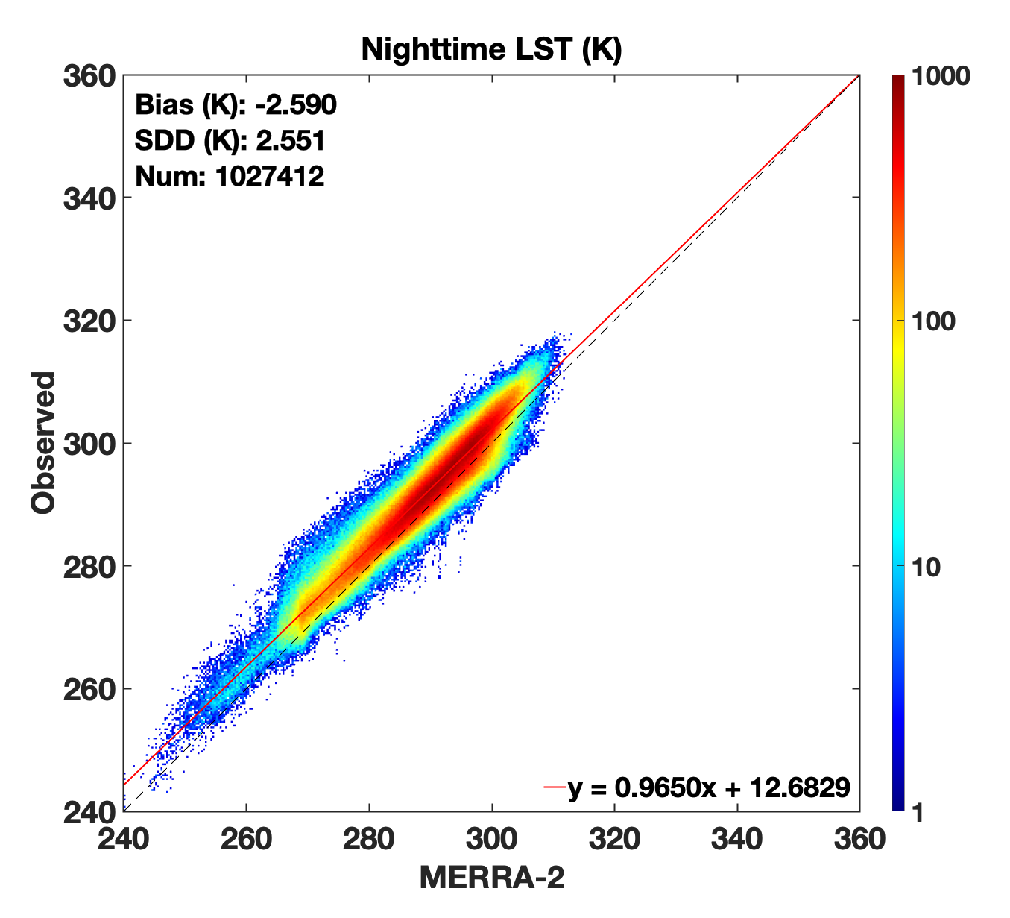
Reanalysis LST vs. Truth
GEOS5 and MERRA-2 LST reanalyses are poor estimates of observed values
Relative uncertainties (SDDs) of each reanalysis compared to truth are large, biases are significant and distinct
Cloud retrievals are sensitive to such differences
GEOS5.4.1
Day
MERRA-2
Day
GEOS5.4.1
Night
MERRA-2
Night

Slide 10
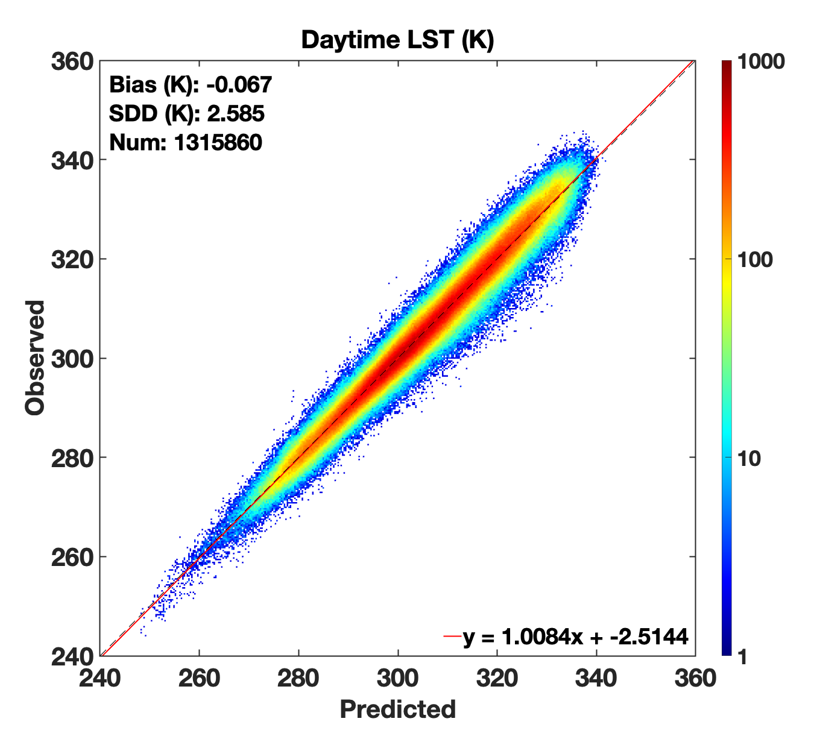
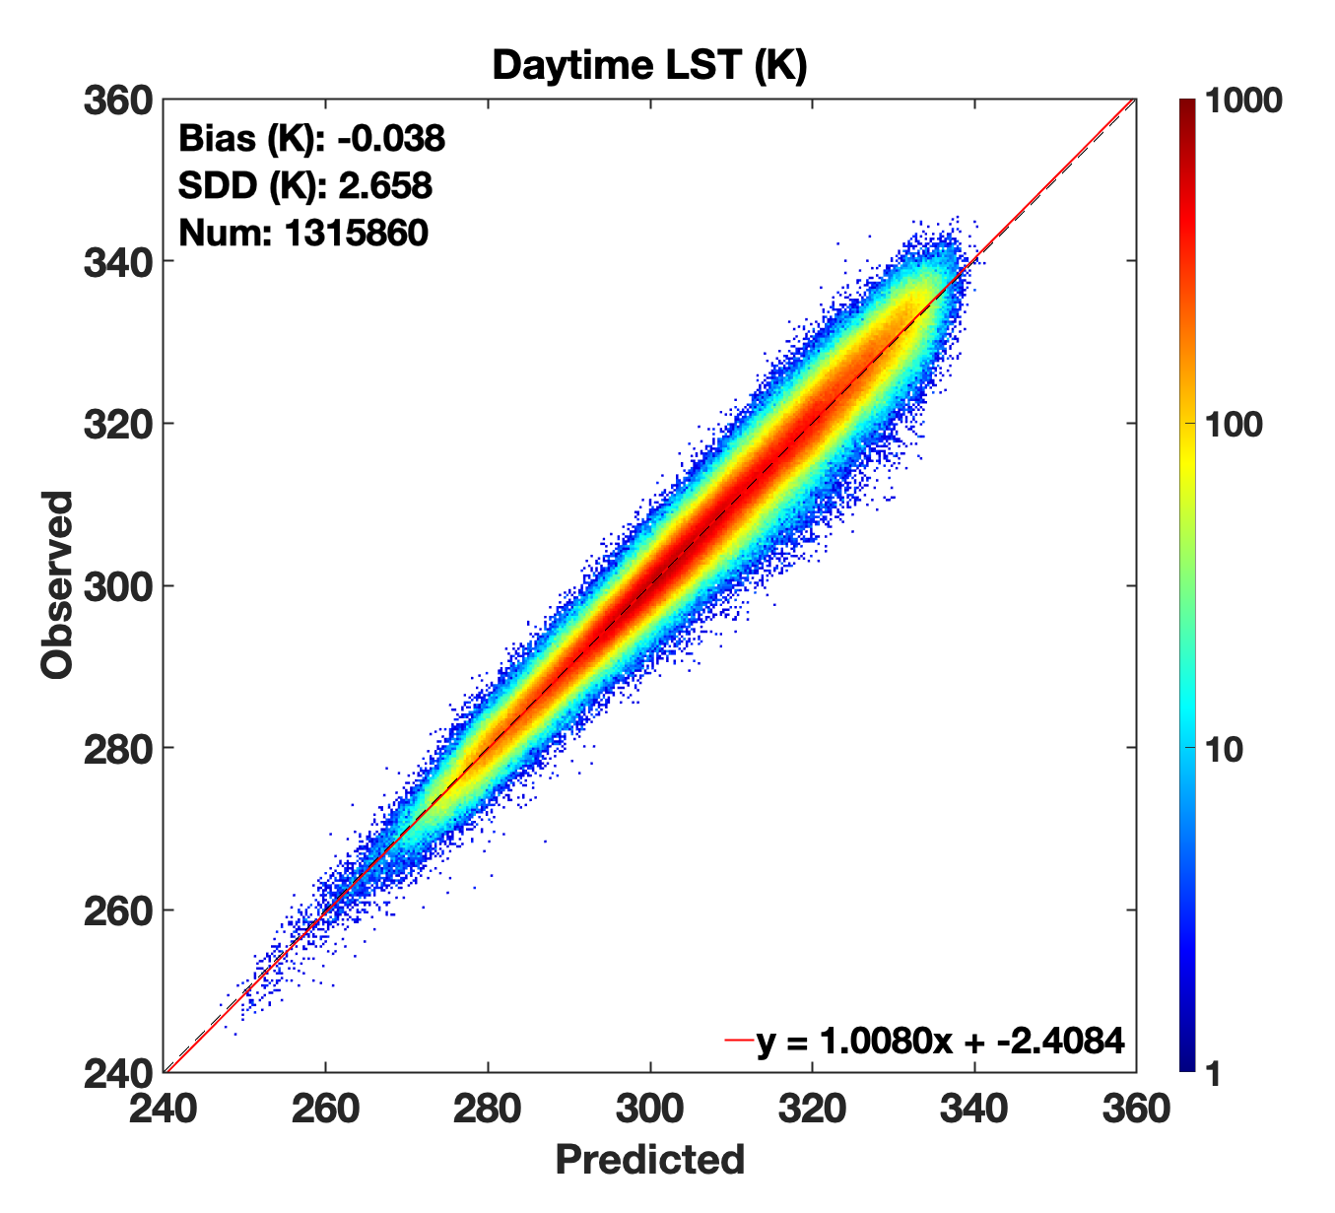
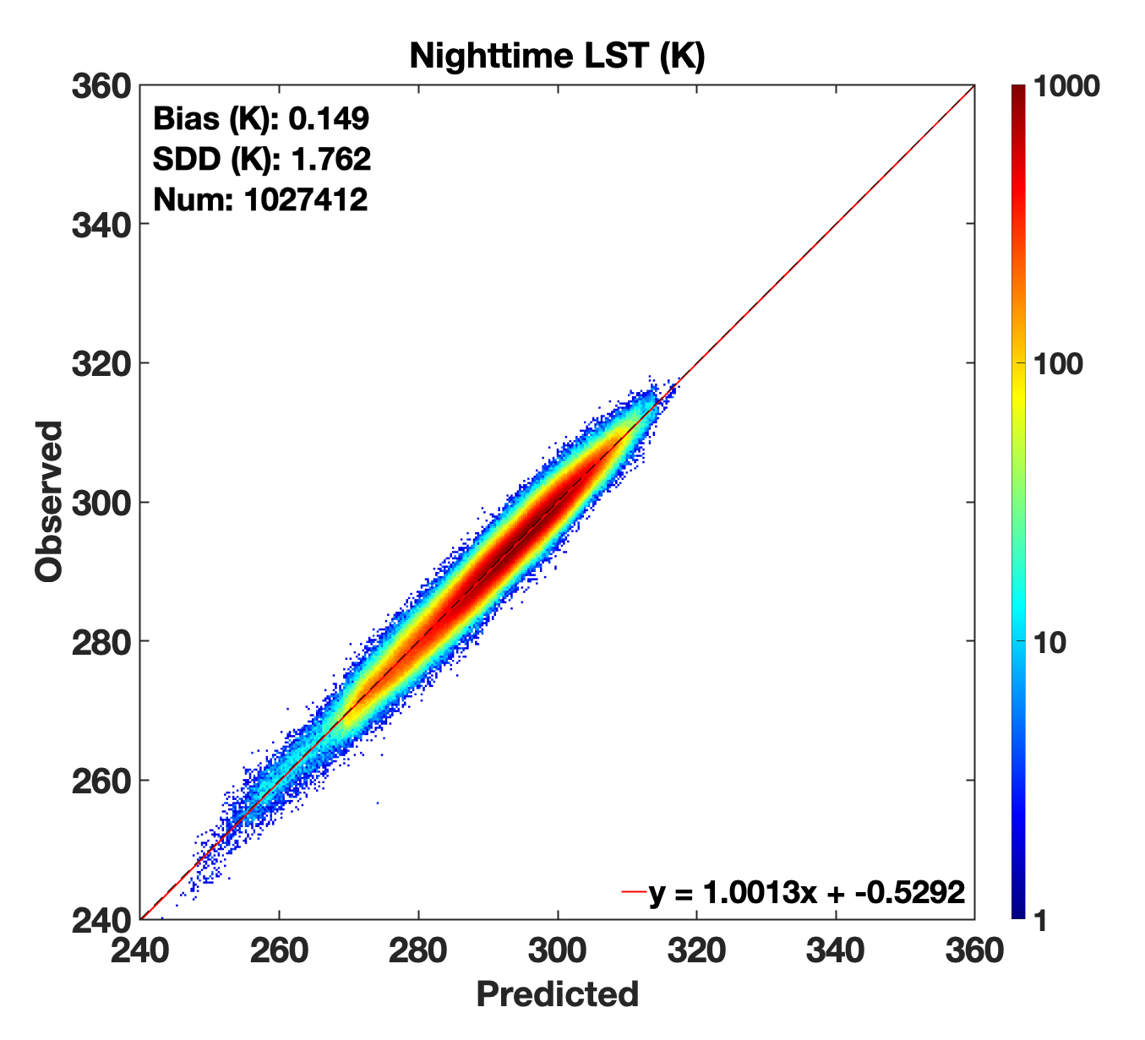
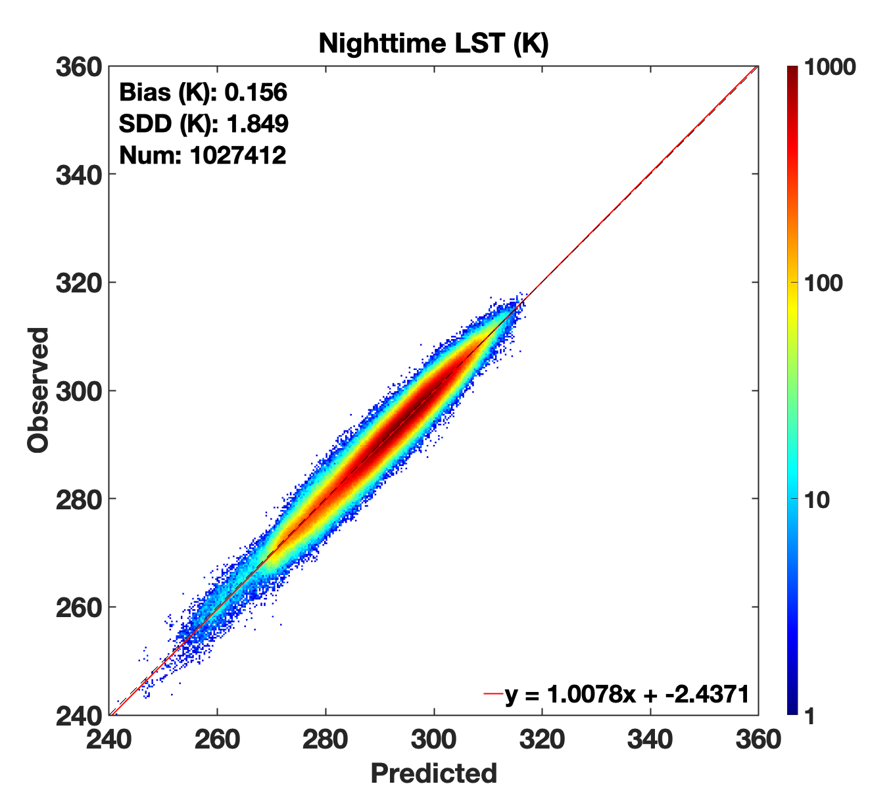
DNN LST vs. Truth
LSTs predicted by the DNNs are more consistent with observation
Prediction biases relative to truth are comparable and small, uncertainties are less than those of reanalysis estimates
Cloud retrieval logic would be relatively consistent regardless of which DNN predictions are used (based on GEOS5 or MERRA-2 T_{air})
DNN
Day
(based on GEOS5.4.1 T_{air})
DNN
Day
(based on MERRA-2 T_{air})
DNN
Night
(based on GEOS5.4.1 T_{air})
DNN
Night
(based on MERRA-2 T_{air})

Slide 11
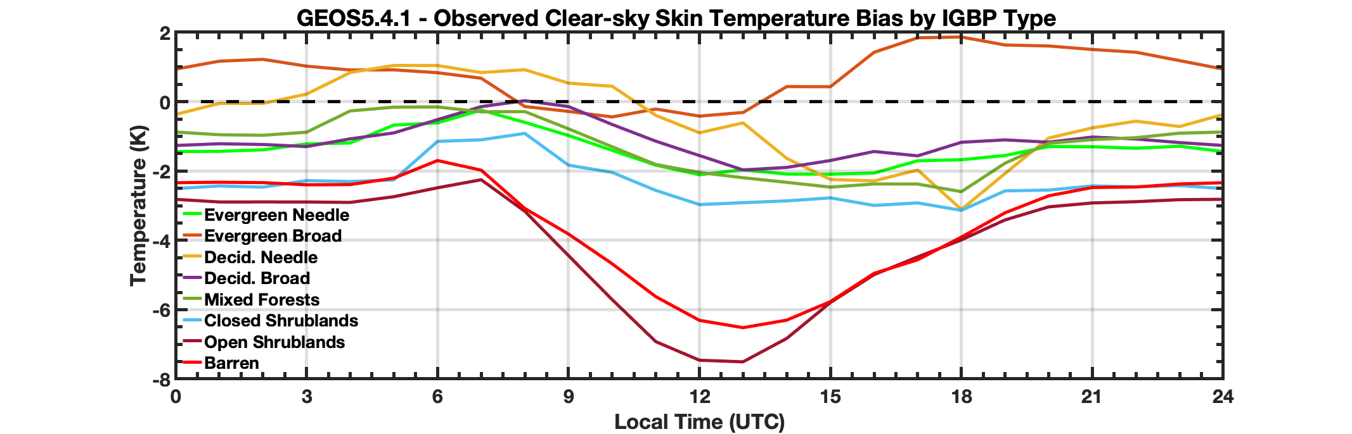
GEOS5.4.1 Diurnal Analysis
Diurnal reanalysis LST bias patterns and magnitudes are sensitive to scene type
Consideration for such can complicate cloud retrieval logic reliant on different reanalyses
The DNN inherently accounts for these dependencies, and can help simplify retrieval logic

Slide 12
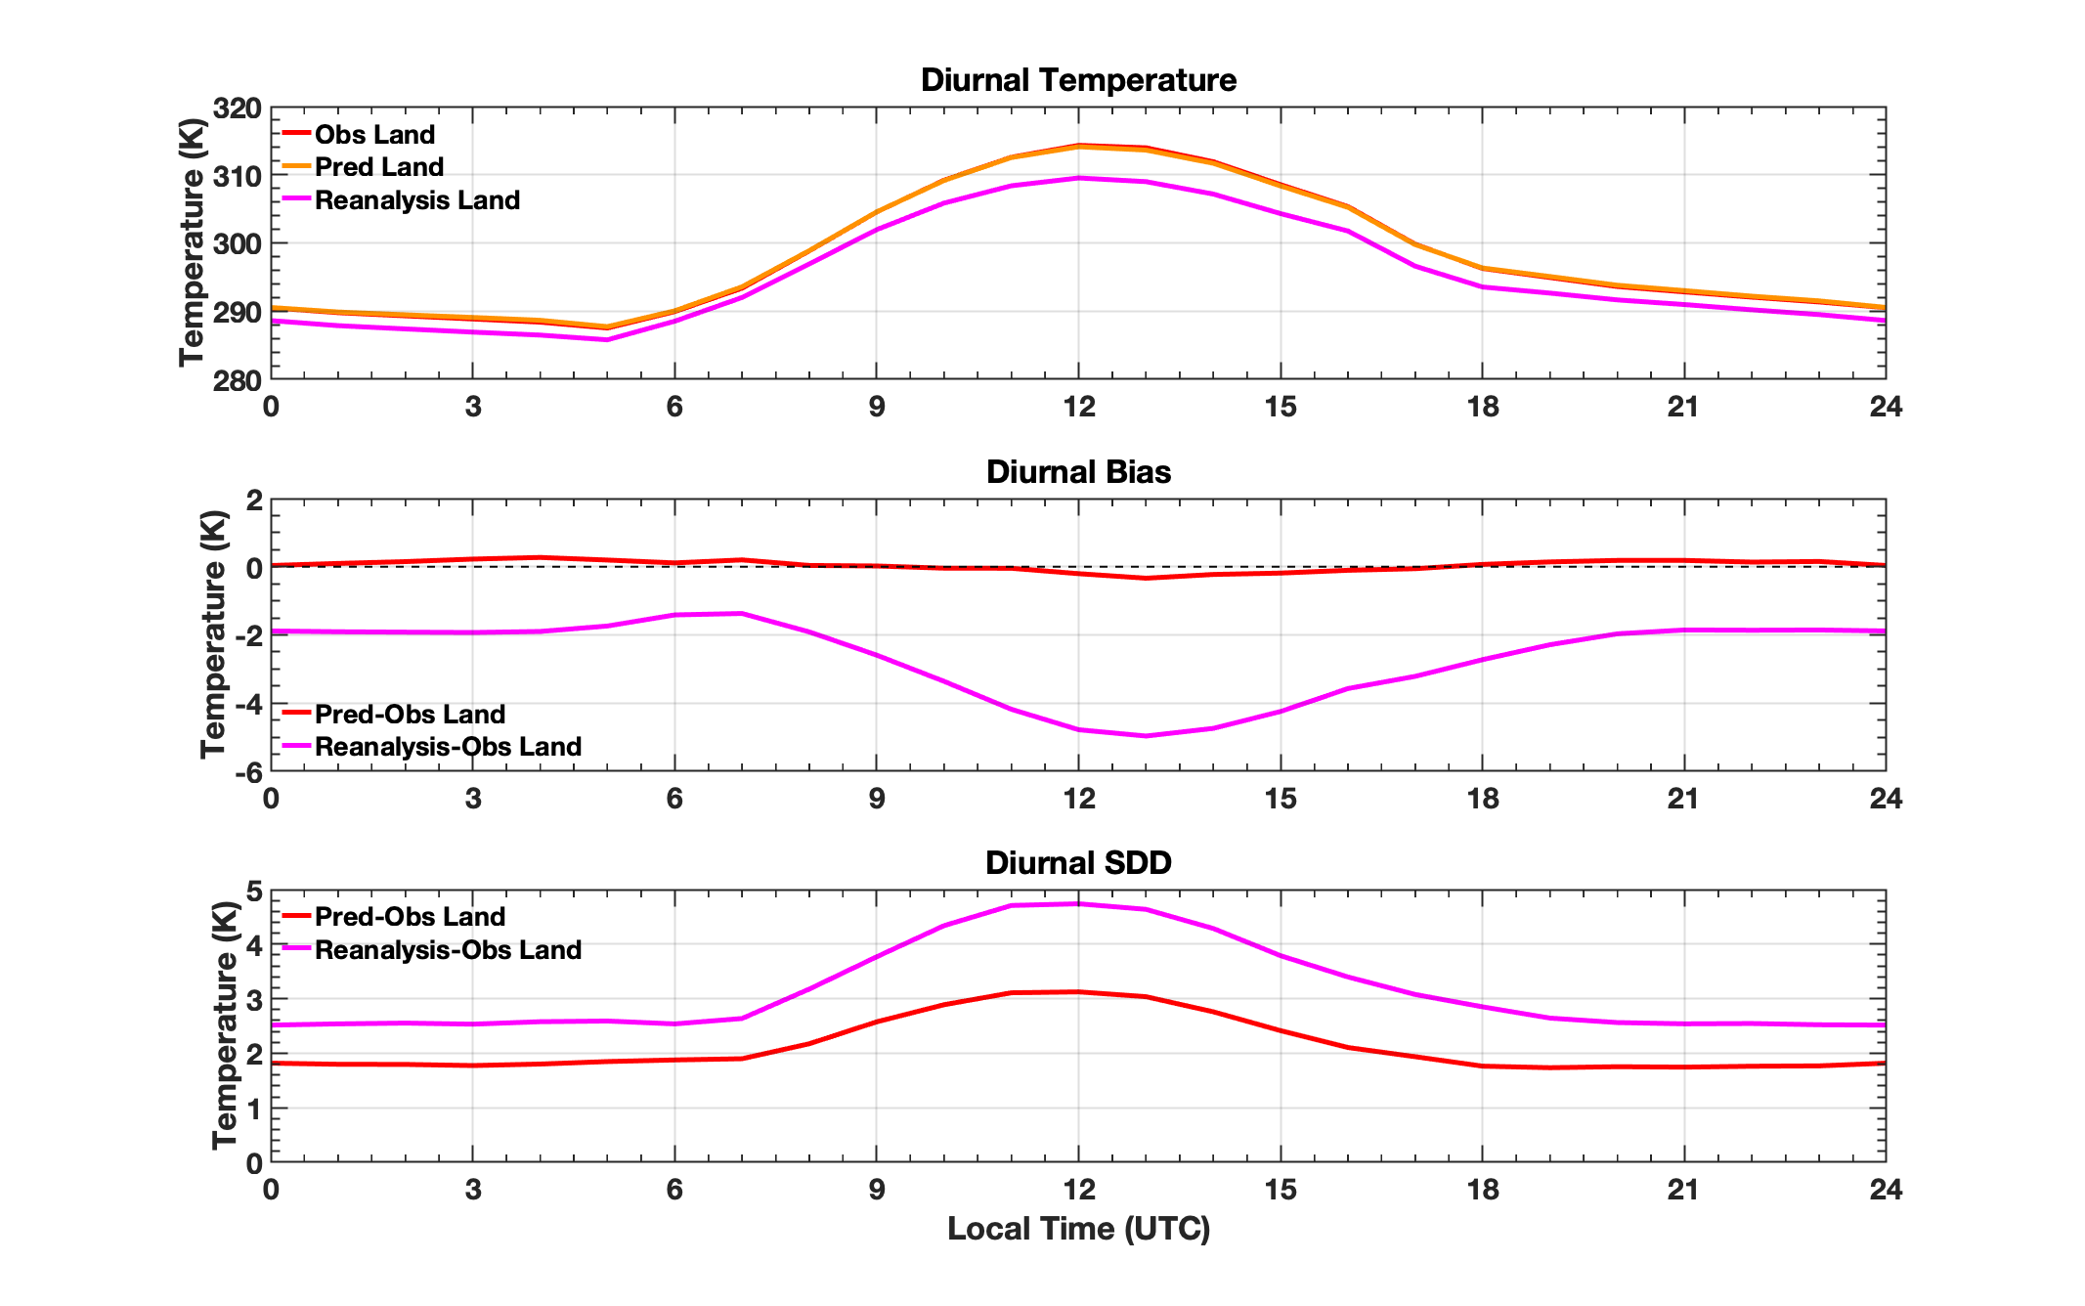
DNN vs. GEOS5.4.1 Diurnal Analysis
Magnitude of reanalysis LST bias and uncertainty has strong diurnal dependency
DNN-predicted LST bias mostly uninfluenced by diurnal pattern
Diurnal signal seen in uncertainty, however

Slide 13
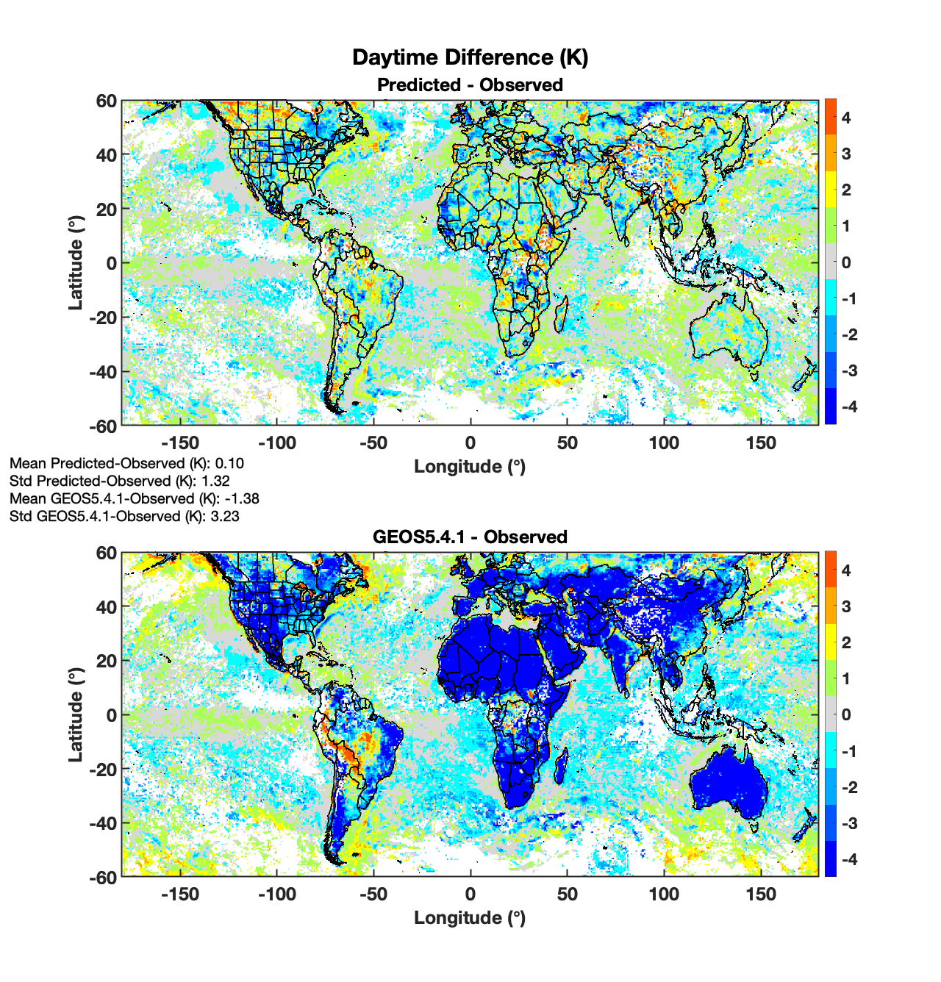
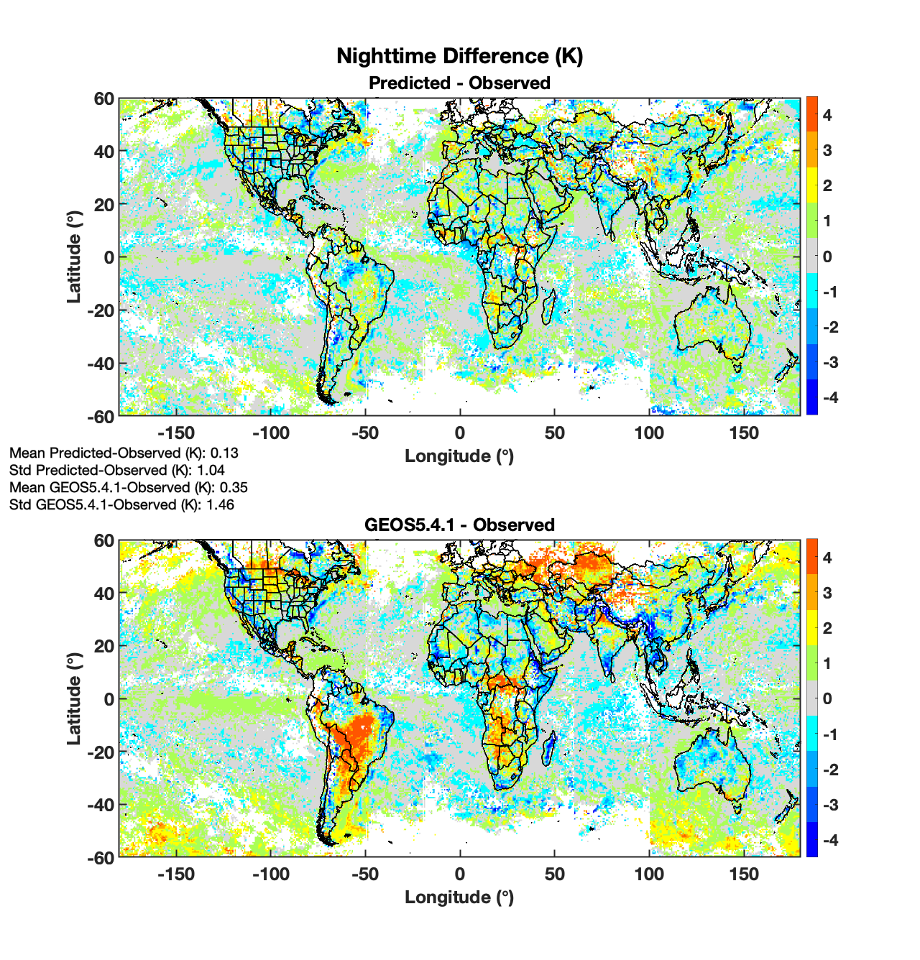
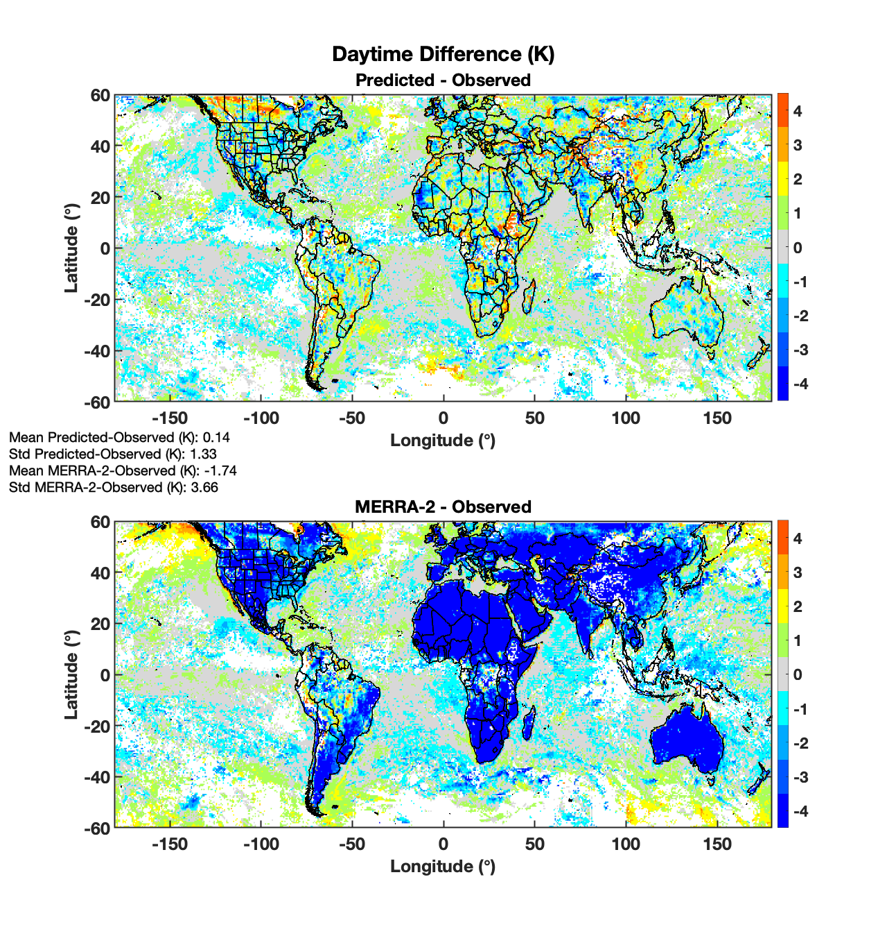
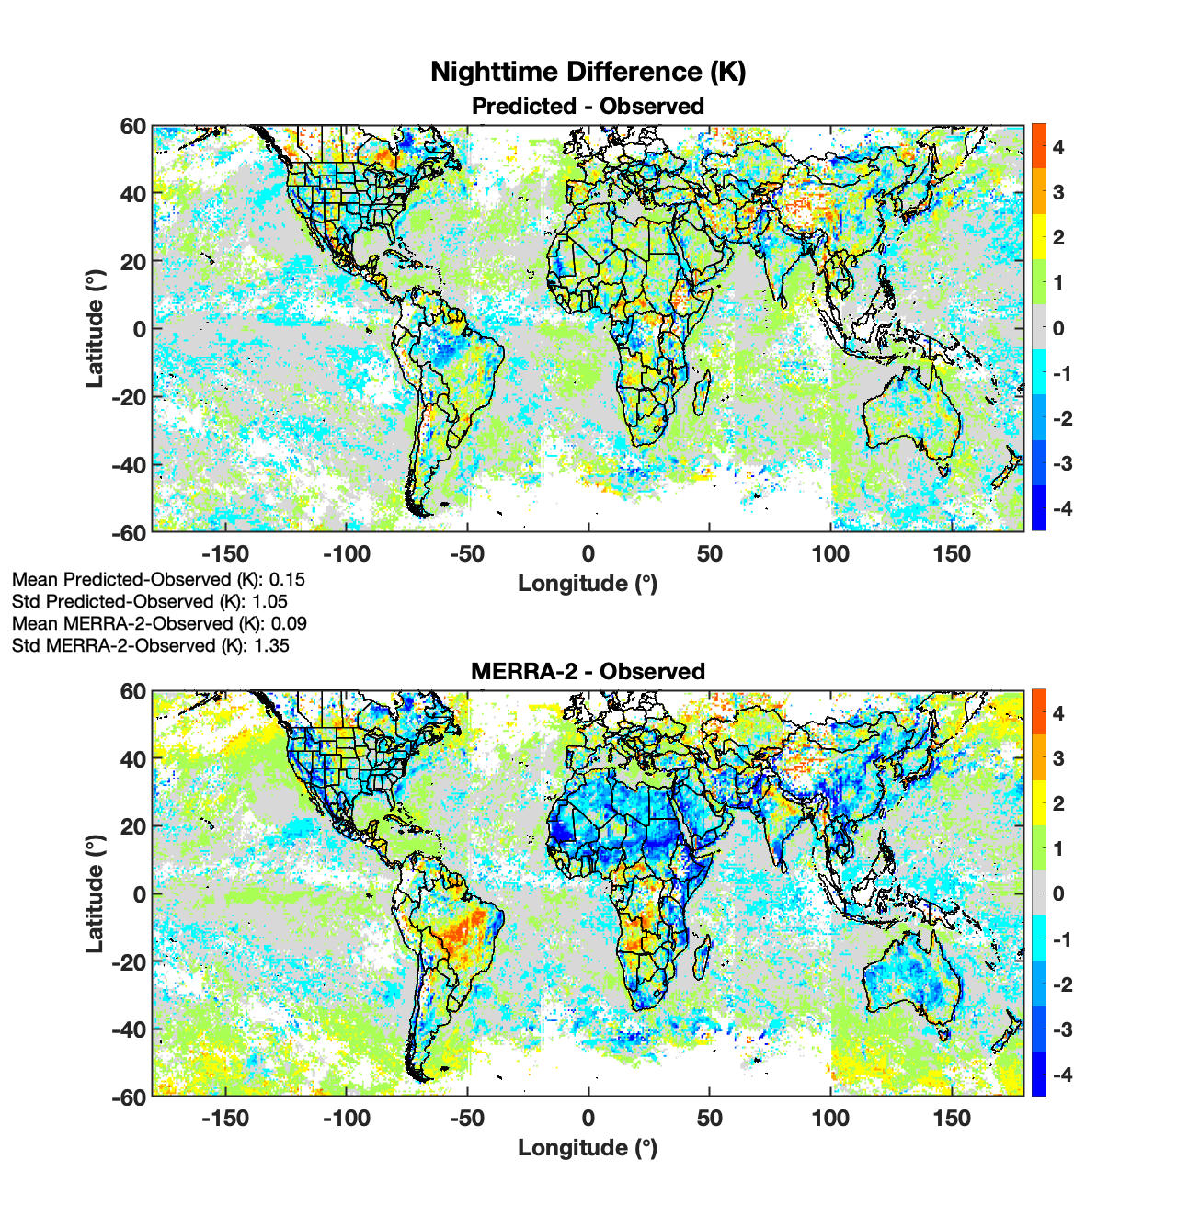
Conclusions
DNN-predicted expected clear-sky T_{skin} has much smaller overall bias relative to observation, compared to that for reanalysis
Differences in T_{skin} from different reanalyses can be significant, whereas predictions from the GEOS5- and MERRA-2-based DNNs are comparable
Diurnal bias of reanalysis T_{skin} highly dependent on scene type, whereas the DNN inherently accounts for diurnal effects and scene type

Slide 14
Backup Slides

Slide 15
DNN and GEOS5.4.1 Regional Differences

Slide 16
DNN and MERRA-2 Regional Differences

Slide 17
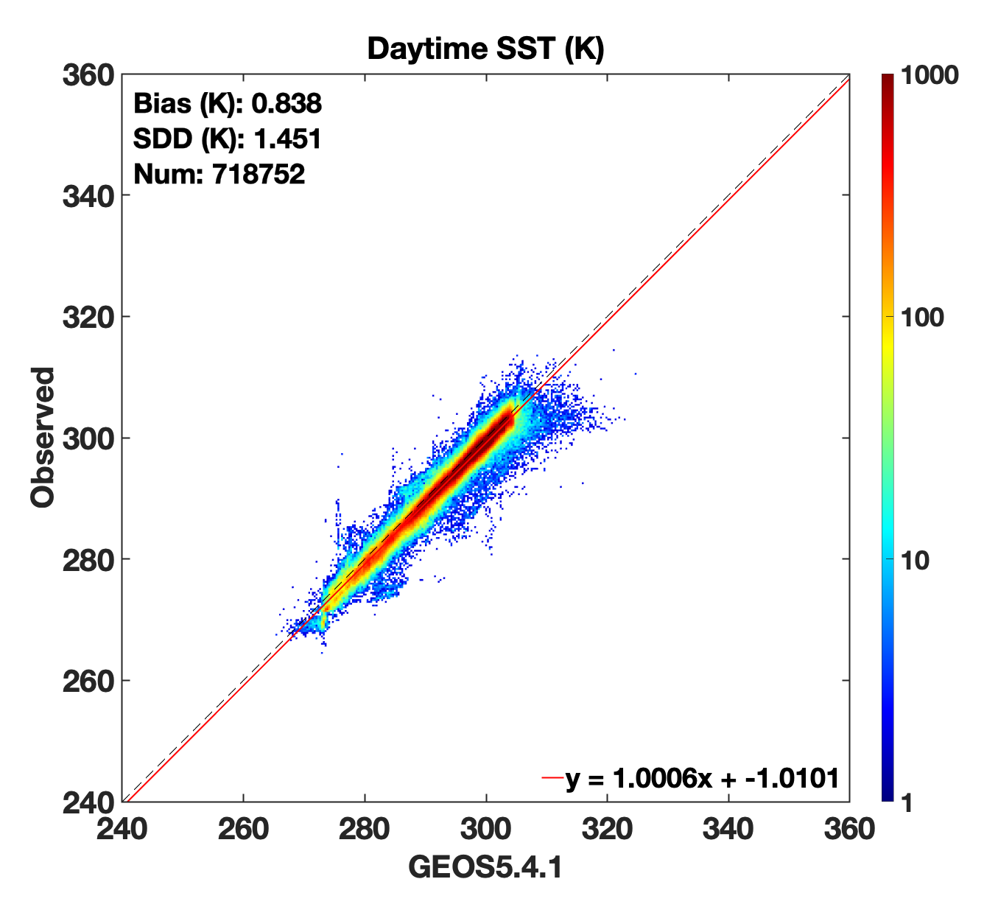
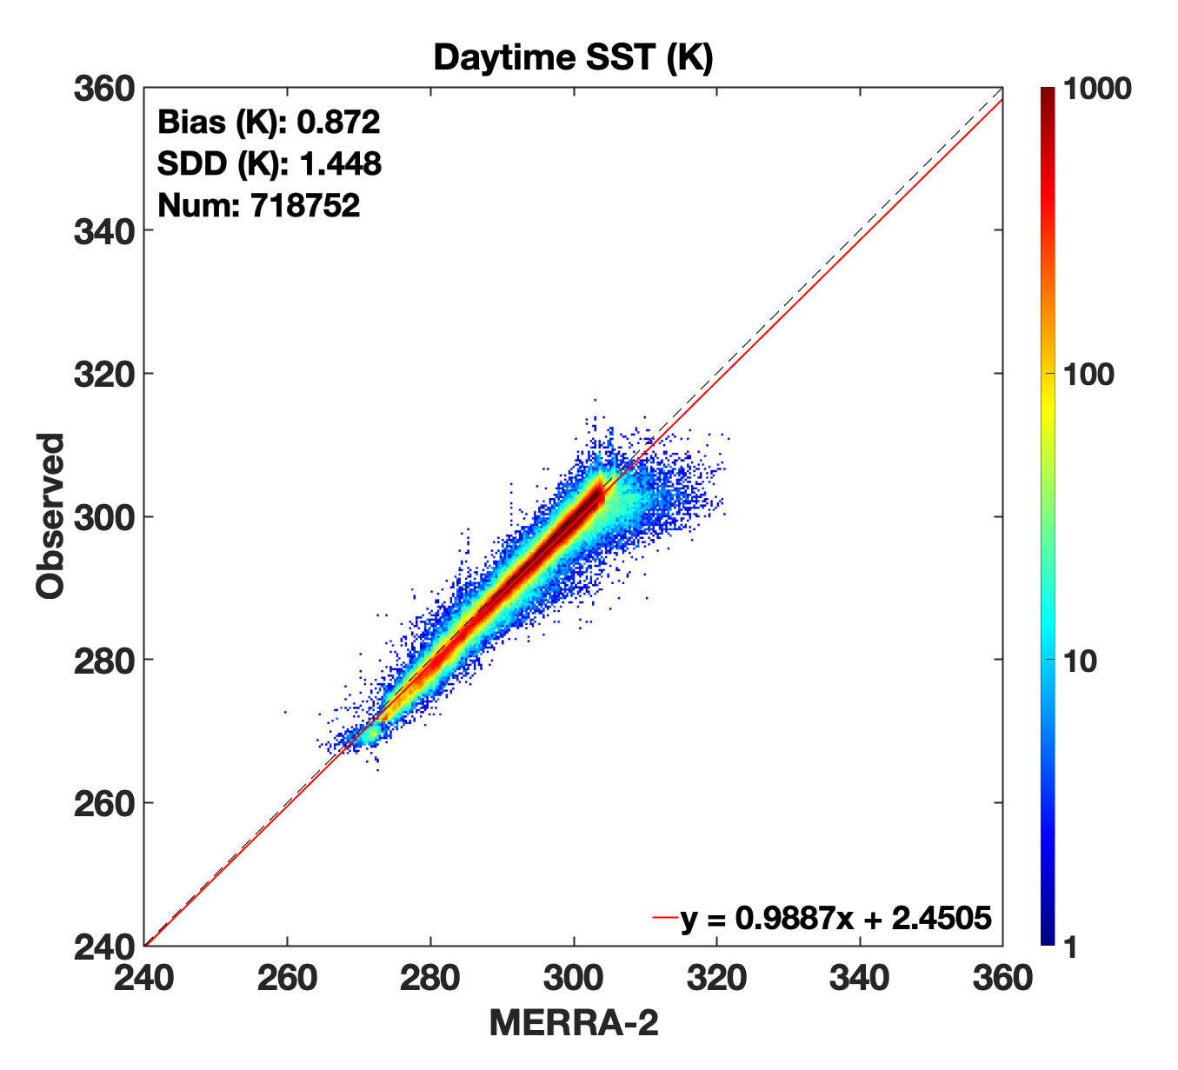
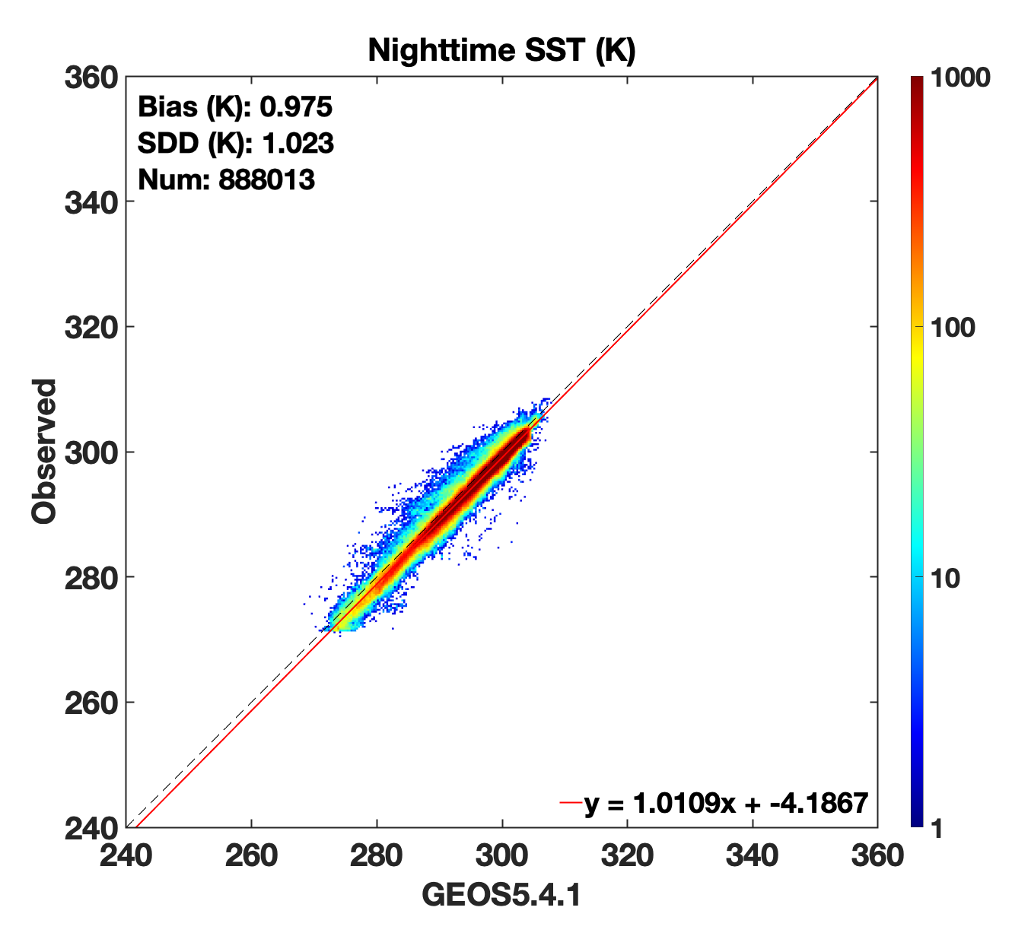
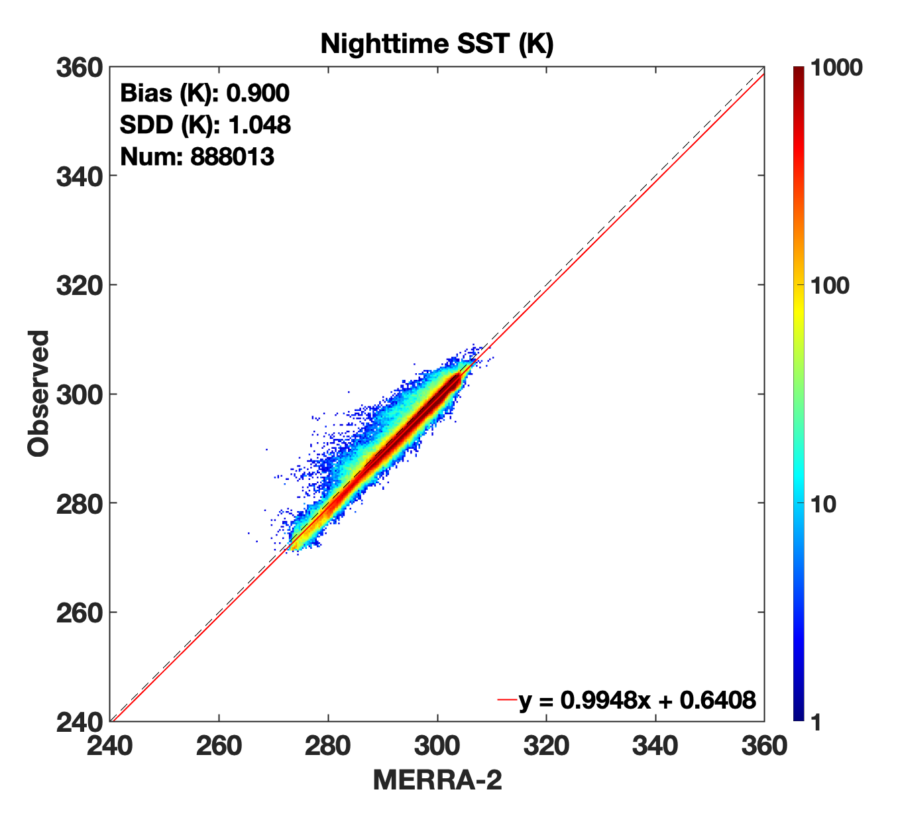
Reanalysis SST vs. Truth
GEOS5.4.1 and MERRA-2 Sea Surface Temperature (SST) reanalysis biases and uncertainties smaller compared to those of LST
Biases approach 1 K, and outlier patterns are irregular
Smaller relative differences compared to those for LST, but can be improved
GEOS5.4.1
Day
MERRA-2
Day
GEOS5.4.1
Night
MERRA-2
Night

Slide 18
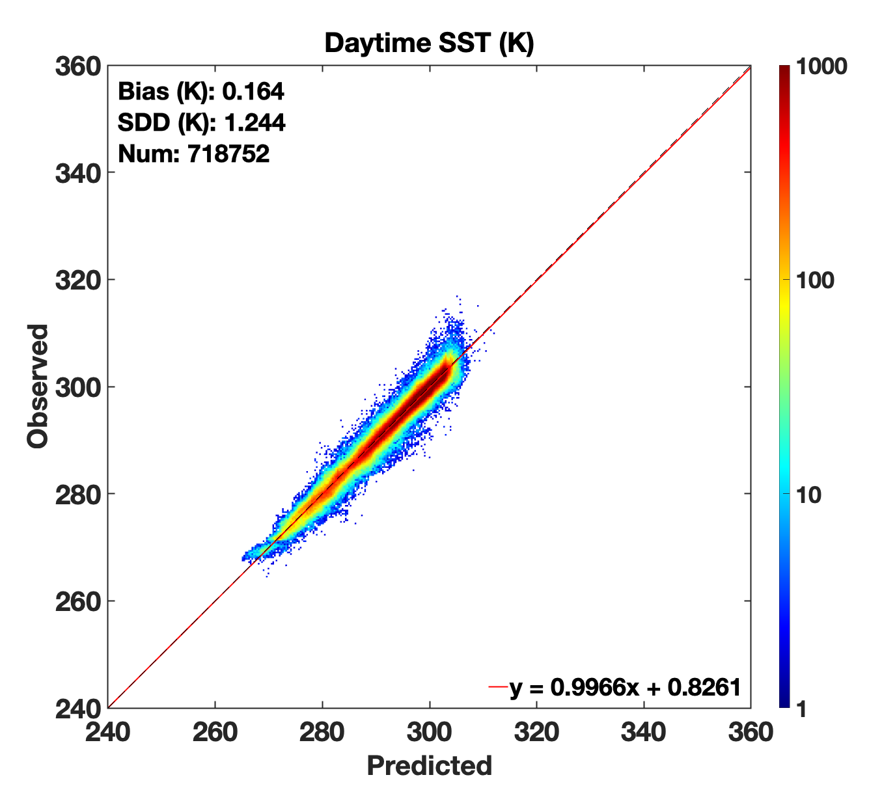
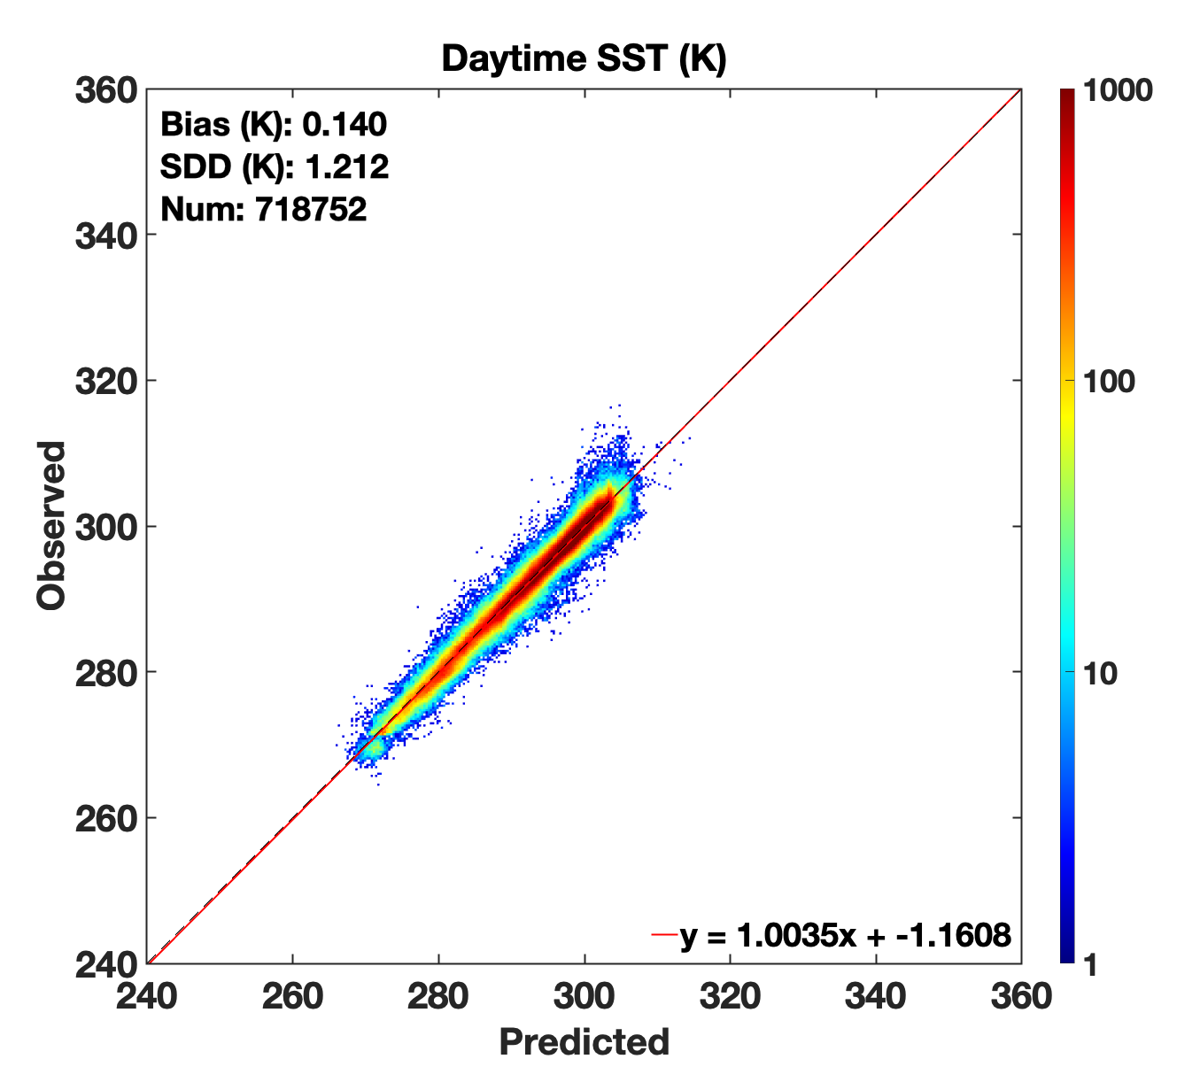
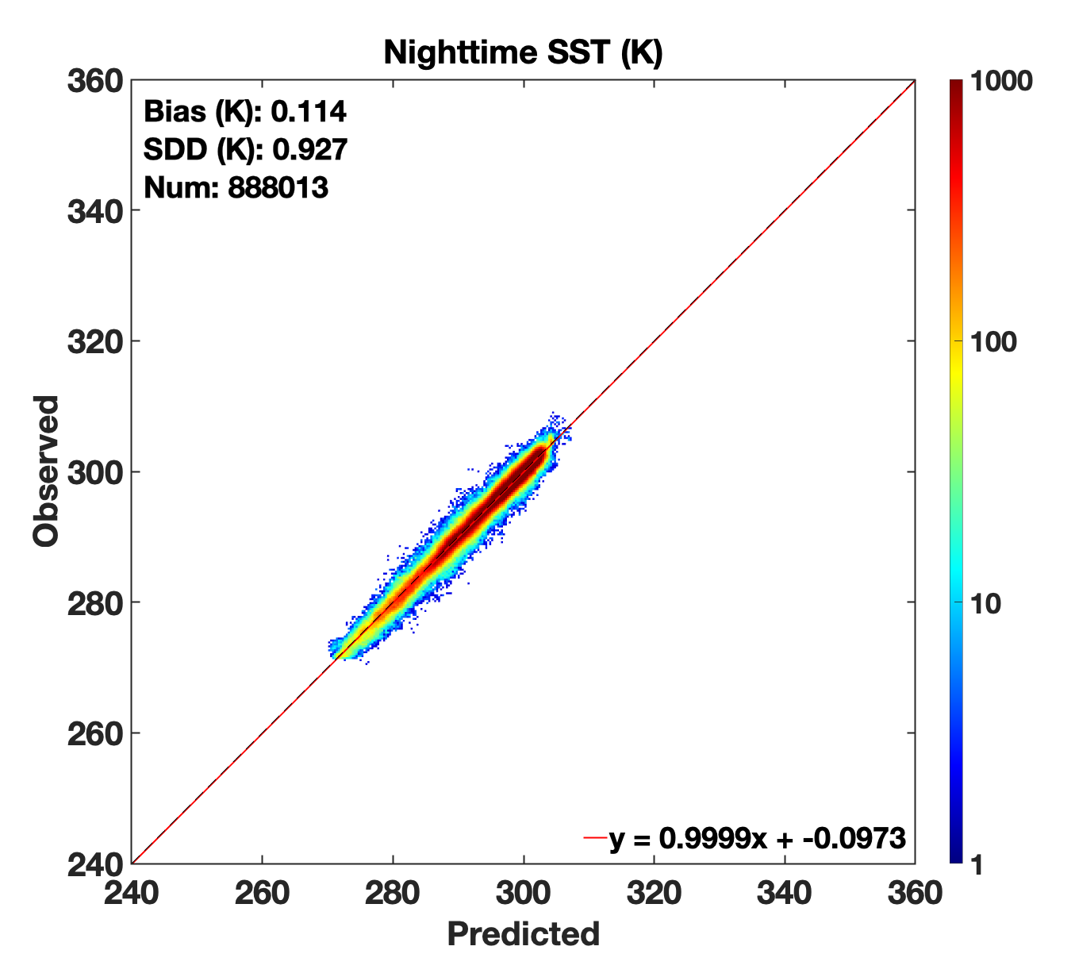
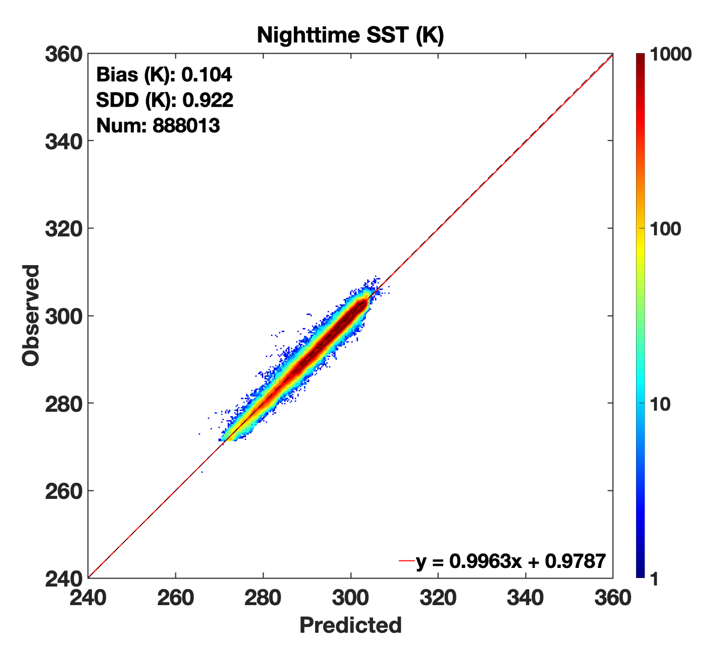
DNN SST vs. Truth
DNN-predicted SSTs are an improvement over reanalysis estimates
Biases and uncertainties significantly reduced, outlier patterns are mitigated
Relative consistency within 0.01-0.02 K and small uncertainty helps cloud retrieval
DNN
Day
(based on GEOS5.4.1 T_{air})
DNN
Day
(based on MERRA-2 T_{air})
DNN
Night
(based on GEOS5.4.1 T_{air})
DNN
Night
(based on MERRA-2 T_{air})

