Slide 1

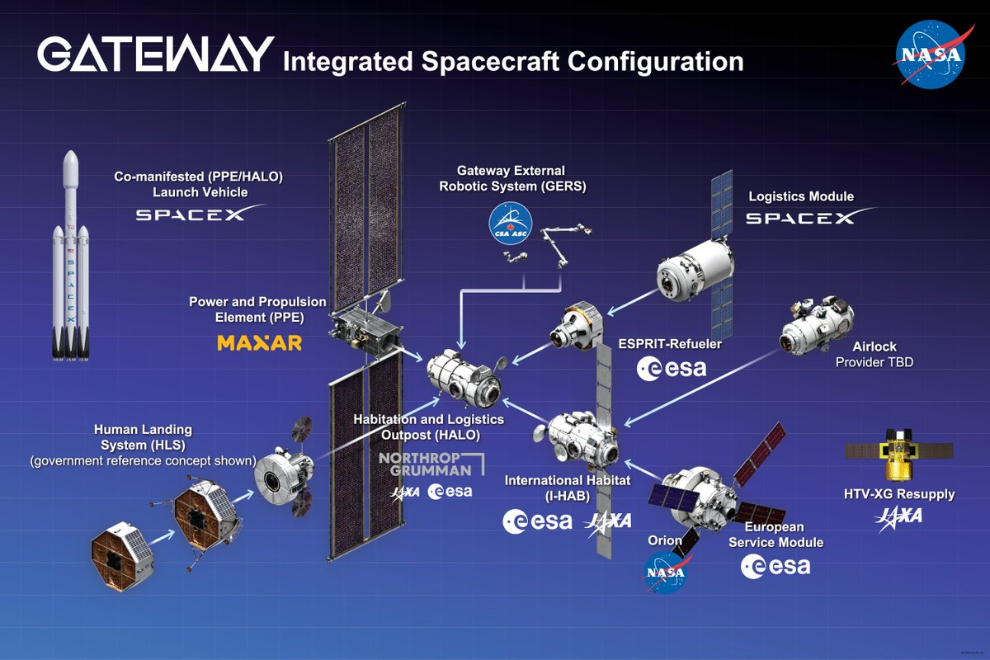
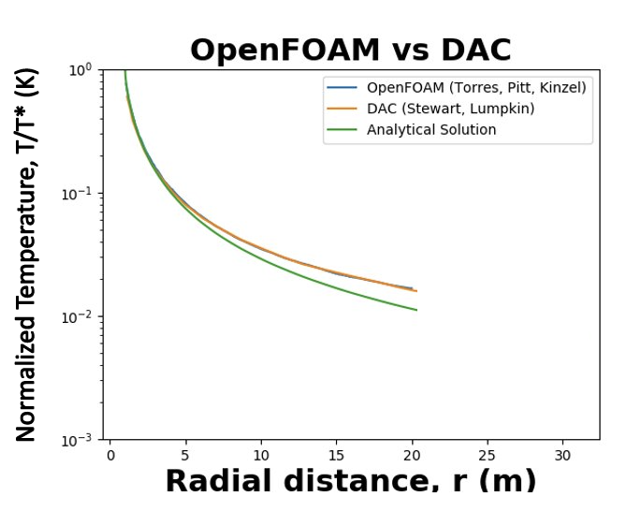
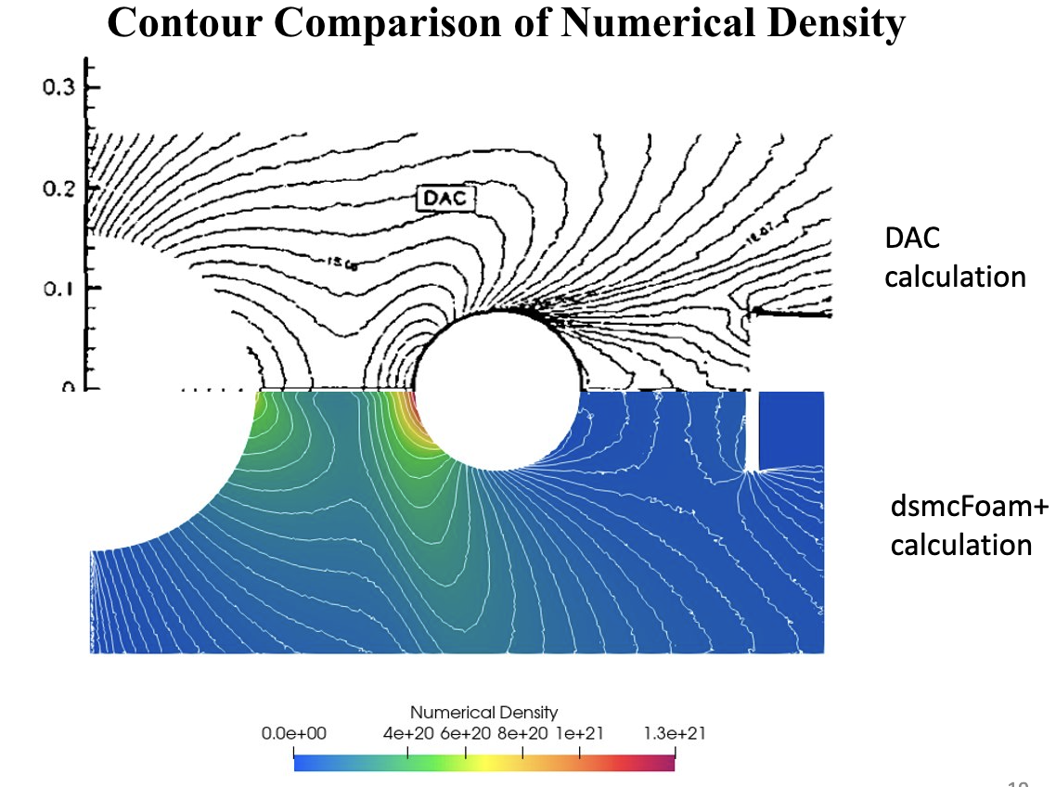
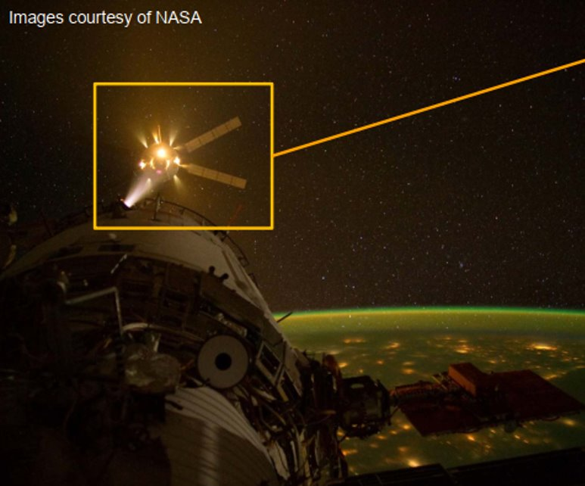
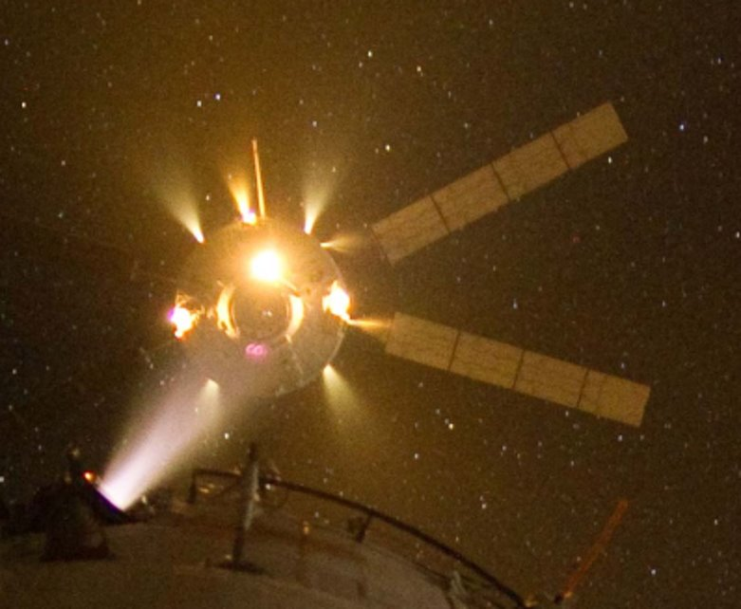
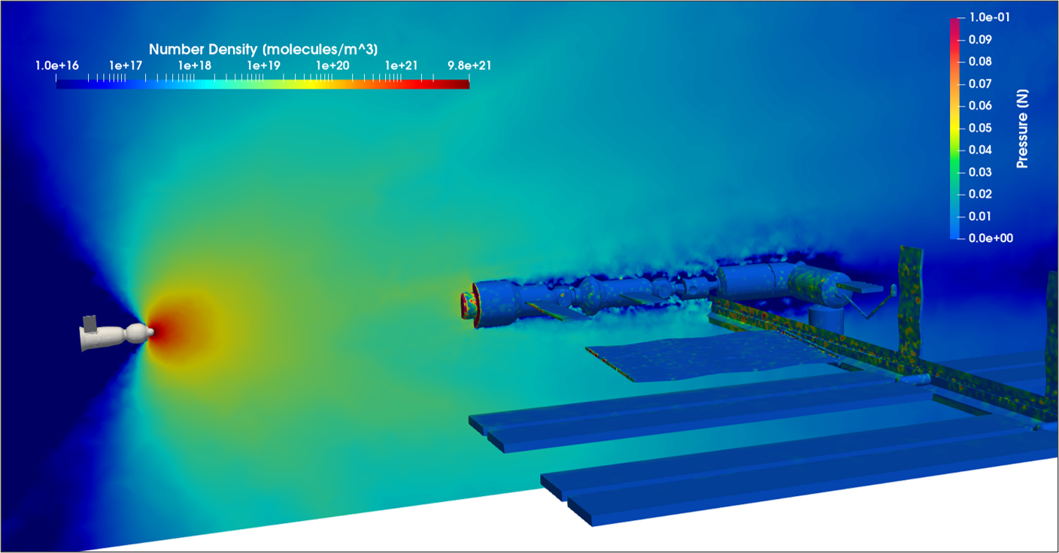
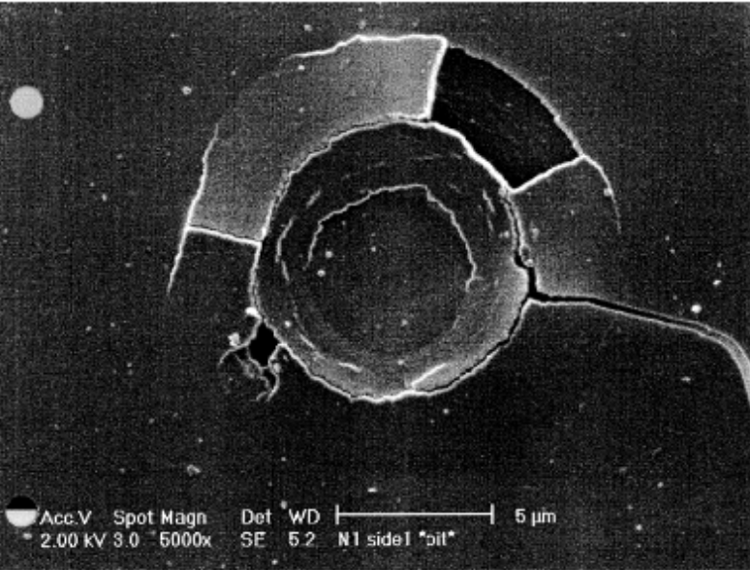
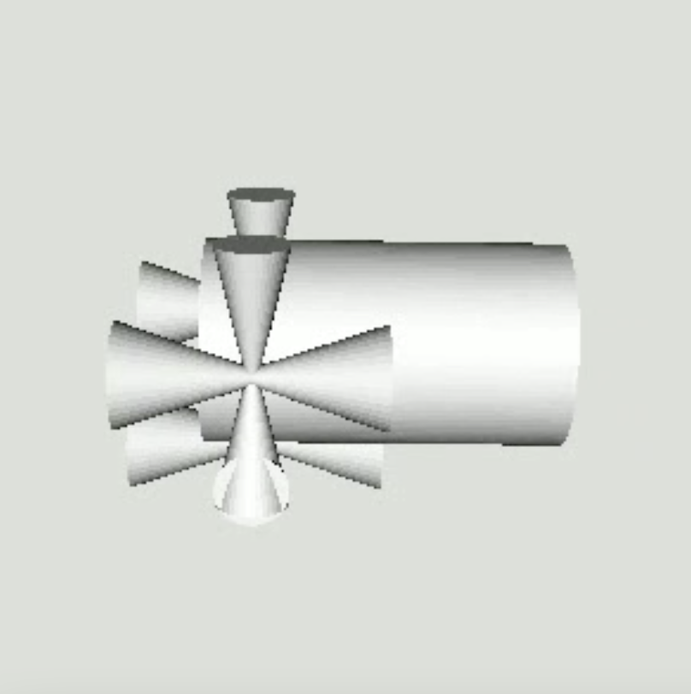
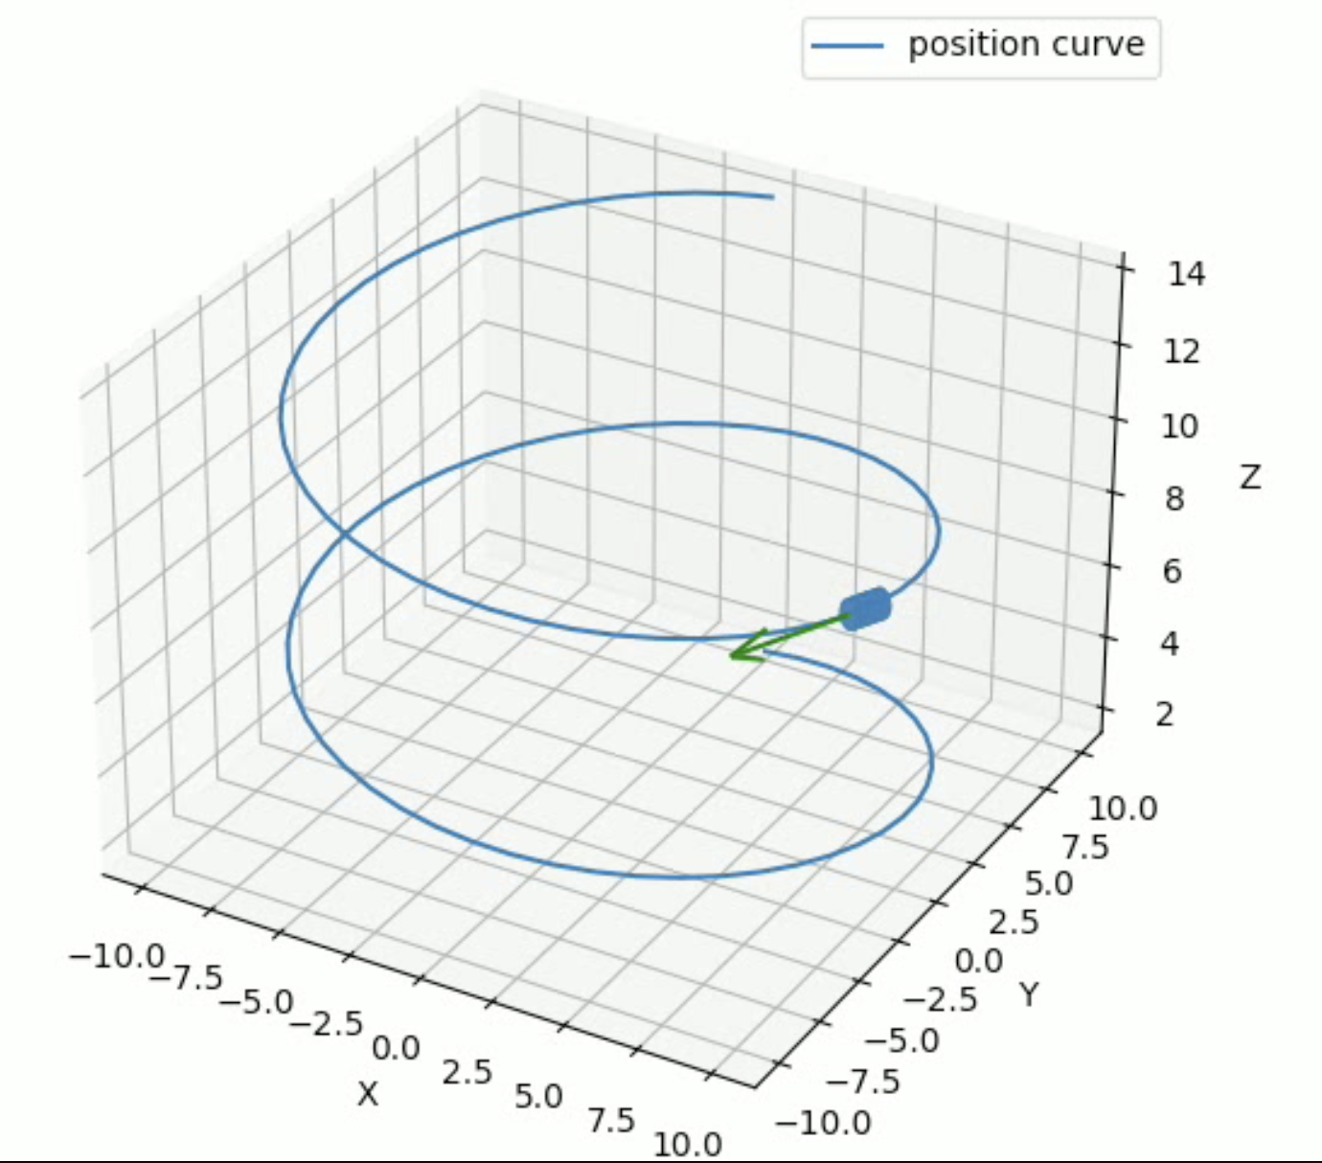
Towards Plume Impingement Modeling in Space Environments
Development of Verification Cases and Visualization Tools
Torres-Figueroa, Andres (OSTEM Intern)
Pitt, Jonathan S., PhD (DS-000)
Location: Kennedy Space Center
Introduction
Results
NASA is building a space station to support lunar and deep space operations—Lunar Gateway.
Will have a "piecemeal" assembly process like the ISS.
Assembly requires docking maneuvers made possible by a sequence of hot gas RCS thruster firings
Rarefied Plume: Comparison Cases
Figure 1: Lunar Gateway Configuration
These firings inevitably form large multiphase plume structures
Plume interaction with the station's outer surface can lead to
detrimental effects
Figure 4: Axisymmetric Radial Expansion
Figure 5: Impingement in the Wake of a Cylinder
Application Case
Figure 2: Close-Up of ATV Docking Showing Plume Structures,
Soares (2015)
Plume Impingement Effects
Unwanted Forces and Moments
Excess Heat Transfer
Sediment Deposition
Surface Erosion
Motivation
Avoiding these effects is necessary to preserving the lifecycle of active space stations.
Developing simulation tools that can accurately and efficiently these effects is key to designing the guidance and control algorithms used for docking of approaching modules.
Figure 3: Droplet Impact Features on PIC Camera,
Soares (2002)
Figure 6: Full Scale Case of a Notional Configuration of Plume Impingement onto the ISS
Focus
This research makes progress towards developing simulation tools on two fronts.
Comparison study of OpenFOAM and DAC calculations, for justification of setting up a full-scale rarefied plume impingement case.
development of a prescribed motion visualization tool for estimating plume impingement over the timescale of an entire docking event.
Visualization Tool
Dynamic Docking Sequence
Figure 7: Thruster Configuration of Visiting Vehicle
Figure 8: Can Move Objects Along a Prescribed Motion Curve

Slide 2
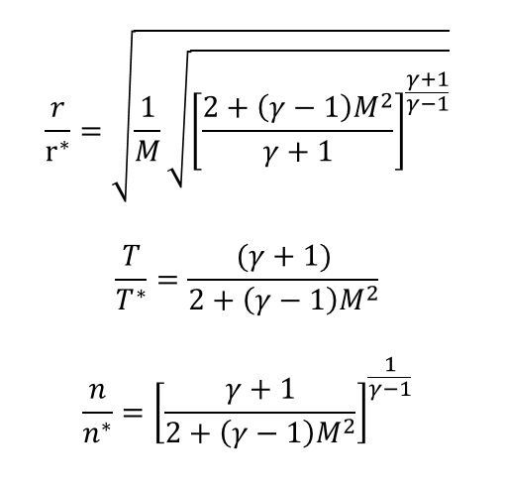
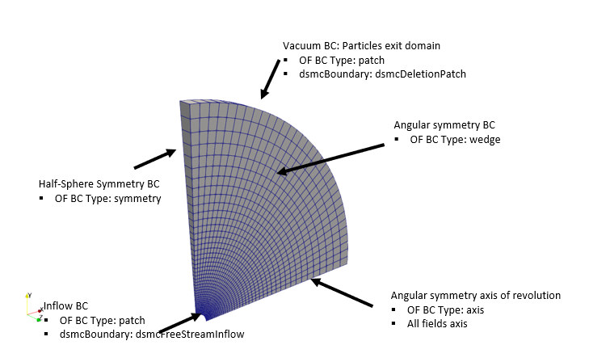
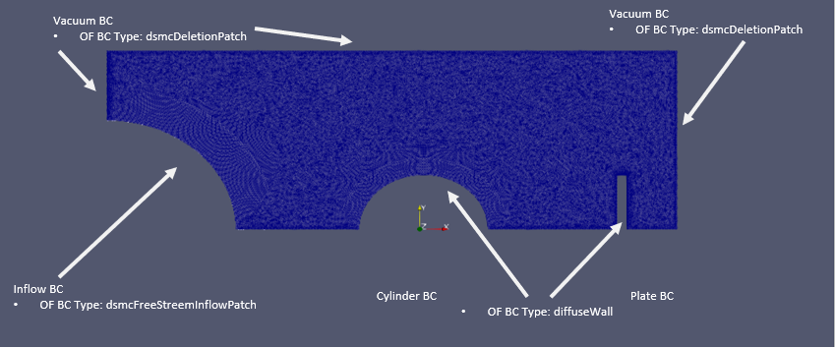
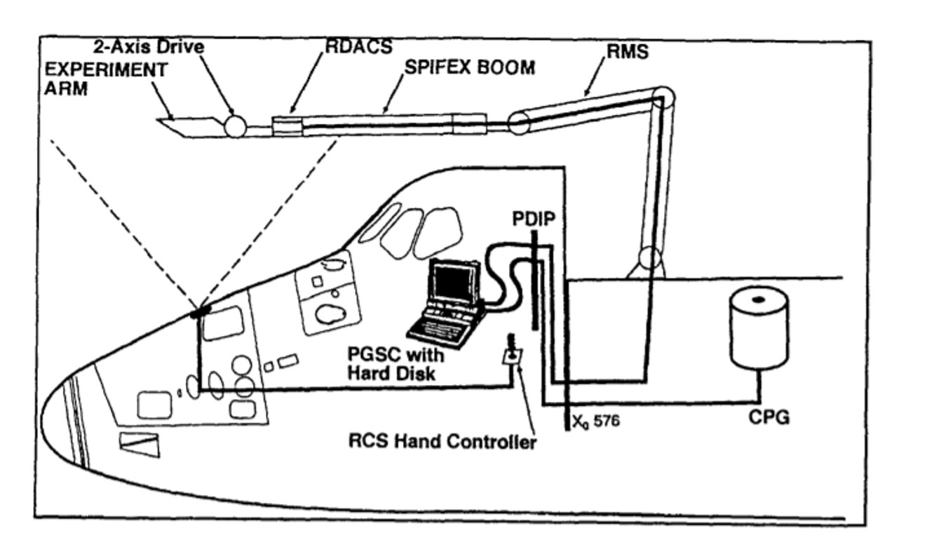
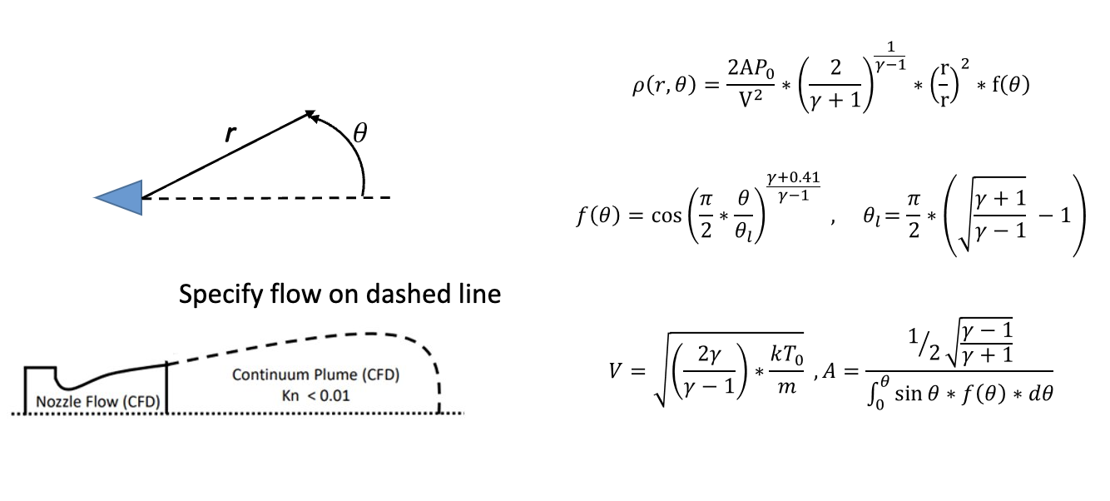
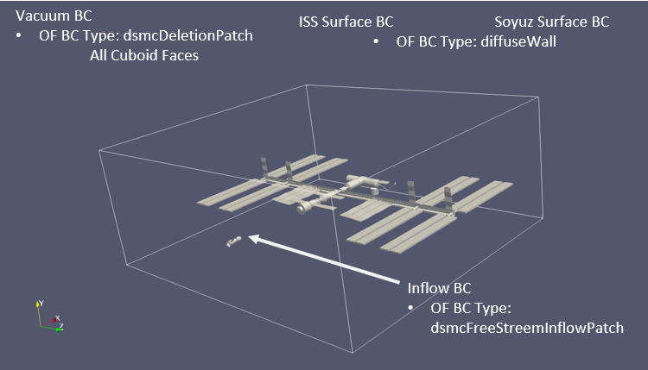
Methodology
Conclusion
Comparison Case: Axisymmetric Radial Expansion
Rarefied Plume Calculations
Several cases for rarefied plume impingement in space environments were successfully recreated using dsmcFoam+ :
  Isentropic spherical expansion using 1D and 2D axisymmetric approaches in OpenFOAM
  2D approximation of a 3D laboratory scale impingement experiment
Full scale analysis cases are underway, and further studies seem feasible
Working towards recreating the “gold standard” validation experiment or SPIFEX for rarefied plume impingement modeling using dsmcFoam+
Dynamic Docking Visualization
Used Python to develop a prescribed motion visualization tool to estimate plume strike effects over the time scale of an entire docking event.
Provides quick calculations to inform which firings and regions need higher fidelity simulation.
Figure 9: Isentropic Equations
Figure 10: Boundary Conditions
Comparison Case: Impingement in Wake of a Cylinder
Figure 11: Boundary Conditions - 2D approximation of 3D experiment
Figure 14: Diagram of SPIFEX Experiments
Figure 12 Plume Source Flow Model for Inlet Surface
Application Case: Full Scale 3D ISS Simulation
Acknowledgements
This internship opportunity has given me the chance to fulfill my childhood dream and contribute towards the progress of human spaceflight. Finding mentorship is key for accomplishing such a goal. For that I want to thank Drs. Jonathan Pitt, Michael Kinzel, and Seetha Raghavan for all their support and guidance over the last school year. Through their direct guidance and the community, they set up for us, I gained a clearer picture of what type of problems need to be solved, and what is being done to tackle them. I am beyond excited for the future of this industry and will continue contributing over the next few decades.
Figure 13: Boundary Conditions Full Scale 3D Simulation
Visualization Case: Overview
Framework in Python taking the following as input
  STL files of visiting (VV) and target (TV) vehicles.
  Vehicle Definition File (VDF) for the VV.
  Jet Firing History (JFH) as VV approaches TV.
Loop through each thruster defined in the VDF, place an STL of a plume, at the proper orientation and location.
Loop through each firing in the JFH, transform VV and active thruster plumes accordingly
For each firing in the JFH calculate the plume strikes at each vertex of the TV from every active thruster.
Write plume strike data to a file format readable by TecPlot.

