Slide 1


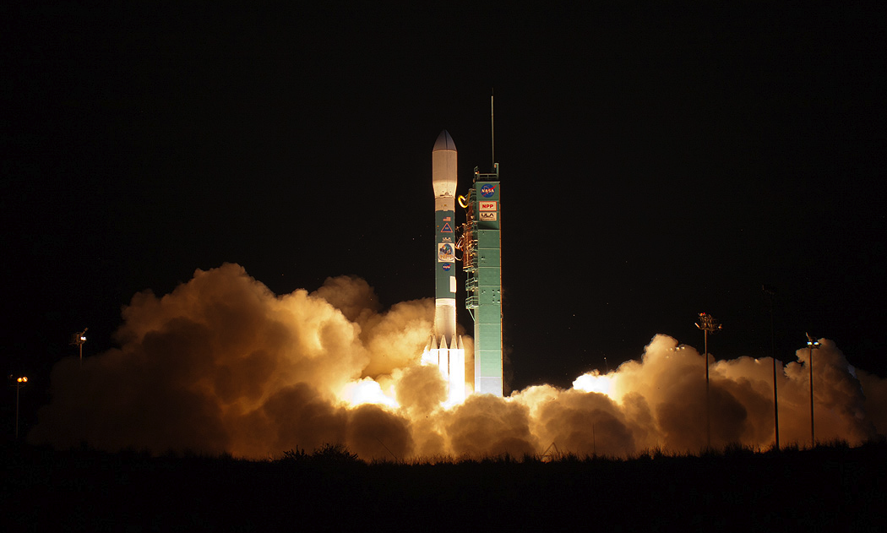
State of CERES
Norman G. Loeb
NASA Langley Research Center, Hampton, VA
CERES Science Team Meeting, October 12-14, 2022
Max Planck Institute, Hamburg, Germany

Slide 2
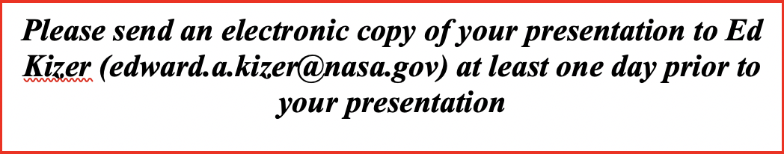
CERES Science Team Meeting
Review status of CERES Instruments and Data Products
Invited Presentations Session. Each presentation is 45 min including time for questions.
Contributed Science Reports. Each report is 20 min including time for questions.

Slide 3
CERES Technical Meeting
Review Status of CERES Instruments and Data Products:
State of CERES
CERES Terra, Aqua, S-NPP, NOAA-20 Instrument Calibration Update
MODIS & VIIRS Cloud Algorithm & Validation Status
ADM, SARB and TISA Working Group Reports
EBAF Update
FLASHFlux Update
Data Management Team Update

Slide 4
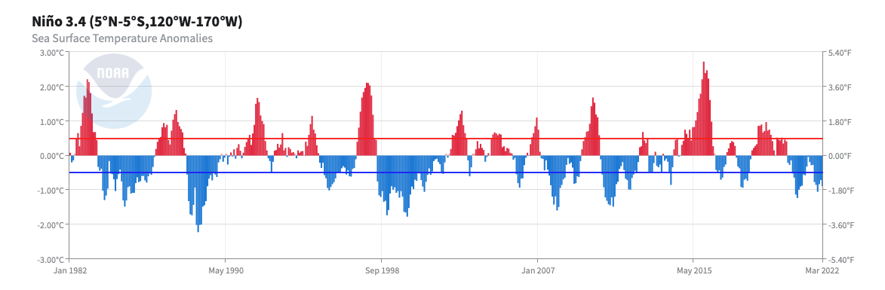
Niño 3.4 Index (ONI) Anomaly & PDO Index (01/2000 – 03/2022)
2015-2016
2009-2010
2002-2003
2006-2007
2018-2019
Niño 3.4 Index (ºC)
2020-2022
1998-2001
2007-2008
2010-2012
<PDO> = −0.87
(Jan 00 – Feb 14)
<PDO> = 0.7
(Mar 14 – Jun 17)
<PDO> = −0.89
(Jul 17 – Mar 22)
Jan 2000

Slide 5
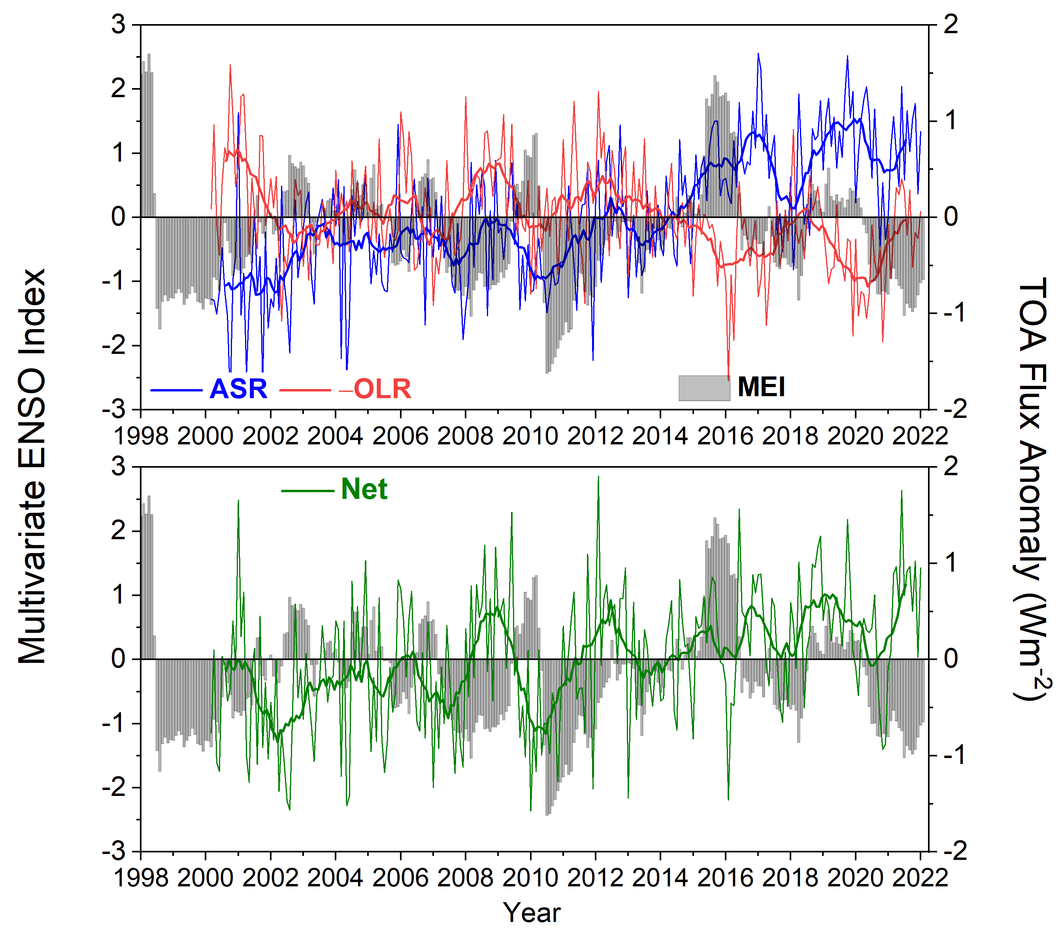
Global Mean All-Sky TOA Flux Anomalies & Multivariate ENSO Index (CERES EBAF Ed4.1; 03/2000 – 01/2022)
EBAF Trends (03/2000-01/2022)
ASR: 0.69 + 0.20 Wm⁻² per decade
LW: -0.27 + 0.21 Wm⁻² per decade
NET: 0.42 + 0.20 Wm⁻² per decade
EEI Changes: First and Last 5 years
  EEI (03/2000—02/2005): 0.44 Wm⁻²
  EEI (02/2017—01/2022): 1.14 Wm⁻²
  ΔEEI: 0.7 Wm⁻²
  => Approximate doubling of EEI

Slide 6
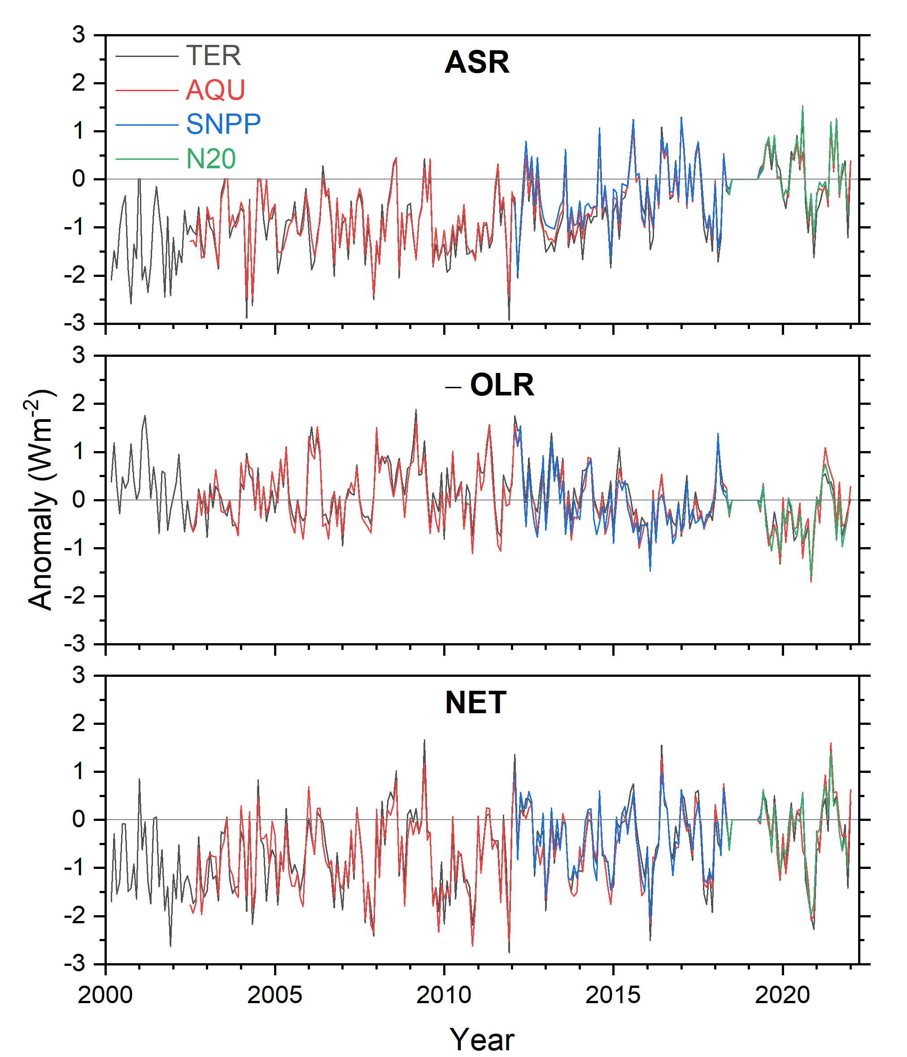
Global Mean All-Sky TOA Flux Monthly Anomalies (03/2000-01/2022; Climatology: 05/2018—06/2019 )
Based upon CERES SSF1deg products (no GEO)
NET monthly anomalies consistent to 0.3 Wm⁻² (1σ)
No evidence of CERES instrument drift

Slide 7
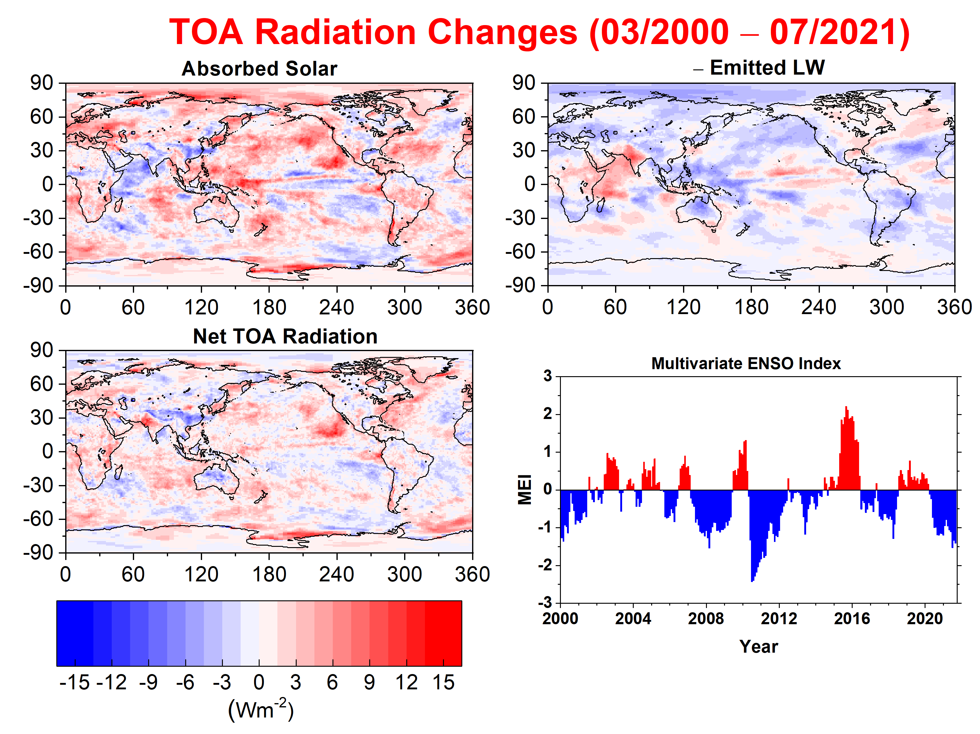
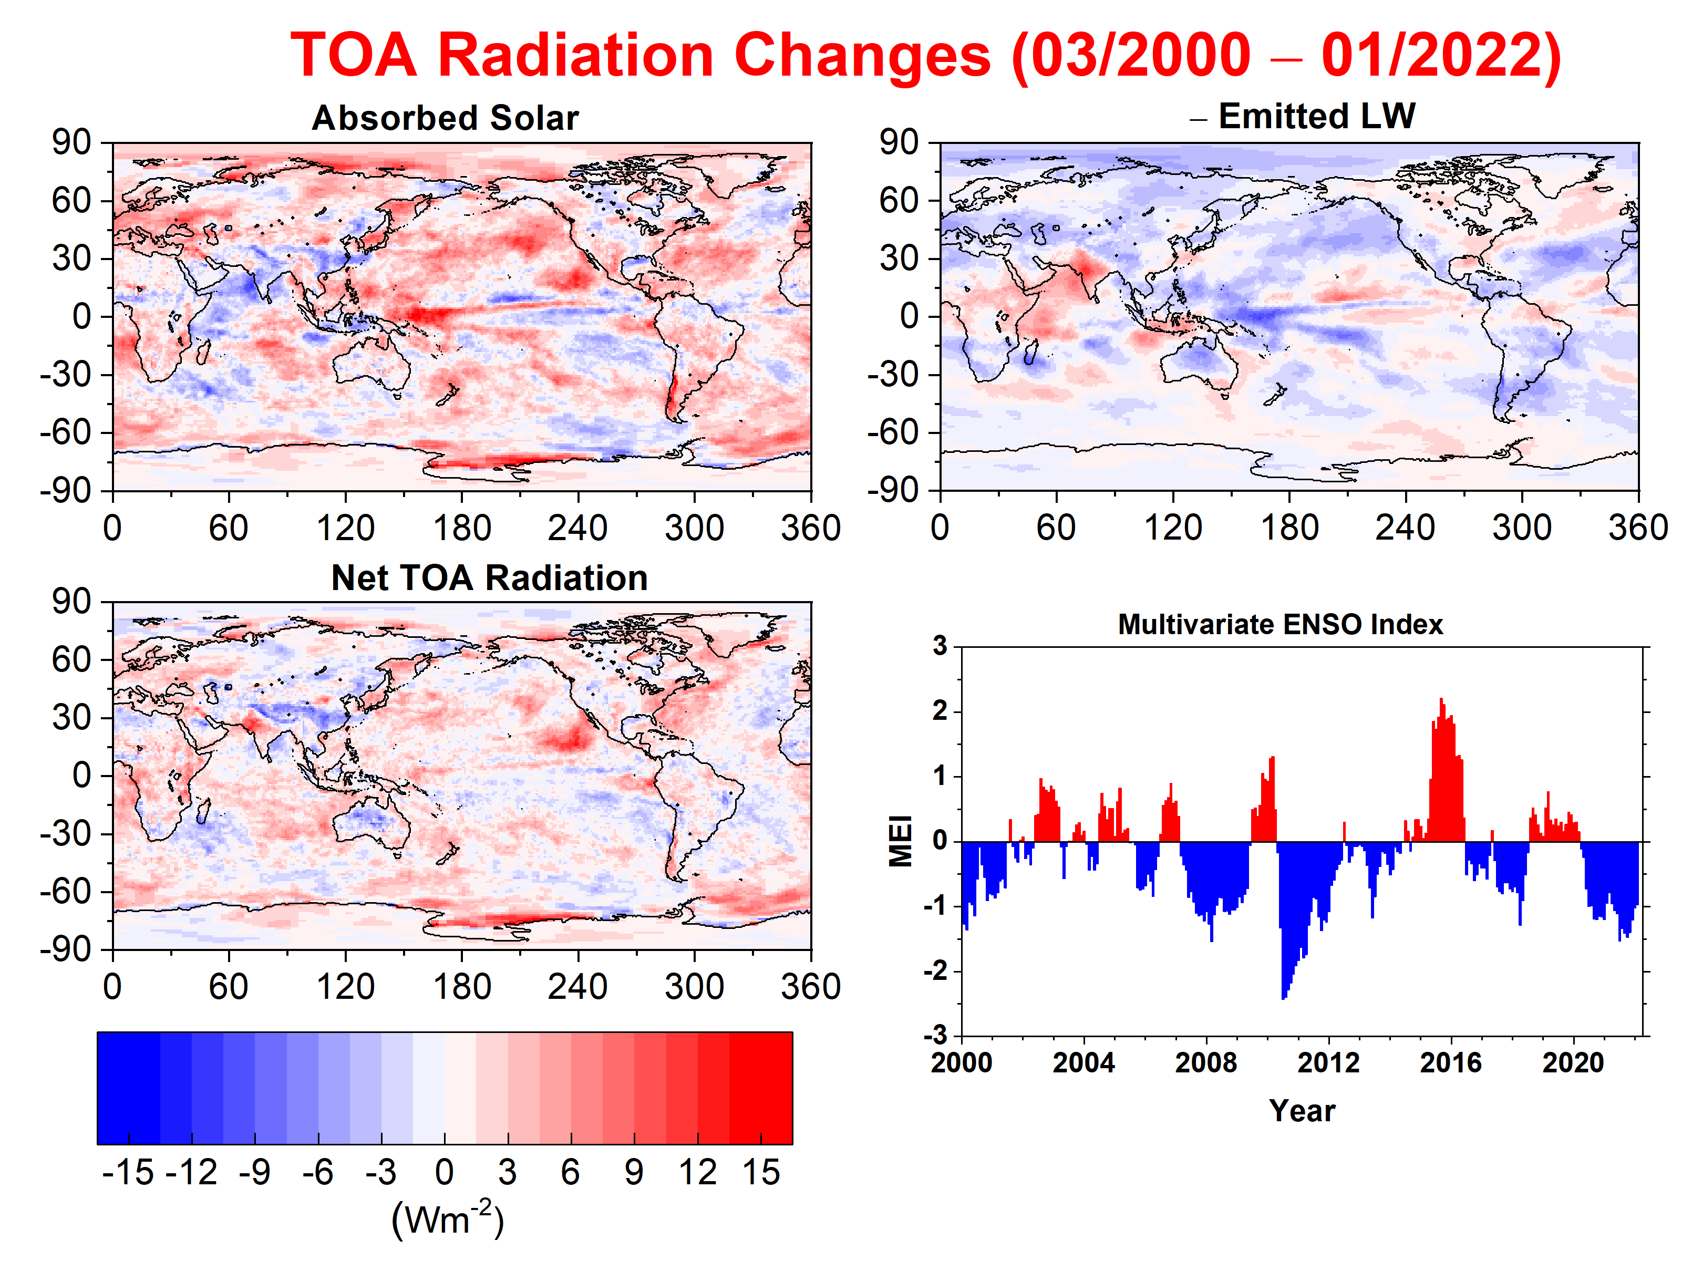

Slide 8
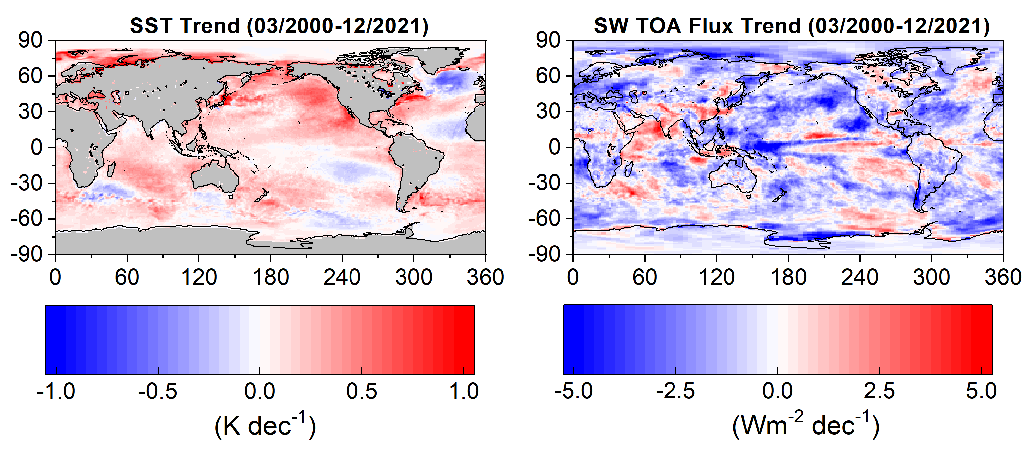
SST trend shows strong warming over Northern Hemisphere Eastern Pacific Ocean
Northeast Pacific experienced marine heatwaves (“blobs”) in 2013-2015 and 2019-2020
SW TOA flux trend pattern is closely linked to SST trend pattern (especially in regions with abundant low cloud)

Slide 9
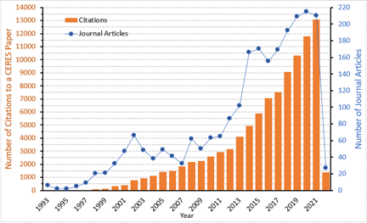
CERES Journal Publications and Citation Counts
(For Papers Between 1993-2022; Updated March 8, 2022)
- Total number of peer-reviewed journal articles: 2,359
- Total number of citations to CERES papers: 96,853
(Compiled by Dennis Keyes)

Slide 10
Number of Unique Users by CERES Data Product (through March 31, 2022)
Level | Product | 2013 | 2014 | 2015 | 2016 | 2017 | 2018 | 2019 | 2020 | 2021* | 2022*
1b | BDS | 19 | 14 | 11 | 13 | 14 | 10 | 12 | 19 | 5 | 0
2 | SSF | 223 | 247 | 253 | 278 | 327 | 235 | 251 | 229 | 209 | 74
 | FLASH_SSF | 23 | 30 | 61 | 41 | 68 | 101 | 92 | 97 | 85 | 38
 | CCCM | 37 | 28 | 55 | 54 | 49 | 49 | 36 | 37 | 35 | 1
 | ES8 | 31 | 16 | 21 | 15 | 15 | 10 | 8 | 8 | 0 | 0
 | SSF-MISR | 5 | 4 | 2 | 1 | 3 | 1 | 1 | 4 | 3 | 0
3 & 3b | EBAF | 602 | 731 | 787 | 783 | 935 | 928 | 995 | 1010 | 921 | 310
 | SYN1deg | 353 | 382 | 438 | 494 | 607 | 639 | 754 | 827 | 765 | 285
 | SSF1deg | 157 | 166 | 160 | 194 | 190 | 159 | 221 | 199 | 185 | 52
 | CldTypHist | 57 | 41 | 40 | 47 | 86 | 87 | 79 | 84 | 74 | 20
 | FluxByCldTyp |  |  |  |  |  |  |  | 44 | 56 | 12
 | ES4 | 27 | 19 | 13 | 12 | 17 | 17 | 17 | 10 | 5 | 0
 | ES9 | 13 | 9 | 5 | 5 | 8 | 6 | 6 | 3 | 2 | 0
 | FLASH_TISA | 17 | 15 | 15 | 36 | 52 | 65 | 81 | 127 | 103 | 29
FLASHFlux via POWER since last year: 105,702
* The numbers are lower because most orders through ASDC now come from Direct Data Download, which are not currently captured in the ESDIS Metrics System (EMS), although they are working on it.

Slide 11
Aqua Status
  March 31, 2022: Fault in primary Power Controller (PC-A) was detected. Swap to redundant PC-B was automatically made.
  Spacecraft was put into Earth Point Safe Mode
  Root cause: Likely a solar weather event while the Aqua was passing through the South Atlantic Anomaly, leading to one or more bit flips.
  Current Status: Aqua fully recovered and brought out of safe mode on April 14. FM3 and FM4 were brought out of safe mode April 15 and are nominal.

Slide 12
Future Operations of Terra, Aqua and S-NPP
  President’s in-guide budget for Terra, Aqua and Aura ends science data collection in 2023, even though the missions can last at least through 2026 (Terra & Aqua), albeit with a drifting MLT.
  Aqua, Terra and Aura Projects are investigating alternate scenarios that might enable the missions to continue operating beyond 2023 (e.g., cost savings) should there be an opportunity.
  S-NPP (launched in 2011), will continue to operate at least through spring 2024, 1.5 years after JPSS-2 launches in September 2022.
    S-NPP can last at least through 2027 based upon available consumables.
  If S-NPP ends science data collection in 2024, that will leave only CERES FM6 (NOAA-20, L2017), to provide overlap with Libera, scheduled for launch in 2028.

Slide 13
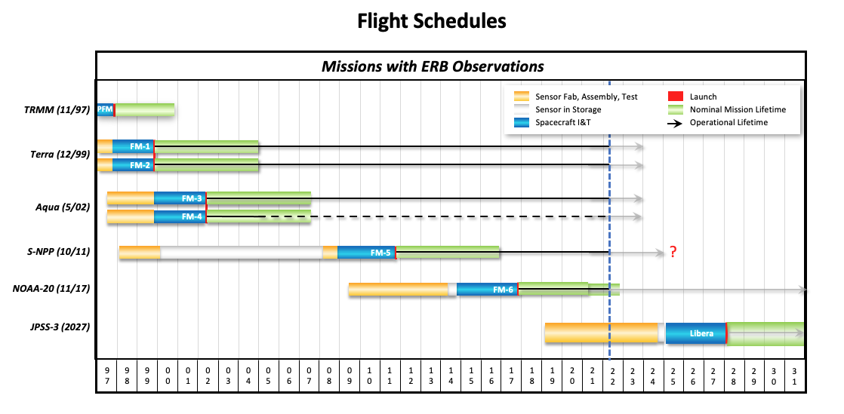
Currently, 6 CERES instruments fly on 4 satellites: Terra (L1999), Aqua (L2002), SNPP(L2011), NOAA-20 (L2017)
Libera scheduled for launch in 2027 on JPSS-3

Slide 14
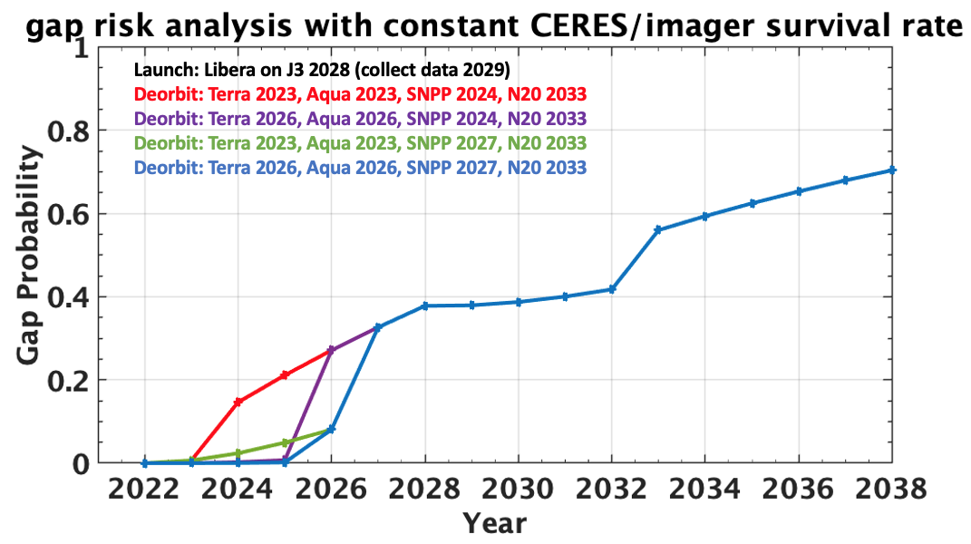
Gap risk in 2025 exceeds 20% if SNPP ends in 2024 and TER & AQU end in 2023. Remains <5% if either SNPP ends in 2027 or TER & AQU end in 2026.
Gap risk in 2026 reaches 27% if SNPP ends in 2024 but remains <10% if SNPP ends in 2027.
Gap risk reaches 38% when Libera launches in 2028 for all scenarios.

Slide 15
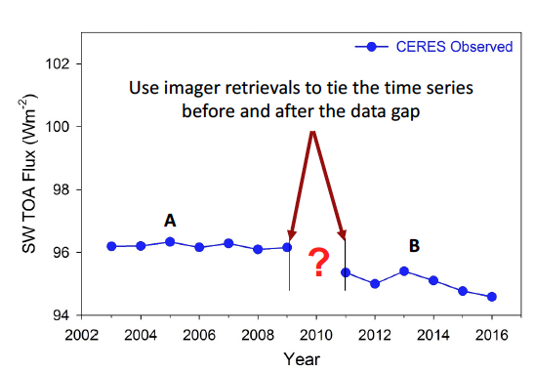
Bridging a Data Gap in the ERB CDR
Goal: Examine the feasibility of using less-accurate imager retrievals to compute radiative fluxes and tie the time series before and after a data gap together.
Global Annual Mean SW TOA Flux

Slide 16
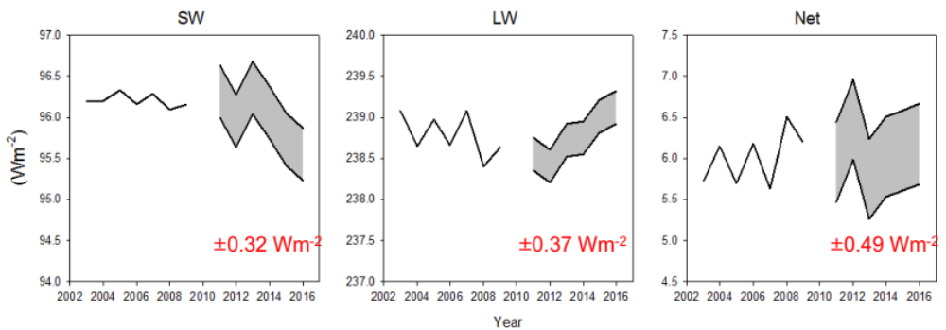
Bridging a Data Gap in the ERB CDR
Assumes imager remains healthy and perfectly stable across the data gap. The longer the gap, the greater the risk.
The resulting uncertainty is too large to enable decade-to-decade changes in EEI to be resolved.
Time to detect a real trend above uncertainty would increase substantially.
A gap would require considerable extra post-processing effort, thereby delaying release of the ERB data products.

Slide 17
Planning for Terra & Aqua Edition 5
Main Considerations:
1) GMAO improvements to their atmospheric reanalysis system.
  CERES and GMAO hold WebEx meetings every 3 weeks to gauge progress and provide ongoing validation results for the latest GEOS FP or FPIT version.
2) MODIS Collection 7 schedule.
4) CERES production code improvements.
5) CERES algorithm improvements (particularly those enabling a seamless transition across satellite platforms).
Note: EBAF Ed4.2 will be released this year in order transition from Terra+Aqua to NOAA-20 and to mitigate discontinuities in EBAF-SFC associated with input reanalysis data and GEO artifacts.

Slide 18
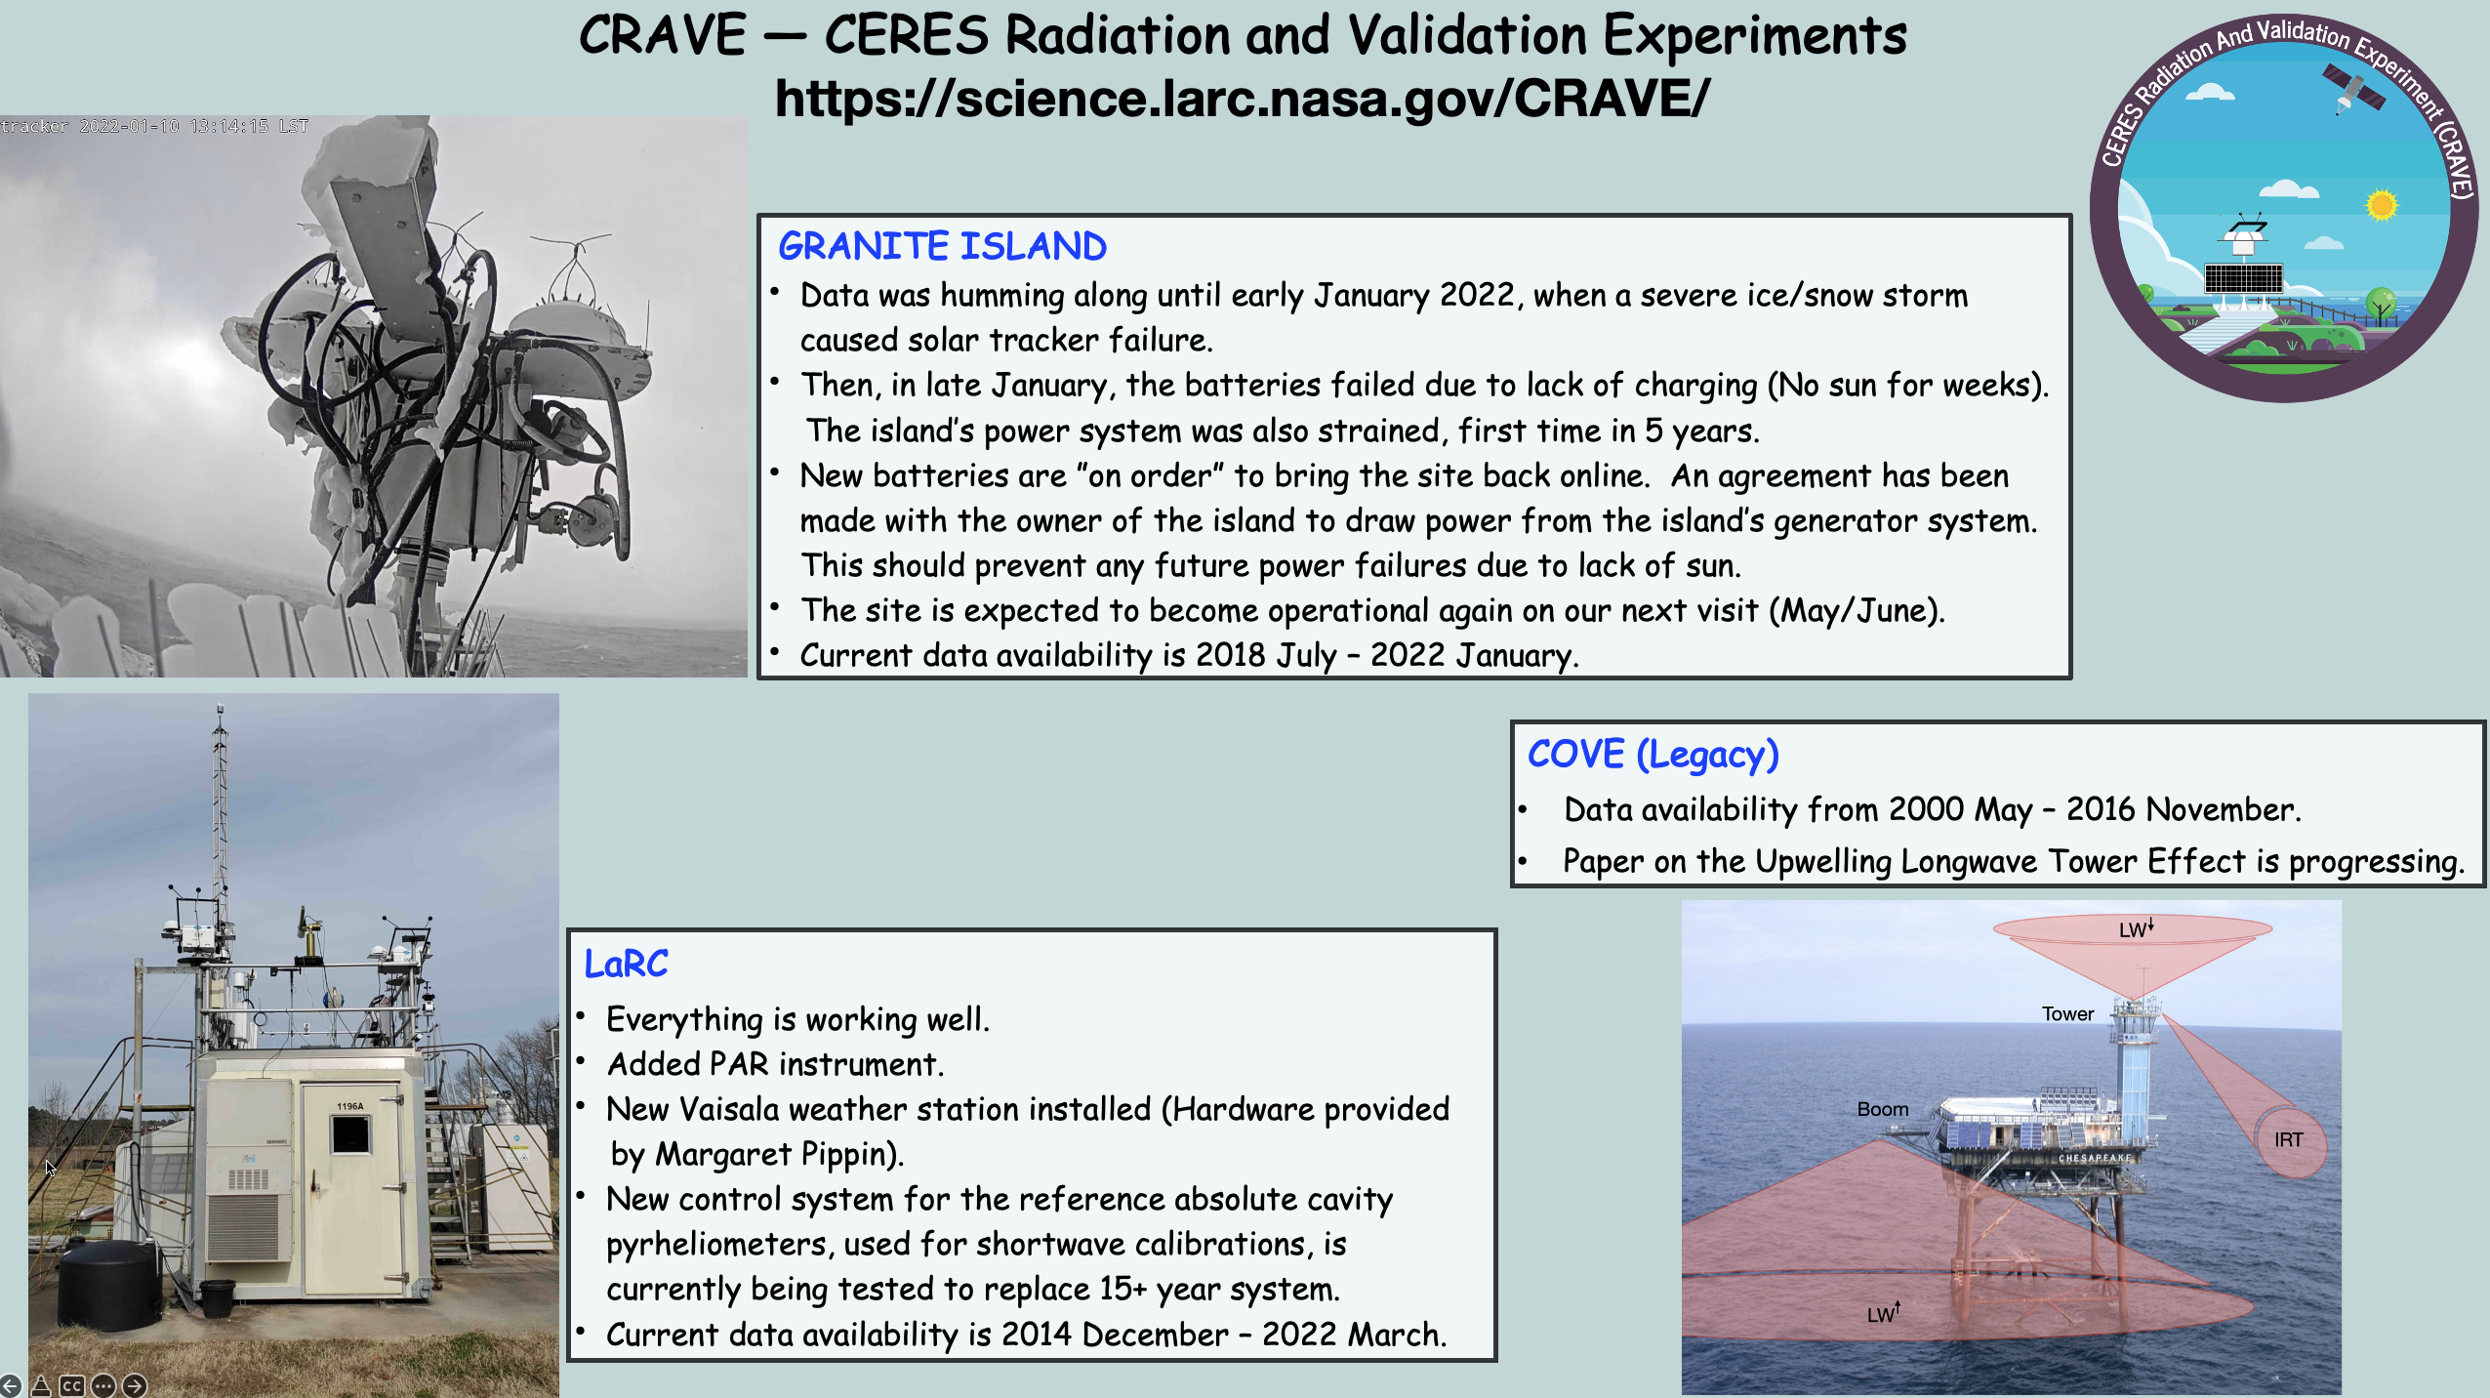

Slide 19
Upcoming Conferences & Meetings of Interest
Fall 2022 ERB Workshop (CERES/Libera/GERB/ScaRaB)+Science
October 12-14, 2022, Hamburg, Germany.
Fall AGU
December 12-16, 2022, Chicago, IL

