Slide 1
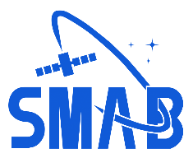

Space Shuttle Launch Availability Circa 2003-2005
SACD Risk Workshop
William M. Cirillo
Space Mission Analysis Branch
August 10, 2022

Slide 2
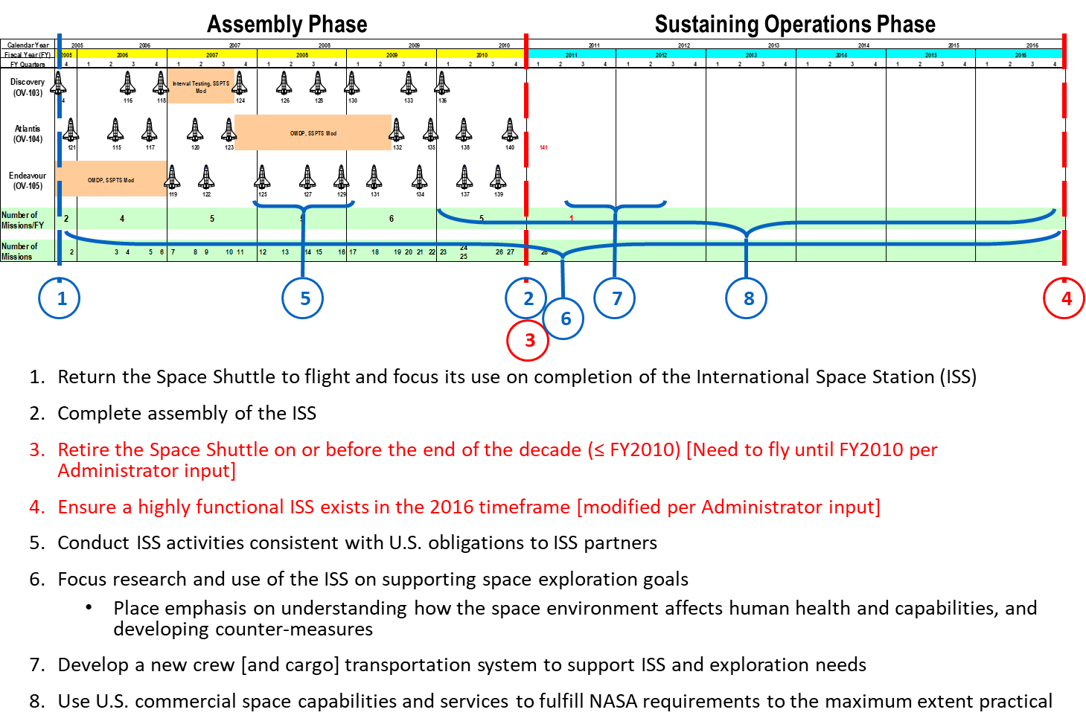
Situation (context of risk activity)
Vision for Space Exploration
ISS & Space Shuttle Program Related Objectives
2003 (February) Loss of Space Shuttle Columbia.
2004 (January) President George W. Bush releases “Vision for Space Exploration”.
2004 (Summer) NASA Administrator Sean C. O’Keefe and Human Spaceflight leadership informed that 28-flight Space Shuttle manifest to complete the International Space Station (ISS) would not be completed by 2010.
2005 (April) – Michael D. Griffin becomes NASA Administrator.
2005 (Summer) Exploration Systems Architecture Study (ESAS) & Shuttle/Station Configuration Team (SSCOT).
  “NASA is also currently examining alternative configurations for the Space Station that meet the goals of the Vision and the needs of our international partners, while maintaining safety as our highest priority. This team is conducting a 60-day study of the configuration options for the ISS and assessing the related number of flights needed by the Space Shuttle before it retires no later than the year 2010. The scope of the Shuttle/Station Configuration Options Team study spans ISS assembly, operations, and use and considers such factors as international partner commitments, research utilization, cost, and ISS sustainability. ” Michael D. Griffin Statement to Committee on Science, House of Representatives, June 27, 2005
1

Slide 3
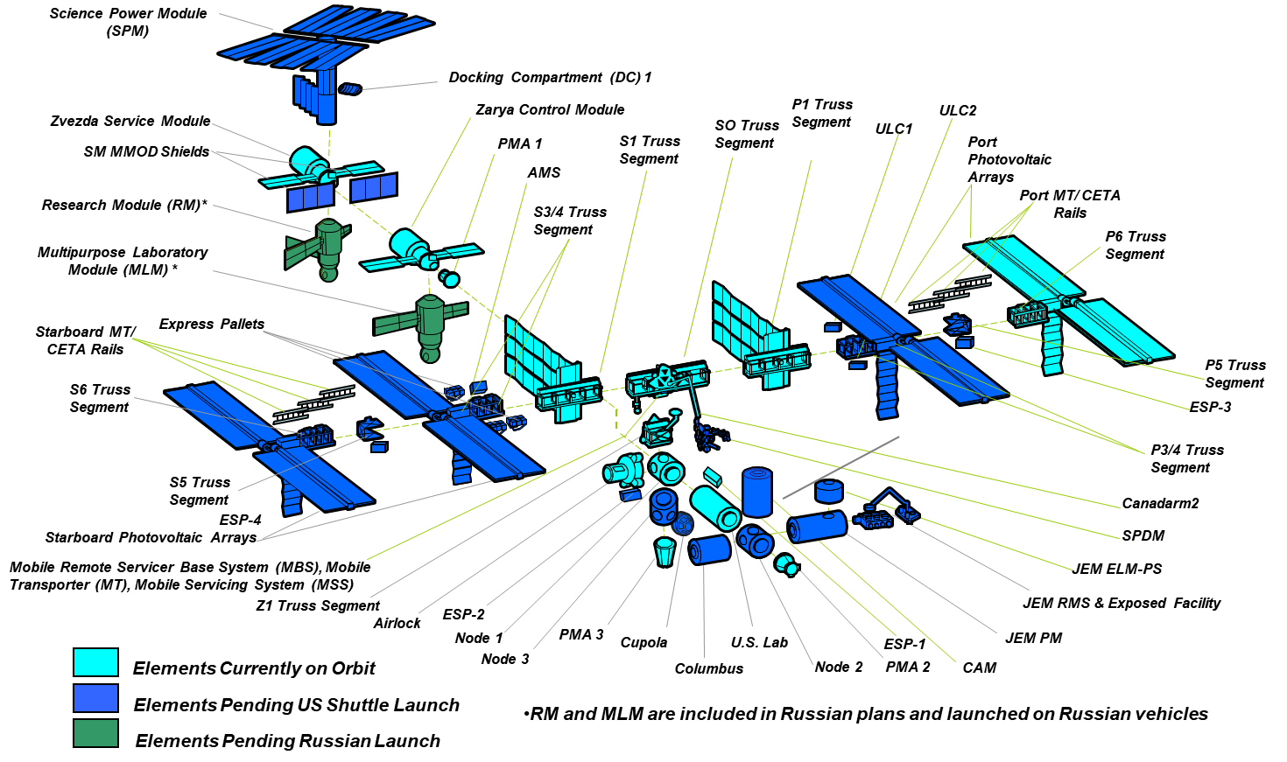
Task (definition of activity)
2005 (May) Administrator Griffin informed by White House that they would sanction a total of 15 Space Shuttle flights before retirement at the end of FY2010.
2005 (May) under the auspices of the ESAS and SSCOT teams, a small group was chartered with analyzing several Space Shuttle flight manifests to determine how many Space Shuttle flights were likely to be achieved post Return to Flight.
  22+1 Flight Sequence
  Completes ESA and JAXA International Partner module delivery as scheduled
  Removes RSA Science Power Module
  Maximizes Maintenance and Spares pre-positioning delivery
  Requires ORU Store and Burn philosophy
17+1 Flight Sequence
  Completes ESA and JAXA International Partner module delivery as scheduled
  Removes RSA Science Power Module
  Significantly reduces IP outfitting
  Reduces Maintenance and Spares delivery
  Requires ORU Store and Burn philosophy
≤ 12 Flight Sequence with Deferred Assembly
  Defers ISS assembly post 11A until Exploration HLLV is available [~mid-2011]
  Maximizes early ISS exploration utilization
  Reduced number of ISS flights increases crew safety
Final ISS Vehicle Configuration circa January 2005 Heads of Agencies Meeting
2

Slide 4
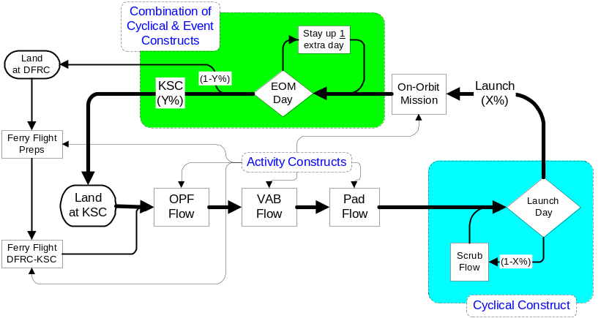
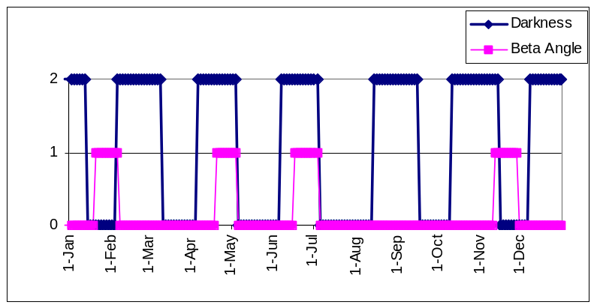
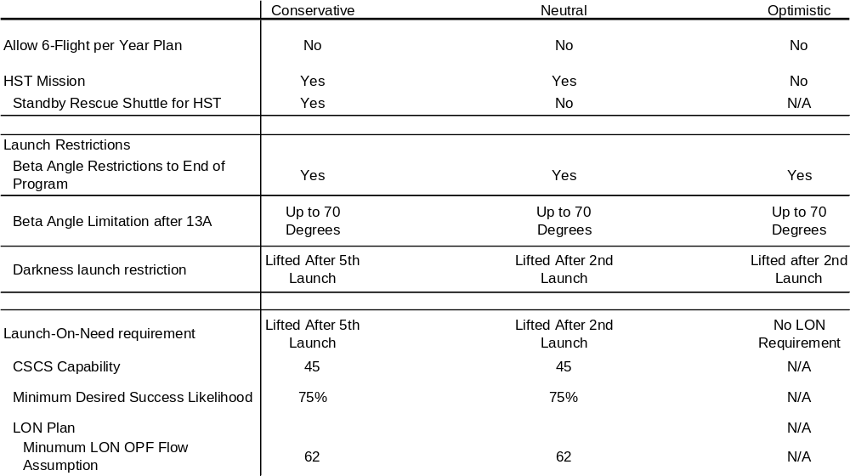
Action (methods used to address the problem)
Utilized a discrete event simulation model, the Manifest Assessment Simulation Tool (MAST), developed by Dr. Grant Cates, Kennedy Space Center (KSC).
Dr. Cates worked with the Space Shuttle Program Offices at JSC and KSC as well as the Space Operations Mission Directorate and ISS Program Office to develop a Conservative, Neutral, and Optimistic flight rate set of Input Parameters, including:
  Workforce Augmentation
  Embedded margin in manifest
  Launch in daylight requirement can be extended
  Launch on need requirement can be extended
  Loss of vehicle probability can be specified
  Loss of mission probability can be specified
  Beta angle requirement can be altered
  Infrastructure assumptions regarding when facilities are closed
  Empirical or Theoretical Distributions
  More optimistic launch probabilities
  Hubble mission scenario
Manifest Assessment Simulation Tool (MAST)
3

Slide 5
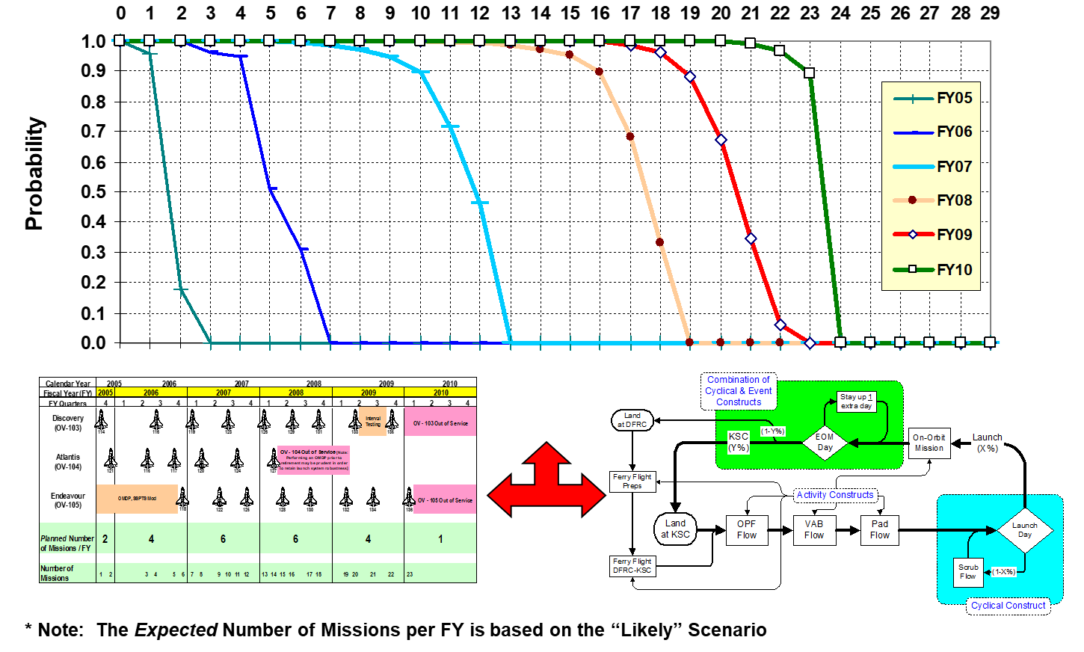
Action (methods used to address the problem) (Concluded)
MAST was used to analyze each potential Space Shuttle flight manifest.
For each Space Shuttle flight manifest option, the probability of achieving the number of launches through a given period (Fiscal Year) was determined
Expected* Number of Space Shuttle Flights by Fiscal Year Based on Manifest Option 05B-14
4

Slide 6
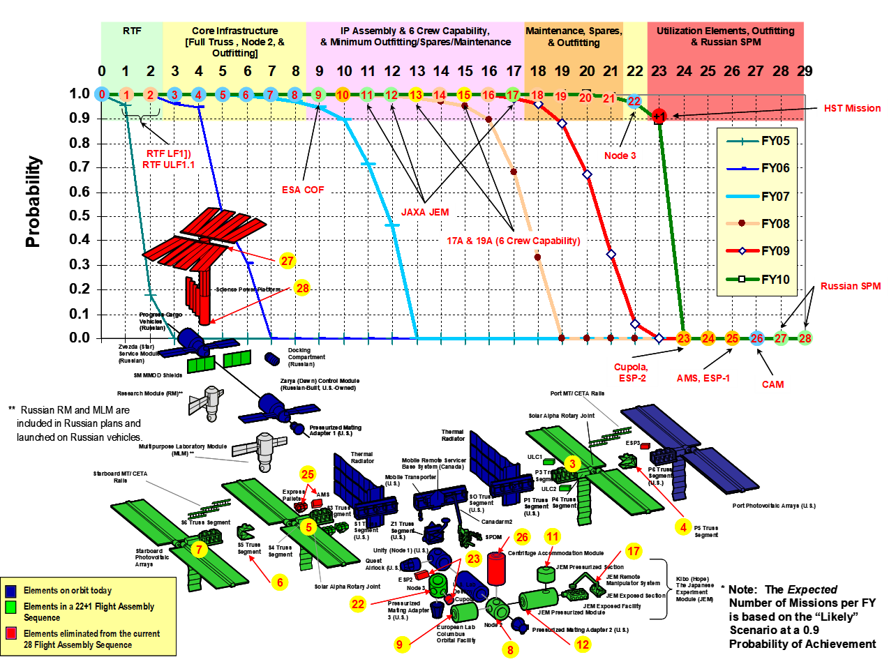
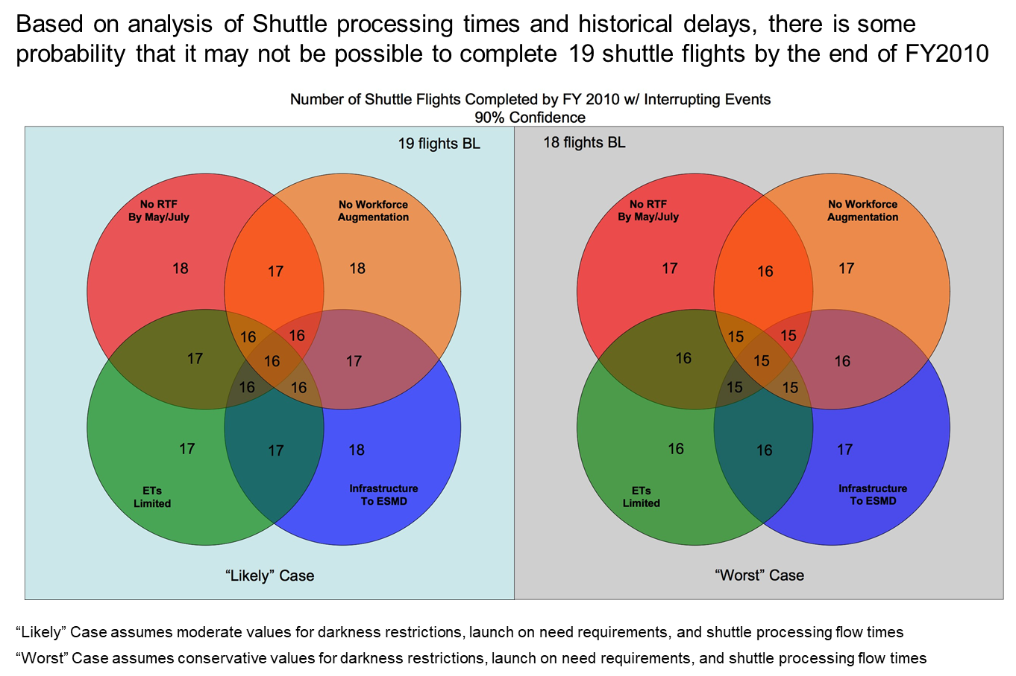
Results (how did this activity inform decisions… etc.)
2005 (July) NASA Administrator Griffin negotiated with the White House to settle on a 20 (19+1)-flight Space Shuttle manifest to:
  Finish the assembly of the International Space Station to the greatest extent possible while honoring the VSE end of FY2010 retirement date, and;
  Conduct one final Hubble Space Telescope servicing mission.
After SSCOT ended, the SMAB-lead portion of the SSCOT team continued to update their analysis at the request of William Gerstenmaier, Associate Administrator for Human Exploration and Operations:
Space Shuttle final flight ended on 21 July 2011.
Expected* 22+1 Flight ISS Assembly Sequence Based on Manifest Option 05B-14
5

Slide 7
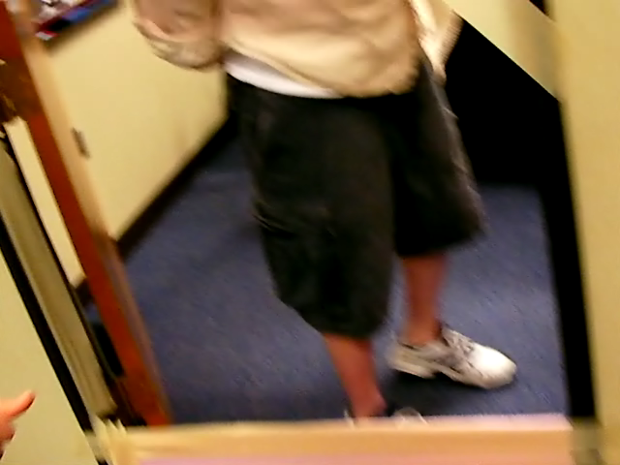
Risks…they come in many forms…
6

