Slide 1

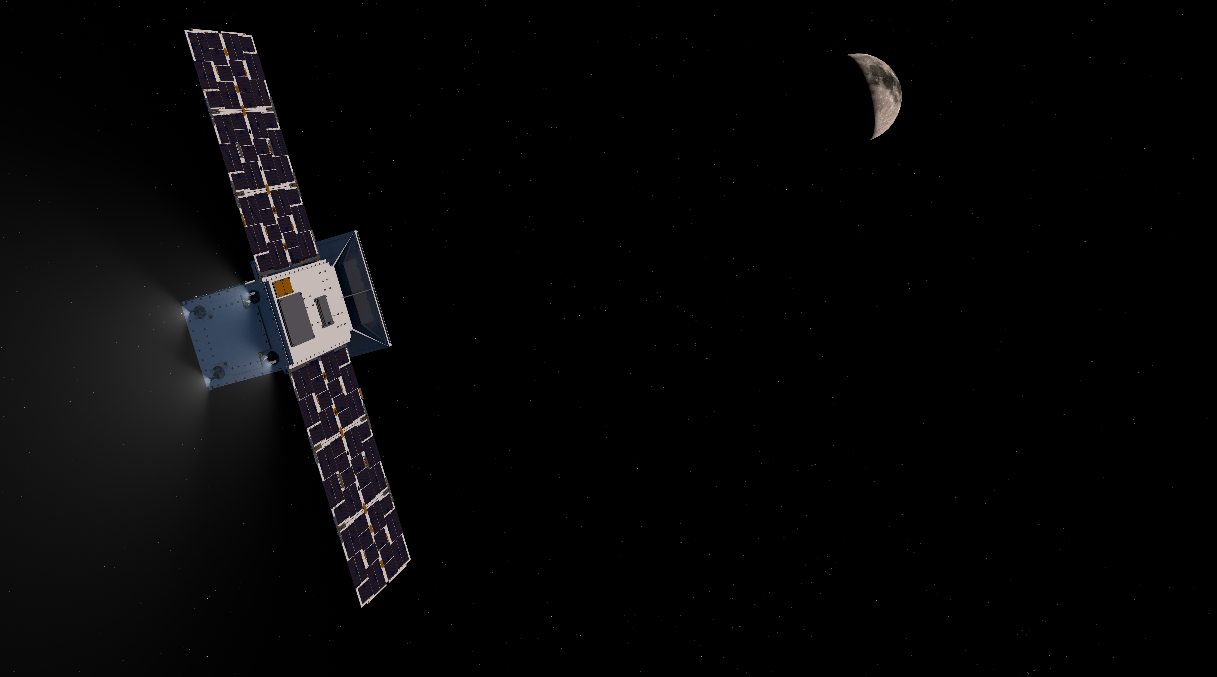

Space Technology Mission Directorate Small Spacecraft Technology
National Aeronautics and
Space Administration
National Aeronautics and
Space Administration
National Aeronautics and
Space Administration
NASA Small Spacecraft Technology Program
Roger C. Hunter
Program Manager
Small Spacecraft Technology Program
NASA Town Hall ✦ August 8, 2022
Small Satellite Conference

Slide 2
2022-2023 Launch Schedule
Technology Demonstrations | Launch Timeframe
PTD-3: Pathfinder Technology Demonstrator-3: Payload: TBIRD 200GB Laser Communications | Launched May 25, 2022
CPOD: CubeSat Proximity Operations Demonstration | Launched May 25, 2022
CAPSTONE: Cislunar Autonomous Positioning System Tech Ops & Navigation Experiment | Launched June 28, 2022
CLICK-A: CubeSat Laser Infrared CrossLinK | Launched July 14, 2022
Starling: Demonstration of Autonomous Swarm Technologies | Late 2022
ACS3: Advanced Composite Solar Sail System | 1H 2023
Lunar Flashlight: Mapping of Water and Volatiles at the Lunar Surface | Early 2023
PTD-4: Pathfinder Technology Demonstrator-4: Payload: LISA-T High-Power Deployable Solar Array Antenna | Mid 2023
PACE-2: Payload Accelerator for CubeSat Endeavors | Mid 2023
CLICK B/C: CubeSat Laser Infrared CrossLinK | Late 2023

Slide 3
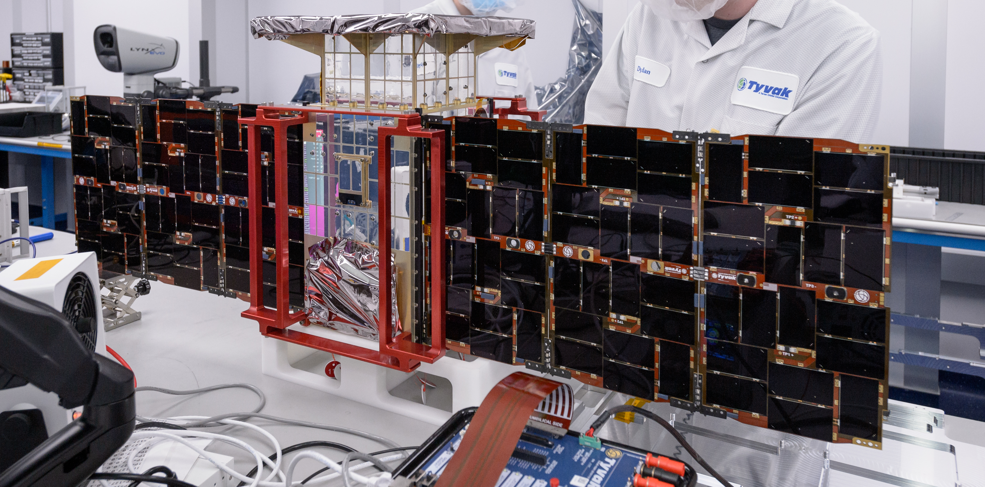
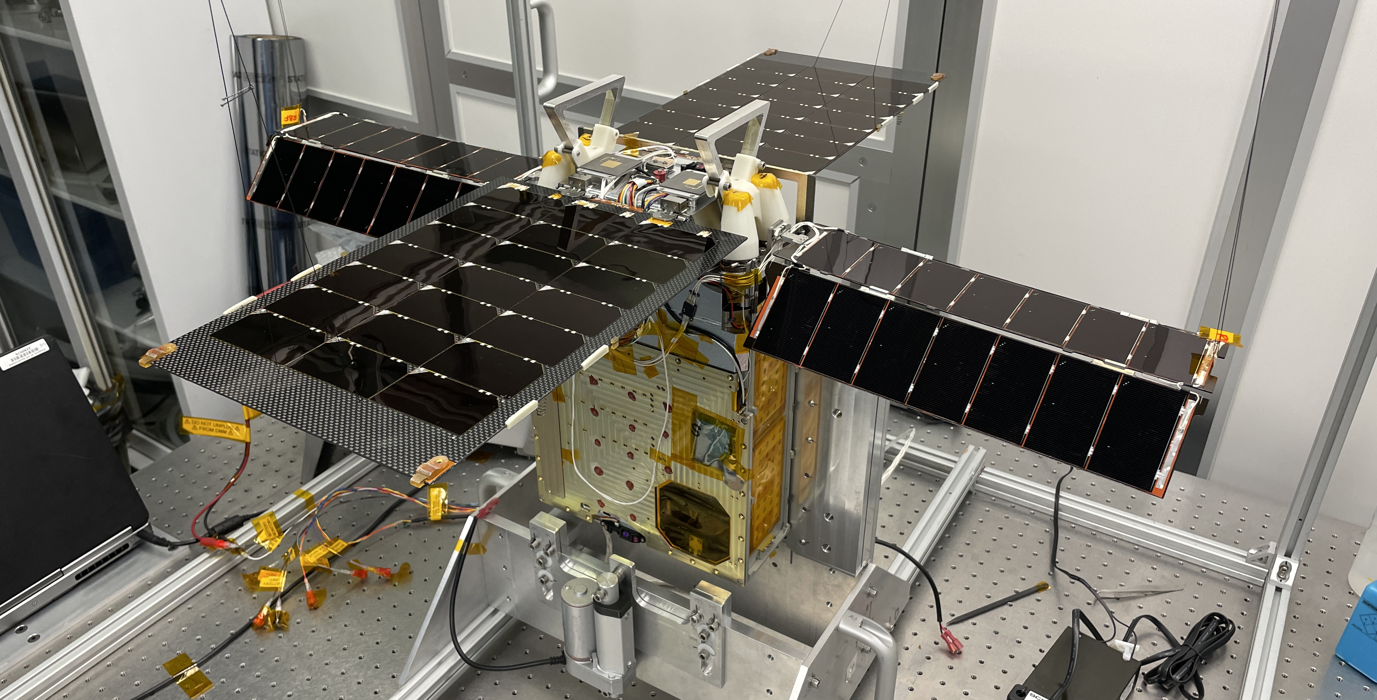
U-Class Exploration Mission Status
CAPSTONE
Launched: June 28, 2022
Demonstrate how to enter and function in a near rectilinear halo orbit around the Moon and demonstrate spacecraft-to-spacecraft navigation
Lunar Flashlight
Launch Timeframe: Early 2023
Characterize lunar in-situ resource utilization potential. Measure quantity and distribution of surface ice deposits in lunar South Pole cold traps with a compact laser spectrometer
Image Credits: NASA
Image Credits: NASA/JPL-Caltech
3

Slide 4
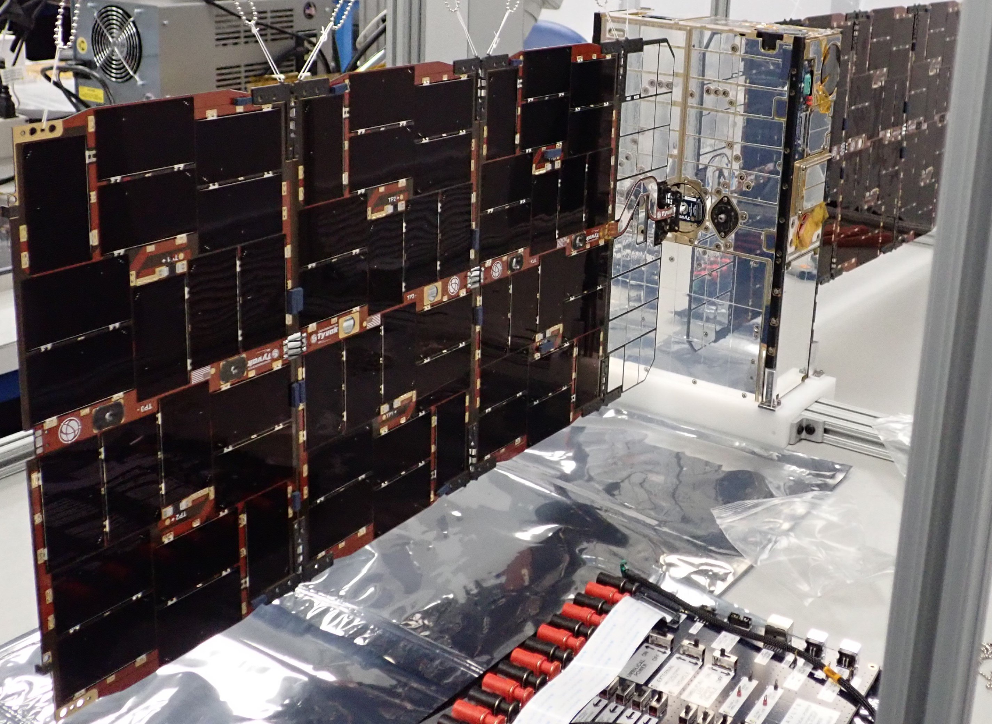
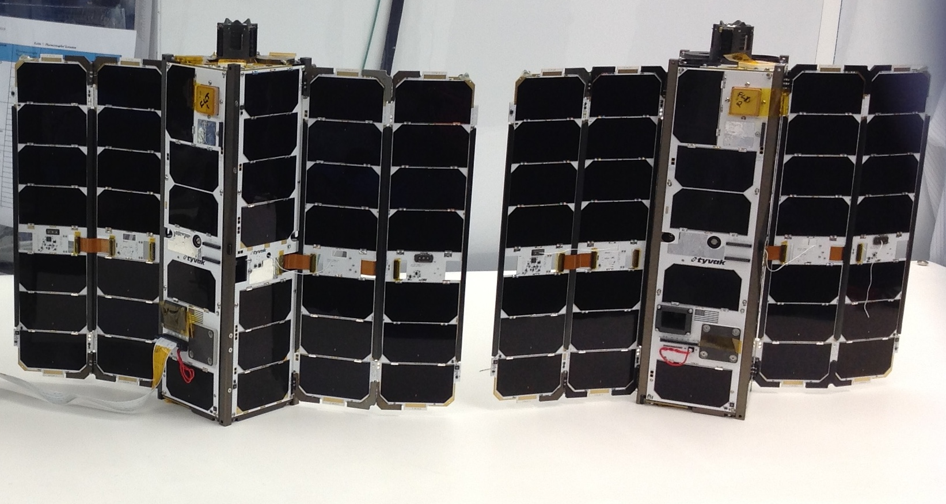
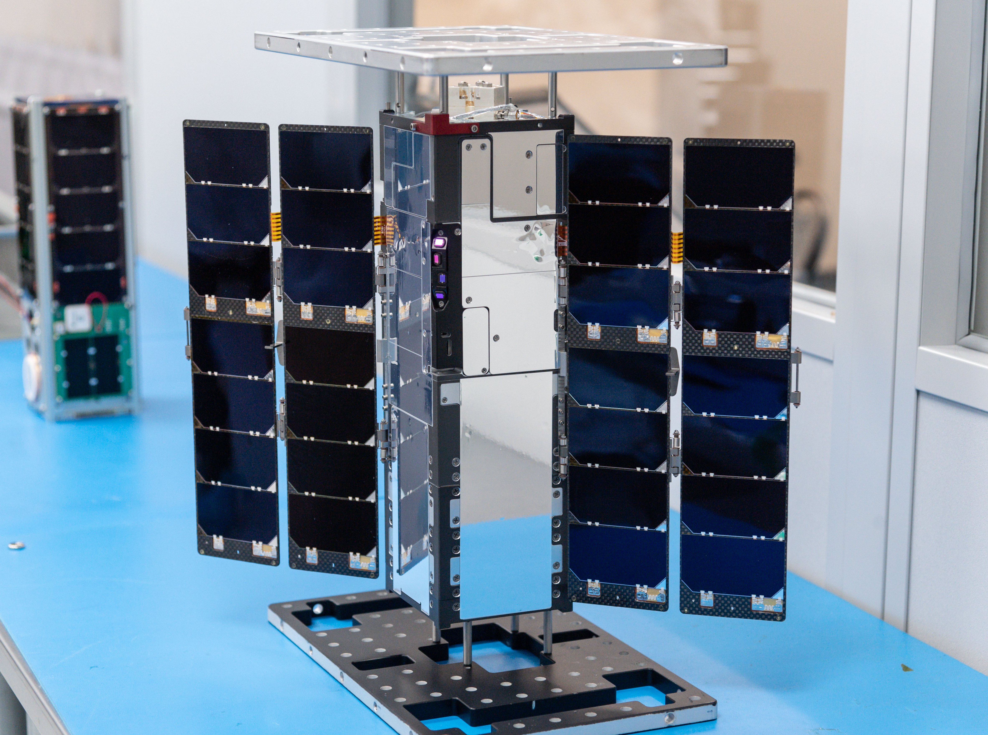
On-Orbit U-Class Technology Demonstration Missions – 2022
Pathfinder Technology Demonstrator (PTD-3)
Launched: May 25, 2022
Demonstrate TeraByte InfraRed Delivery (TBIRD) technology for high-bandwidth laser communications - 200 gigabit per second data downlink rate
CubeSat Proximity Operations Demonstration (CPOD)
Launched: May 25, 2022
Demonstrate rendezvous, proximity operations and docking using two 3U CubeSats
CubeSat Laser Infrared CrossLinK (CLICK-A)
Launched: July 14 2022
Risk reduction mission to
test elements of an optical communications system via a single 3U spacecraft and a ground station telescope
Image Credits: Terran Orbital Corporation
Image Credits: Terran Orbital Corporation
Image Credits: NASA
4

Slide 5
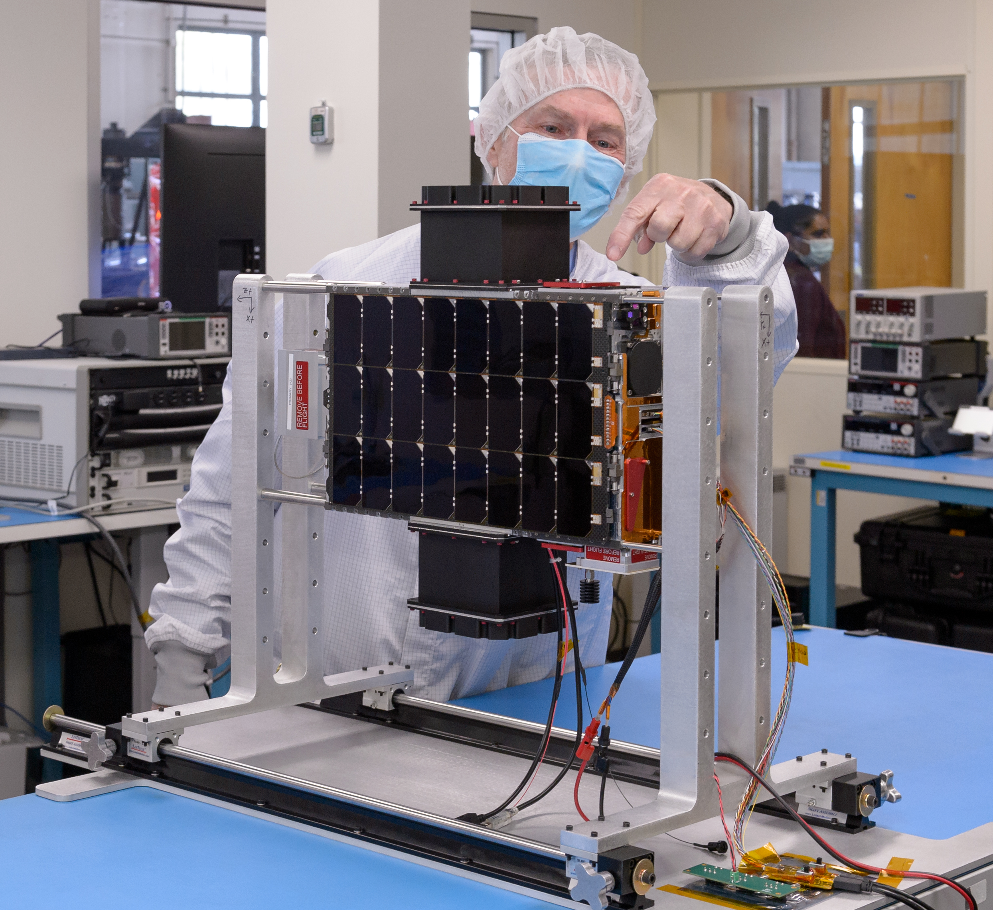
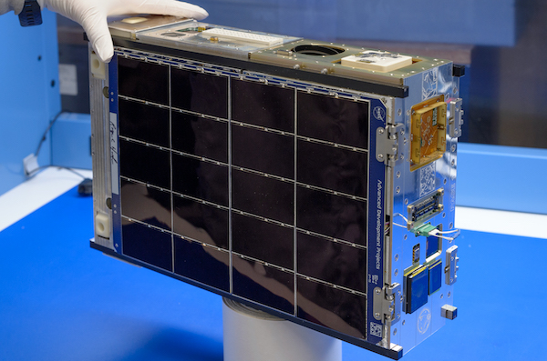
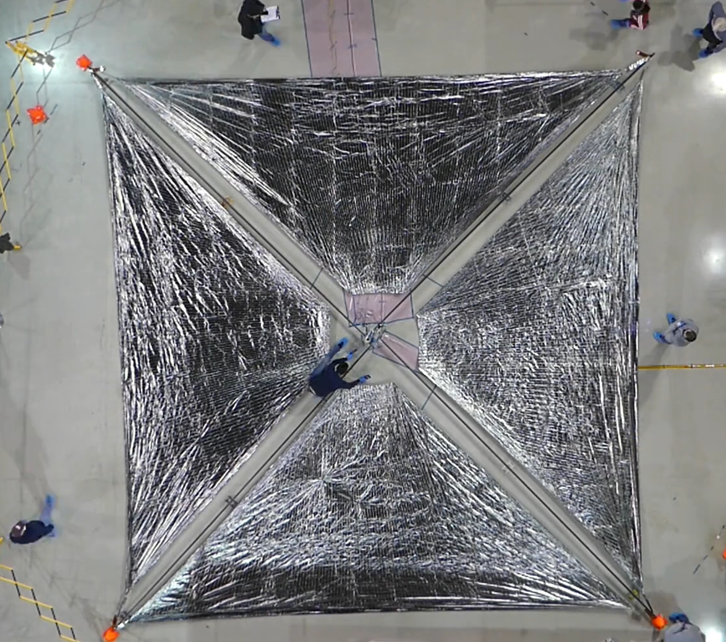
Upcoming U-Class Technology Demonstration Missions – 2022
Starling
Autonomous Swarm Tech.
Launch: Late 2022
Demonstrate swarm maneuver planning and execution, communications networking, relative navigation, and autonomous coordination between four 6U CubeSats
PACE-2
Launch: Mid 2023
Demonstrate upgrades to the PACE avionics system as well as a camera and image processing payload
Advanced Composite Solar Sail System (ACS3)
Launch: 1H 2023
Demonstrate deployment
of the composite boom
solar sail in low-Earth orbit. The unfurled solar sail will measure approximately 84 m²
Image Credits: NASA
Image Credits: NASA
Image Credits: NASA
5

Slide 6
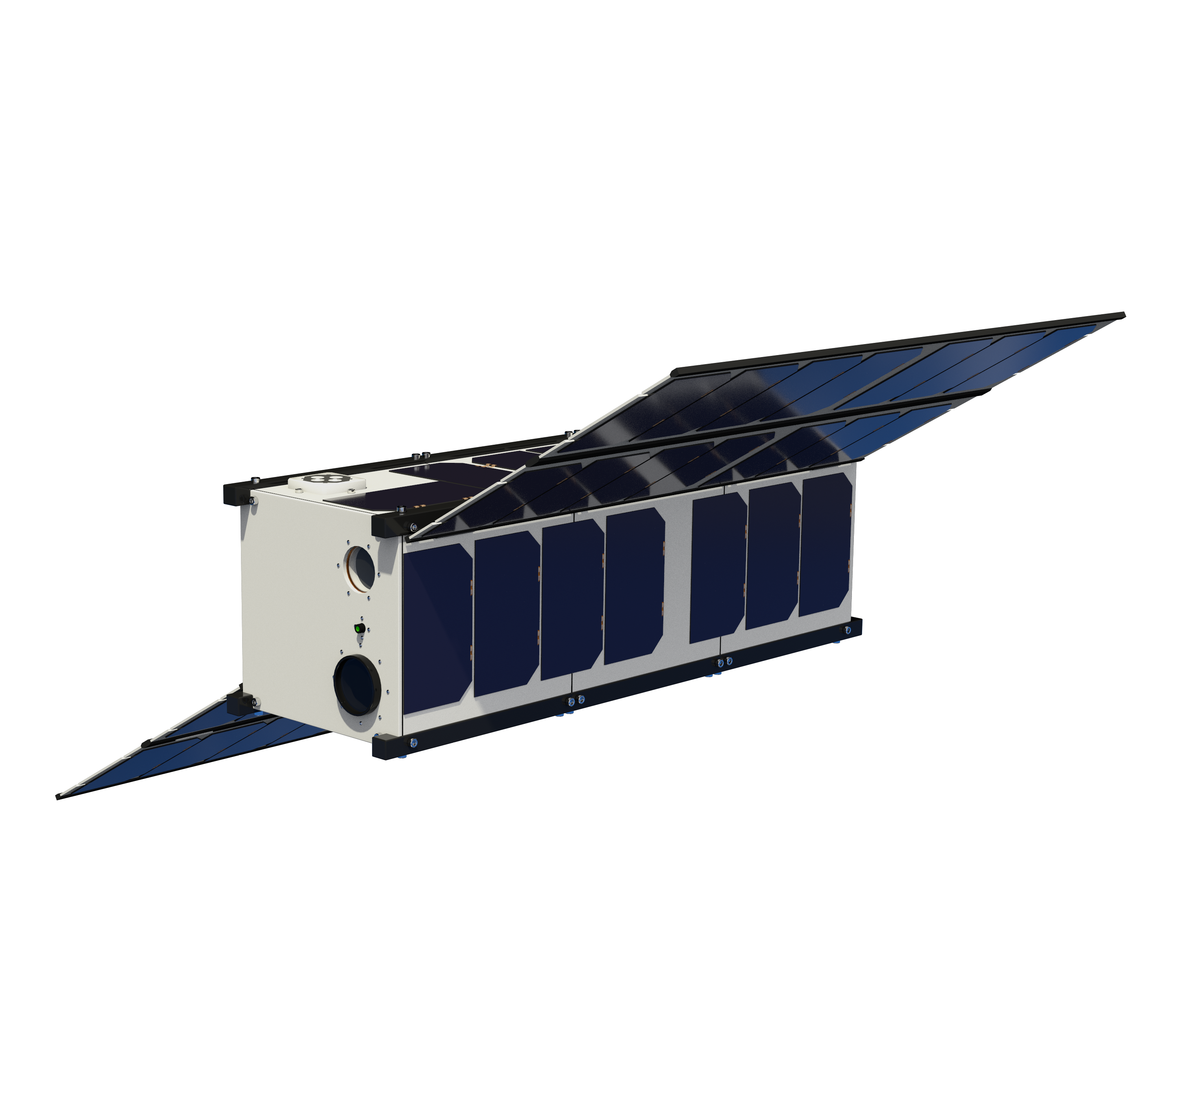
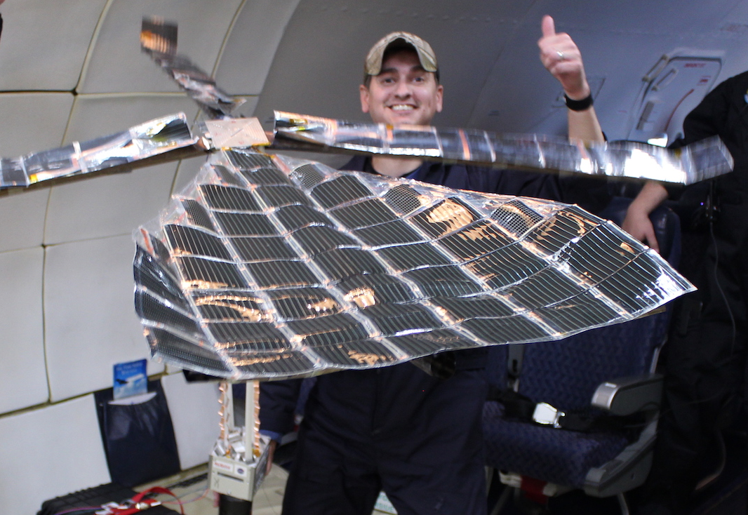
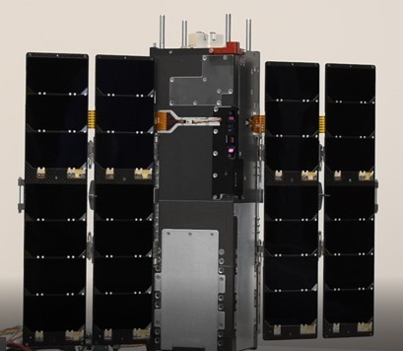
Upcoming U-Class Technology Demonstration Missions - 2023
Pathfinder Technology Demonstrator
(PTD-4)
Launch: Mid 2023
Demonstrate Lightweight Integrated Solar Array and anTenna (LISA-T), a high-power, low-volume deployable solar array with an integrated antenna
CubeSat Laser Infrared CrosslinK
(CLICK B/C)
Launch: Late 2023
Demonstrate optical crosslink and precision ranging between two 3U CubeSats at a data rate of 20 Mbps and range up to 580 km
Image Credits: NASA
Image Credits: NASA (illustration) and
Blue Canyon Technologies (photograph)

Slide 7
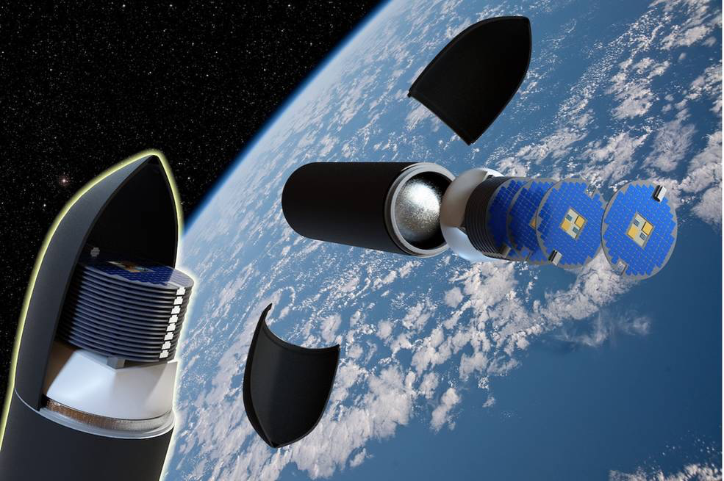
nasa.gov/smallspacecraft

