Slide 1
Human Exploration Supportability Analysis Andrew Owens Space Mission Analysis Branch Strategic Analysis and Concepts Directorate NASA Langley Research Center SACD Risk Workshop August 10, 2022

Slide 2
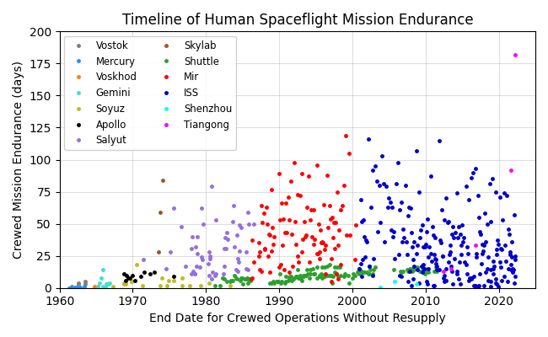
Future Human Exploration Missions Face Unprecedented Supportability Challenges
Current long-duration operations rely on regular resupply and mitigate risk with access to abort
Crewed missions beyond Low Earth Orbit (LEO) will not have these options
Long periods of logistical isolation
Limited/existent abort options
Mission planning must ensure adequate spares, maintenance items, and crew time to maintain system operations
Includes all human spaceflights up to April 18, 2022.
LEO Endurance Record: 182 d (Tiangong, April 15, 2022)
Lunar Endurance Record: 12.5 d (Apollo 17, Dec 19, 1972)
Owens et al. “Integrated Logistics and Supportability Challenges of Sustained Human Lunar Exploration.” 51st International Conference on Environmental Systems, St. Paul, MN, 2022. ICES-2022-90.

Slide 3
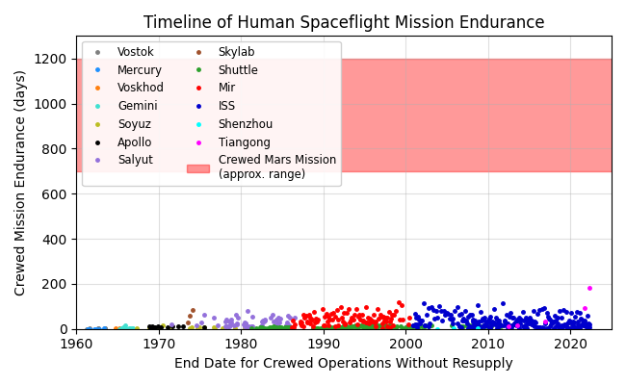
Future Human Exploration Missions Face Unprecedented Supportability Challenges
Current long-duration operations rely on regular resupply and mitigate risk with access to abort
Crewed missions beyond Low Earth Orbit (LEO) will not have these options
Long periods of logistical isolation
Limited/existent abort options
Mission planning must ensure adequate spares, maintenance items, and crew time to maintain system operations
Includes all human spaceflights up to April 18, 2022.
Crewed Mars mission endurance range: 700-1,200 days (Shorter missions require exponentially more propellant)
New approaches are required to mitigate the risk of insufficient maintenance resources for crewed exploration beyond LEO.
Lunar Endurance Record: 2.5 d (Apollo 17, Dec 19, 1972)
LEO Endurance Record: 182 d (Tiangong, April 15, 2022)
Owens et al. “Integrated Logistics and Supportability Challenges of Sustained Human Lunar Exploration.” 51st International Conference on Environmental Systems, St. Paul, MN, 2022. ICES-2022-90.

Slide 4
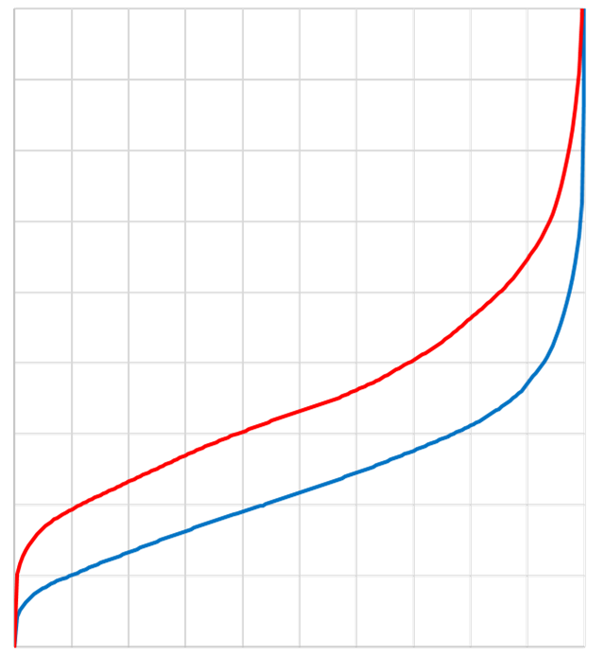
Supportability Analysis Combines Expert Input, Historical Data, and Probabilistic Modeling
Discussions with Subject Matter Experts (SMEs)
Initial failure rate estimates, with uncertainty
Spares Mass and Risk Tradeoff
Higher Mass
Observed operating time and failures
Bayesian Analysis
Mission endurance
For a given mission and system…
Specifying spares mass target defines maximum POS
ISS data, ground test data
Spares mass and POS evaluation
Spares Mass
Each point along the curve represents a specific allocation of spares to replaceable items in the system, optimized to minimize mass and maximize POS
Updated failure rate estimates, with uncertainty
Supportability Analysis
Maintenance crew time evaluation
Reliability growth modeling, projected uncertainty reduction
Spares allocation optimization
Discussions with SMEs
Before Testing and Upgrades
Initial system characteristics (mass, level of repair, etc.)
Supportability Forecasting
Projected exploration system characteristics
After Testing and Upgrades
Specifying POS target defines minimum spares mass
Testing and upgrades improve mass/risk tradeoff
0.0
0.1
0.2
0.3
0.4
0.5
0.6
0.7
0.8
0.9
Lower Mass
Planned or proposed upgrades
Planned or proposed testing
1.0
Probability of Sufficiency (POS)
Higher Risk
Lower Risk
Discussions with SMEs

Slide 5
Supportability Analysis Combines Expert Input, Historical Data, and Probabilistic Modeling
Discussions with Subject Matter Experts (SMEs)
Initial failure rate estimates, with uncertainty
Spares Mass and Risk Tradeoff
Higher Mass
Observed operating time and failures
Bayesian Analysis
Mission endurance
For a given mission and system…
Specifying spares mass target defines maximum POS
ISS data, ground test data
Spares mass and POS evaluation
Spares Mass
Each point along the curve represents a specific allocation of spares to replaceable items in the system, optimized to minimize mass and maximize POS
Updated failure rate estimates, with uncertainty
Supportability Analysis
Maintenance crew time evaluation
Reliability growth modeling, projected uncertainty reduction
Spares allocation optimization
Discussions with SMEs
Before Testing and Upgrades
Initial system characteristics (mass, level of repair, etc.)
Supportability Forecasting
Projected exploration system characteristics
After Testing and Upgrades
Specifying POS target defines minimum spares mass
Testing and upgrades improve mass/risk tradeoff
Sensitivity analysis and trade studies tend to be much more valuable than one-off analyses
0.0
0.1
0.2
0.3
0.4
0.5
0.6
0.7
0.8
0.9
Lower Mass
Planned or proposed upgrades
Planned or proposed testing
1.0
Probability of Sufficiency (POS)
Higher Risk
Lower Risk
Discussions with SMEs

Slide 6
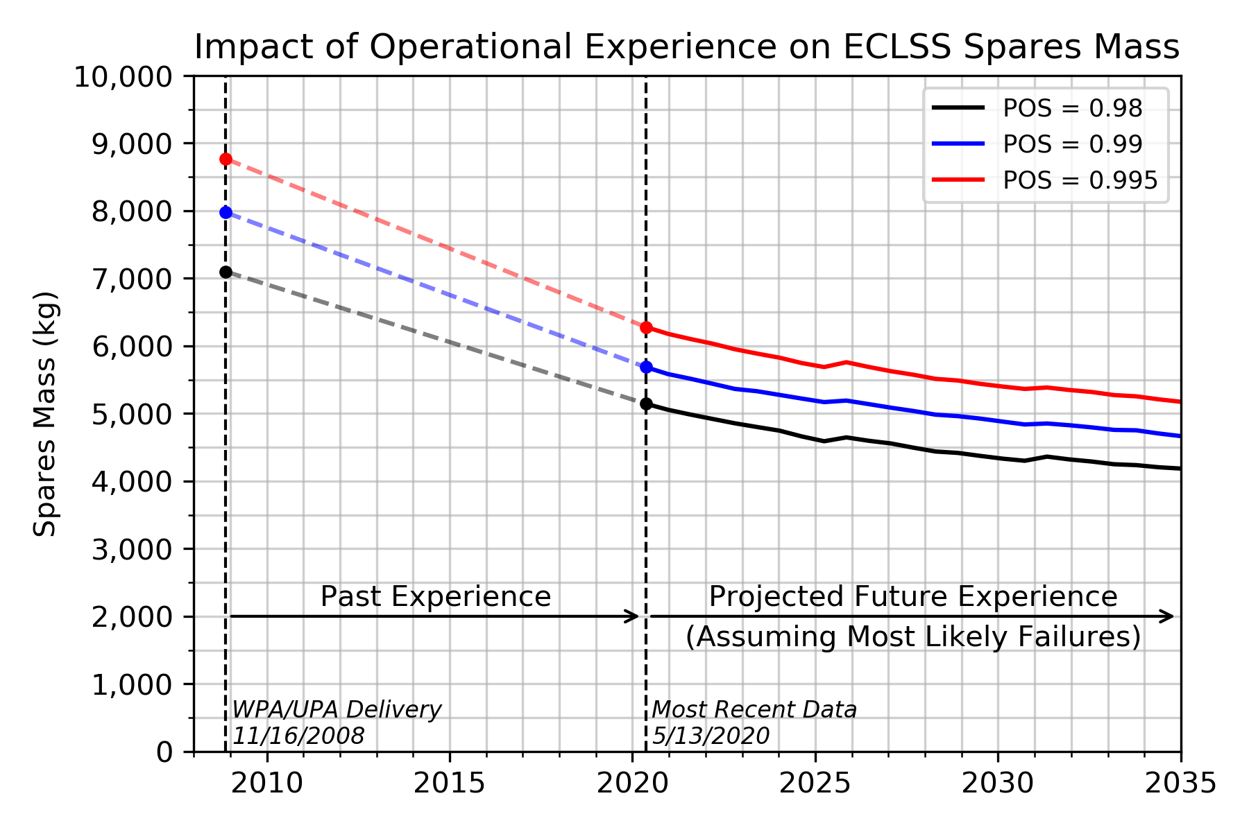
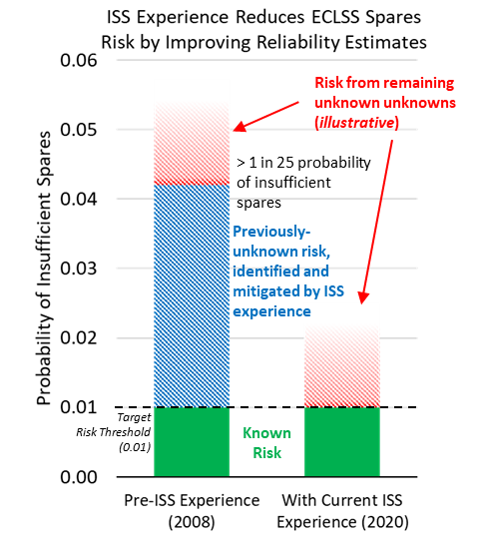
Supportability Analysis Informs a Range of Development and Planning Activities
Supportability analysis characterizes the relationship between:
System design and technology selection
Testing and operational heritage
Mission endurance
Spares and maintenance mass and crew time
Probability of sufficiency
Trade studies inform targeted application of limited development and test resources
Campaign Architecture
Logistics evaluation and system sizing
Resupply flight cadence
Risk assessment
Crew time and concept of operations evaluation
Sensitivity analysis and trade studies
System and Subsystem Design
Technology selection and sizing
Integrated assessment of tradeoffs with other system decisions
Level of repair analysis
Identification of targeted testing/upgrade opportunities
Technology Portfolio Management
Candidate technology evaluation and trade studies
Reliability target and test criteria definition
Ground test program definition and budget/schedule sensitivity
Program Evaluation
Engineering value of historical ISS operations
Projected supportability benefits of future ISS operations
Projected supportability benefits of Gateway, Mars Transit Habitat shakedown missions, and lunar surface activities
If Mars mission spares allocations had been planned using initial failure rate estimates, spares mass and risk would have been higher due to inaccurate failure rate estimates. Testing and operational experience provides the data required to refine those estimates and reduce risk.

