Slide 1










SERVIR-CArbon Pilot (S-CAP) Overview
Christine A. Evans ^{1,2} Daniel E. Irwin ²
Emil A. Cherrington ^{1,2} Ashutosh Limaye ²
Africa I. Flores-Anderson ^{1,2} Eric R. Anderson ²
¹ Earth System Science Center, University of Alabama Huntsville
² SERVIR Science Coordination Office, NASA Marshall Space Flight Center
August 10, 2022

Slide 2


Overview
Background
  SERVIR’s land cover services
  SERVIR-CArbon Pilot (S-CAP)
Methodology
Results
Implications
Future activities
Summary

Slide 3
1. Background: SERVIR activities in LC monitoring
Network est. in 2005 + supporting land cover monitoring + other activities in 5 regions
Partnership w/ regional centers of excellence, international orgs like FAO, private sector
Focus on capacity development
  SAR Handbook
  Collect Earth Online [for reference data collection]
  Emerging technologies
Focus on services leveraging the service planning approach
Multiple services focusing on wall-to-wall mapping
Ongoing global* change detection inter-comparison exercise

Slide 4
1. Background: S-CAP objectives
Strengthen the ability of the SERVIR network to integrate GHG estimation into services & other activities
Development of transparent & replicable methodologies for GHG estimation / carbon accounting which make use of SERVIR land cover datasets -> open science / demystification
Development of GHG estimates for pilot countries in SERVIR’s focus regions, also in conjunction with the ongoing SERVIR global land cover change inter-comparison exercise
Evaluation of the potential to integrate GHG estimation methods into SERVIR land cover-related services
Collaboration with NASA CMS scientists for strengthening of SERVIR GHG monitoring capacities
Development of training materials for GHG estimation using land cover products

Slide 5
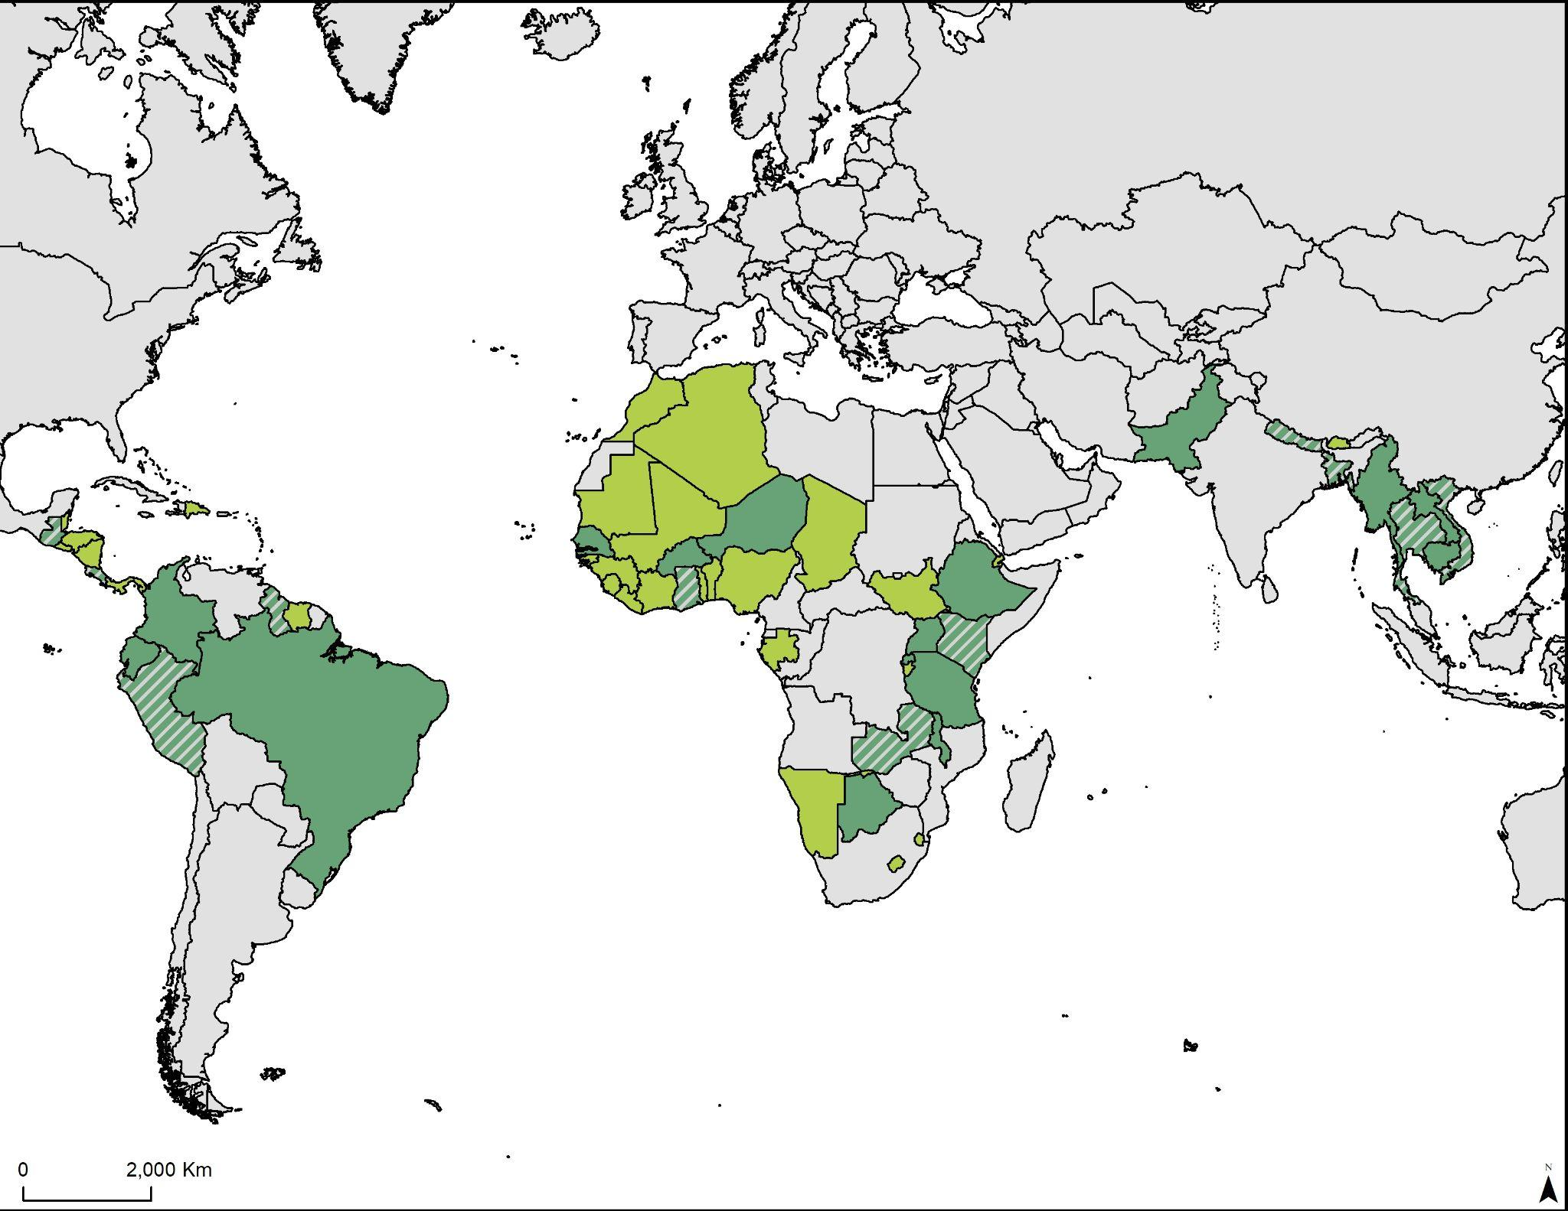
Pilot Countries
Americas
Guyana
  Costa Rica
  Guatemala
  Peru
Africa
Ghana
Zambia
  Kenya
Asia
Bangladesh
Thailand
  Nepal
  Vietnam

Slide 6
2. Methodology: Overview
Global Land Cover
MODIS - MCD12Q1
JAXA F/NF
Global Forest Watch
F/NF reclassification
Annual activity data
Resample to 100m (1 ha.)
Regional Land Cover
RCMRD - CCDC (Zambia)
MapBiomas (Guyana)
Rapid Land Cover Mapper (USGS) (Ghana)
RLCMS (Thailand, Bangladesh)
Above Ground Biomass
Saatchi et al 2011
Avitable 2015
Geocarbon 2020
GEDI l4b 2021
ICIMOD 2015
IPCC Emission Tables
Parameterization
Annual activity data
Resample to 100m (1 ha.)
Change Detection Algorithm
LandTrendr
CCDC-SMA
Reduce region to activity data
Biomass x 0.48 = Carbon Stock
Emission = Area x Carbon Stock
Emission Ensemble &
Comparison to REDD+ FREL Reports

Slide 7
2. Methodology: Global RS data
1. Land cover / Land cover change*
JAXA F/NF (2007-2018)
NASA MCD12Q1 (2001-2020)
WRI Global Forest Watch (2000-2020)
SERVIR-generated from CCDC, LandTrendr (1990-2021)
Regional datasets (e.g. MapBiomas, RLCMS, WA LC Atlas)
National FREL reports
2. Above Ground Biomass (Carbon)
Saatchi et al. 2011 (c. 2000)
Baccini et al. 2012 (c. 2000)
GeoCarbon 2014 (c. 2010)
Avitable et al. 2015 (c. 2000)
ICIMOD 2015
NASA GEDI biomass 2021 (2019-2021)
National FREL reports
IPCC Emission Factor Database
Used to estimate area changed (i.e., activity data)
Used as emission factor (EF) data, where
C = 0.48 to 0.5 x AGB, and where CO₂e = ⁴⁴/₁₂ x C

Slide 8
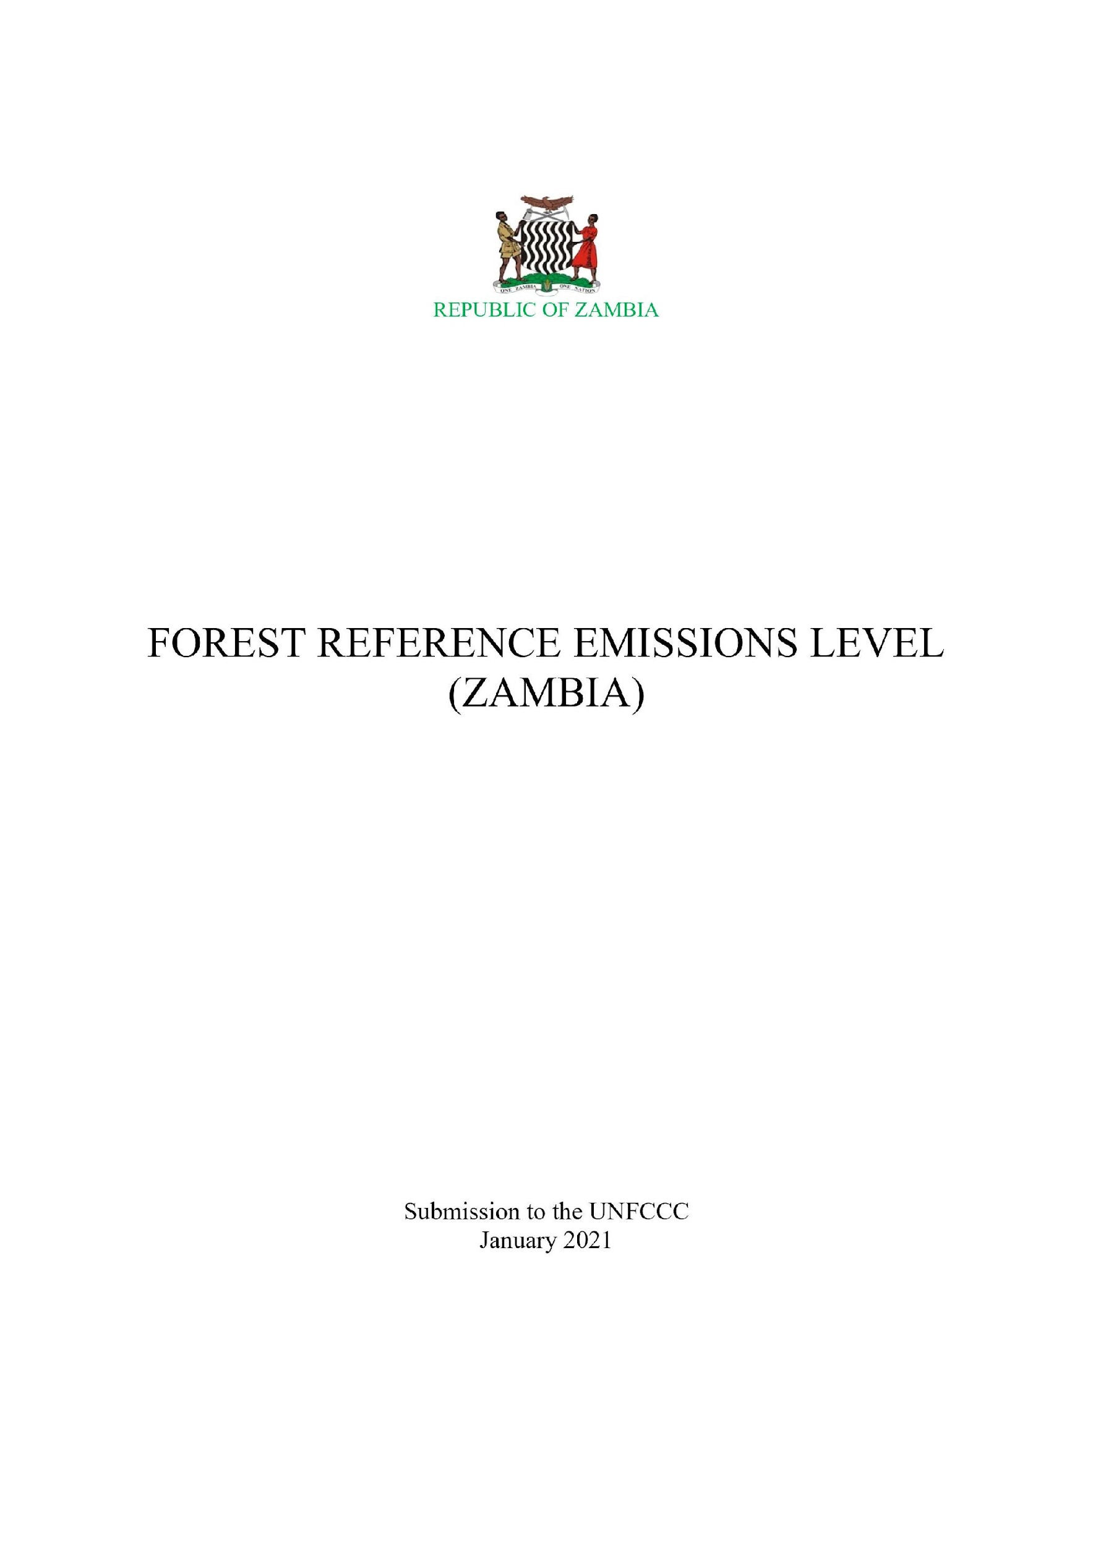


2. Methodology: National data from REDD+ FREL Reports
Average Change in Forest Area (ha./year) | AGB Carbon Stock (tons CO₂) | Emissions = Area x AGB (tons CO₂e per year)
191,596.23 | 29.20 | 5,594,609.83
“Total deforestation for the period 2009-2018 was approximately 1,915,962.27 ha. which translates to an annual average deforestation of 191,569.23 ha. across the country”
Average Change in Forest Area (ha./year) | AGB Carbon Stock (tons CO₂) | Emissions = Area x AGB (tons CO₂e per year)
14,070.0 | 58.266 | 819,854.0
“The average annual historical emissions due to deforestation in the period 2000-2015 has been estimated to be 819,854 t CO2e/year at the national scale”
Average Change in Forest Area (ha./year) | AGB Carbon Stock (tons CO₂) | Emissions = Area x AGB (tons CO₂e per year)
5,791.67 | 198.57 | 1,150,070.83
“Guyana has established the time period for historic emissions to be from 2001-2012, a total of 12 years...Total deforestation over the historic period is estimated to be 69.5 thousand ha.”

Slide 9
3. Results: Ensemble Results: >200 estimates thus far
Guyana
Ghana
Thailand
LC Dataset | AGB Dataset | Change in Forest Area (ha./yr) | Emissions = Area x AGB (per year)
MCD12Q1 | IPCC Tier 1 | 21,924.83 | 5,392,192.69
Landtrendr | Saatchi 2011 | 11,145.71 | 2,283,644.71
GFW | Avitable 2015 | 8,011.96 | 2,392,852.87
MapBiomas | GeoCarbon 2020 | 15,334.04 | 3,457,519.98
FREL | FREL | 5,791.67 | 1,335,558.33
LC Dataset | AGB Dataset | Change in Forest Area (ha./yr) | Emissions = Area x AGB (per year)
MCD12Q1 | IPCC Tier 1 | 36,677.75 | 8,677,209.03
Landtrendr | Saatchi 2011 | 96,047.22 | 5,021,348.57
GFW | Avitable 2015 | 33,545.45 | 921,829.09
USGS | GeoCarbon 2020 | 106,502.68 | 2,737,118.93
FREL | FREL | 20,792.00 | 892,392.64
LC Dataset | AGB Dataset | Change in Forest Area (ha./yr) | Emissions = Area x AGB (per year)
MCD12Q1 | IPCC Tier 1 | 1,119,450.61 | 20,128,622.19
Landtrendr | Saatchi 2011 | 112,677.40 | 13,952,842.30
GFW | Avitable 2015 | 118,888.89 | 9,721,544.44
RLCMS | GeoCarbon 2020 | 102,641.35 | 4,985,203.83
FREL | FREL | 27,401.64 | 2,916,904.58
Bangladesh
Zambia
LC Dataset | AGB Dataset | Change in Forest Area (ha./yr) | Emissions = Area x AGB (per year)
MCD12Q1 | IPCC Tier 1 | 19,286.22 | 1,688,512.99
Landtrendr | Saatchi 2011 | 8,033.19 | 1,051,624.47
GFW | Avitable 2015 | 13,892.44 | 1,037,209.73
RLCMS | GeoCarbon 2020 | 10,051.61 | 831,067.32
FREL | FREL | 14,070.00 | 819,802.62
LC Dataset | AGB Dataset | Change in Forest Area (ha./yr) | Emissions = Area x AGB (per year)
MCD12Q1 | IPCC Tier 1 | 98,035.05 | 16,613,020.02
Landtrendr | Saatchi 2011 | 192,428.68 | 12,082,596.64
GFW | Avitable 2015 | 92,000.00 | 2,416,840.00
RCMRD | GeoCarbon 2020 | 192,816.67 | 8,854,141.33
FREL | FREL | 100,840.12 | 2,944,531.49

Slide 10
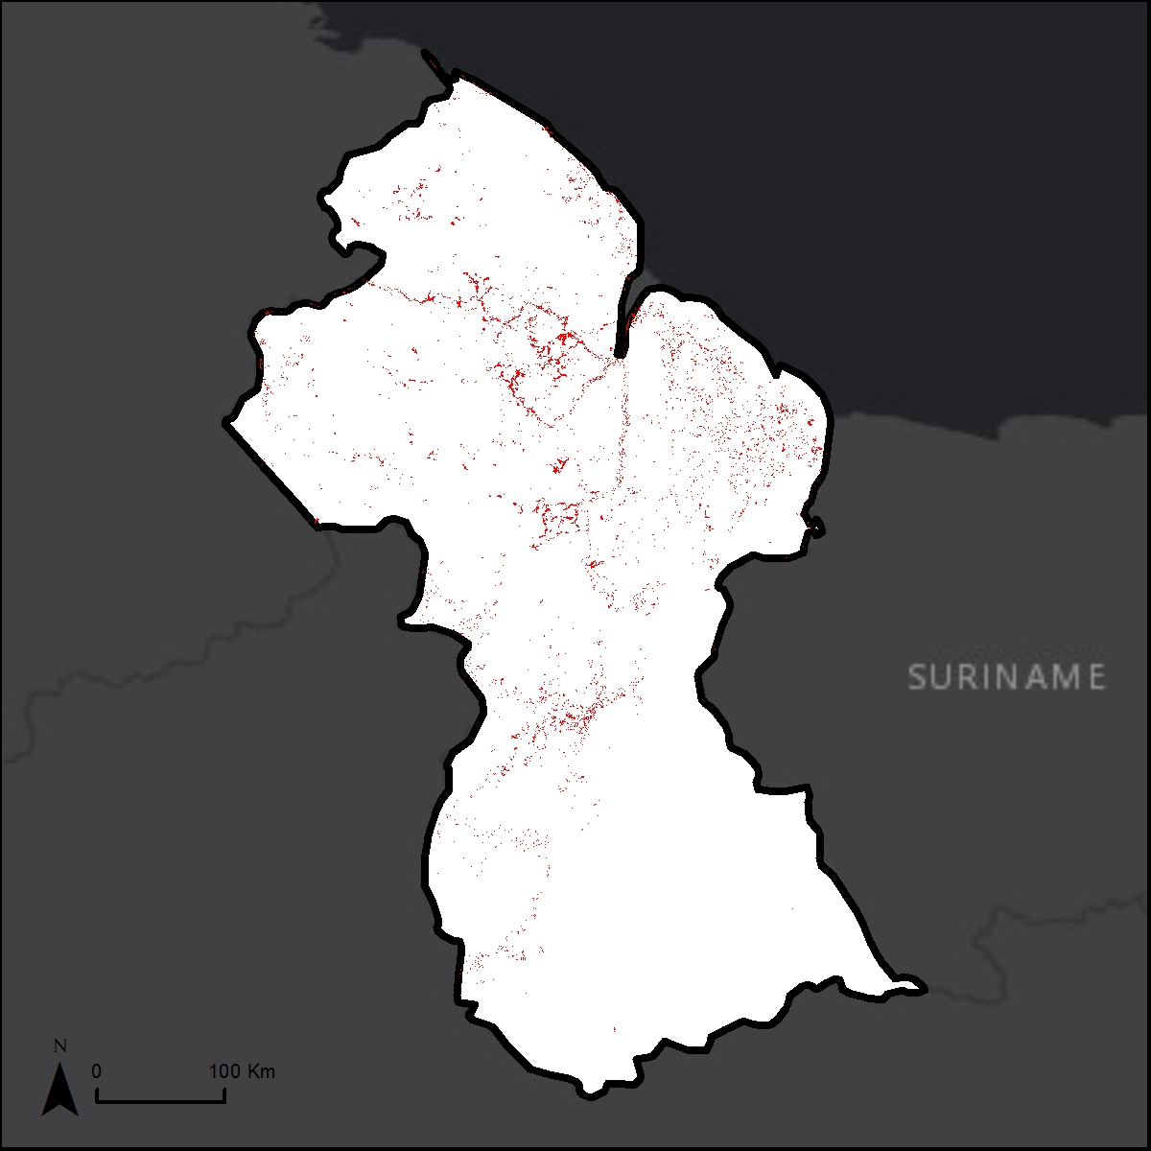
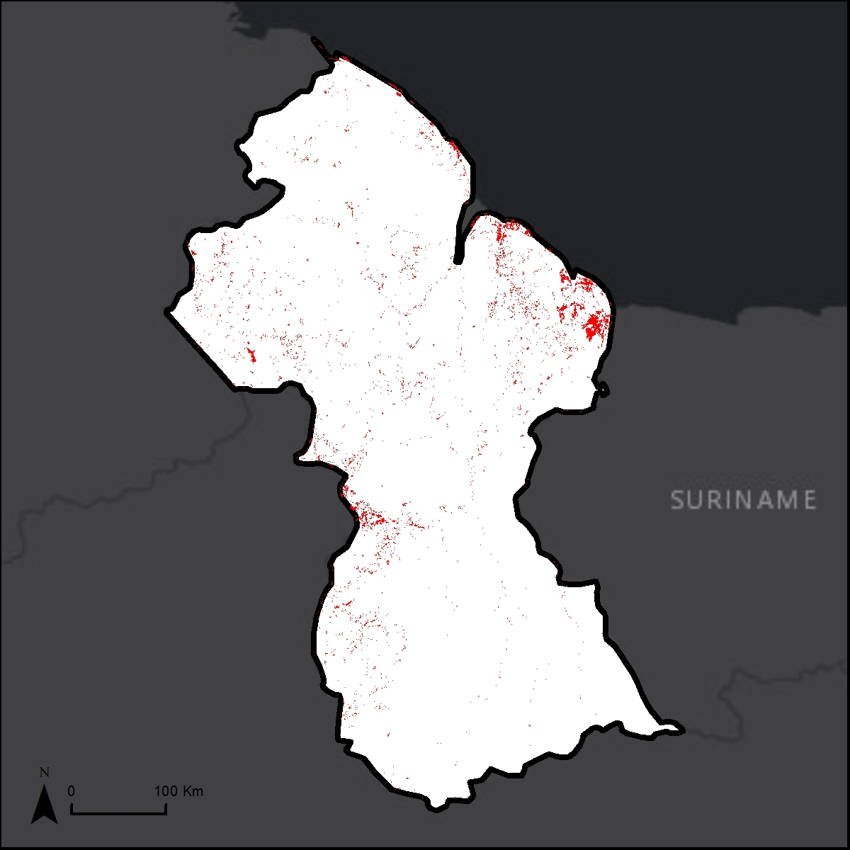
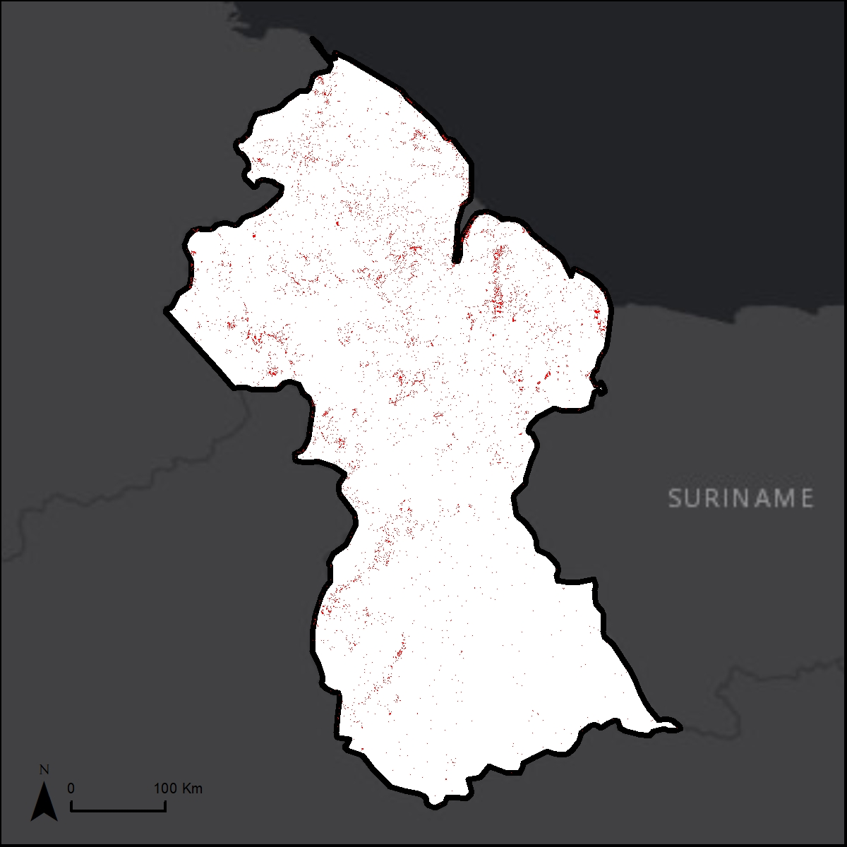
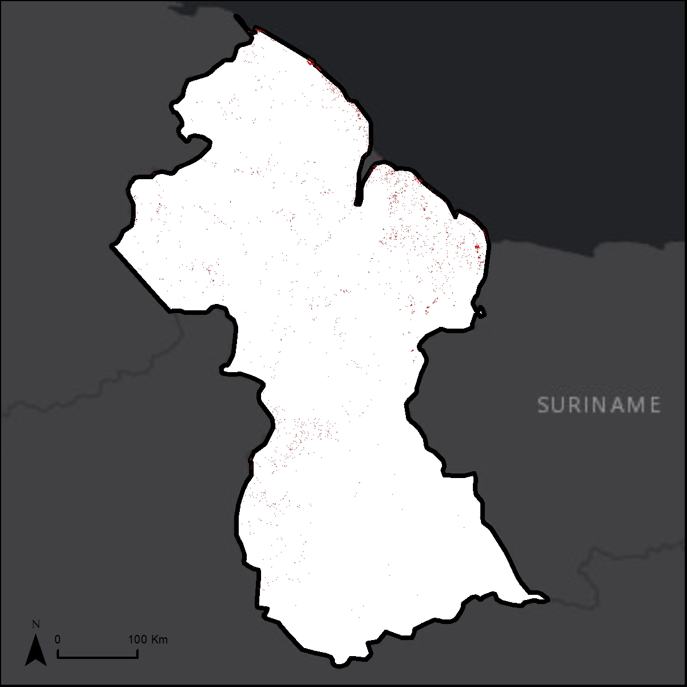

3. Results: Global & Regional Remote Sensing data - Guyana
MODIS
2001-2016
JAXA
2007-2017
GFW
2001-2020
MapBiomas
2000-2020
Land Cover Dataset | Average Change in Forest Area (ha./year) | AGB Dataset | AGB Carbon Stock (tons CO2/ha.) | Emissions = Area x AGB (per year)
MCD12Q1 | 21,924.83 | Saatchi 2011 | 182.83 | 4,008,516.67
MCD12Q1 | 21,924.83 | Avitable 2015 | 220.66 | 4,837,932.99
JAXA F/NF | 37,705.40 | GeoCarbon 2020 | 179.60 | 6,771,889.84
JAXA F/NF | 37,705.40 | Saatchi 2011 | 134.08 | 5,055,540.03
GFW | 11,631.58 | Saatchi 2011 | 227.54 | 2,646,649.47
GFW | 11,631.58 | Avitable 2015 | 298.66 | 3,473,887.37
MapBiomas | 15,334.04 | GeoCarbon 2020 | 225.48 | 3,457,519.98
MapBiomas | 15,334.04 | Avitable 2015 | 193.55 | 2,967,904.00
Up to a
87.60% difference
global
regional

Slide 11
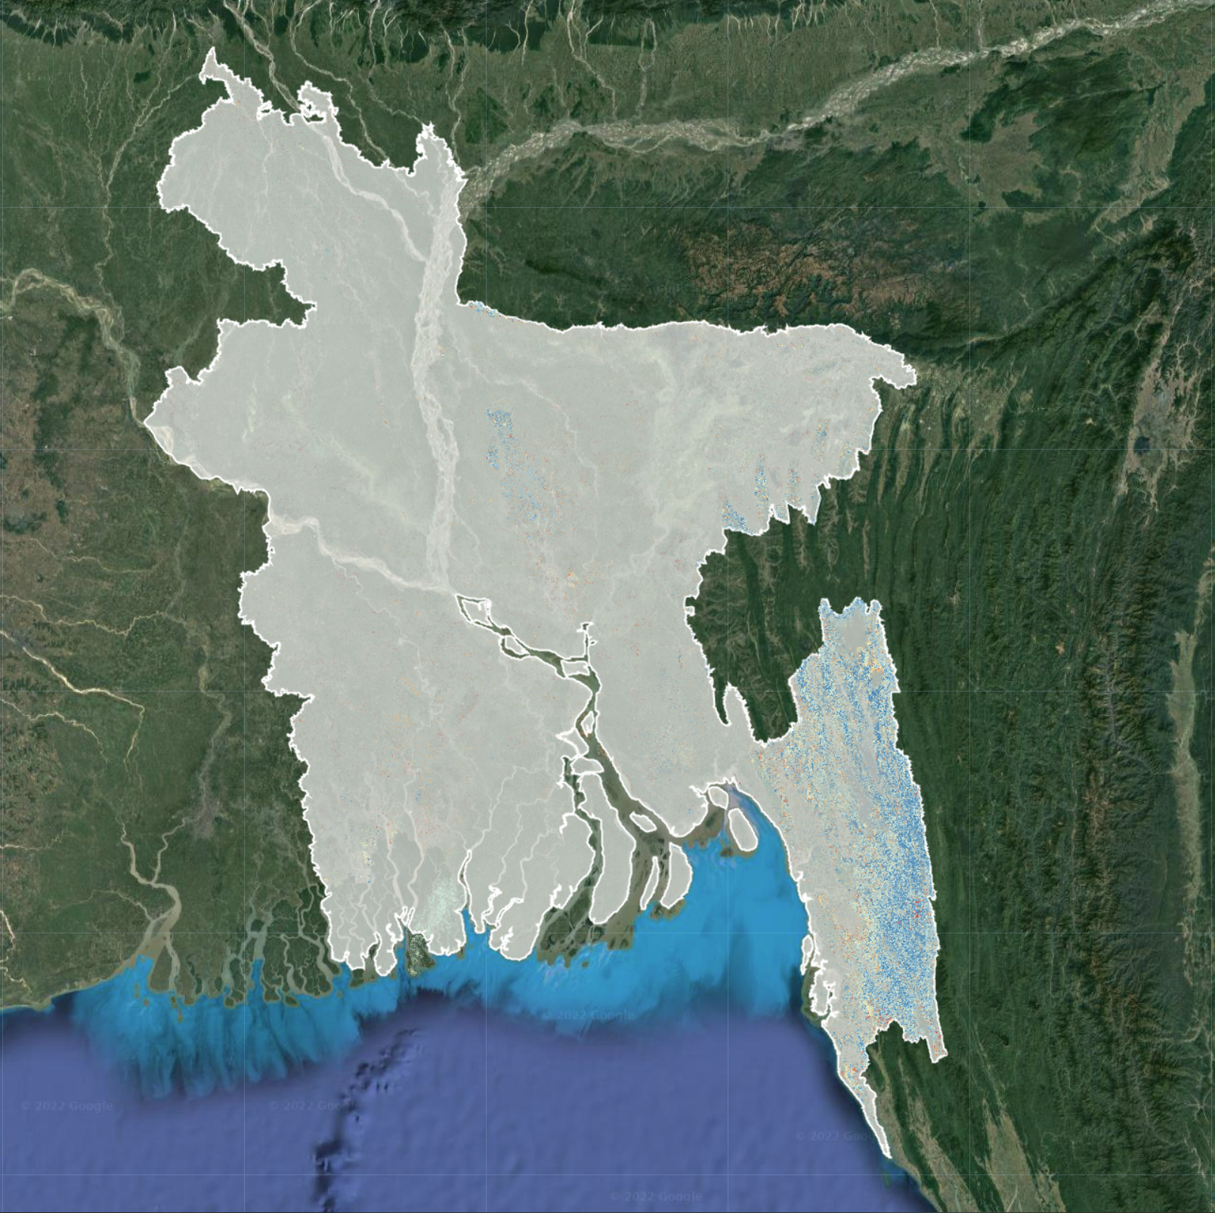
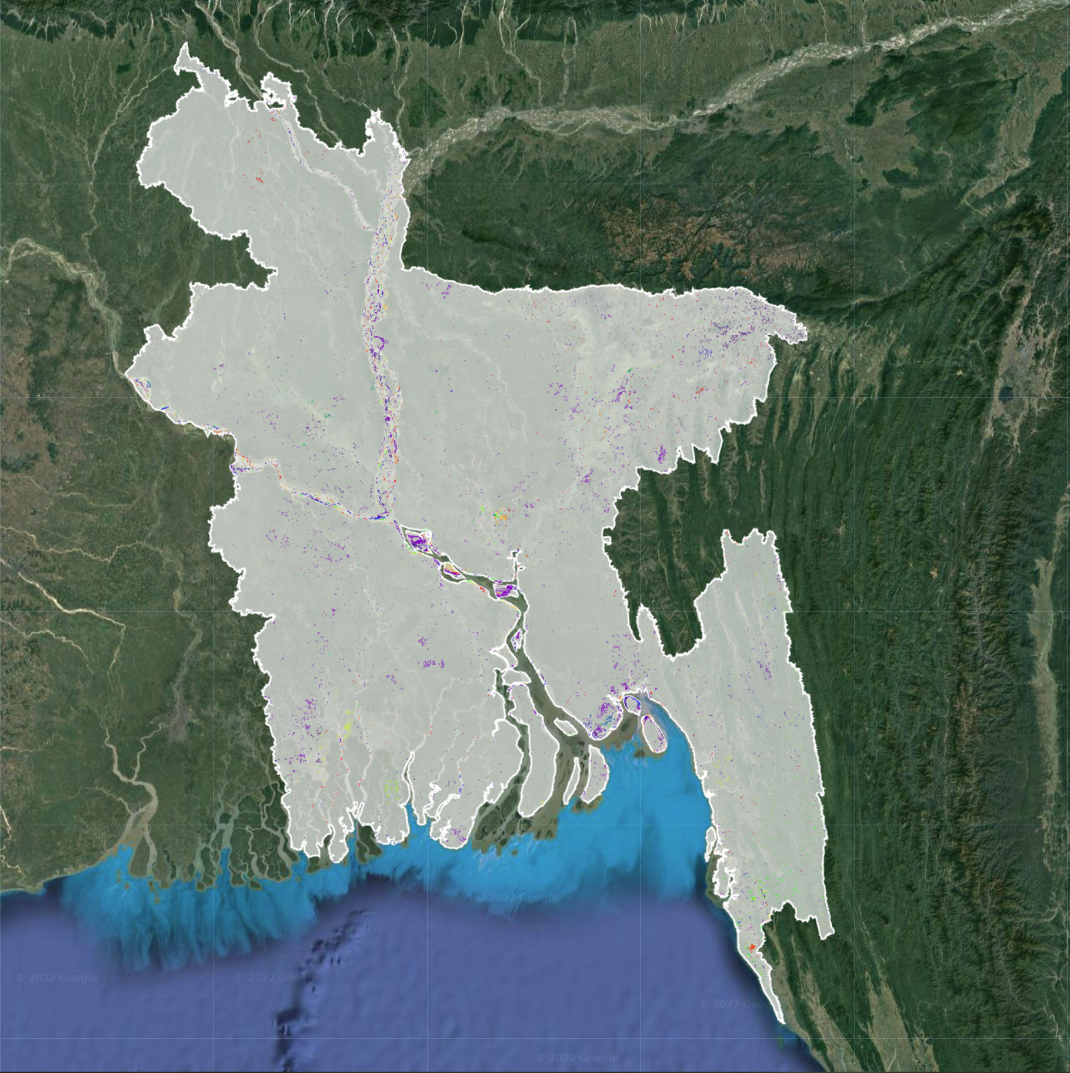
3. Results: Global LCC Intercomparison Project Algorithms - Bangladesh
Continuous Change Detection and Classification - Spectral Mixture Analysis (CCDC-SMA) algorithm
2000-2019
https://t.co/M3pVPLQPE1
LandTrendr spectral-temporal
segmentation algorithm.
1990-2020
https://code.earthengine.google.com/?accept_repo=users/emaprlab/public
Parameters
Threshold: 4450
Number of consec: 5
Start year: 2000
End year: 2019
Start day: 1
End day : 365
Forest mask: Hansen GFW - “treecover2000”
Deforestation mask: RLCMS 2019 non forest cover
Parameters
Collection:
startYear = 1990
endYear = 2020
startDay = 01-01
endDay = 12-31
Landtrendr:
maxSegments: 6
spikeThreshold: 0.9
vertexCountOvershoot: 3
preventOneYearRecovery: true
recoveryThreshold: 0.25
pvalThreshold: 0.05
bestModelProportion: 0.75
minObservationsNeeded: 6
Change:
delta: loss
sort: greatest
year: start: 1990 end: 2020
mag: 100
dur: 4
preval: 300
mmu: 8
Change Algorithm | Change in area (ha/yr) | AGB dataset | Carbon stock | Emissions (tons CO₂e)
CCDC-SMA | 60,767.18 | Saatchi et al 2011 | 146.48 | 3,540,660.43
CCDC-SMA | 60,767.18 | Avitable 2015 | 45.48 | 8,901,176.32
CCDC-SMA | 60,767.18 | GeoCarbon 2020 | 117.73 | 2,763,691.28
LandTrendr | 8,033.19 | Saatchi et al 2011 | 130.91 | 1,051,624.47
LandTrendr | 8,033.19 | Avitable 2015 | 81.54 | 655,026.04
LandTrendr | 8,033.19 | GeoCarbon 2020 | 135.13 | 1,085,524.51

Slide 12
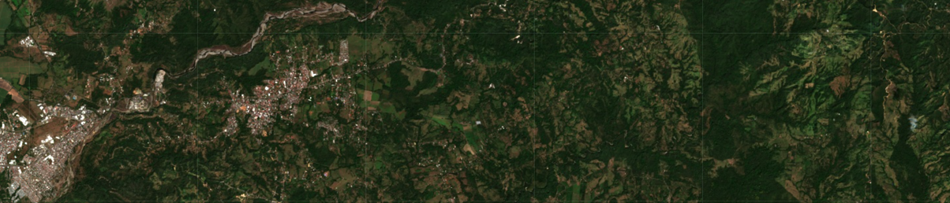
4. Implications: Policy Relevance
Improved understanding of carbon dynamics (nationally, regionally)
USG support for climate change mitigation activities
USAID’s Global Climate Change program’s Sustainable Landscapes goal is “to assist countries to reduce greenhouse gas emissions from deforestation and land degradation and to enhance sequestration of carbon associated with sound land use and management”
SDG Target 15.2: “By 2020, promote the implementation of sustainable management of all types of forests, halt deforestation, restore degraded forests and substantially increase afforestation and reforestation globally”
Glasgow Leaders’ Declaration (COP26) goal of global net zero deforestation by 2030: “conserve forests and other terrestrial ecosystems and accelerate their restoration”
Image source: Sentinel-2
Notes:
edit last bullet

Slide 13
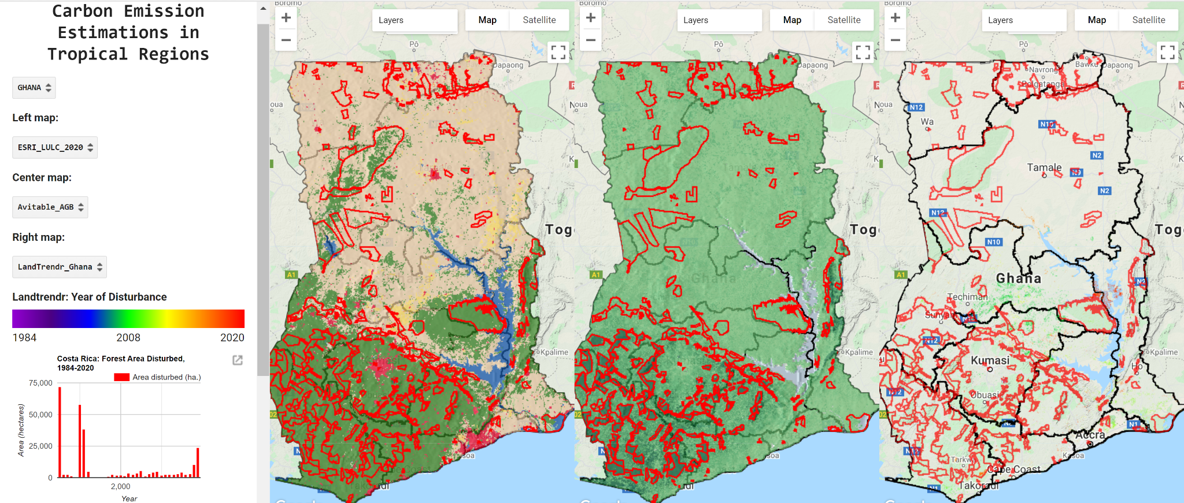
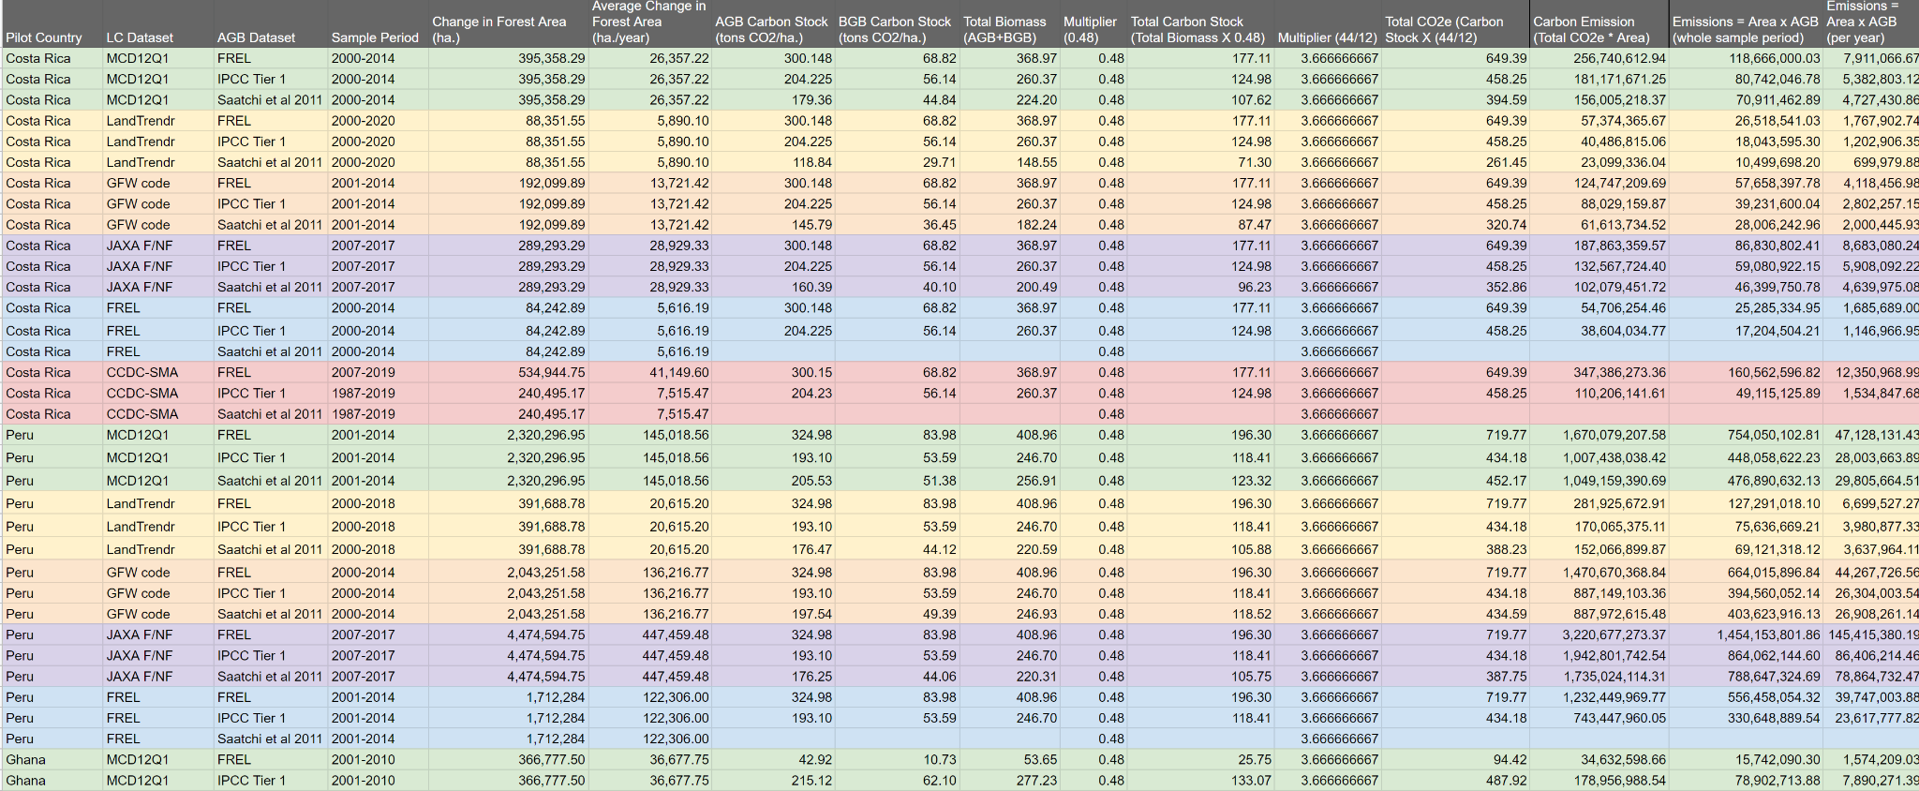
5. Future activities: FY2022-FY2023
Google Earth Engine App & Estimation Ensemble
Technical Assessment Group
Evaluation of integration of outputs into existing hub services
  (e.g., Guyana: mangrove monitoring service, RAMI, RLCMS)
Capacity development activities with SERVIR hubs
Development of training materials for GHG estimation using SERVIR land cover products
Collaboration with NASA DEVELOP
Prototyping of S-CAP platform for integration of external LC, AGB data -> BYOD
Scientific publications

Slide 14
6. Summary: SERVIR-CArbon Pilot (S-CAP)
Why?
CC mitigation: Countries need to monitor + report on CO₂ / GHG emissions
Simple transition from LC data to GHG emission estimation
Support Hubs’ integration in REDD+ reporting processes*
Quantifying uncertainty
Who?
SERVIR global network: SCO, Hubs, AST, TAG
  1 pilot country per SERVIR region
Linkages w/ SilvaCarbon
How?
Analysis of existing data, incl. LC outputs from Hub services
Analysis of data from IPCC’s Emission Factor Database
Application of methodologies consistent w/ IPCC’s Good Practice Guidance (2019 refinement)
What?
Capacity building activities w/ Hubs
GHG estimates for pilot countries
Hub integration of GHG emission estimates into their LC services -> e.g.
“In the Mekong, 100,000 ha. of forest were lost in 2021, and the associated emission was 52,800,000 tons of CO₂.”
Prototype platform (SERVIR only)

Slide 15






Thank you
cae0004@uah.edu | eac0021@uah.edu

