Slide 1
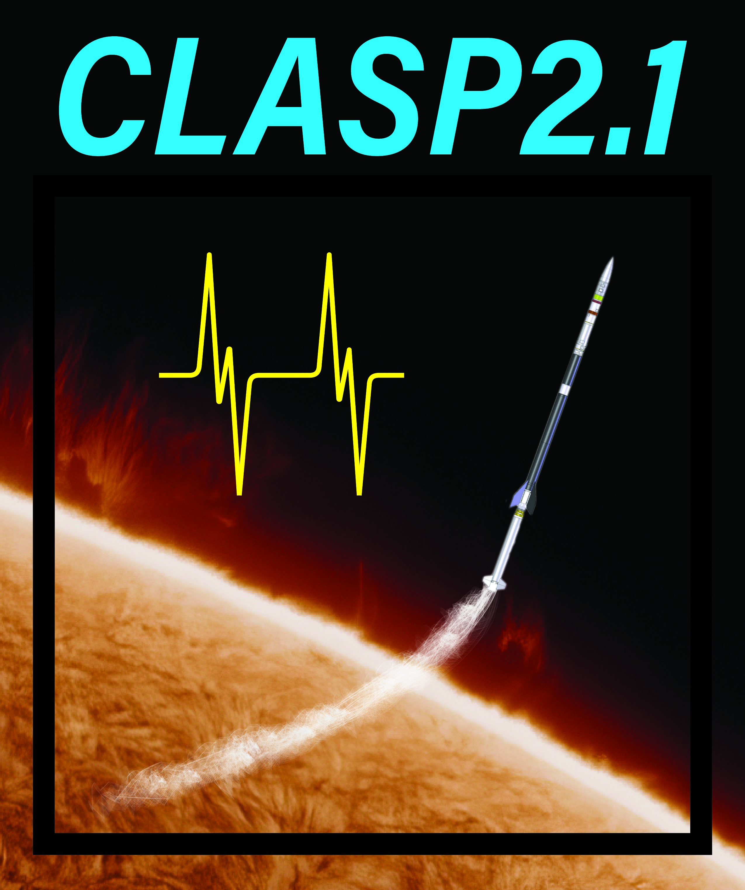
Ultraviolet Mapping of Polarization Profiles in
Chromospheric Plage with CLASP2.1
David E. McKenzie¹, Ryohko Ishikawa², Javier Trujillo Bueno³, Frederic Auchere⁴, Ken Kobayashi¹, Amy Winebarger¹, Ryouhei Kano², Donguk Song^{2,5}, Takenori Joten Okamoto², Laurel Rachmeler⁶, Bart De Pontieu⁷, Genevieve Vigil¹, Adam Kobelski¹, Luca Belluzzi⁸, Ernest Alsina Ballester³, Tanausú del Pino Aleman³, Christian Bethge⁹, Taro Sakao¹⁰, Jiri Stepan¹¹
¹NASA MSFC; ²NAOJ; ³IAC; ⁴IAS; ⁵KASI; ⁶NOAA; ⁷LMSAL; ⁸IRSOL; ⁹CU-Boulder; ¹⁰ISAS/JAXA; ¹¹Academy of Sciences of the Czech Republic

Slide 2
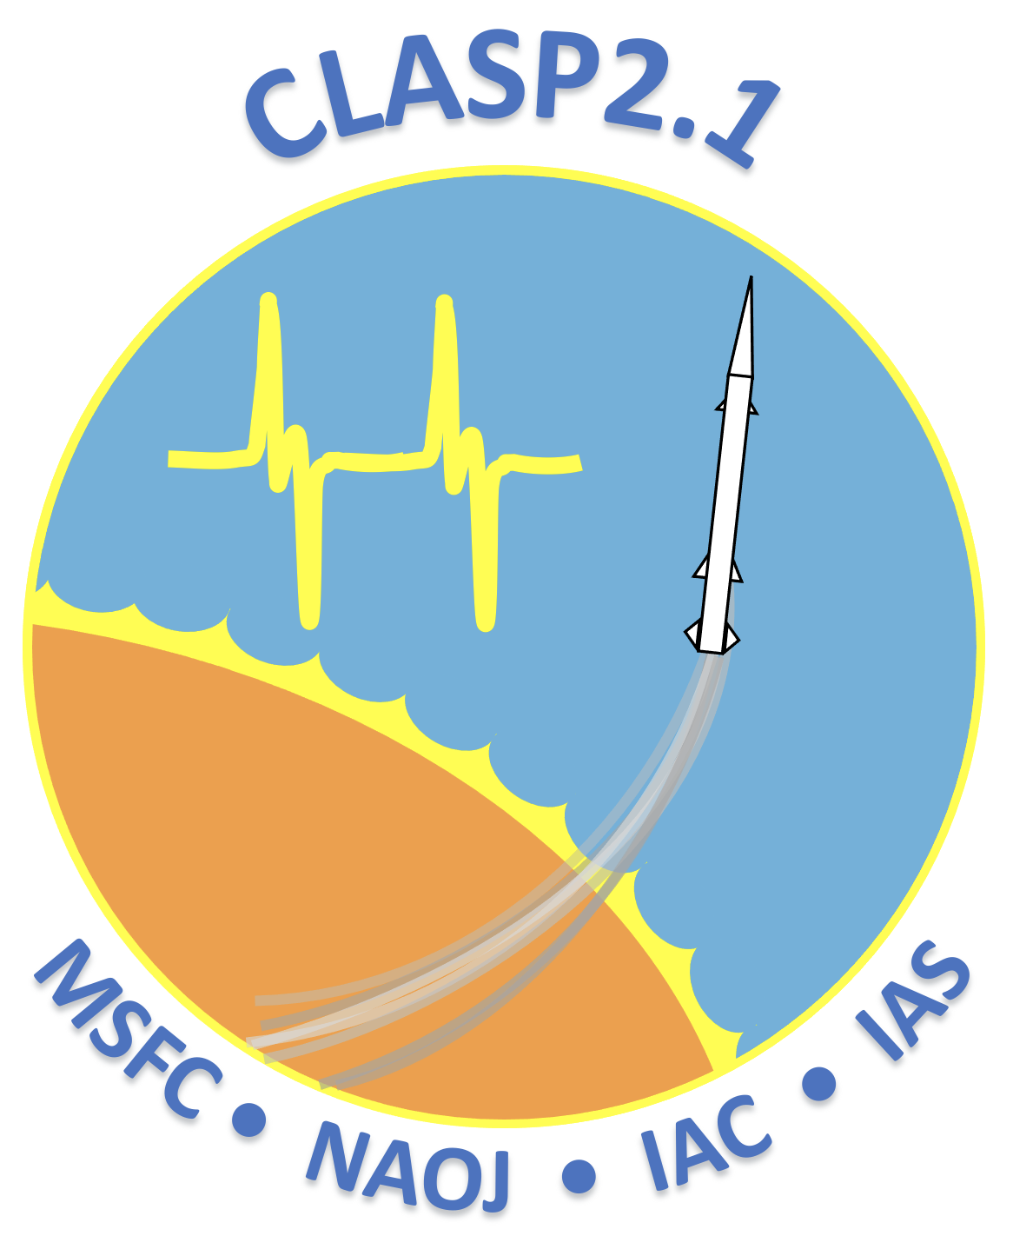
CLASP2.1 Team
David McKenzie (NASA/MSFC), PI
Ryohko Ishikawa (NAOJ), Co-PI
Javier Trujillo Bueno (IAC), Co-PI
Frédéric Auchère (IAS), Co-PI
Ken Kobayashi (NASA/MSFC), DepPI
Takenori Okamoto (NAOJ), PS
Donguk Song (KASI), IS
Anthony Guillory (NASA/MSFC), PM
Libby Creel (NASA/MSFC), PM
Howard SooHoo (NASA/MSFC), CE
Ryouhei Kano (NAOJ)
Amy Winebarger (NASA/MSFC)
Genevieve Vigil (NASA/MSFC)
Brent Beabout (NASA/MSFC)
Dyana Beabout (NASA/MSFC)
Andy Young (NASA/MSFC)
Harlan Haight (NASA/MSFC)
William Hogue (NASA/MSFC)
Adam Kobelski (NASA/MSFC)
Laurel Rachmeler (NOAA)
Christian Bethge (U.Colo.)
Bart De Pontieu (LMSAL)
Taro Sakao (JAXA)
Luca Belluzzi (IRSOL)
Jirí Štêpán (ASCR)
Tanausú del Pino Alemán (IAC)
Ernest Alsina Ballester (IAC)
Notes:
This team list illustrates a few things: First, we have a great collaboration spanning multiple institutions.
Also, the CLASP missions are thoroughly international, spanning 7 countries, with each partner bringing something critical for the success of the mission.
And, we have not one PI, but 4 CO-PIs, emphasizing that we can’t do this without the contributions of each other.

Slide 3
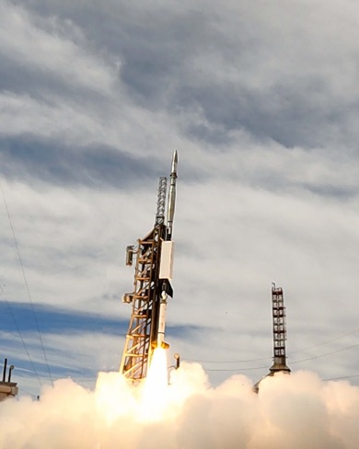
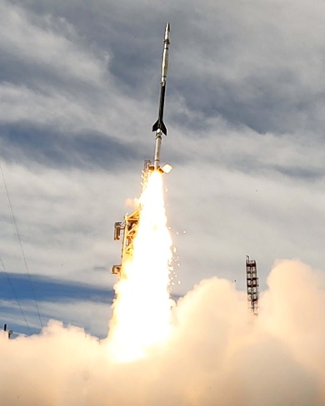

CLASP2.1 Launch: 08 October 2021
Image credits: WSMR Photo

Slide 4
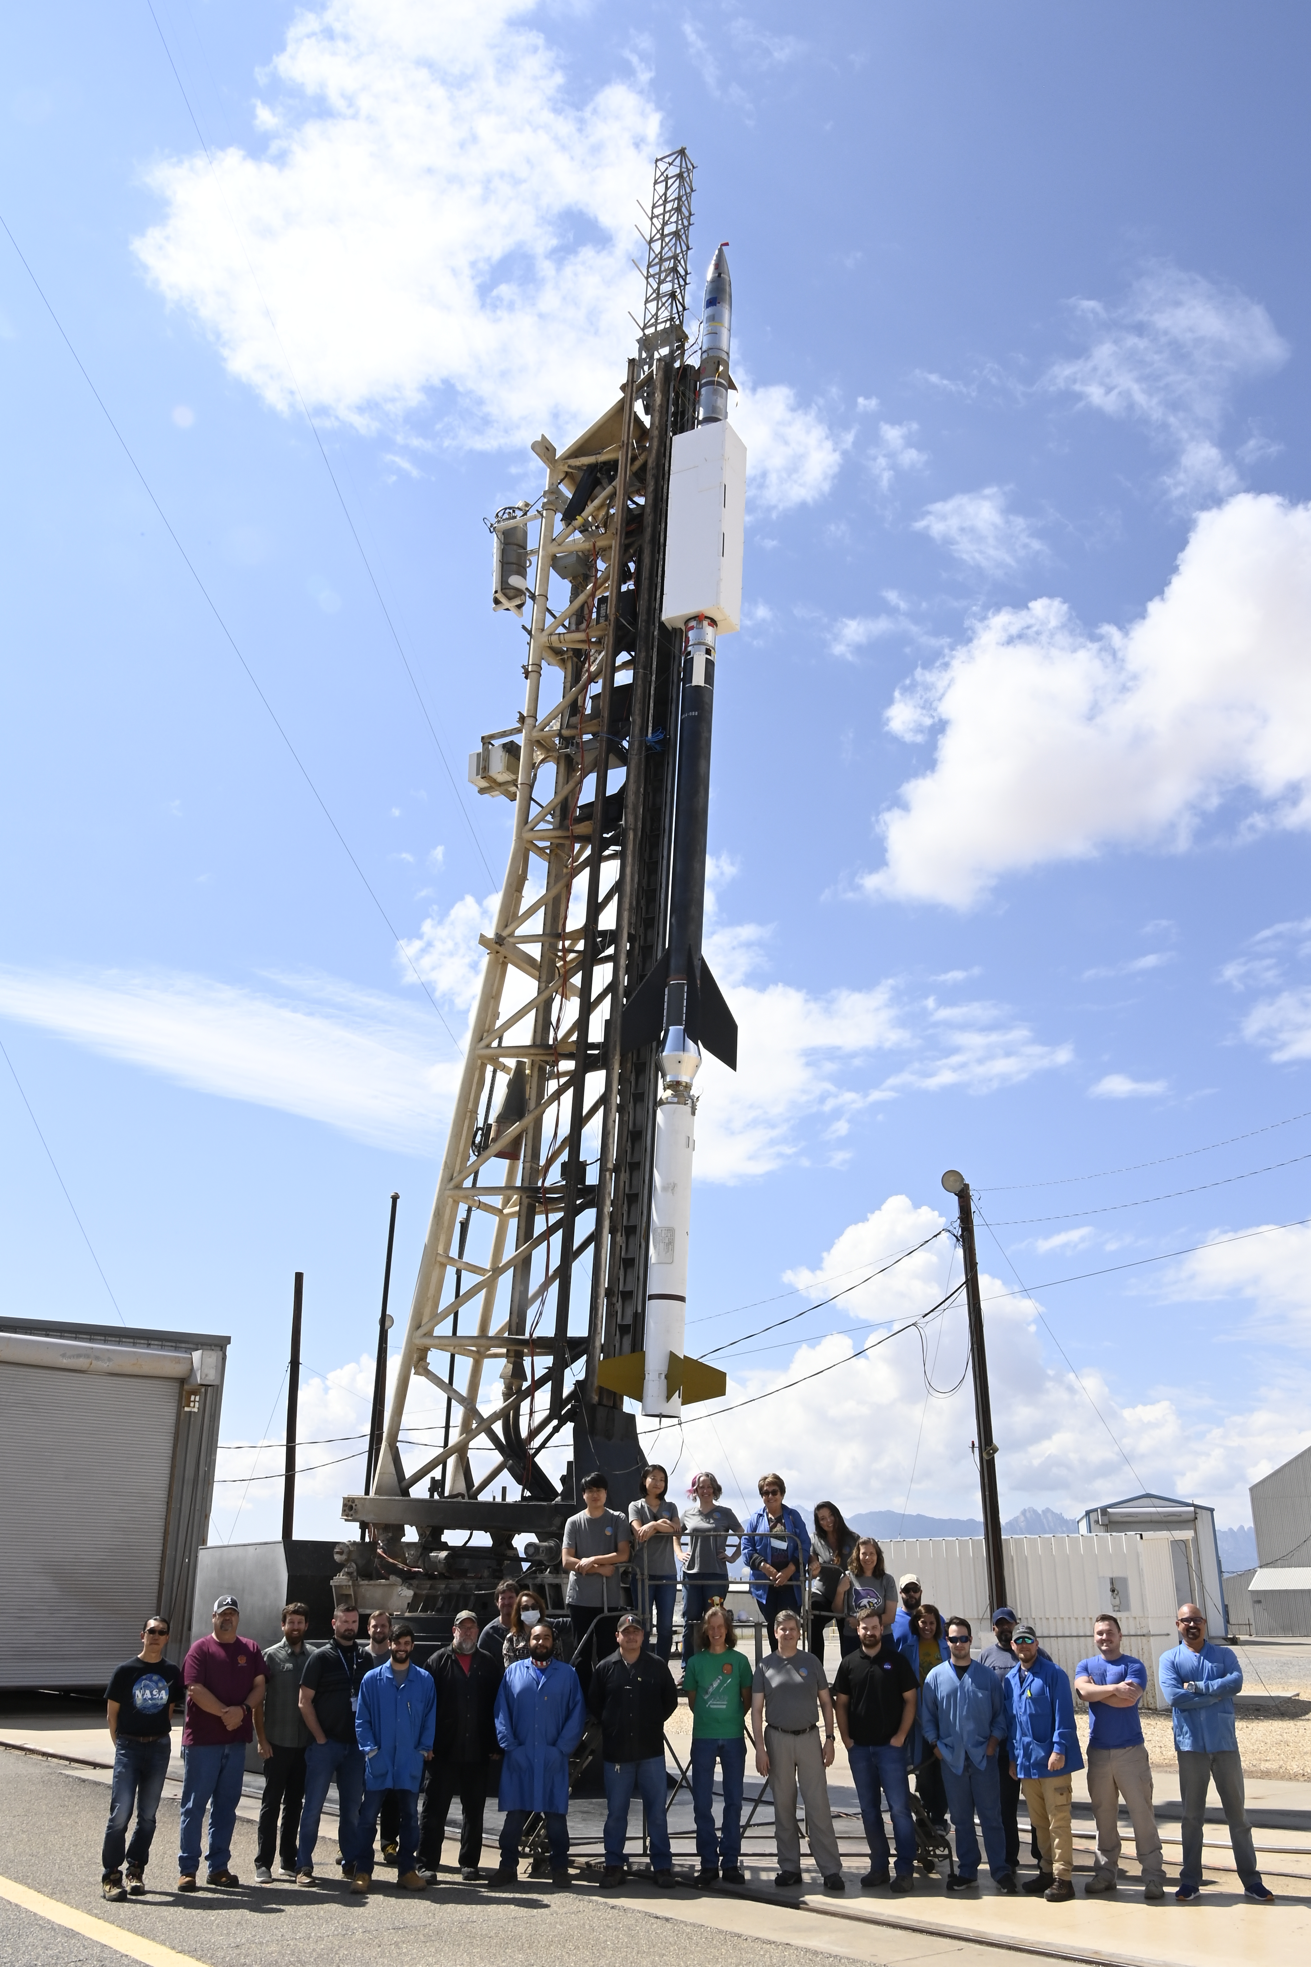
CLASP2.1 Vital Statistics
“JUST OFF THE PAD” [excerpted]
DATE LAUNCHED Oct 8, 2021
TIME: 11:40:00.5 MT
TYPE OF ROCKET: Terrier Mk70 - Black Brant Mk 4
FLIGHT NO: 36.374
LAUNCH SITE: White Sands Missile Range, NM
ALTITUDE PREDICTED: 267.4 km
ACTUAL ALTITUDE: 272.4 km
PAYLOAD WEIGHT: 1251 lbs.
ACS SYSTEM: SPARCS VII
RECOVERY SYSTEM: 1250# NFORSe
EXPERIMENT: The experiment reports good and promising data. Initial pointing was right on target and allowed for 15 manual repointings at our active region target (8 required for Comprehensive Success). Target may have been slightly dimmer than expected but will need confirmed with post-flight processing, not a large concern at this point.
Image credits: WSMR Photo
Notes:
Proposal submitted 10/7/2020 – Launched on 10/8/2021 → 366 Days!! Thanks to this great team.
Despite COVID, international travel restrictions, quarantine rules
You might recall we had a launch slip of three days: Every detail matters! Fuller explanation available on request.
(The full “Just off the Pad” notification includes remarks about the 10-minute delay, and contact info for MM and MOM. Email from Sarah Ross, 10/08/2021.)

Slide 5
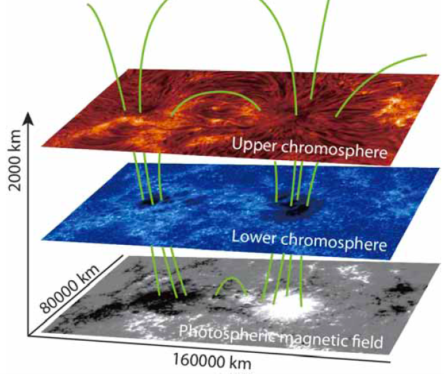
Goal of the CLASP missions
The CLASP missions have one primary objective: enable mapping of the magnetic field in the Sun’s chromosphere.
Magnetic field is the source and storage medium of energy for solar flares, mass ejections, and space weather. Magnetism is everything.
The chromosphere is a key layer of the Sun’s atmosphere, and yet we do not have measurements of the magnetic field there – we only measure the magnetism in the photosphere, the “surface” of the Sun, and it’s not sufficient.
CLASP, CLASP2, and now CLASP2.1 have developed and demonstrated a technique for making these measurements, as pathfinders for a future satellite chromospheric observatory.

Slide 6
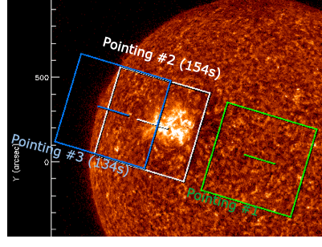
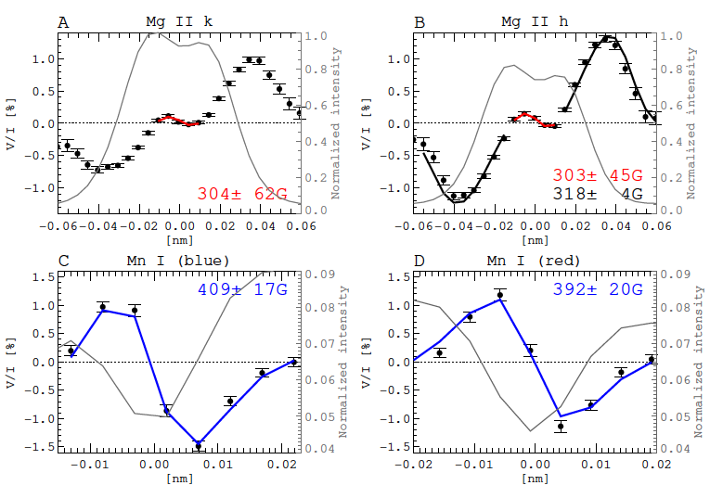
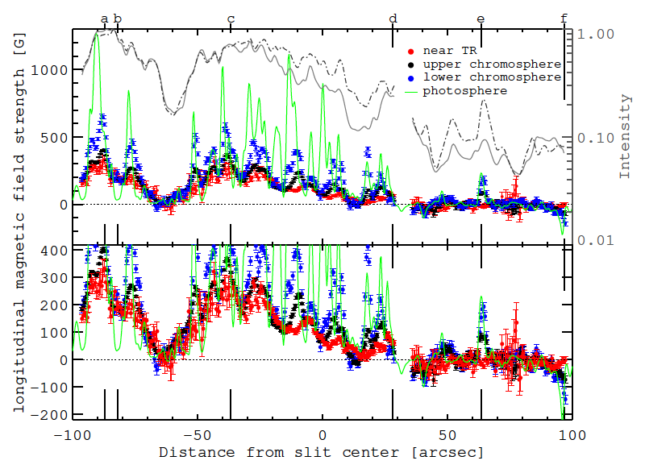
CLASP2 to CLASP2.1
What CLASP2 did:
Adapted from Ishikawa et al. (2021) Science Advances, vol.7, issue 8, pg. eabe8406
Circular Stokes polarization from CLASP2 (36.332 McKenzie)
First of its kind!
The result is a 1-dimensional magnetogram, a measure of magnetic field strength along a narrow track on the Sun.
Notes:
Minimum required times:
d.c., 13s
plage, 63s
QS, 33s

Slide 7
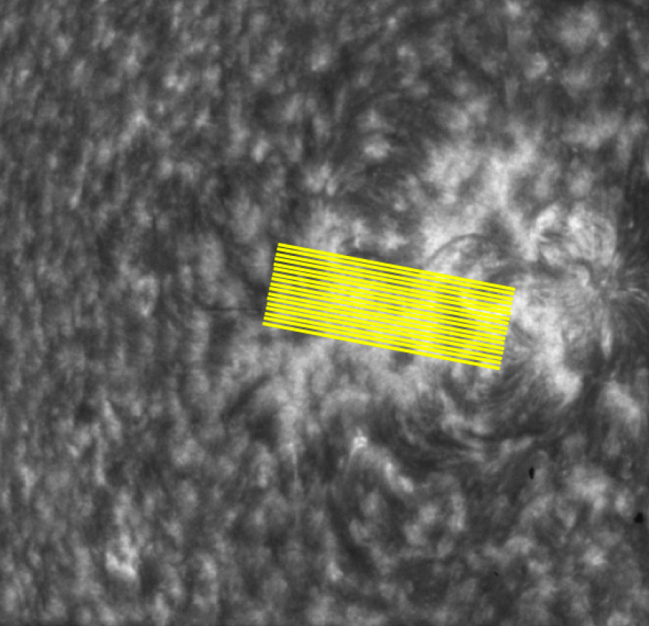
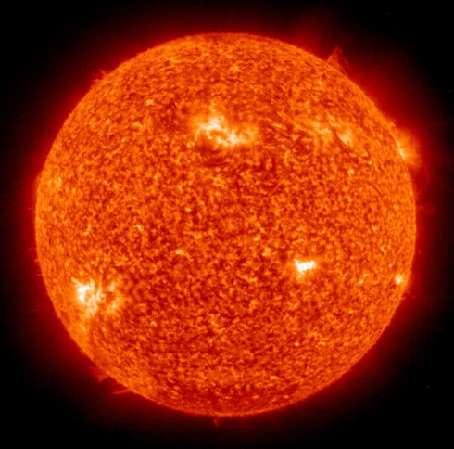
CLASP2 to CLASP2.1
CLASP2.1 objective: Expand the 1-D “magnetogram” of CLASP2 over a 2-D area.
Solution: Scan the spectrograph slit over the target.
For adequate signal/noise, we require at least 16 seconds “dwell” at each slit location
To make a useful/compelling data product, we require at least 8 pointings, approximately 2 arcsec apart
CLASP2
CLASP2.1 concept
Notes:
Emph: We started with an idea, which worked. Then the NSROC tech thought of a way to make it BETTER. That worked too!
We required at least 8 pointings, figured we should get 12+. We actually got 16. ☺

Slide 8
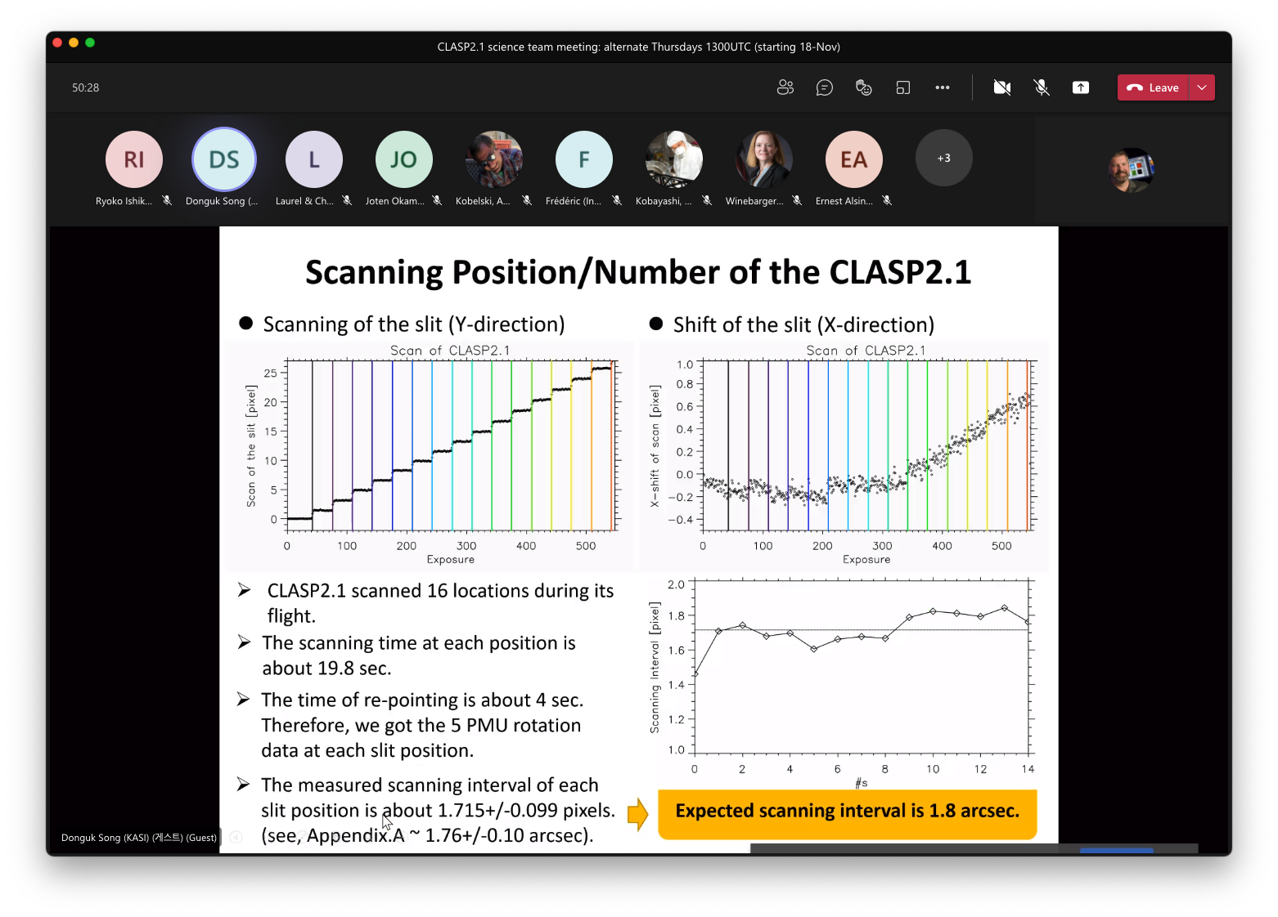
CLASP2.1 Preliminary results
Both the slitjaw (SJ) and spectro-polarimeter (SP) systems performed nominally.
The pointing plan worked just like we’d hoped. We required at least 8 pointings, we actually got 16!
Stability and resolution are consistent with the 2019 flight, and met expectations.
The target region produced a flare and Earth-directed CME immediately after our observations, so we likely captured the magnetic field during the buildup.

Slide 9
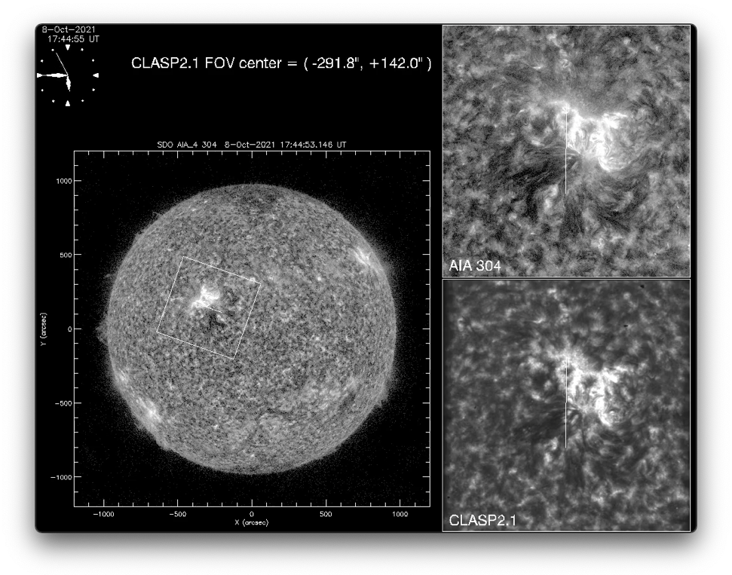
CLASP2.1 Preliminary results

Slide 10
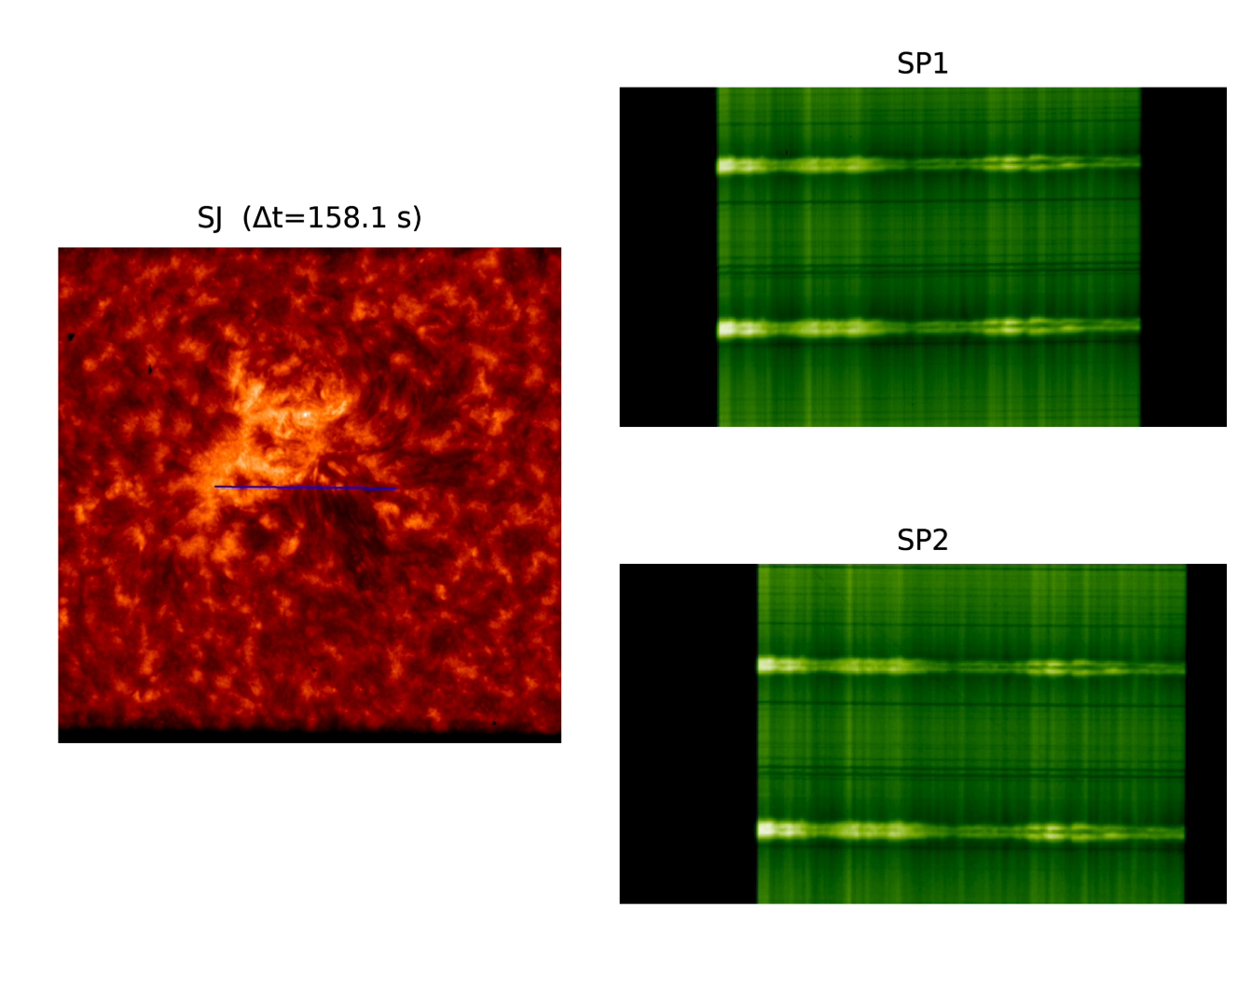
CLASP2.1 Preliminary results
Direction of slit scan
Raw data from CLASP2.1

Slide 11
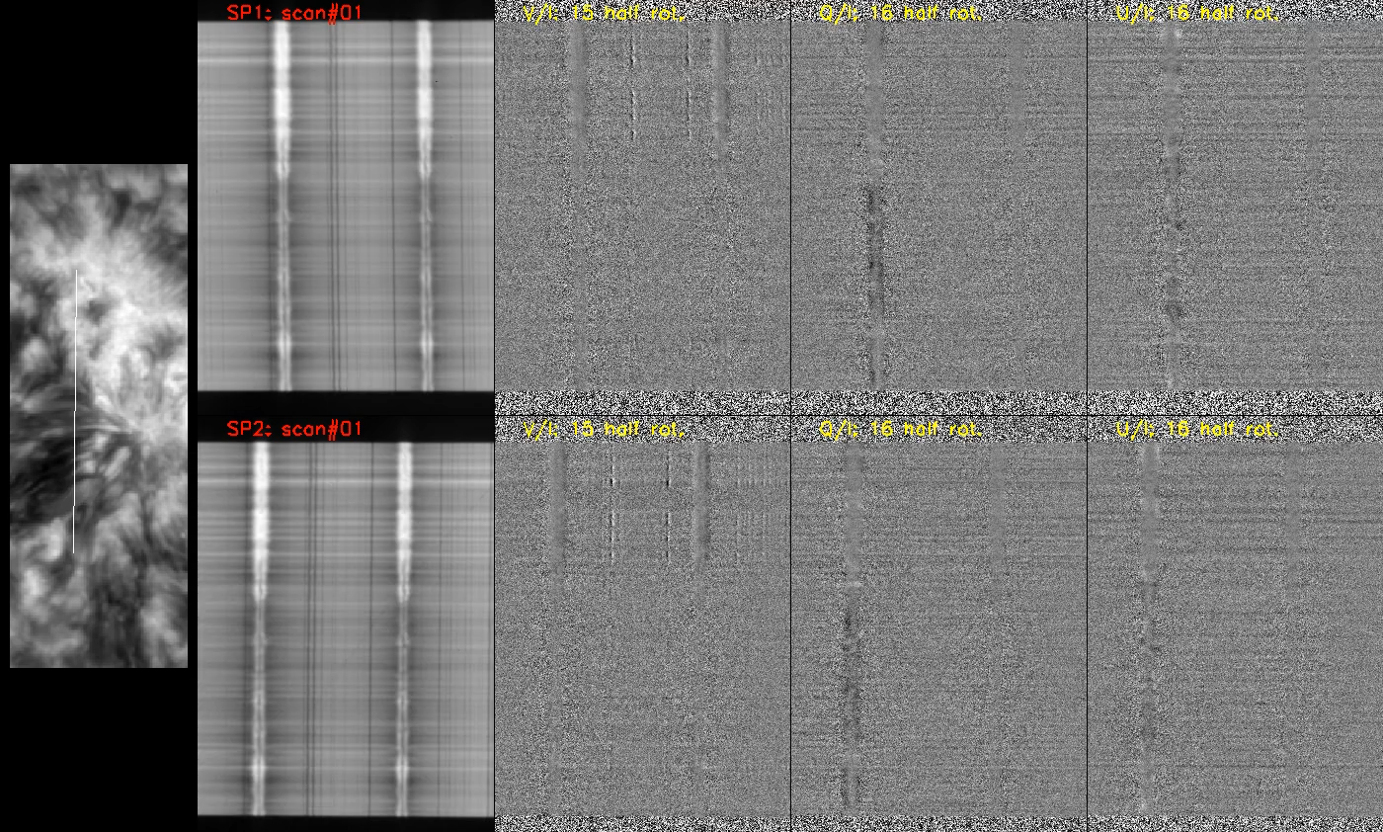
CLASP2.1 Preliminary results
Direction of slit scan
Demodulated I, V, Q, U from CLASP2.1

Slide 12
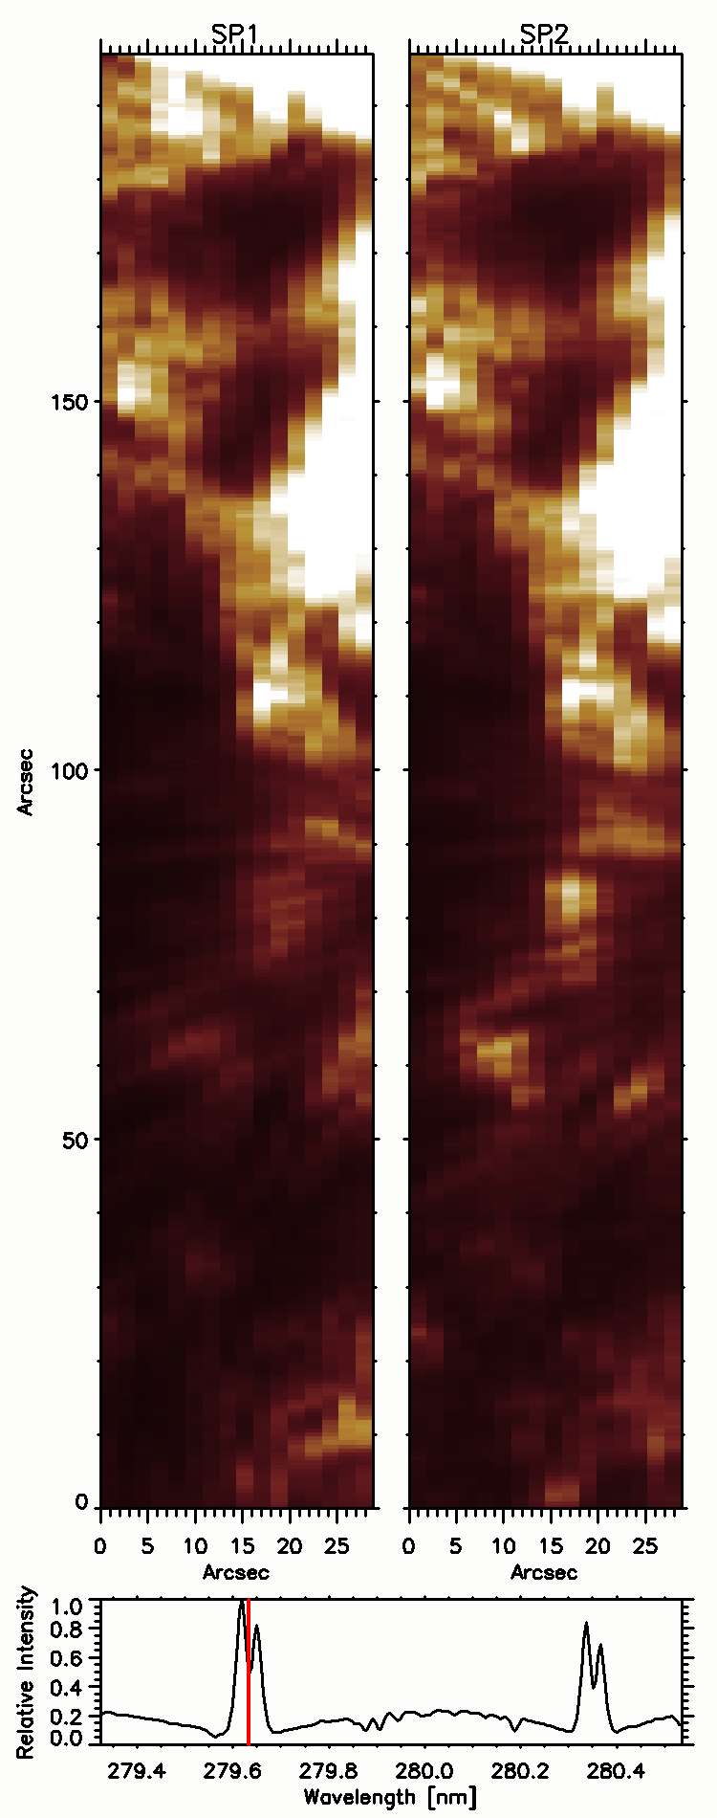
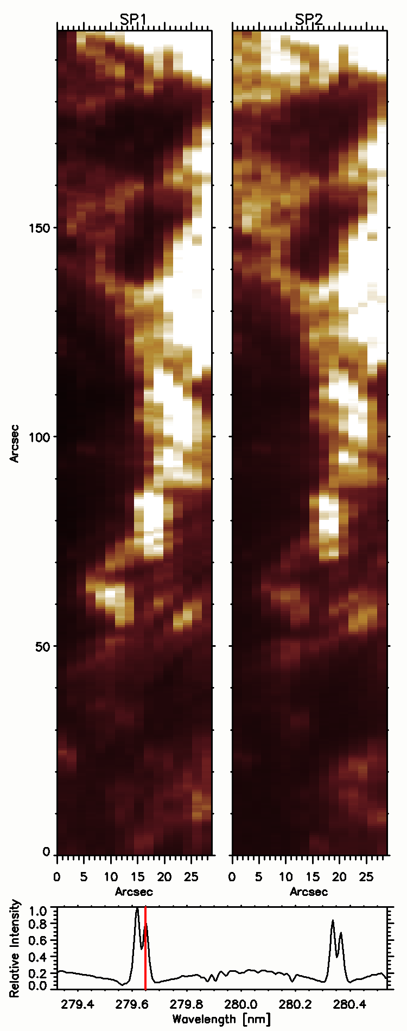
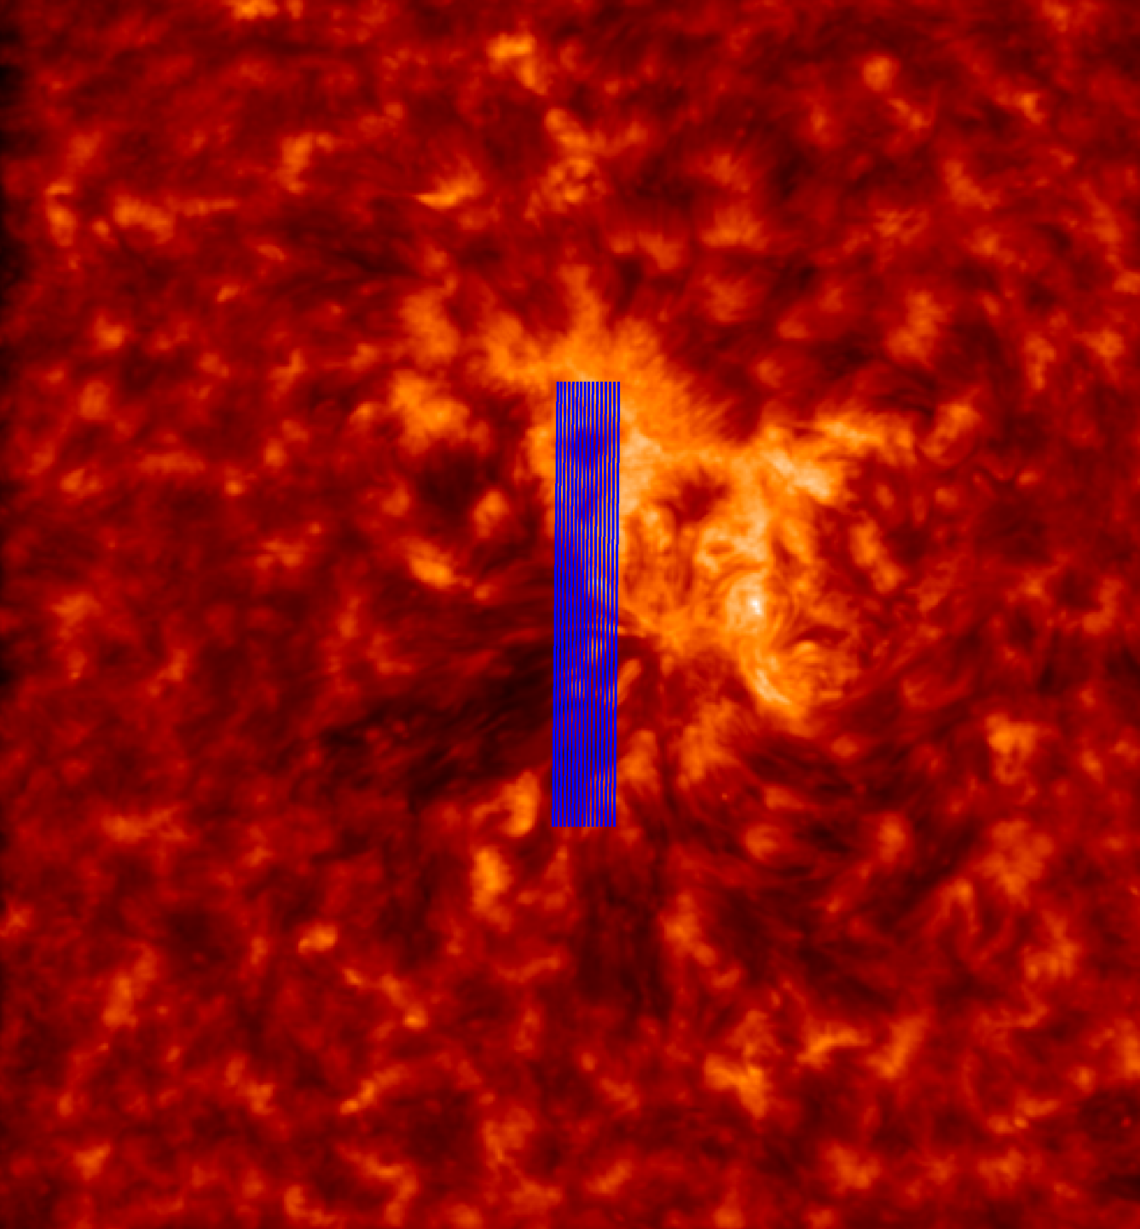
CLASP2.1 Preliminary results
Stacking the exposures from 16 positions, side by side, creates a “raster image” of the target area.
With a full spectrum at each of the 16 positions, we can select any wavelength to produce a raster map for the same region, sampling a variety of heights.
Examples: Two different heights sampled by portions of the Mg II k line (K2R and K3).
The polarization results, and the magnetic field strengths, will be shown in the same way. This will be the first-ever UV magnetogram of the chromosphere.

