Slide 1
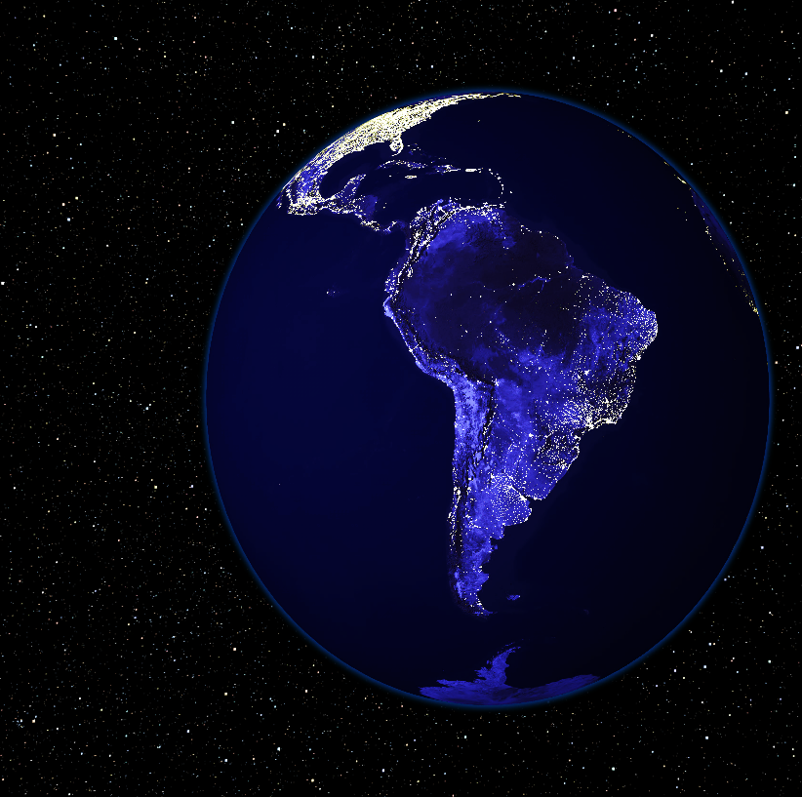

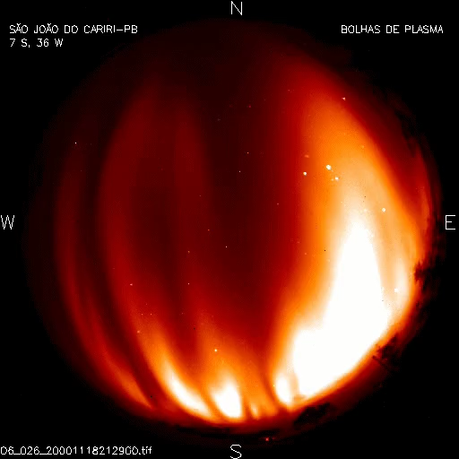

SCIENCE CONOPS FOR APPLICATION OF SPORT MISSION DATA TO STUDY LARGE (~1000KM) IONOSPHERIC PLASMA DEPLETIONS
Linda Habash Krause, Shelia Nash-Stevenson, Stephen Clanton
NASA Marshall Space Flight Center
Rebecca L. Bishop
The Aerospace Corporation
Charles M. Swenson
Utah State University
Joaquim E. R. Costa, Marcelo Banik de Pádua
Instituto Nacional de Pesquisas Espaciais (INPE)
Marco A. Ridenti, Luis Loures, Lidia Shibuya, Jonas Sousa Santos‪
Instituto Tecnológico de Aeronáutica (ITA)
Guan Le, Todd Bonalsky
NASA Goddard Space Flight Center
Rod A. Heelis, Mark W Mankey
University of Texas, Dallas

Slide 2
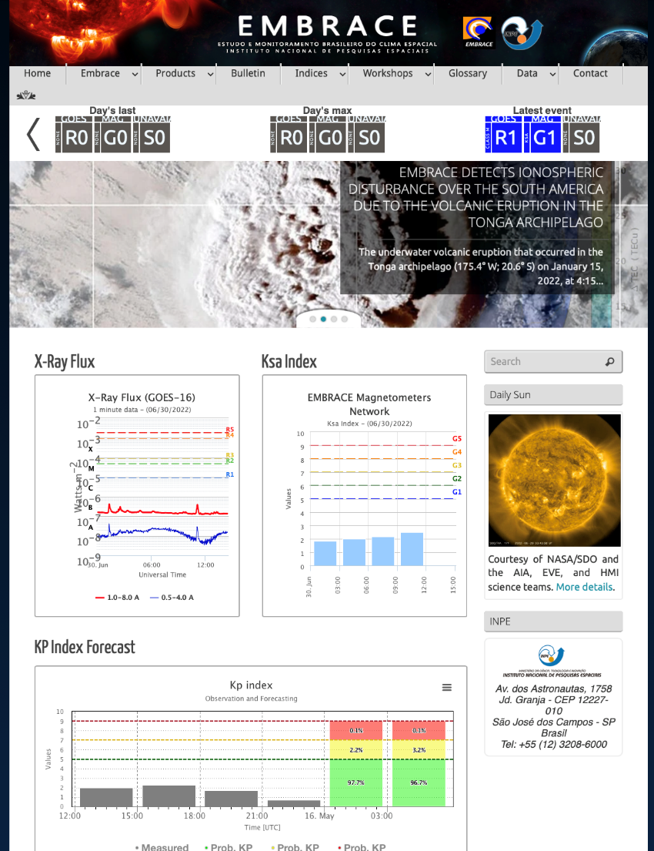
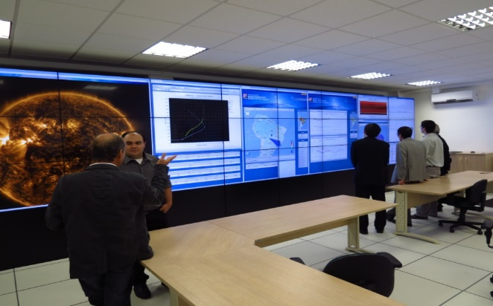
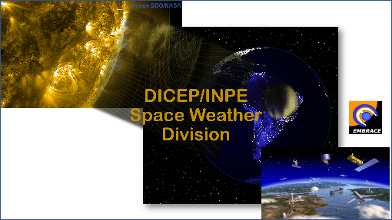
MOTIVATION: Enhance Space Weather Ops
Daily bulletins in [Portuguese and English]
Visitor Center
A portal for space weather monitoring
Data and Products
Free data access
http://www2.inpe.br/climaespacial/portal/en/

Slide 3
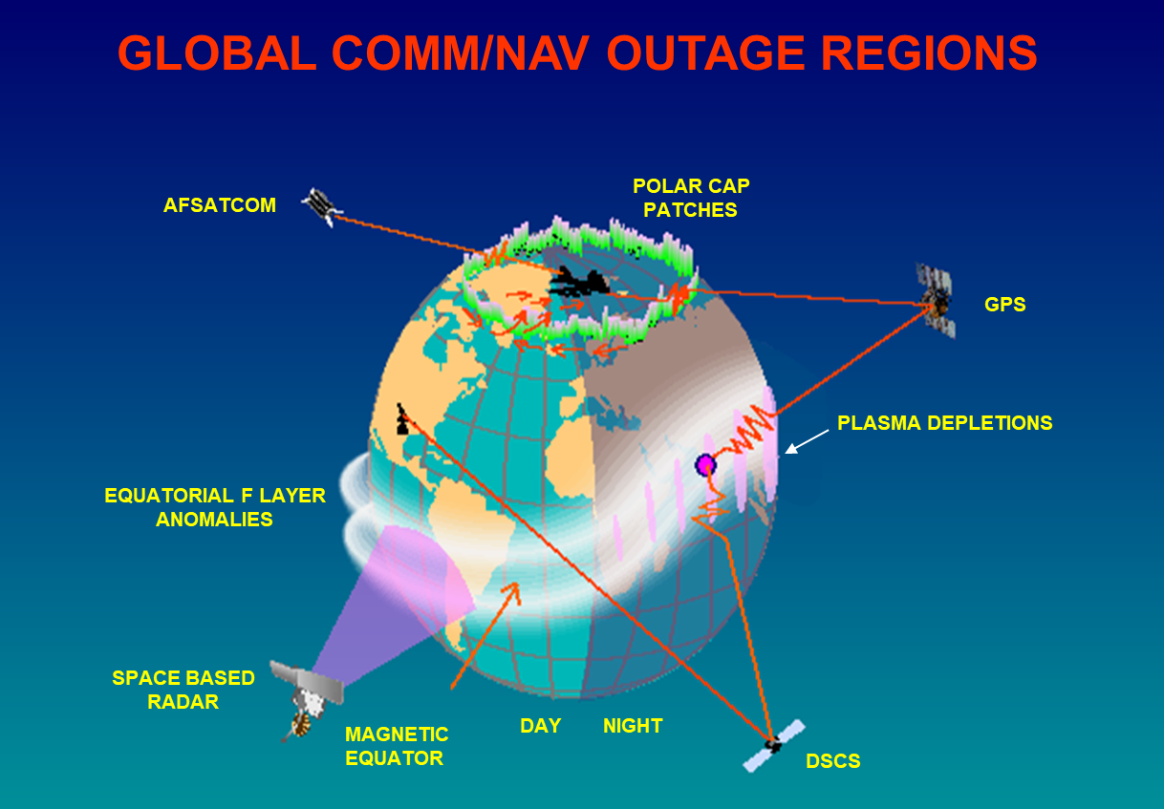
MOTIVATION: Enhance Ability to Predict Comm/Nav Outages
Space Weather storms create turbulent plasmas in our upper atmosphere
Plasma turbulence can lead to radio wave scrambling (AKA “Scintillation”)
GPS and other GNSS signals can experience outages, sometimes for hours

Slide 4
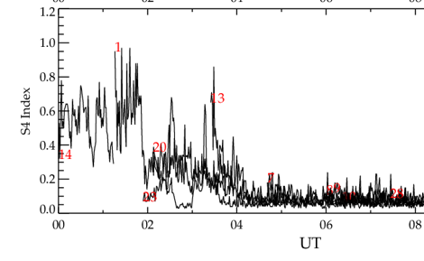

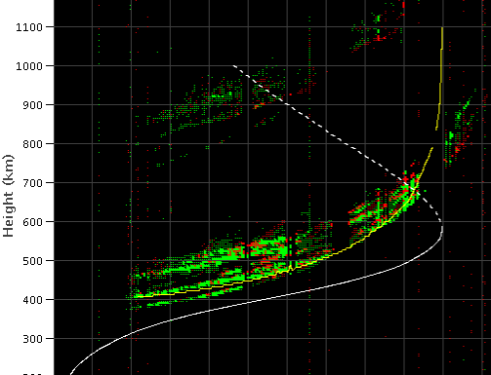
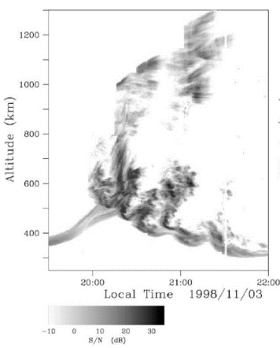
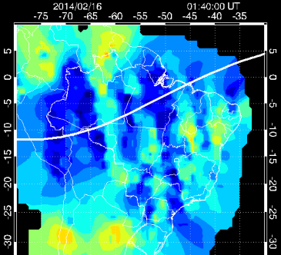
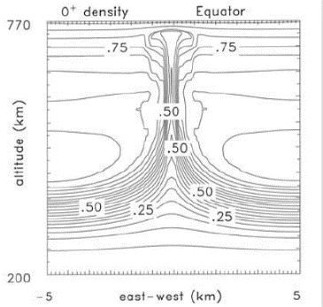

The Culprit: Equatorial Plasma Bubbles
Ionosonde
Airglow depletion
Spread F
GNSS Receiver
6300 airglow imager
Scintillation, S4
Equatorial Plasma Bubbles
VHF Radar
TEC Mapping
Plumes
Source:Workshop for EPB Campaign, 25-26 September 2019
Hisao Takahashi
Simulation model

Slide 5
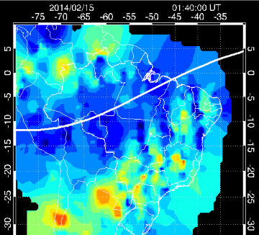
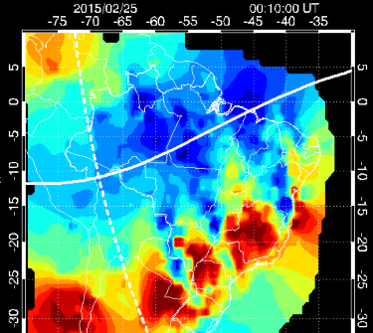
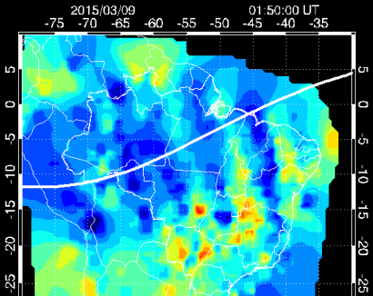
Background: Periodic Plasma Bubble structures
2014 Feb. 15, 01:40 UT
2014 Feb. 16, 01:40 UT
2015 Feb. 25, 00:10 UT
2015 March 9, 01:50 UT
Bubble scales: 1 - 1000 km
Periodic structures occur most frequently in February and March.
BUT this is for the Brazilian longitude sector. What about the others?

Slide 6
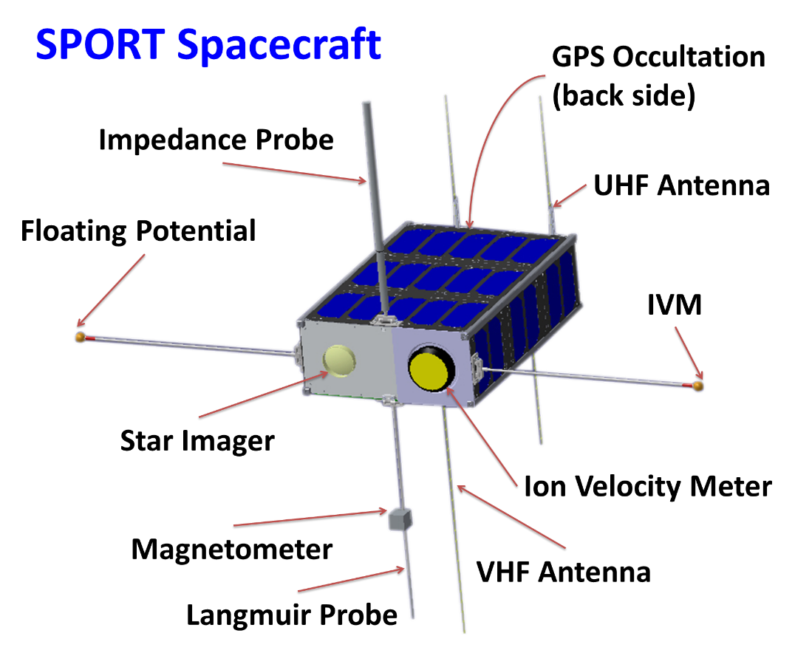
Scintillation Prediction Observatory Research Task (SPORT)
Science Goals
What is the state of the ionosphere that gives rise to the growth of plasma bubbles that extend into and above the F-peak at different longitudes?
How are plasma irregularities at satellite altitudes related to the radio scintillations observed passing through these regions?

Slide 7
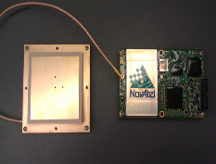
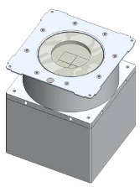
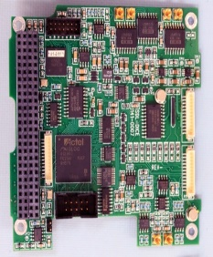
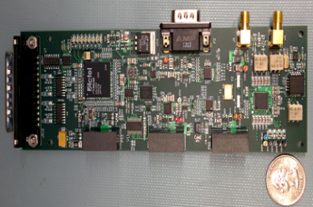
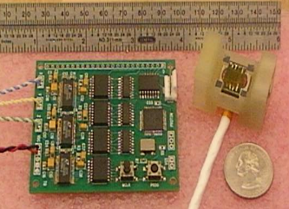
SPORT Instrument Measurement Mapping
Instruments
GPS Occultation
RPA/Drift meter
Langmuir
Impedance
E-Field
Magnetometer
Required Measurement
Density profiles
Scintillation Index (S4)
In situ plasma density
Plasma motion
Small scale structures / waves
Magnetic field structure
Plasma temperature
CTECS
I.V.M
Langmuir & Impedance Probes
Magnetometer

Slide 8
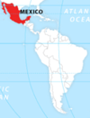
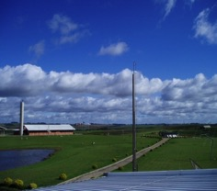
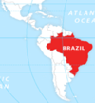

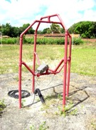
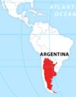
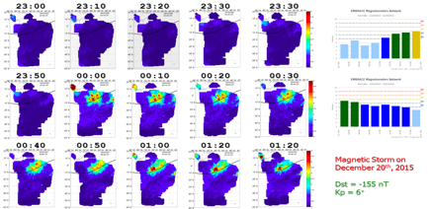
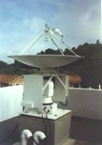
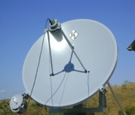
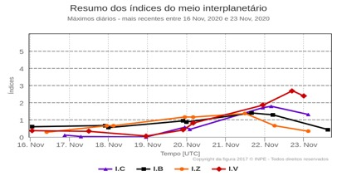
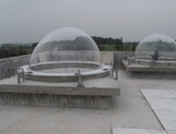
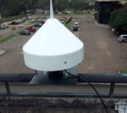
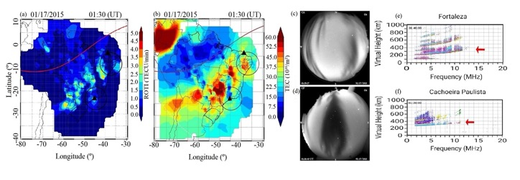
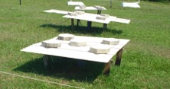
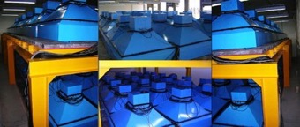
Instruments network and Services in Latin America
Instruments
MÉXICO
International Cooperation
Ionosonde
Ionosonde
Products
BRAZIL
Solar
Telescopes
ARGENTINA
CHILE
All-Sky imagers
GNSS receivers
Magnetometers
Cosmic Ray Detectors

Slide 9

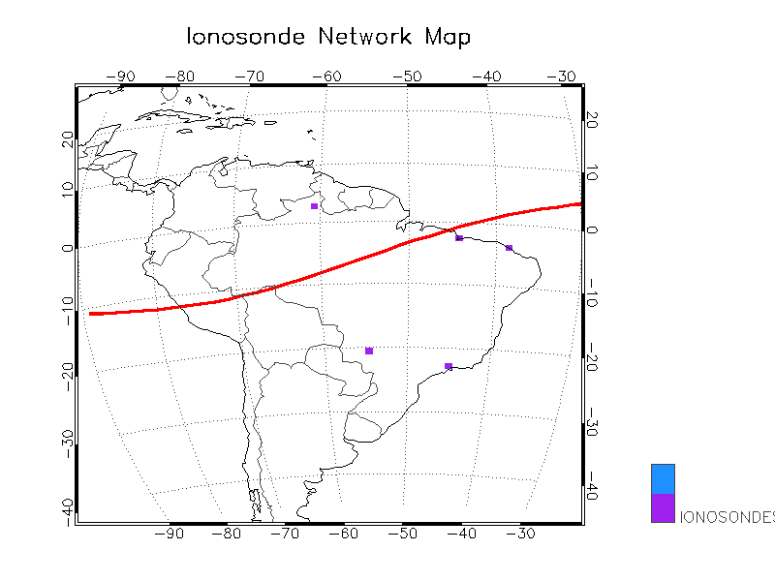



Ground-Based Digital Ionosondes → Plasma Density
Digisonde network that monitors ionosphere of E and F layers in seven locations over Brazil

Slide 10
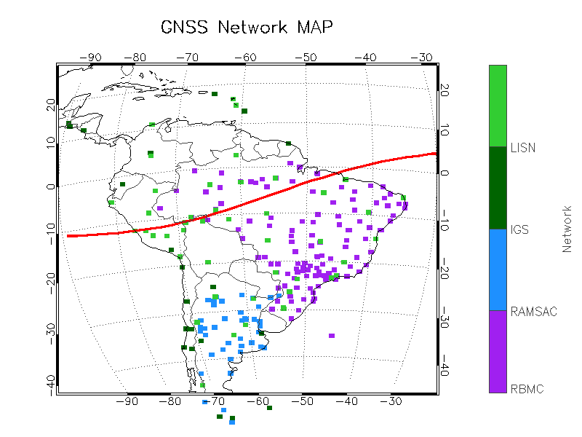
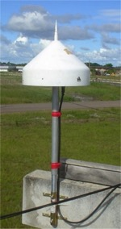

Ground-Based GNSS Receivers → TEC
A network of over 200 GNSS’ monitors
(sixteen of them measuring
S4 index ).

Slide 11
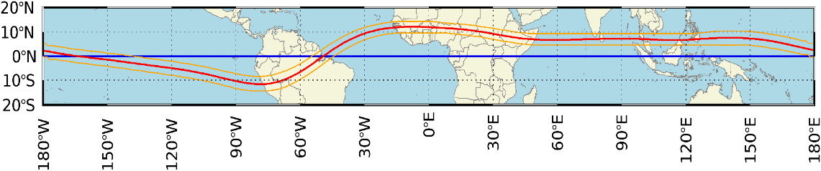
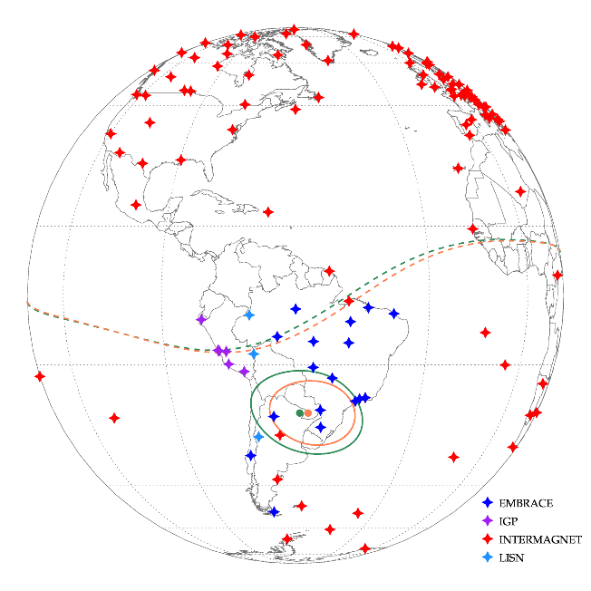
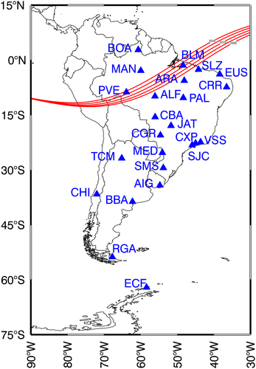
Ground-based Magnetometers
Geographic equator
Magnetic equator
19 magnetometers installed by EMBRACE magnet (three outside the Country)
5-year plan for 30
sony.chen@inpe.br
Embrace/INPE: Geomagnetismo
9 de novembro de 2021

Slide 12
SPORT Mission Timeline Concept
Satellite Bus Checkouts
Complete, Nominal Operations Begin
Calibration
Maneuvers
Complete
Science
Operations Begin
End of Life
Instrument
Checkouts
Complete
1st Contact
Cal-Roll
Cal-Roll
Deploy
Roll Z
Launch
UTD
USU
Roll Y
Collect / Download
GPS
Roll X
Collect / Download
Review Data
repeat
L+550 day
(TBR)
L+19 day
L+30 day
L+16 day
L+1 day
L+10 day

Slide 13
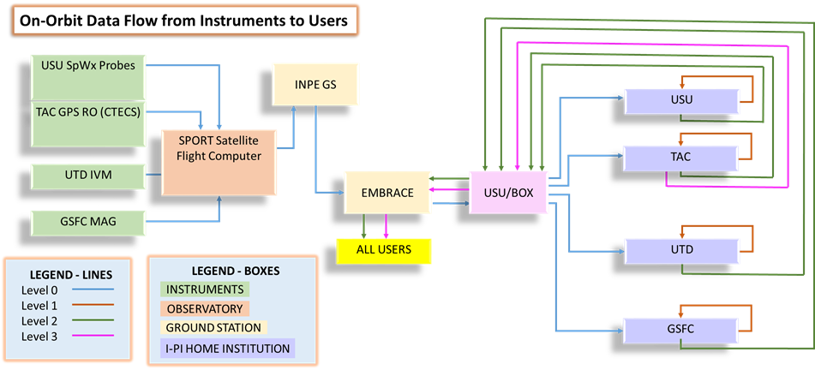
SPORT Mission Data Flow

Slide 14
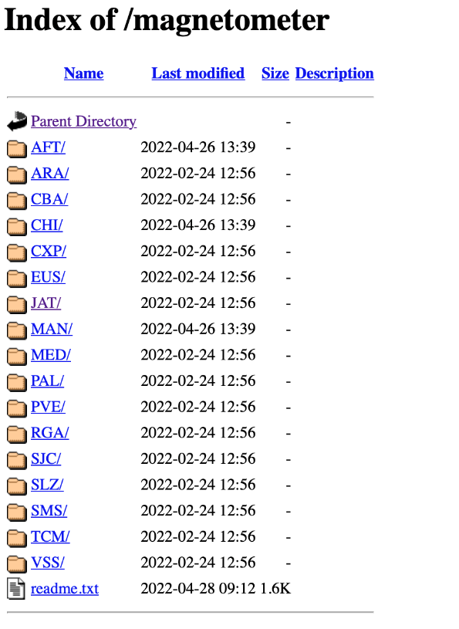
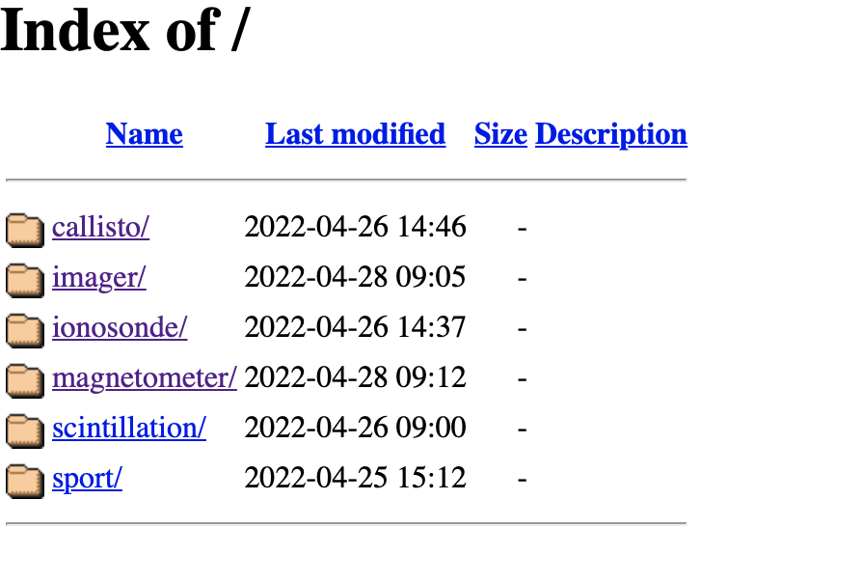
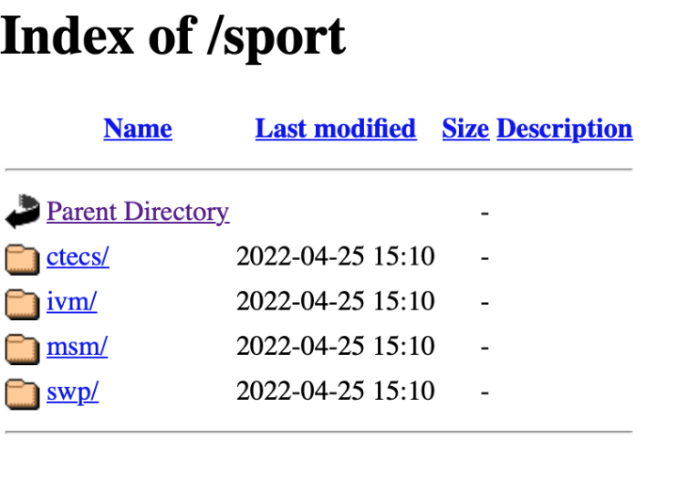
Data Sharing
https://embracedata.inpe.br/

Slide 15
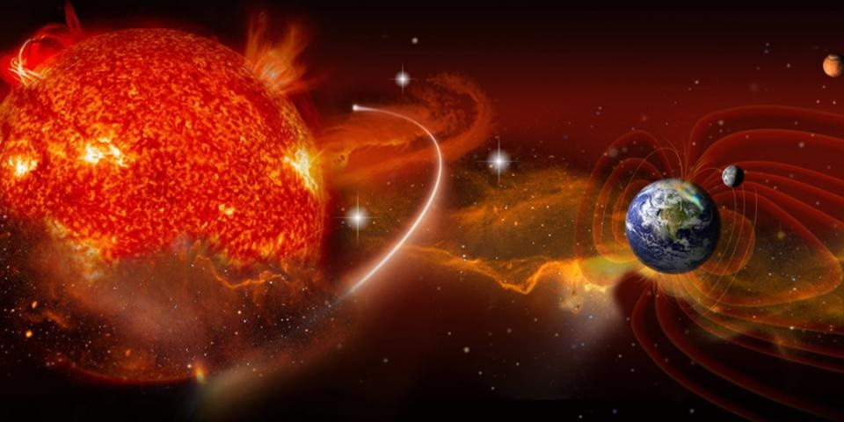
THANK YOU

