Slide 1
System Safety Analysis of Complex NASA Systems with Model Based Engineering
Nancy J. Lindsey, RMA SME & Deputy R&M Tech. Fellow HQ/GSFC
Miranda Cooter, System Safety Engineer GSFC/360
Austin Hodges, Reliability Engineer Axient /371
Nobel Sindjui, Reliability Engineer GSFC/371
Sponsored by NASA/HQ : John Evans and Anthony DiVenti
Aug 17th 2022
ISSC 2022 - System Safety Management SESSION - PAPER ID 28
Notes:
System Safety Analysis of Complex NASA Systems
with Model-Based Engineering

Slide 2
Agenda
Project and Study Overview
Study Methodology and Modeling
Study Assessment Process and Findings
Study Recommendations on Process and Environment
Study Path Forward
Notes:
Not a tool trade but a feasibility study

Slide 3
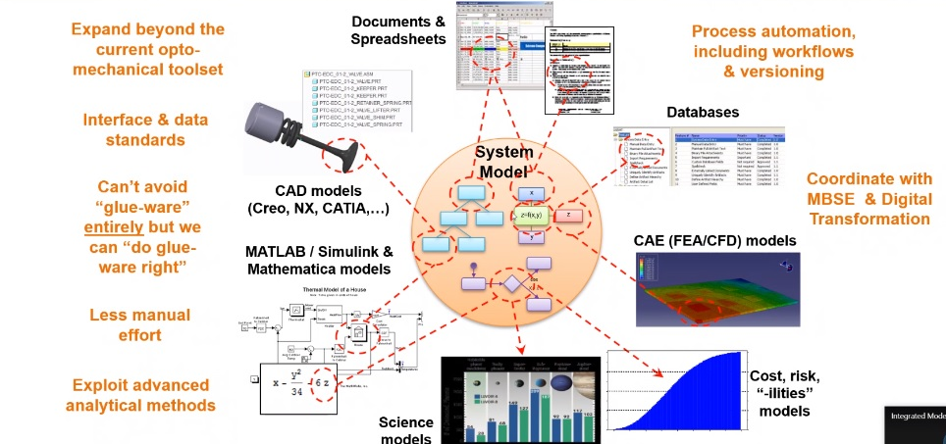
Motivation
RMA Analysis and Findings
MAR
Waivers/
Deviations
MRB/ARB Data
Supplier Data META
System Safety Analysis and Findings
SWA Analysis and Findings
Quality Assurance and Findings
Notes:
SMA needs to be in MBE the Picture - MBSMAI efforts will ensure this.
The emergence of model-based engineering is transforming design and analysis methodologies. A recognized benefit of model-based engineering is the existence of a “single source of truth” about the system that becomes the authoritative source of data and information for designers, analysts, and developers. This promotes consistency and efficiency as the design emerges and can be used to further optimize the design. While the initial concept of MBE was everything in one model (as testing and feasibility studies have found MBE) is moving to a system of models in which data is exchanged between optimized models to give a full picture. As you can see in the image there is a core model that provides/receives data from external sources/models (red arrows). However, the SE model you see on the screen contains design, requirements, and programmatic but needs SMA integration to be complete.
SMA or Safety and Mission Assurance includes RMA (Reliability/Maintainability/Availability. System Safety, Software Assurance, and Quality Engineering). These processes also need to exchange data with the core to correctly inform stakeholders of risks and mitigation strategies.
SMA processes at NASA/GSFC are not broken but can be improved by any process or methodology that enable additional consistency, accuracy, and efficiency therefore model based engineering was investigated.

Slide 4
MBSMAI Goals/Objectives
 | Phase 1: Reliability FY19-FY20 (Completed) | Phase 2: System Safety & System FY21-FY22 (Complete) | Phase 3: QE & SWA EST:FY23
Objectives | Evaluate utility and compatibility with NASA Reliability Engineering Analysis. | Evaluate utility and compatibility with NASA System Safety Engineering Analysis. | Evaluate utility and compatibility Software Assurance and Quality Engineering
 | Provide Modeling Guidance Generate/Share Reference Model | Provide updated Modeling Guidance Update/Share Reference Model | Provide updated Modeling Guidance Update/Share Reference Model
 | Provide Recommendations for MBMA/MBx Process Strategies | Updates Recommendations for MBMA/MBx Process Strategies | Updates Recommendations for MBMA/MBx Process Strategies
 | Support modeling environment/tool definition/development by providing requirements for enable SMA. | Update requirements for environments/tools to enable SMA. | Update requirements for environments/tools to enable SMA.
Deliverables | NTRS Reports, Modeling Tips, RAMS report, Presentations. (Includes model-based RE artifacts) | NTRS Reports, Modeling Tips, Conference report/poster, Presentations. Smallsat/generic model, (Includes model-based SS/RE artifacts) | NTRS Reports, Modeling Tips, Conference report/poster, Presentations. (Includes model-based SWA/QE/RE artifacts)
Potential Benefits | Analyst Agnostic Project Support. Reduced time/costs, Increased analysis, Increased timely influence MBx Skills developed and knowledge gained | Analyst Agnostic Project Support. Reduced time/costs, Increased analysis, Increased timely influence More MBx Skills developed and knowledge gained | SWA – Requirement tracking, Analyst Agnostic Project Support. Reduced time/costs, Increased analysis, Increased timely influence QA - Automated MAR generation/verification RE- SW FMECAs/FTs More MBx Skills developed and knowledge gained
Notes:
SMA processes at NASA/GSFC are not broken but can be improved by any process or methodology that enable additional consistency, accuracy, and efficiency therefore model based engineering was investigated
Therefore MBSMAI Goals/Objectives:
Investigate methodologies for the deployment of Model Based SMA/MA:
Evaluate MBSMA applications and artifacts (Lifecycle milestone SMA products)
Integrate with other disciplines (Quality, Software Assurance, Safety, Risk)
Gather views for multiple stakeholders
Create compelling story of successful MBSMA implementation
Provide Recommendations, Guidance, and Risk-Based Strategies for MBSMA/MA and MBSE Collaboration
Develop solution spaces for robotic and manned-flight MBSMA
Identify SMA analysis compatibility with MBSE/MBSMA and recommend modeling and/or SMA process changes
Identify modeling collaboration and transition points that would lead to recommendations (e.g., skill and knowledge based modeling assignments) for modeling efficiencies.
Identify where current MBSMA Tools or tool capabilities are sufficient or where new ones are required And recommend changes.
Provide Recommendations for model and tool/plug-in configuration controls, validation, and verification..
Not a tool trade but a feasibility study
This study used SysML/MagicDraw and MADe. What is MADe? Maintenance Aware Design environment (MADe) is a model-based modeling environment that provides a suite of software tools that can be used to design, assess, and optimize Reliability/Maintainability and conduct Safety Hazard Analyses and Hazard Mitigation Management.

Slide 5
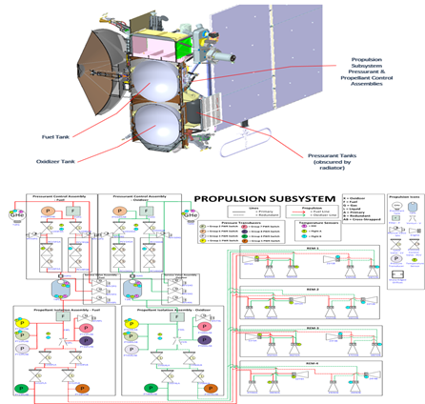
MBSMAI Methodology for System Safety
This Study used one test case, the MADe Europa Propulsion model from phase 1, which consisted of nine main Functional Block Diagrams, one at System level and eight at the Subsystem level and added a Propulsion Ground Support Equipment (PGSE) system in order to simulate the pre-launch fueling phase of the mission.
Model
Report
Evaluate
Modeling Process Guidance
SysML/MagicDraw
Model
Report
Evaluate
Optimal Modeling Environment Requirements*
MADe
* Tool readiness was also assessed.
Notes:
MBSMAI Phase 1 Produced six model test cases for the system safety phase to use:
(2 Mechanical Test Cases) The EUROPA propulsion subsystem, shown on the left, provided by GSFC that will be part of the Europa Flyby Mission spacecraft to the Jupiter system to perform repeated close flybys of the giant planet's large moon Europa to investigate its potential habitability. The spacecraft would collect information on Europa's ice shell thickness, composition and surface geomorphology. The propulsion subsystem contains tanks, valves, thrusters in multiple redundant configurations. This test case was selected for phase 2 (SS) since it had the most SS-concerns.
(2 Electronic Test Cases) A sounding rocket Celestial ACS (CACS) Subsystem, shown in the middle, from a Wallops Flight Facility Sounding Rocket. A sounding rocket carries experiments to altitudes between 50 and 1,500 km and fly nearly parabolic trajectories while its Celestial ACS is used to align sounding rocket payloads towards celestial targets. The CACS has sensors (STs), avionics (power/command/TLM), and multiple valves.
(2 Electromechanical Test Cases) A JSC developed ISS (International Space Station) brine evaporation system, called the Capillary-Based Brine Residual In-Containment (CapiBRIC). The CapiBRIC system uses unique containment geometry, capillary flow, and static phase separation to enable water evaporation in a microgravity environment. This system is comprised of an air outlet, blower, inlet assembly, reservoir, tray, filters, heaters, shells, sensors, and control electronics.
1 Test Case was chosen for efficiency since Phase 1 showed the evaluation of feasibility was not impacted by test case types. While there were many System Safety specific modeling tools available (and we are not doing a tool trade) it was decided to conduct phase 2 (System Safety) with the same tools as phase 1. SysML/Magic Draw and MADe. However, only MADe had built in hazard analysis capabilities to leverage.
What is MADe? Maintenance Aware Design environment (MADe) is a model-based modeling environment that provides a suite of software tools that can be used to design, assess, and optimize Reliability/Maintainability and conduct Safety Hazard Analyses and Hazard Mitigation Management.

Slide 6
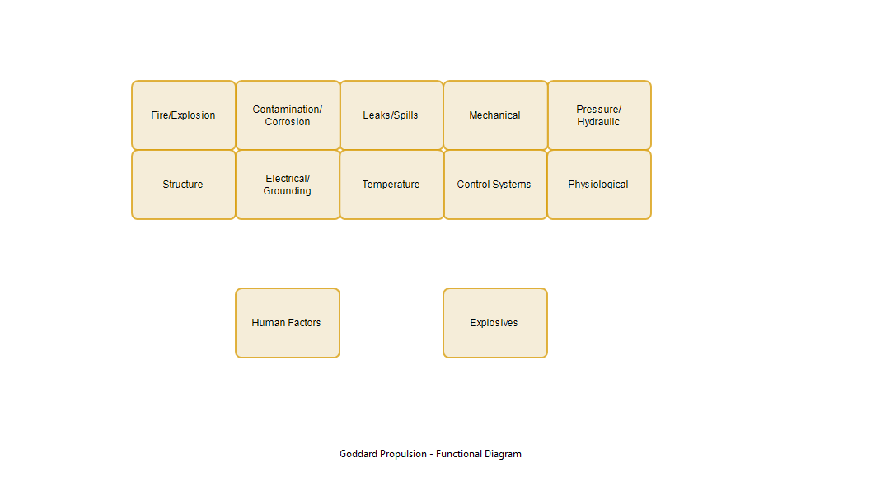
MBSMAI Phase 2: EUROPA Propulsion Modeling and Assessment Process
Identify what hazards categories might be present by component
Postulate and characterize the hazards present for each category
  Likelihood
  Severity/Consequence
  Causes
  Controls
  Verification Methods
  Verifications
Link Hazard Causes to Components and Failure Modes
Verify Inhibit sufficiency
Generate Safety (SDP) and Hazard Reports (HA, OHA, O&SHA)
Iterate modeling/assessment
Twelve Hazard Categories were considered, 10 of which were determined to be present in the Europa Propulsion System
Notes:
MADe’s approach to safety analysis is based on SAE ARP 4761, while NASA’s safety approach consists of first identifying what hazards might be present in the system and then associating potential hazards with components in a system, subsystem, or testing facility. Therefore, to perform NASA safety analyses in MADe, hazard categories were entered as “Functions”; hazards were equated to “Functional Failures” and hazard causes to “Failure Conditions” in the model’s “Functional Diagram” based on system safety engineering assessing the system components against the hazard categories. As a result, all hazards and associated hazard causes for each hazard category were conceptualized for each modeling element. Further analysis of each hazard included evaluating the hazard’s causes, severity, likelihood, and then postulating hazard controls, and verification methods to mitigate the hazards.
Hazard Categories defined by the study’s System Safety Expert ) (based on Textbook: “System Safety Engineering and Risk Assessment: A Practical Approach”)are Fire/Explosion, Contamination/Corrosion, Leaks/Spills, Mechanical, Pressure/Hydraulic. Structure, Electrical/Grounding, Temperature, Control, Physiological, Human Factors, and Explosives. Given that our study case was a propulsion subsystem only 10 of these 12 (or all but HF and explosives) were modelled/assessed.
For example: Under fire/explosion a systems safety engineer must consider/model if the system has the * Existence of Endothermic and exothermic Chemicals/fuels, * Combustible materials and atmospheres, * Presence of Fuel/Oxidizers, * Pressure and/or ignition sources, * Pressure releases, and *High-heat sources so hazard causes can be identified.
Textbook Reference: System Safety Engineering and Risk Assessment: A Practical Approach by Nicholas J. Bahr; published by Taylor & Francis Group, LLC 2015

Slide 7
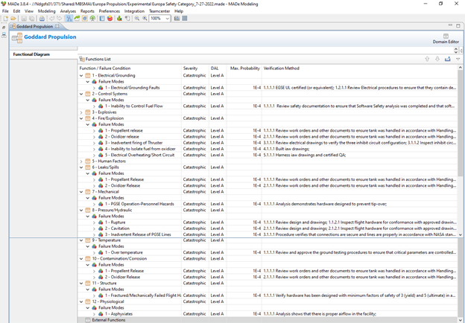
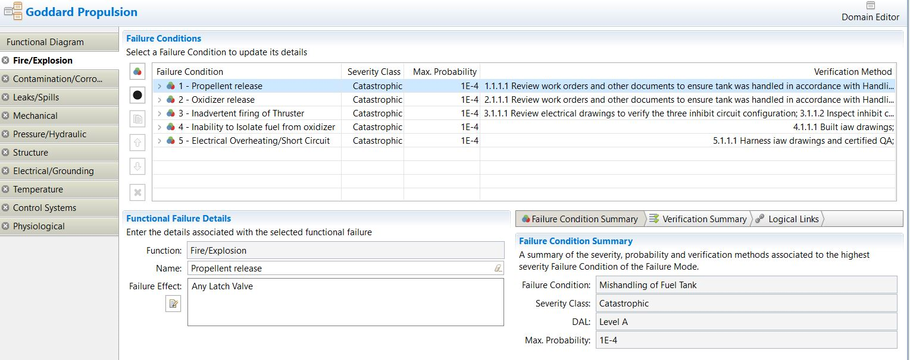
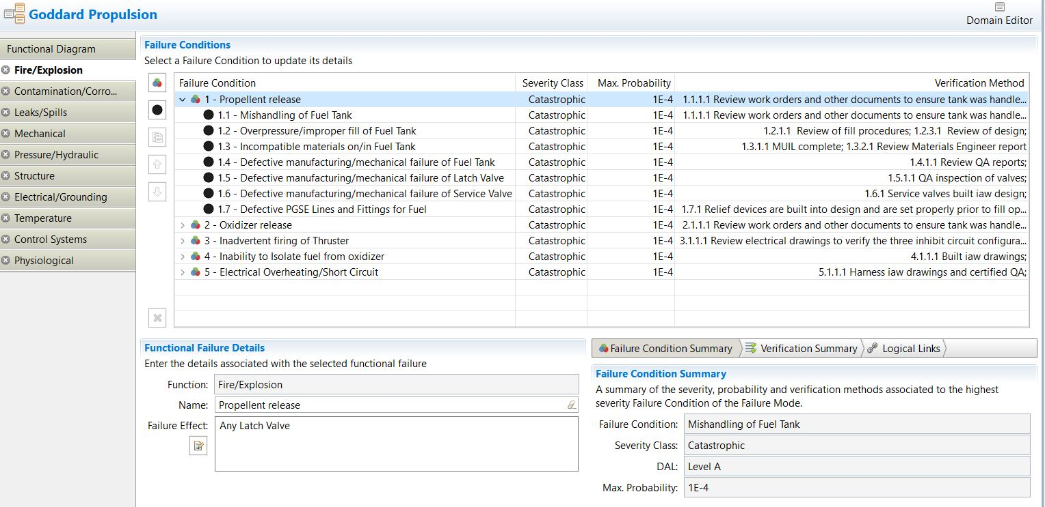
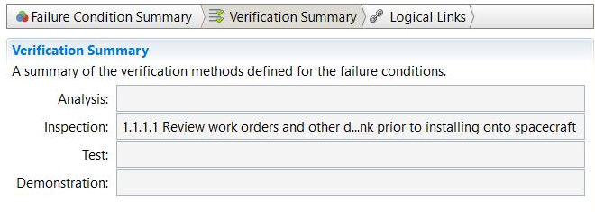
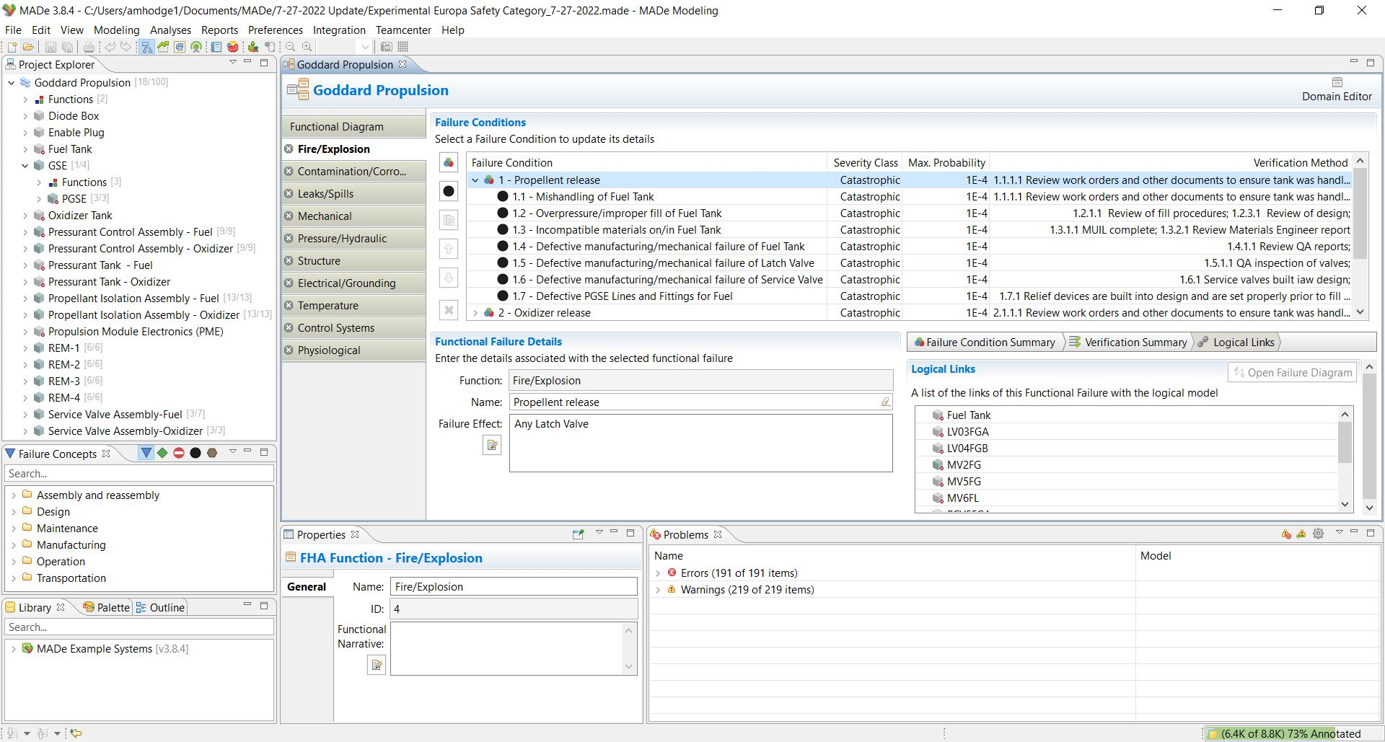
MBSMAI Phase 2: EUROPA Propulsion Modeling and Assessment Process
Identify what hazards categories might be present by component
Postulate and characterize the hazards present for each category
  Likelihood
  Severity/Consequence
  Causes
  Controls
  Verification Methods
  Verifications
Link Hazard Causes to Components and Failure Modes
Verify Inhibit sufficiency
Generate Safety (SDP) and Hazard Reports (HA, OHA, O&SHA)
Iterate modeling/assessment
18 Hazards and 84 Causes were modelled that were each given appropriate severity, default likelihood, controls, verification methods, and verifications.
Notes:
MADe’s approach to safety analysis is based on SAE ARP 4761, while NASA’s safety approach consists of first identifying what hazards might be present in the system and then associating potential hazards with components in a system, subsystem, or testing facility. Therefore, to perform NASA safety analyses in MADe, hazard categories were entered as “Functions”; hazards were equated to “Functional Failures” and hazard causes to “Failure Conditions” in the model’s “Functional Diagram” based on system safety engineering assessing the system components against the hazard categories. As a result, all hazards and associated hazard causes for each hazard category were conceptualized for each modeling element. Further analysis of each hazard included evaluating the hazard’s causes, severity, likelihood, and then postulating hazard controls, and verification methods to mitigate the hazards.
For the Propulsion subsystem of this 18 Hazards and 84 Causes were modelled that were each given appropriate severity, default likelihood, controls, verification methods, and verifications. Click
Continuing with our example…. Fire/explosion hazard mechanisms of Propellent release (Presence of Fuel/Oxidizers), Oxidizer Release (Presence of Fuel/Oxidizers), Inadvertent Firing of Thrusters (ignition sources), Inability to Isolate fuel from oxidizer (Exothermic/explosion), and Electrical Overheating/Short Circuit (High-heat sources/ignition sources) so hazard causes could be identified. Click
Furthermore, Propellent release causes were determined by systems safety to be mishandling of the fuel Tank, Overpressure/Overfill of Fuel Tank, Incompatible material on/in Fuel Tank, Defective /failed Tank/Valves or lines and fittings.
Each of these machanism was then characterized with Severity/Consequence, Likelihood, Controls, Verification Methods, and Verifications: Catastrophic, 1E-4, and specific verification data (e.g., Review of fill procedures, Review od debris, inspection of valves, etc.) via MADe property details entry frames Summary, Click
Verification Click
and Logical Links.
Click Mishandling

Slide 8
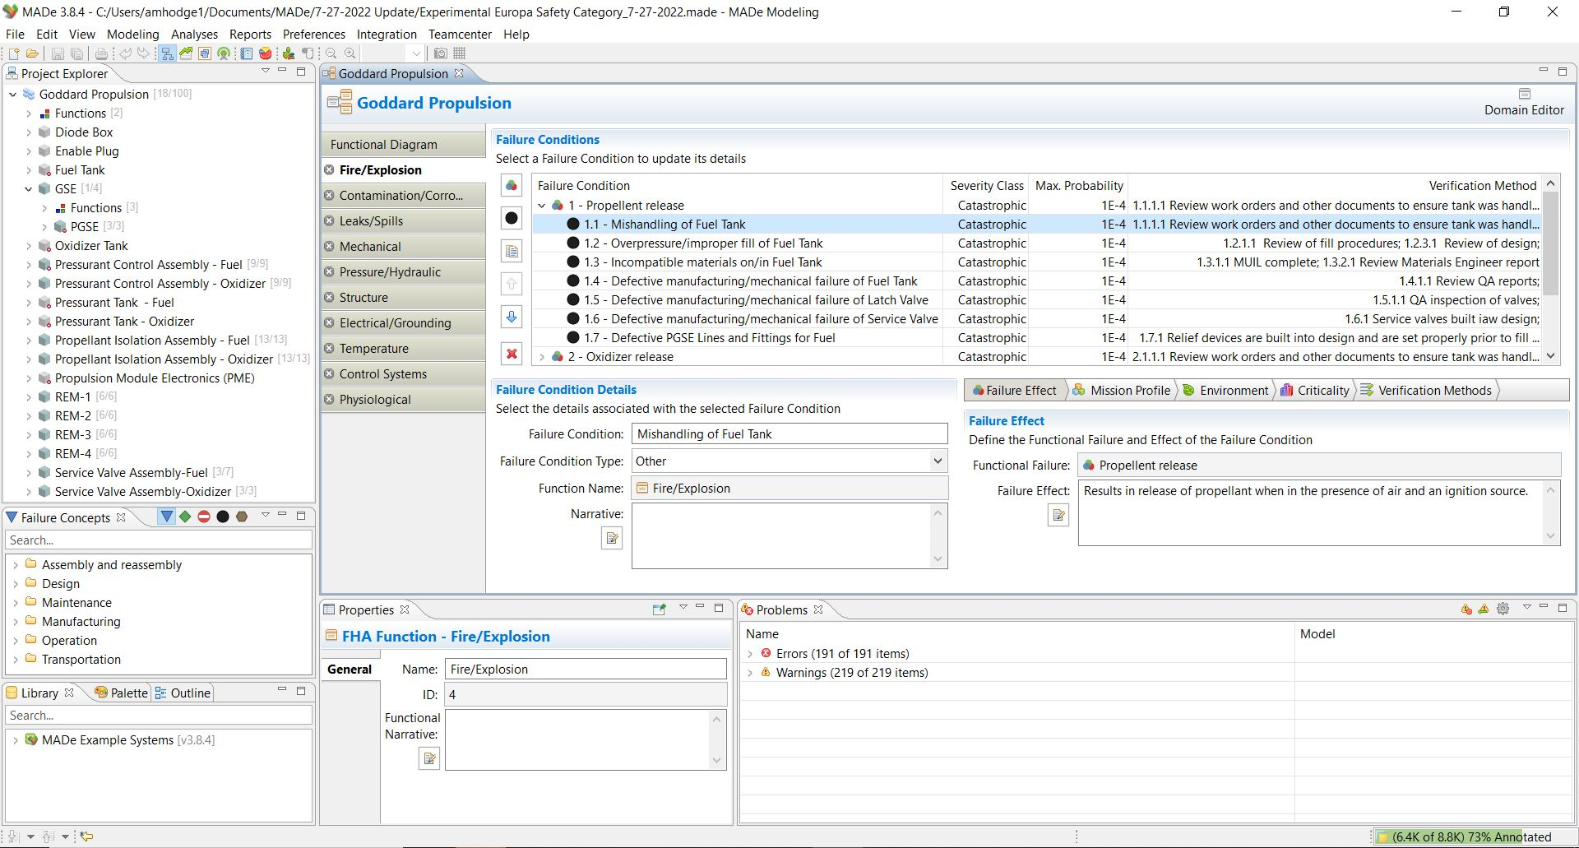
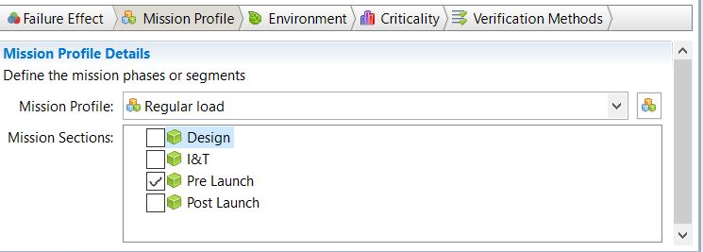
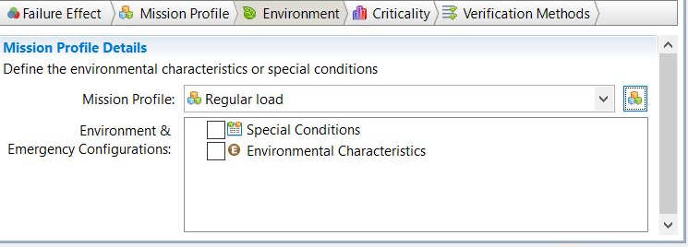
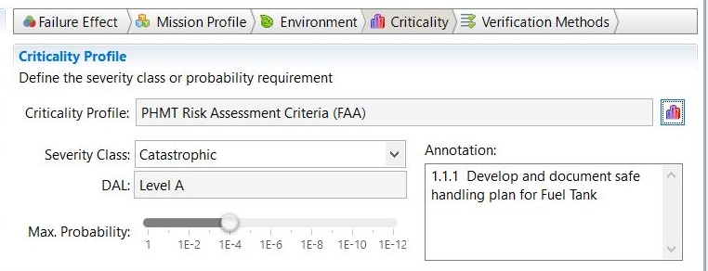
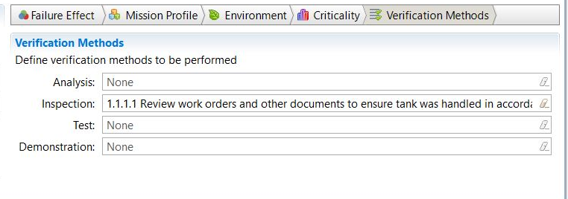
MBSMAI Phase 2: EUROPA Propulsion Modeling and Assessment Process
Identify what hazards categories might be present by component
Postulate and characterize the hazards present for each category
  Likelihood
  Severity/Consequence
  Causes
  Controls
  Verification Methods
  Verifications
Link Hazard Causes to Components and Failure Modes
Verify Inhibit sufficiency
Generate Safety (SDP) and Hazard Reports (HA, OHA, O&SHA)
Iterate modeling/assessment
18 Hazards and 84 Causes were modelled that were each given appropriate severity, default likelihood, controls, verification methods, and verifications.
Notes:
Optional Slide
Continuing with our example…. Fire/explosion hazard mechanisms of Propellent release and cause mishandling of the fuel Tank
Each of these causes was then characterized with effects, Likelihood, applicable mission phase, environment, Criticality, and Verification Methods, and Verifications: Pre-Launch, Catastrophic, 1E-4, Controls (annotation) and specific verification data (e.g., Review work orders) via MADe property details entry frames Failure effects, Click
Mission Profile Click
Environment (N/A) Click
Criticality Click.
And Verification Methods

Slide 9
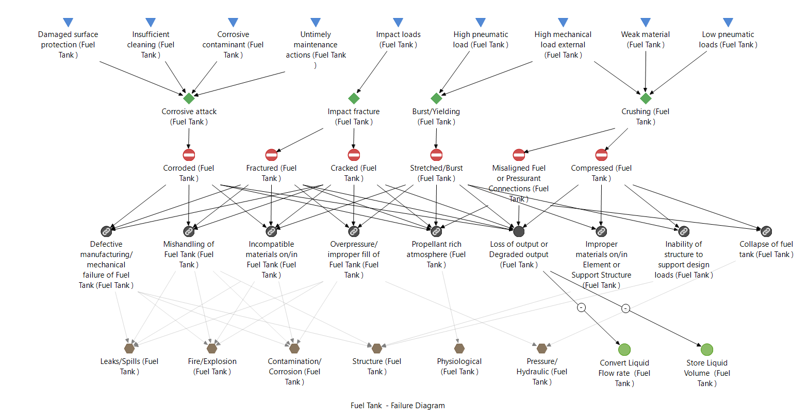
MBSMAI Phase 2: EUROPA Propulsion Modeling and Assessment Process
Identify what hazards categories might be present by component
Postulate and characterize the hazards present for each category
  Likelihood
  Severity/Consequence
  Causes
  Controls
  Verification Methods
  Verifications
Link Hazard Causes to Components and Failure Modes
Verify Inhibit sufficiency
Generate Safety (SDP) and Hazard Reports (HA, OHA, O&SHA)
Iterate modeling/assessment
56 Failure diagrams were enhanced with hazard and hazard causes. This enables both fault tree generation and integration of hazard data with FMECAs and Reliability Engineering.
Notes:
MADe’s approach to safety analysis is based on SAE ARP 4761, while NASA’s safety approach consists of first identifying what hazards might be present in the system and then associating potential hazards with components in a system, subsystem, or testing facility. Therefore, to perform NASA safety analyses in MADe, hazard categories were entered as “Functions”; hazards were equated to “Functional Failures” and hazard causes to “Failure Conditions” in the model’s “Functional Diagram” based on system safety engineering assessing the system components against the hazard categories. As a result, all hazards and associated hazard causes for each hazard category were conceptualized for each modeling element. Further analysis of each hazard included evaluating the hazard’s causes, severity, likelihood, and then postulating hazard controls, and verification methods to mitigate the hazards.
In order to integrate safety scenario and failure scenarios 56 Failure diagrams
(Each component in MADe functional diagrams is associated with a failure diagram to complete the model. A failure diagram in MADe contains all potential failure modes (red Circles) , effects (Brown Hexagon (hazard) and black circles/green function circles) , causes (Linked black circles (Hazard Causes) and blue triangle (failure causes)), and detection (black circles/green function circles). As modelled, the electrical failure mechanisms and causes in the propulsion components were auto populated by MADe as a default on the failure diagrams; mechanical failure mechanisms were easily added to the library component failure diagram manually (one time operation and can be used again and again). )
were enhanced with hazard and hazard causes. This enables both fault tree generation and integration of hazard data within FMECAs.
For example: The study Fuel Tank was linked to the Leak/Spill, Fire/Explosion, Contamination/Corrosion, Structure, Physiological, and Pressure/Hydraulic Hazards. When completed insight- is provide to analysts via this type of diagram of the relationship of hazard causes and failure cause that would contribute to a hazardous condition. It also enables the production of Hazard/Safety-FTs as Miranda will share next along with other safety analysis/artifact findings.

Slide 10
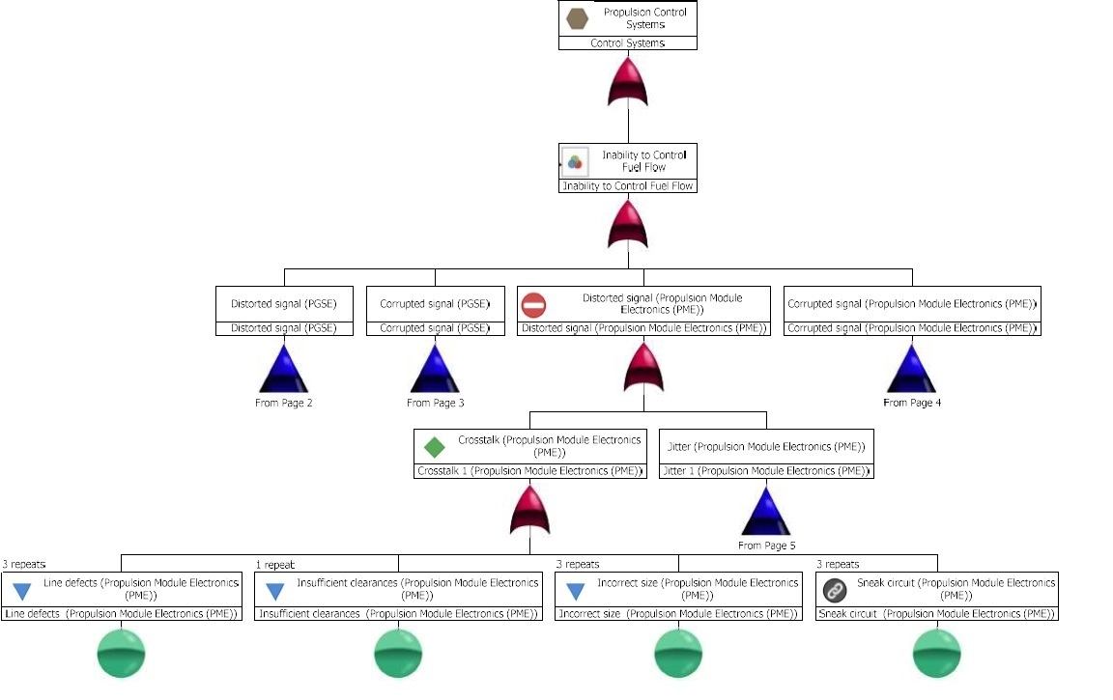
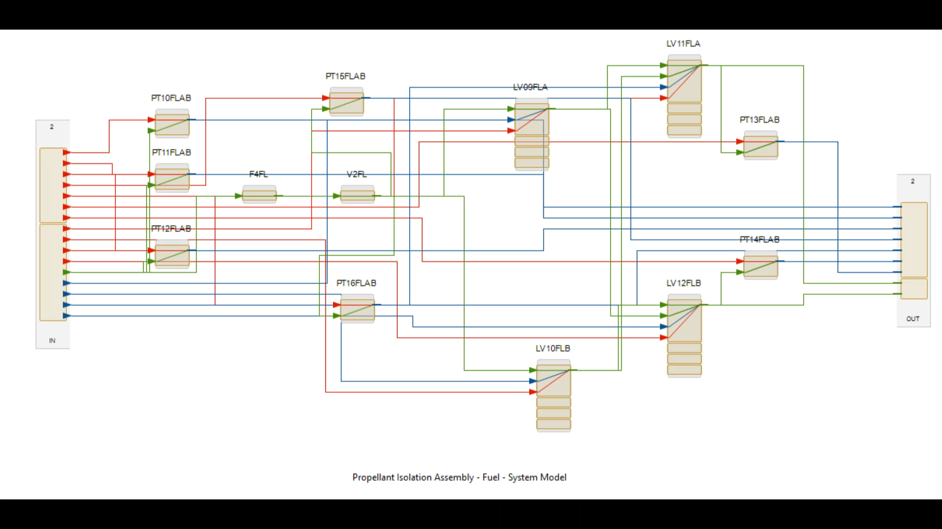
MBSMAI Phase 2: EUROPA Propulsion Modeling and Assessment Process
Identify what hazards categories might be present by component
Postulate and characterize the hazards present for each category
  Likelihood
  Severity/Consequence
  Causes
  Controls
  Verification Methods
  Verifications
Link Hazard Causes to Components and Failure Modes
Verify Inhibit sufficiency
Generate Safety (SDP) and Hazard Reports (HA, OHA, O&SHA)
Iterate modeling/assessment
Safety Fault Trees are helpful to validate the model and provide clear evidence of Fault Tolerance. Simulations demonstrate fault tolerance at a component level and assist with procedure development.
Notes:
(Miranda presents)
This study shows that the use of a system model to conduct System Safety Analyses and develop hazard reports for flight systems has clear advantages and can improve accuracy and consistency. However, the model must be validated and proper tools with compatible methods need to be developed.
Fault tree:
Shown here is a classic fault tree based on our MADe model. A fault tree represents fault tolerance. Postulating operations and failures within the model can demonstrate where unanticipated hazards might exist and can be used to validate the model.
This particular fault tree is for Inability to control fuel flow due to a signal issue. This is one of the simpler fault trees and can be shown on one page. Component defects that lead to the failure are shown on the bottom row. The “And” gates validate the fault tolerance.
This fault tree was not generated by the MADe tool but instead generated in a separate tool based on the MADe model. It is expected that the MADe developers will eventually add this capability to the tool. This fault tree was generated from the MADe model based on identified hazard traced down to the components.
Simulations:
Simulations can be used to validate planned procedures as well as inhibit structures. This simulation shows that it takes three failures to flow fuel past the thrusters. First, the A side valves are locked closed so that the inhibits for the B side can be tested. Then, the B Side Latch valves are opened. The tool shows the consequence of this action flowing fuel through the valves down to the thrusters. It is clear that the thrusters do not open because they are unaffected by the fuel.
Simulations can be used to verify that an inhibit and/or fault tolerance remains in place following a design change. They can also be used to model a procedure or order of valve opening for development.
Simulations are a powerful tool and, when the model is accurately represented, can assist by showing how a complex system works in the context of nominal and off-nominal operation.

Slide 11
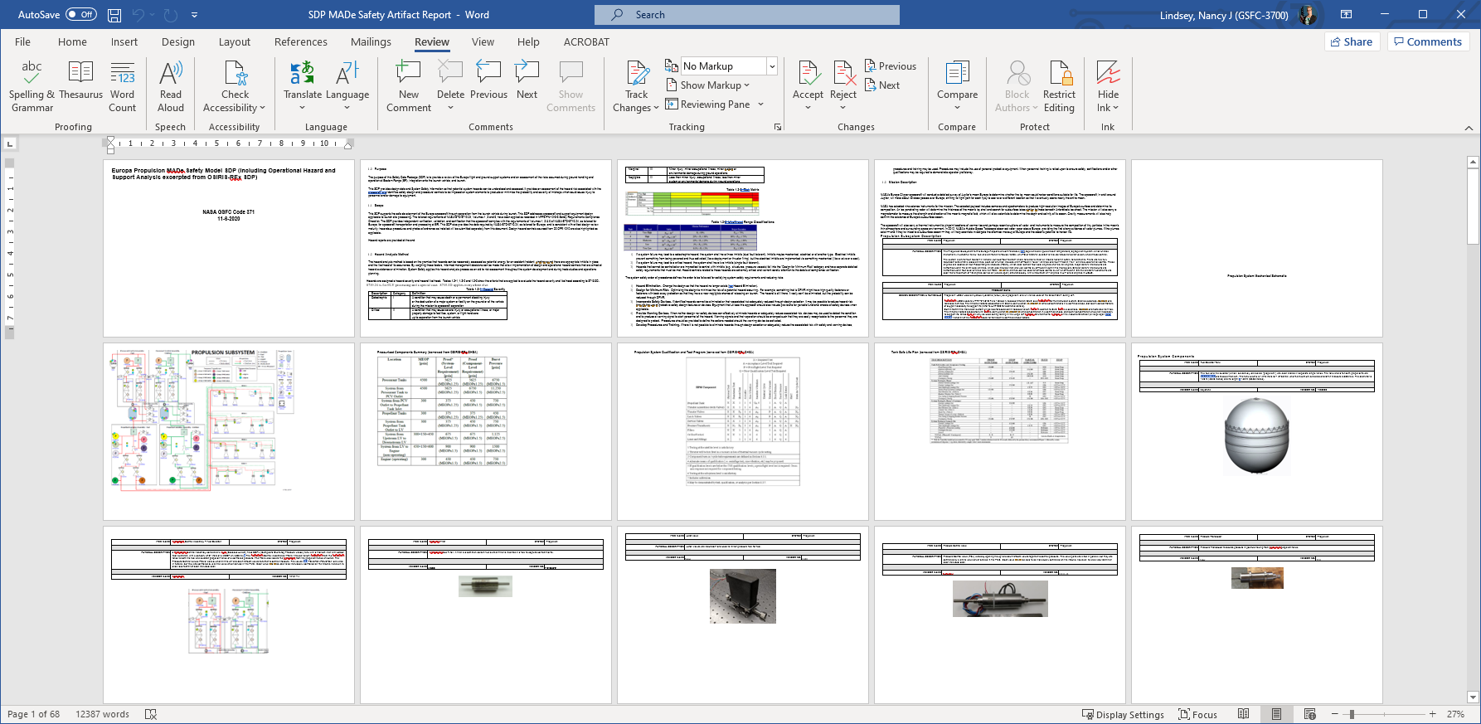
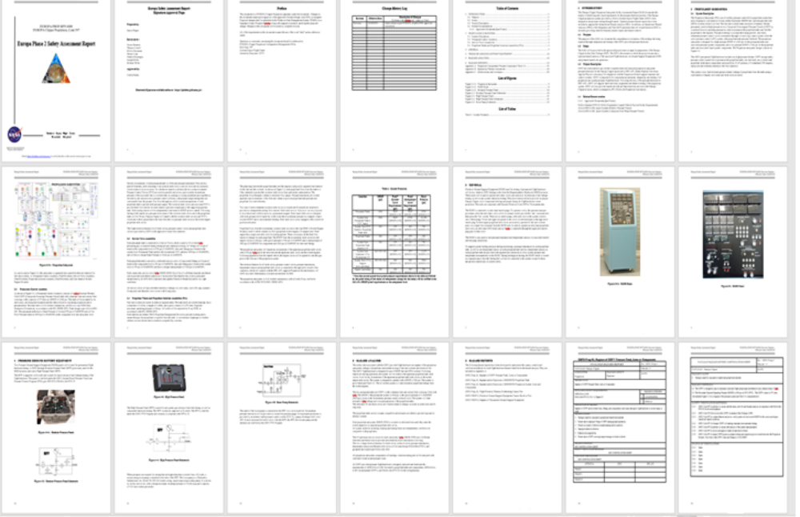
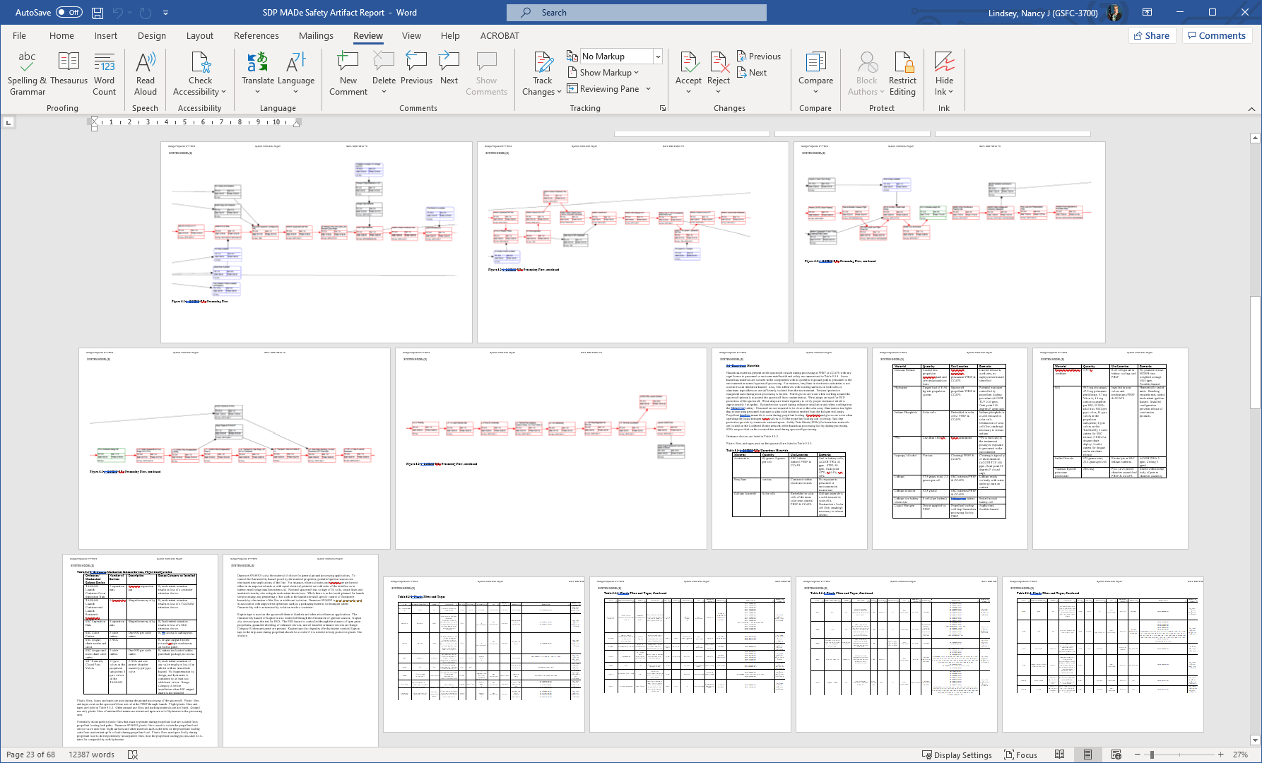
MBSMAI Phase 2: EUROPA Propulsion Modeling and Assessment Process
Identify what hazards categories might be present by component
Postulate and characterize the hazards present for each category
  Likelihood
  Severity/Consequence
  Causes
  Controls
  Verification Methods
  Verifications
Link Hazard Causes to Components and Failure Modes
Verify Inhibit sufficiency
Generate Safety (SDP) and Hazard Reports (HA, OHA, O&SHA)
Iterate modeling/assessment
A model will need to include written descriptions of each component to create accurate reports.
A library of components would facilitate this and lend standardization to the descriptive text.
Notes:
(Miranda presents)
The descriptive portion of a Safety Data package is vital to understanding . Often, Safety engineers work closely with discipline and system engineers to conduct the analysis. The information received sometimes lags the design and the analysis must be revisited and updated.
Using an integrated model which is automatically modified as the system evolves allows for near-continuous evaluation of the system hazards, once they are assigned. If the model is built from the ground up, then hazard assessments can be updated in near realtime and are based on actual components. A library of components which include a description of their function along with language which can be leveraged to make salient associations between components based on model linkages would improve this process. Using such a library can improve consistency and efficiency.
The first picture illustrates a traditional SDP while the second one illustrates what was produced by the MADe tool. Note that the descriptive information provided by the MADe tool was manually entered for this study.
For efficiency, component and system level descriptions should be entered as the system is designed. A library of component and system descriptions could be built to aid in this process. That way, the tool could produce the descriptions without the analyst having to enter them in manually.

Slide 12
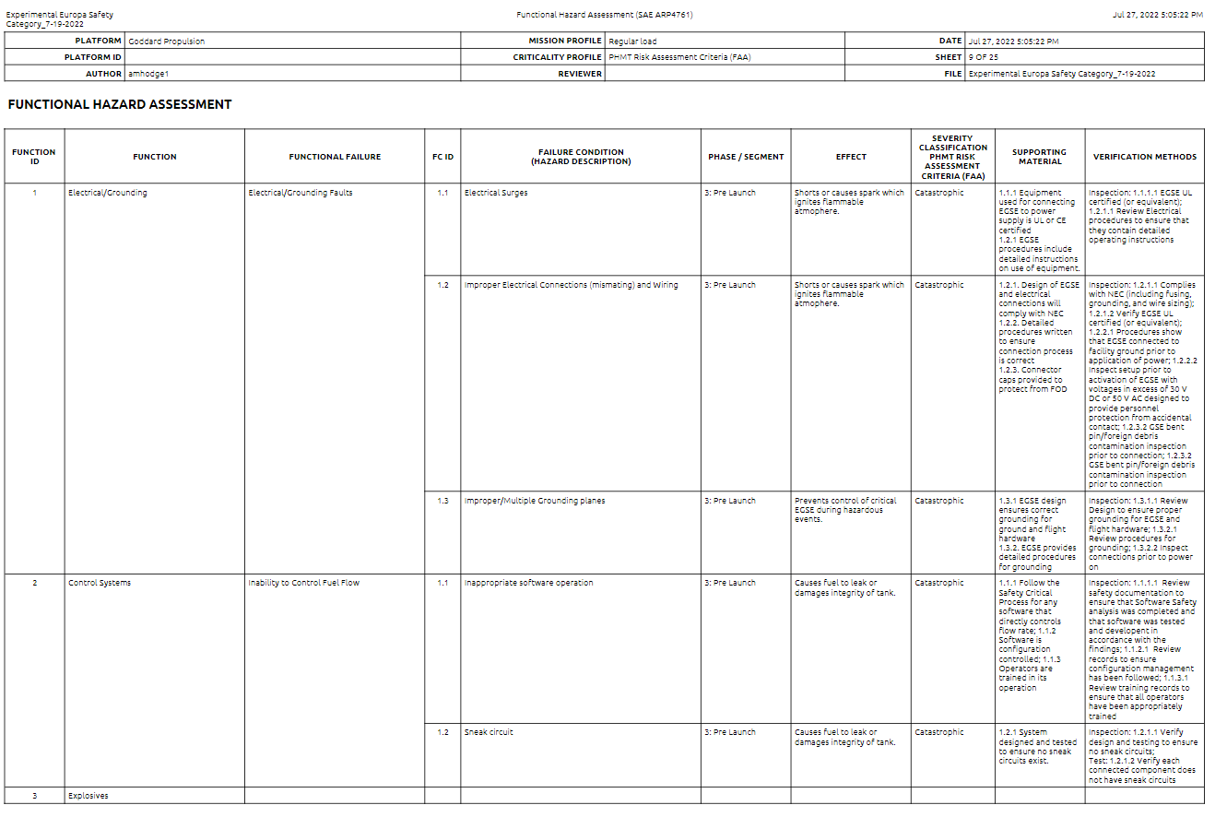
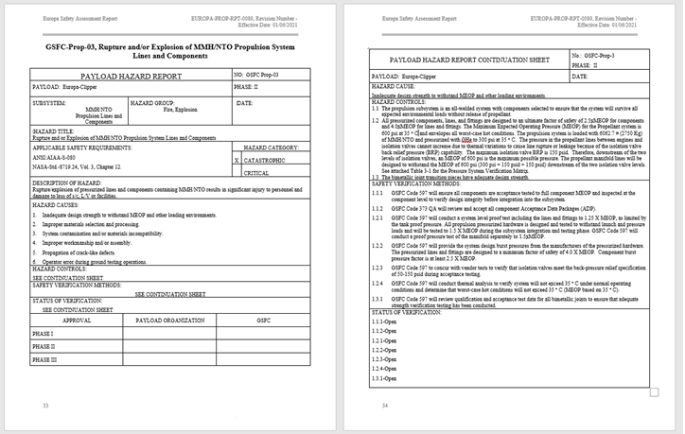
MBSMAI Phase 2: EUROPA Propulsion Modeling and Assessment Process
Identify what hazards categories might be present by component
Postulate and characterize the hazards present for each category
  Likelihood
  Severity/Consequence
  Causes
  Controls
  Verification Methods
  Verifications
Link Hazard Causes to Components and Failure Modes
Verify Inhibit sufficiency
Generate Safety (SDP) and Hazard Reports (HA, OHA, O&SHA)
Iterate modeling/assessment
A model lends itself to improvements in the traditional forms (Excel).
A Library of hazards and categories will improve standardization.
Notes:
(Miranda Presents)
This first image is a “traditional” hazard report. It provides causes and then shows how the causes are mitigated.
MADe’s approach to safety analysis is based on SAE ARP 4761, while NASA’s safety approach consists of first identifying what hazards might be present in the system and then associating potential hazards with components in a system, subsystem, or testing facility – similar to what’s descrbed in MIL-STD_882.
In order to perform a NASA safety analyses in MADe, hazard categories were entered as “Functions”; hazards were equated to “Functional Failures” and hazard causes to “Failure Conditions” in the model’s “Functional Diagram” based on system safety engineering assessing the system components against the hazard categories. As a result, all hazards and associated hazard causes for each hazard category were conceptualized for each modeling element. Further analysis of each hazard included evaluating the hazard’s causes, severity, likelihood, and then postulating hazard controls, and verification methods to mitigate the hazards.
Additionally, the MADE Hazard Reports, produced in Excel, did not include the same Severity and Likelihood assessment vocabulary as NASA. This means that the image from MADe was post-processed to match the traditional product.
An MBSE system being used for Safety Analysis would have to be able to directly use System and Subsystem style analyses and produce Hazard Reports using NASA’s vocabulary. The spreadsheet-style hazard report, however, is perfectly acceptable and perhaps an improvement over the MS word form.

Slide 13
Is Model-Based Engineering valid and useable for System Safety Engineering?
Model-Based Engineering is found to be valid and useable for System Safety Engineering for NASA Safety and Mission Assurance,
if adequate modeling processes and environment are established.
Notes:
Our Study was not to perform modeling for its sake nor to simply evaluate tools; it was to Provide Recommendations, Guidance, and Risk-Based Strategies for MBSMA/MA and MBSE. Collaboration to our NASA community and our Reliability community (you). In short, our work was intended to demonstrate (or not) the feasibility of using a System model to conduct System Safety Analyses.
Effective model-based System Safety must be analyst/modeler-agnostic while still efficiently producing complete, accurate, and more consistent Safety Artifacts. Existing tools fall short of this goal, however improved tools and the use of Model Based System Engineering could improve the consistency, accuracy and timeliness of System Safety analyses. An added benefit would be improved communication and dialog between designers and System Safety engineers using the modeling and tool as a framework.
Considerations/Findings:
Model-Based functional models need extensive component details to make them complete (e.g., Propulsion Latch Valves need power/command inputs and telemetry outputs to fully characterize their functionality, and a traditional block diagram may not have this level of detail in just one source) and to support simulations.
A single system model should be built that includes lower-level components as well as connections representing all functions (e.g., power, signal, material transfers). This model should be validated against the system by the System Engineers and used to conduct SMA analyses including validating and verifying hazard analyses as well as safety requirements for manufacturing, pre-launch processing and launch.
Any lack of standardization or framework within a modeling environment will provide more liberty in the modeling process to generate findings/results/artifacts. But the results may not necessarily be accurate when done by discipline engineers without modeling experience, and “Modeling Expert” intervention may be required as an additional step to ensure accuracy and consistency. Although this additional step may increase the confidence in the model, it is in contradiction with other goals of Model-Based Engineering to reduce time and cost factors.

Slide 14
Recommended Process Guidance for Cross-Discipline Model-Based Engineering
Create a multi-discipline mission specific modeling team (Systems Engineering (SE) and Safety and Mission Assurance (SMA) at a minimum);
Clearly define modeling responsibilities (e.g., SEs model requirements, Designers model structure (Functional Block Diagram/Wire Diagram), SSEs model hazards (categories, mechanisms, causes, and linkages), verifications, and controls, REs model failure behaviors, characteristics and mitigations (and assist with safety-cause linking);
Complete modeling and share common data between modeling elements;
Produce System Safety artifacts (and simulation results) and share resulting data between modeling elements;
Verify and refine modeling (and designs) until a final and acceptable result is achieved;
Share modeling with future missions.
Models must be built and validated collaboratively through multi-discipline teams.
Modeling does not replace the discipline expert’s inputs and engineering judgement.
Notes:
NANCY returns.
Results and tool summary: No Artificial Intelligence; however, tool libraries can facilitate consistency; Not all tools are ready to support all disciplines. Tool enhancement/development will be needed to match NASA/GSFC needs.
Considerations/Findings:
Model-Based functional models need extensive component details to make them complete (e.g., Propulsion Latch Valves need power/command inputs and telemetry outputs to fully characterize their functionality, and a traditional block diagram may not have this level of detail in just one source) and to support simulations.
A single system model should be built that includes lower-level components as well as connections representing all functions (e.g., power, signal, material transfers). This model should be validated against the system by the System Engineers and used to conduct SMA analyses including validating and verifying hazard analyses as well as safety requirements for manufacturing, pre-launch processing and launch.
Any lack of standardization or framework within a modeling environment will provide more liberty in the modeling process to generate findings/results/artifacts. But the results may not necessarily be accurate when done by discipline engineers without modeling experience, and “Modeling Expert” intervention may be required as an additional step to ensure accuracy and consistency. Although this additional step may increase the confidence in the model, it is in contradiction with other goals of Model-Based Engineering to reduce time and cost factors.

Slide 15
Recommended Optimal Modeling Environment Requirements for Cross-Discipline Model-Based Engineering
The optimal modeling environment for Systems Engineering and System Safety should be developed or purchased to include:
Support for the development of models from the traditional system safety artifacts rather than only deriving the artifacts from the models for efficiency via model re-use (import existing hazard analyses and/or SDPs).
The ability to ingest and parse or allocate text, diagrams, illustrations, and images to safety products and/or models.
The ability to reuse component level models for consistency and to take advantage of subsystems which have already been validated to ensure efficiency and accuracy.
An easily mastered structure and interface for efficiency.
The ability to create a functional model of the systems for efficiency and clarity.
The ability to ensure that changes to one diagram (e.g., adding a component or deleting a failure condition) propagate to other parts/diagrams of the model automatically (including link breaks) and/or shows as an error that needs to be resolved by the modeler.
The ability to simulate the accumulation of material or actuations on modeling elements as well as failures for efficiency and accuracy.
The ability to allocate requirements to a functional diagram/element to analyze whether or not safety requirements have been met.
The ability to fully edit hazard-modeling elements (including identifiers) to ensure accuracy.
The ability to develop libraries of hazard categories with baseline definitions and implication data for consistency and accuracy:
  Potential element causes or element types (graphical hazard tree for input)
  The library could extend to controls and verifications
  As the library is built, the speed and efficiency of conducting the analyses will improve since manual inputs are reduced.
Tools must be: Easy to use, Collaborative (i.e., multiple simultaneous users), contain discipline specific libraries and provide interactive modules using a shared “single source of truth”.
Notes:
Tools must be: Easy to use, Collaborative (i.e. multiple simultaneous users), contain discipline specific libraries and provide interactive modules using a shared “single source of truth”.
Sky Blue (efficiency): Easily ingest and reuse data/components/models
Yellow(consistency): Contains the capabilities to fully model and analyze a system/requirements. Propagates new and change data throughout.
Unhighlighted (efficiency): Easy to use and enhance./customize.

Slide 16
Recommended Optimal Modeling Environment Requirements for Cross-Discipline Model-Based Engineering
The optimal modeling environment for Systems Engineering and System Safety should be developed or purchased to include (continued):
The ability to add models of systems or portions of system models to a library of shareable models for efficiency.
The ability to input/import results and tracking/verification supporting data (i.e., procedures, control inspection, verifications, etc.) for safety report production efficiency and accuracy.
The ability to copy hazard modeling without linkages or challenge the modeler to verify linkages if applicable.
The ability to combine models and duplicate models for reuse in future modeling efficiency.
Provisions for model component and system consistency error checking and reporting for improved modeling accuracy.
Model change control/reporting (i.e., detailed configuration control) including the ability to revert to a previous model for accuracy.
The ability to import requirements, CAD, and BOM/part lists type data to create modeling elements or as supporting data for efficiency.
The ability to select and allocate requirements to each element or hazard for verification/compliance recording efficiency.
An export or reporting function for fault tree and simulation results for understanding and accuracy validation.
Modeling diagrams that connect hierarchically to each other allowing non-modelers to easily traverse and drill down within the severities and likelihoods model for understanding and accuracy validation.
The ability to produce a preliminary hazard assessment and subsequent hazard reports using NASA-defined severities and likelihoods.
The ability to produce a fault tree with a hazard as the top-level event (pulling causes and contributions from all system elements) and precise Boolean logic for accuracy.
The ability to produce a compliance checklist per NASA-STD-8719.24.
The ability to hold and report SDP package information in the NASA format.
The ability to export to NASA databases directly.
Performance that shortens analysis time while maintaining consistency and accuracy between models.
Tools must be: Easy to use, Collaborative (i.e., multiple simultaneous users), contain discipline specific libraries and provide interactive modules using a shared “single source of truth”.
Notes:
Tools must be: Easy to use, Collaborative (i.e. multiple simultaneous users), contain discipline specific libraries and provide interactive modules using a shared “single source of truth”.
Sky Blue (efficiency/accuracy): Easily ingest and reuse data/components/models and built-in error checking to assist with validation
Yellow (consistency/accuracy): Contains the capabilities to fully model and analyze a system/requirements. Propagates new and change data throughout and create sufficient outputs
Unhighlighted (efficiency/accuracy): Easy to use and enhance/customize and track changes; shortens analysis time

Slide 17
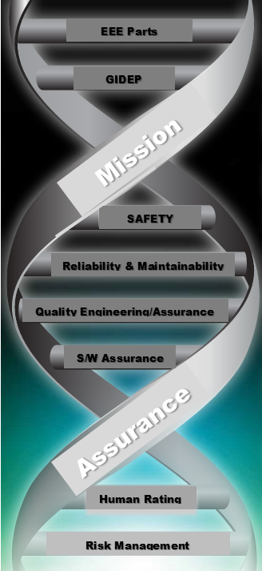
Conclusions and Path Forward
Conclusions
Model-Based Organizations, including NASA, must decide for themselves how to implement model-based engineering in a way that makes sense for all their engineering, assurance, operational, and production elements. Therefore it is essential to engage subject matter experts from each element as early as possible.
Not all tools are ready to support all disciplines.
Path Forward
Conduct Phase 3 of this study in which evaluations and testing will consist of follow-on System Safety evaluations with more complex system/model (e.g., Cubesat Mission) and Software Assurance /Quality Engineering Analysis compatibility..
Work with tool vendors to customize tools for even more compatibility with SMA disciplines.
Notes:
Model-Based Engineering is found to be a valid and useable for Reliability Engineering for NASA
Safety and Mission Assurance if an adequate modeling processes and environment are established.

Slide 18


