Slide 1
Vehicle Analysis Branch
Aggregate Risk Assessment with Rolled-up Risks
Roger Lepsch and Ann Shih, NASA LaRC SACD/VAB
SACD Risk Workshop, 8/10/2022

Slide 2
Outline
Introduction on Concept for Aggregate Risk Assessment
  Risk Roll-up Process
  Better Insight into the Risk Profile / Risk Posture
Application of Aggregate Risk Assessment – An Example
  Risk Identification by Stakeholders for the Human Landing System (HLS) Program
  Qualitative Risk Roll-up Steps for the HLS Program
  Risk Roll-up Illustration
Concluding Remarks
Notes:
This type of risk rollup was used for Mars 2020, and it has worked out well for the Mars Program Office. Hoppy Price (Mars Program Chief Engineer at JPL) provided a sample of JPL Mars 2020 Perseverance Risk Report for top aggregate risks.
Rolled-up Risks:
Present a way that makes it easier to see an overall summary of risks
Facilitate understanding of the effectiveness of risk barriers, and vulnerabilities/weaknesses.

Slide 3
Concept for Aggregate Risk Assessment
The risk management for a typical space mission program involves analyzing and tracking a voluminous portfolio of individual risks with assigned likelihood and consequence (LxC) level in a risk matrix.
Instead of a collection of numerous, diverse, individual risks, the aggregate risk assessment examines individual risks and aggregates those that are in related areas to a higher-level risk, or an aggregated risk.
This risk roll-up process in the aggregate risk assessment results in fewer significant risks, providing a more holistic understanding of the broad concern and better communication on risk profile for the program.
  Focuses on the forest rather than the trees
The likelihood and consequence of an aggregated risk reflects the severity (L,C) of the sum total of risks binned under it
  The process of rating the likelihood and consequence of an aggregated risk requires understanding the key detailed risks binned under it and exercising expert judgement along with available risk data/info
  The aggregate risk assessment was conducted by various projects/programs in the past, such as Mars 2020 Perseverance and James Webb Space Telescope.
Notes:
This type of risk rollup was used for Mars 2020, and it has worked out well for the Mars Program Office. Hoppy Price (Mars Program Chief Engineer at JPL) provided a sample of JPL Mars 2020 Perseverance Risk Report for top aggregate risks.
Rolled-up Risks:
Present a way that makes it easier to see an overall summary of risks
Facilitate understanding of the effectiveness of risk barriers, and vulnerabilities/weaknesses.

Slide 4
Application of Aggregate Risk Assessment (1/3)
The goal of HLS program is to enable sustainable lunar exploration this decade and beyond by fostering the commercial expertise and technologies, and empowering industry to develop human-rated landing systems.
  Risks identified/mitigated by commercial providers
  Risks identified/mitigated by NASA HLS teams
Since the HLS is the final mode of transportation taking astronauts to the lunar surface, the HLS must interface with other NASA programs in order to achieve the mission objectives. The interfacing programs include Space Launch System/Orion, Extravehicular Activity-Human Surface Mobility, and Gateway.
  Risks identified/mitigated by cross-program with HLS impacts
Various NASA programs and commercial providers may have different definitions on risk LxC levels from those used by the HLS program. Risks identified by multiple stakeholders must be considered, reviewed, and combined for aggregate risk assessment.
Notes:
This type of risk rollup was used for Mars 2020, and it has worked out well for the Mars Program Office. Hoppy Price (Mars Program Chief Engineer at JPL) provided a sample of JPL Mars 2020 Perseverance Risk Report for top aggregate risks.
Rolled-up Risks:
Present a way that makes it easier to see an overall summary of risks
Facilitate understanding of the effectiveness of risk barriers, and vulnerabilities/weaknesses.

Slide 5
Application of Aggregate Risk Assessment (2/3)
Review individual risks identified by various stakeholders and bin risks under major, high-level risk areas
  Examples: Performance Margins, Component Development, Descent and Landing, Lunar Surface Operations
Evaluate assigned (L,C) for each risk based on stakeholder’s risk scorecard definitions.
Reconcile (L,C) with NASA HLS risk scorecard definitions, if needed.
For each high-level risk area (or a silo), perform risk roll-up to obtain the aggregated risk.
  If there are numerous individual risks, assess individual risks that are most similar and interrelated, leaving out few dissimilar ones in the first roll-up iteration, and determine (L,C) of the aggregated risk with rationales documented
  For a risk area, if there are few and/or nearly no similar risks, a first-order approach in the first iteration may simply increase the L of the single worst risk in this category with no change in C level
Plot these aggregated risks plus any risks dropped off in Step 4.i on a 5x5 risk matrix, then evaluate them to determine if additional roll-up iteration is desired and feasible, potentially into a single aggregated risk for the mission/program.

Slide 6
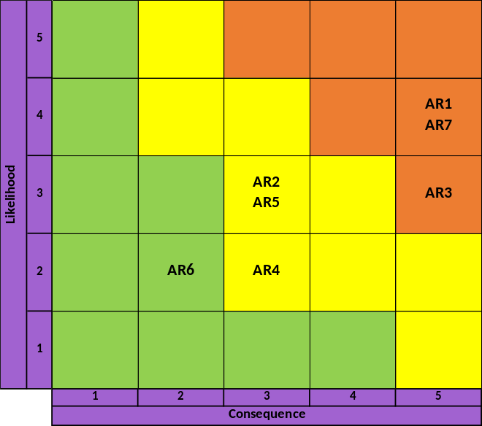
Application of Aggregate Risk Assessment (3/3)
Illustrate Risk Roll-up Steps 4 & 5
Major Risk Areas
in Design Dev Test and Eval Domain
Major Risk Areas
in Flight Operations Domain
Aggregated Risk (AR)
AR1
AR2
AR3
AR4
AR5
AR6
AR7
risk roll-up
Individual Risk
Rsi
R1, R2, R3, R4, R5
Rsj
Rsk
Rsl
Rsm
Rsn
Determine (L,C) for an aggregated risk
  Approach 1: Simply take the (L, C) of single worst risk
  Approach 2: Compute the centroid value of L and C of the individual risks
  Approach 3: Have SMEs evaluate these individual risks (including criticality, sensitivity, uncertainty, amplification, etc.) and reach consensus on (L,C)

Slide 7
Concluding Remarks
Aggregate risk assessment for the HLS program is an on-going effort.
Aggregate risk assessment takes the approach of management of a few aggregate risks vs numerous individual risks. The risk posture of a program can then be characterized and communicated by a small set of aggregated risks that sum up all of the major risk areas.
It is important to document the systematic risk roll-up process and how “new” aggregated risks are assessed. If the lower-tier risks are changed, the associated aggregated risk should be re-evaluated accordingly.
Notes:
This type of risk rollup was used for Mars 2020, and it has worked out well for the Mars Program Office. Hoppy Price (Mars Program Chief Engineer at JPL) provided a sample of JPL Mars 2020 Perseverance Risk Report for top aggregate risks.
Rolled-up Risks:
Present a way that makes it easier to see an overall summary of risks
Facilitate understanding of the effectiveness of risk barriers, and vulnerabilities/weaknesses.

