Slide 1


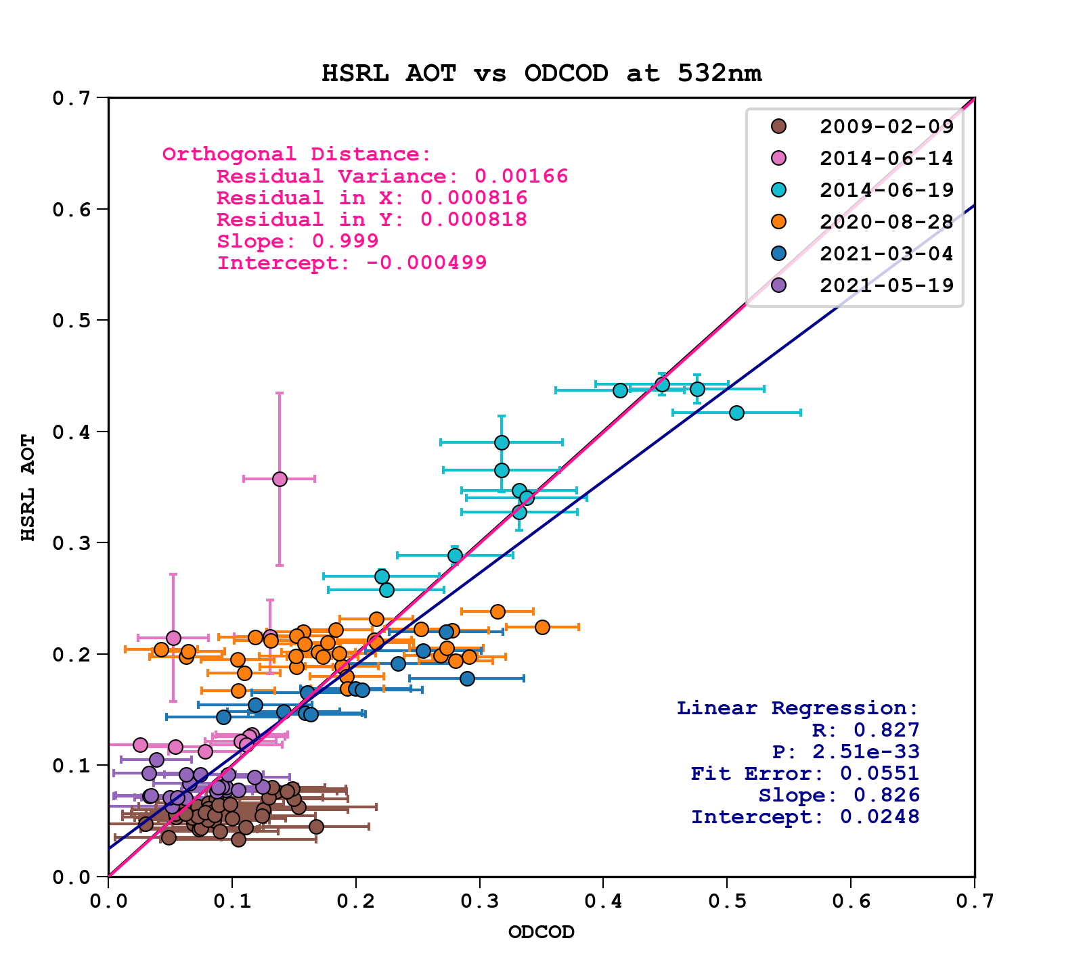
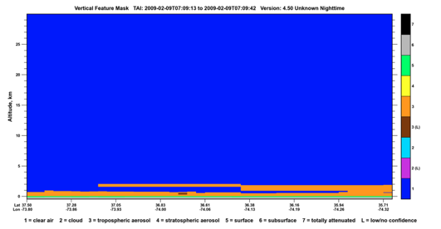
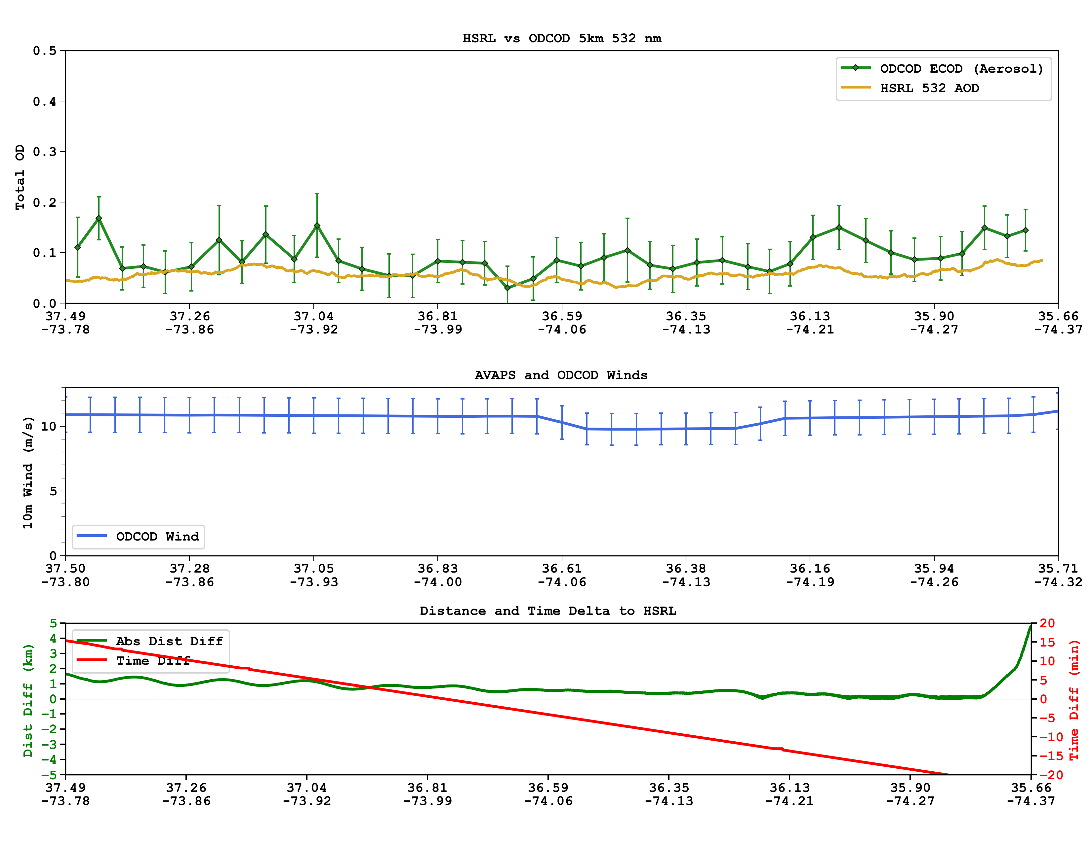
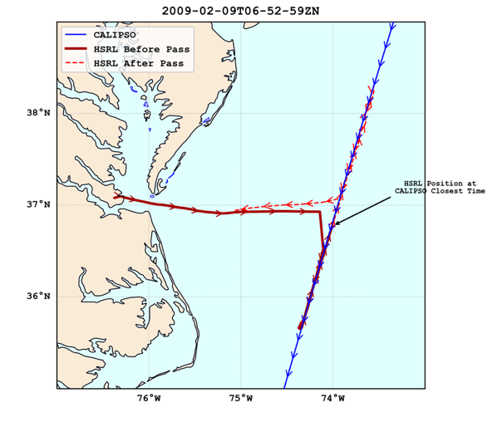
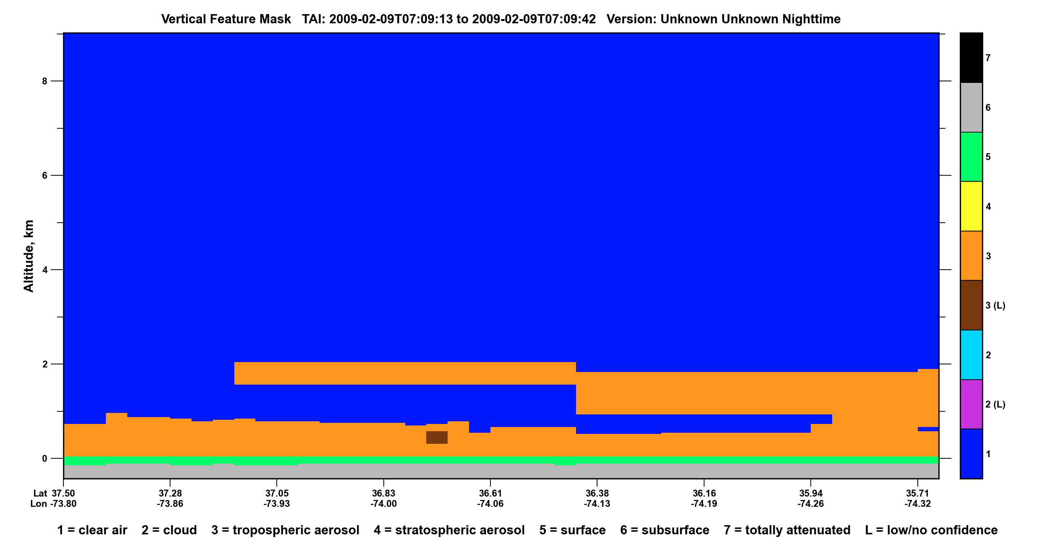
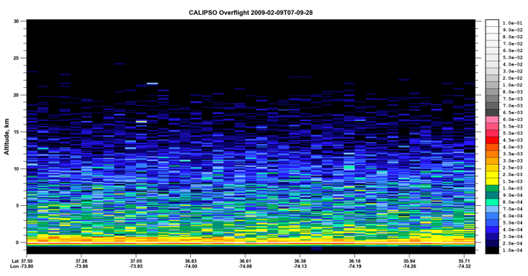
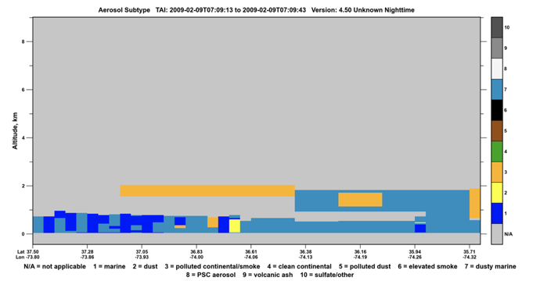
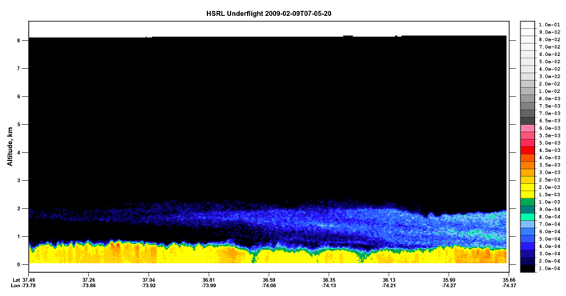
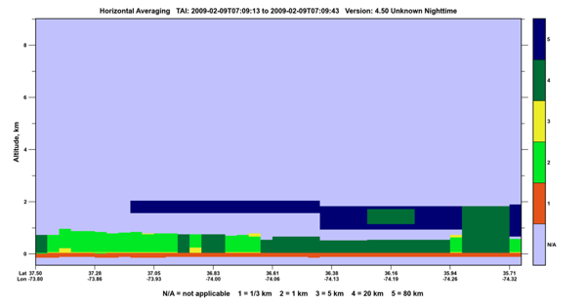
CALIPSO’s New ODCOD Product
Compared to Langley’s HSRL and HSRL-2
R. Ryan¹, S. Rodier¹, R. Ferrare², J. Hair², M. Vaughan², D. Winker²
http://www-calipso.larc.nasa.gov
(1) Science Systems and Applications, Inc., Hampton, VA
(2) NASA Langley Research Center, Hampton, VA
Author POC: robert.a.ryan@nasa.gov
Overview
CALIPSO’s Version 4.51 Level 2 data release introduces an all-new group of science data sets containing estimates of total column effective optical depths derived from CALIOP ocean surface backscatter measurements and MERRA-2 reanalysis wind speed data with a bias correction applied from AMSR-E and AMSR-2 analysis over the years of the CALIPSO mission. This new data product is known as the Ocean Derived Column Optical Depth product (ODCOD).
The ODCOD algorithm uses CALIOP’s ocean surface lidar return to estimate the effective total column optical depth overhead; i.e., the single scattering optical depth reduced by the contributions of multiple scattering to the ocean surface signal. Because the retrieval generates a single estimate for the entire column based solely on the surface backscatter, there is currently no way to correct for multiple scattering effects from different kinds of features within the column. This new retrieval will be provided for the entire mission, day and night, at 532nm, and is reported at single shot, 1km, and 5km resolutions for all profiles in which a valid lidar ocean surface return is detected. This poster presents a collection of HSRL and HSRL-2 CALIPSO under-flight case studies that compare the HSRL measured aerosol optical depth with the estimated total column optical depth derived by ODCOD.
Flight Dates
6 dates were chosen for the quantity of data available from ODCOD and the HSRL as well as good colocations. Most data from the flights are less than 20 minutes apart in time and less than a few hundred meters from the CALIPSO ground track.
2009-02-09
  HSRL-1
  Part of the CAL-VAL Flight Campaign
  Off Virginia/North Carolina Coast
2014-06-14
  HSRL-1
  Part of the CAL-VAL Flight Campaign
  Near Bermuda
2014-06-19
  HSRL-1
  Part of the CAL-VAL Flight Campaign
  Near Bermuda
2020-08-28
  HSRL-2
  Part of the ACTIVATE Campaign
  Off Virginia Coast
2021-03-04
  HSRL-2
  Part of the ACTIVATE Campaign
  Off Virginia Coast
2021-05-19
  HSRL-2
  Part of the ACTIVATE Campaign
  Off Virginia Coast
ODCOD-HSRL AOD Difference
 | Median | MAD | Mean | Std. Dev.
Feb 9th 2009 | 0.029 | 0.016 | 0.036 | 0.028
Jun 14th 2014 | -0.049 | 0.037 | -0.066 | 0.060
Jun 19th 2014 | -0.016 | 0.021 | -0.012 | 0.041
Aug 28th 2020 | -0.032 | 0.041 | -0.02 | 0.069
Mar 4th 2021 | 0.025 | 0.028 | 0.022 | 0.042
May 19th 2021 | -0.010 | 0.021 | -0.008 | 0.029
All | 0.007 | 0.030 | 0.001 | 0.057
ODCOD 532nm at 5km resolution with reported estimated uncertainty error bars on the x-axis vs median of HSRL points closest in distance to the respective CALIPSO footprint with median absolute distance reported as error bars. Since there is uncertainty in both ODCOD and HSRL estimates as well as the uncertainty associated with colocations, the orthogonal fit is a better way to fit this data and the small residual variance and slope of nearly 1 and intercept very close to zero show nice agreement between these datasets.
Due to the difference in the flight altitude of the HSRL instrument of ~ 8.5 km vs the calibration altitude of CALIOP at 37.5 km, a background optical depth difference of 0.016±0.03 is suggested by Kim, et al., 2017 as the background upper troposphere and stratosphere aerosol optical depth above the HSRL profile. The median difference shown here of 0.007 is nicely within these bounds.
Kim, et al., 2017, Quantifying the low bias of CALIPSO’s column aerosol optical depth due to undetected aerosol layers, J. Geophys. Res. Atmos., 122, 1098–1113, doi:10.1002/ 2016JD025797.
A Closer Look at 2009-02-09
CALIPSO VFM: to 30km Shows Nothing Overhead
Optical Depth reported by ODCOD in Green HSRL 532 AOD in Gold
CALIPSO VFM: to 8.5 km
MERRA-2 Corrected Wind Speeds at 10m used by ODCOD Retrieval
CALIOP 532nm Attenuated Backscatter
Aerosol Subtype:
Marine
Dusty Marine
Polluted Continental/Smoke
Colocation Distance Difference in Green (in km)
Time Difference in Red (in minutes)
Each case study was examined in similar fashion and all show reasonable agreement between the HSRL and ODCOD retrieval. A few cases where large wind variability was observed by dropsonde measurements result in large swings of the ODCOD estimate (on the order of -0.04 per +1 m/s difference). This is due to the MERRA-2 winds being selected from a large 0.5º latitude by 0.625º longitude grid box and then only interpolated in time between two 3-hour average values. The surface reflectivity estimate used by the ODCOD algorithm is driven by capillary waves which are created by surface winds over the course of only a few moments. This wind variability over a given scene is another source of uncertainty in the ODCOD estimate.
HSRL 532nm Attenuated Backscatter
Horizontal Average
80km
1km
20km

