Slide 1
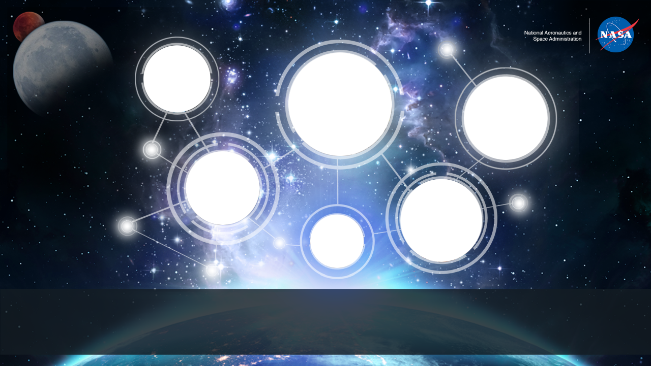

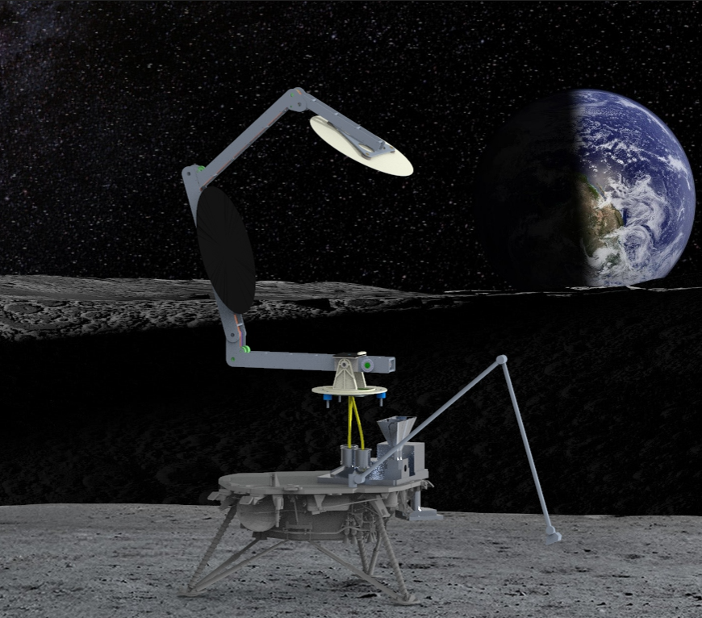
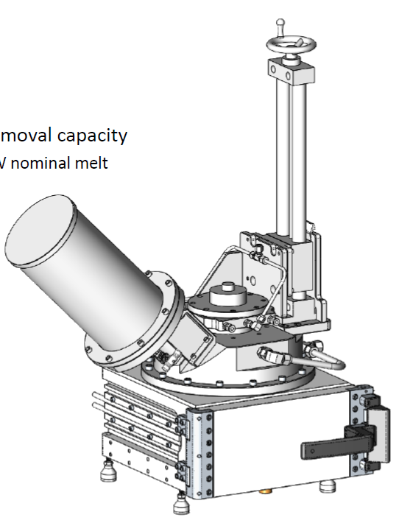
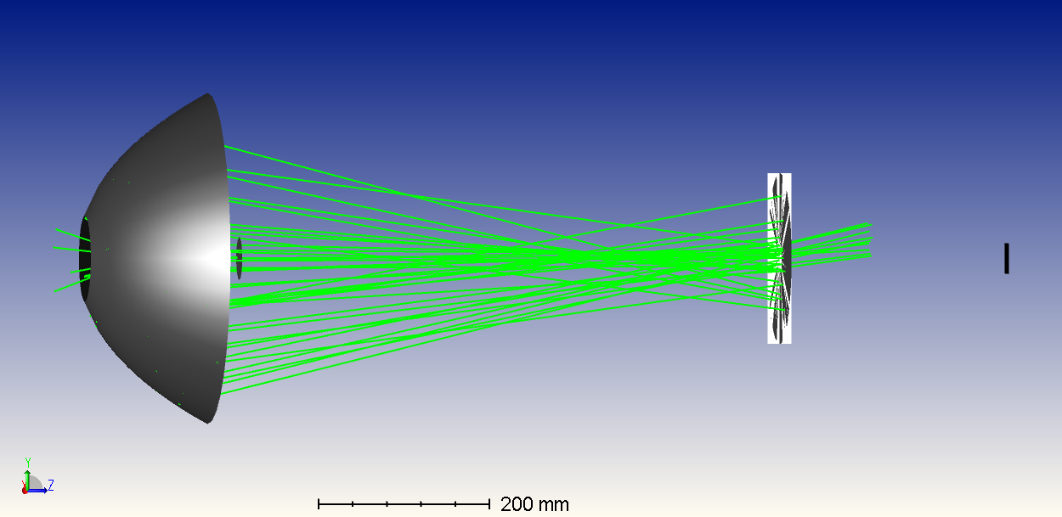
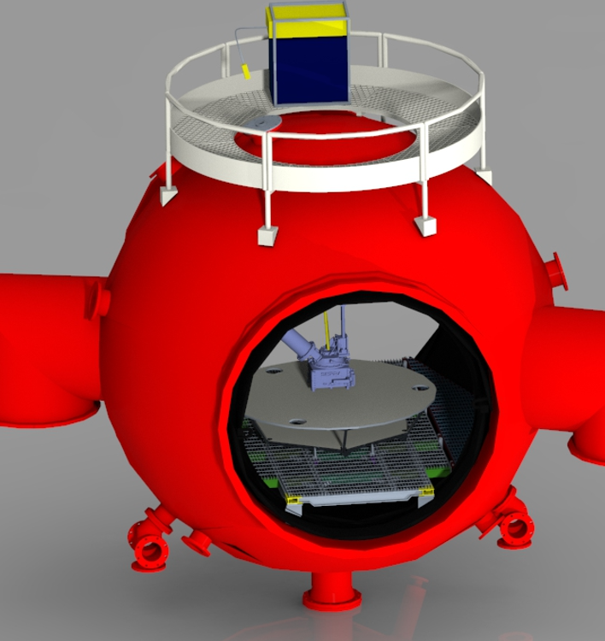
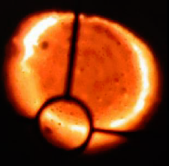
Space Technology Mission Directorate
Game Changing Development Program
Aaron Paz| Carbothermal Reduction Demonstration (CaRD)| NASA APL ISRU Technology Review | 08.17.2022

Slide 2
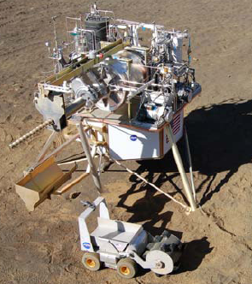
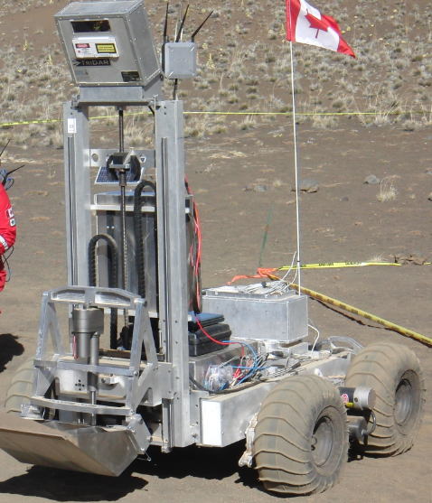
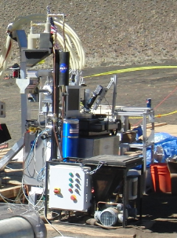
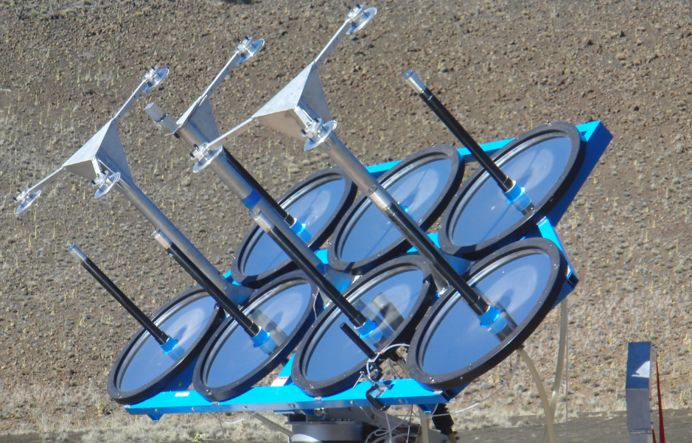
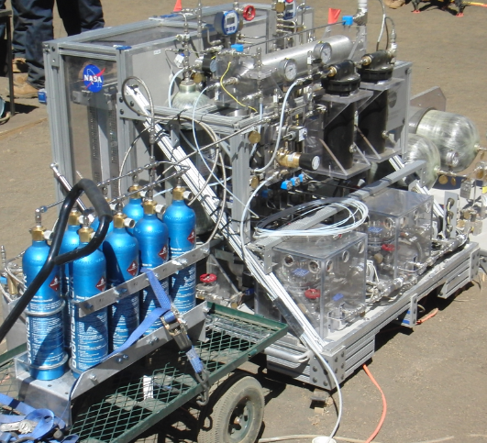
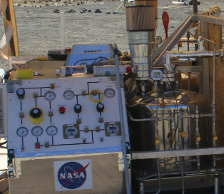
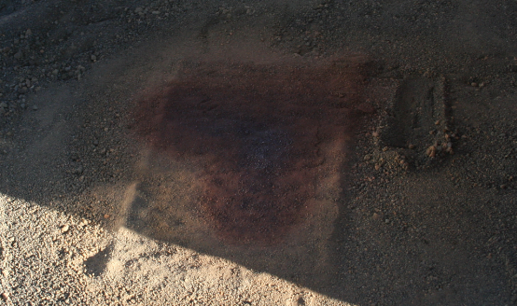
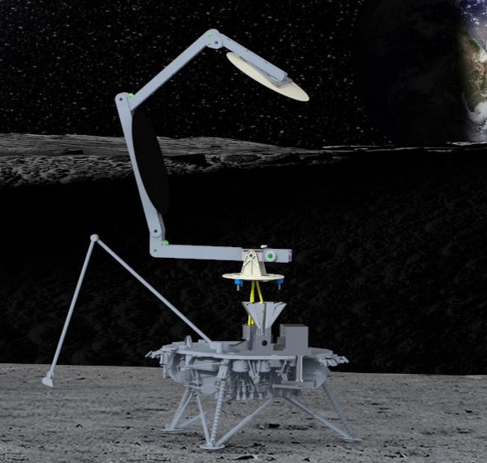
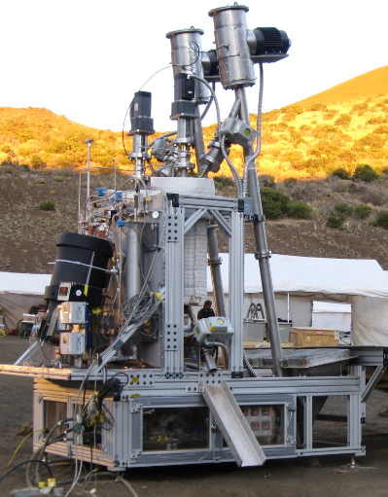
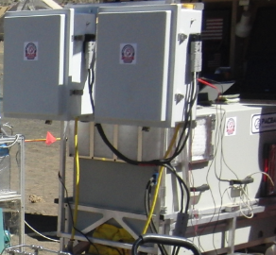
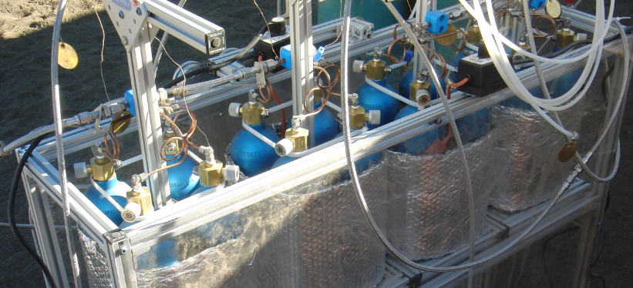
Introduction – Oxygen from Regolith (O2FR) Demonstrations
2008
2010
CaRD
Carbothermal Reduction Module- Orbitec
Solar Concentrator - PSI
Excavator - CSA
CaRD project intends to raise the TRL of an integrated solar concentrator/carbothermal reactor/gas analysis system in order to propose a flight demonstration that uses actual lunar regolith and solar flux at the lunar poles
Regolith
Thermal Power
Thermal Power
Water
PILOT-Lockheed Martin
Hydrogen
Water
Oxygen
Fire
Sintered Landing Pad
Water Electrolyzer – NASA
Cryocart–NASA
Hydrogen
ROxygen-NASA
H2 Storage - NASA
Fuel Cell - CSA

Slide 3
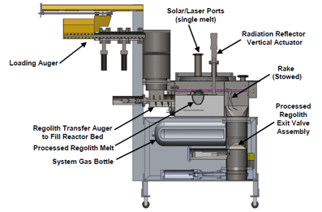
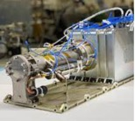
Introduction – Simplified CaRD Conops
Solar concentrator focuses light and directs it into optical waveguide
Solar Light
Tracking Mechanism
Reaction
Products
Light
Image: Section view of 2010 field demo reactor
Gas Analysis
2.Optical waveguide (fiber optic bundle) carries concentrated light to reactor
3. Concentrated light melts regolith. Carbothermic reaction removes oxygen from silicate minerals in the form of CO
4. Mass spectrometer is used to determine the amount of CO produced from the reaction

Slide 4

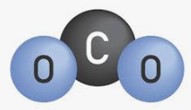
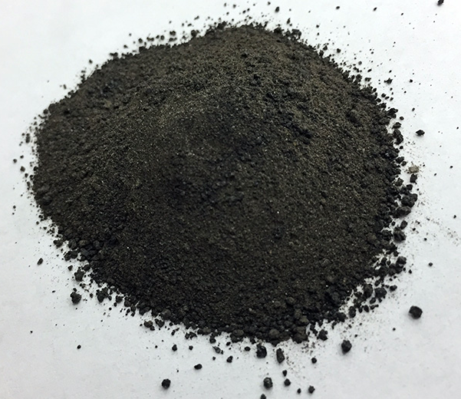
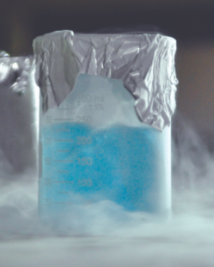
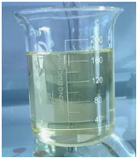
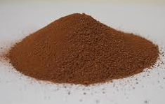
Introduction – Why Carbothermal?
Carbothermal Reduction is the only O2FR method with the following combination of factors
Has demonstrated automated transportation of regolith into and out of the reaction zone
Has been demonstrated at a relevant scale
Can be applied anywhere on the lunar surface
Has commonality with Mars ISRU
Has commonality with ECLSS
End-to-end
Lunar Carbothermal O2FR Process
Methane Gas
Common to Mars ISRU, Carbothermal and ECLSS
CH₄
Common to Mars ISRU and Carbothermal
Carbothermal Reactor
CH_{4,} CO, H_{2,} CO₂
Sabatier Reactor
CH₄
Soil Excavation
Inlet Hopper
H₂O
Condenser
H₂O
H₂
Spent Soil Disposal
Outlet Hopper
Water Electrolysis
O2 Liquefaction & Maintenance
Water Cleanup
O₂
O2 Dryer
End-to-end
Mars Propellant Production Process
Dust Filtration
CO₂ Collection
CO2
Sabatier Reactor
CH₄
Condenser
CH₄ Liquefaction & Maintenance
H₂O
CH₄
CH₄ Dryer
H₂O
H₂
Soil Excavation
Inlet Hopper
Regolith Dryer
Water Cleanup
Water Electrolysis
O2 Dryer
O2 Liquefaction & Maintenance
H₂O
O₂
Spent Soil Disposal
Outlet Hopper

Slide 5
Project Overview
Technology Product Capability
  Oxygen from Regolith (O2FR) technology development effort that can transition to mid-size CLPS payload upon completion of the project
  Integrated demonstration of solar concentrator, carbothermal reactor, and gas analysis system in a relevant environment
Technical Capabilities
  Light-weight deployable solar concentrator heats regolith beyond melting point
  Concentrated solar energy is routed through fiber optic cable (developed through SBIR program) to carbothermal reactor
  Automated O2FR process (developed through Tipping Point) receives concentrated solar energy where regolith is melted
  Reaction products are analyzed using modified COTS mass spectrometer
Exploration & Science Applicability
  This technology has the potential to produce several times its own weight in oxygen once deployed on the lunar surface, enabling long term habitability of the moon with minimal dependence on earth resupply
  Prospecting missions are not required to begin deploying this technology at a useful scale on the lunar surface
  Carbothermal reduction has commonality with Mars ISRU and ECLSS systems
Notes:
Provide an overview of the Project/Task
The slide content is intended to remain static unless significant changes are made to the Project
Pictures are encouraged, please provide new pictures as frequently as possible

Slide 6

Team Members / Project Org Slide
STMD Interfaces
ISRU SCL
(Jerry Sanders)
ISRU TIM
(Omar Hatamleh)
Program Element
Manager
(QuynhGaio Nguyen)
ISRU SCL Deputy
(Julie Kleinhenz)
1.0 Project Management
Aaron Paz
3.0 Integration
Aaron Paz
1.2 KSC PM
Annie Meier
4.2 TVAC Tests Thomas Viviano
4.3 Test Director Anastasia Ford
3.1 Fluids
Naina Noorani
3.2 Optical
Desmond O’Connor
3.3 Thermal
Lisa Erickson
4.0 Testing
Mike Reddington
5.0 Solar Concentrator
Tony Colozza
5.1 Optical Waveguide
Luis Rodriguez
6.0 Carbothermal Reactor
Diane Linne
7.0 Chemistry
Trey Barnes
8.0 Avionics
Chris Bond
9.0 Software
Jim Kania
Nilab Azim
Jennifer Williams
Alex Decamargo
Beau Peacock
Ryan O’Farrell
Kevin Smith
Optical Waveguide
Bill Kessler
Carbothermal Reactor
Brant White
1.1 GRC PM
Erica Montbach
Nathaniel Cain
Stephen Simmons
Joel Olson
Ray Pitts
Monique Moore
2.0 Systems Engineering
Aaron Paz
2.1 KSC SE
Jonathan Martinez
Mac Zborowski
Lawrence Kren
Rick Wainner
Takashi Nakamura
Will Clark
Kristin Galbally-Kinney
Rick Burkholder
Nathan Haggerty
Matthew Bair
Pat Verstegen
Bob Youngquist
LOWE PM (Koorosh Araghi)
NASA Headquarters
Johnson Space Center
Glenn Research Center
Kennedy Space Center
Physical Sciences Inc.
Sierra Space Corp.
Notes:
If you have submitted a Project Plan, you could utilize the Organizational Chart found in section 8.3 – Management Structure

Slide 7
Collaborations & Partnerships
Contributing partners
  JSC Engineering has contributed ~500K
  Sierra Space contribution toward Tipping Point contract is ~850K
Infusion/transition plan
  Subscale ground demonstration
  Subscale flight demonstration
  Pilot Plant demonstration
  Full scale demonstration
NASA Centers
GRC
JSC
KSC
Public/Private Partnerships
Sierra Space
SBIR/STTR
Physical Sciences Inc. (Phase 2 80NSSC20C0201)
Sierra Space (Phase 3 80NSSC20C0048)
Collaborative multidisciplinary partnerships to leverage fiscal resources, ideas, knowledge & expertise.

Slide 8
Project Goals
Need
In April 2020, NASA submitted the Plan for Sustained Lunar Exploration and Development to the National Space Council. The report defines several goals for the Artemis Program and states that “ISRU will enable the production of fuel, water, and/or oxygen from local materials, enabling sustainable surface operations with decreasing supply needs from Earth.”
Draft Goals (Project Plan in Work)
Goal #1 | Raise TRL of individual components within two years to allow for maximum flexibility and de-scope options.
Goal #2 | Raise TRL of an integrated Carbothermal reduction system to TRL6 by performing a ground demonstration in a relevant environment.
Goal #3 | Develop a systems engineering framework for an O2FR ground demonstration that prepares team for flight demo opportunities.
Goal #4 | Utilize model-based systems engineering for requirements development and SE products that can be applied to future ISRU projects and flight demonstrations.

Slide 9

Project Objectives
Draft Objectives (Project Plan in Work)
Objective #1 | Develop Mission Concept Review (MCR) products per NPR 7123.1C but apply them to a ground demonstration in a relevant environment.
Objective #2 | Develop preliminary requirements for ground demonstration based on environmental requirements for previous lunar surface missions and NASA standards.
Objective #3 | System Requirements Review (SRR)
Objective #4 | Preliminary Design Review (PDR)
Objective #5 | Critical Design Review (CDR)
Objective #6 | Develop engineering test units (brassboards)
Objective #7 | Test brassboards in a thermal vacuum chamber (TRL 5)
Objective #8 | Develop integrated prototype system
Objective #9 | Test integrated prototype system in thermal vacuum chamber (TRL6)
Objective #10 | Final report

Slide 10
TRL Progression CaRD
Project Milestone
GCD (Key) Milestone
Controlled Milestone
TRL/SRL/MRL Progression
FY22 | FY23 | FY24
KCTE-1 Prototype System
Integrated Brassboard TVAC Test
Integrated Prototype Test (Ambient)
Integrated Prototype TVAC Test
KCTE-2 Solar Concentrator Subsystem
KCTE-3 Optical Waveguide Subsystem
6
KCTE-4 Gas Analysis Subsystem
KCTE-5 Lander to System Interface
KCTE-6 Solar Concentrator to Optical Waveguide Interface
Solar Concentrator Thermal Cycle Test
KCTE-7 Optical Waveguide to Carbothermal Reactor Interface
KCTE-8 Carbothermal Reactor to Gas Analysis Interface
5
TRL
Calibration Test
Laser Vacuum Test
4
Notes:
Chart purpose: show TRL/SRL/MRL advancement over the project lifecycle schedule. Show TRL advancements as whole integer increases. Show how Key and Controlled milestones align with TRL advancement.
TRL/SRL/MRL may not advance at each milestone. Often several milestones are required to produce a step increase in TRL/SRL/MRL.
There can be one, or more, of these charts per project as needed.
For projects with fewer technical elements, the TRL/SRL/MRL data can be combined on one chart.
For more complex projects, the TRL/SRL/MRL progression can separated into multiple charts by project technical area.
Show TRL, SRL, and MRL data for each technical element on the same chart.
Delete TRL/SRL/MRL axis-labels that do not apply – e.g., remove SRL/MRL for projects/technical areas where SRL and MRL do not apply.

Slide 11
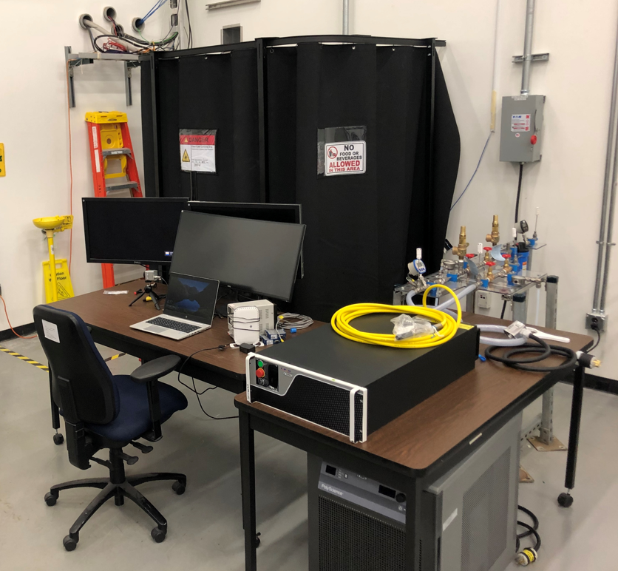
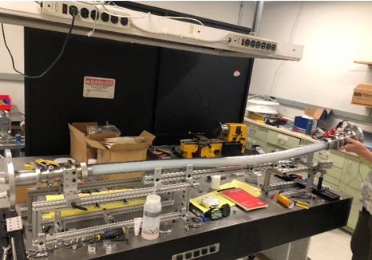
Accomplishments
  Developed laser test stand with calorimeter
  Defined interface details between laser and vacuum chamber
  Laser support cart design, software, and structural analysis
  Completed carbothermal reactor testing
  Began gas analysis subsystem calibration
  Integrated CAD of vacuum test
  Completed integrated fluid system schematic
  Completed integrated electrical schematic
  Completed System Requirements Review
  Initiated composite mirror procurement
  Developed interface details between solar concentrator and fiber optics
  Developed solar concentrator deployment concept
  Completed checkout of laser and calorimeter
  Delivered laser to PSI for optical waveguide testing
2KW laser test stand with Calorimeter
Optical Waveguide Developed by PSI

Slide 12
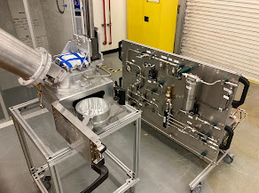
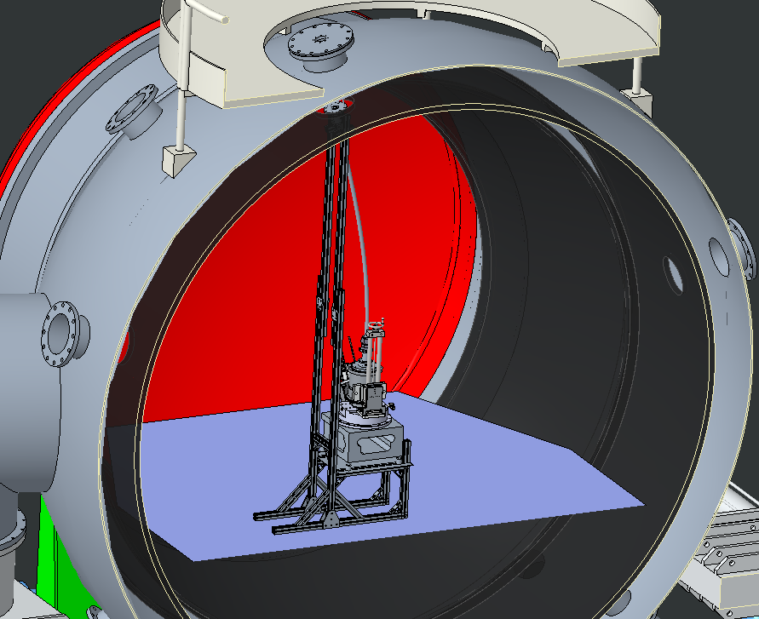
Accomplishments
  Developed laser test stand with calorimeter
  Defined interface details between laser and vacuum chamber
  Laser support cart design, software, and structural analysis
  Completed carbothermal reactor testing
  Began gas analysis subsystem calibration
  Integrated CAD of vacuum test
  Completed integrated fluid system schematic
  Completed integrated electrical schematic
  Completed System Requirements Review
  Initiated composite mirror procurement
  Developed interface details between solar concentrator and fiber optics
  Developed solar concentrator deployment concept
  Completed checkout of laser and calorimeter
  Delivered laser to PSI for optical waveguide testing
Carbothermal Reactor Developed by Sierra Space
Integrated Brassboard CAD
(isometric cross section view)

Slide 13
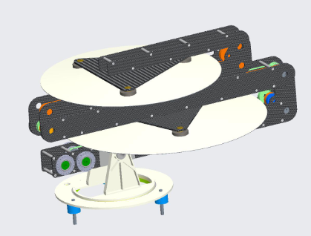
Accomplishments
  Developed laser test stand with calorimeter
  Defined interface details between laser and vacuum chamber
  Laser support cart design, software, and structural analysis
  Completed carbothermal reactor testing
  Began gas analysis subsystem calibration
  Integrated CAD of vacuum test
  Completed integrated fluid system schematic
  Completed integrated electrical schematic
  Completed System Requirements Review
  Initiated composite mirror procurement
  Developed interface details between solar concentrator and fiber optics
  Developed solar concentrator deployment concept
  Completed checkout of laser and calorimeter
  Delivered laser to PSI for optical waveguide testing
Solar concentrator stowed
Solar concentrator deployed

Slide 14
Project Assessment Summary
Project Name | Performance |  |  |  | Comments
 | C | S | T | P
Oct |  | LT |  |  | CR budget caused cost overruns and affected long term milestones
Nov |  | LT |  |  | CR budget caused cost overruns and affected long term milestones
Dec |  | LT |  |  | Funding drop fixed cost overruns, long term milestones still affected.
Jan |  | LT |  |  | PY21 funds for WYE near exhaustion
Feb |  |  |  |  | Enough funding was received to address overruns. Agreed to rebaseline long term milestones affected by CR budget in project plan.
Mar |  | NT |  |  | Funds for WYE support exhausted. Integrated brassboard test was affected.
Apr |  | NT |  |  | Guideline was reduced. Obligations exceeded guideline. Work stoppage issued
May |  | NT |  |  | Guideline was increased at the end of May, but funds were not distributed until June
June |  |  |  |  | Agreed to update integrated brassboard test completion milestone in project plan
July |  |  |  |  | Uncertainty around FY23 budget could affect Phase 2E/3 for optical waveguide prototype
LT = Long term (prototype) milestones affected.
NT= Near term (brassboard) milestones affected

Slide 15
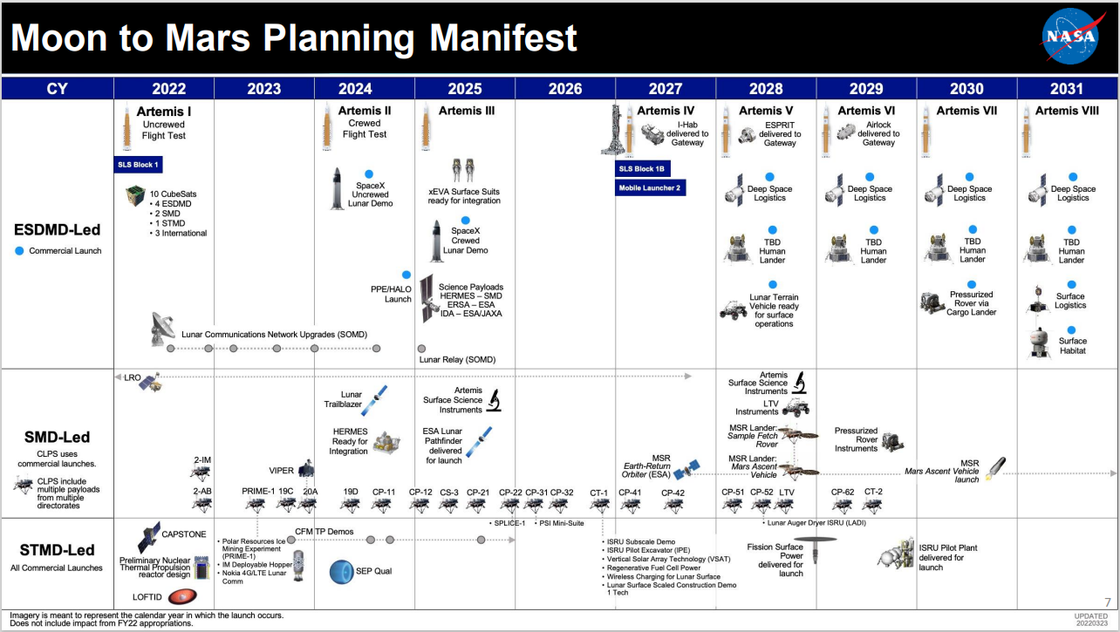
Infusion/Transition Plan
Moon to Mars Planning Manifest from FY23 NASA budget request summary
CLPS Lead Time (~3 years)
CT-1 Requirements for CLPS defined
CaRD Brassboard
ISRU Subscale Demo Flight Hardware
Included in CaRD project scope
Waveguide SBIR Phase 2 (PSI)
CaRD Prototype
Not Included in CaRD project scope
COPR-TP (Sierra Space)
Relevant Contracts not funded by CaRD

Slide 16

Infusion/Transition Plan
Full Scale
10MT/yr
(2 kg/hr)
SBIR Phase 3 (GRC-Sierra Space)
Full Scale Plant
COMPASS Study
3.5 MT/yr per module
Pilot Plant
1MT/yr
(0.2 kg/hr)
Studies/Development
Pilot Plant 2029
Completed
Active
Needed
CLPS Demo
(single melt)
CLPS Demo 2026
Demonstrations
Requirements
Studies/Development
Ground Demo
(single melt)
Ground Demo 2024
CaRD
SBIR Phase 3 (JSC-Sierra Space)
SBIR Phase 2 (PSI)
COPR TP(Sierra Space)

Slide 17
Summary
Team is on track to complete integrated brassboard test under vacuum in early FY23
Despite budget issues, the team was able to meet many technical objectives for the year. However, the reduced budget will result in a scope reduction for the prototype, as well as prototype milestone slips. The project plan in development will capture the scope and schedule going forward.

