Slide 1
Towards the Prediction of Entry Capsule Dynamic Stability Characteristics with Reduced Free Flight Motion in FUN3D Eli Shellabarger, NASA Langley Research Center
TFAWS Aerothermal Paper Session
Presented By Eli Shellabarger
Thermal & Fluids Analysis Workshop TFAWS 2022 September 6th-9th, 2022
Virtual Conference

Slide 2
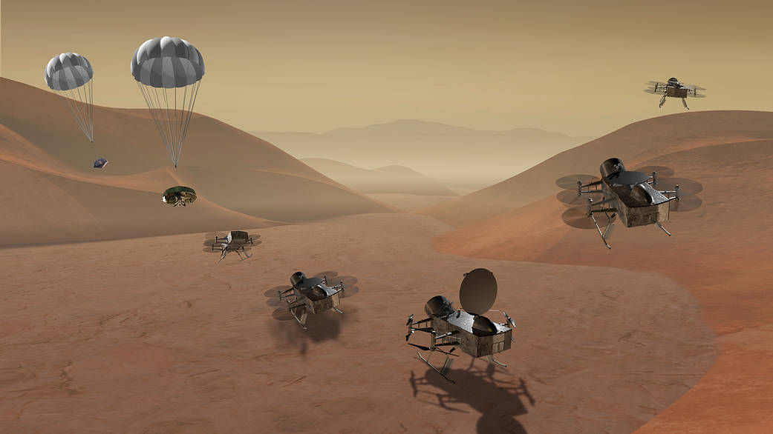
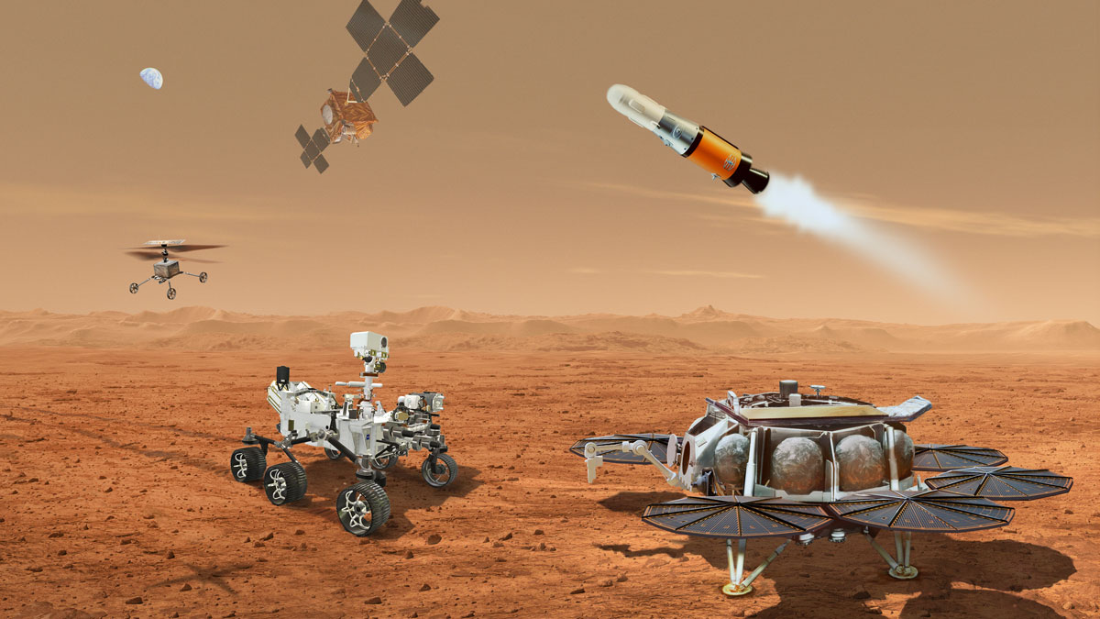
Motivation
Multiple entry, descent, and landing (EDL) flight projects are actively working to characterize entry capsule dynamic stability in the subsonic, transonic, supersonic flight regimes
Limited access to in-demand ground test facilities
Expand / enhance available test data with free-flight computational fluid dynamics (CFD)
Provide greater insight to ground test cases
Simulate cases not possible in ground testing
Isolate component effects and flowfield physics
Constraining degrees-of-freedom (DOF) reduces model complexity and isolates DOF contributions
Dragonfly mission to Titan
Image credits: NASA
Mars Sample Return
Objective: Verify FUN3D’s 6-DOF path and begin active application to flight projects. Work towards a computational predictive capability for entry capsule dynamic stability such that data from concurrent ground testing will enable validation efforts of this solver and its continued use on EDL vehicles.

Slide 3
Outline
Motivation
Outline
Background
Solver
Verification
Application to Flight Projects
Future Work
Summary
References
Questions

Slide 4
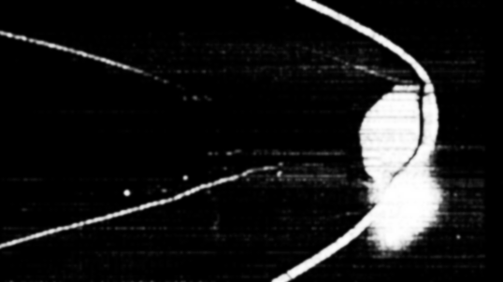
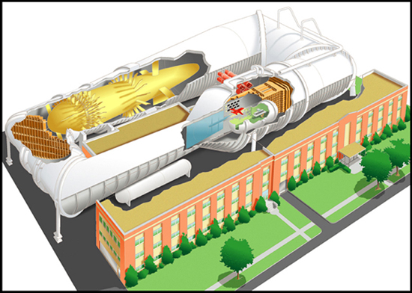
Background
Historical Approach
Historical EDL flight and test data
Degradation of data poses concerns
Ground testing
Wind Tunnel (VST, TDT)
Ballistic Range
Limitations
Other Current Computational Approaches to Capsule Stability
ARC/ESM Free-Flight CFD (US3D) [2,3,4]
POST2/FUN3D Coupling [5]
OVERFLOW 6-DOF [6]
Above: Genesis ballistic range test report [1] image (left) compared to a rescanned image at similar orientation and unknown condition (right)
Below: NASA LaRC’s Transonic Dynamics Tunnel (Image Credit: NASA)

Slide 5
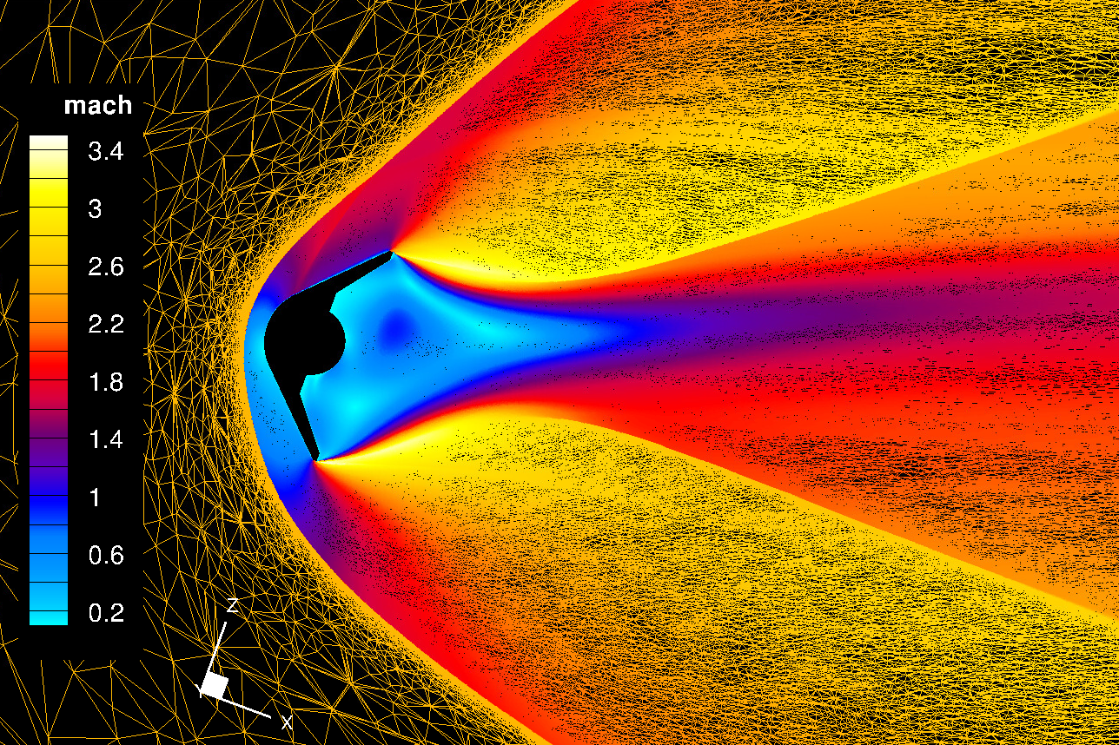
Solver
FUN3D
Circa late 1980s
Unstructured solver
NASA LaRC developed
Widely used by government, academia, and industry
Active use for capsule aerodynamics, EDL technologies
Offers multiple approaches
6-DOF Library
Developed by Koomullil et al. [7]
Coupled to FUN3D in late 2000s [8]
Little documented use in FUN3D
Required rediscovery
Applications of FUN3D on MSR-EES
Above:
FUN3D DDES (Mach 2.0 at sea level) Mach contours showing qualitative agreement with ballistic range shadowgraph image.
Right:
FUN3D Adaptive RANS (Mach 2.5 at sea level) applied to ballistic range case.

Slide 6
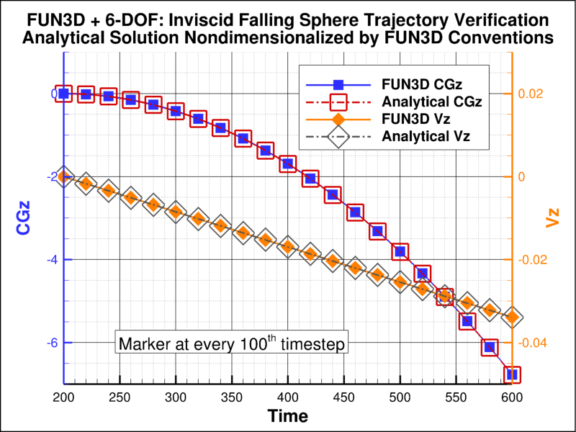
Verification: Falling Sphere
Inviscid Case
Analytical solution
Verify body movement
Viscous Case
Step towards application
$$z_{t}=z_{0}+v_{z,0}t+\frac{1}{2}gt^{2}$$
$$v_{z,t}=gt$$

Slide 7
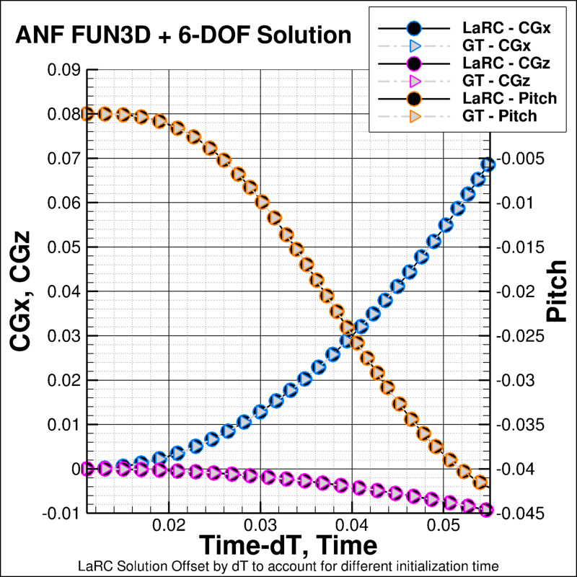
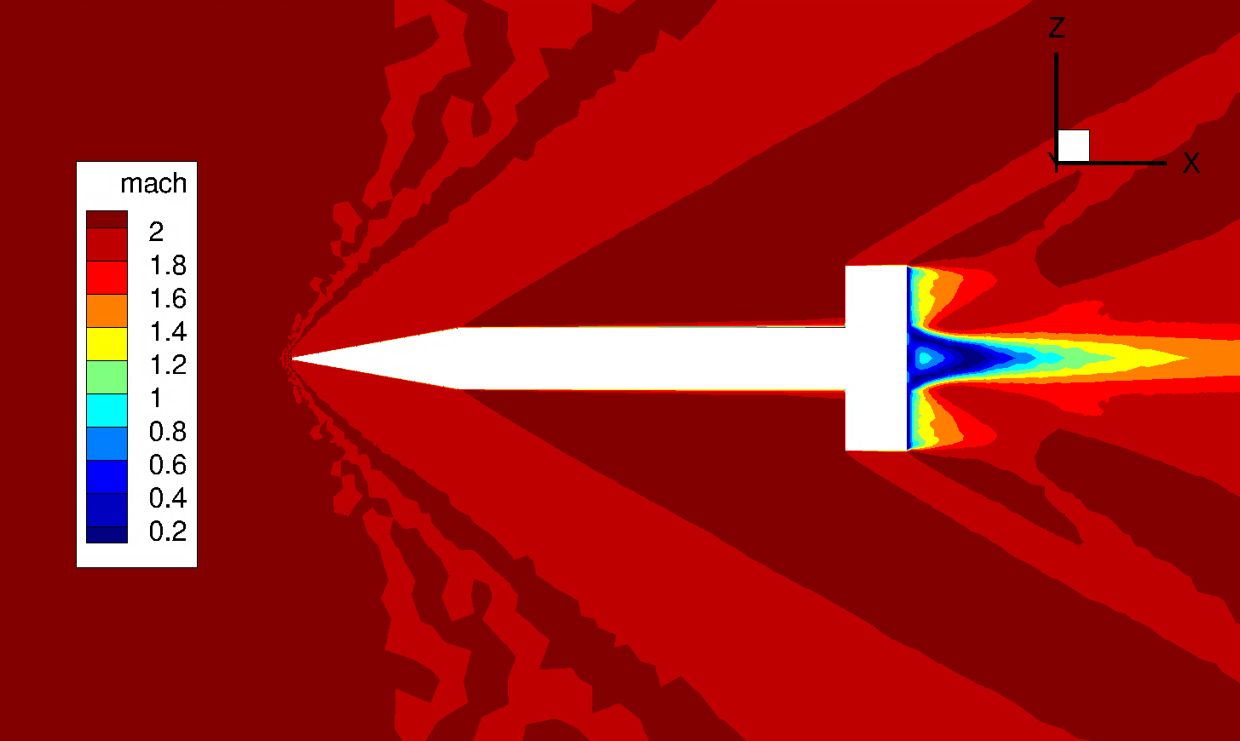
Verification: Army-Navy Finner
Provided by GT POST2/FUN3D team
Case uses FUN3D’s 6-DOF path
Used in GT framework verification [9]
Verify LaRC solver build
Army-Navy Finner (ANF) geometry in unpowered 6-DOF free flight, Mach 2 condition at $t_{final}$
Solutions verify solvers behaving as expected

Slide 8
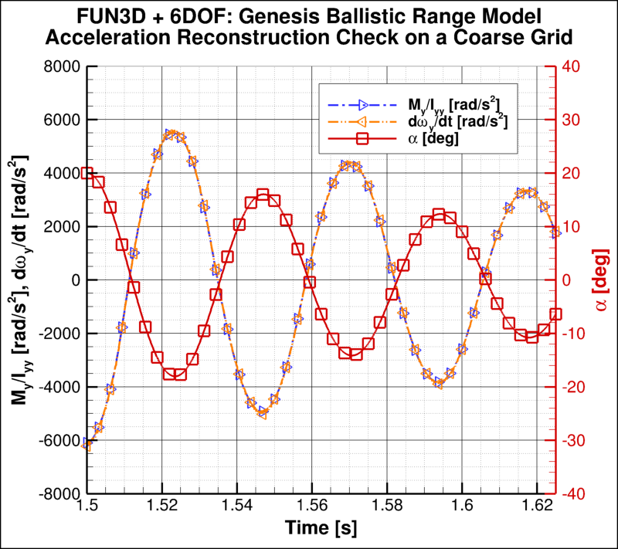
Verification: Blunt Bodies
Final step before application to flight vehicles
Verify free-to-pitch solution against $M_{i}=I_{ii}\frac{dω_{i}}{dt}$

Slide 9
Flight Project Applications: Dragonfly
Dragonfly Entry Capsule
TDT and Genesis ballistic range conditions [1]
Genesis Model in the Eglin Ballistic Range (rescanned)

Slide 10
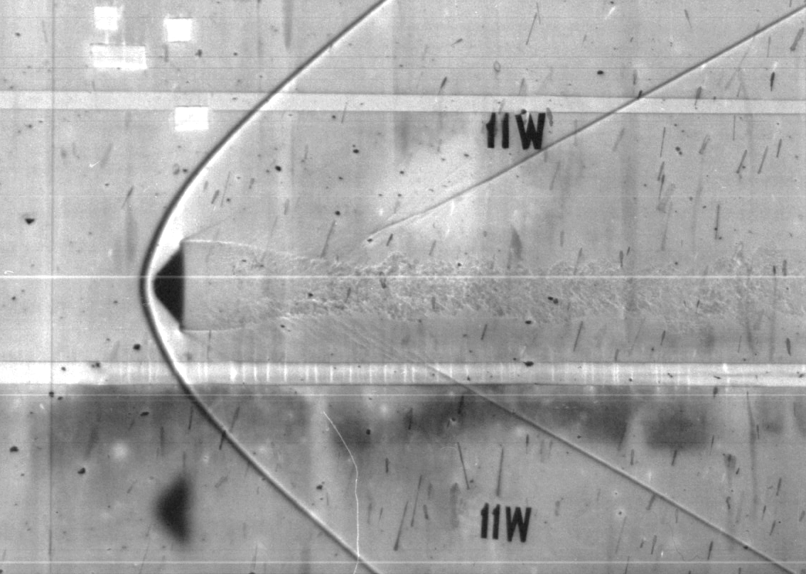
Flight Project Applications: Mars Sample Return
Earth Entry System (EES)
Current focus on ballistic range conditions
Expand to compare with recent TDT testing
EES Model in Ballistic Range

Slide 11
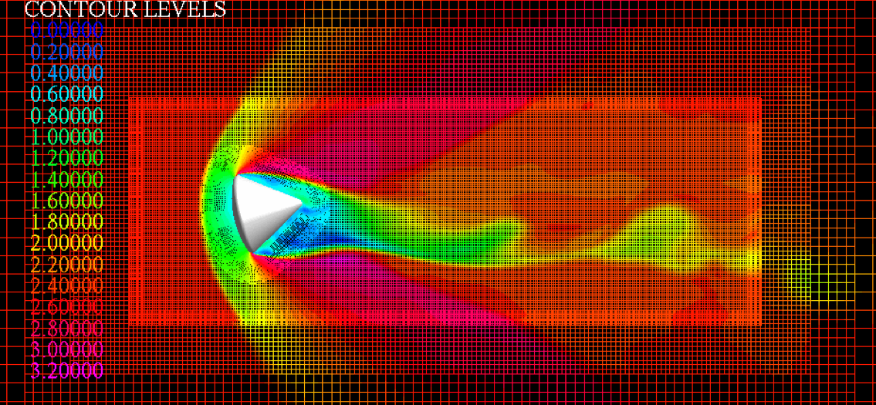
Future Work
MSR-EES, Free-to-Pitch, Ballistic Range Preliminary FUN3D DDES (29M grid points)
Mach 2.0 at Sea Level
Data Reduction Pipeline
Lower-Transonic Free-to-Pitch
Dynamically scale to match recent testing in TDT
Scale Resolving
Refine back-shell contribution
Large difference in temporal scales
Validation by ground test data
Comparisons to other solvers
OVERFLOW Apollo Capsule
Ballistic Range Case
Credit: NASA
Multiple orders of magnitude difference in temporal scales to be resolved between fluid and rigid body motion.
Further work needed to investigate resolving three-dimensional breakdown in the shear layer.

Slide 12
Summary
FUN3D’s 6-DOF path has been brought into active use at NASA LaRC
Enhance and expand dynamic stability characterization efforts
Multiple tests have verified the functionality of this solver for use
Applications to EDL flight projects have begun
The data produced in upcoming work will:
Be compared to ground test data
Enable future validation efforts of the FUN3D + 6-DOF solver
Contribute to dynamic stability characterization of entry capsules
Return to use, verification, and Dragonfly application efforts with FUN3D’s 6-DOF solver are funded by the NASA Engineering and Safety Center (NESC)

Slide 13
References
F. McNeil Cheatwood, Gerald L. Winchenback, Wayne Hathaway, and Gary Chapman. Dynamic Stability Testing of the Genesis Sample Return Capsule. In 38th Aerospace Sciences Meeting and Exhibit, Reno, NV, January 2000. NTRS Document 20000027509.
Eric C. Stern, Vladimyr M. Gidzak, and Graham V. Candler. Estimation of Dynamic Stability Coefficients for Aerodynamic Decelerators Using CFD. In 30th AIAA Applied Aerodynamics Conference. New Orleans, LA, June 2012.
Joseph M. Brock, Eric C. Stern, and Michael C. Wilder. CFD Simulations of the Supersonic Inflatable Aerodynamic Decelerator (SIAD) Ballistic Range Tests. In 55th AIAA Aerospace Sciences Meeting, Grapevine, TX, January 2017.
Quincy E. McKown, Cole D. Kazemba, Eric C. Stern, and Joseph M. Brock. Attitude Reconstruction of Free-Flight Trajectories Using Non-Linear Pitch Damping Coefficient Curves. In AIAA SciTech Forum, San Diego, CA, January 2022.
Zachary J. Ernst, Madilyn K. Drosendahl, Bradford E. Robertson, and Dimitri N. Mavris. Development of a Trajectory-Centric CFD-RBD Framework for Advanced Multidisciplinary/Multiphysics Simulation. In AIAA SciTech Form, San Diego, CA, January 2022.
Darby Vicker and Alan Schwing. OVERFLOW Simulations of MSL Ballistic Range Model. Presented at 13th Symposium on Overset Composite Grids and Solution Technology, October 2016. NTRS Document 20170004993.
Roy P. Koomullil and Nathan C. Prewitt. A Library Based Approach for Rigid Body Dynamics Simulation. In 18th AIAA Computational Fluid Dynamics Conference, Miami, FL, June 2007.
Robert T. Biedron and James L. Thomas. Recent Enhancements to the FUN3D Flow Solver for Moving-Mesh Applications. In 47th AIAA Aerospace Sciences Meeting, Orlando, FL, January 2009.
Zachary J. Ernst, Brett R. Hiller, Chelsea L. Johnson, Bradford E. Robertson, and Dimitri N. Mavris. Coupling Computational Fluid Dynamics with 6DOF Rigid Body Dynamics for Unsteady, Accelerated Flow Simulations. In 2018 AIAA Atmospheric Flight Mechanics Conference. Kissimmee, FL, January 2018.

Slide 14
Questions?

