Slide 1
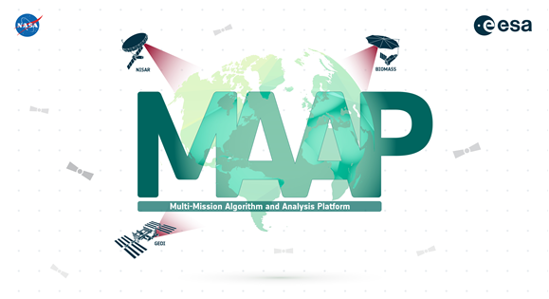
Joint ESA-NASA Multi-Mission Algorithm and Analysis Platform (MAAP)
FOSS4G 2022-08-25
Gerald “Stinger” Guala*, Clément Albinet, Björn Frommknecht, Kevin J. Murphy, Henri Laur, Aimee Barciauskas, George W. Chang, Hua Hook, Laura Innice Duncanson, Kaylin Bugbee & Marco Lavalle

Slide 2
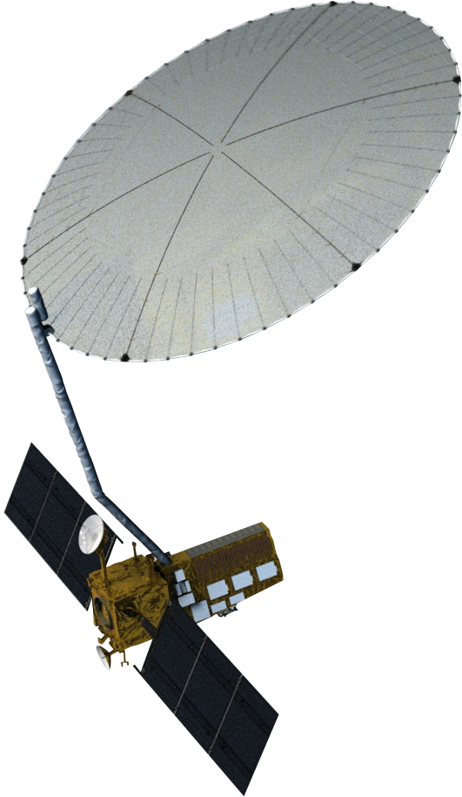
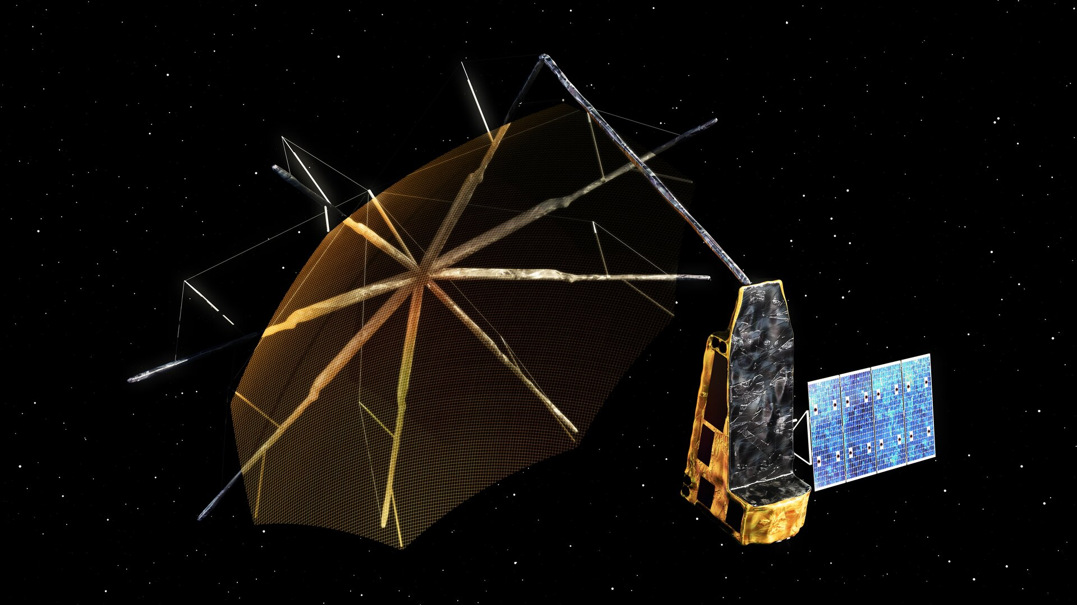
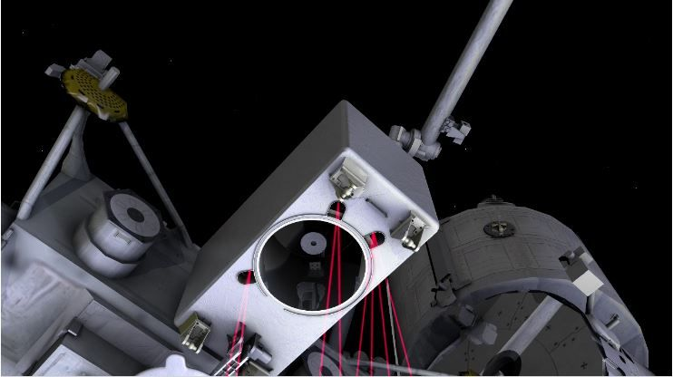
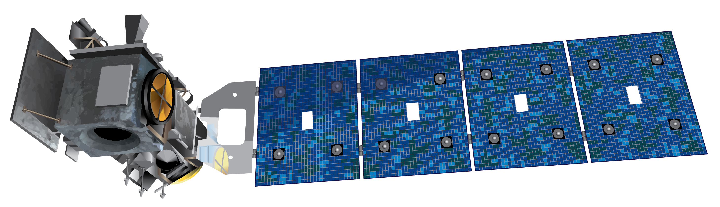
The Requirements:
We need to understand the carbon budget and related ecological processes at global and integrated regional scales.
Recent and upcoming new satellite missions have more complex and voluminous data that needs to be incorporated into the analyses.
Multiple data types, footprints, formats etc. need to be integrated from numerous other sources.
Both ESA and NASA need to cooperate closely with compatible analyses and evaluation while addressing the IP and the challenges of sharing data and algorithms.
The solution needs to be generalized so that it is transferable to other disciplines, fully scalable, and it has to be a flagship for open-source science.
BIOMASSS
NISAR
ICESat-2
GEDI

Slide 3
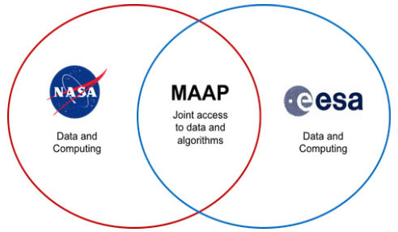





The Solution:
Multi-Mission Algorithm and Analysis Platform
Cloud Native
Jointly developed and managed:
Joint Coding Environment:
Data Processing System (DPS)
AWS/Pleiades (HEC)
MAAP Dashboard
Common shared APIs allow use of data sets, code, and applications across both ESA and NASA implementations
Container Orchestration for Pipeline Applications (COPA)
Enhanced Data Visualization (EDAV)

Slide 4
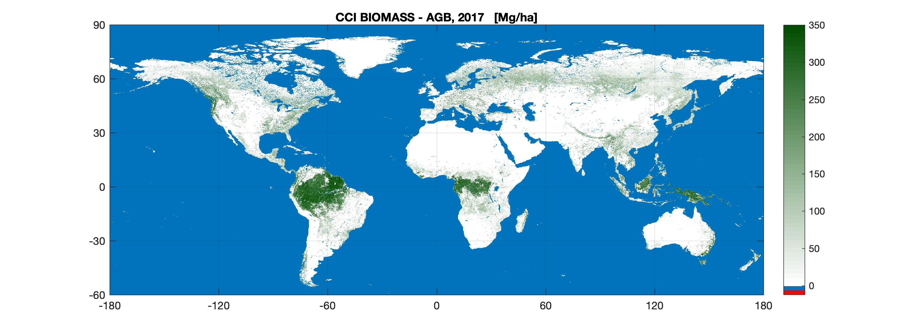
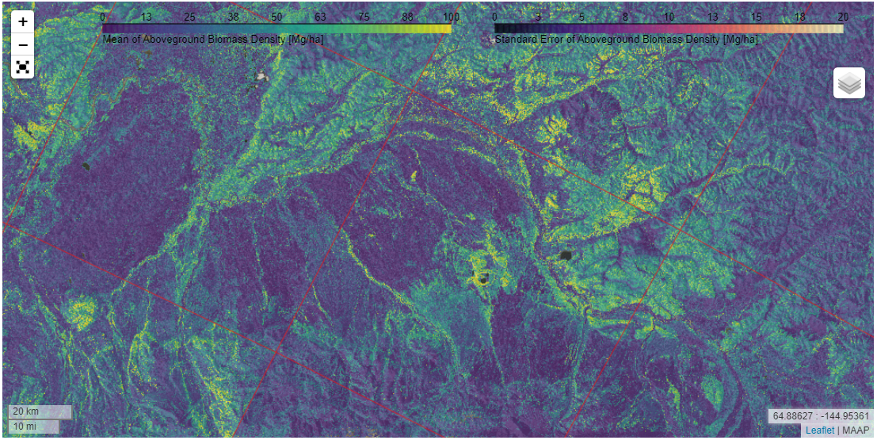
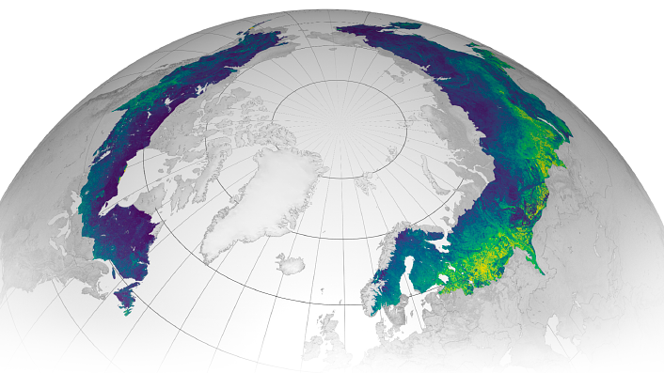
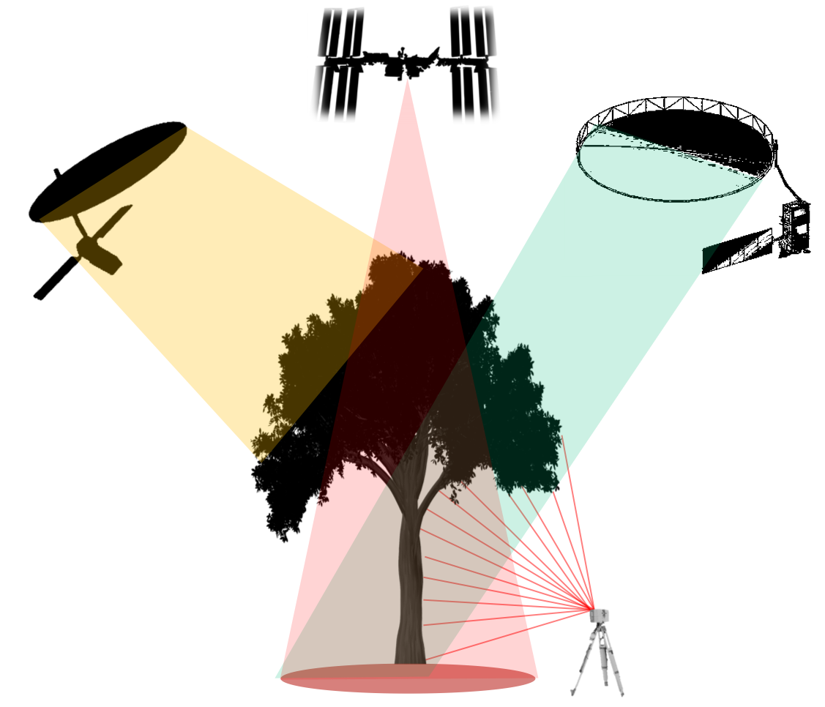


Recent Projects on MAAP Enabling Open Science and International Collaboration
Aboveground Biomass Density (Mg/ha)
MAAP hosts CEOS Biomass Harmonization Activity
  Example of international collaboration (JAXA, ESA, NASA)
  Associated Earthdata Dashboard Released
  Presented at COP26
  Engagement with countries for policy uptake of products
ICESat-2 boreal-wide 2020 biomass product created on MAAP
  Example of wide area processing + open science
NISAR above-ground biomass (AGB) mapping algorithm developed in MAAP using NASA UAVSAR airborne data and published in peer-review journal
ARD (Analysis Ready Data) defined by CEOS CARD4L demonstrated in MAAP for geocoded, terrain-corrected polarimetric SAR data in preparation for NISAR
CCI Biomass
2020
JPL Biomass
2020
GEDI Biomass
2020

Slide 5

Joint press release announces MAAP v1, “NASA, ESA Partnership Releases Platform for Open-source Science in the Cloud”
MAAP products can be explored on the MAAP Dashboard at https://earthdata.nasa.gov/maap-biomass or the joint platform entrance at scimaap.net.
MAAP also can be accessed through individual NASA (https://maap-project.org) and ESA (https://esa-maap.org/) landing pages.
The Repo: https://github.com/orgs/MAAP-Project/repositories

