Slide 1
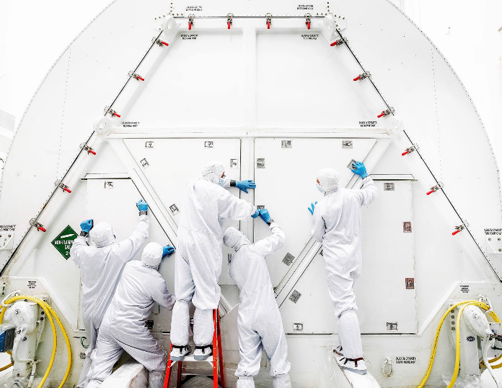
Precious Cargo: Transporting contamination-sensitive instruments & optics
(12224-5)
Joseph Ward, Craig Jones
KBR Inc., Fulton, MD 20759
Edwin Goldman
Prime Science and Technology, Inc., Baltimore, MD 21201
(Photo Credit: NASA/Chris Gunn)
SPIE Optics + Photonics 2022, Conference 12224 Space Systems Contamination: Prediction, Control, and Performance August 23– 24, 2022

Slide 2
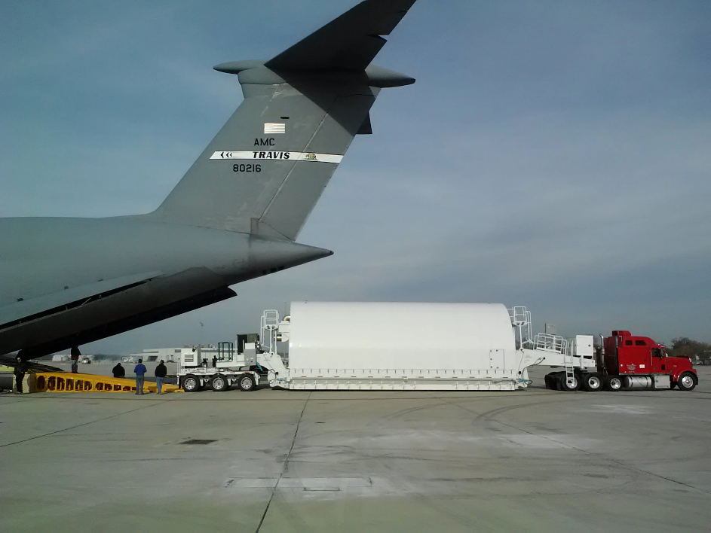
Space Telescope Transporter for Air, Road and Sea (STTARS) Transporter
STTARS configuration
Used for transportation of Optical Telescope Element / Integrated Science Instrument Module(OTIS), backplane and pathfinder
33.5 meters long, 5.2 meters high and 4.6 meters wide (110’x17’x15’)
HEPA and charcoal filtration
Observatory STTARS (OSTTARS) configuration
Transported Observatory
A spacer was necessary that increased the overall height to 5.5 meters (18 feet)
(Credit: USAF Photo/John Andersen)

Slide 3
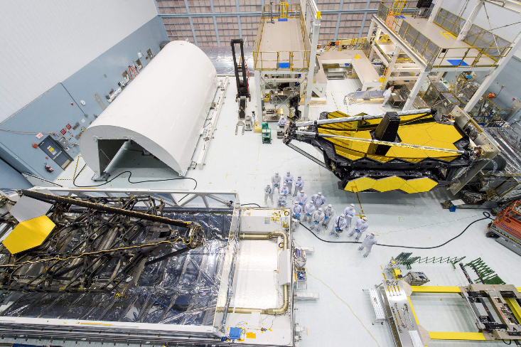
CC Requirements
Surface Cleanliness
  Exterior – VC
  Pallet Interior – VC2
  Tent Frame Exterior – VC2
  Tent Frame Interior – VC2+UV
Air Quality
  At filter face – ISO 5
  Between tent frame and lid – ISO 7
  Inside tent frame – ISO 7
  Hydrocarbons - >15ppm
Fallout
  PAC Allocation for JWST transport to launch site – 0.003
  NVR Allocation for JWST transport to launch site – 5Å
(Credit: NASA/GSFC)

Slide 4
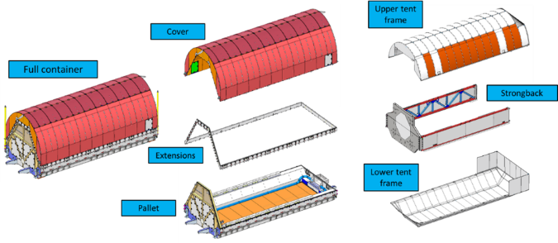
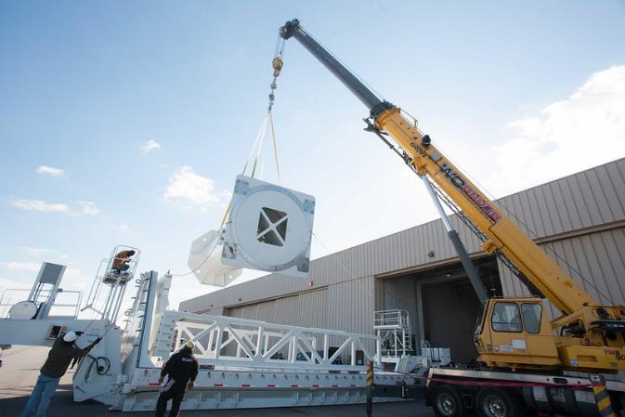
STTARS/OSTTARS Design
All materials used in the construction of the shipping container were tested for cleanroom compatibility (NVR, contact transfer, and particle generation)
All lid and tent frame structure and surfaces were either clear anodized, chemfilmed or powder coated.
Dunshield was used to enclose the STTARS tent frame for OTIS shipments. The OSTTARS tent frame was designed to use clear anodized aluminum enclosure.
Structures were painted with low outgassing DuPont Imron polyurethane paint commonly used in the aircraft industry
(Credit: NASA/GSFC)
(Credit: NASA/GSFC)

Slide 5
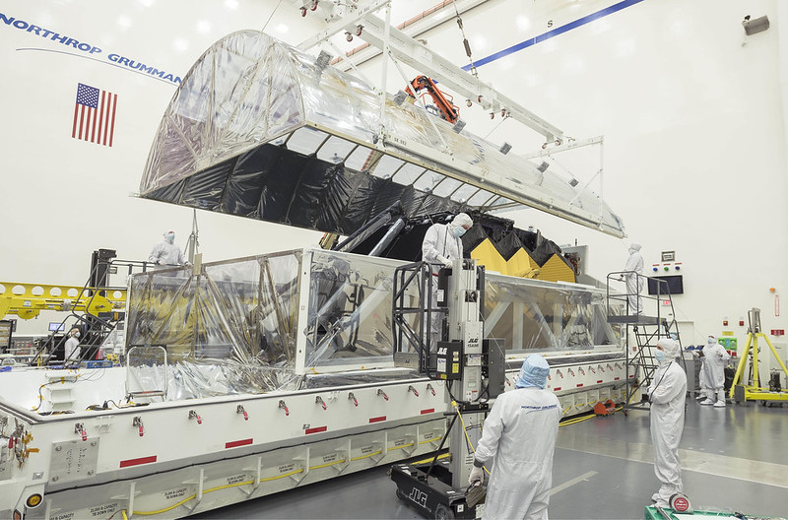
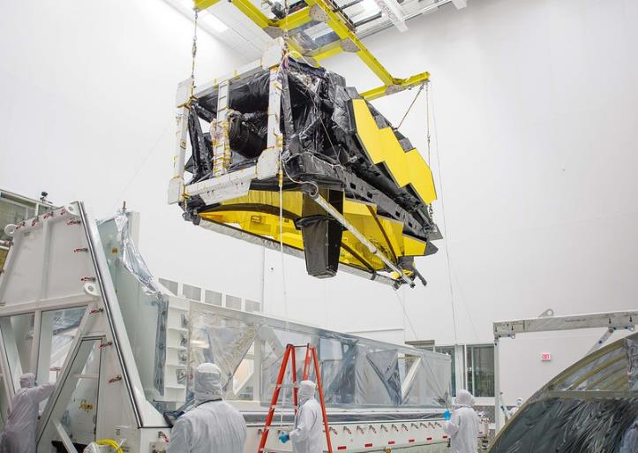
Transport of OTIS to Northrup Grumman
Transportation of OTIS from JSC to Northrup Grumman (NG). February of 2018
Following delivery of OTIS, STTARS was sent to Nelson Mfg. for modification.
(Photo Credit: NASA/Chris Gunn)
  Removing the upper tent frame at NG
Loading OTIS into the tent frame in STTARS
(Photo Credit: NASA/Chris Gunn)

Slide 6
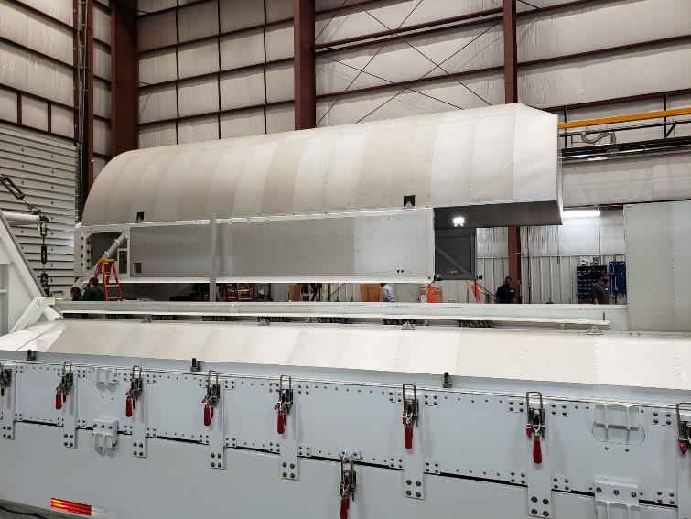
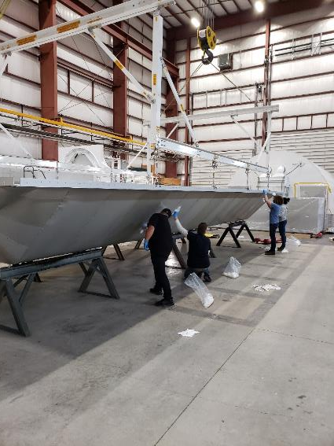
Modifications of STTARS
The Observatory was too large for STTARS. Modifications to STTARS were necessary and included the following:
  Tombstone
  Arms
  Upper tent frame
  Lower tent frame
  End gate
  Filter box
  Ductwork
  Spacer
(Credit: NASA/GSFC)
(Credit: NASA/GSFC)

Slide 7
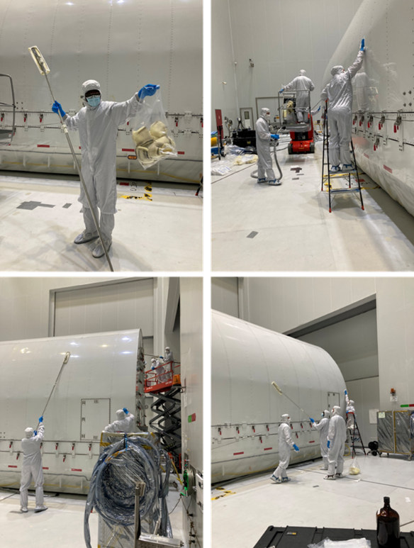
Cleaning of OSTTARS
Cleaning took place in stages
  Rough Cleaning at Nelson Manufacturing
  Detailed Cleaning in M4 at Northrup Grumman in Redondo Beach
  Final inspection and touch up cleaning in M8 cleanroom at Northrup Grumman in Redondo Beach
  Cleanings consumed approximately
    100 L of isopropyl alcohol (IPA)
    15 cases of sealed border cleanroom wipes
    24 L of deionized Water
    10 cases of mop heads
    6 rolls of 10’ C-Fold low outgassing polyethylene film
    3 rolls of 20’x 100’ Uline polyethylene film
    Crew sizes varied from 7 during the rough cleaning stage to a high of 12 for the final cleaning.
(Credit: NASA/GSFC)

Slide 8
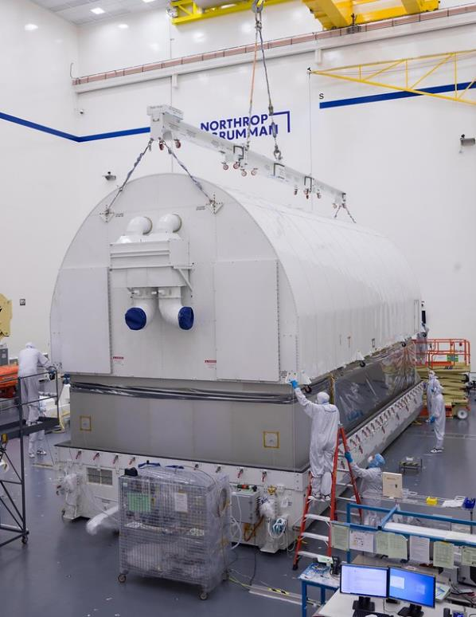
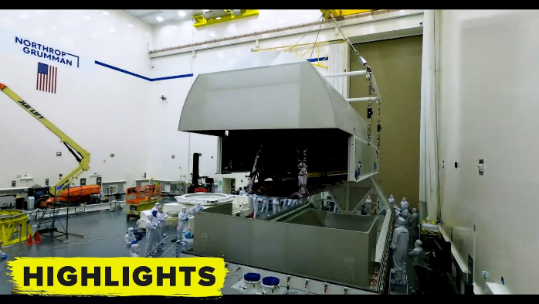
JWST loaded into OSTTARS
  JWST lifted into OSTTARS mounted to the tombstone with the arms and upper tent frame installed.
  Closeouts of the tent frames completed.
  Interior contamination samples placed immediately before the lift.
  Exterior samples placed immediately before cover install.
(Credit: NASA/GSFC)
(Credit: NASA/GSFC)

Slide 9
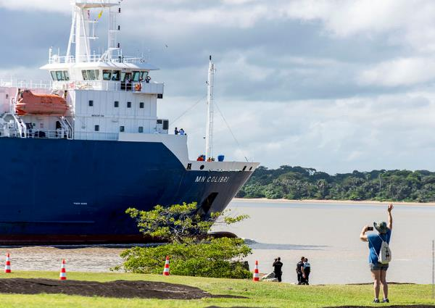
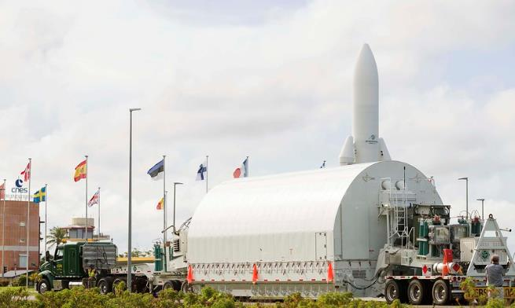
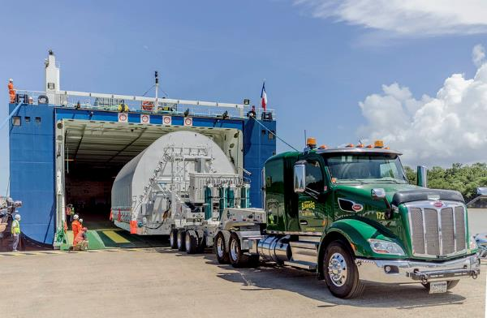
Arrival at CSG
(Photo Credit: ESA/CNES/Arianespace/Optique vidéo du CSG)
  Arrival at the port in Kourou, French Guiana on 10/12/2021.
  JWST was purged 100% of the time.
  Purge gas was Clean Dry Air from a tube trailer.
  Multiple tube trailers traveled with JWST for backup and use throughout the campaign.
(Photo Credit: NASA/Chris Gunn)
(Photo Credit: NASA/Chris Gunn)

Slide 10
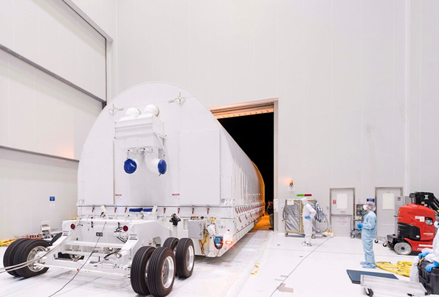
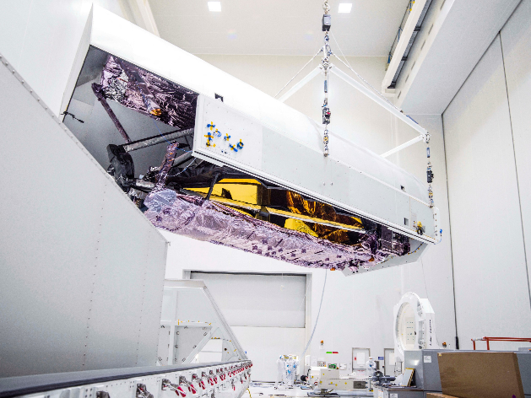
Move into S5C and Lift
  OSTTARS backing over the polyethylene “diapers” as it enters the S5C airlock
  The rear running gear that housed the ECU was replaced with the small rear steerable for entry into the building
  Prior to cover removal, the airlock underwent a settling period followed by a cleaning of the floors and GSE.
  The exterior of OSTTARS was cleaned
  Samples outside the tent frame were collected immediately after cover removal
  Samples inside the tent frame were collected immediately after JWST lift
(Photo Credit: NASA/Chris Gunn)
(Photo Credit: NASA/Chris Gunn)

Slide 11
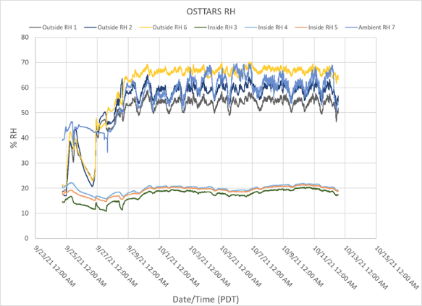
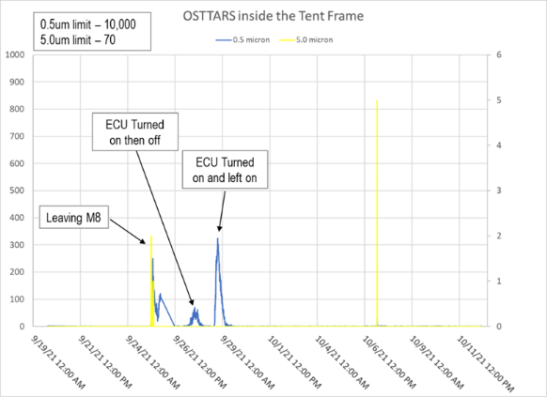
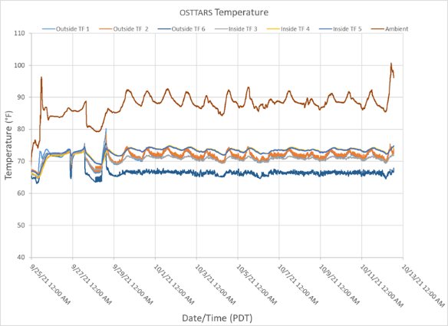
Particle counts and Temp/RH
  Particle counts maintained requirements with significant margin. Only spikes were due to operational changes to the Environmental Control Unit and road travel.
  Temperature inside the tent frame averaged about 70°F
  Relative Humidity (RH) inside the tent frame maintained approximately 20%
  Temperature and RH maintained even while the container was exposed to high temperatures and high RH.

Slide 12
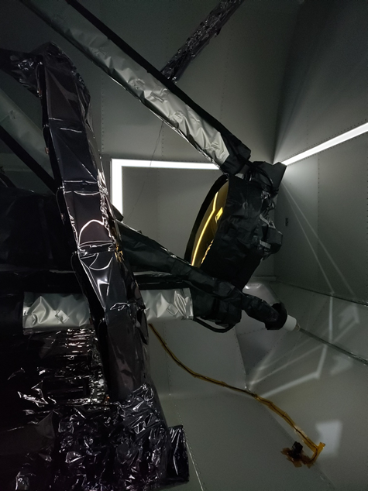
Fallout Results
Average PAC/Day inside the tent: 0.000145
Average PAC inside the tent: 0.003376
Total exposure inside Tent Frame: 24 Days
Total exposure outside Tent Frame: 22 Days
Wafers Inside Tent Frame
Date Deployed: | 9/20/21 | Date Collected: | 10/14/21
Location #1 | Wafer ID / PAC / Daily PAC
A | 01-09-21-48 /0.003229 /0.00014
B | 07-31-21-06 /0.003523 /0.00015
Inside Tent Frame NVR Foils
Date Deployed: | 9/20/21 | Date Collected: | 10/14/21
Location | Foil ID / Results (mg/sqft)
#1 | #1 / 0.03mg
#2 | #2 / 0.01mg
Wafers Outside Tent Frame
Date Deployed: | 9/21/21 | Date Collected: | 10/13/21
Location #1 | Wafer ID / PAC / Daily PAC
C | 07-31-21-15 /0.014684/0.00067
D | 01-09-21-42 /0.029835 /0.00136
Outside Tent Frame NVR Foils
Date Deployed: | 9/21/21 | Date Collected: | 10/13/21
Location | Foil ID / Results (mg/sqft)
#3 | #3 / 0.00
#4 | #4 / 0.03
(Credit: KBR Inc/Joseph Ward)

Slide 13

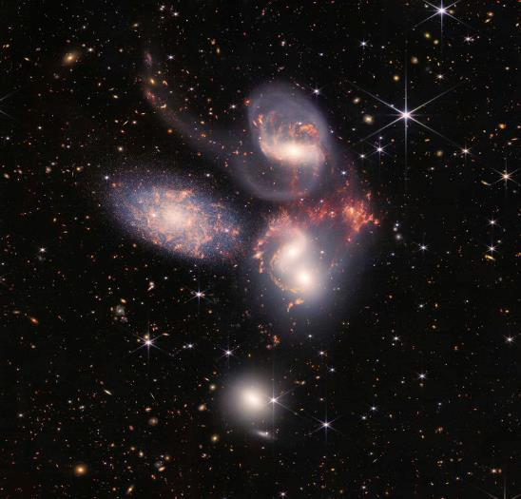
Summary
  The average fallout inside the tent frame for the entire JWST transport was 0.003 for particulate and 2 Å for NVR. Both met the allocation for transportation.
  Particle counts, temperature and relative humidity easily met their requirements, despite extreme ambient conditions.
  A trained and experienced CC Team was vital to successfully preparing OSTTARS for the JWST transportation.
  Thank you to an incredible team and for the friendships that last a lifetime!
(Images Credit: NASA, ESA, CSA, and STScI)

