Slide 1

IPPW 2022 Short Course
Introduction to Aerocapture, Entry, Descent, and Landing
Topic: CFD 101: Grid Generation
Presenters: Adam Wise
Date: 28 August 2022

Slide 2
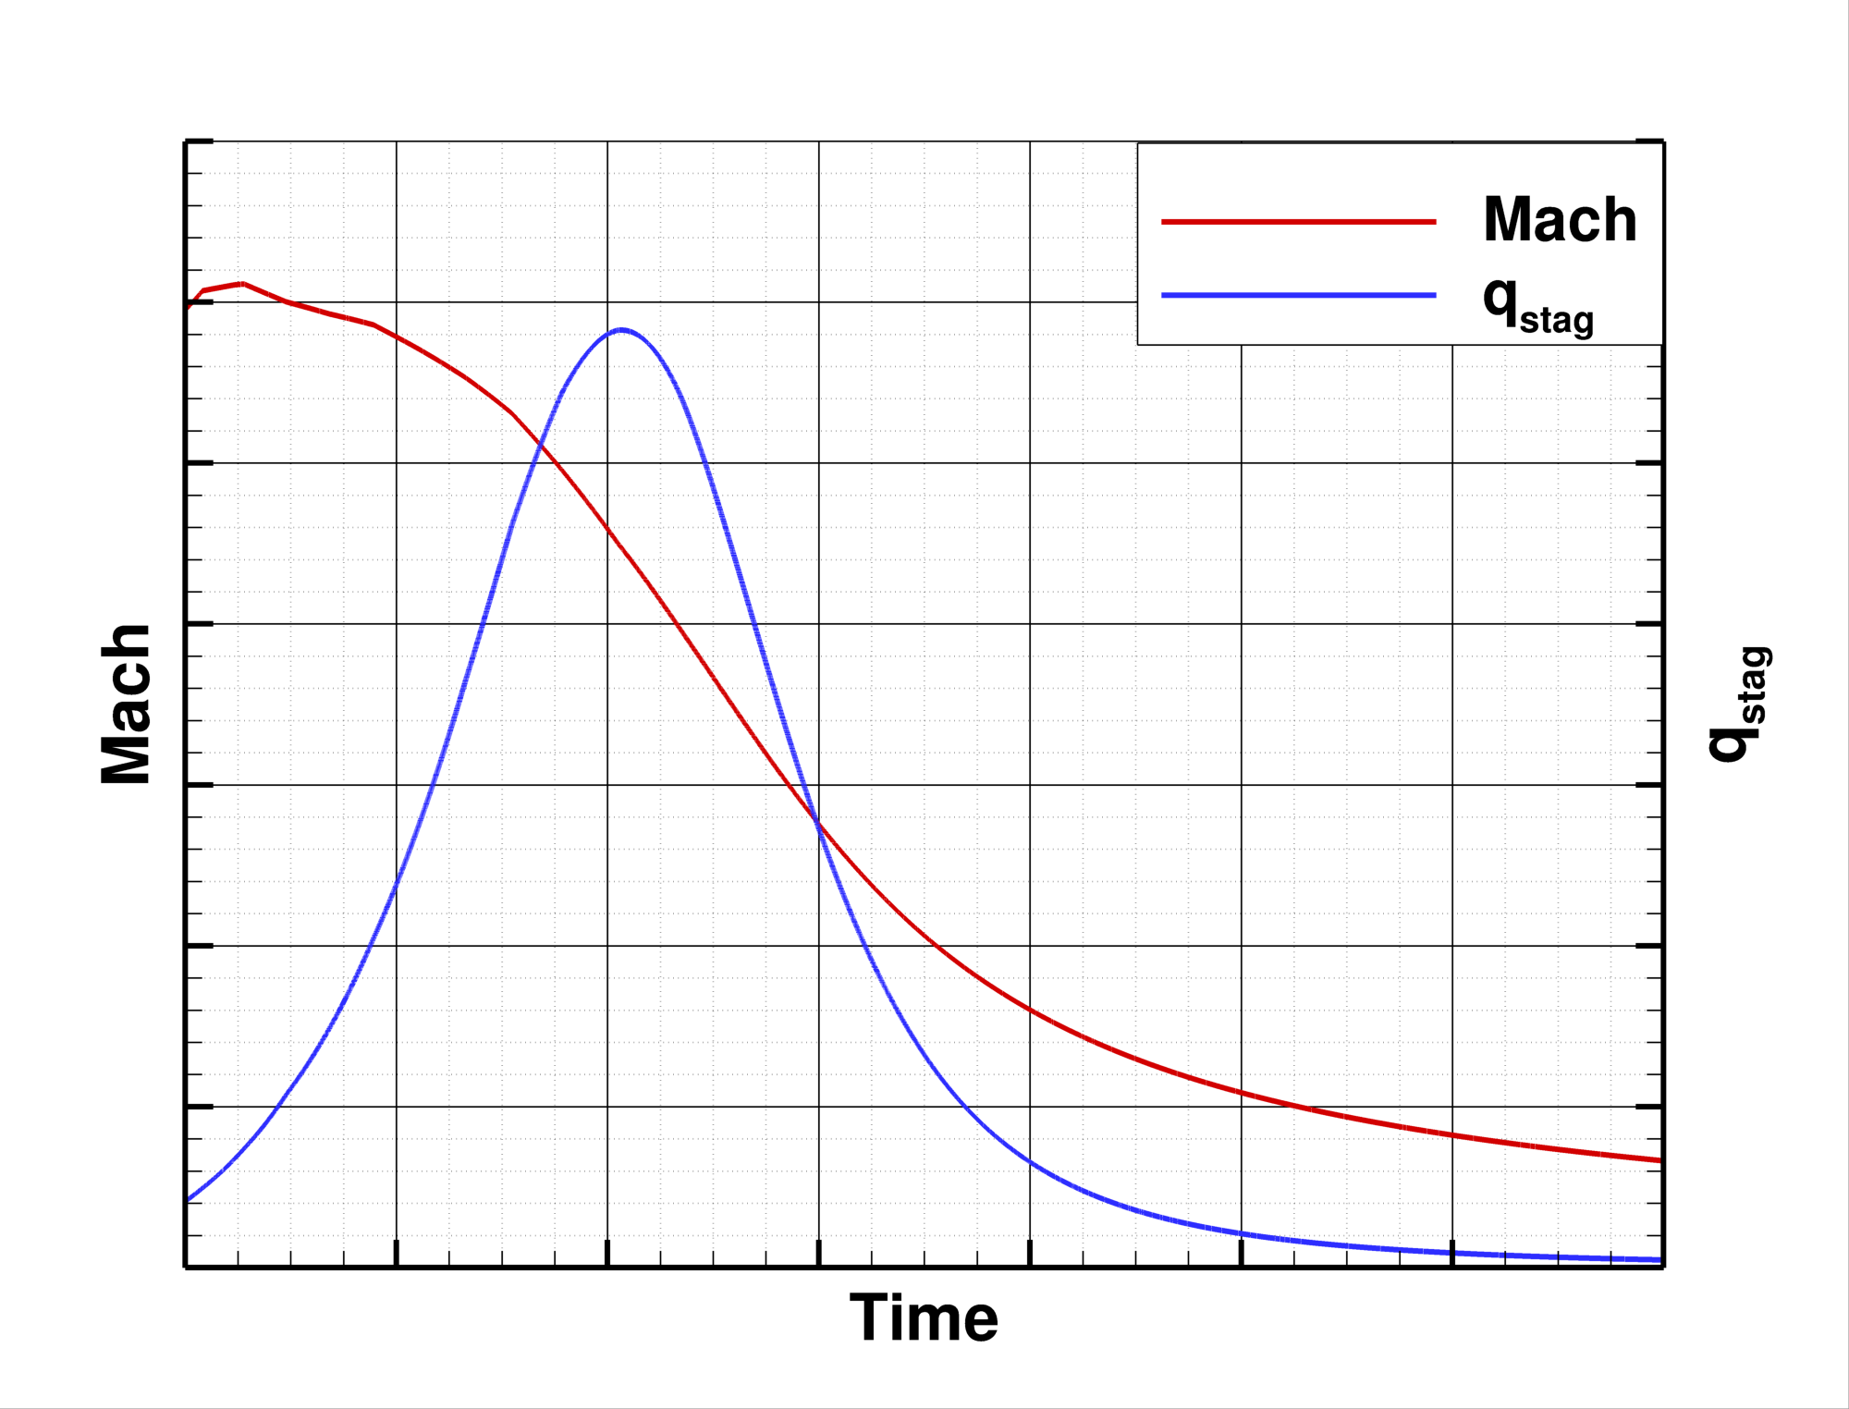
Introduction
What is needed?
  Trajectory conditions that span the heat pulse
  A reacting CFD solver such as LAURA, DPLR, FUN3D, US3D, etc.
  Geometry definition – drawing, surface grid, CAD
  A grid specifically tailored for accurate computation of surface heating quantities
Why is this important?
  Along with the discretization and solver, a good grid is critical to estimate environments that Entry, Descent and Landing (EDL) vehicle Thermal Protection Systems (TPS) will experience

Slide 3
Outline
What makes a good grid?
  Focus on aeroheating
Example Workflow
  Step through an example grid generation workflow - Inflatable reentry vehicle
Issues & Advancements
  Briefly mention where typical aerothermodynamics grids give us trouble and some ways forward

Slide 4
Outline
What makes a good grid?
  Focus on aeroheating
Example Workflow
  Step through an example grid generation workflow - Inflatable reentry vehicle
Issues & Advancements
  Briefly mention where typical aerothermodynamics grids give us trouble and some ways forward

Slide 5
What Type of Geometry?
Axisymmetric Blunt body - We simulate this type of vehicle a lot!
  Capsules
  HIADs
Sometimes grids also need to be made for…
  Lifting bodies
  Wing-bodies
  Etc.
Sometimes grids need to include local features, such as…
  Protuberances, e.g., antennae radomes
  Cavities, e.g., inset access panel
  Nozzles
  Etc.

Slide 6
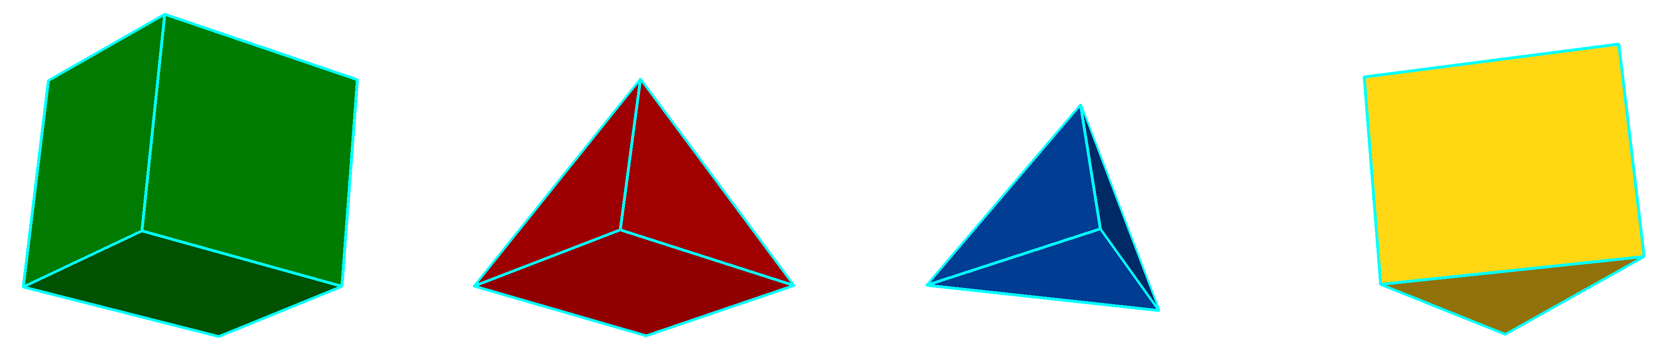
What Type of Grid?
Many different grid element types, including:
…but what grid type should be used to get the best surface heating results?
  Hexahedral!
  …or, possibly, triangular prisms
Hexahedron Pyramid Tetrahedron Triangular prism

Slide 7
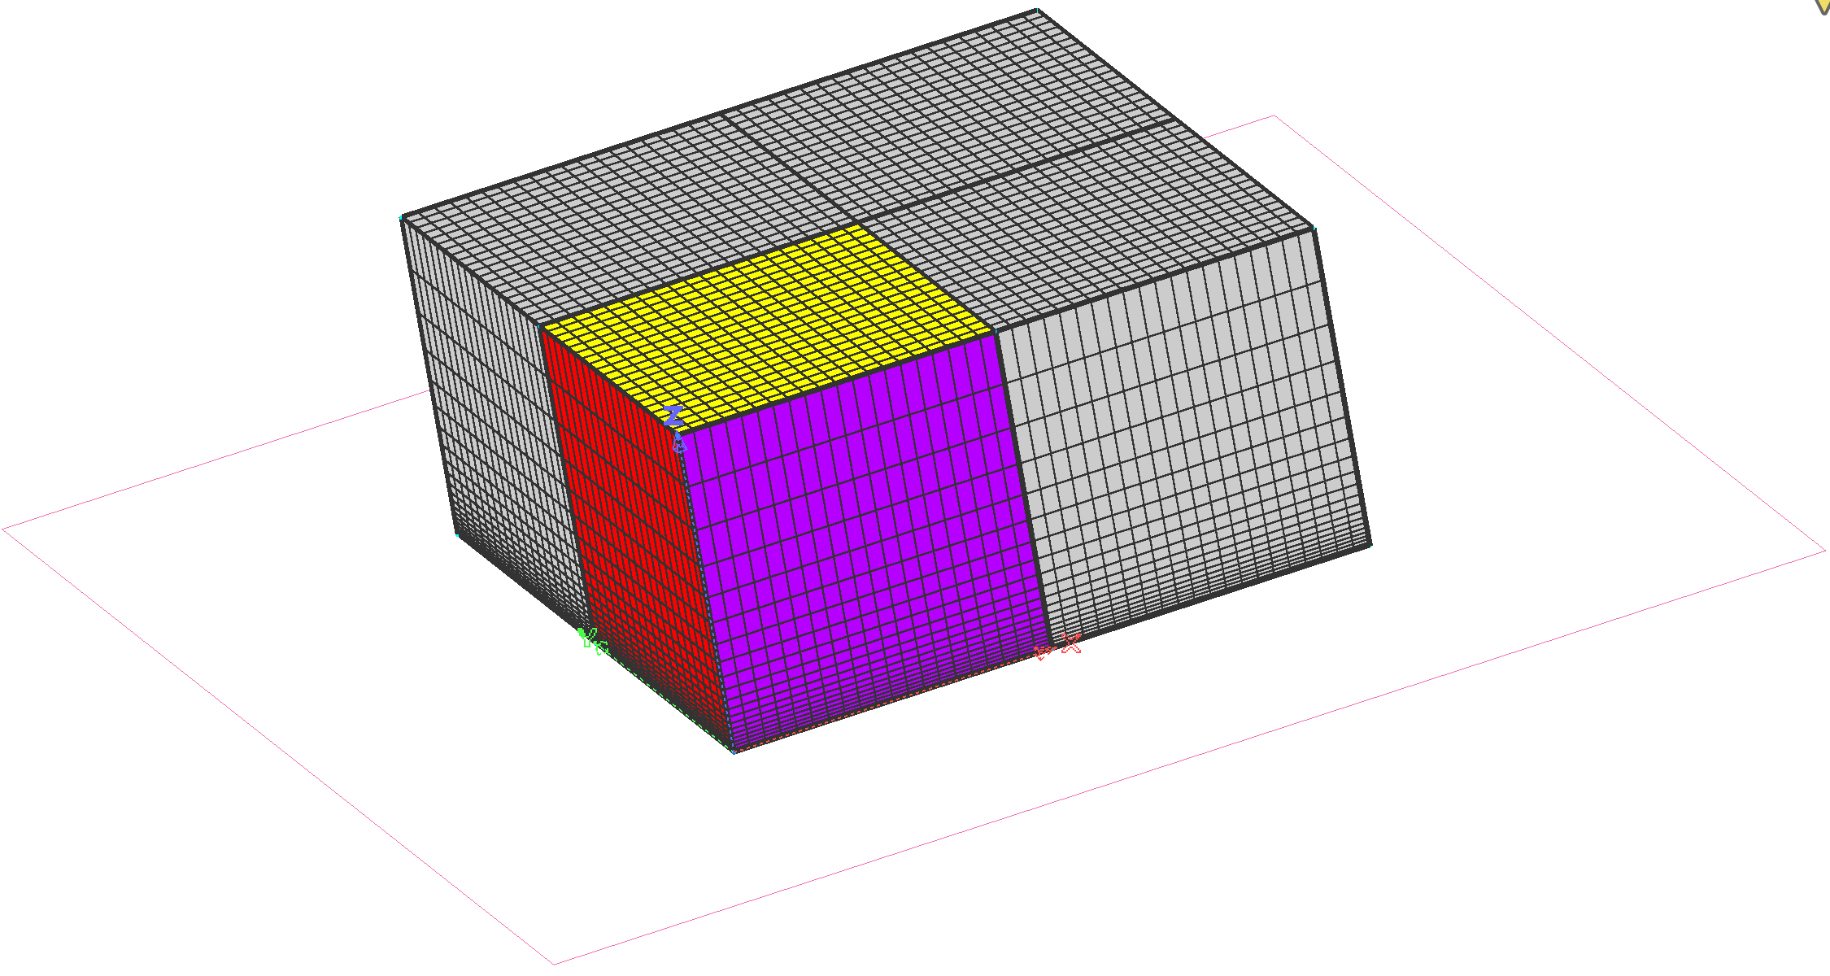
Structured, Point-matched, Multiblock Grids
Block
  3D volumes made of an ordered collection of hexahedral elements
  I x J x K dimensions
  6 faces – Domains
  Point-matched - Adjacent blocks share faces
k
Flow
i
j

Slide 8
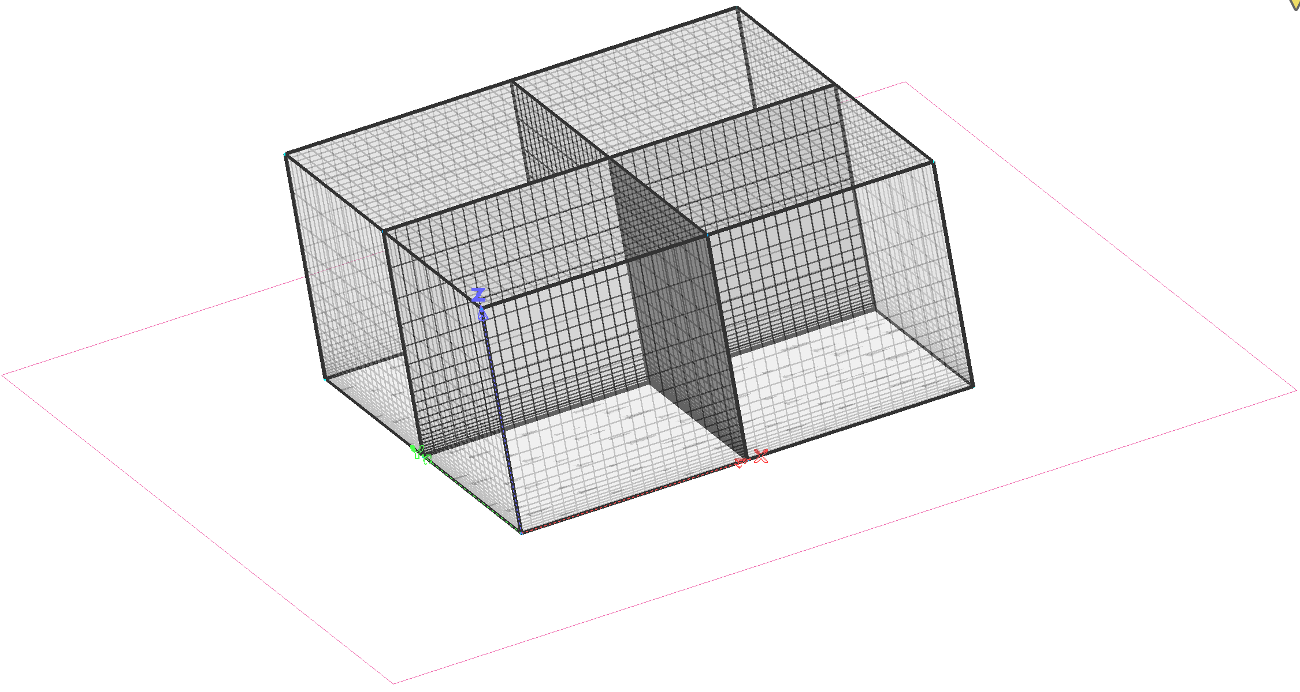
Structured, Point-matched, Multiblock Grids - Block
Block
  3D volumes made of an ordered collection of hexahedral elements
  I x J x K dimensions
  6 faces – Domains
  Point-matched - Adjacent blocks share faces
k
Flow
i
j

Slide 9
Structured, Point-matched, Multiblock Grids - Domain
Domain
  2D face made of an ordered collection of quadrilateral elements
  I x J, or I x K, or J x K dimensions
  4 edges – Connectors
  Point-matched - Adjacent domains share edges
k
Flow
J-min face
i
j

Slide 10
Structured, Point-matched, Multiblock Grids - Connector
Connector
  1D curve or line segment made of an ordered collection of points
  I, or J, or K dimensions
k
Flow
i
j

Slide 11
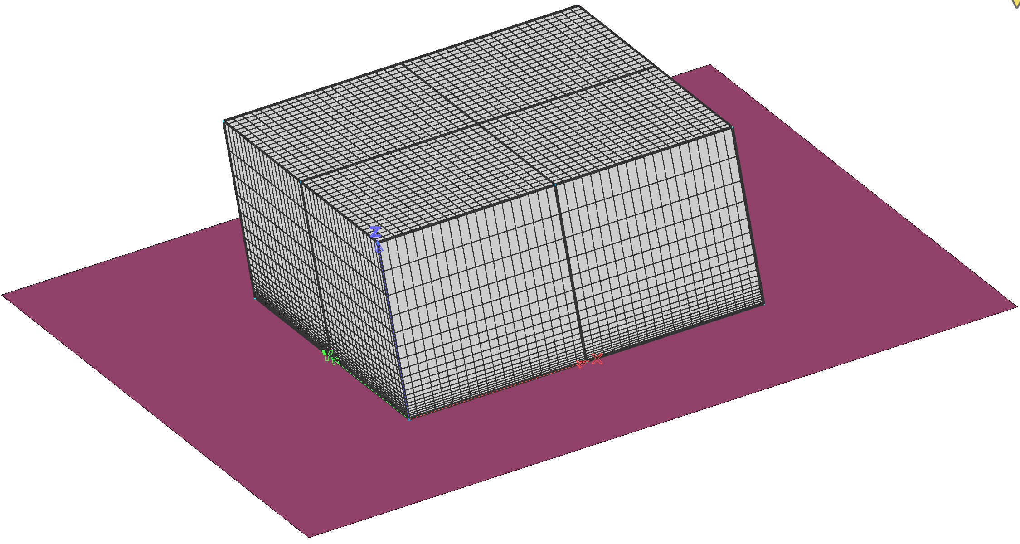
Structured, Point-matched, Multiblock Grids - Database
Database
  Geometry entities that define the shape of the vehicle being gridded
  Surface grids comprised of connectors and domains are projected onto, or created directly on the database ensuring the shape of the grid matches the shape of the geometry
k
Flow
i
j

Slide 12
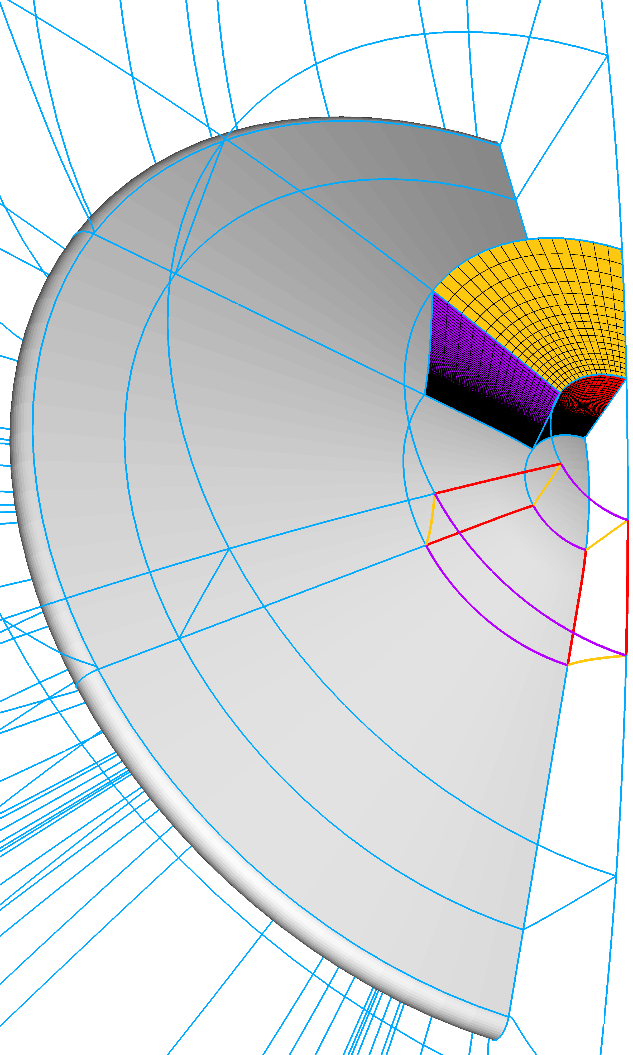
What Makes a Good Aerothermodynamic Grid?
We know what makes a good structured grid
  Surface orthogonality
  Viscous spacing with low cell Reynolds number at the wall; ~1
  Controlled stretching ratios;
  Grid aligned to the bow shock
  Unbroken grid lines that extend from the vehicle surface to the outer boundary
  Singularity free (3D)
  Nose patch corners far from stagnation point
Chief difficulties
  Square peg – round hole
  Impractical – hand crafting difficulty and time
  Local modifications – global effects
Flow
i
k
j

Slide 13
Outline
What makes a good grid?
  Focus on aeroheating
Example Workflow
  Step through an example grid generation workflow - Inflatable reentry vehicle
Issues & Advancements
  Briefly mention where typical aerothermodynamics grids give us trouble and some ways forward

Slide 14
Workflow Setup
Axisymmetric Geometry
Grid Generation Tool – PointWise
  PointWise, Inc.
  Follow-on software tool after Gridgen
  Structured and Unstructured (including hybrid and viscous) mesh creation and modification
  Flexible CAD import, modification (quilting, cutting, etc.) and basic surface creation
  Scriptable
Grid Interpolation Tool – Radial_interp
  Developed by David Saunders (AMA, Inc., ARC-TSA)
  https://sourceforge.net/projects/cfdutilities/files/RADIAL_INTERP/
  Generates a new volume grid or flowfield from the original volume data and a new surface, or volume, grid
  Assumes:
    Plot3D, multiblock structured grids
    One layer of blocks from the geometry surface to the outer boundary

Slide 15
Basic Workflow Procedure
Create connectors that conform to the vehicle’s outer mold line (OML) along one half of the symmetry plane
Dimension the connectors and distribute the points
Extrude a 2D grid using hyperbolic grid solver through the boundary layer
Use Bezier curves to create connectors that bound the extent of the 2D freestream domain; then create and smooth the domain (Elliptic)
Extrude (rotate) the 2D domain 180-degrees to create a 3D volume grid with symmetry plane
Replace poles on the surface grid with H-grid patches
Use Radial_interp to create a new 3D volume grid without poles
Define boundary conditions

Slide 16
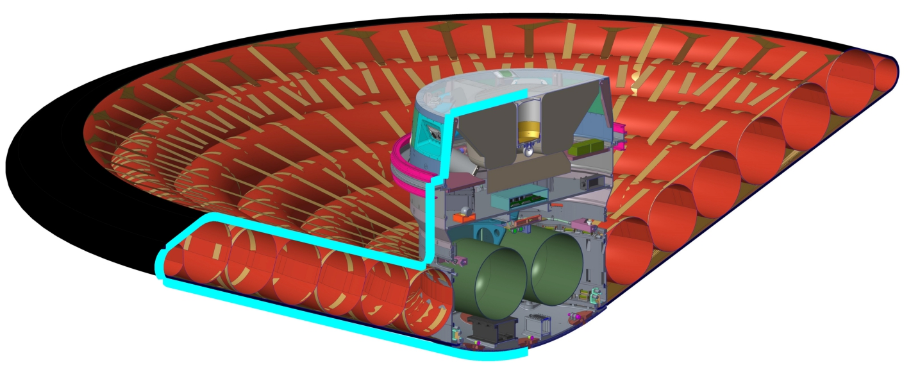
1. Create Connectors
Create connectors that conform to the vehicle’s outer mold line (OML) along one half of the symmetry plane
Pointwise Database (geometry definition)
  Technical drawing or analytic definition – create within PW
  CAD or surface grid – CAD cleanup, quilting, intersecting/cutting, etc.
Draw surface centerline on appropriate DB surfaces
  Ensure that surface grid points constrained DB surface
Flow

Slide 17
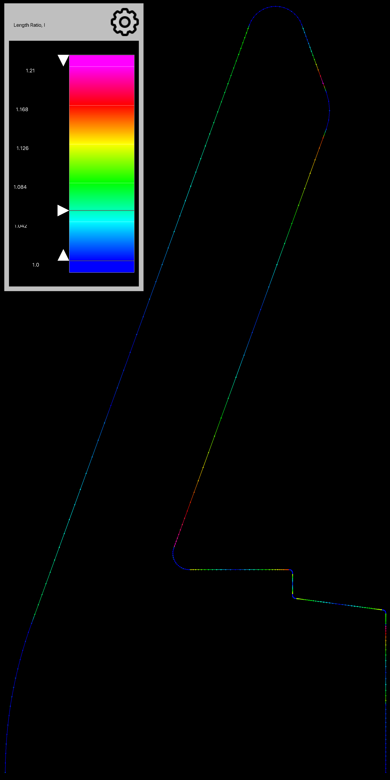
2. Dimension and Distribute Points
Dimension the connectors, consider:
  Geometry features – steps, local curvature, etc.
  Local flow features – e.g., expanding flow near the max-diameter shoulder
  Overall grid point count
…distribute the points
  Hyperbolic tangent distribution function
  Keep stretching ratio ~1.2 on fine grid

Slide 18
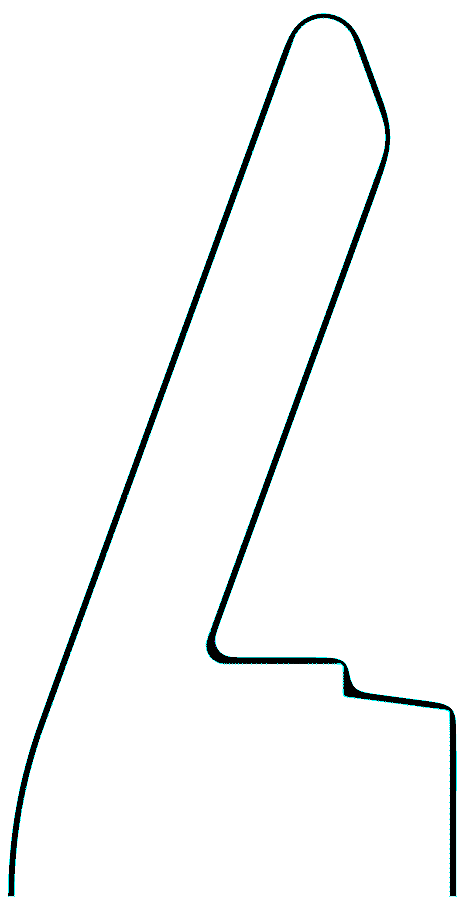
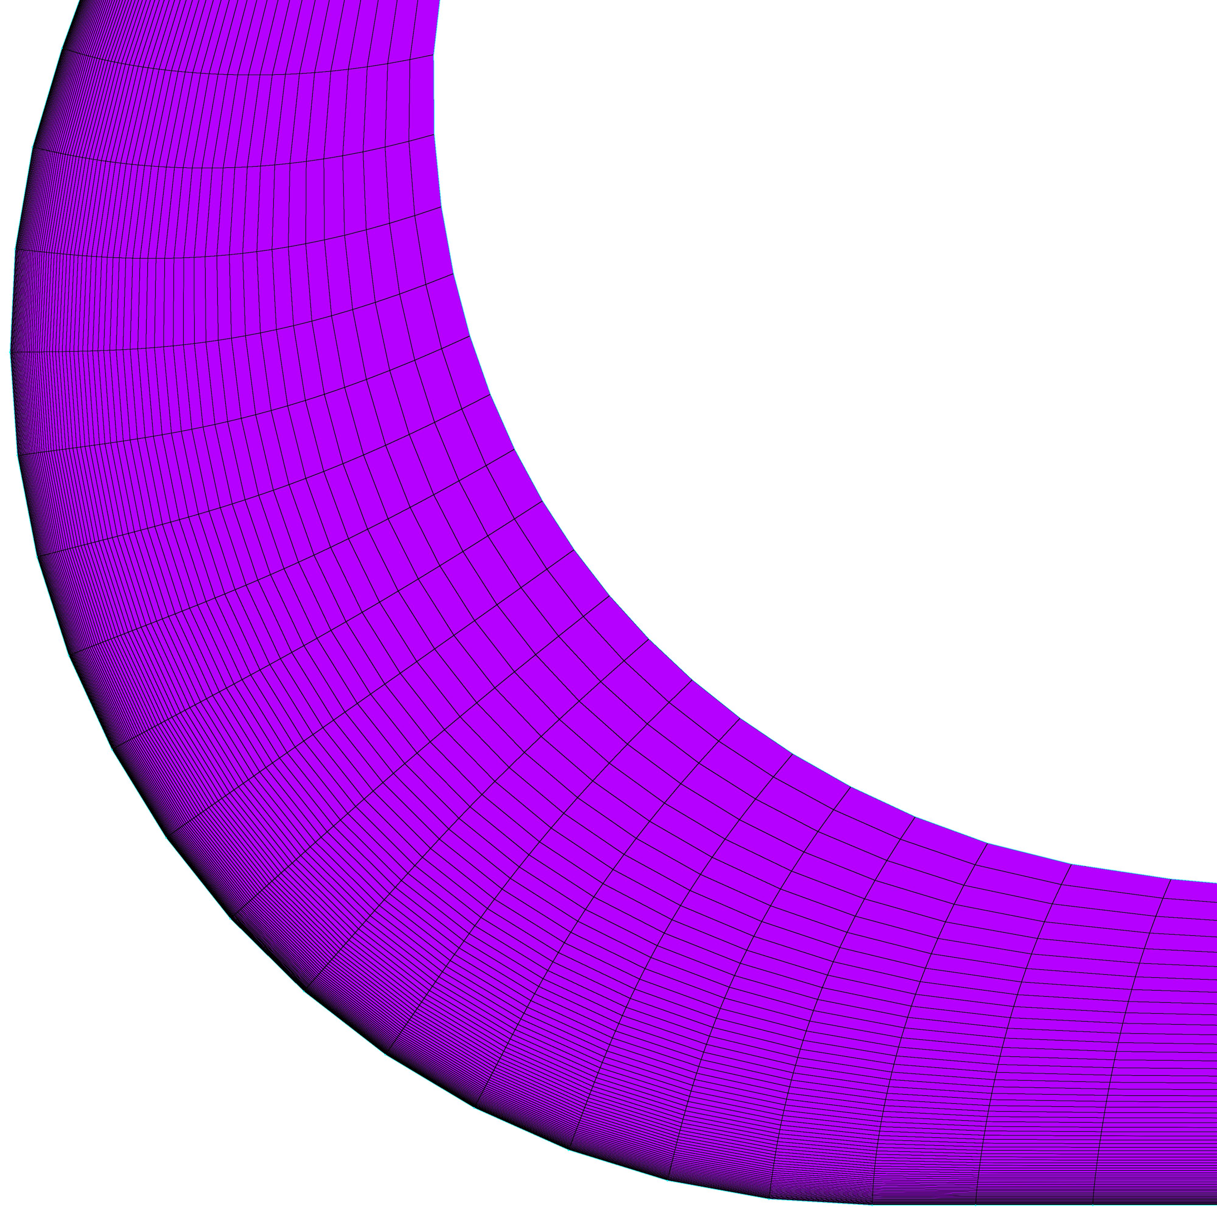
3. Grow Boundary Layer Grid
Extrude a 2D grid using hyperbolic grid solver through the boundary layer
  Ensures surface orthogonality
  Try to extrude beyond local features such as high-curvature regions, cavities and steps
Flow
Hyperbolic PDE – initial value problem
  2D/3D extrusion method
Hyperbolic PDE – initial value problem
  2D/3D extrusion method

Slide 19
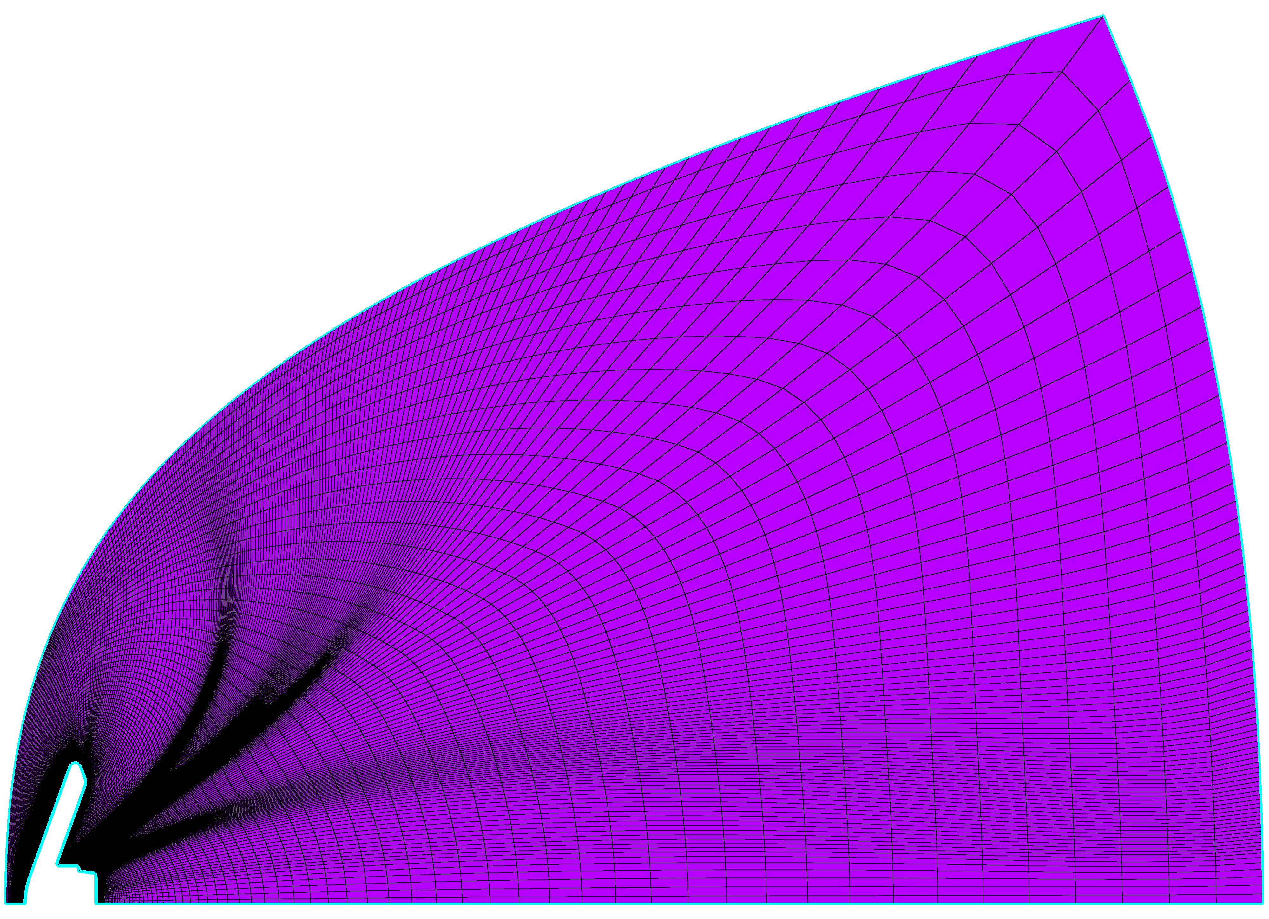
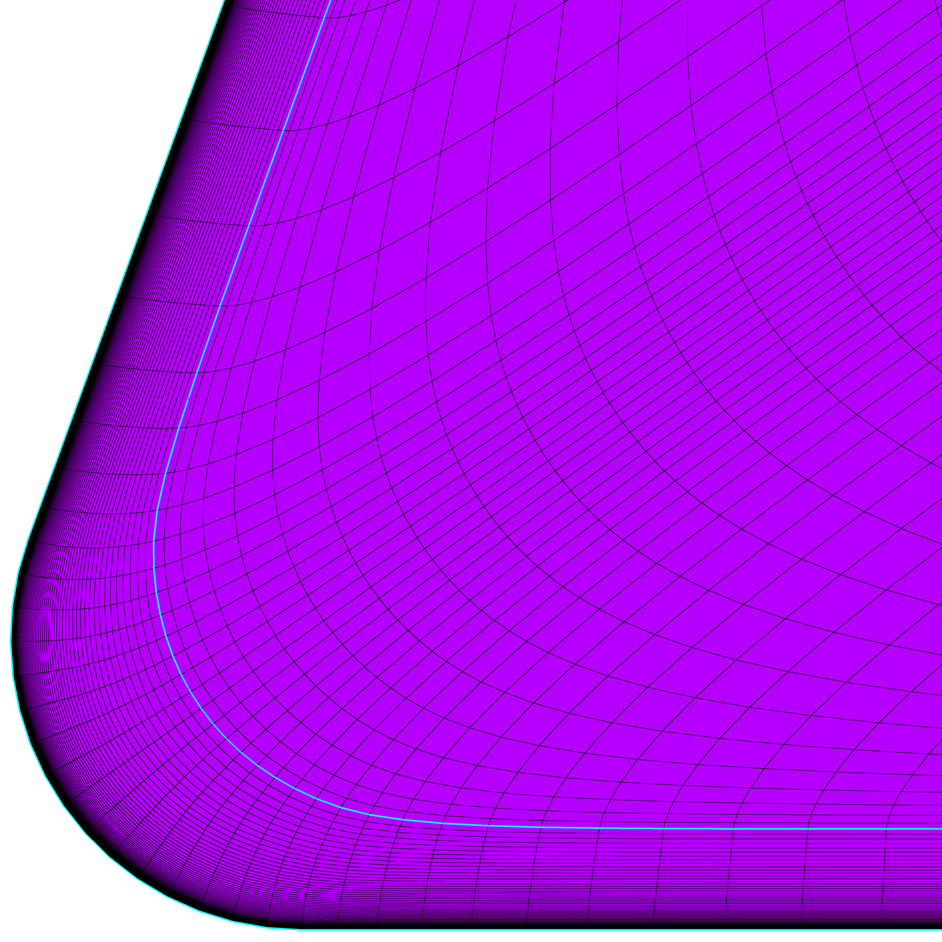
4. Attach Inviscid Domain
Use Bezier curves to create connectors that bound the extent of the 2D freestream domain
  Create the inviscid domain(s)
  Used elliptic solver to smooth
Control domain size and shape
Elliptic PDE – boundary value problem
  Iterative domain and block smoothing
  Various BCs - Adjacent, Interpolate, Orthogonal, Current
  Set relaxation factor to zero for hyperbolically grown layers
Spacing:
Adjacent
Angle:
Adjacent
Hold fixed

Slide 20
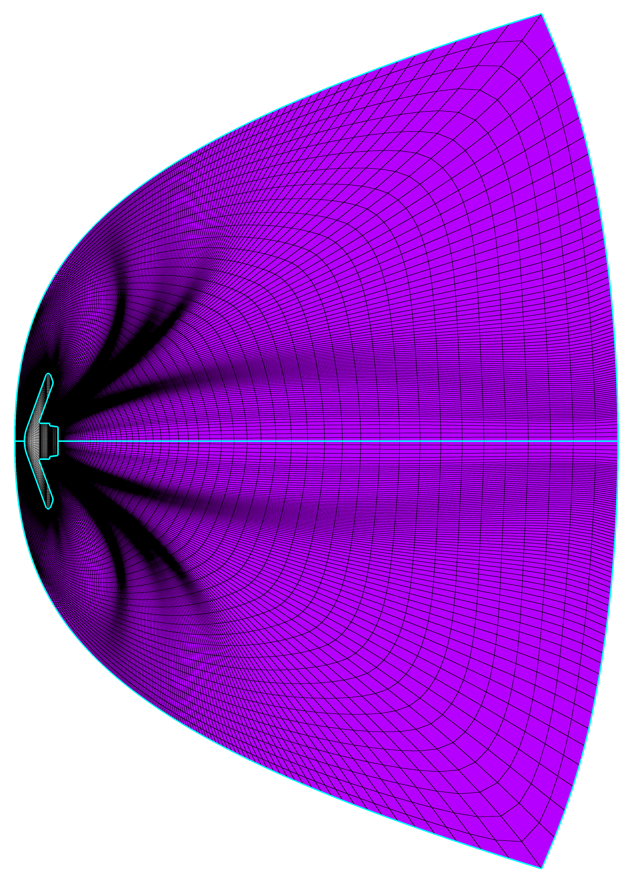
5. Extrude (rotate)
Extrude (rotate) the 2D domain 180-degrees to create a 3D volume grid with symmetry plane
  Project 2D mesh to symmetry plane
  Extrude (rotate) about geometry’s axial centerline
  Reorder ijk orientations if needed
i
k
j
Pole

Slide 21
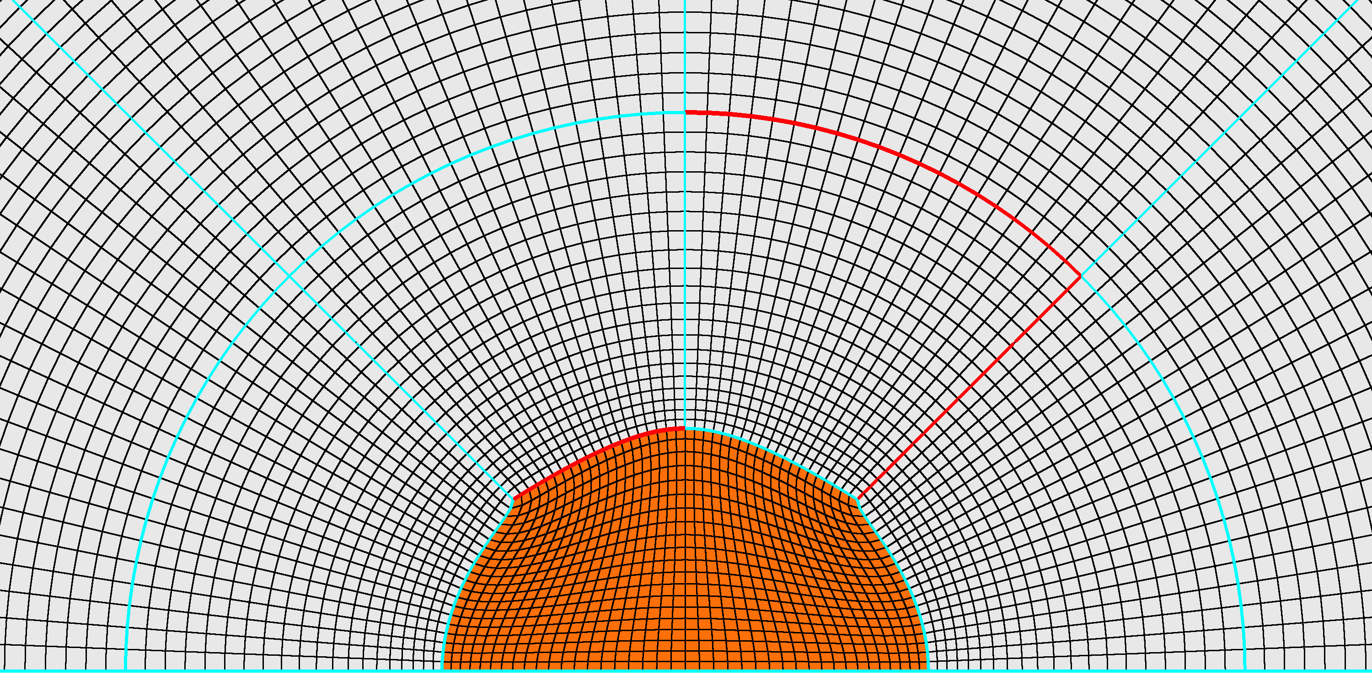
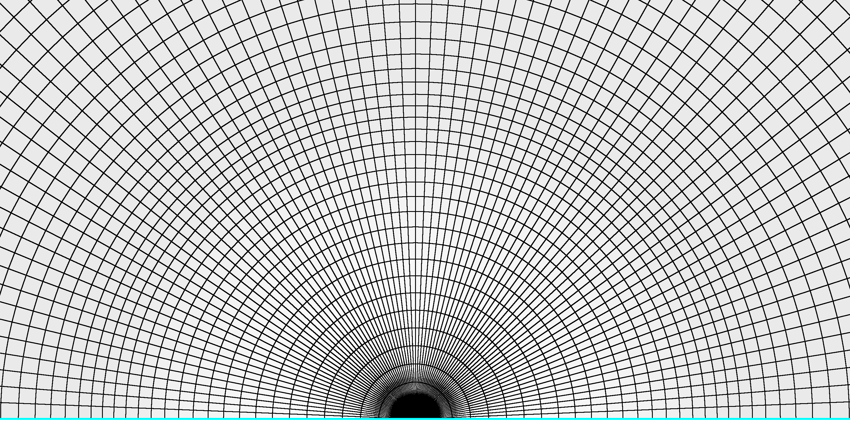
6. Replace Surface Poles with H-Grids
Replace poles on the surface grid with H-grid patches
  Consider corner quality
  Properly distribute (TanH) points and match adjacent domain boundary spacings
  Elliptic smoothing –> check stretching ratios
i
j
Spacing:
Adjacent
Angle:
Orthogonal
i
j
Spacing:
Interpolate
Angle:
Orthogonal
Spacing:
Adjacent
Angle:
Adjacent

Slide 22
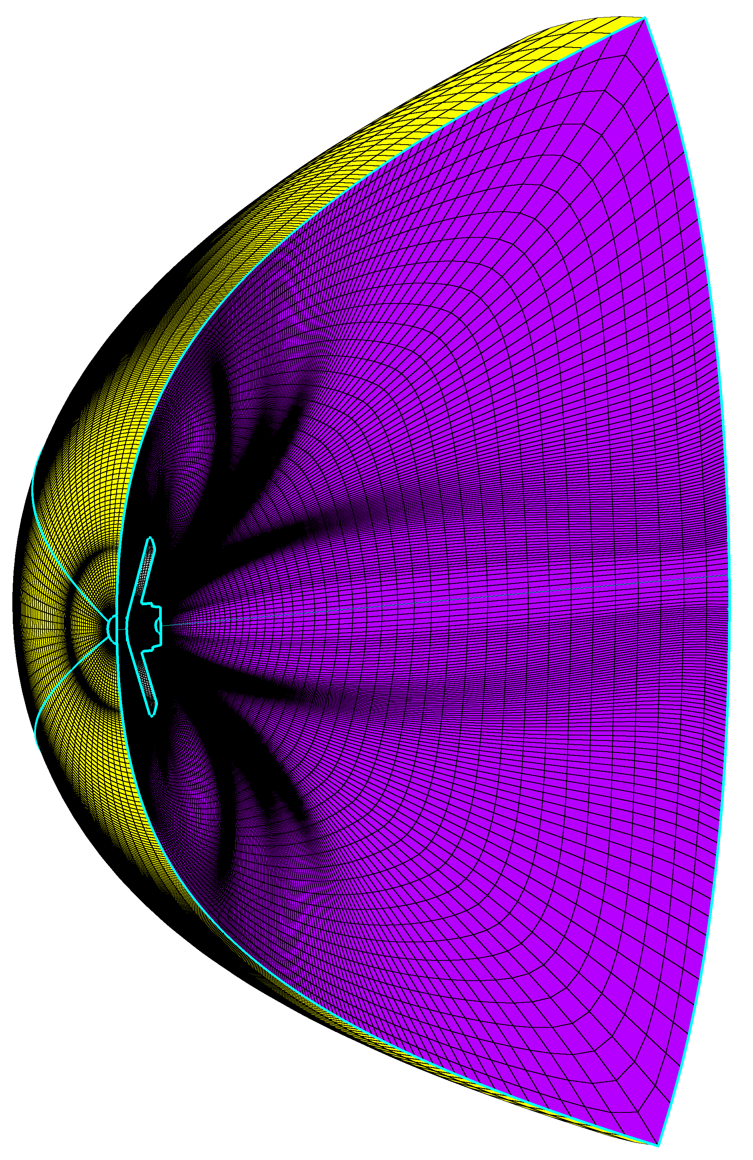
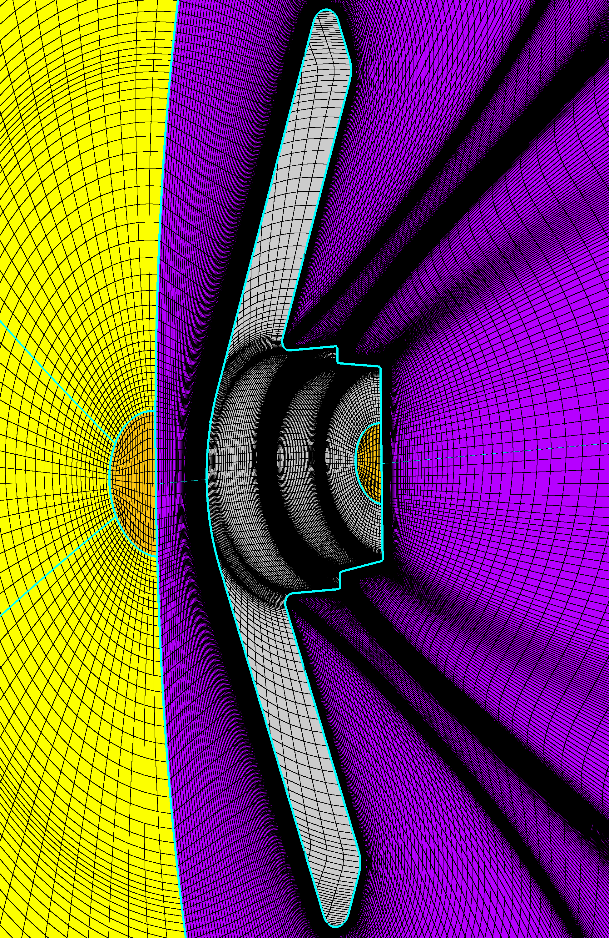
7. Use Radial_Interp
Use Radial_interp to create a new 3D volume grid without poles
  Use Radial_interp to generate pole-less volume grid
  Split the blocks up into equal sizes
    Some CFD codes are more efficient if this pre-processing step is made
  Reorganize blocks -> Logical order for BC setup, finding potential problems and post-processing
i
j
k

Slide 23
8. Define Boundary Conditions
Freestream
Outflow
Define boundary conditions
  Select ’LAURA’ as the flow solver in PointWise
  Define B.C. on outer control volume domains
  “Export -> CAE…” to write out grid and boundary condition file
Wall
Symmetry Plane

Slide 24
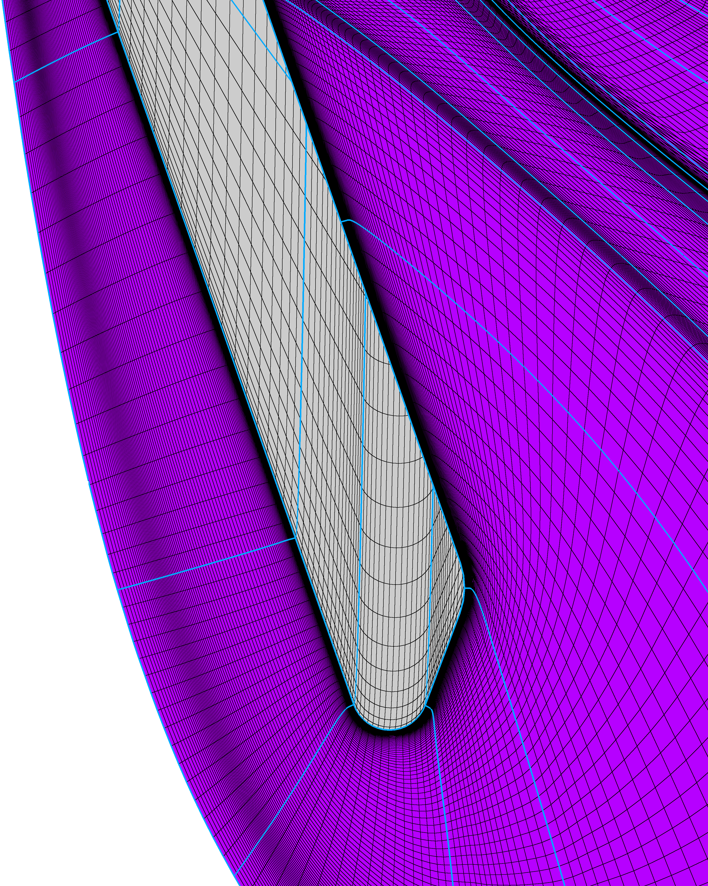
Adapt Grid to Bow Shock
Shock alignment and clustering
Cell Reynolds number
K distribution and stretching
Flow

Slide 25
Outline
What makes a good grid?
  Focus on aeroheating
Example Workflow
  Step through an example grid generation workflow - Inflatable reentry vehicle
Issues & Advancements
  Briefly mention where typical aerothermodynamics grids give us trouble and some ways forward

Slide 26
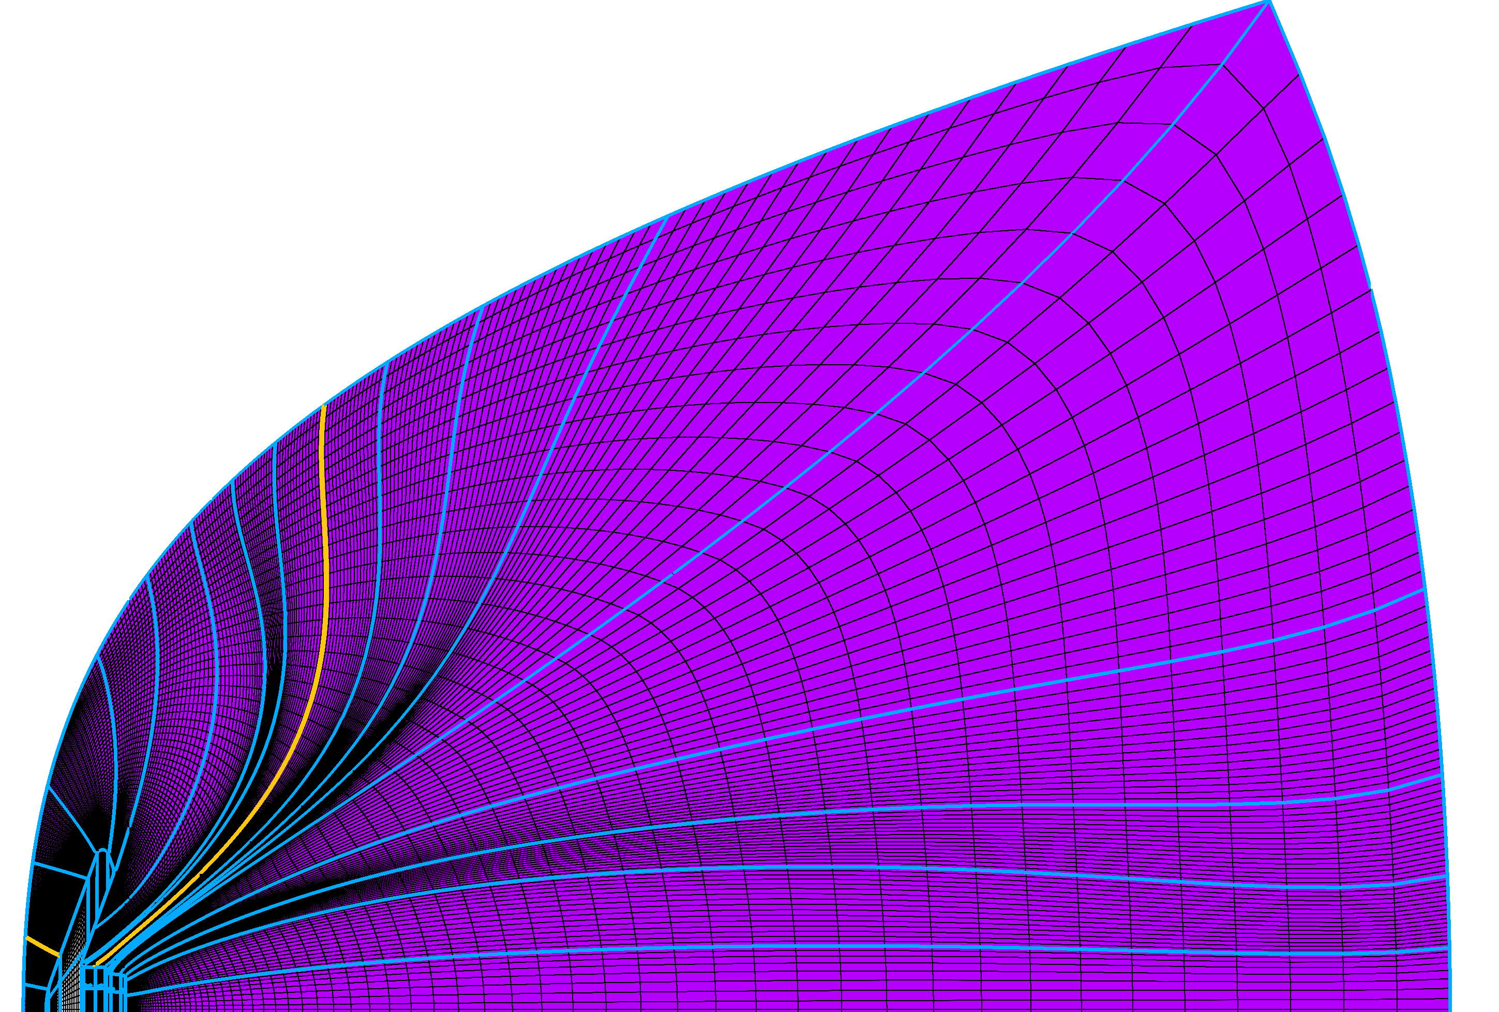
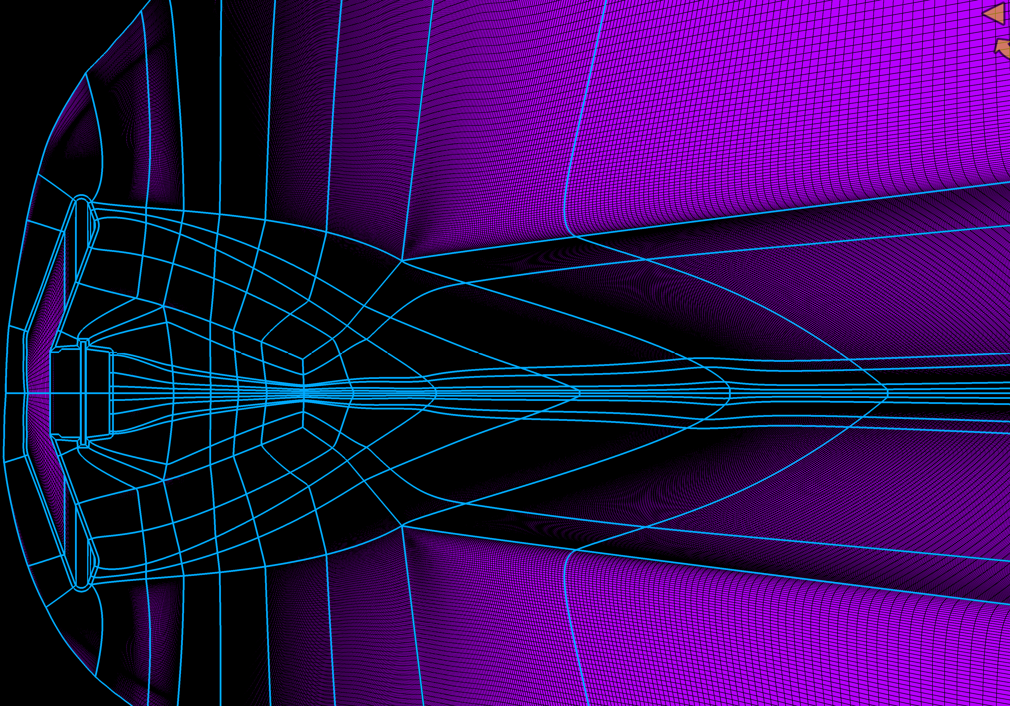
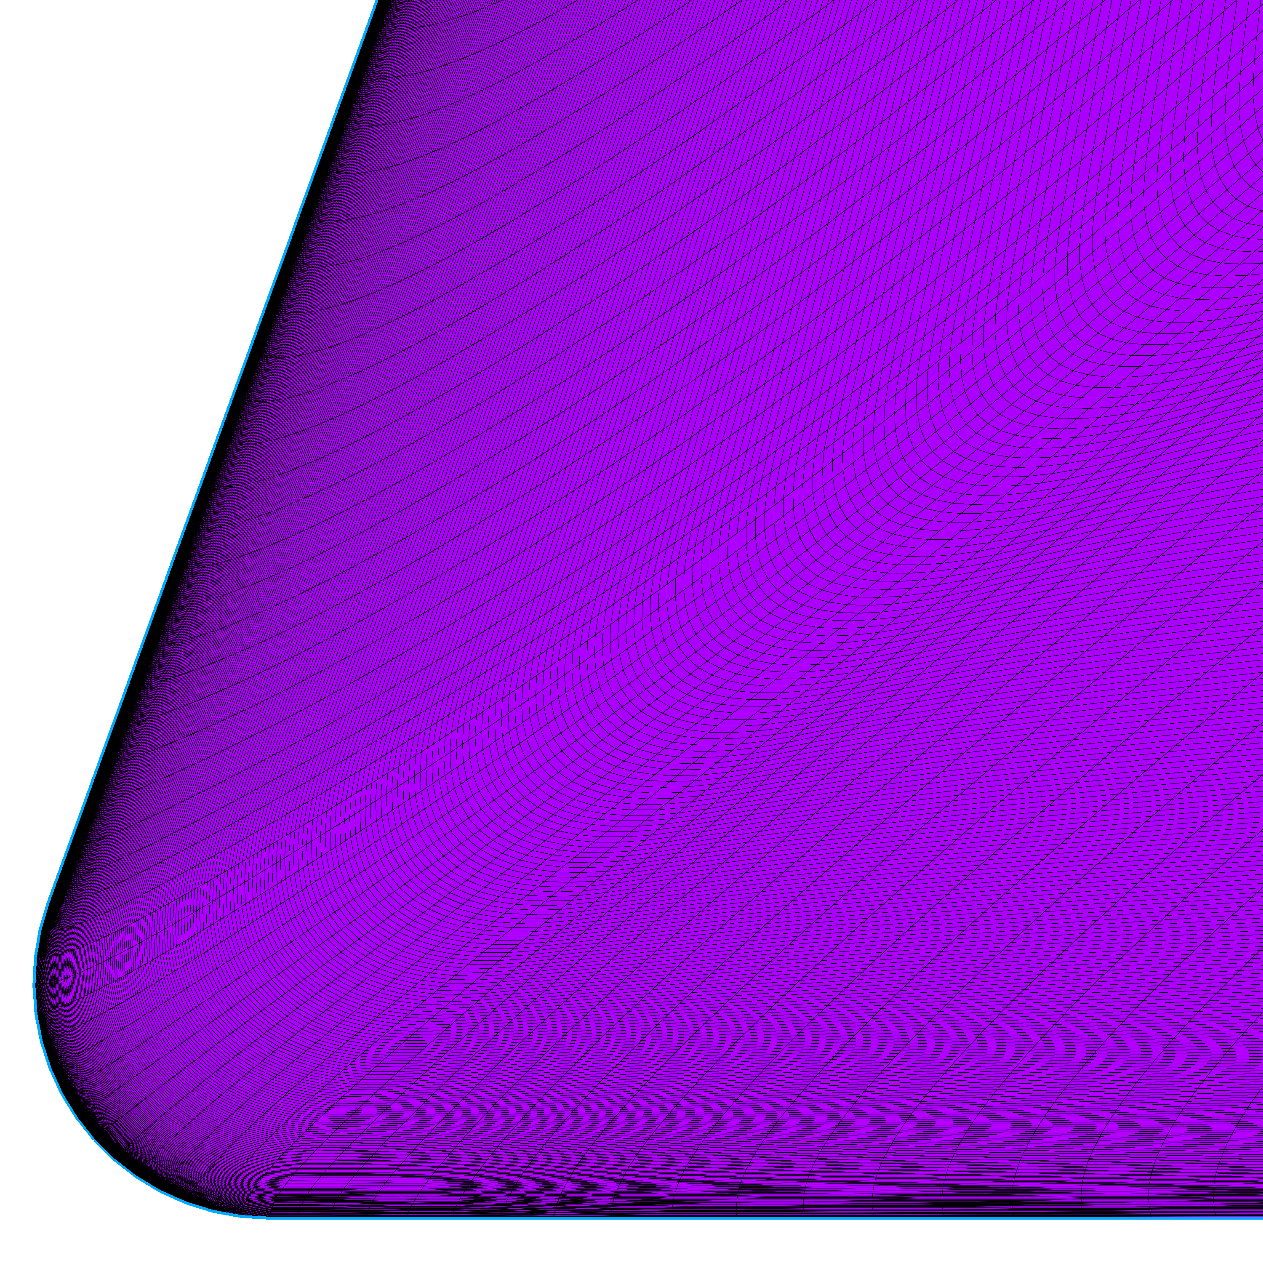
Structured Grid Difficulty
Stacked block topology
Arc Length
Throw more points at it?
Wasted points, topology unchanged
Arc Length

Slide 27
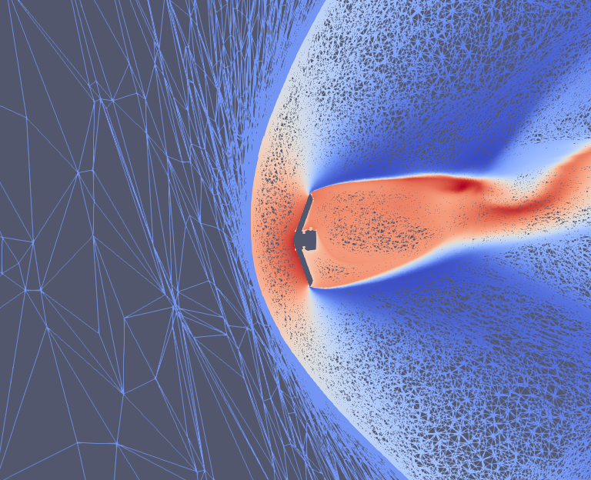
Unstructured Grids
As geometries become more complex, unstructured grids could be a solution
  Much more flexible and their generation can be automated
  Grid is only part of the “equation”
    Solver and Discretization
  Structured grids are currently the only robust option
    Radiation, ablation, etc.
Flow
Refine
Hybrid mesh – prisms in BL, tetrahedrals in freestream

Slide 28
Questions?

