Slide 1
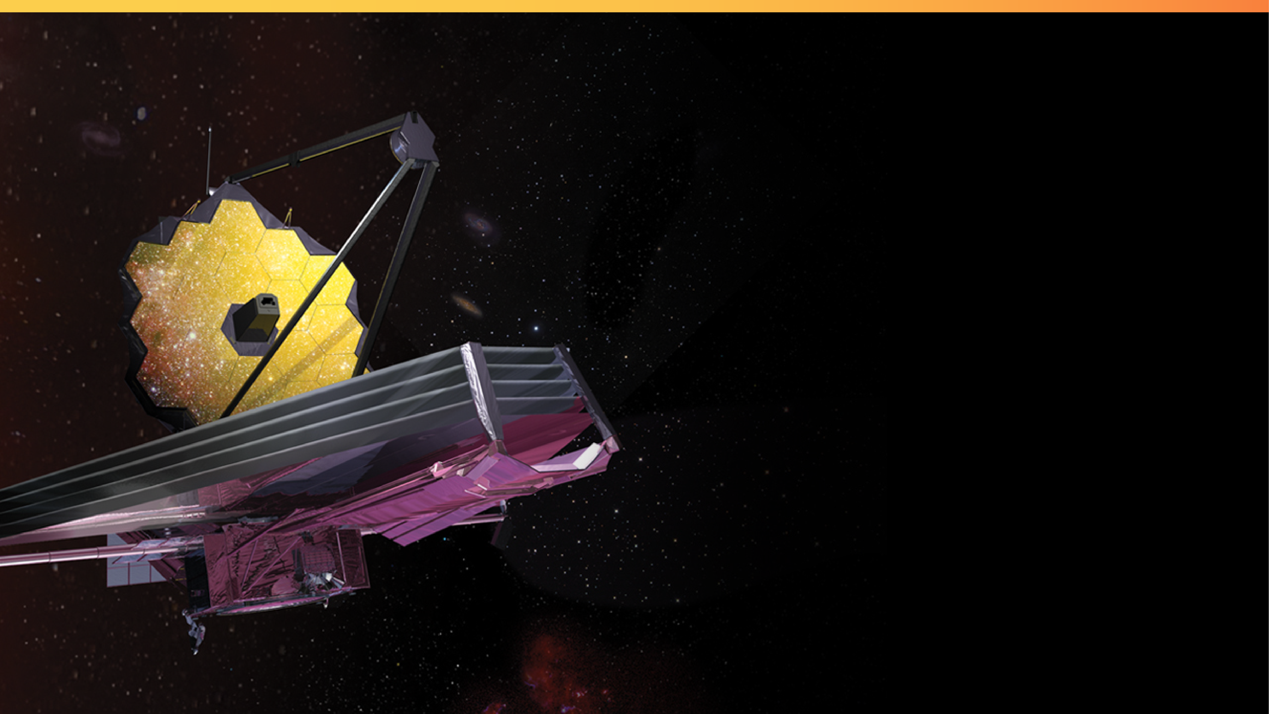

Obtaining cryogenic molecular transport data for analysis
(1224-4)
Elaine Stewart, Eve Wooldridge
Goddard Space Flight Center, Greenbelt, MD 20771
Kelly Henderson Nelson, Mike Woronowicz, and George Meadows
KBR Inc., Fulton, MD 20759
SPIE Optics + Photonics 2022, Conference 12224 Space Systems
Contamination: Prediction, Control, and Performance August 23– 24, 2022
Notes:
Please display this slide on screen before your presentation begins and during your introduction.
In this notes pane area, you will find supporting information for each slide and links to additional resources.
You may customize this presentation—removing slides, changing the order, and more. If you would like to add slides, there are templates at the end. We recommend adding slides to this document (not importing slides from this template into your file). Using this as your primary file will preserve the fonts and styling.
You do not have to use all of the slides in this template. Delete any slides that you do not plan to use in your presentation.
If you need to share your presentation, it is best to save your presentation as a PDF file.
The templates are accessible with existing content, but make sure that your final presentation still meets accessibility standards once you add your own content and images. For general PowerPoint Accessibility Guidelines: https://webaim.org/techniques/powerpoint/
__________________________
Image Credit: NASA, ESA, Northrop Grumman
https://webbtelescope.org/contents/media/images/2017/28/4051-Image
Updated: July 19, 2022

Slide 2


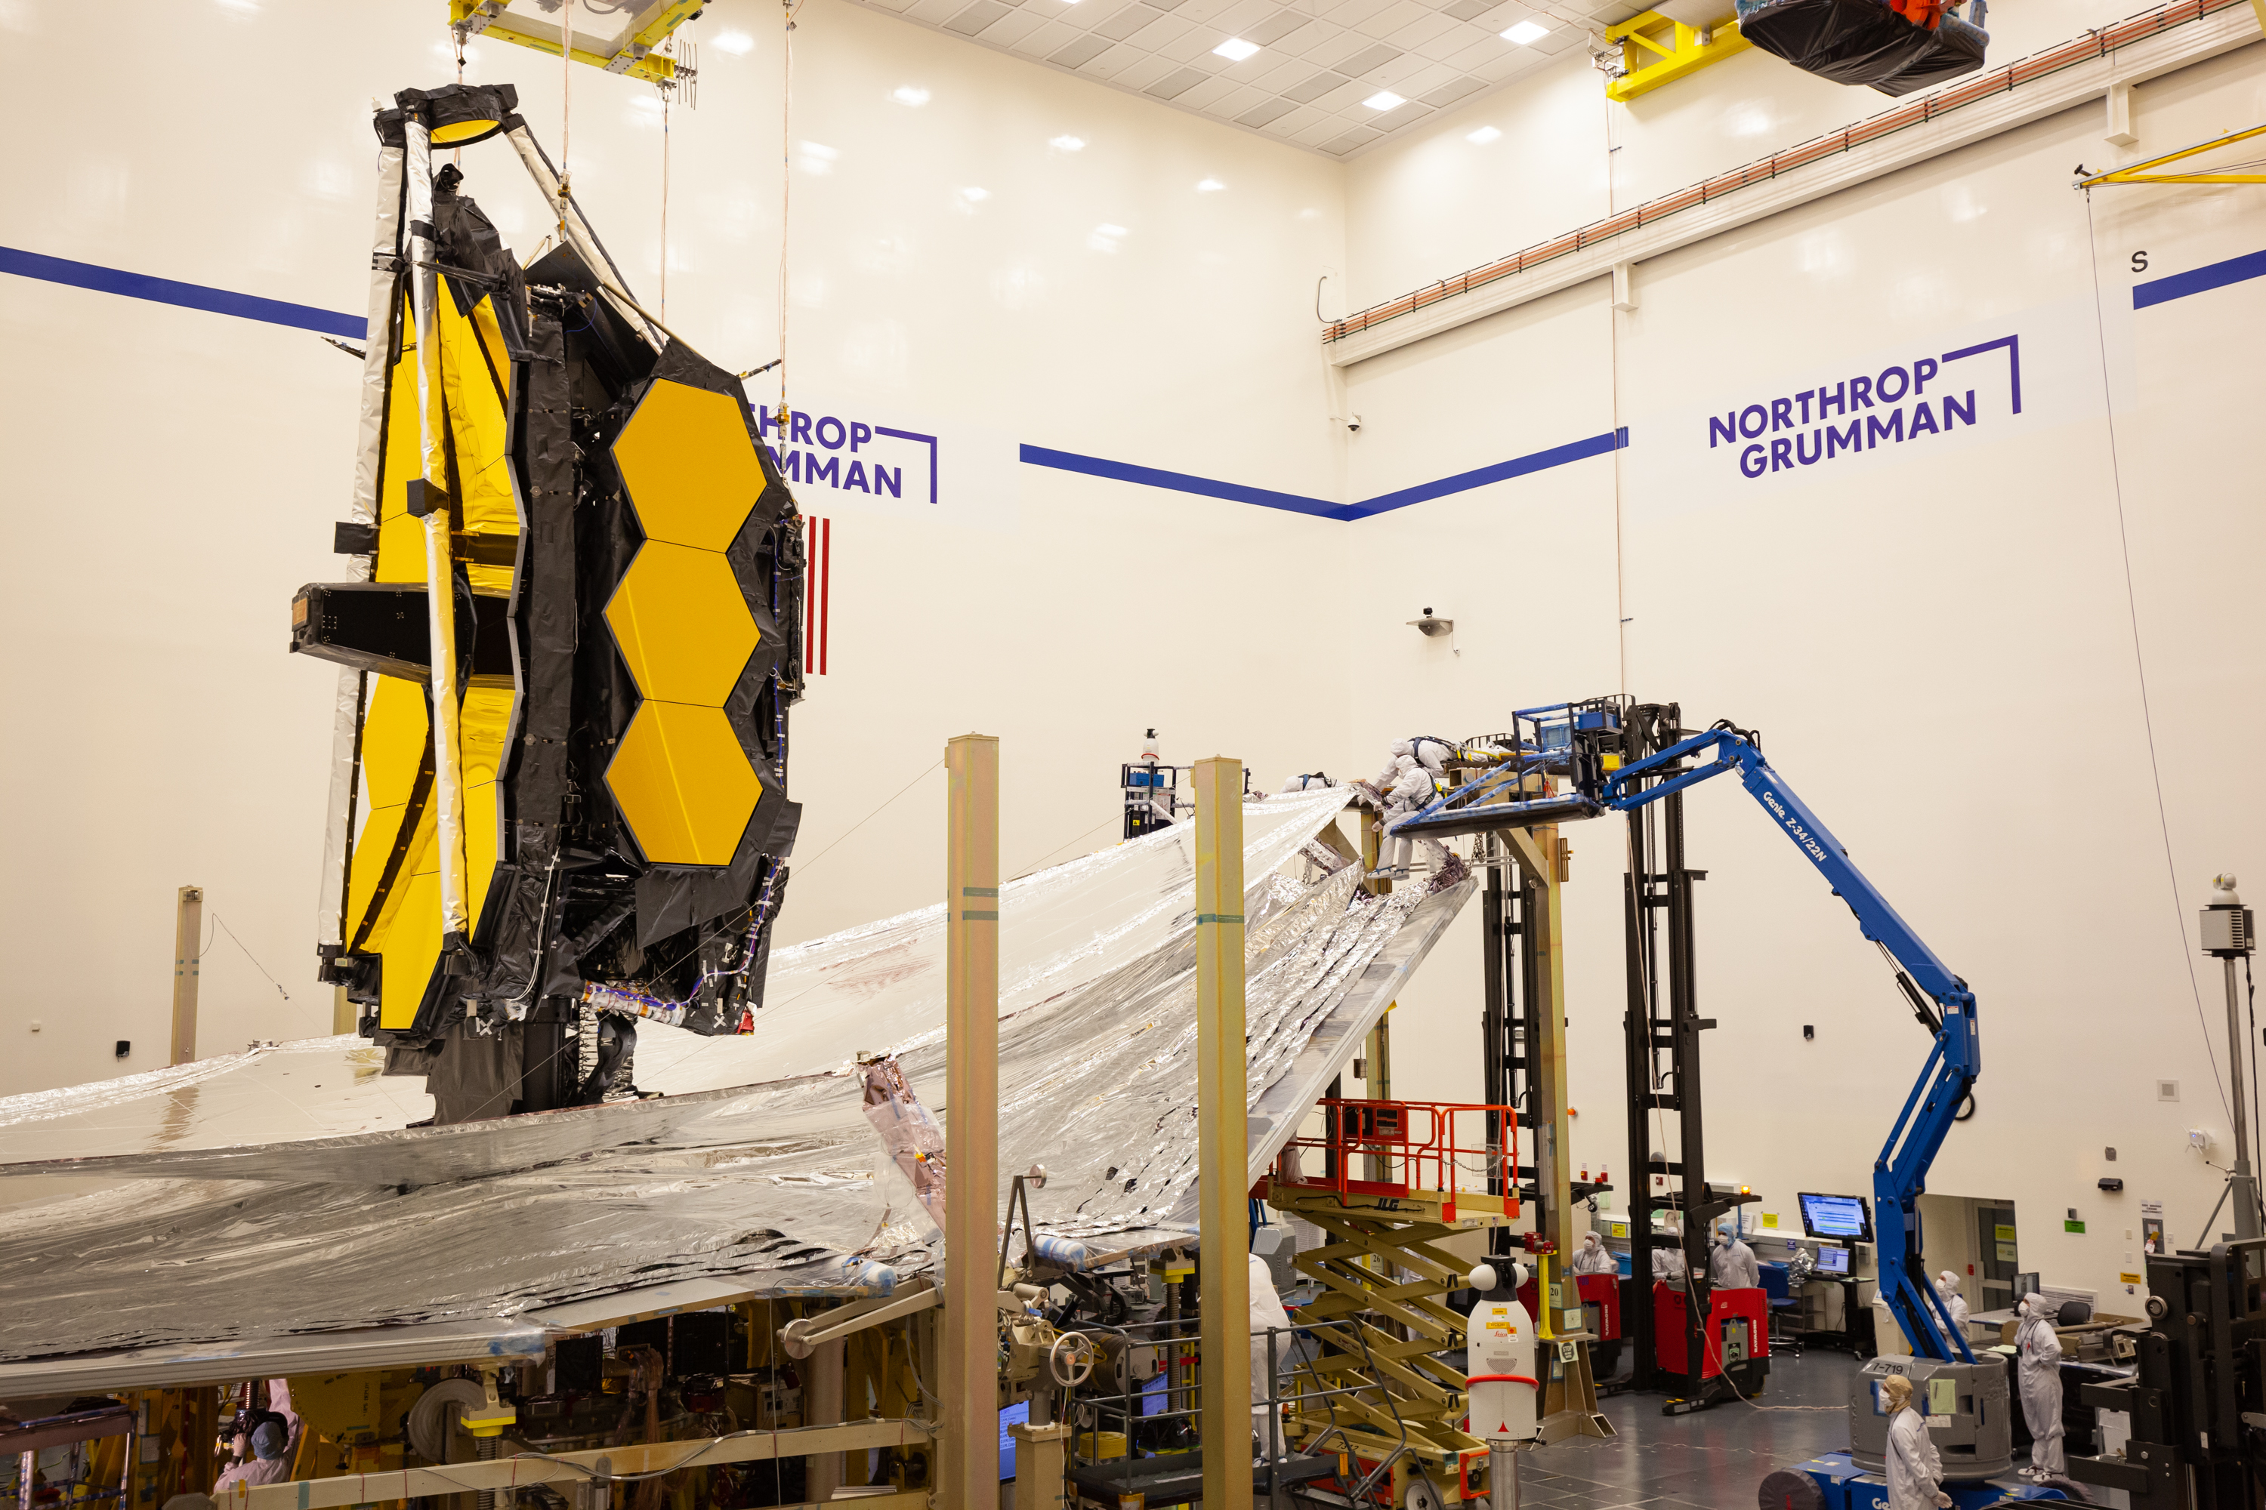
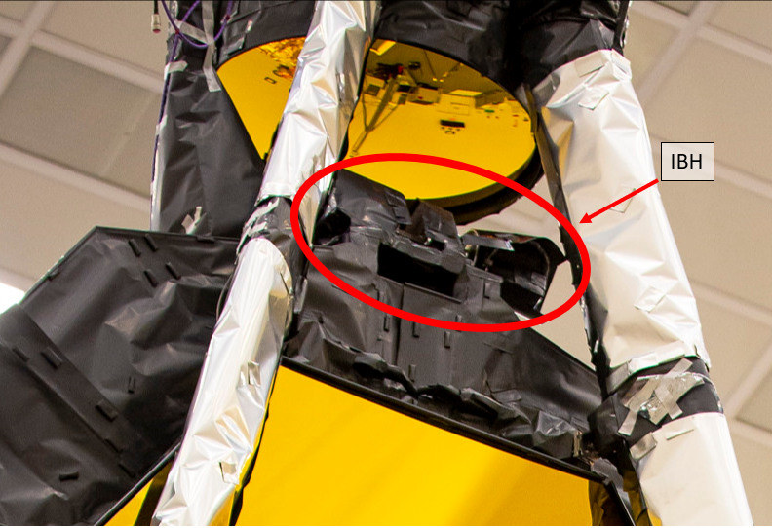

In-Board Hinge (IBH) and Secondary Mirror (SM)
SM
Credit: Northrop Grumman
Credit: Northrop Grumman
SM in stowed configuration for 10 days during cool down to operational temperature
IBH is an outgassing and water vapor contamination threat as a thermal enclosure which contains cables, motors, resolvers, and coatings
Notes:
[Note to presenter: This slide is optional.]

Slide 3
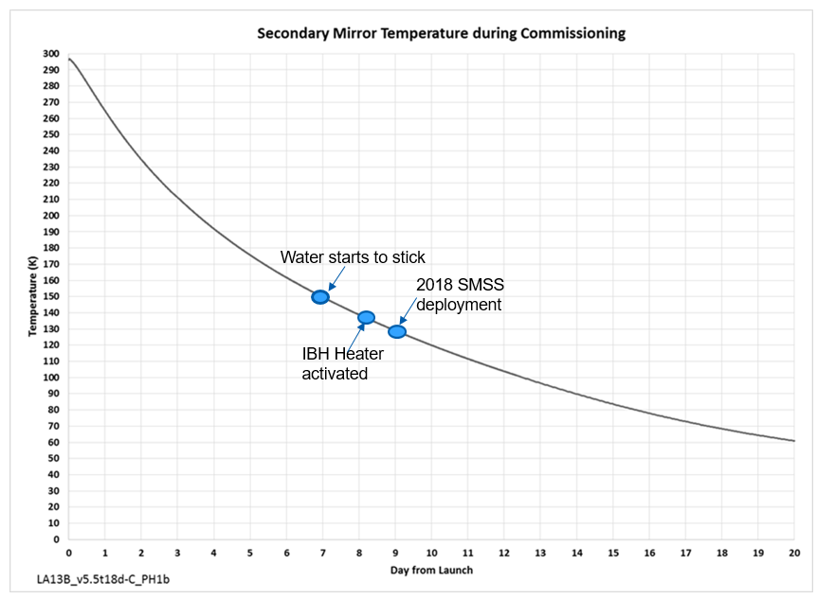
Secondary Mirror Temperature during Commissioning
SM is cold enough to condense water when IBH heater is activated at day 8 of commissioning
Investigated and mitigated concerns for molecular or ice accumulation:
Modifications to IBH thermal enclosure blanketing
Outgassing testing for radiator paint and IBH engineering test unit for incorporation to molecular transport analysis
Notes:
[Note to presenter: This slide is optional.]

Slide 4
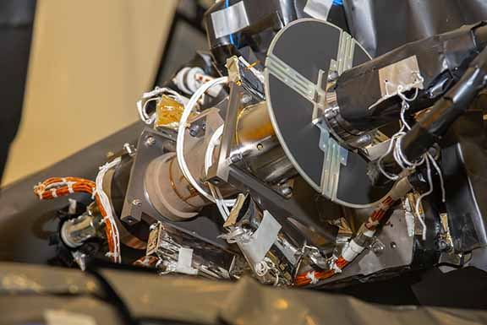
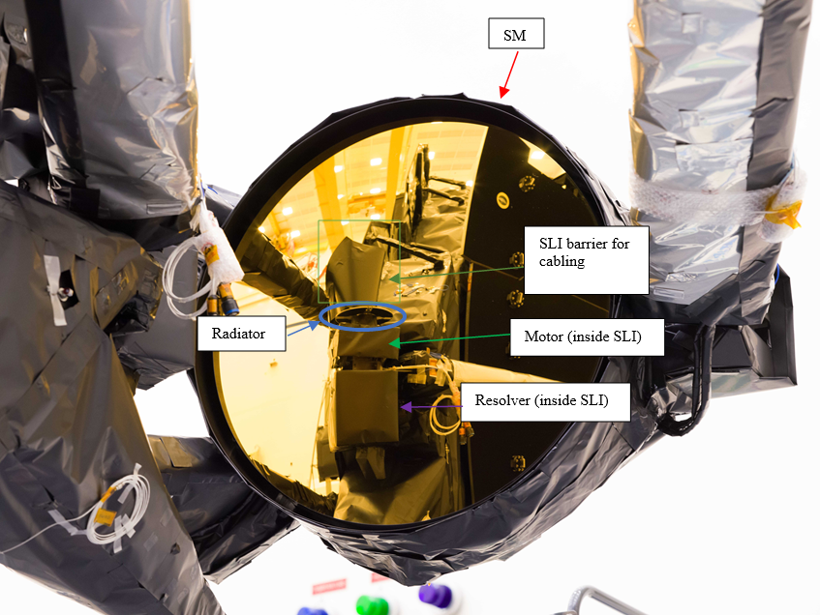
IBH Single Layer Insulation (SLI) Blanketing Improvements
Motor
Resolver
Credit: NASA/Jolearra Tshiteya
Credit: NASA/Chris Gunn
Initial inspection to original IBH SLI enclosure revealed leak paths
Improvements implemented with additional incremental inspections and venting checks:
Ensured adhesive contact to structure, elimination of line of sight from IBH outgassing sources to SM optical surface, and directional venting for IBH outgassing surfaces away from SMA
Notes:
[Note to presenter: This slide is optional.]

Slide 5
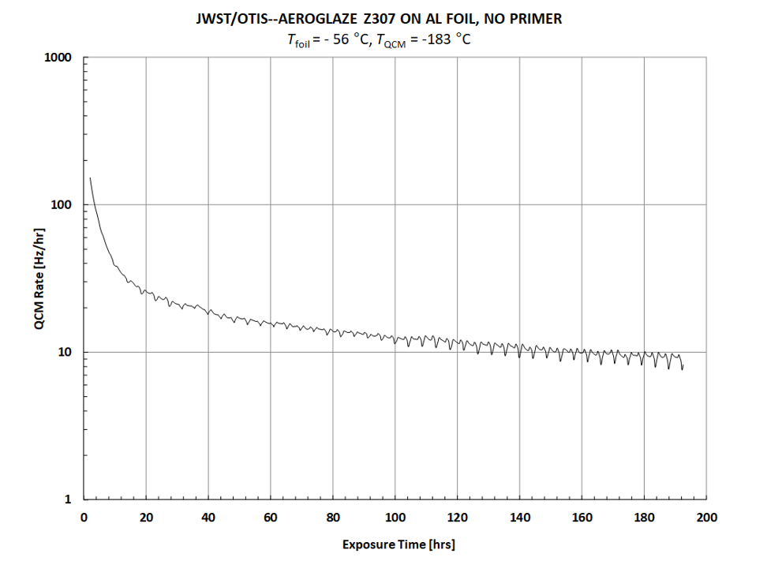
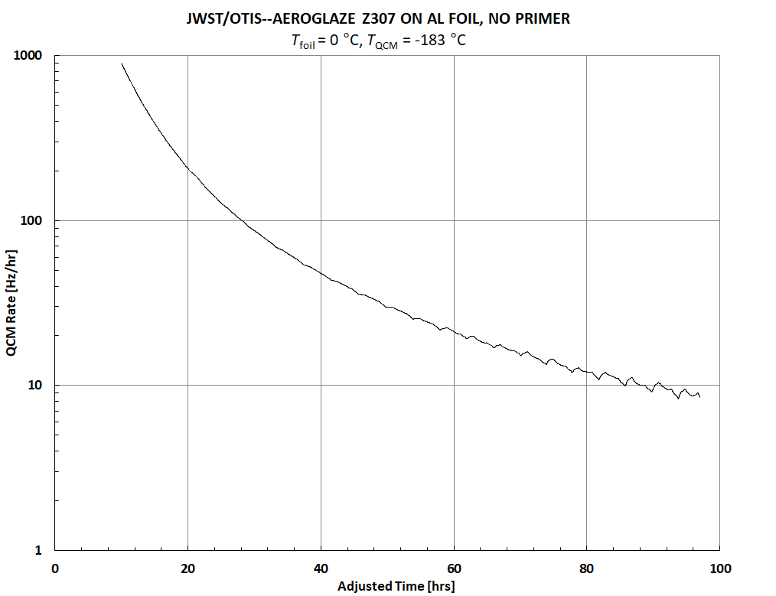
Aeroglaze Z307 Outgassing test (ASTM E 1559 test)
Test Parameter | Phase I | Phase II
Pressure (Torr) | <1e-05 | <1e-05
QCM Temp (C) | -183C | -183C
Cell effusion Temp | -56C | 0C
Duration | 8 days + 3hrs or when directed | 21 hrs or when directed
QCM rates in Hz/hr maintained at -183C with the temperature of the foil at
-56C and 0C
used in molecular transport analysis to identify the risk for moisture condensation on the SM from the radiator prior to deployment
Notes:
Mention 2 phases for testing and be clear!

Slide 6
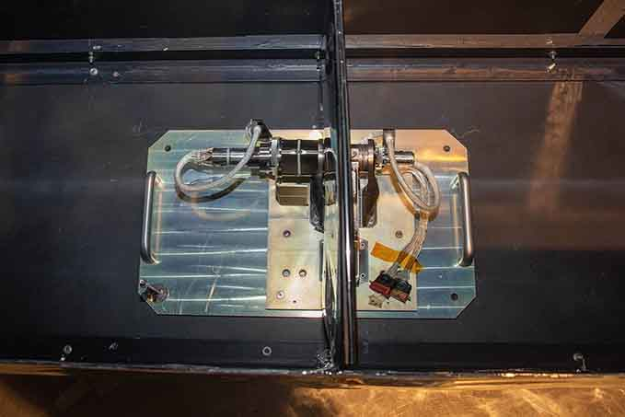
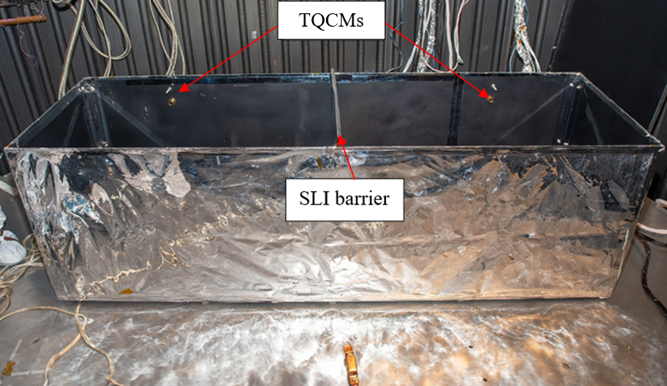
Engineering Test Unit (ETU) Outgassing Test Preparation
Test Parameter | Phase I | Phase II
Facility Shroud Temp | LN2 (-166C) | LN2 (-166C)
Bakeout Box Temp | -100C | -100C
Box Lid Configuration | Open 10cm (4”) | Open 10cm (4”)
TQCM Temp | LN2 (-186C) | LN2 (-186C)
ETU Motor Temp | -55C | +20C
ETU Resolver Temp | -58C | +20C
Time Criteria | 8 days + 3hrs or when directed | 72 hrs or when directed
SLI barrier to separate motor and resolver sides
Bakeout box(w/lid and vent) used to control environment
and ensure that it was neither a source nor collector
of water
Credit: NASA/Jolearra Tshiteya
Credit: NASA/Jolearra Tshiteya
Notes:
Following on orbit profile which starts at -55C, hinge heated up to +20C. For phase 1 and 2

Slide 7
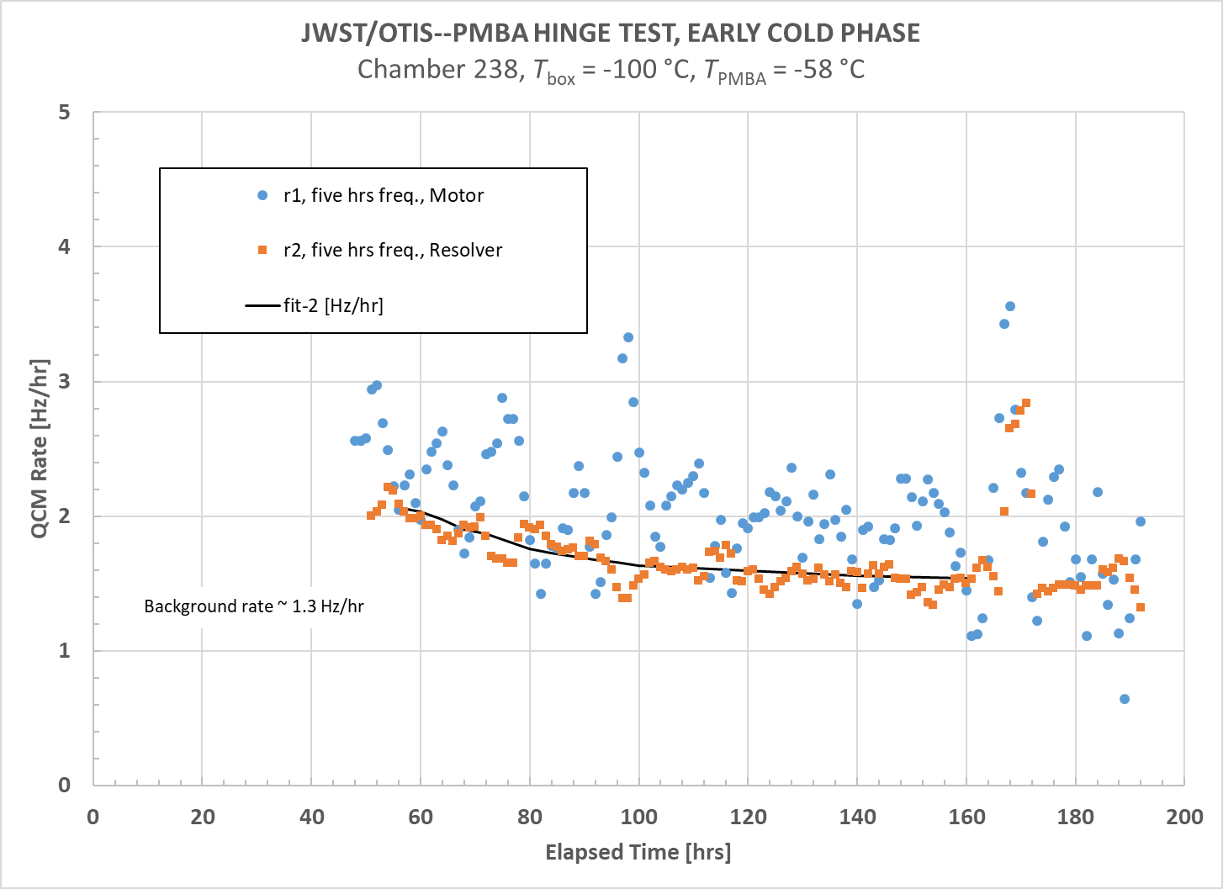
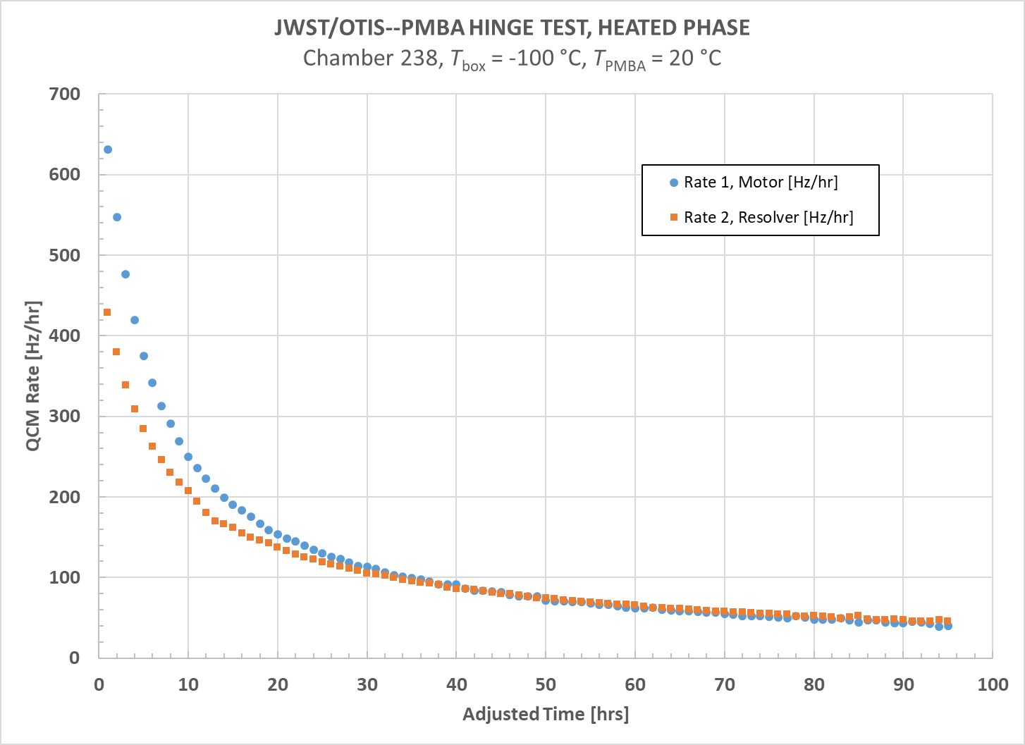
Engineering Test Unit (ETU) Outgassing Test Results
With a chamber background rate less than 1.3 Hz/hr, it is observed that the outgassing rate of the motor and resolver is quite low. The data shows that the measured motor QCM Hz/hr rate > resolver rate
Motor side QCM did have a larger quantity of water vapor deposition than the resolver. After approximately 30 hrs, the rate of removal from the motor and resolver QCMs were at the same rate
Notes:
[Note to presenter: This slide is optional.]

Slide 8
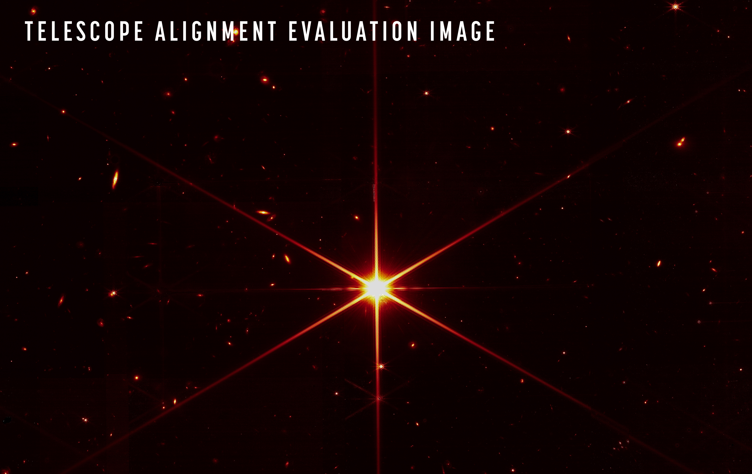
Discussion
Outgassing rates from Z307 radiator paint, resolver, and motor sides were used for a geometric analysis of ice deposition on orbit for Webb sensitive surfaces
-analysis indicated we were within on orbit
allocation
Webb on-orbit commissioning team performed a bakeout of the IBH prior to SM deployment while the optics were still too warm to condense water vapor to mitigate any changes from leaks that may have been introduced during launch
SM, together with the rest of the JWST optics, has performed flawlessly on-orbit, indicating that IBH outgassing did not reach the SM
-fine phasing and first images testify to the success of the many contamination measures taken
Notes:
[Note to presenter: This slide is optional.]

Slide 9
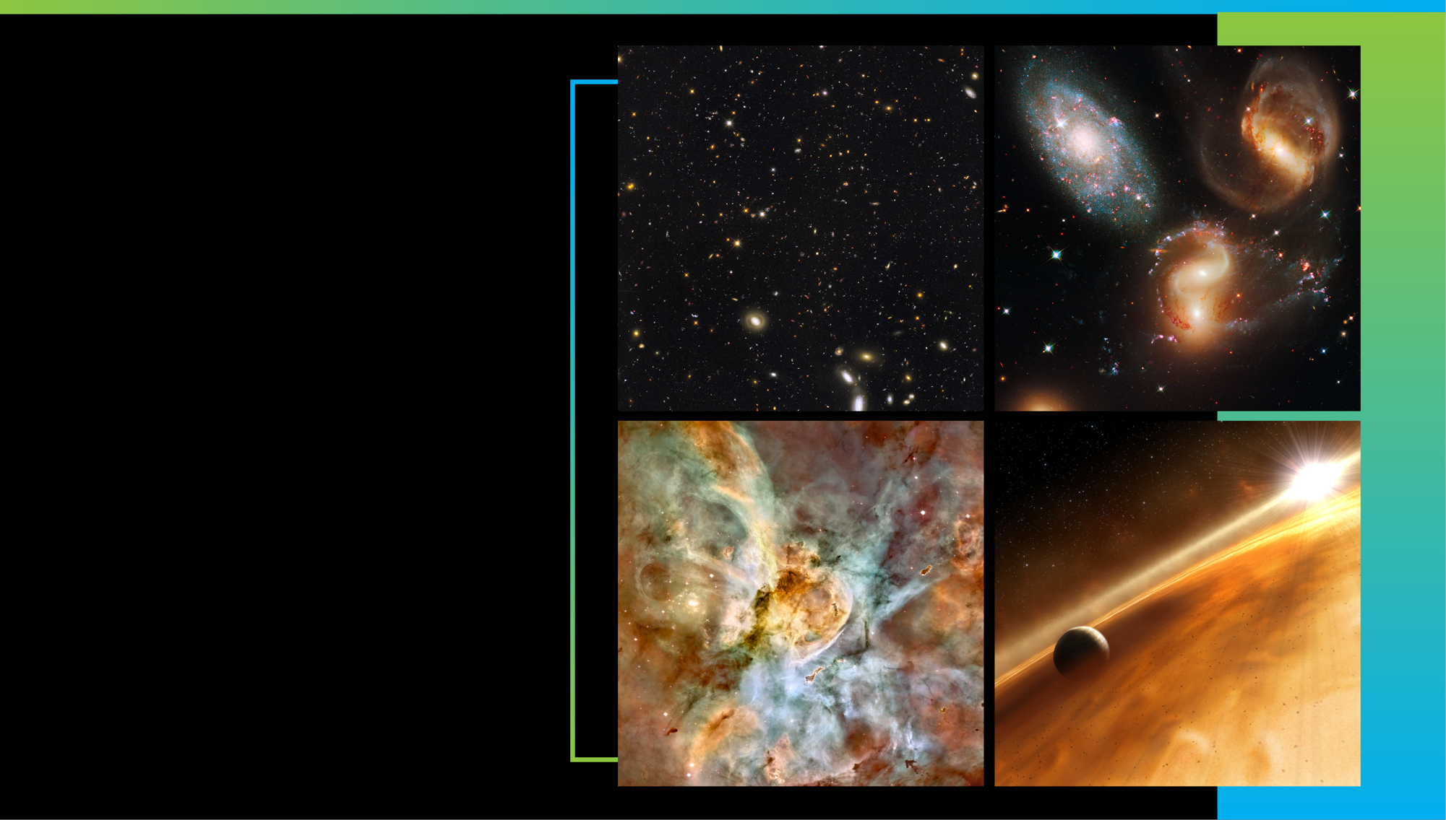
Acknowledgements
We would like to thank Josh Levi, Paul Reynolds, Chris Johnson, Diane Swenton, John McCloskey, Dan McGregor, Melina Espiritu, Bruce Haines, Drew Uhl, Jolearra Tshiteya, Chris Gunn, Connor Knowles, and Craig Jones for their part in planning and performing this test.
Early Universe
Galaxies over Time
Star Life Cycle
Other Worlds
Notes:
Webb is actively taking new images and spectra! There is so much in the universe it will examine.
Webb will capture light from the first generation of galaxies in the early universe, and help us map how galaxies change over time.
It will help researchers study how stars form, live, and die.
Webb will find and explore the atmospheres of distant worlds.
It will also observe planets in our own solar system, including Mars, Jupiter, Saturn, Uranus, Neptune—along with their moons. Webb will also study small bodies across the Solar System, including asteroids, comets, and Kuiper Belt objects.
Plus, the telescope will observe black holes near and far, including our Milky Way’s supermassive black hole Sagittarius A* (A-star).
Be sure to follow Webb’s discoveries in the news!
__________________________
Ongoing/upcoming news releases: https://webbtelescope.org/news/news-releases
Suggest to viewers that they can sign up to receive our new releases by email by entering their email address at the bottom of this page under “STScI Inbox Astronomy Newsletter”: https://webbtelescope.org/news
Image Credits:
Early Universe: GOODS-S/ERS2 Field
Credit: NASA, ESA, Rogier Windhorst (ASU), S. Cohen (ASU), M. Mechtley (ASU), M. Rutkowski (ASU), Robert O'Connell (UVA), P. McCarthy (OCIW), N. Hathi (UC Riverside), R. Ryan (UC Davis), Haojing Yan (OSU), Anton M. Koekemoer (STScI)
https://webbtelescope.org/contents/media/images/2021/004/01EX2AXKF1EKA0J7K1965PCNBC
Galaxies over Time: Stephan’s Quintet
Credit: NASA, ESA, and the Hubble SM4 ERO Team
https://hubblesite.org/contents/media/images/2009/25/2606-Image.html
Star Lifecycle: Carina Nebula
Credit: Hubble Image: NASA, ESA, N. Smith (University of California, Berkeley), and The Hubble Heritage Team (STScI/AURA); CTIO Image: N. Smith (University of California, Berkeley) and NOAO/AURA/NSF
https://hubblesite.org/contents/media/images/2007/16/2099-Image.html
Other Worlds: Illustration of a planet in a dusty debris disk
Credit: NASA, ESA, and L. Calcada (ESO for STScI)
https://webbtelescope.org/contents/media/images/4193-Image

Slide 10
References
“NASA’s James Webb Space Telescope,” Space Telescope Science Institute. https://jwst.stsci.edu/about-jwst.
“Webb Telescope Science Themes,” NASA GSFC, https://jwst.nasa.gov/science.html.
“Contamination Control and Hardware Processing Solutions,” Burns, et al, NASA, 5-537166.
“The Next Generation Space Telescope, A Presentation to the NGST Study Office,” Goddard-Led Study Team, August 1996
“Webb Telescope Works. Perfectly.”, Cowing, K., March 16, 2022. http://nasawatch.com/archives/2022/03/webb-space-tele-4.html)
Brieda, Lubos., "Numerical study of water ice and molecular contamination build up during JWST deployment," Proc. SPIE 1224-3, (2022).
Notes:
[Note to presenter: This slide is optional.]

Slide 11
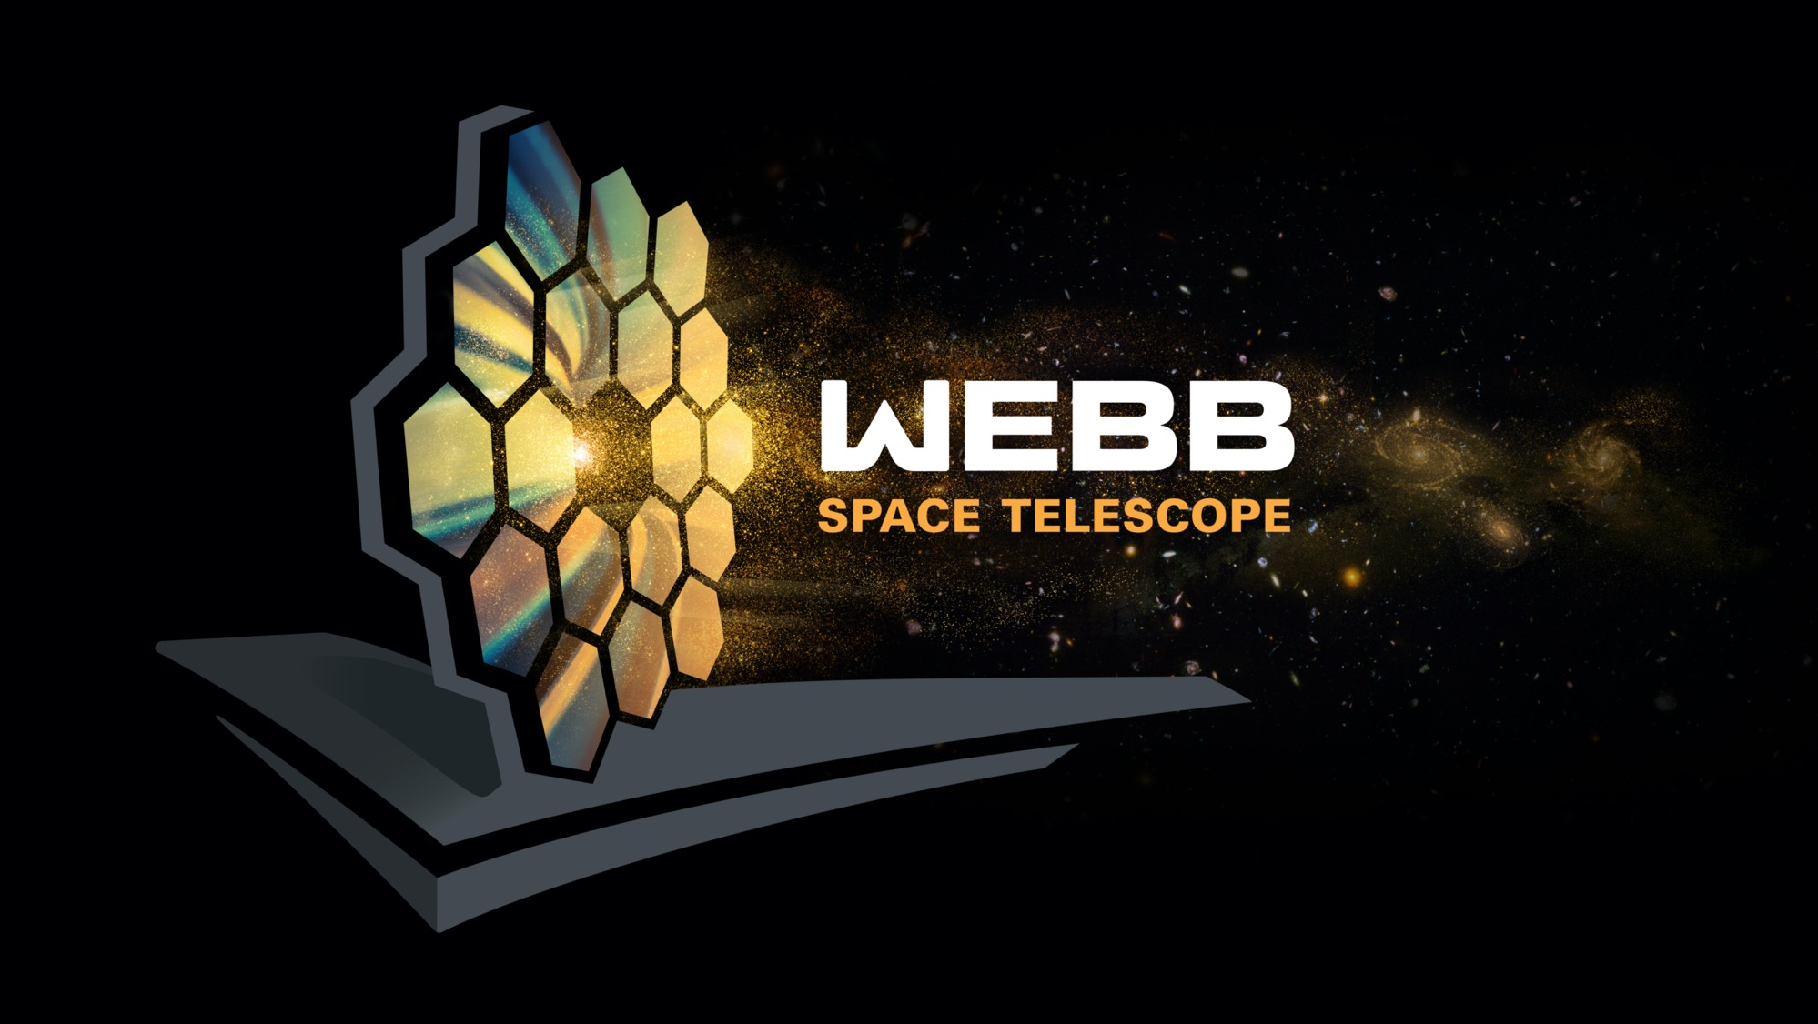
Questions?
Notes:
Complete FAQs:
Why do we have to wait so long between Webb’s launch and its first images?
In the six months after launch, Webb underwent a complex commissioning process. This included:
Deployments: This began when the telescope launched, on December 25, 2021, and continued for about 30 days. In a series of steps, Webb unfolded from its compact launch configuration. This included deploying, tensioning, and separating Webb’s sunshield, extending its secondary mirror support structure, and unfolding the wings of the primary mirror.
Telescope mirror alignments: This began just a month after launch and continued for about three months. Teams aligned Webb’s 18 hexagonal mirror segments so that they work together as one and are in focus for all of Webb’s four science instruments.
Science instrument calibrations: This began about four months after launch and continued for approximately two months. Webb’s instruments underwent a series of calibrations and tests. Engineers and scientists tested each mode to verify they are working as expected, understand their performance, and learn how to optimally extract science information.
During the deployment and alignment phases of commissioning, Webb cooled to its operating temperature. This slow, controlled cooling was necessary to prevent water that was outgassing from Webb to form ice on Webb’s optics and detectors and cold radiator surfaces, which would degrade the telescope’s performance.
How much data will Webb transmit each day?
Webb can downlink at least 57.2 gigabytes of recorded science data each day, with a maximum data rate of 28 megabits per second.
How long does data take to travel from Webb to Earth?
Traveling at the speed of light, it takes about 5 seconds for data to travel from Webb in its orbit around L2 to the Earth. All communications are routed through NASA’s Deep Space Network, with three ground stations located in Canberra, Australia, Madrid, Spain, and Goldstone, California.
Which frequencies do we use to communicate with the telescope?
S-band frequencies are used for command uplink, low-rate telemetry downlink, and ranging. Ka-band frequencies are used for high rate downlink of science data and telemetry.
What is a Lagrange point?
Lagrange points, discovered by mathematician Joseph Louis Lagrange, are special equilibrium points for small objects (like a spacecraft or an asteroid) orbiting two much larger objects (like the Earth and the Sun). At these points in space, the gravity of the two large objects balance the orbital motion of the third object. Lagrange points can be used by spacecraft to reduce propellant consumption needed to remain in position.
There are five Lagrange points for any system, labeled L1 to L5. Of the five points, three are unstable and two are stable. The unstable Lagrange points—L1, L2, and L3—lie along the line connecting the two large masses. Spacecraft orbiting at these points need to perform station keeping to remain in their orbits, by periodically expending small amounts of propellant. The stable Lagrange points—L4 and L5—occur at the apex of two equilateral triangles that have the large masses at their vertices. L4 leads the orbit of Earth and L5 follows.
See the diagram here: https://solarsystem.nasa.gov/resources/754/what-is-a-lagrange-point/
Webb orbits around the second Sun-Earth Lagrange point (L2). This point is approximately 1.5 million kilometers (930,000 miles) from Earth, “behind” the Earth as viewed from the Sun. All Lagrange points move in lockstep with the Earth as it rotates around the Sun, completing an orbit in one year.
Are there other spacecraft that orbit at L2?
Yes. There are several spacecraft that orbit or have orbited at L2. They include the Herschel Space Observatory, the Gaia space observatory, the Planck space observatory, and the Wilkinson Microwave Anisotropy Probe (WMAP).
Does Webb orbit exactly at L2?
No. Webb will orbit around L2, not sit stationary precisely at L2. If Webb were located exactly at L2, it would see the Sun eclipsed by the Earth, blocking the power it receives on its solar arrays. Webb loops around L2 in a six-month, tilted, elliptical orbit, which is slightly larger than the size of the Moon’s orbit around the Earth. This ensures that spacecraft never falls into the shadow of the Earth or the Moon—and remains charged. Here is a diagram of the obit to scale: https://www.flickr.com/photos/nasawebbtelescope/51886649707
What is Webb’s anticipated lifetime?
Webb will contain enough propellant for about 20 years of maneuvers at L2, and the Webb Science and Mission Operations Center at the Space Telescope Science Institute (STScI) will have the ability to adjust the science operations of the observatory to maximize potential as it ages. NASA engineered Webb so that all critical subsystems are dual or will degrade gracefully with age. For instance, the Near Infrared Camera (NIRCam) has two identical camera systems so that the optical quality can be maintained even if one fails.
How much of the sky can Webb see?
Over the course of six months, as Webb orbits the Sun with Earth, it has the ability to observe almost any point in the sky. Webb’s field of regard is limited to a 50-degree swath of the celestial sphere: About 39% of the sky is potentially visible to Webb at any given time. Because Webb must face away from objects that are warm and close enough to interfere with its ability to observe faint infrared light, it cannot observe the Sun, Mercury, Venus, Earth, the Moon, or other objects as they pass through the inner Solar System.
Can we can service Webb?
The quick answer is no. To meet Webb’s science goals, the telescope has to be far away from the heat of the Earth. This is why the telescope had to be so thoroughly tested before launch. This isn’t the first mission that is unserviceable. Other space telescopes, such as Spitzer and Herschel, successfully completed their missions in unserviceable orbits.
What are galaxies?
A galaxy is collection of stars, gas, dust, and dark matter bound together by gravity. The smallest galaxies may contain only a few hundred thousand stars, while the largest galaxies have thousands of billions of stars. Our Milky Way galaxy 100,000 light-years across and contains about 100 billion stars, including the Sun and our solar system.
Galaxies are classified or grouped by their shape. Round or oval galaxies are elliptical galaxies and those showing a pinwheel structure are spiral galaxies. All others are called irregular because they do not resemble elliptical or spiral galaxies.
__________________________
Resources:
News releases: https://webbtelescope.org/news/news-releases
How to receive our releases via email (enter your email address at the bottom of this page under “STScI Inbox Astronomy Newsletter”): https://webbtelescope.org/news
Overview of the telescope: https://webbtelescope.org/webb-science/the-observatory
Image Credit: NASA

