Slide 1
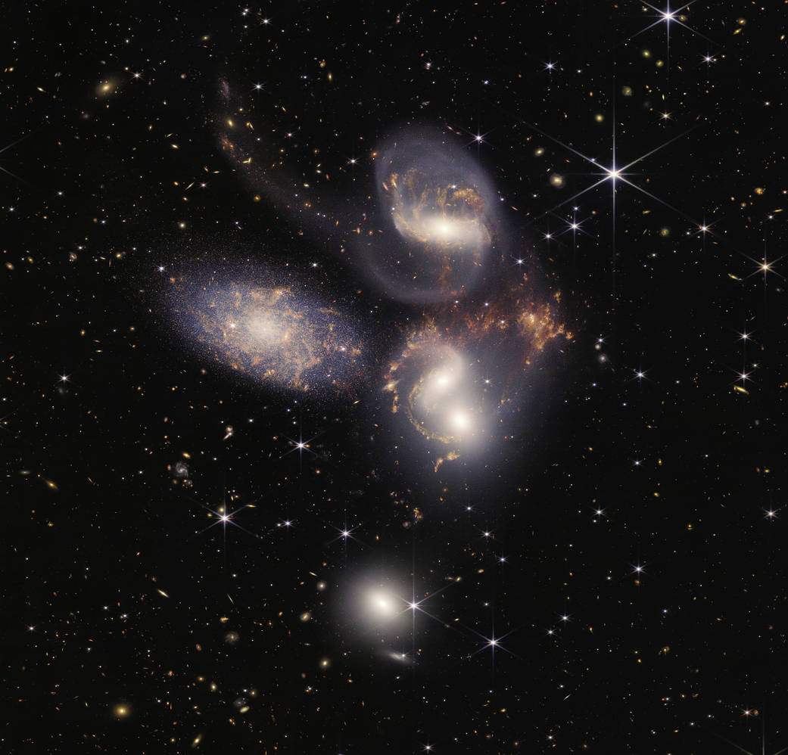
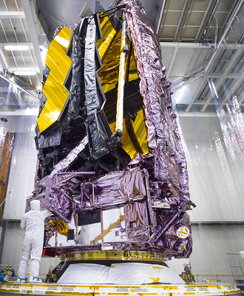
Predicting contamination accumulation in facilities with limited data
(1224-14)
Credit: NASA/Chris Gunn
Elaine Stewart, Eve Wooldridge
Goddard Space Flight Center, Greenbelt, MD 20771
Joe Ward
KBR Inc., Fulton, MD 20759
SPIE Optics + Photonics 2022, Conference 12224 Space Systems Contamination: Prediction, Control, and Performance August 23– 24, 2022

Slide 2
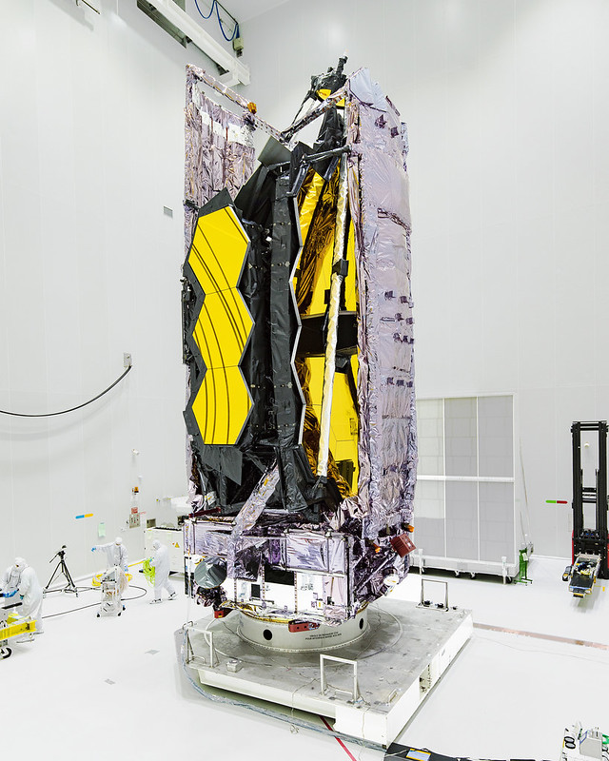
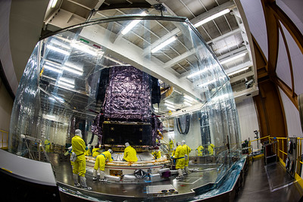
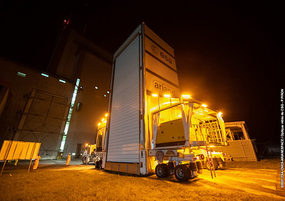
Contamination Control (CC) Requirements
Air Quality:
  ISO 7 facilities required, but many Centre Spatial Guyanias (CSG) facilities certified to ISO 8
Surface Cleanliness
 | Particulate (PAC) (Percent Area Coverage) | Molecular (Å) (Angstroms)
Primary Mirror (PM) | 1.50 | 350 allows for 50Å carbon
Secondary Mirror (SM) | 0.50 | 350 allows for 50Å carbon
S5-C
Implemented specific protection during transports and particularly challenging environments
PFEI
CCU-3
Credit: ESA/M.Pedoussaut
Credit: ESA/M.Pedoussaut
*Plate-Forme Elévatrice Inferior (PFEI)
*Conteneur Charge Utile 3 (CCU-3)
Credit: NASA/Chris Gunn

Slide 3
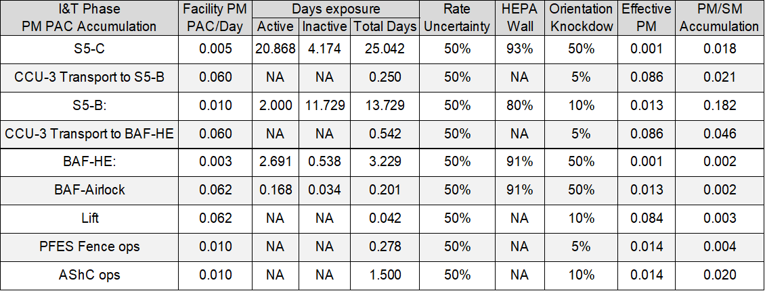
Launch Site Facility Predictions
CC team faced challenges with predicting fallout in the various facilities due to limited data, varying required cleanliness levels from previous missions, and COVID restrictions preventing planned visits to the launch site.
^{*Integration & testing (I&T)}
*Air shower curtain (AShC) ops involved an enclosure specifically designed for JWST to provide protection and environmental control on PFEI/Plate-Forme Elevatrice Superior (PFES) platforms. PFES fence was not implemented, but there were still operations on the platform within the AShC
*Bâtiment Assemblage Final (BAF) and BAF encapsulation hall (BAF-HE)
Overall assumptions used for rates and durations
Active: Planned work in each facility during pre-established shifts
Inactive: Limited or no access due to safety or facility restraints
PM and SM accumulations have a 50% rate uncertainty applied
  Used since PAC/day rates do not have long term data to back up the rate
ESA facility, Herschel-Planck (HP) and Automatic Transfer Vehicle (ATV) data have been used where applicable. These missions did not have cleanliness requirements as strict as Webb, but did implement further cleaning as compared to previous campaigns and used similar facilities for processing.
High efficiency particulate air filters (HEPA) wall reductions based on testing conducted at Goddard Space Flight Center
Orientation knockdown factor

Slide 4
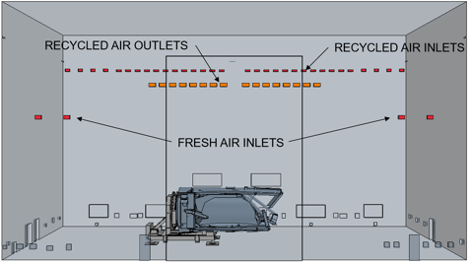
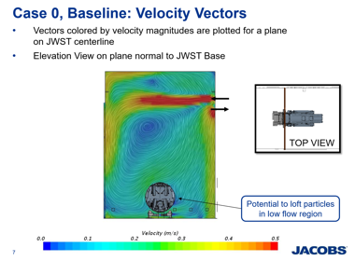
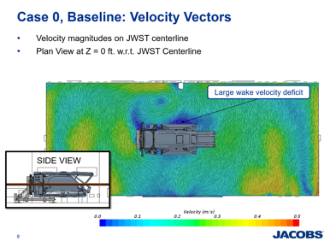
Orientation Knockdown Factor
Current NASA study has shown that for short durations (~3months) the ratio between horizontal and vertical surfaces were variable.
Surface orientation wrt air flow had a greater effect than orientation wrt gravity
S5-C & S5-B have similar facility air flow configurations to each other
The configuration causes turbulent air flow within the cleanroom
A 70% reduction in fallout cannot be consistently assumed for vertical surfaces
(Credit: Jacobs Engineering/P. Agarwal, A. Flynt, and A. Kharazi)

Slide 5
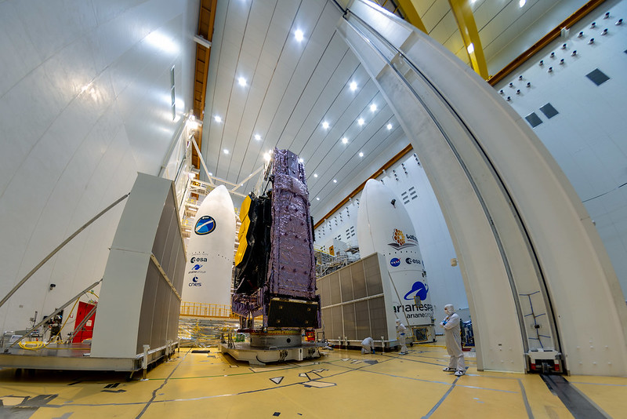
Portable HEPA Modules
To be used in S5-C, S5-B, BAF-HE and the BAF airlock, which did not have HEPA or molecular filtration
The modular filters built on dollies to enable mobility include molecular filtration and are designed to enable ISO Class 7 air cleanliness within Class 8 facilities
S5-C Room Filtration: F8 filters
  F8 filters are ~90% effective, HEPA filters are 99.99% effective at removing 0.3um particles and above
  No carbon filtration, this was the primary reason for the HEPA modules
  Same filters as in BAF-HE and S5-B
BAF-HE
HEPA testing conducted at Goddard
Facility | Orientation | Fallout Rate Reduction | Adjusted Fallout Rate Reduction
S5-B | Overall | 79% | *
 | Horizontal | 80% | *
 | Vertical | 69% | *
S5-C | Overall | 91% | *
 | Horizontal | 93% | *
 | Vertical | 0% | 35%
BAF HE | Overall | 88% | *
 | Horizontal | 91% | *
 | Vertical | 0% | 47%
Credit: ESA/M.Pedoussaut

Slide 6
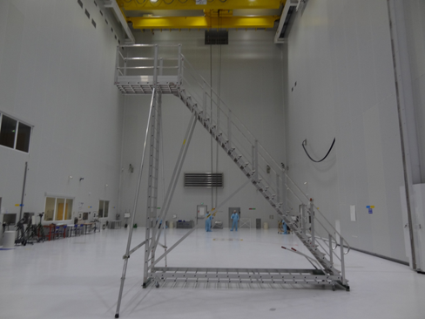
S5-C Predictions
Duration: ~ 1 month; majority of the launch campaign in S5C
Number of HEPA filter modules: 12
  HEPA modules may be turned off and moved around at different times base on I&T ops
Facility PAC/Day assumed: 0.005 PAC/day
  Based on ESA facility data and ATV campaign
Positive pressure: 13Pa
S5-C cleanroom
Photo taken during April 2019 GOWG
Air Supply
Air Return
Credit: NASA

Slide 7
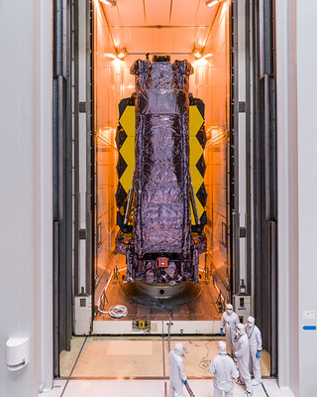
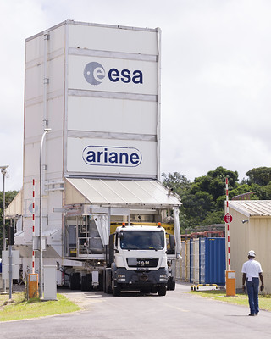
CCU-3 Transportation Operations
Duration of each transport is estimated to be 12 hrs from beginning of the transport operations to the end.
  Assume 9 Hours in the airlocks
  Assume 3-hour transport time in the CCU-3 (based on HP times)
Rate of 0.060 PAC/Day assumed for S5-C to S5-B and S5-B to BAF
  Weighted average rate from HP and ESA provided data
Notes:
  JWST will pass through three different airlocks: S5-C airlock, S5-B airlock and the BAF airlock
Credit: NASA/Chris Gunn
Credit: NASA/Chris Gunn

Slide 8
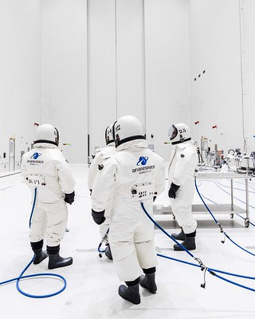
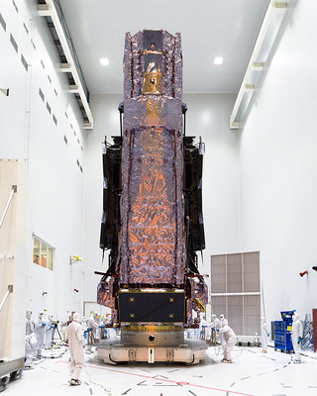
S5-B Predictions
Duration: ~2 weeks
Number of HEPA filter modules: 4
  HEPA filter modules will not operate when fueling
    Operates 2 days, first and last day
0.0104 PAC/Day assumed
  Data from HP and ESA facility data
  Less personnel will be in S5-B but less air flow also
Filtration: F8 filters, No carbon filters
  F8 filters are ~90% effective, HEPA filters are 99.99% effective at removing 0.3um particles and above
Positive Pressure: 13Pa
Credit: NASA/Chris Gunn
Credit: NASA/Chris Gunn

Slide 9
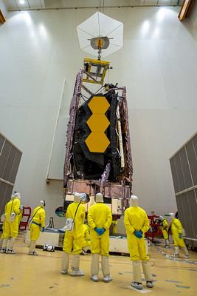
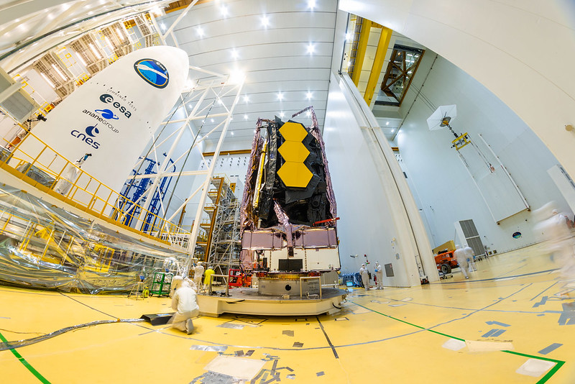
BAF-HE & BAF airlock
BAF-HE: Assumed 0.003 PAC/Day based on HP and ATV fairing processing data
BAF airlock:
Duration: 5 hours
PAC/Day assumed: 0.062 PAC/day
  This rate is the average PAC from general background wafers deployed during the fallout test performed by NASA
Credit: ESA/M.Pedoussaut
Credit: ESA/M.Pedoussaut

Slide 10
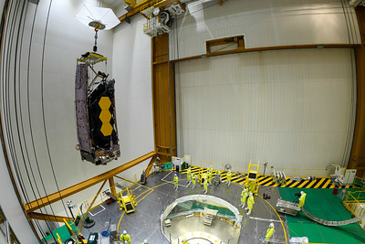
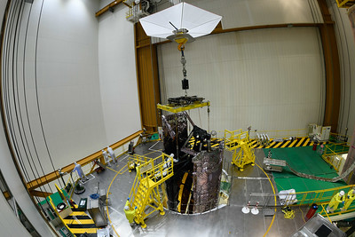
Lift & PFES operations
Lift: 0.062 PAC/Day for the lift
PFEI/PFES operations: 0.010 PAC/Day
  Based on HP and ESA provided facility data
Credit: ESA/M.Pedoussaut
Credit: ESA/M.Pedoussaut

Slide 11
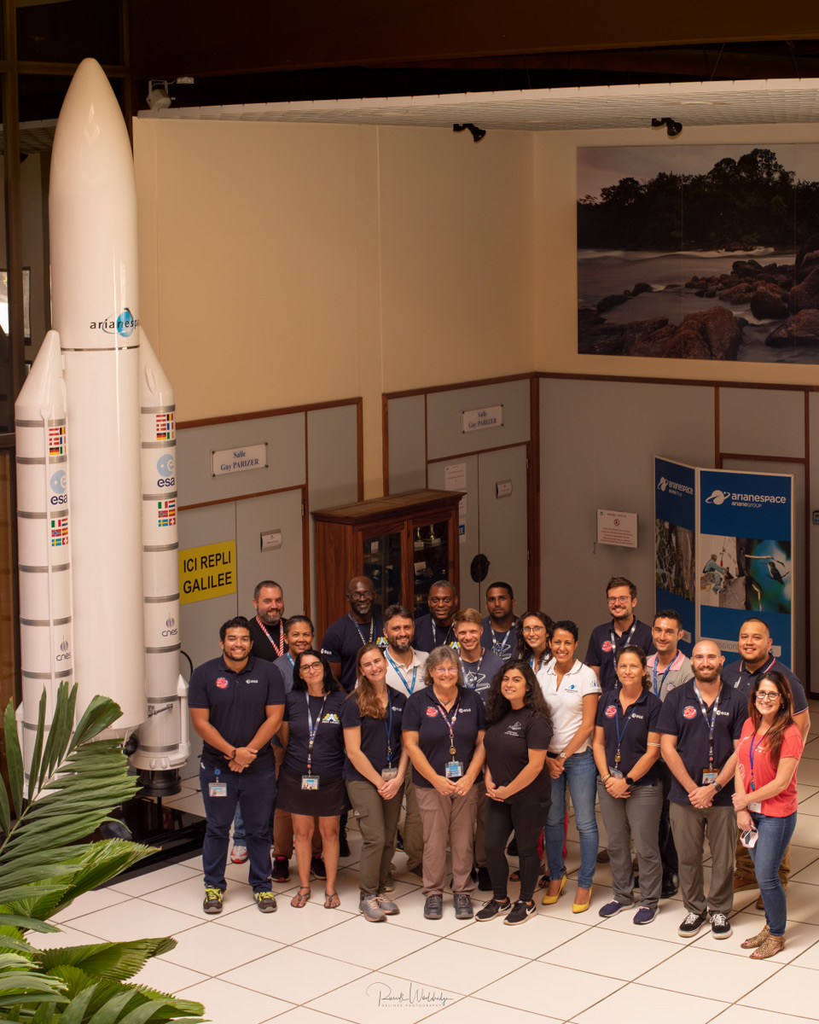
Contamination Implementation
Due to predictions, further cleaning and focus on contamination efforts were possible during the launch campaign
  Daily cleanings and processing of all hardware needed in the cleanrooms by our team
  Cleaning of suits utilized during fueling
  Facilities were cleaned, inspected, and monitored prior to observatory arrival
  Ariane 5 fairing cleaning and inspection with white and UV light
  HEPA walls utilized when approved by safety and I&T
  CCU3 transporter cleaned top to bottom prior to each move
Credit: R. Wooldridge

Slide 12
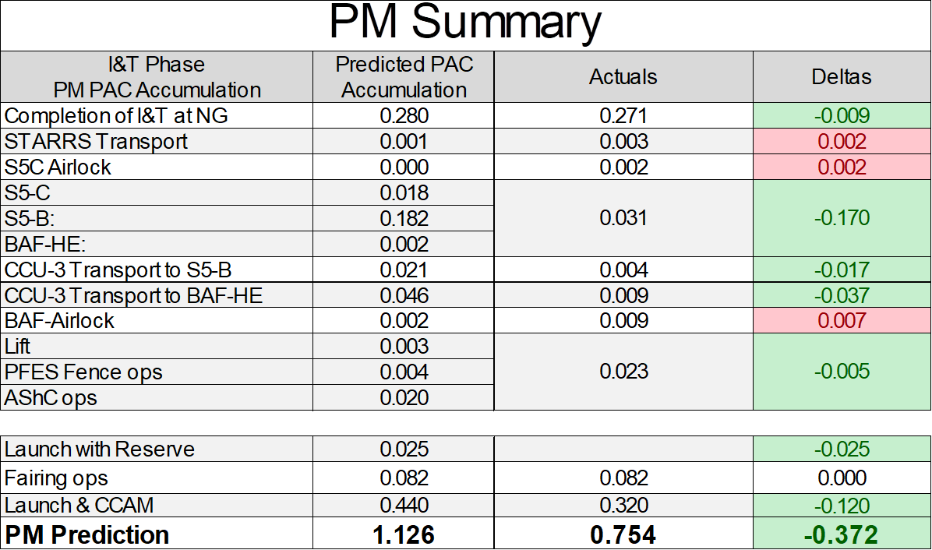
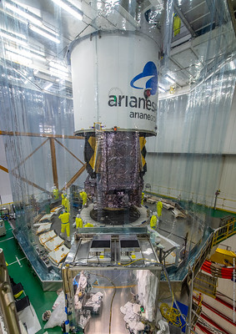
Discussion-PM Summary
PM Segment Assembly witness samples (PMSA), silicone wafers that had been tracking with the mirrors since the original arrival of the mirrors from Ball Aerospace to GSFC, were utilized for the S5-C, S5-B and BAF-HE exposure of the Observatory
Additional JWST exposures were tracked with surrogate wafers for the CCU-3 transports from S5-C to S5-B and S5-B to the BAF and BAF-airlock, PFES & PFEI operations.
Credit: ESA/CNES/Arianespace

Slide 13
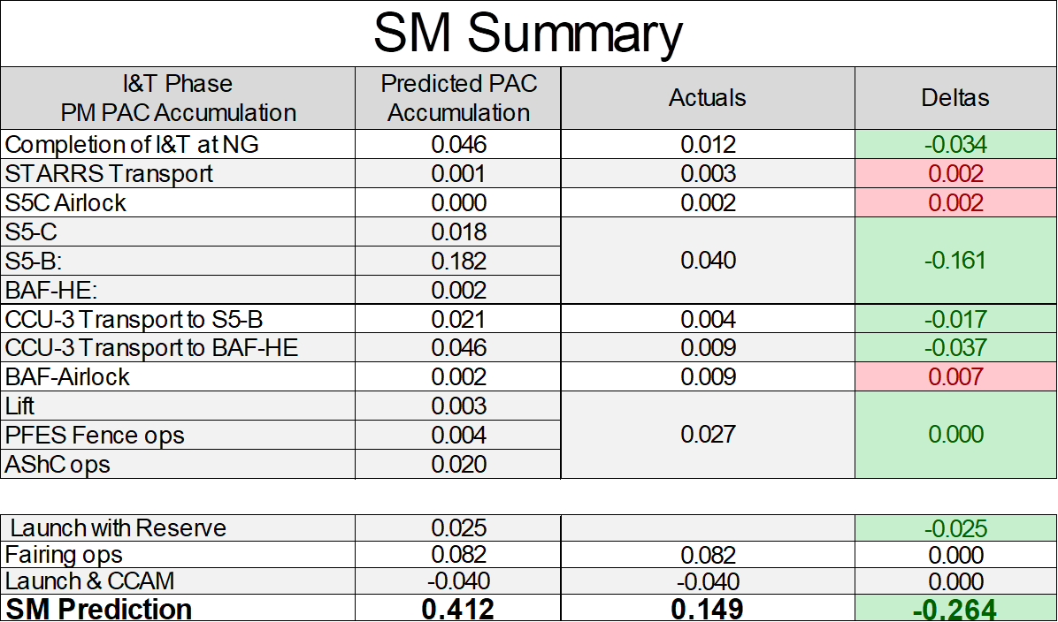
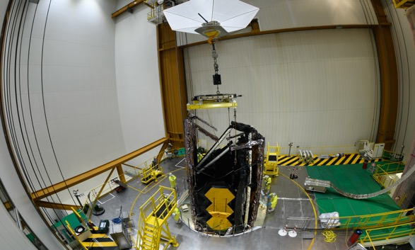
Discussion-SM Summary
SM was separated from PM accumulation for fairing encapsulation, due to the lowering of the PFES for fairing operations. SM was exposed above the PFES floor, while PMSA remained within AShC. A surrogate wafer was exposed during fairing encapsulation operations with a resulting 0.006 PAC.
Credit: ESA/M.Pedoussaut

Slide 14
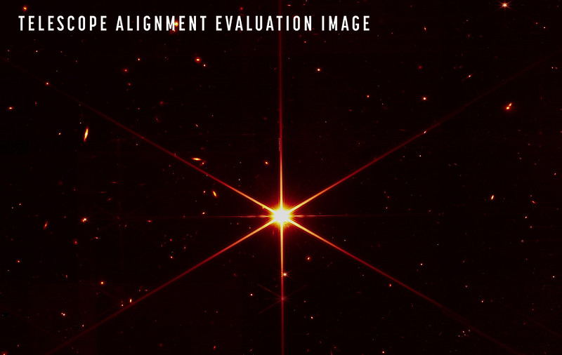
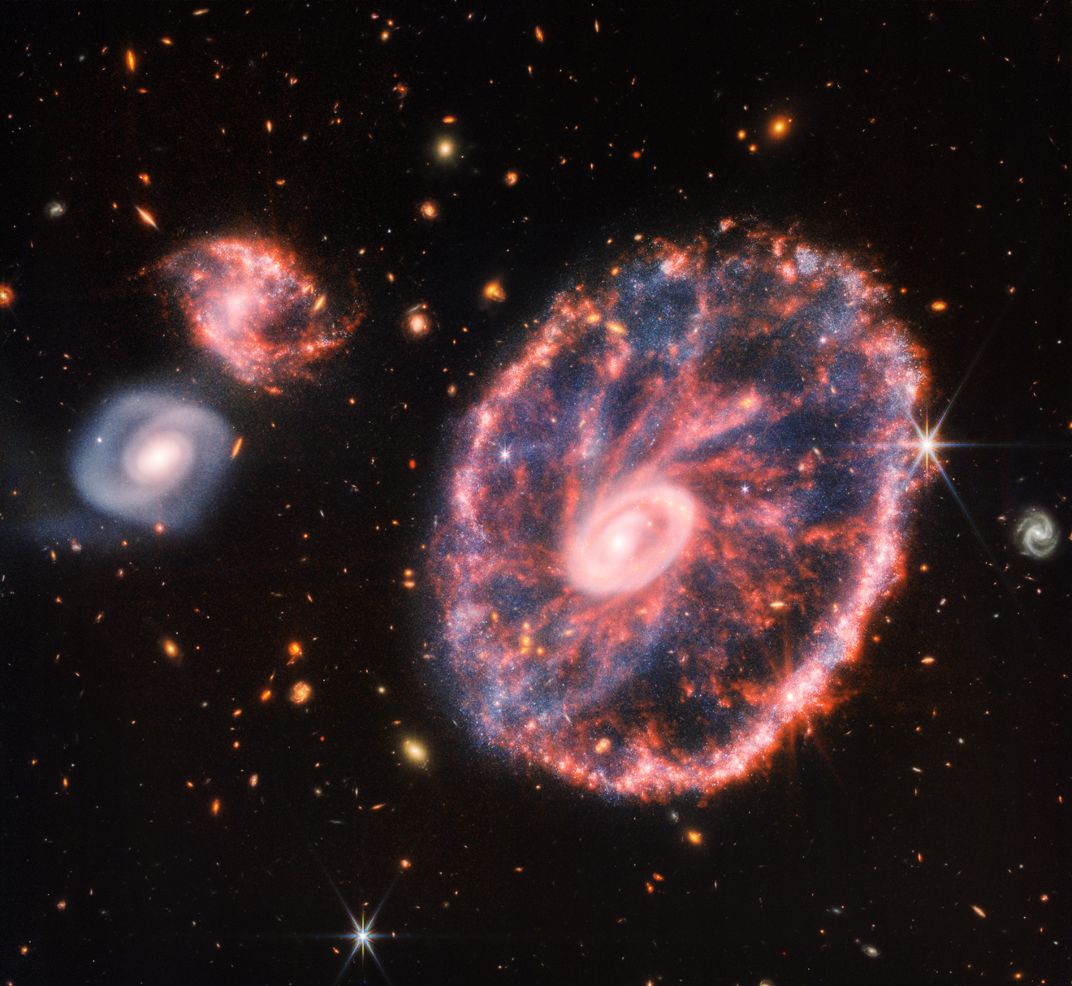
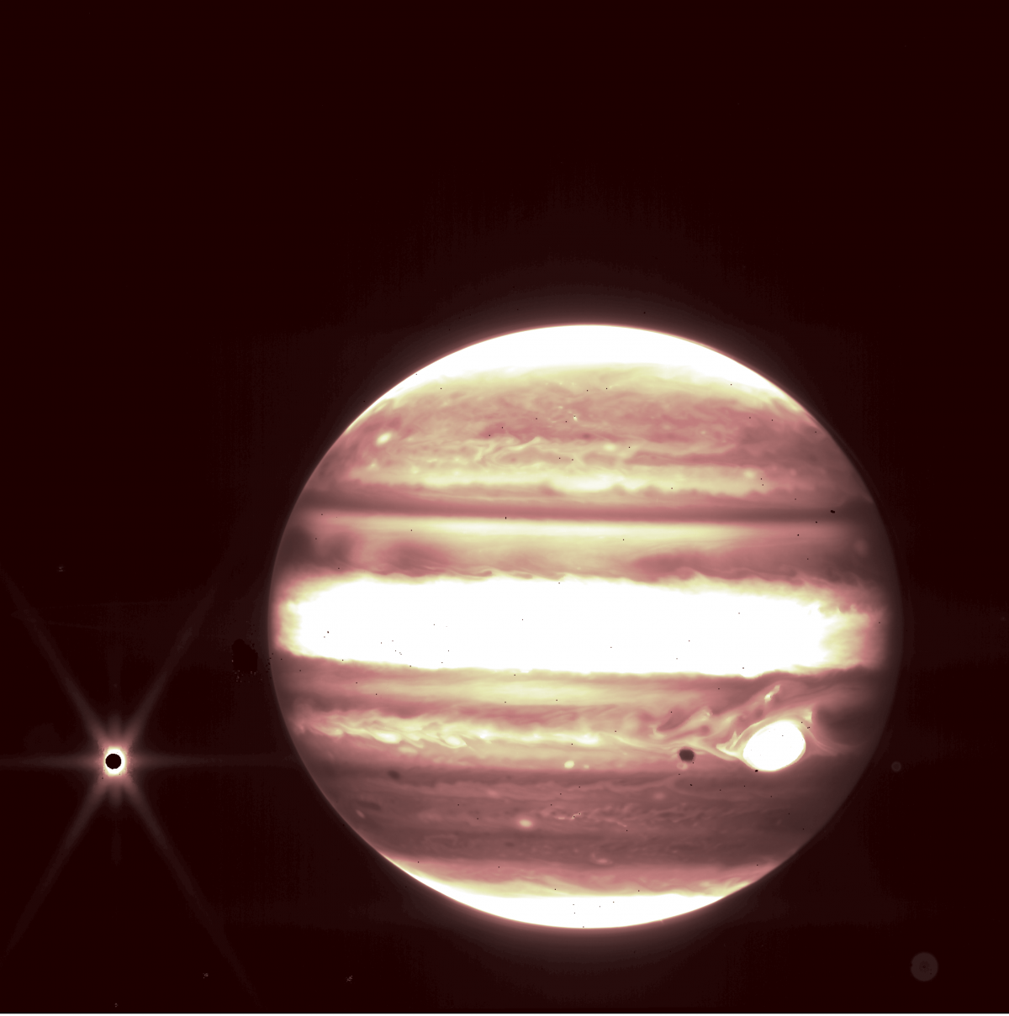
Summary
JWST PM and SM cleanliness requirements for launch site allocation compared to actual PAC
Predictions for fallout as compared to actual particulate accumulated show that our control efforts were successful in greatly improving expected performance, enabling JWST cleanliness requirements to be met with margin
Ultimate measure for success of the launch campaign CC program are the calibration and first images
 | Particulate, PAC |  | Molecular, Å
 | Allocation | Measured | Allocation | Measured
PM | 0.60 | 0.16 | 55 | 1.0
SM | 0.42 | 0.17 | 55 | 1 .0
JWST PM and SM cleanliness requirements and achieved levels
 | Particulate, PAC |  | Molecular, Å
 | EOL Reqt | Measured | EOL Reqt | Measured
PM | 1.5 | 0.75 | 300 | 45
SM | 0.50 | 0.15 | 300 | 59
Credit: NASA
Credit: NASA
Credit: NASA

Slide 15
References
Abeel, A. C., Wooldridge, E. M., Ward, J. O., Calcabrini, M., Schmeitzky, O., “Overview of contamination control for the James Webb Space Telescope launch campaign”, Proc. SPIE 12224, Space Systems Contamination: Prediction, Control, and Performance 2022, 12224-13P (24 August 2022); https://spie.org/optics-photonics/presentation/Overview-of-contamination-control-for-the-James-Webb-Space-Telescope/12224-13
Wooldridge, E. M., Arenberg, J., "Contamination effects and requirements derivation for the James Webb Space Telescope," Proc. SPIE 7069, Optical System Contamination: Effects, Measurements, and Control 2008, 70690J (2 September 2008); https://doi.org/10.1117/12.801664
Wooldridge, E. M , Abeel, A. C.,. Jones, C. B., Goldman, E. M., Lepage, C. D.," Transforming any facility for meeting strict cleanliness requirements," Proc. SPIE 12224, Space Systems Contamination: Prediction, Control, and Performance 2022, 12224-12 (23 August 2022); https://spie.org/optics-photonics/presentation/Transforming-any-facility-for-meeting-strict-cleanliness-requirements/12224-12
Abeel, A. C., Jones, C. B, Wooldridge, E. M., Goldman, E. M., and Lepage, C. D., “Evaluating the performance of portable air filter walls for James JWST Space Telescope launch campaign.”, Proc. SPIE 12224, Space Systems Contamination: Prediction, Control, and Performance 2022, 12224-11P (23 August 2022); https://spie.org/optics-photonics/presentation/Evaluating-the-performance-of-portable-air-filter-walls-for-the/12224-11?SSO=1
Rumler, P. ESA JWST Launcher Liaison. “Contamination Control Feedback from ATV Launch Campaign”. 28 March 2008.
Rumler, P., Schmeitzky, O. “Ariane 5 Cleanliness, Herschel-Planck Launch Campaign Experience”. ESA-ESTEC, 20 May 2009.
Van Eesbeck, M., Schmeitzky, O. “ Herschel-Planck Launch campaign”. ESA-ESTEC, 02 July 2009.
Calcabrini, M. and Erin, B., “JWST-Launch Vehicle Provider-Contamination Control Implementation Plan,” Issue 9-Revision 0, Arianespace, (October 2021).
Stewart, E. M. and Wooldridge, E. M., "Study of fallout metrics for contamination analysis: Vertical to horizontal particle accumulation ratio", Proc. SPIE 11489, Systems Contamination: Prediction, Control, and Performance 2020, 114890P (21 August 2020); https://doi.org/10.1117/12.2566604
Kharazi, A., Flynt, G. A., and Agarwal, P., “95815: JWST Clean Room CFD: AT-006: JWST in S5-C Analysis,” Jacobs Engineering, (20 February 2017).
Lepage, C. D., Abeel, A. C., Stewart, E. M., Rodriguez, I., Horton, C. T., Morales, K. Z., Transforming any facility for meeting strict cleanliness requirements," Proc. SPIE 12224, Space Systems Contamination: Prediction, Control, and Performance 2022, 12224-16 (24 August 2022); https://spie.org/optics-photonics/presentation/Establishing-cleaning-methods-for-cleanroom-and-safety-suits-at-remote/12224-16?SSO=1
Pinol, N., Fisher, A., and Betz, L., , “NASA’s Webb Reaches Alignment Milestone, Optics Working Successfully”, NASA HQ press release, March 16, 2022. (http://spaceref.com/news/viewpr.html?pid=59635) (https://www.nasa.gov/press-release/nasa-s-webb-reaches-alignment-milestone-optics-working-successfully)

Slide 16
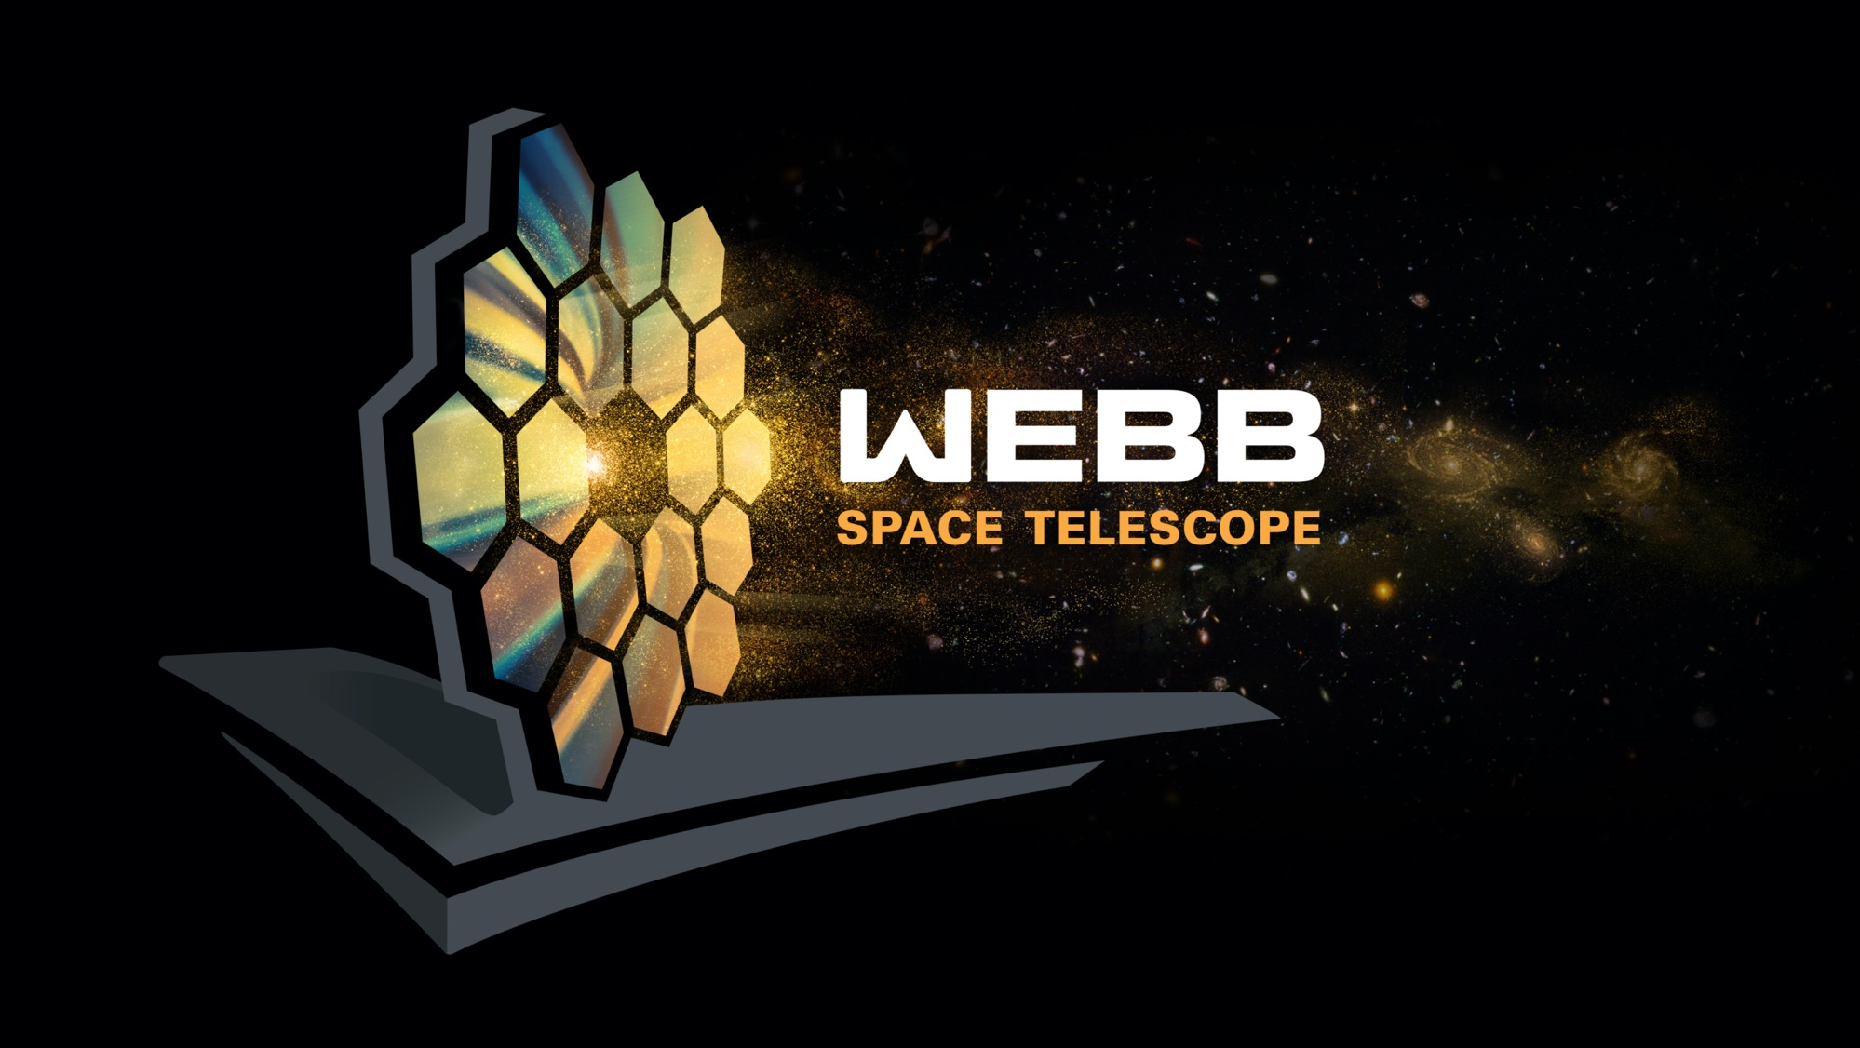
Questions?
Notes:
Complete FAQs:
Why do we have to wait so long between Webb’s launch and its first images?
In the six months after launch, Webb underwent a complex commissioning process. This included:
Deployments: This began when the telescope launched, on December 25, 2021, and continued for about 30 days. In a series of steps, Webb unfolded from its compact launch configuration. This included deploying, tensioning, and separating Webb’s sunshield, extending its secondary mirror support structure, and unfolding the wings of the primary mirror.
Telescope mirror alignments: This began just a month after launch and continued for about three months. Teams aligned Webb’s 18 hexagonal mirror segments so that they work together as one and are in focus for all of Webb’s four science instruments.
Science instrument calibrations: This began about four months after launch and continued for approximately two months. Webb’s instruments underwent a series of calibrations and tests. Engineers and scientists tested each mode to verify they are working as expected, understand their performance, and learn how to optimally extract science information.
During the deployment and alignment phases of commissioning, Webb cooled to its operating temperature. This slow, controlled cooling was necessary to prevent water that was outgassing from Webb to form ice on Webb’s optics and detectors and cold radiator surfaces, which would degrade the telescope’s performance.
How much data will Webb transmit each day?
Webb can downlink at least 57.2 gigabytes of recorded science data each day, with a maximum data rate of 28 megabits per second.
How long does data take to travel from Webb to Earth?
Traveling at the speed of light, it takes about 5 seconds for data to travel from Webb in its orbit around L2 to the Earth. All communications are routed through NASA’s Deep Space Network, with three ground stations located in Canberra, Australia, Madrid, Spain, and Goldstone, California.
Which frequencies do we use to communicate with the telescope?
S-band frequencies are used for command uplink, low-rate telemetry downlink, and ranging. Ka-band frequencies are used for high rate downlink of science data and telemetry.
What is a Lagrange point?
Lagrange points, discovered by mathematician Joseph Louis Lagrange, are special equilibrium points for small objects (like a spacecraft or an asteroid) orbiting two much larger objects (like the Earth and the Sun). At these points in space, the gravity of the two large objects balance the orbital motion of the third object. Lagrange points can be used by spacecraft to reduce propellant consumption needed to remain in position.
There are five Lagrange points for any system, labeled L1 to L5. Of the five points, three are unstable and two are stable. The unstable Lagrange points—L1, L2, and L3—lie along the line connecting the two large masses. Spacecraft orbiting at these points need to perform station keeping to remain in their orbits, by periodically expending small amounts of propellant. The stable Lagrange points—L4 and L5—occur at the apex of two equilateral triangles that have the large masses at their vertices. L4 leads the orbit of Earth and L5 follows.
See the diagram here: https://solarsystem.nasa.gov/resources/754/what-is-a-lagrange-point/
Webb orbits around the second Sun-Earth Lagrange point (L2). This point is approximately 1.5 million kilometers (930,000 miles) from Earth, “behind” the Earth as viewed from the Sun. All Lagrange points move in lockstep with the Earth as it rotates around the Sun, completing an orbit in one year.
Are there other spacecraft that orbit at L2?
Yes. There are several spacecraft that orbit or have orbited at L2. They include the Herschel Space Observatory, the Gaia space observatory, the Planck space observatory, and the Wilkinson Microwave Anisotropy Probe (WMAP).
Does Webb orbit exactly at L2?
No. Webb will orbit around L2, not sit stationary precisely at L2. If Webb were located exactly at L2, it would see the Sun eclipsed by the Earth, blocking the power it receives on its solar arrays. Webb loops around L2 in a six-month, tilted, elliptical orbit, which is slightly larger than the size of the Moon’s orbit around the Earth. This ensures that spacecraft never falls into the shadow of the Earth or the Moon—and remains charged. Here is a diagram of the obit to scale: https://www.flickr.com/photos/nasawebbtelescope/51886649707
What is Webb’s anticipated lifetime?
Webb will contain enough propellant for about 20 years of maneuvers at L2, and the Webb Science and Mission Operations Center at the Space Telescope Science Institute (STScI) will have the ability to adjust the science operations of the observatory to maximize potential as it ages. NASA engineered Webb so that all critical subsystems are dual or will degrade gracefully with age. For instance, the Near Infrared Camera (NIRCam) has two identical camera systems so that the optical quality can be maintained even if one fails.
How much of the sky can Webb see?
Over the course of six months, as Webb orbits the Sun with Earth, it has the ability to observe almost any point in the sky. Webb’s field of regard is limited to a 50-degree swath of the celestial sphere: About 39% of the sky is potentially visible to Webb at any given time. Because Webb must face away from objects that are warm and close enough to interfere with its ability to observe faint infrared light, it cannot observe the Sun, Mercury, Venus, Earth, the Moon, or other objects as they pass through the inner Solar System.
Can we can service Webb?
The quick answer is no. To meet Webb’s science goals, the telescope has to be far away from the heat of the Earth. This is why the telescope had to be so thoroughly tested before launch. This isn’t the first mission that is unserviceable. Other space telescopes, such as Spitzer and Herschel, successfully completed their missions in unserviceable orbits.
What are galaxies?
A galaxy is collection of stars, gas, dust, and dark matter bound together by gravity. The smallest galaxies may contain only a few hundred thousand stars, while the largest galaxies have thousands of billions of stars. Our Milky Way galaxy 100,000 light-years across and contains about 100 billion stars, including the Sun and our solar system.
Galaxies are classified or grouped by their shape. Round or oval galaxies are elliptical galaxies and those showing a pinwheel structure are spiral galaxies. All others are called irregular because they do not resemble elliptical or spiral galaxies.
__________________________
Resources:
News releases: https://webbtelescope.org/news/news-releases
How to receive our releases via email (enter your email address at the bottom of this page under “STScI Inbox Astronomy Newsletter”): https://webbtelescope.org/news
Overview of the telescope: https://webbtelescope.org/webb-science/the-observatory
Image Credit: NASA

Slide 17
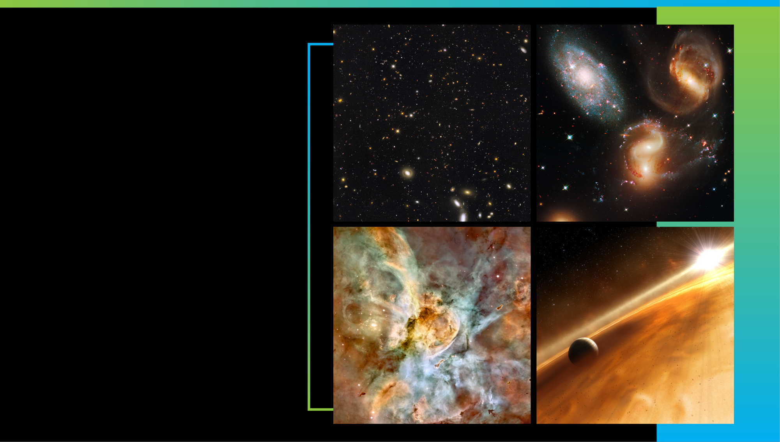
Acknowledgements
We would like to acknowledge the entire Contamination Control Engineering team for their efforts to predict the contamination predictions for the launch campaign and the ESA, Arianespace, and NASA JWST scientists, engineers, and managers who contributed to reviewing and providing guidance for launch site operations. Thank you to Amir Kharazi, Austin Flynt, and Pulkit Agarwal of Jacobs Engineering for performing the CFD analyses for HEPA module testing.
Early Universe
Galaxies over Time
Star Life Cycle
Other Worlds
Notes:
Webb is actively taking new images and spectra! There is so much in the universe it will examine.
Webb will capture light from the first generation of galaxies in the early universe, and help us map how galaxies change over time.
It will help researchers study how stars form, live, and die.
Webb will find and explore the atmospheres of distant worlds.
It will also observe planets in our own solar system, including Mars, Jupiter, Saturn, Uranus, Neptune—along with their moons. Webb will also study small bodies across the Solar System, including asteroids, comets, and Kuiper Belt objects.
Plus, the telescope will observe black holes near and far, including our Milky Way’s supermassive black hole Sagittarius A* (A-star).
Be sure to follow Webb’s discoveries in the news!
__________________________
Ongoing/upcoming news releases: https://webbtelescope.org/news/news-releases
Suggest to viewers that they can sign up to receive our new releases by email by entering their email address at the bottom of this page under “STScI Inbox Astronomy Newsletter”: https://webbtelescope.org/news
Image Credits:
Early Universe: GOODS-S/ERS2 Field
Credit: NASA, ESA, Rogier Windhorst (ASU), S. Cohen (ASU), M. Mechtley (ASU), M. Rutkowski (ASU), Robert O'Connell (UVA), P. McCarthy (OCIW), N. Hathi (UC Riverside), R. Ryan (UC Davis), Haojing Yan (OSU), Anton M. Koekemoer (STScI)
https://webbtelescope.org/contents/media/images/2021/004/01EX2AXKF1EKA0J7K1965PCNBC
Galaxies over Time: Stephan’s Quintet
Credit: NASA, ESA, and the Hubble SM4 ERO Team
https://hubblesite.org/contents/media/images/2009/25/2606-Image.html
Star Lifecycle: Carina Nebula
Credit: Hubble Image: NASA, ESA, N. Smith (University of California, Berkeley), and The Hubble Heritage Team (STScI/AURA); CTIO Image: N. Smith (University of California, Berkeley) and NOAO/AURA/NSF
https://hubblesite.org/contents/media/images/2007/16/2099-Image.html
Other Worlds: Illustration of a planet in a dusty debris disk
Credit: NASA, ESA, and L. Calcada (ESO for STScI)
https://webbtelescope.org/contents/media/images/4193-Image

