Slide 1
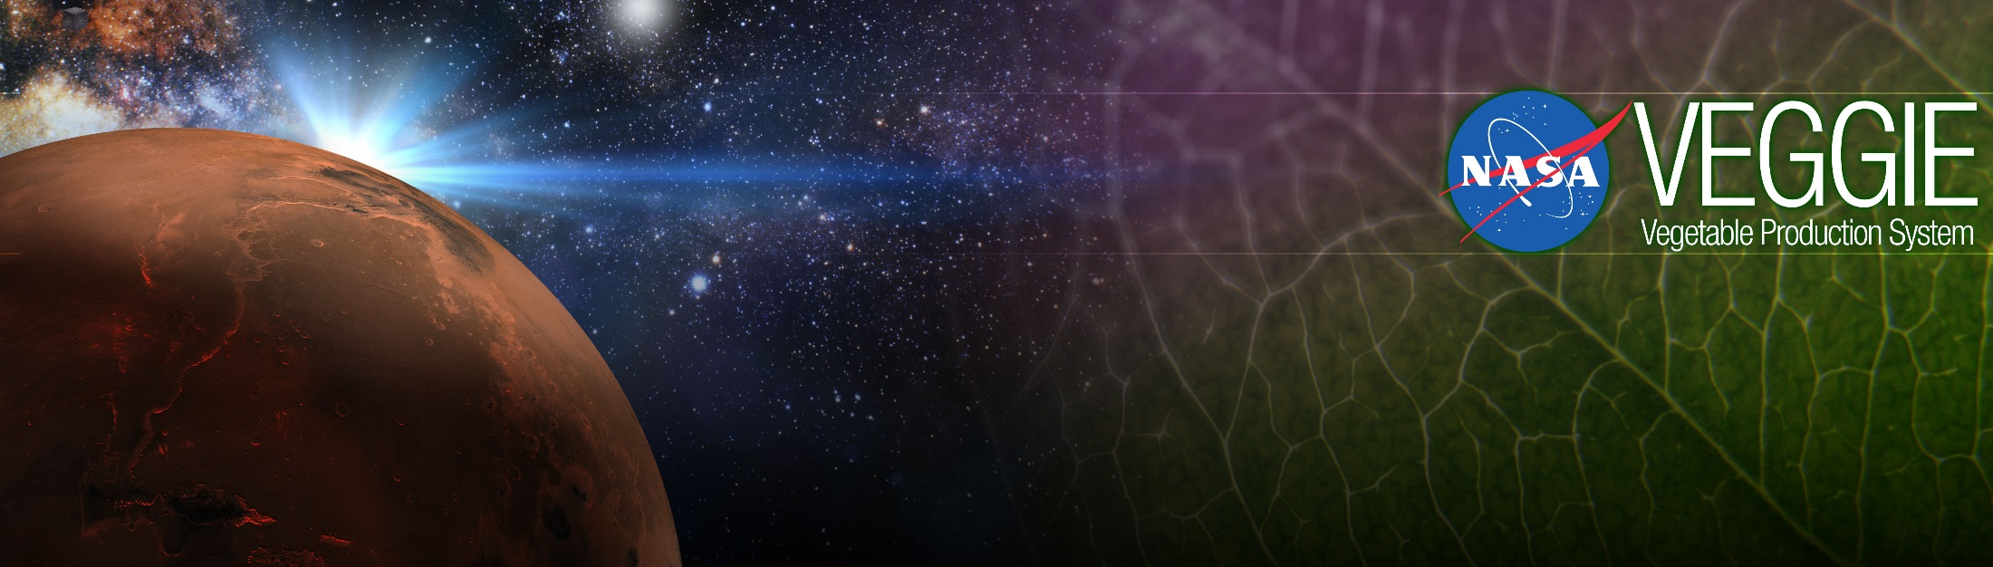
Space Crop Production Controlled Environments
Gioia Massa, Ralph Fritsche, Raymond Wheeler
NASA, Kennedy Space Center, FL, USA

Slide 2
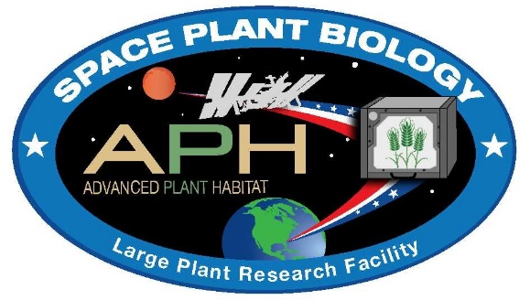

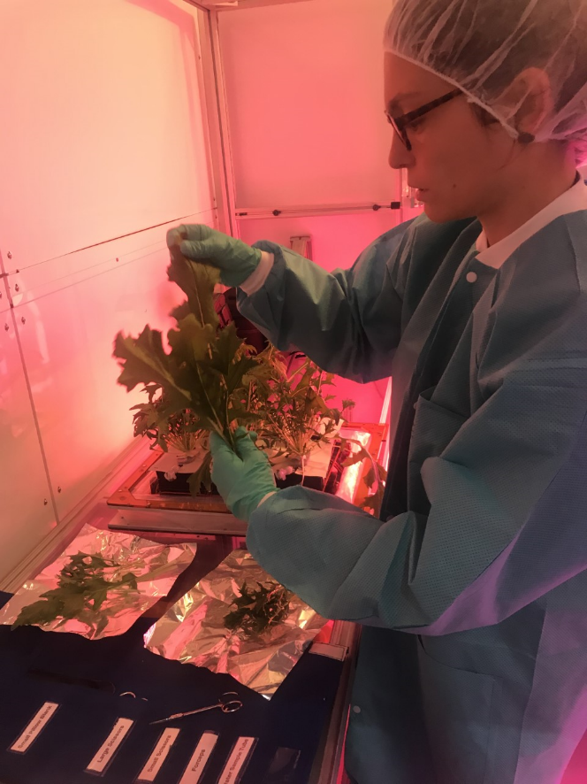
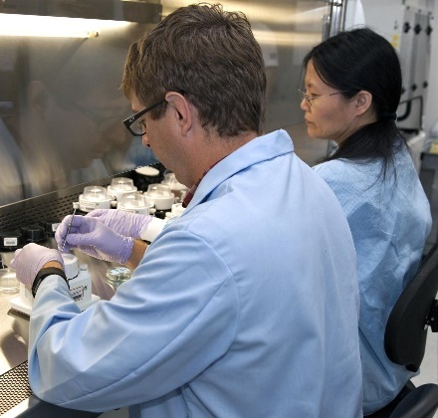
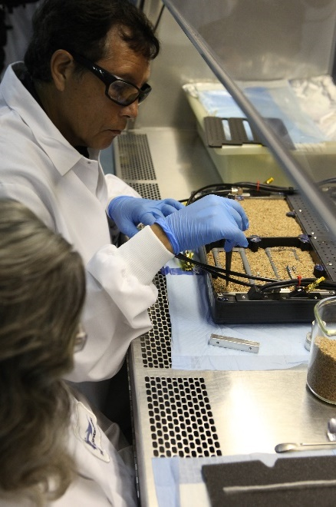
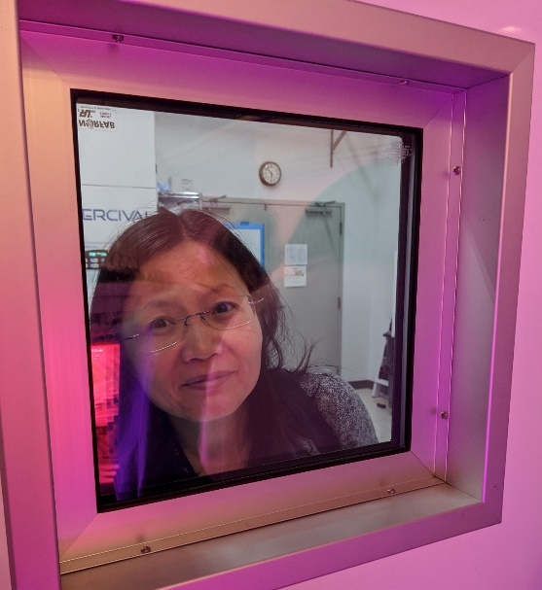
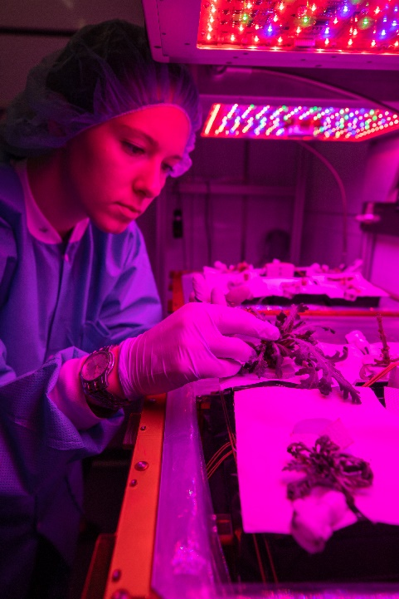
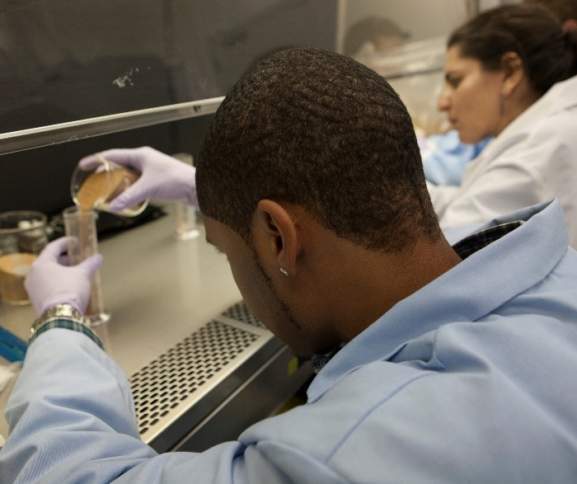
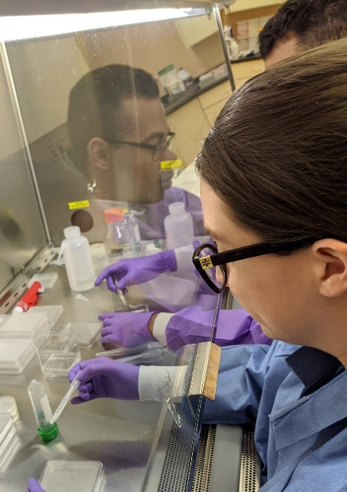
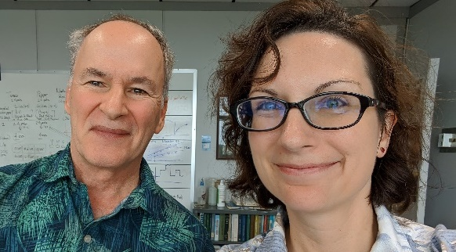
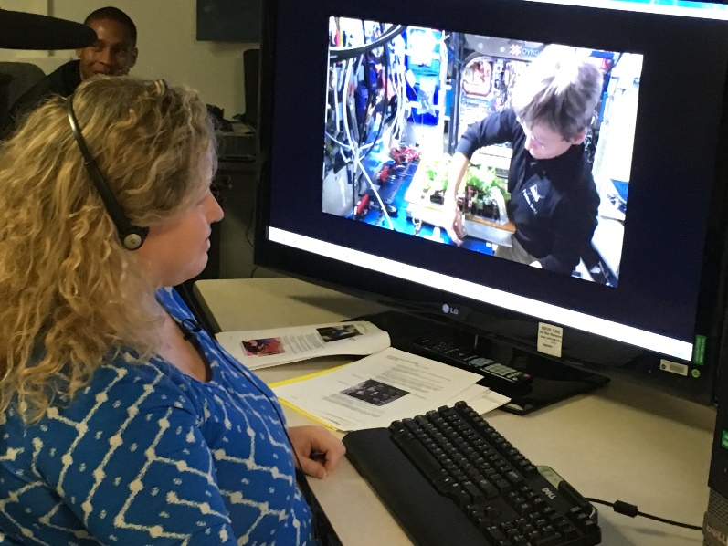
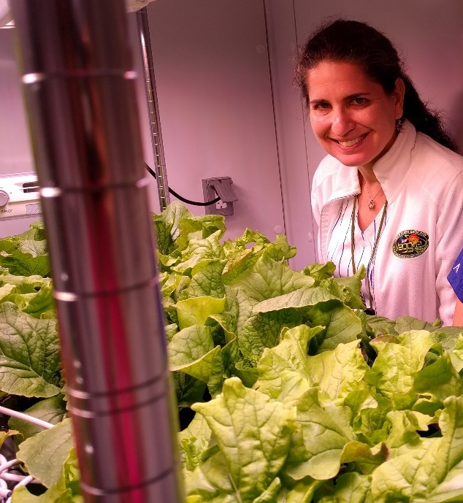
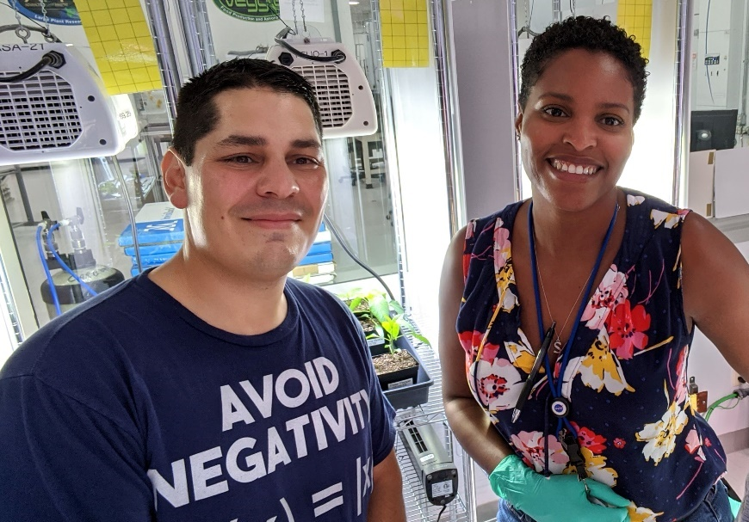
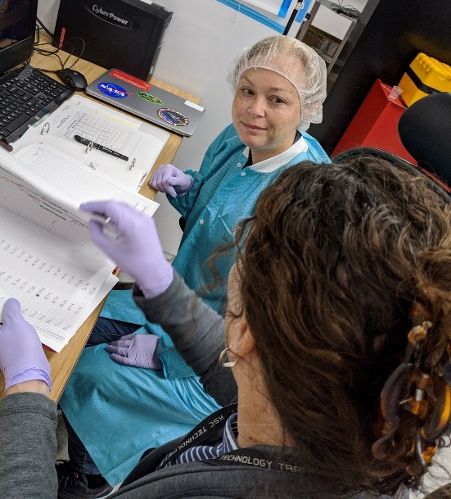
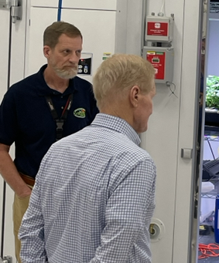

Slide 3
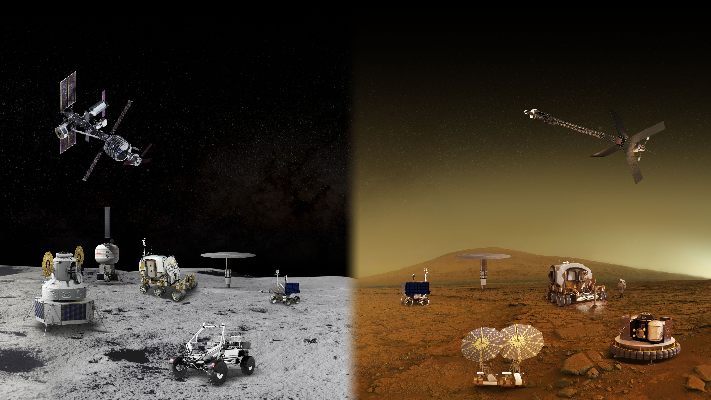
MOON AND MARS EXPLORATION
Operations on and around the Moon will help prepare for the first human mission to Mars
GATEWAY
Long Durations in Zero Gravity
TRANSIT HABITAT
and mars transit
Crew Size
Mobile Expedition Duration
Mobile Exploration Range
Surface
Habitat
Pressurized rover
Surface Fission Power
In-Situ Resource Utilization
Partial Gravity Operations
Human Landing system
Lunar
Terrain
vehicle
Autonomous Robotics Systems & Contingency Crew Transportation

Slide 4
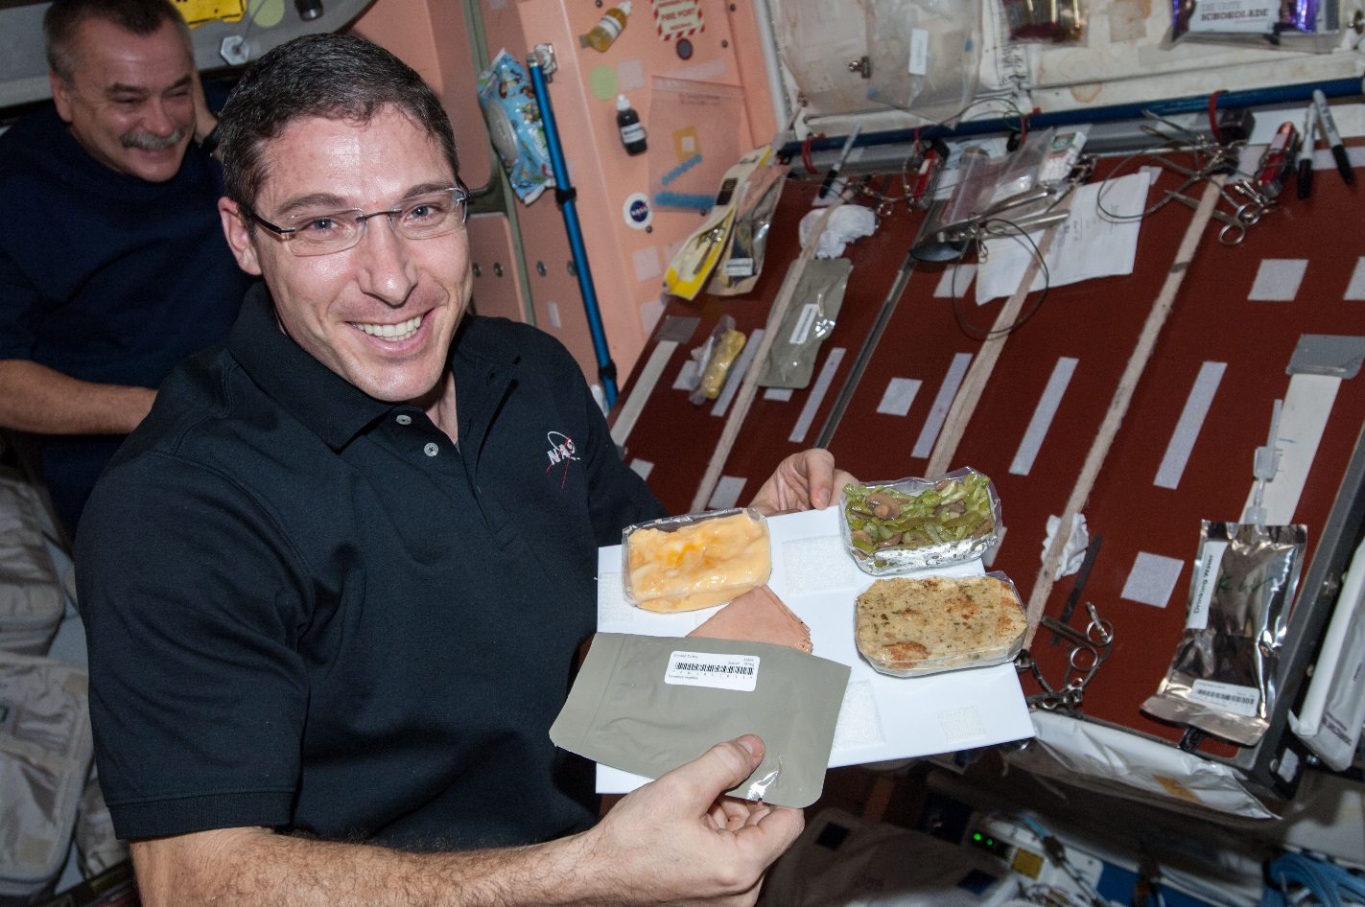
Why grow plants in space?
Food
Psychological well being
Atmosphere
Water

Slide 5
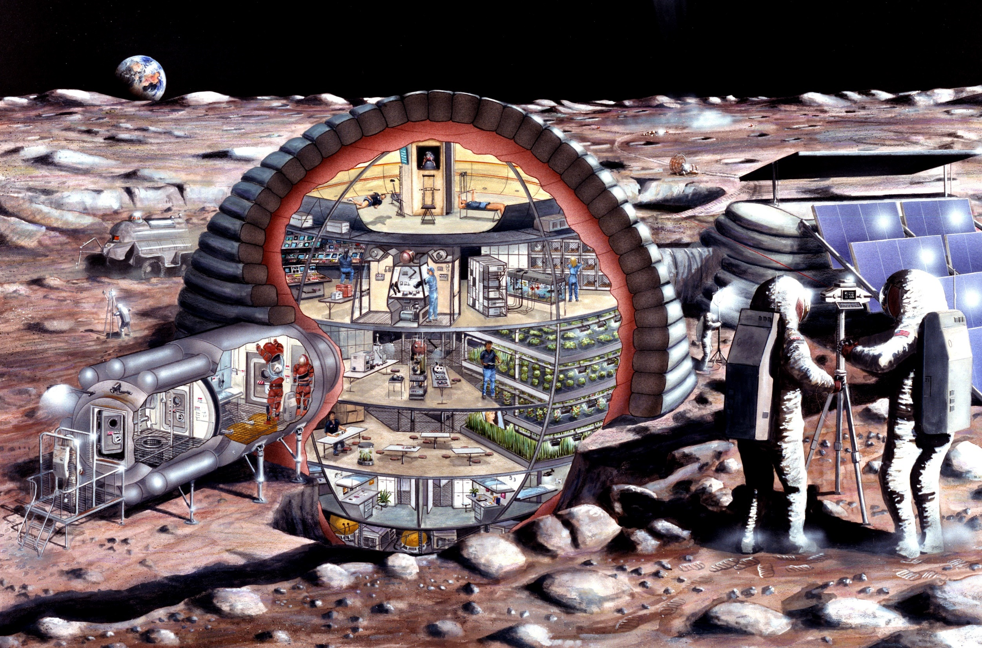

Slide 6
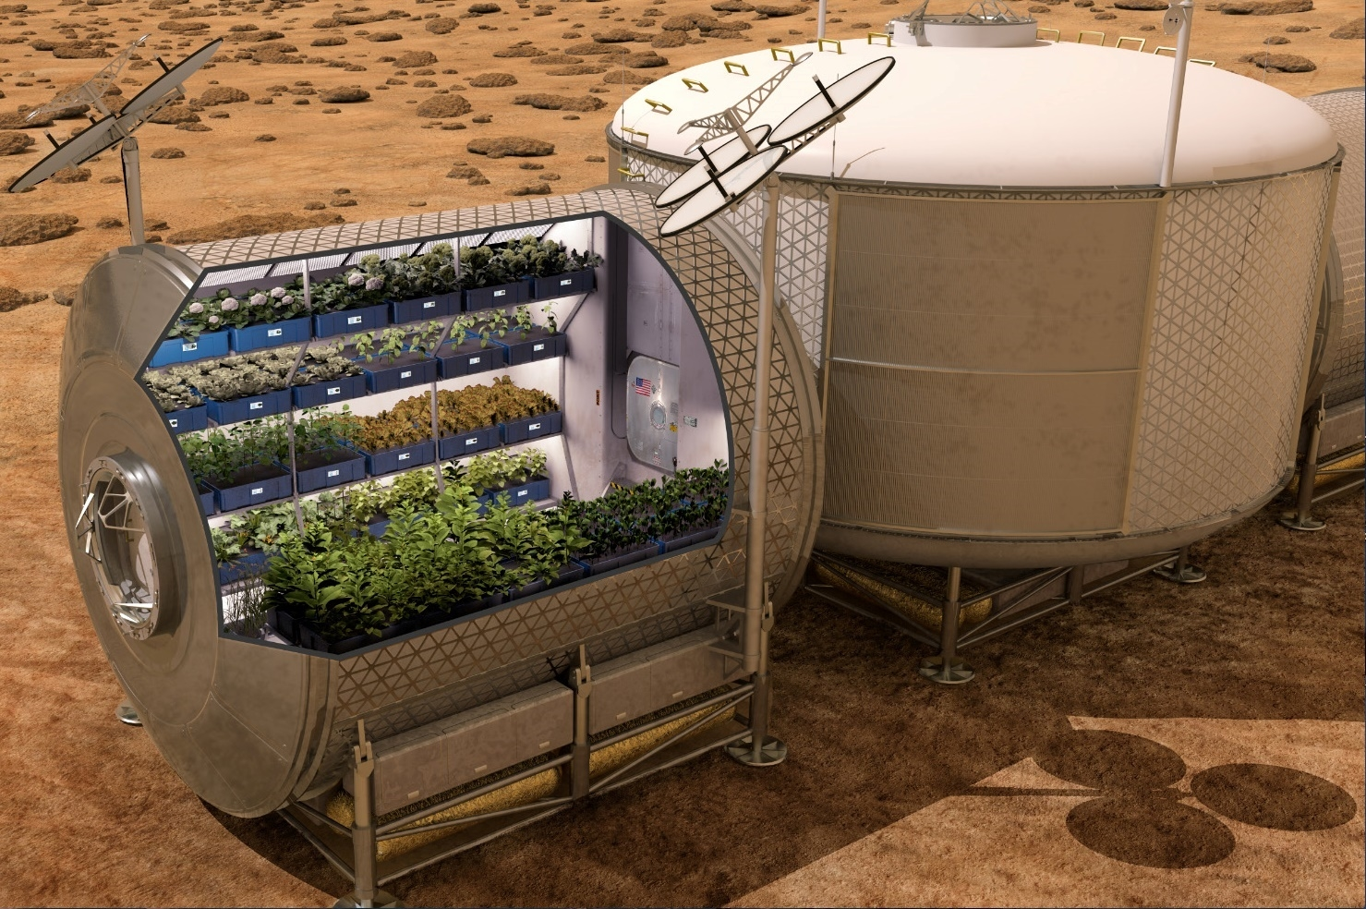

Slide 7
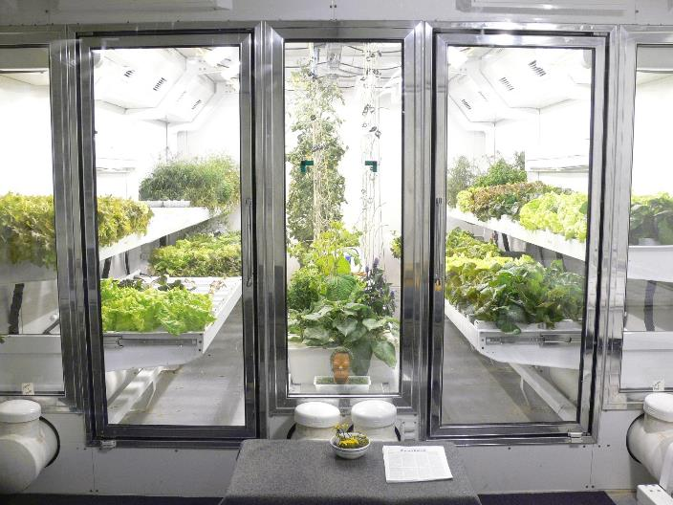
South Pole Greenhouse
Photo courtesy of Lane Patterson

Slide 8
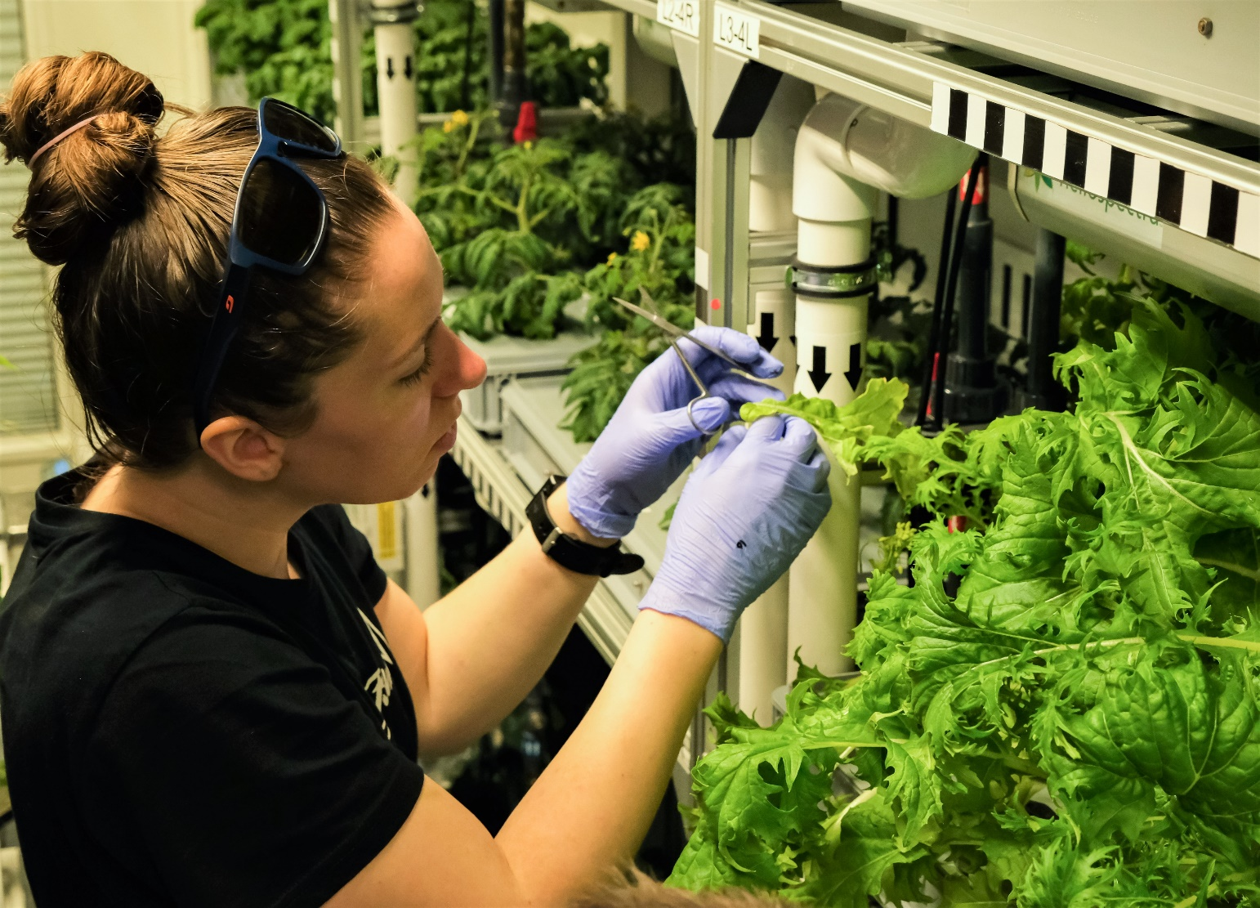
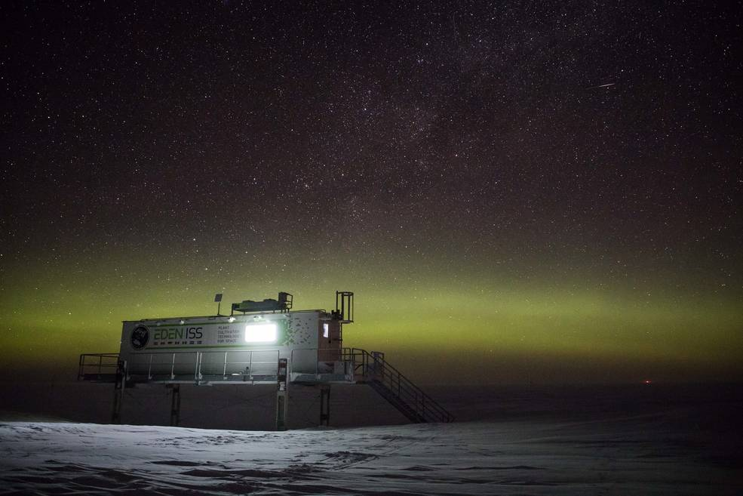
EDEN ISS Antarctic Greenhouse
The EDEN ISS greenhouse, developed by the German Aerospace Center; DLR, in Antarctica since 2018.
Credit: Hanno Müller, AWI
Jess Buncheck – KSC scientist – Tending plants in EDEN ISS, 2021
Notes:
It was created to conduct research into food production in deserts and cold regions, as well as exploring the possibility of growing fresh food in the hostile conditions on the Moon or Mars.

Slide 9
The Space Crop Production Vision
Ensure Food System Security on Long Duration Missions Beyond LEO
Near-Term Goal
Nutrient Supplementation of Prepackaged Food
Long-Term Goal
Caloric Replacement to Move Towards Earth Independence
Notes:
Ralph
Ensure Food System Security on Long Duration Missions Beyond Low Earth Orbit (LEO)
Food and nutrition are the first line of defense for crew health and performance
Provide safe, nutritious and acceptable fresh food
Add variety to crew diet
Enhance morale
* Food security is the condition in which crew have continuous access to sufficient safe and nutritious food which meets both their dietary needs and food preferences in order to maintain peak health and performance.
Nutrient Supplementation of the Prepackaged Food System - Needed for: Deep Space Transport
Fresh produce supplements vitamins (B₁, K, C) and bioactive compounds that degrade in the stored food system on multi-year exploration missions
“Pick-and-Eat” crops that require no processing and minimal preparation will provide variety, customization, and psychological appeal
Enable testing and demonstration of dependable crop production before reliance on system.
Limiting factors are vehicle resources mass, power, volume, water, air, crew time
Caloric Replacement to Facilitate Earth Independence - Needed for: Long duration Surface missions on the Moon and Mars
Reduce up-mass associated with pre-packaged food
In addition to “pick and eat” crops, include staple crops that require processing and preparation
Bioregenerative capability will be required for long duration surface missions

Slide 10
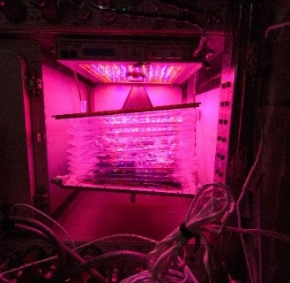


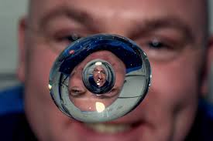

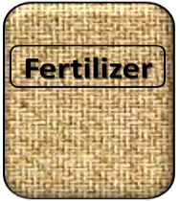
The Space Environment
….and how these work with and without Gravity!
Humans like white light, but plants may grow well with other wavelengths
No convection in space so need to mix the air
O₂
Water forms a ball, and water and air don’t mix well, and roots need both!
Fertilizer is heavy to launch so we need to learn how to recycle plant waste

Slide 11
Space Crop Production Challenges
Deep Space
Water
Recycling
Radiation
Pressure
Micrometeorites
Surface
Microgravity
Fluid movement
No convection
Dust
Partial gravity
Plant Size
High CO₂
Food Safety & Microbiome
Nutrient output
Sustainability
Abiotic stresses
Vehicle resources
Crew time
Waste
Productivity
Stress tolerance
Environmental optimization
Crop scheduling
Crop

Slide 12
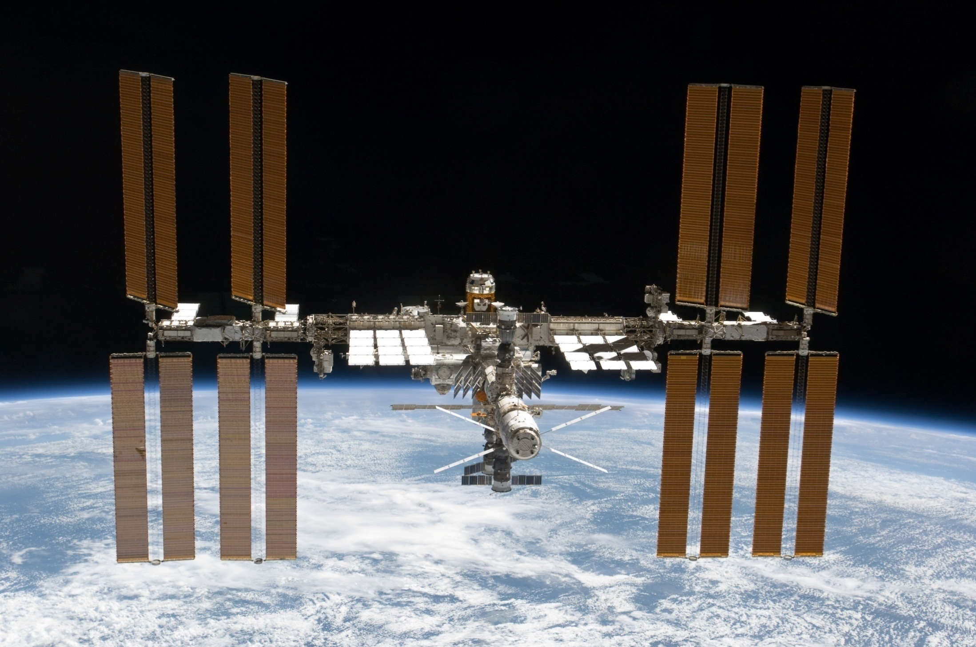
The International Space Station

Slide 13
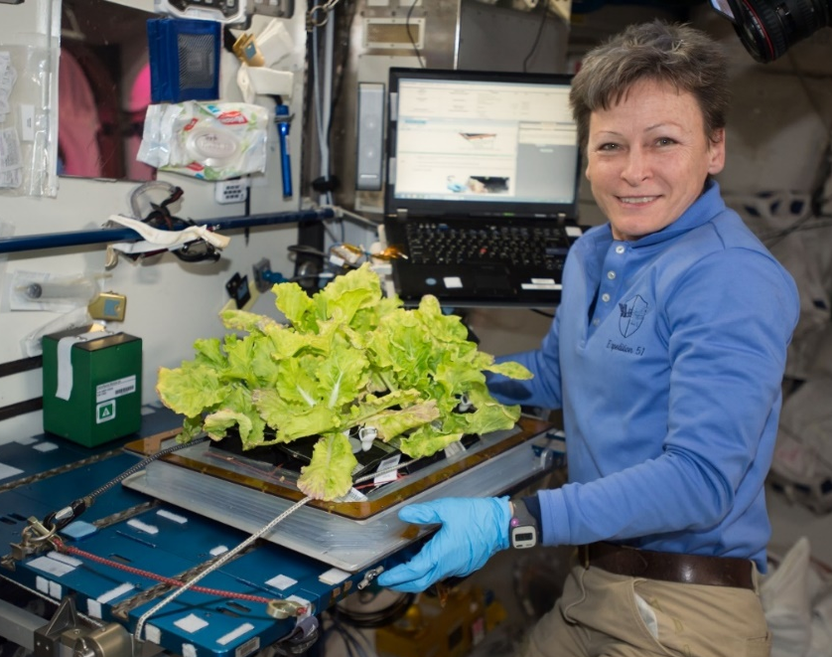
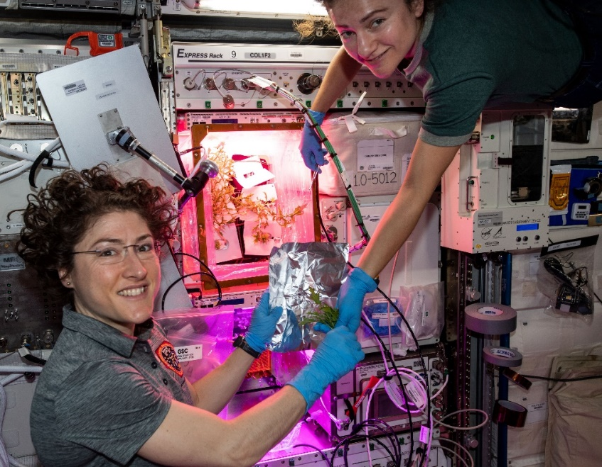
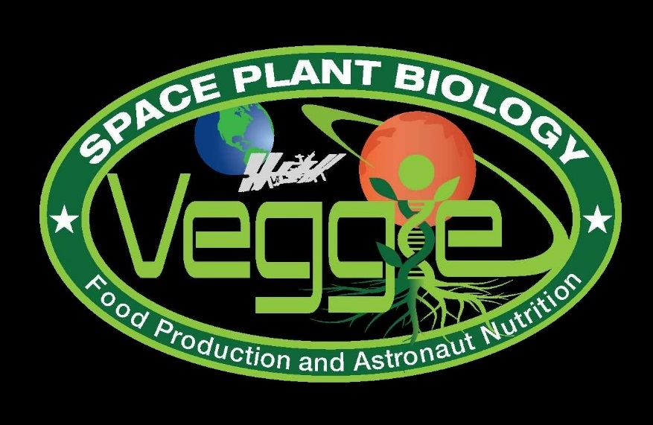
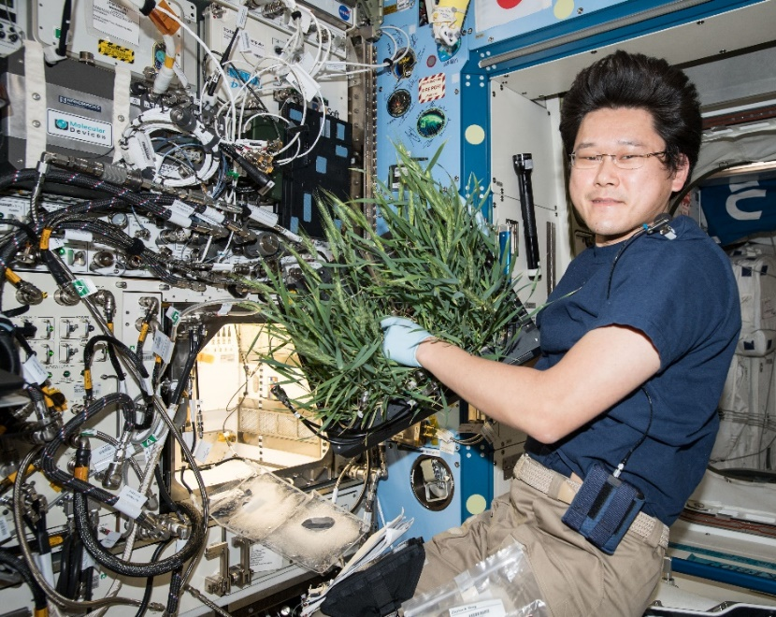
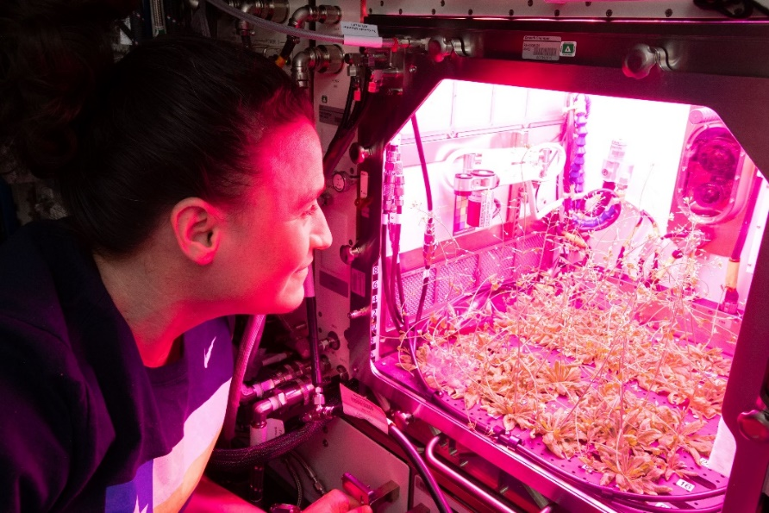
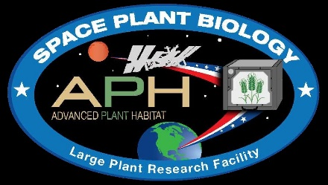
Current NASA Large Plant Research Capabilities On ISS
Notes:
Veggie and the Advanced Plant Habitat

Slide 14
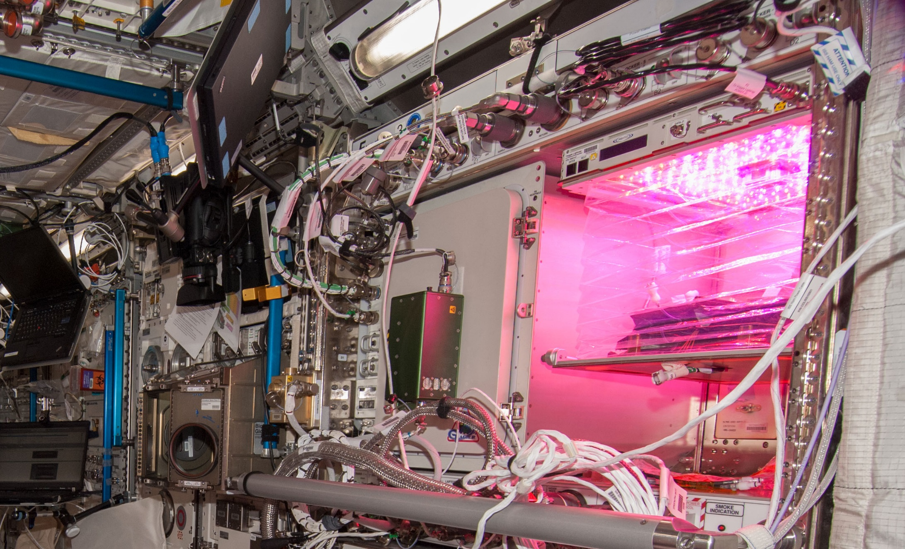
Veggie on ISS

Slide 15
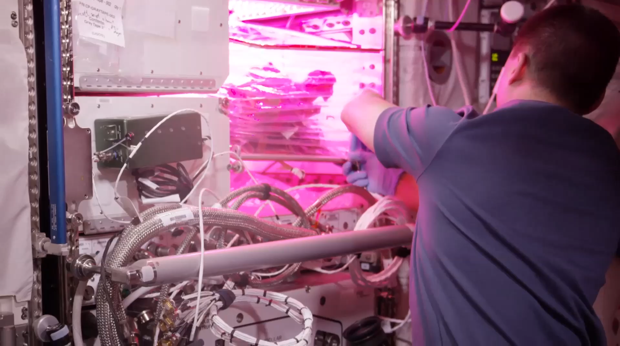
VEG-01B Harvest (August 2015)
Notes:
Veg-01 second crop, first consumption

Slide 16
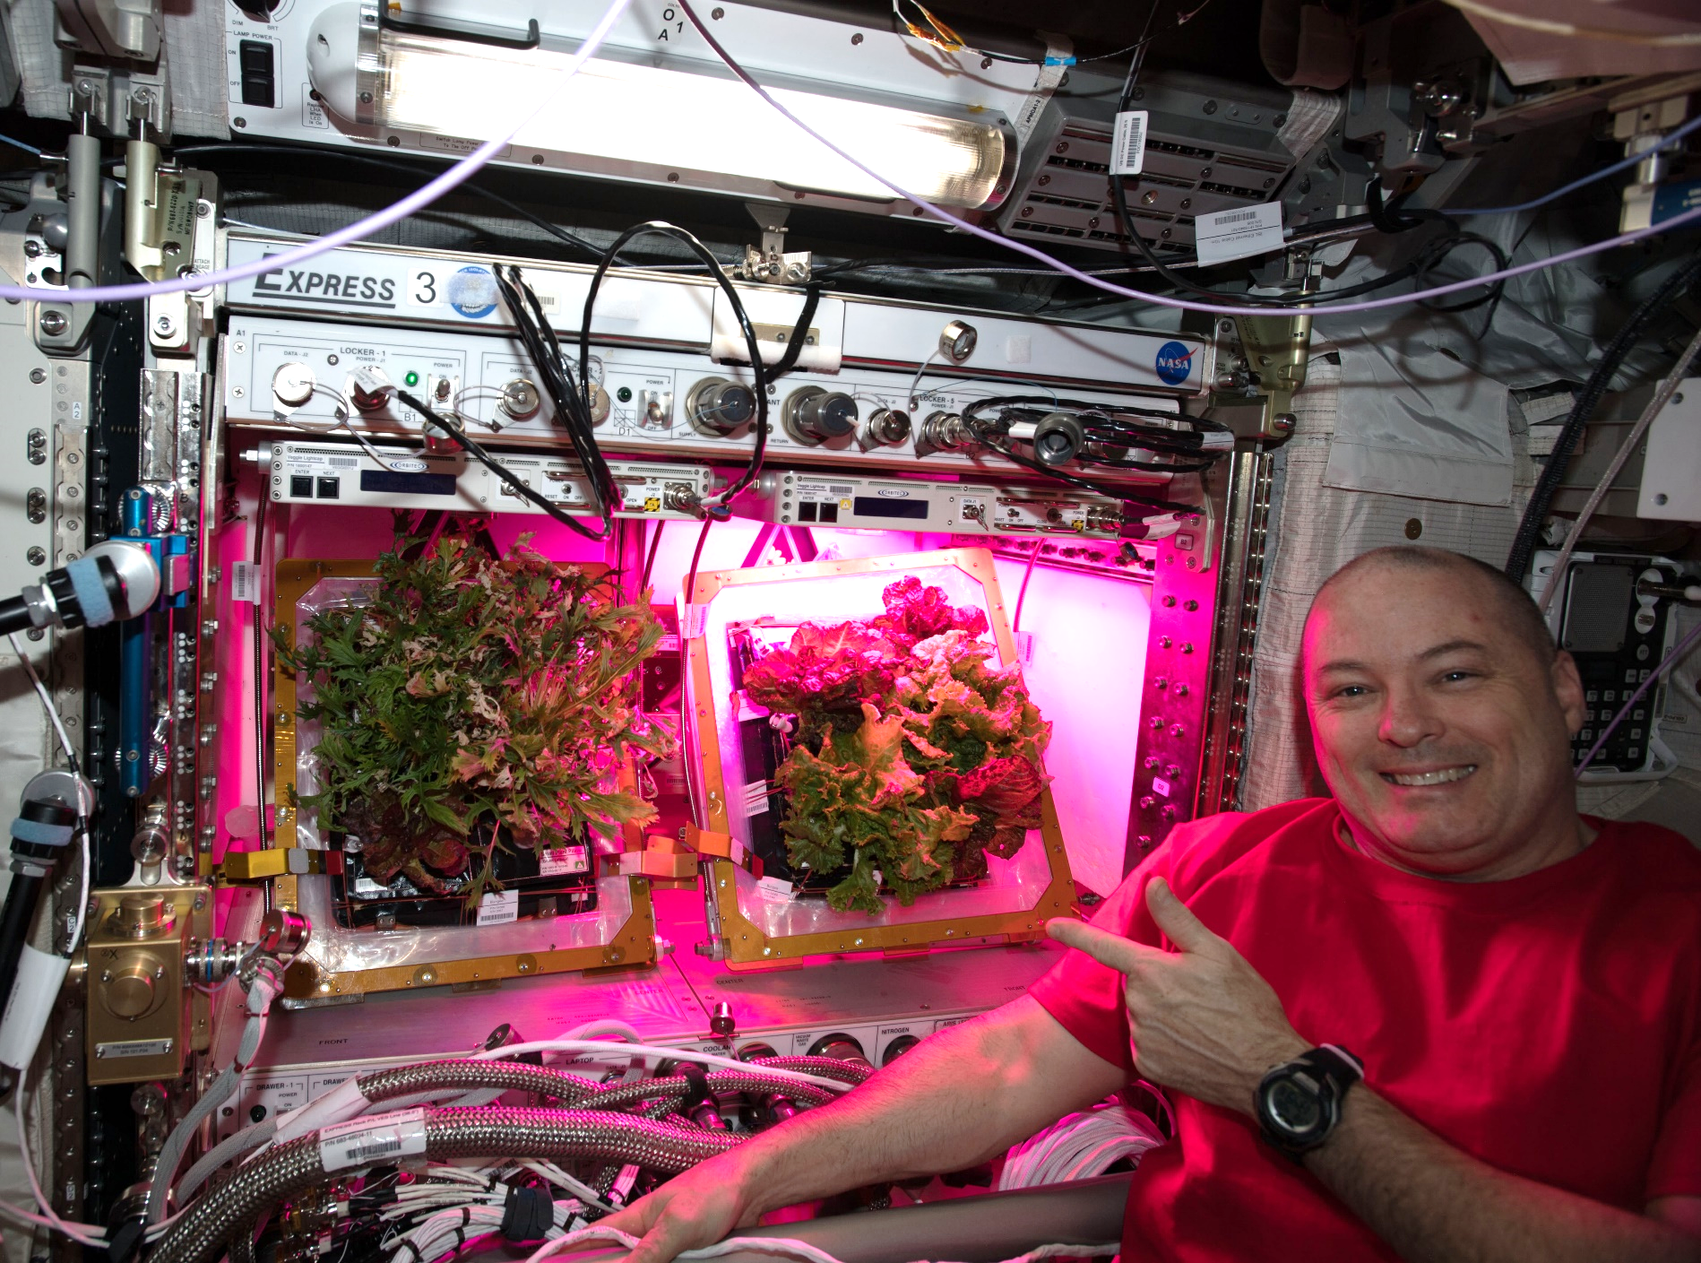
A Tale of Two Veggies

Slide 17
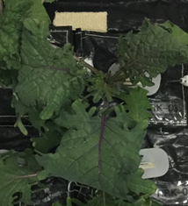
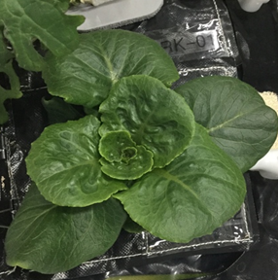
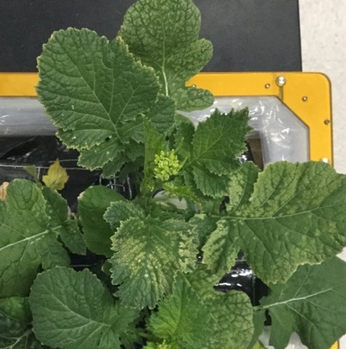
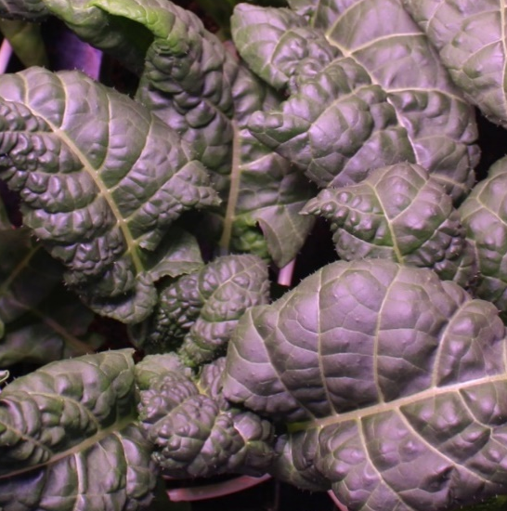
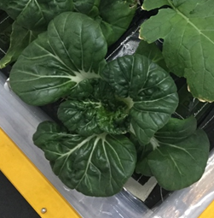
VEG-03 Crop Testing
Red Russian Kale
*Dragoon Lettuce
Wasabi Mustard
*Extra Dwarf Pak Choy
Amara Mustard
*= Student Selected Crops!

Slide 18
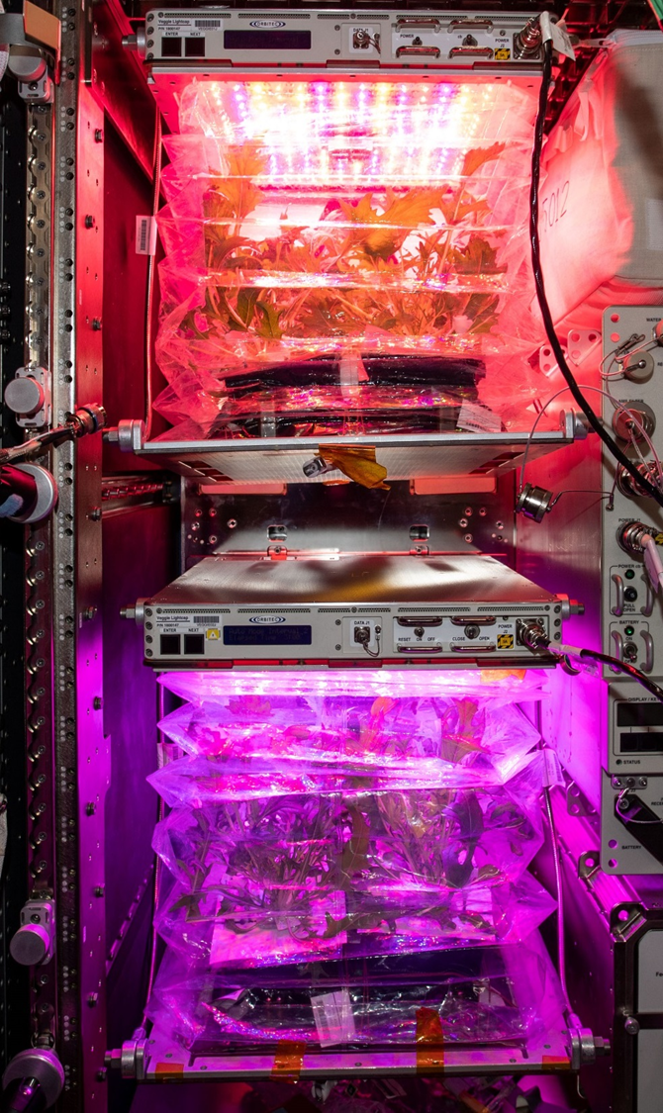
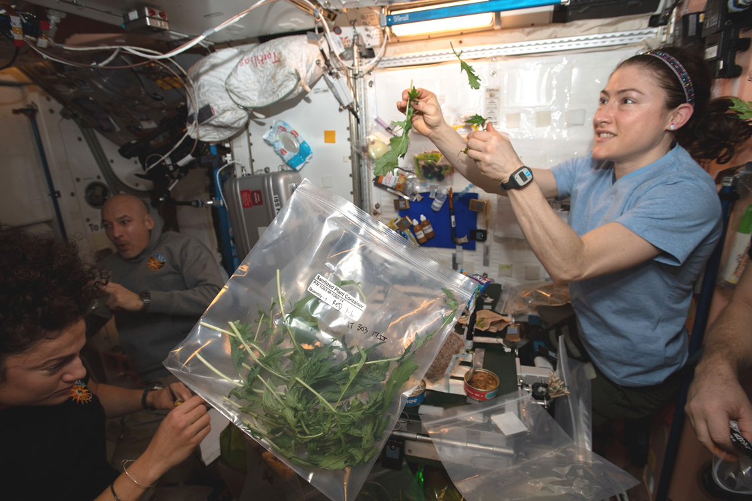
VEG-04
Research to study the impacts of Red: Blue: Green light ratios on Mizuna crop growth, nutrient composition, organoleptic appeal and microbial food safety with additional assessments of crew behavioral health.
Collaboration between KSC, JSC, Purdue University and Sierra Space

Slide 19
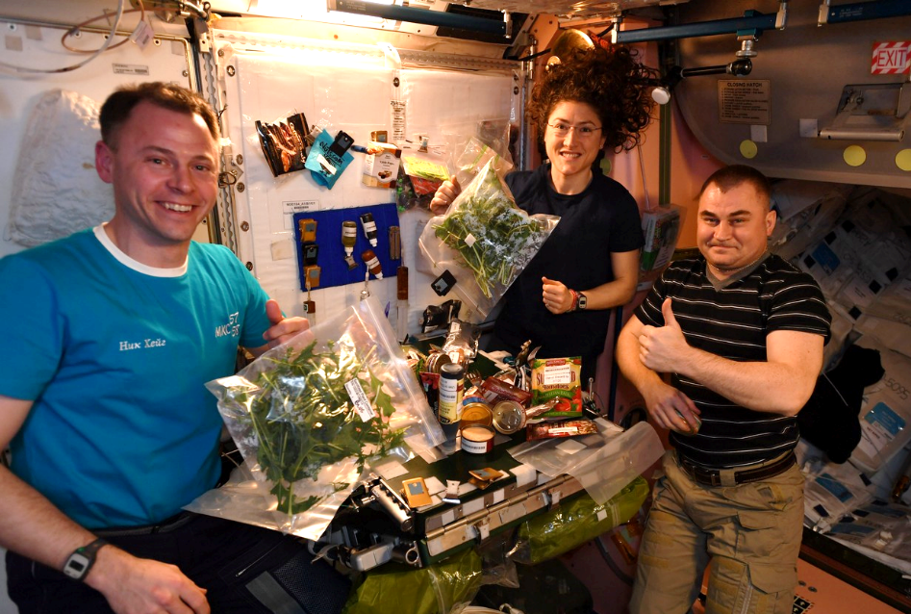
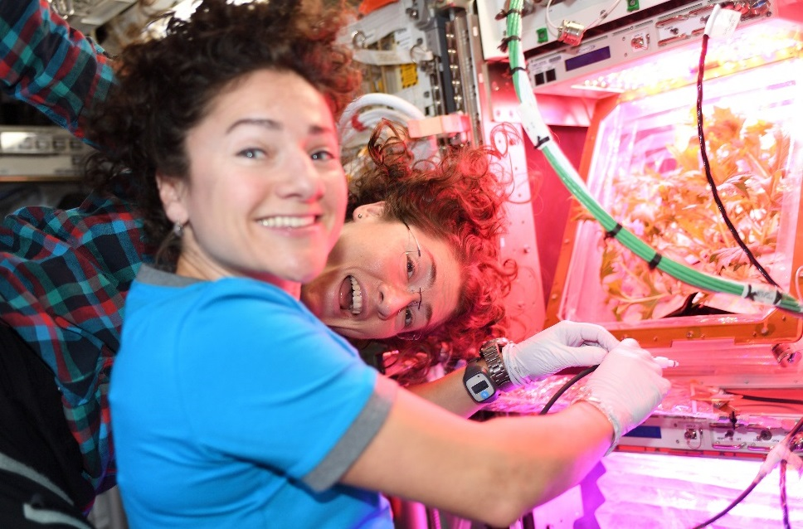
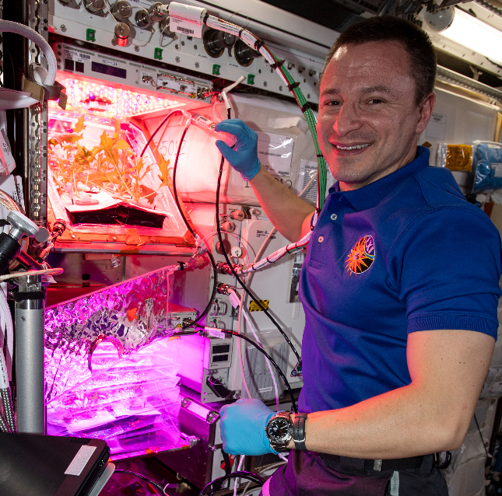
VEG-04 Crew Engagement

Slide 20
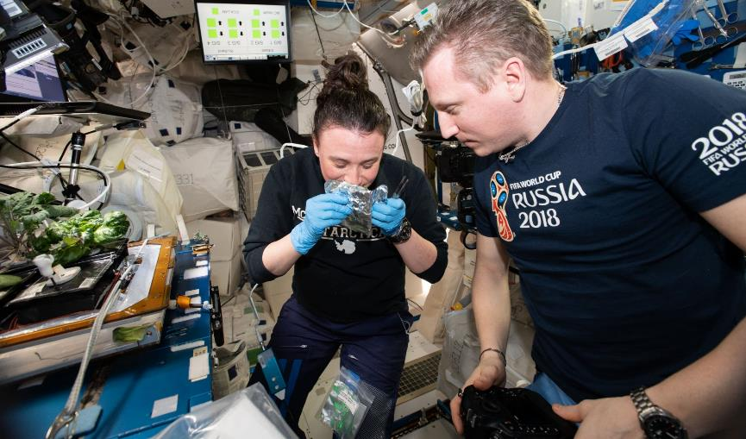
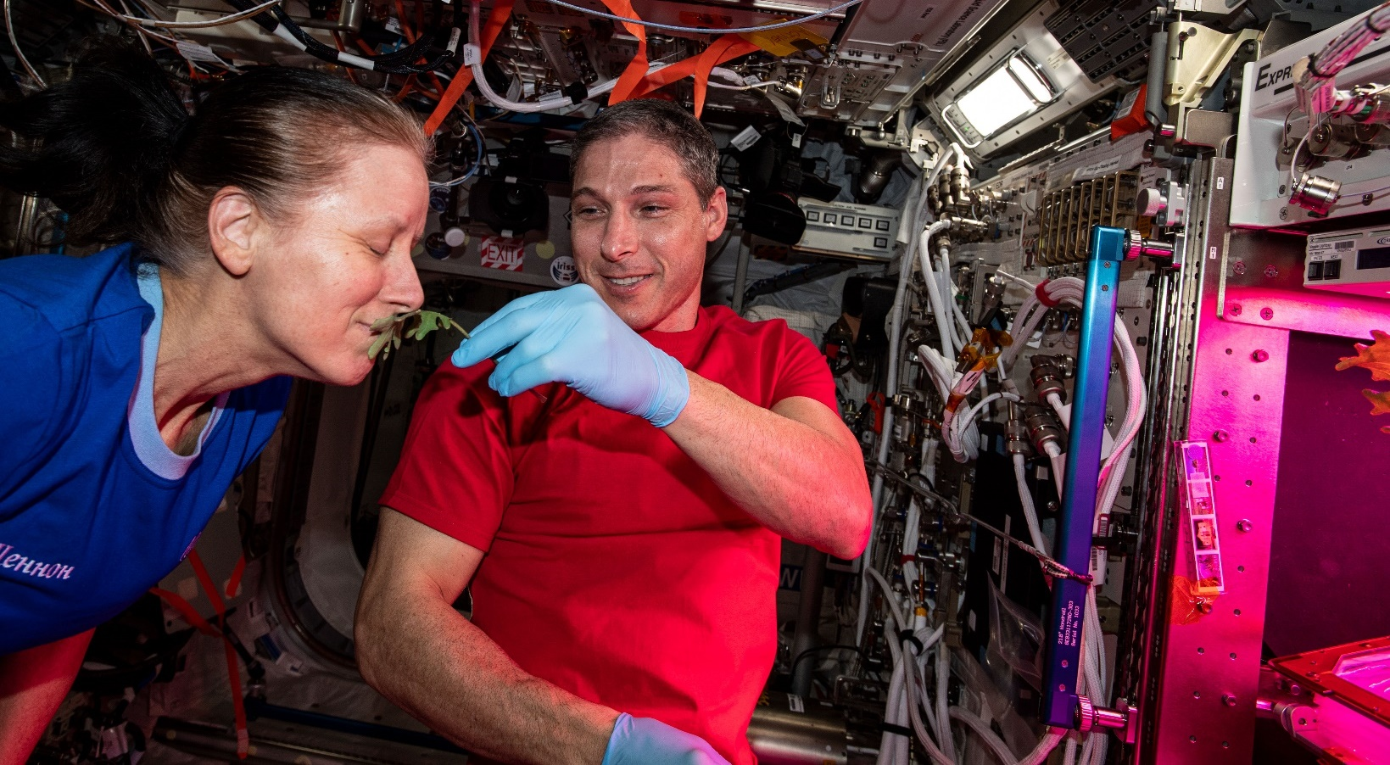
Plant Aromas Also Enhance Astronaut Experiences

Slide 21
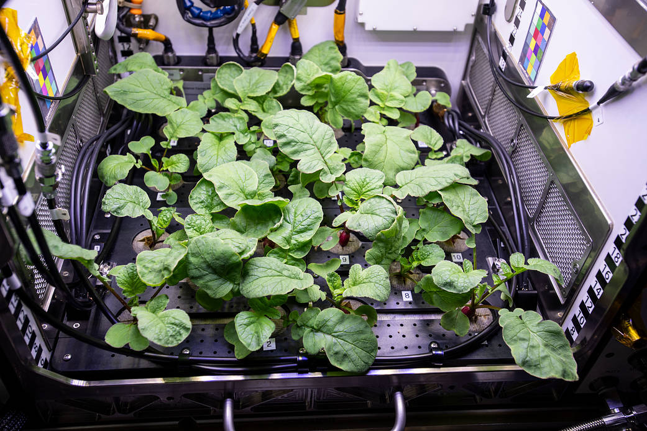
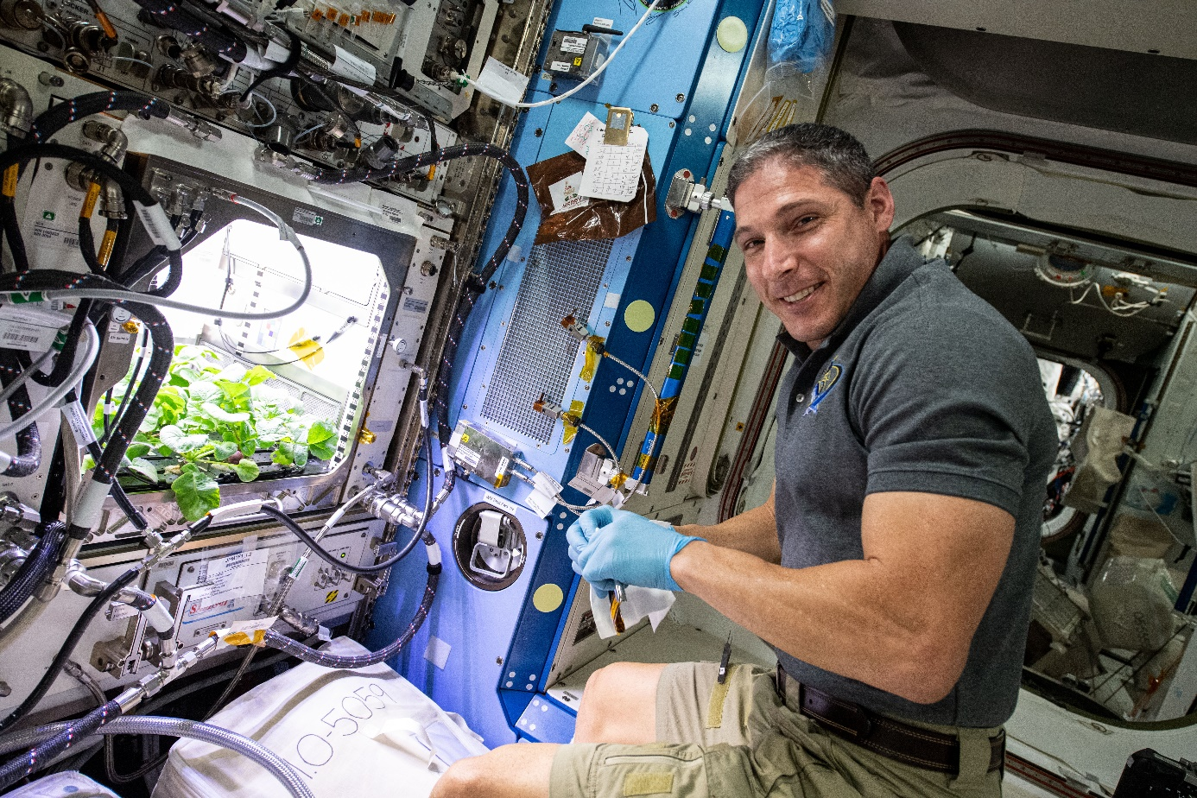
APH Crop Research
PH-02 Radish Experiment
PI Karl Hasenstein – University of Louisiana, Lafayette

Slide 22
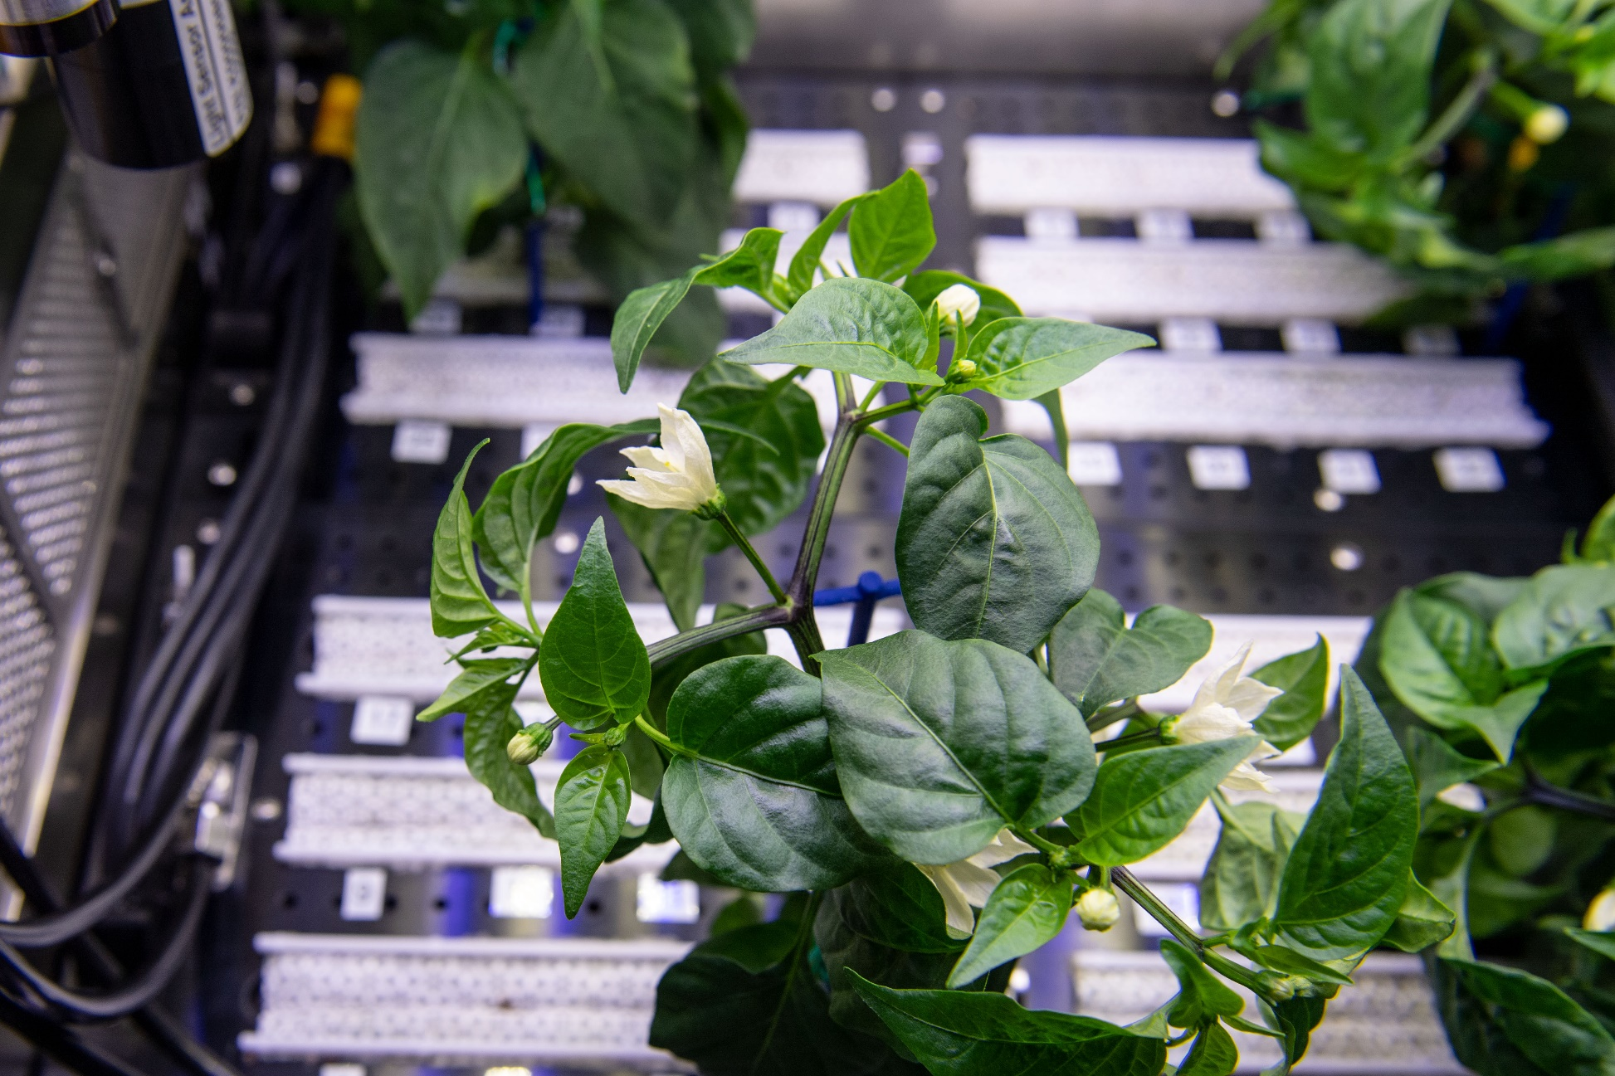



Space Chile!
Española Improved Hatch Chile Peppers in APH
PH-04 mission July – Nov. 2021
Red or Green?

Slide 23

Space Chile!

Slide 24

Ohalo III Vision
Ohalo III will be a water and nutrient delivery and volume optimization testbed for microgravity space crop production.
Ohalo III is an early-stage demonstration system to mimic a future Mars transit vehicle crop production capability.
  Moving from plant and crop research capabilities to crop production capabilities
Origin of the name: Ohalo II is an archeological site of a settlement 23,000 years old on the sea of Galilee, Israel, where ~150,000 specimens of plant remains have been collected. While some species were wild, many would only thrive in agricultural land. It is the earliest evidence for small-scale plant cultivation, approximately 11,000 years before the agricultural revolution. Ohalo III aims to take the first farms out of this world!

Slide 25

Flying soon on ISS – Ohalo III
Ohalo will be an operational crop production system testbed, pulling from both Veggie and APH
Ohalo consists of the following major subsystems:
  Power & electronics (Zeus) module
  Environmental control (Aeolus) module
  Water (Poseidon) module
  Growth chamber (Gaia)
  Two lighting (Helios) modules
  Support structure (Atlas)

Slide 26
Ohalo III Goals
Serve as an ISS platform for growing crops and performing technology demonstration
Maximize space crop harvest within a given volume
Minimize flight-crew operational and maintenance actions
Maximize operational and maintenance access
Use of modular concepts
Accommodate a variety of space crops
Capable of supporting staggered growth cycles
Have a minimum of a 5-year operating life

Slide 27


Slide 28
Ohalo III
Ohalo will be a larger capability ~ 2 x the size of APH (about 0.4m² growth area total) and it will have the flexibility to have both nursery and production areas.
It will have the capability of hosting a variety of different root zone subsystems
NASA has funded 5 projects to explore water and nutrient delivery and spatial optimization options to design these “hosted hardware” subsystems
Chamber atmosphere and growth lighting will be controlled
All aspects must comply with ISS requirements.

Slide 29

Thank you!
Veggie, APH, Ohalo III and Space Crop Production teams
NASA’s astronauts
NASA’s Space Biology Program, ISS Program, Human Research Program, Exploration Capabilities Program

